Slide 1
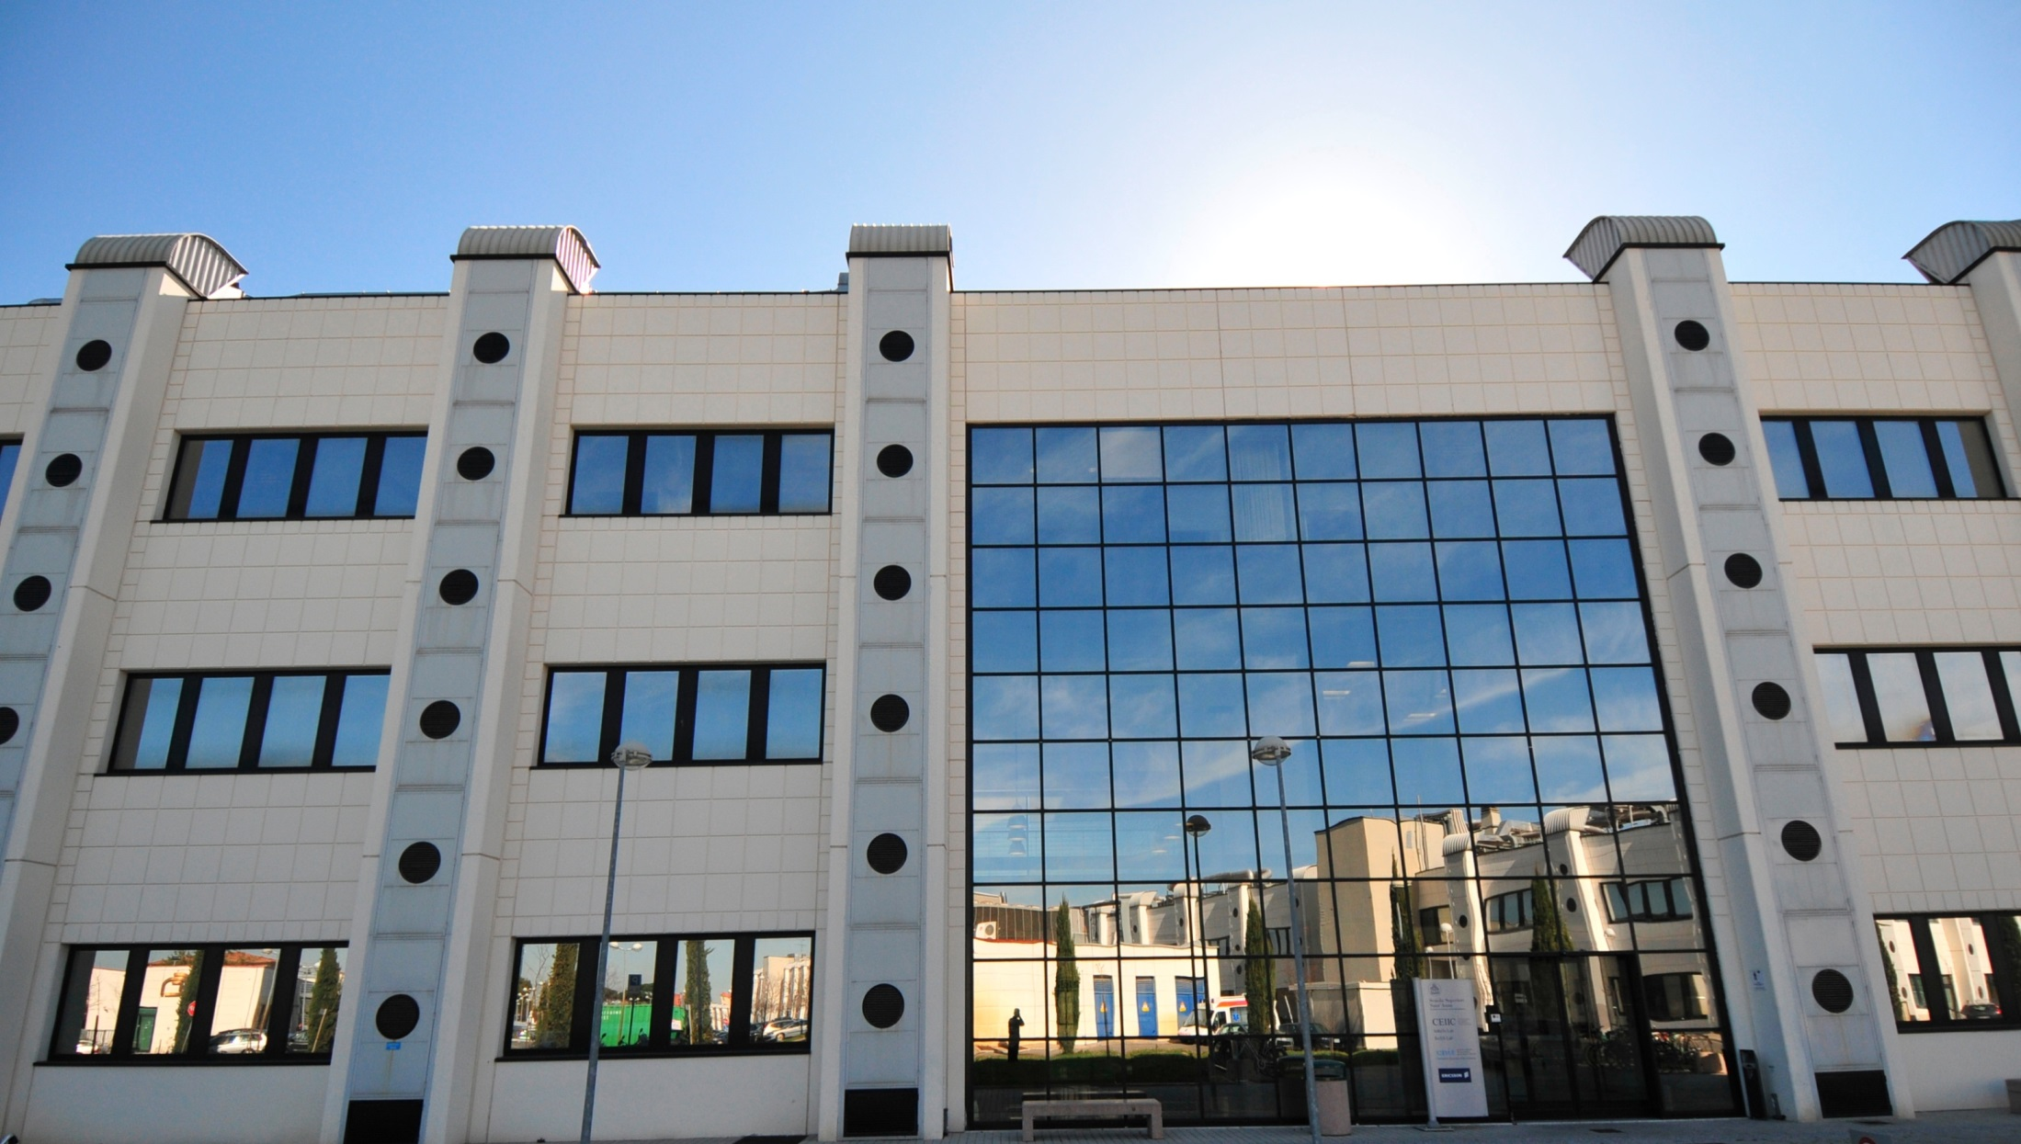
Integrated photonics to revolutionize the Data Center hardware
Marco Romagnoli
CNIT & TeCIP - Scuola Superiore Sant’Anna

Slide 2
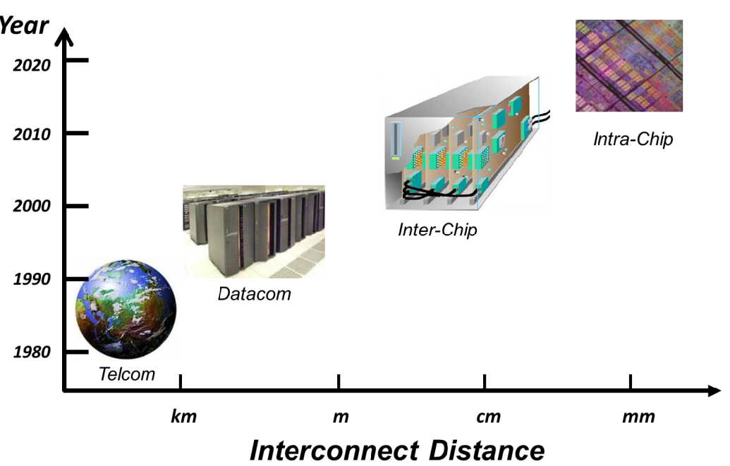
Zettabyte era
Disaggregation at system level
Integration at chip level
Optical interconnection at shorter reach
Electronics-photonics convergence
Cost, energy and bandwidth density
Architecture, components, programming
Make it happen or end the information age

Slide 3
Example of large volume applications
Active Optical Cable
Wireless communications
100GE Optical Interfaces (CFP, CXP, CPAK, QFSP, ..)
Inter Chip and Board Level Interconnection

Slide 4
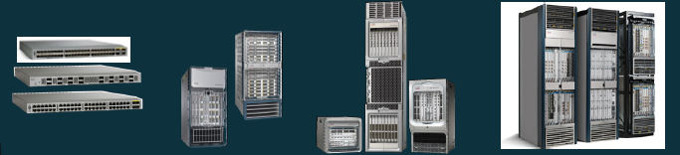
Optical Interfaces for Different Network Platforms
Datacom (CXP, CPAK)
Telecom (CFP)
Data center access
Data center aggregation
Edge routing
Core routing
The Optical challenges: Bandwidth Density
Consumption
Cost

Slide 5
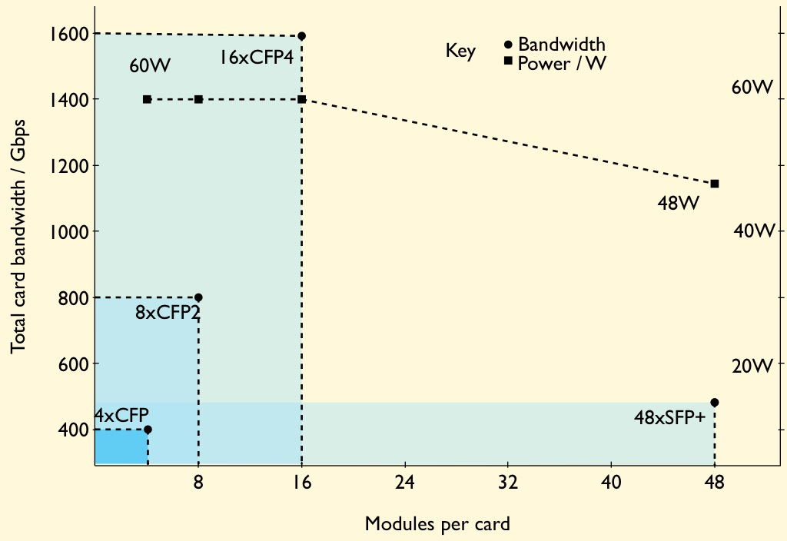
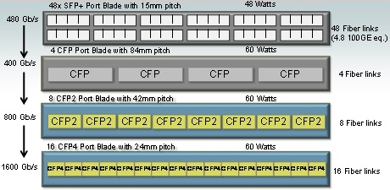
The CFP (C Form-Factor Pluggable) optical module to enable Terabit blades or line-cards
The next-generation CFP modules - the CFP2 and CFP4 (10/40 km) multiplies the number of 100 Gb/s optical module interfaces on a blade.
Using the CFP4, up to 16, 100Gbps modules will fit on a blade, a total line rate of 1.6 Tb/s. With a goal of a 60W total module power budget per blade, that equates to 27Gb/s/W. In comparison, the power-efficient SFP+ achieves 10Gbps/W.

Slide 6
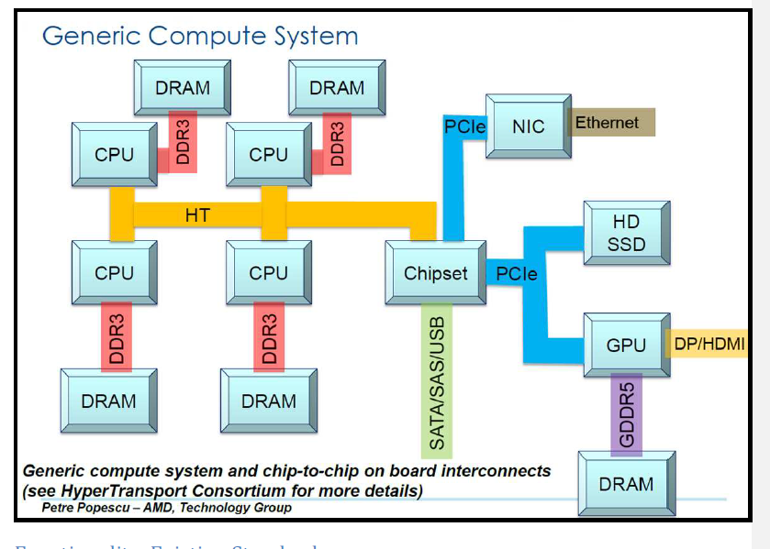
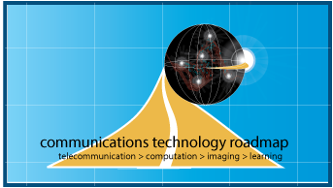

Inter Chip and Board Level Interconnection
Case study: «Optical PCIe3.0»
working group within the Communication Technology Roadmap (CTR4) of the Microphotonics Center Consortium (MPhC) at MIT

Slide 7
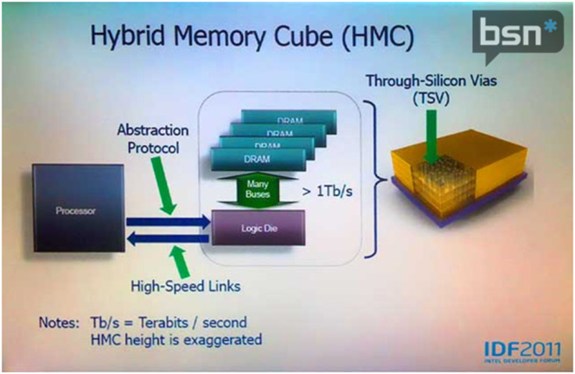







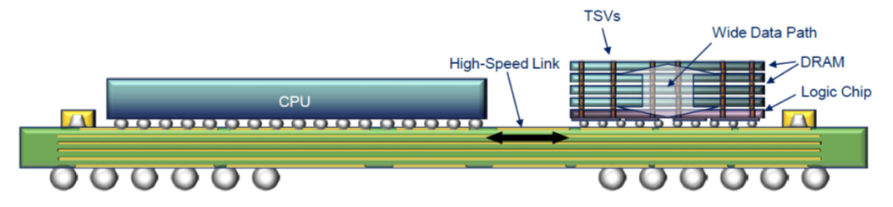
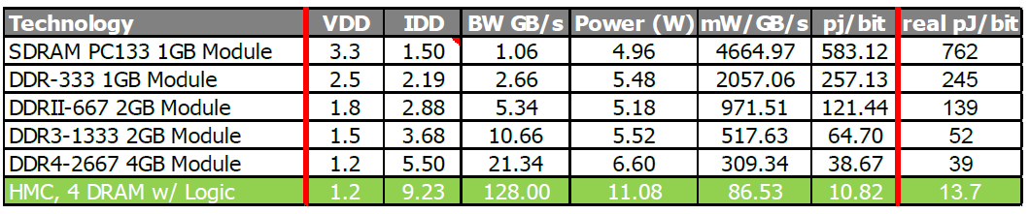
Chip to Memory Interconnection
Interconnection through Si interposer

Slide 8
Technology
Photonic Electronic Integration
Silicon Optical Interposer
Si Photonics readiness
Laser Integration

Slide 9
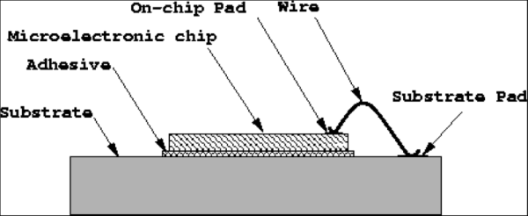
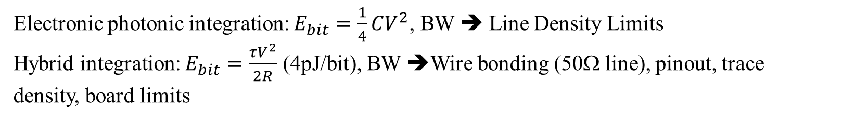
Si Photonics - Advantage of full integration
Cost: photonic-electronic chip (development, mask set, wafers, manufacturing). Save in packaging, wire bonding and traces/pin-out.
Technology: low capacitance 3D integration. Node scalability, low consumption and improved yield.
Performances: trade off between consumption, size, IL and link/system specs
Maturity of individual components: to be improved but not conceptually limited.
50Ω line
Photonic chip

Slide 10


Photonic Electronic Layer - 3D Integration
3D integration of SOI technology for the photonic layers with Si CMOS circuit layers.
Integration in a 65nm node/12” fab based on wf/wf or wf/die bonding and low capacitance TSV technology.
Bond Pads
Si
TSV
TSV
Si Logic Layer
Thermal Compression
Bonding
PD
Mod
SOI Photonics Layer
Si waveguide
BOX
Substrate

Slide 11
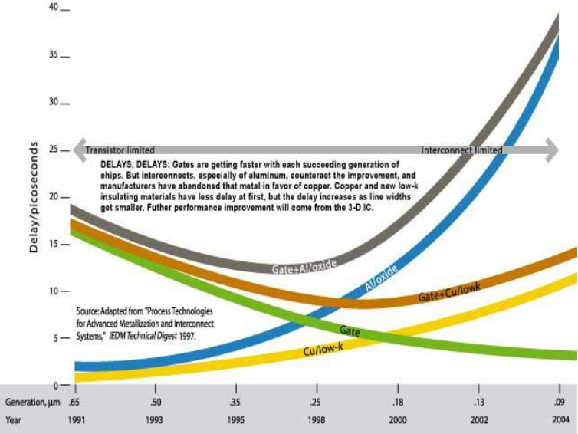
Electrical Interconnect Limitations
Bandwidth Limitations – Wires are not scalable i.e. bandwidth is limited by area
Power Limitations - Total interconnect power is high ~50% of Total Chip Power Expected to rise to >80% (limit 200W).
Signal Integrity and Latency (RC delay) will increase considerably with scaling, sheet Resistance and Capacitance increase as RC = R_{sheet}C_{sheet}/²
Xtalk between metal wires requires a minimum pitch that limitates interconnection density
Repeaters in electrical lines increase delay
C_{wire}= 2 pF/cm
R_{wire}= 20 Ω/cm
Al/Oxide + Gates
Al/Oxide
Sam Naftziger, AMD fellow
2011 VLSI Symposium Keynote
Cu + Gate
Cu
Gate

Slide 12
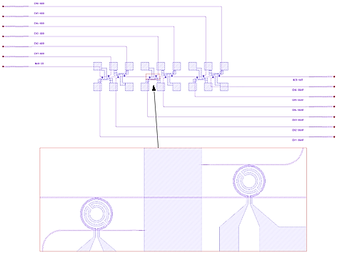
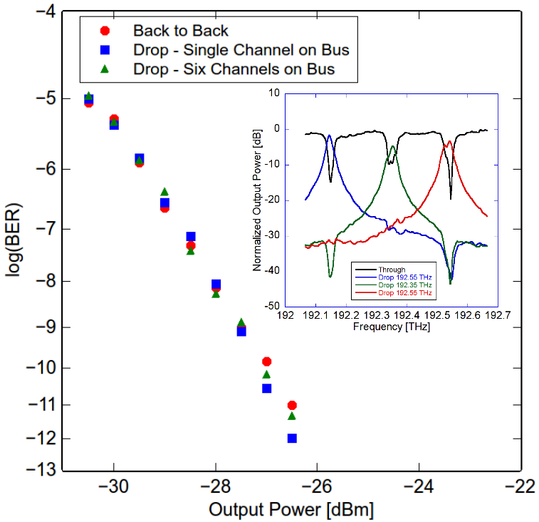
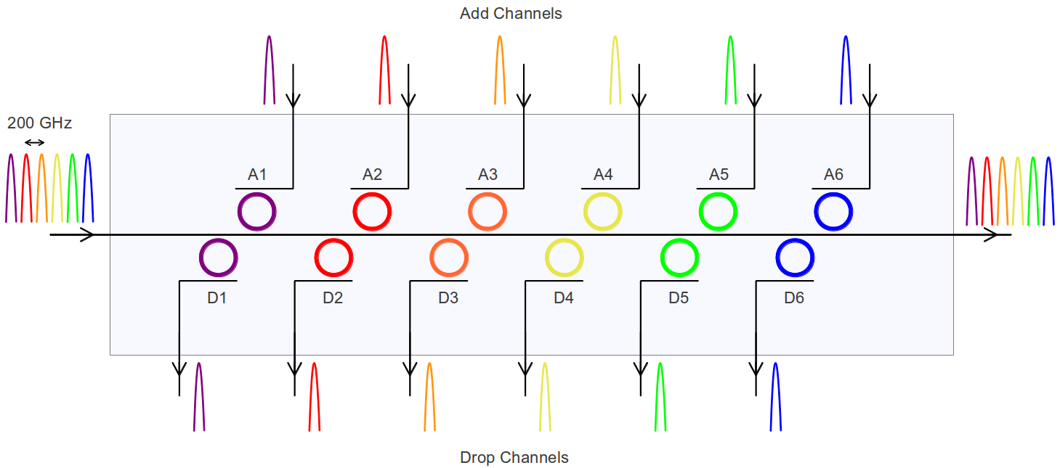
Optical Interconnect and Switching
Optical links are distance and power independent
BW density can increase by wavelength multiplexing
Latency is given by propagation distance (5ps/mm)
Optical switching
Reconfigurable Optical Add Drop Multiplexer
CNIT/Ericsson OFC 2014

Slide 13
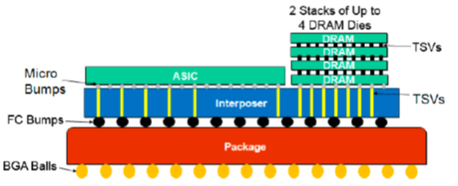
Si Interposer and Si Optical Interposer
Si Interposer
Metal Pad / via
480nm
Oxide
P+
1.5um
100nm
220nm
Ge
N
N+
P
P
P+
N
N+
N+
P+
Silicon Waveguide
BOX
Ge Photodetector
MZI Modulator
Si Optical Interposer
Si Substrate
Silica Waveguides
Heat Sink
Coupler
Silicon Waveguides, resonators, detectors
Micro Bumps
Micro Bumps
Optical Fiber I/O
HMC
ASIC
HMC
Interposer
Package
Redistribution layer
Flip Chip Bumps
BGA Balls
Interpose / Photonics Layer
TSV
Redistribution Layer

Slide 14
Si Photonics Modulators
Parameter/device type | MZI | Microring | MZI MOSCAP | FK Ge EAM | Hybrid InP/Si MZI
Bandwidth (nm) | >20 | 0.1 | >100 | 20 | 100
Temp Sensitivity (GHz/K) | NA | 3 ÷ 10 | NA | NA | ?
Energy Cost (fJ/bit) | 5 ÷ 30 x10³ | 7 ÷ 50 * | 500** | 50 ÷ 100 | 8000 (state switching)
Footprint (µm²) | 200 ÷ 10000 | 20 ÷ 100 | 500x5 | 25 | 250 ÷ 500
Speed (GHz) | 30 | 25 | 10*** | 30 | 25
Insertion Loss (dB) | 7 | 7 | 15 | 3 ÷ 4 | 4
Extintion Ratio (dB) | 1 @ 30Gb/s | 8 @ 16 Gb/s | >10 | 4 ÷ 7.5 | 10 @ 25Gb/s, 18 static
Voltage | 6.5 | 1 ÷ 2 | 1 | 4 | 1.2
Static Tuning | Phase adjustment | 0.2 nm/mW (thermal) | Phase adjustment
* add 100fJ/bit for thermal trimming
** 1pJ/bit including driver
*** progressing towards 40Gb/s

Slide 15
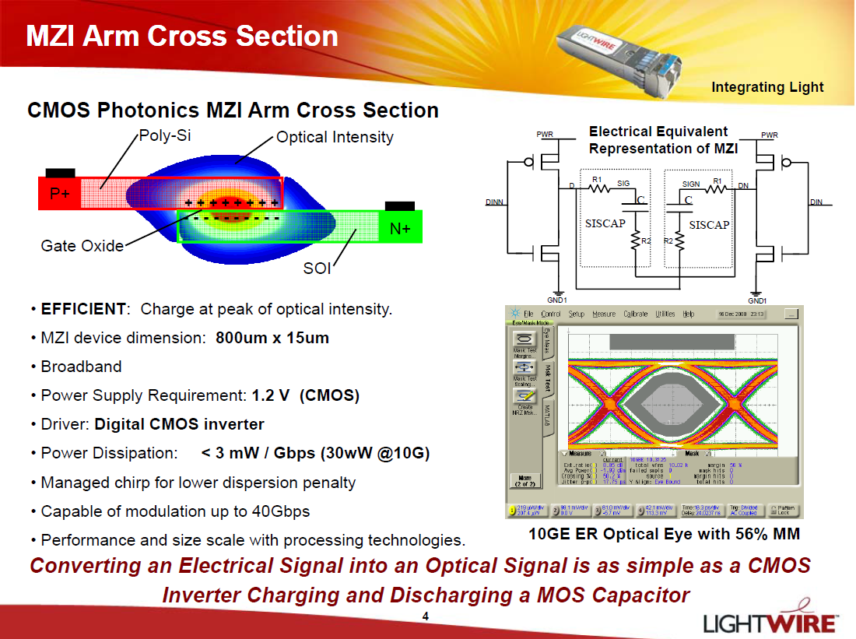

Si Photonics: Accumulation Modulator

Slide 16
Si Photonics: Detector Integration
Responsivity (A/W) @ 1550nm |  | 3dB bandwidth (GHz) |  | Dark Current Density (mA/cm²) | Dark Current (μA) @ -1V | Device Design | Reference
Max | 0 bias | Max | 0 bias
1.0@-3V | - | 4.5@-3V | - | 0.7* | 2×10⁻⁴ | butt, p-i-n | Liu 2006 Beals 2008
1.08 | 1.08 | 7.2 | 6.6 | 1.3x 10^{3 *} | 1 | top, p-i-n | Ahn 2007
1 | 0 | 25@-6V | - | 6.5 x 10^{5 *} | 130 | butt, msm | Vivien 2007
0.89 | 0.89 | 31@-2V | 15.7 | 51@2V | 0.17@-2V | bottom, p-i-n | Yin 2007
0.85 | 0.85 | 26 | - | - | 3 | bottom, p-i-n | Masini 2008
0.65 | - | 18 | - | 125 | 0.06 | bottom p-i-n | Wang 2008
1.1 | - | 37@-3V | 17.5 | 1.6×10⁴ | 1.3 | butt p-i-n | Feng 2009
1@-4V | 0.2 | 42@-4V | 12 | 60 | 0.018 | butt, p-i-n | Vivien 2009
0.42 | 0 | 40@-2.5V | - | - | 90 | bottom msm | Assefa 2010
0.95 | - | 36 | - | 29 | 0.0046 | bottom, p-i-n | Liao 2011
0.64 | - | 8 | - | - | 0.5 | bottom, JFET | Wang 2011
J. Michel et al., Nature Photonics, 4, 527 (2010)

Slide 17

ADN3000-06/11 Integrated Optical Receiver (Analog Devices)
Wavelength agnostic: works across all key optical wavelengths including 850 nm, 1310nm and 1550 nm
No bonding wires
Single, fully-tested die solution reduces cost: No separate tests required for the TIA and PD
65-mW power consumption: 50 percent powewr reduction compared to standard designs
Product | Sample Availability | Pricing Each Per 1000 | Data Rate (Gbps) | Detector Size (um) | Differential Output Swing (mV p-p) | Optical Modulation Amplitude (dBm) | Power Dissipation (mW)
ADN3000-06-50 | Now | $3.95 | 6 | 50 | 240 | -19 | 65
ADN3000-11-35 | Now | $5.95 | 11 | 35 | 240 | -17 | 65
APPLICATIONS
Optical receivers up to 10 Gbps
6G CPRI, OBSAI, and 8G short range and LTE receivers
Receiver optical subassemblies (ROSA)

Slide 18
Si Photonics Full integration: Integrated Laser Source
VCSEL: conventional solution for <100m reach. Good for power consumption, temperature stability, packaging and cost. MM and SM version. High T operation.
Hybrid mounting III-V Laser: conventional solution. It can be butt coupled or coupled through grating coupler. Coupling loss 1 ÷ 3dB, Packaging, assembly.
Cost and large consumption. High T operation.
Bonded III-V Laser: remarkable solution with a certain maturity. CMOS manufacturing to be demonstrated. High T operation.
Quantum Dot Laser: It can be butt coupled or coupled through grating coupler. Coupling loss 1 ÷ 3dB, TEC, Packaging, assembly. Very high T operation.
Ge Laser: early stage. Monolithic integration. Potential good performance (power and threshold). Large gain BW and wide tunability. Best at high T (80 ÷ 100°C).

Slide 19
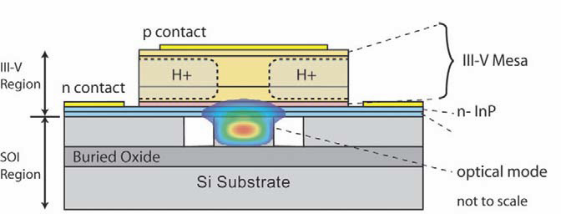
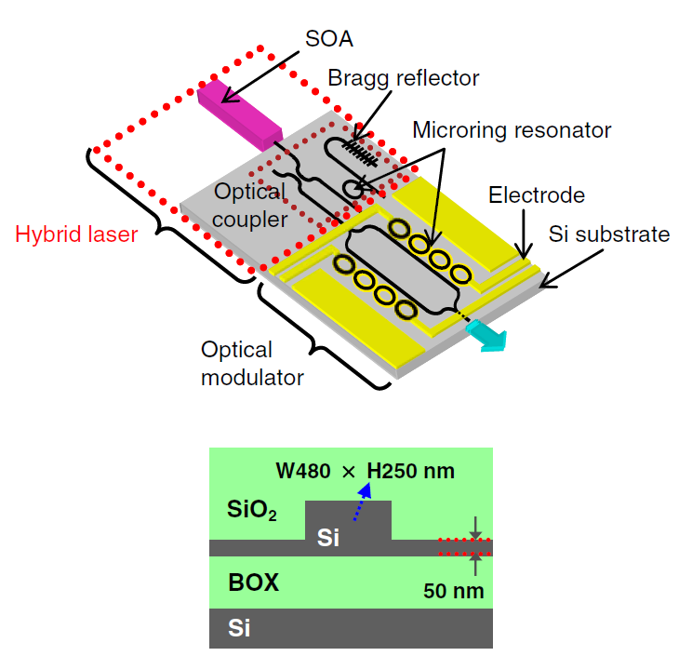
Aurrion
Fujitsu
Hybrid Silicon Platform bonds III/V wafer or die to silicon. 150-mm wafer bonding and processing possible;
III/V processed in low-temperature back-end process;
Mode couples to III/V → optical gain, detection or modulation from III-V Material.
Hybrid III/V SOA mounted on Si Platforrm;
Mode butt couples to III/V → optical gain
Fujitsu

Slide 20

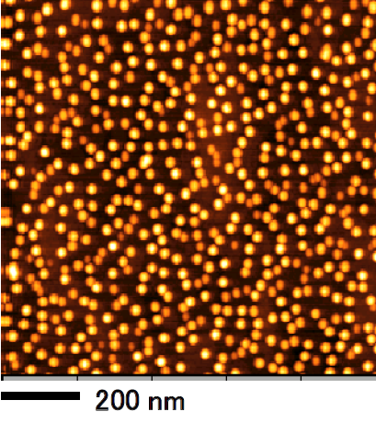
Quantum Dot Laser
- InAs multi-stacked quantum dot active layers sandwitched by GaAs/AlGaAs cladding layers on a 3-inch GaAs substrate
- Leading-edge highly-uniform,and high-density quantum dots for high optical gain
- Light emission wavelength of 1.21to1.29 μm at room temperature

Slide 21
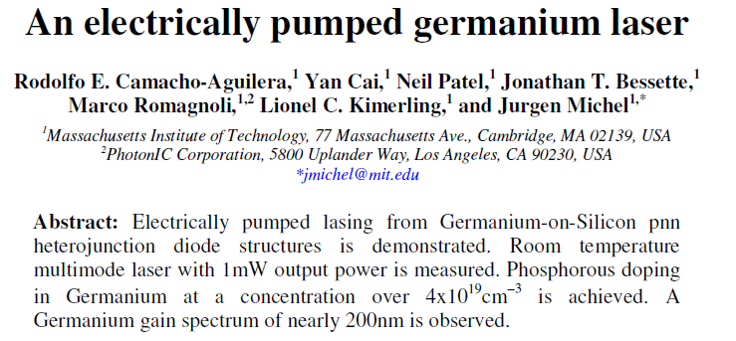
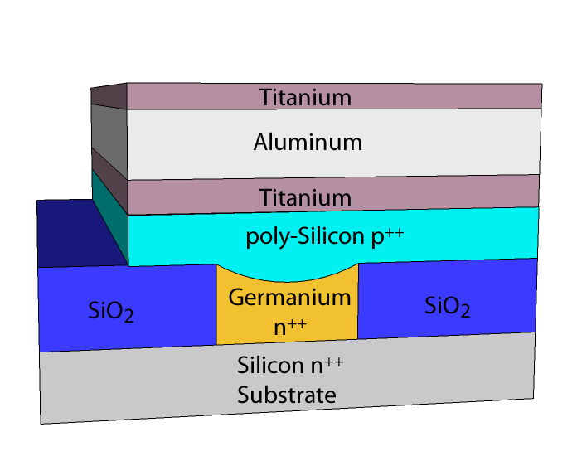
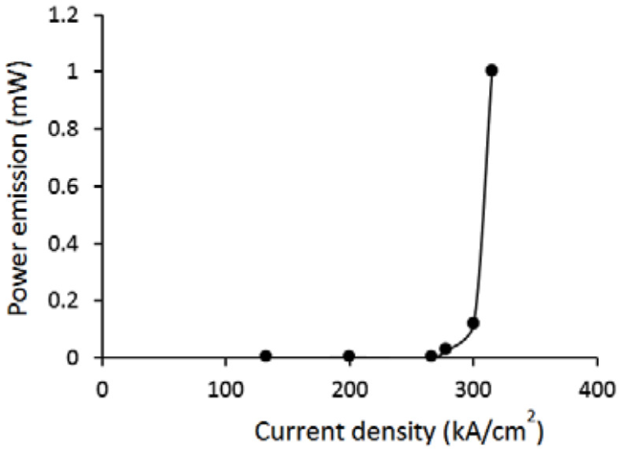

Slide 22
Conclusion
Assuming
Maturity of Si Photonics, good performance, component availability
Initial stage of photonics electronics integration
Needs
Low consumption, uncooled operation laser integration evolution
Photonic Electronic convergence through Si optical interposer (3D integration, TSV’s interconnections)
Result
Huge energy saving
Latency control
Increased BW density
Miniaturization
Lower costs
Zettabyte Era

Slide 23
thank you!
email: marco.romagnoli@cnit.it

