Slide 1

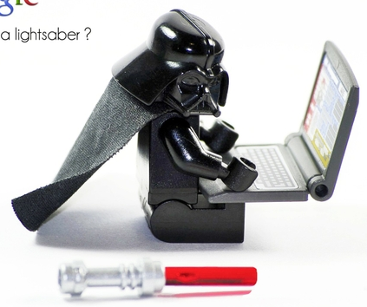
DAQ and Computing
Emanuele Leonardi
PADME Collaboration Meeting
LNF - October 29, 2015

Slide 2
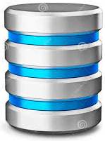
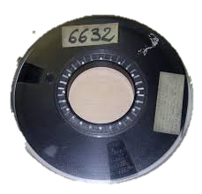
Target
64ch
FADC
Spectrometer Veto
200 ch
FADC/TDC
High Energy Positron
veto 64ch
FADC/TDC
ECAL
656 ch
FADC
SAC
32 ch
FADC
L1 DAQ
1 process per DAQ board
Run Control
Trigger Distribution System
Temporary disk buffer
L0 DAQ
1 process per DAQ board
ADC zero suppression
L1 DAQ
Event build
BTF
Beam
Trigger
Other
Trigger
Neutral Filter (Inv)
1 or more ECAL clusters
Charged Filter (Vis)
2 or more tracks
50 Hz
Trigger signal
PADME experiment site
Data flow
RAW data
Central Data Recording Facility
PADME
DAQ Schema

Slide 3
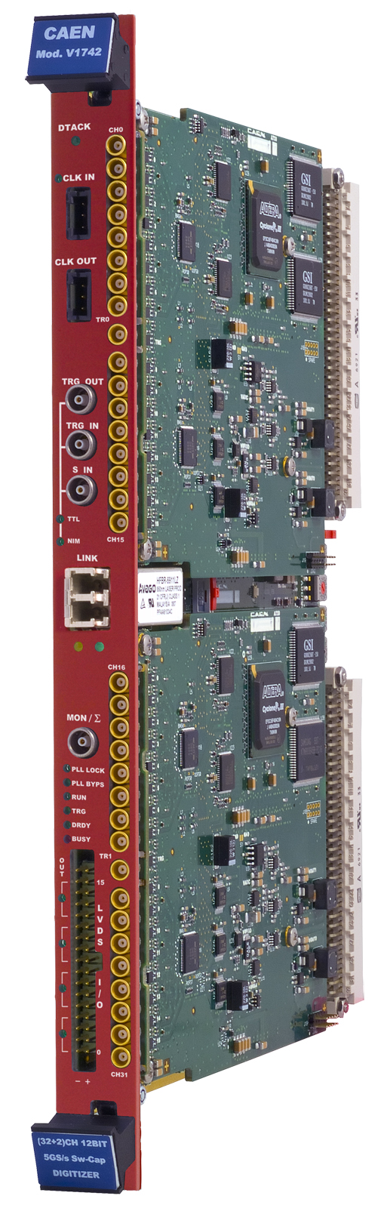
CAEN V1742
Switched capacitor digitizer based on DSR4 chip
32 channels (+ 2x2 triggers)
1 Vpp on 12 bits
1024 samples @ 5-2.5-1 GHz
181 μs dead time
80 MB/s optical link to A2818/A3818 PCI controllers
External clock I/O
Ch 0-7
TR0
Two V1742 boards (64 chns) and 1 A3818 controller (2 optical links) are currently available and will be used during the November test beam
Ch 8-15
Start/Stop DAQ
Optical link
To ensure multi-board synchronization:
Centralized trigger signal distribution
Control DAQ Start/Stop via S_IN
Synchronous reset of trigger time tag
Use an external clock source for all boards to avoid inter-board time drift O(1 ppm)
Ch 16-23
TR1
N.B. All this requires dedicated hardware interacting with the Run Control
Ch 24-31

Slide 4
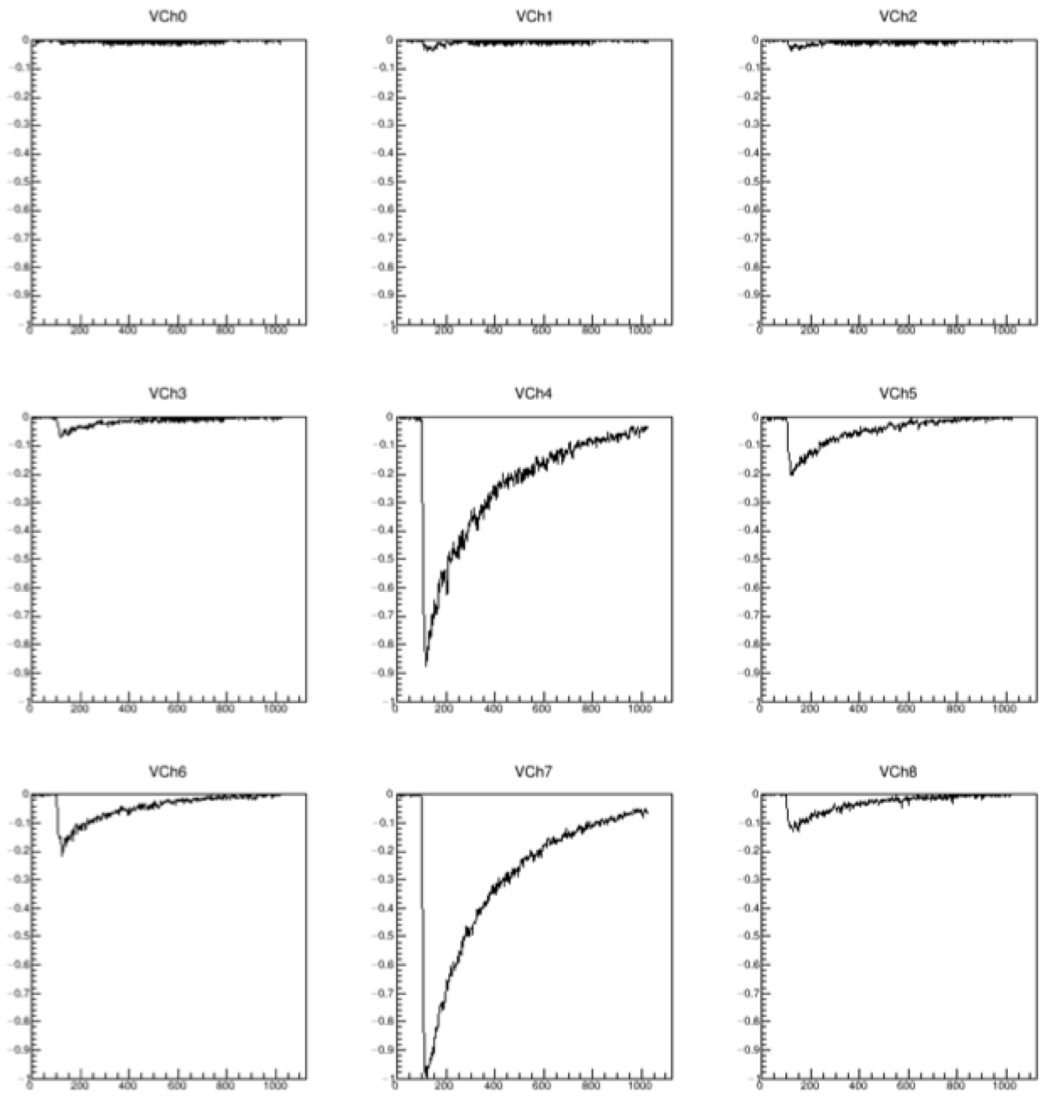
CAEN V1742 configuration
Set timing of sampling window wrt trigger signal (Post Trigger) to:
get as much as possible of the signal shape
keep a bit of pre-signal baseline for pedestals and zero suppression (see later)
Trigger line
Post Trigger
BGO signal
DC Offset
Set DC Offset of sampling window to:
keep as much as possible of signal dynamics
keep baseline including pre-’CAEN correction’ noise fluctuations
1 V
ADC sampling
window
1024 ns

Slide 5
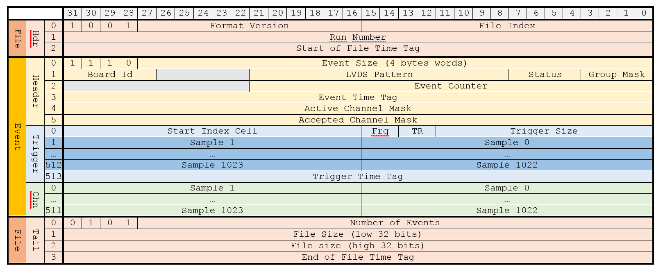
PadmeDAQ
Handles DAQ for a single V1742 board
Written in C, uses CAENDigitizer libraries
Collects data from V1742 board
Applies DSR4 corrections (from CAEN)
  Sample size: 12bit➔16bit
Applies zero-suppression (see next slide)
Writes data to file in DAQ-format
  Modeled on V1742 native data format
Logs process info to Database
  Start/Stop time, File list and sizes, #Events
Tested up to 250Hz
To be replaced by S_IN-controlled DAQ Start/Stop
N.B.
22bit Event Counter: <24h roll-over @ 50Hz
31bit Trigger Time Tag: ~18s roll-over @ 58.6MHz
Reading many events in a go improves efficiency

Slide 6
Zero Suppression
ECAL expected occupancy: O(1 channel/event)+noise
Most of the channels will be empty most of the times
Zero-suppression will substantially reduce the amount of data saved to disk
Expect a factor O(50) reduction
Algorithm
Start ADC acquisition window ~100ns before start of spill
Use first 80 ADC samples to compute Baseline and RMS
Define threshold at Baseline-X*RMS
Find largest set of consecutive samples below threshold
If largest set contains more than N samples, channel is accepted
X,N can be used to tune the algorithm
Note: zero-suppression can be applied on a per-board basis
E.g.: ON for ECAL and veto, OFF for Target and SAC

Slide 7
Preliminary test on 3x3-crystals detector.
Signal: test beam (500 MeV), ~4.5K events
Noise: off-beam (i.e. empty + cosmic ray), ~30K events
Apply zero suppression with different values of X,N
X=3, N=4 ➔ ~15000 noise reduction factor, <10⁻⁴ inefficiency
Need to study efficiency as a function of energy released in the crystal

Slide 8
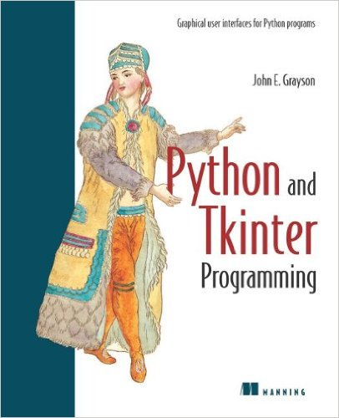

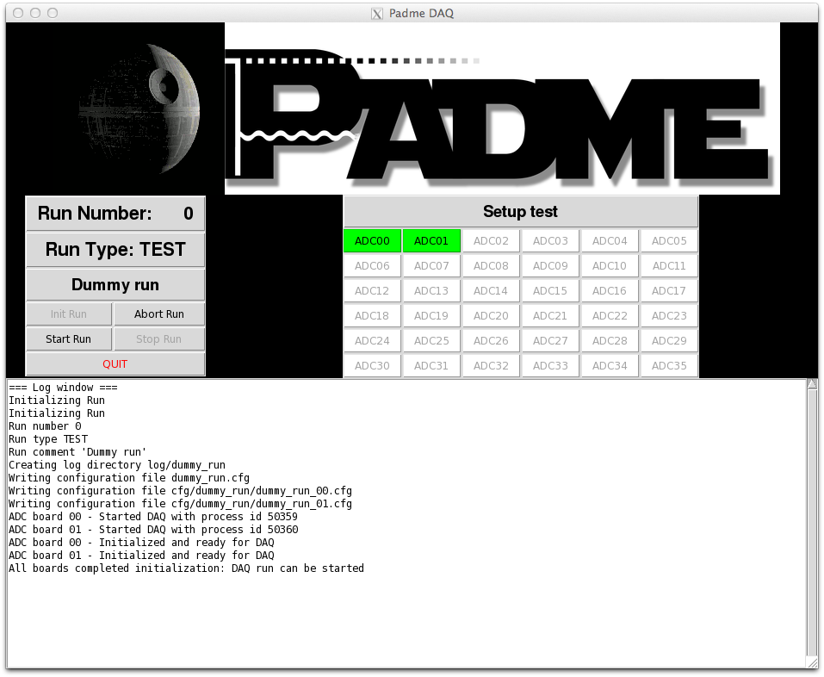
Run Control
Written in Python
  uses Tkinter graphical library
Interacts with:
  User via GUI
  DAQ processes
    Create configuration files
    Spawn processes
  Trigger Controller
  DAQ Start/Stop Controller
  Database
Currently allows:
  Set run number/type
  Load predefined DAQ setup
  Init/Start/Stop run
  Create Run structure in DB
  View DAQ log files in real time
To Do

Slide 9
Level1
Read content of DAQ files from different boards and build merged events
Write merged events to ROOT file in RAW Event format
Can get the set of files to merge:
  from the DB by specifying the run to merge
  from a user-defined list of files
To Do:
Define absolute time for event
Create L1 filtering algorithms
  Neutral filter: 1 or more ECAL clusters
  Charged filter: 2 or more tracks
Need a map to match BoardId with connected Detector/Channels
TRawEvent
UInt_t | fRunNumber
UInt_t | fEventNumber
UChar_t | fNADCBoards
TClonesArray* | fADCBoards
TADCBoard
UChar_t | fBoardId
UShort_t | fLVDSPattern
UChar_t | fStatus
UChar_t | fGroupMask
UInt_t | fEventCounter
UInt_t | fEventTimeTag
UInt_t | fActiveChannelMask
UInt_t | fAcceptedChannelMask
UChar_t | fNADCChannels
TClonesArray* | fADCChannels
UChar_t | fNADCTriggers
TClonesArray* | fADCTriggers
TADCChannel
UChar_t | fChannelNumber
UShort_t | fSamples[1024]
TADCTrigger
UChar_t | fGroupNumber
UShort_t | fStartIndexCell
UChar_t | fFrequency
Bool_t | fTriggerSignal
UInt_t | fTriggerTimeTag
UShort_t | fSamples[1024]
RAW Event
Structure
(preliminary)

Slide 10
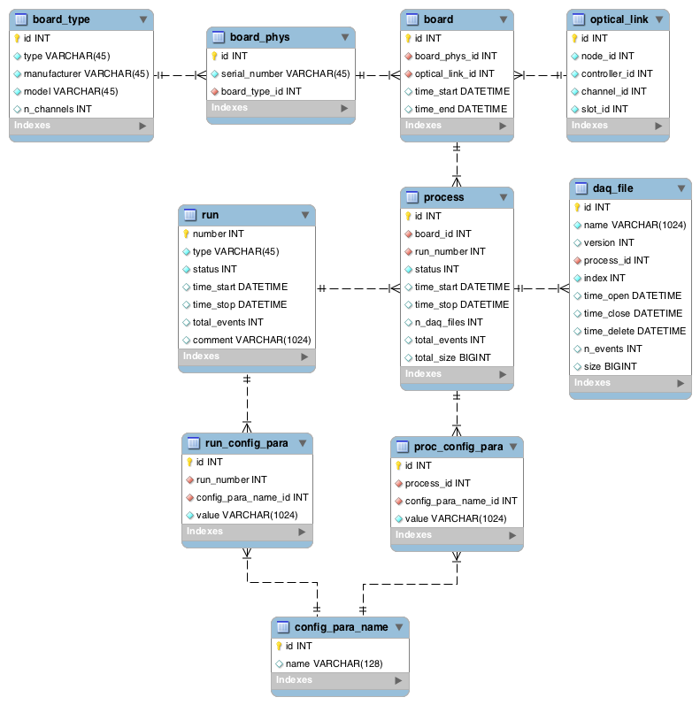
Database
Currently implemented
with SQLite3
Will use MySQL
Local MySQL server at the experiment with only DAQ/DCS related info
Central MySQL server (LNF IT?) with full information
  Detector geometry
  Calibration constants
  DAQ configurations
  Detector conditions
  Data Files/Replicas

Slide 11

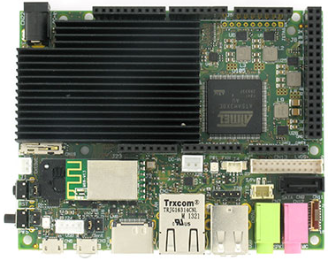
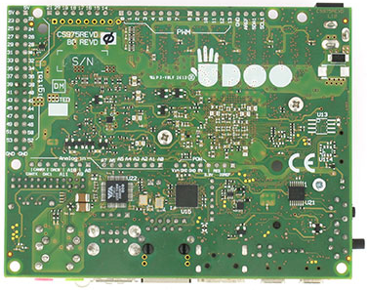
Detector Control System
Investigating the UDOO platform
Freescale i.MX6 ARM Cortex-A9 (4-core/1 GHz)
Atmel SAM3X8E ARM Cortex-M3 (= Arduino DUE)
76 GPIO (compatible with Arduino DUE shields)
RAM 1 GB
Gigabit Ethernet + WiFi
SATA connector
Linux (UDOObuntu, Debian Wheezy, Archlinux)
Runs all Arduino DUE sketches
99€ per board (~150€ inc. VAT, power, SD card, case,…)

Slide 12
Analysis
PADME
Dataflow
Model
THIN
RECO
Streams
THIN
Skim
RECO
Streams
Reconstruction
SIMU
Legenda
Calibration Constants
File Data Format
DB Data Format
RAW
Monte Carlo
Simulation
Calibration
Calibration Data
Conditions
Configuration
Data Processing
Data Producer
TDAQ
DCS
Data Consumer
Experiment

Slide 13
Software Management
We are creating a software management area on the GitHub system
→ functionalities similar to SVN/CVS
https://github.com/eleonardi/padme
Anybody can read the area (¡¡¡ No sensitive data/passwords !!!)
Only invited users can commit software
Detailed information to access the area and retrieve/commit software will be circulated as soon as the initial structure is in place.
Package | Language | Libraries | Description
PadmeDAQ | C | CAENDigitizer | ADC board control and data acquisition
RunControl | Python | Tkinter | Control of DAQ process
Level1 | C++ |  | Event build and filtering
PadmeMC | C++ | Geant4 | Detector simulation
PadmeReco | C++ |  | Detector reconstruction
PadmeAnalysis | C++ |  | Physics analysis
PadmeRoot | C++ | Root | Persistency library
PadmeDB | C++ | MySQL | DB-interaction library

Slide 14
Conclusions
Basic DAQ structure is in place and will be used for November test beam
  Configure CAEN V1742 ADC boards and read data
  Merge data from multiple ADC boards into single event
    Handle event timing synchronization
  Write RAW events to ROOT files
  User GUI to control DAQ
Zero suppression implemented in DAQ and under study
Database structure under development
First ideas for DCS (UDOO board)
Software management with Git/GitHub

