Slide 1
PADME Ecal status
Mauro Raggi
PADME collaboration meeting
Frascati, 29th Ottobre 2015

Slide 2
PADME Ecal remainder
PADME Ecal is the heart of the PADME invisible experiment
Calorimeter performance reflects on the M²_{Miss} resolution which is a crucial ingredient of the invisible decay sensitivity
Ecal is supposed to measure E, position and time of the cluster
  Δx,Δy ~ 2-3 mm
  σ(E)/E ~ 1-2%/sqrt(E) for energy as low as 50-100MeV
  ΔT < 500 ps on single cell
Need a very dense, high light yield, good timing crystal and a segmentation at the cm² level in the readout

Slide 3
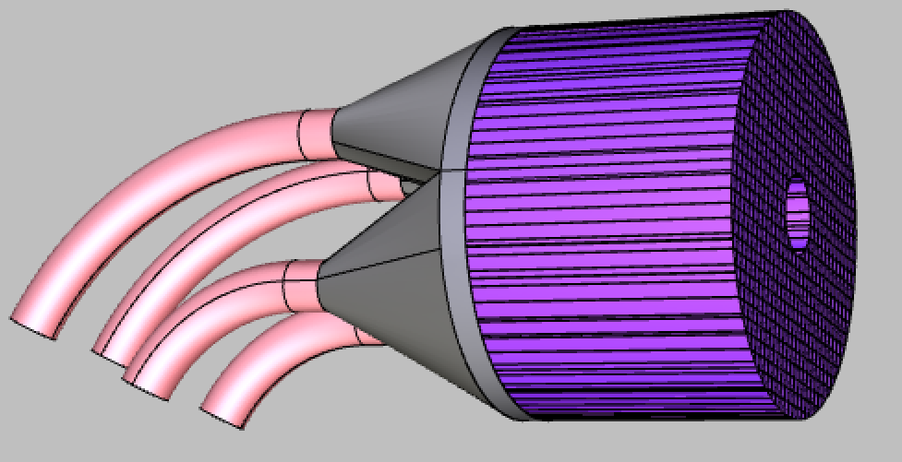
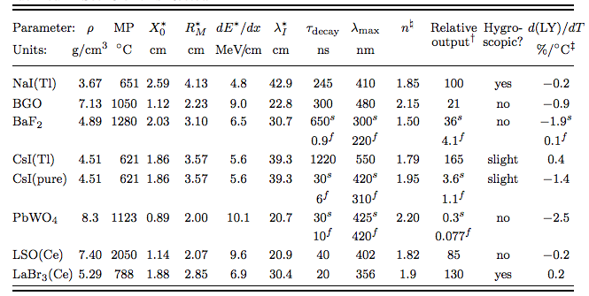
The calorimeter geometry
30 cm
Baseline solution cylindrical shape: radius 150 mm, depth 220 mm
  Inner hole 4 cm radius
  Active volume 13120 cm³ total of 656 crystals 10x10x200 cm³
New solution cylindrical shape: radius 300 mm, depth 220 mm
Material BGO: high LY, high ρ, small X₀ and R_{M}, long τ_{decay}, (free form L3)
Expected performance for LYSO ECAL:
  σ(E)/E =1.1%/√E ⨁ 0.4%/E ⨁1.2% superB calorimeter test at BTF [NIM A 718 (2013) 107–109]
  σ(θ)₂₀₀ = 3 mm/2 m ~1.5 mrad σ(θ)₄₀₀ = 3 mm/4 m ~0.75 mrad
  Angular acceptance 1.15-4.3 degrees

Slide 4
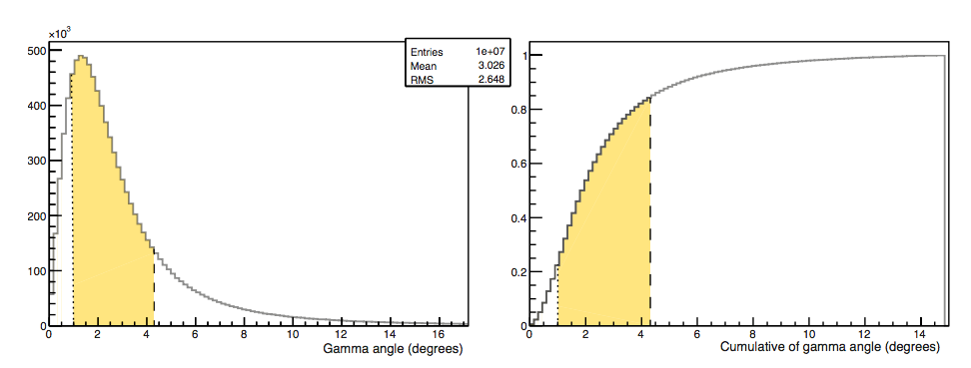
Calorimeter geometry studies
Geometrical acceptance with present angular coverage almost saturated
  Inner hole 1.15 degree
  Max angle 4.3 degree

Slide 5
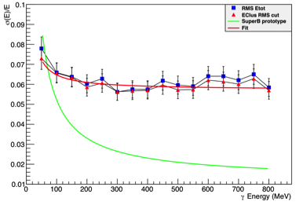
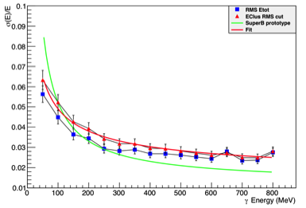
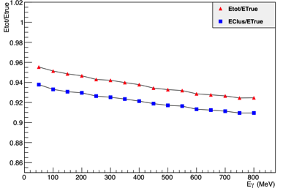
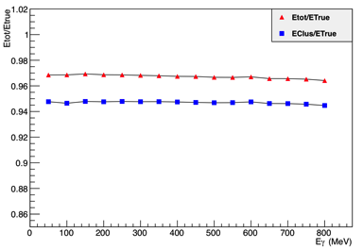
PADME calorimeter simulation
15 cm long LYSO crystals
20 cm long LYSO crystals

Slide 6
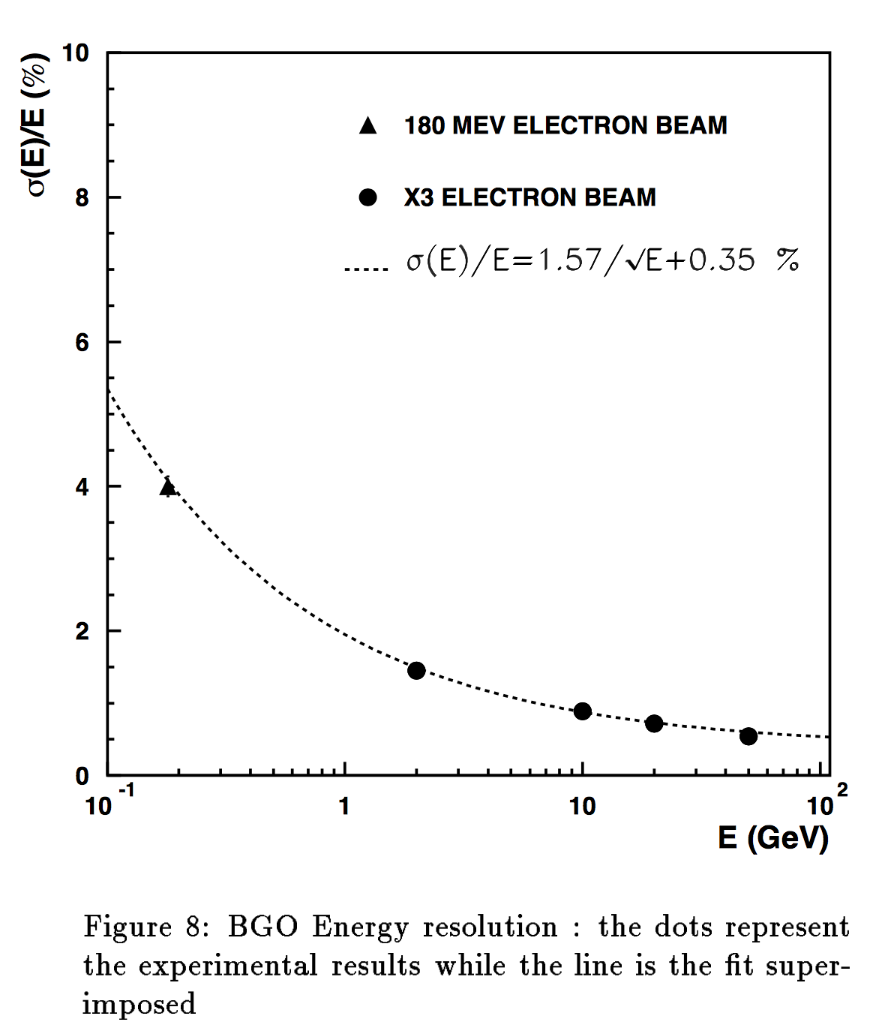
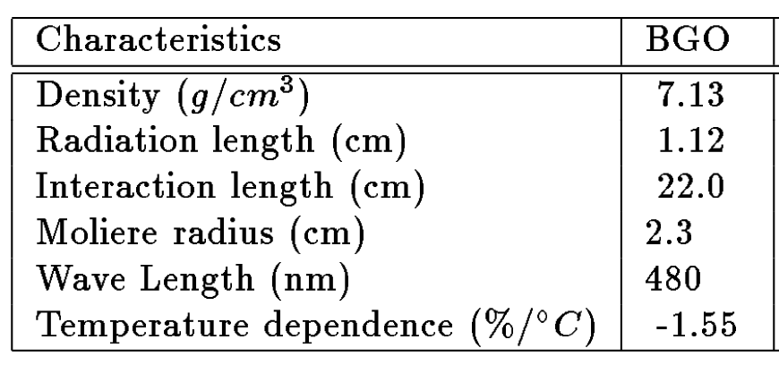
L3 BGO calorimeter performance

Slide 7
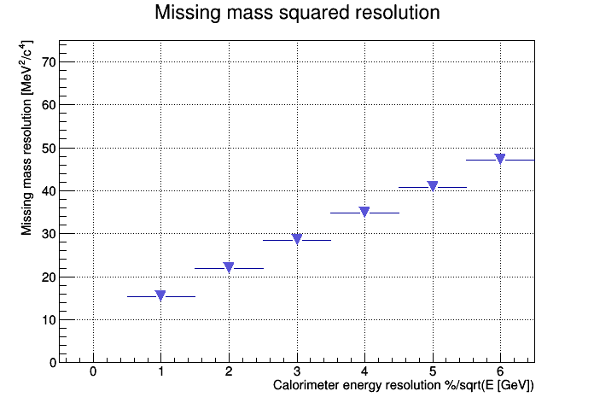
Missing mass and Ecal resolution
LYSO
L3 BGO
Are we able to get the same figure of merit with PADME Ecal?

Slide 8
BGO crystal procurement
At present we have collected:
  ~70 crystals of different shapes at LNF
  72 crystals stored at CERN already property of INFN
Informal agreement to get ~500 crystal from dismounted L3 Ecal
Investigation started for testing and characterizing crystals at CERN:
  Remove original photodiodes
  Remove painting
  Heat the crystal at 300 degree for annealing
  Label each crystal
  Measure the transmittance using the old L3 machine.
Technician at CERN taking care of the procedure identified
  Characterization could start in march 2016

Slide 9
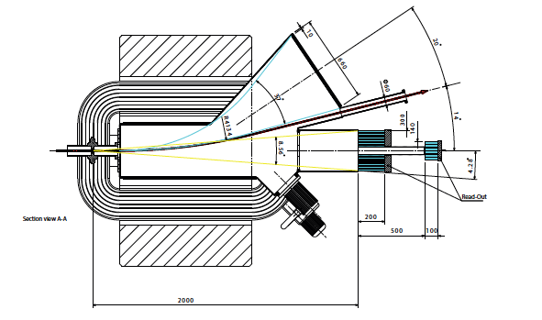
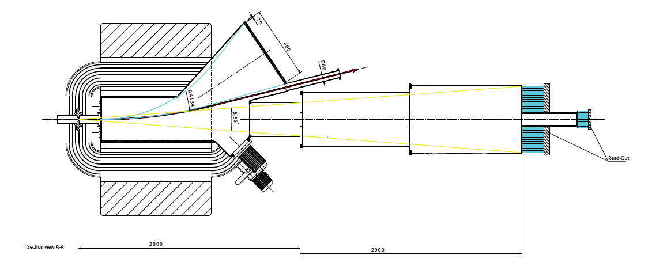
10x10 mm² @ 2m or 20x20mm² @4m
Add just a longer decay region to the 200 cm layout leaving the magnet region and veto detector unchanged.

Slide 10
Pro and cons
656 crystals 1x1cm at 2 meters | 656 crystals 2x2cm at 4 meters
Advantages | Advantages
Smaller Crystals: better timing resolution, slightly better spatial resolution | Larger Crystals: Lower occupancy, easier calibration, easier cutting, more photo sensors choice, easier calibration
Smaller ECAL: support design easier, smaller vacuum chamber diameter | Larger ECAL: better lateral shower containment, higher rate capability due to lower occupancy
Smaller distance: easier vacuum chamber design, less sensitive to beam divergence | Larger distance: better angular resolution, reduced energy leakage form showers in the magnet material, better cl to cl separation, less sensitive to beam spot size
 | Larger SAC: higher rate capabilities
Disadvantages | Disadvantages
Small crystals: few photo sensors | Larger Crystals: higher photo sensors cost
Small ECAL: bad lateral containment | Larger ECAL: bigger vacuum chamber
Short distance: sensitive to beam spot | Larger distance: longer vacuum chamber
Small SAC: higher pile Up probability | Larger SAC: Higher material cost

Slide 11
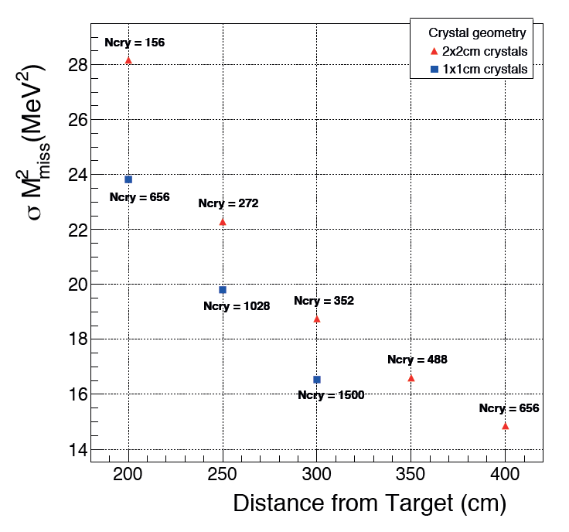
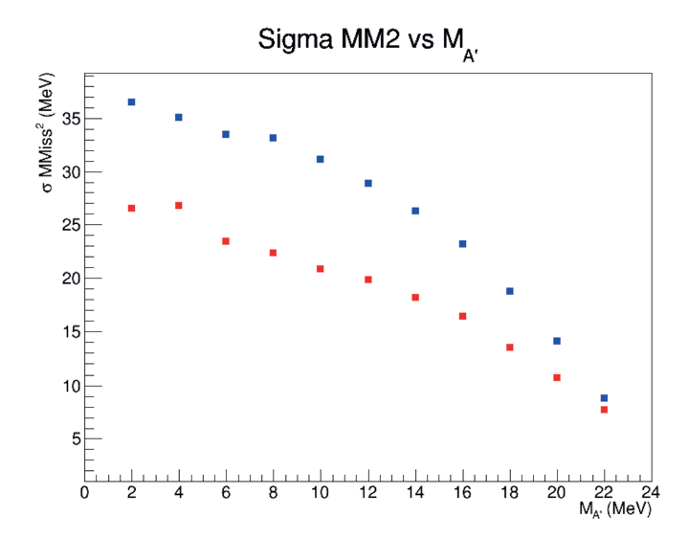
Expected performance comparison
Improvement mainly due to better angular resolution when the calorimeter distance increase
Depending on dark photon mass angular resolution is no more the dominant contribution to the MMiss² resolution and the gain is reduced

Slide 12
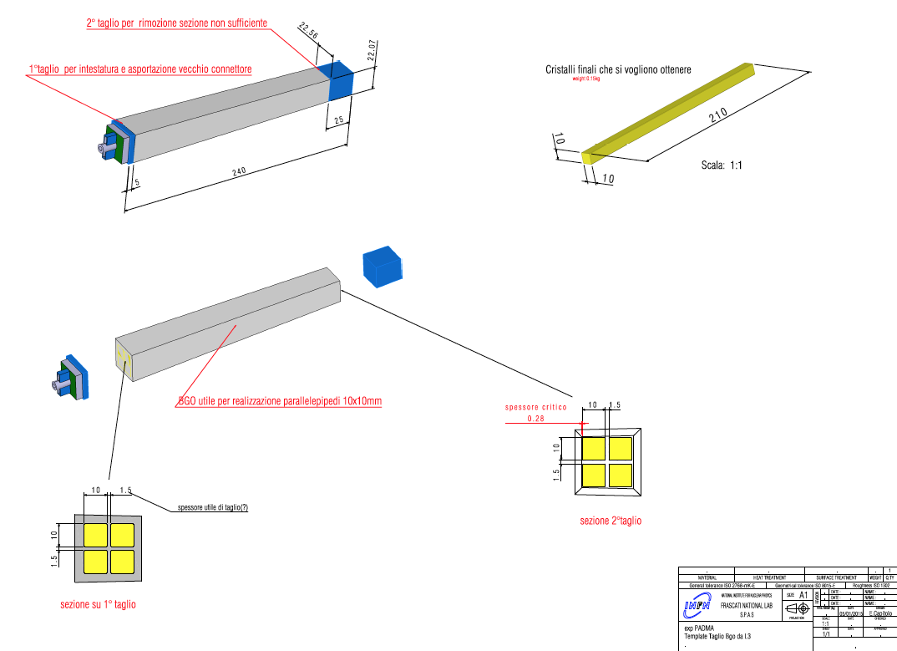
PADME L3 BGO crystals baseline
Not all the crystals can be uses for such a procedure depending on the dimension of the front face.

Slide 13
Alternative solution 20x20x220mm³
Easier cutting procedure can be applied to any kind of crystals

Slide 14
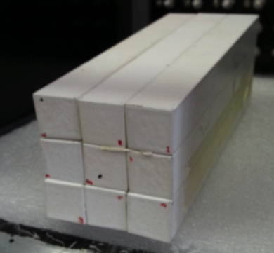
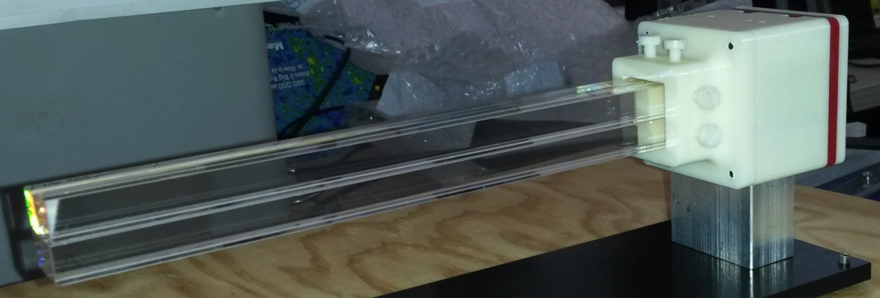
Cutting the L3 BGO crystals
We already have 3 crystals in cut by Silo firm into 10x10mm² samples:
  8 crystals 10x10x220 mm optically polished (1 broken)
  4 crystals 10x10x220 mm raw surfaces
  Cutting + polishing cost is 200+VAT € per original L3 crystals (4 PADME crystals)
  Cutting order 200 L3 crystals will cost 50K€ to be compared with 450K
Order has been placed for cutting 25 crystals in 20x20x220 m³
  Cutting cost is in this case 94.8€ VAT included
  In this case we need 656 crystals ~63K€

Slide 15
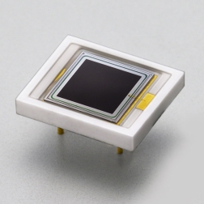
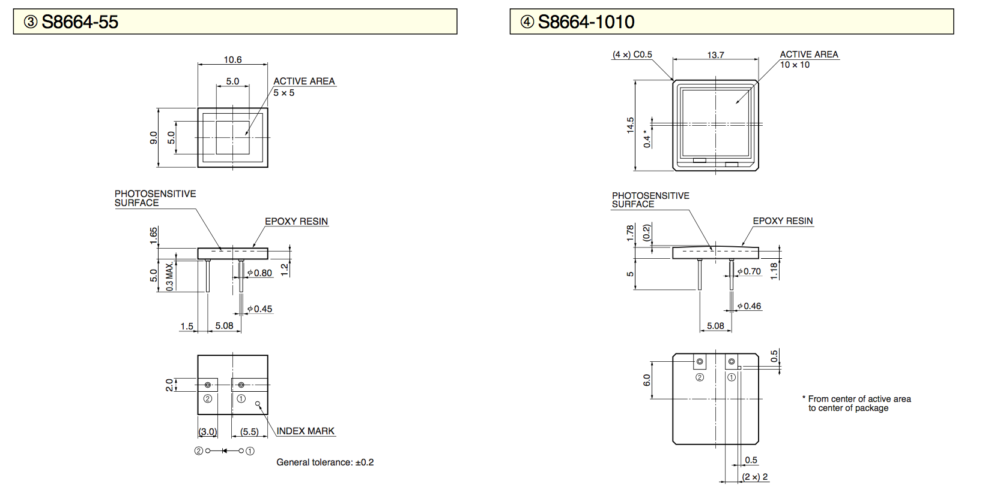
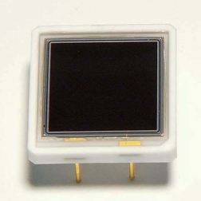
Calorimeter photosensors
The basic solution for the photo sensors is APD hamamatsu S8664-55
  High gain
  Price 124 euro/pcs (total cost 700 pcs~ 87K)
Depending on the amount of light in case of 20x20mm² crystals
hamamatsu APD S8664-1010
  Quoted price 315 euro/pcs (total cost 700 pcs 220K€)

Slide 16
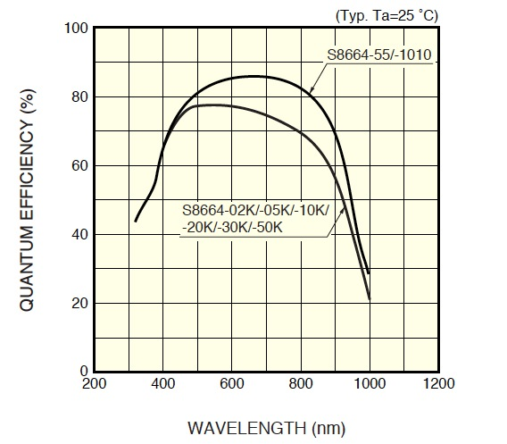
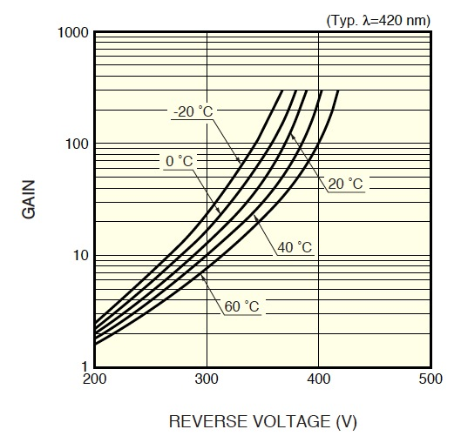
QE and GAIN of hamamatsu APD

Slide 17
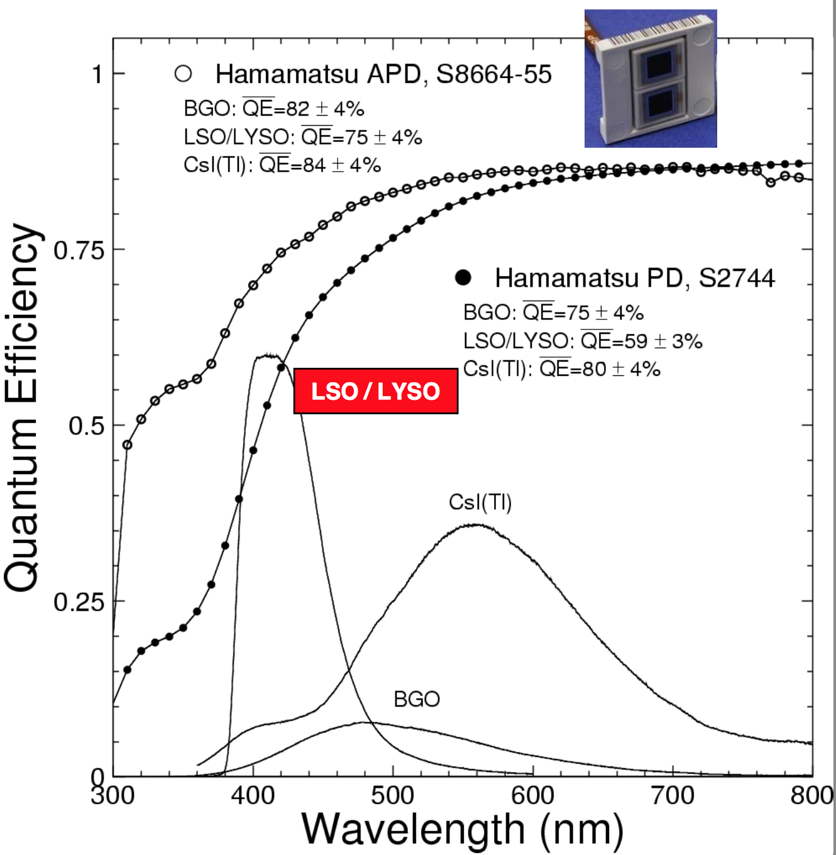
BGO QE matching with APD

Slide 18
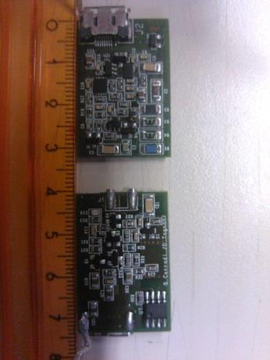
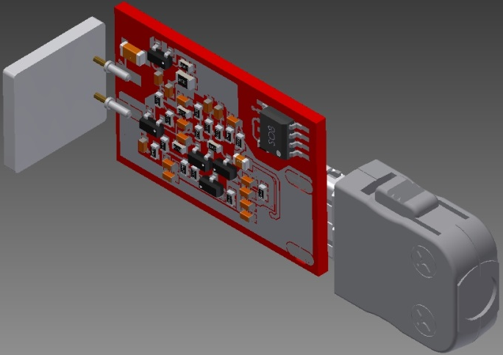
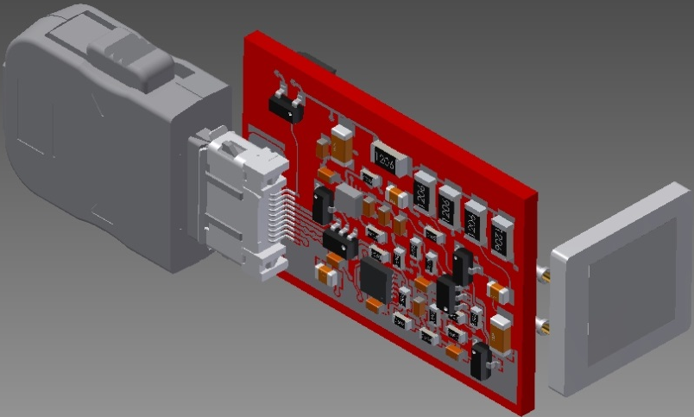
Ecal front-end electronics?
TOP side View
Detector linear voltage regulator
- Transimpedence preamp and detector
- Voltage regulator programmable.
BOTTOM side View. Charge preamp View.

Slide 19
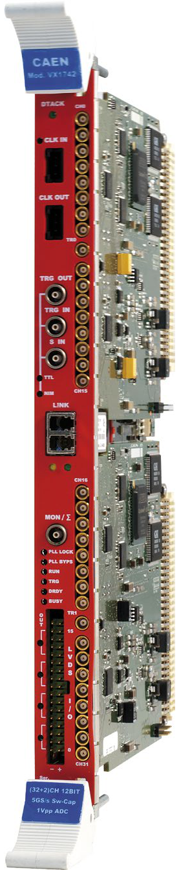
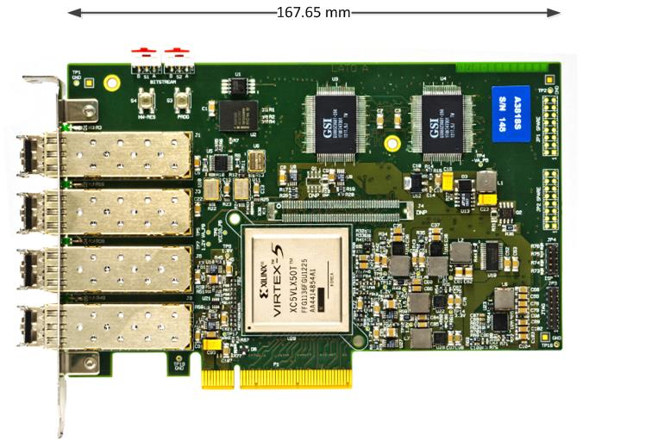
Calorimeter readout
V1742
PCI Express CONET2 Controller
12-bit @ 5 GS/s, 1024 samples per event
5, 2.4,1 GS/s selectable sampling frequencies
VME64/VME64X (32 ch.)
Special analog inputs 2 ch.
1 Vpp input dynamic range with programmable DC offset adj.
16 programmable LVDS I/Os
Daisy chain capability
A3818
PCI Express CONET2 Controller
PCIExpress x8 card 4 independent optical links
CONET2 CAEN Proprietary Optical link Compatible
Up to 32 CAEN CONET2-compliant Optical slave cards (CAEN VME Bridges or Waveform Digitizer) controlled by a single A3818
Data Transfer rate up to 85MB/s per link
Threshold (mV)
Minimum effective threshold < 12 mV
Small dispersion (RMS = 1.3 mV)
High and Low threshold channels can be swapped reducing the minimum threshold

Slide 20
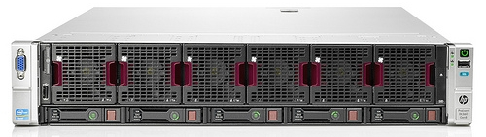
Calorimeter readout model
A3818
Server
All the chain already available test will start in May for the PADME test beam.
CAEN V1742
Needs 21 V1742 to collect a total of 656 channels
Each board receive the trigger from L0 trigger distribution system
  On each trigger all the boards digitize all channels and send data to optical links
Each board receive a clock input daisy chained
4 V1742 digitizers connected on each of the 4 optical receiver on A3818 installed in the server
  16 V1742 boards per A3818 on a single server

Slide 21
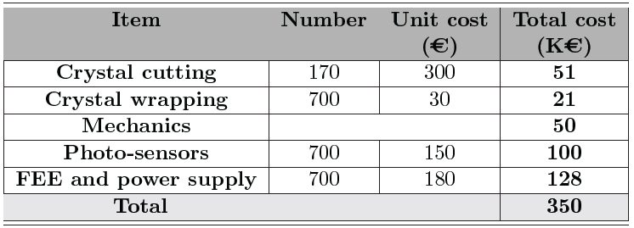
ECAL core cost comparison
400 cm
63
x2 ?
50
220
128
482
Cost increase can be contained by reducing the number of crystals or using the same photosensors for both solutions.
In the latter case the total amount of collected light is reduced by factor 4.
Cost of the front-end electronics seems underestimated in the TP.

Slide 22
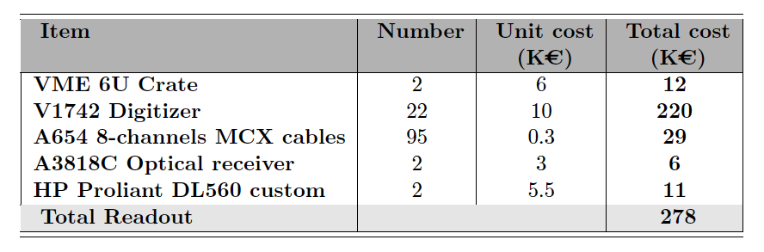
Ecal readout cost
The ECAL readout cost is unchanged for the two solution.
  Can save money with an intermediate solution (3.5m just 488 crystals)

Slide 23
Ecal test beam preparation status
We plan to equip a 3x3 20x20 mm² crystal matrix for the next test beam:
  9 crystals currently at SILO for cutting procedure
  Read out: 10 APD S8664-1010 on loan from Belle II (thanks to Giuseppe and Riccardo)
  40 channels of FE electronics + power supply in production at ARTEL.
  64 FADC channels + readout software already in use at Frascati
  Mechanical support refurbishing ongoing

Slide 24
Conclusions
The PADME ECAL material will be the BGO from L3 ECAL
The procurement of the crystals is almost completed
Procedure for crystals selection at CERN established
Calorimeter layout to be finalized choosing in between 20x20 or 10x10mm² crystals dimension.
  Sensitivity comparison required by INFN as milestone
Photo sensors will be APD the size of which depends on crystal dimension and light output.
  Any other vendor with reasonable solution?

