Slide 1
Positron beam for PADME
Paolo Valente*, Bruno Buonomo, Luca Foggetta, Claudio Di Giulio
con lo staff del LINAC di DAFNE
INFN Laboratori Nazionali di Frascati
*INFN Sezione di Roma

Slide 2
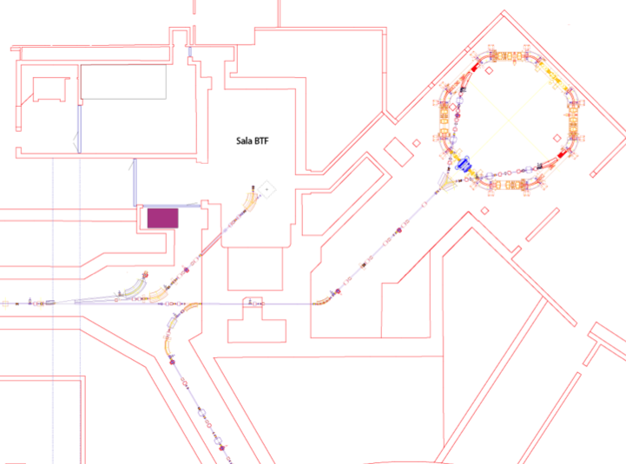
The DAΦNE complex
Power supplies
BTF
control room
BTF
Damping
Ring
transfer line
LINAC
transfer line
Main rings

Slide 3
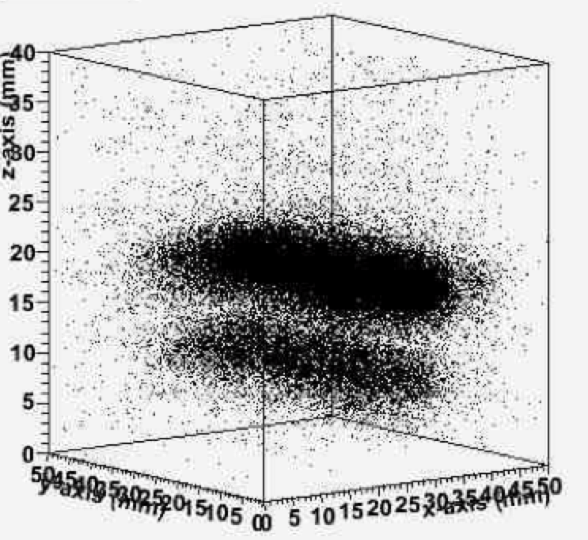
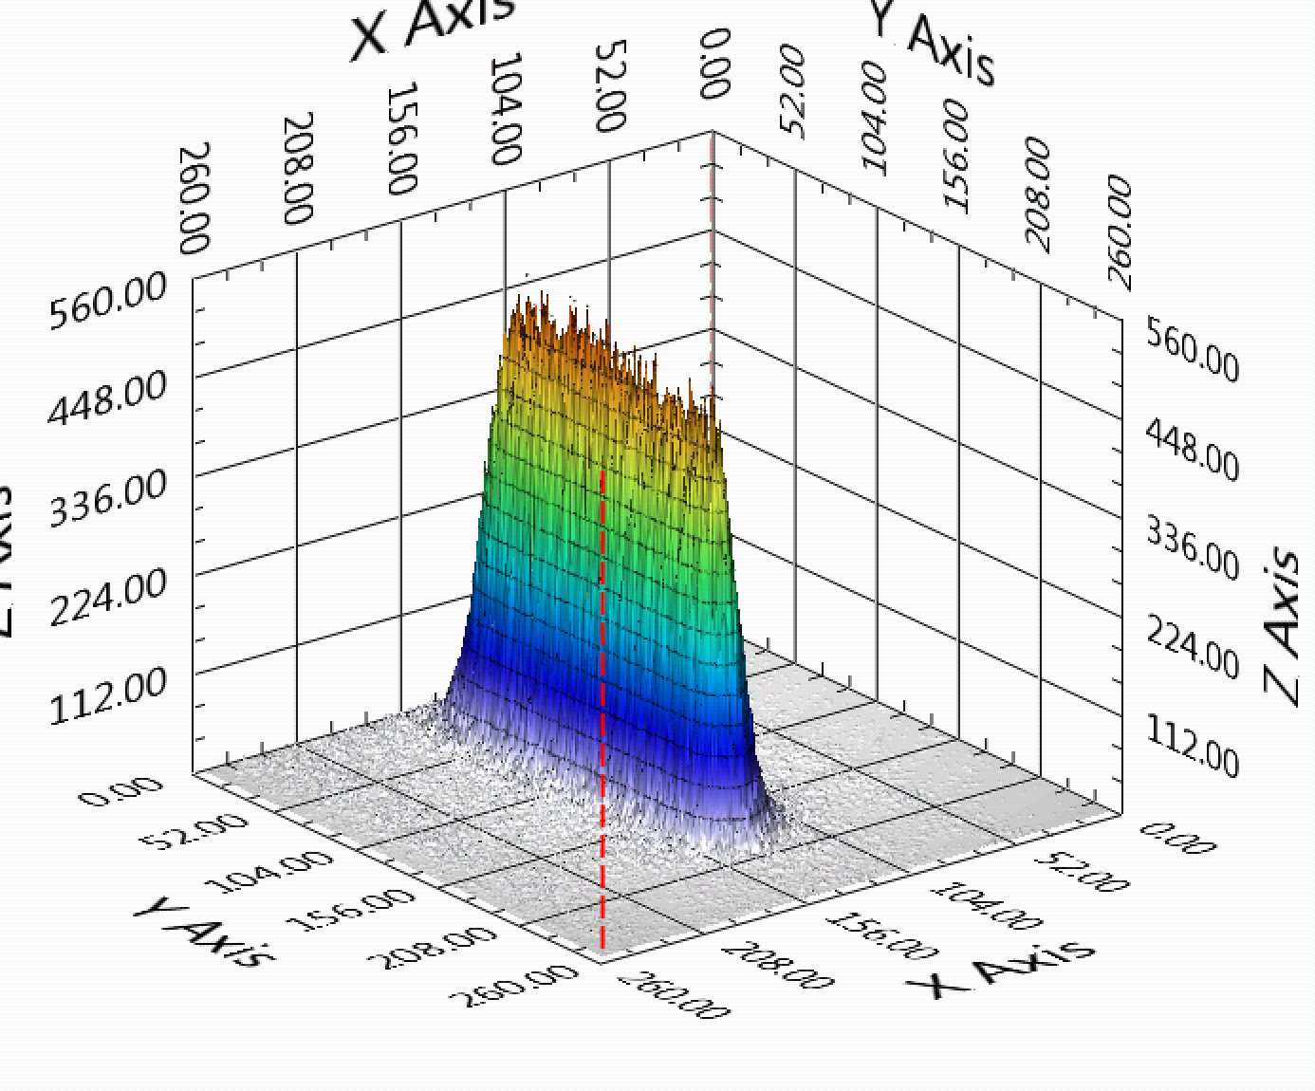
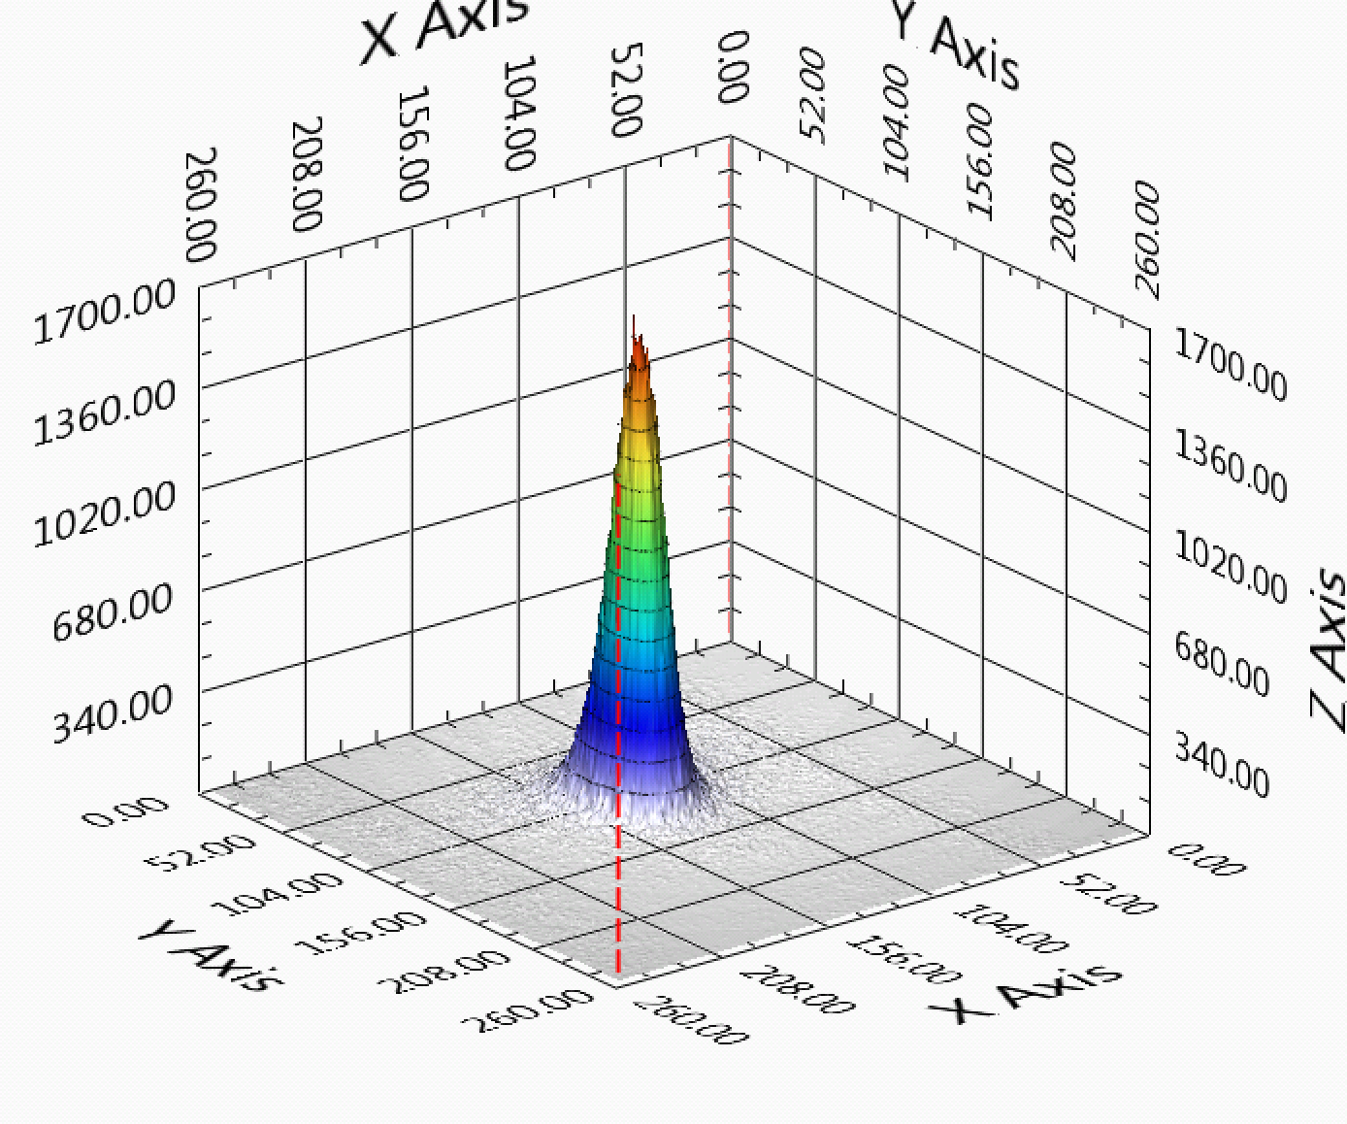
BTF strong points …
Efficiency
Taking out the linac down-time and the dead-time during the switch of the LINAC and the transfer lines from electron to positron mode, the fraction of time with beam available to BTF is >90%
However during injections for DAΦNE the number of bunches available to BTF goes down from 49 to 2 per second
Flexibility
Beam parameters can be adjusted in fairly wide ranges, quickly and with a good reproducibility
User-friendly diagnostics
Diagnostics has been continuously improved during the years, both from the point of view of performance and ease of use
In particular GEM TPC and MediPix/FitPix detectors allows real-time adjustment and monitoring of the beam spot size and position
Calorimeter particle counting and WCM intensity measurement
Wide range of services
Network, DAQ, gas distribution
Magnetic fields
Remotely controlled x-y trolley, linear and rotation stages
Vacuum and (with some limitation) cryogenics setups

Slide 4
… and limitations
In parasitic operations
The duty cycle is limited, mainly by the switch between electrons and positrons, but more importantly the intensity of the beam on the BTF target (and thus downstream in the BTF line) changes by almost an order of magnitude in the two modes
The maximum energy is limited to 500 MeV (in “single particle”, lower at high intensity)
The bunch length is fixed at 10 ns
Working with the BTF target
The maximum intensity is limited to 10³-10⁴ particles/bunch only lowering the selected energy and opening the collimators, thus worsening the momentum resolution (up to 1-2%)
The beam spot
Is practically Gaussian, it’s not easy to have an uniform intensity over a large area even defocussing and working with the collimators
The angular divergence
It’s of the order of 1-2 mrad, essentially dominated by the Coulomb scattering on the exit window (500 μm thick Beryllium)
The last dipole adds a significant dispersion when increasing the intensity: opening of the collimators the entrance angle in the energy selection dipole increases, thus spoiling the momentum resolution
The diagnostics
Intensity is measured well in the low multiplicity range (by calorimeters) and above 10⁷ particles/bunch (without target, by Integrating Charge Toroid), but with less accuracy in the intermediate range
MediPix/FitPix are imaging detectors, not really a tracking system
The GEM TPC has a sub-mm resolution only in the drift coordinate
Tagged photons
Are available, but with a low rate and not uniform energy resolution
Neutrons
Can be produced, but with RP limitations on the repetition rate and run duration,
Diagnostics has to be improved

Slide 5
BTF improvements
In the last years we have been constantly working in order to improve:
The efficiency in terms of beam availability and stability
The ease of tuning of beam parameters, through a constant work on the diagnostics
We have also put forward a number of ideas in order to widen the range of beam parameters:
2003-2004: Photon tagging
2008-2010: n@BTF, optimized target for studying the photo-production of neutrons
Upgrade of the shielding for high intensity operation
Pulse length >40 ns
Improved target for positron production
Improved collimation (aiming at hundreds of μrad)
Second beam line
Improved photon tagging
Dosimetry for irradiation
Integrated facility for space characterization
Energy upgrade
…

Slide 6
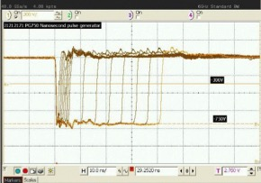
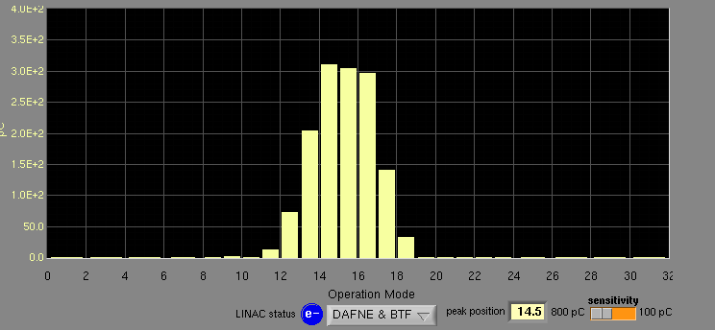
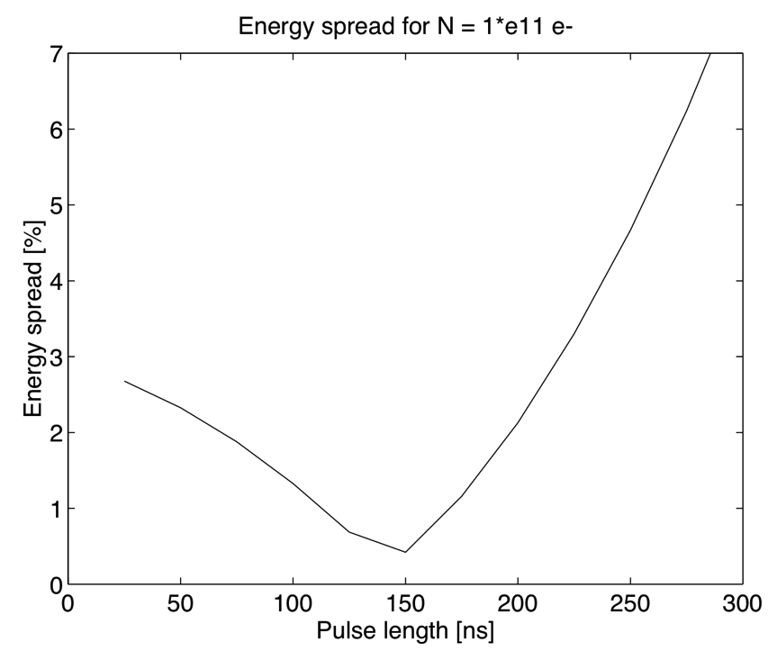
Bunch length
Diluting in time electrons/positrons in one linac bunch can be very useful for a number of applications (e.g. decreasing pile-up)
Assuming constant current from the gun cathode, a longer pulse will correspond to a larger beam charge
The main limitation comes from the RF pulse compression, needed to reach higher energy: SLac Energy Doubling system (SLED)
Outside flat top the accelerating field decreases rapidly, thus increasing the energy spread
We aim at extending from 40 to 200 ns in the first phase
SLAC LINAC successfully operated at 500 ns with multiple phase inversions
10 ns
40 ns
Planned purchase of new gun pulser, from 1 to 4500 ns. Hopefully by the end of the year

Slide 7
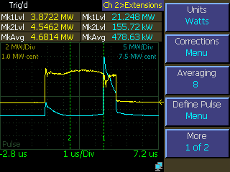
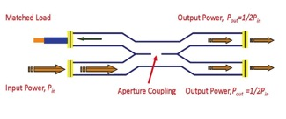
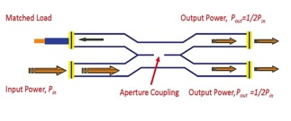
SLED
90° phase shift:
90°
0°
Input power
90°
-90°
accelerator
-90°
Resonant
cavities
3.7 μs
0.8 μs
0°
-180°
0°
-90°
After 180° phase inversion:
accelerator
-90°
-90°
Resonant
cavities
-180°
-180°
-180°

Slide 8
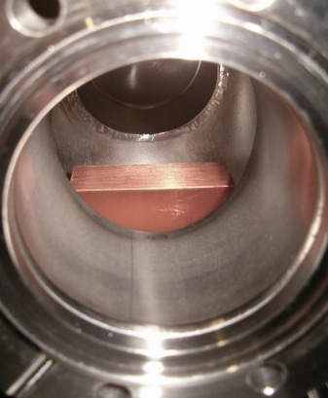
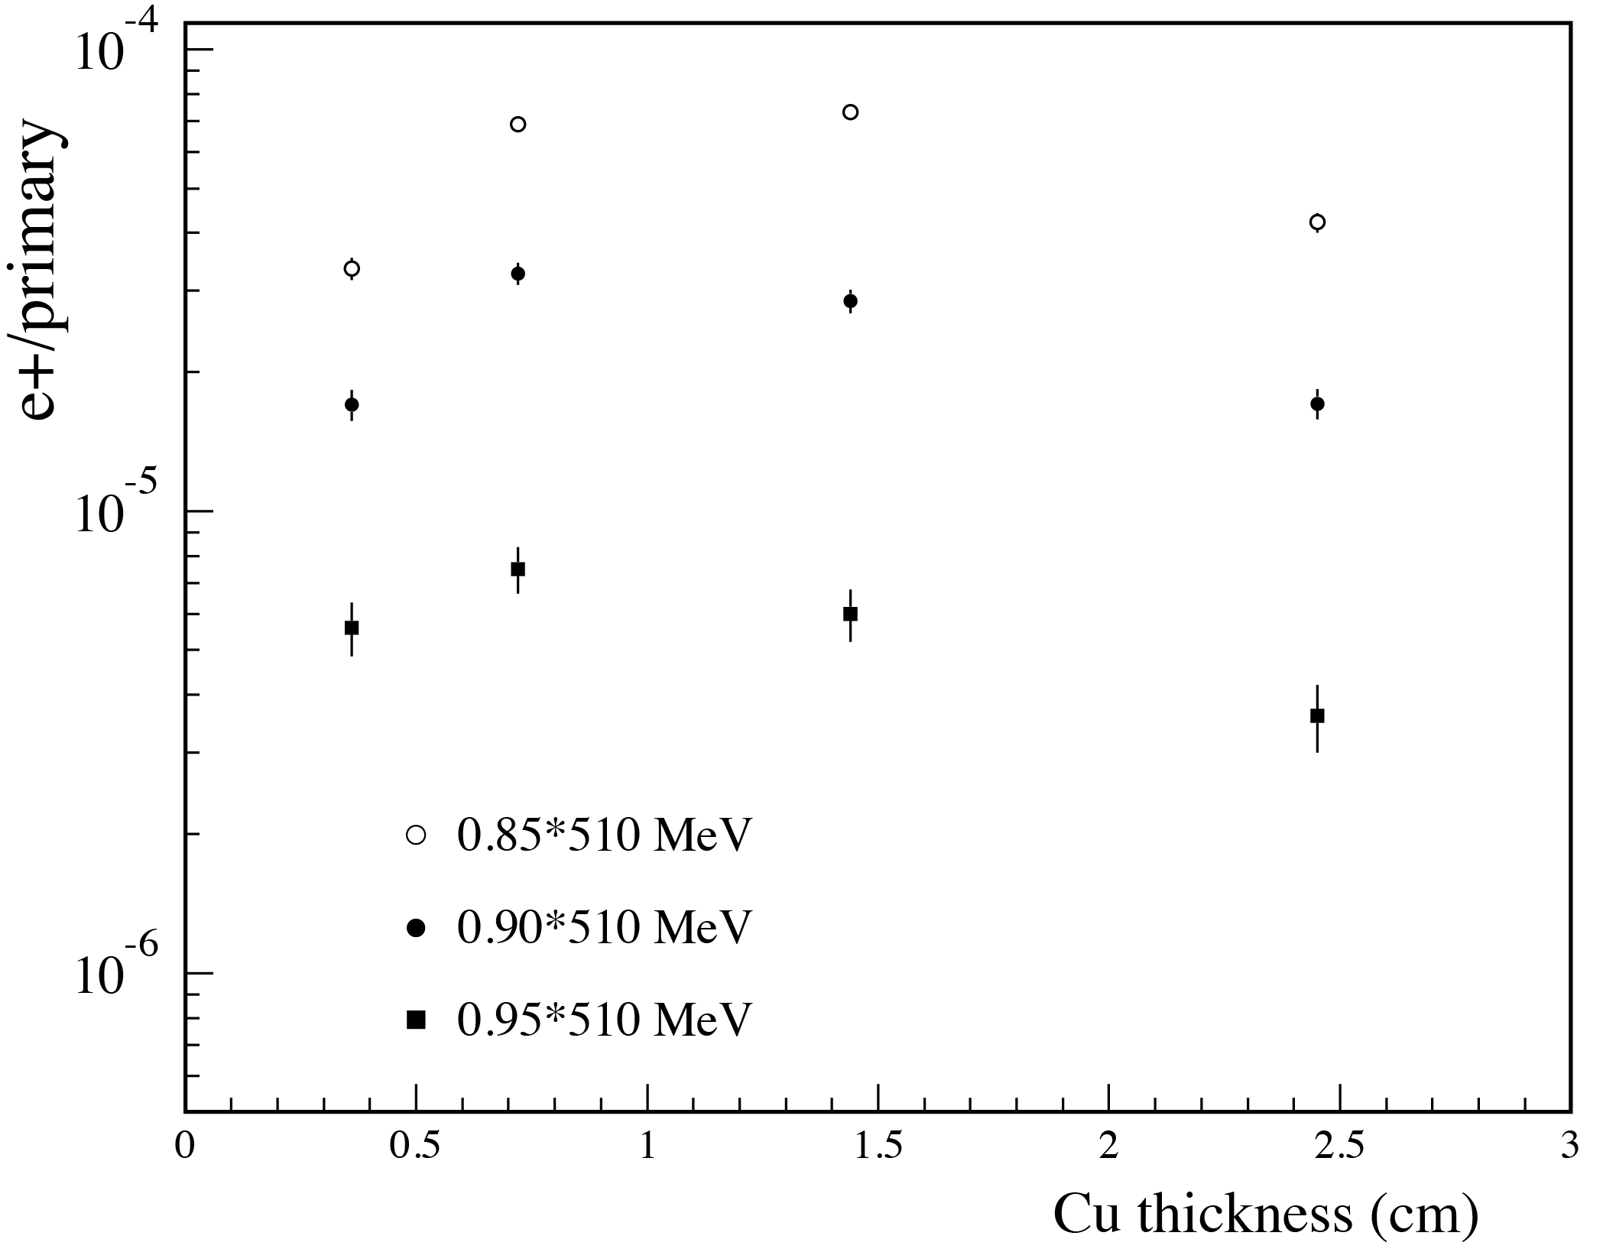
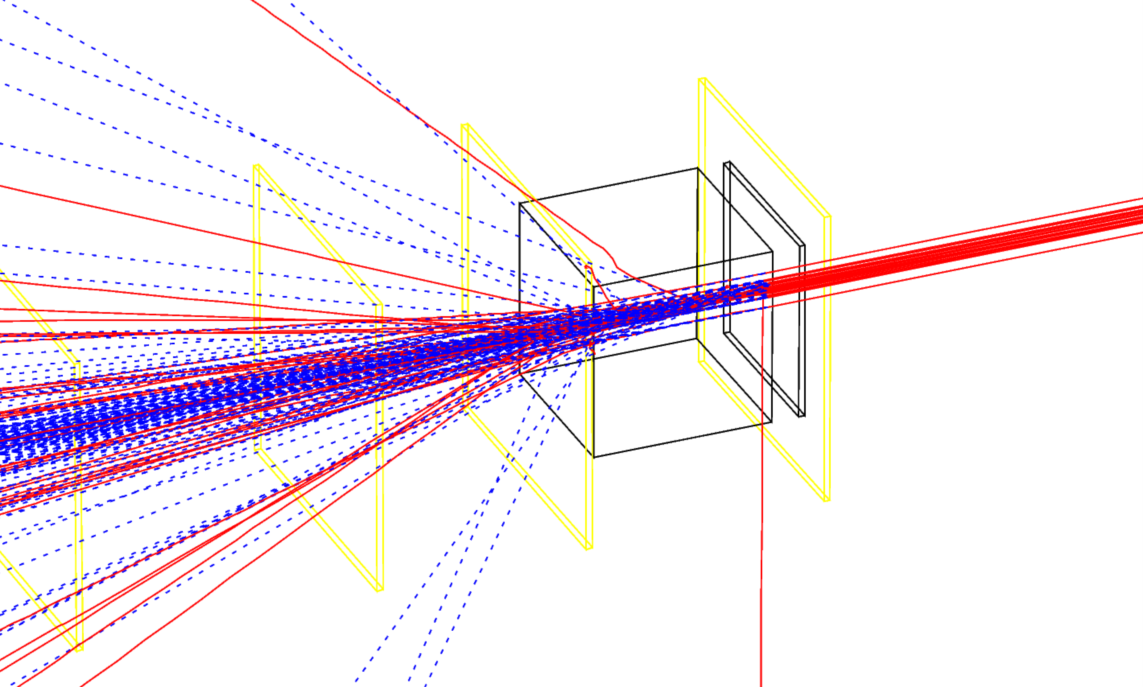
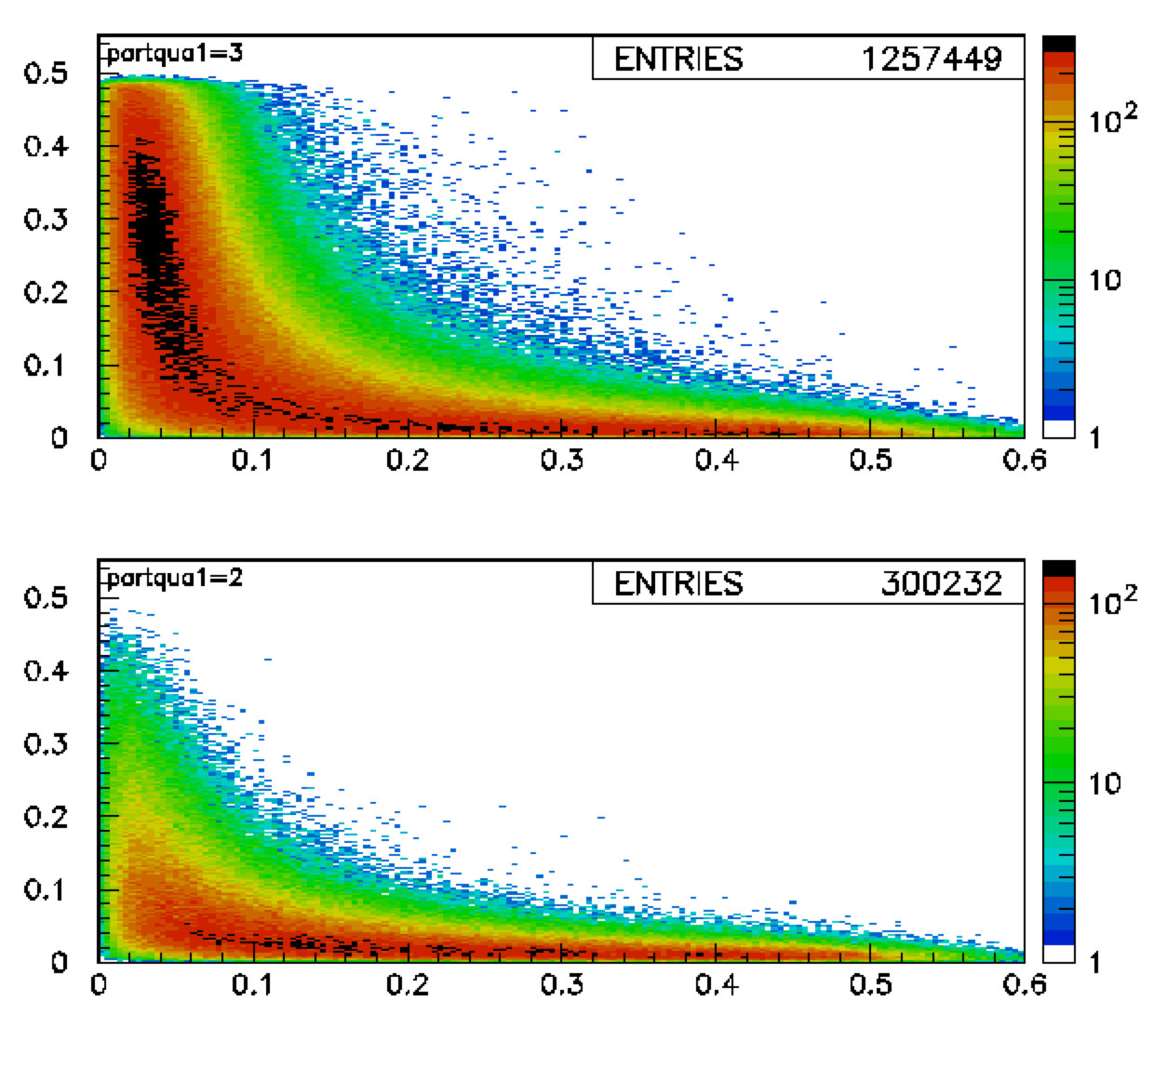
New target
Present Copper target optimized for the production of maximum number of secondaries
Three steps: 1.7, 2.0 e 2.3 x₀
Not the optimal solution for high-energy (E ≈ E₀) positron production
Optimize depth of Copper target
On-going:
Try different material(s)
Optimize geometry
Positron yield vs. thickness
(no fit)
Al
W
0.5 x₀
1.0 x₀
1.7 x₀
electrons
positrons

Slide 9
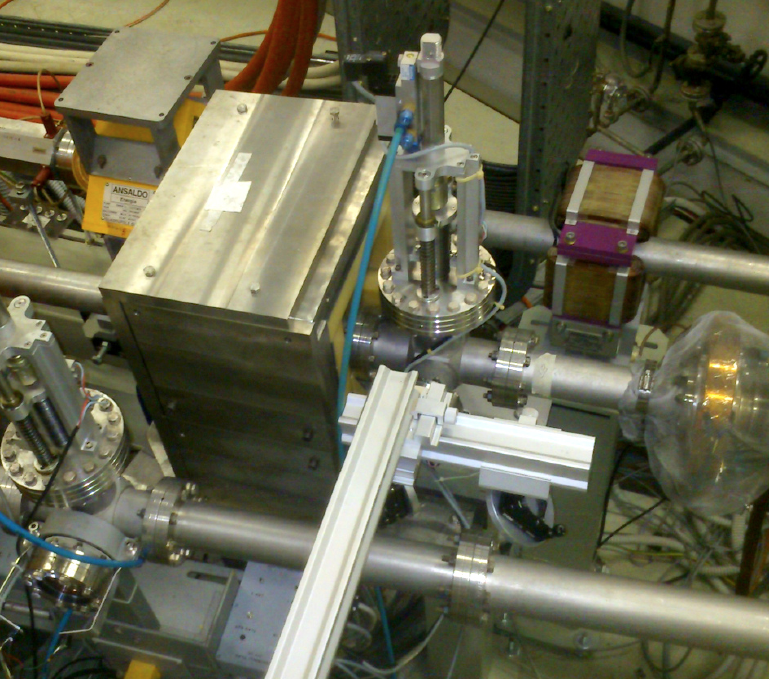
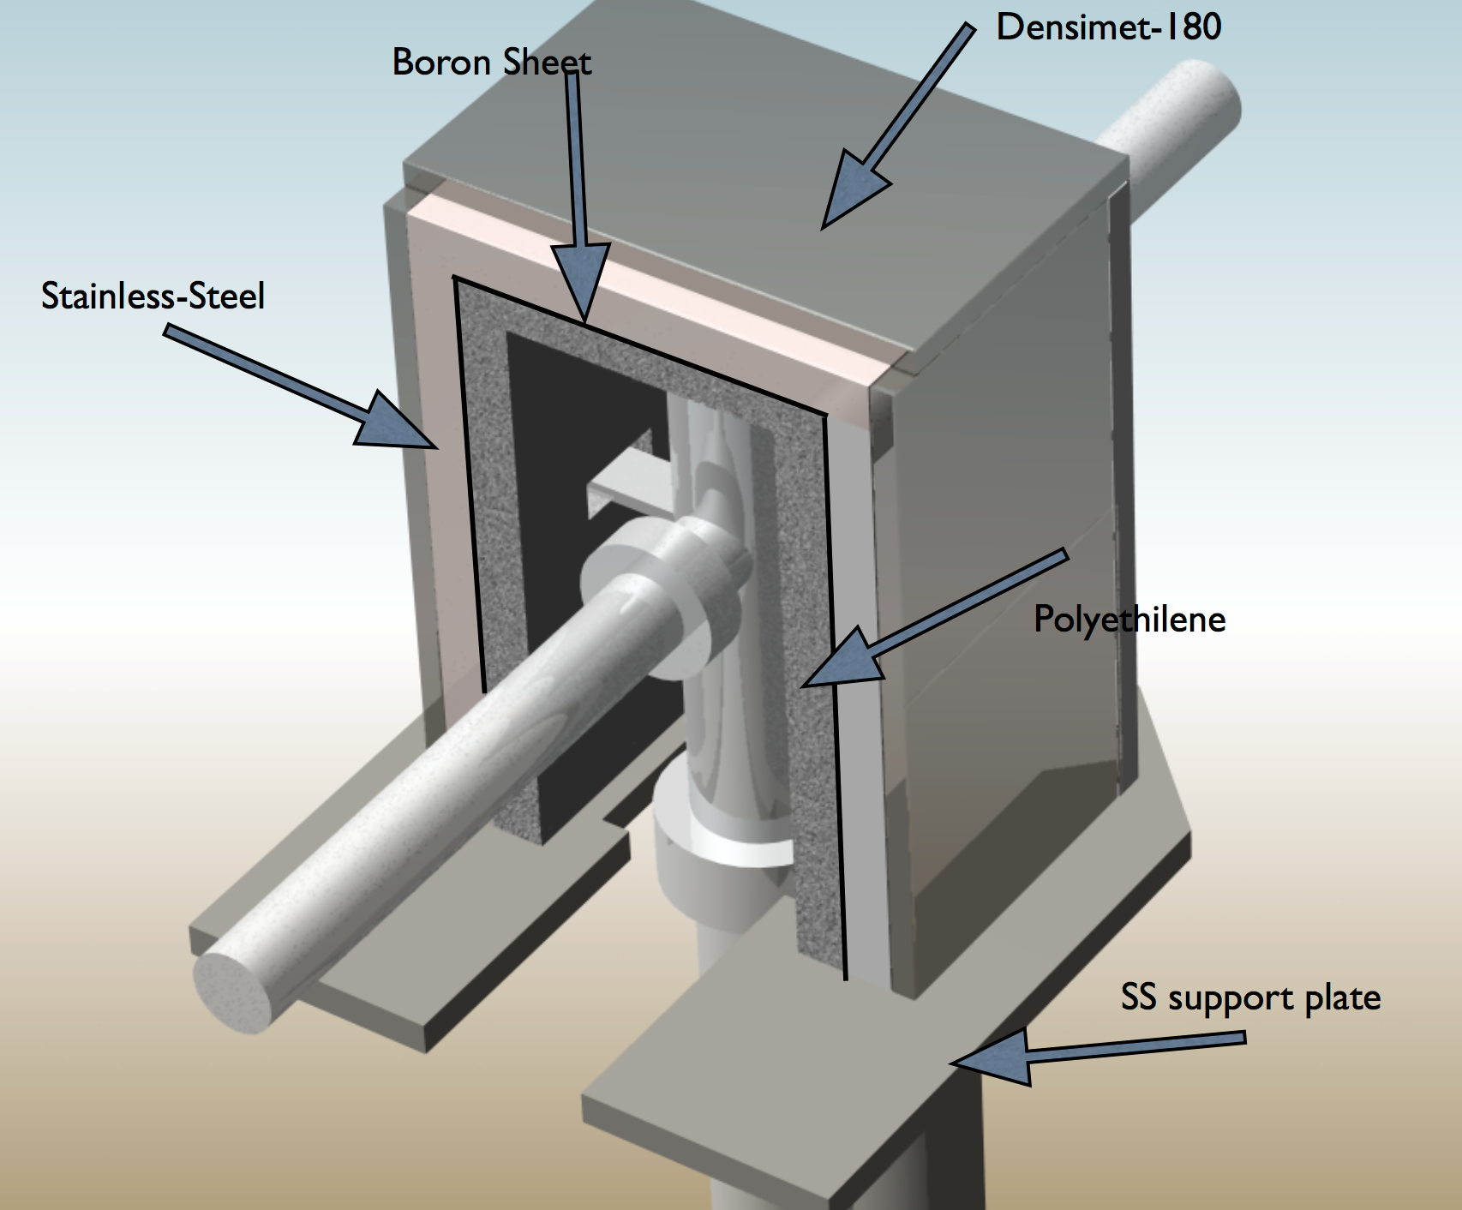
BTF target assembly and shielding

Slide 10
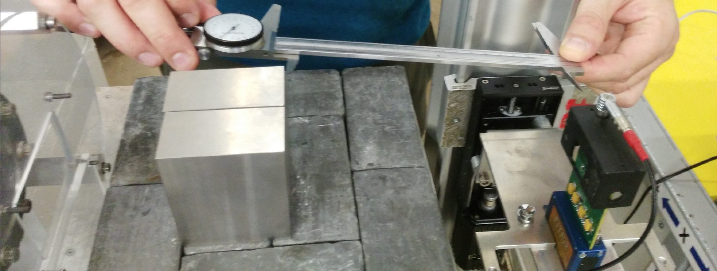
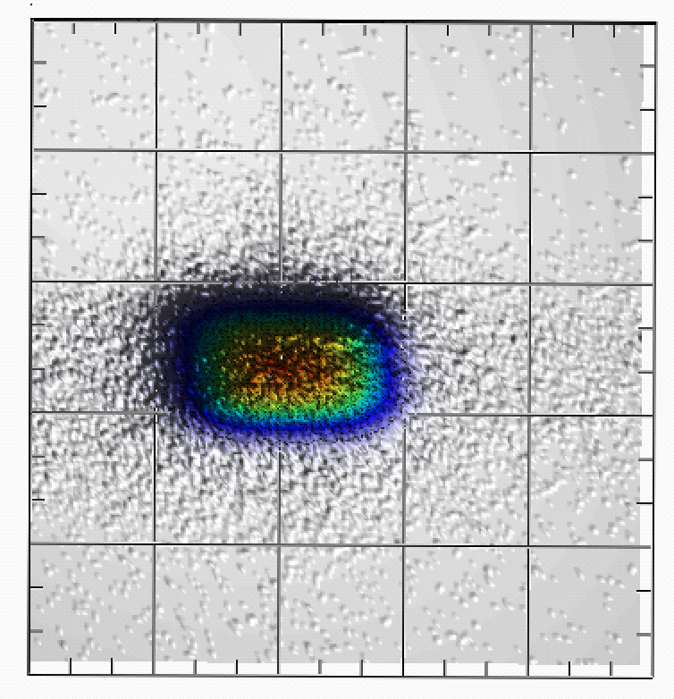
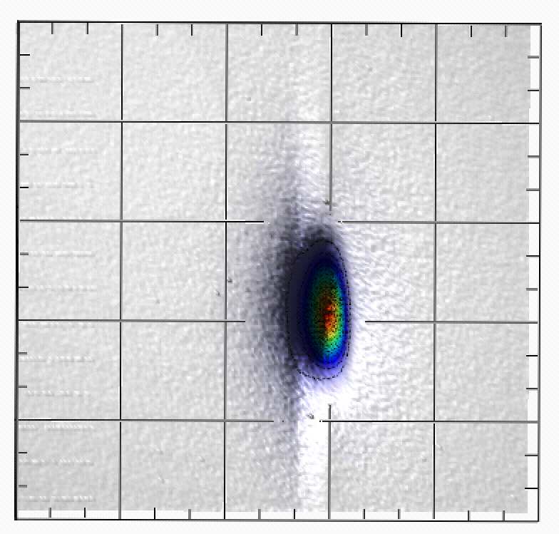
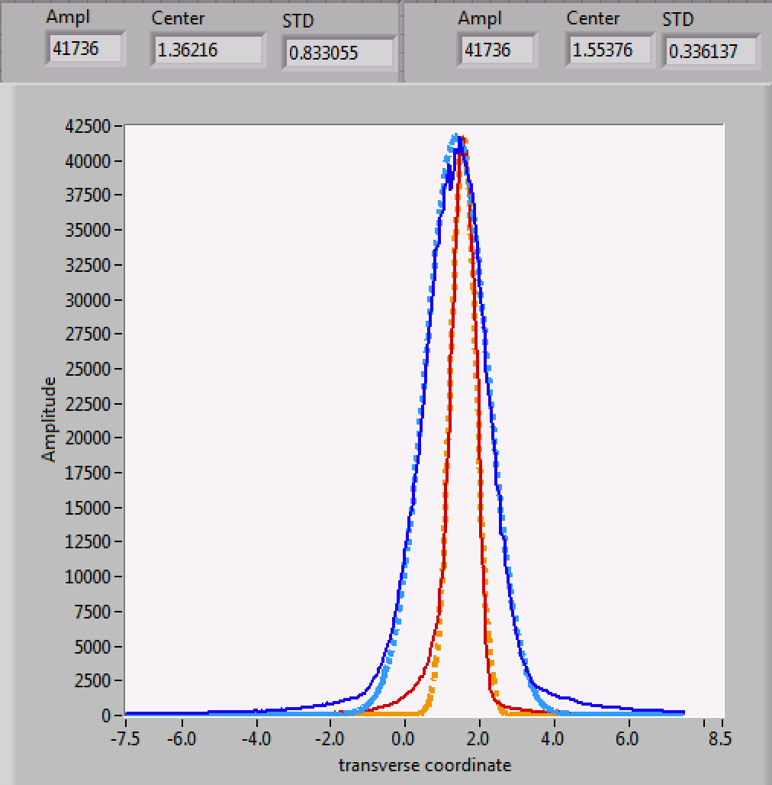
Improved collimation
15 cm
6 cm
20 cm
60 mm of Tungsten collimator
≈ 0.15 mm gap
≈ 100 particles/bunch at 450 MeV

Slide 11
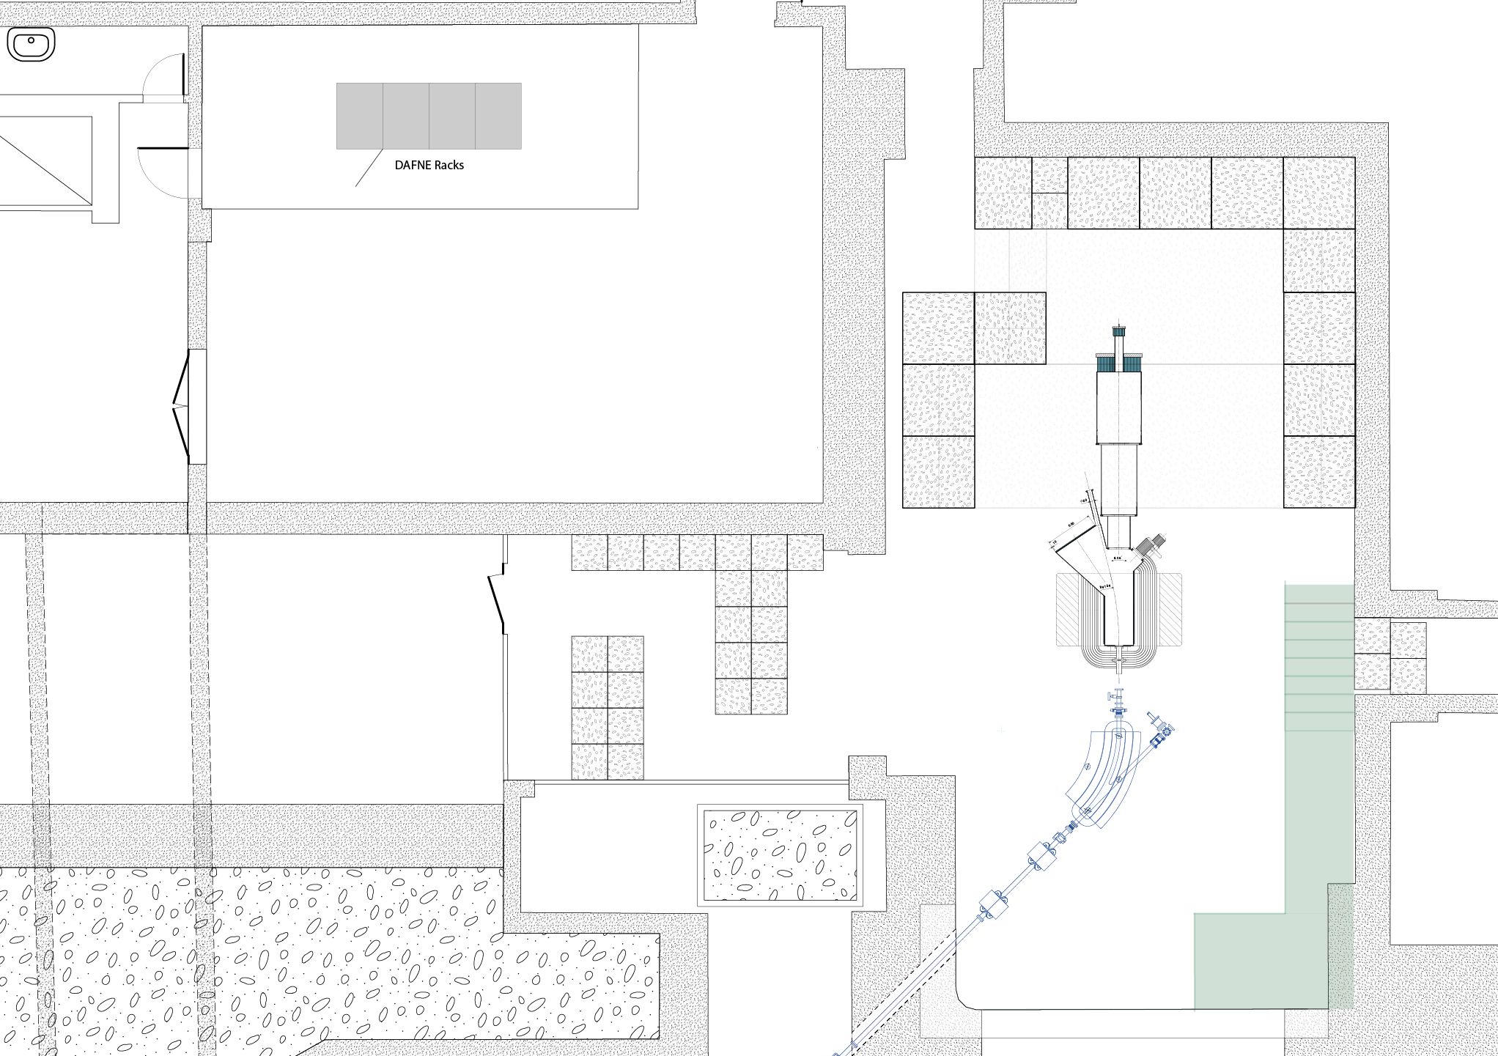
Possible PADME installation (present BTF)

Slide 12
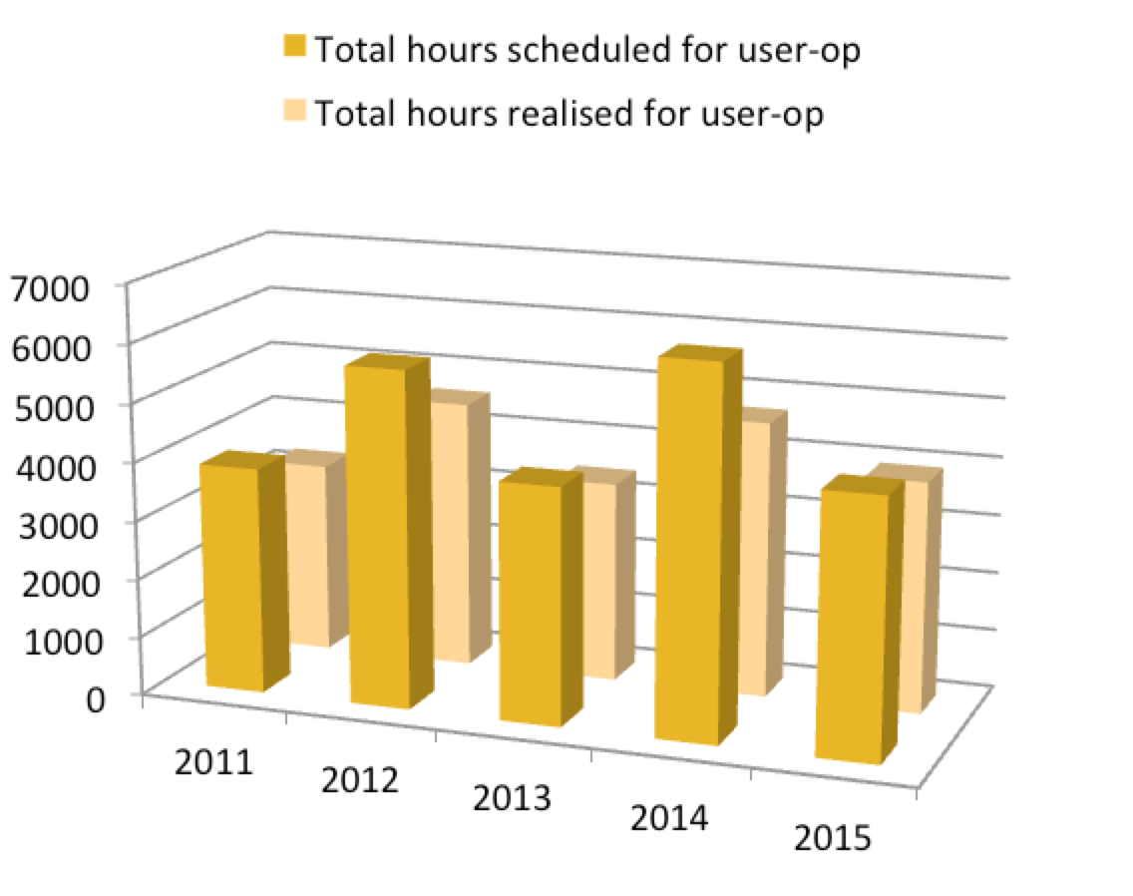
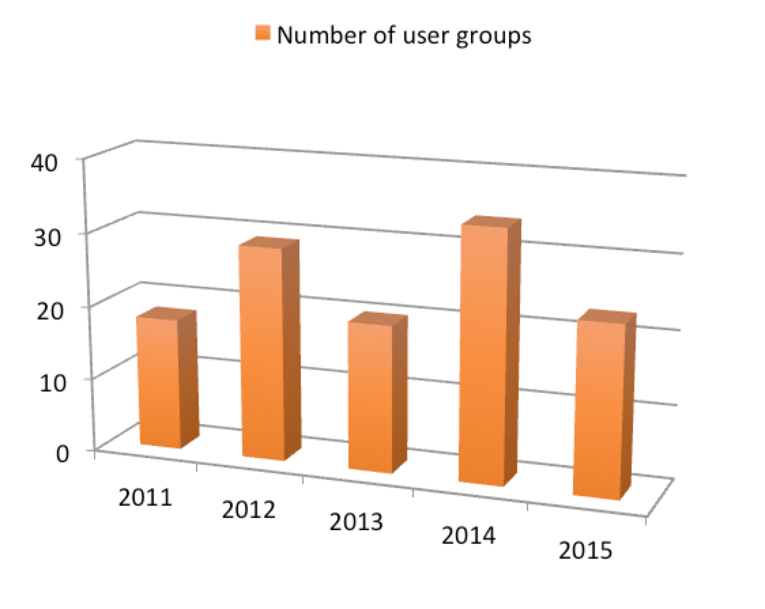
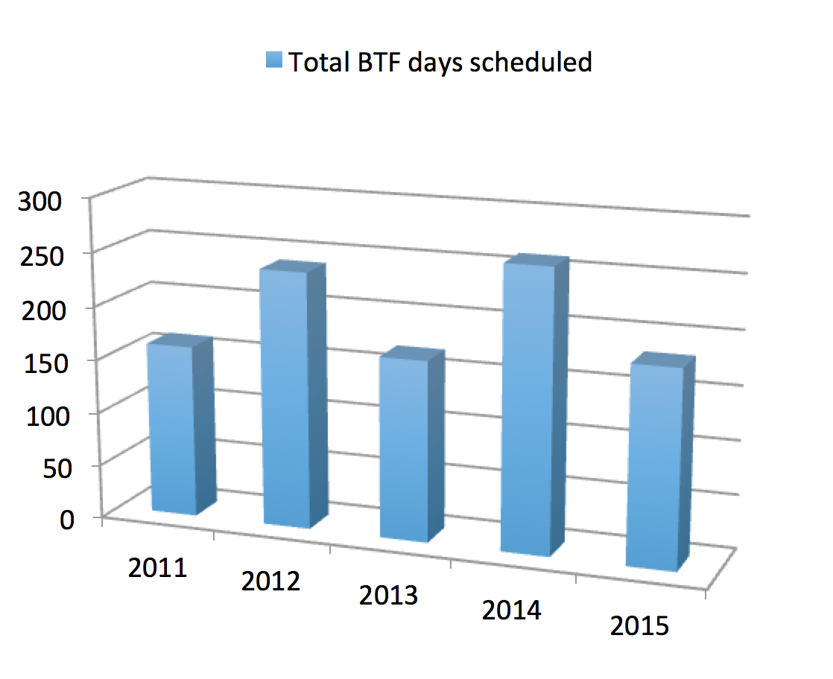
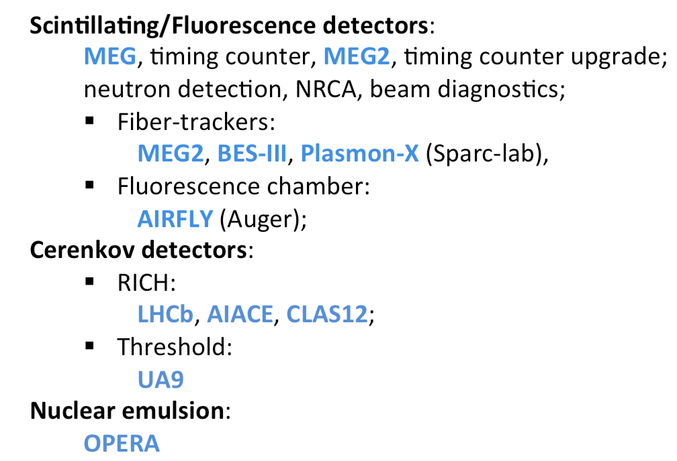
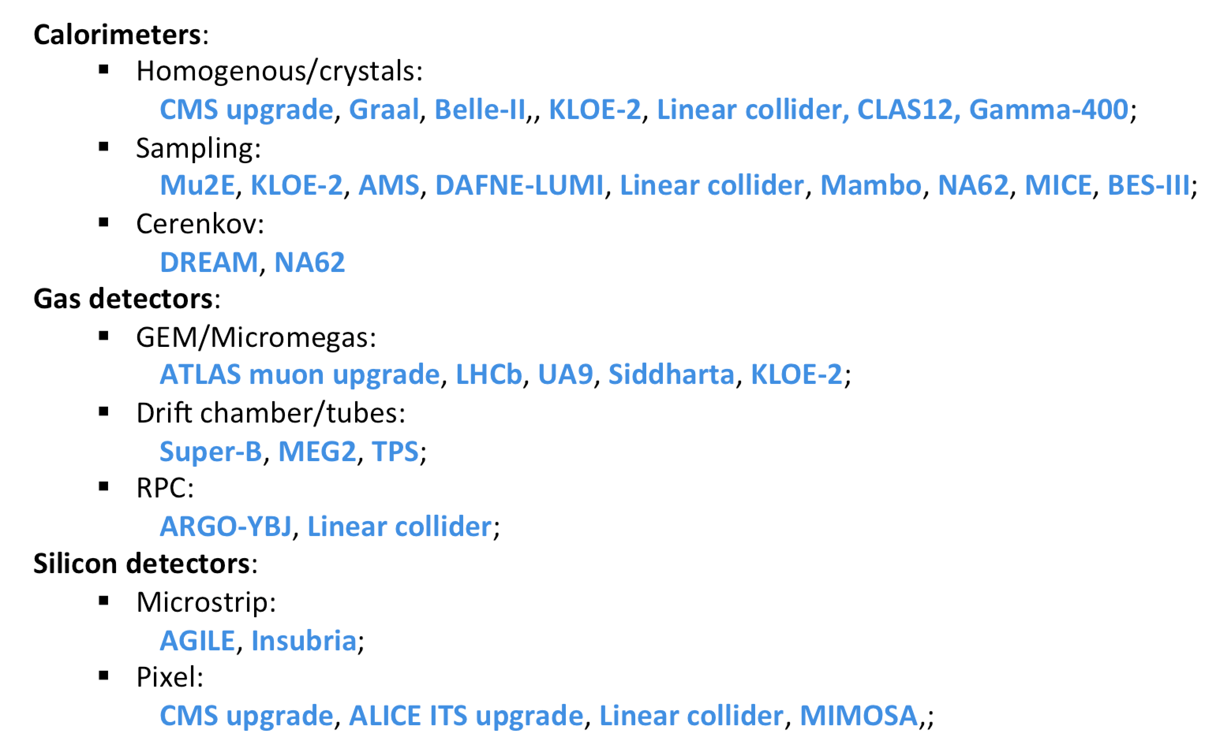
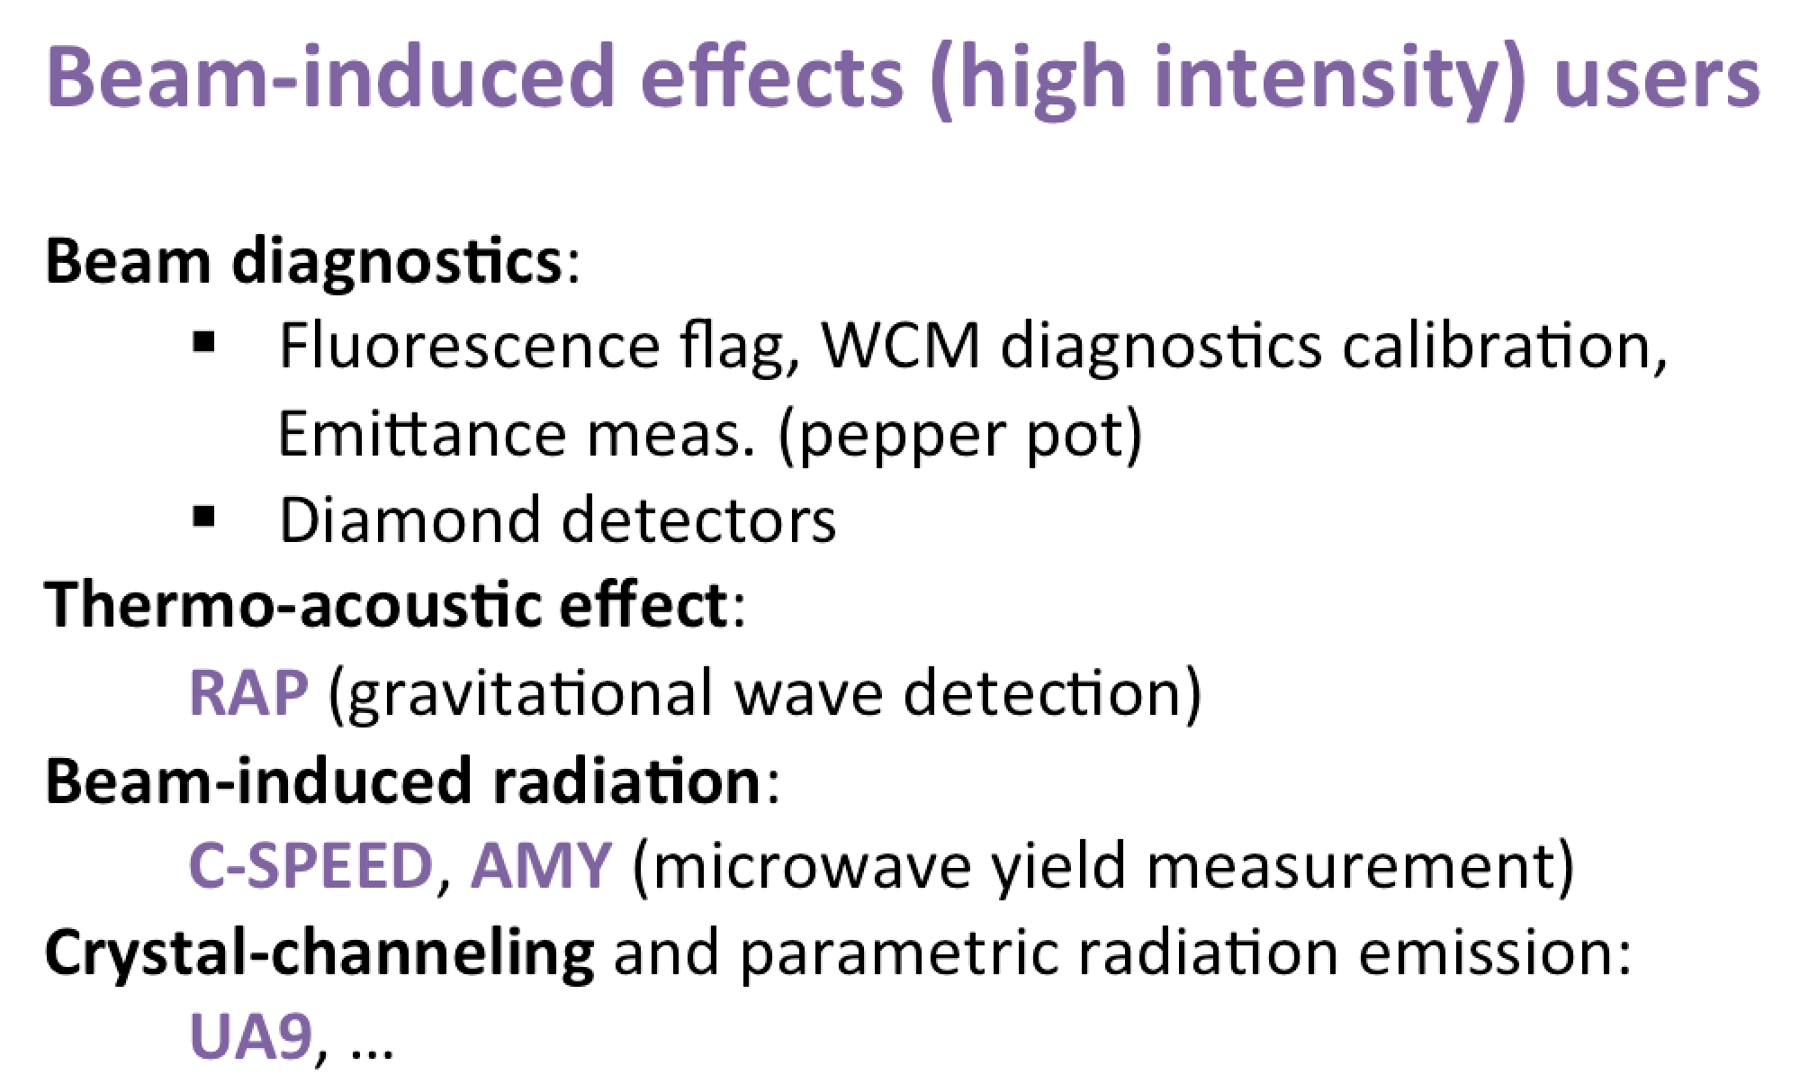
Access to the facility
90% of shifts for detector testing and calibration
The Beam-Test activity will be completely stopped running PADME in the present configuration

Slide 13
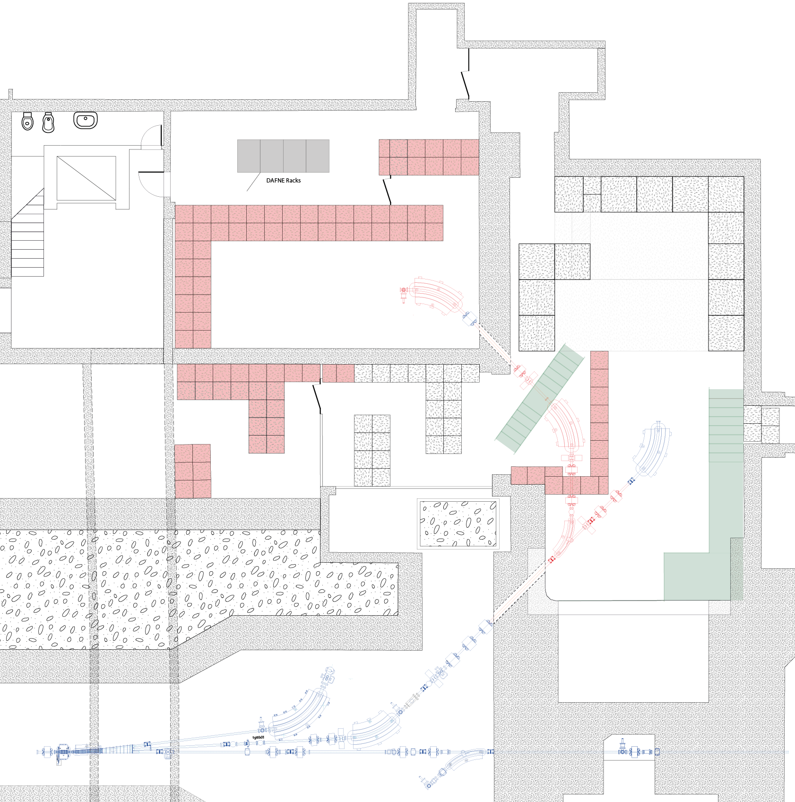
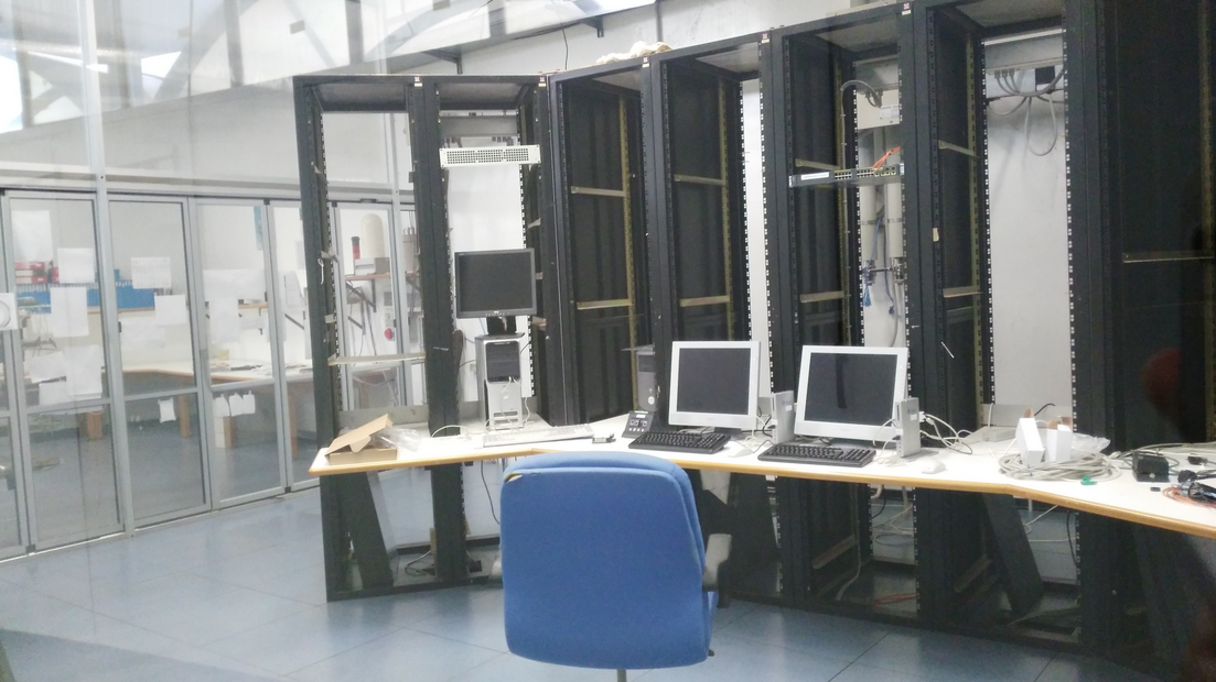
Doubling of beam-line
Basic idea: extend the present experimental area using the present control room
New elements in red
AIDA 2020 WP 15.4.1
New control room ready
On-going design of the new lines
Request for funding to INFN MAC (Machine Advisory Committee)

Slide 14
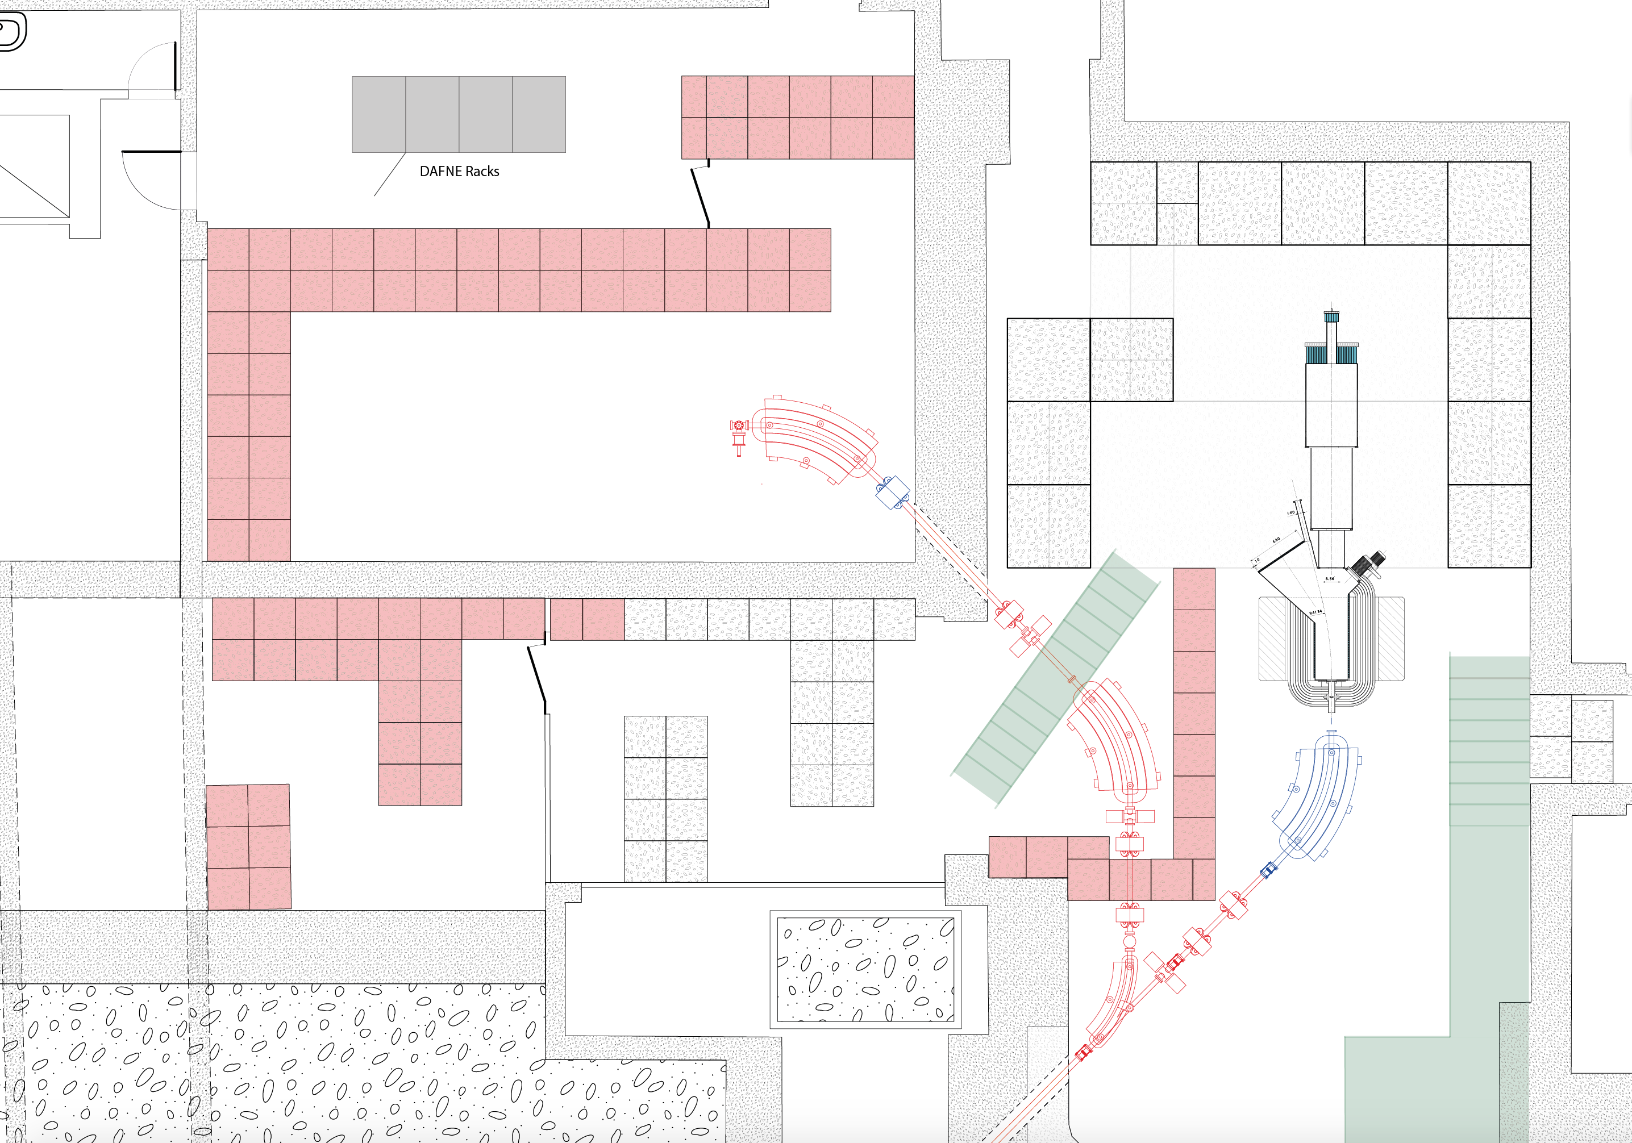
Possible PADME installation
beam-test area

Slide 15
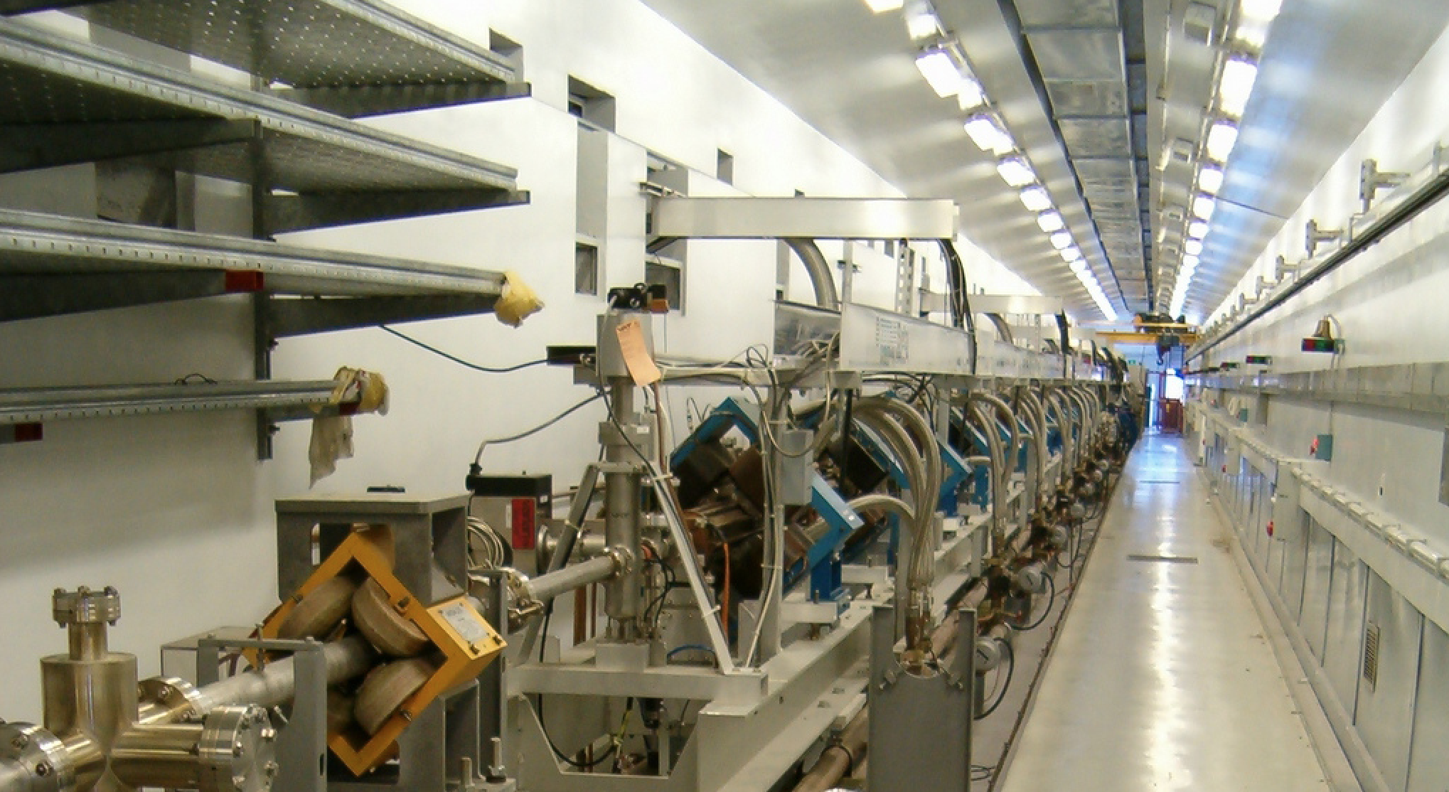
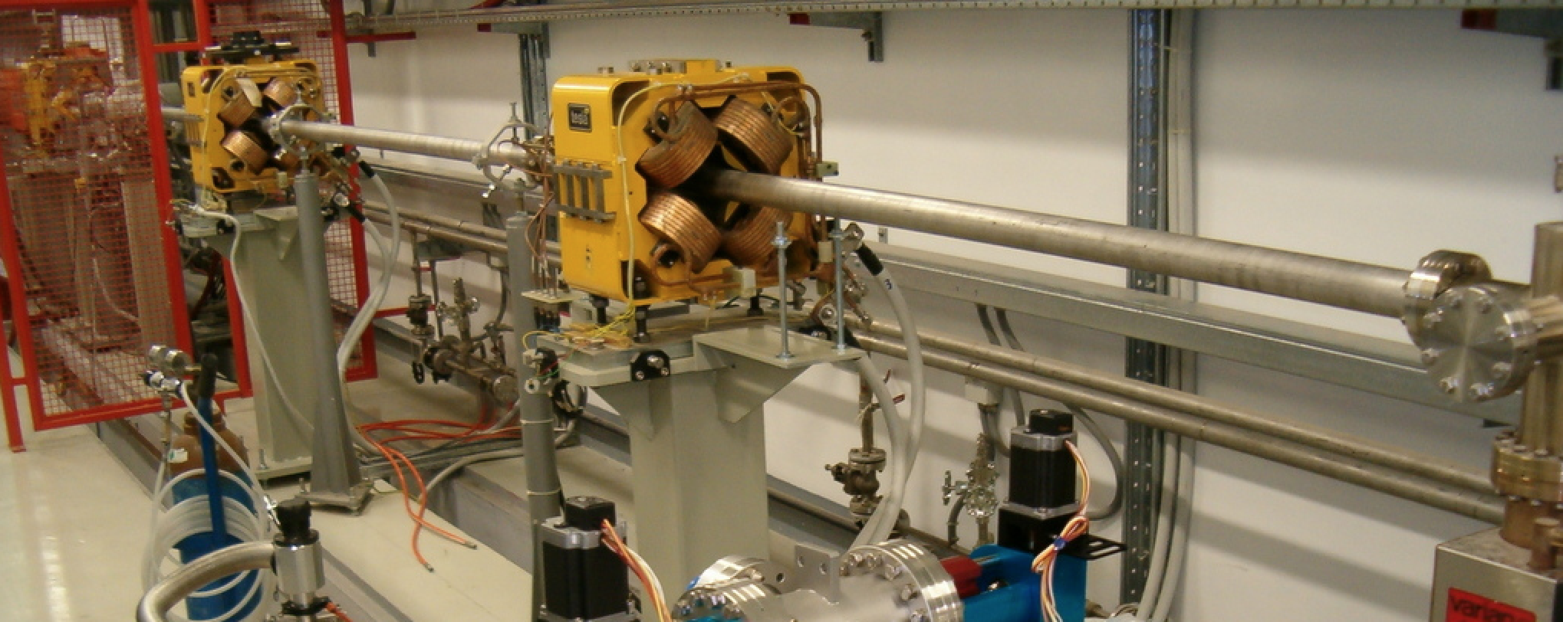
Energy upgrade
Approximately 15 m drift at the end of the linac: add 4 accelerating sections, fed by one or two RF stations (reaching 1 GeV for e⁻). It is also possible to double the RF power in the other 8 sections after the positron converter (now fed by modulators C and D, to reach 1.2 GeV for e⁻)
(Similar to what proposed in: R. Boni, arXiv:0402081 [physics])
BTF/spectrometer/injection three-way switchyard
Last accelerating section
E
E
F
+200 MeV
+310 MeV

Slide 16
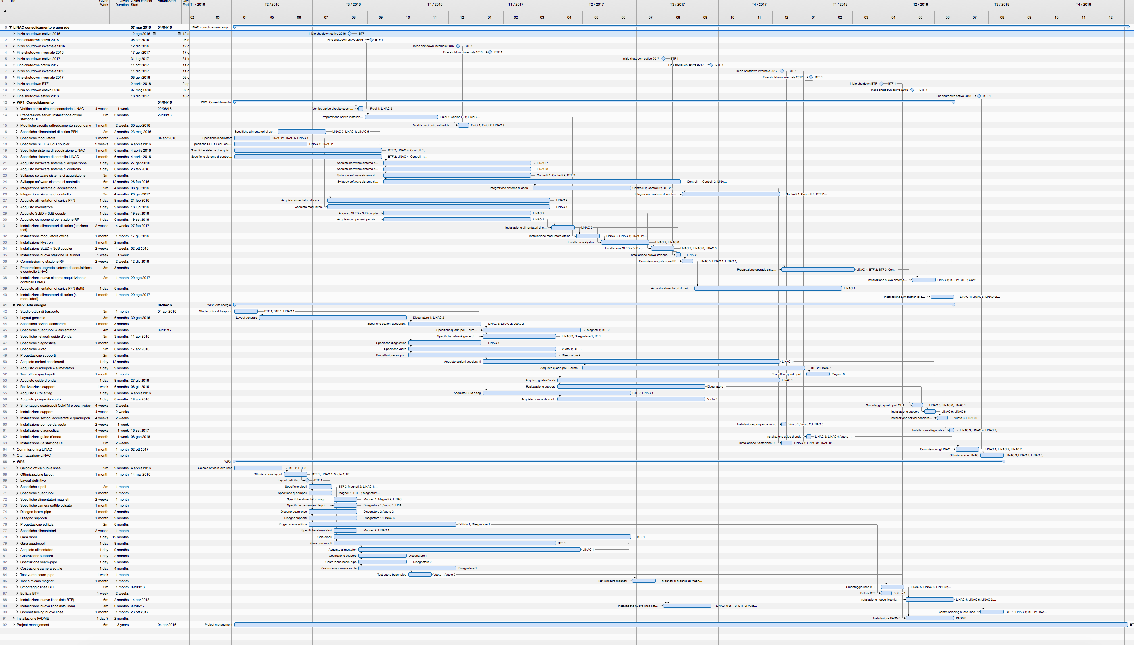
Planning
2016
2017
2018

Slide 17
Conclusions
Choices of the lab/management
Sharing of the LINAC
PADME luminosity in parasitic running with DAFNE as a collider is reduced at least by an order of magnitude:
40 ns operation not possible: bunch length fixed to 10 ns for injecting into the damping ring (1/4 of the luminosity)
Energy obviously limited to 510 MeV (reduction of cross section)
No beam during electron/positron switch
AND
Intensity during positron injection almost an order of magnitude less
Only electron mode out of injection practically useful (less than 40%)
How long will be the KLOE run?
What will come after?
To Do
Short-medium term
Pulse length >40 ns (buying 1 to 4500 ns pulser by the end of 2015)
Probably “something” has to be done on the phase inversion or on the low-level RF to extend to several hundreds ns
Possibility of a half-energy (350-400 MeV), high-luminosity run (100× more positrons on target) without SLED compression
Improved target for positron production
Improved collimation (aiming at hundreds of μrad)
Longer term
Second beam line
PADME installation better to come right before the installation of additional beam-pipe and magnets
PADME run without a second BTF line would impact the operation (essentially no beam-tests during PADME runs)
Energy upgrade
Implies a longer LINAC shutdown
Requires a significant financial effort

Slide 18
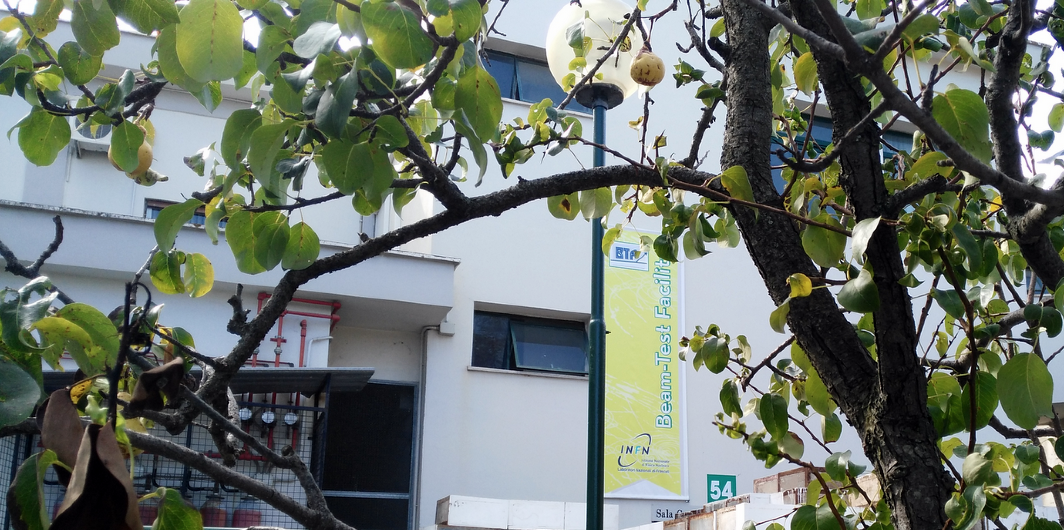
Looking forward for the fruits of our work

Slide 19
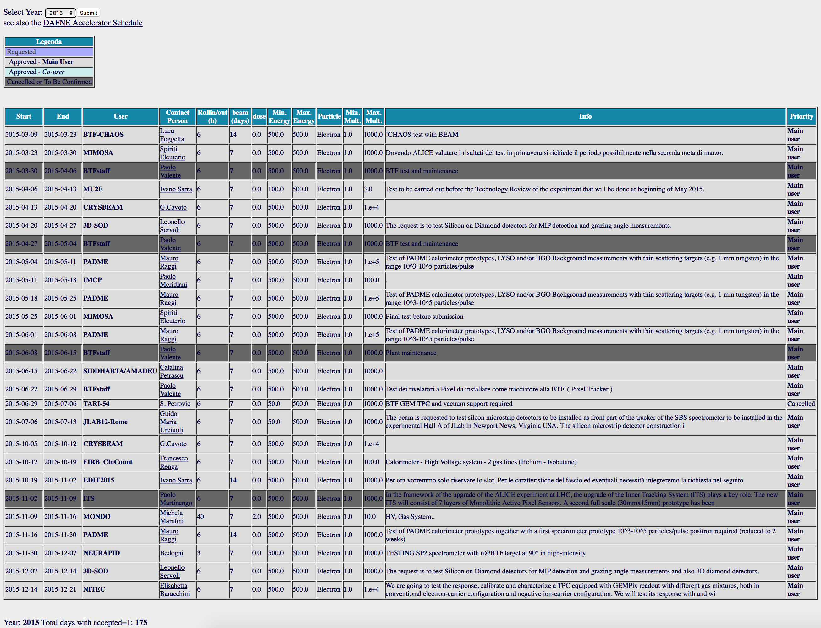
Call and Schedule
Two calls/year, typically ending in November and May
Scheduled shifts from January to July and from September to December
1 week shifts from Monday to Monday
Beam request web form:
http://www.lnf.infn.it/acceleratori/btf/request.html
BTF running subject to regular linac operations
BTF planning strongly linked to the DAΦNE one
BTF Users Committee helps for the assignment of beam shifts
1 in 5 or 6 shifts dedicated to maintenance, facility improvements
High intensity runs to be agreed with RP

Slide 20
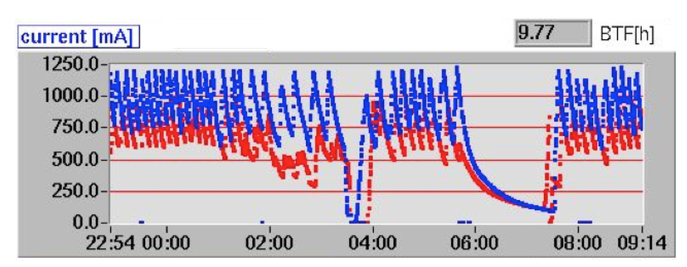
DAΦNE timing
25 or 50 Hz repetition rate
Last bunch every second always to spectrometer line
Accumulator
BTF line
Spectrometer
Main rings
LINAC = LINAC shots are delivered at 25(50) pulses/s and dumped at the end of TL
LINAC+BTF = LINAC shots are delivered with a selectable duty cycle to BTF: 1 to 24(49) pulses/s. Remaining pulses are dumped at the end of the TL
GLOBAL = LINAC shots are delivered with a variable duty cycle to BTF according to injection parameter in ACCUMULATOR
NO INJECTION = SELECTABLE from 1 to 24(49) pulse per second
INJECTION = the injection needs are DAΦNE Control Room controlled. Typically injection pulses are at 2Hz, taking from 1 up to 7 LINAC bunches per sequence. BTF delivers 22 down to 10 bunches per second

Slide 21
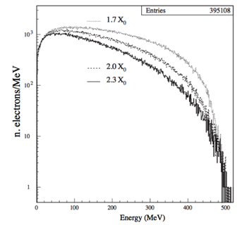
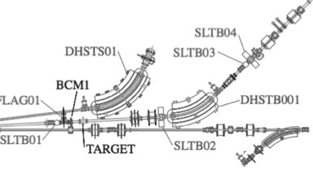
Beam intensity fine tuning
Adjustment of the number of particles can be achieved:
Without changing the momentum resolution:
Modulating the LINAC current [not possible in ‘parasitic mode’, rough] (transport optics or modulators power/phase, etc.)
Collimating the beam before the target, using the up-stream vertical slits [large range]
Choosing one of the three target depths [step change, very reproducible]
Collimating the beam after the dipole, using the down-stream vertical slits [fine, small range]
Also changing the momentum resolution:
Closing/Opening the horizontal collimators [both upstream and downstream]

Slide 22
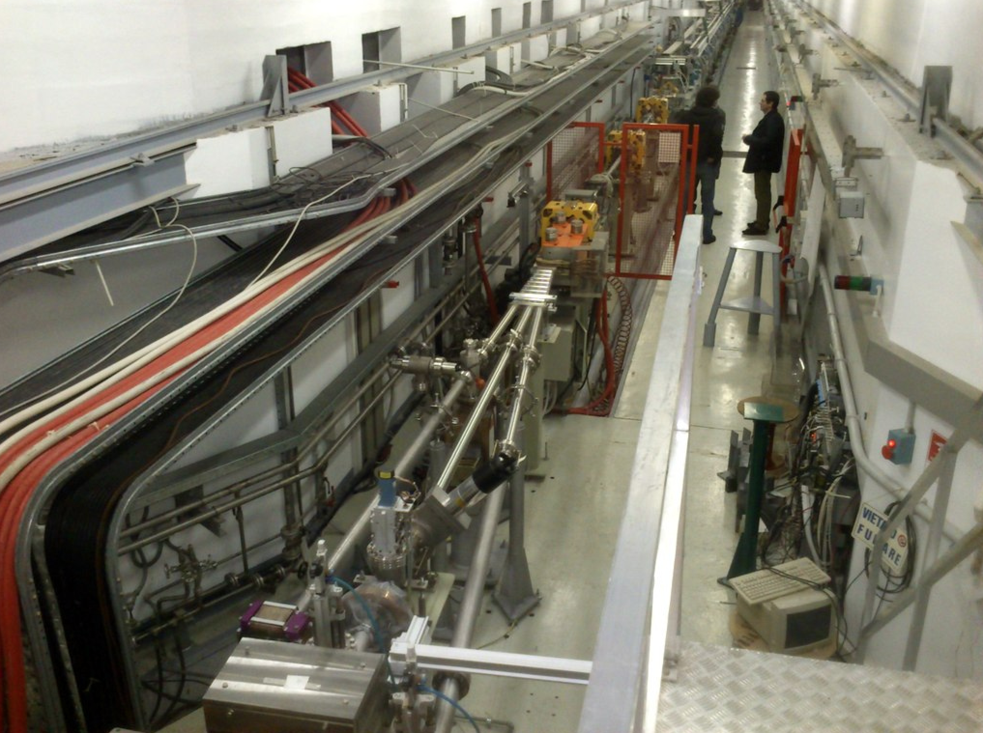
Accelerating section
Pulsed dipoles 3°/6°
Target

