Slide 1
Fractal Evolutionary Technique for Filling Urban Gaps in 3D Models
XXXI PhD Course Welcome Day (26 November 2015)
PhD School
“SCIENCE AND ENGINEERING OF THE ENVIRONMENT, CONSTRUCTION AND ENERGY" - XXIX CYCLE
Bashar Swaid
Prof. Roberta Lucente; Prof. Eleonora Bilotta; Prof. Pietro Pantano

Slide 2
Experiences Gained During the Doctoral Academic Period
Research Activities
Scientific Activities
What is the PhD?
Why SIACE?
How?

Slide 3

Research Activities ???

Slide 4
Research Activities as “LOOP”
Studying, Analyzing and Evaluating Current Scientific Theories
Developing, Simulating and Designing Various Scenarios
Re-building New Interdisciplinary Approach
Current Theory Assesment’s
Developing New Scenarios, Approach
Evaluating and Rebuilding New Theory

Slide 5
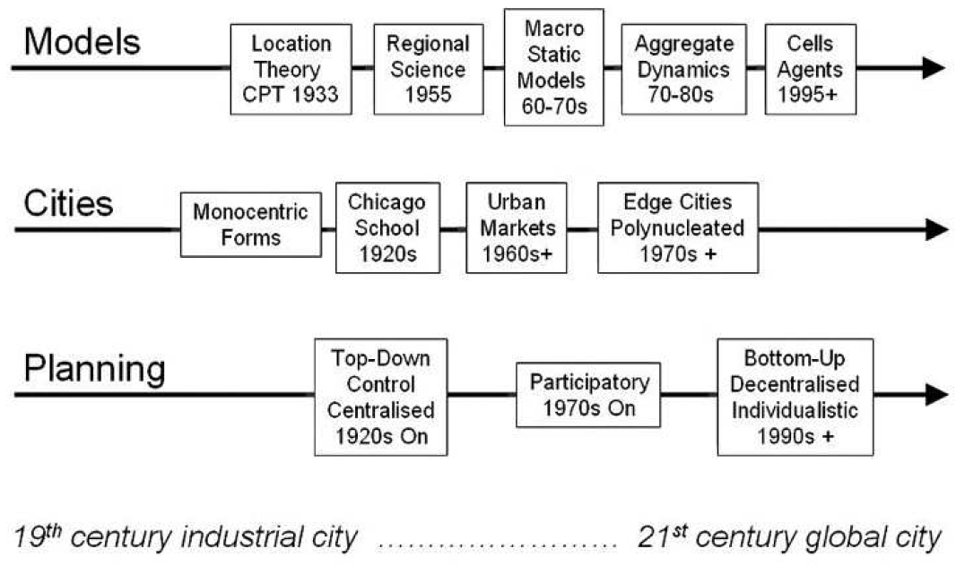
Algorithmic & Parametric
Hierarchical&
Lattice
Self Organizing
&
Evolutionary
Research Activites

Slide 6
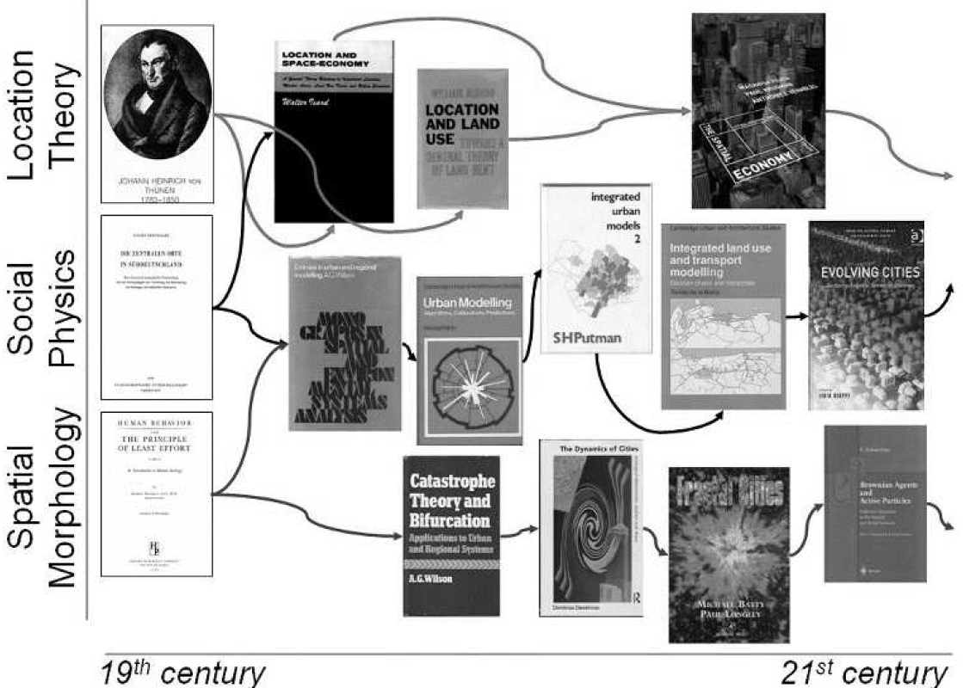

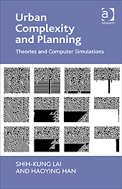
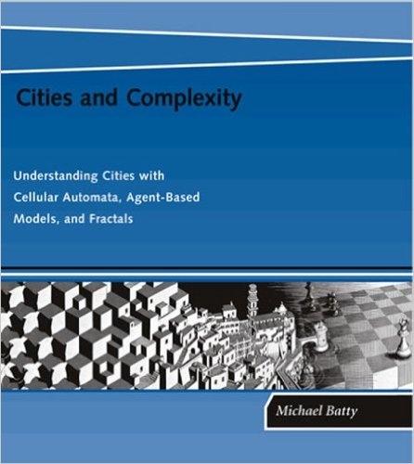
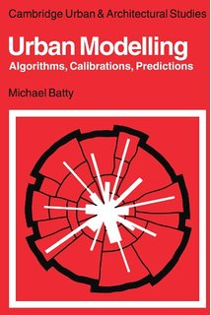


???
Research Activites

Slide 7
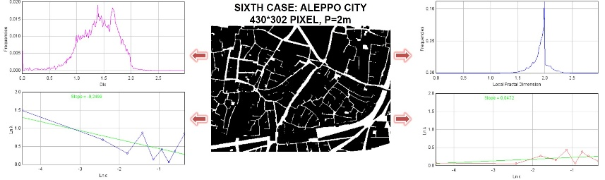
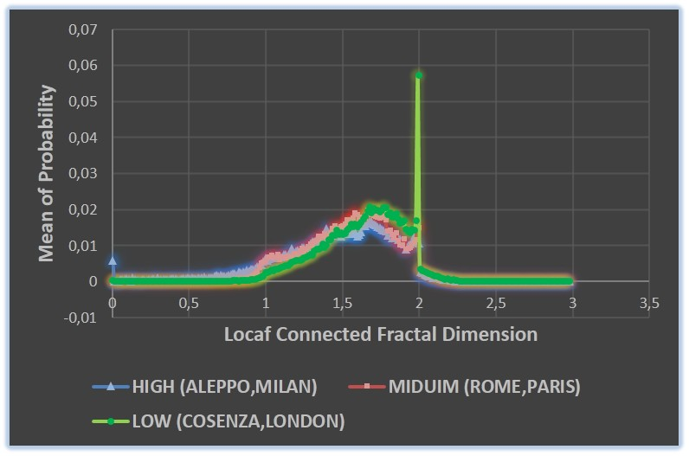
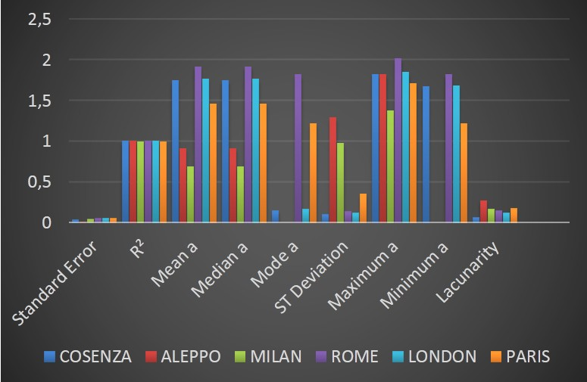
Analyzing and Evaluating Current Scientific Theories

Slide 8
Developing, Simulating and Designing Various Scenarios
Step 1: Seed Emergence
Species Genotype & Phenotype
Parameters and Criteria's?
Step 2: Generator Techniques
Step 3: Optimization Algorithm
Engineering& Scientific Complexity
Global & Local Optimization
Parameters and Criteria's?
Parameters and Criteria's?
− +
Fitness Function
(Threshold)

Slide 9
Re-Building Interdisciplinary Model
Group A: Engineering or Physical Analysis
Group B: Artificial Intelligence Analysis
Group C: Mathematics' and Statistical Analysis
Group A
Global & Local Scales
Functions?
Group B
Global Scale Local Scale?
Tools?
Group C
Group A Group B Relationships
Techniques?

Slide 10
In Scientific Fields Copyright & Patent Should be Investigated

Slide 11

Scientific Activities
Courses & Seminars
Poster Sessions
Publication
Conferences & PhD School

Slide 12
Key advice: organize your self
Ideas, Objectives, Time schedule, and life

Slide 13
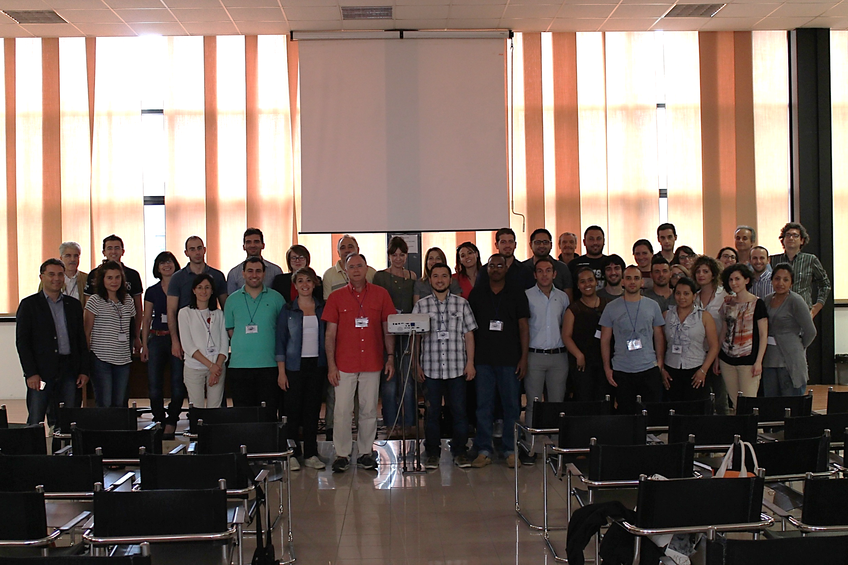

Thank you

