Slide 1
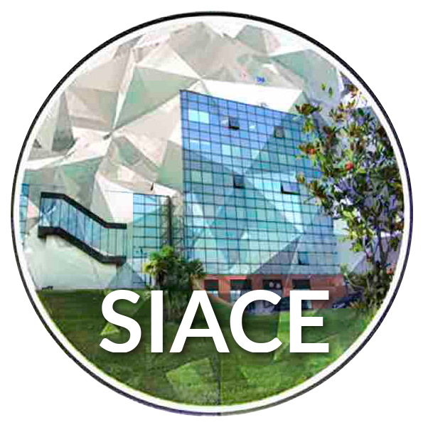
http://www.phd-siace.unical.it/
SIACE: facing the challenge of internationalization…
Efrem Curcio, Enrico Drioli

Slide 2
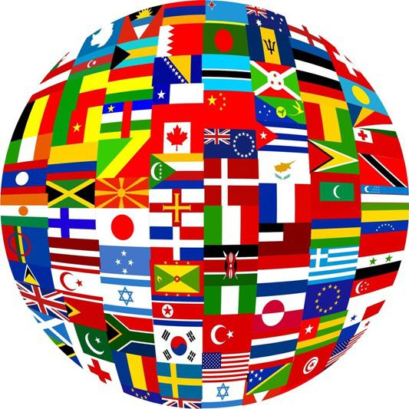
Internationalization of Education
Today, post-graduate education systems are increasingly part of an international context: expansion outside national boarders holds enormous potential for advancing a more effective future-oriented PhD
Internationalization forced national institutions towards common standards or “converging practices”
Responsibility to educate the next generation of professionals and scholars within an international community in order to compete in a global market.
“Think globally and act locally”: define and solve societal problems according to a multi- and interdisciplinary approach within an international context.

Slide 3
Exploiting opportunities from EU…
Erasmus Mundus Doctorate in Membrane Engineering (EUDIME)
Mission: implementing - at international level -excellence, innovation, mobility and multidisciplinarity in investigation approaches related to membrane science and technology.

Slide 4
Title of this slide

Slide 5
Associate industrial partners
Mikropur s.r.o.

Slide 6
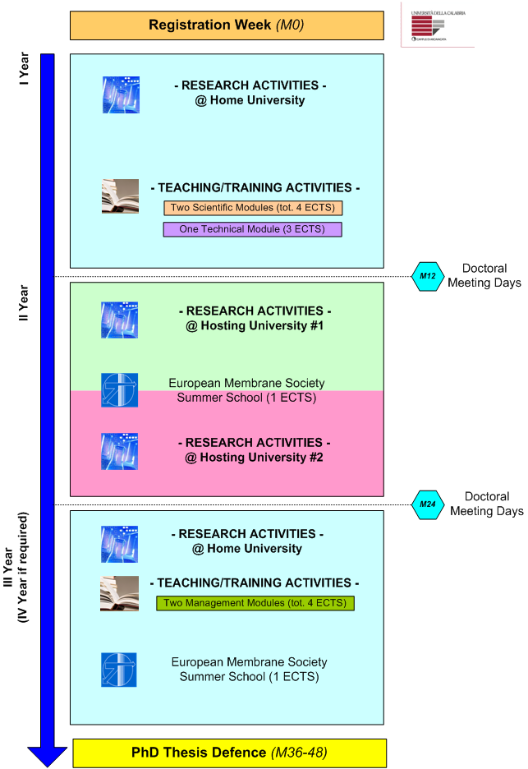
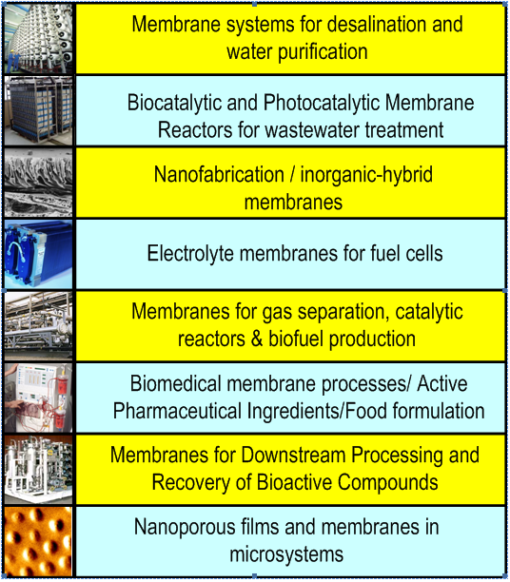
Research pathway

Slide 7
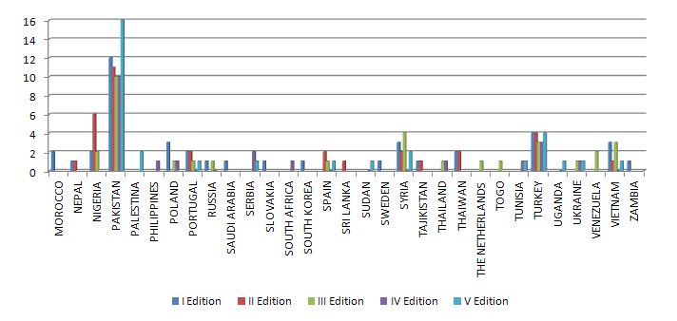
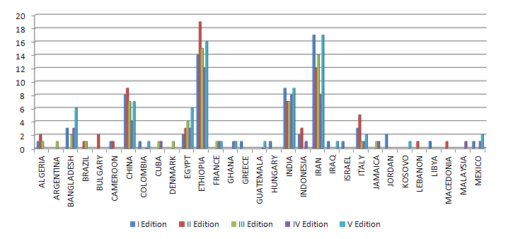
Title of this slide
468 applications received in 5 years ….

Slide 8
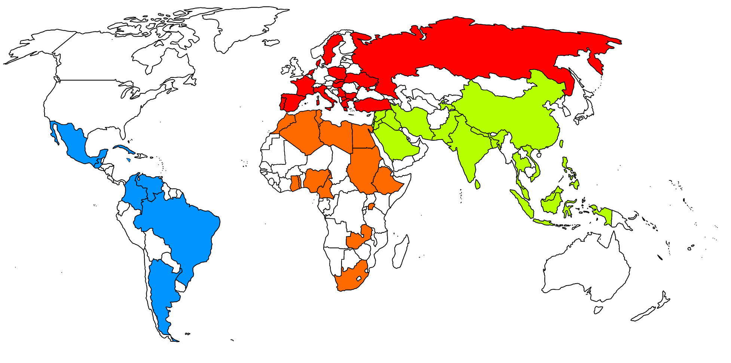
Title of this slide
… from 62 Countries…
ALGERIA
ARGENTINA
BANGLADESH
BRAZIL
BULGARY
CAMEROON
CHINA
COLOMBIA
CUBA
DENMARK
EGYPT
ETHIOPIA
FRANCE
GHANA
GREECE
GUATEMALA
HUNGARY
INDIA
INDONESIA
IRAN
IRAQ
ISRAEL
ITALY
JAMAICA
JORDAN
KOSOVO
LEBANON
LIBYA
MACEDONIA
MALAYSIA
MEXICO
MOROCCO
NEPAL
NIGERIA
PAKISTAN
PALESTINA
PHILIPPINES
POLAND
PORTUGAL
RUSSIA
SAUDI ARABIA
SERBIA
SLOVAKIA
SOUTH AFRICA
SOUTH KOREA
SPAIN
SRI LANKA
SUDAN
SWEDEN
SYRIA
TAJIKISTAN
THAILAND
THAIWAN
THE NETHERLANDS
TOGO
TUNISIA
TURKEY
UGANDA
UKRAINE
VENEZUELA
VIETNAM
ZAMBIA

Slide 9
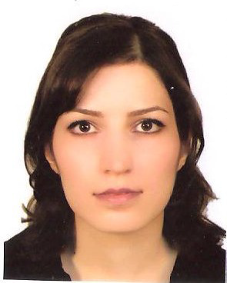
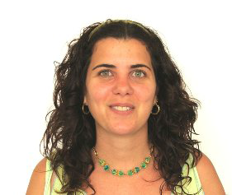
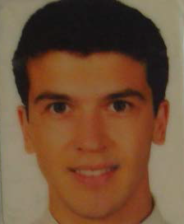
EUDIME-SIACE STUDENTS
Hydrogel Composite Membranes: Preparation, Characterization and Performance in Crystallization
Shabnam Majidi Salehi
(IRAN) – XIX cycle
Airama Albisa Novo
(CUBA)
semestral mobility from University of Zaragoza
Power Generation by Salinity Gradient Power - Reverse Electrodialysis
Ahmet Halil Avci
(TURKEY) – XXX cycle

Slide 10
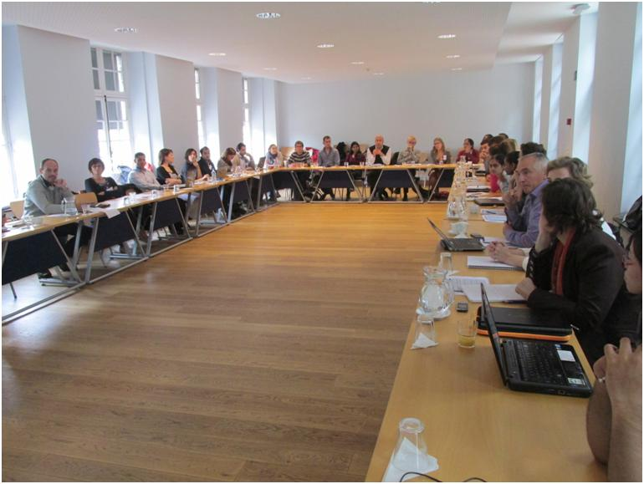
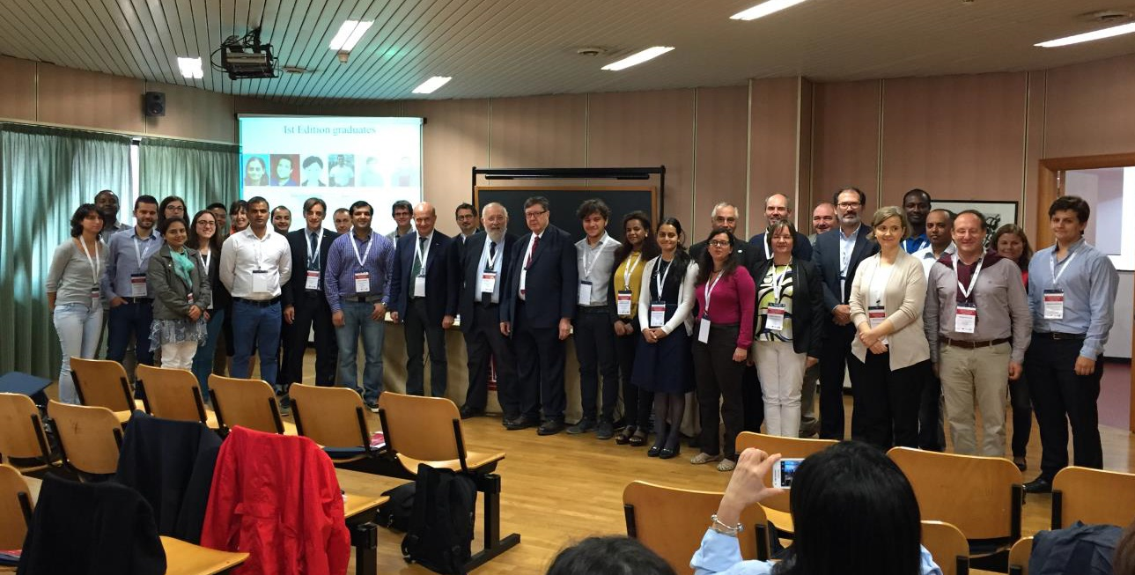
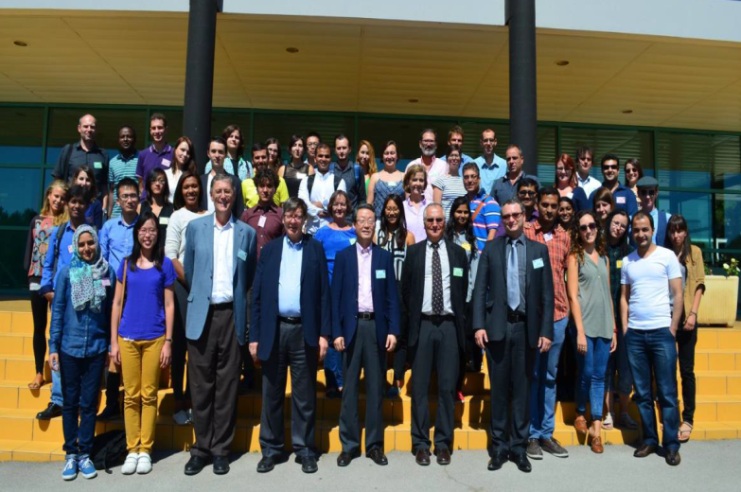
Title of this slide
38 selected Erasmus Mundus students working and travelling all around Europe (2 mandatory semestral mobilities)
Leuven 2013
Rende 2015
Montpellier 2014

Slide 11
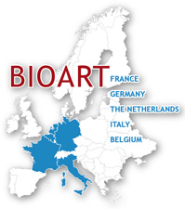
Bionethos

Slide 12
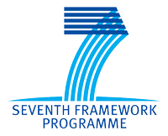
What Bioart does…
BIOART provides state-of-the-art multidisciplinary training for 16 young researchers (11 Early Stage Researcher positions and 5 Experienced Researcher positions).
BIOART gives them the skills required to make a significant impact in the treatment of kidney and liver diseases.
 | A prototype artificial kidney device enabling prolonged/continuous removal of uremic toxins
 | A prototype bioartificial kidney device that utilizes human renal epithelial cells for removal of uremic toxins
 | A prototype bioreactor device to ensure viability and functions of hepatocyte cells

Slide 13
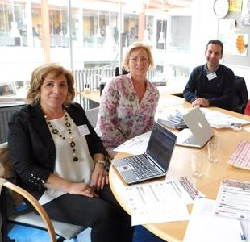
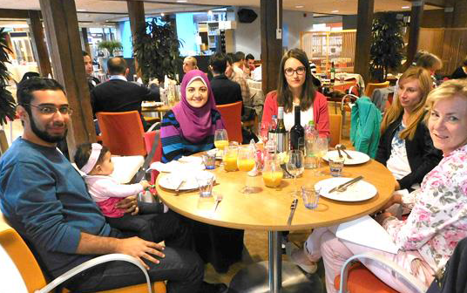
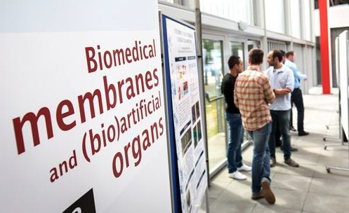
Dr. Loredana De Bartolo, BIOART responsible at ITM-CNR.

Slide 14
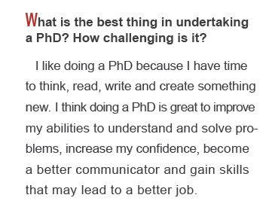
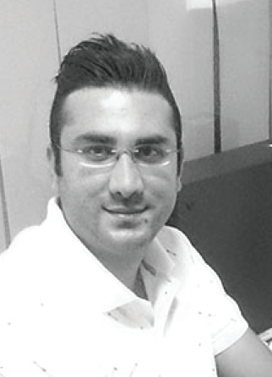
Investing in your future …

Slide 15
Other collaborations…
STEFAN SCHMIDT
Innovative Mixed Matrix Bicontinuous Microemulsion Coating for water Treatment Application
(Germany)
VELENTINA GROSSO
Preparation of Mixed Matrix Membranes for Water Purification
(Saudi Arabia)
(South Korea)

