Slide 1



New detectors for light sources
Lodovico Ratti
Università degli Studi di Pavia and INFN Pavia
lodovico.ratti@unipv.it

Slide 2

Outline
X-ray free electron lasers (FELs) and their applications
Main specifications for 2D X-ray imaging at FELs
Detectors for the Eu-XFEL
AGIPD, LPD, DSSC
input dynamic range issue
The PixFEL project
slim edge sensor
front-end electronics
Summary and outlook

Slide 3
Free electron laser facilities
FELs provide high intensity beams of ultrafast X-ray pulses
energy range: 100 eV to >10 keV (λ from 10 nm to 0.1 nm)
pulse duration: femtoseconds to picoseconds
repetition rate: 10 Hz (continuous mode) to 5 MHz (burst mode)
peak brightness: in excess of 10³³ ph s⁻¹ mm⁻² mrad⁻¹
Project | Start of operation | Electron beam energy [GeV] | Photon energy [keV] | Repetition rate [Hz] | Number of X-ray pulses/train @inter-train period
FLASH@DESY | 2005 | 1.25 | 0.03-0.3 | 5 | 800@1 us
LCLS@SLAC | 2009 | 14.5 | 0.3-10 | 120 | 1
SACLA@RIKEN | 2010 | 8 | 4.5-15 | 60 | 1
Fermi@ELETTRA | 2010 | 2.4 | 0.01-0.06 | 10 | 1
SwissFEL | 2016 | 5.8 | 12 | 100 | 2@50 ns
Eu-XFEL | 2017 | 17.5 | 0.4-20 | 10 | 2700@220 ns
LCLSII | >2020 | 4-14.5 | 0.2-25 | 120 - 10⁶ | 1

Slide 4
Brilliance and energy
No “classical” laser device can provide hard X-rays and, in the soft X-ray range, no laser gets even close to FEL brilliance
Several orders of magnitude in brilliance between synchrotrons and FELs
FELs promise to provide a very powerful probing tool in a lot of basic and applied science field
New technologies under study (energy recovery LINAC, FEL intracavity ICS, laser wakefield accelerators) may lead to cheaper, more compact sources of X- (or gamma-) rays

Slide 5
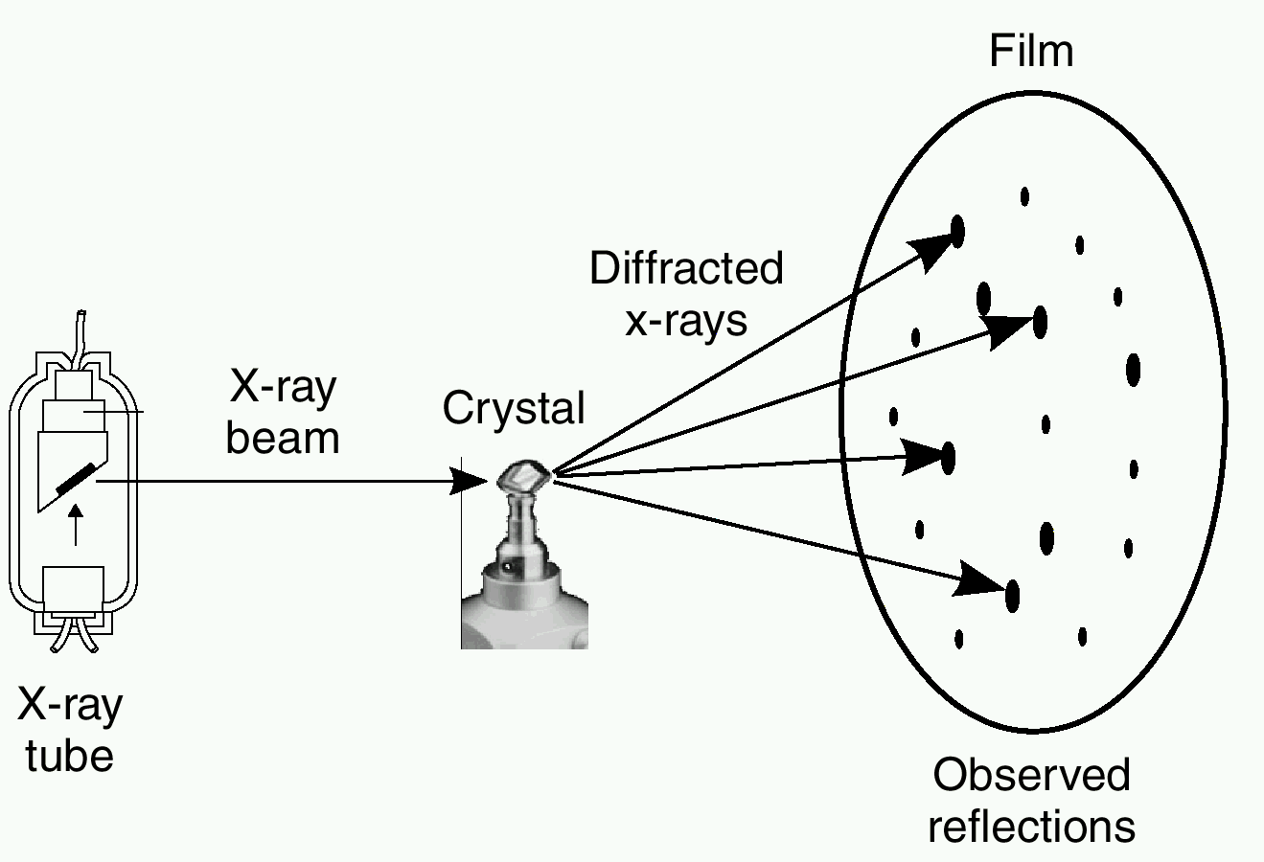
What is so special with FELs
Broad science base accessible: structural biology, chemistry, material science, atomic and molecular science
Unprecedented features of X-ray FELs can make a number of new measurements possible
In X-ray crystallography, the sample is a periodic structure ➔ scattered amplitude at the Bragg peaks amplified by the square of the number N of unit cells
small and/or non-periodic samples (single biomolecules or small cells) ➔ increased source brightness to compensate for the lack of Bragg peak amplification
STRUCTURAL BIOLOGY
In some applications (e.g., X-ray absorption spectroscopy) a pump-probe technique is used – 1) a dynamic process is initiated, 2) after a pre-set delay τ, the excited sample is probed by a synchronized X-ray pulse, 3) measurement is repeated for different values of τ
process evolving while the pulse is passing through the sample (which also undergoes Coulomb explosion) ➔ very short pulses to avoid “blurred” pictures
CHEMISTRY

Slide 6
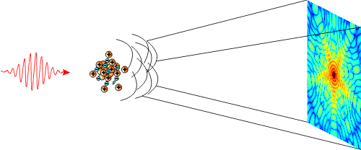
2D X-ray imaging challenges
Many measurements based on scattering of coherent X-ray pulses and detection of diffraction patterns with a large pixel camera
New detectors are needed to comply with extremely challenging requirements
pulse structure: high rate single shot imaging (4.5 MHz), frame storage of a complete bunch train (2700 pulses)
dynamic range: single photon resolution, integration of up to 10⁴ ph/pixel/pulse
energy range: 0.25 keV to 25 keV
radiation hardness: 10 MGy to 1 GGy over three years of operation
angular resolution: 7 mrad to 4 urad ➔ pixel size from 700 um to 16 um (also depending on the distance from the sample)
angular coverage: diffraction experiments require a 0.1 nm resolution ➔ scattering angles of 120°
dead area: as small as possible

Slide 7
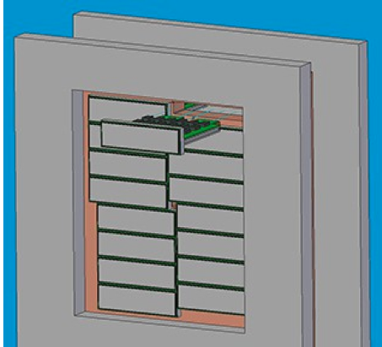
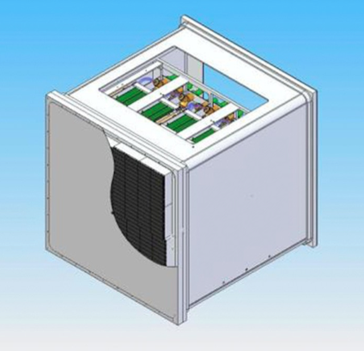
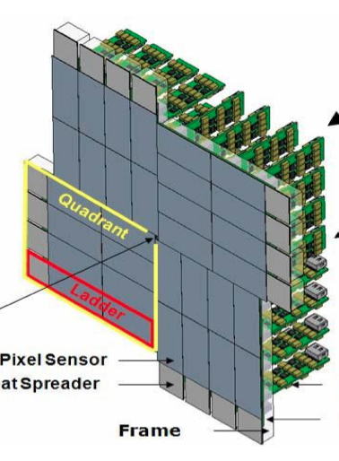
Overview of Eu-XFEL imaging detectors
Based on hybrid pixel sensor technology – front-end in 130 nm CMOS technology - modular detectors (fully depleted silicon) with a dead area of about 15%
AGIPD – Adaptive Gain Integrating Pixel Detector
energy range: 3-13 keV
dyn. range: 10⁴ ph@12 keV
single photon sensitivity
storage cells (analog): ~300
pixel pitch: 200 um
LPD – Large Pixel Detector
energy range: 1-25 keV
dyn. range: 10⁵ ph@12 keV
single photon sensitivity
storage cells (analog): ~512
pixel pitch: 500 um
DSSC – DEPFET Sensor with Signal Compression
energy range: 0.5-6 keV
dyn. range: 6000 ph@1 keV
single photon sensitivity
storage cells (digital): ~640
pixel pitch: 236 um

Slide 8
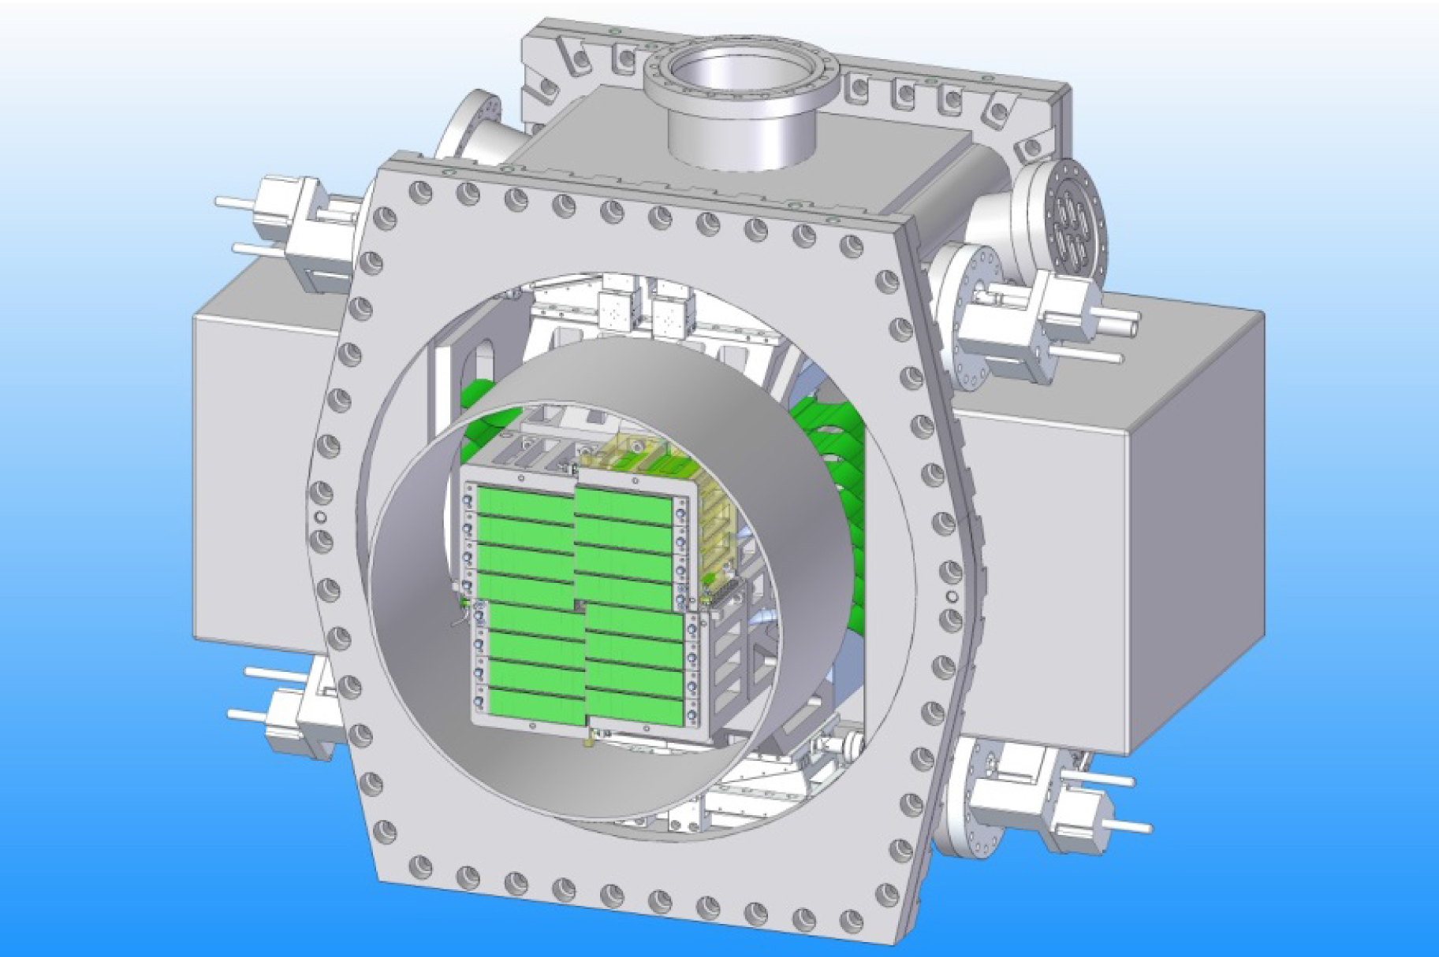
The AGIPD detector
The AGIPD (adaptive gain integrating pixel detector) Consortium includes groups from PSI, University of Hamburg and Bonn, DESY
16 modules to build a megapixel camera – each module consists of 2x8 ASICs bump bonded to a silicon sensor of 128x512 pixels
In the front-end chip, the problem of covering large input dynamic range is addressed by means of a gain switching technique
Readout chip designed in a 130 nm CMOS technology, vertical integration approach currently being investigated

Slide 9
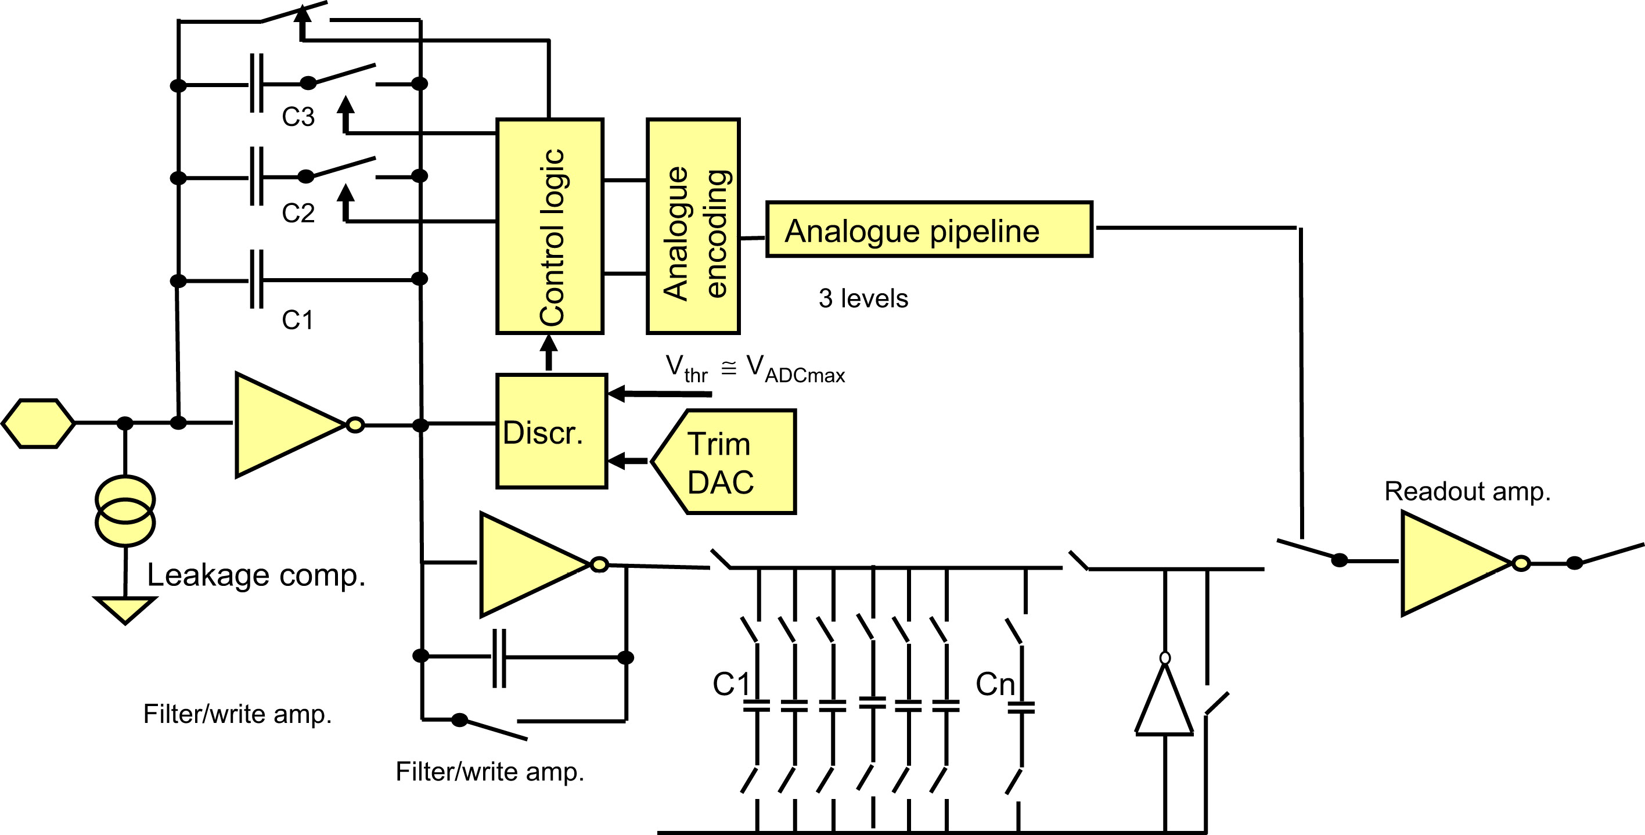
AGIPD front-end chip
individual programming of the integrator gain to adapt to the expected flux or dynamical switching during operation if the flux is unknown – in the adaptive mode, the used gain setting has to be stored together with the data
352 storage capacitors available to store 352 images during the 600 us pulse train – careful design of the switches is required to enable fast capacitor charge as well as negligible leakage
off-chip ADC – 14 bit resolution

Slide 10
Signal compression with the AGIPD channel
C1
C1+C2+C3
C1+C2
Output voltage
# of photons
Adaptive gain integration: the gain is changed as soon as the full dynamic range of the readout channel is reached – three different gain levels
The same output voltage can be obtained with three different input signals ➔ need for storing the gain setting information

Slide 11
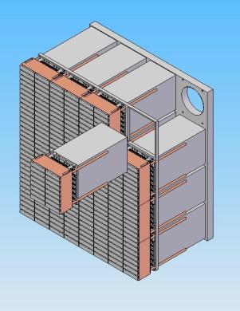
The LPD detector
The LPD (large pixel detector) is under development at the Rutherford Appleton Laboratory (RAL) in UK
Megapixel camera organized in so called supermodules of 256x256 pixels each – 8 chips (8x32 pixel each) bump bonded to a 128x32 pixel sensor, 2x8 of these tiles used to construct a supermodule
Relatively large cell pitch, 500 um, mostly to make room for in-pixel storage capacitors
Use of an interposing layer to adapt the pitch of the sensor to the readout pitch ➔ more flexibility, further shield against radiation but more parasitics at the front-end input (➔ noise)
The elementary cell of the readout chip is based on three different channels operated in parallel, each with its own gain setting and followed by its own analog pipeline

Slide 12
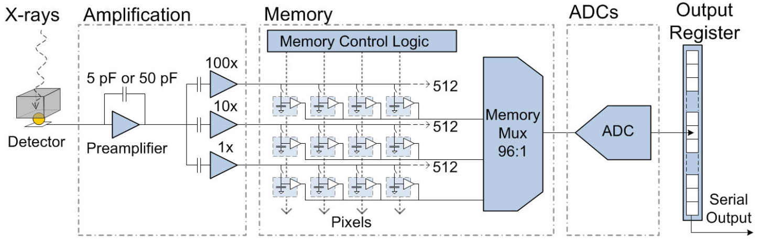
The LPD readout chip
Koch et al., “Performance of an LPD prototype detector at MHz frame rates under Synchrotron and FEL radiation”, 2013 JINST 8 C11001.
preamplifier with configurable gain and gain stages operated in parallel
16 ADCs per chip serving 8x32 channels
512 deep analog pipelines, one for each of the three parallel paths; may be merged together in case the flux can be managed with a single channel
serialization and output

Slide 13
Signal compression with the LPD readout channel
x100
x10
x1
Output voltage
# of photons
Multiple gain concept: three parallel channels with different gain – only the largest signal at the output of a non saturated channel is preserved
A veto system is used for efficient usage of the available memory cells – data storage is inhibited in case of an unsuccessful experiment

Slide 14
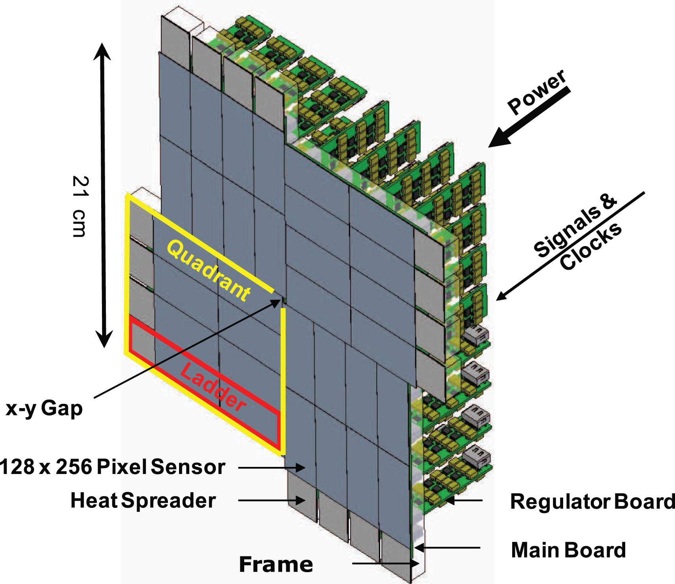
The DSSC detector
The DSSC (DEPFET sensor with signal compression) collaboration (involving a number of German and Italian research groups) is developing an hybrid pixel detector for X-ray FEL applications
4 quadrants, 4 ladders, 8 monolithic sensors of 128x256 pixels per quadrant, overall sensing area of 21 cm x 21 cm
Each ASIC includes 64x64 channels ➔ 8 ASICs needed for each sensor
Detector operation based on the features of the DEPFET sensor with signal compression (DSSC)

Slide 15
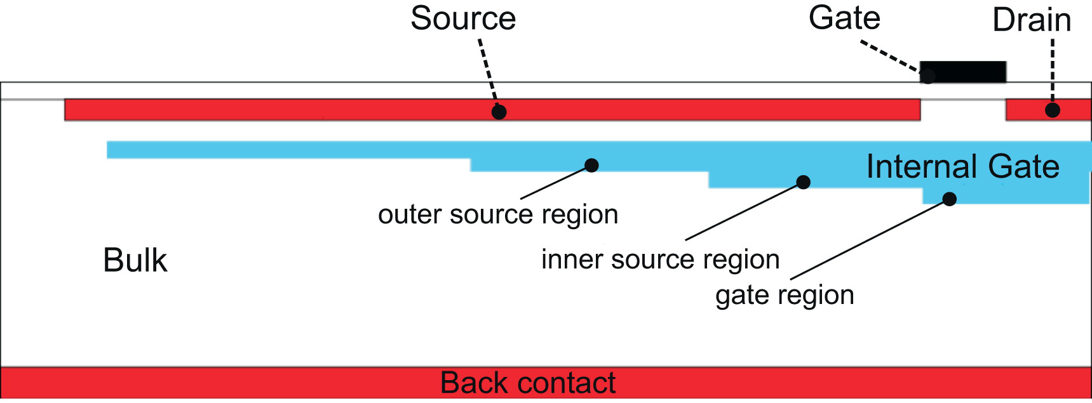
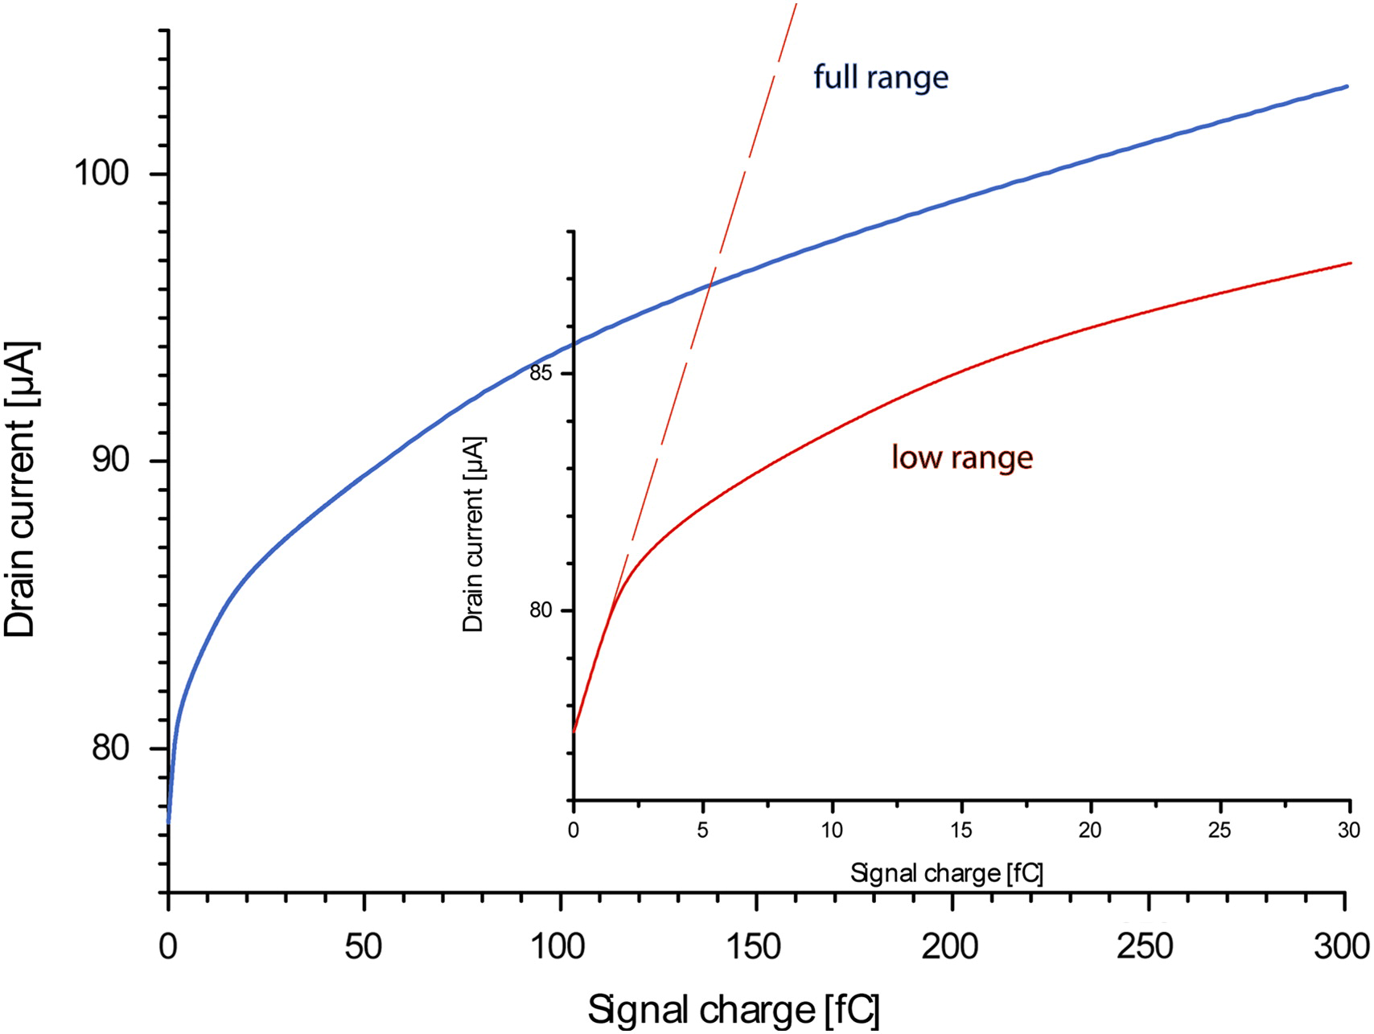
Signal compression with the DSSC
G. Lutz et al., “DEPFET sensor with intrinsic signal compression developed for use at the XFEL free electron laser radiation source ”, NIMA, vol. 624, 2010, pp. 528 - 532
The DSSC is a DEPFET with a strongly non linear current charge characteristic, able to cope with the wide input dynamic range requirements set by the European XFEL
the internal gate extends below the large area source
for small signals, charge accumulates under the gate region ➔ full contribution to current increase
for larger signals, the additional charge spills over into the region below the source ➔ the incremental effect on the current gets lower and lower
Hexagonal pixels ➔ more homogeneous field, minimum collection time, less charge sharing

Slide 16
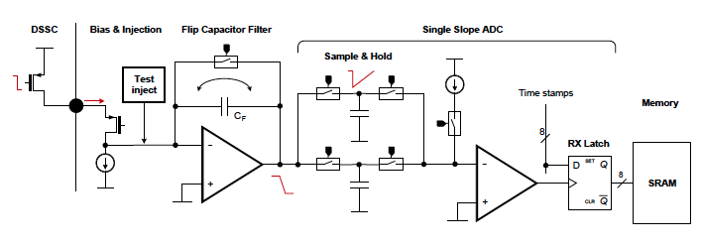
Readout channel for the DSSC detector
time variant filter with a trapezoidal waiting function, performing a correlated double sampling
sample and hold capacitors for interleaved operation of the ADC
discriminator used to latch an 8 bit time stamp once the threshold is reached
stores 640 words of 9 bits during the X-ray pulses train

Slide 17
The PixFEL collaboration
Develop high performance X-ray imaging instrumentation for the experiments at the next generation of free electron lasers
Use innovative solutions and technologies, investigated by the HEP community, to improve pixel detector performance for application to photon science
Synergy with other activities going on in the HEP community: pixel detector development for LHC upgrade - slim edge, 65 nm CMOS, radiation hardness – and European projects – 3D integration
Key technologies: active edge sensors, 65 nm CMOS process, vertical integration
Participating groups
INFN Pavia, Università di Pavia and Università di Bergamo: L. Ratti, M. Manghisoni, D. Comotti, L. Fabris, M. Grassi, L. Lodola, P. Malcovati, V. Re, G. Traversi, C. Vacchi
INFN Pisa and Università di Pisa: G. Rizzo, G. Batignani, S. Bettarini, G. Casarosa, F. Forti, M. Giorgi, F. Morsani, A. Paladino, E. Paoloni
INFN Trento and Università di Trento: L. Pancheri, G.-F. Dalla Betta, R. Mendicino, G. Verzellesi, H. Xu, M.A. Benkechkache

Slide 18
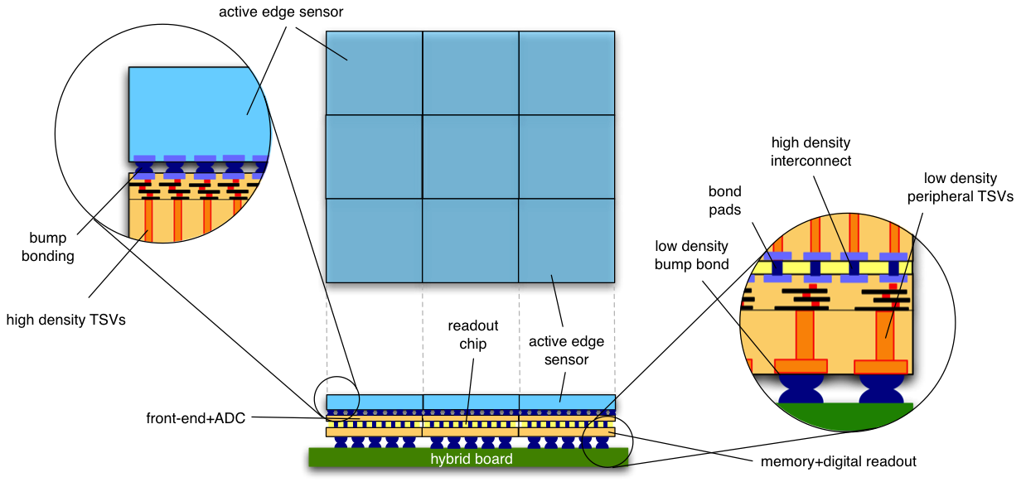
Long term goal of the PixFEL project
Develop a four-side buttable, multi-layer module for the assembly of large area detectors with minimum dead area
Good efficiency from 1 keV (optimized entrance window) up to 10 keV (450 um thickness)
9 bit resolution (effective), 5 MHz sampling rate
burst and continuous mode operation
wide dynamic range (1 to 10000 photons), single photon sensitivity
1 kframe

Slide 19
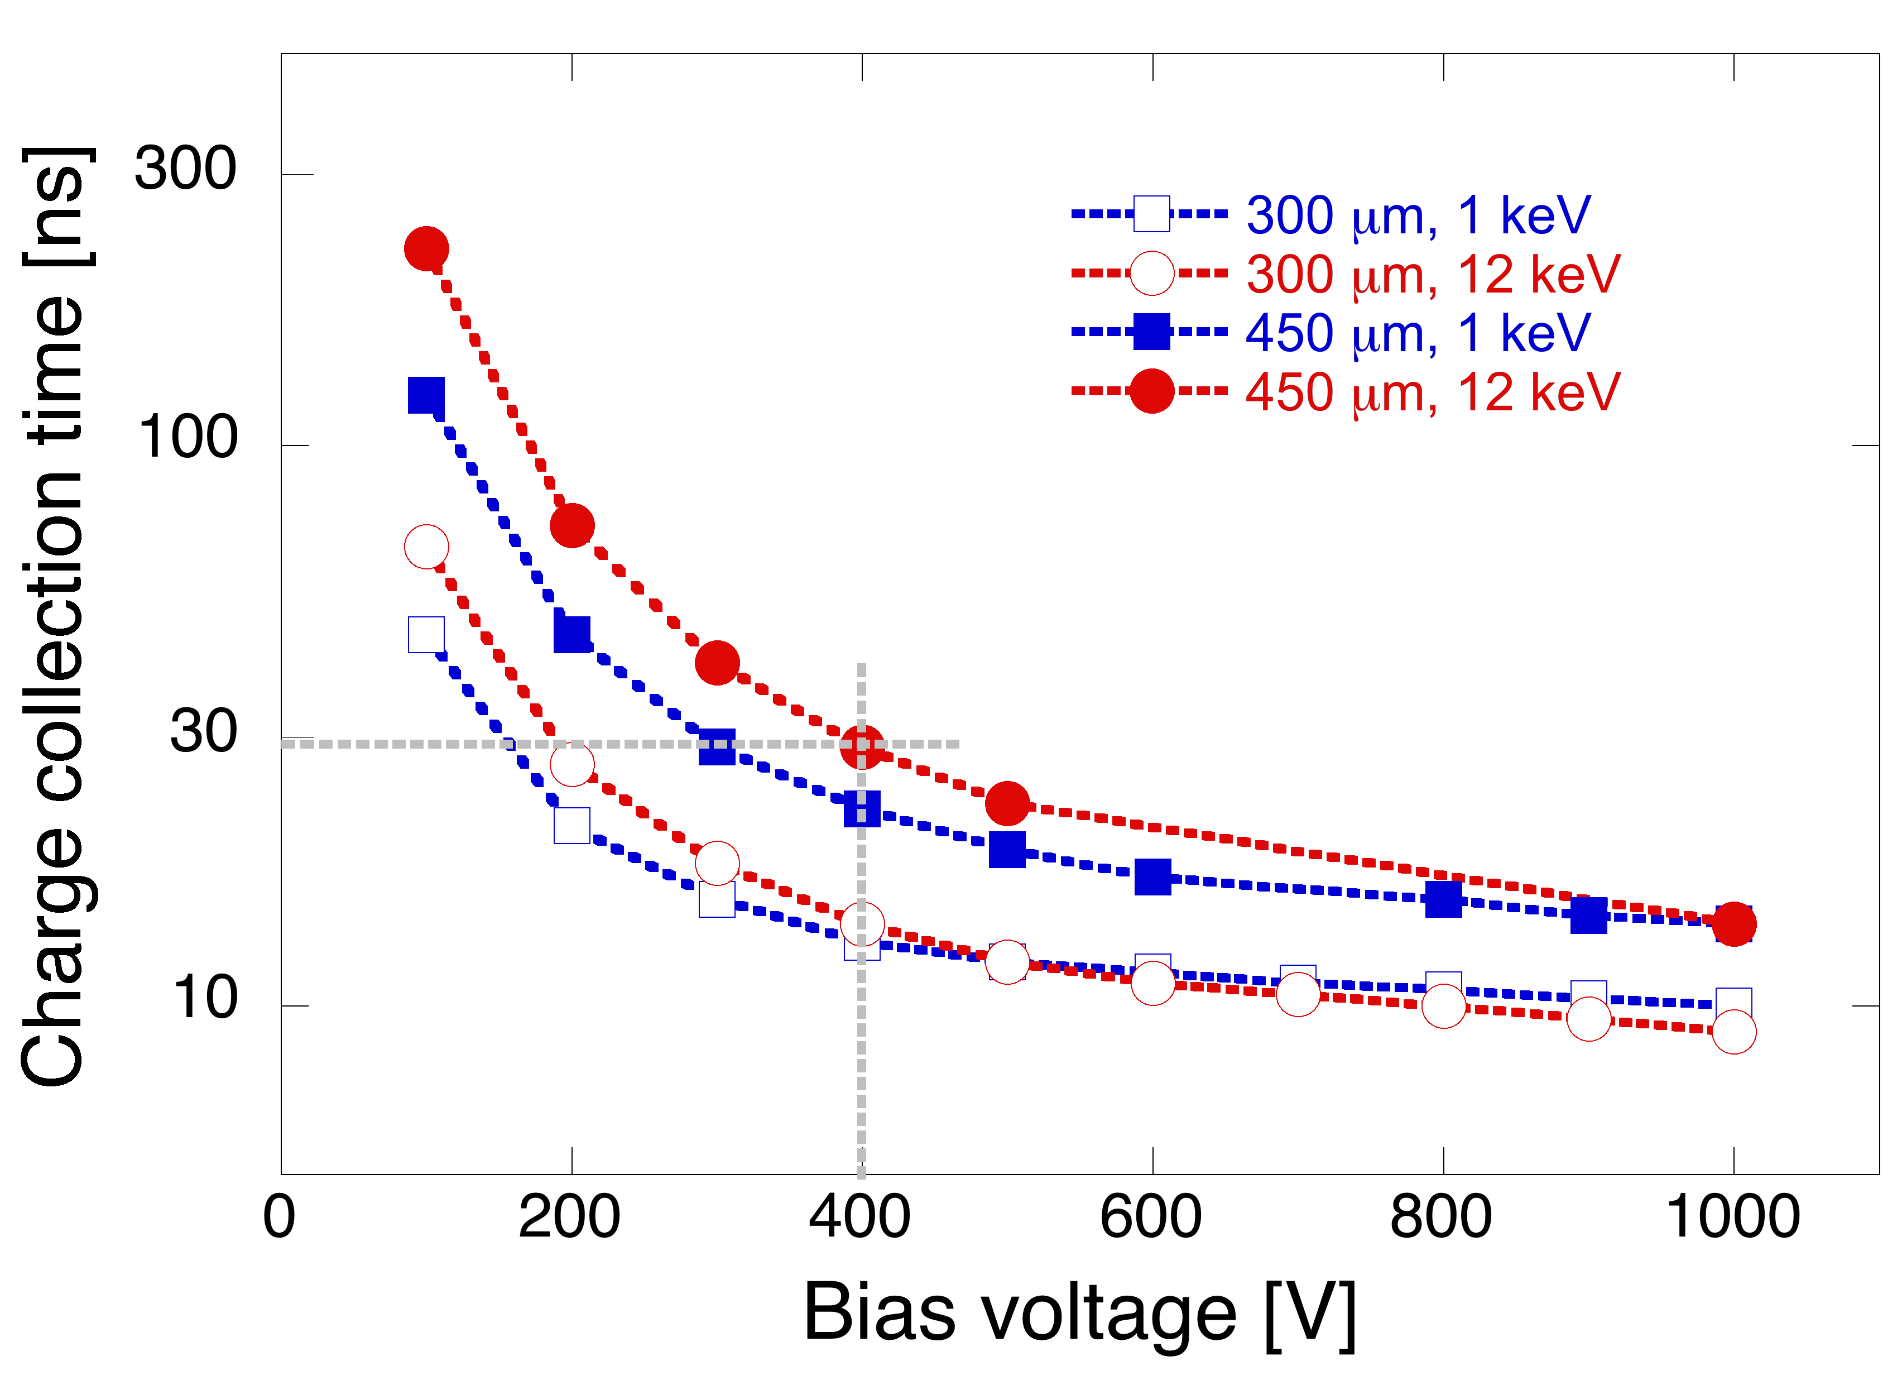
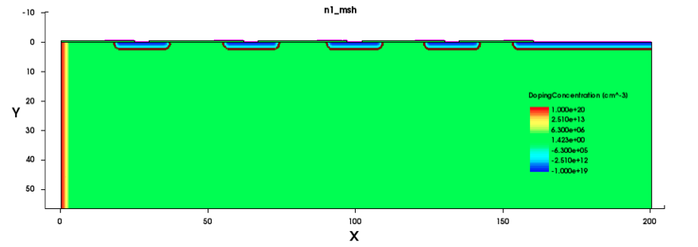

Active edge sensor optimization for FELs
Already developed by FBK for Alice and ATLAS
Main issues: plasma effect, thickness and entrance window
High bias voltage mitigates the plasma effect: with V_{bias}=400 V, fast collection time (<30 ns) and small collection distance (<100 um)
10⁴ photons
Breakdown voltage >400 V for all the operation lifetime (1 GGy total ionizing dose)
with ~160 um gap, 2% dead area seems feasible
total gap: 155 um
4 GR, 2.4 um junction depth, 300 nm thick oxide

Slide 20
Readout channel
charge preamplifier
time-variant trapezoidal filter
transconductor
10 bit SAR ADC
65 nm CMOS technology, low power flavor
Designed for operation at a maximum sampling frequency of 5 MHz

Slide 21
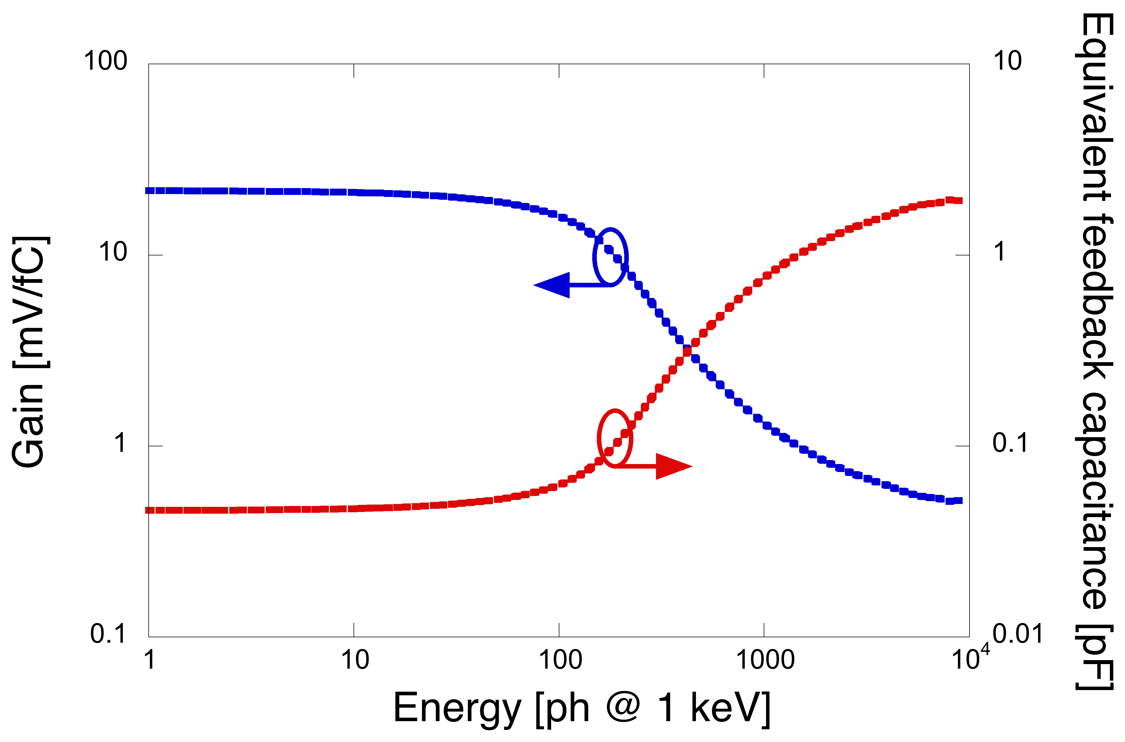
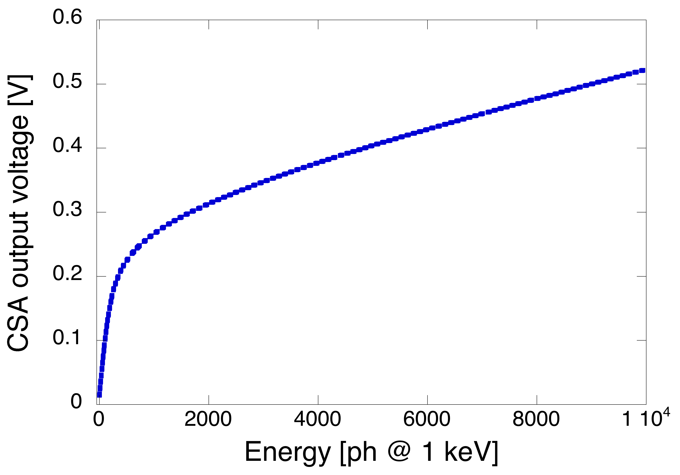
Dynamic compression
1 keV – 10 keV operation
gate to channel cap
G_{le}
C_{max}
overlap cap
PMOS input W/L=40/0.15
C_{min}
G_{he}
Based on the non-linear feature of a MOSFET operated in inversion mode
|Δv_{out}|<<V_{Th} ➔ C_{f}=C_{min}, Gain=G_{le}
|Δv_{out}|>>V_{Th} ➔ C_{f}=C_{max}, Gain=G_{he}
MOS cap W/L=40/4
G_{he}=25 uV/ph
V_{out} vs Q_{in} trans-characteristic
nonlinear capacitance equation
integrate and invert
G_{le}=1 mV/ph
M. Manghisoni et al., “Dynamic compression of the signal in a charge sensitive amplifier: from concept to design”, IEEE TNS

Slide 22
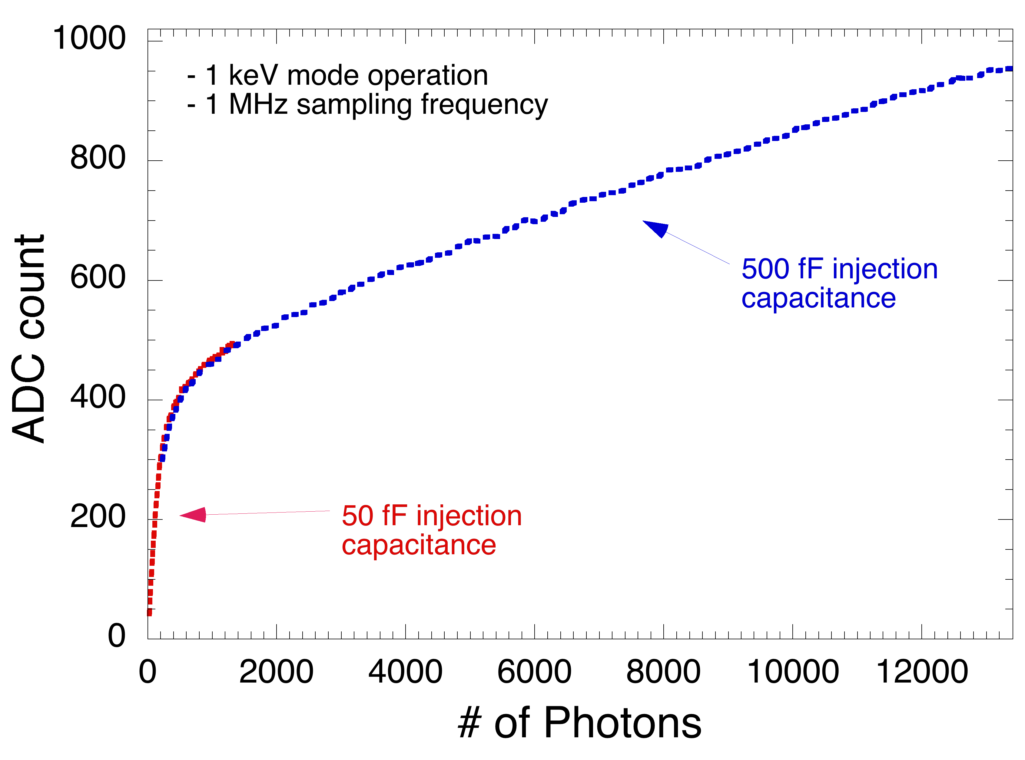
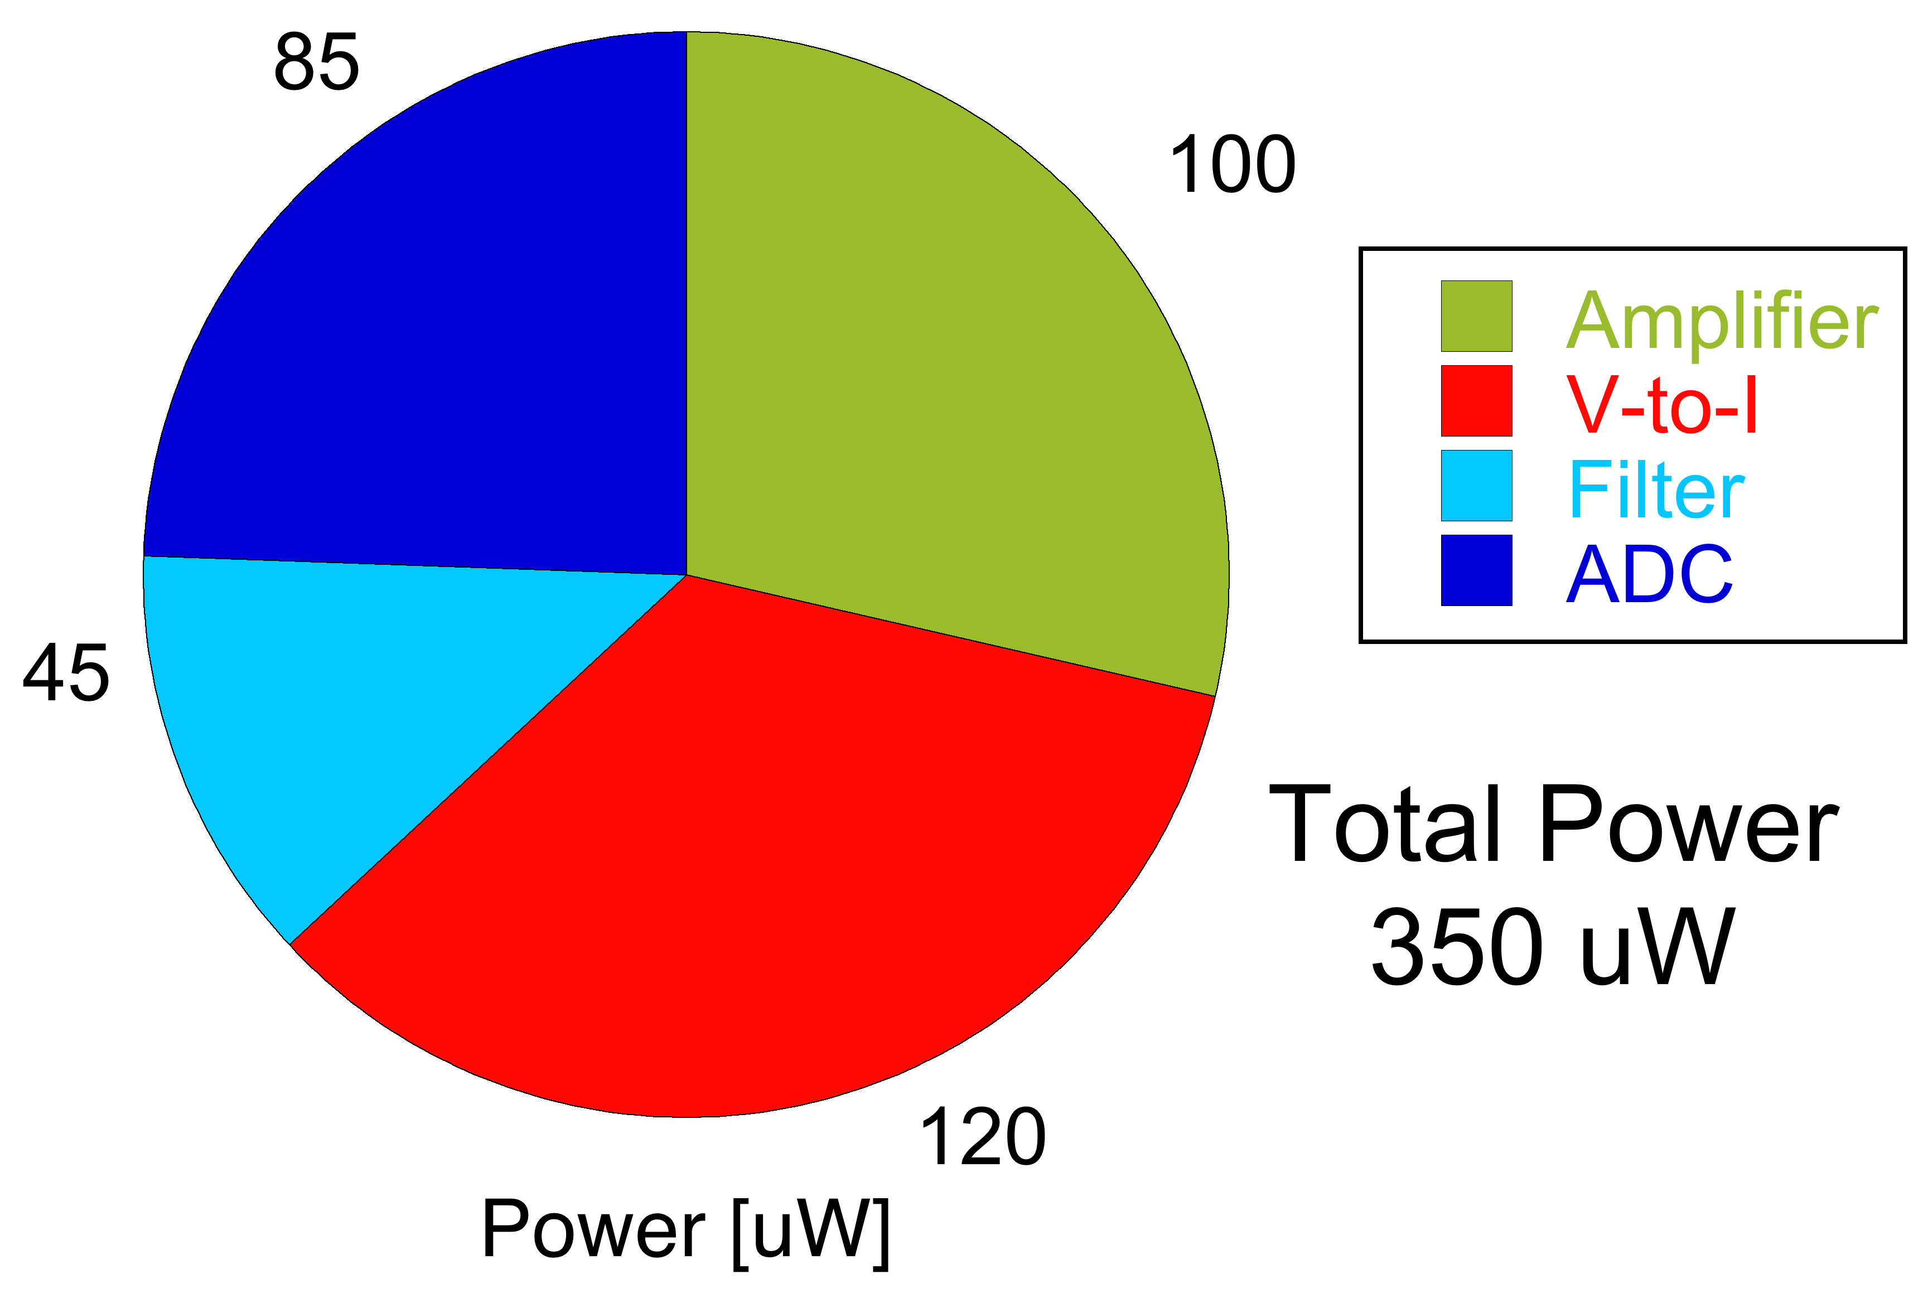
Overall channel trans-characteristic
Selectable injection capacitance, 50 or 500 fF – needed to cover the large input dynamic range during the tests
Well detectable bilinear characteristic
Low energy gain: G_{le}=1.87 mv/ph (1.6 mV/ph by design)
High energy gain: G_{he}=35.3 uV/ph (40 uV/ph by design)

Slide 23
Summary and outlook
The advent of free electron laser facilities opens up new possibilities to probe matter using X-rays with unprecedented features
high brightness
ultrafast pulses
tunability in a large energy range
New instrumentation is needed to comply with the challenging requirements of the experiments at FELs
advanced microelectronic technologies (scaled CMOS, vertical integration, active edge detectors)
innovative solutions, also borrowed from HEP community
The INFN PixFEL experiment has entered the game in 2014 – encouraging results from the tests on the first prototypes
Number of facilities steadily growing, application field rapidly expanding - need for skilled and qualified engineers and physicists to develop advanced instrumentation

Slide 24
Bakup slides

Slide 25
HEP vs photon science (from P. Siddons and S. Hermann)
Different cultures
Different detectors
HEP
teams of hundreds for one experiment
experiment takes years
detector IS experiment (scientists closely involved in the design)
Photon science
teams usually <10
experiment takes hours or days
SAMPLE is experiment (detector a necessary evil)
HEP
vertex trackers
experiment design is detector driven
large structure
low mass
moderately large signals
trigger based readout
Photon science
X.ray cameras
detector design is general purpose
compact
stopping power needed for X-rays
small signals
full detector readout needed
… but also similarities
silicon
small pixels
advanced microelectronic processes
complex system issues: data rate, processing and storage, mechanical assembly and cooling

Slide 26
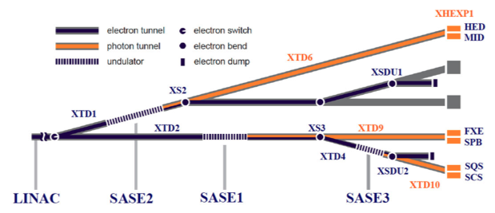
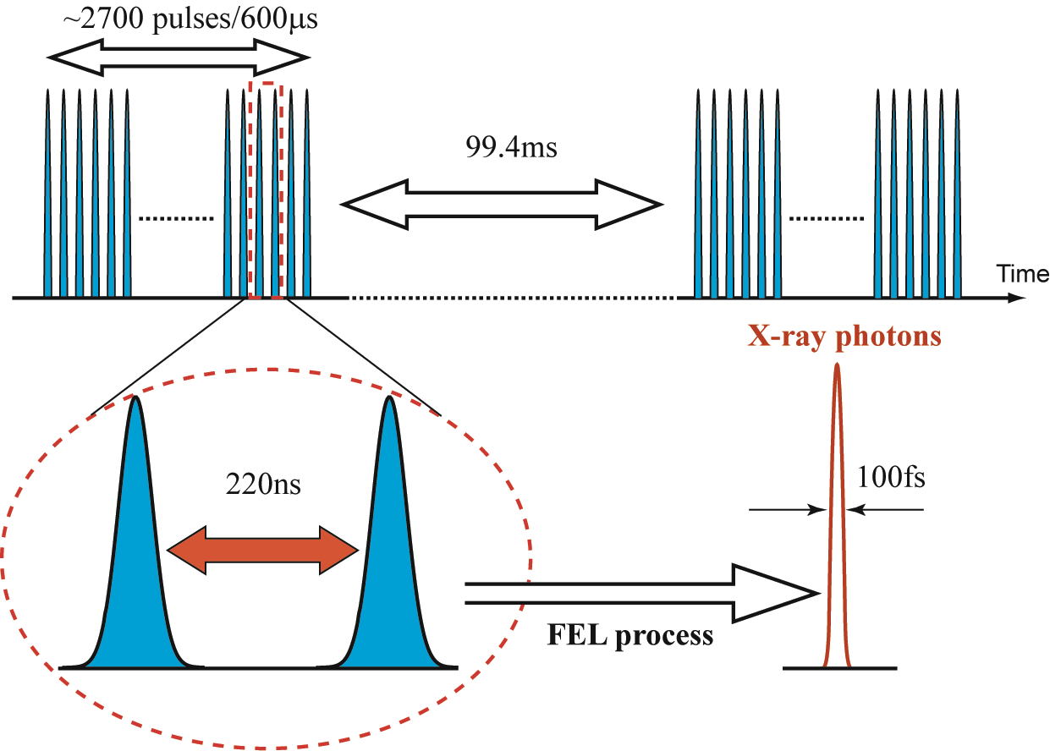
Beam-line and beam-time structure
Beam lines with different photon energies available at each facility
Beam-line structure @Eu-XFEL
Very different beam structure from one FEL facility to the other – some pose very challenging requirements on the instrumentation
Eu-XFEL
LCLS
LCLSII

Slide 27
Active edge sensors
Active edge to minimize the gap between the active region and edge of the sensor and avoid leakage current injection from the damaged cut region
Main issues:
plasma effect: large charge concentration due to huge signals (10⁴ photons @ 1 keV=2.8x10⁶ e/h pairs) ➔ degradation charge collection distance and time
thick sensitive region for good efficiency @10 keV
thin entrance window for good efficiency @1 keV
High bias voltage mitigates the plasma effect: with V_{bias}=400 V, fast collection time (<30 ns) and small collection distance (<100 um) ➔ optimization of the sensor edge is required to maximize the breakdown voltage
10⁴ photons
10⁴ photons @ 12keV

Slide 28
Sensor optimization for FELs
Edge geometry optimization to increase breakdown voltage
edge distance, guard ring number and gap, field plate
oxide thickness and junction depth
G.-F. Dalla Betta, “Design and TCAD Simulations of Planar Active-Edge Pixel Sensors for Future XFEL Applications”, N08-7
Present optimization result
4 guard rings with external field plate
2.4 um junction depth
300 nm oxide thickness
With the present optimization, breakdown voltage > 400 V for all the operation lifetime (1 GGy total ionizing dose)
Assuming a ladder (=sensor) area of 2.56x5.12 cm² and a gap of 160 um, ~2% dead area seems feasible (including mechanical tolerance for the overall detector assembly)
total gap:
155 um

Slide 29
Dynamic range
In diffraction imaging applications, the dynamic range of the signal to be processed can be as large as 80 dB (1 to 10⁴ photons)
Single photon resolution is a desirable feature of the readout electronics – 1 ADC count for each additional photon
n_{ph}
V_{out}
V_{out}
V_{max}
pixel
ampli
ADC
Assuming V_{max}=1 V, n_{max}=10⁴, E_{ph}=1 keV
LSB=100 uV, no. of bits ≥ 14 ➔ large area, power dissipation, data rate
G=100 uV/ph≈0.4 uV/el≈2.5 mV/fC ➔ poor SNR, or large power dissipation
G
n_{max}
n_{ph}

Slide 30
Signal compression
Possible solution: cover the dynamic range using a piecewise linear gain (signal compression) - the simplest choice may be a bilinear characteristic
V_{out}
implement single photon resolution for n_{ph} ≤ n_{H}
chose the gain accordingly for the remaining part of the characteristic
V_{max}
G_{L}
V_{H}
Assuming V_{max}=1 V, n_{max}=10⁴, n_{H}=100, V_{H}=200 mV
G_{H}=2 mV/ph, G_{L}≈80 uV/ph
LSB=2 mV, no. of bits ≥ 9
in the low gain region, n=25 ph/ADC count ➔ quantization noise
n_{max}
G_{H}
n_{H}
n_{ph}
LSB {
n_{ph}
n’_{ph}
n’_{ph}+25

Slide 31
Shot or Poisson noise
The number of photons hitting a pixel during diffraction imaging experiments is subject to fluctuations according to a random process described by Bose Einstein statistics ➔ photon shot noise with variance σ²_{p}
h=Plank’s constant
k_{B}=Boltzmann’s constant
T=absolute temperature
λ=photon wavelength
Actually, for hc/λ>>k_{B}T, Poisson statistics is a good approximation of Bose-Einstein statistics and
Shot noise increases with the square root of the number of photons ➔ no use in having single photon resolution when the number of detected photons gets large

Slide 32
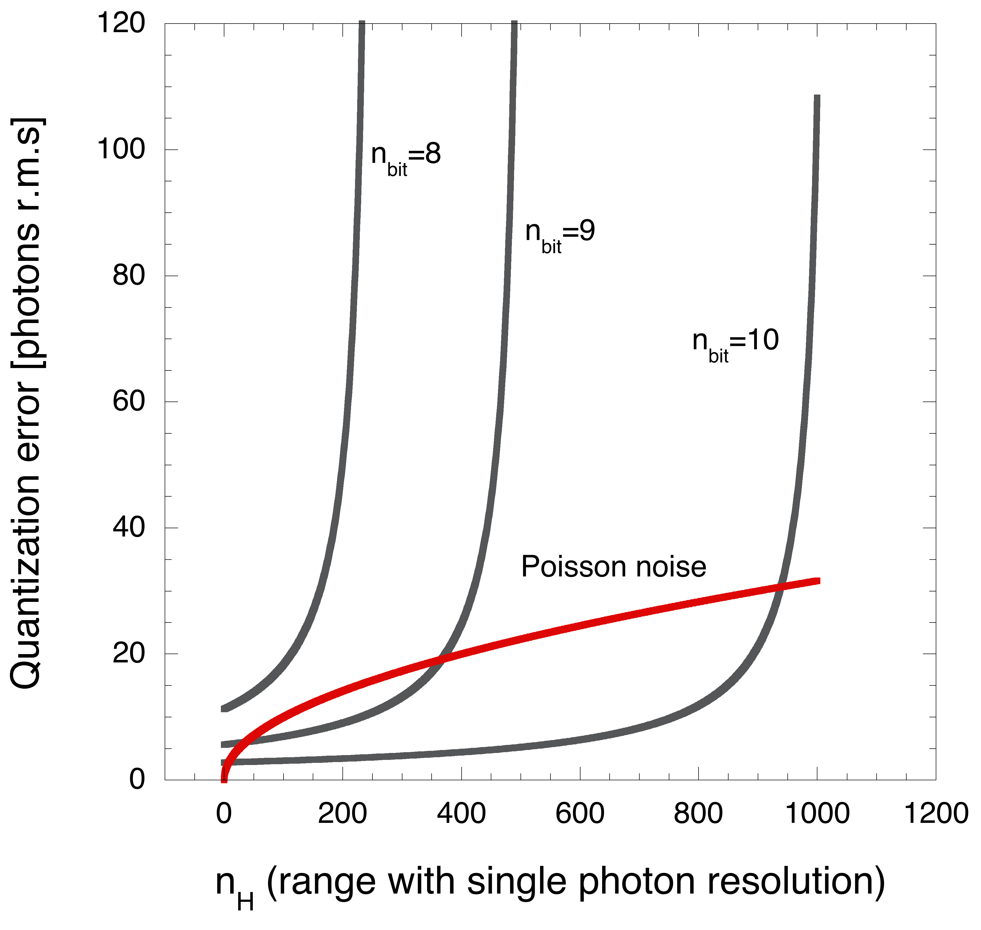
Quantization vs Poisson noise
Choose n_{H} (i.e., the range in which single photon resolution is implemented) and the number of bits in such a way that
case of bilinear characteristic
Once number of bits m is given
For a bilinear, compressed characteristic, at least 9 bits are needed for quantization noise to be always smaller than Poisson noise

Slide 33
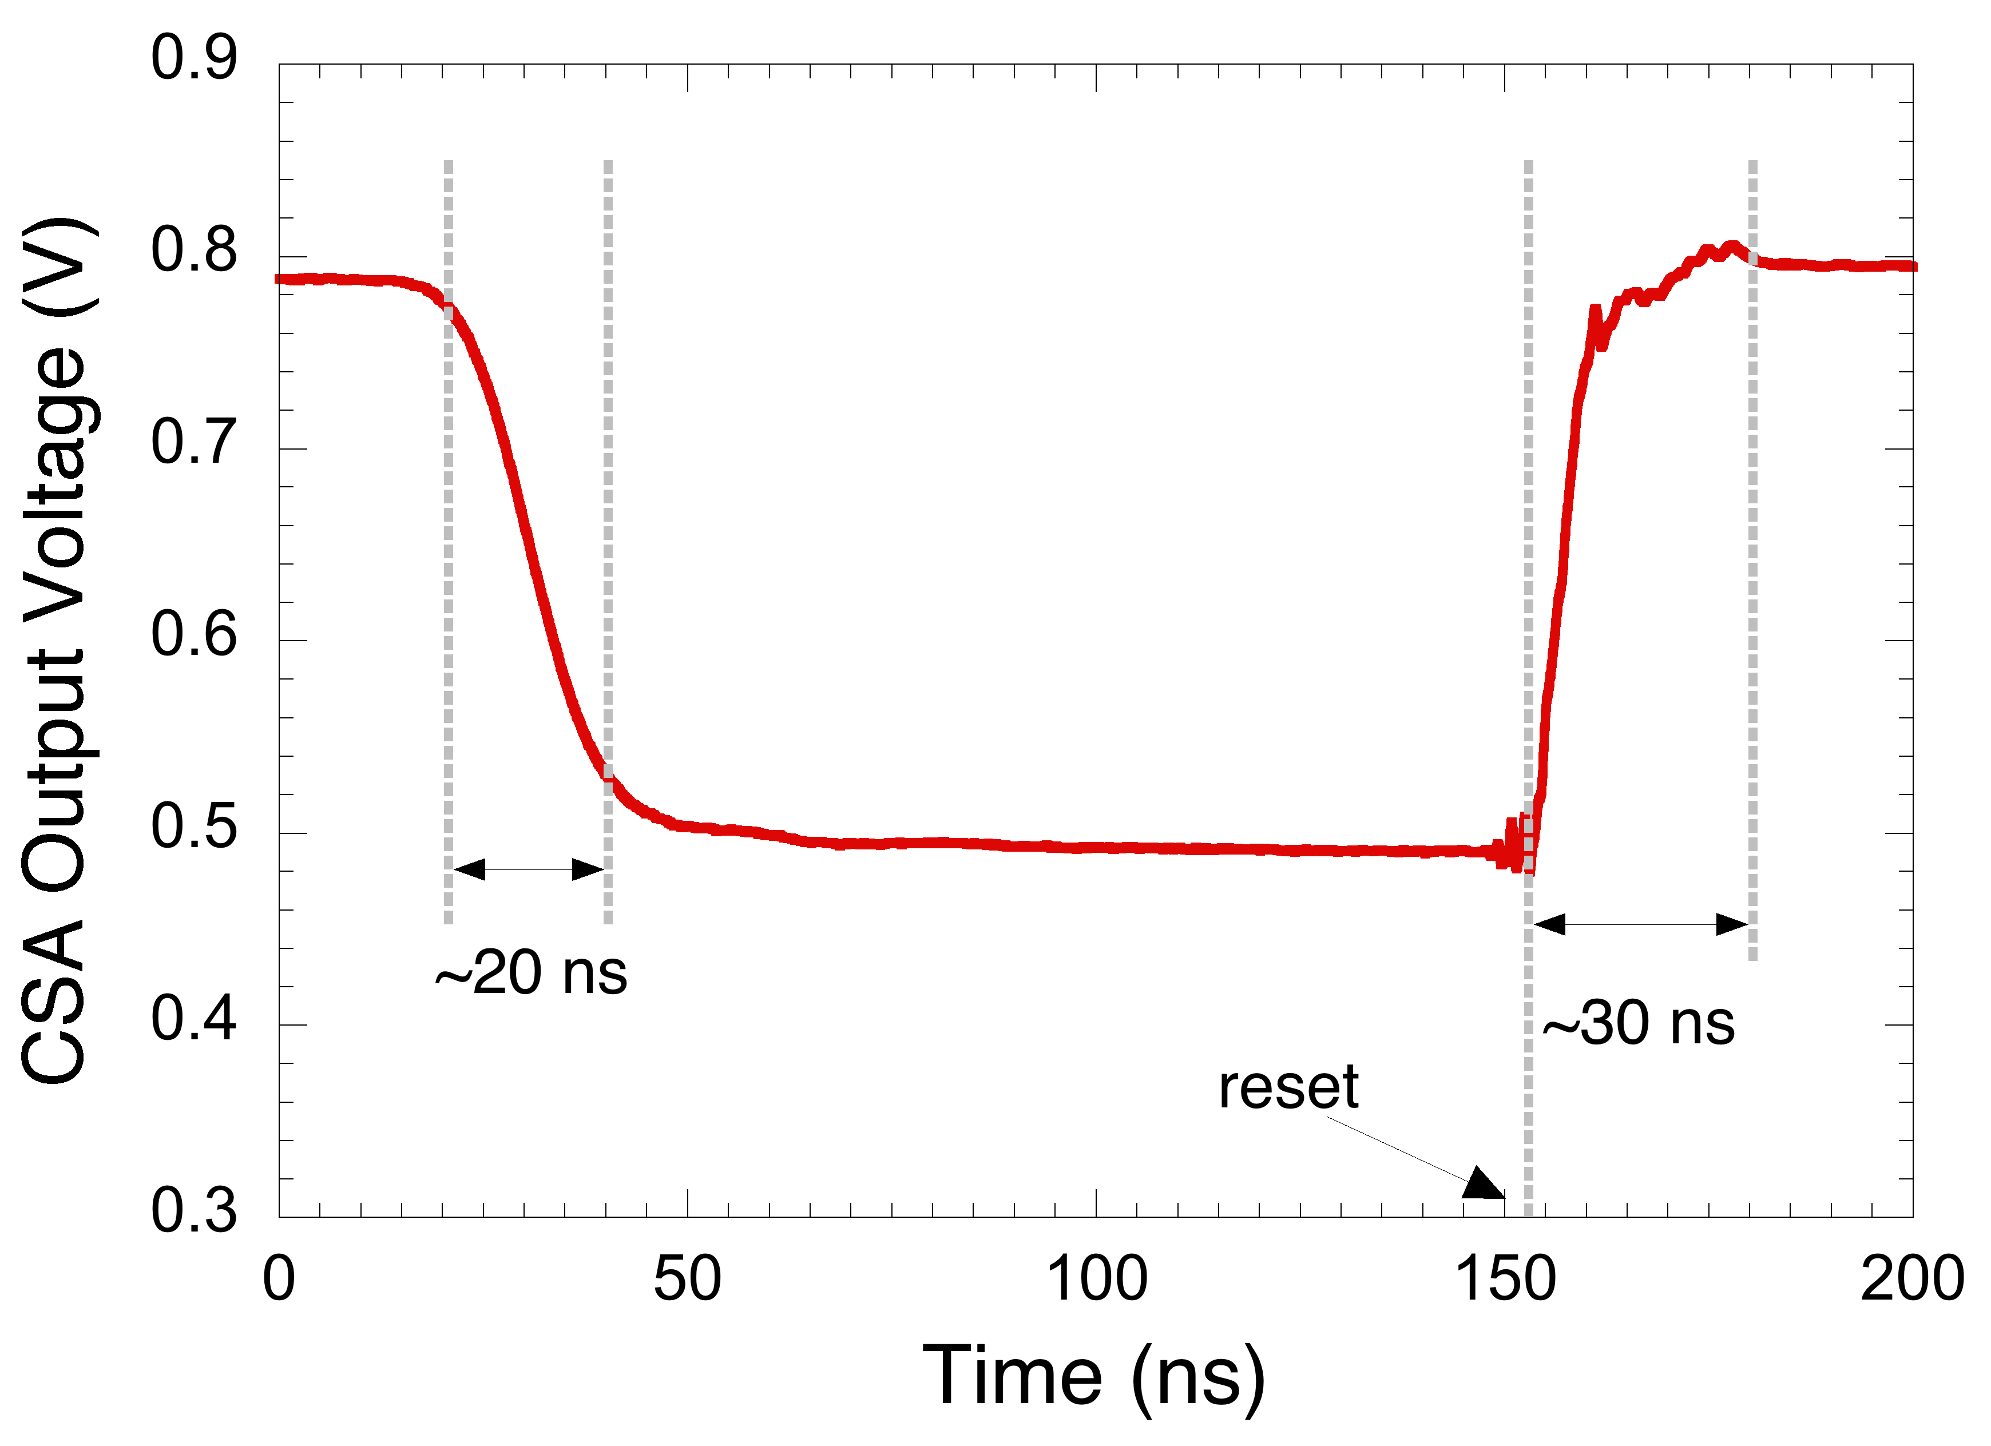
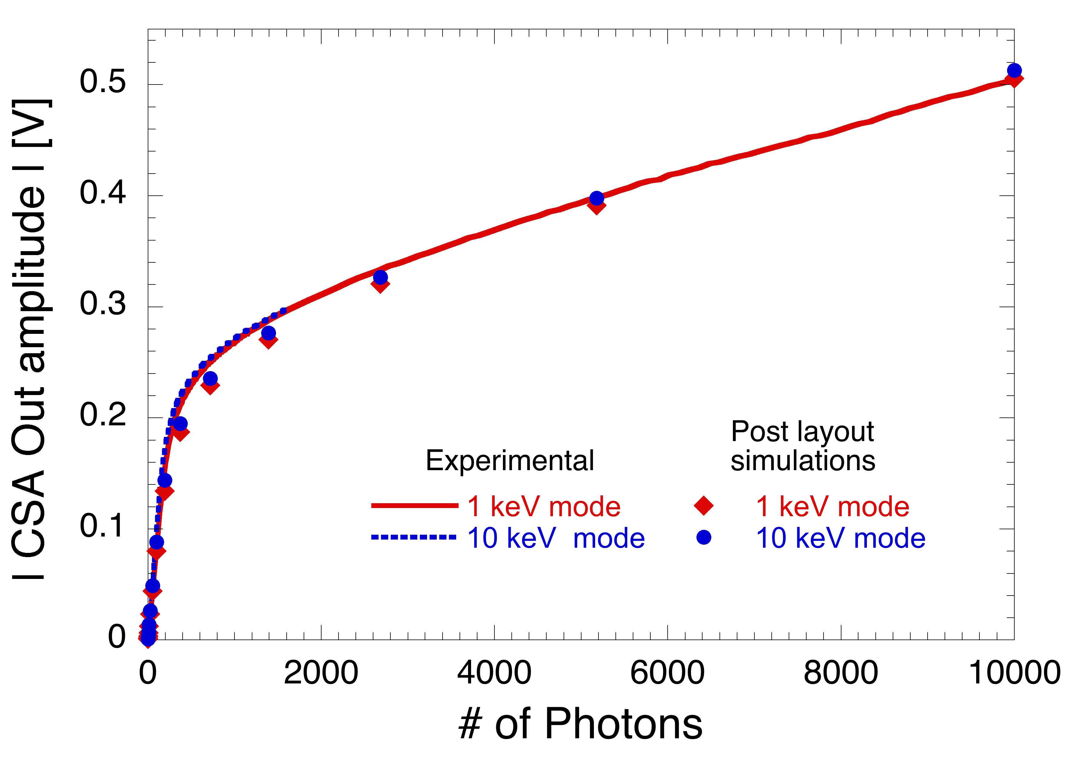
CSA response
1500 ph. input signal
20 ns for full charge integration, 30 ns reset time – compatible with 5 MHz processing (50 ns slots)
Low energy gain: G_{le}=1.08 mv/ph (1 mV/ph by design)
High energy gain: G_{he}=23.1 uV/ph (25 uV/ph by design)
Full dynamic range of 10⁴ photons is covered

Slide 34
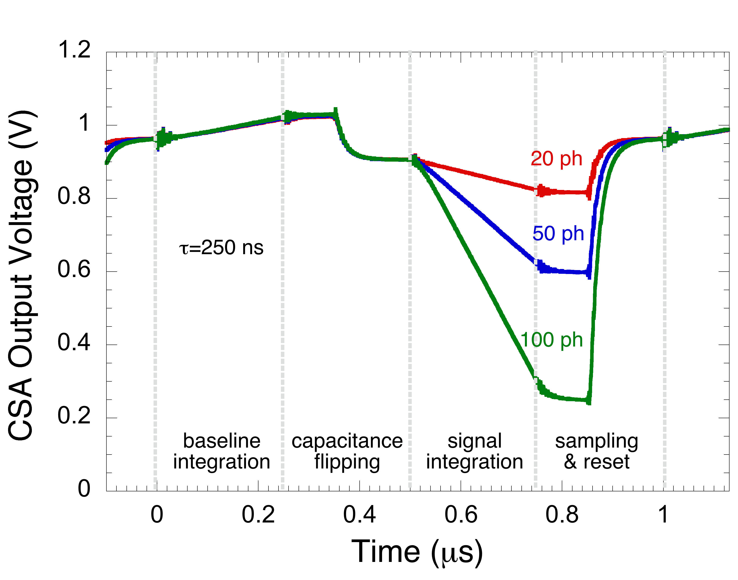
Flip-capacitor filter response
Events with a known repetition rate ➔ time variant shaping
controlled time to return to base
directly provides the ADC with the sample to convert
correlated double sampling
trapezoidal shaping function
S0
S1-S4
S2-S3
L. Bombelli et al., NIMA, vol. 624, pp. 360-366, 2010

Slide 35
10 bit time-interleaved SAR ADC
Two split capacitive DACs in a time-interleaved structure; for each DAC
pre-charge during one sampling period
conversion during the subsequent period
No need for a dedicated stage to charge the DAC (~2.3 pF)
Avoid large current peaks due to fast capacitance charge
Comparator based on a pre-amplification stage (to avoid kickback noise), a second gain stage and a latch
L. Lodola, “Interleaved SAR ADC for in-pixel conversion in future X-ray FEL applications”, 2015 PRIME Conference, DOI: 10.1109/PRIME.2015.7251339

Slide 36
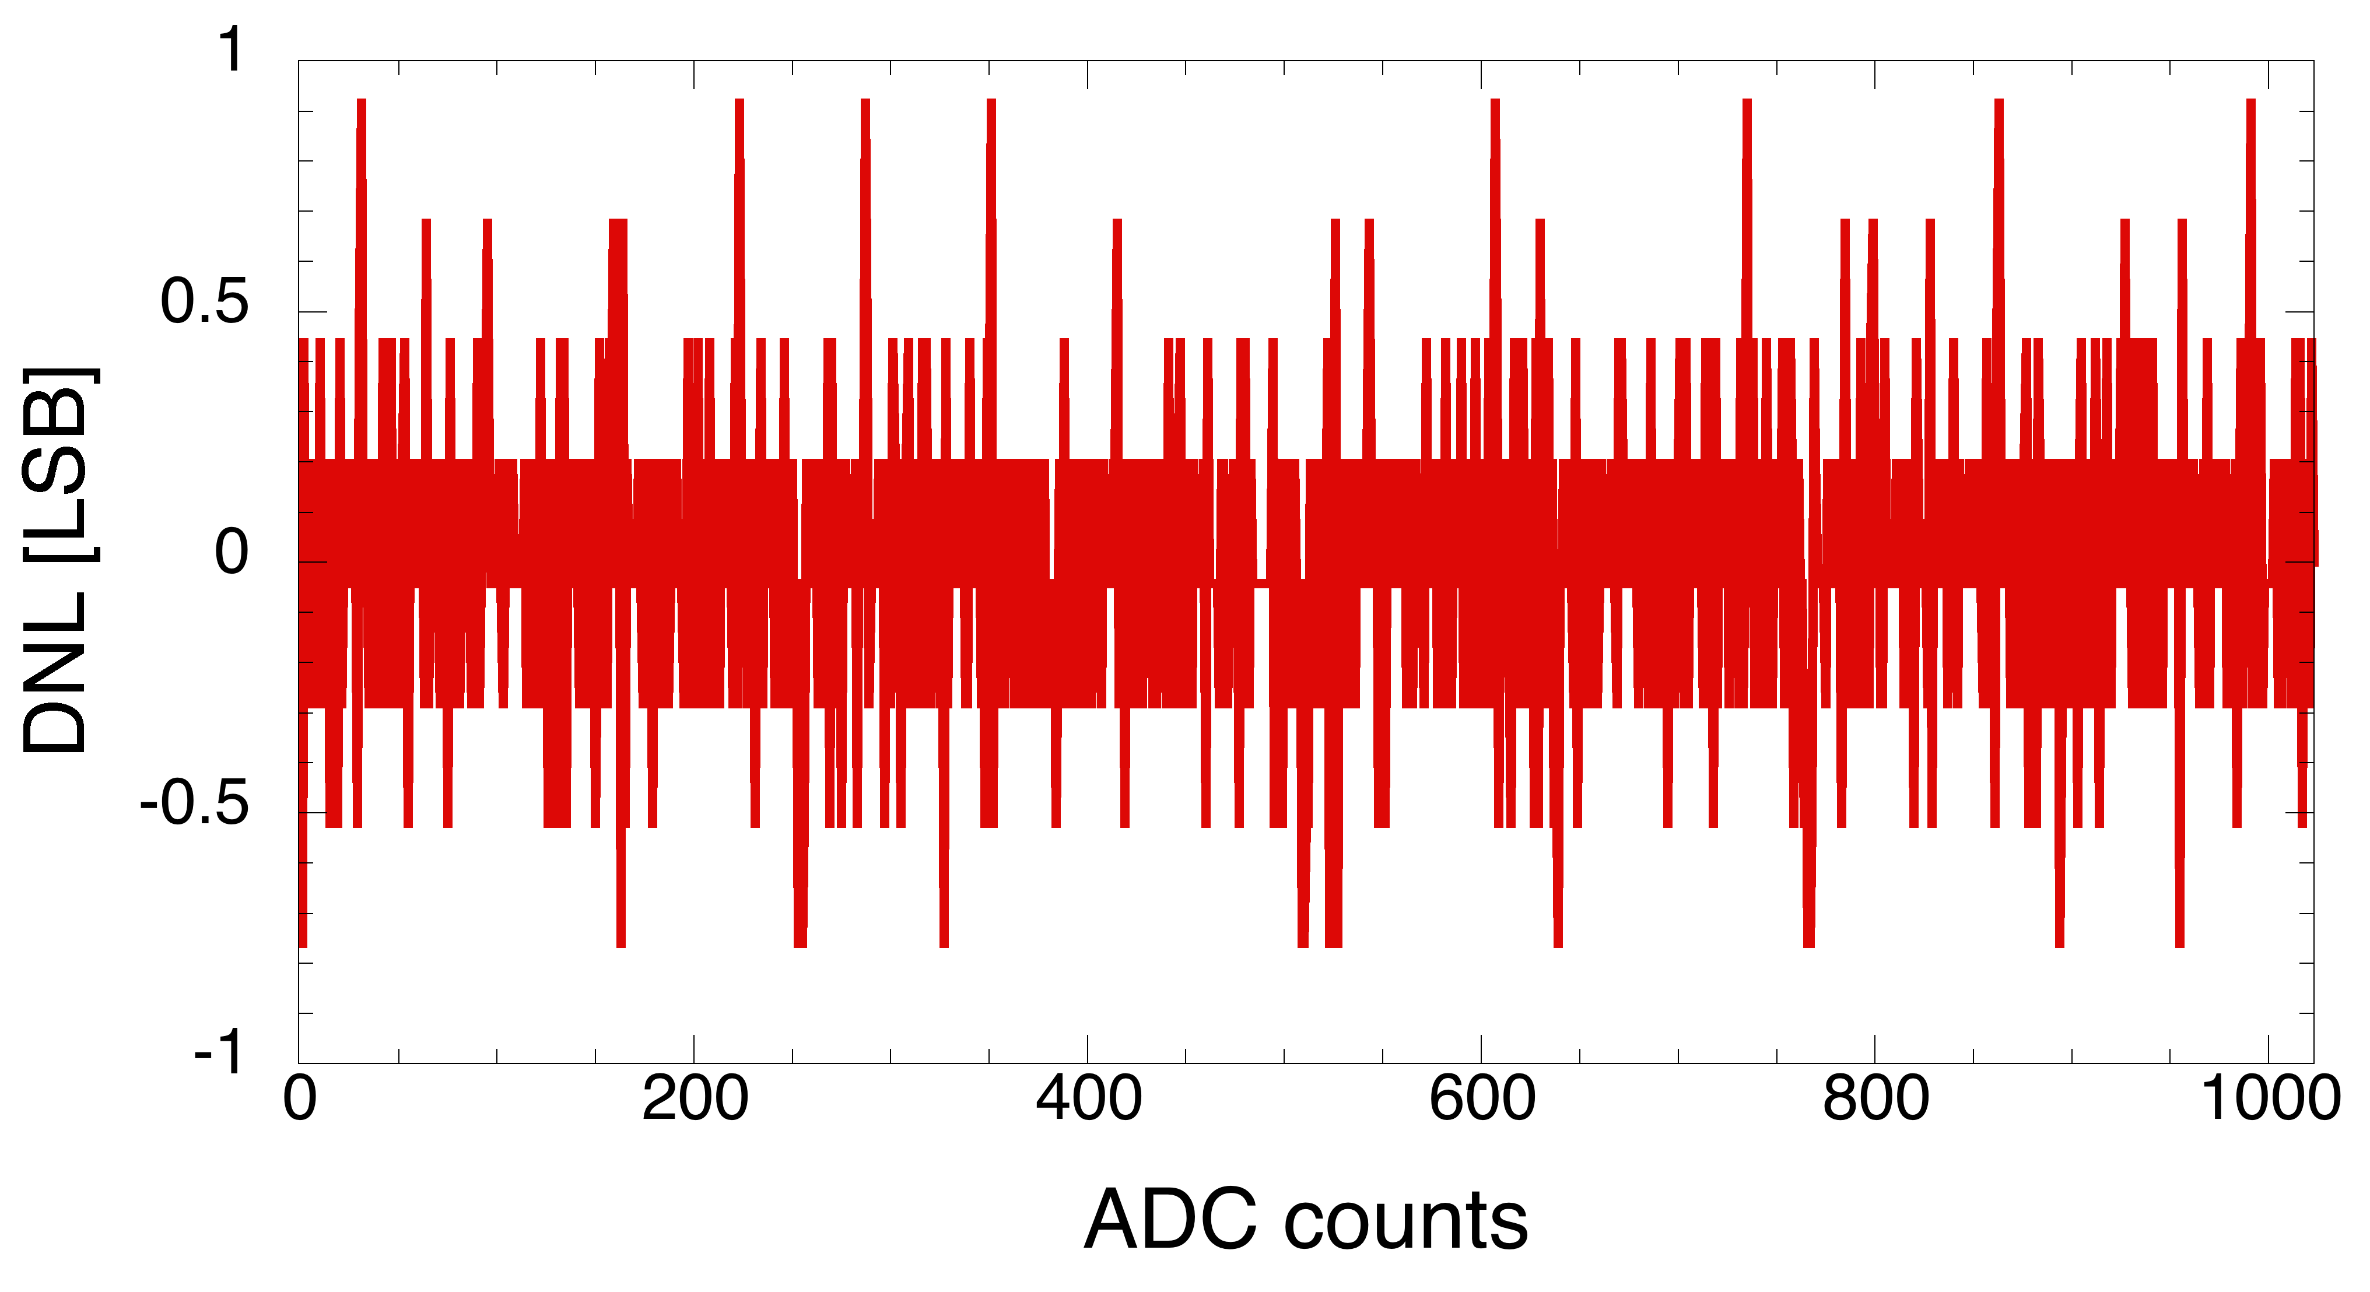
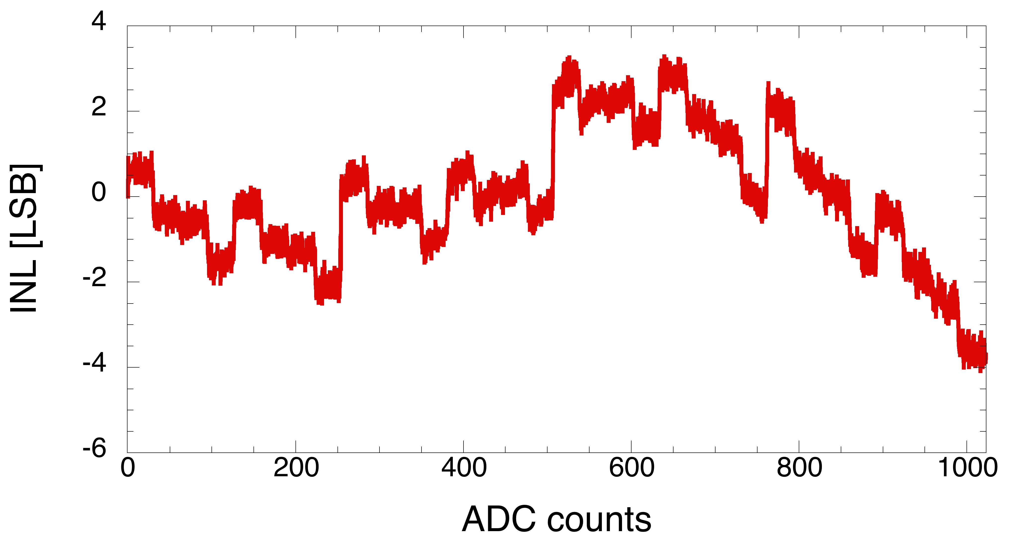
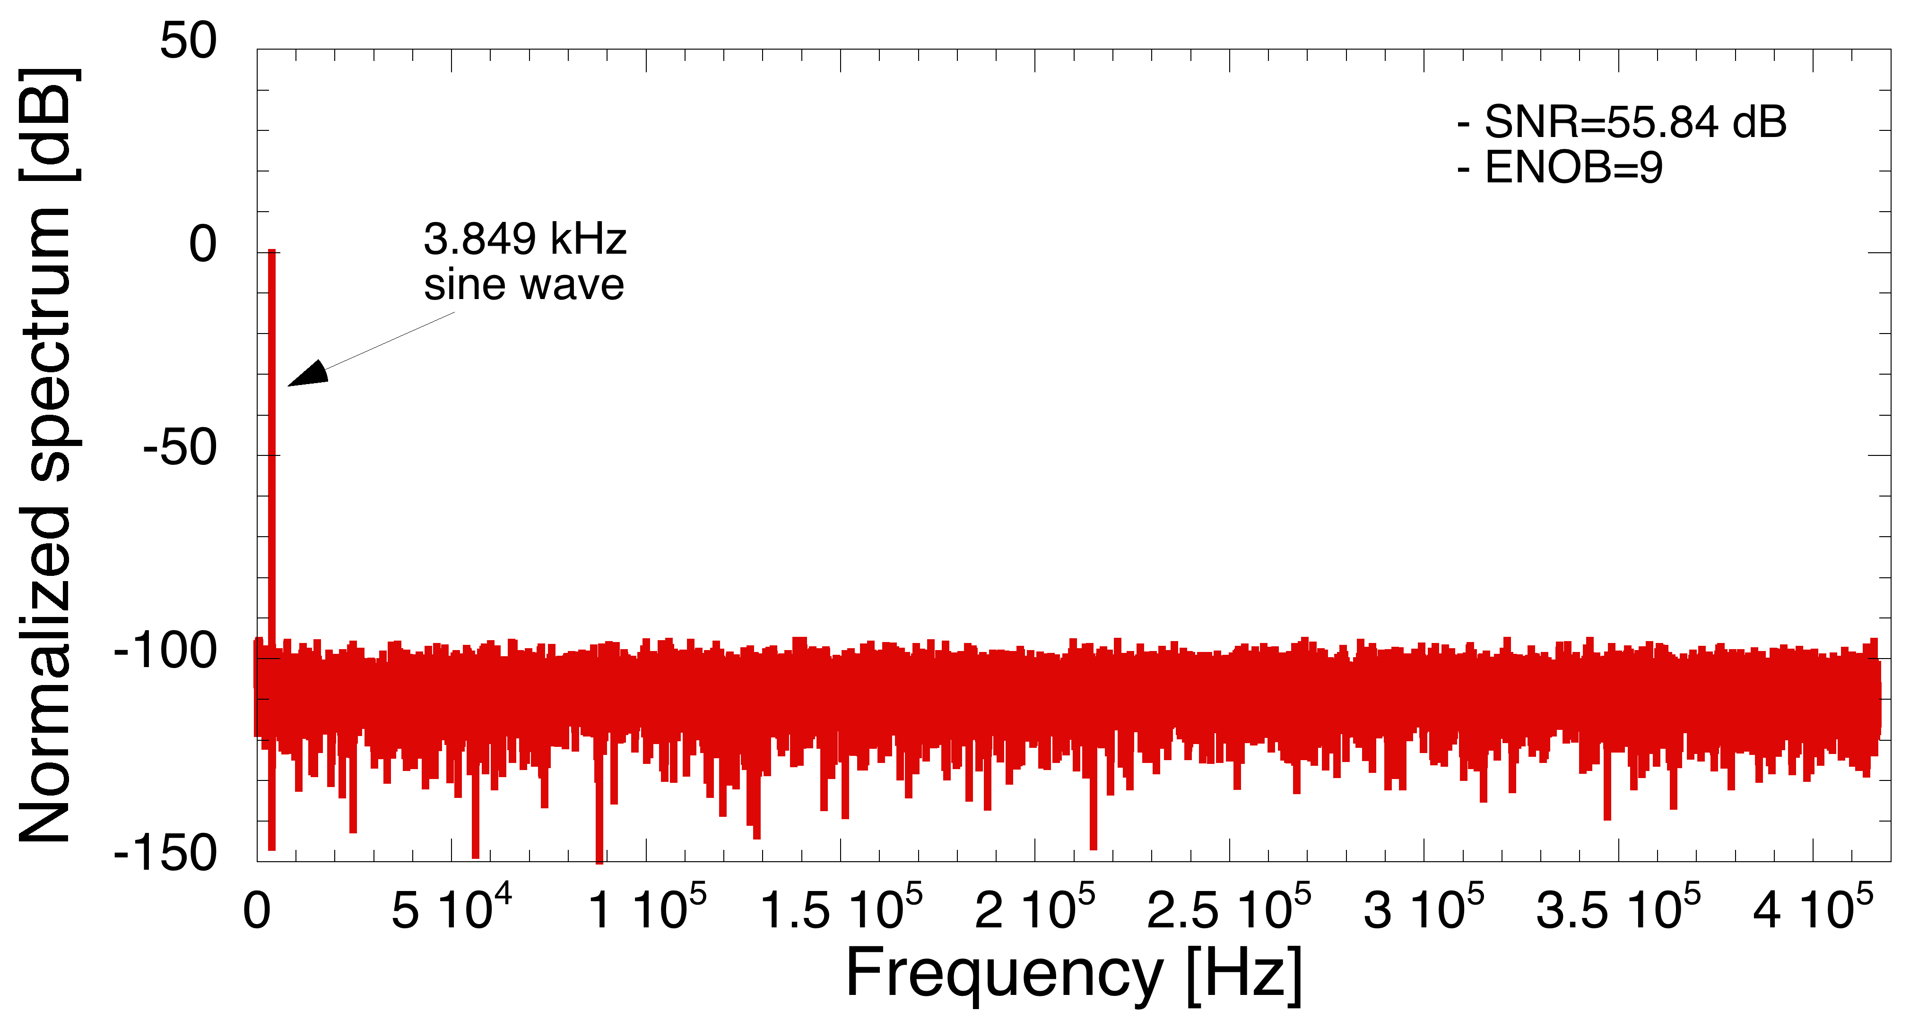
ADC performance
1.82 MHz sampling operation achieved, 10 bit conversion in 11 clock periods (T_{CK}=50 ns)
SNR compatible with a ~300 uV rms noise referred to the ADC input
|DNL| < 1 LSB ➔ no missing codes

Slide 37
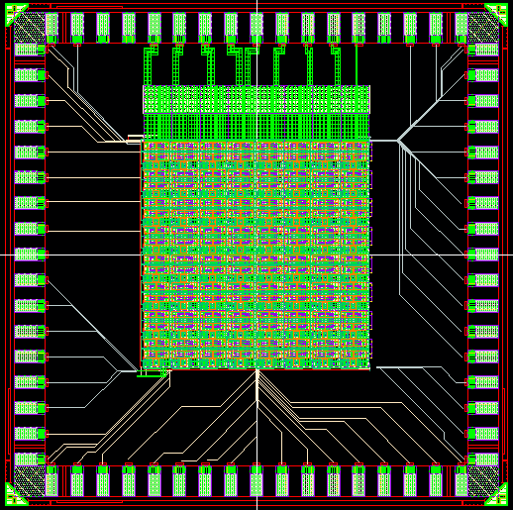
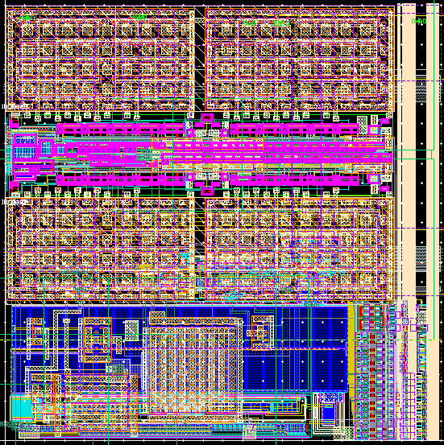
October 2014 submission: 8x8 array
SAR ADC
110 um
FCF+transc.
Preampli
110 um
digital readout

