Slide 1
FTK IAPP Executive Board Meeting: 12/11/2015
WP5: A new approach to
Image Processing
Calliope-Louisa Sotiropoulou

Slide 2
A New Approach to Image Processing
WP5: Image Processing
Impact of IAPP outside HEP community

Slide 3
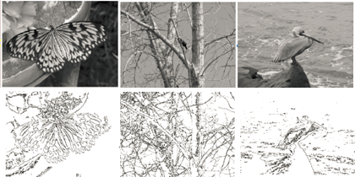
A New Approach to Image Processing
The particle tracking problem is in fact an image processing problem
HEP
Before Filtering
After Filtering

Slide 4
Simulating the Human bRain for Image Processing - SHRIMP
Simulation → shrimpSim
Hardware → shrimpImp (needs improvement.. ☺ )

Slide 5
Main Idea of the Algorithm

Slide 6
Pattern Identification: Implementation

Slide 7
Accumulator: Implementation

Slide 8
Preliminary Performance Results

Slide 9
Image Processing Hardware

Slide 10
Current Status
First part of Training Firmware implemented and integrated in the Ultrascale
Thanks to the help of Christos we have IP Ethernet communications to execute the tests
Testing for Pattern Identification and Accumulator process done by using real photos and comparing output with shrimpSim
Training Firmware in Progress
  Missing Look-Up-Tables → We have good progress with the shrimpSIM made by Akis (see his presentation)
  After LUTs are ready the progress will go faster
Submitted abstract in VCI conference (Vienna 2016)

Slide 11
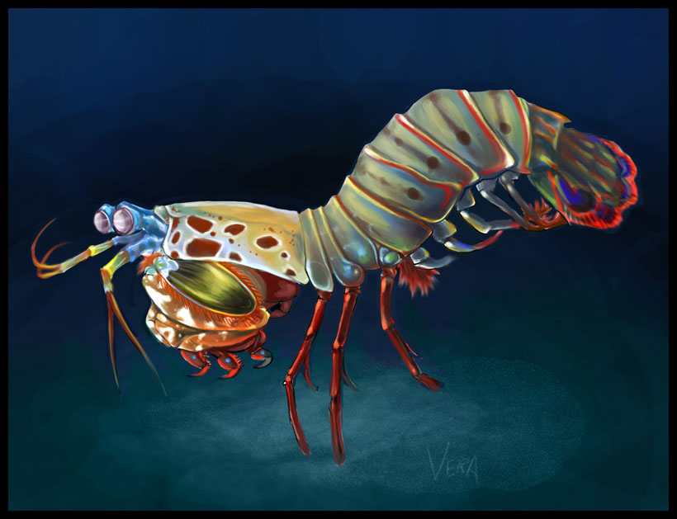
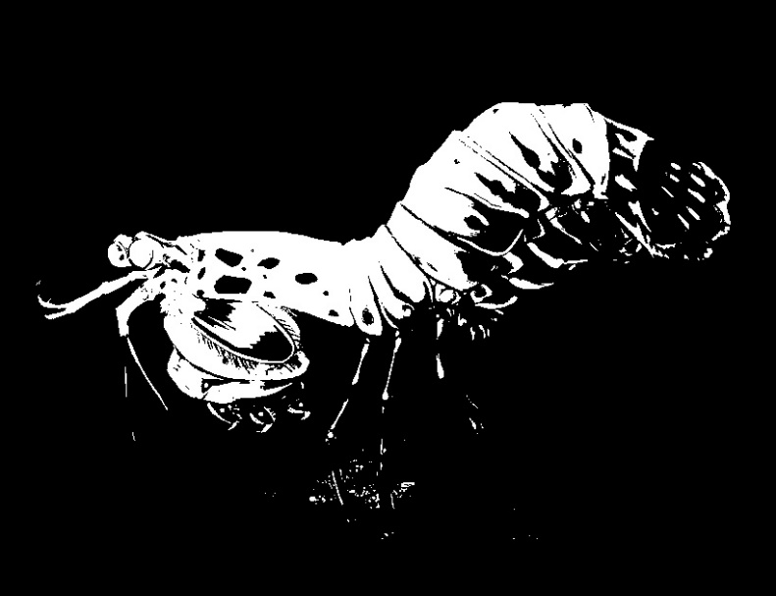
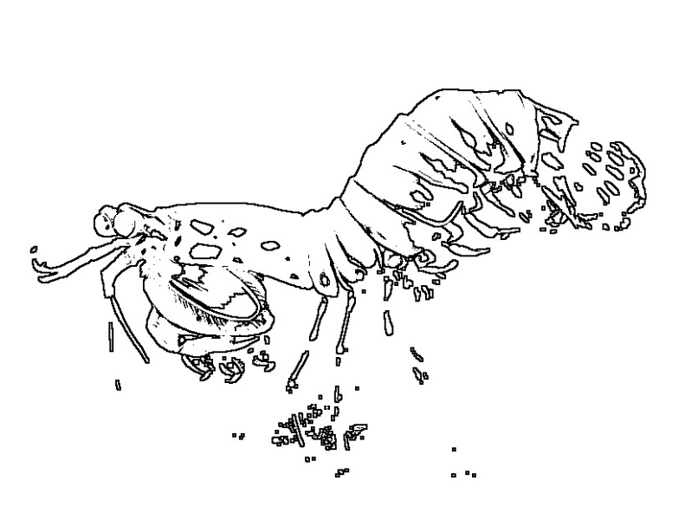

Example Input Output (see Akis presentation)
SHRIMP

Slide 12
Thank you…

Slide 13


FTK for Image Filtering
Build small arrays of pixels (3x3 for static images or 3x3x3 for movies – 3rd dimension for time) that are AM patterns (M. Del. Viva, G. Punzi)
B/W 2⁹=512 patterns: 101-010-100, ……. , 111-011-001
4 gray level 2¹⁸= 256 Kpatterns: 00,00,01-00,01,00-11,00,10 …..
B/W + time 2²⁷= 128 Mpatterns: 111,000,000 - 000,111,000 - 000,000,000
Training: Calculate the frequency of each pattern in the sample images/frames
Compute Probability Density Histograms (PDHs) for different training image sets
Select the relevant patterns to be put in the AM bank
Running stage: Send the patterns to the AM chip to be filtered

Slide 14
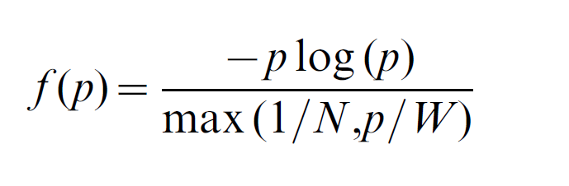
FTK for Image Filtering
Choice of relative patterns: Choose the pattern set that maximizes entropy H under real constraints
Unbounded entropy
Entropy yield per unit cost and for each pattern:
Where p is the probability that a given portion of the input data matches a specific pattern, N is the maximum number of storable patterns and W is the maximum allowed total rate of pattern acceptance.

Slide 15
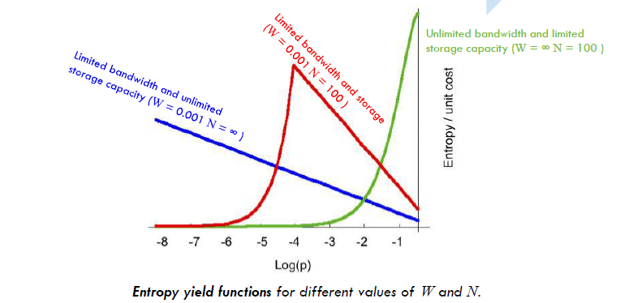
FTK for Image Filtering

Slide 16
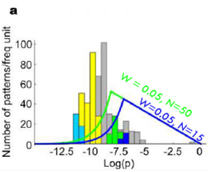
Entropy Calculation for “relevant patterns”
Probability distribution of the Ntot = 2^9 possible 3x3 square pixel matrices in black/white for natural images
50 Relevant
Patterns
used
16 Relevant
Patterns used

