Slide 1
CMS upgrade
L. Benussi
On behalf of CMS Frascati group
50th Frascati Scientific Committee Meeting

Slide 2
CMS upgrade
Content
  Search for high mass resonances in dimuon channels
  Upgrade for Phase2 RPC and GEM
    GE1/1 assembly site
    R&D on new detector technologies for the Phase2 Upgrade GE2/1(μ-rWELL)
    Search for ECO-Gas and new materials
LNF staff
  Benussi L. 100% LNF
  Bianco S. 100% LNF
  Muhammad S. 100% LNF PhD Student
  Raffone G. 50% LNF
  Piccolo D. 100% LNF
  Primavera F. 100% LNF
Associated
  Ferrini M. 80% Roma1 Univ.
  Saviano G. 90% Roma1 Univ.Materials Eng
  Parvis M. 100% Poli Torino Chem. Eng.
  Caponero M. 70% ENEA Frascati Optoelectornics
Technicians
  Passamonti L 50% LNF
  Pierluigi D. 50% LNF
  Russo A. 50% LNF
The group grows by two FTE with respect to 2014. One FTE (F. Primavera) focused on Z’ analysis.

Slide 3
  Search for high mass resonances in dimuon channels

Slide 4
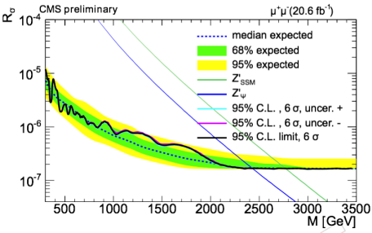
Search for high mass resonances in dimuon channels
EXO-12-061
Run 1 results using 20.6/fb of data at √s = 8 TeV:
excluded Z’_{ψ} (Z’_{SSM}) with mass up to 2.4 (2.8) TeV
Perspectives for Run2:
for resonances with mass between 2 and 3 TeV we can reach the same sensitivity of Run1 with ~1 fb⁻¹ of data collected at 13 TeV
The search for Z’ decaying into di-lepton pairs is one of the CMS “early analysis”.

Slide 5
Search for high mass resonances in dimuon channels
  LNF contribution:
    Hotline analysis (using the Official Package developed since Run1 and modified for Run2)
    Background estimation
    Trigger studies
    Plan is to use the present analysis expertise to study the impact of muon upgrade on Z’ for HL-LHC
    Ref. F.Primavera (LNF) AN-15-061, AN-15-223 and PAS EXO-15-005

Slide 6
  Upgrade for Phase2 RPC and GEM

Slide 7
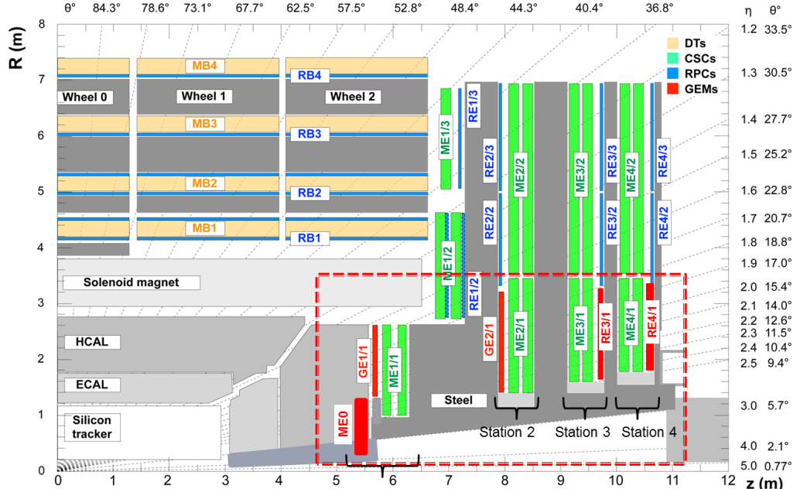

GE1/1 and GEM R&D for Phase2
GE1/1: Embarking on production
Trigger and reconstruction
1.55 < |η| < 2.18
baseline detector for GEM project
36 staggered super-chambers (SC) per
endcap, each super-chamber spans 10°
One super-chamber is made of
2 back-to-back triple-GEM detectors
Installation: LS2 (2018-19)
144 Chambers
CMS Frascati heavily involved in chamber final design, assembly protocol definition and detector production.
GE2/1:R&D in progress
ME0 : R&D in progress
Trigger and reconstruction
1.55 < |η| < 2.45
18 staggered SC per endcap,
chamber spans 20°
Installation: LS3 (2022-24)
216 Chambers
CMS Frascati starting an R&D for new detector technology for GE2/1
Muon tagger at highest η
6 layers of Triple-GEM
chamber spans 20°
Installation: LS3 (2022-24)
72 Chambers

Slide 8
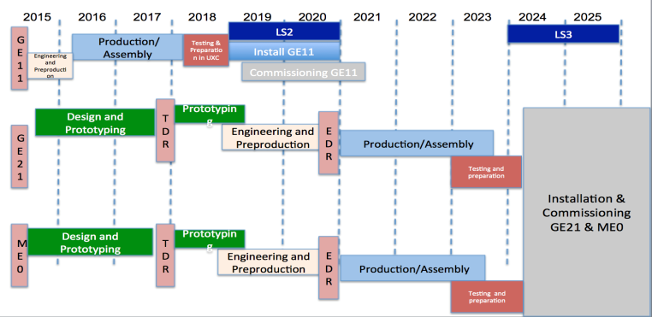
GE1/1 and GEM R&D for Phase2
GE1/1 timescale fully compatible with GE2/1 R&D
GE1/1 fully approved financed by INFN
GEM R&D Phase2 approved and financed by INFN

Slide 9
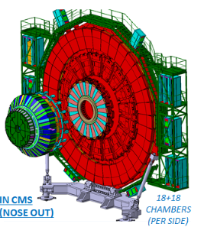
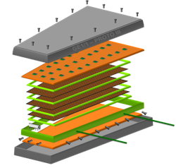
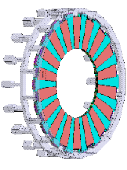
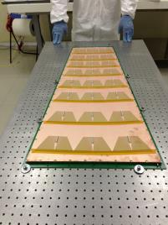
GE1/1
GE1/1 in high-η region1.5<|η|<2.2
10⁰ trapezoidal triple-GEM chambers, 144 in total
Long (1.5<|η|<2.2) and short (1.6<|η|<2.2) version
36 super-chambers in each endcap.
Muon
Endcap
Station 1
GE1/1
Front-end
superchambers
10º
short
long

Slide 10
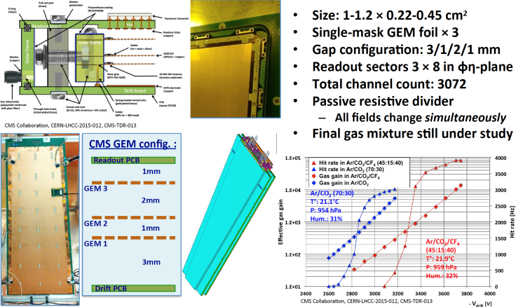
GE1/1
GE1/1 Assembly technique completely glue-free.
Totally mechanically assembled.
Chambers can be fully disassembled if problems during constructions
This choice is cost effective and reduce enormously the time needed for the assembly
23/11/2015

Slide 11
GE1/1 R&D: completed
Deformation monitoring of GEM films
Characterize tensile properties of materials pre- and post- irradiation
Characterize stretching of GEM, develop optical Moire’-based techniques for QA/QC
Install Fiber Bragg Grating optical deformation sensors permanently on GEM chambers
GOAL: 30μm precision on transverse plane (100μm affects detector performance)
See references for preliminary results

Slide 12
GE1/1
Frascati has the responsibility to assemble up to 40 GE1/1 chambers (approved and financed by INFN)
GE1/1 chambers assembly will start on the second half of 2016
Assembly time budget 1 chamber/working week
  GE1/1 Assembly 1 day
    GEM foils check
    Chamber assembly
  Gas Leak Test: 1 day
  HV test and signal monitoring: 1 day
  Gain uniformity test: 2 days
  50 weeks (40 + 10 of contingences) needed to complete 40 GE1/1 chambers in Frascati (1 Physicist & 2 Technicians)

Slide 13
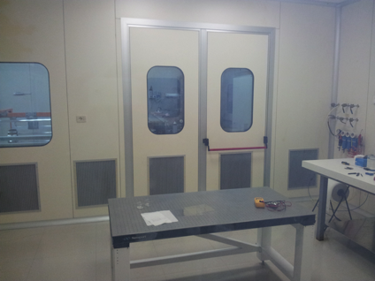
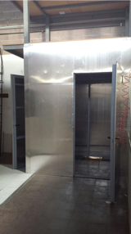
GE1/1
  Clean room ready and fully operational (class<1000) equipped with 2 benches for the assembly. Already used to assemble 2 prototypes
  X-ray station for gain uniformity test ready. X-ray gun Amptek 50keV installed in the bunker. LNF Radio-Safety certified. Ongoing the installation of the gas lines.
  Gas system ready
  Leak current station under construction

Slide 14
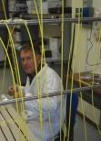
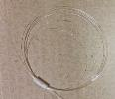
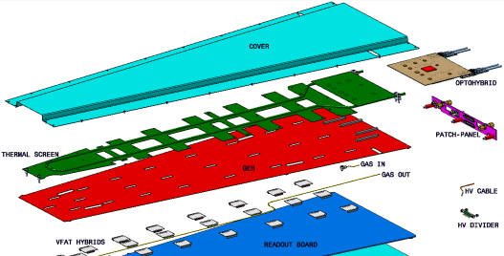
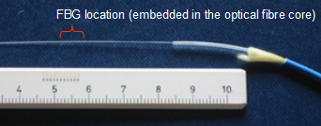
GE1/1
Temperature monitoring of GEM by use of Fiber Bragg Grating sensors
L1
L2
L3
L4 (?)
F.O connector
FBG sensor
Production and calibration of arrays of FBG sensors, custom dimensions, ready to be deployed on: Cooling Plate; GEB; Readout Board
Array of FBG sensors on GEM:
'bare' Optical Fibre (d=0.25mm)
Fast response
Can fit between boards

Slide 15
  From GE1/1 to GE2/1

Slide 16
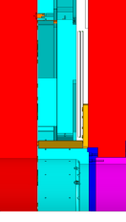
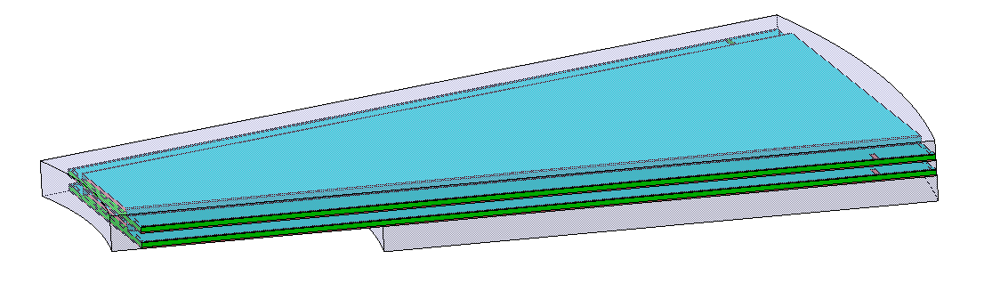
GE2/1 Detector layout
20° GE2/1, with more than 3 times the area of GE1/1, will be the largest GEM detector ever built.
81 mm
-for GE21 (only 81 mm available, 20 mm less than GE11)
YE2
YE1
ME2/1 CSC
The construction of a GEM requires some time-consuming assembly steps such as the stretching (with quite large mechanical tension to cope with, 1 kg/cm) of GEM foils.
The splicing/joining of GEM foils smaller detectors to realize large surfaces is difficult unless introducing not negligible dead zones (2÷3 mm).
Shielding
Foil stretching without spacers and no-gluing (NS2 technique developed for GE1/1) should be validate for the larger area of GE2/1

Slide 17
CMS is currently investigating the application of the following technology for GE2/1 station :
The µ-RWELL (by G. Bencivenni et al)
Ref. To be published in NIM A, contrib ELBA conf 2015

Slide 18
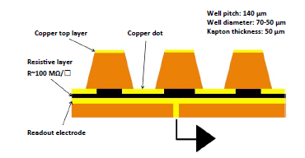
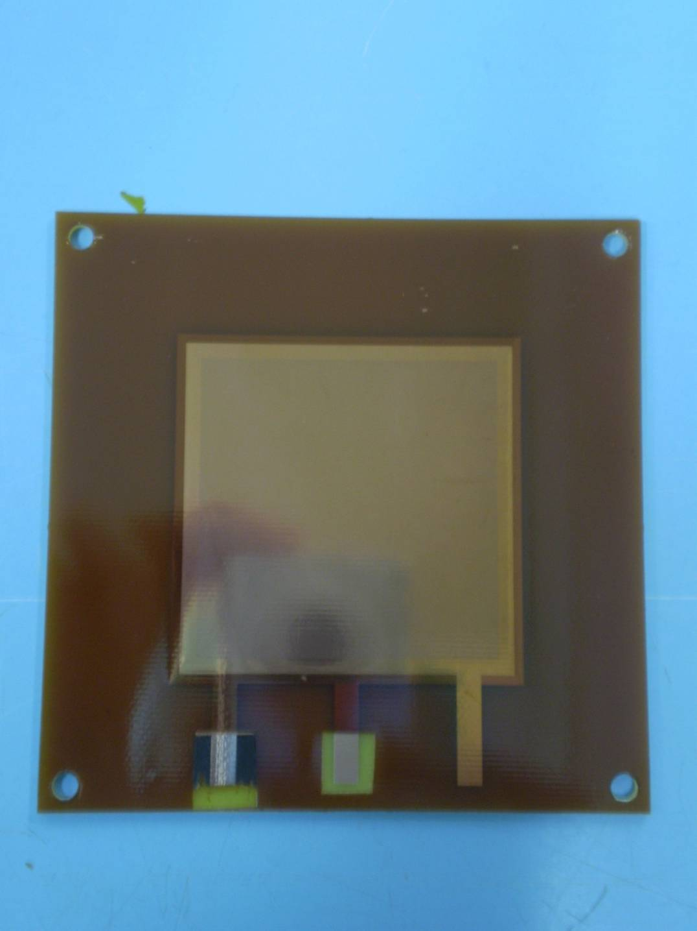
The µ-RWELL: a novel architecture
By G. Bencivenni, R. De Oliveira, G. Morello, M. Poli Lener
The goal of this study is the development of a novel MPGD by combining in a unique approach the solutions and improvements proposed in the last years in the MPGD field (RD51).
The µ-RWELL is realized by coupling:
a “suitable patterned GEM foil” for the “amplification stage” → OK;
a “resistive stage” for the discharge suppression & current evacuation
a simple readout PCB board → OK
1
2
3
The detector is compact, simple to build & cost effective :
only two mechanical components: µ-RWELL_PCB + cathode
no critical & time consuming assembly steps: no gluing, no stretching, easy handling
no stiff & large frames
large area with PCB splicing technique (dead zone <0.5 mm)
The µ-RWELL is easy to operate:
very simple HV supply: 2 independent channels or a trivial passive divider
The simplest scheme of µ-RWELL detector
5 cm
100 MΩ/☐

Slide 19
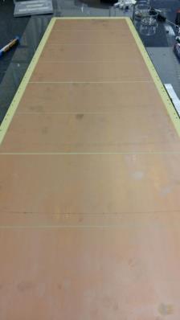
µ-RWELL for CMS-Muon system
In collaboration with
G. Bencivenni, R. De Oliveira, G. Morello, M. Poli Lener
As a first step, the prototype will be based on the GE1/1 PCB readout:
PCB r/o ~1.2x0.5 m divided in 8 r/o sectors
One single resistive layer with DLC technique with edge current evacuation scheme (expected part. Rate ~10 kHz/cm² )
One amplification stage (50 µm or 125 µm thick)
1200 mm
8 r/o sectors
A very simplified
detector scheme

Slide 20
R&D phase2:
Eco-friendly gas mixtures
General issues
We are looking for an eco-gas component to replace R134a and eventually SF₆ with performance similar to present RPC and GEM system and working if possible with the same front end electronics
  FEB threshold ~150 fC
  Total charge per hit ~30pC (imply ~1.5 pC induced charge)
  Cluster size ~2
Identified Gas components
  CO₂
  HFO1234ze tetrafluoreprophene
  HFO1234yf (warning HMIS =2 moderate flammability)
Ref:
L. Benussi et al.
A study of HFO-1234ze (1,3,3,3-Tetrafluoropropene) as an eco-friendly replacement in RPC detectors
E-Print: arXiv-1505.01648
L. Benussi et al.
Properties of potential eco-friendly gas replacements for particle detectors in high-energy physics
e-Print: arXiv:1505.00701

Slide 21

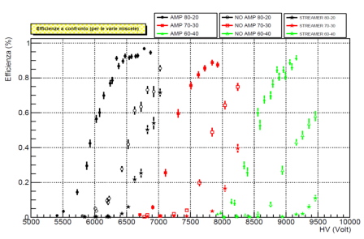
Common R&D with ATLAS
A common R&D (ATLAS+CMS) has been funded by INFN on this subject. LNF has a major role with the responsibility this task for the CMS RPC and GEM.
Testing HFO 1234ze/Ar eco-friendly gas mixtures
L. Benussi et al.,
A study of HFO-1234ze (1,3,3,3-Tetrafluoropropene) as an eco-friendly replacement in RPC detectors
E-Print: arXiv-1505.01648
Thanks to Barbara Liberti:
Univ. Roma Tor Vergata
LNF measurements: D. Piccolo et al.
21

Slide 22
Material Studies
Once identified a good candidate we have to study chemical compatibility with RPC and GEM material.
The strategy followed is two-fold, namely a static and a dynamic search.
  The static search is performed by comparing materials properties (by means of SEM-EDS, XPS, XRD, FTIR analyses) before and after exposure to candidate ecogases in standard operating conditions.
  The dynamic search consists of sampling and analysis (mass spectrography, F- and Cl- sensors) of candidate ecogases as exhausted by detectors after operation in electric fields and irradiation conditions.
Activity coordinated by Associates engineers of ENEA, Sapienza and Politecnico Torino
Joint ATLAS-CMS phase 2 R&D approved and financed by INFN

Slide 23
Conclusions
The group has grown in size
CMS Frascati group has past experience in experiment construction and QC
Relevant contribution to R&D in progress for Muon upgrade
Both construction plan and R&D plan fit well with the group size and skills
R&D and Construction timelines well syncrhonized
New resources are also contributing to simulation for Muon upgrade studies

Slide 24
2015 References
Fiber Bragg grating sensors for deformation monitoring of GEM foils in HEP detectors
L. Benussi et al. Published in IEEE Nucl.Sci.Symp.Conf.Rec. 2015
A study of HFO-1234ze (1,3,3,3-Tetrafluoropropene) as an eco-friendly replacement in RPC detectors
L. Benussi et al. e-Print: arXiv:1505.01648
Properties of potential eco-friendly gas replacements for particle detectors in high-energy physics
L. Benussi et al.. May 4, 2015. 38 pp. e-Print: arXiv:1505.00701
A novel application of Fiber Bragg Grating (FBG) sensors in MPGD
presented by L. Benussi at MPGD Trieste 2015
Candidate eco-friendly gas mixtures for MPGD
presented by G. saviano at MPGD trieste 2015
Characterization of gem foils and materials
presented by S. Muhammad at MPGD trieste 2015
Fiber Bragg Grating sensors for deformation monitoring of GEM foils in HEP detectors
presented by M. Caponero at IWAI Gallipoli 2015
Materials studies for gaseous muon detector at HL-LHC
presented by S. Muhammad at Euroforum school Strasbourg France 2015
Fibre Bragg Grating (FBG) sensors as flatness and mechanical stretching sensors
presented by S. Muhammad at Elba2015

Slide 25
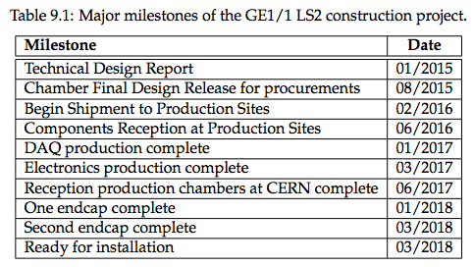
Spares

Slide 26
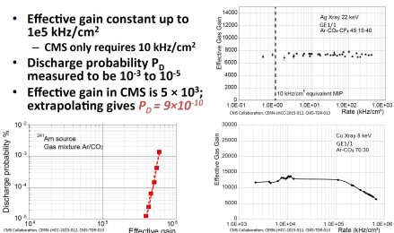
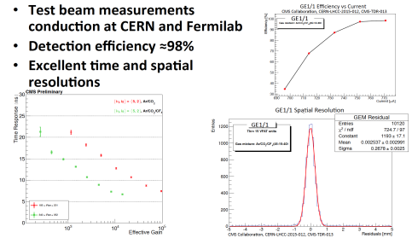
GE1/1 and R&D for Phase2
CMS GEM characteristics and performances

Slide 27
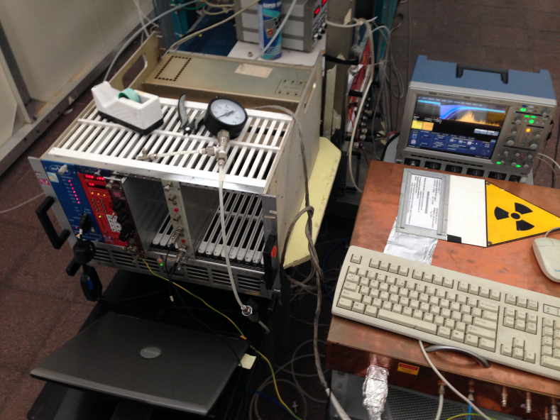
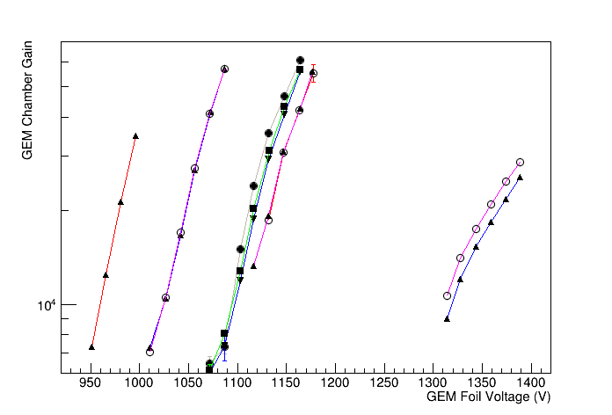
Test molecules similar to banned but with lower Global Warming / Ozone Depleting Power
(3,3,3-tetrafluoropropene HFO-1234yf , 1,3,3,3-tetrafluoropropene HFO-1234ze, 3,3,3-trifluoropropene HFO-1233zd , trifluoroiodo- CF₃i)
- Test gas compatibility with GEM and GEM materials
- Gas gain measurements for different gas mixture. studies of gas gain vs. environmental pressure and temperature for different gas mixture, Time resolution studies
Eco-friendly gas mixtures for GEM
The laboratory has environmental sensors to continuously ambient Pressure, Temperature and Relative Humidity. Sensors are also located into the gas lines to monitor P,T and RH of the gas.
10X10 cm² triple GEM chamber (3-1-2-1) using a Fe⁵⁵ or X-ray gun
Ar/CO2 80/20
Ar/CO2 90/10
Ar/CO2/CF4 45/15/40
Ar/CO2 70/30
Data are acquired by means of a 10
Giga sample oscilloscope.
Signals are analyzed offline.
Measurements have been done with standard gas mixtures to validate the system
In the beginning of May 2015 started to test Ar-HFO based gas mixtures

Slide 28
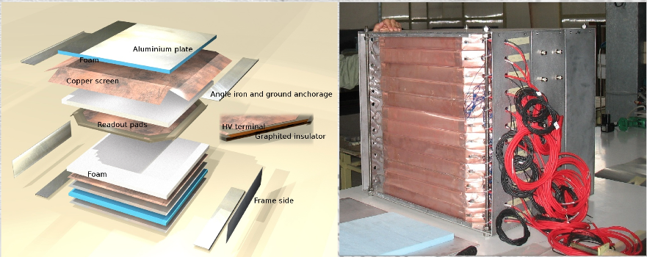
Experimental Set-up in Frascati
12 single gap RPCs, 2 mm wide gas gap
50 x 50 cm²
Double Pad readout
  partial cancellation on single mode noise
  Expected about x2 induced signal charge
Scintillator layers on top and bottom for trigger
Gas chromatograph: for gas mixture analysis
4 channels Oscilloscope lecroy104xi (5 Gsamples, 1 GHz): for signal readout
  Full digitization of signal
  By hand measurement

Slide 29

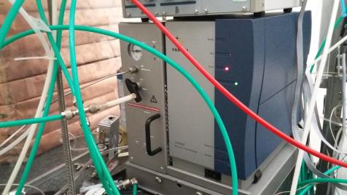
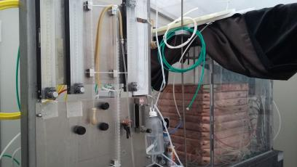
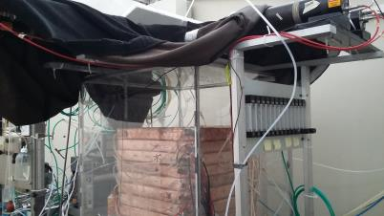
Sampling before and after RPC chambers
Gaschromatograph in-line
with RPC chambers

Slide 30
Tests at LNF laboratory
From R134a to
HFO1234ze
CO2- HFO1234ze
Based mixtures

Slide 31
RPC Phase2 Material Studies
Joint ATLAS-CMS phase 2 R&D
WP Electrodes (up to 1-2 kHz)
  Lower resistivity (< 10¹⁰) materials (HPL, glass) and thinner electrodes (< 2mm)
WP Gap and Chamber Prototypes (new configuration)
  Double- and multi-gap, smaller gap (< 2 mm), improved time resolution (100 ps), technological improvements (mechanics, gas distribution, high voltage connector and cooling)
WP Low-threshold Front End Electronics
WP Eco-friendly gas mixtures
  Search for replacements of C₂H₂F₄ (R134a) and SF₆
WP Irradiation studies
  GIF++ (aging), Frascati BTF (n/γ sensitivity), Louvain & Pavia (FEE)

Slide 32
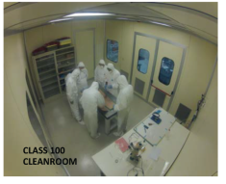
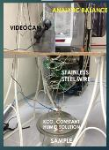

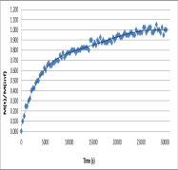

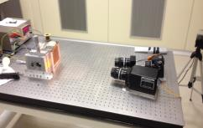
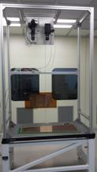
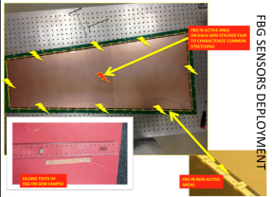
Monitoring of Deformation of GEM films
1) Characterize stretching of GEM, develop optical Moire’
based techniques for QA/QC.
2) Characterize tensile properties of materials pre- and post- irradiation
DGEM=(3.3 ± 0.1)10-­‐10 cm2/s
MOIRE` PRELIMINARY
CAMERA
RECEIVER LENS
RONCHI GRATING
PROJECTOR
STEPPING MOTOR
RONCHI GRATING
Next step Inter-calibration
between FBG and Moire
READY
Ready to start studies of stretching monitorin&tensile load characterization on GE1/1

Slide 33
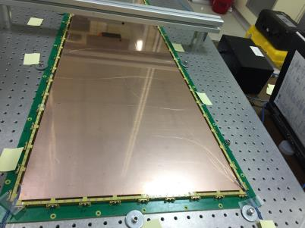
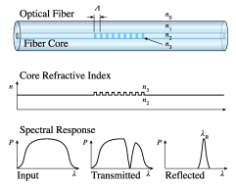
Fiber Bragg Grating applications
To validate the GE1/1 mechanical technology (Glue-Free assembly)
we used an FBG array glued on the GME foils of a real size GE1/1 prototype
Objectives:
Verify the simultaneous stretching of the foils
Quantify the applied force and verify that is still in the “Young” region
Optimization of the assembly procedure and the definition of the assembly protocol
FBG working principle:
The grating reflects only its characteristics light wave-length. If the grating is deformed the wavelength shifts.

Slide 34
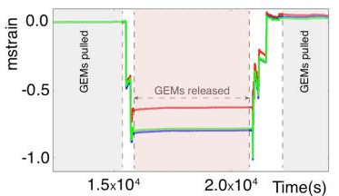
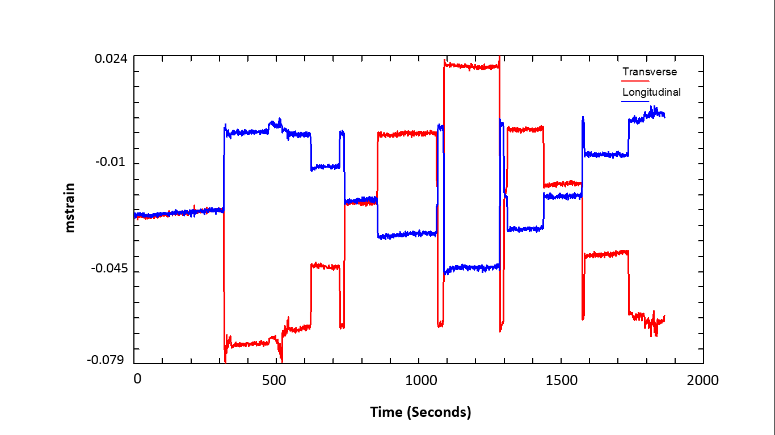
Fiber Bragg Grating applications
The sensors placed in the middle of the foils are monitored during the stretching procedure.
After the complete relaxation of the GEM stack the foils were stretched again up to the operational value.
The final position of “ALL” the FBG sensors reproduce almost perfectly the initial position before relaxation.
This demonstrate that the stretching procedure of the GE1/1 chambers act on each layer in the same way.
FBG as load gauge:
By applying different weights on a single screw (replaced by a eyelet) we measured the weight equivalent to the operational tensile load. This is necessary to tune the dynamometric screwdriver used during assembly
A=2.86 kg
B=5.65 kg
C=8.5 kg
D=11.3 kg
Initial
operational
conditions
A+B=C
A
B
D
Stretching screw
removed

Slide 35
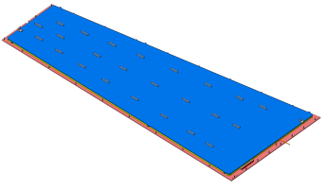
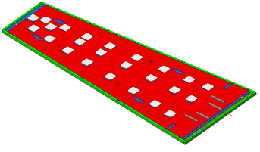
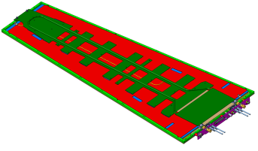
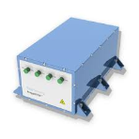
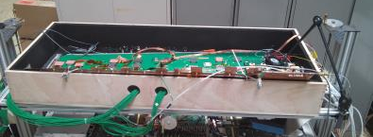
Fiber Bragg Grating applications
Temperature monitoring of GEM by use of Fiber Bragg Grating sensors
Array of FBG sensors prepared @ LNF
FBG sensors installed during GEM chamber assembly @ CERN
Test @ CERN ongoing
Step 1
Install FBGs on
Reading Board
Step 2
Mount GEB
and install FBGs
Step 3
Mount Cooling Plate
and install FBGs

Slide 36
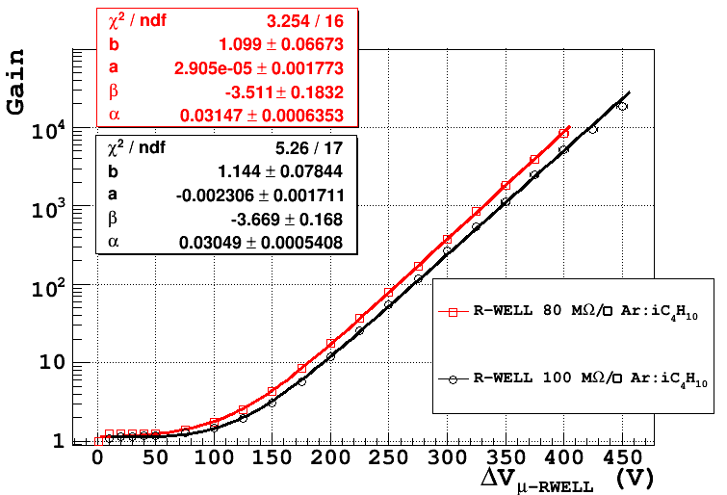
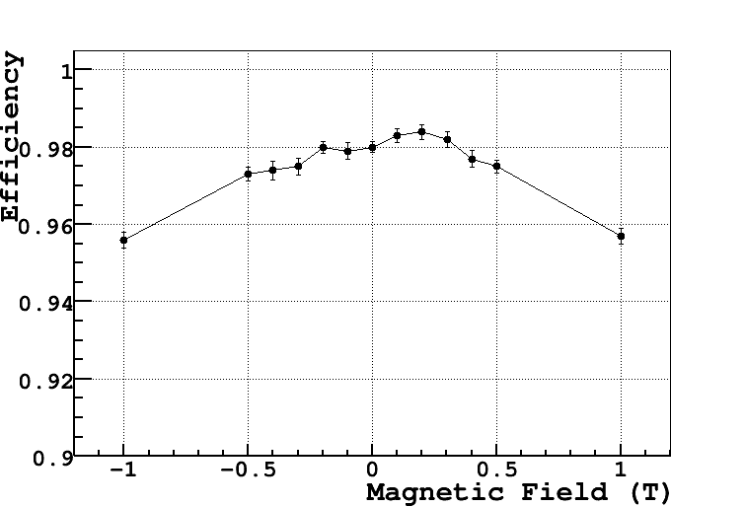
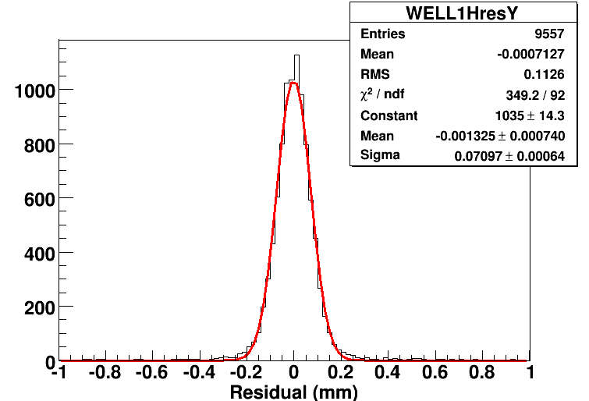
µ-RWELL performances
In collaboration with
G. Bencivenni, R. De Oliveira, G. Morello, M. Poli Lener
X-Ray Gun
GAIN UP TO 10⁴
μ-RWELL vs B (G = 4000)
σ_{RWELL} = (52+-6) µm
@ B= 0T after TRKs contribution substruction
∼98 %
Test Beam
Test Beam
Ref. To be published in NIM A, contrib ELBA conf 2015

