Slide 1
Study of CsI(tl) eltx
Pre-amp Pulse processing
Kuzim ditribution study
Eltx scheme

Slide 2
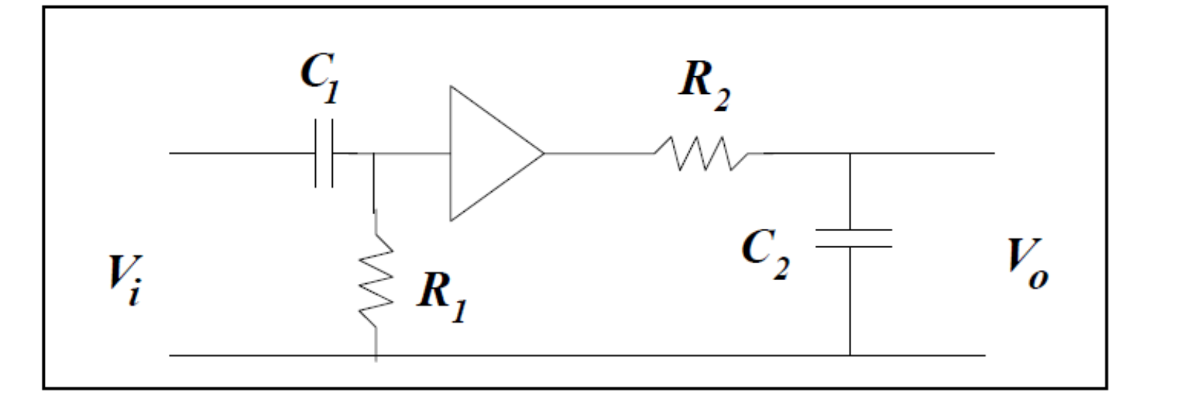
Eltx General layout
Shaper
To DAQ
It’s τ is
the main
feature of
this part of the circuit
N times
M times

Slide 3
Some theory
The output of this filter to a θ(t) is:
or
If τ₁ different from τ₂
If τ₁ = τ₂

Slide 4
Pre-amp output
Pulsing with a led
Channel 2
Channel 3
The two channel are very similar if not identical this is the output given to an approx Dirca delta (By D. Tagnani& R. De Sangro

Slide 5
Fit to the shape
τ=40 μs

Slide 6
Kuzmin parametrization 1
He assumes the scintillation charateristc energy realease time
are small with respect to pre-amp stage output (physics driven assumption)
The shaping circuit shaping time are small with respect to the pre-amp integration time. We think this assumption is correct.
Non ne sono sicuro ma:
a) 32 tic della funzione dovrebbero corrispondere a un tic dell' ADC.
b) 1 tic dell’ADC dura DT = 0.567 microsecondi (questo è sicuro)
Quindi direi che un tic della funzione dura DT / 32 = 17.7 nanosecondi
By G. De Nardo

Slide 7
Kuzmin parametrization 2
Under Guglielmo
assumption we get:
2.2*τ=300*17.7 ns
τ = 2.6 μs

Slide 8
Fit of the output shapes
2 hypothesys
1) cr-rc with different τs: fun = [2]*(x**[0])*exp(-(x)*[1])+[5]*(x**[3])*exp(-(x)*[4])
NO. NAME VALUE ERROR NEGATIVE POSITIVE
1 p0 4.25733e+00 6.10326e-06
2 p1 5.14089e-02 2.49127e-07
3 p2 -4.94500e-01 1.26221e-05
4 p3 4.25175e+00 6.10543e-06
5 p4 5.13272e-02 2.47983e-07
6 p5 5.03530e-01 1.28593e-05
EXTERNAL ERROR MATRIX. NDIM= 6 NPAR= 6 ERR DEF=1
3.725e-11 1.511e-13 2.383e-11 9.657e-12 -1.478e-13 2.418e-11
1.511e-13 6.206e-14 1.489e-13 -1.540e-13 5.325e-14 1.448e-13
2.383e-11 1.489e-13 1.593e-10 -2.372e-11 -1.530e-13 -6.866e-11
9.657e-12 -1.540e-13 -2.372e-11 3.728e-11 1.513e-13 -2.411e-11
-1.478e-13 5.325e-14 -1.530e-13 1.513e-13 6.150e-14 -1.493e-13
2.418e-11 1.448e-13 -6.866e-11 -2.411e-11 -1.493e-13 1.654e-10

Slide 9
Fit result

Slide 10
Fit Kuzmin
2) Simpler hypothesis:
fun= [2]*((x)**[0])*exp(-(x)*[1])
EXTERNAL ERROR MATRIX. NDIM= 3 NPAR= 3 ERR DEF=1
7.256e-03 4.680e-05 -1.190e-16
4.680e-05 3.059e-07 -7.653e-19
-1.190e-16 -7.653e-19 1.955e-30
FCN=327.797 FROM MIGRAD STATUS=CONVERGED 61 CALLS 62 TOTAL
EDM=7.25556e-09 STRATEGY= 1 ERROR MATRIX ACCURATE
EXT PARAMETER PARABOLIC MINOS ERRORS
NO. NAME VALUE ERROR NEGATIVE POSITIVE
1 p0 1.00777e+01 8.51800e-02
2 p1 6.98135e-02 5.53098e-04
3 p2 4.10362e-15 1.39827e-15

Slide 11
Results

Slide 12
Choice
the second Hypothesis is simpler:
The circuit is:
If R₁C₁ << τ pre-amp it derives the signal
10

Slide 13
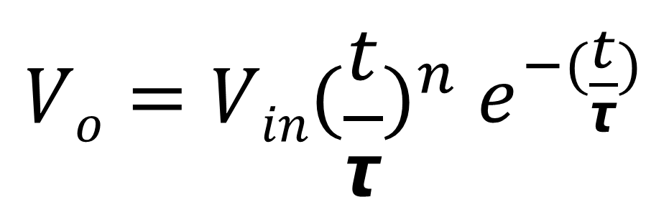
The output for that circuit is
Where the input is assumed to be a θ(t) the pre-amp output is close to it (τ=40 μs)
$$Vo=Vin{(\frac{t}{τ})}^{n} e^{−(\frac{t}{τ})}$$
P0=n=10 fit result
P1=1/τ τ= 14.32∗17.7= 250 ns fit result
P2=V_{in} (1/τ)^{n}= 4.1*10⁻¹⁵
Abbiamo un piccolo problema:
Se assumiamo che Guglielmo abbia ragione ne segue:
= 250 ns (tick da 17.7 ns).
Altrimenti:
τ = 250∗32 ns = 8 μs (tick da 17.7*32 ns).
In our case n=10

Slide 14
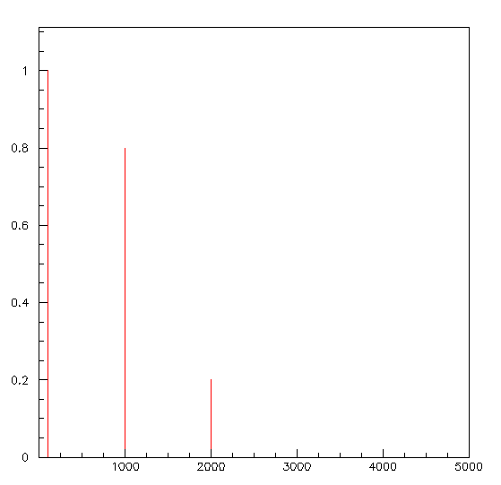
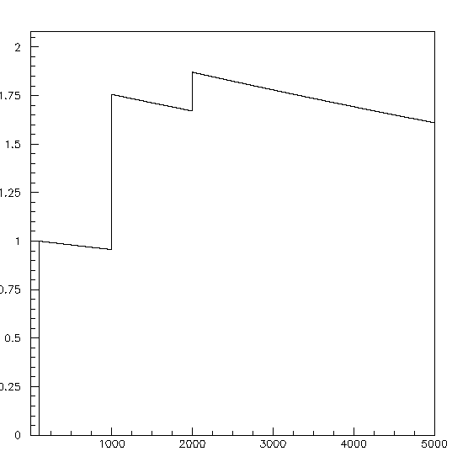
Pile up simulated studies
Input signal to pre-amp
Pre-amp output signal

Slide 15
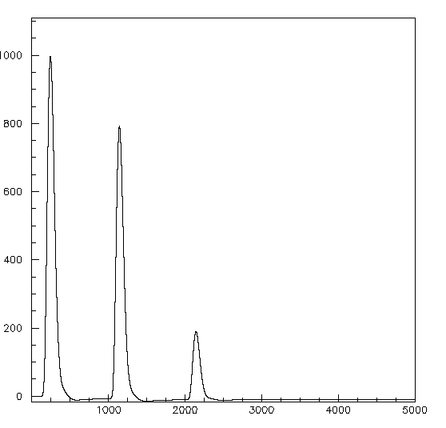
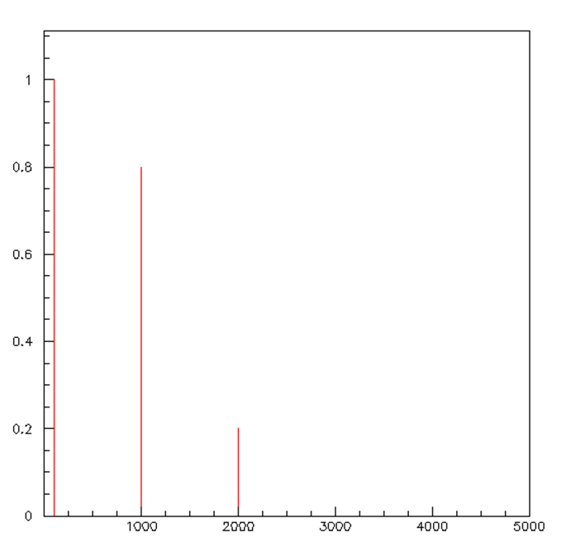
Pile –up 2
After convolution with kuzmin distribution
After the derivative of
the pre output

Slide 16
Codes
void Convolve(const double* const input,
unsigned int inputLength,
const double* const filter,
unsigned int filterLength,
double* output)
{
unsigned int i;
unsigned int j;
unsigned int lengthOfOutput = inputLength
+ filterLength - 1;
for(i = 0; i < lengthOfOutput; ++i)
{
output[i] = 0.f;
}
for(i = 0; i < inputLength; ++i)
{
for(j = 0; j < filterLength; ++j)
{
output[i + j] += input[i] * filter[j];
}
}
}
void Computederiv(const double* const input,
double* output,
int len)
{
int j;
for(j=0;j<len-1;j++)
{
output[j-1]=input[j+1]-input[j];
}
}

