Slide 1
Introduction
Guglielmo De Nardo
University of Napoli and INFN

Slide 2
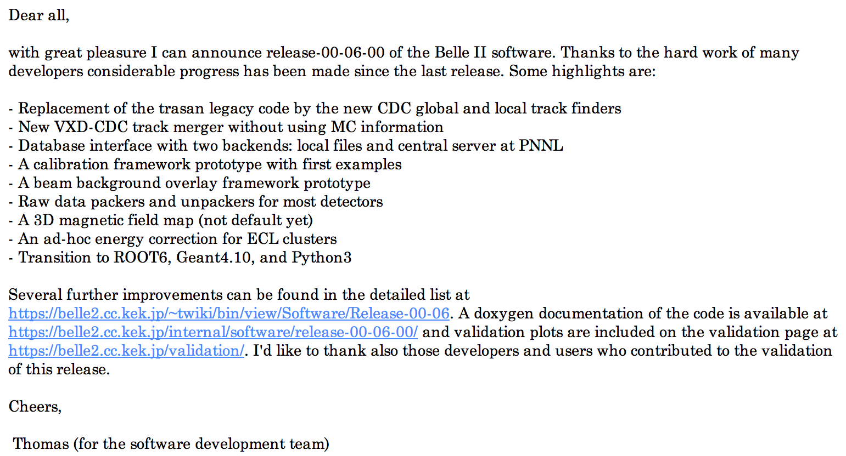
Software
Release V00-06-00 proudly announced by T. Kuhr on software mailing list on Dec 19th
→ Elisa and Eugenio talks on ecl and tracking

Slide 3
Software status
Most notable improvements
  Conditions database framework
  MC free tracking and restructuring → Eugenio
  Bias in neutral cluster energy removed
  Still timing from waveform fit not fully exploited in reconstruction of neutral clusters
    Seriously affecting physics analysis
    Should be a milestone for next release to have mature cluster reconstruction software and check immunity to background conditions

Slide 4
Physics Tools
Most of the needed Physics Tools are in place
  PID, composition of particles, decay tree Fitter, Ntuple maker ←→analysis variables, B tag reconstruction…
Development made by few people with common use cases in mind
  Completeness and correctness of the tools to be verified doing Physics with them
    This also will drive further developments

Slide 5
B2TIP
Last meeting October 28-29 2015 @ KEK
  https://kds.kek.jp/indico/event/19103/
  Very interesting contributions from theory and experiment but few detailed studies with Belle II simulation
    MC5 production was just starting
Next meeting May 23-25 2016 @ Pittsburg
  Much progress expected from Belle II physics studies
  Goal: assess physics reach of golden modes with 5 and 50 ab-1
Next next meeting Oct-Nov 2016 @ MIAPP Munich
  A first draft of the physics book should be delivered

Slide 6
MC5 production
Data produced on the GRID but copied at KEK
  Everyone can use KEK queues
  At some point we should be allowed to run on the GRID
    Technically is already possible. We miss an analysis model for that -→ discussion at Computing session today
Currently available O(100M) B+B- ,B0B0, continuum
  Good, but far from the original plan (1 ab-1)
  A fraction of requested signal also available at KEK
  https://belle2.cc.kek.jp/~twiki/bin/view/Computing/MC5Release4Physics

Slide 7
Opportunities to join Physics
Coordination of efforts with working groups regular meetings is starting.
  In addition to general software and physics meetings
  with indico pages, mailing lists
Working group | Frequency so far | Meting so far
First year Physics/Phase 2 | monthly | 9
WG1- SL and missing energy | bi-weekly | 4
Combined Performances (PID) |  | 1

Slide 8
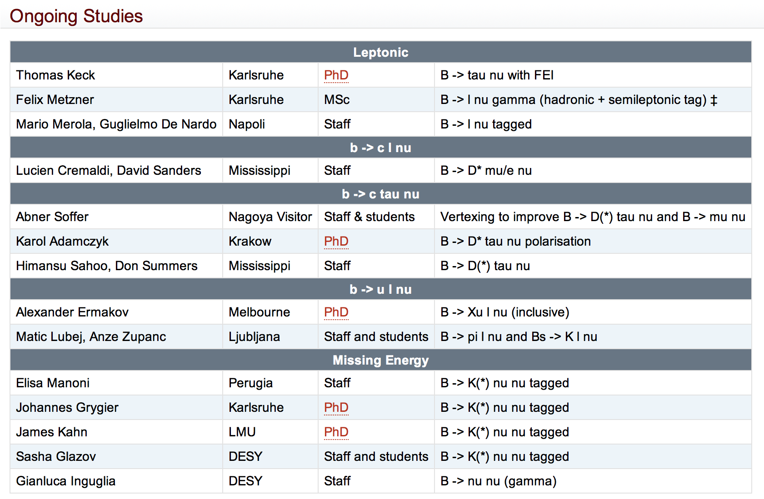
Opportunities in WG1
(Real) work started on golden modes
  B → tau nu, B → K(*) nu nu → Mario ed Elisa talks
  Many topics uncovered, lot of room for contributions

Slide 9
Opportunities
We currently active in
  Semileptonic and Missing Energy (conv. G. De Nardo)
  Charm (conv. G. Casarosa)
  TD CP violation (conv. A. Gaz)
  First year Physics
If you’d like to start an analysis, consider to join one of the above groups!
→ Giulia and Roberto talks for more details on Charm and First year
→Elisa and Mario for missing energy studies
In any case look ar Physics web page for ongoing analyses
  https://belle2.cc.kek.jp/~twiki/bin/view/Physics/Analyses

