Slide 1
Beast : Crystal Calorimeter Status Report
On behalf of the Beasts

Slide 2
(some of the beasts!)

Slide 3
Overall System
6 50x50x300 mm³ pure CsI crystals equipped with PMT readout.
6 25x25x200 mm³ pure Lyso crystals equipped with PMT readout.
6 50x50x300 mm³ CsI(tl) crystals equipped with PMT readout.
3 T+IRH sensors per BOX read by usop
DAQ eltx and sw

Slide 4
6 2 inches PMT from Photonis CsI
6 1 inches for LYSO
6 2 inches for CsI(tl)

Slide 5
Bestcsi daq
It consists of a SBC (l2moto1) running on a VME crate and of a pc (beastcsi).
SBC tasks:
VME data collection (FROM V1730s and scalers)
network data delivery
PC (beastcsi) tasks: collects data from network (from SBC and usop)
Pubblishes via epics scaler variables archives data
Everything can be driven by a java interface (for debugging reason)
or by epics (standard running procedure) A state machine has already been Implemented and it is currently used to drive the system.

Slide 6
Where are we now?
Beastcsi (pc) and l2moto1 (SBC) (192.168.10.12) have been succesfully integrated in beastmaster network (192.168.10.11)
The data acquisition program collects data from V1730s and V815s.
It writes data on the pc we’ll deliver data to the raid system as soon as possible.
The enviromental informations from usop have been integrated..
We produce rootples reading data from disk.
We pubblish the scaler variables according to P. Lewis prescriptions.

Slide 7
GUI for the user
Written in cs-studio (G. Tortona)
It drives the daq system into the
corresponding state via a click.
The states of the state machine
already match P Lewis requirements
for integration. I’ve added 3 more
States, they can be ignored at this
level.

Slide 8
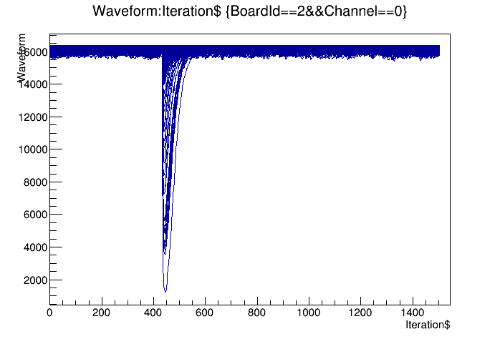
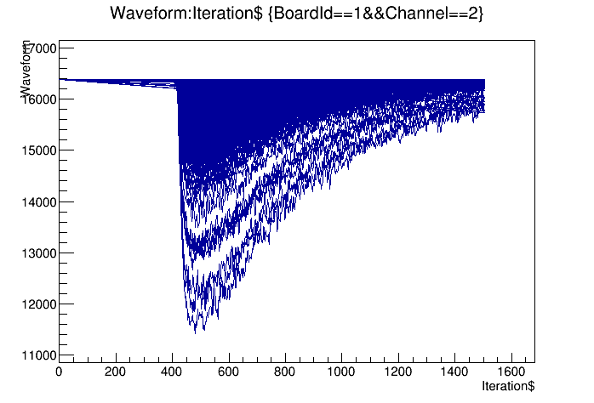
Crystal example plots
LYSO from
CsI (tl doped)
On the left side we have the LYSO waveform from the first V1730 CsI pure in the middle
while on the right side we have the CsI(tl doped) waveform from the other V1730.

Slide 9
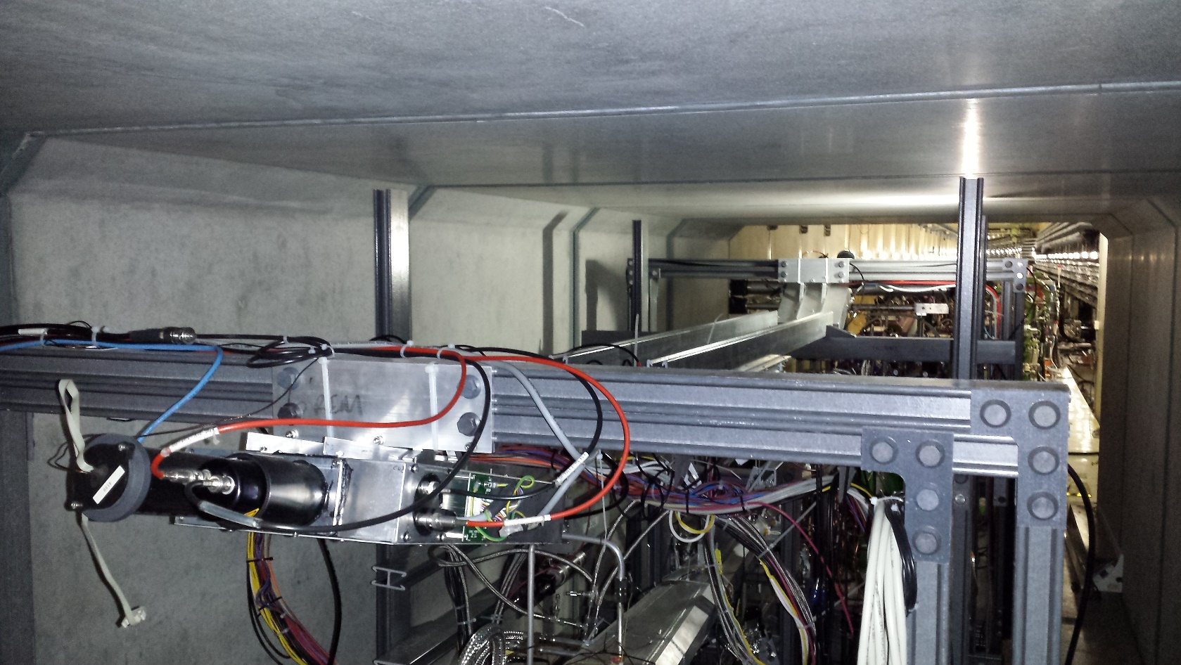
General overview: the original goals
Remove the two “top” boxes
Install remaining CsI(Tl) crystals
Close lid, check signal integrity
Calibrate!
  ¹³⁷Cs
  ⁶⁰Co
  Cosmic rays
Notes:
9

Slide 10
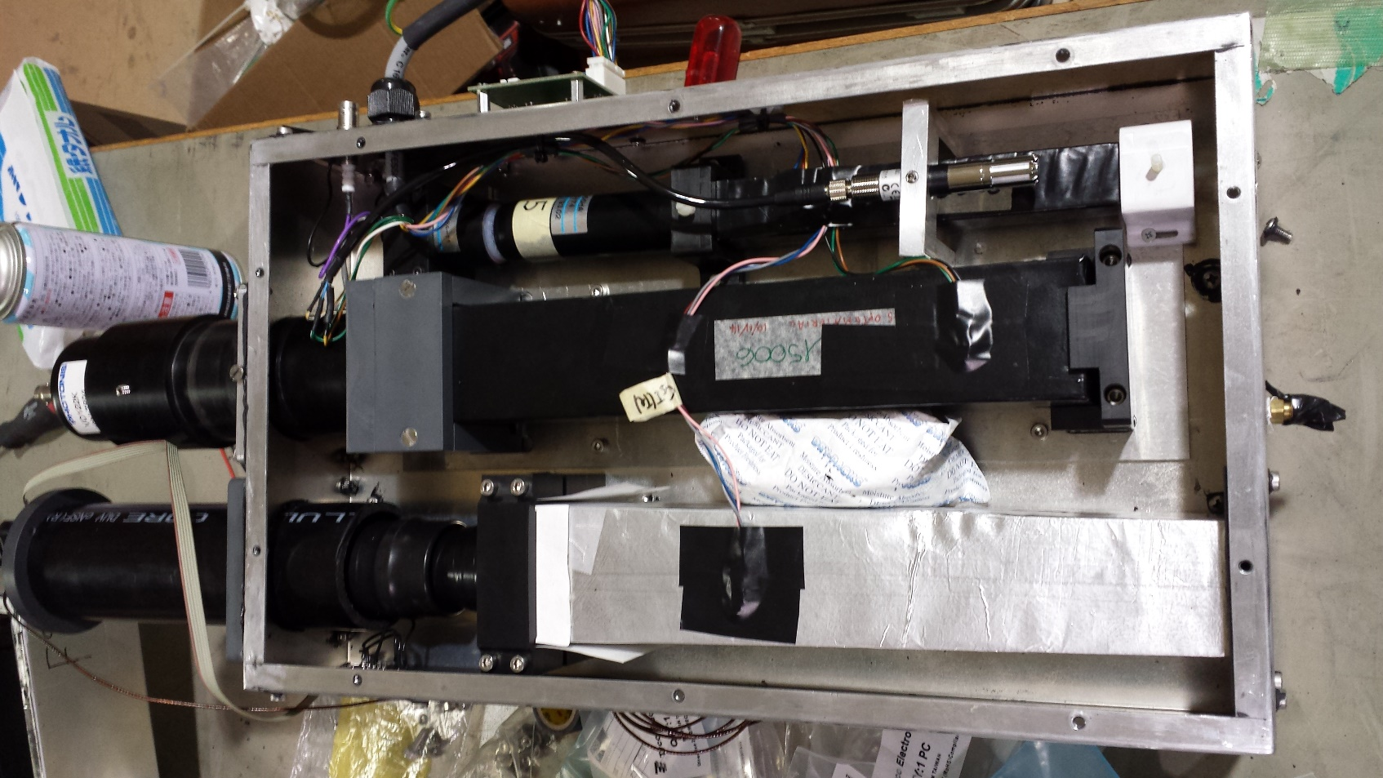
Installation of the crystals
The top two crystals are “different” (no better, no worse, just different)
  They are the best two that went under radiation hardness study
  Readout from the “right” face (left of this picture)

Slide 11
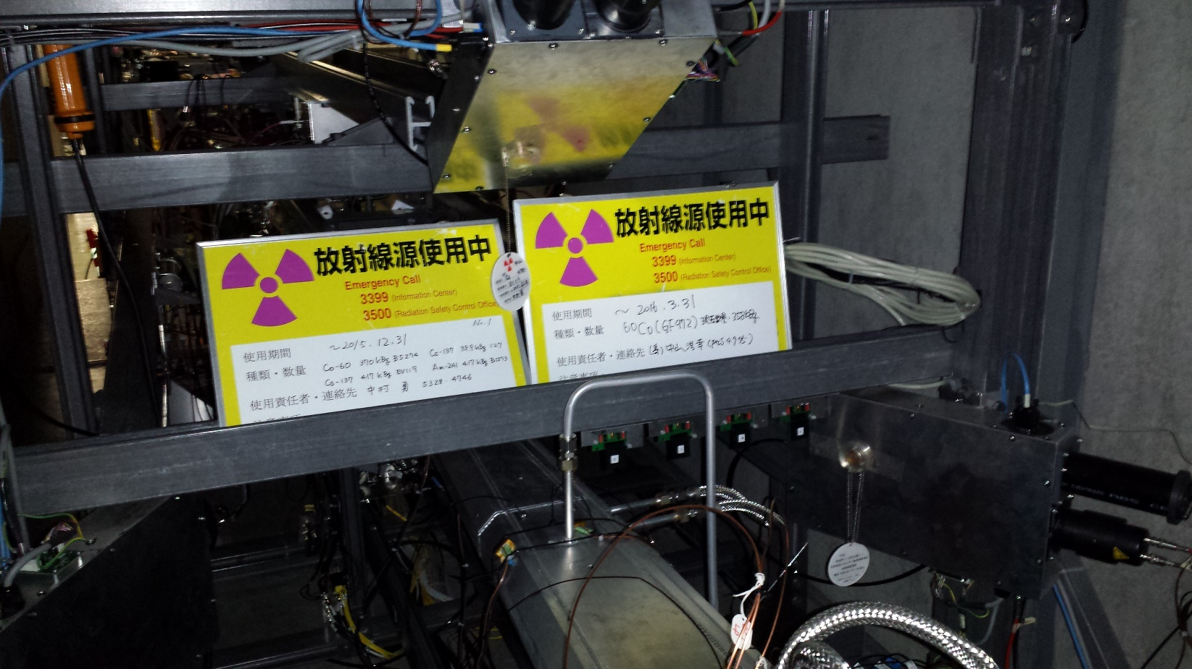
Calibration
Use two different types of sources, two different positions
  ¹³⁷Cs: one photo-peak at 662 keV
  ⁶⁰Co: two photo-peaks: 1173 keV and 1333 keV (avg. at 1253 keV)
  P1: between CsI(pure) and CsI(Tl). P2: between CsI(pure) and LYSO.
P1
P2

Slide 12
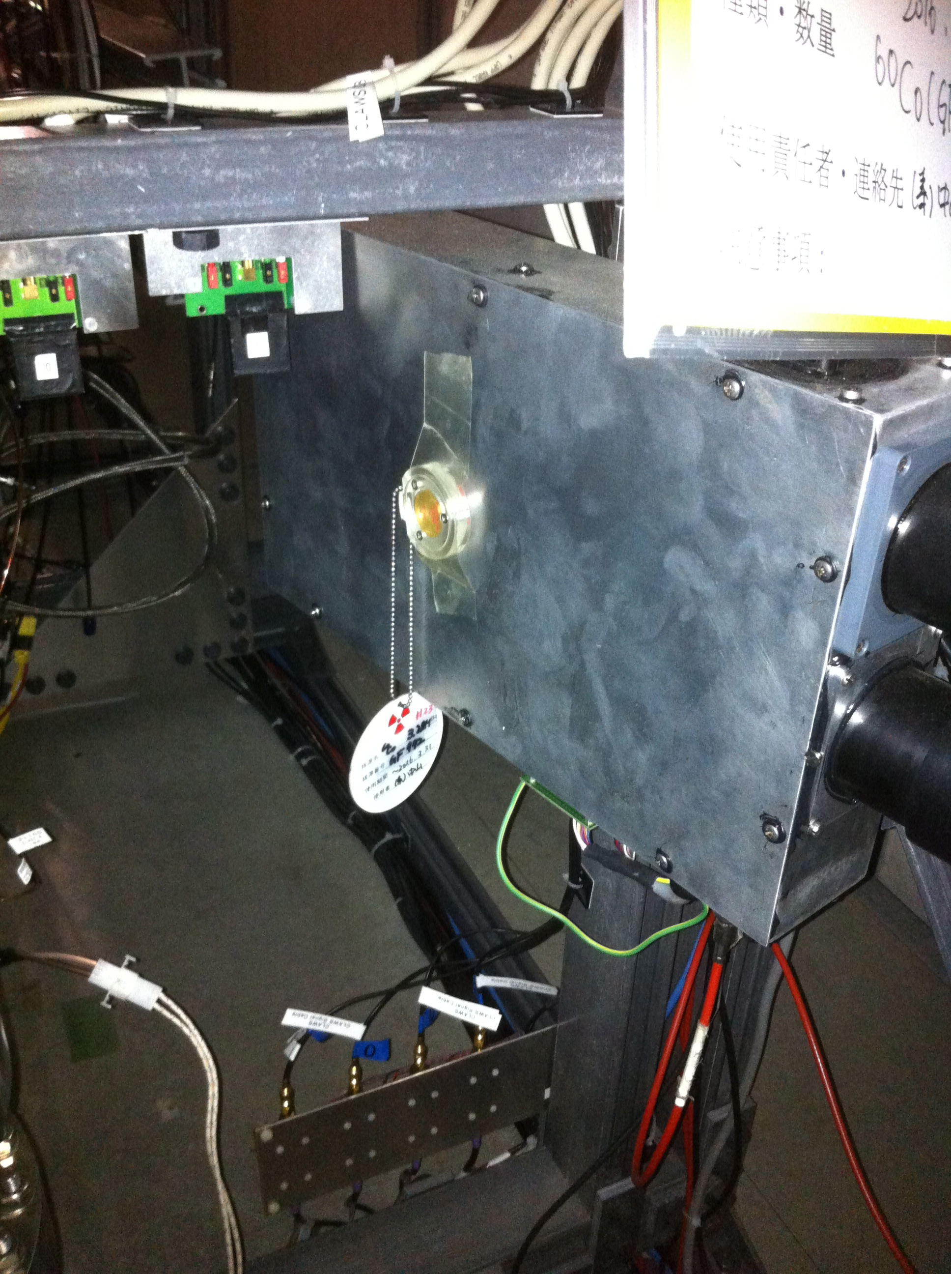
Source

Slide 13
Calibration
Also use cosmic rays (MIPs)
The MIP energy isn't exactly the same for all boxes:
  Use 30.1 MeV for the side boxes (F1,F3, B1,B3)
  30.7 MeV for F2 (which is at 13.9º w.r.t. horizontal)
  34.1 MeV for B2 (which is at 29.0º w.r.t. Horizontal)
Fits (simply using ROOT's Fit Panel):
  Gaussian for ⁶⁰Co
  Gaussian + Exponential for ¹³⁷Cs
  Landau for cosmic ray runs.

Slide 14
Calibration Sources
⁶⁰Co source
  1.17MeV photon
  1.33MeV photon
  2.5MeV both photon collected
Cosmic rays
  ~20MeV deposit
  Corrected for boxes F2 and B2 due to bending angle

Slide 15
Calibration Sources
Cs¹³⁷
Co⁶⁰
CR peak ~30 MeV

Slide 16
Calibration results (Forward)

Slide 17
Calibration results (Backward)

Slide 18
Forward Boxes
¹³⁷Cs not used due to LYSO non-linearity at low energy

Slide 19
Backward Boxes
¹³⁷Cs not used due to LYSO non-linearity at low energy

Slide 20
Calibration Curves - CsI

Slide 21
Conclusions
6 CsI (Tl), CsI and Lyso channels show expected behaviour between 0.7MeV and 30MeV
Also (not shown): pedestal run with random trigger
  Mean compatible with zero.

Slide 22
Extra material

Slide 23
Digitizer settings as entered in config. file
CsI(Tl) channels
RecordLength (samples) | 2000
PreTrigger (samples) | 1000
PulsePolarity | NEGATIVE
BaselineDCoffset (%) | 10
TriggerThreshold (LSB) | 80
TrgHoldOff (8 ns) | 250
NSBaseline (2 := 256 samples) | 2
LongGateWidth (ns) | 6200
ShortGateWidth (ns) | 1000
PreGate (ns) | 200
ChargeSensitivity (4 := 1.28pC/LSB) | 4

Slide 24
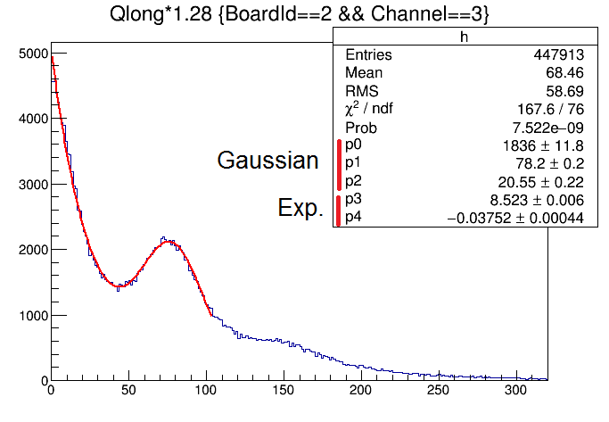
Example Cs-137 fit – Channel 3
Charge (pC)

Slide 25
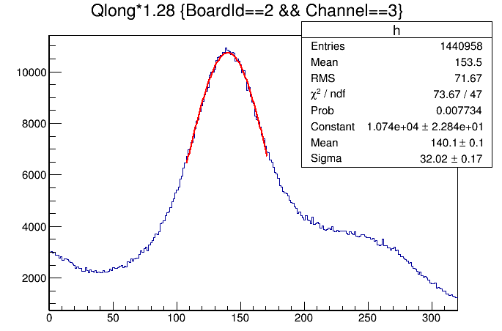
Example Co-60 fit – Channel 3
Charge (pC)

Slide 26
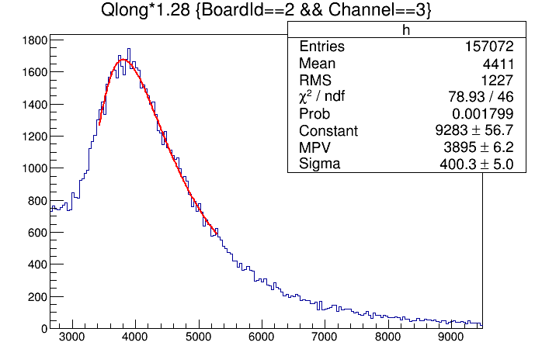
Example MIF fit – Channel 3
Charge (pC)

Slide 27
Example calibration line fit – Channel 3
Peak Energy MeV | Peak Charge pC
0.662 | 7.82E+001
1.25 | 1.40E+002
30.11 | 3.90E+003

