Slide 1
Network & Storage
Dr. Silvio Pardi
INFN-Napoli
Belle II Italia
21 December 2015

Slide 2
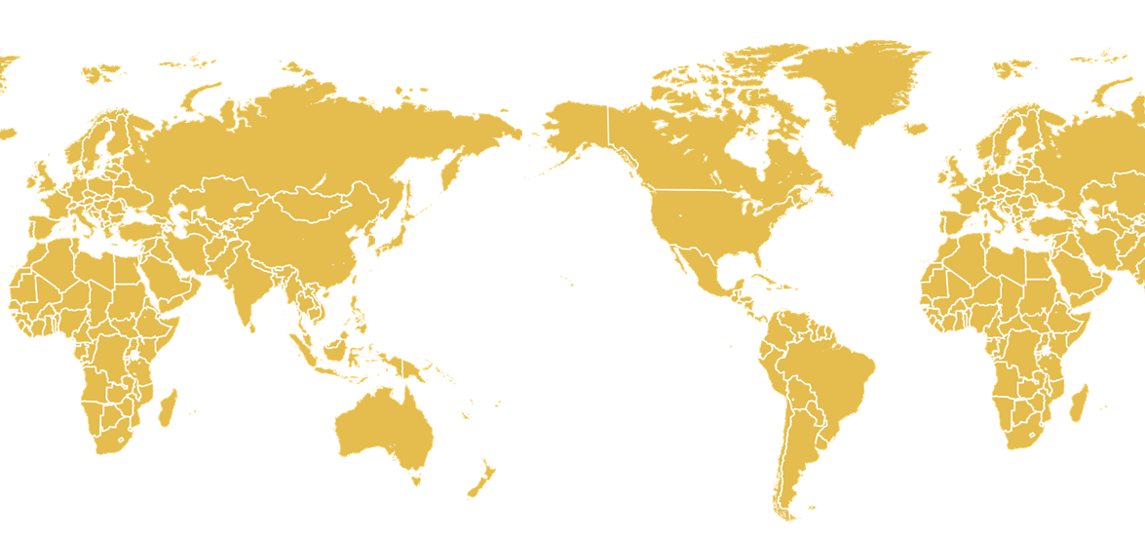
Countries Involved
Currently there are 18 Countries involved in the main data movement activities and we have 23 Storage Endpoints. (Contributing Number of Countries per region)
6
3
3
4
1
1
Australia
Austria
Canada
China
Czech Rep.
Germany
India
Italy
Japan
Korea
Mexico
Poland
Russia
Slovenia
Taiwan
Turkey
Ukraine
USA

Slide 3
Network Estimation 2016-2018
Belle II computing model has to manage several data flows, that can be classified in:
RAW DATA
MDST from Data Processing
MDST from Data Reprocessing
Monte Carlo Data
User Analysis
Each data flow has a different data distribution pattern and involves different sites.

Slide 4
RAW Data Strategy
2021-2024
2016-2020
Max 15Gbps
Max of 8 Gbps (PNNL)
Effect of the new RAW data distribution strategy

Slide 5
MDST Expected Data Flows
Grey line 2021-2024
2016-2020
IN-BOUND
OUT-BOUND

Slide 6
Monte Carlo Production (Data Challenge)
Strategy under investigation: Each MC-Site will replicate the produced data, to 2 sites of different regions: the goal is to have 3 copies of the whole MC production.
Site | Fraction %
KEK | 22,31%
PNNL | 14,46%
Korea | 4,94%
Germany | 13,01%
Italy | 12,43%
Slovenia | 2,33%
Australia | 2,91%
Canada | 2,91%
Austria | 1,74%
China | 2,62%
Czech Rep. | 1,16%
India | 3,20%
Mexico | 1,74%
Poland | 2,03%
Russia | 8,14%
Taiwan | 2,91%
Turkey | 0,58%
Ukraine | 0,58%
Site%
Site%
Site%
Site%
MC Site1
MC Site2
MC Site3
MC Site4
MC%
MC%
MC Site5
MC Site6
MC Site7
MC Site8
Site%
Site%
Site%
Site%

Slide 7
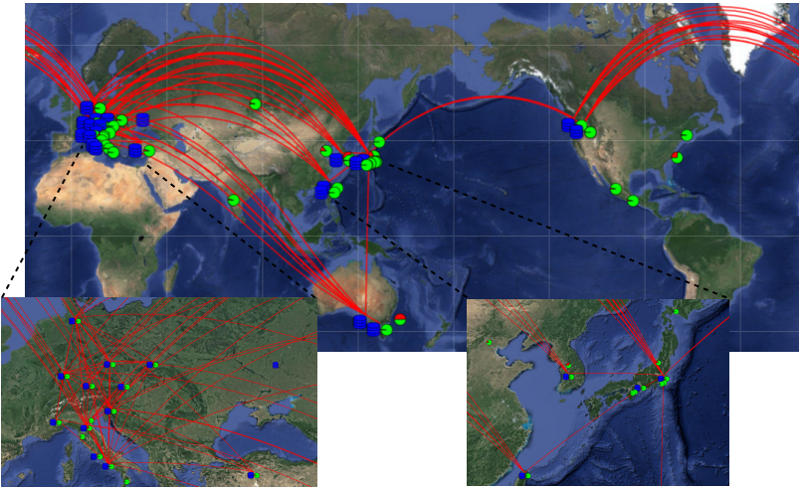
Network usage during the MC5 Campaign

Slide 8
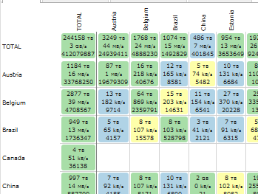
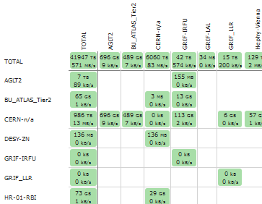
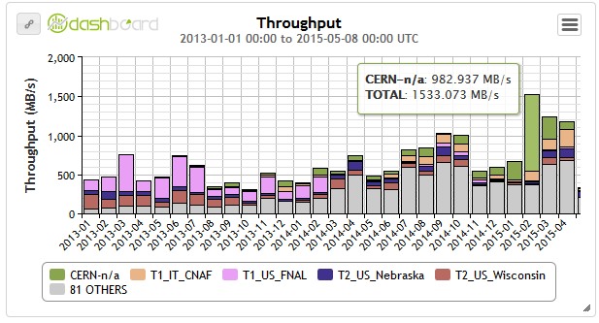
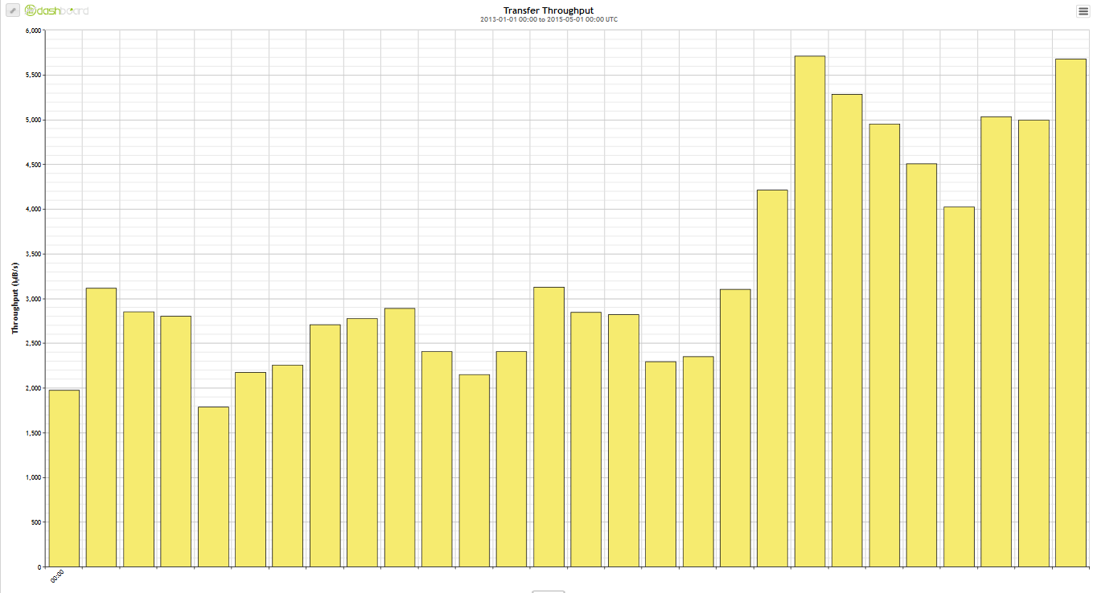
Distributed User Analysis
WLCG-FTS dash
Xrootd dash
Average throughput since 2013
3GB/s vs 571MB/s
Comparison between WLC-FTS dash and the xrootd dash of the CMS experiment
Form a first and fast analysis seem that the whole xrootd activity (that we can mainly attribute at the distributed analysis) introduce an additional 15% of traffic to respect FTS data movement.
In this work this value as been used as “rule of thumb” to estimate User Analysis incidence on the whole traffic. A more fine estimation will be complete after 2016
Peak of 1.5GB/s
6GB/s

Slide 9
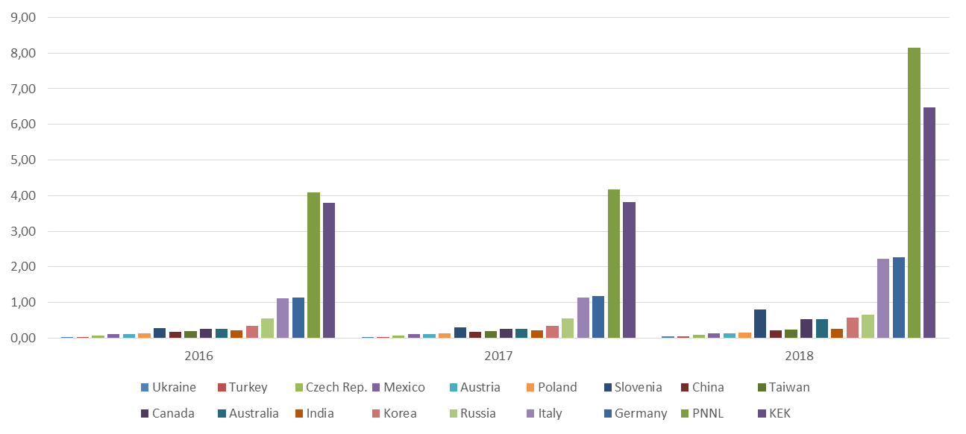
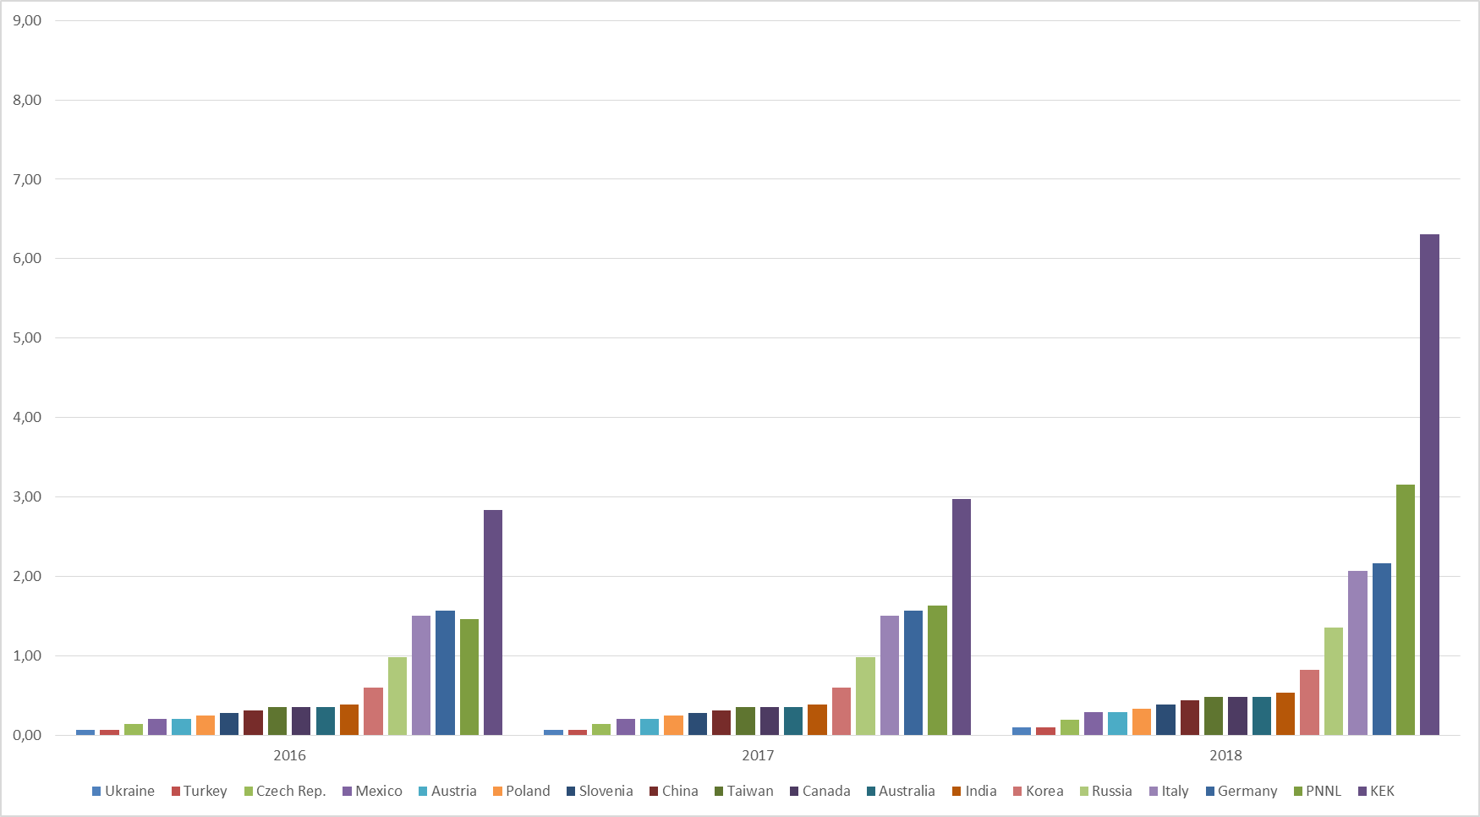
TOTAL IN-BOUND for 2016-2018
Peaks :8Gbps PNNL
6.5 Gbps KEK
TOTAL OUT-BOUND for 2016-2018
Peaks: 6.5 Gbps KEK, 3Gbps PNNL, 2Gbps Germany and Italy

Slide 10
SINET4

Slide 11
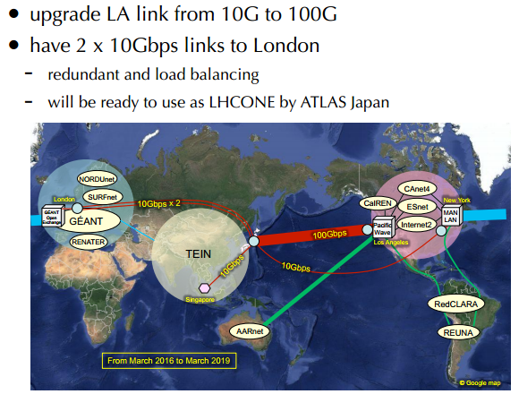
SINET5 - 2016

Slide 12
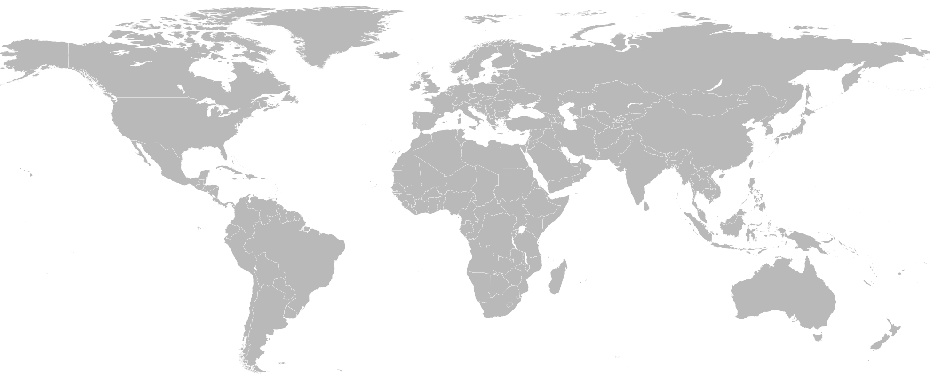
Belle II worldwide network paths
100G
20G
40G
LON
AMS
10G
2x100G
100G
PAR
GEN
BOS
100G
NYC
100G
MAD
LAX
WDC
TOK
10G
MUM
10G
10G
SG
Primary route
Backup route

Slide 13
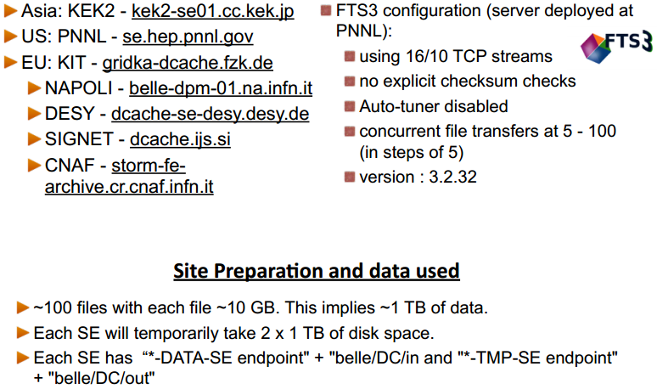
Data Challenge 2015: GRID Sites & FTS

Slide 14
Data Challenge 2015 Summary (I Phase)
 | 2018 | 2024 | 2015 Data Challenge Results | Comment
KEK➔PNNL | 4 Gbps | > 12 Gbps average | ~4Gbps Spikes at 9 Gbps | Result from gsiftp Network tuning required
KEK ➔ SIGNET | 0.5Gbps | 1 Gbps average | 0.8 Gbps (high success rate) 2.4 Gbps (low success rate)
KEK ➔ NAPOLI | 1 Gbps * | 5 Gbps/2* | 3 Gbps | 3 Gbps with appropriate load. Higher bandwidths may be possible
KEK ➔ KIT | 1 Gbps * | 5 Gbps/2* | 3.5 Gbps
KEK ➔ DESY | 1 Gbps * | 5 Gbps/2* | 3.0 Gbps
* Equal site splitting in country

Slide 15
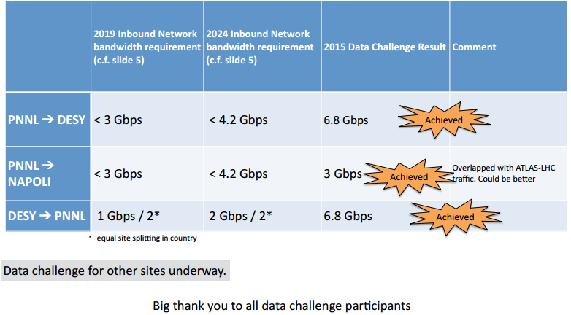
Data Challenge 2015 Phase II: Summary
PNNL->CNAF
First test ~700MB/s
Test with CNAF
Still ongoing
V. Bansal - Belle-2 Network Meeting @ SC15
“Results and plans for Belle II Networking and Data Challenges”

Slide 16
Storage

Slide 17
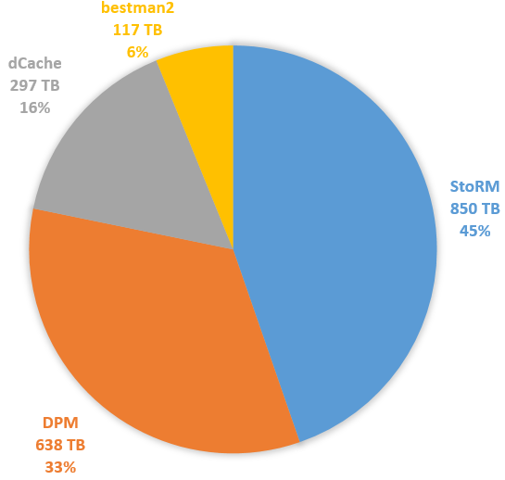
Current Storage Elements
30 Storage currently working
Backend Type:
5 DISET
2 xroot
10 DPM
6 dCache
6 StoRM
1 bestman2
Reserved disk space for BELLE: 1.9 PB ~30% used
Capacity for storage Type
23 SRM

Slide 18
Ongoing certification procedure
For each SE we are testing:
The presence of BELLE Space Token
The presence of the following directory structure and ACL settings
/belle/ (Role=Null R-X, Role=production/lcgadmin RWX)
/belle/DATA (Role=Null R-X, Role=production/lcgadmin RWX)
/belle/TMP (Role=Null RWX, Role=production/lcgadmin RWX)
We open a TEAM Ticket on GGUS for each site affected by misconfigurations

Slide 19
HTTP Deployment Task Force
All the pieces are now in place for HEP exploitation of the HTTP protocol.
Atlas and LHCb (at least) are developing their HTTP infrastructures.
The majority of storage systems are able to offer an HTTP interface.
ROOT support is available via davix, and studies have shown that this can allow HTTP to reach a performance comparable with that of the xroot protocol.
At the moment there are many site misconfigurations and instabilities which could be tracked and fixed at the WLCG level for all experiments

Slide 20
GridFTP with redirection
Disk node
Disk node
Head node
FS
FS
DB
DMLite
RFIO
DMLite
DMLite
GridFTP
GridFTP
Globus IPC
GridFTP
SRM
GridFTP (data)
GridFTP (control)
GridFTP (data)
SRM
(only if you really need to)
It is fully supported by FTS3 and gfal2-util CLI
It is seen as the most useful way of deploying GridFTP with DMLite-based storage
It renders SRM (along with its overhead) unnecessary for most typical use cases
Client

Slide 21
Http Testing infrastructure for Belle II
Sta per iniziare una sperimentazione per l’utilizzo di http in belle II.
Verificare che il software di belle II sia in grado di utilizzare http o individuare le modifiche necessarie.
Selezionare un set di Storage Element configurati con Http che possano essere monitorati dalla Http-TaskForce.
Gli storage saranno inseriti in una federazione http di test.
A breve invierò una call for interest per collezionare I siti che sono interessati a partecipare alla prima sperimentazione.

Slide 22
Thank you

Slide 23
Backup

Slide 24
Belle II User analysis strategy in testing
Options for Physics skims from bulk MDST
Output Physics Object + MDST (μDST)
Direct copy to WN using DIRAC
Stream data using XRootD
Output Index file which point to skimmed events
Access bulk MDST directly via root on large cluster
Stream from bulk MDST using XRootD
Local Cluster/Workstation root
The set of possible options for user analysis currently under investigation, includes xrootd-based strategies

Slide 25
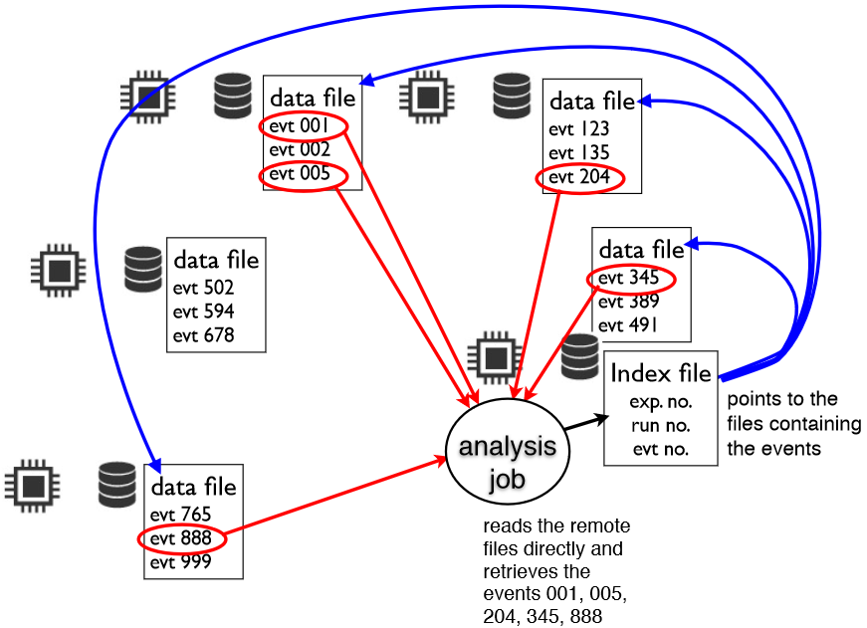
Belle II analysis model with Index file
Data is analyzed on remote WN. Only selected Events transferred.
Ongoing tests in order to test the whole chain, the gbasf2 support and performances with xrootd.
Storage considered for the ongoing tests
Storage | Type
b2se.mel.coepp.org.au | DPM
coepp-dpm-01.ersa.edu.au | DPM
belle-dpm-01.na.infn.it | DPM
dcache.ijs.si | dCache
KEK | StoRM

Slide 26
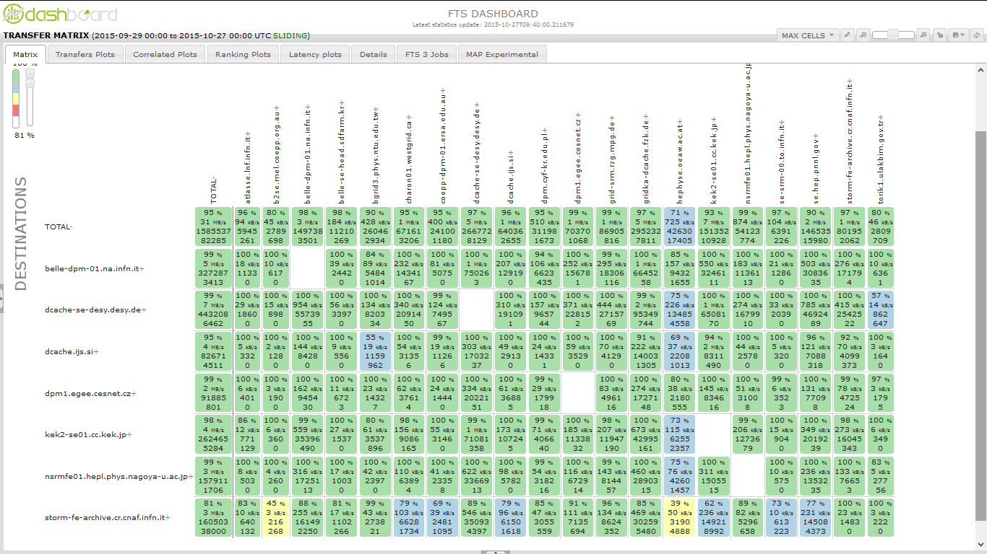
Network usage during the MC5 Campaign
In the ongoing MC5 production we are managing about 50K transfer jobs for day, involving an increasing number of sites.

Slide 27
Network usage during the MC5 Campaign

Slide 28
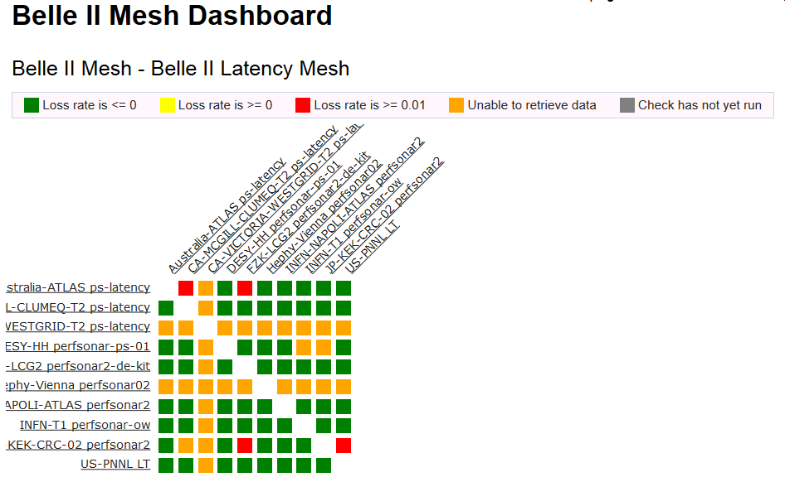
perfSONAR dashboard

Slide 29
perfSONAR dashboard

Slide 30
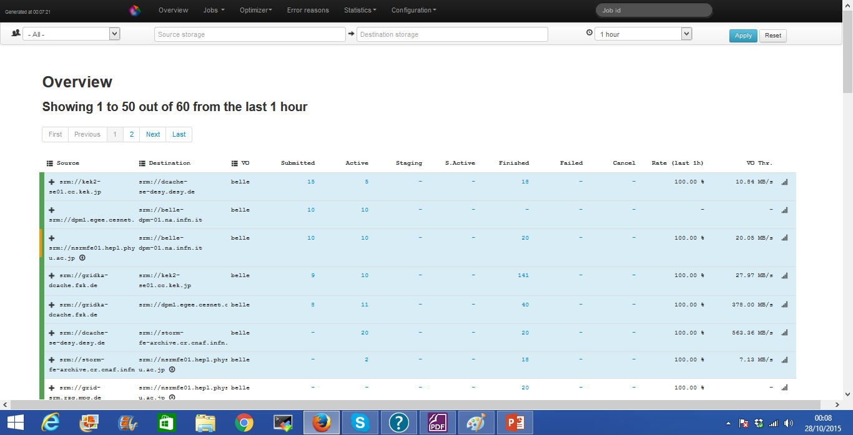
FTS3 Dashboard

Slide 31
RAW Data
Involved sites
RAW data are produced at KEK and replicated at PNNL
After 2020 the second RAW data copy will be distributed in additional sites: Italy, Germany, Canada, Korea, and India.
100%
100%
KEK
Until 2020 100%
PNNL
30%
AFTER 2020
ITALY
GERMANY
CANADA
KOREA
INDIA

Slide 32
MDST from Data Processing 2016-2018
MDST will be produced during data taking ad KEK and PNNL and then moved to other countries with the goal to have 3 full copy of processed data (Asia, USA, EU). (network transfer) After 2020: Italy, Germany, Canada, India and Korea will participate at the Raw Data processing.
100%
100%
40%
60%
60%
40%
KEK
40%
PNNL
60%
ITALY
GERMANY
SLOVENIA
CANADA
AUSTRALIA

Slide 33
Reprocessed Data 2016-2018
Data reprocessing will be performed at PNNL (100%) and then replicated in other countries in order to have 3 full copy.
100%
100%
KEK
100%
PNNL
ITALY
GERMANY
SLOVENIA
CANADA
AUSTRALIA

Slide 34
Monte Carlo RAW DATA 2016-2018
Two copies of RAW Monte Carlo Data, one in KEK and one in PNNL
100%
100%
MC%
MC%
MC%
MC%
KEK
MC%
PNNL
MC%
MC%
MC%
MC Site1
MC Site2
MC Site3
MC Site4
MC Site5

Slide 35
Monte Carlo Analysis 2016-2018
MC%
MC%
MC%
MC%
MC Site1
MC Site2
MC Site3
MC Site4
100%
MC%
MC%
MC%
MC%
MC%
KEK
MC%
PNNL
the goal is to have 3 full copies of processed MC.
MC%
ITALY
GERMANY
SLOVENIA
CANADA
AUSTRALIA

