Slide 1
TECHNICAL DIVISION ACTIVITIES
COMMISSIONE DI VALUTAZIONE DEI LABORATORI
Frascati October 7-8th, 2015
Ugo Rotundo

Slide 2
TECHNICAL DIVISION ACTIVITIES SUBJECTS
DTSG’s (Divisione Tecnica e Servizi Generali) GENERAL DUTIES
DTSG’s OBS (ORGANIZATION BREAKDOWN STRUCTURE)
OVERVIEW OF DTSG DEPARTMENTS’ ACTIVITIES
DTSG’s PROJECTS OF INTEREST
PLANS AND BUDGET

Slide 3
TECHNICAL DIVISION ACTIVITIES DTSG’s GENERAL DUTIES
According to LNF-INFN General Regulation dated October 25th 2011, DTSG’s duty is to support Frascati National Laboratories (LNF-INFN) statutory activities by means of provision of:
Management, Operation & Maintenance of LNF infrastructures and utility facilities owned by the Laboratories.
Design and engineering services for research and development activities; procurement and warehouse services; general services.
Project Management for erection of new facilities and infrastructures located at LNF site and/or upgrading of the existing ones.
Engineering services (project management, procurement and engineering disciplines expertise) to support the development and implementation of LNF-INFN domestic and international projects.
These duties are satisfied by means of the following organization.

Slide 4
TECHNICAL DIVISION ACTIVITIES DTSG’s ORGANIZATION STRUCTURE

Slide 5
TECHNICAL DIVISION ACTIVITIES OVERVIEW OF DTSG’s DEPARTMENTS ACTIVITIES
CIVIL WORKS DEPT.
The Civil Works Dept. supervises civil engineering projects (feasibility studies, PM, Acceptance Test); manages routine maintenance and improvement projects for buildings and other infrastructure.
Manning:
3 people, 1 time-based contract

Slide 6
TECHNICAL DIVISION ACTIVITIES OVERVIEW OF DTSG’s DEPARTMENTS ACTIVITIES
GENERAL SERVICES DEPT.
General Services Dept. is in charge of the LNF and INFN Central Administration general services (mainly subcontractors management) such as:
Bar/Canteen LNF, Cleaning Service, Security Service, Landscaping Service, Porterage, Reuse of discarded furniture, Coffee breaks and lunches, Rat and pest control, Purchase of hygienic materials and rental of no-dust carpets, Work clothes purchasing and laundry, Drink water dispensers rental, Microbiological analyses of LNF bar food & equipment, Lease, insurances, maintenance and documentation of LNF vehicles, Support to scientific secretariats in the organization of events, Liaising with the City of Frascati for licenses, authorizations and taxes, Liaising with the ENEA Frascati Center, Public tenders for large service contracts.
Manning:
2 people on staff (1 close to retirement)

Slide 7
TECHNICAL DIVISION ACTIVITIES OVERVIEW OF DTSG’s DEPARTMENTS ACTIVITIES
CENTRAL STORES AND PURCHASING DEPT.
The Central Stores and Purchasing Dept. supervises the purchasing and storing of goods of the Central Stores as well as those of the Metals Stores, and incoming and outgoing materials. The LNF, the Central Administration and some INFN Sections and groups have access to the LNF Stores. The Dept. carries out market researches upon request of the users for the extension and upgrade of the items in stock, maintains quality standards of stored items, and performs maintenance and updating of their electronic records, including the online General Catalogue database for the general users. Routine activities, include mail handling services and management of small handling equipment such as the fork lift and small office equipment.
Manning:
7 people on staff (2 close to retirement)

Slide 8
TECHNICAL DIVISION ACTIVITIES OVERVIEW OF DTSG’s DEPARTMENTS ACTIVITIES
MECHANICAL DESIGN & CONSTRUCTION DEPT.
The Mechanical Design & Construction Dept. (SPCM):
designs, builds, installs, verifies the dimensions of, and performs structural calculations for mechanical components and for particle detectors for experimental apparata;
designs, builds, installs, verifies the dimensions of, and performs structural calculations for mechanical components and apparata for accelerator physics;
purchases and stocks mechanical components, tools, and general purpose goods for the mechanics workshop.
Manning:
8 people, 6 staff (2 close to retirement with loss of competencies for retirement); 2 time-based contract

Slide 9
TECHNICAL DIVISION ACTIVITIES OVERVIEW OF DTSG’s DEPARTMENTS ACTIVITIES
ELECTRIC SYSTEMS DEPT.
The Electric Systems Dept.:
develops, designs, builds, and manages electrical systems for the accelerators and civil infrastructure of the Laboratories;
manages the telecom system of LNF and AC;
Dept. head also ENERGY MANAGER for LNF;
the staff ensures early intervention in case of failure, and cooperate with other depts for all electrical issues;
collaborates in the operation of the accelerators.
Manning:
7 people, 6 staff; 1 time-based contract

Slide 10
TECHNICAL DIVISION ACTIVITIES OVERVIEW OF DTSG’s DEPARTMENTS ACTIVITIES
HVAC DEPT.
The HVAC Dept.:
develops, designs, builds and manages cooling and HVAC systems for the accelerators and civil infrastructures of the Laboratories;
the staff ensures early intervention in case of failure, and cooperate with other depts for “fluids” related issues;
collaborates in the operation of the accelerators.
Manning:
6 people, 4 staff (loosing competencies for retirement); 2 time-based contract

Slide 11
TECHNICAL DIVISION ACTIVITIES DTSG’s PROJECTS OF INTEREST
LNF IN HOUSE PROJECTS
DTSG is in charge of project management for erection of new facilities and infrastructures located at LNF and/or upgrading of the existing ones.
Big effort has been made to improve the Accelerators (DAFNE & SPARC) up-time by means of:
Dafne ancillary control system revamping, aimed to increase the reliability and the efficiency (2013-2014)
BTF cooling by LINAC system, formerly by DR system (beginning 2013)
Sparc ancillary control system revamping, aimed to increase the reliability and the efficiency (2012-2013)

Slide 12
TECHNICAL DIVISION ACTIVITIES DTSG’s PROJECTS OF INTEREST
LNF IN HOUSE PROJECTS 2
Other LNF in house projects currently in progress, or recently closed are:
Energy saving spread activity, both in the civil and in the accelerator field: Heat recovery, substitution of old boilers for heat pumps (started beginning 2013), cooling plant optimization & heat recovery for buildings’ heating
LNF Data Centre expansion (ended middle 2013)
Feasibility study for the realization of a Visitors’ Centre (2015)

Slide 13
TECHNICAL DIVISION ACTIVITIES DTSG’s PROJECTS OF INTEREST
LNF-INFN DOMESTIC AND INTERNATIONAL PROJECTS
DTSG is providing engineering services (project management, procurement and engineering disciplines expertise) to support the development and implementation of LNF-INFN national and international projects currently in progress.
CUORE
JEM-EUSO
ELI-NP
XPR (CNAO)
PED4PV

Slide 14
TECHNICAL DIVISION ACTIVITIES DTSG’s PROJECTS OF INTEREST
CUORE & JEM-EUSO
DTSG’s SPCM bears direct responsibility in:
design, production, construction and installation of CUORE (Cryogenic Underground Observatory for rare Events) at LNGS for the study of Neutrinoless Double Beta Decay (engineering coordination and integration of the whole experimental apparatus)…

Slide 15
TECHNICAL DIVISION ACTIVITIES DTSG’s PROJECTS OF INTEREST
JEM-EUSO
… and of JEM-EUSO (Extreme Universe Space Observatory) to be installed aboard the International Space Station or a satellite for the study of Ultra High Energy Cosmic Rays (photo detector module and focal surface layout and mechanics).

Slide 16
TECHNICAL DIVISION ACTIVITIES DTSG’s PROJECTS OF INTEREST
ELI-NP
The DTSG supports the design, construction and commissioning of the Extreme Light Infrastructure for Nuclear Physics, to be installed in Magurele, Bucharest – Romania.
DTSG Depts. involved with direct responsibilities are:
CW collaborating for space management and plants integration;
ES & COOLING WP leaders for electrical and cooling plants

Slide 17
TECHNICAL DIVISION ACTIVITIES DTSG’s PROJECTS OF INTEREST
XPR @ CNAO
Several DTSG’s people are involved in the realization of the new Experimental Radiation Facility at CNAO premises, sharing with CNAO people the responsibility for the tasks relative to Vacuum, Electrical Installations and Cooling & HVAC plants.

Slide 18
TECHNICAL DIVISION ACTIVITIES PLANS AND BUDGET
DTSG’s HIGHLIGHTS
Total manpower @ October 7th 2015, 38 people (6 time-based contracts)
DTSG’s total expenditure for Services and Materials @2014: 4,5 M€
DTSG’s for inhouse requirements: 1,3 M€
DTSG’s for fixed LNF services contracts: 2,4 M€
Fundings from other Divisions: 0,8 M€

Slide 19
TECHNICAL DIVISION ACTIVITIES PLANS AND BUDGET
BUDGET 2015 BREAKDOWN [k€]
Spese generali | 35
Edilizia | 325
Servizi Generali | 250
Magazzini e Approvigionamento | 70
Progettazione e costruzioni meccaniche | 70
Impianti elettrici | 240
Impianti a fluido | 330
Totale | 1320

Slide 20
TECHNICAL DIVISION ACTIVITIES PLANS AND BUDGET
DTSG’s OUTLOOK
In a mid term projection (2-5 years) DTSG will loose more than 40% (11 staff in the next 5 years) of its original (49) manpower since its foundation in 2009. DTSG will loose manpower, knowledge and know-how obliging DTSG to somehow redistribute the workload among the remaining DTSG people and in some cases with no chance to replace them because of lack of competencies (Metrology unit for instance is already not anymore manned since mid 2012).
Overall, in the coming years DTSG will be not able anymore to provide LNF current volume of core activities with the support and services so far supplied.

Slide 21
TECHNICAL DIVISION ACTIVITIES PLANS AND BUDGET
MITIGATION ACTIONS
The replacement of dismissed (and/or to be) personnel is not a viable solution mainly due to national regulation, explicitly forbidding hiring of technicians (up until mid 2016). Moreover the preservation of lost knowledge and know-how would have required more resources and middle/long term planning.
In order to avoid to affect in the coming years statutory LNF activities there are only two possible mitigation actions on medium/short term basis.
Review of LNF resources and organization trying to optimize and redistribute in house existing human resources, if any, according to the requirements of statutory LNF activities
Outsourcing of required resources as much as possible if available in the italian and international market (but loosing the capability of early intervention)

Slide 22
SPARE SLIDES

Slide 23
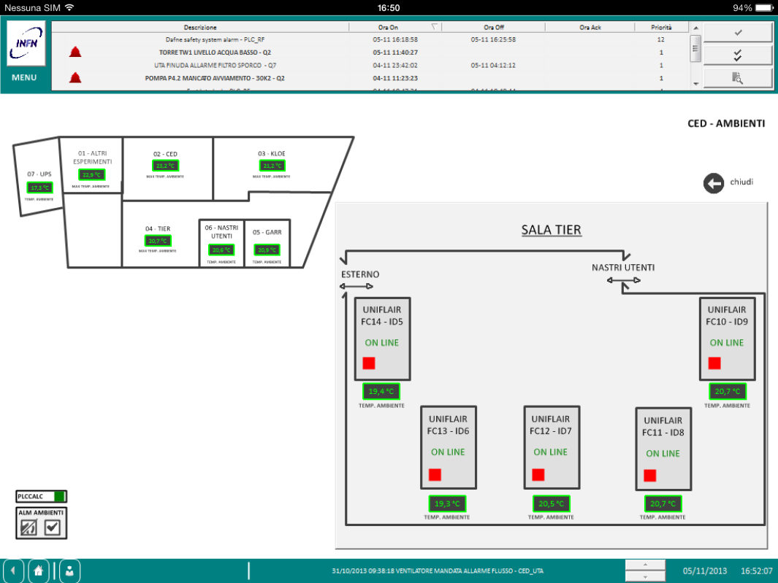
LNF Data Centre
This activity incremented the reliability of the DC, implementing a back-up system for cooling and an UPS supply to the factory machines and CRAC units.

Slide 24
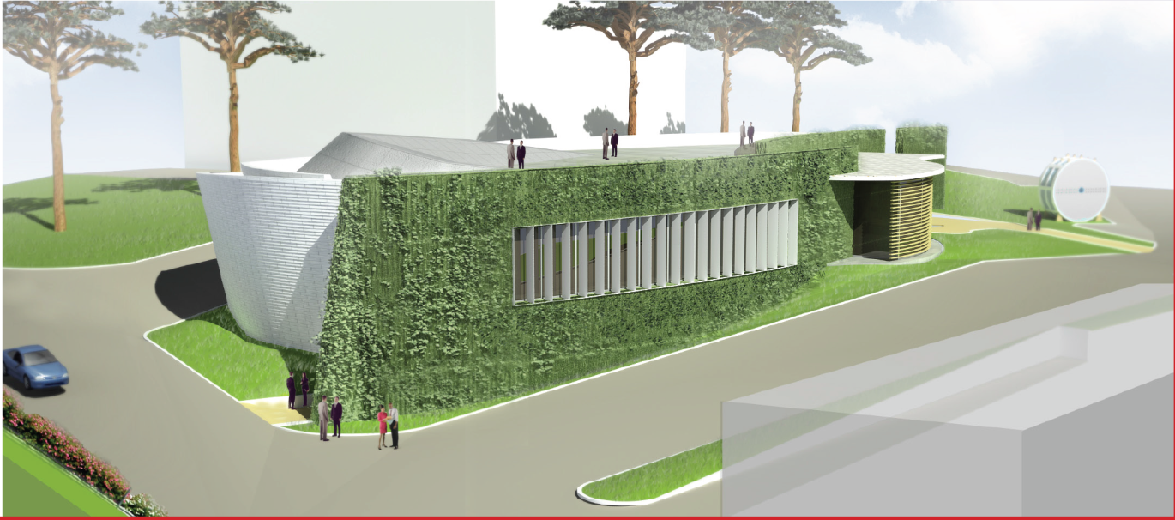
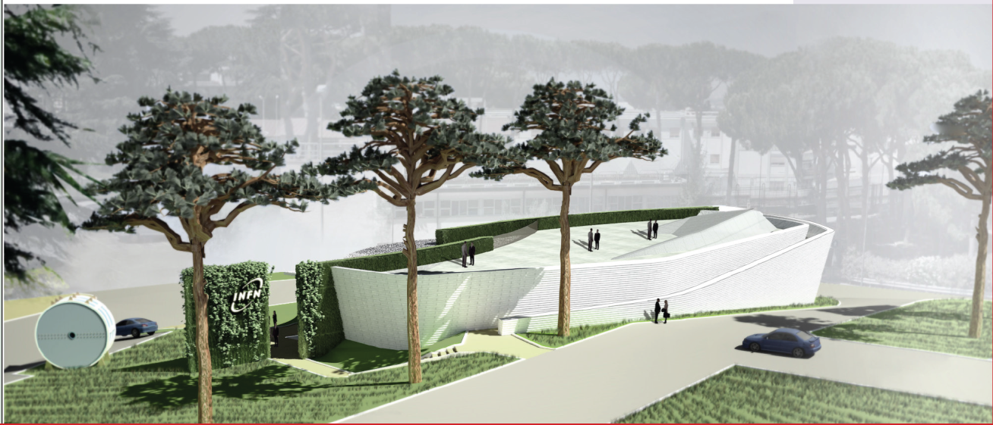
Rendering of Visitors’ Centre

Slide 25
TECHNICAL DIVISION ACTIVITIES DTSG’s PROJECTS OF INTEREST
CUORE
Detector Towers (19 over 19), stored @LNGS

Slide 26
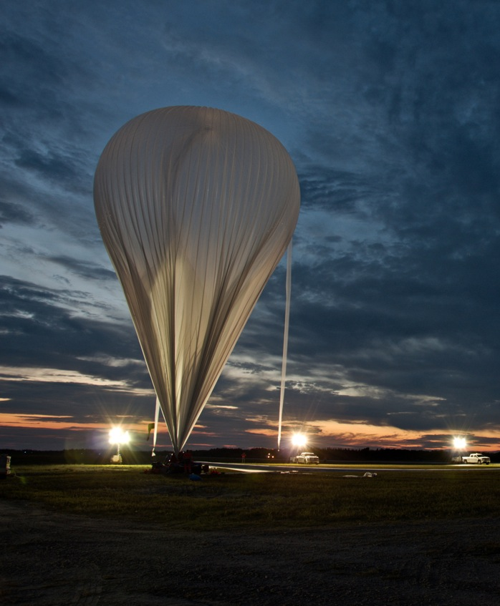
JEM-EUSO
Photo Detector Module prototype, ready for test on board a stratospheric balloon @Timmins base (Ontario, Canada).

Slide 27
ELI-NP 2
The ELI Linac is subdivided in Bays

Slide 28
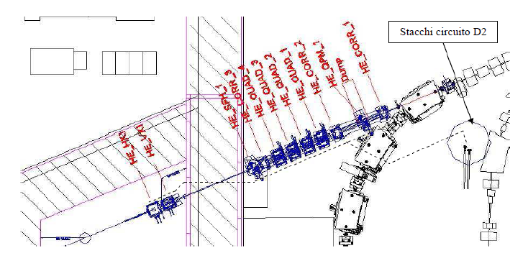
XPR @ CNAO 2
The new XPR project detaches from the CNAO Synchrotron
The new line has different configurations in order to satisfy different users’ needs (e.g. radiation damage, dose calculation, etc.)

Slide 29
TECHNICAL DIVISION ACTIVITIES DTSG’s PROJECTS OF INTEREST
PED4PV
DTSG personnel participate to the experimental activities of the PED4PV project, aimed to demonstrate that the Pulsed Electron Deposition (PED) technique is a valid and innovative method to realize thin film based Photo Voltaic (PV) cells. Scope of the task, performed at the LNF, is the deposition of Molybdenum thin film as back contact on several substrates of various nature, such as: glass, stainless steel, copper, bronze, ceramic, cement. A dedicated thin film deposition system, realized in 2013, is now working with good performance.
Besides the deposition of the molybdenum back contact, a successful activity on the deposition of the Transparent Conductive Oxides (TCO) aluminum doped zinc oxide (AZO), has been carried out. Recently the feasibility to deposit the CdS heterojunction layer through a sputtering technique, instead of through the traditional chemical bath deposition technique has been tested.

Slide 30
PED4PV 2
The deposition Sputtering Chamber

