Slide 1

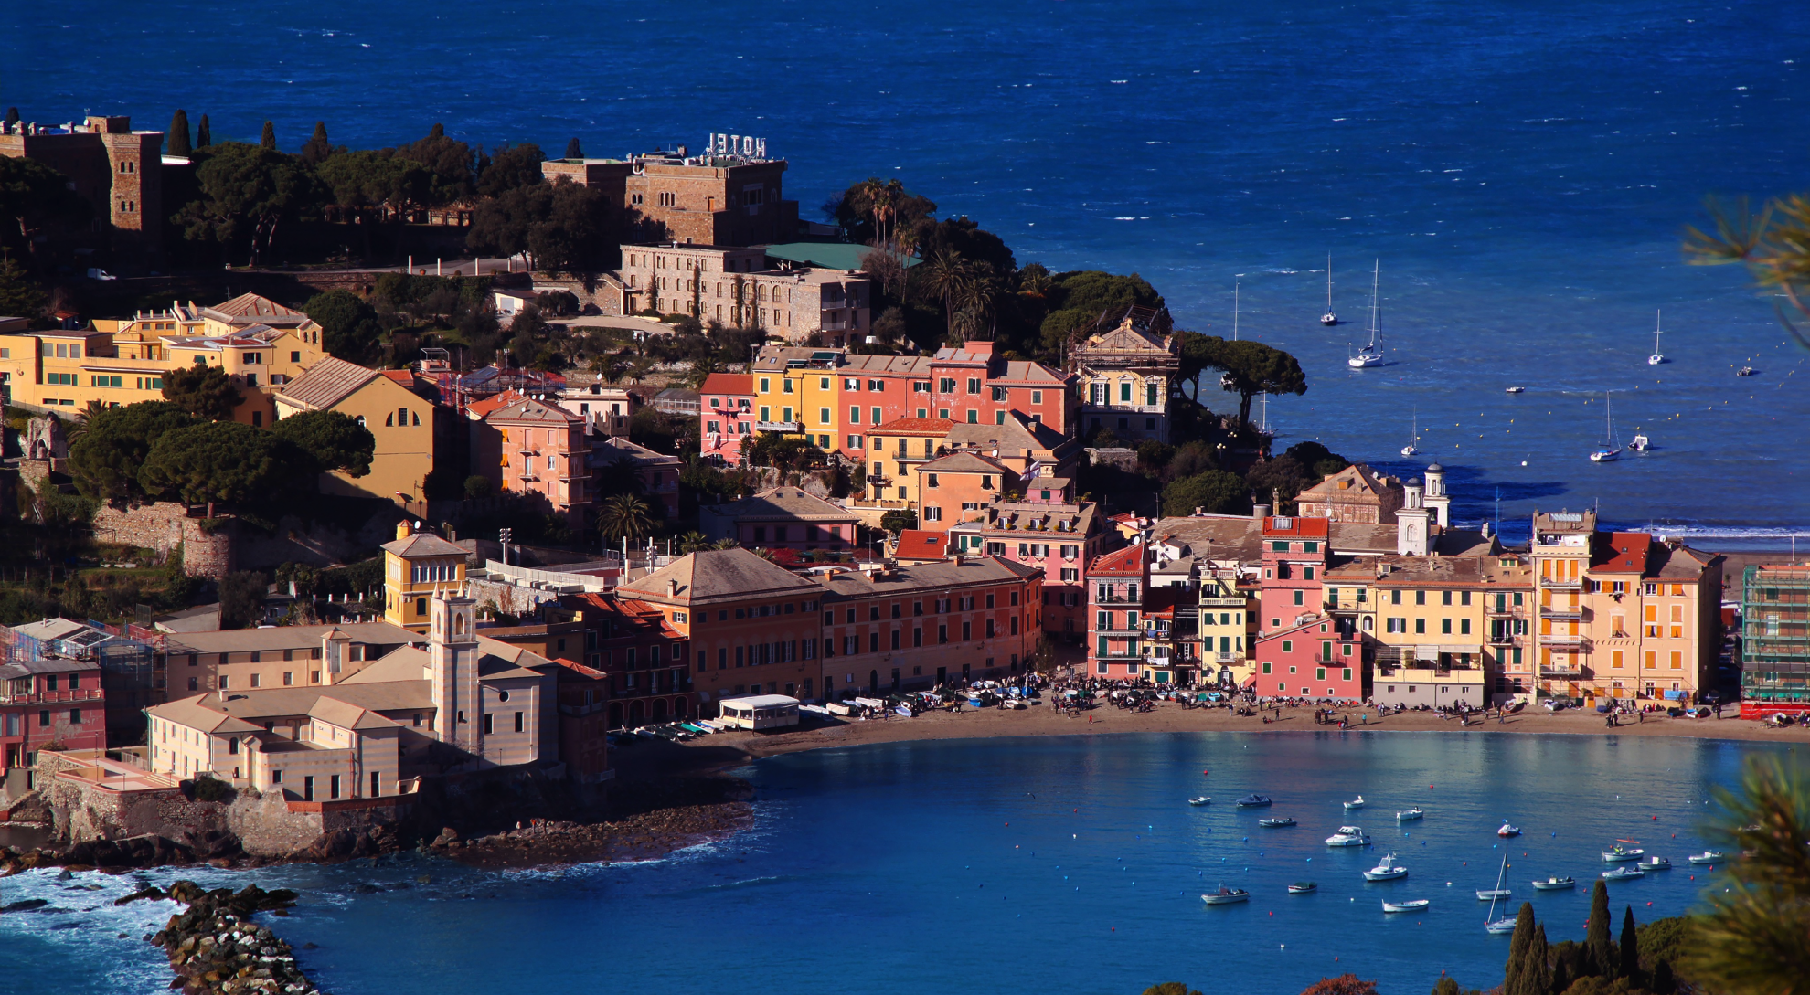
Welcome to Pixel 2016
On behalf of the INFN Section of Genova hosting the 8th edition
Photo credits: C. Biggio
Giovanni Darbo
Director of Genova INFN Section

Slide 2
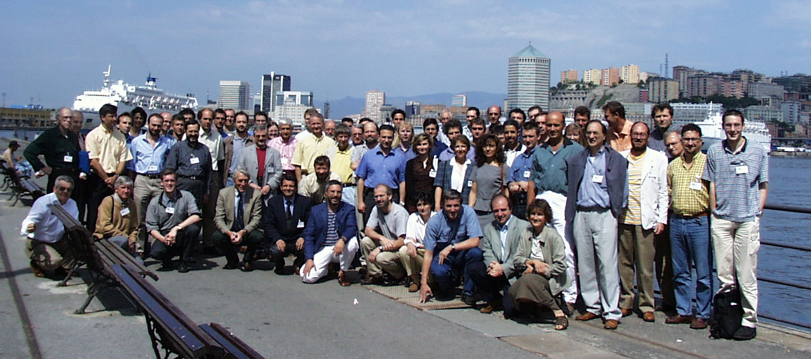
Pixel 2000
We had in Genova also the first edition!

Slide 3
Genova – Since Long Time in Pixel
RD19-WA97 – from 1992 to 1998
ATLAS-PIXEL – since 1995
CMS-PIXEL – since 2013

Slide 4
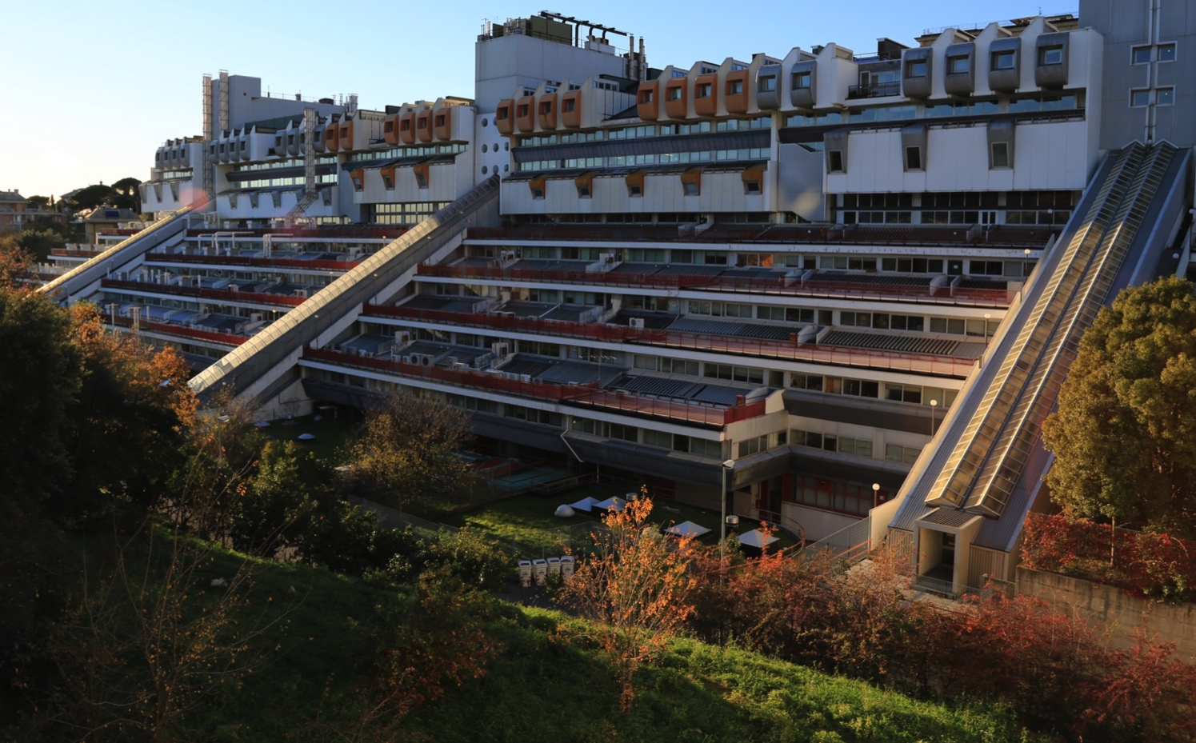
INFN Genova
75 staff: physicists, engineers, technicians and administrative
120 associates: professors, master and PhD students

Slide 5
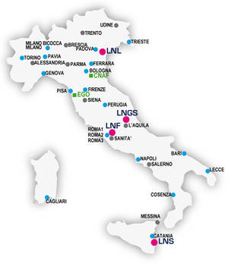
Founded 8 August 1951
1800 staff & 3600 associates
20 Sections & 4 National Labs
Catania, Frascati, Gran Sasso and Legnaro
www.infn.it

Slide 6
INFN Genova Section - Numbers
INFN Research groups in Genova (106 FTE in 2016)
Group 1: Particle physics – at CERN, PSI (previously also FNAL, SLAC)
Group 2: Astro-particle physics – at Gran Sasso Lab, Underwater, Balloons
Group 3: Nuclear physics – at Jefferson Lab, CERN, Gran Sasso
Group 4: Theoretical physics
Group 5: Applied superconductivity (magnets), detector development, environmental and medical physics
Researchers | FTE INFN | FTE Genova
Group 1 | 733.6 | 29.3
Group 2 | 624.5 | 22.7
Group 3 | 428.2 | 16.6
Group 4 | 979.5 | 26.7
Group 5 | 538.7 | 10.8

Slide 7
Enjoy the Conference
and the stay in
Sestri Levante and Liguria

