Slide 1
Pixel DAQ and Trigger for HL-LHC
P. Morettini

Slide 2
Pixel detectors for HL-LHC
When thinking to a Pixel Detector for HL-LHC, the first problem to attack seems to be the radiation hardness.
And certainly, reaching 1 Grad and 1.4x10¹⁶n_{eq} cm⁻² it’s not a trivial task.

Slide 3
Radiation Fluences: 1 MeV n_{eq}.cm⁻²
8 MGy , 1.4x10¹⁶ n cm⁻²
1 MGy , 2x10¹⁵ n cm⁻²
2 MGy , 4x10¹⁵ n cm⁻²
L0
L1
L0
ATLAS ITk Simulation, FLUKA to 3,000 fb⁻¹

Slide 4
Pixel detectors for HL-LHC
When thinking to a Pixel Detector for HL-LHC, the first problem to attack seems to be the radiation hardness.
And certainly, reaching 1 Grad and 1.4x10¹⁶n_{eq} cm⁻² it’s not a trivial task.
However, 3D sensors and even planar sensors may achieve adequate radiation tolerance. Same is true for the readout electronics, in 65 nm technology.
Data extraction is another challenging aspects related to the high fluence.
In this talk, we will go through the problems we are facing, the solutions we are exploring and the new technologies that could help us in the future.

Slide 5
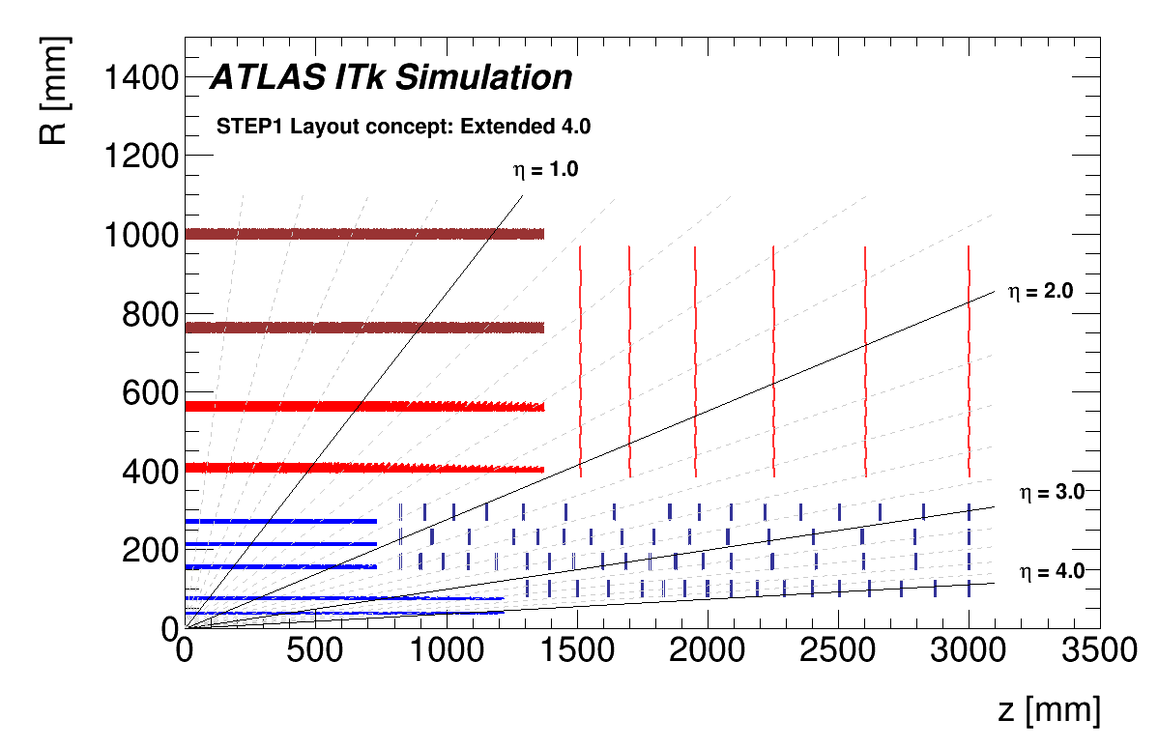
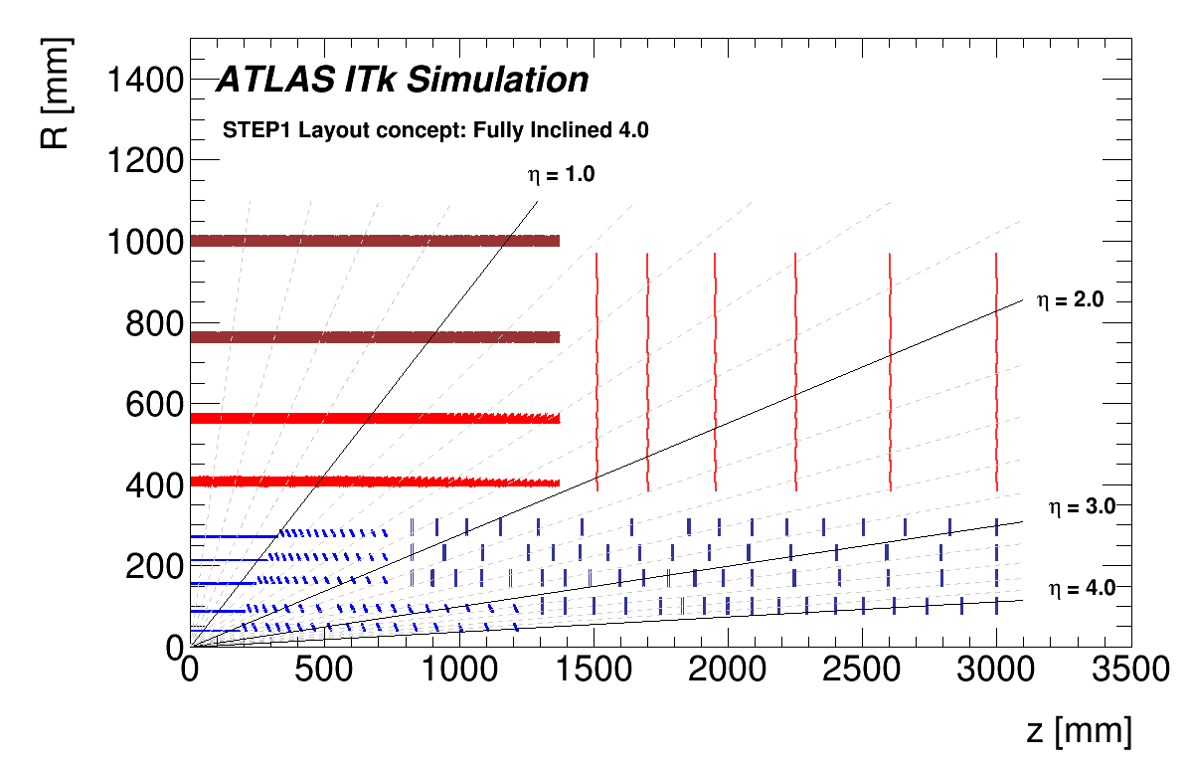
Tracker layouts for HL-LHC
Strips
CMS
Pixel+Strips
Pixel
Strips
ATLAS Extended
Pixel
Strips
ATLAS Inclined
Pixel

Slide 6
Trends in Trigger and DAQ
Nowadays, the most popular approach in calorimeters and muon detectors is to extract data from the front-ends at 40 MHz and bring everything on surface.
There are obvious advantages, especially from the trigger: the complexity is moved off-detector, and the performance may follow the technology evolution.
But for the Pixel Detectors this approach is still unfeasible…

Slide 7
Pixel occupancy at HL-LHC
ATLAS Simulation: Pixel (50 x 50 μm²) occupancy
0,007 %
0,010 %
0,006 %
0,015 %
0,05 %
0,06 %
0,12 %
0,15 %
0,25 %

Slide 8
Can the occupancy be reduced?
We may try to act on the detector parameters to adjust the cluster size:
Pixel size and active area thickness
  The baseline here is 50 x 50 x 150 μm³, but these numbers can be reduced.
Analog information
  Assume ~8 bits of ToT per cluster, maybe with the ability to reduce this number if needed.
Sensor inclination
On-chip data compression
Distance from the beam

Slide 9
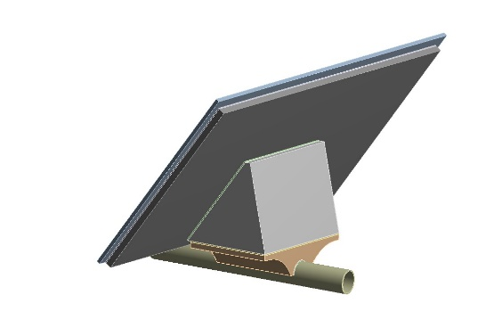
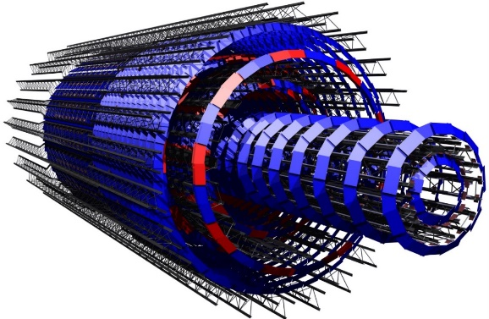
Sensor inclination
Two different philosophies:
Minimize the cluster size by selecting normal incidence and rely on the intrinsic hit resolution.
  Asymptotically, the aim could be to use pure digital readout and very small pixels (minimize overlaps and space-point formation time).
  Local supports may require extra work, but adequate thermal and mechanical performance seem achievable.

Slide 10
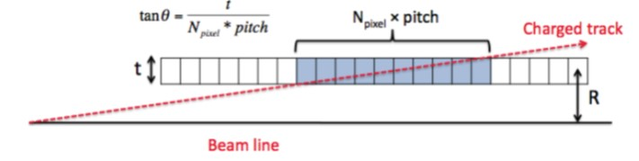
Sensor inclination
Two different philosophies:
Minimize the cluster size by selecting normal incidence and rely on the intrinsic hit resolution.
Make big clusters and try to extract as much as possible from the cluster shape.
  Simpler from the local support point of view.
  There could be no alternative if the pixel size is not small enough or at large η.
  At large η, a single long cluster can provide a measurement of track direction.

Slide 11
On-chip compression
Instead of transmitting individual hits to the read-out system (~25 bits per hit), we could transmit clusters information, saving bandwidth.
This is already done in the ATLAS IBL (FE-I4 chip).
The plan is to be more aggressive for the next generation of FE chips, to achieve a factor of 2 in compression.
  In theory, even stronger compression algorithms are possible, but the optimization may depend on the detector region.
  In general, the idea is to divide the FE chip in regions with private buffers and hit clustering capability.

Slide 12
So, how much bandwidth we need?
With all the assumptions made so far, this is the bandwidth needed per cm² and per MHz of trigger for a possible ATLAS layout:
We see there is a factor of 4-5 reduction moving from inner to outer layers. This identify two regions with different needs.
Barrel |  |  | End-caps
 | Radius | BW/cm² |  | Inner R | BW/cm²
B0 | 39 mm | 1.25 Gb/s | R1 | 80 mm | 0,84 Gb/s
B1 | 75 mm | 0,65 Gb/s | R2 | 150 mm | 0,64 Gb/s
B2 | 155 mm | 0,36 Gb/s | R3 | 212 mm | 0,37 Gb/s
B3 | 213 mm | 0,22 Gb/s | R4 | 275 mm | 0,23 Gb/s
B4 | 271 mm | 0,14 Gb/s

Slide 13
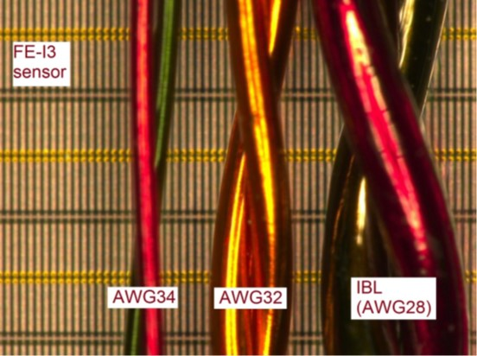
Data transmission cables
In general, there is some tendency to try to place optical conversion stages in an accessible area.
Optical components are in any case not rad-hard enough for the inner layers, which means we need a low mass copper solution.
Several prototypes are under test, including controlled impedance flex lines, twisted pairs, micro-coaxial cables.
Flex cables
Micro twisted pairs
Twinax
0,3 mm
2 mm

Slide 14
Data transmission cables 2
In the range 5-7 m, 5-6 Gb/s looks possible, provided error correction algorithms and pre-emphasis are used.
This imply that the design of TX section is the FE chip must be tuned for the specific transmission line in use.
The actual performance must be studied on a realistic system test.

Slide 15
Possible trigger rates
If we assume 5 Gb/s as the limit for a single data line, we stick to one data line per FE chip, and assume an area of 2 x 2 cm², we can extract data at:
1 MHz in the inner region (R < 10 cm)
4-5 MHz in the outer region (R > 20 cm)

Slide 16
More links per FE?
With max one link per FE, we need more than 20 K data links for an ATLAS like Pixel tracker (~7K in the inner section, R < 10 cm).
Difficult to believe we can fit much more…

Slide 17
Pixel detector readout options
We could decide to read our Pixel Detectors at a rate of 1 MHz, triggered by calorimeters and muons.
The extracted data can be used for the subsequent trigger levels, in offline-like algorithms or to feed fast tracking processors.
We know, however, that an early use of tracks in the trigger algorithms is beneficial for both leptonic and hadronic triggers.

Slide 18
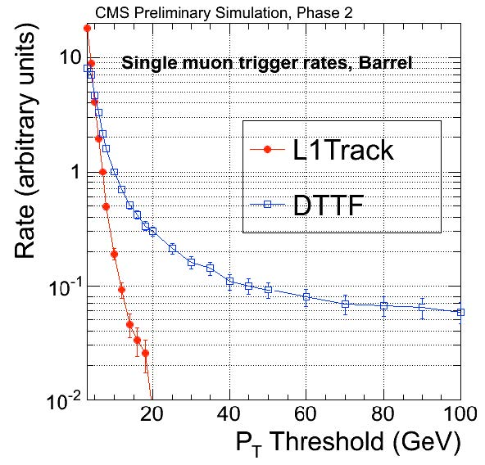
Tracking in leptonic triggers
Tracks in leptonic triggers, introducing a precise p_{T} measurement, can sharpen the turn-on curve and reduce the rate for a give threshold.
ATLAS μ turn-on
ATLAS τ rate vs efficiency
CMS μ rate vs threshold

Slide 19
Tracking in hadronic triggers
The background in multi-jet triggers gets a large combinatorial contribution from pile-up events at HL-LHC. A track trigger can be used to select multiple jets from the same primary vertex.
ATLAS Trigger
Simulation

Slide 20
Possible track trigger strategies
To provide a contribution to the first level or trigger there are two options:
Self-seeded detectors: can autonomously select high-p_{T} tracklets and send them to the trigger processor.
Two-stage trigger: a first, low latency, trigger based on muon an calorimeters is sent to specific regions of the tracker, that can contribute to a second stage decision.

Slide 21
Self-seeded detectors
The approach used in the CMS Pixel-Strip and Strip-Strip doublets, in the outer tracker. Here macro-pixels (100 μm x 1.5 mm) are used to get precise z measurement.
The correlation between two layers can identify high momentum tracks and send them to the trigger processor.
This approach benefits from the intense CMS magnetic field.

Slide 22
Self-seeded trackers in L1 trigger
Data corresponding to pairs of space points above the p_{T} threshold (~10% of the total) are immediately sent to a fast trigger processor, reconstructed and combined with muons and calorimeters.
The L1 trigger is then used to extract full data from the front-end.

Slide 23
Two stage first level trigger
If the self-triggered option is not feasible, a low latency pre-trigger, based on muons and calorimeters can be used:
L0 (Latency ~6 μs, Rate 2-5 MHz)
Identify a lepton or jet “Region of Interest” (RoI)
L1 (Latency 15-30 μs, Rate 600-800 kHz)
Full read-out
Three options for the tracker layers:
Read everything at L0 and feed the L1 track trigger.
At L0 read only data in the RoI (eventually compressed) and all the rest at L1.
Read everything at L1 (not participating to the track trigger). May still need a double buffer in the FE…

Slide 24
Two stage trigger schema

Slide 25
Considerations on trigger latency
The space for buffers in the FE chip is limited.
The evaluation made by the RD53 collaboration indicates 12.5 μs as a reasonable trigger latency limit in the 65 nm technology.
A two stage Lo/L1 trigger can give more time to the fast track processors, as events not selected at L0 could be removed from the buffers, allowing larger L1 latencies.
Direct access buffer
Double buffer
L1
L0
L1
L0
Simple, more power consumption
Complicated, more flexible

Slide 26
Beyond HL-LHC
In general, it seems that the techniques illustrated so far can guarantee an efficient readout of Pixel Detectors, and a good contribution to the trigger system.
There are, however, new technologies now under evaluation that could help bypassing readout limitations in high luminosity environments, allowing even more trigger flexibility.
Will say few words about silicon photonics and CMOS monolithic detectors.

Slide 27
Silicon photonics
Already now, many optical components can be integrated in a standard CMOS process on silicon.
Fiber couplers
Receivers
Modulators
Wave guides
Could be possible to integrate very fast links (mono or multi mode) directly in the FE chips.
The laser source is still an external component.

Slide 28
Silicon photonics: state of the art
Several groups are working to silicon photonics components that can be used in HEP.
Obviously, the important point to verify is radiation hardness. The first results are encouraging, and modulator designs that can withstand 3 MGy are already available.

Slide 29
CMOS
The dream would be to have a full monolithic pixel detector out of the foundry. This is already a reality at low luminosity, but looks more complicated for HL-LHC. Maybe less complicated than initially thought…
The big advantage, obviously, would be in the total cost and in the big simplification in assembly and connections.
But there could be advantages in the trigger/DAQ section as well.
Sensor
Conductive coupling
(bumps)
Sensor
Pre-Amp
Discriminator
Buffers
Pre-Amp
Discriminator
Buffers

Slide 30
CMOS monolithic 2
The cost reduction associated to the adoption of monolithic detectors could give the possibility to produce large areas of highly segmented detectors.
Triple layers of small pixels could be operated in self-seeded mode, even if the magnetic field is not too high.

Slide 31
3D Integration
Even if not impossible, it may be difficult to integrate high performance analog electronics with fast digital readout on a single die. For sure large buffers are incompatible with small pixels.
If the number of connections can be kept low, wafer-to-wafer integration techniques, based on commercial processes, can help decoupling the analog pixel technology from the high density digital part used for trigger and read-out.
Data from
other layers
To trigger processor
To event builder
Buffers
Correlators
Large bumps (C4)
Sensor
Pre-Amp
Discriminator

Slide 32
Summary
Extracting data from the inner layers of a Pixel Detector at HL-LHC could be a complicated task.
Participating to a fast trigger will be even more challenging.
The experience with the existing Pixel Detectors indicates that a large margin in readout capabilities is a key ingredient for stable operations.
We believe we have the right tools in hands, but some more R&D is needed to ensure we can safely operate the inner layers. In particular:
  On-chip data compression
  Support for L1 latencies larger than 12.5 μs
  Max bandwidth on data calbles
In the future, new technologies may significantly improve data extraction capabilities.

