Slide 1
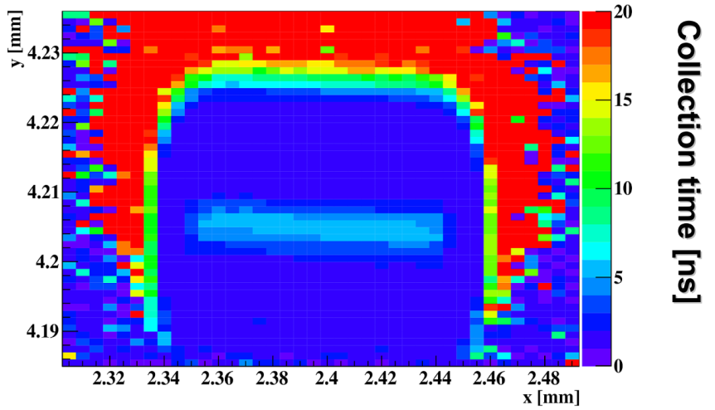




A novel Transient-Current-Technique based on the
Two- Photon-Absorption process for the characterization of the HV-CMOS deep n-well
PIXELS 2016, September 5th, 2016
M. Fernández¹, J. González¹, R. Jaramillo¹, M. Moll², R. Montero³, F. R. Palomo⁴, I. Vila¹
¹Instituto de Física de Cantabria (CSIC-UC)
²CERN
³Universidad del Pais Vasco (UPV-EHU)
⁴Universidad de Sevilla (US)

Slide 2
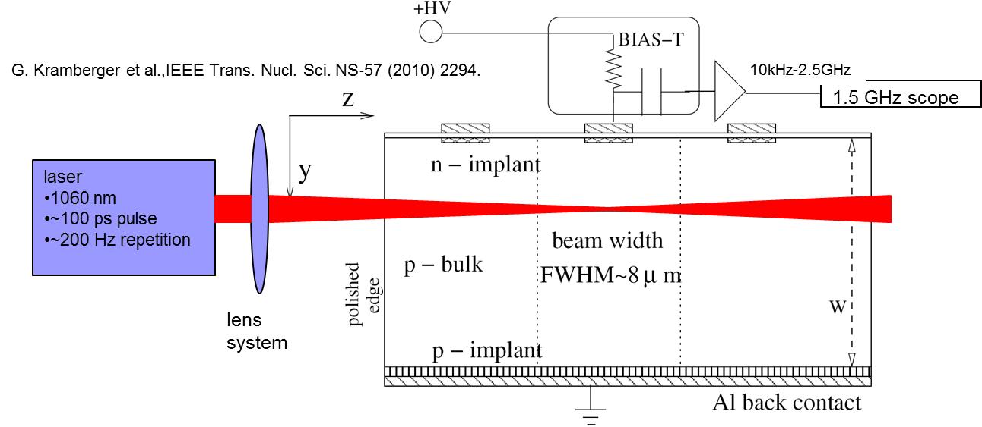
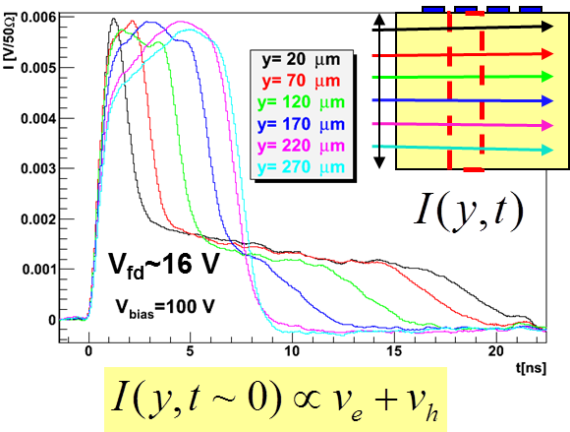
Transient-Technique Basics
Study of transient current of laser-generated non-equilibrium carriers provides information of many internal diode’s characteristics: space-charge geometry, trapping times, CCE, mobility,...
Capital tool for the understanding of the detector’s radiation tolerance
From G. Kramberger, Advanced TCT systems, Vertex 2014
Notes:
Time resolved measurement of the current induced the transient of the non-equilibrium carriers created by a laser pulse.
Mainstream tool for the radiation tolerance assessment.
Edge-TCT configuration as tool for mapping the electric field
Laser light is injected through the edge of the sensor and the current induced in a microstrip on top of the laser beam focus is measured

Slide 3
Transient-Current Technique Basics (2)
Ideally, a TCT technique with non-equilibrium free carriers generation in a very localized volume (micrometric-scale voxel) should allow the best E field mapping and geometry determination of the semiconductor junctions with very small size features of the new generation of position-sensitive-detectors
Let’s see what non-linear optics can do for us…
Notes:
Limitation – electron-hole generate along the whole laser optical path (proportional to the laser intensity)

Slide 4
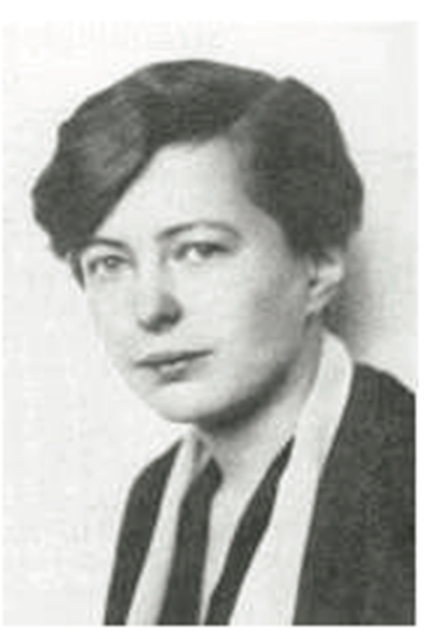
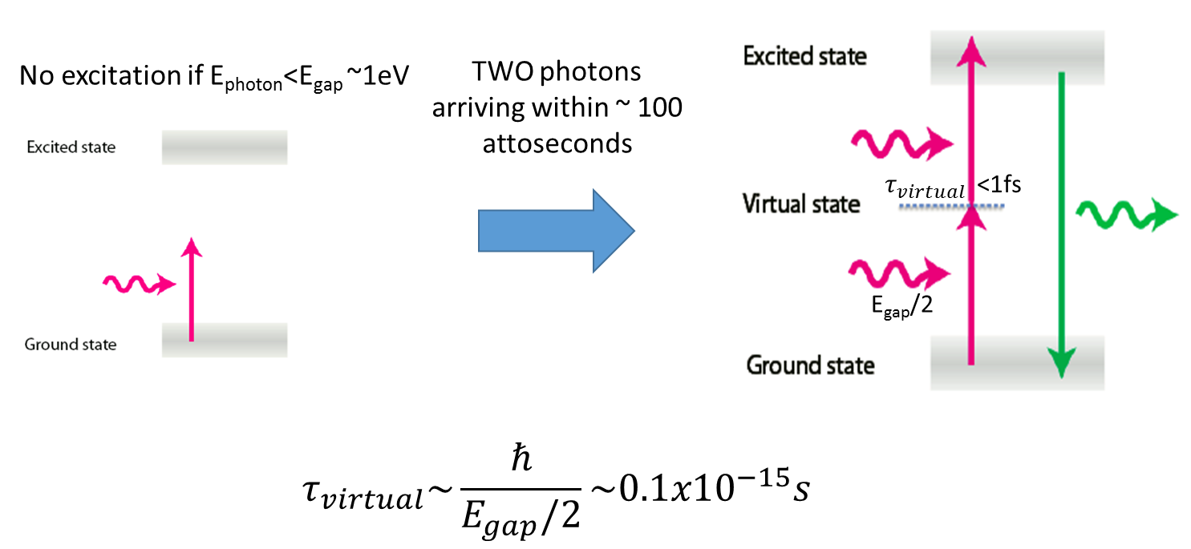
Two-Photo-Absorption Process in Semiconductors 101
Predicted in 1931 by
Maria Goppert-Mayer
1963 Nobel Prize in Physics
In fluorescent molecules, two photon pumping was demonstrated by Webb et al in 1990.
Notes:
Single-photon
Virtual electronic states with a very short lifetime with energy level within the bandgap

Slide 5
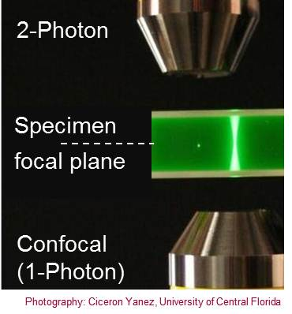
Two-Photo-Absorption Process in Semiconductors 101 (2)
"A picture is worth a thousand words”
TPA-TCT is a way to generate very localized electron-hole pairs in semiconductor devices (microscale volume).
TPA-TCT simplifies the arrangement to inject light into the device and the unfolding of the device internal Electric field and other relevant parameters of the theoretical model.
Notes:
Bottom microscope objective single photon absorption is possible.
top

Slide 6
TPA-eTCT on a HV-CMOS: Set-up

Slide 7
TPA-eTCT on a HV-CMOS: Set-up (2)
Analog readout of of the laser-induced signal collected by deep N-Well (no on-chip amplification)
Notes:
Study of the radiation tolerance of a HV-CMOS charge collecting juntion, the deep n-well (buried n-in-p diode)
Measuring the analogue current out to the n electrode. Edge injection.

Slide 8
TPA-eTCT: Charge Collection Efficiency.
TPA
Fast transient current (∼ 1ns) to estimate the E field.
TPA provides a much better “E field” mapping resolution than Single-Photon Absorption.
SPA
Notes:
Raster scan to map in a plane parallel to the device edge - mapping the value of the charge at 1ns
Potato shape.

Slide 9
TPA-eTCT: Collection Time (95% signal)
Diffusion region
Distinct waveform shape depending on zone of illumination.
  Drift region: fast
  Diffusion region: slow
  At the implant double peak observed in the waveform (two contributions one for drift and another from diffusion).
Drift region
Implant region

Slide 10
TPA-eTCT: Depletion depth vs Vbias
Doping estimation (resistivity) Assuming abrupt n-in-p junction.

Slide 11
TPA-eTCT: Implant depth (along Z)

Slide 12
TPA-eTCT: Neutron Irradiated HV-CMOS
7×1015 neq/cm2 (Caveat: high leakage current 620 mA @50 V)
VERY PRELIMINARY
Dedicated TPA-eTCT characterization campaign going on this week on irradiated
HV-CMOS samples.

Slide 13
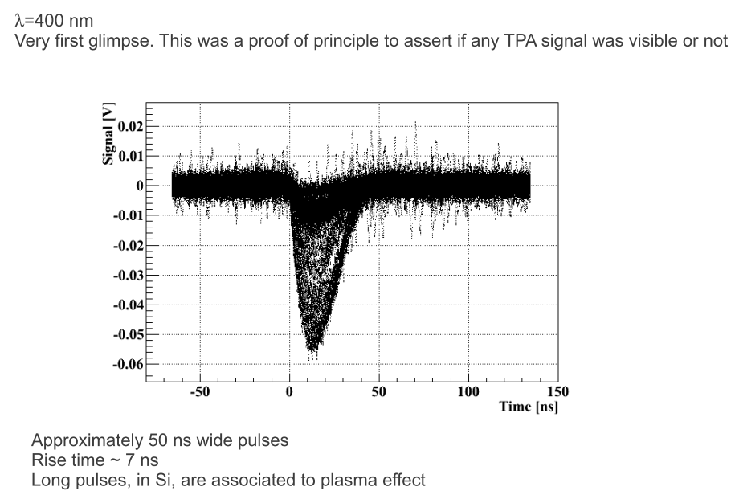
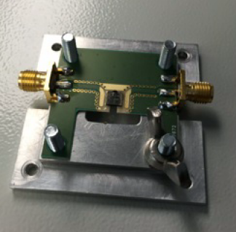
Other possible (exclusive) application
First sub-bandgap laser-induced signals in diamond detectors.
3D diamond detector provided by A. Oh (U. Manchester)
Quick and simple test.

Slide 14
Summary
Development of a TPA based TCT technique validated both on non-irradiated and irradiated sensors.
Localized charge carrier generation: High-resolution 3D mapping of the charge collecting junction and simpler unfolding of sensor’s performance characteristics.
First distinct determination of the deep n-well on HV-CMOS devices and precise determination of its sensitive volume and resistivity
New opportunities: dedicated studies on diamond sensors, active-edge pixels, signal amplification junctions, …

Slide 15
Thank you !
F. Rogelio et al, Two Photon Absorption and carrier generation in semiconductors
https://indico.cern.ch/event/334251/contributions/780784/
I. Vila et al, A novel Transient Current Technique based on the Two Photon Absorption (TPA) process
https://indico.cern.ch/event/334251/contributions/780782/
I. Vila et al, Investigation on the radiation resistance of HV-CMOS and pin diodes using a Transient Current Technique based on the Two-Photon-Absortion Process
https://indico.cern.ch/event/452766/contributions/1117347/
M. Fernández et al, High-resolution three-dimensional imaging of a depleted CMOS sensor using an edge Transient Current Technique based on the Two Photon Absorption process (TPA-eTCT)
(http://www.sciencedirect.com/science/article/pii/S0168900216304569).

