Slide 1
Low energy and high resolution performance of the MÖNCH hybrid pixel detector
Roberto Dinapoli :: SLS Detectors Group :: Paul Scherrer Institut
Pixel 2016
Notes:
MÖNCH is a 25 μm pitch charge integrating detector aimed at exploring the limits of current hybrid silicon detector technology.
It opens new perspectives for many synchrotron applications where currently the detector is the limiting factor e.g. inelastic x-ray scattering (IXS), Laue diffraction and soft X-ray or high resolution imaging.
The reduced input capacitance allows to obtain an impressive low noise of less than 35 electrons RMS and the high segmentation provides high resolution images.
However, the small pixels present many challenges in terms of bump bond yield, electronics design and data throughput.
At this pitch, the charge produced by single X-rays is almost always shared between neighboring pixels.
This allows to interpolate between channels obtaining ~ micron spatial resolution, but on the other hand deteriorates the energy resolving power of the detector.
The possibility of exploiting the charge sharing to improve the spatial resolution requires detailed modeling and characterization, which can also help to retrieve the energy information.
The results obtained using the two existing fully functional prototypes of size 4x4 mm2 (25.6 kpixel) and 10x10 mm2 (160 kpixel) will be presented and the challenges to be faced to develop the planned 4x3 cm2 (1.9 Mpixel) module will be discussed.

Slide 2
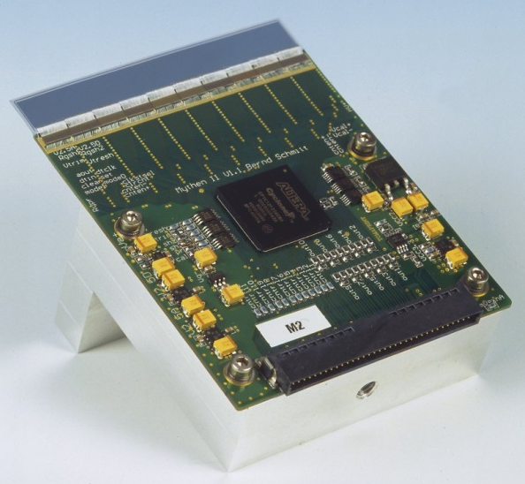
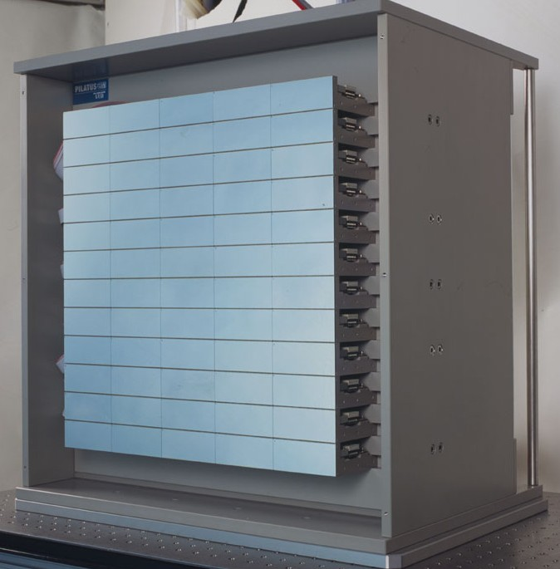
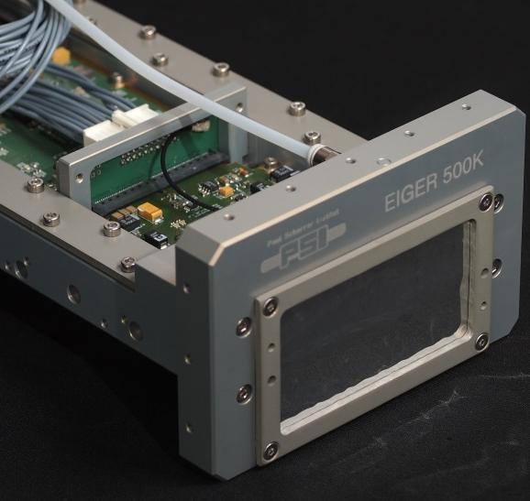


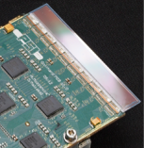

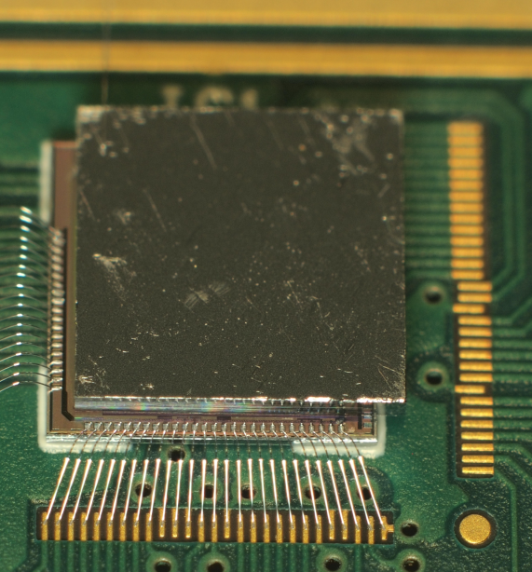

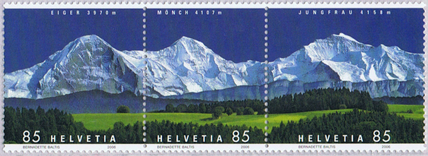

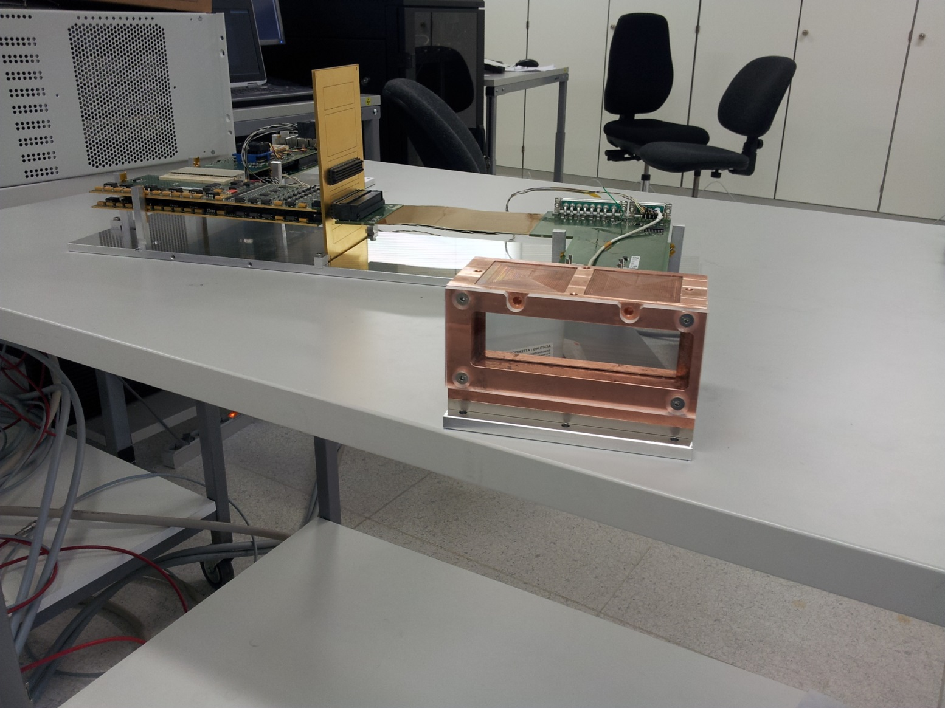
Hybrid Detectors of the SLS Detector group
Microstrips
Pixels
50 um
172 µm
75 µm
Talk by G.Tinti
Single
Photon
Counting
PILATUS
MYTHEN
EIGER
200 µm
Poster by D. Mezza
Charge
Integrating
GOTTHARD
AGIPD
JUNGFRAU

Slide 3
Challenges and solutions
High resolution
Low noise
Large dynamic range

Slide 4
Applications
XRF
Color imaging
Low
noise
High
spatial
resolution
Laue
diffraction
(R)IXS
Soft X-rays
HI-res imaging
Large dynamic range

Slide 5
Applications
XRF
Color imaging
Low
noise
High
spatial
resolution
Laue
diffraction
(R)IXS
MFZ (Maximum Fun Zone)
Soft X-rays
HI-res imaging
Large dynamic range

Slide 6
Challenges and solutions
High resolution
Low noise
Large dynamic range
25 µm pitch pixels
High gain
Adaptive gain
Bump bonding yield
100% charge sharing
Sensitive to leakage current
Many pixels per unit area, i.e. limited resources per pixel, huge data throughput

Slide 7
Challenges and solutions
High resolution
Low noise
Large dynamic range
25 µm pitch pixels
High gain
Adaptive gain
Bump bonding yield
100% charge sharing
Sensitive to leakage current
Many pixels per unit area, i.e. limited resources per pixel, huge data throughput

Slide 8
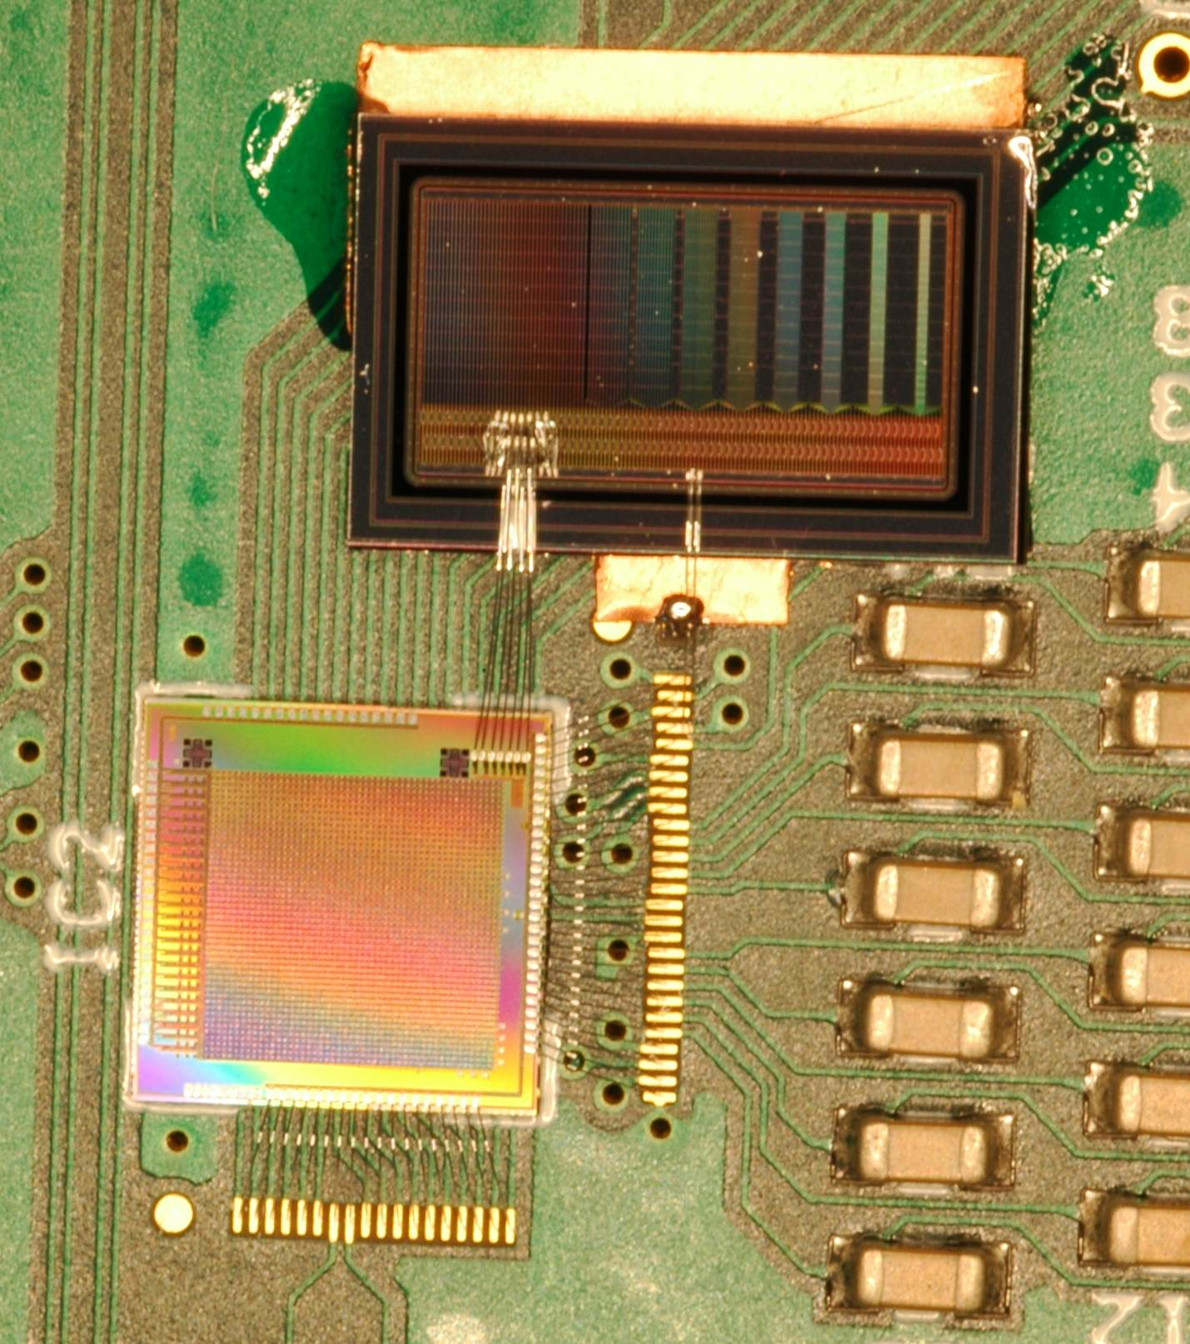
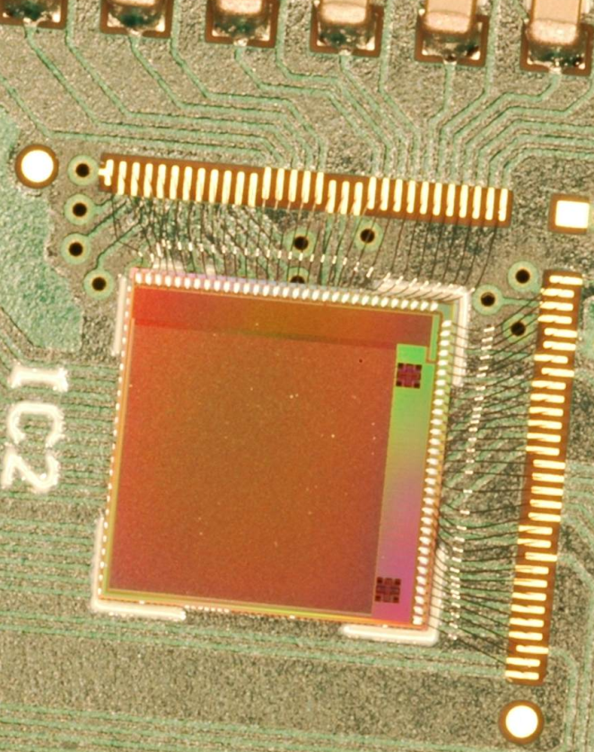
Prototypes
UMC 110nm AE (Al only, shrunk technology, great quality/price)
MÖNCH 01
MÖNCH 02
MÖNCH 01
Multipitch strip sensor
JUNGFRAU01
Area 4x4 mm², 160x160 = 25.6kpixels
Five different pixel architectures
  Different preamp
  Dynamic gain switching
  Input overvoltage control
4 analog outputs
2 kHz frame rate (1Gb port)
“Guest” of Jungfrau01 MPW
Test structures
Seven single pixel channels
Wirebonded to a strip detector for calibration

Slide 9
Basic pixel architecture
Preamp
reset
CDS
reset
PIXEL
Column bus
C_{fb}
Off-pixel
buffer
Detector
CS
Preamp
CDS
Stage
Storage
Test
Column
receiver
Calibrate
Column selection
MUX
MÖNCH 02:
Five different sub-blocks
Single ended
to differential
output driver
(1x/40cols)
Pads

Slide 10
Variations
Preamp
reset
CDS
reset
PIXEL
Column bus
C_{fb}
Off-pixel
buffer
Detector
CS
Preamp
CDS
Stage
Storage
Caps
Test
Column
receiver
Calibrate
Column selection
MUX
Selectable CDS Gain
CDS can be bypassed
two storage caps
Five different preamp versions (including dynamic gain switching)
Single ended
to differential
output driver
(1x/40cols)
Pads

Slide 11
Variations
Preamp
reset
CDS
reset
PIXEL
Column bus
C_{fb}
Off-pixel
buffer
Detector
CS
Preamp
CDS
Stage
Storage
Caps
Test
Column
receiver
Calibrate
Column selection
MUX
C_{fb2}
DGS
C_{fb}
Single ended
to differential
output driver
(1x/40cols)
S
Dynamic gain selection
V_{th}
Q
R
reset
Pads

Slide 12
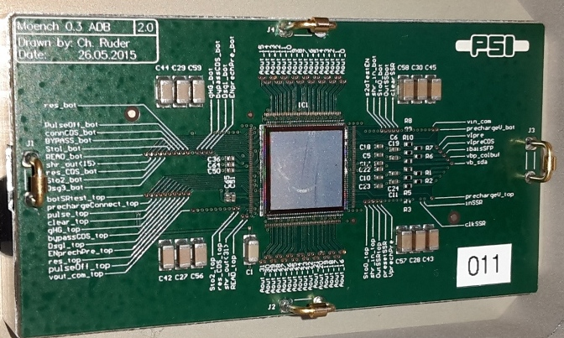
MÖNCH 03
Area 10x10 mm², 400x400 = 160k pixels
Architecture optimized for very low noise (single photon)
32 analog outputs
Currently 2 kHz frame rate (10 Gb port)
Up to 6 kHz by design
Region of interest possible (frame rate > 6kHz)

Slide 13
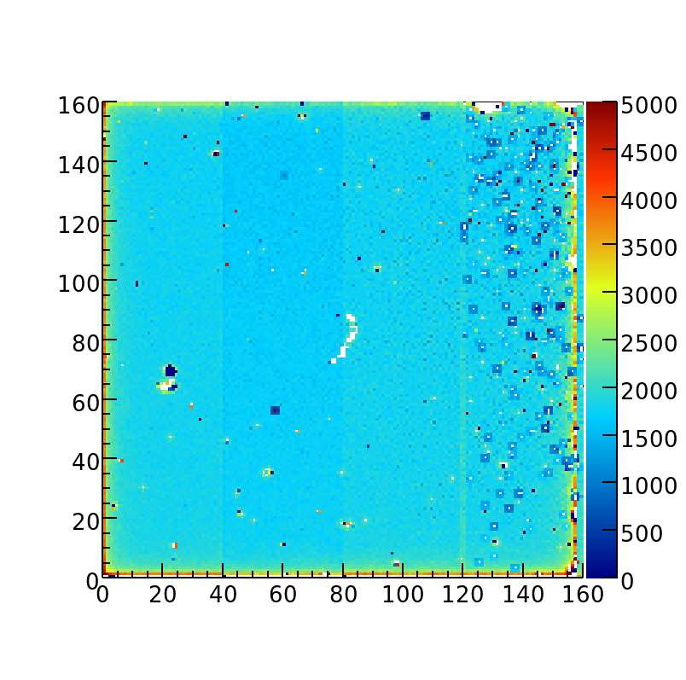
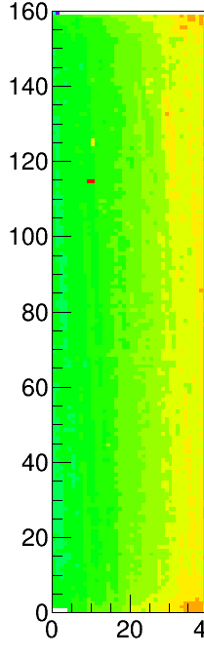

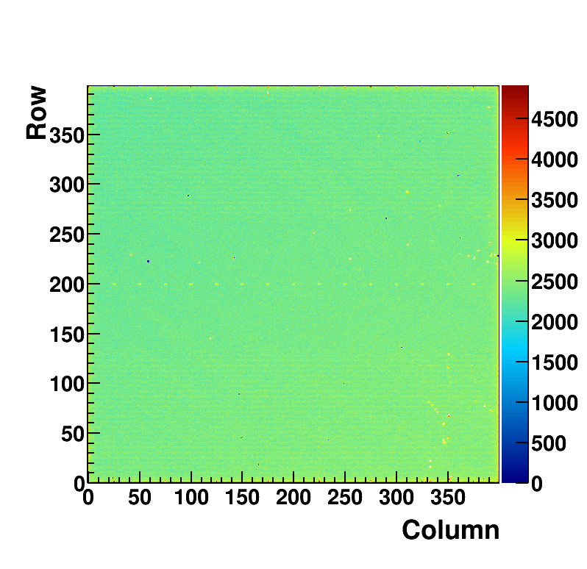
Bump bonding
2013 >95%
2014 >99.95%
Standard Indium process
Performed in-house at PSI
Bump diameter ~ 15 μm
2015 >99.95%
Very first prototypes
Single chip processing
4x1 mm²
After optimization
Single chip processing
4x1 mm²
Wafer processing
1x1 cm²
Notes:
1SC=40x160=6400 pixels

Slide 14
Charge sharing and interpolation
Charge sharing depends on:
  Charge mobility
  Applied bias voltage
  Sensor thickness
  X-ray energy
Radiation
conversion
Charge collection
after drift and diffusion
  Max. 100 photons/mm²/frame to separate single photons
  @10 kHz frame rate =>
    10⁶ photons/mm²/s
    =>Long measurement time
Low resolution
analog image
High resolution
digital image

Slide 15
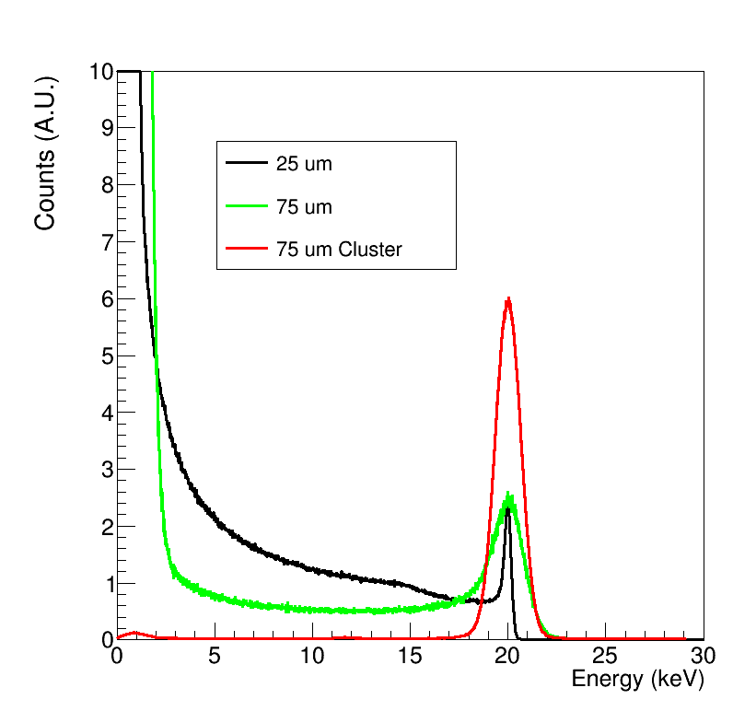
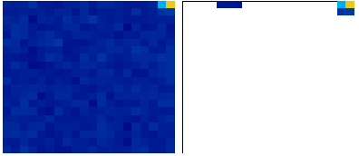
Clustering
In single photon regime, clustering is possible
    Preserves spectral information
    Suppresses charge sharing
    Improves with single-pixel gain calibration
Measured
MÖNCH
JUNGFRAU
Raw data
Clusters

Slide 16
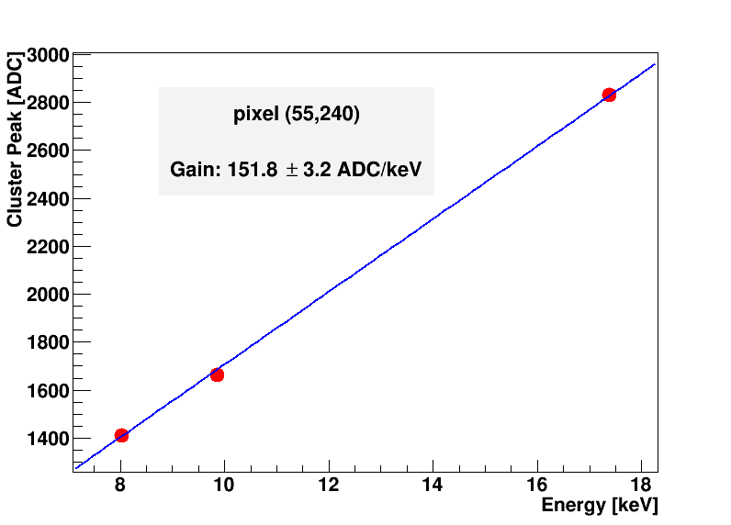
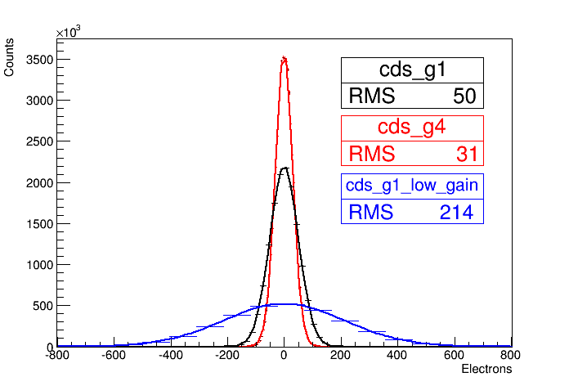
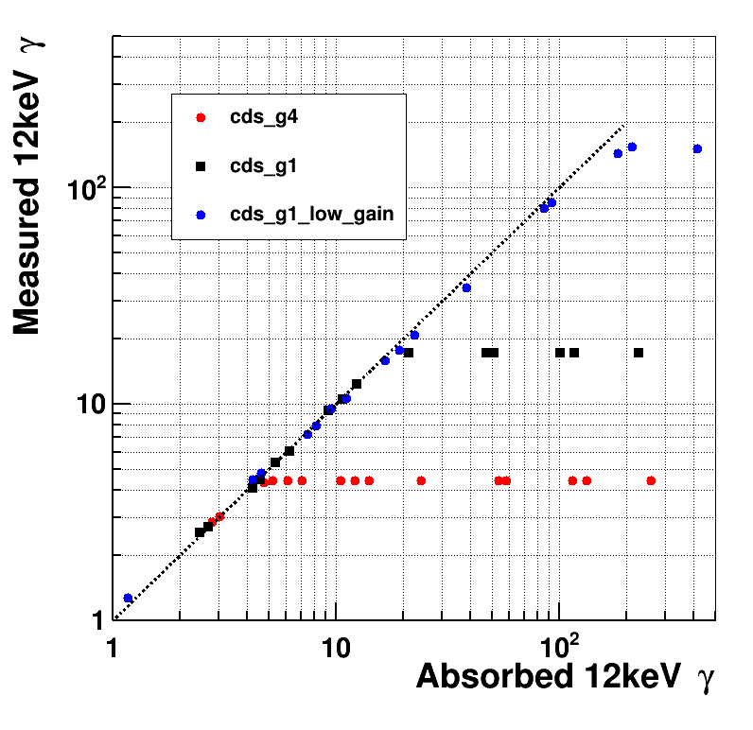
Gain, noise and dynamic range
Gain
Adjustable gain for CDS (static) and preamp (dynamic in MÖNCH02)
Single photon sensitivity down to 600 eV (5σ from noise)
  700 eV for MÖNCH03, probably due to readout system
  Dynamic range up to ≈1800 ∙ 1keV γ, ≈150 ∙ 12keV γ
Mo
Cu
Ge
Noise
Dynamic range
MÖNCH02
MÖNCH03
IR-laser and ND filters
36
MÖNCH03
-800 -600 -400 -200 0 200 400 600 800 e⁻
-2.9 -2.1 -1.45 -0.72 0 0.72 1.45 2.1 2.9 keV

Slide 17
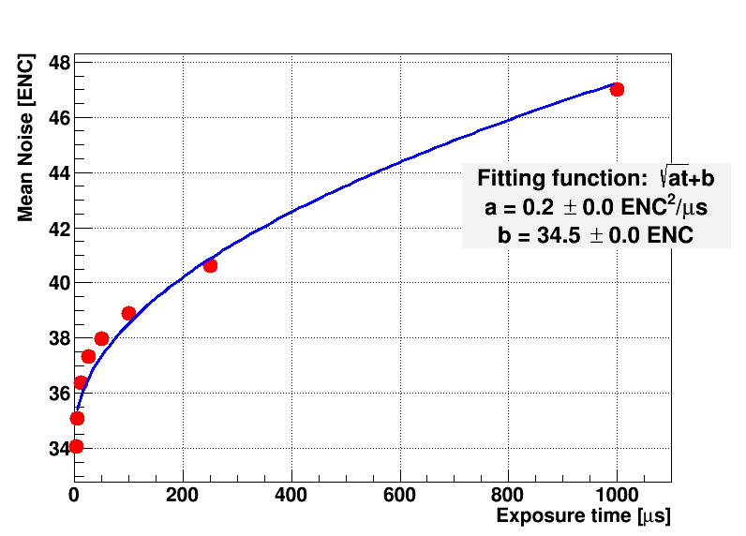
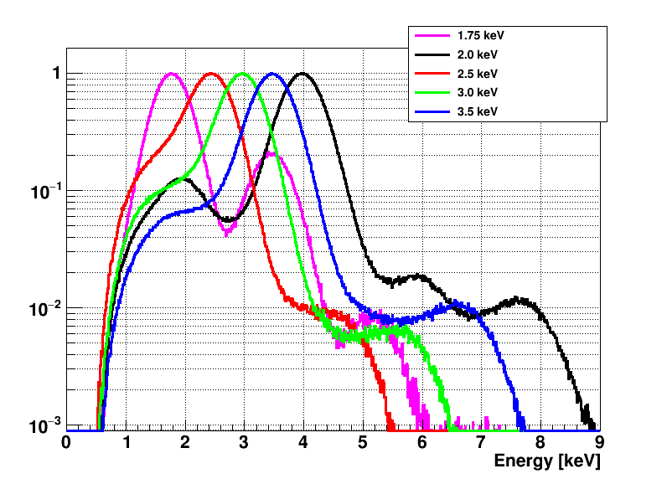
Moench 03 at low energies
Energies between 1.75 keV and 3.5 keV.
Sensor entrance window ~ 1.5 µm.
2×2 subcluster spectra
Photon-finding algorithm works properly, and gain calibration seems to be portable at low energies within a few percent.

Slide 18

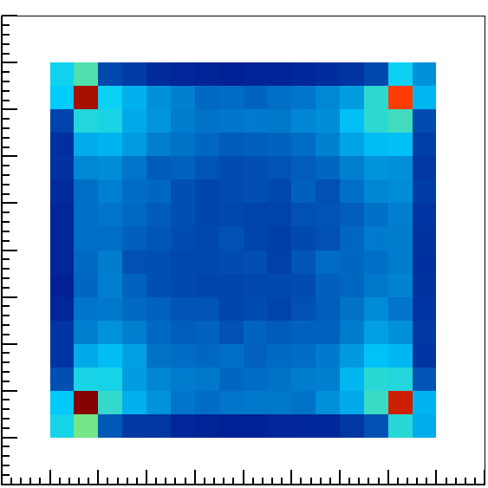
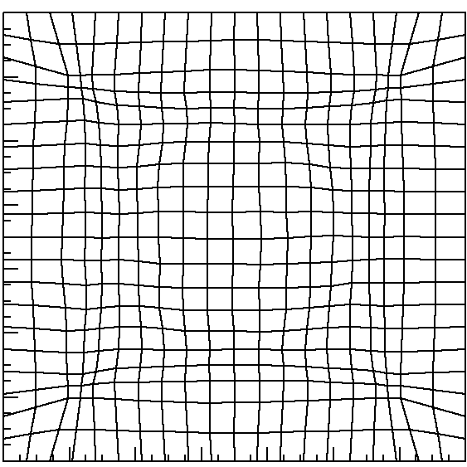
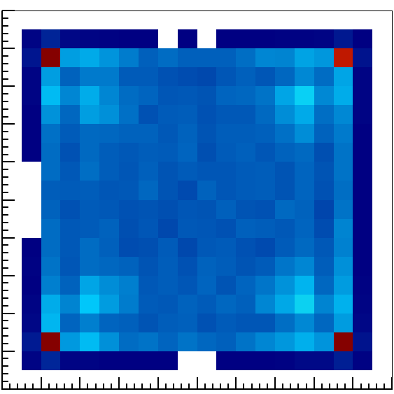
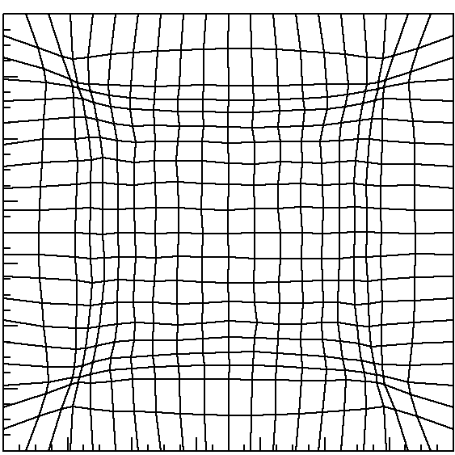
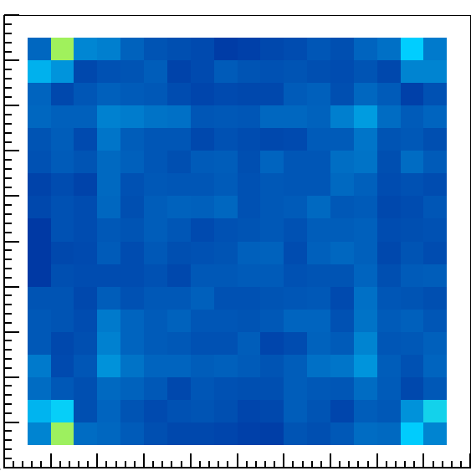
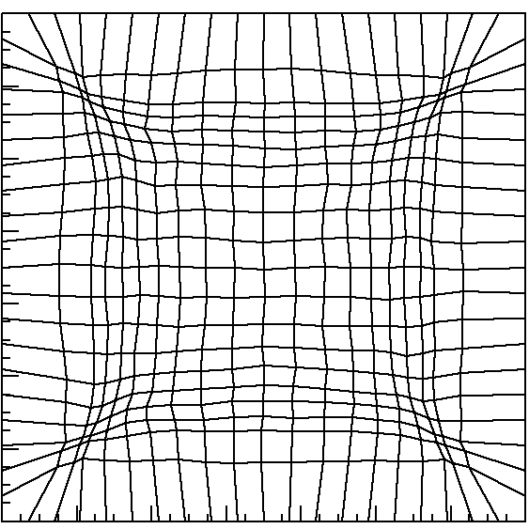
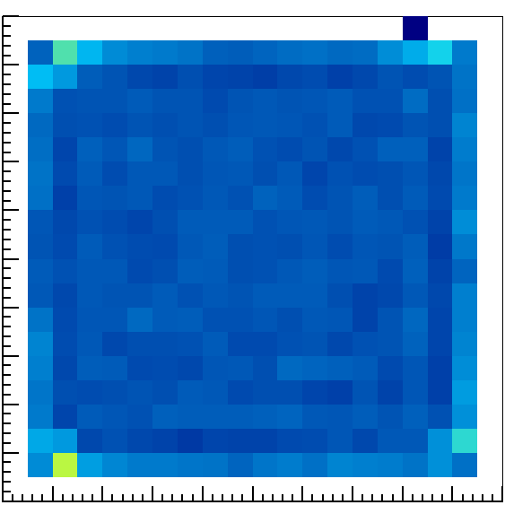
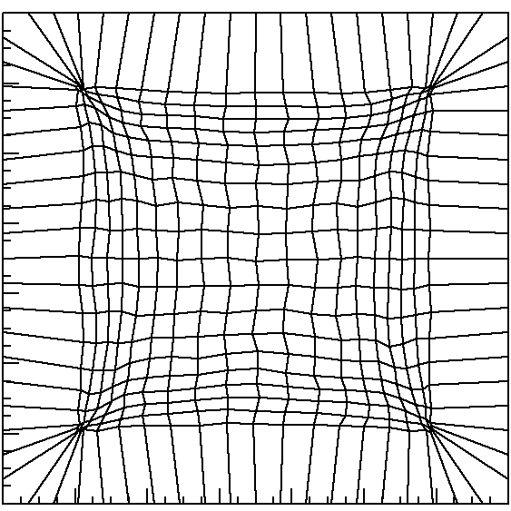
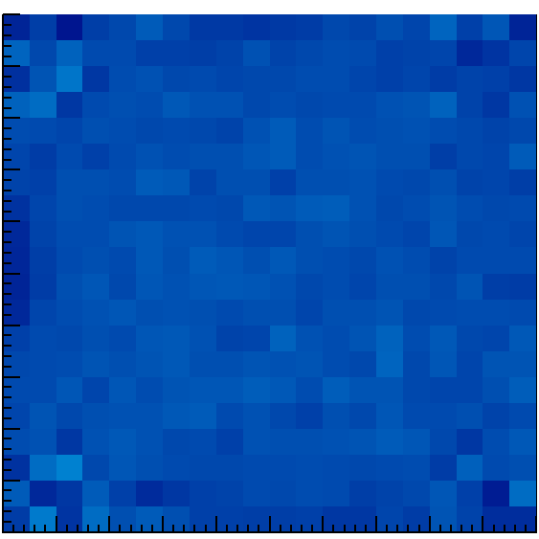
Iterative correction method
The bins of the η-distribution histogram are assigned to position bin within the pixel
  η flat distribution gives flat flatfield image
Iterative algorithm defines η bins map to obtain flat distribution
Algorithm converges once the flat field image is flat
Position dependent resolution
η bin map
Flat field
1
10
20
30
40

Slide 19

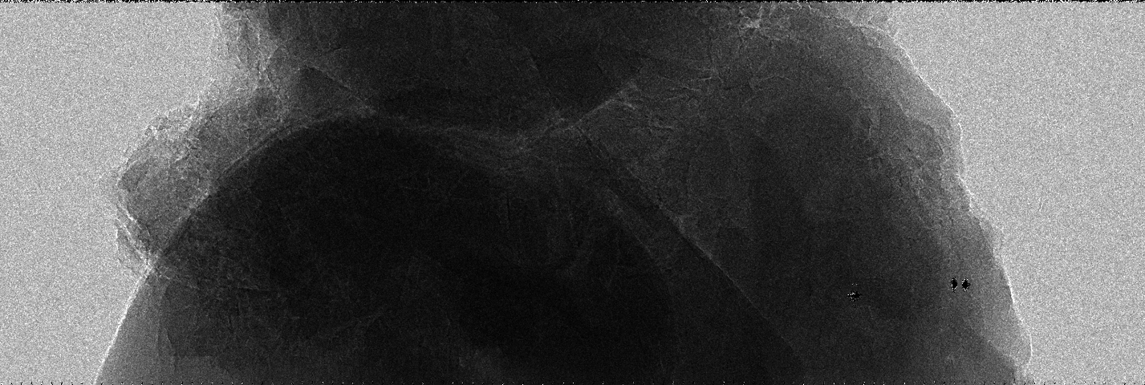
Interpolation
MÖNCH02
TOMCAT 16.7 keV
Kidney stone
2 µm bins
25 µm pixels
Interpolated

Slide 20
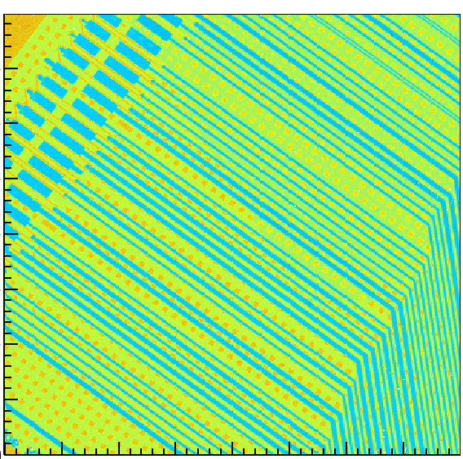
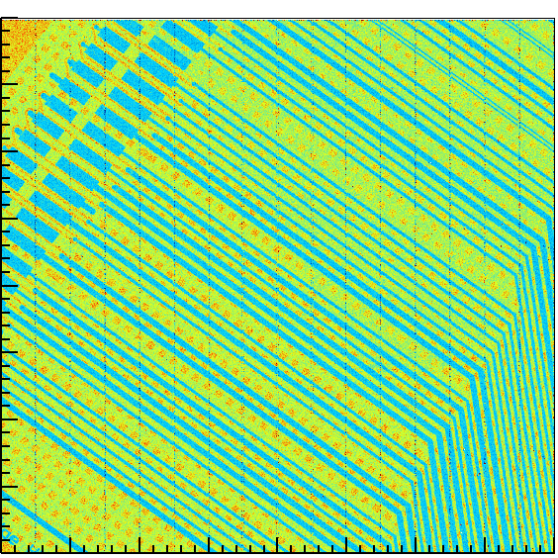
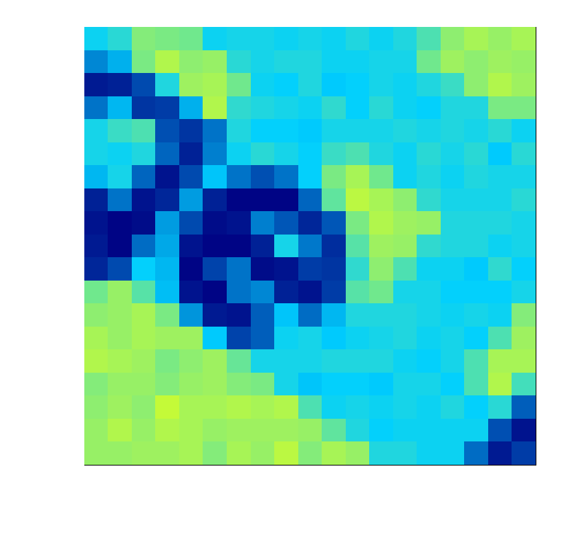
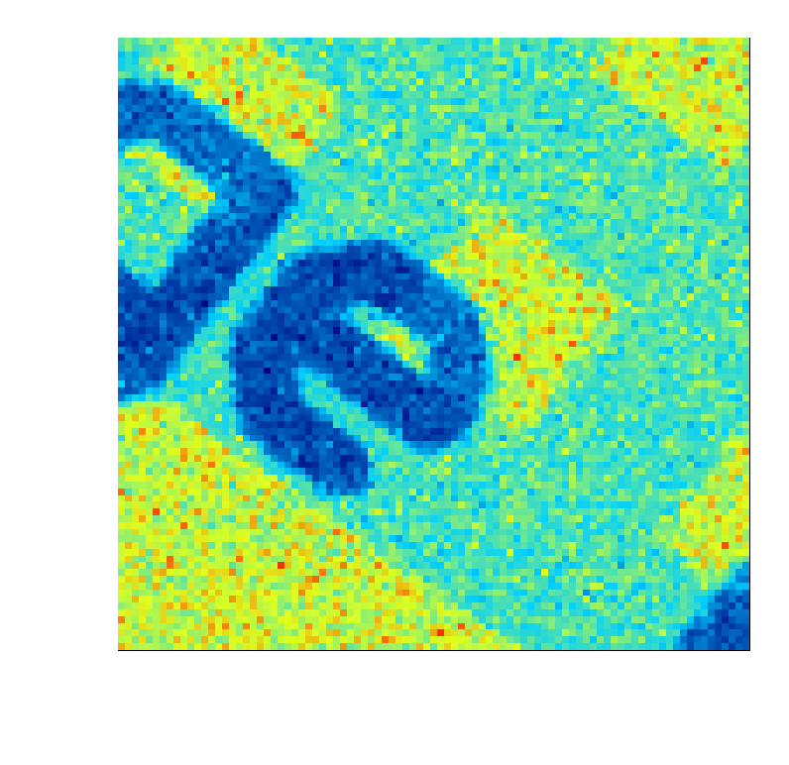
Interpolation
MÖNCH03
W-tube 55kV
EIGER HDI
5 µm bins
25 µm pixels
Interpolated
Grating-based,G2-less, phase contrast imaging

Slide 21
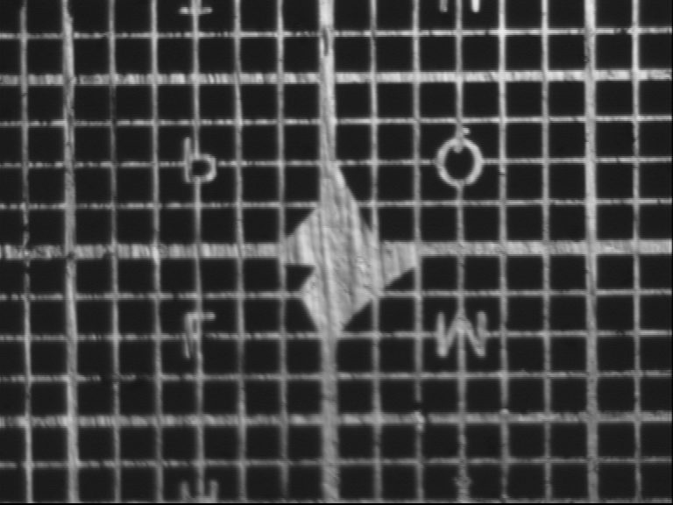
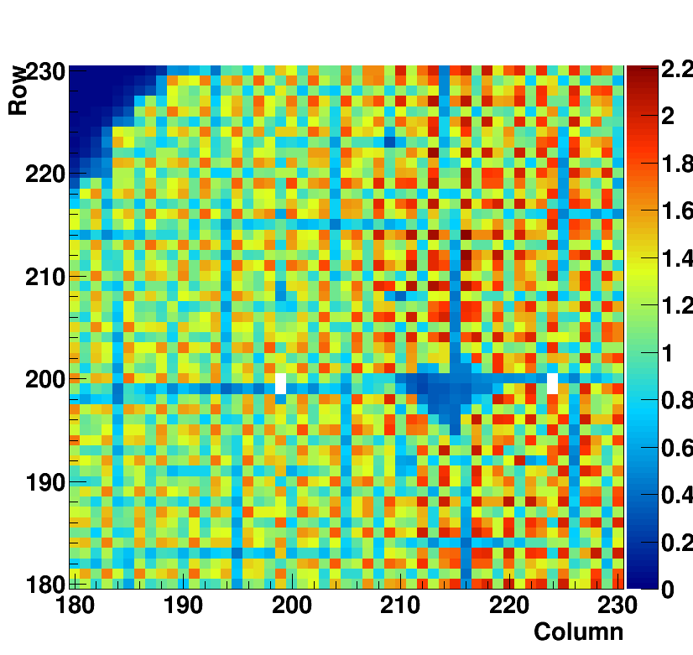
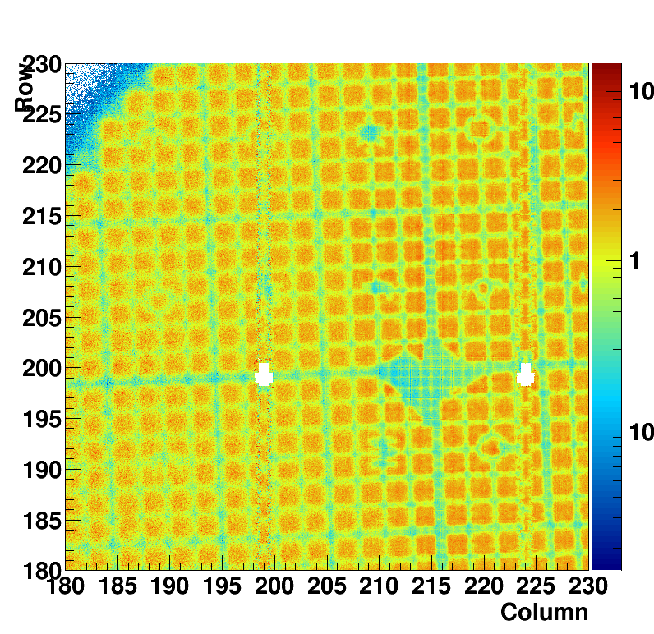
Interpolation at low energy
Absorption image of metal grid
PHOENIX beamline at PSI
2 keV energy photon beam
63 μm pitch
12 μm bar width
51 μm hole width
No position interpolation
25 µm bins
With position interpolation
1 µm bins

Slide 22
Towards larger area
Large area MÖNCH (end 2017?)
  Low noise, dynamic gain switching
  ASIC 2 x 3 cm² (768 x 1024 channels ~800k pixel)
  Modules up to 4 x 3 cm² (~ 1.6M pixel)
  Almost 1G pixel after interpolation
DAQ challenge
  Currently 32x40MHz ADCs, 2X10Gb interfaces
    -Already limited by backend (file writing)
  -On the fly (in firmware?) data compression necessary to avoid data throughput overflow
  -Online clustering
Sensors optimized for soft X-rays
  20-200 nm backplane by FBK

Slide 23
Conclusions and outlook
We are learning how to tame a 25 µm pixel pitch hybrid detector
  Good bump-bond yield, Low noise, Large dynamic range
  Some imaging applications tested…
  …many more still to be tried e.g. Laue diffraction, IXS, soft X-rays < 2 keV
We have to work on final detector system
    Define specifications (XFEL?)
    Large area ASIC
    Thin backplane sensors (FBK)
    Capability to handle huge data amount
  MÖNCH can be a tool to study charge collection
    Different sensor designs, thickness, e⁻/h collection
    High-Z sensors

Slide 24
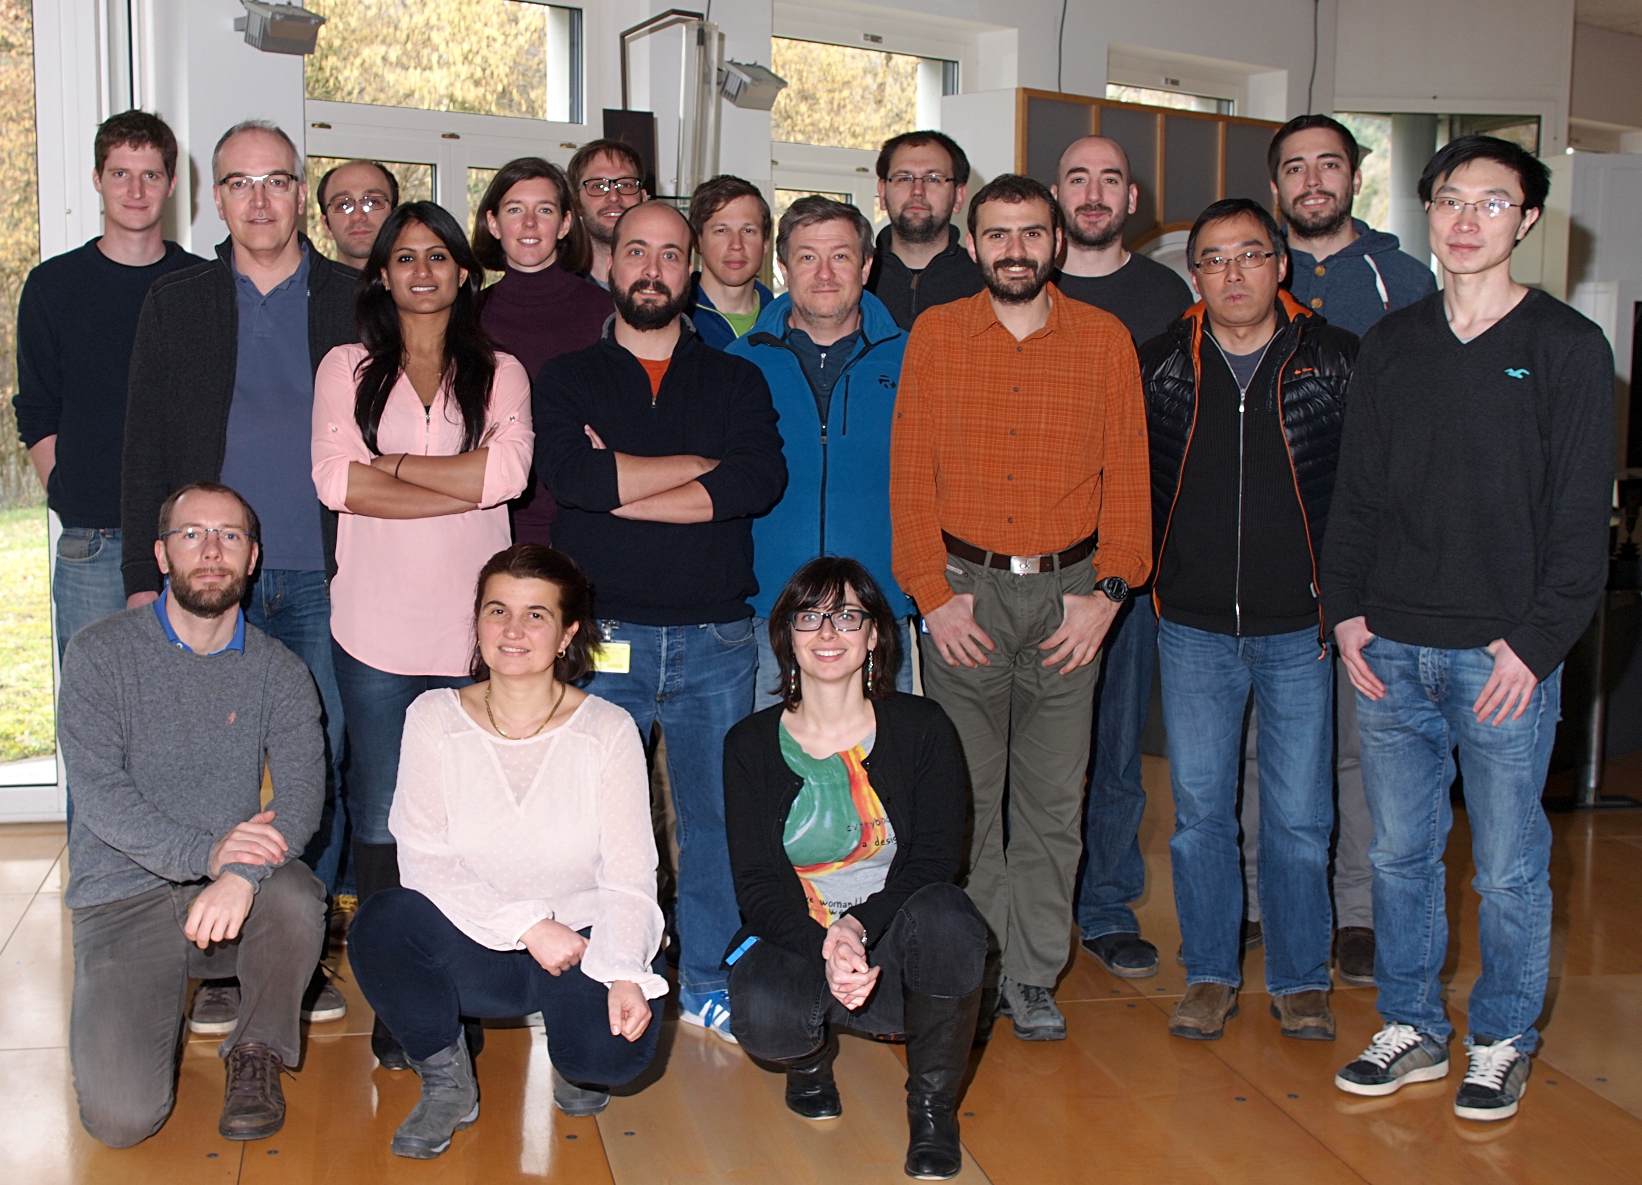
The SLS detector group at PSI
Dominic
Greiffenberg
Martin
Brückner
Lukas
Schädler
Davit
Mayilyan
Sophie
Redford
Christian
Ruder
Erik
Fröjdh
Sebastian
Cartier
Bernd
Schmitt
Roberto
Dinapoli
Davide
Mezza
Jiaguo
Zhang
Dhanya
Thattil
Xintian
Shi
Marco
Ramilli
Aldo Mozzanica
Anna Bergamaschi
Gemma Tinti
Th. Huthwelker @PHOENIX, A. Diaz @cSAXS, Zh. Wang, M.Kagias, M. Stampanoni @TOMCAT

Slide 25
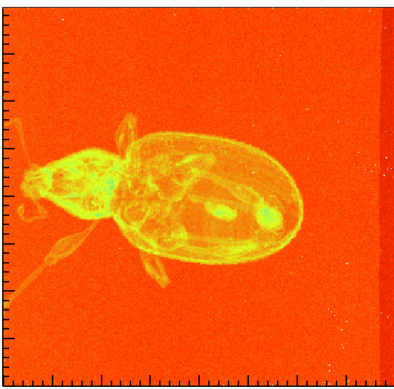
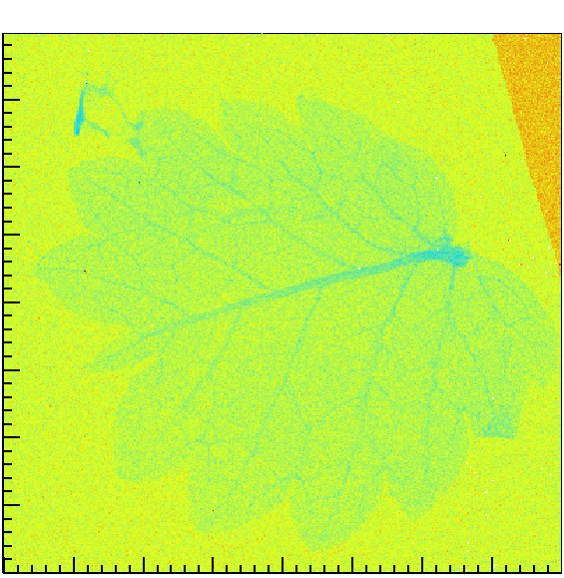
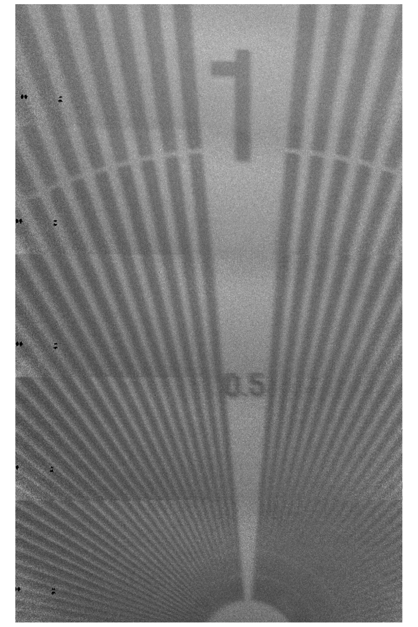
Thank you!

Slide 26
MÖNCH 03 additioal features
Readout on both sides
Improved column buffer
Improved s. ended to diff. off-chip buffer
Storage caps can be kept disconnected from pixel buffer
One storage cap is now a MimCap
Region of interest possible (frame rate > 6kHz)
Additional debugging features

Slide 27
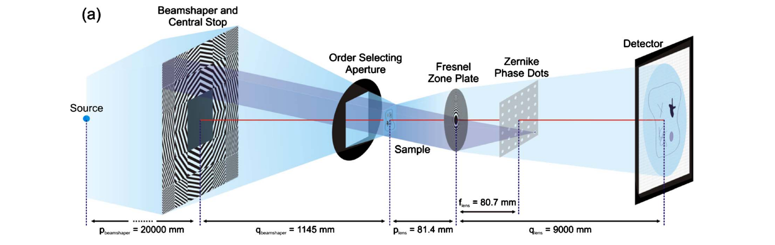
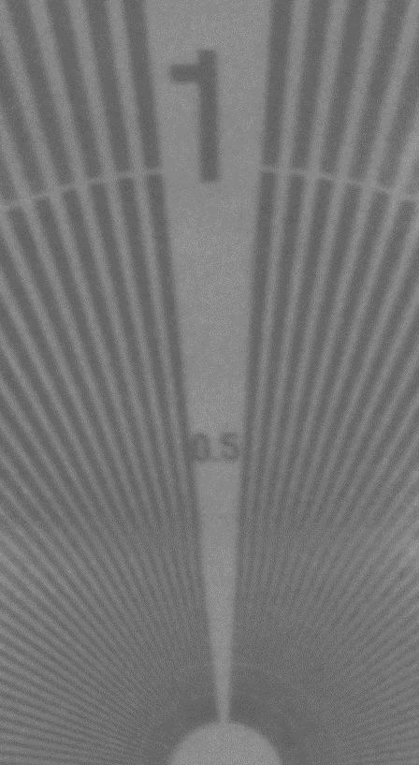
Nanoscope imaging with Moench
Magnification: ~80x
No Zernike phase dots
Si111 and 40 μm Cu
Siemens star test images
80μm
MÖNCH02
25μm pixel
interpolation
5 x stitching
not cooled
Photonic Science CCD
4μm pixel
2 x stitching
cooled

Slide 28
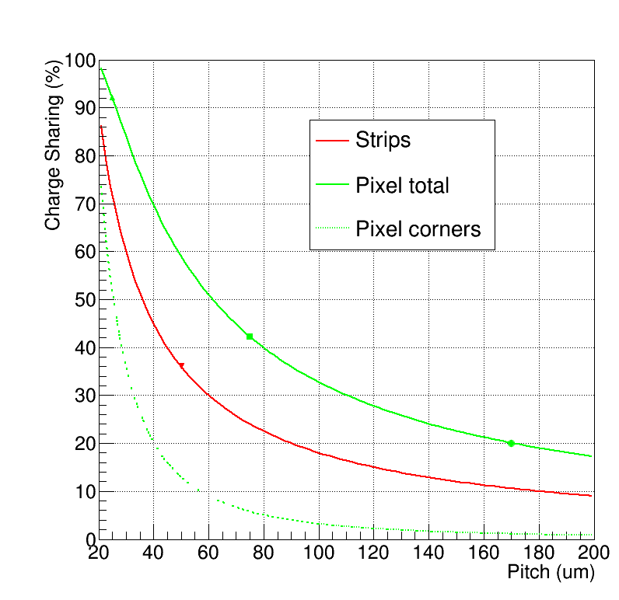
Charge sharing
The charge diffuses while drifting to the electrodes
The diffusion length depends on the drift time:
  Charge mobility/diffusivity
  Applied bias voltage
  Absorption depth
    Sensor thickness
    X-ray energy
The charge can be collected by several strips/pixels
  For 320 um thick sensors, 120V bias voltage we have measured a charge sharing region of 15-20 um
X-ray
MÖNCH
JUNGFRAU
EIGER
PILATUS
MYTHEN
GOTTHARD

Slide 29
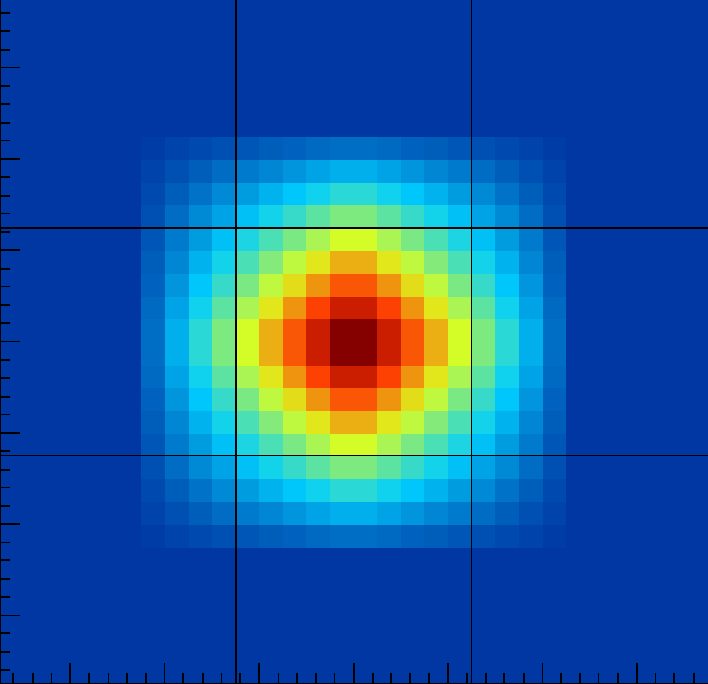
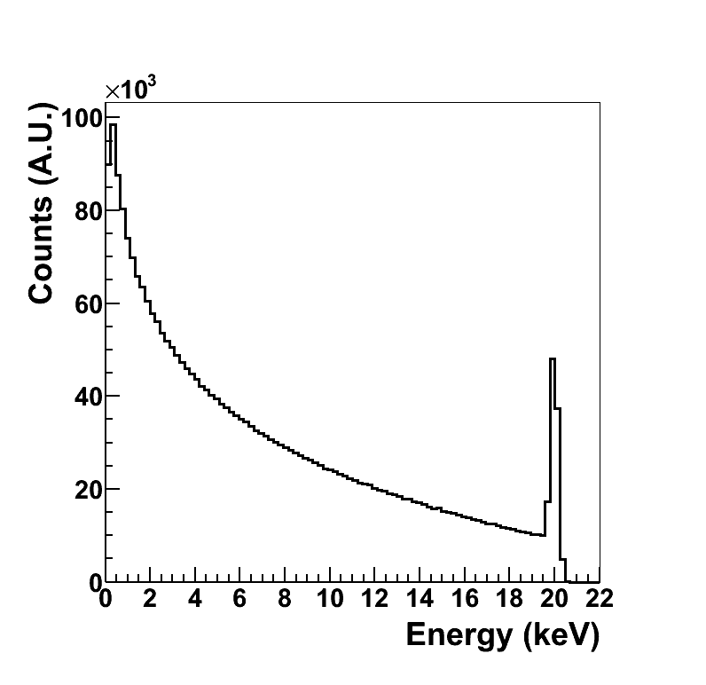

Linear charge collection model
d
p
Full charge collection
Charge sharing
Sides
Corners
Noise convolution
α : d_{chargeSharing} /pitch
Q₀ : total charge
Q : collected charge
σ : electronic noise ENC_{rms}
A : number of photons

Slide 30
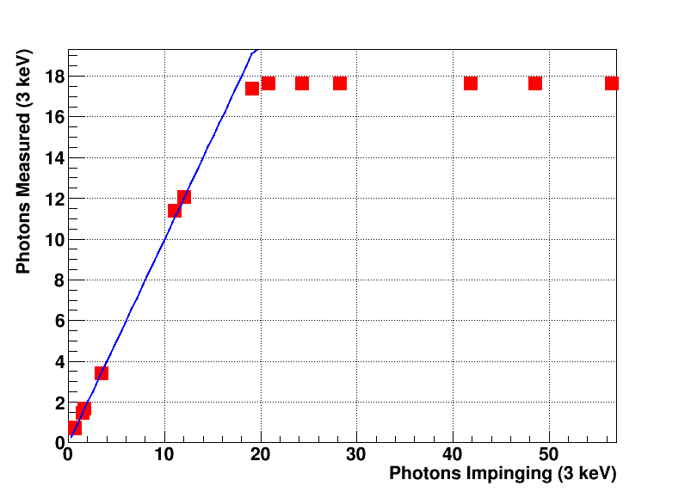
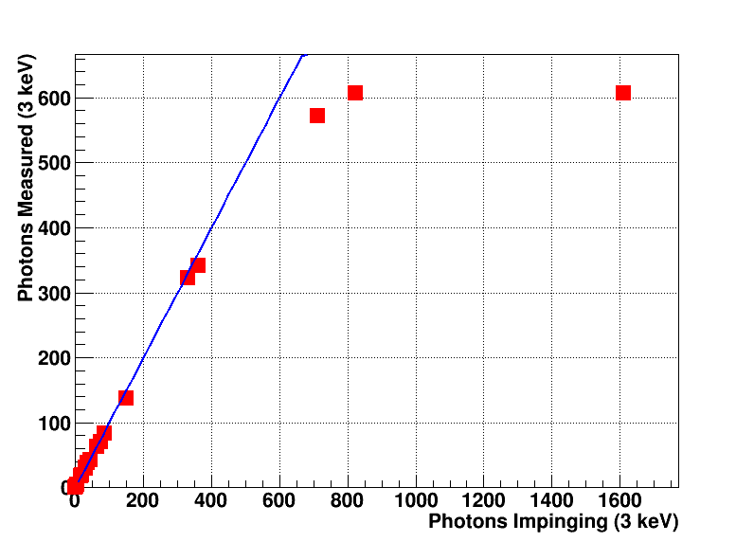
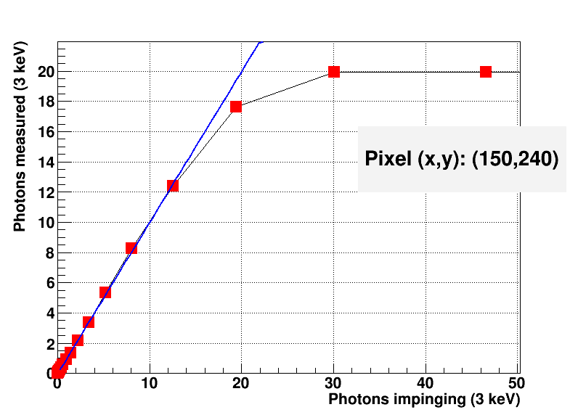
Dynamic range for MÖNCH 03
IR laser
ND filters
Highest Gain Setting
Lowest Gain Setting
3 keV photons
Kapton thickness
Highest Gain Setting
Dynamic range:
600 3 keV photons at lowest gain setting
18 3 keV photons at highest gain setting
  non-linearity due output buffer saturation
  optimize chip settings

Slide 31
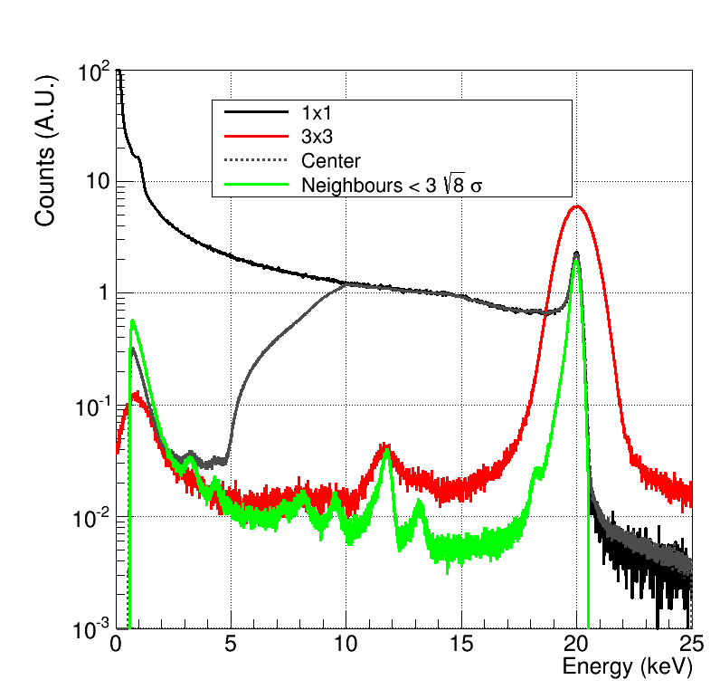
Energy resolution
MÖNCH02 20keV monochromatic data.
The fluorescence lines come from the detector itself.
No spectral information from single pixel with no cuts
Clustering increases the noise
Cuts to charge sharing as “offline collimation”
  99% rejection rate
Use larger pixels
Main beam
20 keV
Compton
Edge
1.45 keV
In
3.3 keV
Au
9.7 keV
Si escape
18.2 keV
Ni
7.4 keV
Ti
4.5 keV
Cu
8.0 keV
Br
11.9 keV
Rb?
13.3 keV

Slide 32





Position dependent resolution
Position dependent resolution
Average better than 2µm
Ultimate lower than 1µm
No interpolation
250 μm
ERF(σ)
Interpolation
Resolution=σ
Charge collection efficiency at 16 keV
Pencil beam scan at cSAXS with nano-focused beam using FZP
Analysis in progress
Selective
radiation damage
Resolution
in X
< 1um RMS
In the corner

Slide 33


Grating-based phase contrast imaging
~ 5 um
No sample
G2 Analyzer grating
G1 Phase grating
Absorption
Darkfield
Sample
Phase shift
A detector with sufficient spatial resolution and SNR allows to remove G2
Lower dose
Shorter exposure
No stepping
Larger area
Higher energies
Creates periodic
intensity
modulations
Makes fringes
visible on large
detector pixels

Slide 34



Phase retrieval
Performed at TOMCAT beamline at PSI
16 keV beam
Si wafer target
Pyramids of different size
Absorption
G2-less works in 2D and matches simulations
Hilbert-transform based algorithm developed to deal with position dependent resolution
Fringes visible only at the boundary between pixels

Slide 35
Imaging
After clustering
  Photon counting behavior
  25 µm spatial resolution
…but we can exploit charge sharing within cluster to interpolate
Images acquired MÖNCH03 with W-anode X-ray tube, 55kV 30mA

Slide 36

Position dependent charge sharing
Looking at the charge collection distribution adds information to the absorption position
Charge collection
Charge collection
Charge collection
Charge collection

Slide 37

η distribution algorithm
η_{x} = R/(L+R)
η_{y} = T/(B+T)
Flat field image acquired previous to the measurement to measure the η correction map
Each (η_{x}, η_{y}) pair can be assigned to a position in the pixel after linearization
Works well in 1D but…
…in 2D η_{x} and η_{y} are strongly correlated and linearization does not work properly
  Non-flat flat field image and artefacts
Iterative method developed to obtain artefact-free images

Slide 38



Energy calibration
Developed linear model to deal with 100% charge sharing
Gain used to convert pedestal distribution into noise in e⁻
Width of the photon peak given by
ENC and Fano Noise
Dynamic range and linearity still to be fully characterized

Slide 39

Pencil beam scan
Experiment at cSAXS with nanofocused beam using FZP
8, 16 keV data acquired
Analysis in progress
Resolution in X
< 1um RMS
Charge collection efficiency at 16 keV
Selective
radiation damage
Resolution in Y
̴̴ ≈1.5um RMS
Beam asymmetry
or
electronic noise

Slide 40


Non uniform charge sharing seems the most limiting factor
Absorption image of metal grid
  63 μm pitch, 12 μm bar, 51 μm hole
PHOENIX beamline at PSI, 2 keV
  In vacuum
No position interpolation
25 µm bins
near the pixel center
With position interpolation
1 µm bins
near the pixel edges

Slide 41


Interpolation limitations
Position resolution improves with:
  Higher Signal to Noise Ratio
    High photon energy
    Low electronic noise
  More uniform charge sharing
    Lower photon energy
    Lower sensor bias
    Thicker sensor
    Smaller pitch

