Slide 1
Development of CdTe Pixel Detectors combined with Aluminum Schottky sensor and Photon-Counting ASICs
H. Toyokawa¹, C. Saji¹, M. Kawase¹, S. Wu¹, Y. Furukawa¹, K. Kajiwara¹, K. Osaka¹, M. Sato¹, T. Hirono², A. Shiro³, T. Shobu³, A. Suenaga⁴, H. Ikeda⁵
¹Japan Synchrotron Radiation Research Institute,
²Universitaet Bonn,
³Japan Atomic Energy Agency,
⁴Howa Sangyo Co., Ltd.,
⁵Japan Aerospace Exploration Agency
H. Toyokawa, PIXEL2016, Sestri Levante, Italy, 5-9 Sep. 2016

Slide 2
Overview
Motivation and Design Concepts
SP8-04F10K detector
  Threshold trimming
  Bias voltage
  Long term stability
  Laue diffraction measurements
  Large area detector
Summary and outlook

Slide 3
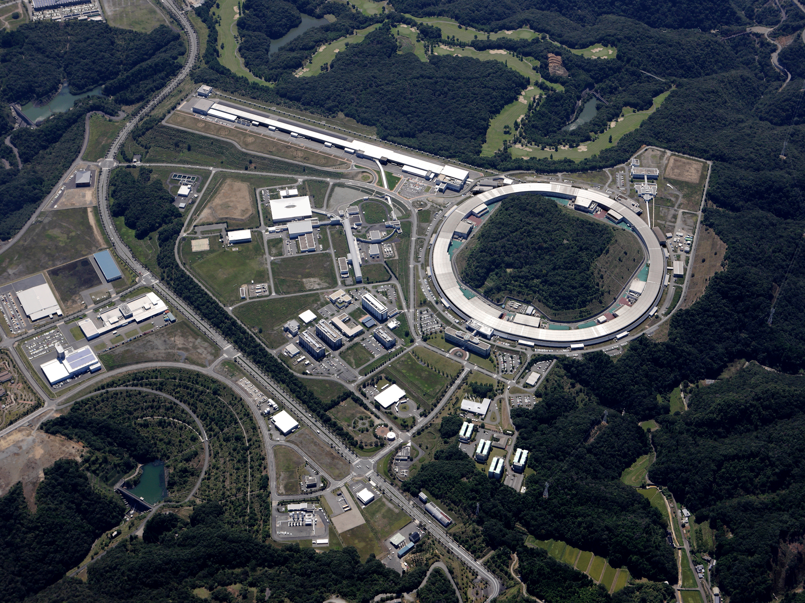
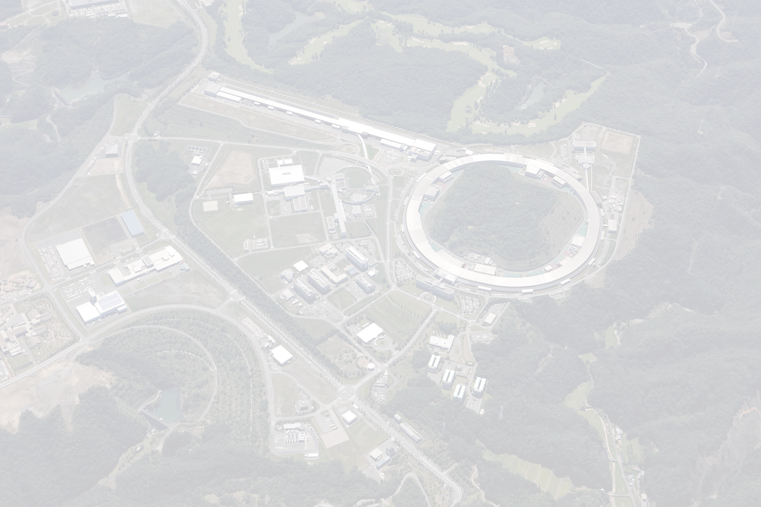
March 2012
SACLA (XFEL) 8 GeV Linac
SPring-8
8 GeV Storage Ring
Oct. 1997
We have been developing 2D-type high energy X-ray detectors combined with CdTe Schottky diode sensors and photon-counting readout ASICs in use for synchrotron radiation experiments.
H. Toyokawa, PIXEL2016, Sestri Levante, Italy, 5-9 Sep. 2016

Slide 4
Pixelated sensor structures
 | CdTe | CZT | Ge | Si
density (g/cm³) | 5.85 | ~5.8 | 5.33 | 2.33
atomic number | 48, 52 | 48, 30, 52 | 32 | 14
band gap energy (eV) | 1.44 | ~1.65 | 0.67 | 1.12
Ionization energy (eV) | 4.43 | ~5.0 | 2.96 | 3.62
resistivity (Ωcm) | 10⁹ | 10⁹~10¹¹ | 3900 | 1400
μ_{e} (cm²/V・s) | 1100 | 1000 | 3900 | 1400
μ_{h} (cm²/V・s) | 100 | 50~80 | 1900 | 480
τ_{e} (s) | 3×10⁻⁶ | 3×10⁻⁶ | >10⁻³ | >10⁻³
τ_{h} (s) | 2×10⁻⁶ | 10⁻⁶ | 1×10⁻³ | 2×10⁻³
X-ray
- Bias voltage
CdTe sensor is generally fabricated with a metal/CdTe/metal structure.
We have investigated Pt/CdTe/Al-pixel configuration by using high resistivity p-type CdTe wafers 750 μm in thickness.
This configuration has the advantage of providing a high Schottky barrier formed on the Al/CdTe interface, and, hence, a benefit to operate the CdTe as an electron-collecting pixelated diode.
Pt
h
e⁻
Al
ASIC
Pt/CdTe/Al-pixel

Slide 5
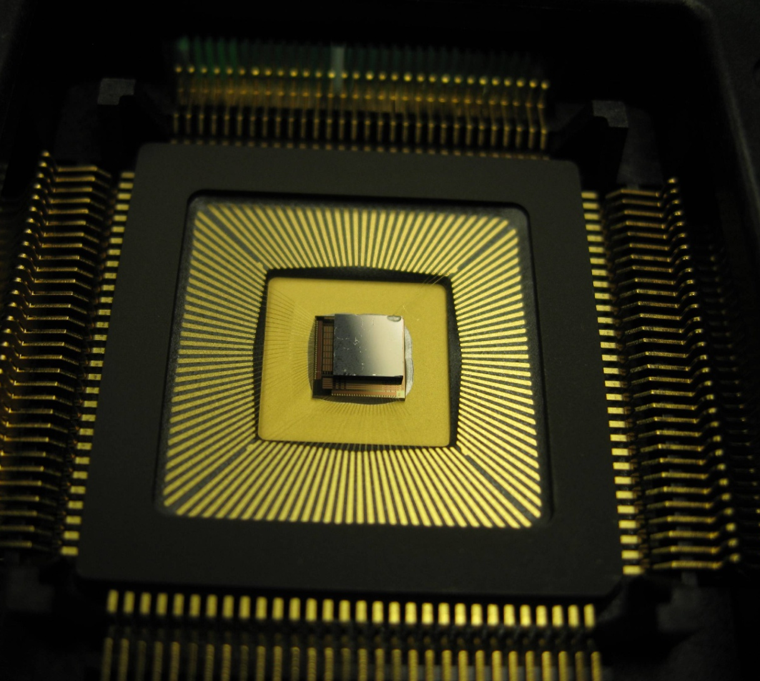
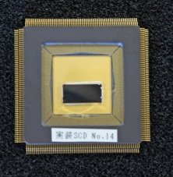
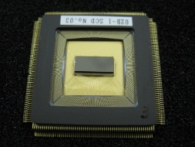
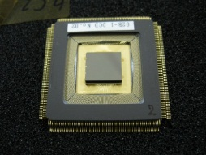
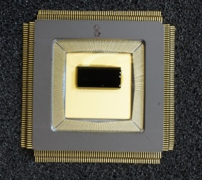
Upgrade to SP8-04 ASIC
 | SP8-01 | SP8-02 | SP8-02B | SP8-03 | SP8-04 (final)
pixel size (μm²) | 200 × 200
format | 16 × 16 | 20 × 50 |  |  | 20 × 50 A1K 20 × 100 W2K 95 × 50 L5K 95 × 100 F10K
preamp | high / low gain |  |  | tunable gain
comparator | upper / lower |  |  | upper/lower×3
counter | 20 bits |  |  | 24 bits
process | 0.25 μm (TSMC) |  |  | 0.18 μm (TSMC)
 | Cybershuttle |  |  |  | Full wafer run
2010
SP8-01
16×16 pixels
2011
SP8-02
20×50 pixels
2012
SP8-02B (optimized ASIC)
20×50, 41×50 pixels
2013
SP8-03 (3-window comp.)
20×50 pixels

Slide 6
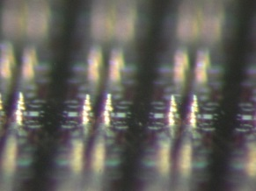
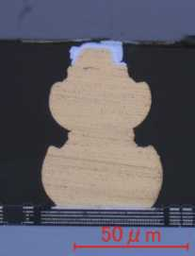
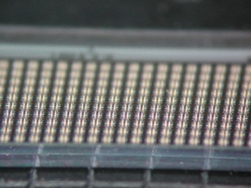
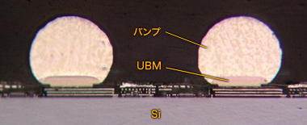
Bump-bonding
SP8-04
SP8-01, 02, 02B, 03
Au-stud bonding
Bi-Sn solder bonding

Slide 7
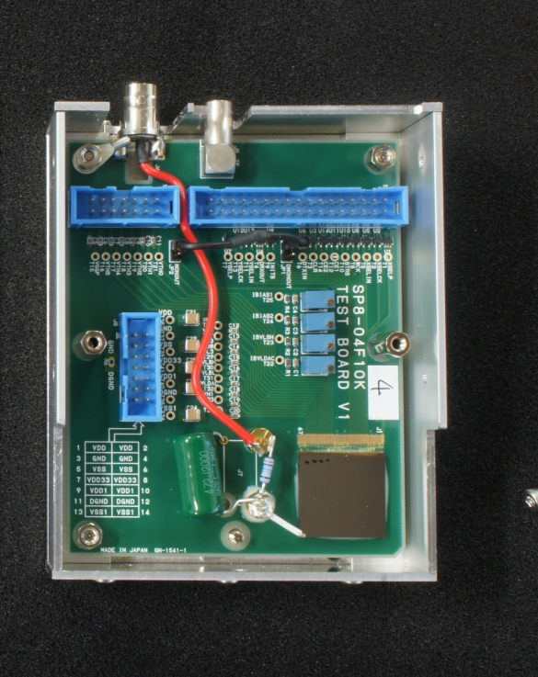
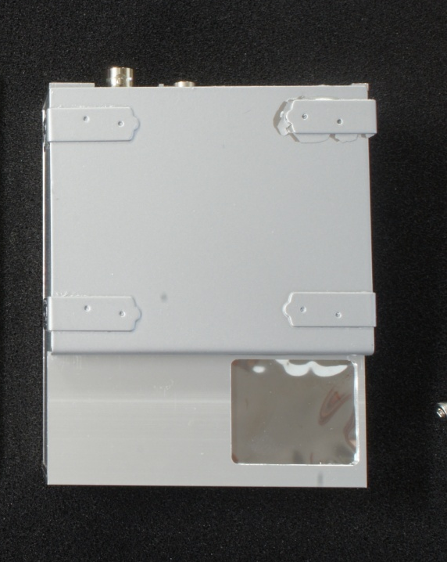
SP8-04F10K single chip detector
Thickness : 750μm
Pixel size : 200μm²
Format : 95×100

Slide 8
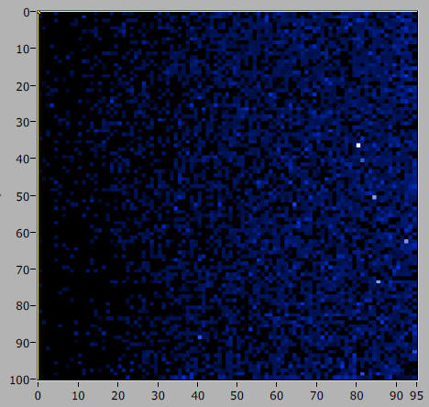
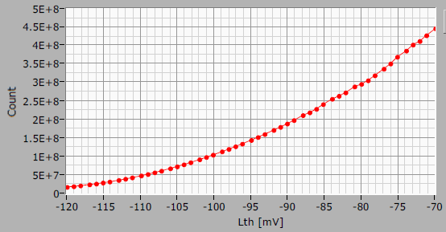
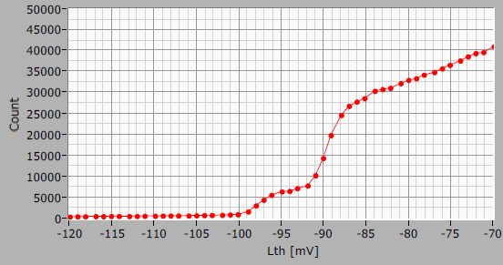
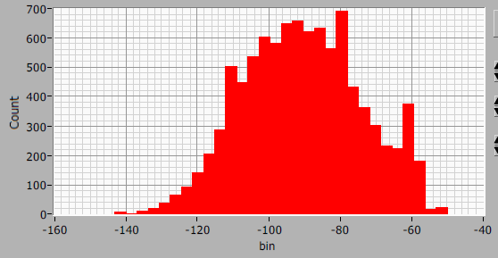
Threshold scan (W fluorescence, untrim)
Thr = -90 mV
Total counts
Pixel (20,65)
Threshold dispersion Kα edge
Kα

Slide 9
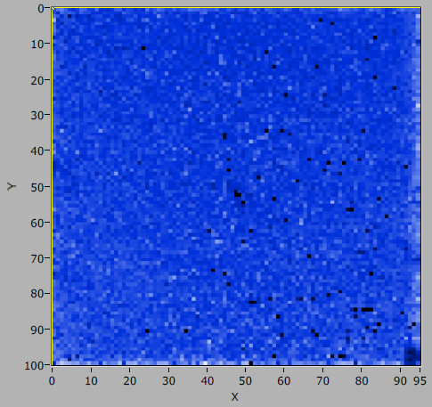
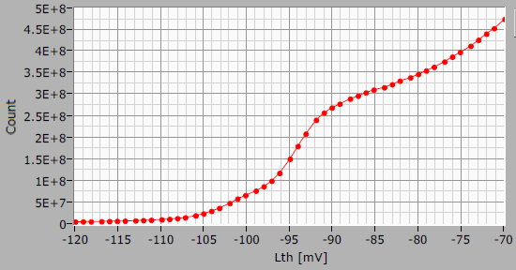
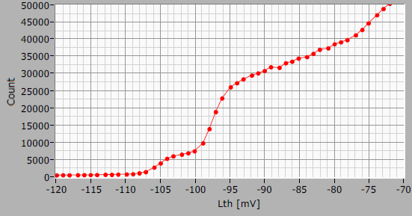
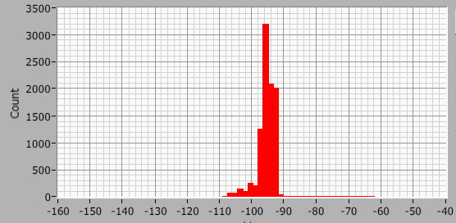
Threshold scan (W fluorescence, trimed)
Thr = -90 mV
Total counts
Pixel (29,60)
Threshold dispersion Kα edge
Kα

Slide 10
Depletion voltages (W theshold scan)
-50 => -400 V
-400 => -600 V

Slide 11
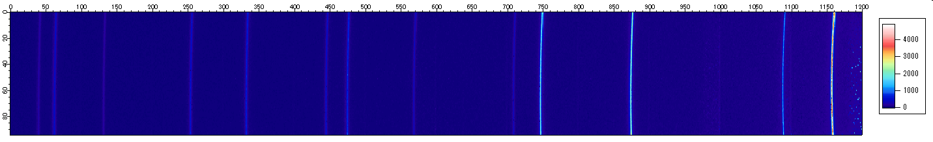
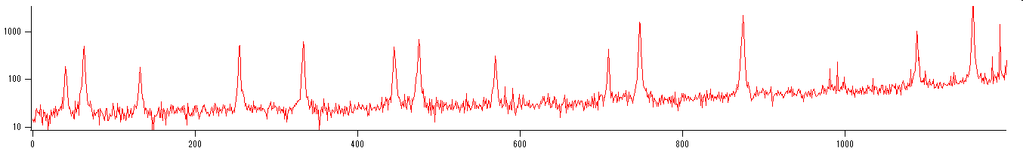
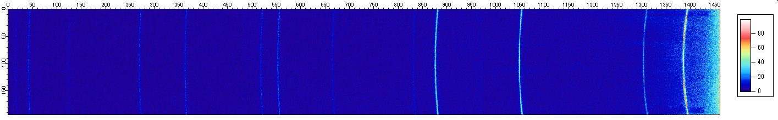
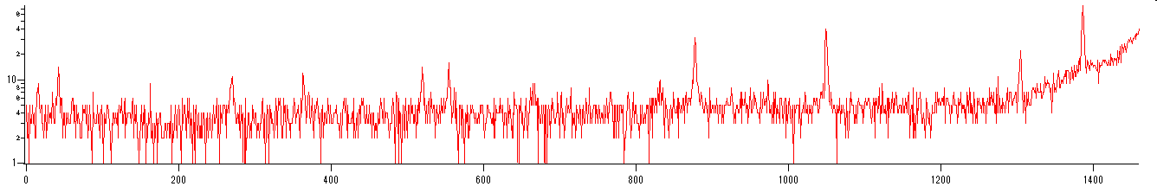
Comparison of CdTe and Si detector
CdTe
PILATUS
CeO₂ diffraction pattern and line profile at 70 keV

Slide 12
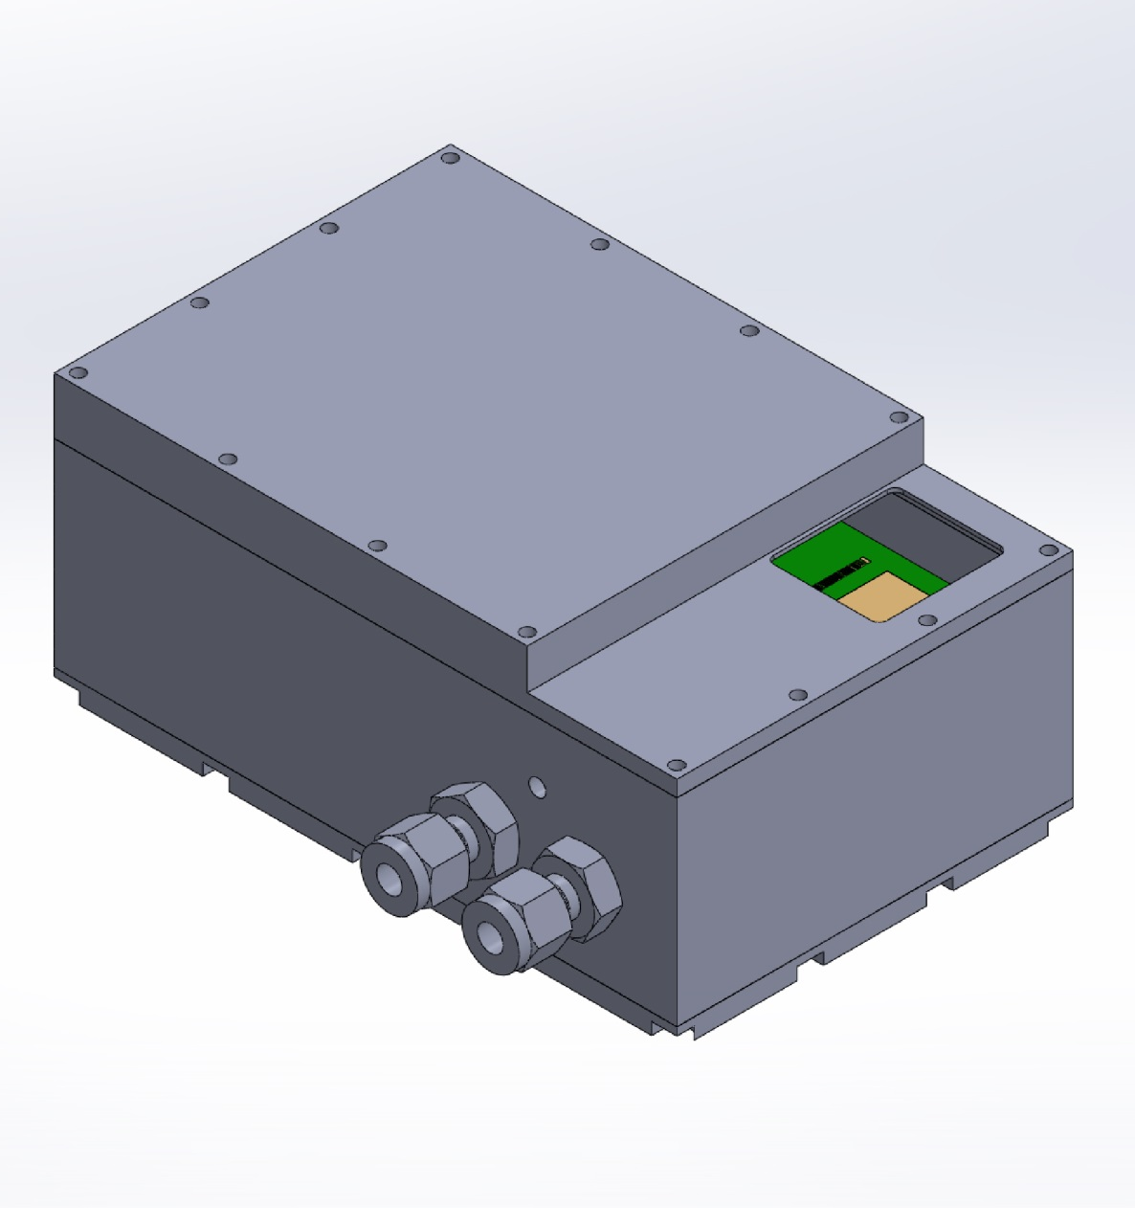
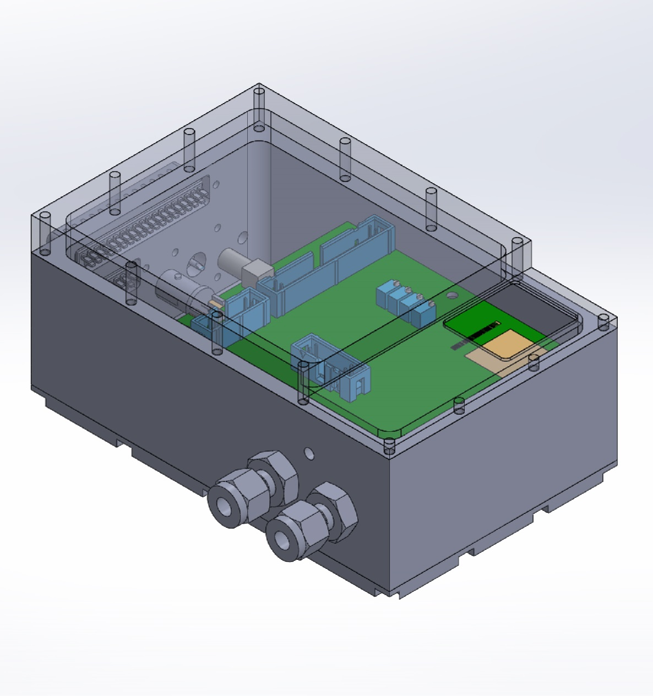
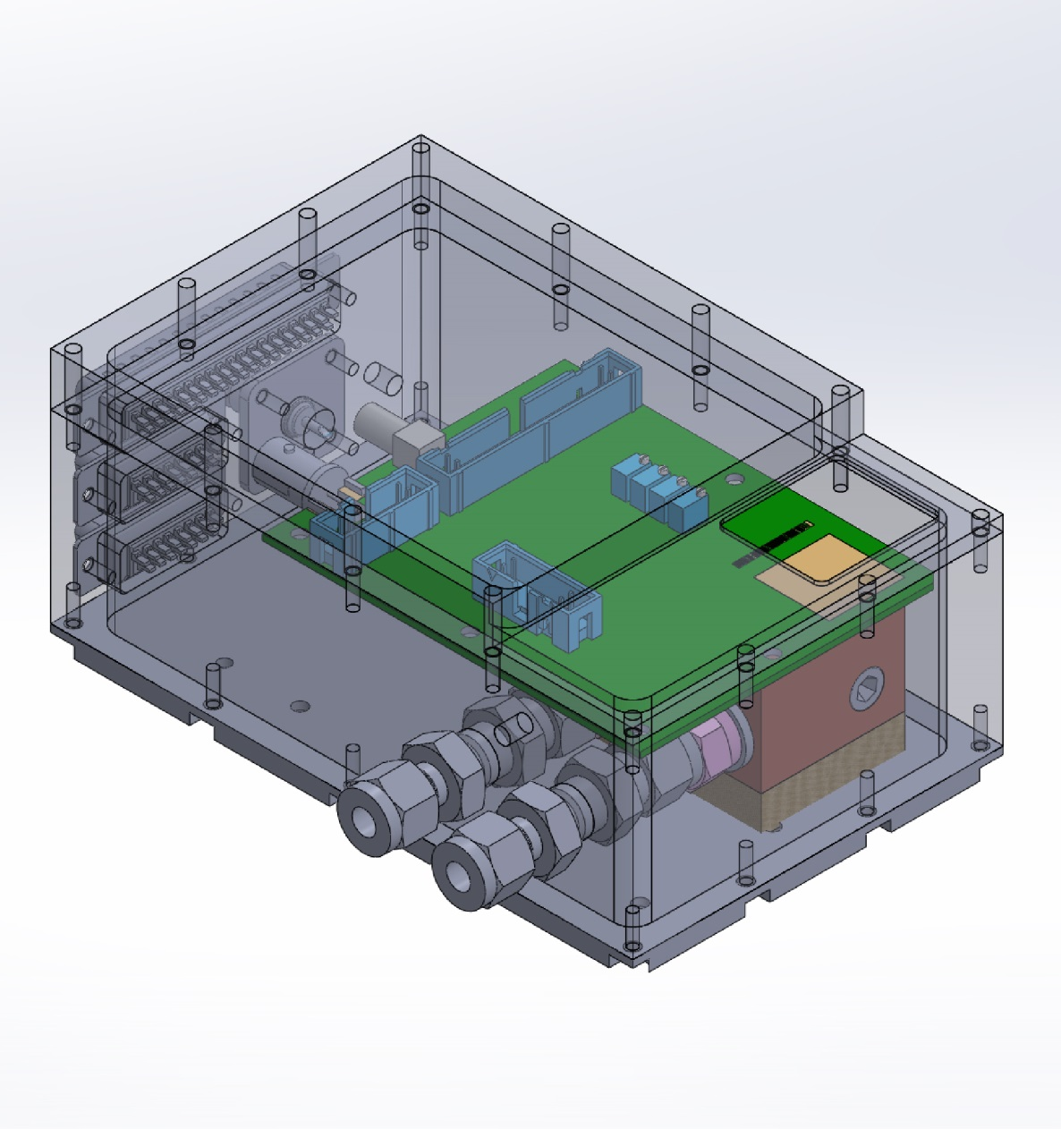
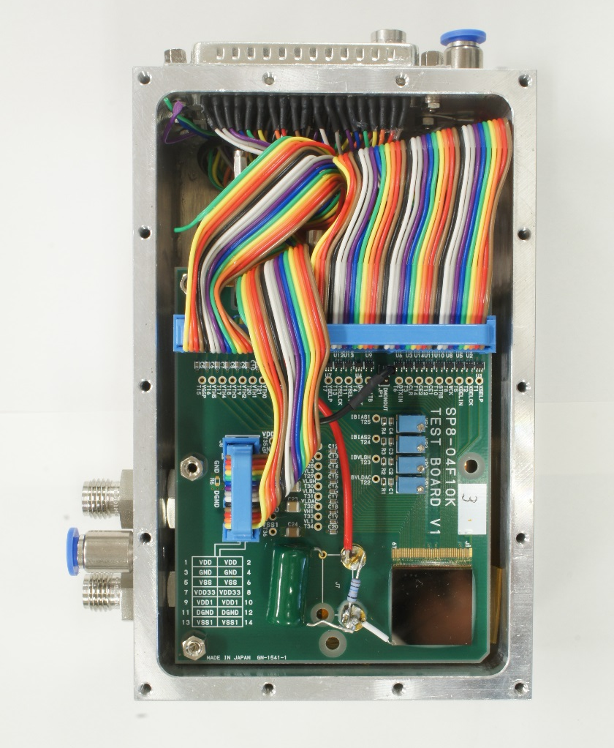
Water-cooled detector

Slide 13
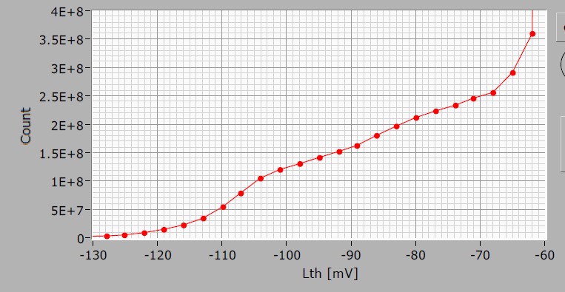
Stability measurement @ 20 degrees
Lower threshold scan
10 sec
0.6%
Pb fluorescence
Temperature = 20 degrees
HV = 500V
Threshold = -90 mV
10 min

Slide 14
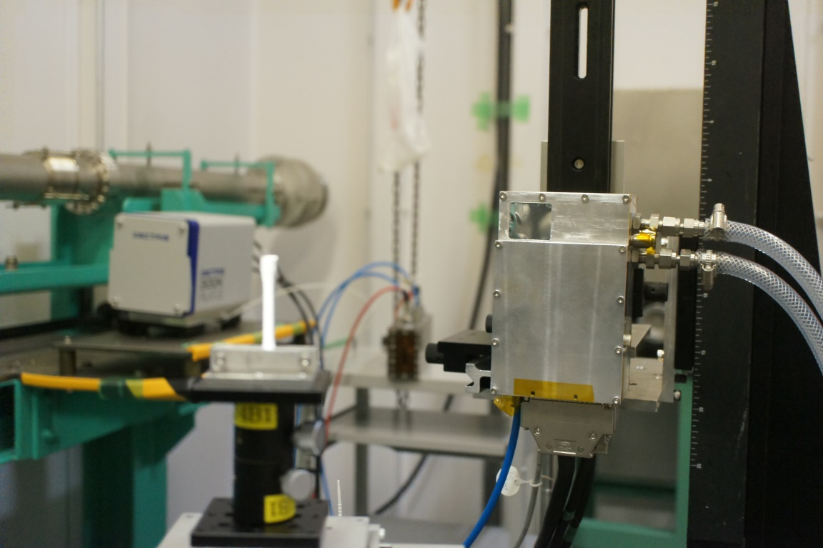

Micro white-Xay Laue diffraction
Experimental setup with Al sample

Slide 15
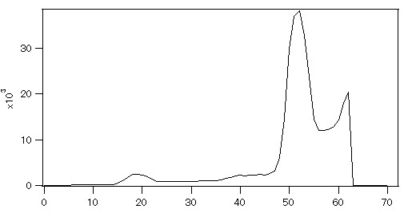
Energy measurement with comparator scan
Comparator threshold
Experimental setup with Al sample

Slide 16
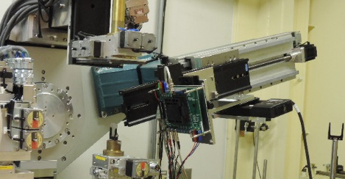

Grain boundary imaging with SP8-02B
silicon steel plate
40×30 positions
0.25mm steps
white x-rays
10×10μm²

Slide 17
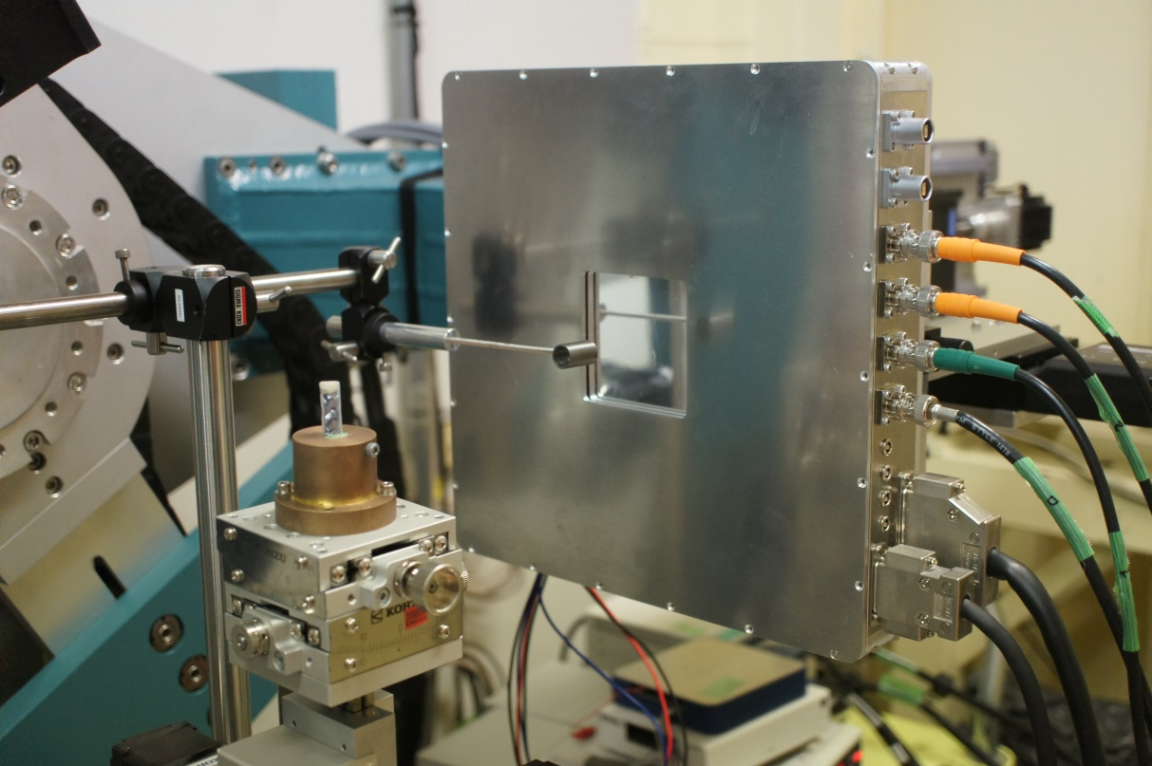
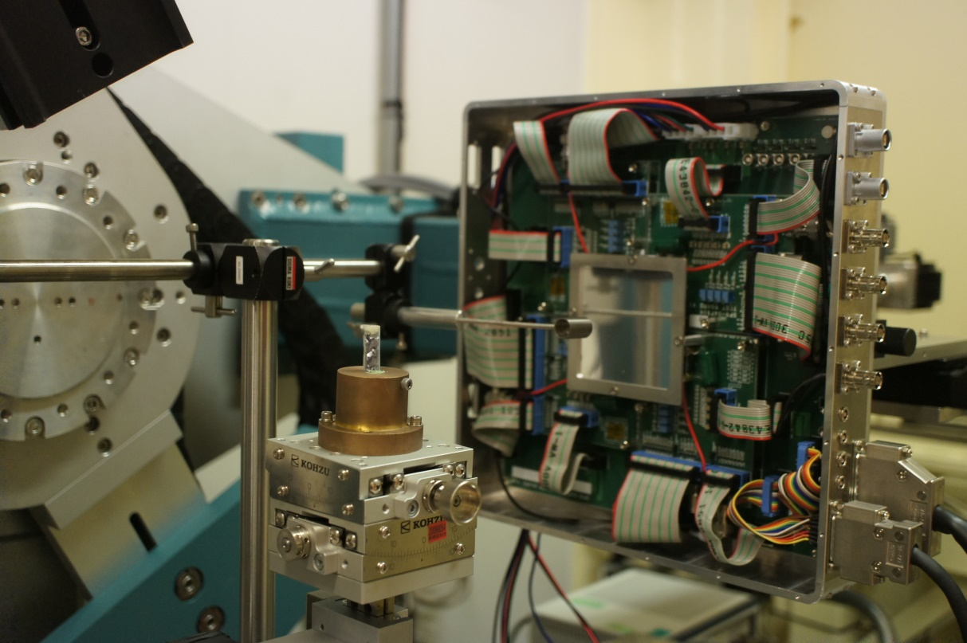
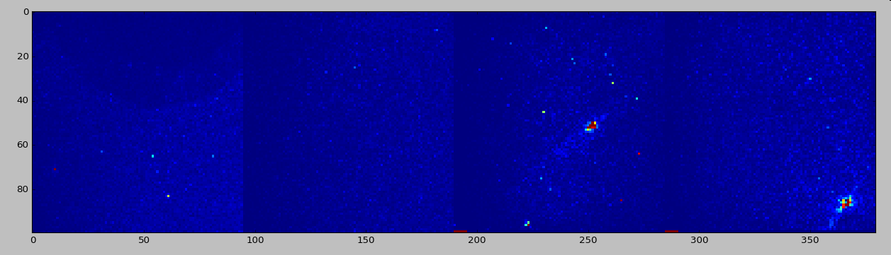
2 × 2 single-board detector

Slide 18
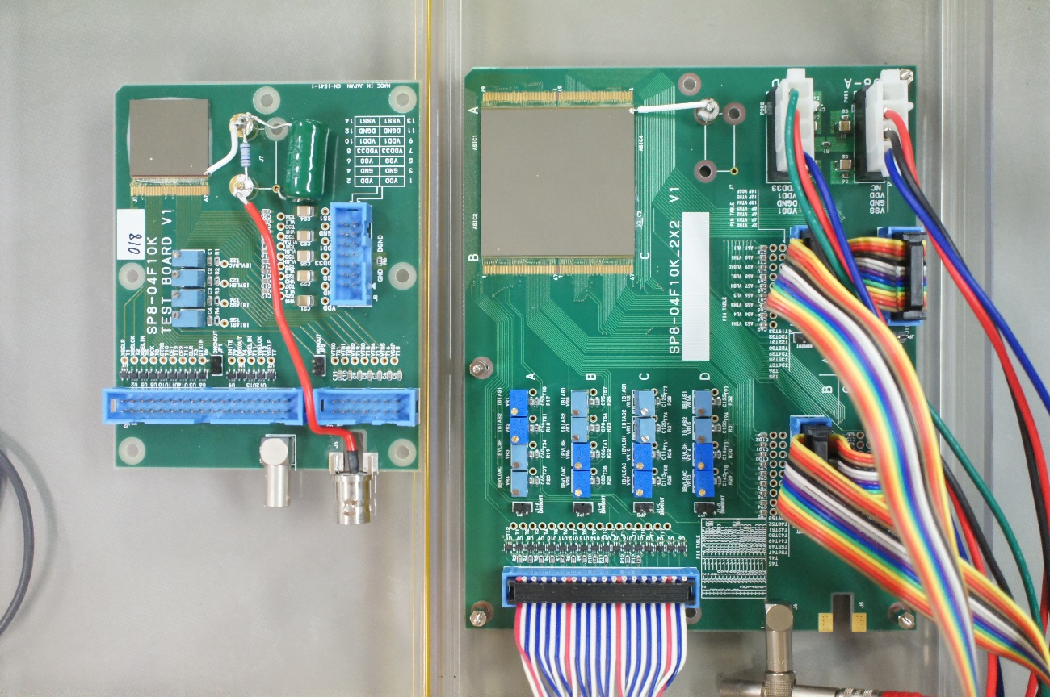
2 × 2 ASICs large area detector
4 cm
SP8-04 F10K
95×100
pixels
CdTe
190 × 200
pixels
3.8 cm

Slide 19
Summary and Outlook
We have been developing 2D high energy X-ray detectors combined with CdTe Schottky diode sensors and photon-counting readout ASICs in use for synchrotron radiation experiments.
SP8-04 ASICs have been processed with TSMC 180 nm technology and F10K ASIC single-chip detector could function as designed.
2 x 2 ASICs large area detector has been newly developed and performances are investigated currently.
2-side buttable design could achieved 8cm x 8cm area detector.
For going to further large are detector, 4-side buttable module will be designed next step.

Slide 20
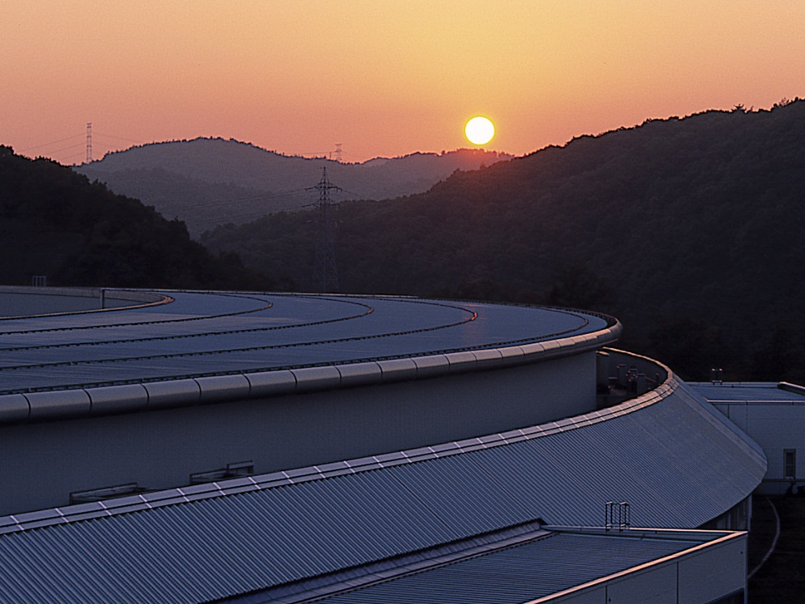
Thank you for your attention!
H. Toyokawa, PIXEL2016, Sestri Levante, Italy, 5-9 Sep. 2016

