Slide 1
Ultra-light Mechanical Supports for Pixel Detectors
PIXEL 2016 Sestri Levante
9-September 2016
Eric Anderssen ECAnderssen@lbl.gov

Slide 2
Overview
Recent Metrics to compare Pixel Detector Mechanics
R&D efforts aimed broadly at improving silicon module support performance and quality for future upgrades
Recent and future examples of low mass pixel supports
Methods to reduce structural and non-structural mass
Thermal performance requirements interaction with structure

Slide 3
Mechanical Parameters of Pixel Detectors
LHC Hybrid Pixels 300-650mW/cm², includes ALICE, CMS, ATLAS, service cross-section dominated by power
R-Φ resolutions 50μm—drives stability requirement, adds in quadrature with %X₀ for resolution calculation
0.2-2.5m² Active Silicon Area, 1.5-2.7η coverage
HL-LHC (and RHIC/EIC, etc) range from 1000mW/cm², to <<100mW/cm² (for MAPS), Service X-section dominated by DATA lines due to new powering schemes or very low power dissipation
Active Areas increase an order of magnitude; pseudo-rapidity increase to 4η for precision physics
Conductor counts stay similar (we hope)

Slide 4
Power Dissipation and Total Power sets differing requirements…
ATLAS and CMS current detectors dissipate ~15kW (600mW/cm²) ~2m² [C3F8]
HL-LHC incarnations approach 100kW for ~10m² [CO2]
ALICE Pixel (0.2m²) dissipates 1.4kW [C4F10]
ALICE ITS upgrade 10m² will dissipate 4kW [Water]
STAR HFT (0.1m²) dissipated 300W total at 300mW/cm²
Air cooling possible for low power density, but only viable for low absolute power (area) in given volume. For high power either evaporative or liquid cooling required…
Evaporative is most efficient—see later talk

Slide 5
Aim to reduce %X₀ all around
Current Hybrid Pixel systems have >2% X₀/layer with Si
Current MAPS achieved ~0.4 %X₀/layer with Si
Future MAPS systems target <0.3 %X₀/layer with Si some less than half of that for specific physics needs
Future Hybrid Pixel systems are proposing and look to achieve under 1% X₀/layer with Si (normal incidence in the barrel)
Local Supports e.g. ‘staves’ dominate at small eta; Services begin to dominate at larger eta…
Service reduction strategies for large eta coverage starts to become important

Slide 6
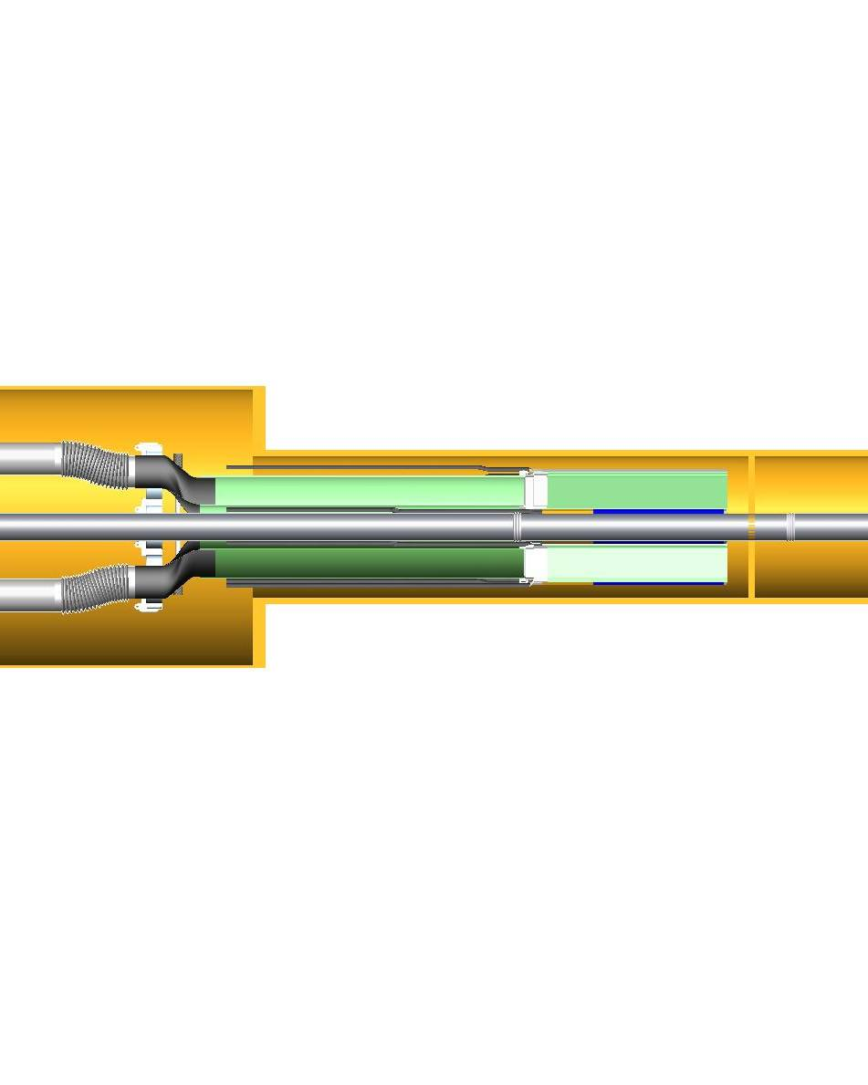
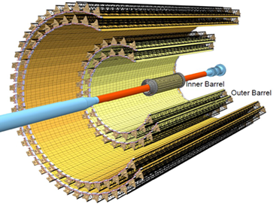
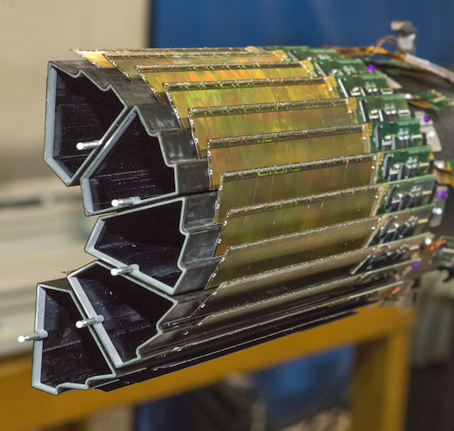
MAPS Examples
ALICE ITS
STAR HFT
HFT was Air cooled due to small area—only 300W and goodly separation between layers, simple forced convection
ALICE ITS Upgrade will have ~4-5kW dissipation with closely packed layers—air cooling paths not sufficient, needs to use monophase cooling to extract heat

Slide 7
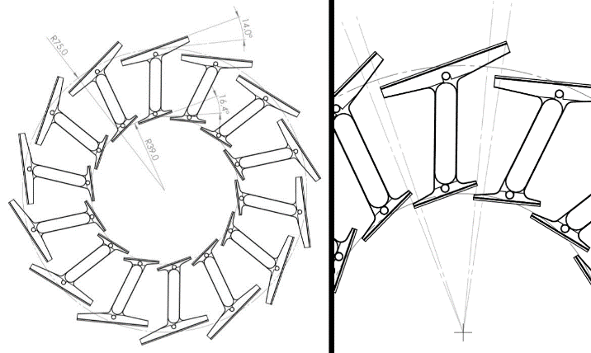
Examples from ATLAS ITK proposals
A common theme in optimizing local supports is to ‘couple’ layers together so that they both share structure and increase sectional inertia
This method was used also in STAR HFT and the original ALICE, obviating the need for ‘global mechanics’ in the central region
The designs shown above integrate cooling directly into the structure

Slide 8
Conductive Heat Flow Paradigm
~0.6W/cm^2 @-15C
Dog on Beach Problem
Previously used Hi-K sheet to deliver heat to cooling channel via thermal contact
Current solution has reduced flux through conductive media
Optimization of material is easier—conductivity is volumetric versus areal
Ability to select ρ/K is useful and important
Thermal Grease 1.4W/mK
CC 40 X 200W/mK (0.5mm)
Flat Tube—increase area
-30C
Sector ‘02
CFRP 1 X 200W/mK (0.075mm)
~1W/cm^2 @-20C
Thermal Grease 1.4W/mK
Carbon Foam (20-40W/mK)
-30C
Current Concept
Buried tube (smaller/higher pressure)

Slide 9
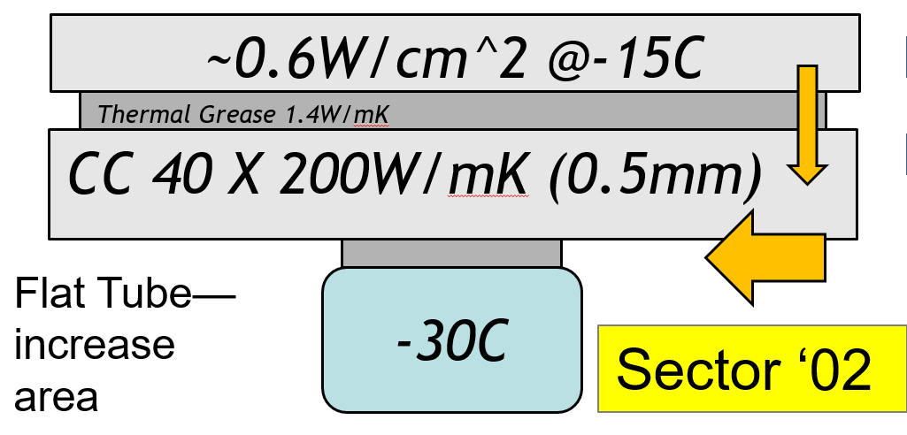
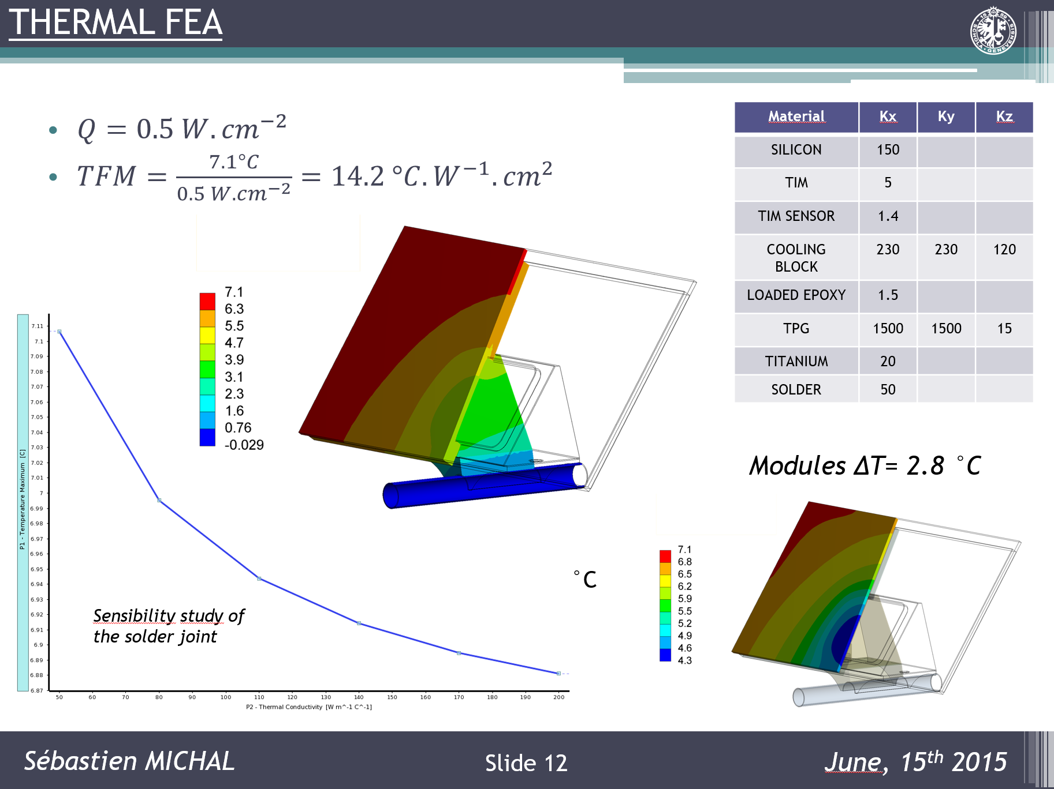
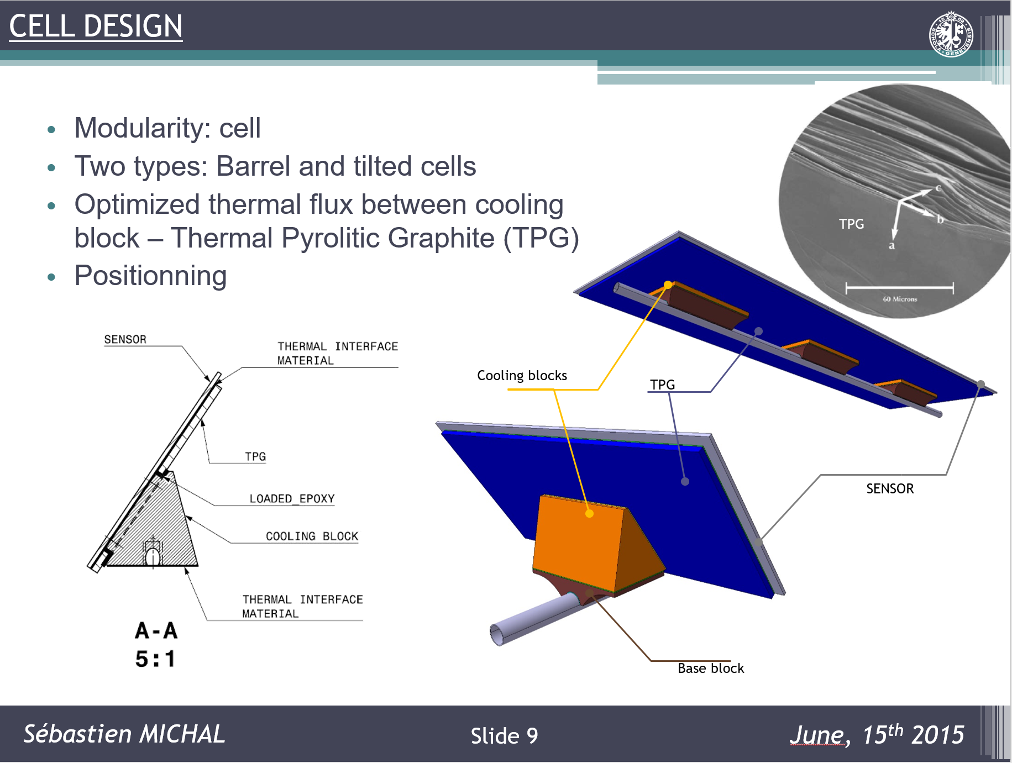
Example of High Conductivity materials to transfer heat to tube
Some designs, due to module orientation relative to tube routing, require interface materials with high thermal conductivity
R&D into properties of these materials is ongoing, developing capabilities to measure them within the community

Slide 10
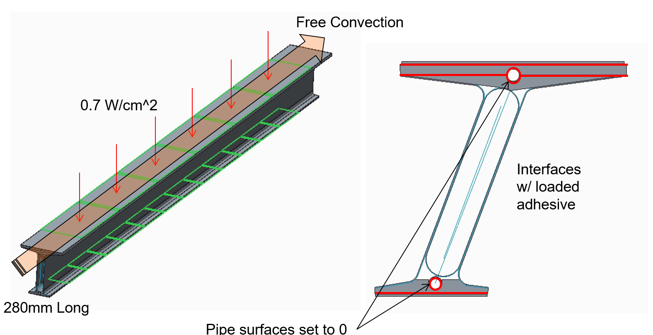
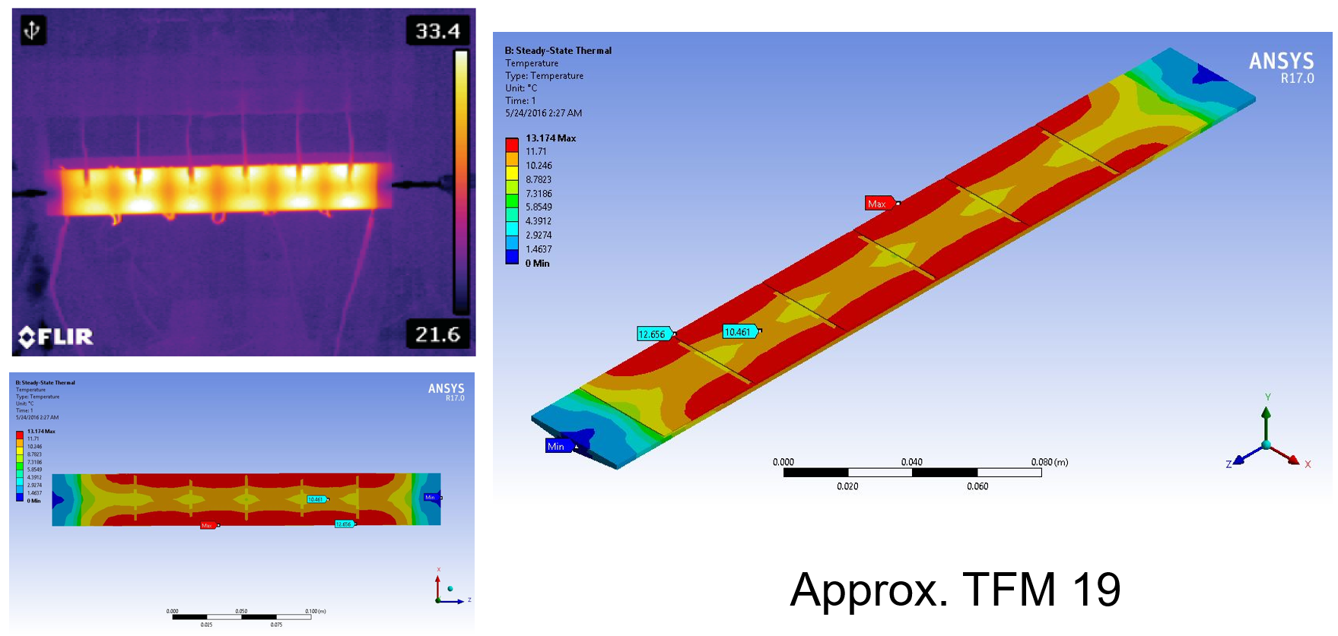
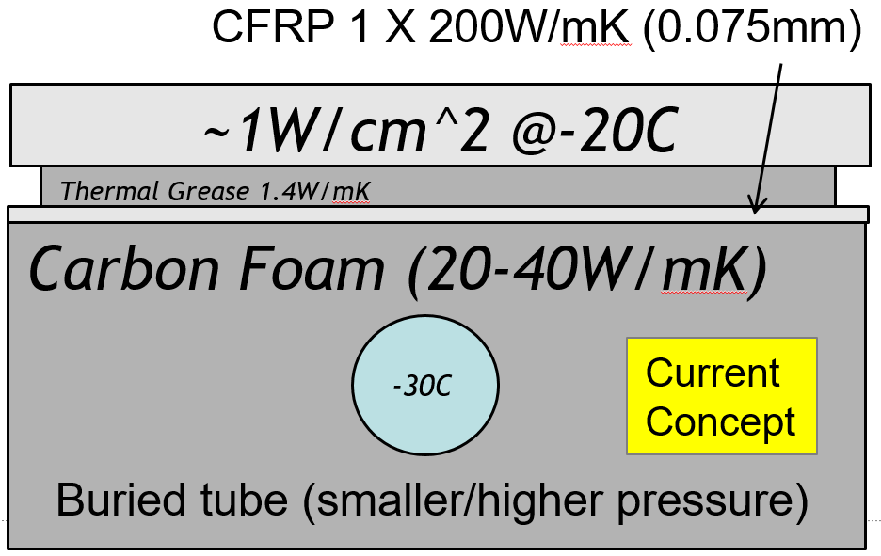
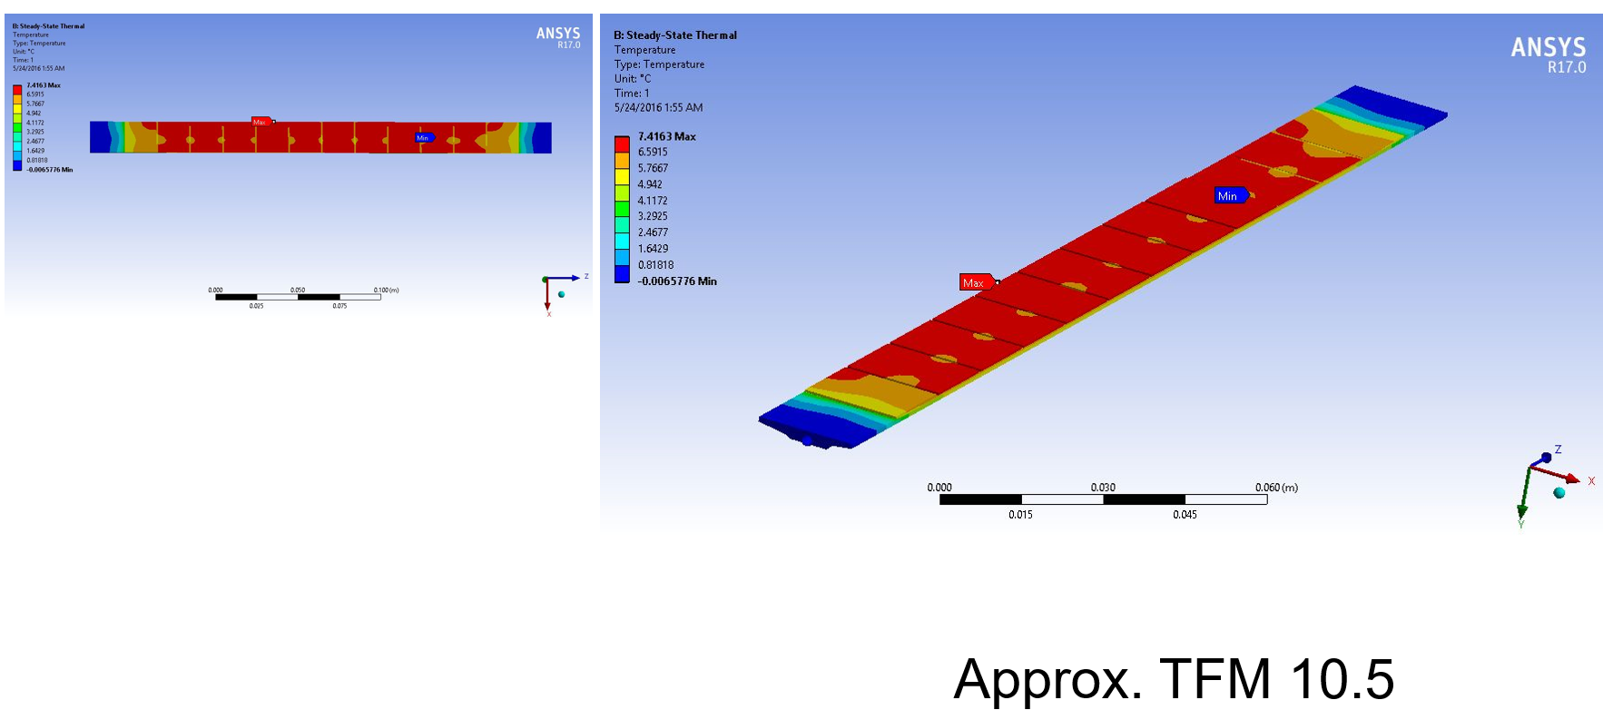
Example of ‘buried tube’ similar to IBL
Graphitic foam has become common on many different detectors
Understanding it’s properties and interfaces is a key driver of module support design

Slide 11
Important interfaces in cross-section
~1.0W/cm²
Silicon Module
1.25 W/mK (100μ) SE4445
Thermal Interface Material
CFRP Face Sheet (?)
~1.0 W/mK (~200μ)
CVD Foam (30-40W/mK)
1.1 W/mK (100μ)
Interface Equivalent
Cooling Tube BC
All ‘Interface Materials’ ~1W/mK; foam and Si >>10W/mK
Variations in module mount TIM have demonstrably affected performance (usually via ‘effective thickness’)
Foam to: tube/face-sheet are similar—tube has higher flux
Improving quality of any one of these can reduce ΔT

Slide 12
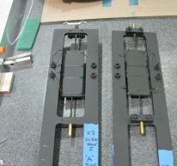
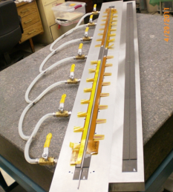
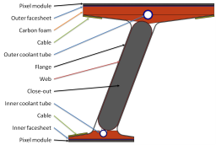
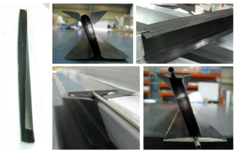
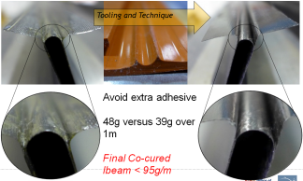

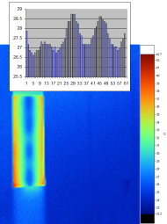
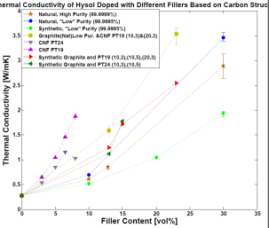
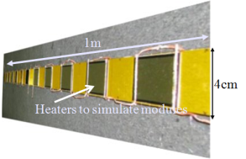
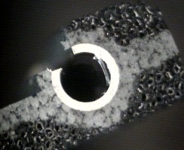

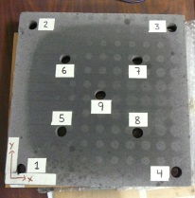
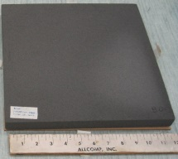

Timeline Prototype and Material Development
Stavelet Test
1.4m Stave
Buried Cable
I-Beam
Thermal Test
1st 1m I-Beam
Co Cure Studies
100g I-beam
Defect Studies
Thermal Cycling
1m Stave
Test w/C02
Foam
Co-Cure
Glue Mass
Studies
Adhesive Modification
Adhesive
K-Studies
BN Doping
Film Adhesive
On Tube/Foam
Allcomp K7
Allcomp K9
continued→
Allcomp K7-130
IBL Prototypes
LOI
30gsm M46J
45gsm K13C2U
45gsm K13D2U
Engineering Run
30gsm M55J
2009
2010
2011
2012
2013
2014
ΔT ~12C
ΔT ~10C
ΔT ~9C
ΔT ~8C
ΔT >7C?
(Peak ΔT for 4cm module 0.5W/cm² 2.2mm OD tube)
Understand/Improve Thermal Performance
Decrease Mass

Slide 13
Stagnation as Motivation
Effort to improve thermal performance stopped when ‘good enough’ was reached ~2011—dictated by Strip Mechanics and old Pixel Tech…
  50% (30%?) improvement on ‘State of the Art’ over what was just installed in LHC detectors…
  Reduced mass was the next frontier--without losing thermal performance gains!
Methods developed to reduce mass began to affect thermal performance negatively ~late 2012
  Reduction (control) of adhesive/resin mass was key (co-cure)
  Flaw detection became important as QC check to validate control of reduced resin volume processes
Thermal interface improvement was required to maintain ‘state of the art’ performance with process variability
Perhaps with some improvements…

Slide 14
Upgrade Mechanics R&D background
Low mass Graphitic foam developments via SBIR ’08—’12
  Installed in IBL, current baseline for many LHC Experiments
  Investigated air cooling for MAPS Detectors
Ultra-low mass pre-pregs (CFRP materials) ’10--’14
  Leveraged STAR requirements (0.3% X₀); developed on spec with suppliers, now available COTS in Pitch and PAN fibers
Co-cure techniques for reduced mass (less adhesive) ‘11--Present
  Developed for ITK Strips, used on STAR IST, ATLAS IBL, HL-LHC
Investigating electrical properties of CFRP ‘12--Present
  STAR E-Field shrouds; may reduce metallic ground planes in the future—speculative, includes Graphite thermal fillers
  Enhanced thermal conductivity of Thermal Interface Materials ‘14--Present
  Survey of fillers for adhesive materials—Natural Graphite

Slide 15
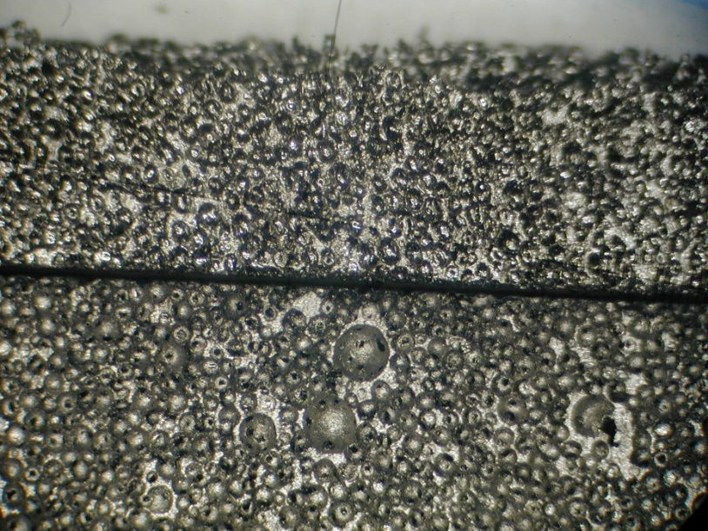
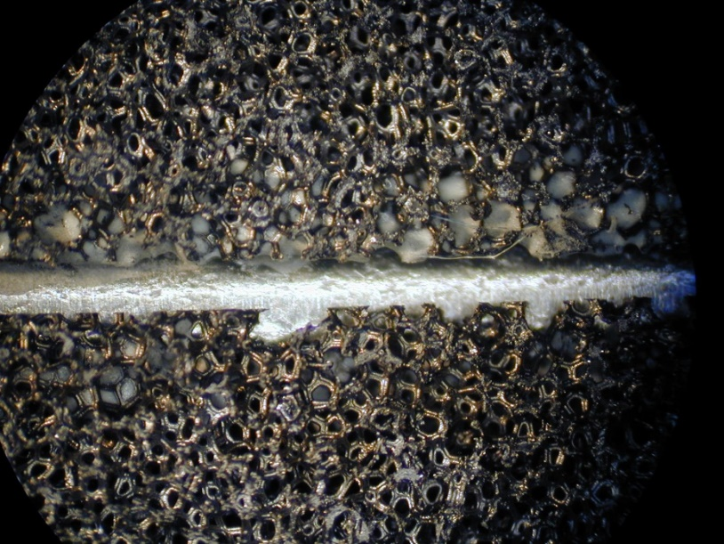
Graphitic Foam Development
Poco top/Koppers k-foam bottom
POCO, Koppers from Klett Patent
  Process yields poor uniformity; exacerbated at lower densities
  K depends on complex process: enhanced in expansion direction
  No longer commercially available?
Allcomp Graphitic Foam via SBIR
  Chemically foamed pre-cursor; defined uniformity and porosity
  Graphite layers built independent
  Nearly isotropic E,K properties
Allcomp has tunable properties
How to benefit from tunable ρ/K is the next level of R&D
Allcomp 0.5 g/cc
NOT Co-cure

Slide 16
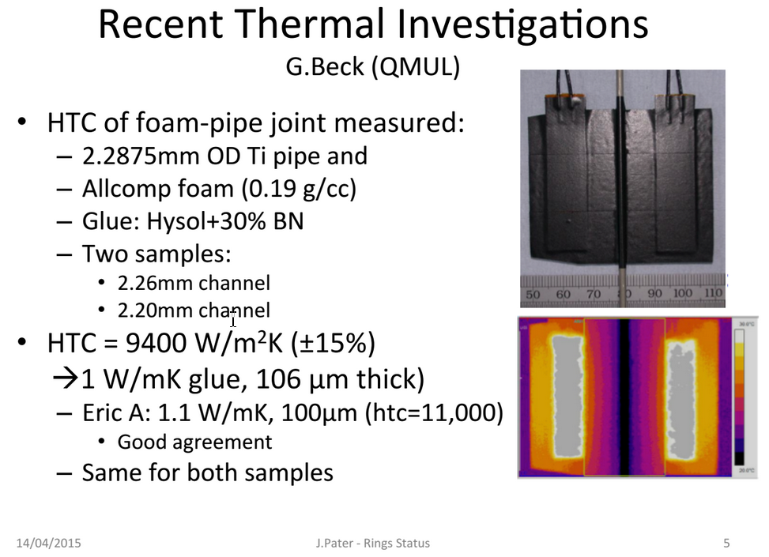
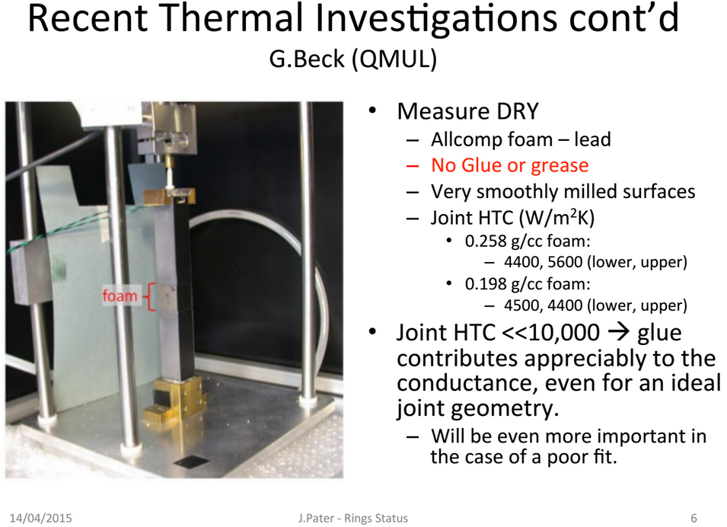
Foam Interface Verification
Graham Beck QMUL
Initial studies with CVD foam ~0.35g/cc density or higher; 0.2g/cc developed with BN filled epoxy simultaneously
Reducing mass in foam required increased attention to interface
G Beck documented that ~1/2 of the thermal conductivity is due to physical contact (conversely poor contact or tolerance control is bad)
Filled Adhesive is fully the other half and bridges gaps—perhaps more

Slide 17
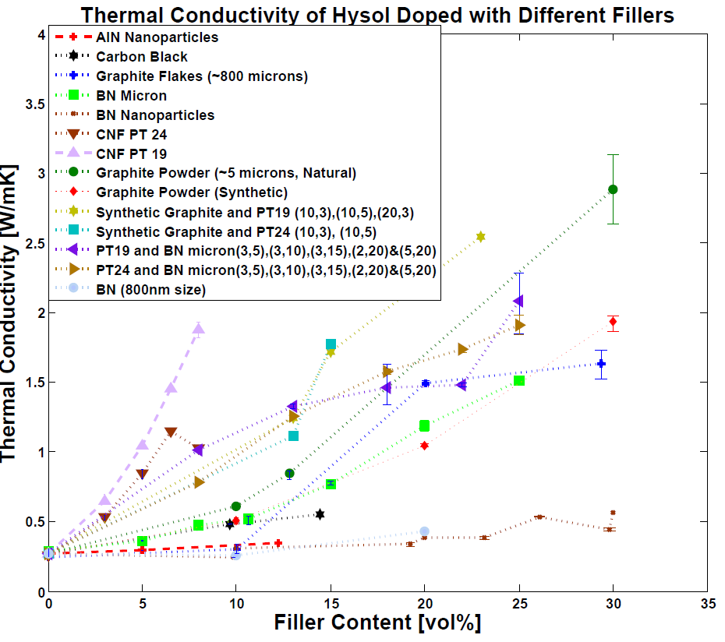
Survey of Various Fillers
HYSOL 9396 basis for survey—used with BN as standard adhesive for ATLAS prototypes
DOW SE4445 used to mount modules (ATLAS Pixel)
Investigated many fillers 10-30% by volume fraction to identify interesting candidates
Nano-particles/fibers and various mixtures included in initial survey
Natural Graphite stuck out…
Non-linear behavior of carbon nano-fibers as well…
SE4445 measured: 1.25W/mK
30% BN Hysol 9396: 1.1W/mK
Latter measured independently at several locations consistently, with several Vf samples.

Slide 18
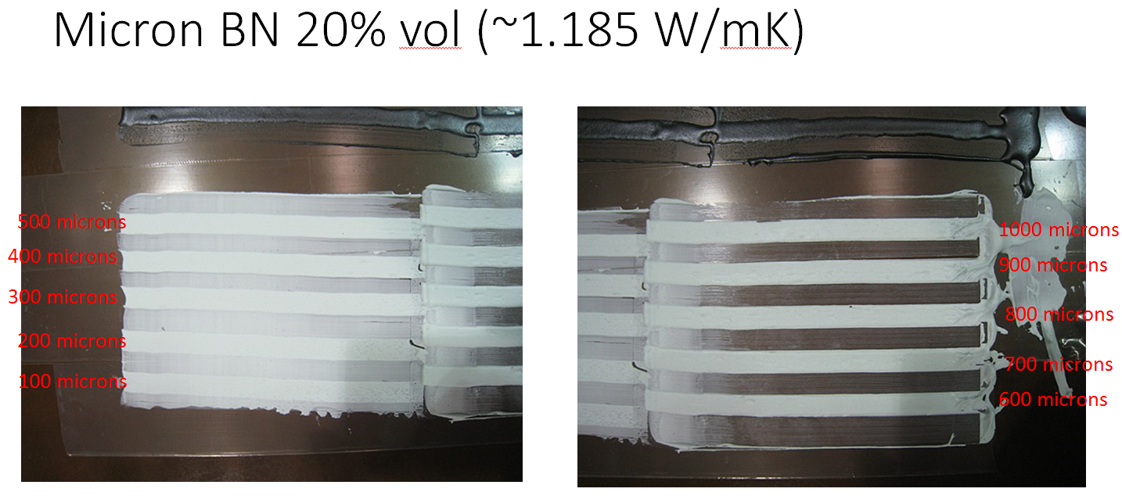
Thermal Conductivity is important, but:
Filled adhesives still need to be used as adhesives…
Used a stepped comb to assess quantitatively—above shows typical BN filled 9396 (20-30% Vf is typical)
%fill is sometimes dictated by assembly method—not by thermal management requirement!

Slide 19
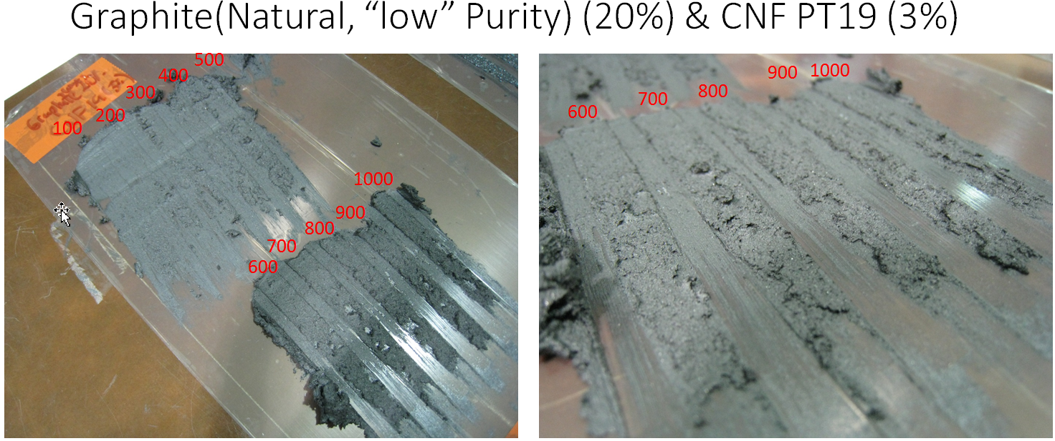
Good example of bad result…
This would be deemed unusable in practical application
It is important how well this mixture performs thermally
It is unusable as an adhesive, but is useful as a data point

Slide 20
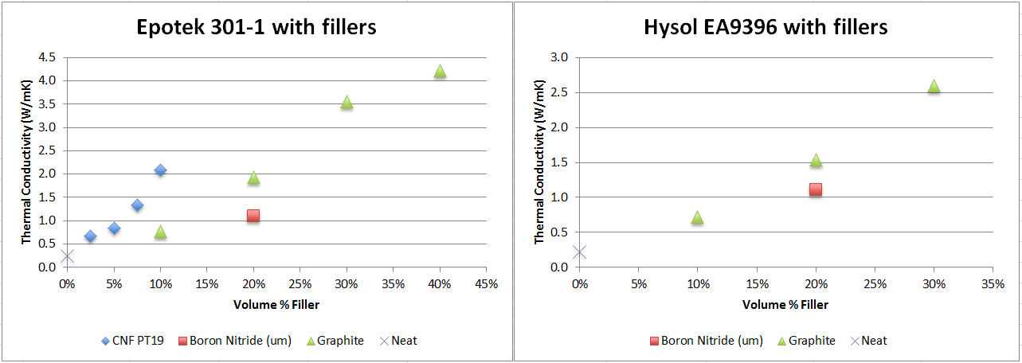
Prime Candidate Filler is Graphite
Sample
‘too conductive’
To measure
Natural Graphite (versus synthetic) proves to be most interesting
Moving to lower viscosity yielded interesting results
Higher conductivity at same Vf in the lower viscosity resin systems
Shear in the mix process may lead to exfoliation and distribution of graphite thru matrix—steeper slope versus Vf!
Similar or better results to industrial diamond powder reported elsewhere

Slide 21
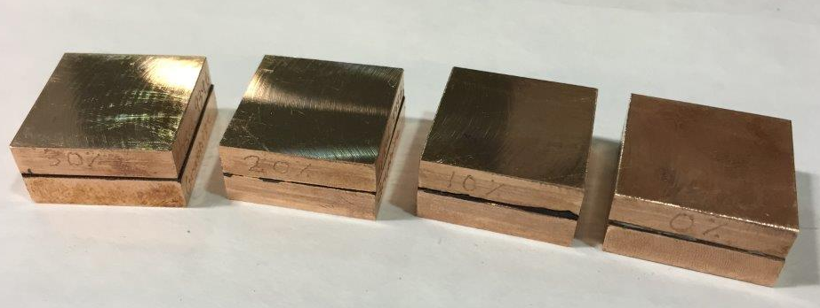
Graphite fill is electrically conductive
Hysol EA 9396 loaded with Graphite powder at 0, 10, 20 and 30 percent
2 copper blocks 25mm x 25mm x 6mm with 0.14mm epoxy bond in between.
Quick resistance measurements.
0% = Open
10% = 87.0 ohm
20% = 15.9 ohm
30% = 00.7 ohm
Cu block = 0.1 ohm
BN is non-conductive electrically
Graphite filled resins may provide an attractive alternative to Silver epoxy for grounding/shielding connections
Silver filled epoxy should be forbidden, or require specific regulatory dispensation to use in LHC upgrades
Alternates need investigation

Slide 22
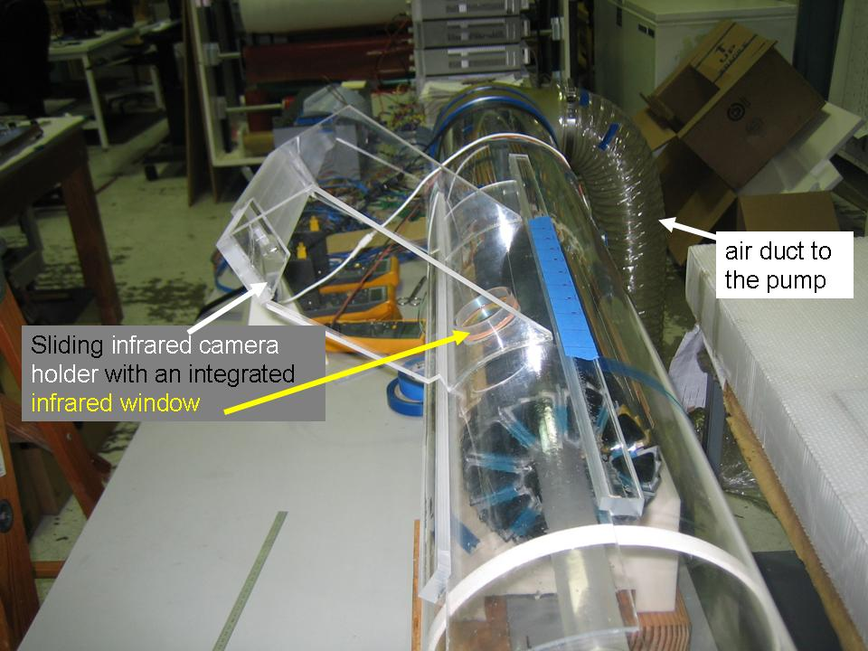
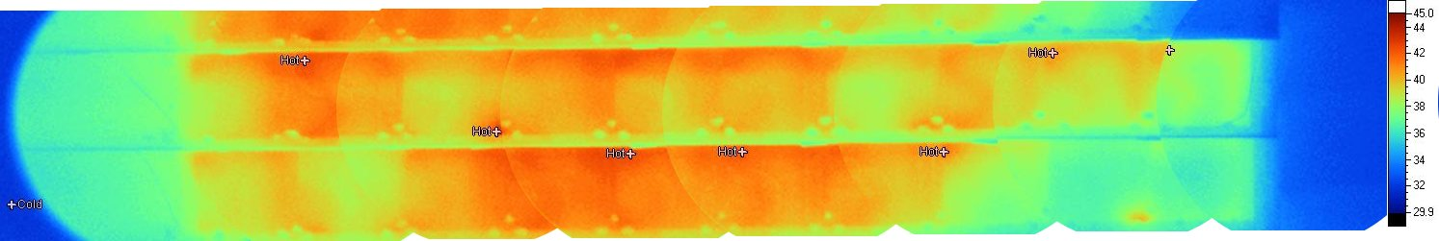
Air Cooling requires full scale testing—not trivial
Platinum on thinned silicon to simulate detector chip heat load
Additional heaters to reproduce driver heat sources
Input and output thermocouple monitoring of air temperature
Thermistors distributed on mockup pixel ladders
IR camera to measure surface temperatures
Air blower with static head of 9 inches of water
air velocities measured with a hot wire velocity sensor
STAR HFT Example shown—note simple ducted flow, needs velocity to get HTC
Thermal image of sector-1 at 290 W dissipated in the detector and at the air flow speed of 12.2 m/s. The image was stitched from 8 individual images of small subsections. Ambient air temperature 31 °C
Result: ΔT = 11 °C with 10.4 m/s air velocity, verifying CFD estimate

Slide 23
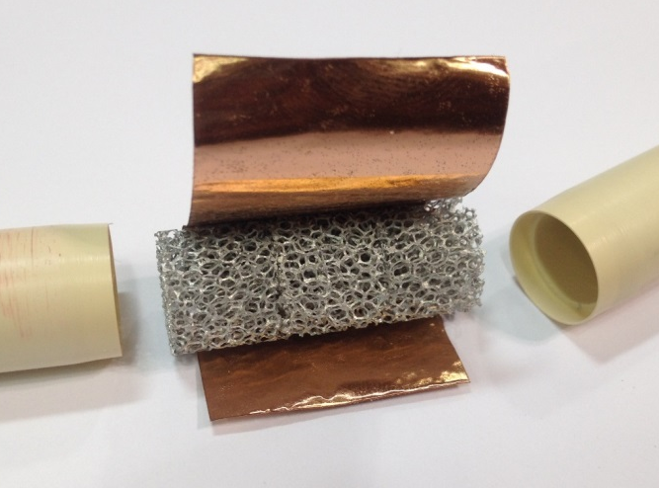
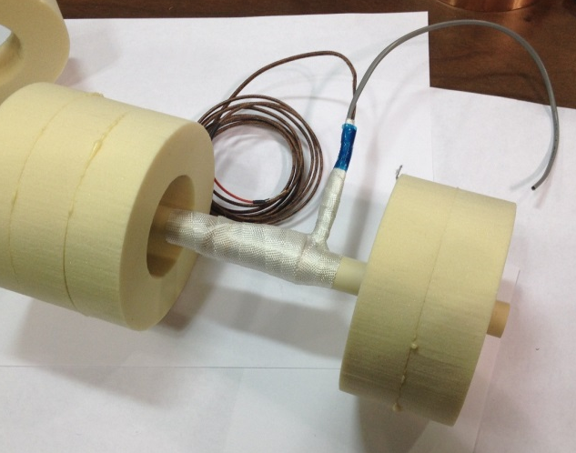
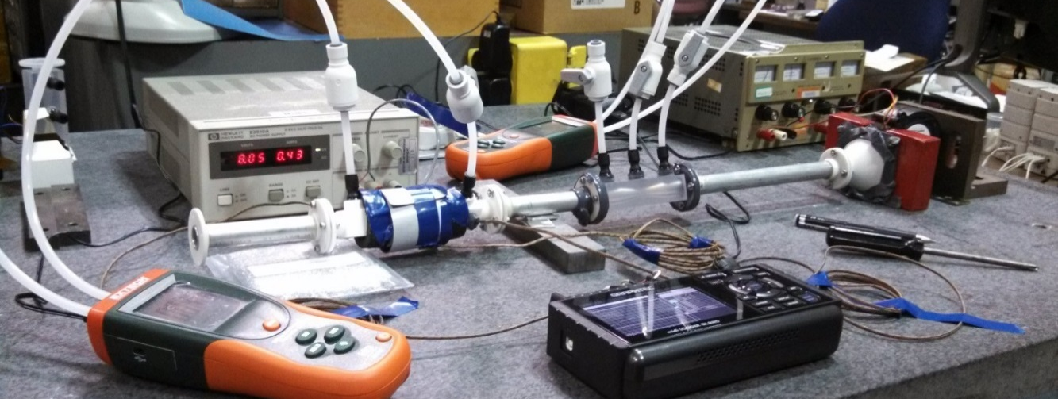
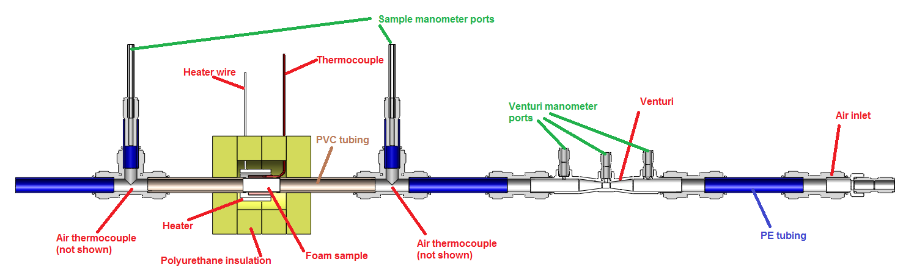
Conductive Foam to enhance HTC in Air Cooling
Tested foams in range of porosity and materials
  Al Foam 5-40ppi
  RVC Foam 30ppi
  Graphitic Foam 30ppi
Al and Allcomp used for conductivity comparison
Al used to measure comparative pressure drops to similar tube
Used round samples to scale to ‘stave-like’ geometry

Slide 24
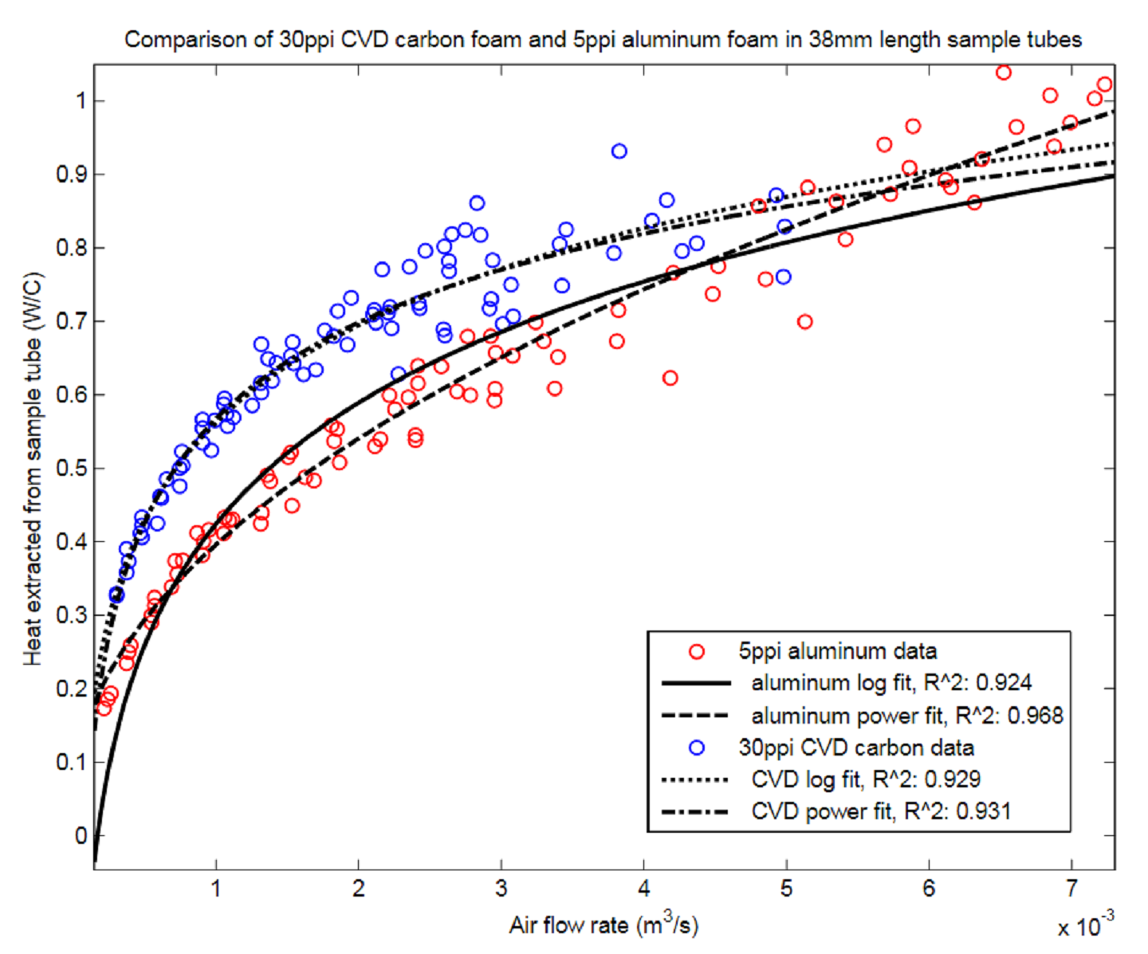
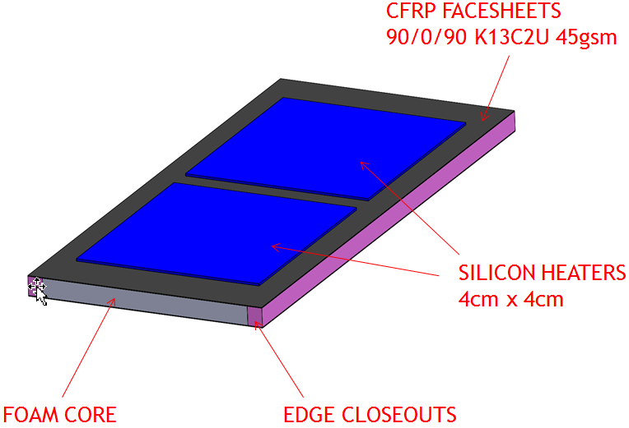
Survey results scaled to practical geometry
Size stave based on cylindrical sample data
Prove performance:
  Silicon temperature
  Air pressure drop
Prove practical construction:
  Assembly feasibility
  Air flow sealing
Al foam data indicated 30ppi practical for pressure drop
Allcomp foam delivered 30ppi and tested for DP and thermal performance
Used to size practical test

Slide 25
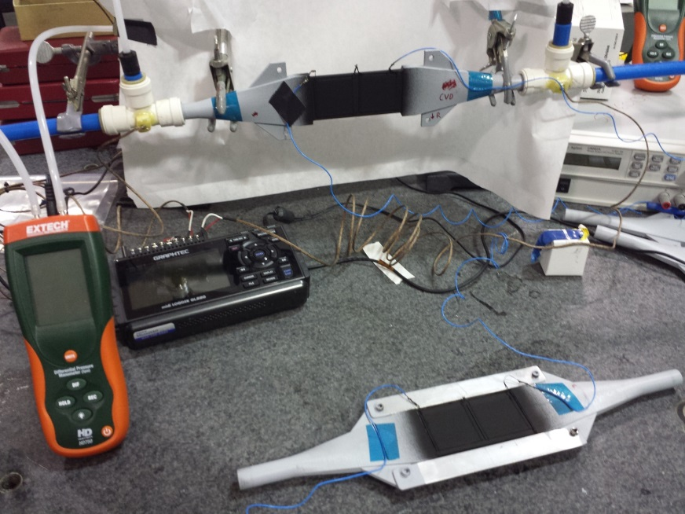
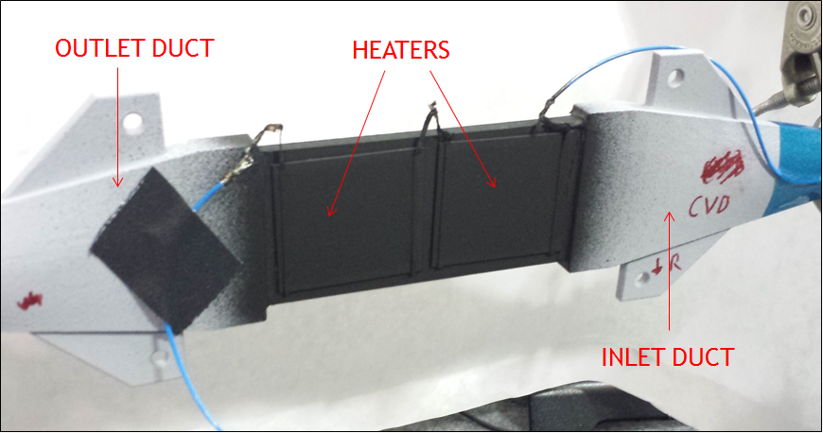
100 mm CVD and RVC test staves
RVC (reticulated vitreous carbon) foam is the precursor to Allcomp foam—CVD of the same ppi (pores per inch)
CVD necessarily reduces the porosity; RVC is what was tested before in round sample
Rectangular ‘Stave-let’ samples of each made to directly compare calculation from round to stave-let, and between RVC and densified CVD (Allcomp) Foam

Slide 26
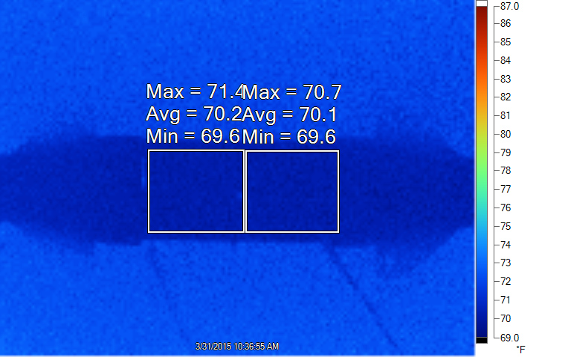
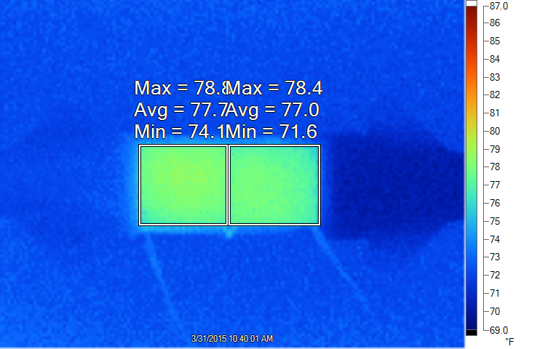
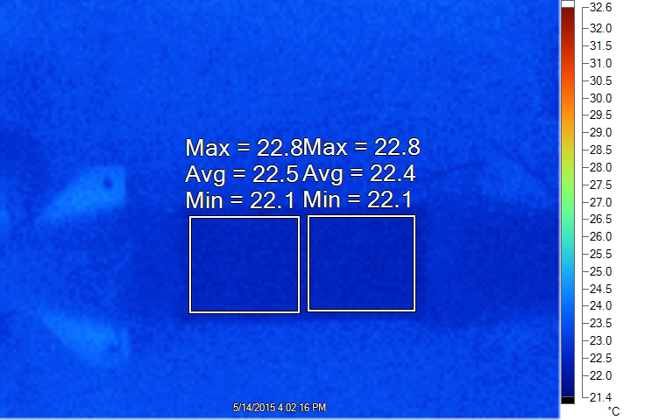
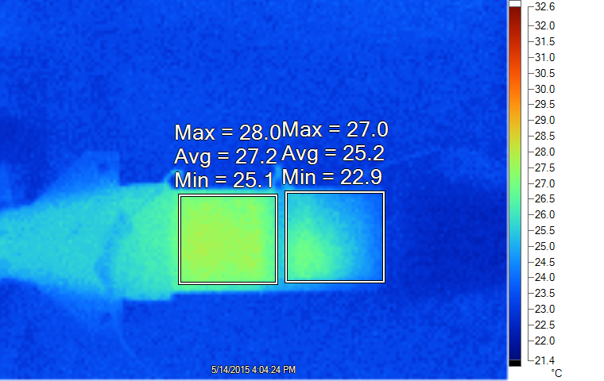
Typical IR Images10cm Stave-lets
(100mW/cm^2 at 5.8cfm)
RVC (non-conductive)
(300mW/cm^2 at 4.1cfm)
CVD (conductive)

Slide 27
Closing remarks
Pixel detector supports interact directly with the cooling system
Many different detectors share common materials and similar design paradigm
Information like this is shared at a yearly Forum on Tracking Detector Mechanics
Continued collaboration on mechanics is allowing low heat load MAPS to move under 0.3%X₀ and bringing Hybrid Pixel structures well under 1%X₀
Thanks for your attention

