Slide 1
Top Level PRM (firmware)
Top Level
Serial to parallel convert (AURORA PROTOCOL)
Input
HIT
Manager Block
Data Organizer
+
Track Fitting
Block
Output
SSID
Manager Block
Parallel to serial convert
(AM PROTOCOL)
REGISTERs
FMS
AM Chip
Input
HIT
Manager Block
Output
ROAD
Manager Block

Slide 2
Top Level PRM (firmware)
Regarding the input data flow of the HITs/ STUBs the logic can be summarized as following:
The input serialized data are received from the FMC connectors by using the protocol AURORA. The block Serial to parallel convert block manages the conversion and the protocl.
The Input HIT Manager Block receives the parallelized data and performs a matching of the internal clocks with dual clock fifos. The output consists of 6 or 8 parallel links.
The 6 or 8 parallel links are received from the Data Organizer and are transformed in SSID.
The 6 or 8 SSID links are received from the Output SSID manager block that implements a matching of clock and prepare the data to send to the AM
A Parallel to serial conversion has been implemented by using the AM protocol. The block Parallel to serial convert block manages the conversion.

Slide 3
INTERFACE: Serial to parallel convert
gtx_rxdata(0)
gtx_rxcharisk(0)
gtx_rxdata(1)
gtx_rxcharisk(1)
gtx_rxdata(2)
gtx_rxcharisk(2)
gtx_rxdata(3)
gtx_rxcharisk(3)
gtx_rxdata(4)
gtx_rxcharisk(4)
gtx_rxdata(5)
gtx_rxcharisk(5)
ReadOnly Register
DP_C2M(0)
HOLD_DP_C2M(0)
DP_C2M(1)
HOLD_DP_C2M(1)
DP_C2M(2)
HOLD_DP_C2M(2)
DP_C2M(3)
HOLD_DP_C2M(3)
DP_C2M(4)
HOLD_DP_C2M(4)
DP_C2M(5)
HOLD_DP_C2M(5)
Serial to parallel convert

Slide 4
INTERFACE: Input HIT Manager Block
HitToDo(0)
HitToDo_dv(0)
HitToDo(1)
HitToDo_dv(1)
HitToDo(2)
HitToDo_dv(2)
HitToDo(3)
HitToDo_dv(3)
HitToDo(4)
HitToDo_dv(4)
HitToDo(5)
HitToDo_dv(5)
HitToDo(6)
HitToDo_dv(6)
HitToDo(7)
HitToDo_dv(7)
EndEvent
FSM_Control_Sig
gtx_rxdata(0)
gtx_rxcharisk(0)
gtx_rxdata(1)
gtx_rxcharisk(1)
gtx_rxdata(2)
gtx_rxcharisk(2)
gtx_rxdata(3)
gtx_rxcharisk(3)
gtx_rxdata(4)
gtx_rxcharisk(4)
gtx_rxdata(5)
gtx_rxcharisk(5)
ReadOnly Register
Input
HIT
Manager Block

Slide 5
INTERFACE: Data Organizer+Track Fitting
Block
HitToDo(0)
HitToDo_dv(0)
HitToDo(1)
HitToDo_dv(1)
HitToDo(2)
HitToDo_dv(2)
HitToDo(3)
HitToDo_dv(3)
HitToDo(4)
HitToDo_dv(4)
HitToDo(5)
HitToDo_dv(5)
HitToDo(6)
HitToDo_dv(6)
HitToDo(7)
HitToDo_dv(7)
EndEvent
FSM_Control_Sig
SSID(0)
SSID_dv(0)
SSID(1)
SSID_dv(1)
SSID(2)
SSID_dv(2)
SSID(3)
SSID_dv(3)
SSID(4)
SSID_dv(4)
SSID(5)
SSID_dv(5)
SSID(6)
SSID_dv(6)
SSID(7)
SSID_dv(7)
EndEvent
FSM_Control_Sig
Data Organizer
+
Track Fitting
Block

Slide 6
INTERFACE: Input HIT Manager Block
SSID(0)
SSID_dv(0)
SSID(1)
SSID_dv(1)
SSID(2)
SSID_dv(2)
SSID(3)
SSID_dv(3)
SSID(4)
SSID_dv(4)
SSID(5)
SSID_dv(5)
SSID(6)
SSID_dv(6)
SSID(7)
SSID_dv(7)
EndEvent
FSM_Control_Sig
SSID_ToAM(0)
SSID_ToAM_charisK(0)
SSID_ToAM(1)
SSID_ToAM_charisK(1)
SSID_ToAM(2)
SSID_ToAM_charisK(2)
SSID_ToAM(3)
SSID_ToAM_charisK(3)
SSID_ToAM(4)
SSID_ToAM_charisK(4)
SSID_ToAM(5)
SSID_ToAM_charisK(5)
SSID_ToAM(6)
SSID_ToAM_charisK(6)
SSID_ToAM(7)
SSID_ToAM_charisK(7)
Output
SSID
Manager Block

Slide 7
INTERFACE: Input HIT Manager Block
SSID_ToAM(0)
SSID_ToAM_charisK(0)
SSID_ToAM(1)
SSID_ToAM_charisK(1)
SSID_ToAM(2)
SSID_ToAM_charisK(2)
SSID_ToAM(3)
SSID_ToAM_charisK(3)
SSID_ToAM(4)
SSID_ToAM_charisK(4)
SSID_ToAM(5)
SSID_ToAM_charisK(5)
SSID_ToAM(6)
SSID_ToAM_charisK(6)
SSID_ToAM(7)
SSID_ToAM_charisK(7)
TO_AM(0)
AM_HOLD(0)
TO_AM(1)
AM_HOLD(1)
TO_AM(2)
AM_HOLD(2)
TO_AM(3)
AM_HOLD(3)
TO_AM(4)
AM_HOLD(4)
TO_AM(5)
AM_HOLD(5)
TO_AM(6)
AM_HOLD(6)
TO_AM(7)
AM_HOLD(7)
Parallel to serial convert
(AM PROTOCOL)

Slide 9
IPBus communication
The slow interface between the Pulsar and PRM mezzanine is implemented by using the IPBus interface.
PULSAR
PRM
IPBus

Slide 10
IPBus communication
The PULSAR is the master of the IPBus
The PRM is one of the slaves
PULSAR
PRM
IPBus
MASTER
IPBus
IPBus
SLAVE
Ethernet

Slide 11

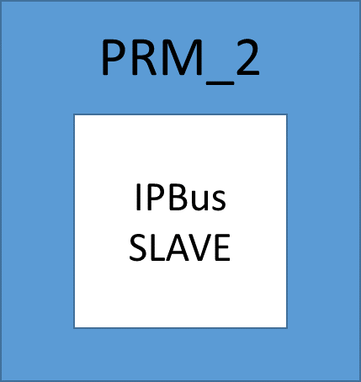
IPBus communication
The PULSAR manages the communication with the two PRMs by dividing the address range
IPBus
PULSAR
IPBus
MASTER
IPBus
Ethernet

Slide 12
IPBus package
The interface signal from the master to the slave are the following:
  ipb_wbus
  ipb_rbus
  ipb_clk
  ipb_rst
The ipb_wbus consists of:
  ipb_addr 32 bit => 4 differential lines
  ipb_wdata 32 bit => 4 differential lines
  ipb_strobe
  ipb_write
The ipb_rbus consists of:
  ipb_rdata 32 bit => 4 differential lines
  ipb_ack
  ipb_err
In total we need 12 differential lines + 4 single ended

Slide 13
Pin out FMC custom

Slide 14
Pin out FMC with IPbus signal

Slide 15
PRM address
The register inside the PRM are the following
  The GREEN is to identify the two PRMs
  The VIOLET is to identify the internal memories (road or hit) of one PRM
  The YELLOW is to identify which memory (inside the hit or road)
  The RED is reserved for PULSAR

Slide 16
In the next slides I put comments
If you wish to add any please edit the document and re-upload it

Slide 17
The input hit manager (comments by Fabrizio)
. We need a data formatter that "translates" the data format from the Pulsar (PRBS2 this is the link of the latest data format I know https://indico.cern.ch/event/363791/contribution/4/material/slides/0.pdf) and provides the cartesian coordinates of the stub inside the trigger tower.
This could presumably reside in the "Input Hit manager" block?
  1a. In order to make such a translation, one needs a LUT (and of course an algorithm) according to the document I prepared some time ago
  1b. There is one complication: I think we need to provide to the L1 Global trigger, not only the list of the tracks and their parameters, but also the list of the hits belonging to the tracks.
  That means that we have a way to store the information of the stub in PRBF2 format back in output and keep this information somewhere.
  1c. Given that the geometry will vary from one tower to another, the LUT will be different from each tower
  1d. We have to understand if the DO keeps track of the entire stub information and only works on stub coordinates or whether the stub is just a pointer to another buffer (that contains the whole info of the stub)?

Slide 18
About DO (Fabrizio comments)
2. In Christos implementation I think that he is trying to have 2 DO: the first one handles the data from one event to be sent to the AM chips and the other one handles the other event, after having received the matched roads and TF is sending the tracks found. In this way one should not wait to have finished the fit in order to process the second event.

Slide 19
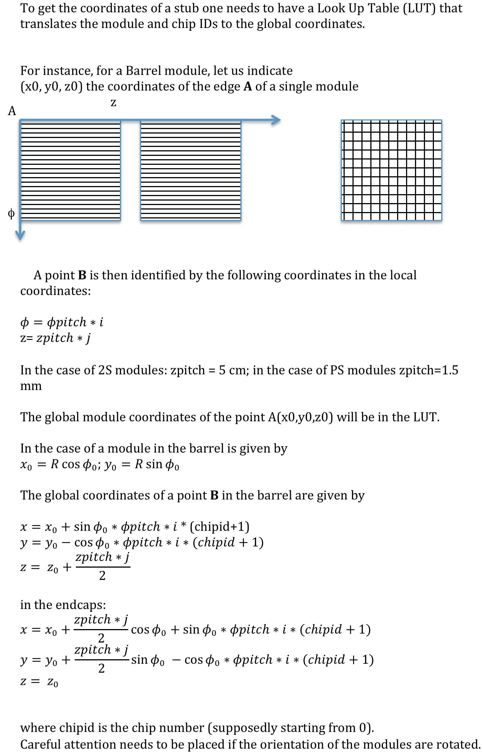
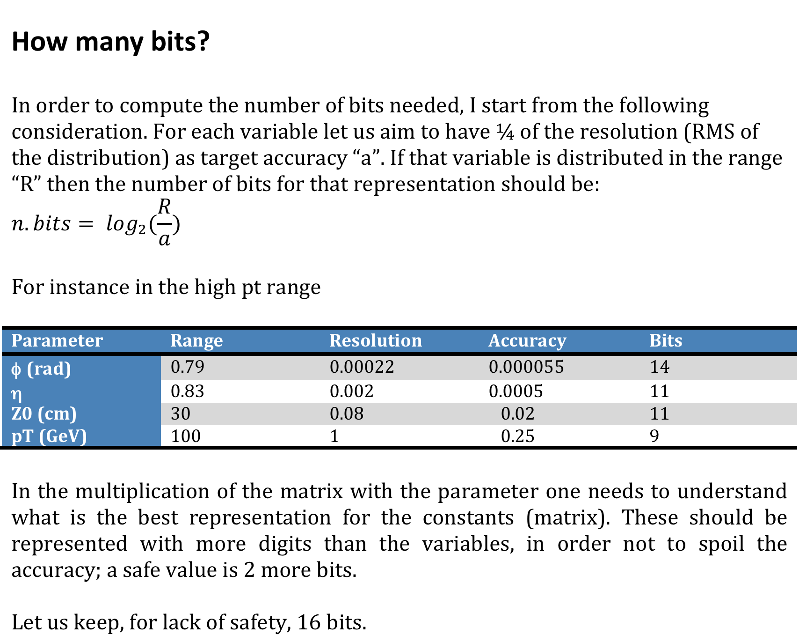

Slide 20
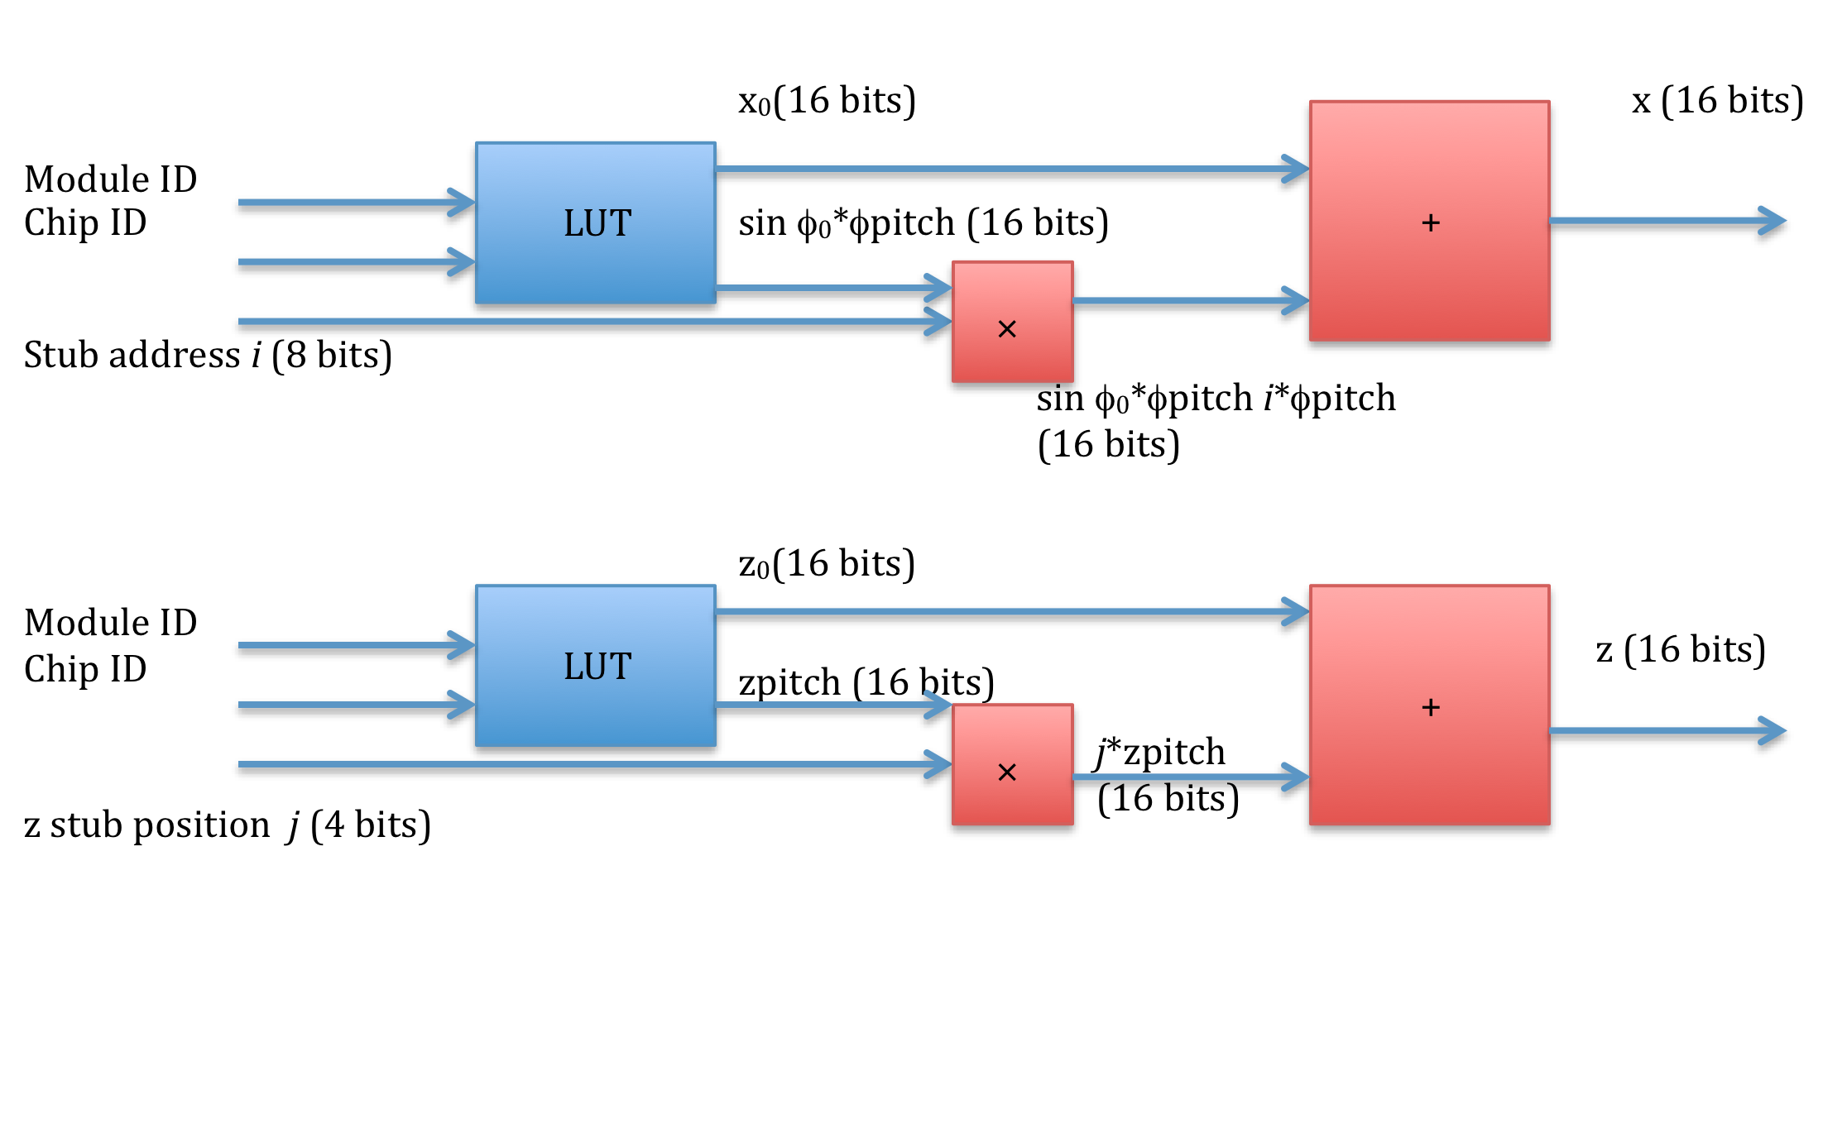
Functional block of the LUT

