Slide 1
Brazing, Copperplating,
Vacuum Design
C. Roncolato

Slide 2
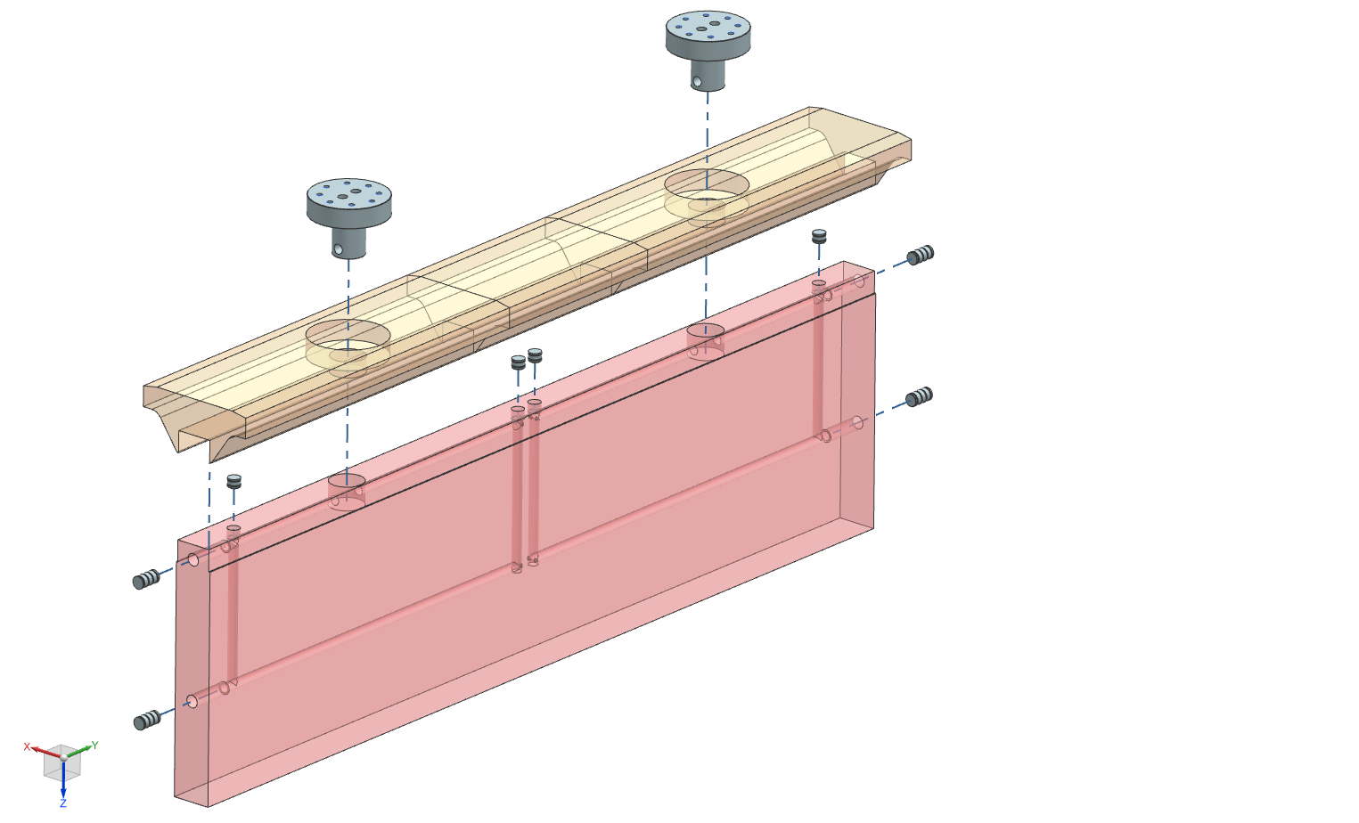
Vacuum Brazing

Slide 3
Physical Issues
Main Features:
Brazing does not involve any substantial melting of the base metals
Maintain closer assembly tolerances and to produce a cosmetically neater joint without costly secondary operations.
Brazing makes it possible to join dissimilar metals (or metals to ceramics). Therefore, steel can be brazed to copper as easily as to another steel.
Brazing also generally produces less thermally induced distortion. An entire part can be brought up to the same brazing temperature.
Brazing readily lends itself to mass-production techniques. In fact, given the proper clearance conditions and heat, a brazed joint tends to make itself and is not dependent on operator skill, as are most fusion welding processes.
As a rule, the HAZ produced during brazing is wider and less sharply defined than those resulting from other fusion-related processes.

Slide 4
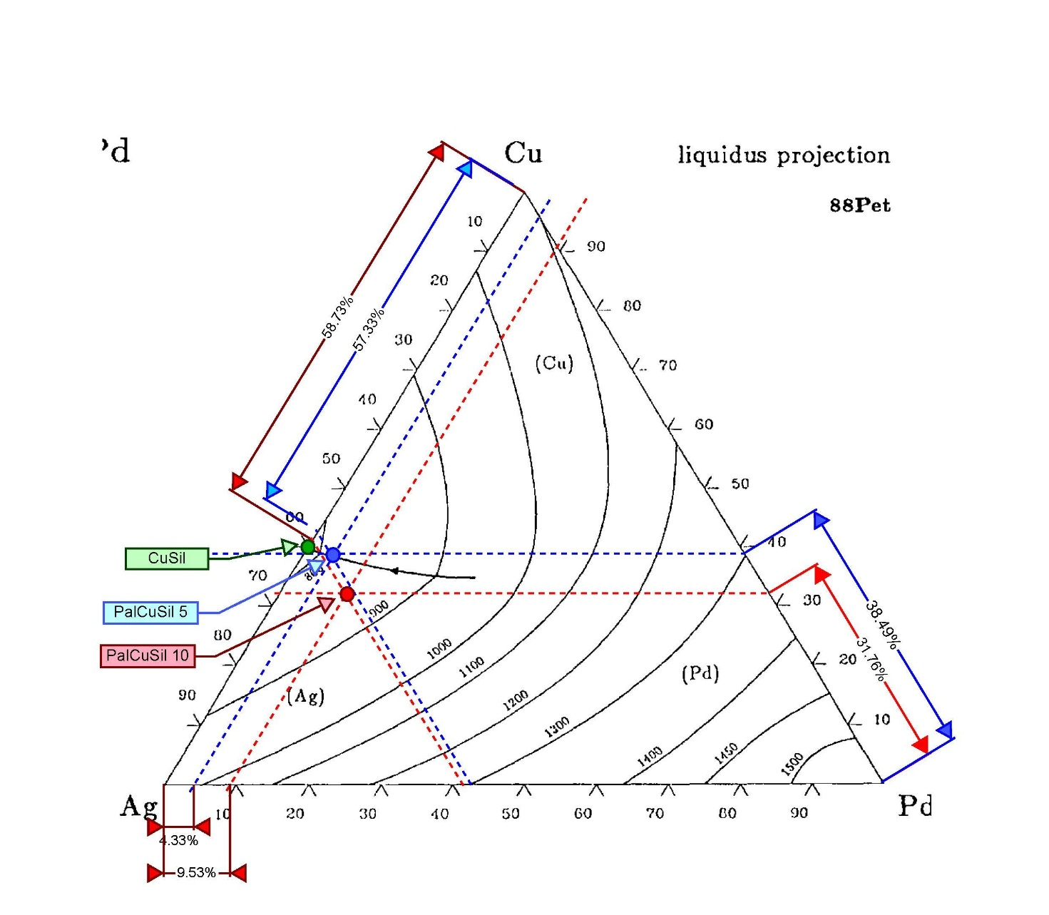
Brazing Filler Metal (BFM)
 | Ag | Pd | Cu | Tsol | Tliq
 | % | % | % | °C | °C
Palcusil 10 | 58 | 10 | 32 | 824 | 852
Palcusil 5 | 68 | 5 | 27 | 807 | 810
Cusil | 72 | 0 | 28 | 780 | 780
Ternary Phase Diagram for Cu-Ag-Pd
Three different alloys can be used to joint parts in several steps.
The amount of Palladium determines the eutectic temperature and the joint performances.

Slide 5
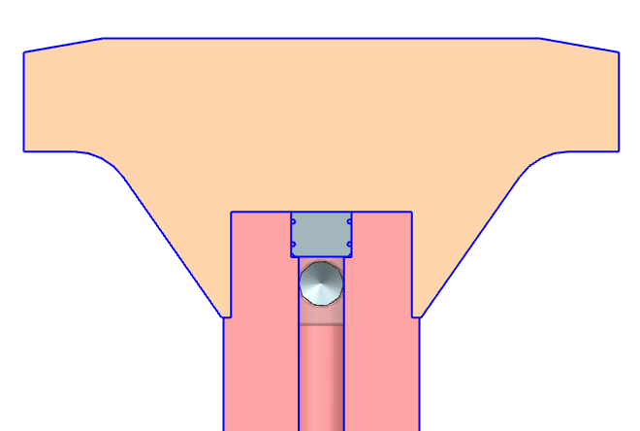
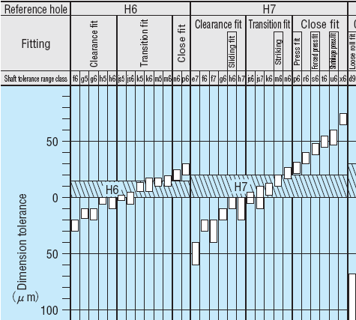
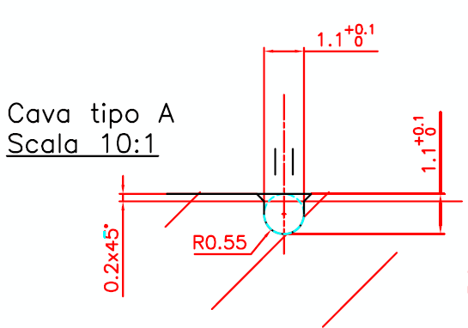
Technological Issues
Water Connection Plug
Base
Water Channel
Electrode

Slide 6
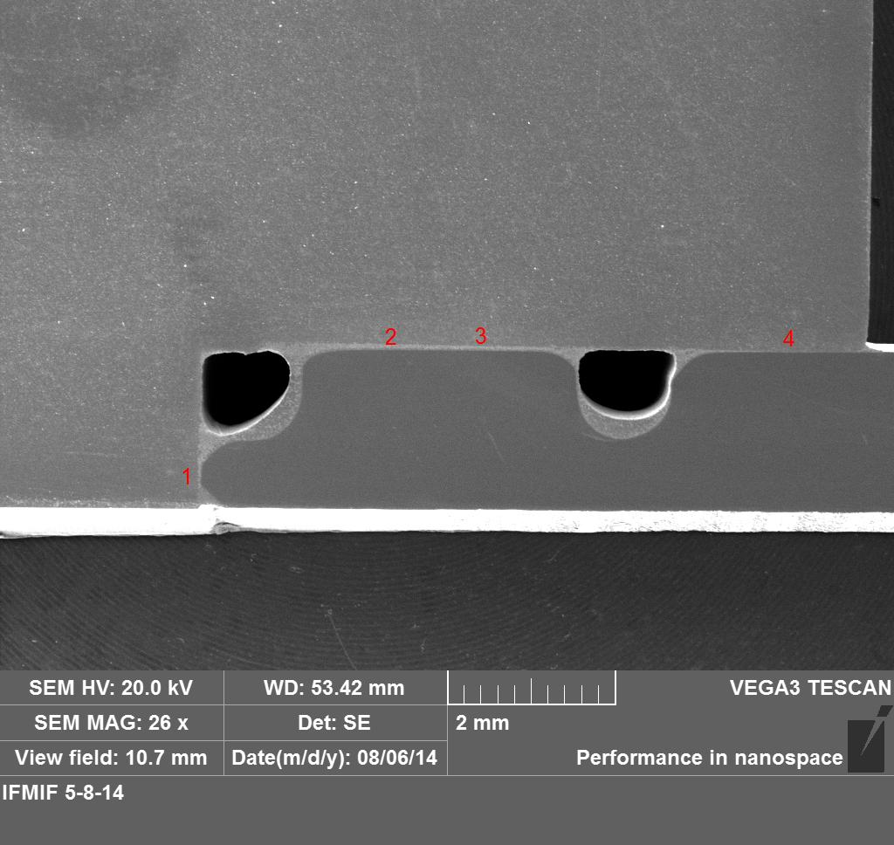
Welding Analysis
The Brazing Filler Metal (BFM) is positioned in the grooves.
After the melting for capillarity flows in the joint gaps, leaving a holes.
Copper
BFM
BFM
Voids
Stainless Steel
In red are shown some points for measurements

Slide 7
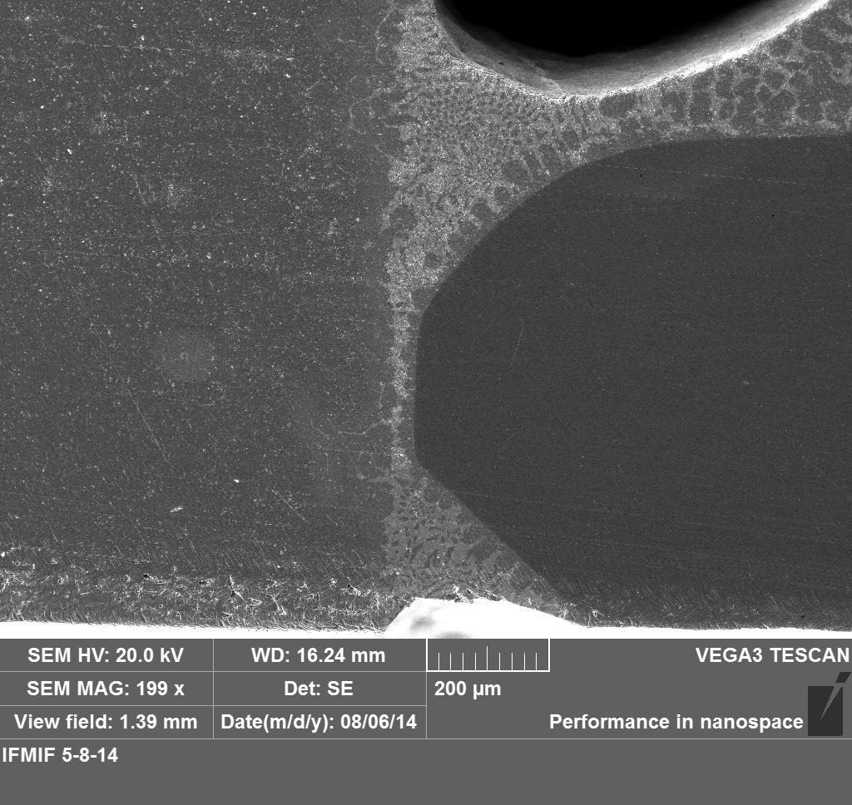
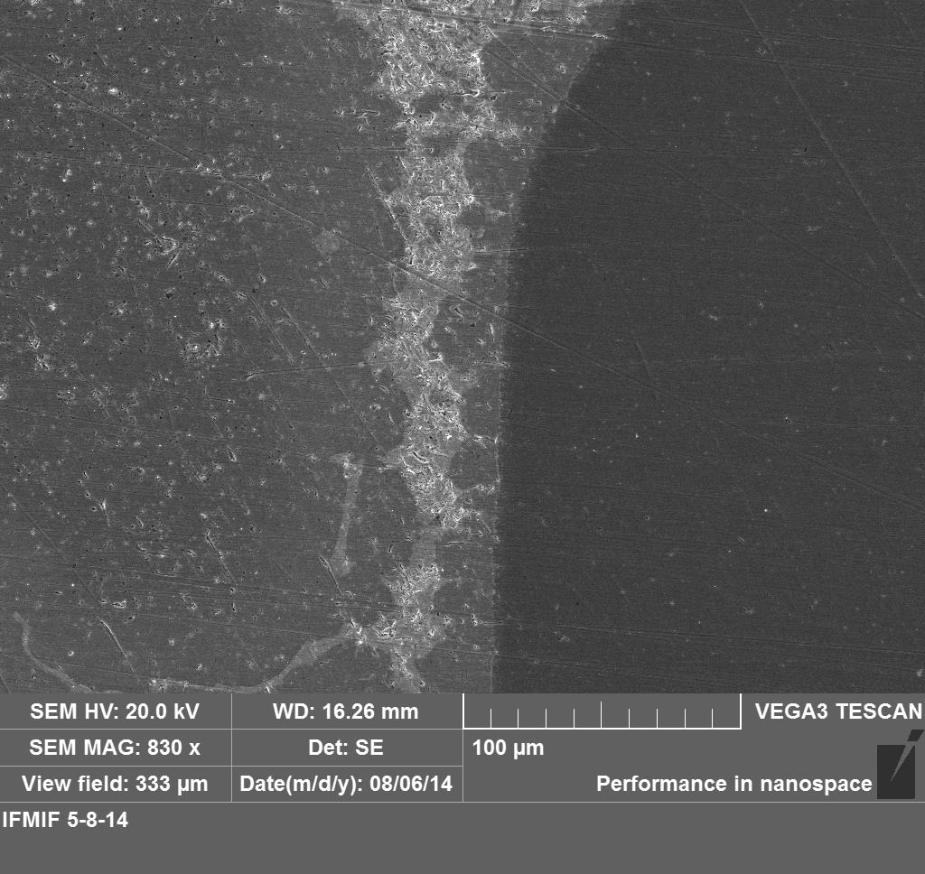
Eutethic Phase Formation
Point 1 with 200x
Point 1 with 830x
This redistribution is accomplished by atomic diffusion. The microstructure of the solid that results from this transformation consists of alternating layers or zones of the Ag and Cu phases that form simultaneously during the transformation. This microstructure is called a eutectic structure.

Slide 8
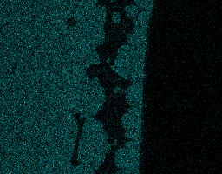

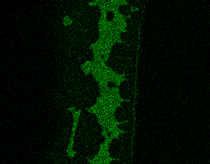
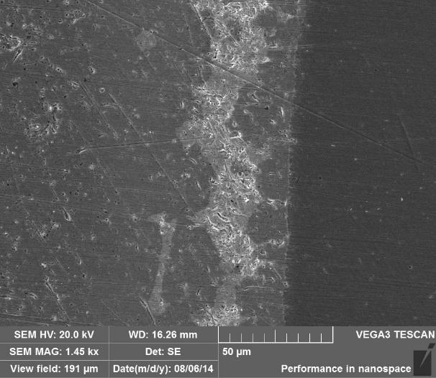
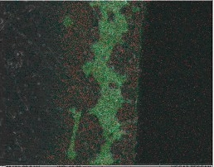



EDAX Analysis
Cu
It is possible to show where the chemical elements are positioned in the joints. Selective scanning are taken, while measuring a particular x-ray emission energy.
Fe
Ag
Ni
Pd
Cr

Slide 9
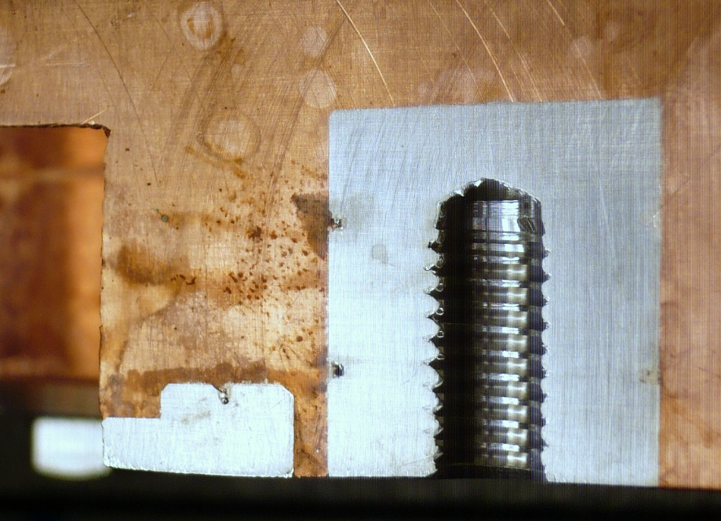
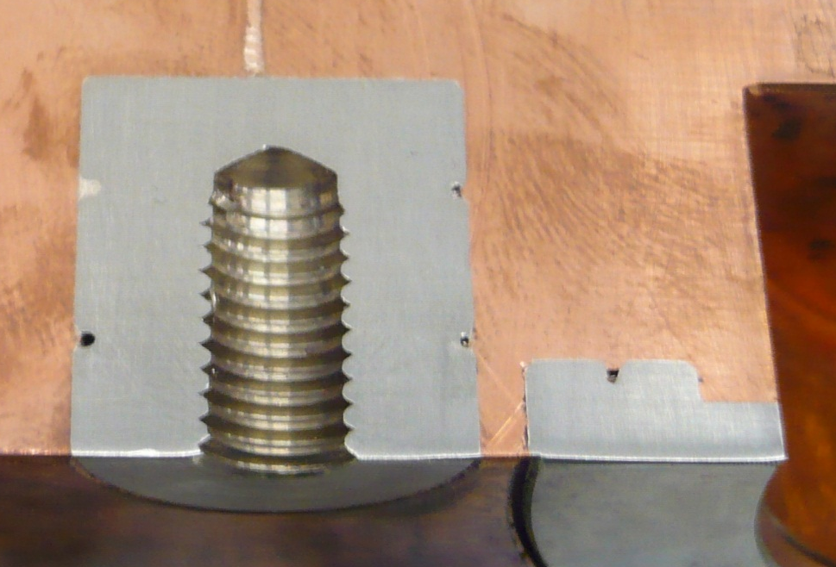
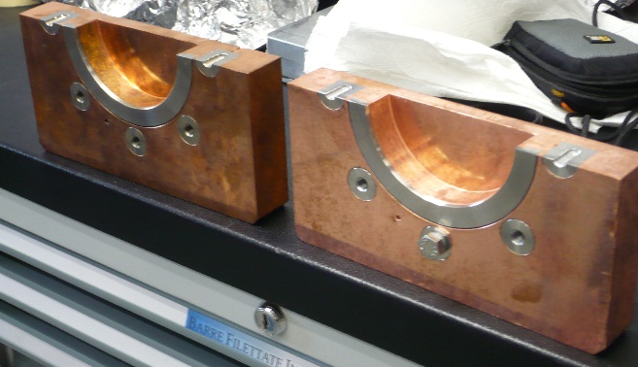
Effect of Cleaning Process
BEFORE
AFTER

Slide 10
Copper Plating

Slide 11
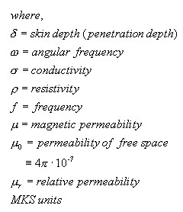
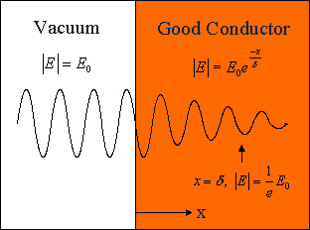
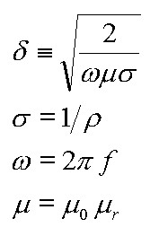
Physical Issue
Layer
Material
Thickness
Electroplating
Copper
x3÷x4 skin depth = 30 μm
Buffer Layer
Nickel / Copper
2÷4 nm
Substrate
Stainless Steel AISI 316L / Mild Steel
≈ 50 mm
 | Frequency | Skin Depth
SPES | 80 MHz | 7.38 μm
ρ (resistivity) = 1.72 mΩ-cm

Slide 12
Experience at CERN (substrate is AISI 316L) 1/3
Small Parts
Ultrasonic Degreasing
detergent NGL 17.40 spec. ALU III: 10 gm/lt
temperature: 50 – 60°C
time: 30 – 120 minutes
frequency: 25 kHz
Jet rinsing, followed by dipping in water.
Cathodic Cleaning
Detergent: Cleanor GL 301: 80 gm/lt
Temperature: 30 - 35°C
Voltage: 5 – 8 V, current density: 5 – 7 A/dm²
Time: 30 – 60 s

Slide 13
Experience at CERN (substrate is AISI 316L) 2/3
Small Parts
Jet rinsing, followed by dipping in water.
Nickel Plating (Wood’s Bath)
Nickel Cloride: 300 gm/lt
Boric Acid : 30 gm/lt
Cloridric Acid : 50 ml/lt
Temperature: 50°C
Voltage: 1.5 – 3.5 V
Current Density: 4 – 10 A/dm²
Time: 1-2 min (pari a 3-5 μm)
Anodic Etching
Sulfuric acid 20% v/v
Temperature: Ambient (20°C)
Voltage: 5 – 6 V
Time: 10 – 15 sec.
Power Supply
+ −
Movement
+
−
+
Jet rinsing, followed by dipping in water.
Activation
Cloridric Acid 50% v/v
Temperature: Ambient (20°C)
Time: 5 sec.
Anode(Nickel)
Sample (Cathode)
Heater
No rinsing, afterwards! Nickel plating strightaway

Slide 14
Experience at CERN (substrate is AISI 316L) 2/3
Small Parts
Jet rinsing, followed by dipping in water.
Copper Plating
Copper Sulfate CuSO4 • 5 H2O: 75 g/l
Solforic Acid (conc.): 100 ml/l
Cloride: 0.075 g/l
Voltage: 1.5 – 3.5 V
Temperature: 20-30°C
Current Density: 2 A/dm²
Time: 75 minuti (pari a 30 mm)
Air blowing for mixing
Bath is filtered

Slide 15
Experience at CERN (substrate is AISI 316L) 2/3
Small Parts
Jet rinsing, followed by dipping in water and cathode removal
Deoxidize
Cloridric Acid 50% v/v
Temperature: Ambient (20°C)
Time: 10-20 sec.
Jet rinsing, followed by dipping in water
Copper Passivation
Jet rinsing, followed by dipping in water
Ultrasonic cleaning in demineralized water
Rinsing with ethyl alcohol folloed by drying with nitrogen

Slide 16
Calculations

Slide 17
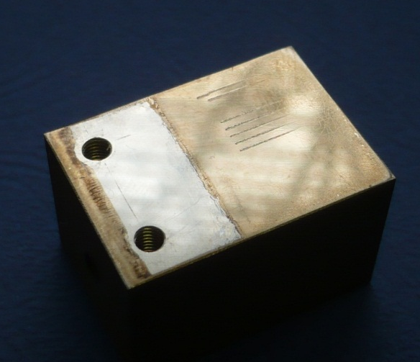
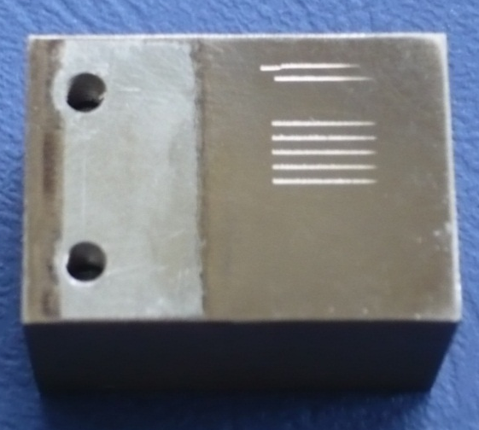
Experience with Nichel Plating at LNL w/ «First» External company
scratch test
Scratch test parameters
Type : Progressive
Begin Load (N) : 0
End Load (N) : 30
Loading rate (N/min) : 60
Speed (mm/min) : 13.62
Length (mm) : 7
AESensitivity : 5
Nickel Plating
AISI 316LN

Slide 18
SEM Imaging after scratch test. Head diameter 100μm
Plastic deformation of the film with cracks

Slide 19
SEM Imaging after scratch test. Head diameter 50μm
Film is already cracked. Cracks are through all the thickness
The smaller head creates a deeper groove. Part of the films are removed generating flakes.

Slide 20
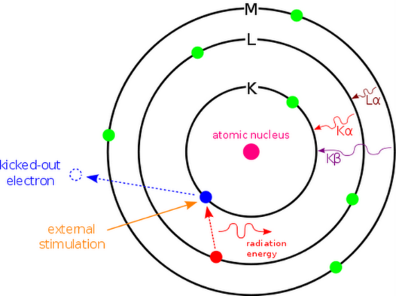
Chemical Analysis with EDS a 20kV
The Nickel plating seems to be contaminated with Zinc.
Principio EDS
Tempo acquisizione = 42s

Slide 21
Deposition from the «second» Company
SEM Imaging after scratch test. Head diameter 100μm

Slide 22
SEM Imaging after scratch test. Head diameter 50μm

Slide 23
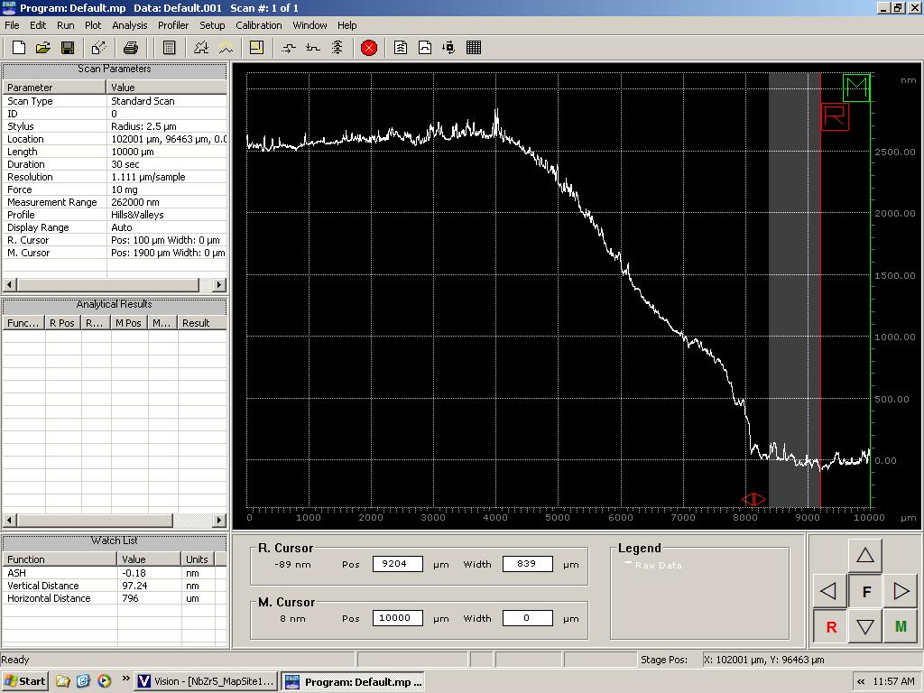
Thickness Calibration
2.5μm
6.25 min/μm

Slide 24
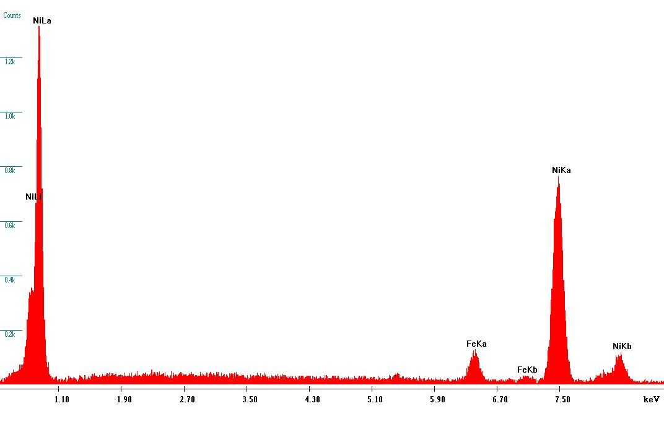
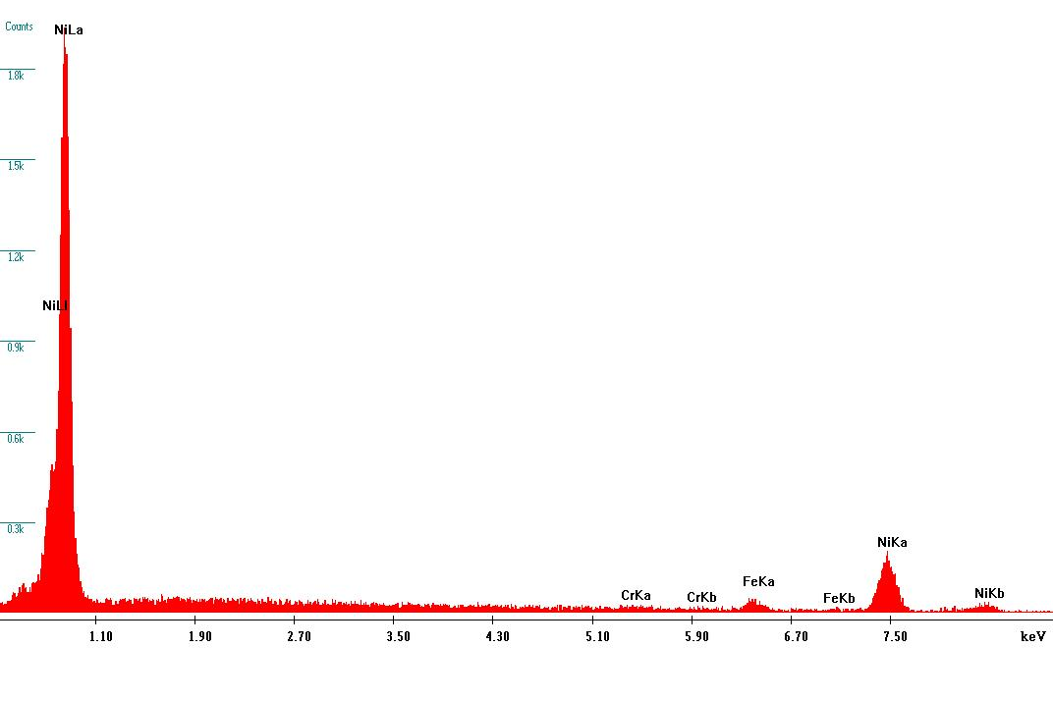
Chemical Analysis with EDS
20 kV
12 kV

Slide 25
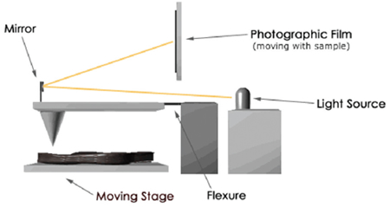
Coppert Plating Analysis (1/2)
The actual thickness of the deposit on the plates were measured with a profile meter. The plates are masked in a way to have a “sharp” step between the Cu layer and the substrate.
The interpolation shows the current density.
J = 2.7 A/dm²

Slide 26

Coppert Plating Analysis (2/2)
EDS Principle
Copperplating is free of other elements (1% range)

Slide 27
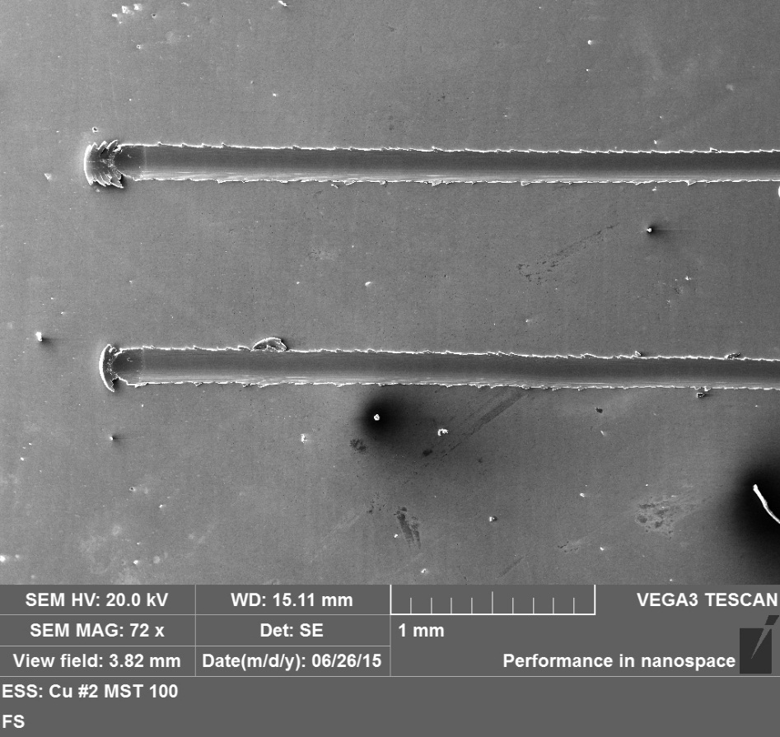
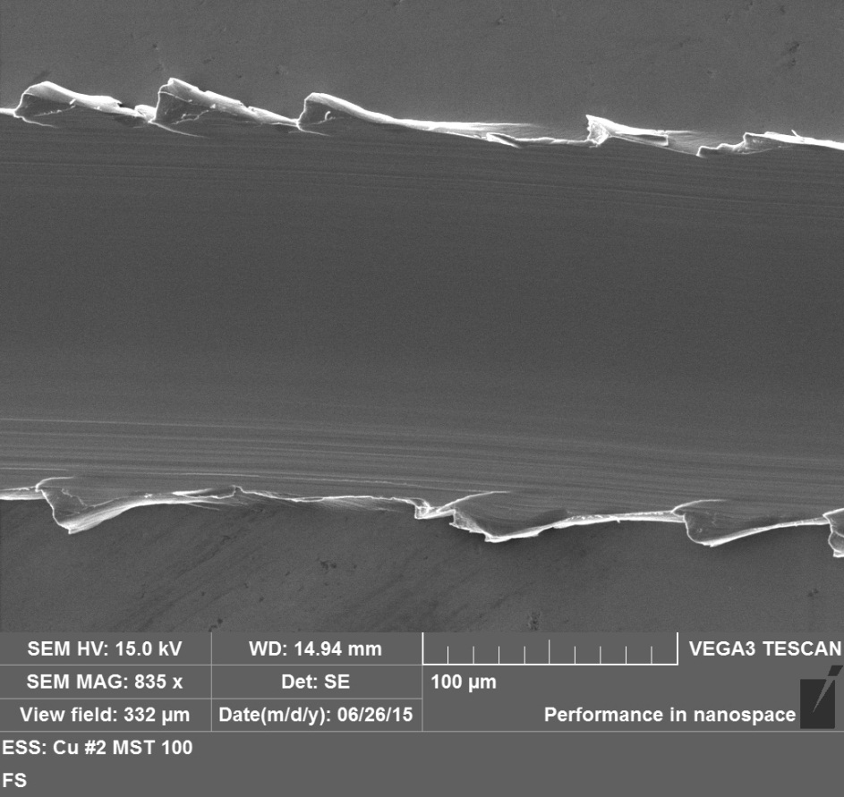
Scratch Test & SEM analysis
Micro Scratch Test with head of 100μm

Slide 28
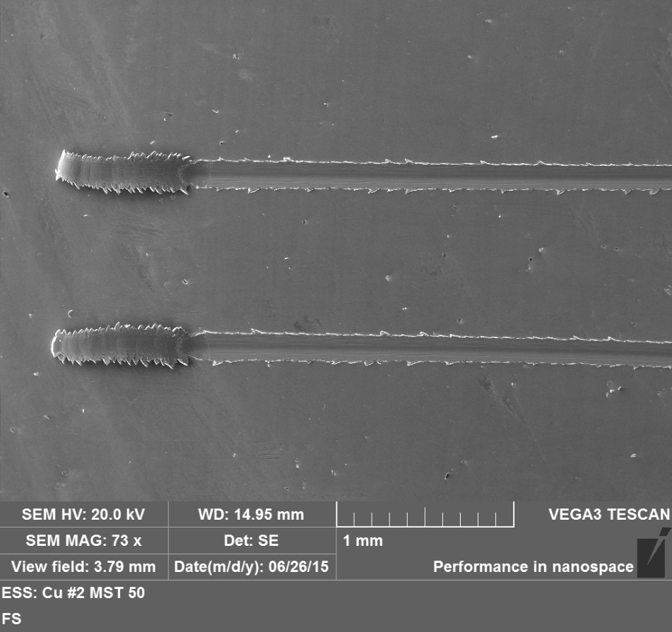
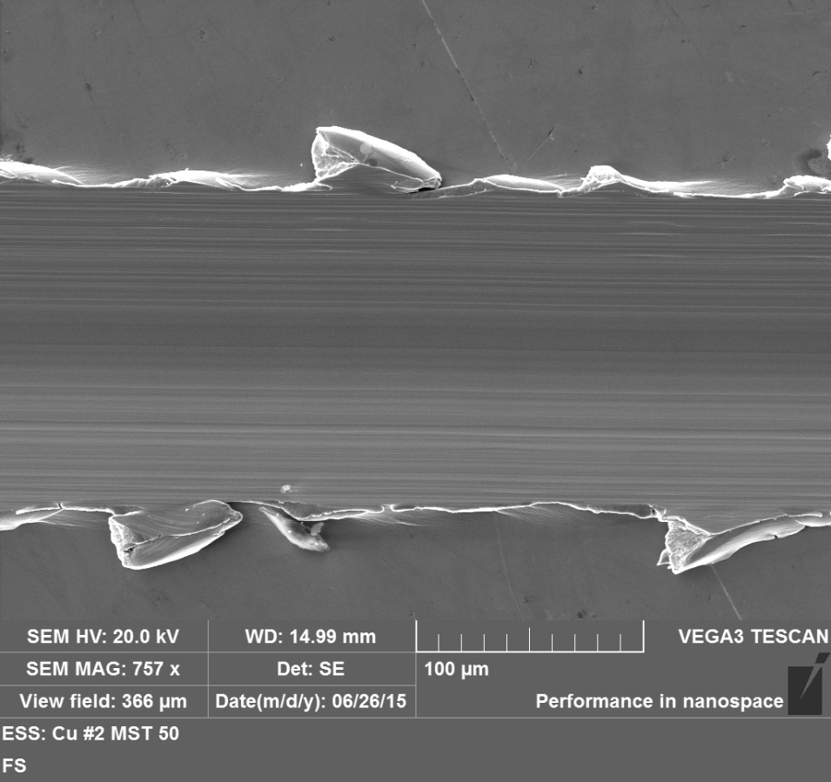
Scratch Test & SEM analysis
Micro Scratch Test with head of 50μm

Slide 29
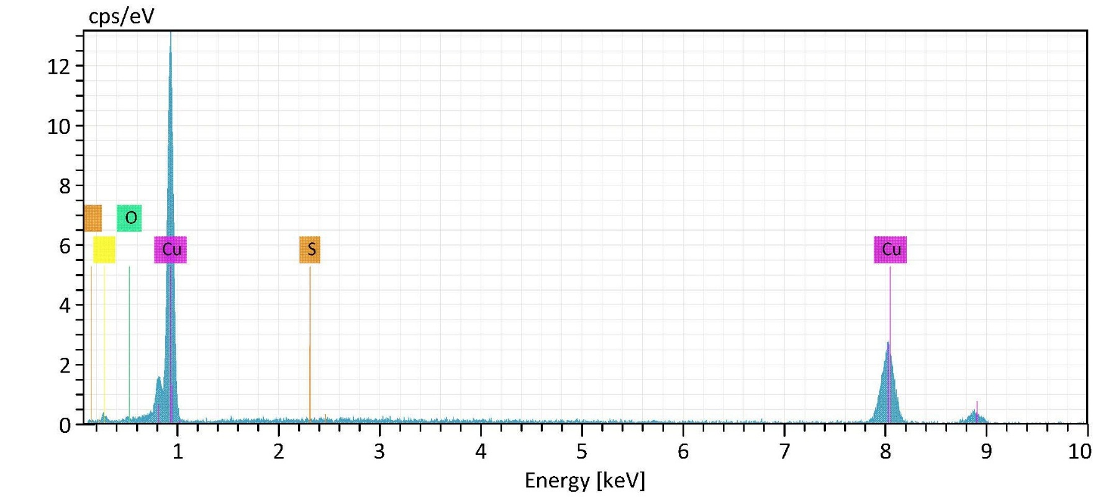
EDAX Scan Analysis

Slide 30
Other example of copper plating

Slide 31
Electroplating Recipe
Buffer layer is made of copper

Slide 32
Problem with plating
Solution?
Solution?
Choose a proper
Curvature Radius
Reversing

Slide 33
Quality Assurance
Outgassing Rate Test
Preparation for testing
The requirement to performance an “Outgassing Rate Test” will be specified prior to manufacture by the VG.
The total out-gassing rate of a vessel or assembly shall be measured after 10 hours of pumping from atmosphere.
The measured outgassing rate shall be <10⁻¹⁰mbar l/s cm².
A hydrocarbon free dry pumping unit and a Residual Gas Analyser (RGA) must be used for these tests.
Testing Requirements
The mass spectrum over the mass range of 1-100 u is to be recorded after 10 hours of pumping from atmosphere.
The “hydrocarbon” content, recorded by the RGA, must not exceed 10% of the maximum allowable outgassing rate.
This can be calculated by summing all the hydrocarbon peak heights >40 u and expressing them as a fraction of the total peak height. From the total measured outgassing rate.
The outgassing rate due to hydrocarbon (HC) is to be calculated as follows:
Hydrocarbon outgassing (%) = Sum of HC peaks / sum of all peaks x measured outgassing rate
Peaks at 17, 18, 28 and 40 u are deemed to be non-hydrocarbon.

Slide 34
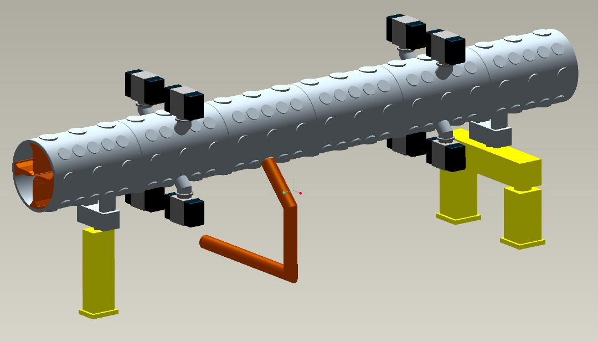
RFQ tank for SPES
Mechanical Specifications:
no. 6 tanks
Φ_{Int} = 754 mm
Length ≈1150 mm
Weight 990 kg (approx)
General Requirements:
Operating Pressure < 1x10⁻⁸mbar
Cleanliness from dust particles and oil
Limited Vibration
No Maintenance

Slide 35
Back-of-The-Envelope Calculation

