Slide 1
SPES RFQ
M. Comunian

Slide 2
OutLine
Input boundary conditions for the design
Main choices on the design
RFQ generation
Performances
Errors Study

Slide 3
Input conditions
“Good” transmission i.e. an internal bunching.
“Low” longitudinal emittance.
Input energy of 5.7 keV/u to get more cells at low energy i.e. low output longitudinal emittance.
Output energy of 727 keV/u to better inject on the ALPI linac.
Frequency of 80 MHz to match the ALPI QWR.
Low RF power consumption.
A/q=7. (132Sn19+).
Current range up to 100 uA.
RMS Input emittance of 0.1 mmmrad

Slide 4
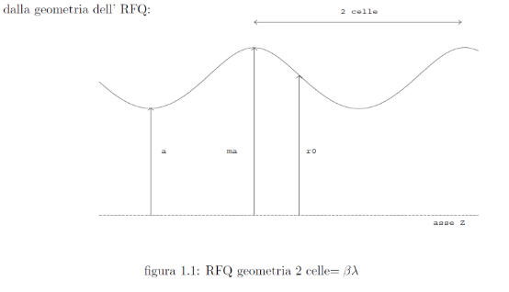
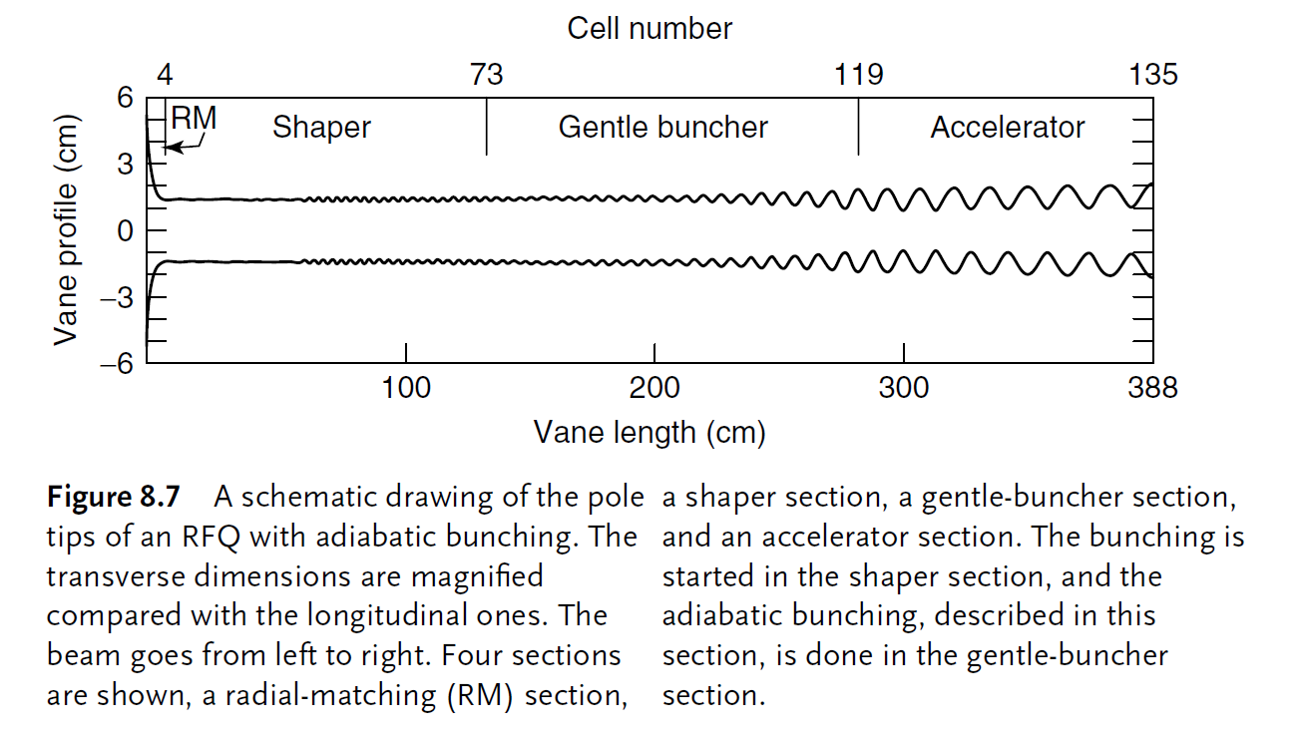
Main Choice
Surface Fields below 1.8 kp.
Linear ramp of the voltage.
Standard 2term modulation.
Total length of 7 meters.

Slide 5
RFQ generation
CORTO:
Generate few cells per
sections with the CERN
“Lead Ion project” style
PARI:
Generate all the RFQ cells.
PARMTEQM:
Transport the particles
inside the cells generated by PARI
Crandall tables:
Estimate the Es and multipoles
on the cells using:
m: modulation
Lc/r0: ratio cell length/r0.
ρ/r0: ratio Radius vane/r0.
TRACEWIN/TOUTATIS:
Transport the particles inside RFQ with
Cells generated by finite elements method

Slide 6
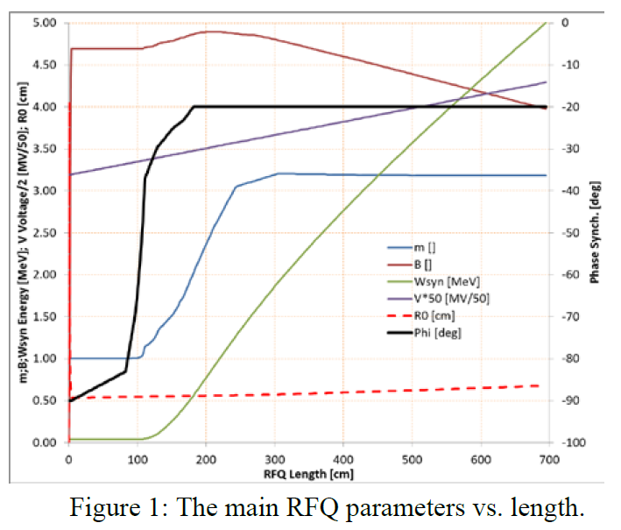
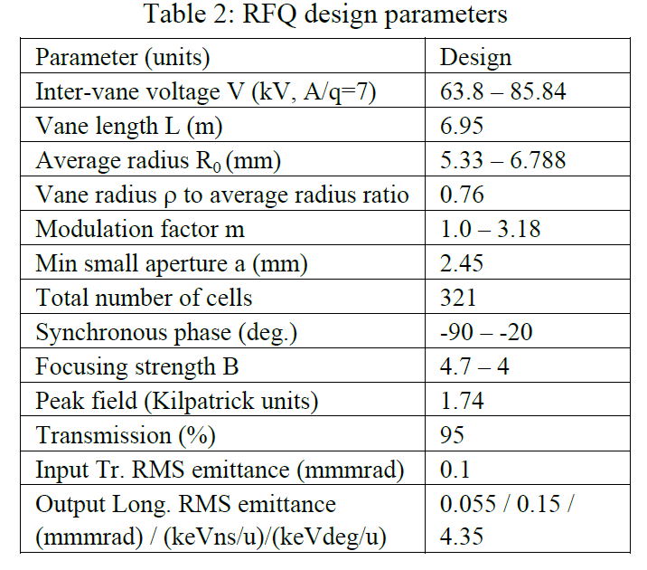
SPES RFQ
Parameter (units) | Design Value
Operational mode | CW
Frequency (MHz) | 80.00
Injection Energy (keV/u) | 5.7 (β=0.0035)
Output Energy (keV/u) | 727 (β=0.0395)
RF power dissipation (kW) | 100

Slide 7
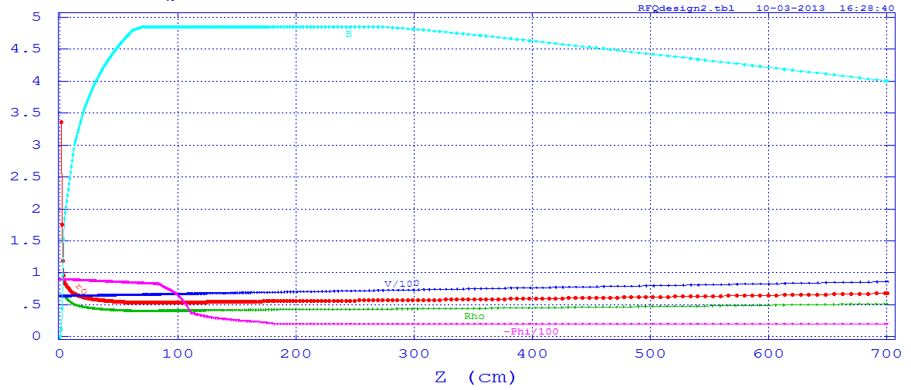
Parameters along the RFQ

Slide 8
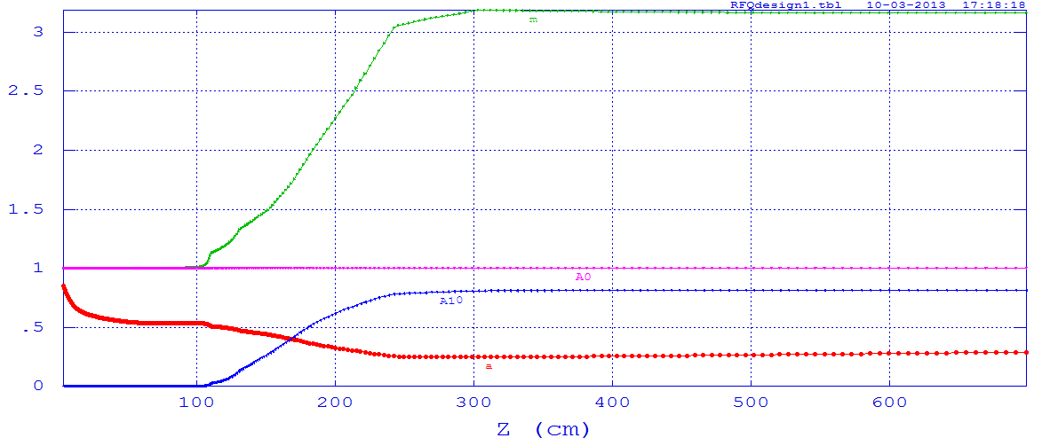
Parameters along the RFQ

Slide 9
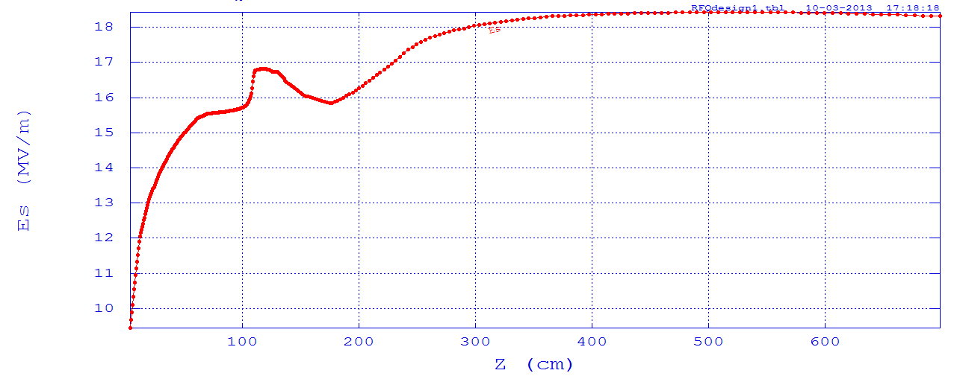
Parameters along the RFQ
Max Es=18.4263 MV/m=1.76 Kp

Slide 10
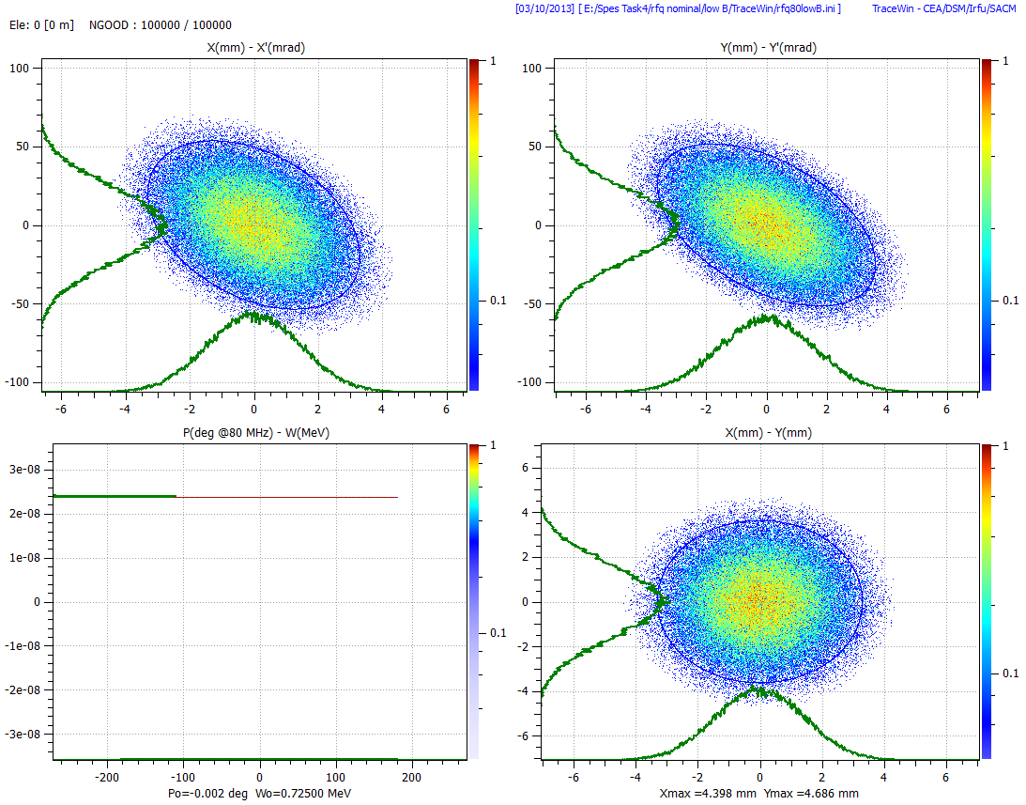
Input phase space
High B: Alfa=1 Beta=0.054 mm/mrad
Low B: Alfa=0.5 Beta=0.07 mm/mrad
X-X'
Emit [rms] = 0.1000 Pi.mm.mrad [ Norm. ]
Emit [95.00%] = 0.5746 Pi.mm.mrad [ Norm. ]
Beta = 0.0667 mm/Pi.mrad
Alpha = 0.4121
Y-Y'
Emit [rms] = 0.1000 Pi.mm.mrad [ Norm. ]
Emit [95.00%] = 0.5731 Pi.mm.mrad [ Norm. ]
Beta = 0.0805 mm/Pi.mrad
Alpha = 0.5639
X-Y
Emit [rms] = 2.0843 mm² [ Norm. ]
Emit [95.00%] = 11.9887 mm² [ Norm. ]
Beta = 0.9104
Alpha = -0.0000
Beta = 0.003516142 Gamma = 1.000006182
Mo = 117281.96487561 MeV
4D (X-X'-Y-Y')
E [rms] = 0.0100000033 (Pi.mm.mrad) ² [ Norm. ]

Slide 11
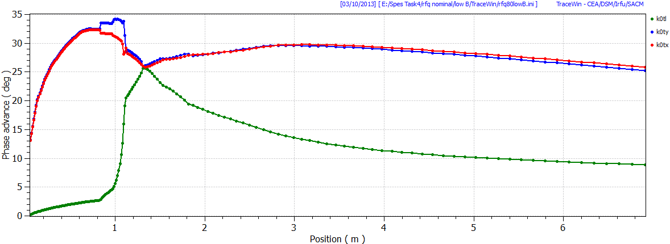
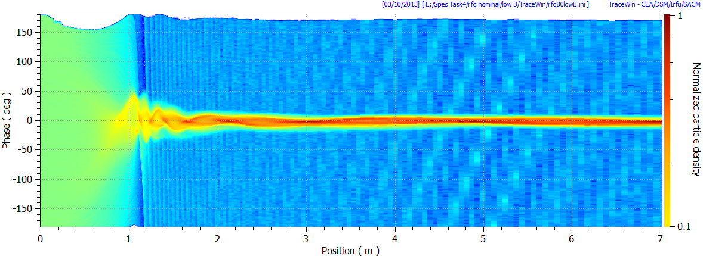
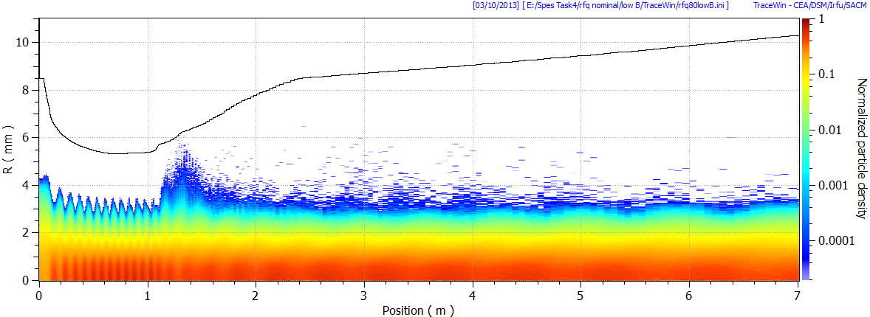
Phase advance

Slide 12
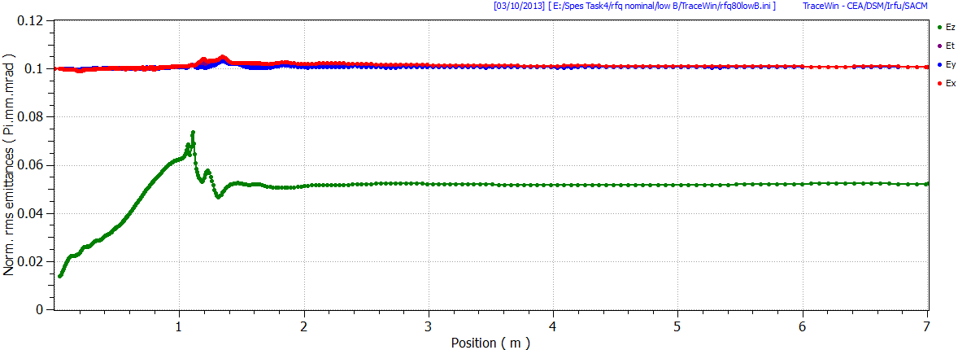
Emittance

Slide 13
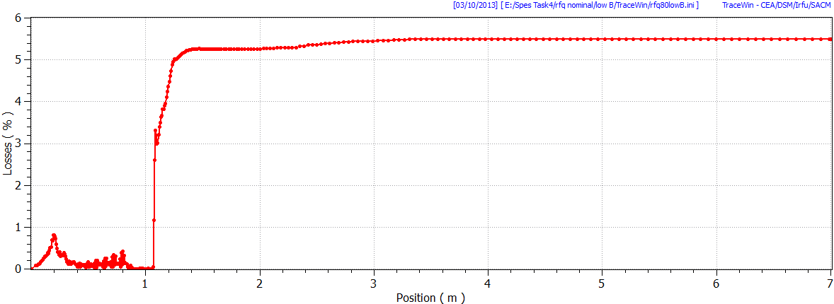
Losses

Slide 14
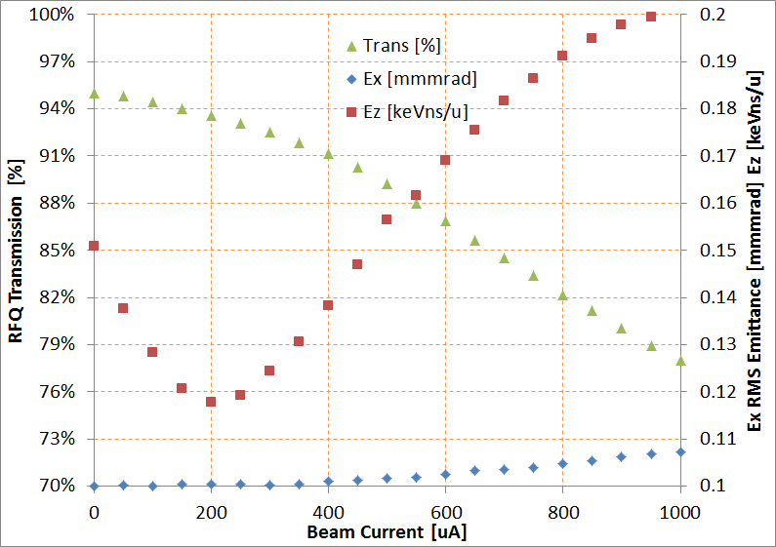
Performances
Input distribution 6σ gaussian
RFQ transmission and emittance as function of beam current

Slide 15
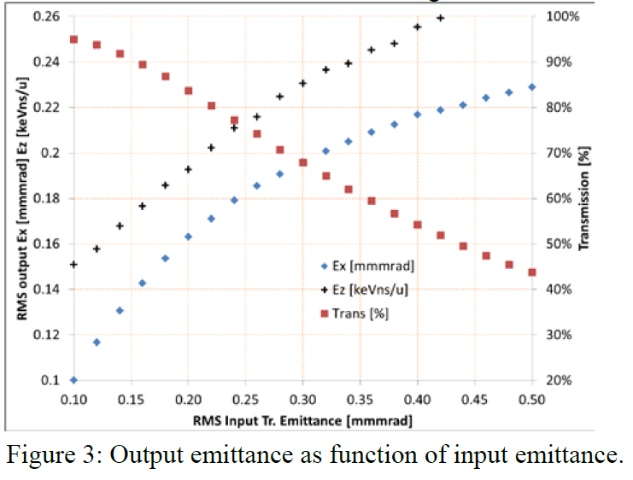
Performances
Input distribution 6σ gaussian

Slide 16
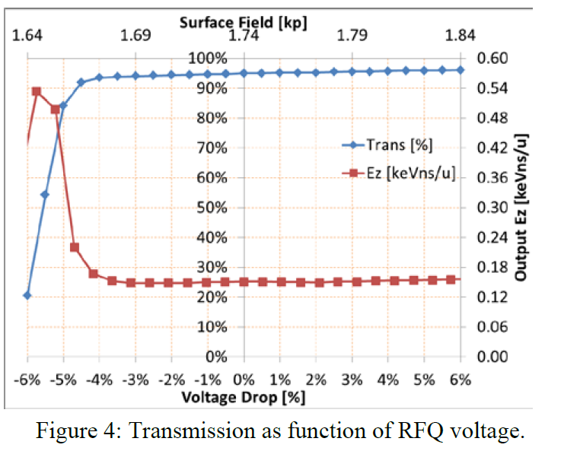
Performances
Input distribution 6σ gaussian

Slide 17
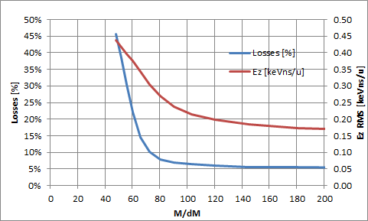
Performances
Input distribution 6σ gaussian
RFQ Mass separation

Slide 18
Errors Study
Voltage tilt and harmonics
Errors on electrodes shapes
Errors on Segments

Slide 19
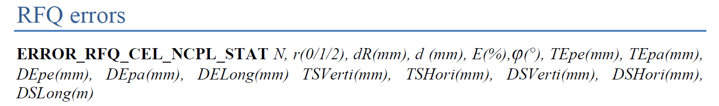
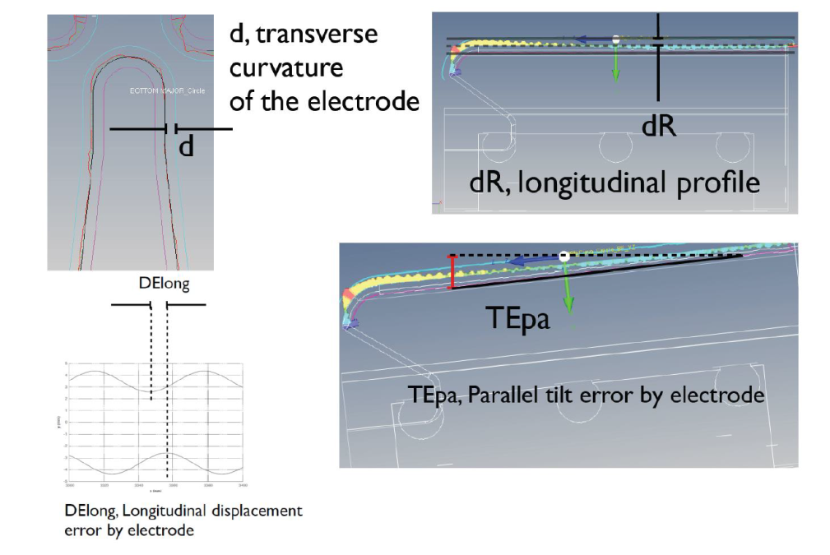
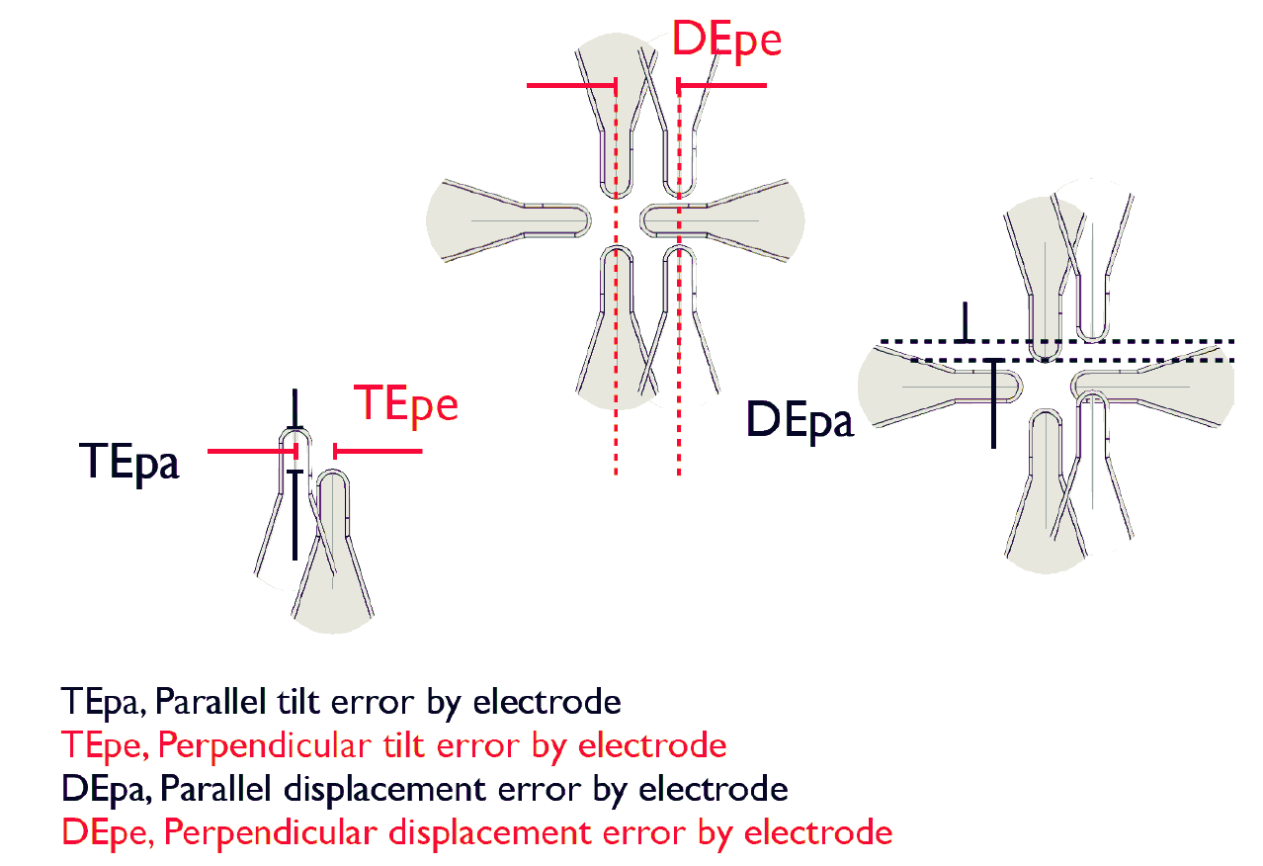
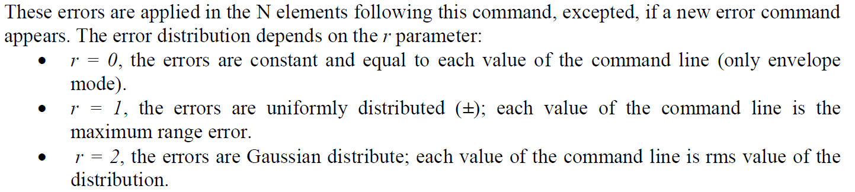
Errors study by TraceWin

Slide 20
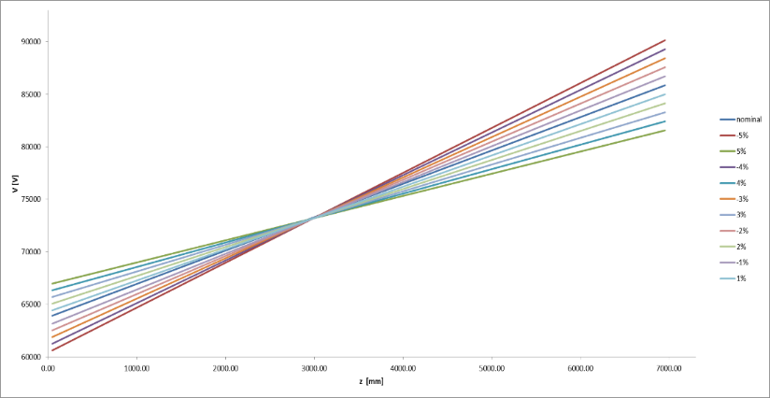
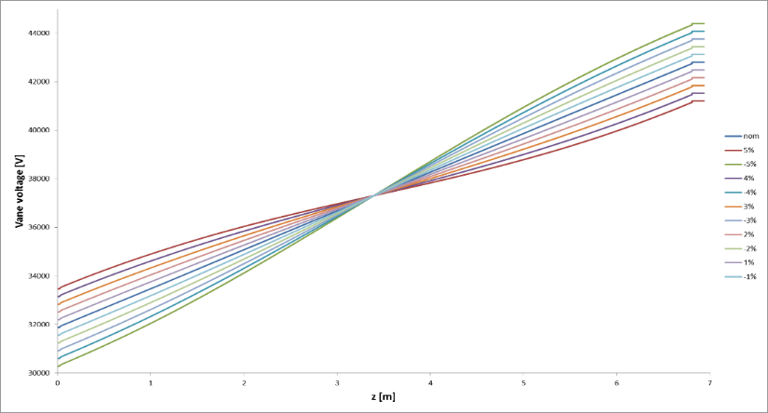
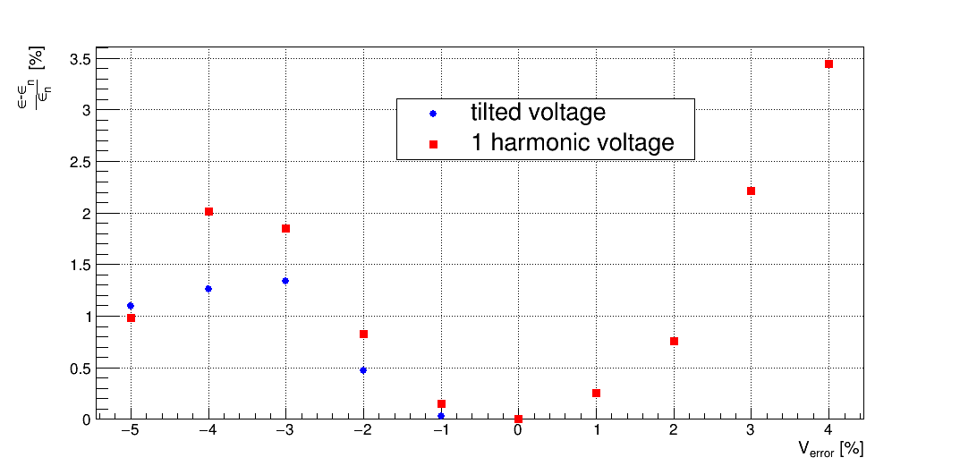
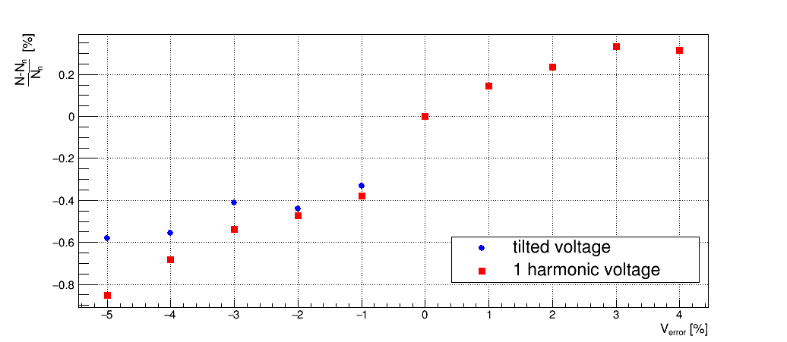
Voltage [V]
(cell voltage)
Vane voltage [V]
TILT
1⁰ harmonic contamination
z[m]
z[m]
Input beam used derives from the front to end MRMS simulation: it includes residual dipoles aberration which consist in a deformed phase space.
The voltage has been changed on the .vane file of Toutatis.
Relative loss growth
Relative longitudinal emittance growth
Tuning range
Tuning range

Slide 21
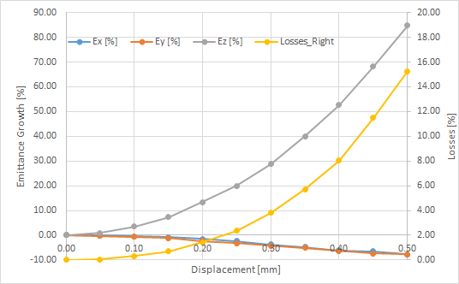
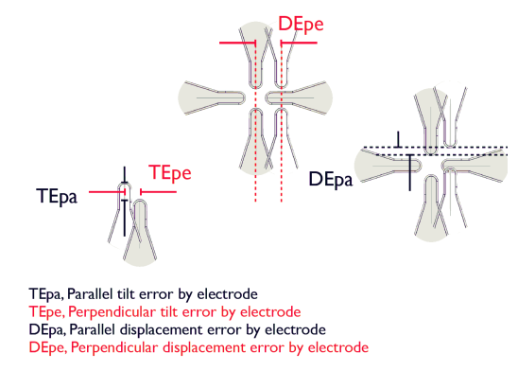
Electrodes Displacement Errors
The RFQ can handles errors displacements of +/- 0.2 mm
Statistical runs of 1000 cases with emittance growth
and losses respect to the nominal case

Slide 22
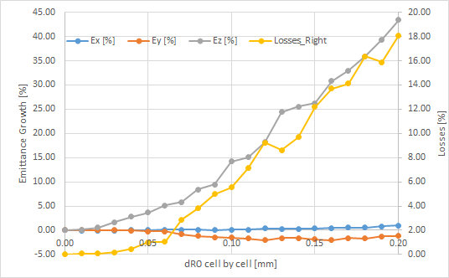
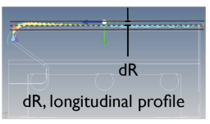
R0 displacement cell by cell
The RFQ can handles R0 errors cell by cell of +/- 0.05 mm
Statistical runs of 1000 cases with emittance growth
and losses respect to the nominal case

Slide 23
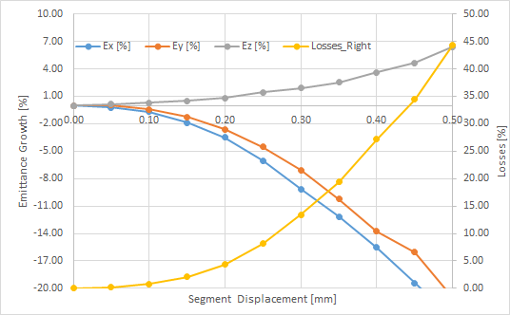
Segment by segment displacement errors
The RFQ can handles R0 errors segment by segment of +/- 0.1 mm
Statistical runs of 1000 cases with emittance growth
and losses respect to the nominal case
Segment length of about 1.1 m

Slide 24
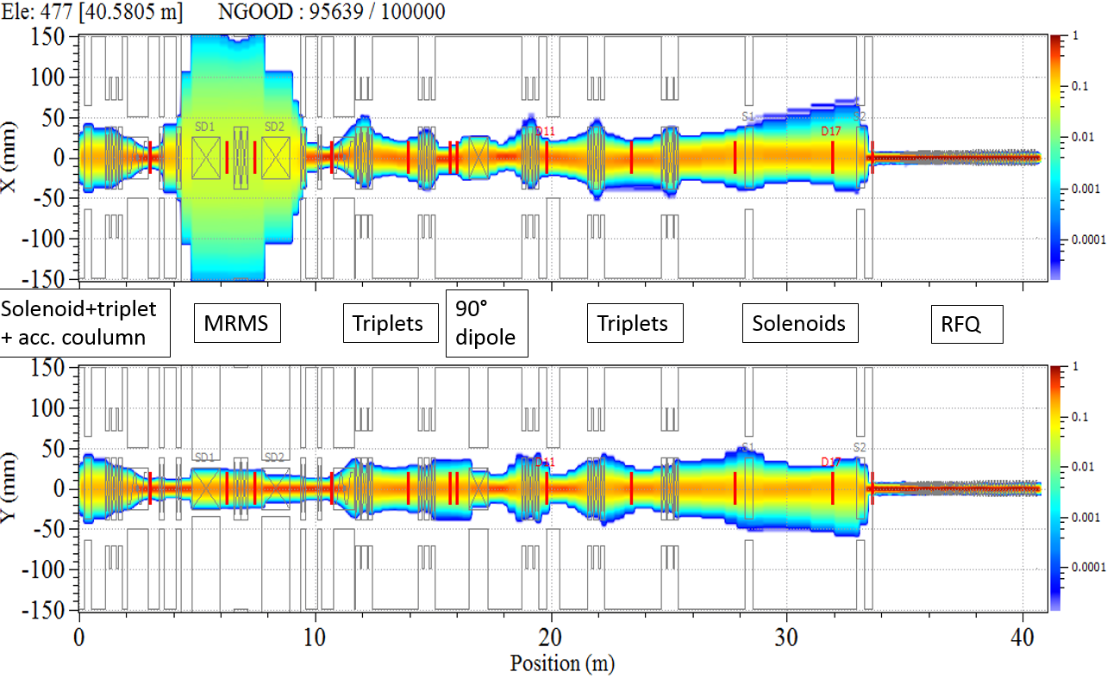
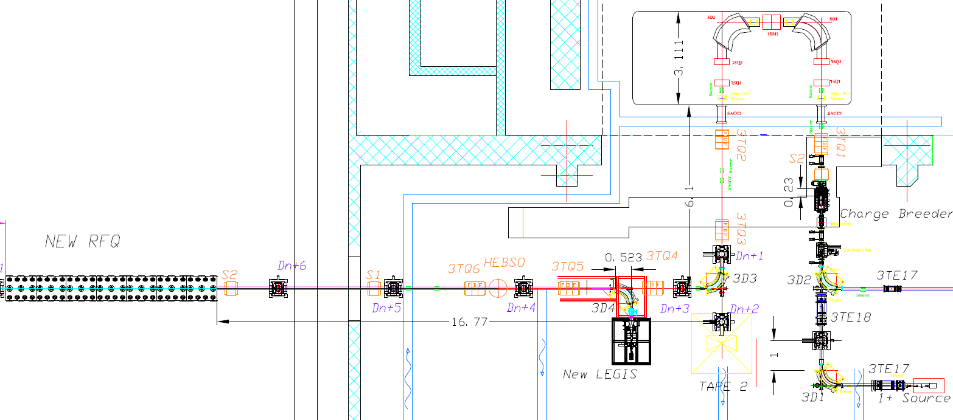
Transport Line to SPES RFQ
Mass Separator
Magnetic Line with
Magnets and Solenoids
CB
1+ Stable Source
RFQ
ECR ion source
Tape System

Slide 25
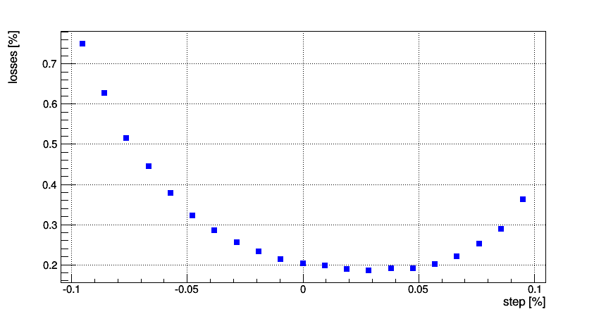
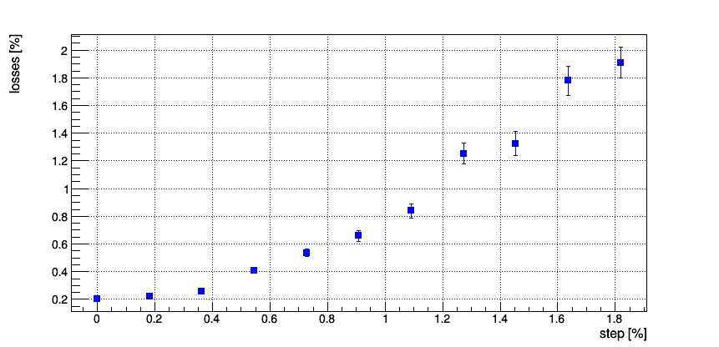
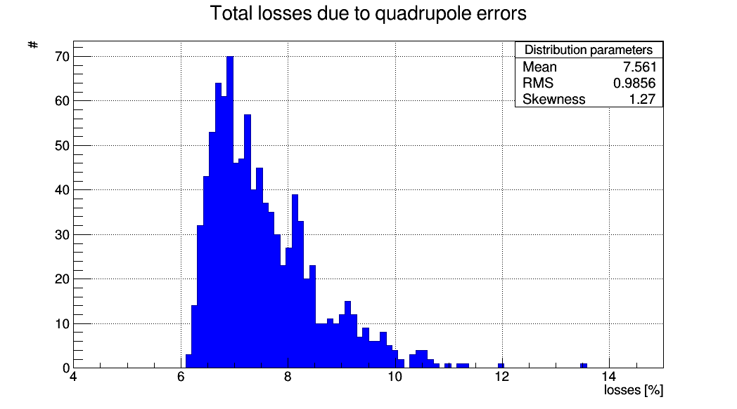
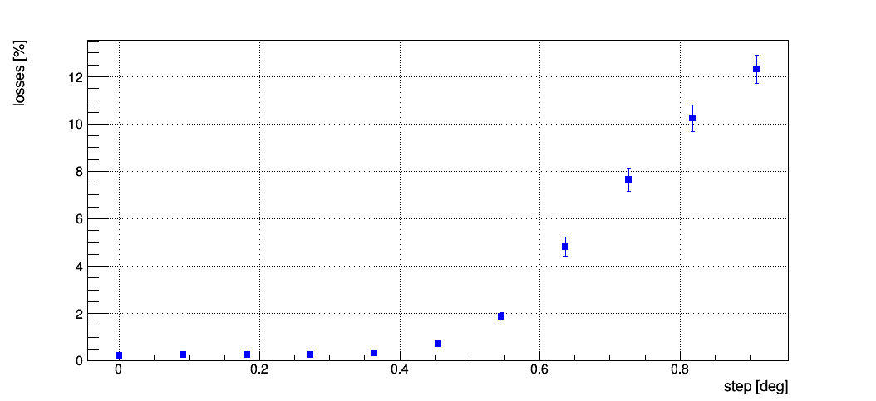
Beam Optics of Transport line from CB via RFQ with static errors study
Quadrupoles errors | Sensibility required
Misalignment | 0.1 mm
Tilt | 0.15
Gradient error | 0.3%
Dipoles gradient error | 0.02%
Multipolar component | 0.6%
Input beam energy input
Input beam error | Applied errors
Mismatch | 10%
Kinetic energy offset | 0.1‰
X’ | 10 mrad
X | 1 mm
Gradient error
Quadrupoles Tilt
With this set of Errors we get an average of
7.4% of losses out of RFQ

Slide 26
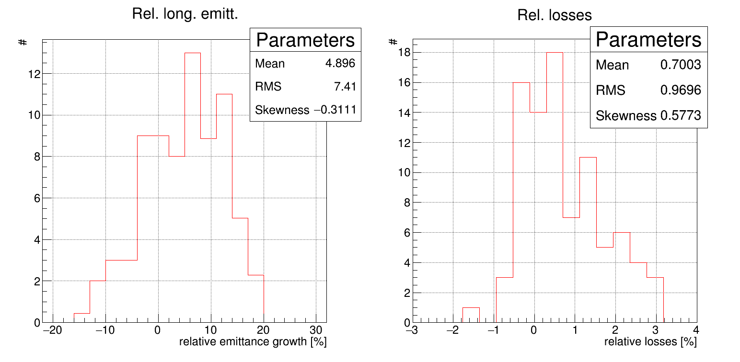
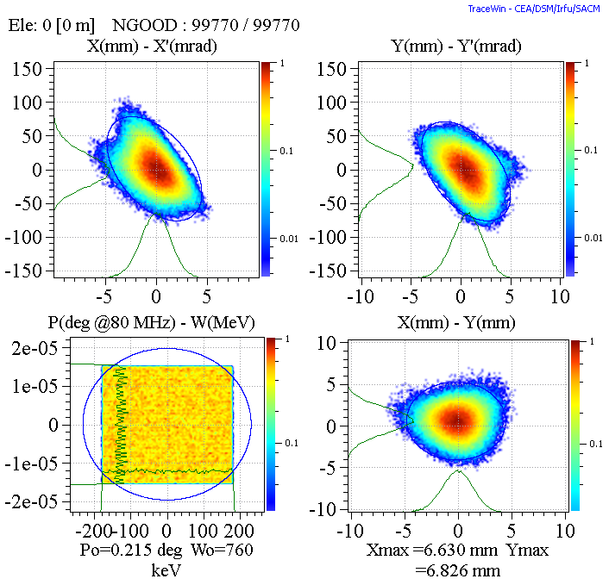
Total errors effect on the SPES RFQ
Input beam comes from the MRMS.
100 cases. Comparison between the nominal losses and long. Emittance.
Error type | Interval error applied
Segment displacement | +-0.1 mm
R0 | +-0.050 mm
Voltage profile (tilt) | +-3%
rho | +-0.020 mm
Input beam

Slide 27
Conclusion
Beam dynamics fully defined.
Errors Study performed.

Slide 28
Backup Slides

Slide 29
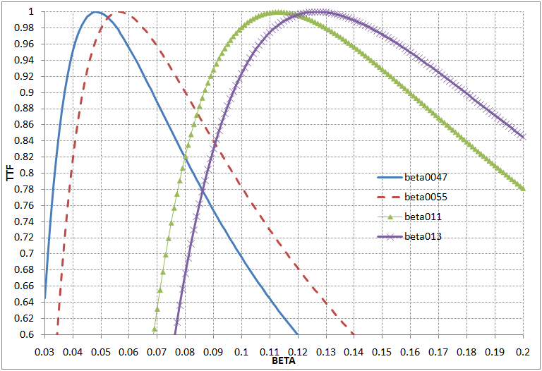
ALPI Cavity TTF

Slide 30
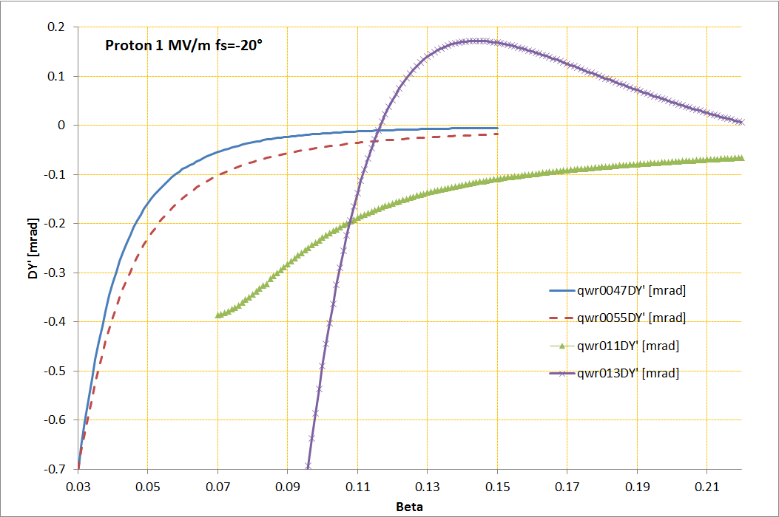
QWR Deflection [mrad] on Y axe
(Proton 1 MV/m ϕs=-20)

Slide 31
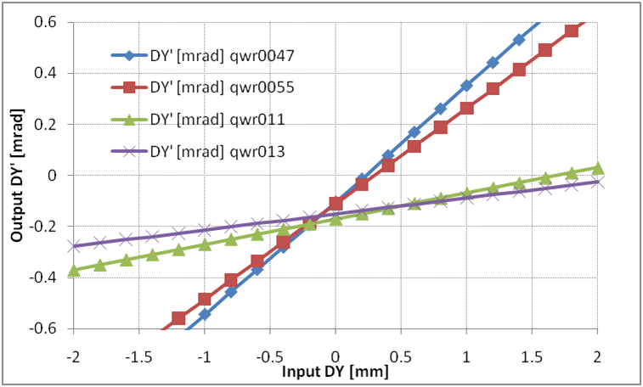
QWR deflection off- Y axe
(Proton 1 MV/m ϕs=-20)

Slide 32
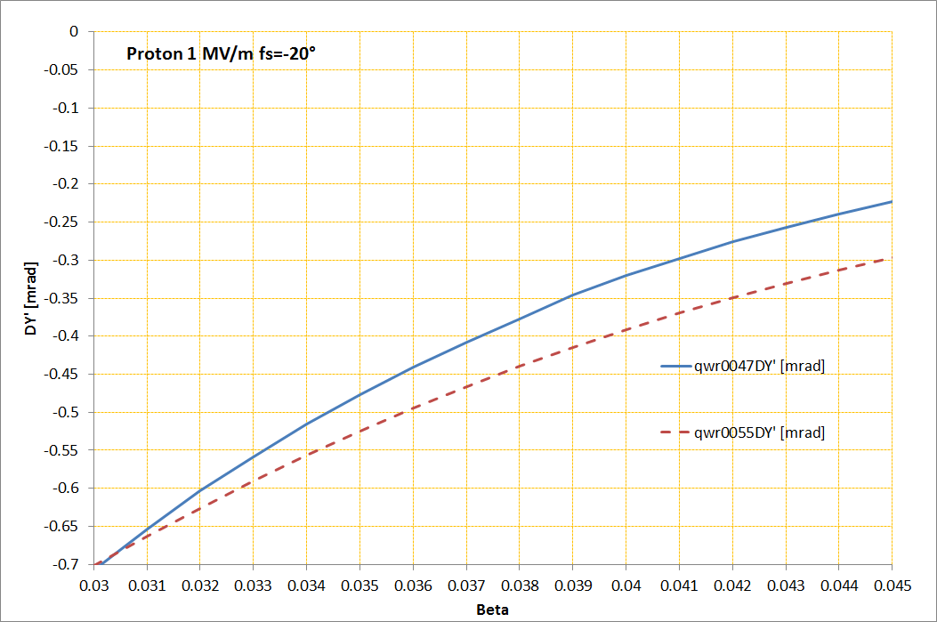
QWR0047 deflection on Y axe
SPES RFQ
PIAVE

Slide 33
Results of the RFQ voltage errors study
The voltage on the RFQ has been titled and shaped (1⁰ harmonic).
For +- 3% voltage error maximum impact on transmission is less than 0.3% relative to the nominal case (93%).
For +- 3% voltage error maximum impact on longitudinal emittance growth is less than 2.5% relative to the nominal case ( 5.15 rms keV/u deg)

Slide 34
SPES RFQ
Parameter (units) | Design Value
Operational mode | CW
Frequency (MHz) | 80.00
Injection Energy (keV/u) | 5.7 (β=0.0035)
Output Energy (keV/u) | 727 (β=0.0395)
RF power dissipation (kW) | 100

Slide 35
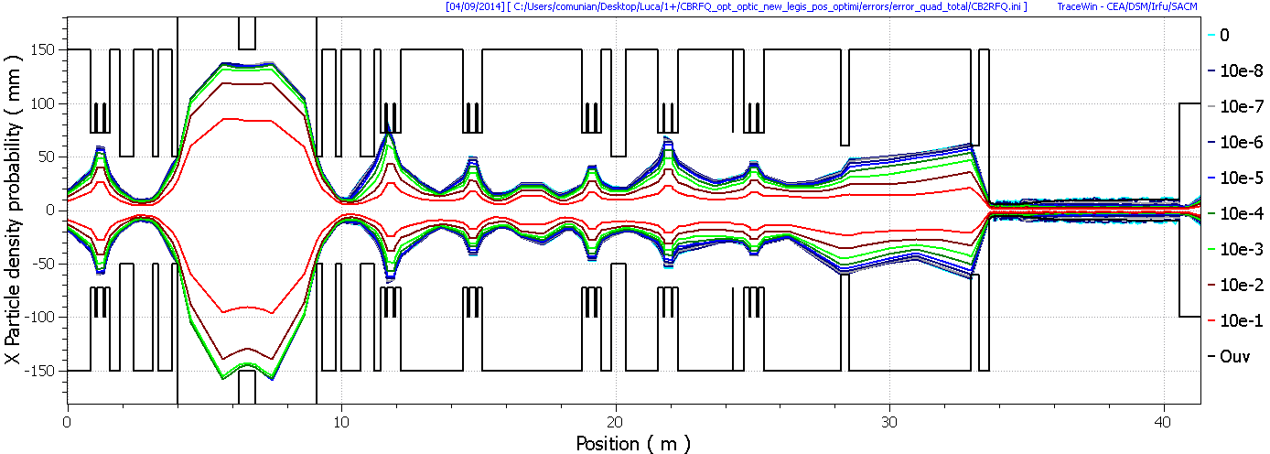
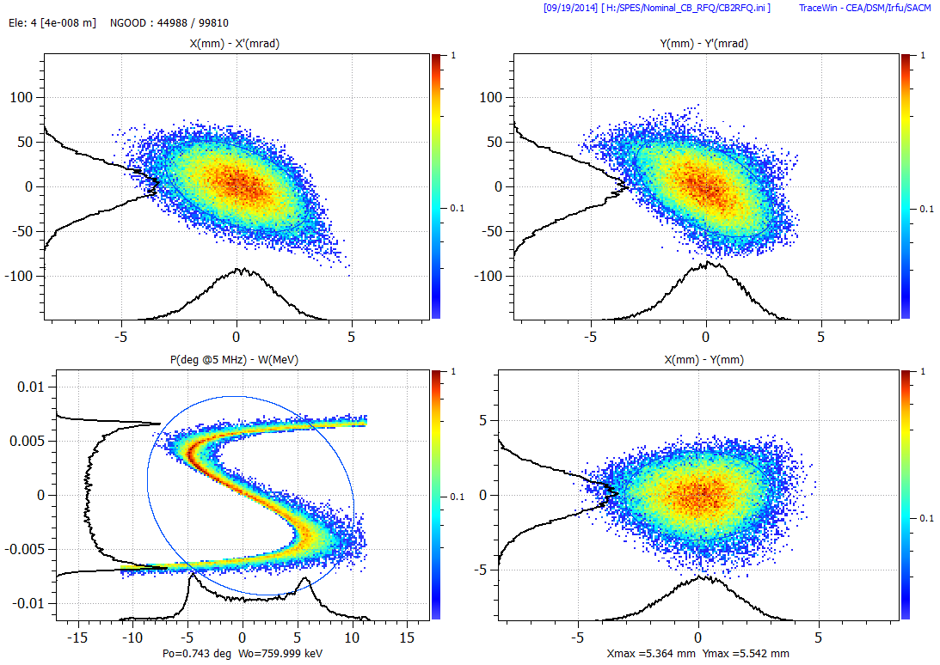
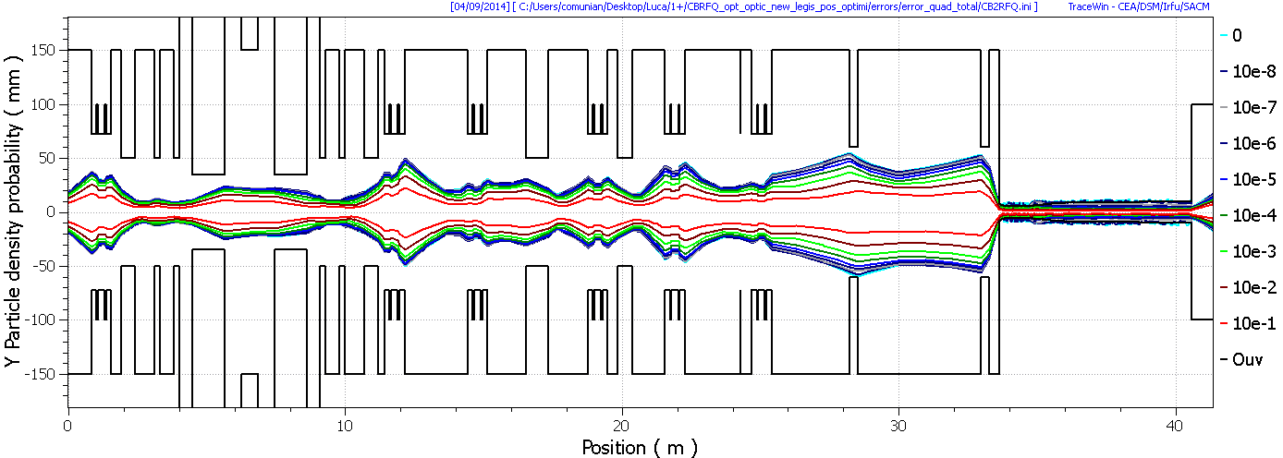
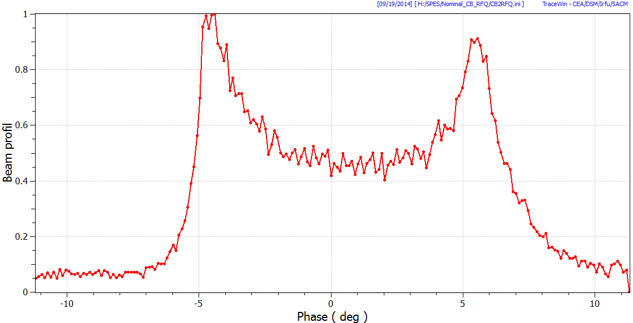
BD from CB to end of RFQ
5 Mhz buncher
IF 5 MHz buncher on:
RFQ
MRMS
Total amount of space occupied by the beam due to quad errors
@ RFQ entrance
Transmission 45 % (chopping the satellite bunches) RFQ output emittance long rms 0.0371 πmmmrad
Without buncher: total losses 93-94 % after the RFQ, output longitudinal emittance 0.067 πmmmrad.
V. Andreev

Slide 36
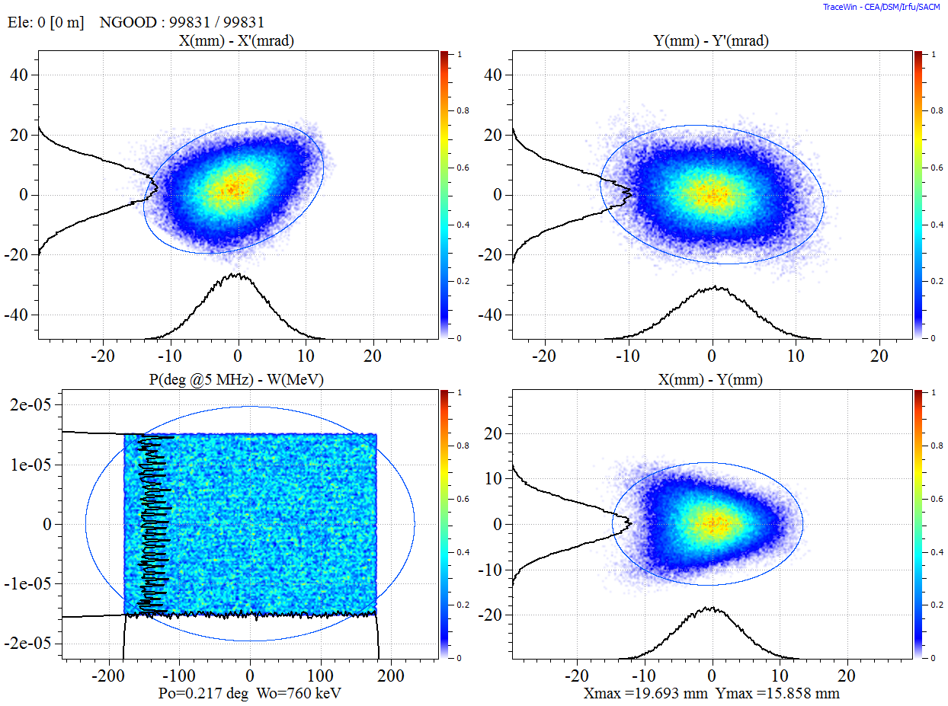
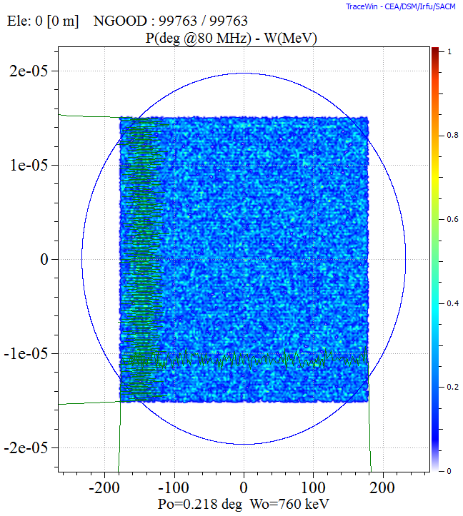
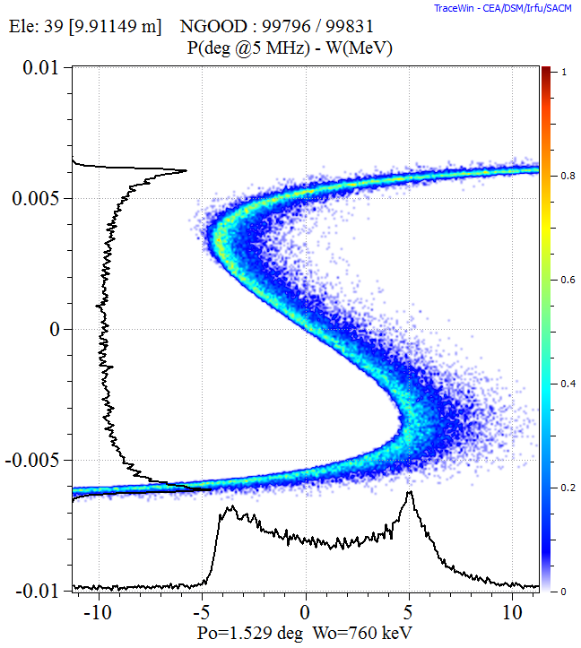
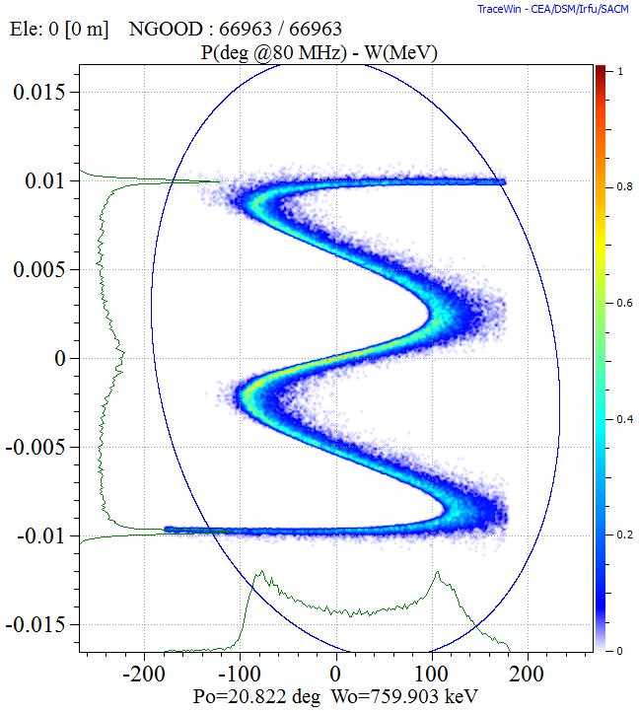

Buncher study
Input beam at the RFQ $±15$eV, ${}_{ }^{132}{{Sn}^{19+}}$, 760 keV. Continuous
n. of harmonics | transmission | emittances ( keV deg/u)
no buncher | 93% | 5.15
1 harmonics | 45% | 2.3
2 harmonics | 60% | 3.36
3 harmonics | 70% | 4.5

Slide 37
SPES RFQ
Comparison PIAVE-new RFQ
Parameter [units] | PIAVE SRFQ | NEW RFQ
A/q | 8.5 | 7.0
Input Tr. Norm. RMS emittance [mmmrad] | 0.071 | 0.1
Output Energy [keV/u] | 587 (β=0.0355) | 727 (β=0.0395)
Output RMS Long. emittance [degkeV/u] | 4.5 | 4.8
Output 90% Long. emittance [degkeV/u] | 29.3 | 26
Transmission [%] | 75 | 95
QWR 0.047 TTF | 0.85 | 0.95
QWR 0047 DY’ [mrad] | -0.48 | -0.32

Slide 38


Comparison PIAVE- SPES RFQ: input tr. Gaussian 3σ
PIAVE:
Emit T in=0.08 mmmrad
W=587 keV/u
Tr=75%
EmitL rms=4.5 degkeV/u
EmitL 95%=29.3 degkeV/u
SPES-RFQ:
Emit T in=0.1 mmmrad
W= 727 keV/u
Tr=95%
EmitL rms=4.8 degkeV/u
EmitL 95%=26 degkeV/u

Slide 39


Comparison PIAVE – SPES RFQ
srfq1
srfq2

Slide 40



PARI input to create an RFQ
r0

Slide 41

B, Es, Phase adv. definition
V= voltage
λ=wave length
c= speed light
M=mass
q=charge
m=modulation
r0=average radius, i.e.
the aperture in the
middle of the cell

Slide 42


Crandall tables

Slide 43

Limit on low B by Crandall tables

