Slide 1
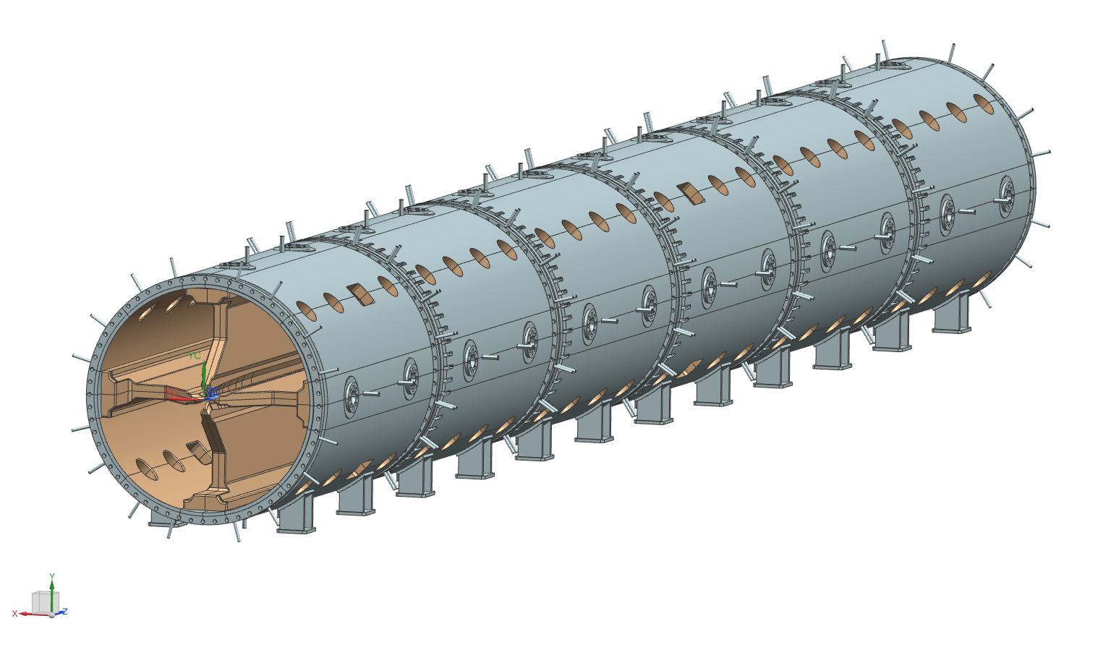
SPES-RFQ review Introduction, general aspects
Andrea Pisent

Slide 2
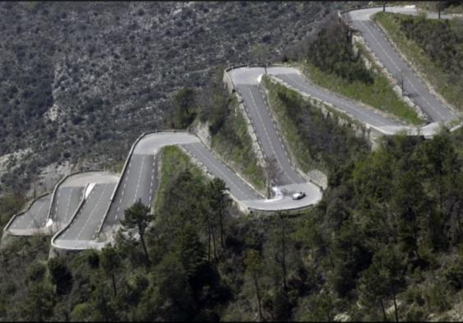
Overview
SPES RFQ design group
SPES RFQ design
Main characterizing choices
Critical requirements

Slide 3
RFQ organization
Andrea Pisent (WU coordinator, LNL)
Antonio Palmieri (deputy coordinator, LNL)
Luigi Ferrari (Mechanics design)
Michele Comunian, Luca Bellan (Beam dynamics, LNL)
Carlo Roncolato (Vacuum system and brazing, LNL)
Next future
Enrico Fagotti (Accelerator Physics and cooling system, LNL)
Damiano Bortolato and Francesco Grespan, Mauro Giacchini (RF system, controls)
Synergies with Torino and Padova INFN sections for the mechanics development (P. Mereu and A. Pepato respectively), common aspects with ESS DTL and IFMIF RFQ design

Slide 4
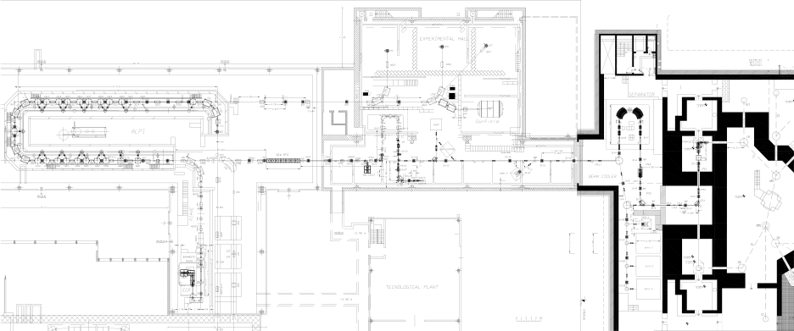
SPES lay out
Exp. areas
MRMS
HRMS
RFQ
Target
ALPI
CB
LRMS
Beam cooler
PIAVE
Cyclotron
XTU-Tandem
1+ Exp. areas
Max A/q=7 the extraction voltage is 40 kV, after the breeder the beam is accelerated by a new 80 MHz cw RFQ, internal bunching
Low longitudinal emittance and larger final energy for better injection into ALPI
Maximum possible current 100 uA

Slide 5
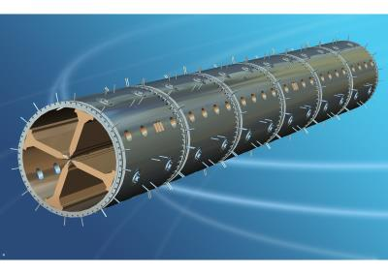
Parameter (units) | Design Value
Operational mode | CW
Frequency (MHz) | 80.00
Injection Energy (keV/u) | 5.7 (β=0.0035)
Output Energy (keV/u) | 727 (β=0.0395)
Accelerated beam current (μA) | 100
Charge states of accelerated ions (Q/A) | 7 – 3
Inter-vane voltage V (kV, A/q=7) | 63.8 – 85.84
Vane length L (m) | 6.95
Average radius R₀ (mm) | 5.33 – 6.788
Synchronous phase (deg.) | -90 – -20
Focusing strength B | 4.7 – 4
Peak field (Kilpatrick units) | 1.74
Transmission (%) | 95
Output Long. RMS emittance (mmmrad) / (keVns/u)/(keVdeg/u) | 0.055 / 0.15 / 4.35

Slide 6
SPES-RFQ design MAIN CHOICES
Beam dynamics
Internal Bunching, low intensity codes for CERN Linac3 (M. Weiss, GD Amendola, M. Comunian thesis, AP).
Design optimized for low longitudinal emittance (ALPI acceptance is limiting)
External bunching (5MHz) will be possible for TOF measurements.
Resonator
Four vanes (no coupling cells, L=1.9λ), ramped field (end cells detuning)
Single coupler (150 kW)
Mechanical design
Copper plated Stainless Steel tank
Metallic joints for sealing
Electrodes in CuOFE, SS inserts and cooling circuit brazed.
Modulation 3d machined after brazing with standard cooling liquid
Cleaning and assembly of the single module in vertical position

Slide 7
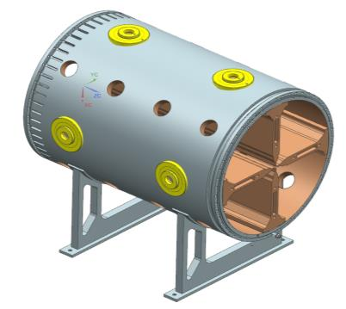
The RFQ: basic facts
The RFQ is composed of 6 modules about 1.2 m long each
Each module is basically composed of a Staniless Steel Tank (AISI LN 304) and four OFE Copper Electrodes (obtained by brazing of two sub-assemblies in order to spare material). The forged tube for the first tank is already at LNL.
A 0.035 mm copper layer is electrodeposited on the tank inner surface.
A spring joint between tank and electrode is used in order to seal the RF.
The electrodes are equipped with two brazed SS inserts in order to allow coupling with the tank
The voltage is linearly variable along the RFQ

Slide 8
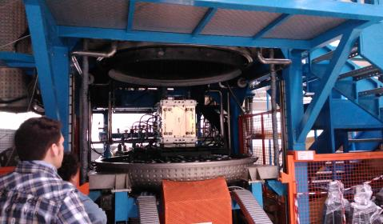
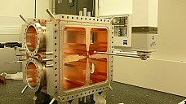
SPES-RFQ Selected technologies
Key mechanical technologies
High precision machining
Qualification of smaller parts, (electrodes) by CMM and large pieces (tank) (laser tracker, arm..)
Vacuum brazing (in house and Cinel)
Copper-plating of large tanks (MoU in preparation with GSI)
Construction procedure
Construction of drift tubes and tanks with base in industry, assembly at LNL.
A dedicated laboratory, with larger crane capabilities (3 tons) respect to M100 has to be prepared for mid 2016.
CMM machine at INFN Padova

Slide 9
About this review
Scope of this review is to validate the Physical and Mechanical design so to be able to launch the construction of the electrodes before the end of 2015
Thank you for your attention

