Slide 1


HIB@LNS 2015
Catania 14-15 December 2015
Diagnostics of FRIBs beam transport line
L. Cosentino¹ , E. V. Pagano^{1,2} , Alfio Pappalardo¹
¹INFN – Laboratori Nazionali del Sud
²Università di Catania

Slide 2
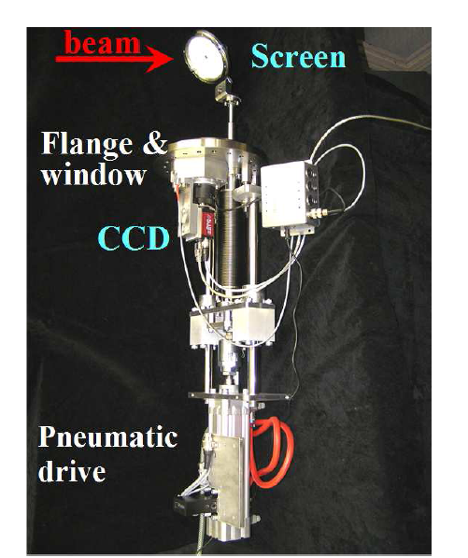
Catania, Italy
15 December, 2015
HIB@LNS 2015
Catania 14-15 December 2015
E. V. Pagano
Univ. of Catania & LNS-INFN
One of the most important task for a beam facility is to maximize the efficiency of the beam transport from the accelerator to the experimental hall.
Current
Transverse profile of the beam
An optimal beam tuning procedure requires that the position, the shape and the intensity of the beam are continuously under control along all the beam line.
Easy task
  For stable beams@LNS (10⁷-10⁹ pps)
For Radioactive Ion Beams (10³-10⁵ pps) the characterisation of the beam properties requires dedicated diagnostic devices.
Notes:
In general the observable are the current, the transverse profile of the beam and the emittance. With stable beam, where, the intensity of the beam is relatively high (10⁷-10⁹ pps) is quite simple to measure such observable, i.e. to current measurement it is possible to use a common farady cup, more in genera, it is possible to measure such observable using commercial instruments.

Slide 3
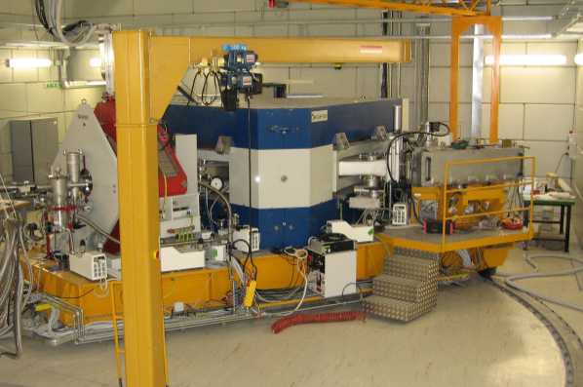
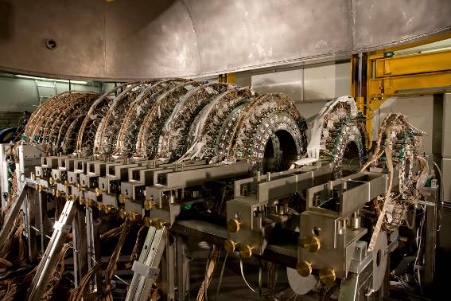
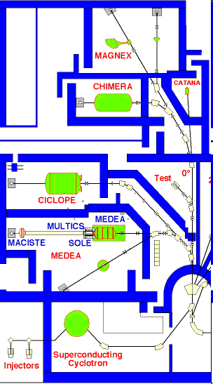
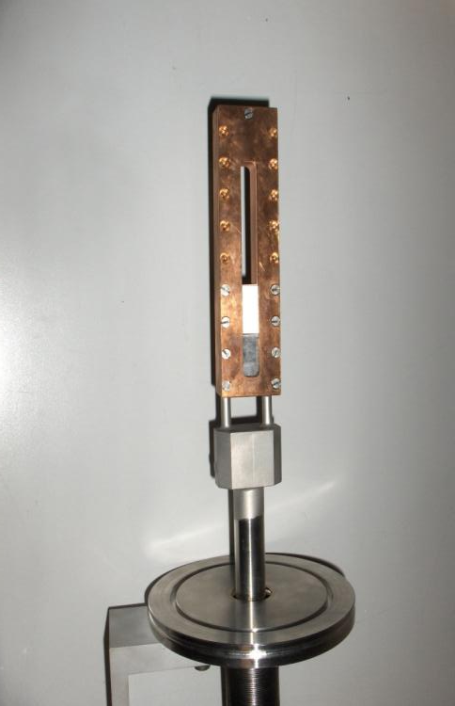
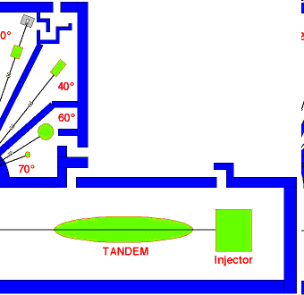
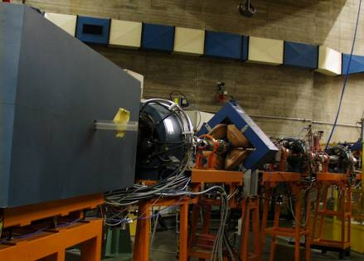
Catania, Italy
15 December, 2015
HIB@LNS 2015
Catania 14-15 December 2015
E. V. Pagano
Univ. of Catania & LNS-INFN
Reaction target and fragments detection
Fragmentation beams at INFN-LNS - Catania
Two 45° dipoles of the beam line allow for the fragments selection
Movable production Target water cooled

Slide 4
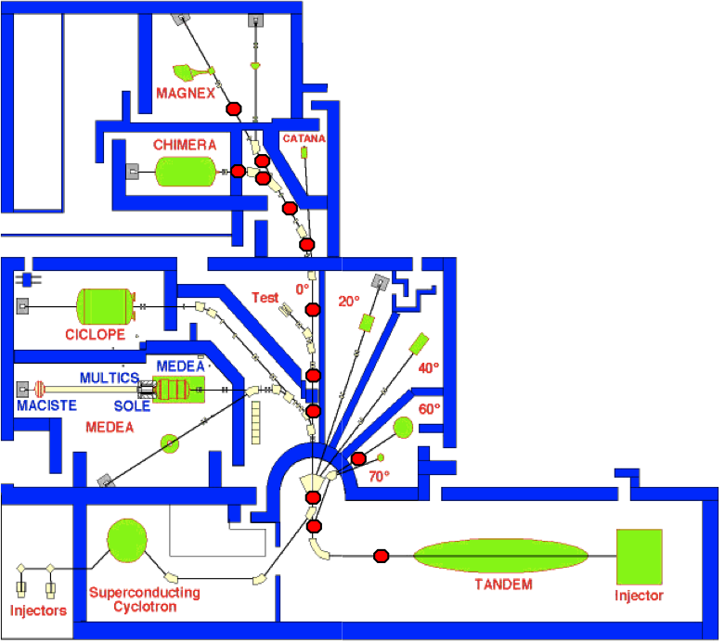
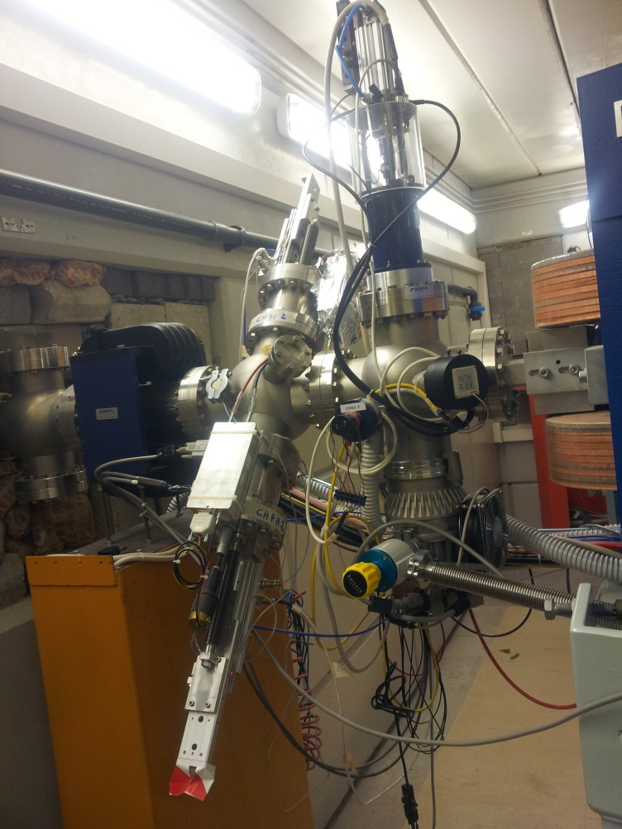
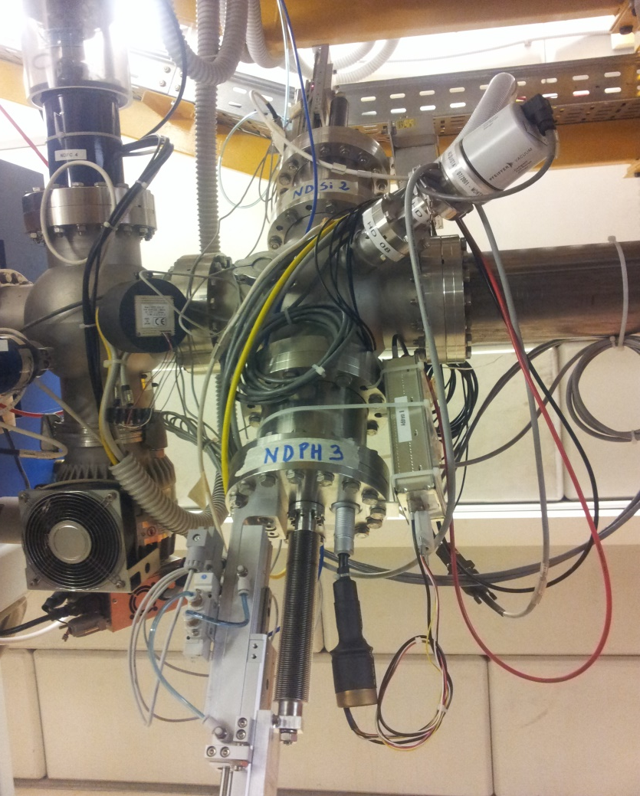
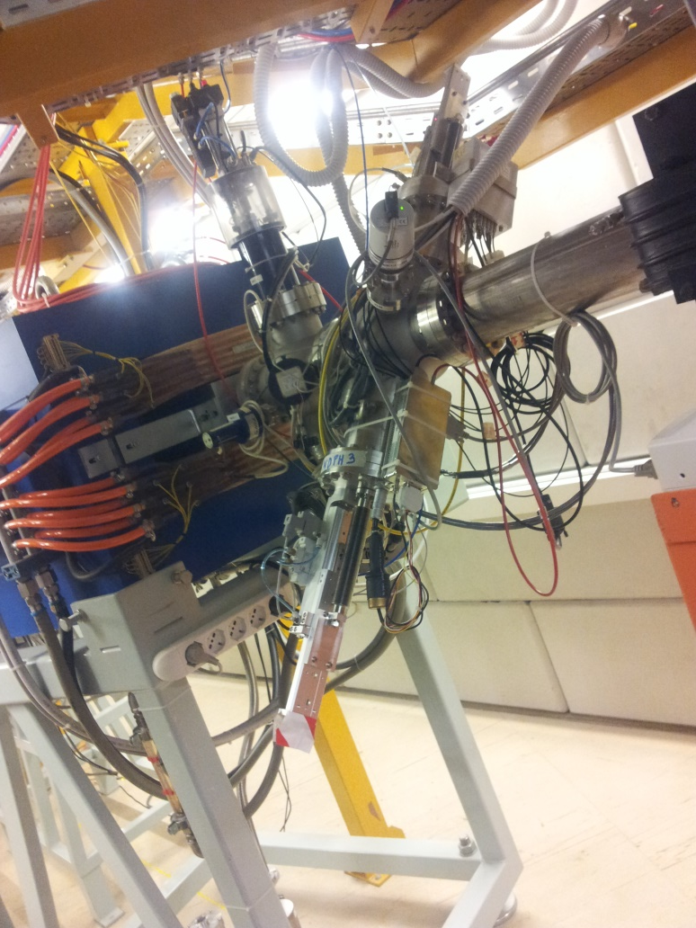
Catania, Italy
15 December, 2015
HIB@LNS 2015
Catania 14-15 December 2015
E. V. Pagano
Univ. of Catania & LNS-INFN
There are 13 diagnostic points where we can measure the variables to optimize the transport of the beam.

Slide 5
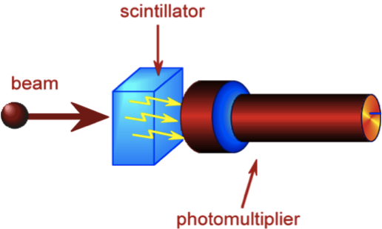
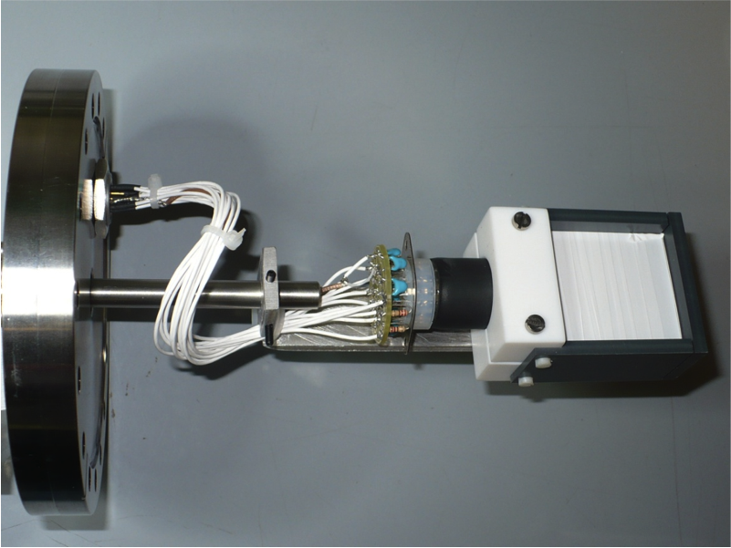
Catania, Italy
15 December, 2015
HIB@LNS 2015
Catania 14-15 December 2015
E. V. Pagano
Univ. of Catania & LNS-INFN
Component along the beam line?
Current measurement
To measure the current of beams with low intensity (below 10⁵ pps) we need to integrate in a proper time range the particles beam counting rate; and to do this, fast signals (15-20 ns) coming from plastic scintillators (NE111, NEXXX, BC404, BC408, Fibres, ecc) are needed.
Plastic scintillator (BC408) optically coupled to a small PMT, working in pulse counting mode
BEAM COUNTING

Slide 6
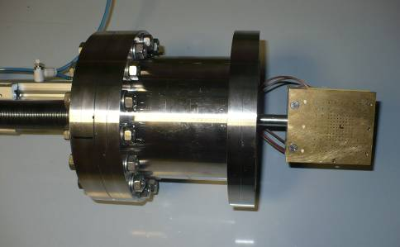
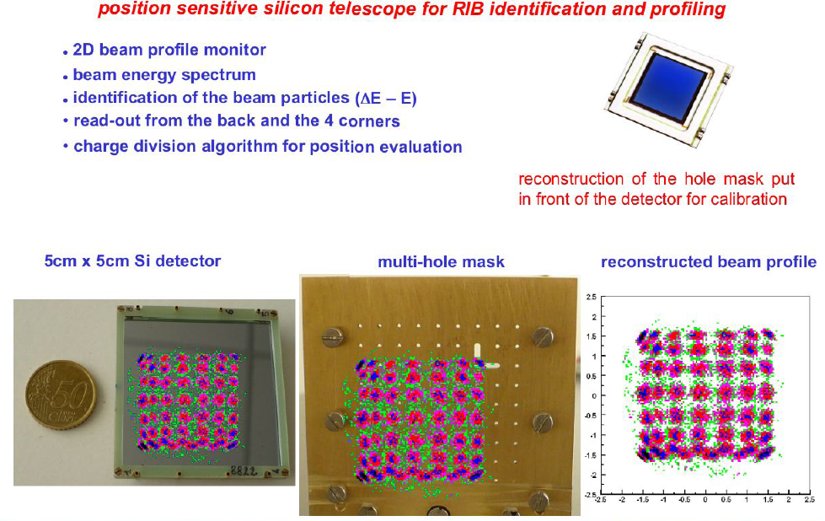
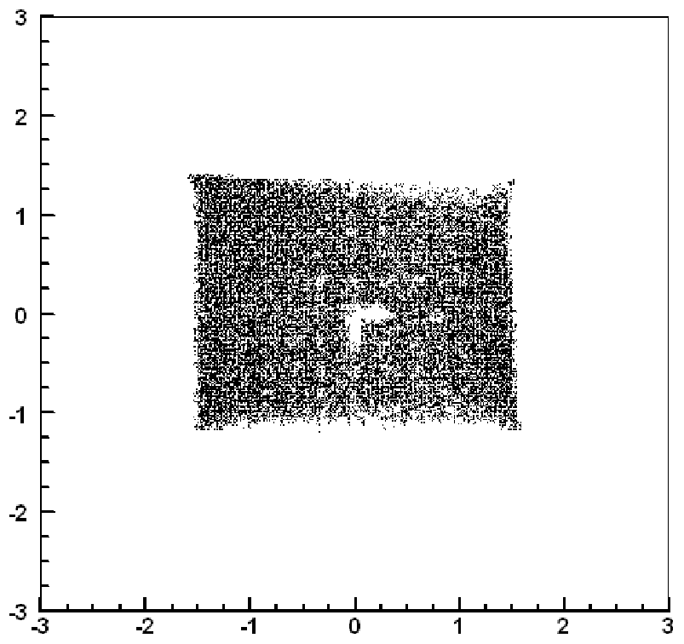
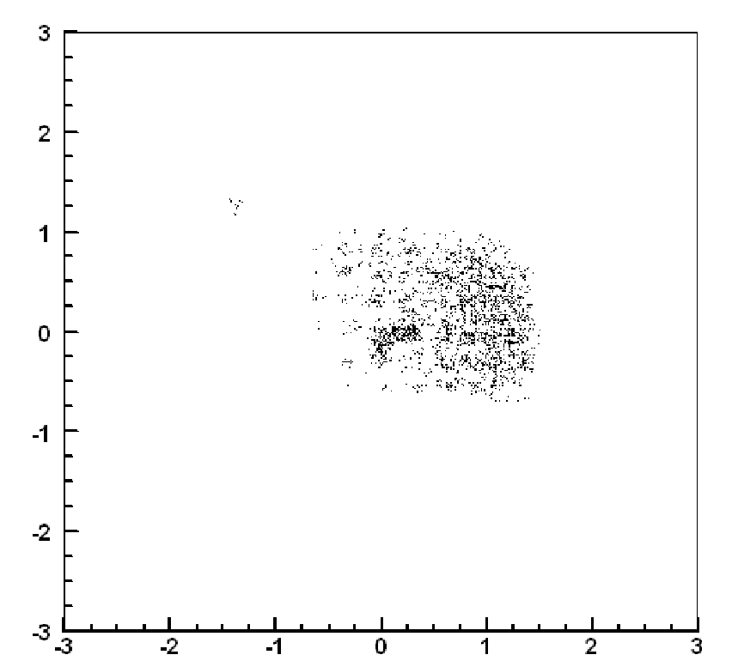
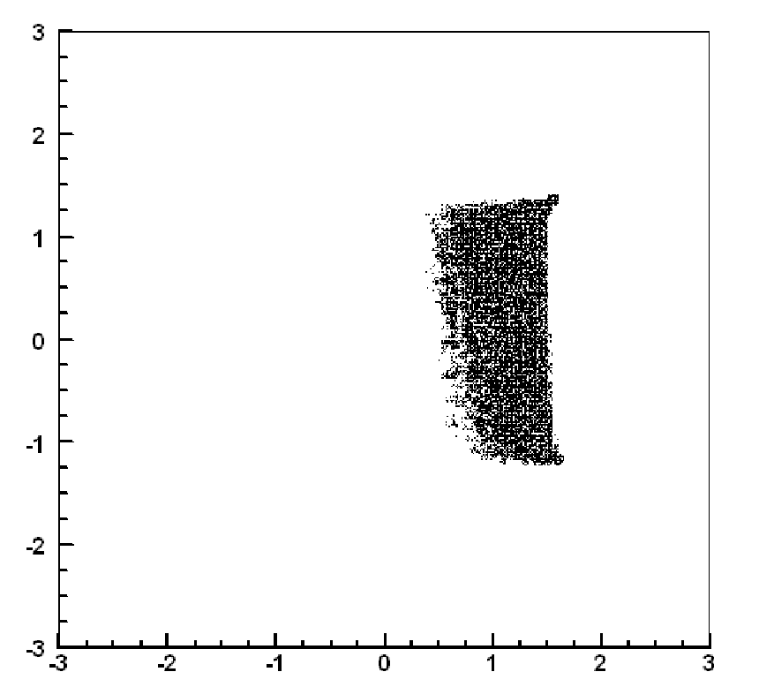
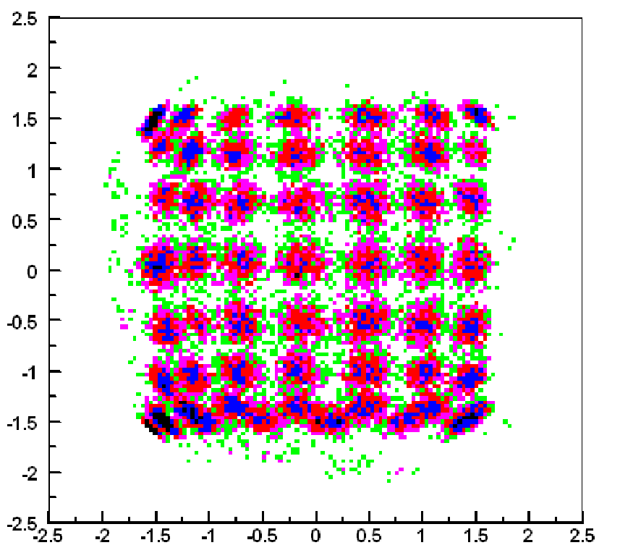
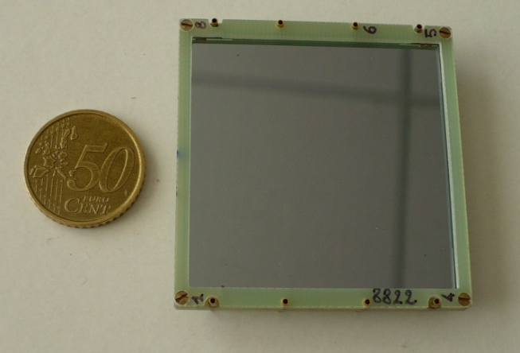
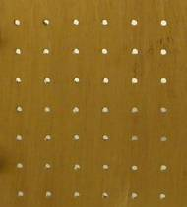
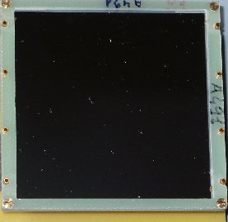
Catania, Italy
15 December, 2015
HIB@LNS 2015
Catania 14-15 December 2015
E. V. Pagano
Univ. of Catania & LNS-INFN
Component along the beam line?
Transverse profile measurement
Real time beam imaging based on fast acquisition system
Spatial resolution 1-2 mm
cm
cm
cm
cm
cm
cm
cm
cm

Slide 7
Catania, Italy
15 December, 2015
HIB@LNS 2015
Catania 14-15 December 2015
E. V. Pagano
Univ. of Catania & LNS-INFN
What Next?
Possible systems to improve the beam transport along with the line
Goals:
Non destructive real time (on-line) diagnostic systems
Good compromise between radiation damage, cost and maintenance
Relatively simple to use
Possible solutions!

Slide 8
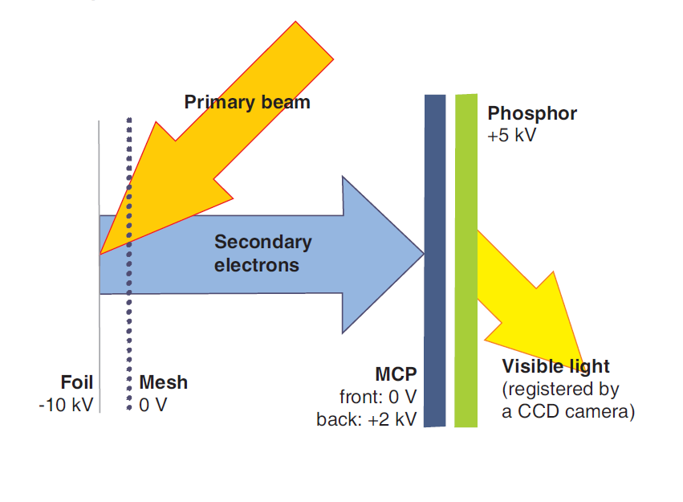
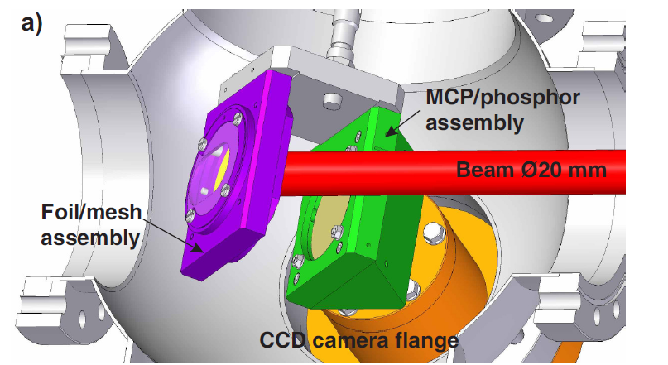
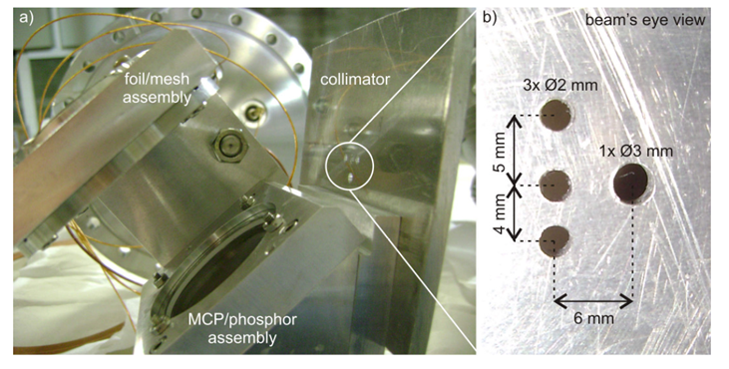
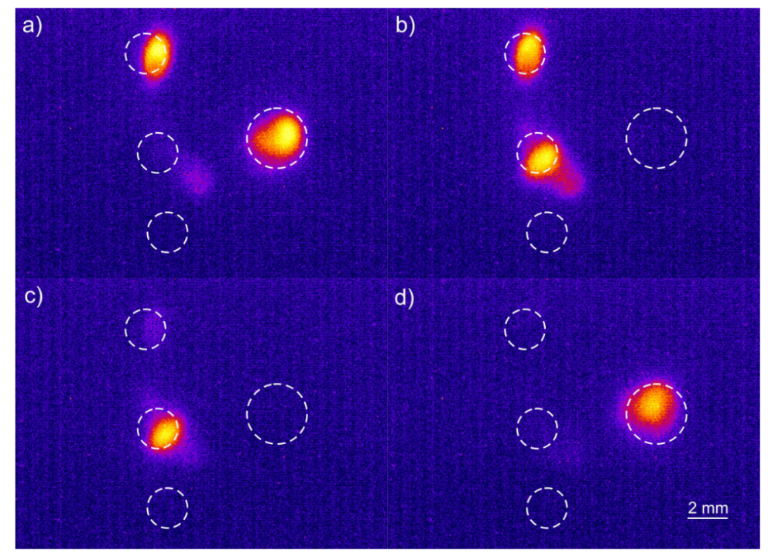
Catania, Italy
15 December, 2015
HIB@LNS 2015
Catania 14-15 December 2015
E. V. Pagano
Univ. of Catania & LNS-INFN
Microchannel Plate (MCP) for Beam Imaging and Ions tagging
proton beam 180 KeV
Intensity < 0.1 pA

Slide 9
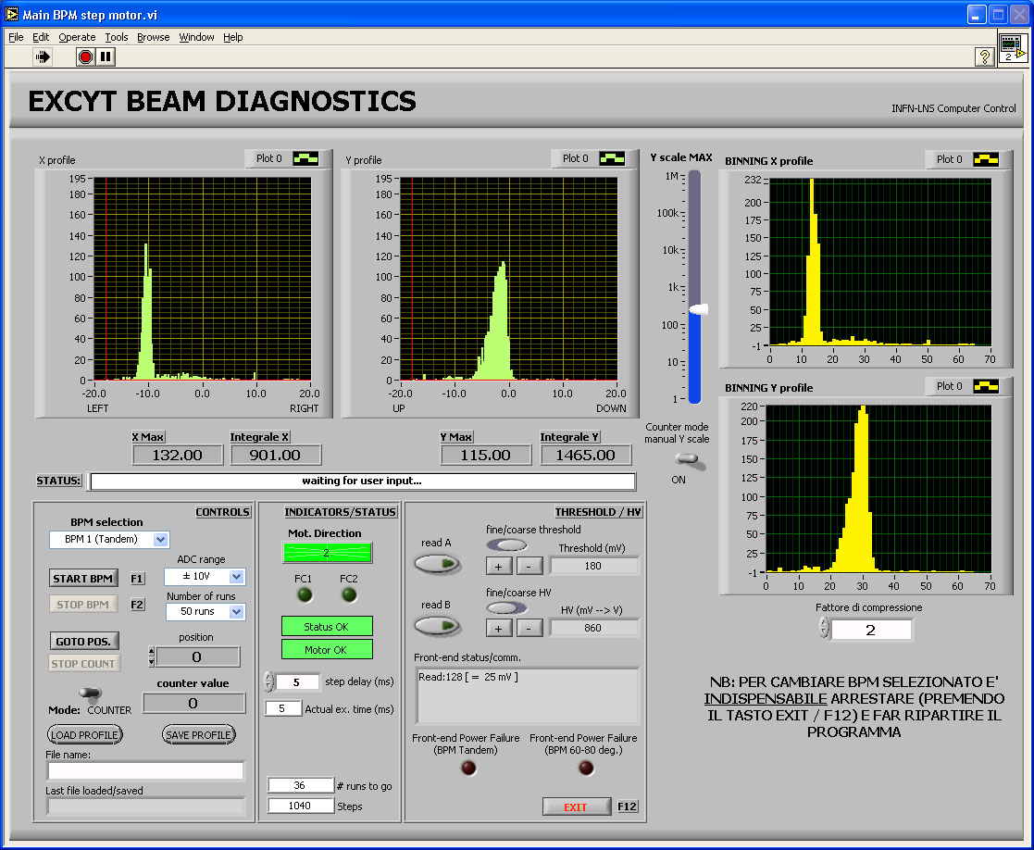
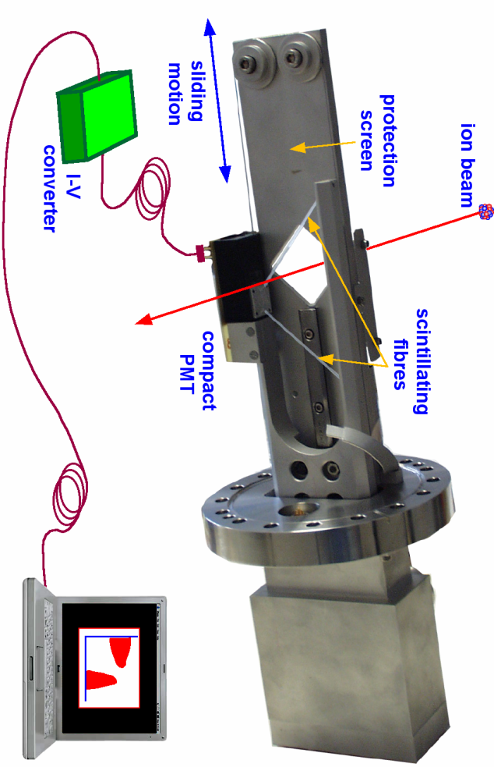


Catania, Italy
15 December, 2015
HIB@LNS 2015
Catania 14-15 December 2015
E. V. Pagano
Univ. of Catania & LNS-INFN
FIBBS (Fibre Based Beam Sensor)
Plastic scintillator fibres
SiPM
μ-sensor
Light collection efficiency at one end: ≈3.5%
scanning a beam with scintillating fibres, in order to produce the 1D intensity distribution
y profile
x profile
⁸Li E = 16 MeV I_{beam}= 7 x 10³ pps
beam profile (mm)
beam profile (mm)
Plastic fibres and compact PMT for particle counting
Fibres diameter: 300 ÷ 500 µm
Notes:
9

Slide 10
Catania, Italy
15 December, 2015
HIB@LNS 2015
Catania 14-15 December 2015
E. V. Pagano
Univ. of Catania & LNS-INFN
Conclusions and remarks
A suitable diagnostics for In flight RIBs made by fast plastic scintillator and position sensitive silicon detectors is already available at LNS. However, It needs improvements in order to maximize the efficiency of the beam transport along with the line.
There are different ideas under developing and others could be taken into account with respect to new technology
Some experimental efforts are needed with some budget (consumable and man power)
Thanks for the attention

Slide 11
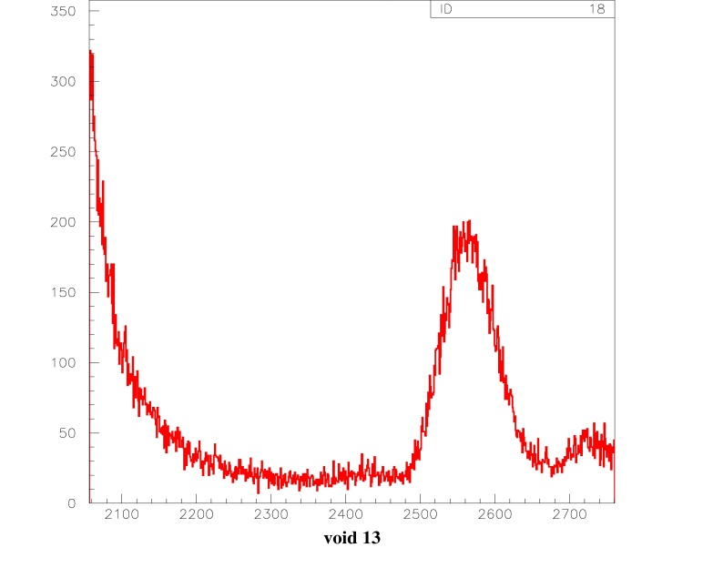
Catania, Italy
15 December, 2015
HIB@LNS 2015
Catania 14-15 December 2015
E. V. Pagano
Univ. of Catania & LNS-INFN
What Next?
Possible systems to improve the beam transport along with the line
Goals:
Non destructive real time (on-line) diagnostic systems
Good compromise between radiation damage, cost and maintenance
Relatively simple to use
Possible solutions!
Ions tagging by TOF measurement
beam
MCP
MCP
T_{Stop}
T_{start}
⁷Li peak @ channel 1926
On-line discrimination among ions having the same energy but different masses.
⁸Li peak
Channel 2567
⁷Li tail
Selected events
TOF - 50 psec/channel

