Slide 1
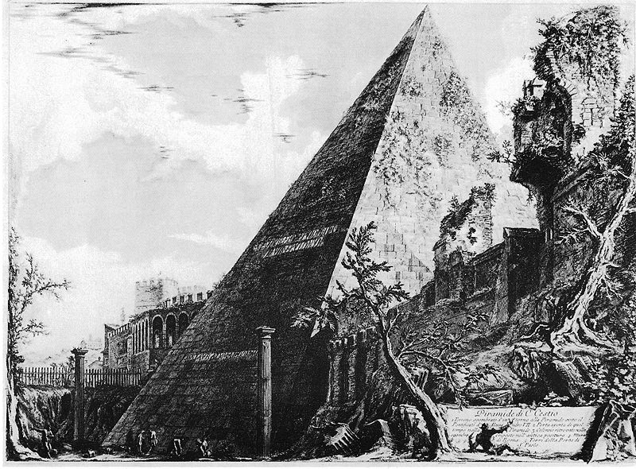
RICAP-18
Roma International Conference on Astroparticle Physics
September 4th – 7^{7h} , 2018 – Roma Physics Department – University Roma TRE
RICAP-18 will be the seventh edition of the RICAP Conference. The Conference, entirely dedicated to the study of high-energy cosmic rays, has been traditionally organized by the INFN sections and Physics Departments of the three public Universities of Roma (University “La Sapienza”, University Roma “Tor Vergata” and University “Roma TRE”). The 2018 edition will be held in Roma TRE University, Roma. Aim of the Conference will be the discussion of some of the most relevant theoretical and experimental results in the field of high-energy cosmic rays (gamma, neutrinos, charged cosmic rays). Special attention will be paid to the multi-messenger search for high-energy cosmic rays sources.
International Organizing Committee Local Organizing Committee
Felix Aharonian Mario De Vincenzi (chair)
Paschal Coyle Antonio Capone
Tom Gaisser Silvia Celli
Francis Halzen Marco Ciuchini
Juan Jose Hernandez Anna Di Ciaccio
Paolo Lipari Biagio Di Micco
Szabolcs Marka Irene Di Palma
Antonio Masiero Giuseppe Di Sciascio
Giorgio Matthiae Marcella Diemoz
Carlos Muñoz Stefano Maria Mari
Piergiorgio Picozza Paolo Montini
Christian Spiering Aldo Morselli
Eli Waxman Francesca Paolucci
Juande Zornoza Gonzalo Rodriguez
Roberta Sparvoli
18
For more information:
Email: Ricap18@gmail.com Web page: ricap18.roma2.infn.it
https://agenda.infn.it/conferenceDisplay.py?confid=7620

