Slide 1
GBT tests
Casimiro Baldanza, Davide Falchieri
INFN Bologna
Corso nazionale INFN "Optoelectronic conversion in the data transmission from detectors"

Slide 2
Outline
GBT FPGA core implementation on KC705 board
test setup description
checking of the GBT link is locked;
checking TX-RX clock alignment
Phase Shifter with programmable delay on scope
BER tests:
full-duplex transmission of a known pattern and BER check;
sending data from GBTx to KC705 (counter + PRBS + fixed pattern)

Slide 3
GBT FPGA: https://espace.cern.ch/GBT-Project/GBT-FPGA/default.aspx
FPGA devices from Altera or Xilinx embed serial transceivers configurable for several standard telecommunication protocols (XAUI, Gigabit Ethernet, PCIe, ...)
But:
transceivers include neither scrambler nor Reed Solomon (RS) encoder nor gearbox
their word aligner/comma detection module are not flexible/configurable enough to fit our needs
the width of the parallel interface of the SERDES can only take predefined values
So the way to implement the GBT protocol on FPGA is:
to use the transceiver in the most basic way (SERDES function)
to implement custom function in logic cells
Targeted FPGAs:
Altera Arria 10
Xilinx Kintex 7
Xilinx Virtex 7
Xilinx Kintex Ultrascale

Slide 4
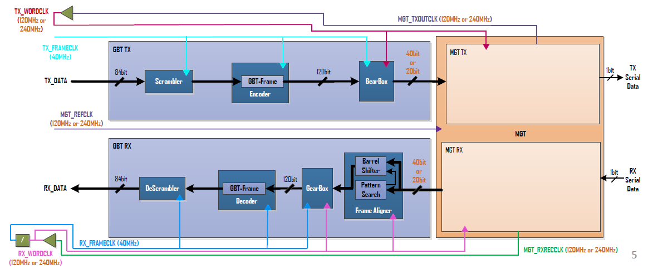
GBT FPGA

Slide 5
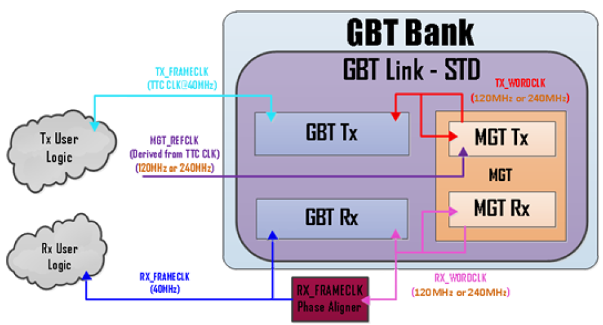
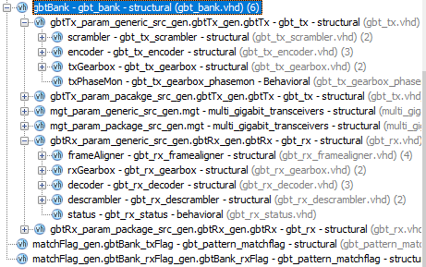
GBT FPGA
The GBT bank may contain multiple GBT links
TX
MGT
RX

Slide 6
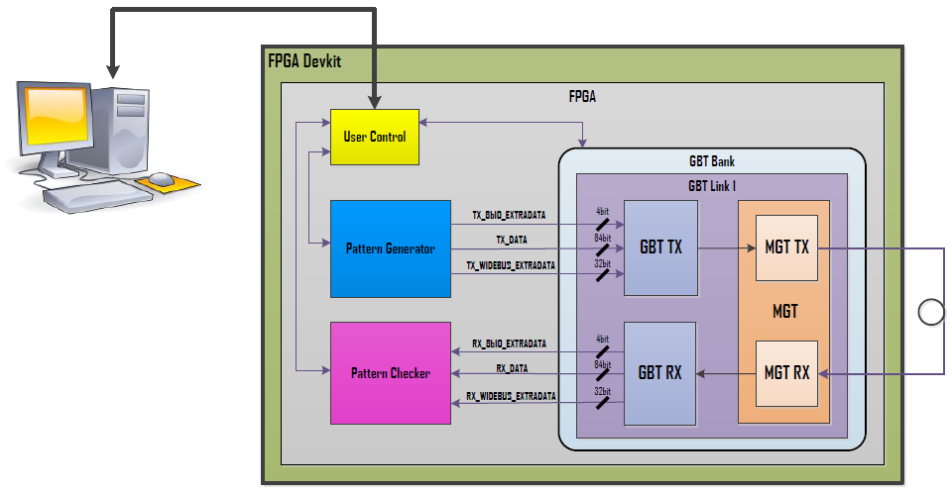
GBT FPGA example design

Slide 7
GBT FPGA: scrambler
Aim of the scrambling:
reduce the occurrence of long sequences of '0' (or '1') only;
achieve a good DC-balance
Scrambler features:
doesn't add any redundancy/overhead
has a latency of 1 clock cycle
generates a pseudo random signal

Slide 8
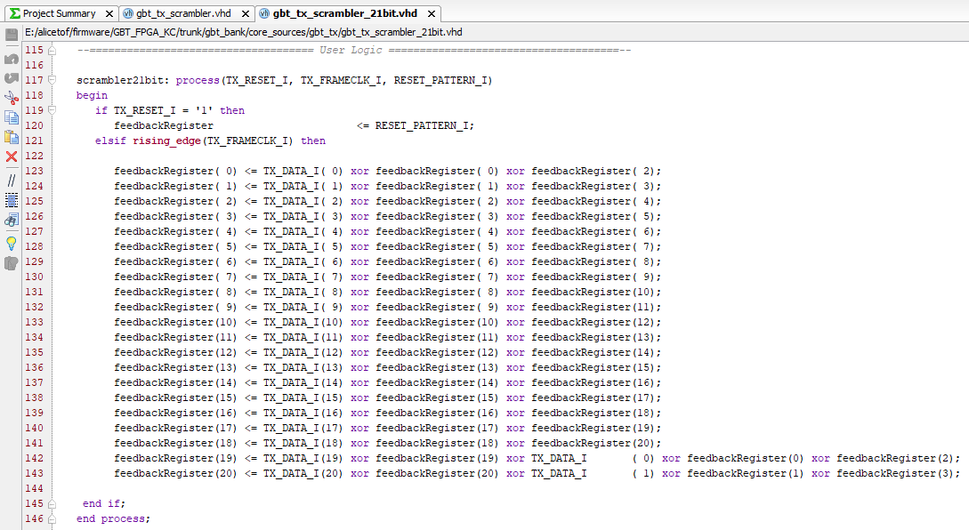
GBT FPGA: scrambler

Slide 9
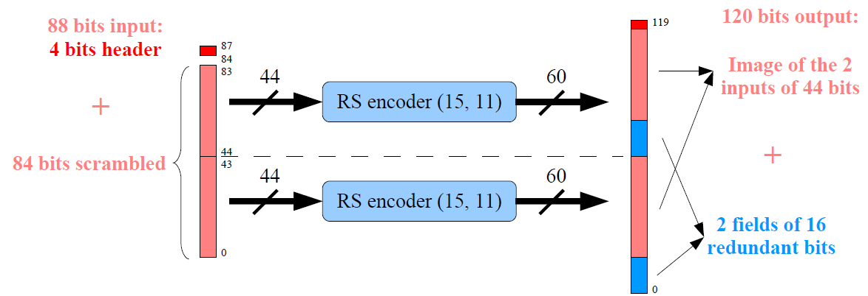
GBT FPGA: Reed Solomon encoder
Aim of the Reed Solomon encoding:
protect the data against transmission errors
Reed Solomon encoder features:
composed of 2 RS encoder (15,11), symbol = 4 bits
only combinatorial logic
allows to correct up to 2 symbols (8 consecutive bits for example)

Slide 10
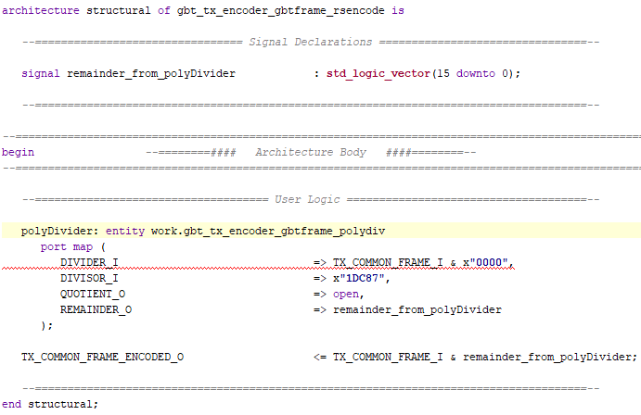
GBT FPGA: Reed Solomon encoder

Slide 11
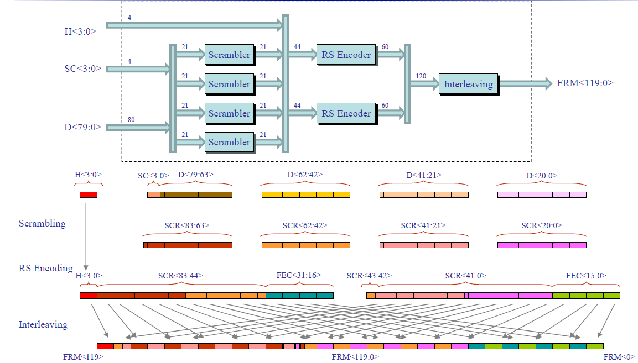
GBT FPGA
The frame is shifted out MSB first, that is: FRM<119>, FRM<118>, … FRM<0> (The header shifts out first)

Slide 12
GBT FPGA: gearbox
Transmitter side
din, 120 bits @ 40 MHz
frame3, word3
frame3, word2
frame3, word1
frame1, word3
frame1, word2
frame1, word1
read pointer
frame2, word3
frame2, word2
frame2, word1
DPRAM
write pointer
frame3, word3
frame3, word2
frame3, word1
frame4, word3
frame4, word2
frame4, word1
frame1, word3
frame1, word2
frame1, word1
word pointer
dout, 40 bits @ 120 MHz

Slide 13
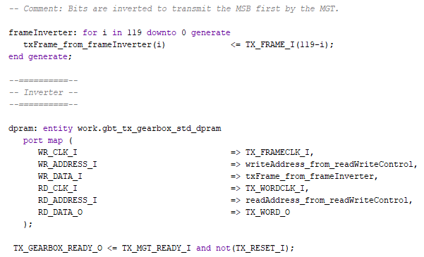
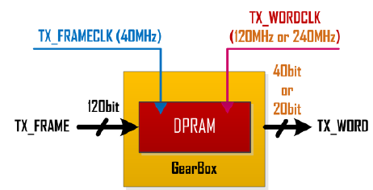
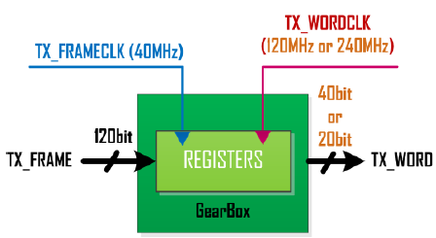
GBT FPGA: gearbox
DPRAM

Slide 14
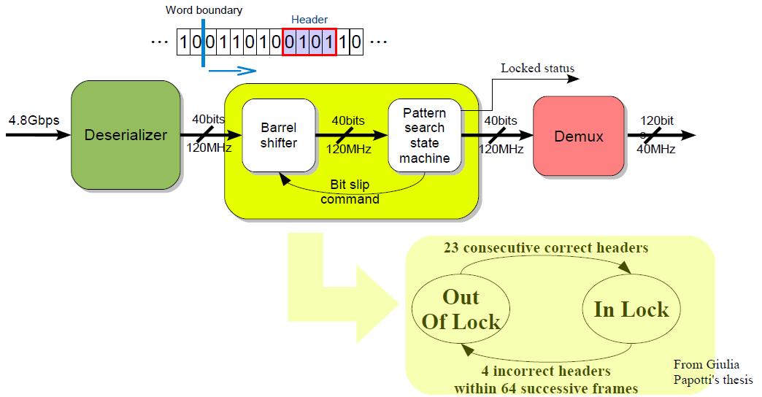
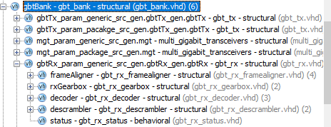
GBT FPGA: frame aligner
The pattern search and alignment functions are achieved with two entities:
a barrel shifter allowing to bit shift the incoming data
a state machine looking at the expected header position in the frame and giving the “locked” status

Slide 15
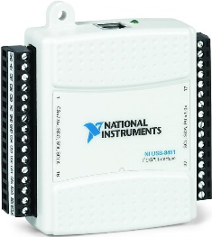
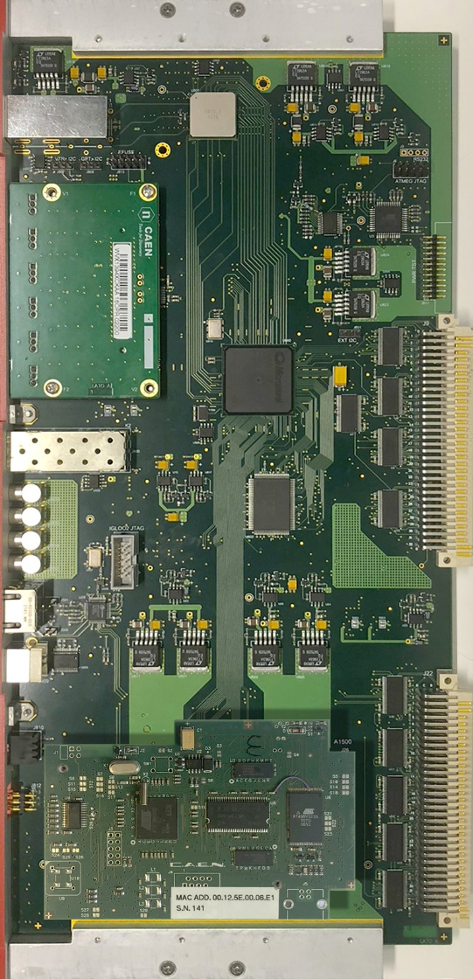
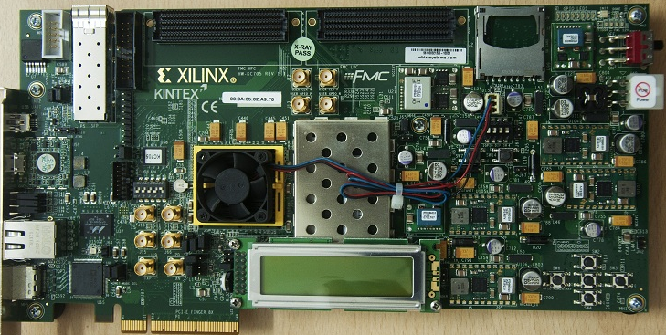
Setup
NI I2C controller
GBT link @ 4.8 Gbps
GBTx
Si5341-EVB
CONET
clock @ 120 MHz
GBT FPGA
KC705
backplane VME

Slide 16
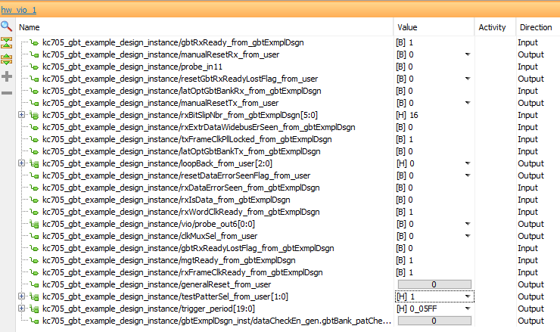
Steps to achieve GBT link lock
Program the PLL clock outputs: 120 MHz LVDS on OUT0 → KC705
OUT1 → oscilloscope
Program the Kintex7 with GBT FPGA core
Turn on DRM2: the GBTx gets configured after power-up via the E-fuses
How to check if the link is ON:
KC705 VIO panel
It might be helpful to reset the GBTx if the watchdog / timeout are not enabled

Slide 17
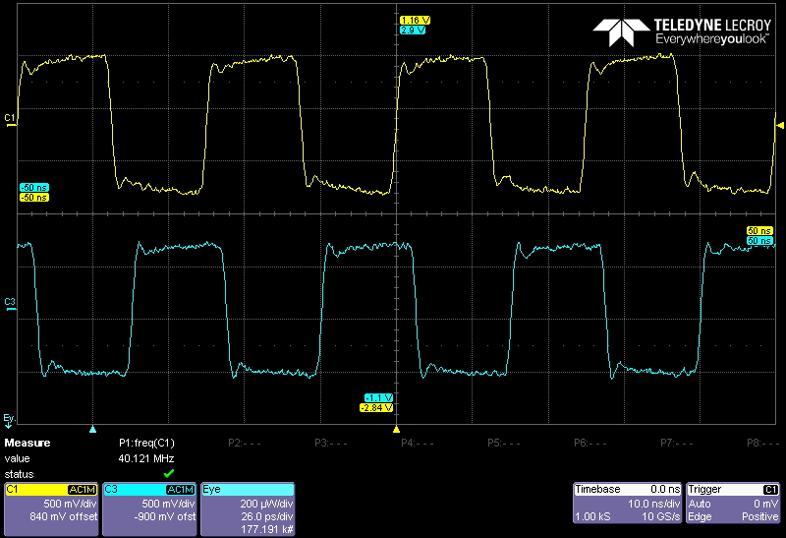
Check RX clock against TX clock
120 MHz clock from SiLabs PLL
GBTx rxclock
shall be in phase when the link is locked

Slide 18
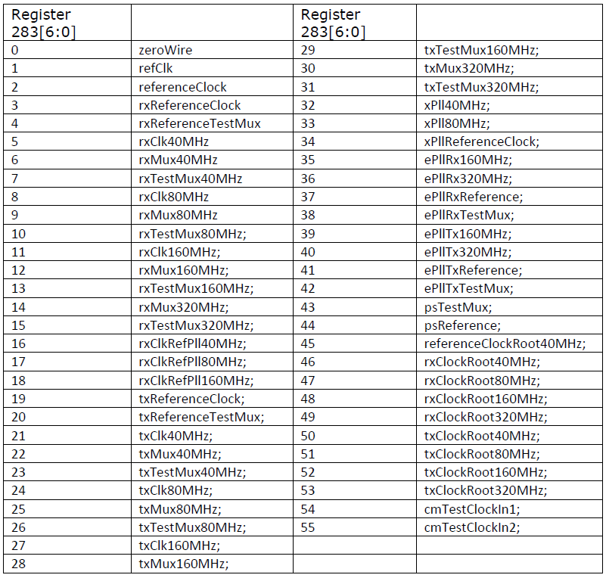
testClockOutput
when register 319[4:0] = 0

Slide 19
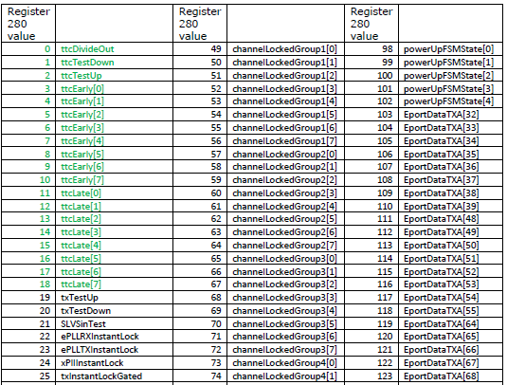
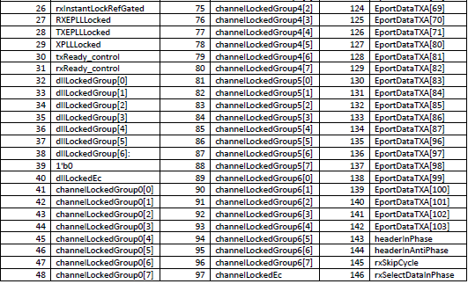
testOutput
register 280

Slide 20
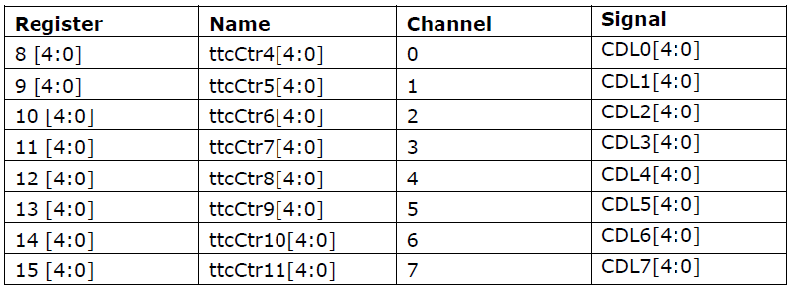
Phase shifter
Setting frequency
FDL0 8:0:4
CDL0 16:0:5
Setting coarse delay registers
Setting fine delay registers

Slide 21
GBTx TX test mode
Igloo2
GBTx
GBT FPGA
normal data
fixed pattern
counter
pseudo-random pattern

Slide 22
BER measurements
Igloo2
GBTx
GBT FPGA
pattern check
known pattern
pattern check + loopback

Slide 23
BER measurements
BER measurements on optical links should be done both in the lab and in the installed system, in order to monitor degradation of the optical links. Monitoring the BER on the system electronics installed in the experiment will allow to plan actions ahead of time.
Note that in the GBT link, the strong error correction will correct (so will hide) problems of the physical layers of the link up to the point when they become dramatic. For this reason, the latest release of the GBT-FPGA code includes a bit error flag (FECcorrectioncounter) extracted somehow "before the error correction" (output of the RS decoder). Consider using this error flag in order to monitor the status of the GBT link.

Slide 24
Registers to monitor: GBT link status indicator
The GBTx features a counter that is incremented each time an error in the downlink frame is corrected by the FEC mechanism.
The counter is not triplicated but gives a strong indication if the link is poor or if there was a single event transient in the link
register 375: FECcorrectionCount
The register 375 is incremented each time a memory block is corrected due to a SEU. Although not ideal, it gives an indication on the particle rate.
register 435: config_reg error_count
.Consider monitoring these two registers plus the FECcorrectioncounter from the GBT-FPGA core to have a “GBT link status” indicator.

Slide 25
Backup

Slide 26
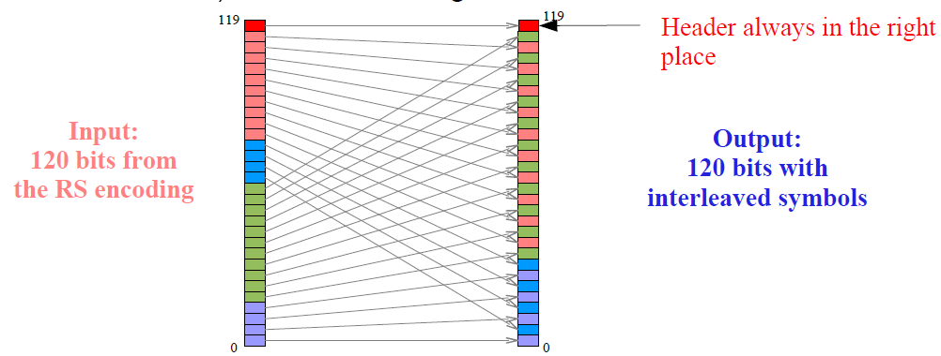
GBT FPGA: Interleaver
Aim of the interleaving:
improve the capacity of the code to correct long burst of errors
Interleaver characteristics:
interleaving made at a symbol level (4 bits)
only “routing”, no clock cycles
increases the code correction capability from 2 to 4 consecutive symbols (16 consecutive bits) without increasing overhead

Slide 27
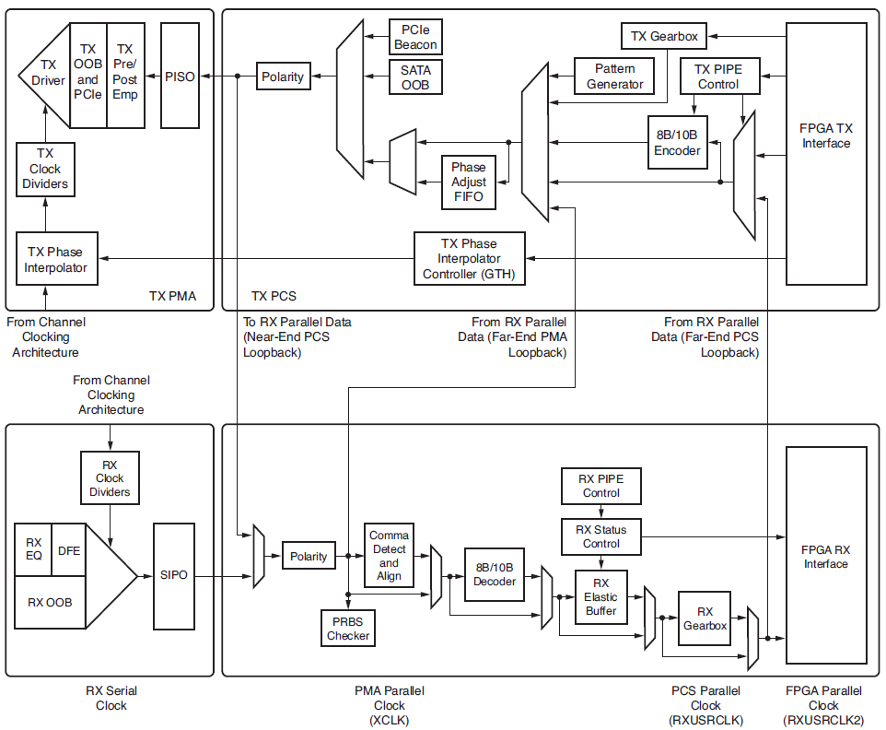
GTXE2_CHANNEL

Slide 28
