Slide 1
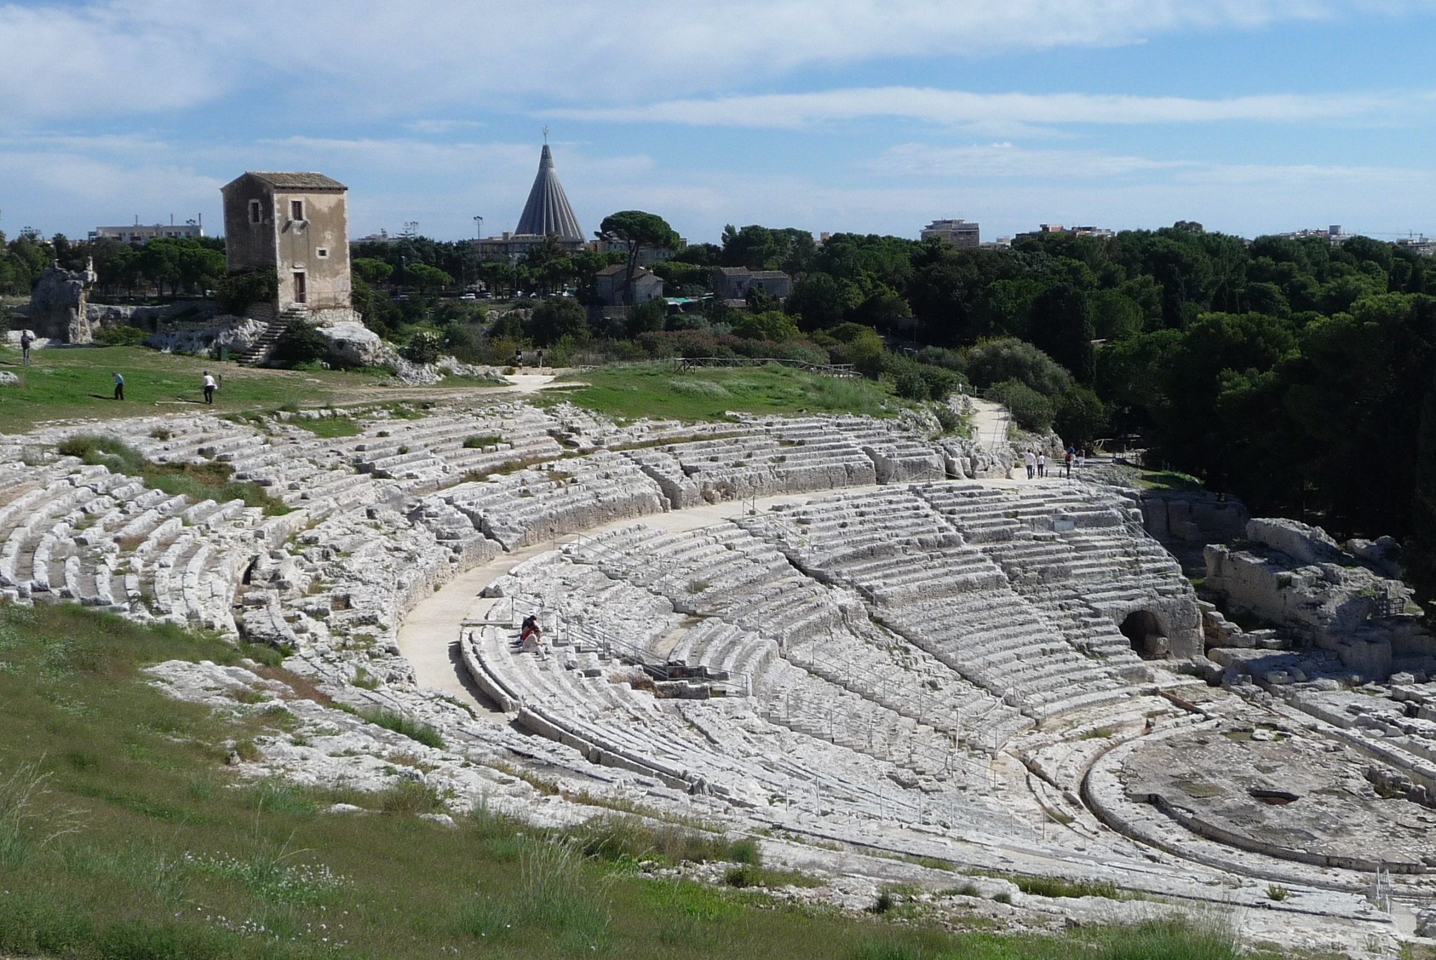
Asy-EoS-2012
International Workshop on Nuclear
Symmetry Energy and Reaction Mechanisms
Nuclear Structure
Heavy Ion Reactions
Neutron skins
Isospin transport
Neutron stars and SN
Astrophysics
Siracusa, Sicily, Italy – September 4-6, 2012
International Scientific Committee
Local Organizing Committee
C. AGODI (INFN-LNS,Catania, Italy)
G. CARDELLA (INFN-Catania, Italy)
E. DE FILIPPO (INFN-Catania, Italy)
G. LANZALONE(Univ.“Kore”, Enna & INFN-LNS, Catania, Italy )
S. PIRRONE (INFN-Catania, Italy)
G. POLITI (University of Catania & INFN-LNS, Catania, Italy)
F. RIZZO (University of Catania & INFN-LNS, Catania, Italy)
P. RUSSOTTO (INFN-Catania, Italy)
G. VERDE (INFN-Catania, Italy)
Local contacts student coordinator
T. MINNITI (University of Messina and INFN-Gr. Coll. Me, Italy)
S. SANTORO (University of Messina and INFN-Gr. Coll. Me, Italy)
Secretary and Press Office
A.L. MAGRÌ (INFN-Catania, Italy)
S. REITO (INFN-Catania, Italy)
Z. BASRAK (Ruder Boskovic Institute, Zagreb, Croatia)
A. CHBIHI (GANIL, Caen, France)
M. CHARTIER (University of Liverpool, Liverpool, U.K.)
M. COLONNA (INFN-LNS, Catania, Italy)
Y. LEIFELS (GSI, Darmstadt, Germany)
J. LUKASIK (IFJ-PAN, Krakow, Poland)
A. PAGANO (INFN-Catania, Italy)
P. RUSSOTTO (INFN-Catania, Italy)
H. SAKURAI (Riken, Japan)
W. TRAUTMANN (GSI, Darmstadt, Germany)
M.B. TSANG (NSCL MSU, East Lansing, USA)
G. VERDE (INFN-Catania, Italy)
S. YENNELLO (Texas A&M, College Station, USA )
“Eureka! Creatività, genio e mistero in Archimede
precursore della ricerca scientifica moderna”
Giovedì 6 Settembre ore 16:00-19:00
Auditorium del Museo Archeologico Regionale “Paolo Orsi” di Siracusa
Provincia Regionale di
Siracusa
Istituto Nazionale di
Fisica Nucleare
Università degli
Studi di Catania
http://www.ct.infn.it/asyeos20102 e-mail: asyeosws@ct.infn.it

