Slide 1
Close out M.A.Giorgi INFN & Universita’ di Pisa
XV SuperB General Meeting
Caltech Dicember 17, 2010

Slide 2
XV Workshop
Activity in all fields as in the last workshops
Before and Toward the Start

Slide 3
XV Workshop
Activity in all fields as in the last workshops
Before and Toward the Start
BUT Caltech Workshop is:

Slide 4
XV Workshop
Activity in all fields as in the last workshops
Before and Toward the Start
BUT Caltech Workshop is:
The Workshop of SuperB approved!

Slide 5
Now
The President of INFN Roberto Petronzio has informed the CERN Council, therefore Agency representatives present at the Council Meeting, about the approval with funding of SuperB.
Now the news is officially and publicly known.
We have been funded starting with the present financial year 19 M€.
The funding profile according with the multiyear plan of INFN approved by MIUR.
Total 270 M€.

Slide 6
From Now
TDR preparation will continue according to the planning and the organization in place.
But hopefully at higher speed !

Slide 7
From Now
We need to get organized in each region for the next phase.
An aggressive program is needed !
We need to focus on the new phase with a strong structure and will start spending, where possible, on investment and infrastructure.

Slide 8
Site choice
The choice of the site is urgent. Decision should be taken in the next few months, then:
Proceed with tenders for the engineering design of the infrastructure.
Apply to local authorities for the necessary authorization, before digging.

Slide 9
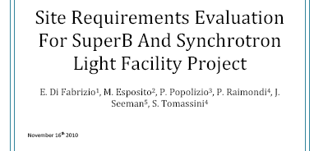
From my presentation last tuesday .
An ad hoc committee has been set up to prepare the document on requirements for the site choice , preliminary to the infrastructure design.
Requirements and design will be reviewed by an International Review Committee

Slide 10
From my presentation last tuesday .
An ad hoc committee has been set up to prepare the document on requirements for the site choice , preliminary to the infrastructure design.
Requirements and design will be reviewed by an International Review Committee
It will be discussed today in the Project Board Session

Slide 11
Moving to next phase
I will send a message to the Steering Committee asking to start discussion with funding agencies in the various regions and update on gathering communities for the
FIRST COLLABORATION MEETING
(March 8 - 11, 2011)
In preparation a meeting (January 20-21, 2011)
of Project Board, Steering committee (perhaps on the phone) .

