Slide 1
Dissipative and non-white noise Collapse Models
- Frascati, 24/09/2015, Sandro Donadi -
UNIVERSITY OF TRIESTE
DEPARTMENT OF PHYSICS
Recent developments in Collapse Models:
dissipative and non-white noise Collapse Models.
Sandro Donadi , Dr. Angelo Bassi
FRASCATI, 24/09/2015

Slide 2
Dissipative and non-white noise Collapse Models
- Frascati, 24/09/2015, Sandro Donadi -
SUMMARY
CSL and QMUPL collapse models;
Dissipative models;
Non-white noise models;
Predictions of the models for radiation emission.

Slide 3
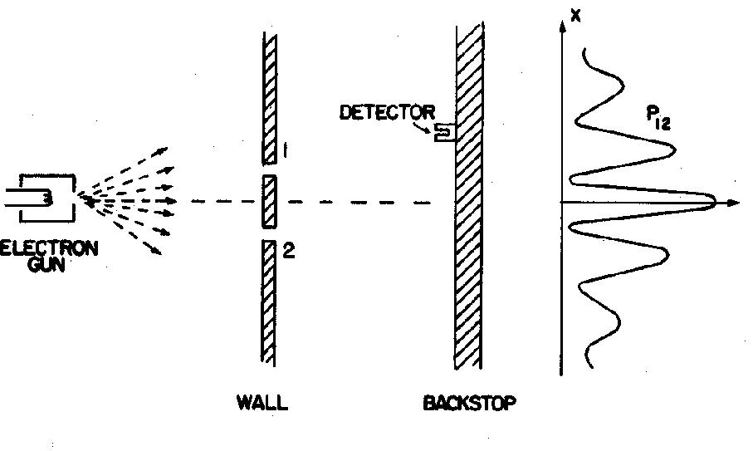
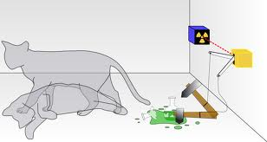
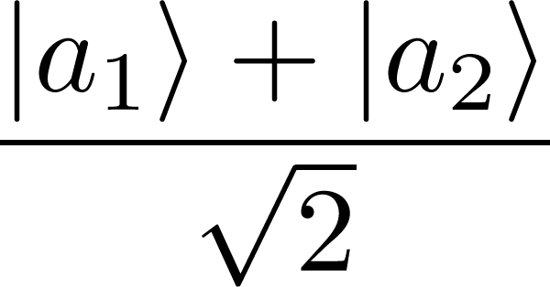
Dissipative and non-white noise Collapse Models
- Frascati, 24/09/2015, Sandro Donadi -
THE MEASUREMENT PROBLEM
The SchrÖdinger equation:
Linear
Deterministic
What exactly qualifies some physical systems to play the role of “measurer”?
Was the wave function of the world waiting to jump for thousands of millions of years until a single-celled living creature appeared? Or did it have to wait a little longer for some better qualified system...with a PhD?
J. S. Bell
OK
KO
The wave packet reduction postulate:
measurement
half of total cases
Non Linear
Stochastic
half of total cases
There are two different laws for the evolution of the state vectors but it is not clear when to use one or the other one.

Slide 4
Dissipative and non-white noise Collapse Models
- Frascati, 24/09/2015, Sandro Donadi -
THE CSL MODEL
(Continuous Spontaneous Localizations)
IDEA: modify the SchrÖdinger dynamics with one which describes also the collapse:
SchrÖdinger
stochasticity
non linearity
: coupling constant between matter and noise.
: correlation length.
MOST IMPORTANT FEATURES
1) Localization in space;
2) Amplification mechanism: the strength of the collapse increases with the size of the system;

Slide 5
Dissipative and non-white noise Collapse Models
- Frascati, 24/09/2015, Sandro Donadi -
CSL MODEL MASTER EQUATION
Von-Neumann
Liouville
Lindblad
IN POSITION REPRESENTATION
GRW
ADLER

Slide 6
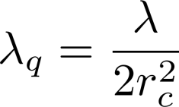
Dissipative and non-white noise Collapse Models
- Frascati, 24/09/2015, Sandro Donadi -
THE QMUPL MODEL
(QUANTUM MECHANICS WITH UNIVERSAL POSITION LOCALIZATION)
WHY QMUPL MODEL?
1) Easy calculations;
2) Master equation in position representation :
QMUPL
CSL
For distances same equation setting:

Slide 7
Dissipative and non-white noise Collapse Models
- Frascati, 24/09/2015, Sandro Donadi -
PROBLEM IN CSL AND QMUPL MODELS
ENERGY INCREASE
Steady increase of energy!
For an electron:
For a monoatomic gas: increase of temperature in one year is:
WHITE NOISE
Problem: Simple for modelling but not realistic.
Motivations: 1) How predictions depend from the noise?
2) Connection with realistic noise fields of nature (maybe cosmological?)

Slide 8
Dissipative and non-white noise Collapse Models
- Frascati, 24/09/2015, Sandro Donadi -
DISSIPATIVE CSL MODEL
States evolve following the equation:
IMPORTANT PROPERTIES
Localization in space; - for CSL.
Amplification mechanism effective; - Energy goes to an asymptotic value.

Slide 9
Dissipative and non-white noise Collapse Models
- Frascati, 24/09/2015, Sandro Donadi -
HOW DISSIPATION WORKS
It is convenient to study the localization operators in the momentum representation:
DISSIPATIVE CSL
CSL
DISSIPATIVE CSL
Function of
Peaked at
CSL
Not a function of
Peaked at

Slide 10
Dissipative and non-white noise Collapse Models
- Frascati, 24/09/2015, Sandro Donadi -
ENERGY IN DISSIPATIVE CSL
E0 > Eas
DISSIPATIVE CSL
E0 < Eas
CSL

Slide 11
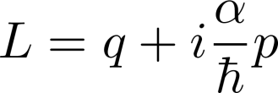
Dissipative and non-white noise Collapse Models
- Frascati, 24/09/2015, Sandro Donadi -
DISSIPATIVE QMUPL MODEL
New parameter related to dissipation
As for CSL model energy under control !
MASTER EQUATION
The dissipative CSL master equation reduces to this one under the conditions:
Same equation of an open quantum system with

Slide 12
Dissipative and non-white noise Collapse Models
- Frascati, 24/09/2015, Sandro Donadi -
NON WHITE NOISE CSL MODEL
The non white noise case corresponds to change the noise as
EQUATION FOR STATE VECTORS
(leading order in gamma)
MASTER EQUATION
(leading order in gamma)
MEMORY EFFECTS!
Relevant properties: 1) Localization in positions with the correct probabilities;
2) Amplification mechanism holds;
3) Predictions depend from the noise correlation function;

Slide 13
Dissipative and non-white noise Collapse Models
- Frascati, 24/09/2015, Sandro Donadi -
PREDICTIONS ON RADIATION EMISSION
CSL/QMUPL
NON WHITE NOISE CSL/QMUPL
Spectral density
of the noise
Interaction with the noise induces radiation emission!
DISSIPATIVE NONWHITE NOISE QMUPL
(semi-classical approach)
Dissipation
friction coefficient

Slide 14
Dissipative and non-white noise Collapse Models
- Frascati, 24/09/2015, Sandro Donadi -
CONCLUSIONS
CSL/QMUPL
 | WHITE | NON-WHITE
NON DISSIPATIVE
DISSIPATIVE
Both dissipation and non-white noises can be introduced without affecting the localization and amplification mechanisms;
Dissipation solves the the energy increase problem;
For radiation emission non white noises introduce a cut-off while dissipation is relevant only when ωk << η;

Slide 15
Dissipative and non-white noise Collapse Models
- Frascati, 24/09/2015, Sandro Donadi -
COLLEAGUES AND COLLABORATIONS
TRIESTE GROUP: A. Bassi, M. Bahrami, A. Grossardt, M.Bilardello, M. Toros, M. Carlesso, G. Gasbarri, M. Caiaffa, L. Ferialdi.
EXTERNAL COLLABORATIONS : - S. L. Adler (Princeton).
- C. Curceanu, K. Piscicchia, A. Di Domenico (Frascati/Rome).
- B. Hiesmayr (Vienna).
- A. Smirne (Ulm).
- D.-A. Deckert,(Munich).
- T.P. Singh (Mumbai).
FINANCIAL SUPPORT

Slide 16
Dissipative and non-white noise Collapse Models
- Frascati, 24/09/2015, Sandro Donadi -
CONCLUSIONS
CSL/QMUPL
 | WHITE | NON-WHITE
NON DISSIPATIVE
DISSIPATIVE
Both dissipation and non-white noises can be introduced without affecting the localization and amplification mechanisms;
Dissipation solves the the energy increase problem;
For radiation emission non white noises introduce a cut-off while dissipation is relevant only when ωk << η;
THANKS

