Slide 1
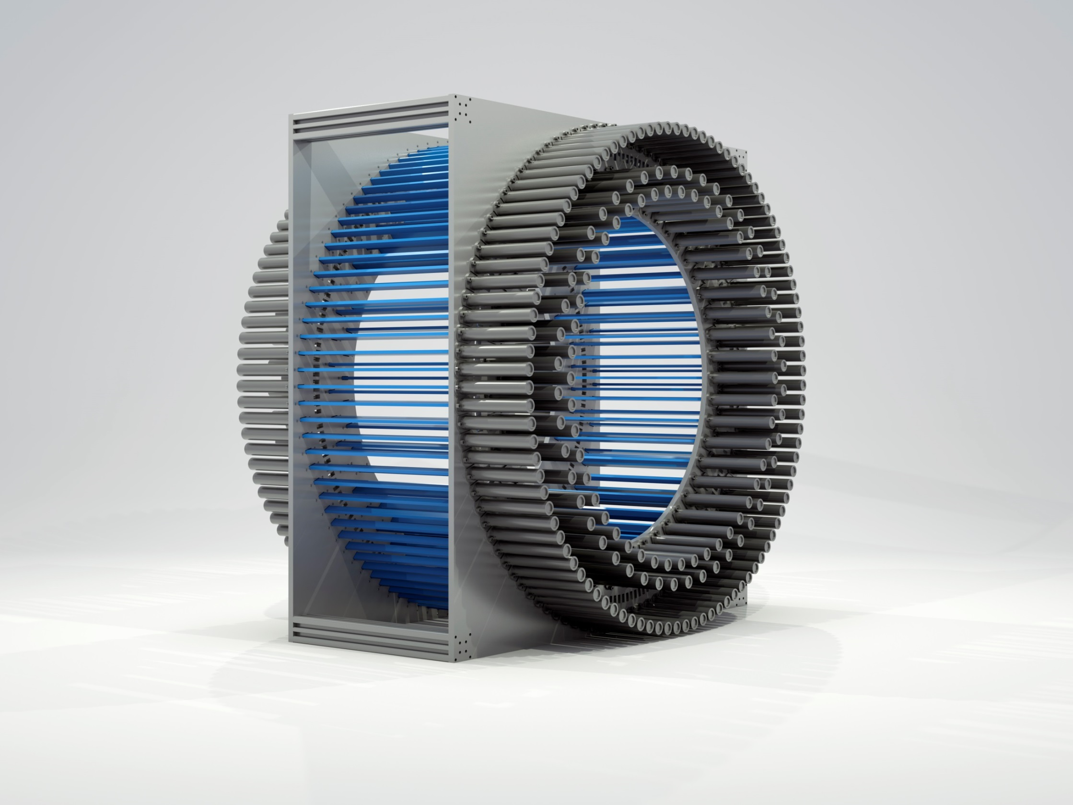

Potential of the J-PET technology for tests of discrete symmetries and quantum mechanics
FQT2015, LNF Frascati, 23-25 September 2015
Paweł Moskal, Jagiellonian University
on behalf and for the J-PET Collaboration
http://koza.if.uj.edu.pl
for and on behalf of the J-PET collaboration
Supported by Polish National Center for Development and Research
and Foundation for Polish Science

Slide 2
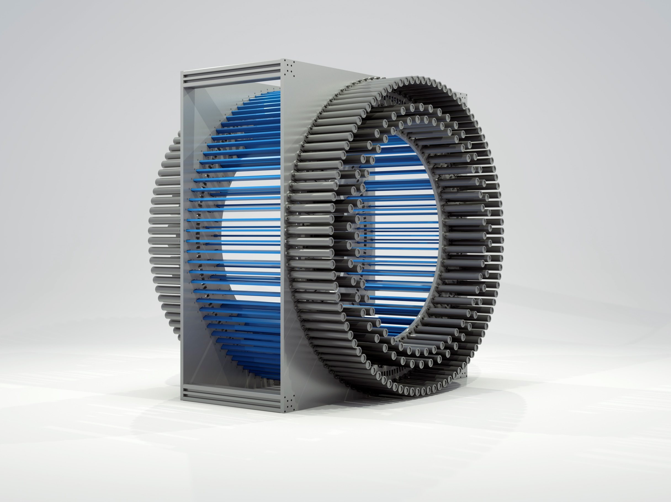

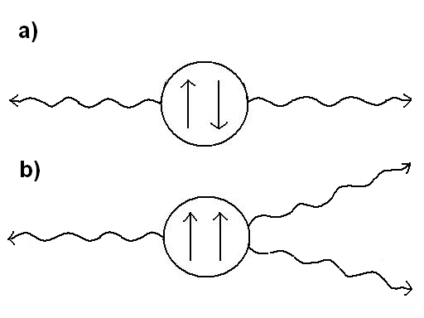
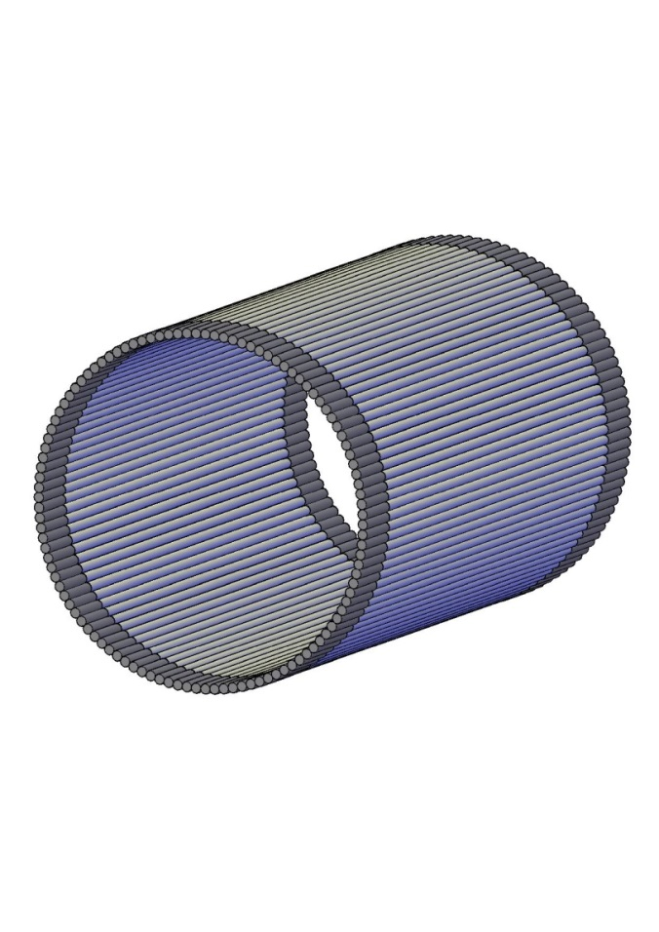
J-PET Jagiellonian PET
¹S₀ Para-positronium tau(p-Ps) ≈ 125 ps
³S₁ Ortho-positronium tau(o-Ps) ≈ 142 ns
Jagiellonian PET
Positronium
Upper limits of C, CP, CPT
Potential of J-PET
Operator C P T CP CPT
S • k₁ x k₂ + + - + -
(S • k₁) (S • k₁ x k₂ ) + - - - +
³S₁ --> 3γ -->
Operator C P T CP CPT
S • E₁ x E₂ + + - + -
S • E₁ + - - - +
¹S₀ --> 2γ -->
Notes:
Correlations also posiible with para-positronium !!!

Slide 3
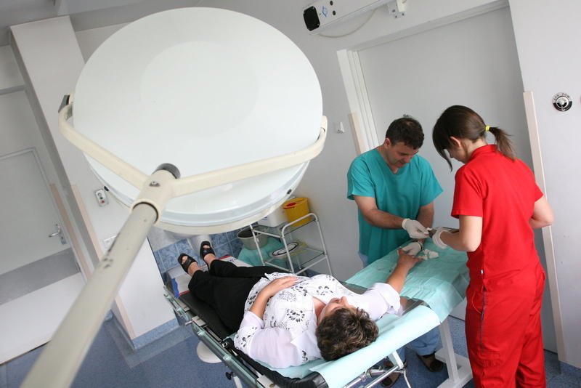
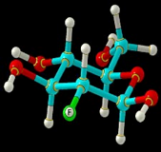
Increased glycolysis in tumor cells
-Warburg phenomenon-
20-30 time higher glucose metabolism
and FDG is trapped in malignant cells.
by nonoxidative breakdown of glucose (a process called glycolysis)
and the subsequent recycling of the metabolite NADH back to its oxidized form
OBRAZ TOMOGRAFICZNY
RADIOACTIVE SUGER
Fluoro–deoxy-glucose (F-18 FDG)
Notes:
Beztlenowa GLIKOLIZA → FDG-P wychwyt i gromadzenie w komorkach
„Aby zobrazować komórkę nowotworową konieczny jest tutaj mechanizm "pułapki molekularnej" pojawiającej się już na następnym etapie: fosforan deoksyglukozy, a więc rózwnież FDG-P, nie jest przeprowadzany do kolejnych etapów glikolizy, nie może również dyfundować na zewnątrz komórki ani ulegać defosforylacji do FDG. W szybkim czasie gromadzi się więc w komórkach nowotworowych w znacznie większej ilości niż w otaczających zdrowych komórkach, co ujawnia się na obrazie PET. „

Slide 4
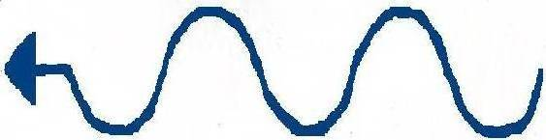
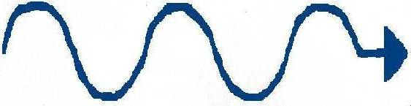
-
-
¹⁸F → ¹⁸O + e⁺ + v_{e}
-
+
-
Rozmiary, pokaz przenikania
na modelu skarpetkowym
Notes:
Pozytnium, spin 0, albo spin 1, symetria C?... Etc…

Slide 5
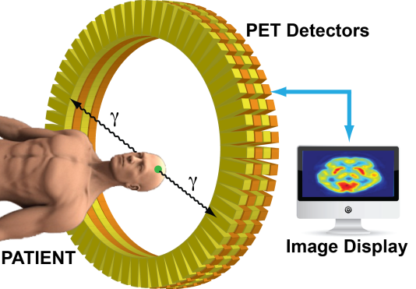
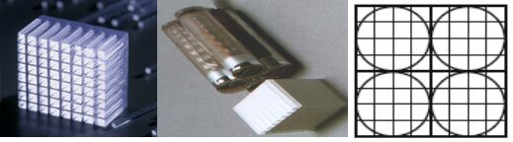
OBRAZ TOMOGRAFICZNY
RADIOACTIVE SUGER
Fluoro–deoxy-glucose (F-18 FDG)
7 mSv
~3 mSv natural background in Poland
~200 000 000
gamma per second
Notes:
7msV a naturalne w polsce jest 2.5msV (10% cosmic ray) a w Norwegii 7-20? A w Colombia 2.4 msV (16% cosmic rays)

Slide 6
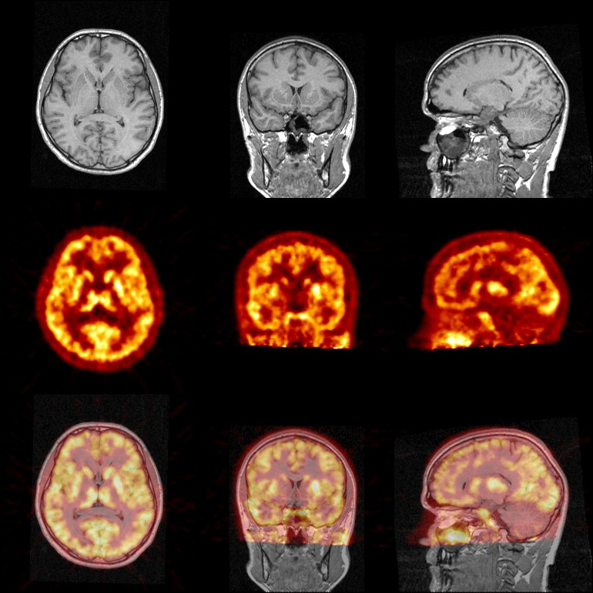
Notes:
Catalina --> provoce -> so thaough I have no result
As regards the brain studies the only I did so far is a check whether I have a brain..
And this is a prove ....I have a prove .... Do you recognise, maybe I should turn to the side ….

Slide 7

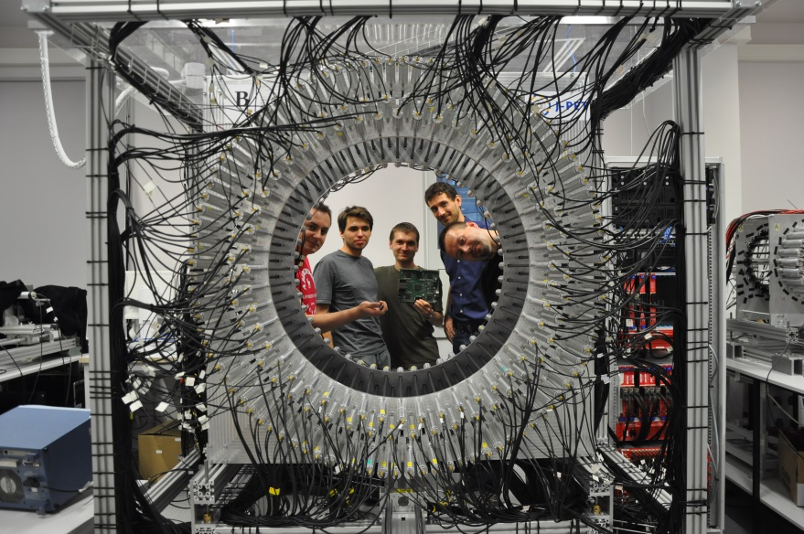
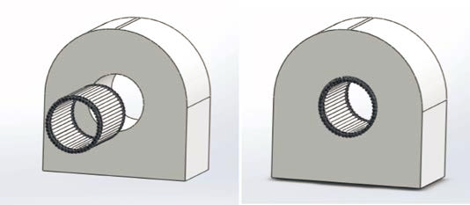
Jagiellonian PET
crystals
→ plastics
AFOV: 17 cm → 50 cm; σ(t-hit) = 80 ps
J-PET / MRI
J-PET: P. M. et al., NIM A 764 (2014) 317.
J-PET: P. M. et al., NIM A 775 (2015) 54.
J-PET: L. Raczynski et al., NIM A 764 (2014) 186.
J-PET: L. Raczynski et al., NIM A 786 (2015) 105.
16 International Patent Applications

Slide 8
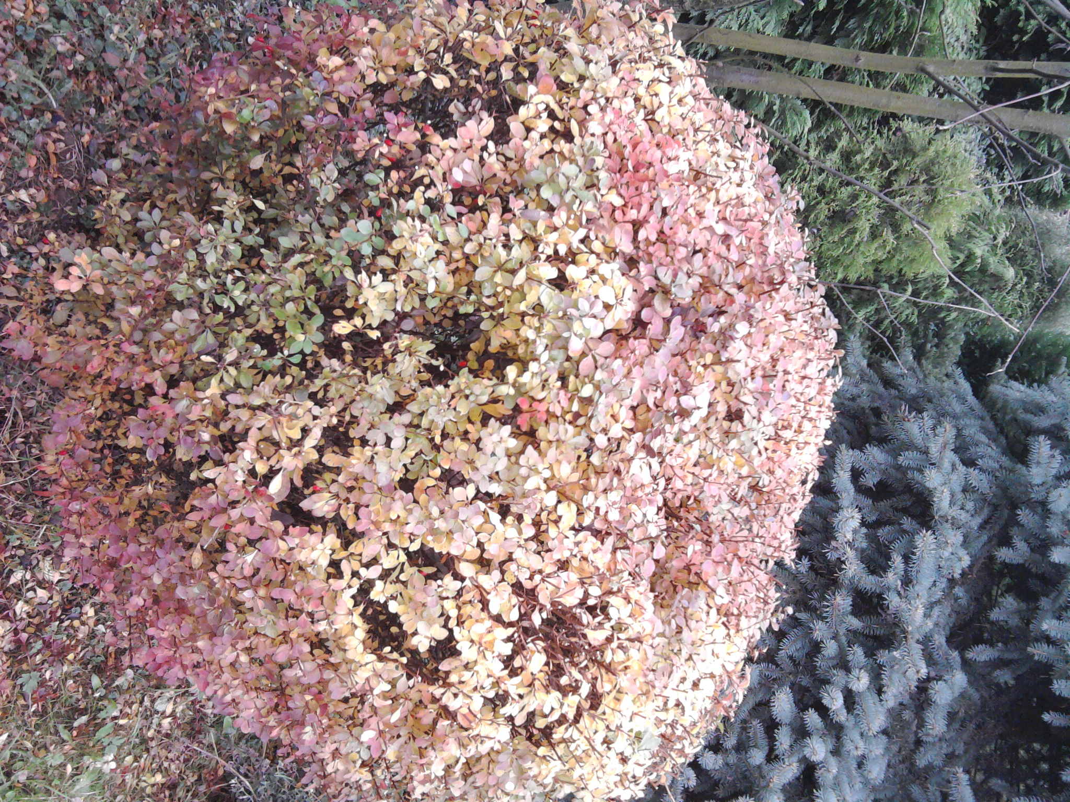
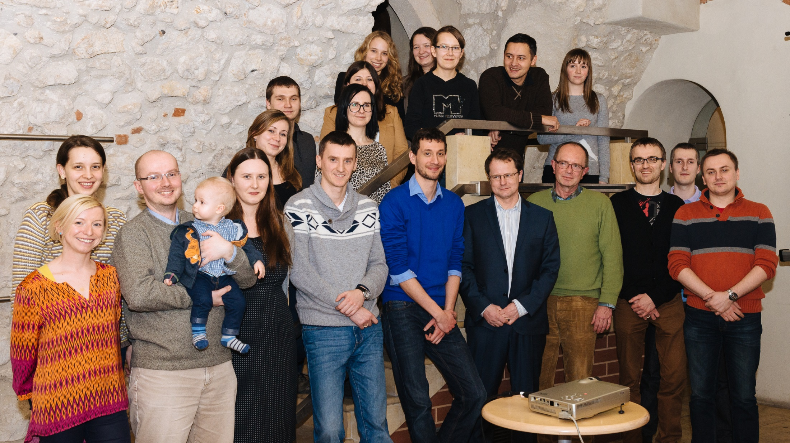
Jagiellonian PET
Notes:
Moze dopisac (GRUPA BADAWCZA JAGIELLONIAN PET)

Slide 9
J-PET Jagiellonian PET
¹S₀ Para-positronium tau(p-Ps) ≈ 125 ps
³S₁ Ortho-positronium tau(o-Ps) ≈ 142 ns
Jagiellonian PET
Positronium
Upper limits of C, CP, CPT
Potential of J-PET
Operator C P T CP CPT
S • k₁ x k₂ + + - + -
(S • k₁) (S • k₁ x k₂ ) + - - - +
³S₁ --> 3γ -->
Operator C P T CP CPT
S • E₁ x E₂ + + - + -
S • E₁ + - - - +
¹S₀ --> 2γ -->
Notes:
Correlations also posiible with para-positronium !!!

Slide 10
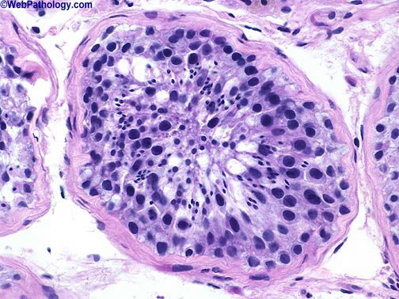
+
-
Rozmiary, pokaz przenikania
na modelu skarpetkowym
Notes:
Tu napisać dużymi literami ¾ ORTHO…. ¼ para…..
Dorobić przypadki żeby się rozpadało na 3 fotony i dorobić przemiane !!! (na przykład napis p-Ps na o-Ps ) się zmienia ….

Slide 11
¹S₀ Para-positronium tau(p-Ps) ≈ 125 ps
³S₁ Ortho-positronium tau(o-Ps) ≈ 142 ns
¹S₀ ³S₁
L 0 0
Positronium size is similar to the size of the hydrogen atom
Production probability and life-time depends on the size of the
free volumes between molecules…
p-Ps -> gg
o-Ps -> ggg
P(o-Ps) = 3 P(p-Ps)
Process kick-off and o-Ps -> p-Ps
(Probability for this processes depends on the size of the free volumes)
Most of o-Ps anyhow will decay to gg
Tu TEZ POWIEDZIEC O BEZPOSREDNIEJ PRODUKCJI
I CZASIE około 300-400ps
Direct annihilation P(gg) = 370 P(ggg) = 10^6 P(gggg) etc…
But in medium this is not
Notes:
Dlaczego jest taka duża różnica …? (phase space, complication -> more coupling constants)
I dlaczego jedno na trzy a drugie na dwa…
Przy przechodzeniu do C wytłumczyć Frmions are described by antisymmetric function
S=1 is symmetric , L=0 is symmetric ➔ C -1 (C odpowiada za przeztrzen ladunków jeśli uwazamy ze elektron i pozytpn to to samo. Etc… Just easer to remember para sounds as pair… O porównaniu do KAONÓW
tylko powiedziec
Dołożyć DIAGRAM FEYNMANA DO ANIHILACJI Z WYKLADU Vettera !!!!
Please note the difference piko and nano factor 1000

Slide 12
¹S₀ Para-positronium tau(p-Ps) ≈ 125 ps
³S₁ Ortho-positronium tau(o-Ps) ≈ 142 ns
¹S₀ ³S₁
L 0 0
S 0 1
J 0 1
-
S = 0
S = 1
+
Positronium size is similar to the size of the hydrogen atom
Production probability and life-time depends on the size of the
free volumes between molecules…
p-Ps -> gg
o-Ps -> ggg
P(o-Ps) = 3 P(p-Ps)
Process kick-off and o-Ps -> p-Ps
(Probability for this processes depends on the size of the free volumes)
Most of o-Ps anyhow will decay to gg
Tu TEZ POWIEDZIEC O BEZPOSREDNIEJ PRODUKCJI
I CZASIE około 300-400ps
Direct annihilation P(gg) = 370 P(ggg) = 10^6 P(gggg) etc…
But in medium this is not
Notes:
Przy przechodzeniu do C wytłumczyć Frmions are described by antisymmetric function
S=1 is symmetric , L=0 is symmetric ➔ C -1 (C odpowiada za przeztrzen ladunków jeśli uwazamy ze elektron i pozytpn to to samo. Etc… Just easer to remember para sounds as pair… (pair of gamma quanta)
O porównaniu do KAONÓW
tylko powiedziec
Dołożyć DIAGRAM FEYNMANA DO ANIHILACJI Z WYKLADU Vettera !!!!
Please note the difference piko and nano factor 1000

Slide 13
¹S₀ Para-positronium tau(p-Ps) ≈ 125 ps
³S₁ Ortho-positronium tau(o-Ps) ≈ 142 ns
¹S₀ ³S₁
L 0 0
S 0 1
C + -
J 0 1
-
S = 0
S = 1
+
C |Ps > = (-1)^{L+S} |Ps >
Positronium size is similar to the size of the hydrogen atom
Production probability and life-time depends on the size of the
free volumes between molecules…
p-Ps -> gg
o-Ps -> ggg
P(o-Ps) = 3 P(p-Ps)
Process kick-off and o-Ps -> p-Ps
(Probability for this processes depends on the size of the free volumes)
Most of o-Ps anyhow will decay to gg
Tu TEZ POWIEDZIEC O BEZPOSREDNIEJ PRODUKCJI
I CZASIE około 300-400ps
Direct annihilation P(gg) = 370 P(ggg) = 10^6 P(gggg) etc…
But in medium this is not
C |nγ > = (-1)^{n} | nγ >
Notes:
Przy przechodzeniu do C wytłumczyć Frmions are described by antisymmetric function
S=1 is symmetric , L=0 is symmetric ➔ C -1 (C odpowiada za przeztrzen ladunków jeśli uwazamy ze elektron i pozytpn to to samo. Etc… Just easer to remember para sounds as pair… (pair of gamma quanta)
O porównaniu do KAONÓW
tylko powiedziec
Dołożyć DIAGRAM FEYNMANA DO ANIHILACJI Z WYKLADU Vettera !!!!
Please note the difference piko and nano factor 1000

Slide 14
¹S₀ Para-positronium tau(p-Ps) ≈ 125 ps
³S₁ Ortho-positronium tau(o-Ps) ≈ 142 ns
¹S₀ ³S₁
L 0 0
S 0 1
C + -
L=0 -> P - -
CP - +
J 0 1
-
S = 0
S = 1
+
Positronium size is similar to the size of the hydrogen atom
Production probability and life-time depends on the size of the
free volumes between molecules…
p-Ps -> gg
o-Ps -> ggg
P(o-Ps) = 3 P(p-Ps)
Process kick-off and o-Ps -> p-Ps
(Probability for this processes depends on the size of the free volumes)
Most of o-Ps anyhow will decay to gg
Tu TEZ POWIEDZIEC O BEZPOSREDNIEJ PRODUKCJI
I CZASIE około 300-400ps
Direct annihilation P(gg) = 370 P(ggg) = 10^6 P(gggg) etc…
But in medium this is not
C |Ps > = (-1)^{L+S} |Ps >
C |nγ > = (-1)^{n} | nγ >
Notes:
Przy przechodzeniu do C wytłumczyć Frmions are described by antisymmetric function
S=1 is symmetric , L=0 is symmetric ➔ C -1 (C odpowiada za przeztrzen ladunków jeśli uwazamy ze elektron i pozytpn to to samo. Etc… Just easer to remember para sounds as pair… (pair of gamma quanta)
O porównaniu do KAONÓW
tylko powiedziec
Dołożyć DIAGRAM FEYNMANA DO ANIHILACJI Z WYKLADU Vettera !!!!
Please note the difference piko and nano factor 1000

Slide 15
-
POSITRONIUM
+
CP = + Para-positronium tau(p-Ps) ≈ 125 ps
CP = - Ortho-positronium tau(o-Ps) ≈ 142 ns
s anty-d
MESON K
π
π
CP ~= + tau(K_{S}) ≈ 90 ps
CP ~= - tau(K_{L}) ≈ 52 ns
K_{S}
π
π
K_{L}
π
Positronium size is similar to the size of the hydrogen atom
Production probability and life-time depends on the size of the
free volumes between molecules…
p-Ps -> gg
o-Ps -> ggg
P(o-Ps) = 3 P(p-Ps)
Process kick-off and o-Ps -> p-Ps
(Probability for this processes depends on the size of the free volumes)
Most of o-Ps anyhow will decay to gg
Tu TEZ POWIEDZIEC O BEZPOSREDNIEJ PRODUKCJI
I CZASIE około 300-400ps
Direct annihilation P(gg) = 370 P(ggg) = 10^6 P(gggg) etc…
But in medium this is not
Notes:
Przy przechodzeniu do C wytłumczyć Frmions are described by antisymmetric function
S=1 is symmetric , L=0 is symmetric ➔ C -1 (C odpowiada za przeztrzen ladunków jeśli uwazamy ze elektron i pozytpn to to samo. Etc… Just easer to remember para sounds as pair… (pair of gamma quanta)
O porównaniu do KAONÓW
Piony C=+ P=-; fotony C=-
tylko powiedziec
Dołożyć DIAGRAM FEYNMANA DO ANIHILACJI Z WYKLADU Vettera !!!!
Please note the difference piko and nano factor 1000

Slide 16
Eigen-state of Hamiltonian and P, C, CP operators
The lightest known atom and at the same time anti-atom
which undergoes self-annihilation as flavor neutral mesons
The simplest atomic system with charge conjugation aigenstates.
Electrons and positron are the lightest leptons so they can not decay
into lighter partilces via weak interactiom ...
effects due the weak interaction can lead to the violation at the order of 10⁻¹⁴.
M. Sozzi, Discrete Symmetries and CP Violation, Oxford Uviversity Press (2008)
No charged particles in the final state (radiative corrections very small 2 * 10⁻¹⁰)
Light by light contributions to various correlations are small
B. K. Arbic et al., Phys. Rev. A 37, 3189 (1988).
W. Bernreuther et al., Z. Phys. C 41, 143 (1988).
Purely Leptonic state !
Breaking of T and CP was observed but only for processes involving quarks.
So far breaking of these symmetries was not observed for purely leptonic systems.
10⁻⁹ vs upper limits of 3 10⁻³ for T, CP, CPT
10⁻⁹ vs upper limits of 3 10⁻⁷ for C
For neutrinos there are indication to maybe see something for CP ???
On the level of 2sigma for delta_cp phase connected to Theta13
M. Gosh et al., PR D89 (2014) 011302(R)
-
+
Notes:
Few interesting facts about POSITRONIUM….

Slide 17
J-PET Jagiellonian PET
¹S₀ Para-positronium tau(p-Ps) ≈ 125 ps
³S₁ Ortho-positronium tau(o-Ps) ≈ 142 ns
Jagiellonian PET
Positronium
Upper limits of C, CP, CPT
Potential of J-PET
Operator C P T CP CPT
S • k₁ x k₂ + + - + -
(S • k₁) (S • k₁ x k₂ ) + - - - +
³S₁ --> 3γ -->
Operator C P T CP CPT
S • E₁ x E₂ + + - + -
S • E₁ + - - - +
¹S₀ --> 2γ -->
Notes:
Correlations also posiible with para-positronium !!!

Slide 18
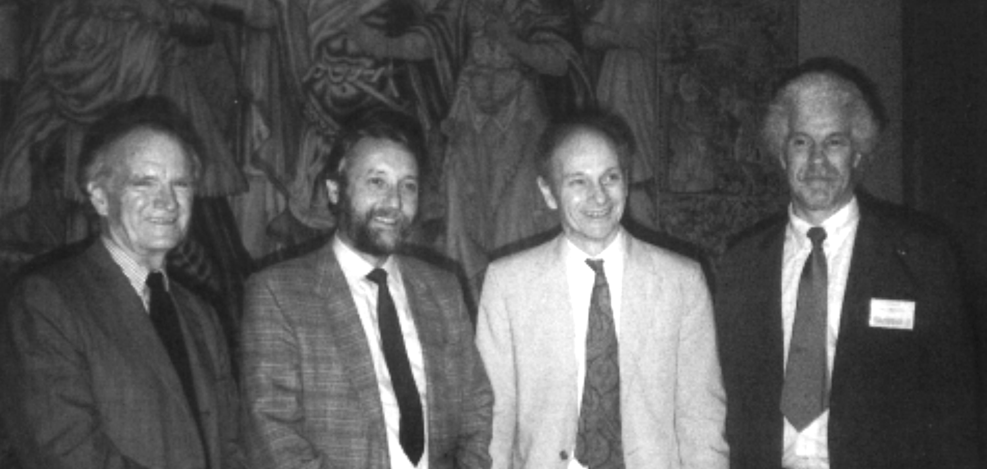
V.L.Fitch, R.Turlay, J.W.Cronin , J.H.Christenson
Phys. Rev. Lett. 13 (1964) 138.
π
π
K_{L}
π
K_{L}
π
π

Slide 19
¹S₀ Para-positronium tau(p-Ps) ≈ 125 ps
³S₁ Ortho-positronium tau(o-Ps) ≈ 142 ns
¹S₀ ³S₁ 2γ 3γ 4γ 5γ …
C + - + - + -
³S₁ --> 4γ
C - +
bound state mixing is not possible because there are
no positronium states with opposite C-parity and the same J^{P}.
BR (³S₁ --> 4γ / ³S₁ --> 3γ) < 2.6 10⁻⁶ at 90%CL
J. Yang et al., Phys. Rev. A54 (1996) 1952
BR (¹S₀ --> 3γ / ¹S₀ --> 2γ) < 2.8 10⁻⁶ at 68%CL
A. P. Mills and S. Berko, Phys. Rev. Lett. 18 (1967) 420
Notes:
Vetter oPs → 4g/oPs→3g) < 3.7 10^-6 at 90%CL
Ale wczesniejszy jest lepszy:
oPs->4g / oPs->3g < 2.6 10^-6 at 90%CL
J. Yang et al., Phys. Rev. A54 (1996) 1952
pPs → 3g/pPs→2g < 2.810^-6 at 68%CL (opisane w sozzi 114)
A. P. Mills and S. Berko, Phys. Rev. Lett. 18 (1967) 420
(osiągnęli porónując konfiguracje symetryczna i niesymetryczna… etc
3 kwanty w stanie konscowym nie mogą być zupełnie symetryczne ponieważ początkowa funkcja jest antysymetryczna…)

Slide 20
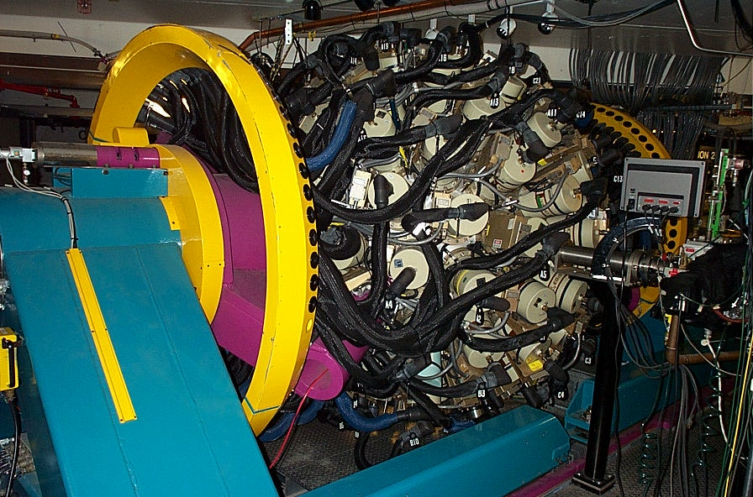
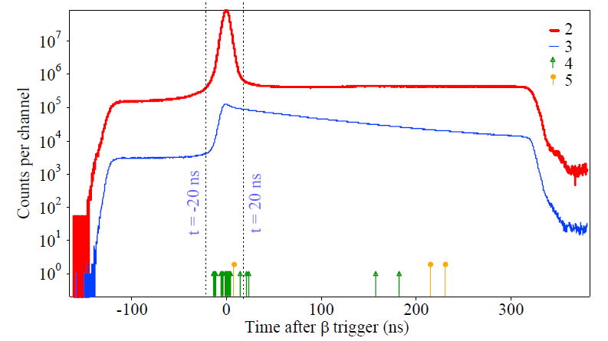
¹S₀ Para-positronium tau(p-Ps) ≈ 125 ps
³S₁ Ortho-positronium tau(o-Ps) ≈ 142 ns
BR (¹S₀ --> 5γ / ¹S₀ --> 2γ) < 2.7 10⁻⁷ at 90%CL
P. A. Vetter and S. J. Freedman Phys. Rev. A 66 (2002) 052505
Result from:P. A. Vetter and S. J. Freedman Phys. Rev. A 66 (2002) 052505
Figure taken form the presentation of A. O. Macchiavelli, Nuclear Structure, Oak Ridge, 2006
Notes:
was achieved in the Lawrence Berkeley National Laboratory in USA by means of the Gammasphere detector, one of the most powerful spectrometer for nuclear structure research
??ARAGONE NATIONAL LABORATORY
Tu przy okazji tego rysunku powiedziec jaki ebyłyby głowne zalety J-PET (having 100ps or better we could study a full function…)
Gammasphere is the world's most powerful spectrometer for nuclear structure research and is especially good at collecting gamma ray data following the fusion of heavy ions.
ARAGONE NATIONAL LABORATORY

Slide 21
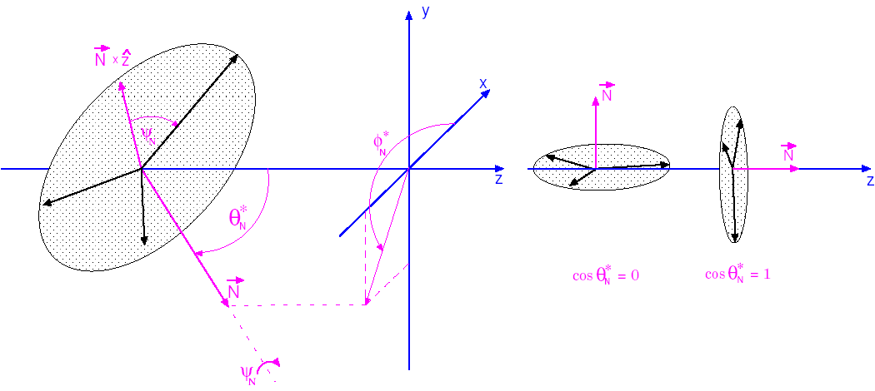

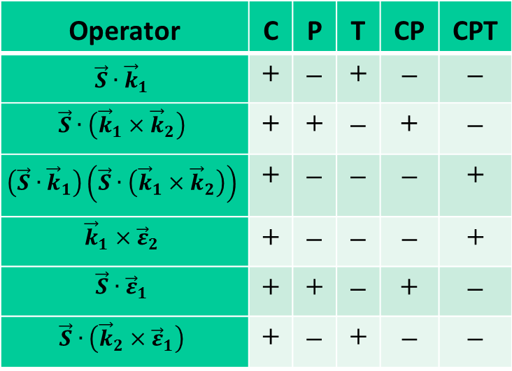



Operator | C | P | T | CP | CPT
$$\vec{S}∙{\vec{k}}_{1}$$ | + | – | + | – | –
$$\vec{S}∙\left({\vec{k}}_{1}×{\vec{k}}_{2}\right)$$ | + | + | – | + | –
$$\left(\vec{S}∙{\vec{k}}_{1}\right)\left(\vec{S}∙\left({\vec{k}}_{1}×{\vec{k}}_{2}\right)\right)$$ | + | – | – | – | +
$${\vec{k}}_{1}×{\vec{ε}}_{2}$$ | + | – | – | – | +
$$\vec{S}∙{\vec{ε}}_{1}$$ | + | + | – | + | –
$$\vec{S}∙\left({\vec{k}}_{2}×{\vec{ε}}_{1}\right)$$ | + | – | + | – | –
|k₁| > |k₂| > |k₃|
Operators for the o-Ps→3γ process,
and their properties with respect to
the C, P, T, CP and CPT symmetries.
$${\vec{k}}_{1 }$$
$$\vec{S }$$
$${\vec{k}}_{3 }$$
$${\vec{k}}_{2 }$$

Slide 22
¹S₀ Para-positronium tau(p-Ps) ≈ 125 ps
³S₁ Ortho-positronium tau(o-Ps) ≈ 142 ns
Operator C P T CP CPT
S • k₁ x k₂ + + - + -
P.A. Vetter and S.J. Freedman,
Phys. Rev. Lett. 91, 263401 (2003).
C_CPT = 0.0071 ± 0.0062
SM 10⁻¹⁰ – 10⁻⁹
photon-photon interactions
Figure taken form the presentation of P. Vetter, INT UW Seattle, November, 2002
Notes:
Pokazac wskaznikiem albo jak zdąże zacieniować pierwszą korelacje
Dopisac w uwagach gdzie jest ta gammashere
Gammasphere is the world's most powerful spectrometer for nuclear structure research and is especially good at collecting gamma ray data following the fusion of heavy ions.
ARAGONE NATIONAL LABORATORY

Slide 23
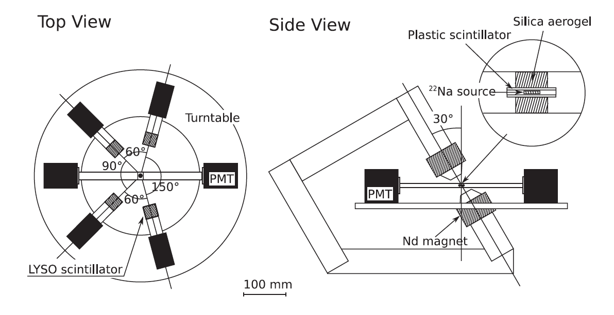
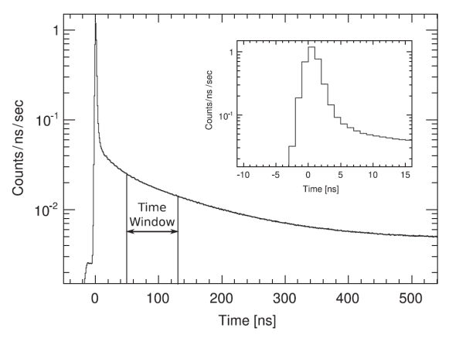
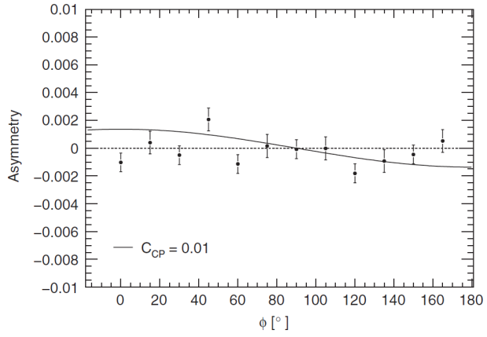
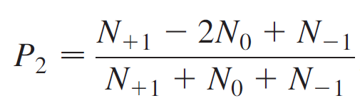
¹S₀ Para-positronium tau(p-Ps) ≈ 125 ps
³S₁ Ortho-positronium tau(o-Ps) ≈ 142 ns
Operator C P T CP CPT
(S • k₁) (S • k₁ x k₂ ) + - - - +
So far best accuracy for
CP violation was reported by
T. Yamazaki et al., Phys. Rev. Lett. 104 (2010) 083401
-0.0023 < C_CP < 0.0049 at 90% CL
vs
SM 10⁻¹⁰ – 10⁻⁹
W. Bernreuther et al., Z. Phys. C 41, 143 (1988)
This is due to photon-photon interactions in the final state
caused by the creation of virtual charged particle pairs)
Notes:
Consider Ortho-positronium This was in fact mostly explored (beacuse it is easy to identify ….) (time
So we wait long enough to be sure that the decay is from ortho-positronium
To most ofen explored correlations….
Tu wytłumaczyć dlaczego to okno …
W polu magnetycznym czas zycia 3S1 z m=0 maleje do około 20 w zaleznosci od pola
A m=1 i m=-1 się nie zmieniaja do tego
będzie potrzeby wzór na P2… i wpisać wzór na asymetrie w środku rysunku !!!
Pokreślić różnice 10^-2 i 10^-10 !! i ze warto zatem próbować….

Slide 24
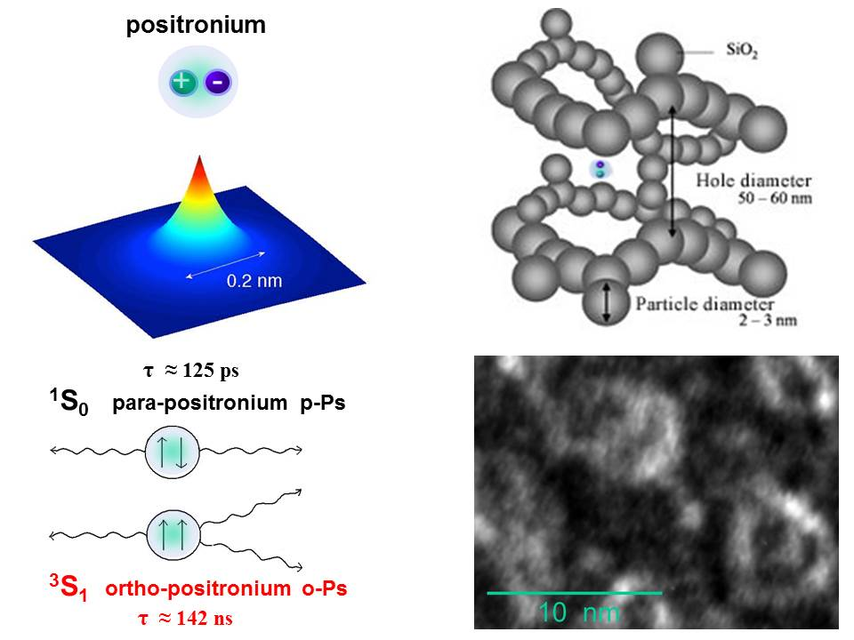
Ortho-positronium life-time tomography

Slide 25
J-PET Jagiellonian PET
¹S₀ Para-positronium tau(p-Ps) ≈ 125 ps
³S₁ Ortho-positronium tau(o-Ps) ≈ 142 ns
Jagiellonian PET
Positronium
Upper limits of C, CP, CPT
Potential of J-PET
Operator C P T CP CPT
S • k₁ x k₂ + + - + -
(S • k₁) (S • k₁ x k₂ ) + - - - +
³S₁ --> 3γ -->
Operator C P T CP CPT
S • E₁ x E₂ + + - + -
S • E₁ + - - - +
¹S₀ --> 2γ -->
Notes:
Correlations also posiible with para-positronium !!!

Slide 26
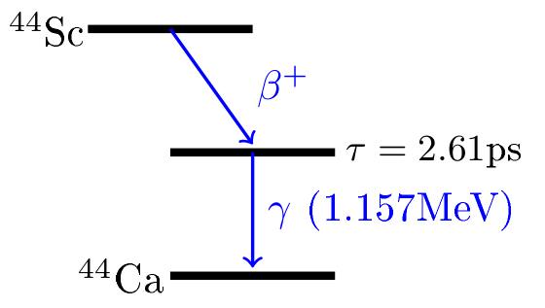
-
-
-
-
-
+
-
-
-
-
-
-
-
Rozmiary, pokaz przenikania
na modelu skarpetkowym
Notes:
Tu napisać dużymi literami ¾ ORTHO…. ¼ para…..
Dorobić przypadki żeby się rozpadało na 3 fotony i dorobić przemiane !!! (na przykład napis p-Ps na o-Ps ) się zmienia ….
Morphometric imaging P.M. Patent application No. … (2013)…

Slide 27
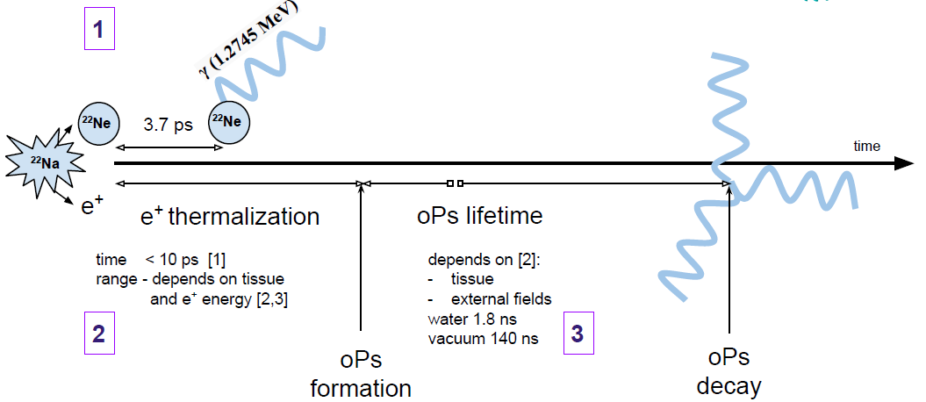
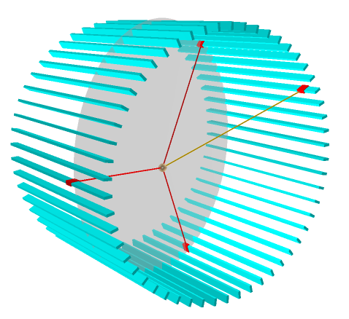
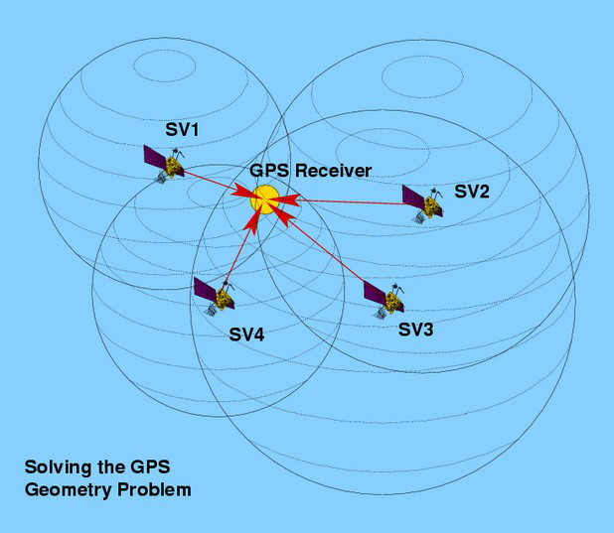
Ortho-positronium life-time tomography
-
-
-
-
-
+
-
-
-
-
-
-
-
Patent applications: P. M., PCT/EP2014/068374; A. Gajos, E. Czerwiński, D. Kamińska, P. M.,PCT/PL2015/050038
Rozmiary, pokaz przenikania
na modelu skarpetkowym
Notes:
Tu napisać dużymi literami ¾ ORTHO…. ¼ para…..
Dorobić przypadki żeby się rozpadało na 3 fotony i dorobić przemiane !!! (na przykład napis p-Ps na o-Ps ) się zmienia ….
Morphometric imaging P.M. Patent application No. … (2013)…

Slide 28
Jagiellonian PET
KING SIZE PET FOR LARGE ANIMALS
P. Moskal et al., NIM A 764 (2014) 317.
P. Moskal et al., NIM A 775 (2015) 54.
L. Raczynski et al., NIM A 764 (2014) 186.
L. Raczynski et al., NIMA 786 (2015) 105.
16 International Patent Applications
AFOV: 17 cm → 50 cm ; σ(t) = 80 ps

Slide 29
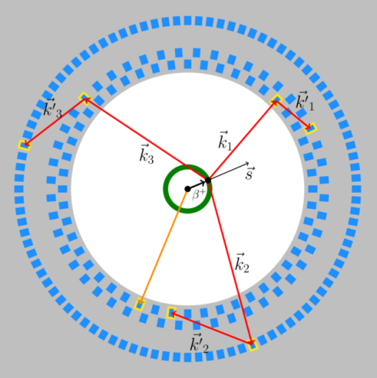

Jagiellonian PET
P. Moskal et al., NIM A 764 (2014) 317.
P. Moskal et al., NIM A 775 (2015) 54.
L. Raczynski et al., NIM A 764 (2014) 186.
L. Raczynski et al., NIMA 786 (2015) 105.
16 International Patent Applications
σ(t-hit) = 80 ps
$${\vec{ε}}_{i}={\vec{k}}_{i }×{\vec{k}′}_{i }$$

Slide 30
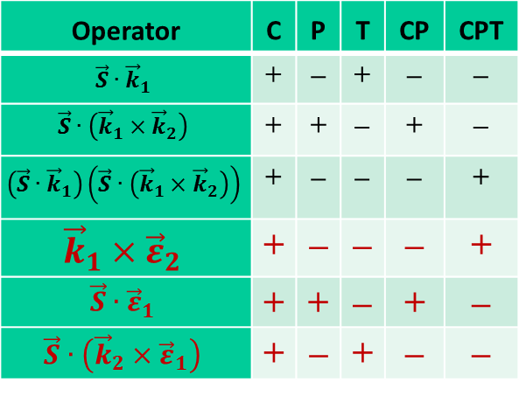
Jagiellonian PET
Operator | C | P | T | CP | CPT
$$\vec{S}∙{\vec{k}}_{1}$$ | + | – | + | – | –
$$\vec{S}∙\left({\vec{k}}_{1}×{\vec{k}}_{2}\right)$$ | + | + | – | + | –
$$\left(\vec{S}∙{\vec{k}}_{1}\right)\left(\vec{S}∙\left({\vec{k}}_{1}×{\vec{k}}_{2}\right)\right)$$ | + | – | – | – | +
$${\vec{k}}_{1}×{\vec{ε}}_{2}$$ | + | – | – | – | +
$$\vec{S}∙{\vec{ε}}_{1}$$ | + | + | – | + | –
$$\vec{S}∙\left({\vec{k}}_{2}×{\vec{ε}}_{1}\right)$$ | + | – | + | – | –
P. Moskal et al., NIM A 764 (2014) 317.
P. Moskal et al., NIM A 775 (2015) 54.
L. Raczynski et al., NIM A 764 (2014) 186.
L. Raczynski et al., NIMA 786 (2015) 105.
16 International Patent Applications
σ(t-hit) = 80 ps
$${\vec{ε}}_{i}={\vec{k}}_{i }×{\vec{k}′}_{i }$$

Slide 31
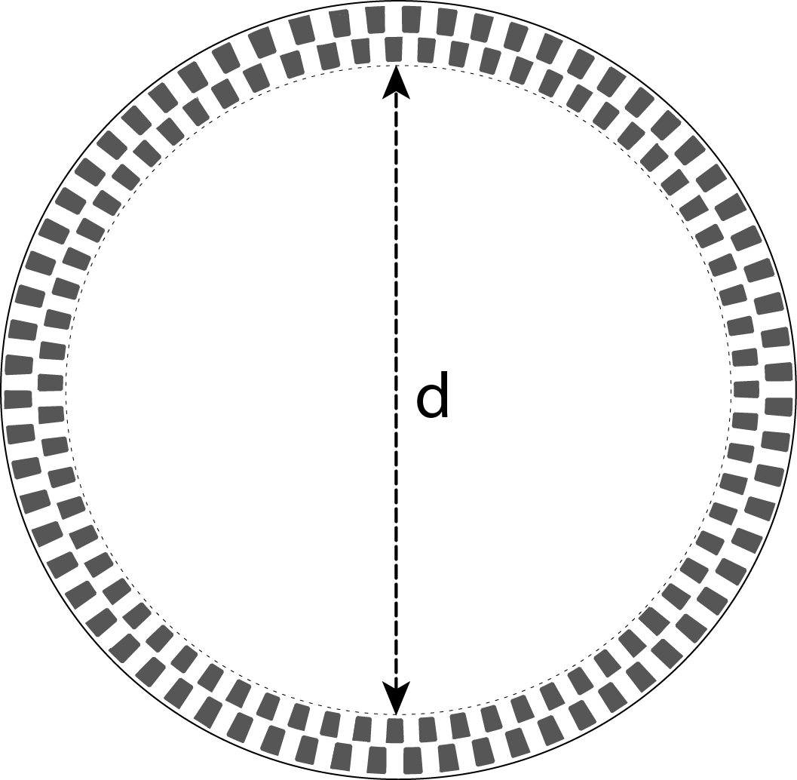
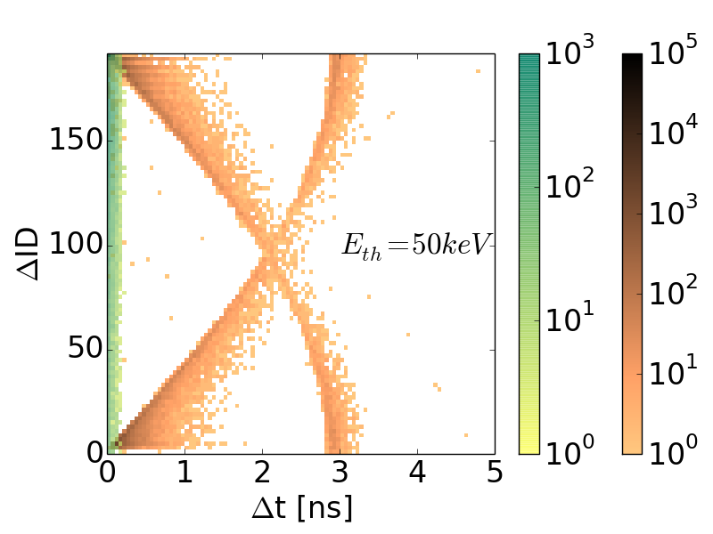
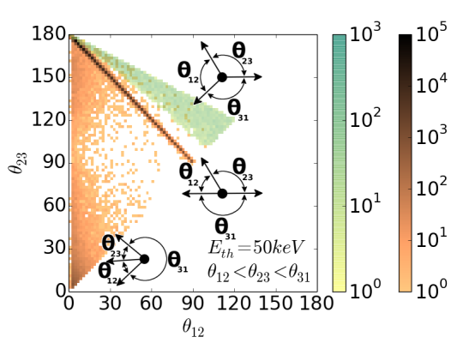
Reduction by factor
10⁹
Notes:
Figure 9. (Left) Simulated distributions of differences between detectors ID (ΔID) and differences of hit-times (Δt) for events with three hits registered from the annihilation e+e- → 2γ (gold colours) and o-Ps → 3γ (green colours). (Middle) Disribution of relative angles between reconstructed directions of gamma quanta. The numbering of quanta was assinged such that θ₁₂ < θ₂₃ < θ₃₁. Shown distributions were obtained requiring three hits each with energy deposition larger than Eth = 50 keV. Gold colour scale shows results for simulations of e+e- → 2γ and green scale corresponds to o-Ps → 3γ. Typical topology of
o-Ps → 3γ and two kinds of background events is indicated.
It is important to stress that in the analysis of previous experiments on CP and CPT symmetries in positronium [PS5,PS7] this kind of background was implicitly neglected and was even not mentioned in the articles [PS5,PS7]. But in priciple, the sample of events recognized as originating from o-Ps decay (N_o-Ps) include events from the following processes: true decays of o-Ps → 3γ (N_o-Ps->3γ); pick-off with subsequent prompt annihillation to 3γ (N_3γ _pick-off); pick-off with subsequent prompt annihillation to 2γ misidentified as 3γ due to secondary scatterings (N_2γ_pick-off); conversion of o-Ps to p-Ps with subsequent C symmetry violating decay to 3γ (N_3γ_conv); and conversion of o-Ps to p-Ps with subsequent annihilation to 2γ misidentified as 3γ due to the secondary scatterings (N_2γ_conv). The conservative upper limit of these background contributions may be estimated as:
N_3γ_conv / N_o-Ps < 0.2 * 2.7 10^-7 ~= 5 * 10^-6 [PS3];
N_2γ_pick-off / N_o-Ps < 0.2 * 10^-9 / (4 * 10^-5) = 5 * 10^-6;
N_2γ_conv / N_o-Ps < 0.2 * 10^-9 / (4 * 10^-5) = 5 * 10^-6;
N_3γ_pick-off / N_o-Ps < 0.2/370 ~= 5 * 10^-4 [G17];

Slide 32
TABLE 2. |  | JPET + START + NEW LAYER | Gammasphere [47] | CP-Tokyo [35]
Detector material |  | EJ-230 / BaF2 | HPGe and BGO | LYSO
Time resolution (sigma) |  | 80 ps / 80 ps | 4.6 ns | 0.9 ns
Reconstruction efficiency including registration of deexcitation γ(start) | p-Ps→2γ | 1.5٠10⁻³ | 4٠10⁻² | ―
 | o-Ps→γγγ_{n} | 3٠10⁻⁴ | 4٠10⁻² | 4٠10⁻⁴
 | o-Ps→3γ | 6٠10⁻⁶ | 5.7٠10⁻³ | ―
Reconstruction efficiency | p-Ps→γγ | 10⁻² | ~4٠10⁻² | ―
 | o-Ps→3γ | 4٠10⁻⁵ | ~5.7٠10⁻³ | ―
Statistics of events (days of run) | p-Ps→2γ | 1.2٠10¹² (~1000)* | ― | ―
 | o-Ps→γγγ_{n} | 2.4 10¹¹ (~1000)* | ― | ~10⁷ (~180)
 | o-Ps→3γ | 5.0 10⁹ (~1000)* | 2.65٠10⁷ (~36) | ―
Angular resolution (sigma) | polar | ~1° | ~4° | ~3.5°
 | azimuthal | 0.5° | ~4° | ~3.5°
Polarization degree | tensor | ~87% | ― | ~87%
 | linear | ~40% | less than 40% | ―
Source activity |  | 10 MBq | 0.04 MBq ²²Na or ⁶⁸Ge (limited by pile-ups) | 1 MBq / ²²Na (limited by pile-ups)
Available angular range |  | full range | full range | few fixed angles
γn denotes not registered photon ; * conservative estimation with 50% duty cicle included in the calculations of the statistics
Notes:
Greenberger-Horn-Zeilinger (GHZ)

Slide 33

It is an open question whether or not the three-photon entanglement can be reduced to the two-photon entanglement and decoherence of the two-photon states does imply decoherence
in photon triplets. This hypothesis can be tested by comparison of measured two- and three-photon correlation functions. There exist three-photon states maximizing the GHZ entanglement and they can be used to test quantum local realism versus quantum mechanics.
Jagiellonian PET
-
+
P. Moskal et al., NIM A 764 (2014) 317.
P. Moskal et al., NIM A 775 (2015) 54.
L. Raczynski et al., NIM A 764 (2014) 186.
L. Raczynski et al., NIMA 786 (2015) 105.
16 International Patent Applications
σ(t-hit) = 80 ps
$${\vec{ε}}_{i}={\vec{k}}_{i }×{\vec{k}′}_{i }$$

Slide 34
It is an open question whether or not the three-photon entanglement can be reduced to the two-photon entanglement and decoherence of the two-photon states does imply decoherence in photon triplets. This hypothesis can be tested by comparison of measured two- and three-photon correlation functions. There exist three-photon states maximizing the Greenberger-Horn-Zeilinger (GHZ) entanglement and they can be used to test quantum local realism versus quantum mechanics.
Jagiellonian PET
It is an open question whether or not the three-photon entanglement can be reduced
to the two-photon entanglement and decoherence of the two-photon states does imply
decoherence in photon triplets. This hypothesis can be tested by comparison of measured
two- and three-photon correlation functions. There exist three-photon states maximizing
the Greenberger-Horn-Zeilinger (GHZ) entanglement and they can be used to test quantum
local realism versus quantum mechanics.
D.M. Greenberger et al., Am. J. Phys. 58(1990)1131
A. Acin et al., Phys. Rev. A63(2001) 042107; N.D. Mermin, Phys. Rev. Lett. 65 (1990)1838
-
+
P. Moskal et al., NIM A 764 (2014) 317.
P. Moskal et al., NIM A 775 (2015) 54.
L. Raczynski et al., NIM A 764 (2014) 186.
L. Raczynski et al., NIMA 786 (2015) 105.
16 International Patent Applications
σ(t-hit) = 80 ps
$${\vec{ε}}_{i}={\vec{k}}_{i }×{\vec{k}′}_{i }$$

Slide 35
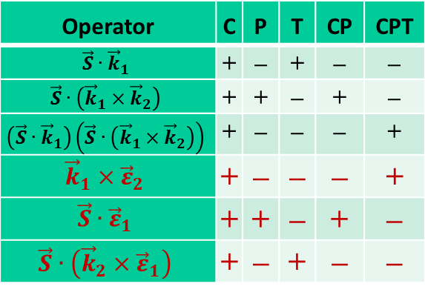
Jagiellonian PET
Operator | C | P | T | CP | CPT
$$\vec{S}∙{\vec{k}}_{1}$$ | + | – | + | – | –
$$\vec{S}∙\left({\vec{k}}_{1}×{\vec{k}}_{2}\right)$$ | + | + | – | + | –
$$\left(\vec{S}∙{\vec{k}}_{1}\right)\left(\vec{S}∙\left({\vec{k}}_{1}×{\vec{k}}_{2}\right)\right)$$ | + | – | – | – | +
$${\vec{k}}_{1}×{\vec{ε}}_{2}$$ | + | – | – | – | +
$$\vec{S}∙{\vec{ε}}_{1}$$ | + | + | – | + | –
$$\vec{S}∙\left({\vec{k}}_{2}×{\vec{ε}}_{1}\right)$$ | + | – | + | – | –
-
+
P. Moskal et al., NIM A 764 (2014) 317.
P. Moskal et al., NIM A 775 (2015) 54.
L. Raczynski et al., NIM A 764 (2014) 186.
L. Raczynski et al., NIMA 786 (2015) 105.
16 International Patent Applications
SM 10⁻⁹ vs upper limits of 3 10⁻³ for T, CP, CPT
SM 10⁻⁹ vs upper limits of 3 10⁻⁷ for C

Slide 36
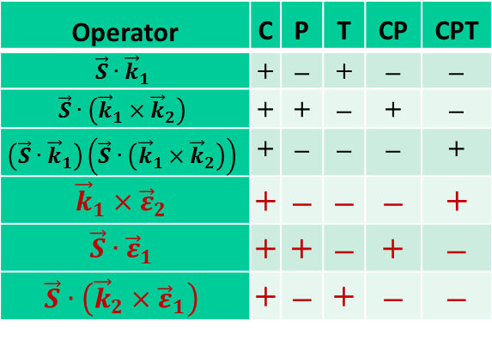
Jagiellonian PET
Operator | C | P | T | CP | CPT
$$\vec{S}∙{\vec{k}}_{1}$$ | + | – | + | – | –
$$\vec{S}∙\left({\vec{k}}_{1}×{\vec{k}}_{2}\right)$$ | + | + | – | + | –
$$\left(\vec{S}∙{\vec{k}}_{1}\right)\left(\vec{S}∙\left({\vec{k}}_{1}×{\vec{k}}_{2}\right)\right)$$ | + | – | – | – | +
$${\vec{k}}_{1}×{\vec{ε}}_{2}$$ | + | – | – | – | +
$$\vec{S}∙{\vec{ε}}_{1}$$ | + | + | – | + | –
$$\vec{S}∙\left({\vec{k}}_{2}×{\vec{ε}}_{1}\right)$$ | + | – | + | – | –
-
+
P. Moskal et al., NIM A 764 (2014) 317.
P. Moskal et al., NIM A 775 (2015) 54.
L. Raczynski et al., NIM A 764 (2014) 186.
L. Raczynski et al., NIMA 786 (2015) 105.
16 International Patent Applications
THANK YOU
FOR YOUR ATTENTION
SM 10⁻⁹ vs upper limits of 3 10⁻³ for T, CP, CPT
SM 10⁻⁹ vs upper limits of 3 10⁻⁷ for C

