Slide 1
Andrea Vinante Testing collapse models using ultracold mechanical resonators INFN – Tifpa, Trento

Slide 2
Spontaneous wavefunction collapse models
Quantum and Classical are micro-macroscopic limits of a more general theory.
Random collapses are intrinsic to quantum evolution = dynamical reduction
Mass-proportional (larger size ⇒ faster collapse) May be related with gravity (Diosi-Penrose model)
Natural Micro-Macro transition @ ∼ 10⁻⁷ m
Everything else is naturally derived: - Quantum Mechanics at microscale - Measurement Postulate and Born rule - Classical Mechanics at macroscale

Slide 3
Continuous Spontaneous Localization (CSL)
Schroedinger equation + Stochastic term (collapse field)
2 phenomenological constants
Correlation Length r_{C}
conventionally r_{C} =10⁻⁷ m, but could be up to 1-2 orders of mag around
Collapse rate λ
Lower bounds
λ ∼ 10⁻¹⁷ s⁻¹ following Ghirardi et al
λ ∼ 10⁻⁸ s⁻¹ following Adler (latent image formation as CSL effect)

Slide 4
Experimental tests of collapse models
Direct (Interferometric): macroscopic quantum superposition
Indirect (non-interferometric): energy non-conservation effects
Heating of protons in intergalactic medium, etc
X-ray spontaneous emission from free electrons
Spontaneous heating of a free particle / mechanical resonator

Slide 5
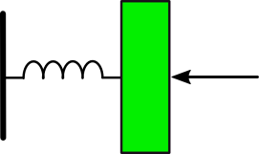
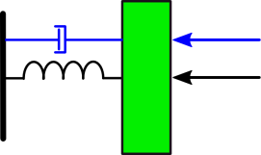
Random Collapse Momentum kick Stochastic driving force
τ=Q/ω₀
$\frac{d\left\langle E\right\rangle }{dt}=\frac{k_{B}T}{τ}−\frac{\left\langle E\right\rangle }{τ}$
F_{therm}
M
$$\frac{d\left\langle E\right\rangle }{dt}∝{ S}_{FF}$$
k=Mω₀²
F_{CSL}
$$\left\langle E\right\rangle =k_{B}T+ΔE_{CSL}=k_{B}\left(T+{ΔT}_{CSL}\right)$$
L. Diosi, PRL 114, 050403 (2015)

Slide 6
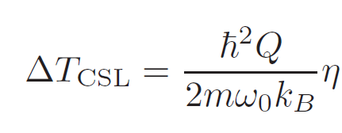
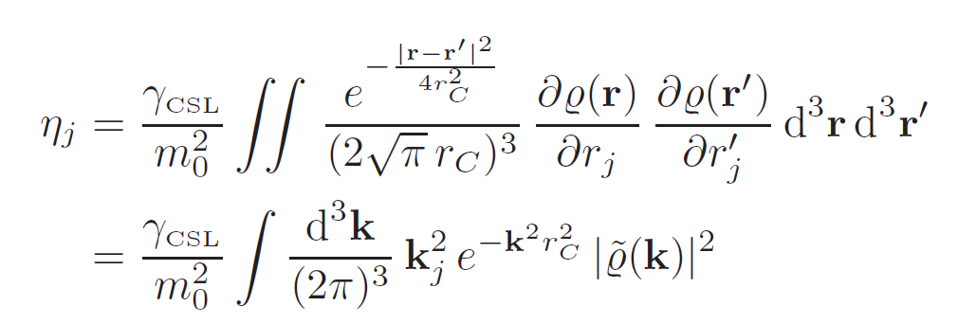
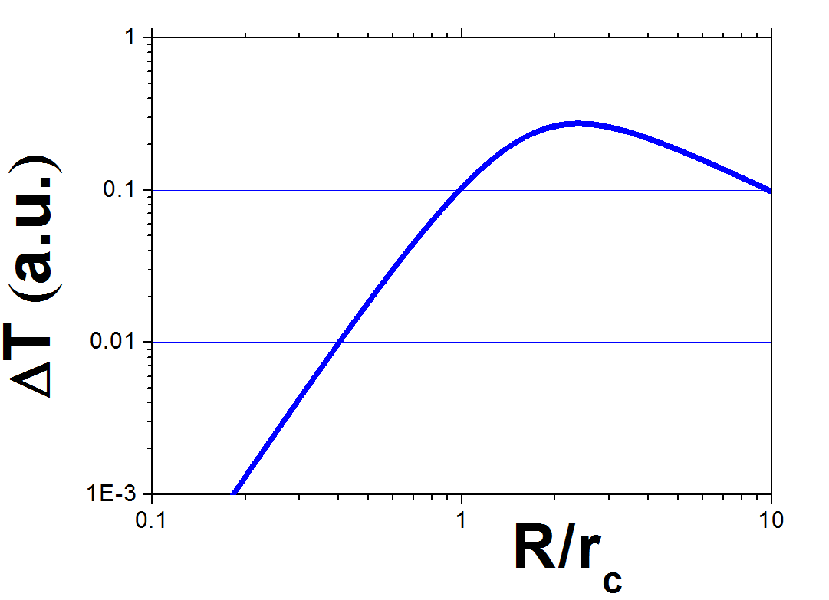
Some Formulas (valid for rigid body motion)
[ $γ_{CSL}={\left(4πr_{c}^{2}\right)}^{3/2}λ ]$
Exact solution for a sphere
MAXIMIZATION of ΔT_{CSL} needs:
High $τ=Q/ω_{0}$
High $ρ$
$$R≃r_{C}$$
MINIMIZATION OF “background” needs low T !

Slide 7
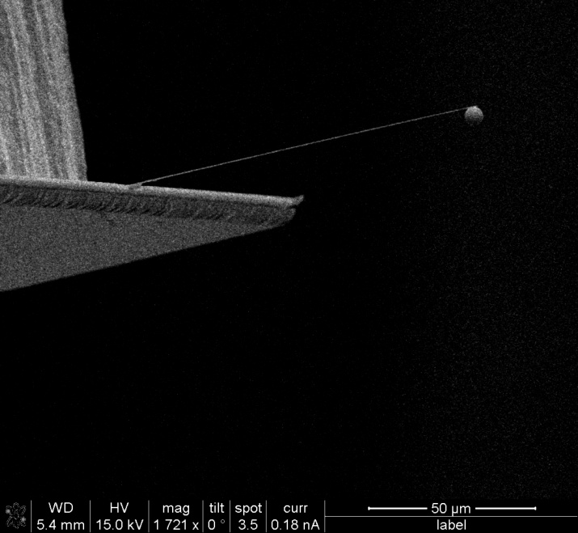
2011 @ T. Oosterkamp group. (Kamerlingh Onnes Laboratory, Leiden University) Silicon nanocantilever (IBM style, D. Rugar group)
Experimental setup
Very high aspect ratio
Thickness=100 nm
(close to standard rc)
Width=5 μm
Length=100 μm
f₀=3084 Hz
Q=4x10⁴

Slide 8
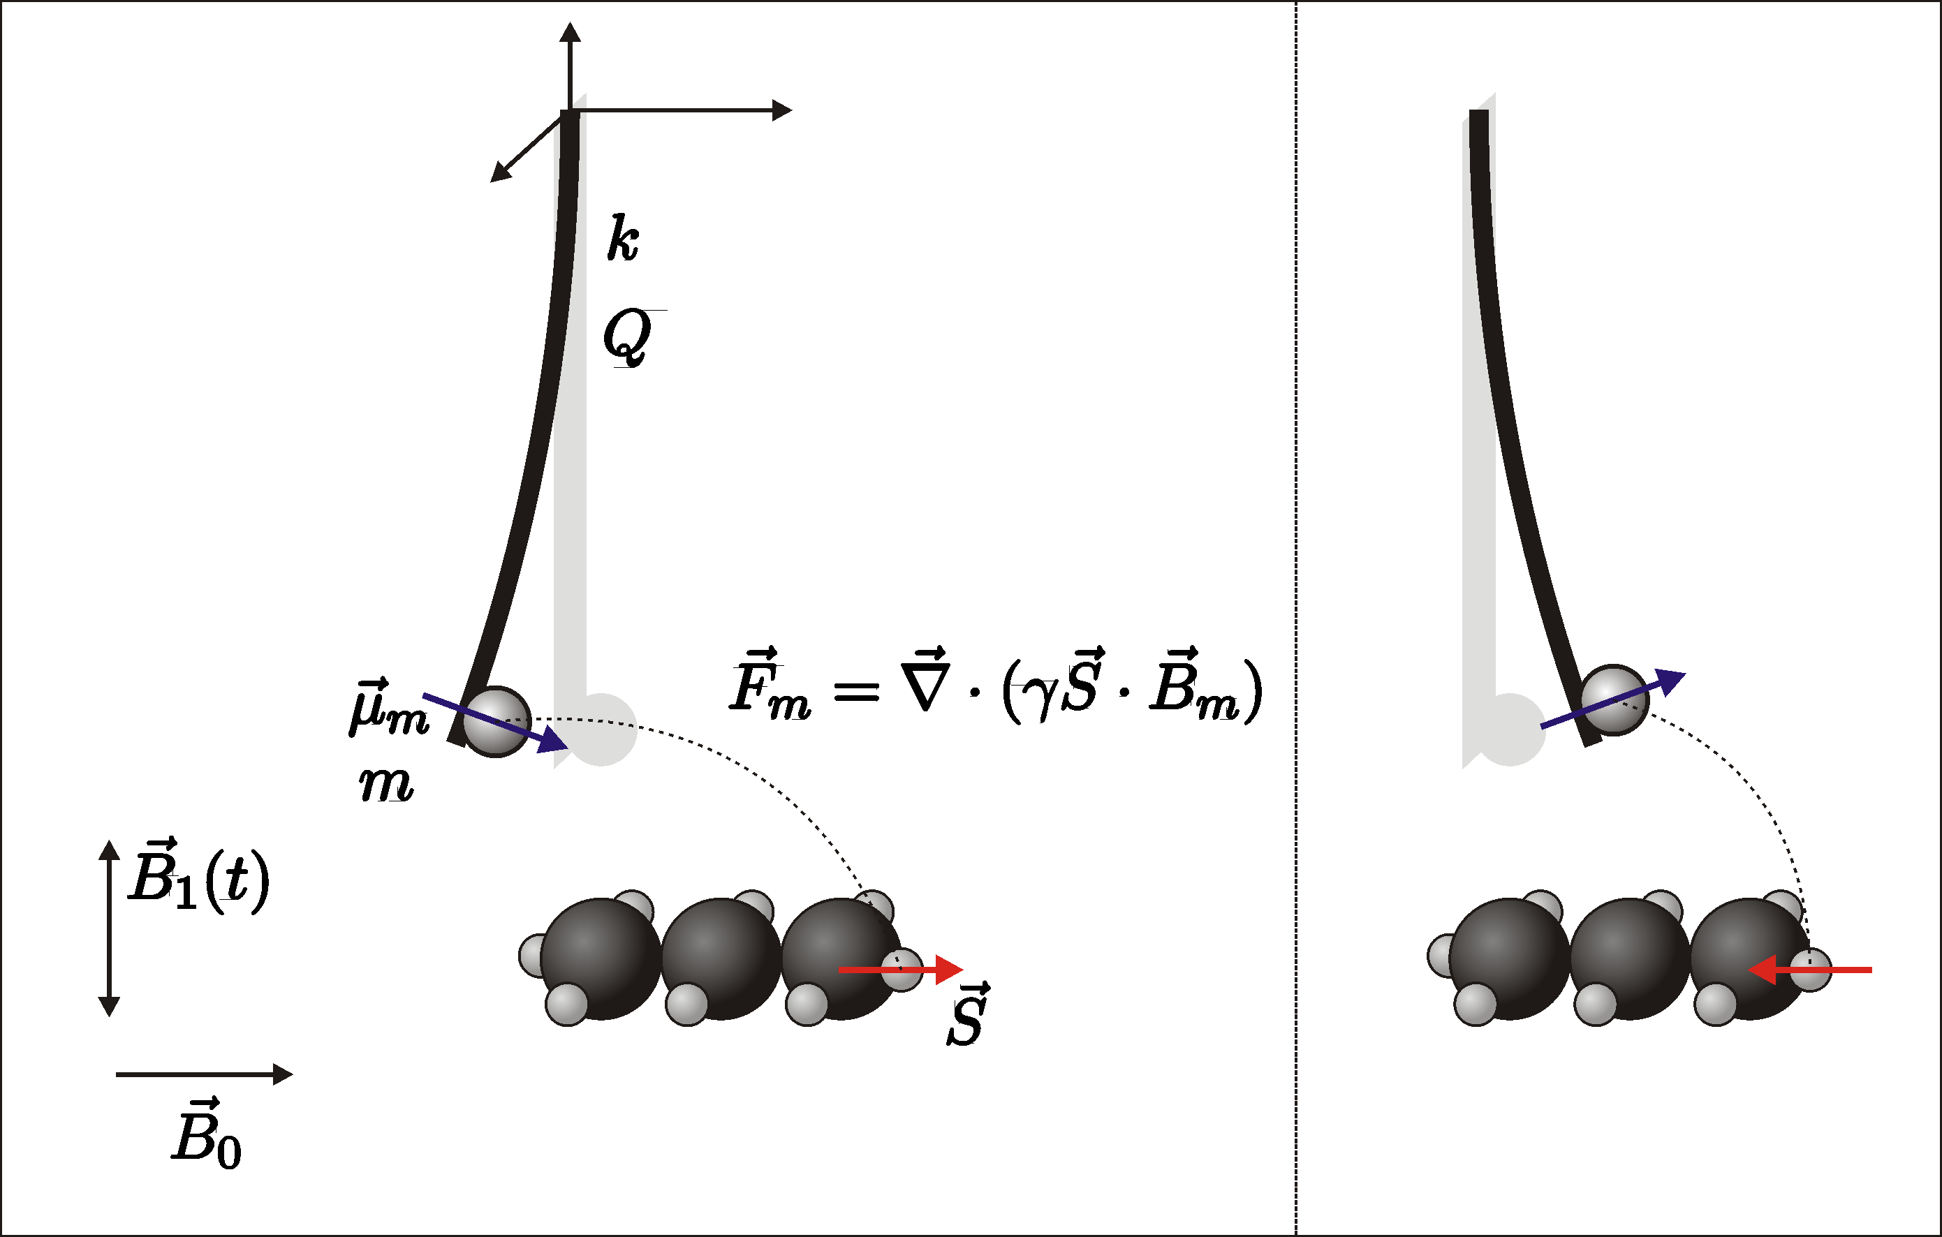
The context: Magnetic Resonance Force Microscopy
Couple mechanical motion to single (or a few) spins in a nearby sample
Spin inversions in the sample Force on the cantilever

Slide 9
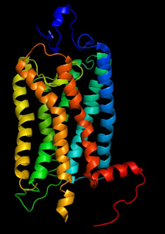
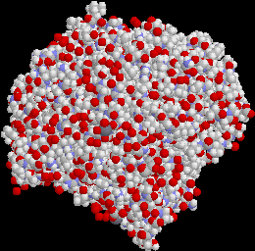
Main applications of MRFM
Molecular Imaging
Magnetic Resonance Imaging
(high resolution thanks to strong field gradients)
3D map of complex biomolecules
(ie proteins).
2) Macroscopic superposition of a
mechanical resonator
Couple to a single spin qubit
(ie diamond NV centers)

Slide 10
The challenge
Very weak forces (<10⁻¹⁸ N)
Force resolution limited by thermal force noise:$S_{ff}=\frac{4k_{B}Tmω_{0}}{Q}$
Try to cool to lowest possible temperature ( ∼ mK range)
PROBLEM:
Standard optomechanical techniques not very suitable
( mechanical resonators can be hardly cooled below 1 K because of heat absorption )
Look for a detection technique compatible with mK temperature

Slide 11
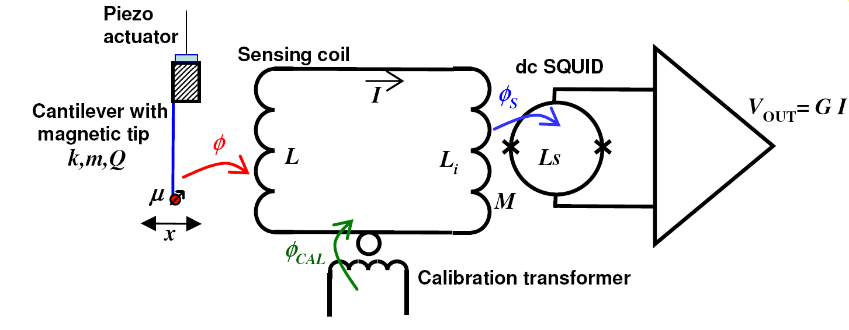
SQUID-based detection
dc SQUID: Most sensitive magnetic flux sensor
Displacement sensitivity ∼ 1 pm/√Hz
O. Usenko et al., Appl. Phys. Lett. 98, 133105 (2011)

Slide 12
Noise spectrum at SQUID output (∼ 10 minutes averaging)
Area under peak ∝ Mean Resonator Energy

Slide 13
Independent calibration of mechanical energy
adimensional coupling
SQUID gain +
Superconducting loop

Slide 14
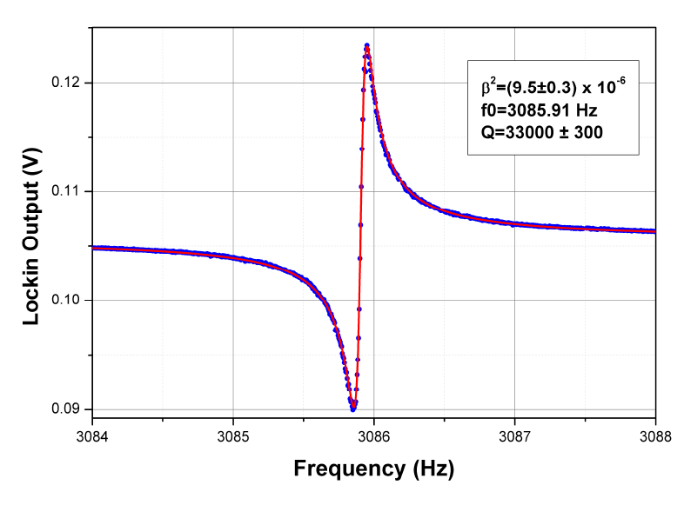
Measuring β²
Inject calibration flux φ_{CAL}
β²

Slide 15
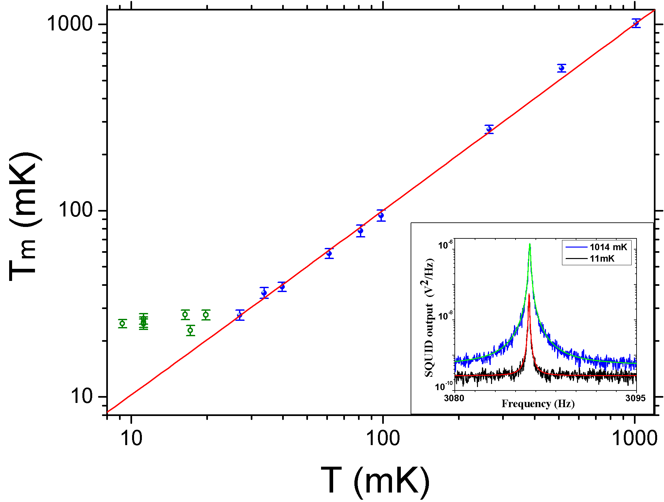
Mean Energy $\frac{\left\langle E\right\rangle }{k_{B}}$ vs Temperature
Force noise S_{ff}=5x10⁻¹⁹ N/√Hz @ T_{m}∼25 mK

Slide 16
Non-thermal energy: how much?
CSL (as other effects...) would cause a finite positive intercept
T_{m}=T+ΔT_{CSL}
Upper limit on ΔT_{CSL} can be obtained by Feldman-Cousins method
(standard for high energy expts)
ΔT_{CSL}< 2.5 mK
( 95% C.L. )

Slide 17
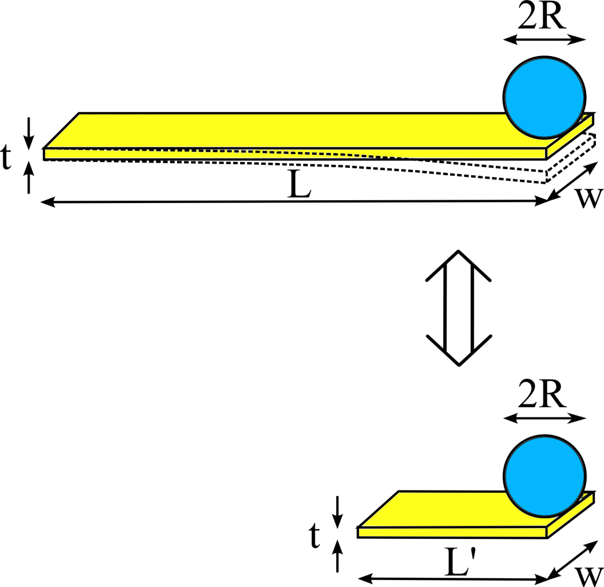
Connect to CSL parameters
Technical issues:
Composite object : CSL force noise acts sphere + cantilever (correlations)
Bending mode (flexural). Standard CSL formulas hold for rigid motion
Solution:
Approximate cantilever bending motion with a rigid translation of a slab with effective mass/length:
$$L^{′}≈0.236 L$$
Collaboration with Trieste theorists
( M.Bahrami , A. Bassi )
Work still in progress !
ρ_{cant}=2330 kg/m³
L=100 μm
t=0.1 μm
w=5 mm
ρ_{sph}=7430 kg/m³
R=2.2 μm

Slide 18
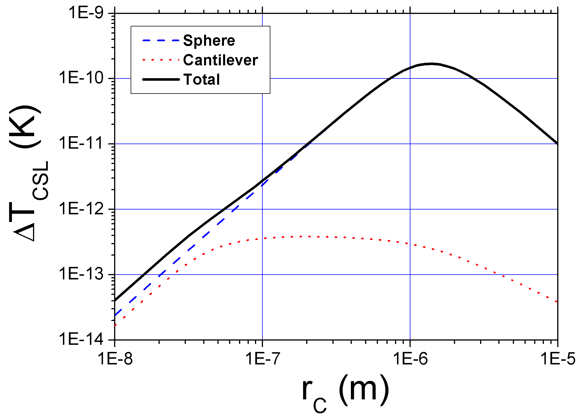
Computed CSL-induced heating vs r_{C}
Assuming Collapse rate from Ghirardi et al: λ=2.2x10⁻¹⁷ Hz

Slide 19
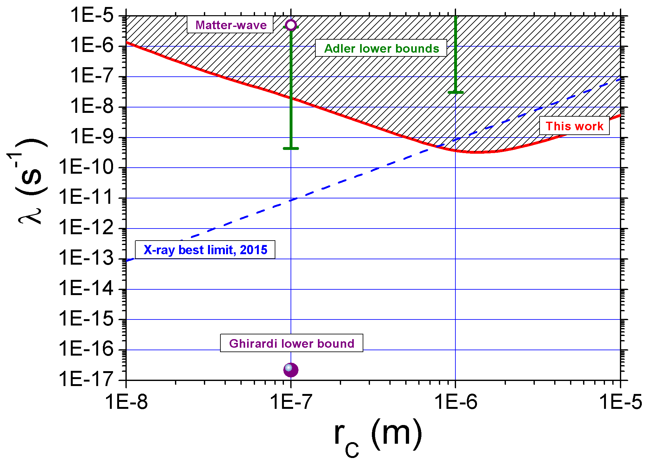
Upper Limit

Slide 20
Some comments
Adler model totally excluded by X-ray
Following Adler, X-ray limits could be evaded by additional hypothesis, i.e. CSL spectrum with cutoff
Upper limits set by mechanical resonators are stronger, in this respect.
∼ same timescale , ms to s, of Adler effects (photographic process)

Slide 21
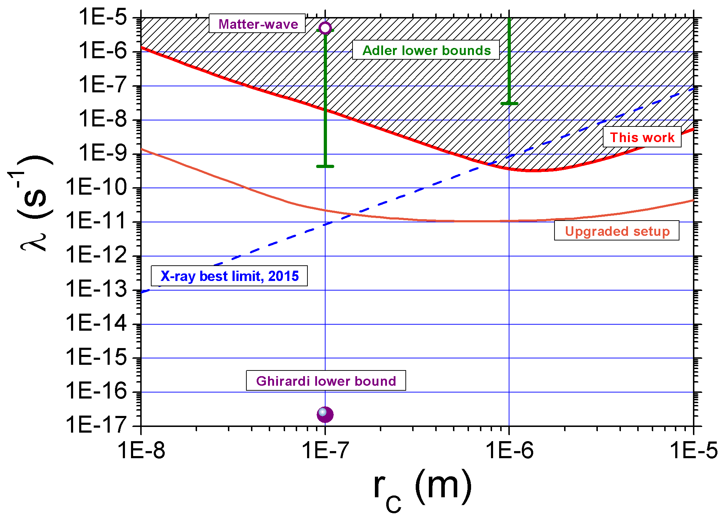
Outlook
Same scheme - improved setup (but existing technology ! )
Q ∼ 10⁵ ⇒ Q ∼ 10⁷ (Diamond cantilevers, C. Degen group, Zurich)
Heavier materials (Pb - Pt - FePt)
Still far from standard CSL…
BUT
experiment will not be so easy …
Vibrational noise
Back-action noise

Slide 22
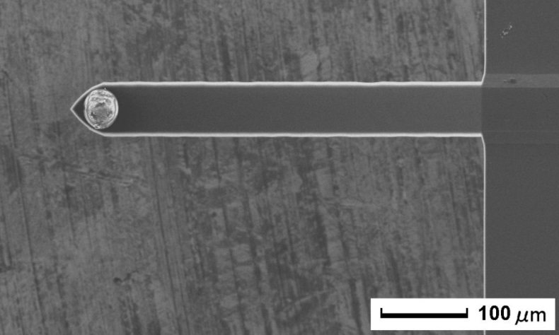
Ultra-high Q with silicon cantilevers
Superconducting (Pb) sphere
on a silicon microcantilever
Direct readout with a SQUID
REMARKABLE feature!
Very high Q∼10⁷
but needs T << 1K

Slide 23
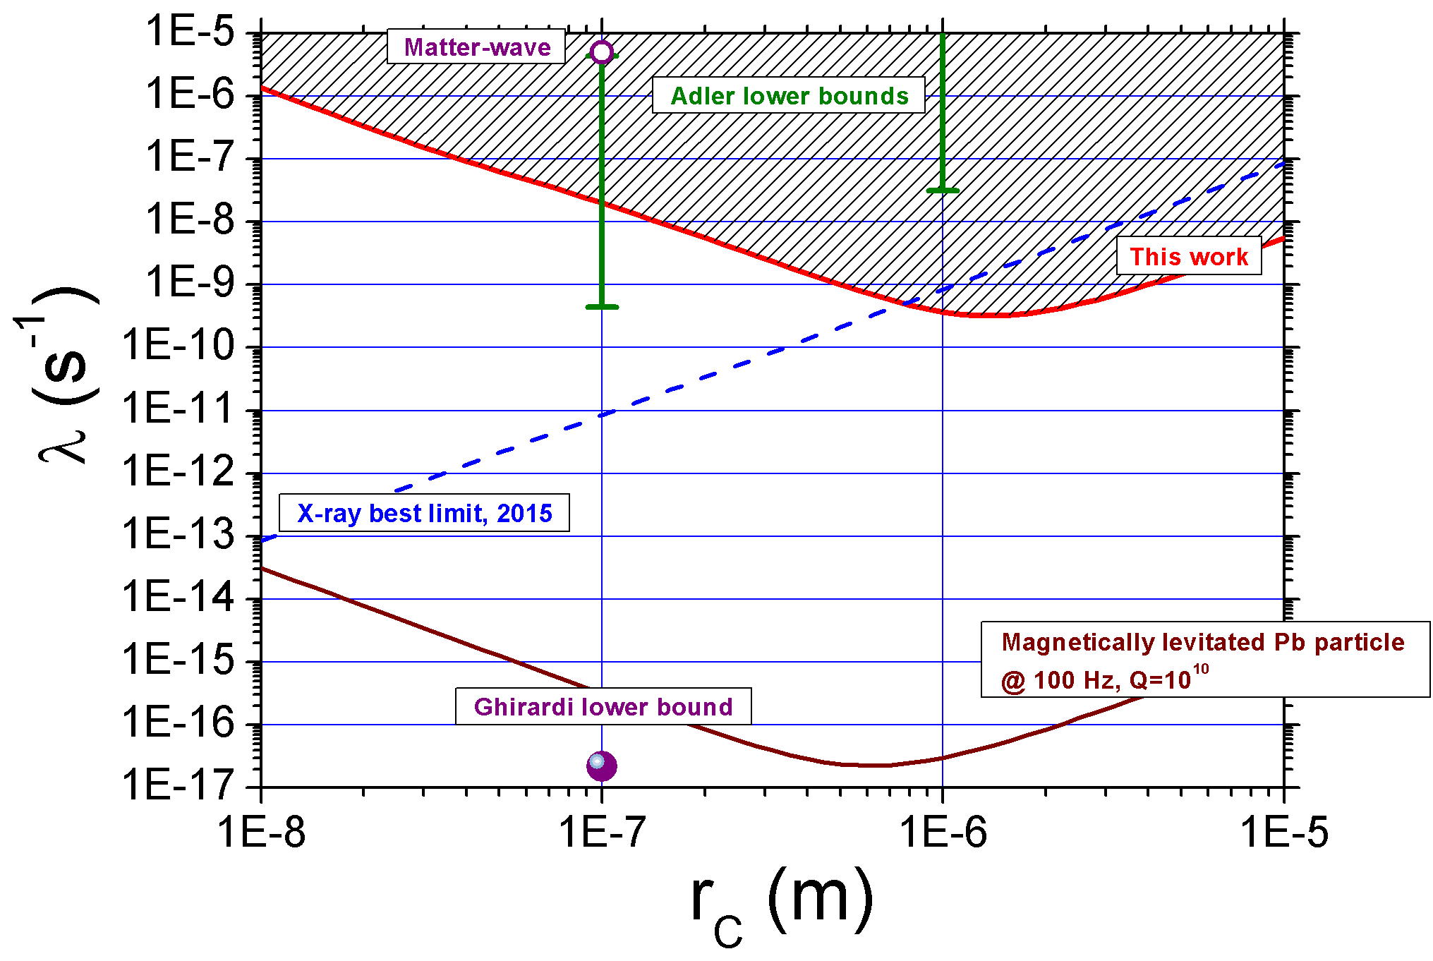
Outlook 2
Magnetically trapped superconducting (Pb) particle
f₀=100 Hz , Q ∼ 10¹⁰
Technology to be developed !!
Could probe all parameter space !
BUT
Yet to be demonstrated that such enormous Q can be achieved

Slide 24
Conclusions
Nano-microcantilevers cooled to mK temperature as sensors of ultra-weak forces
CSL can be probed by a simple monitoring of mean energy vs expected thermal energy
CSL – Adler: partially excluded at r_{C} =100 nm
totally excluded at r_{C} > 300 nm
Thanks to:
Former colleagues in Leiden (T. Oosterkamp, O. Usenko, G.Wijts, W. Bosch)
Trieste theory group (M. Bahrami and A. Bassi)

Slide 25
Measuring α
At T>1.1 K aluminum bonding wires become normal…
α

Slide 26
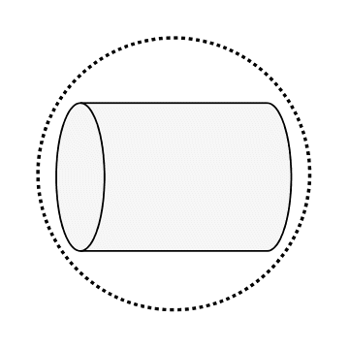
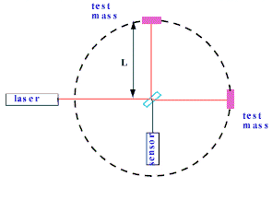
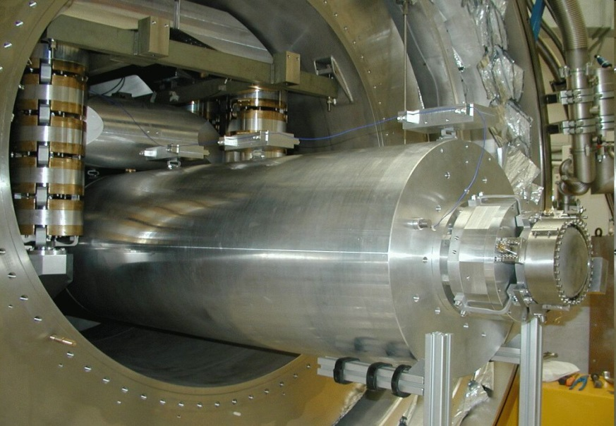
Gravitational wave detectors
Bar detectors vs interferometers (LIGO-Virgo)
The AURIGA detector (Padua, Italy)
Bar Vibration Capacitance change Electrical Current SQUID amplifier
Extreme displacement sensitivity (∼10⁻²⁰ m/√Hz)

Slide 27
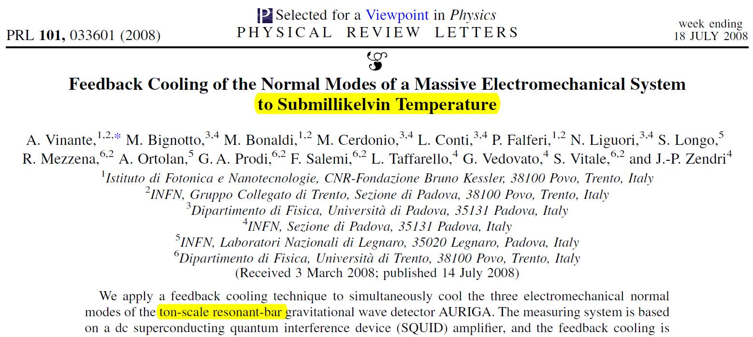
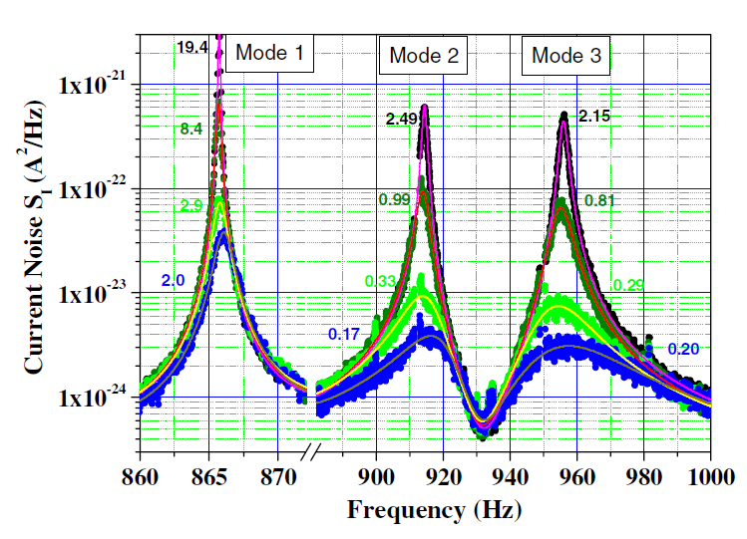
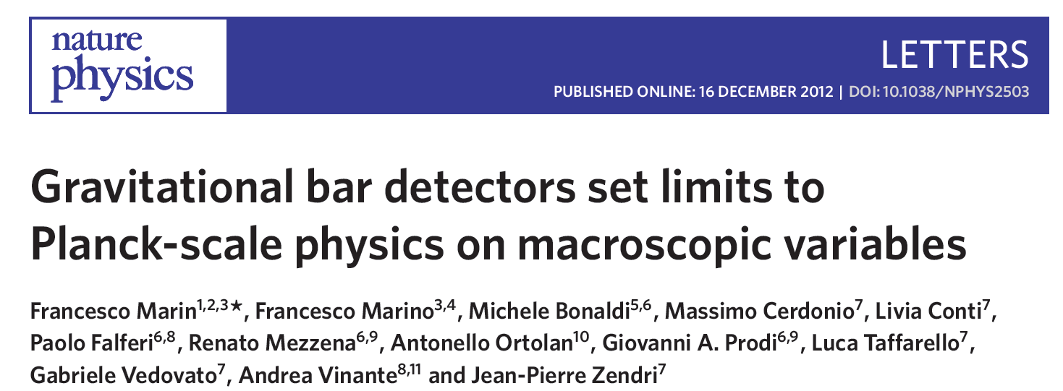
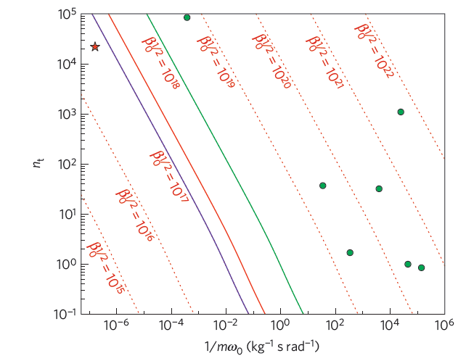
Some relevant results
T=0.17 mK !
N=4000 phonons (1 kHz)

Slide 28
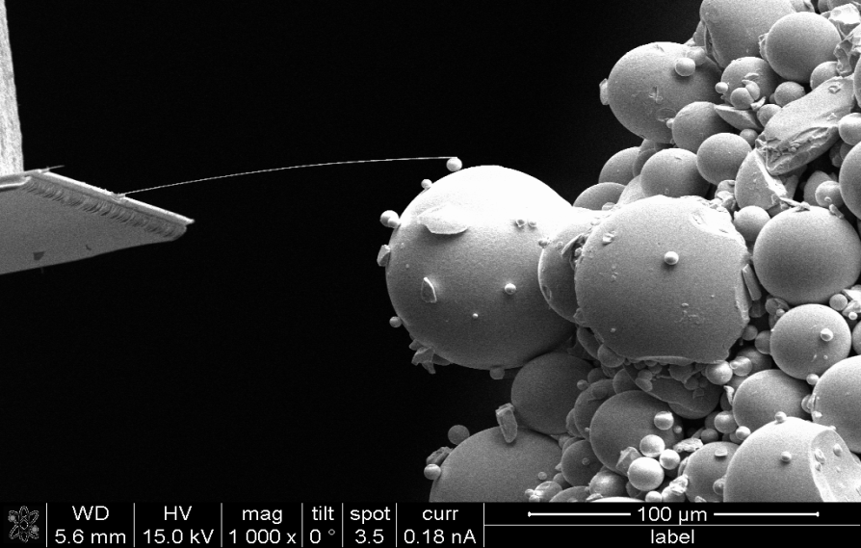
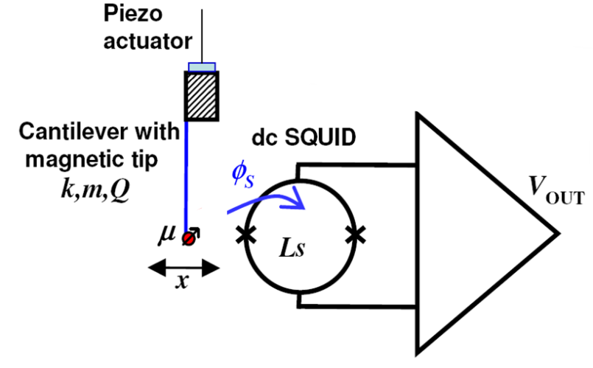
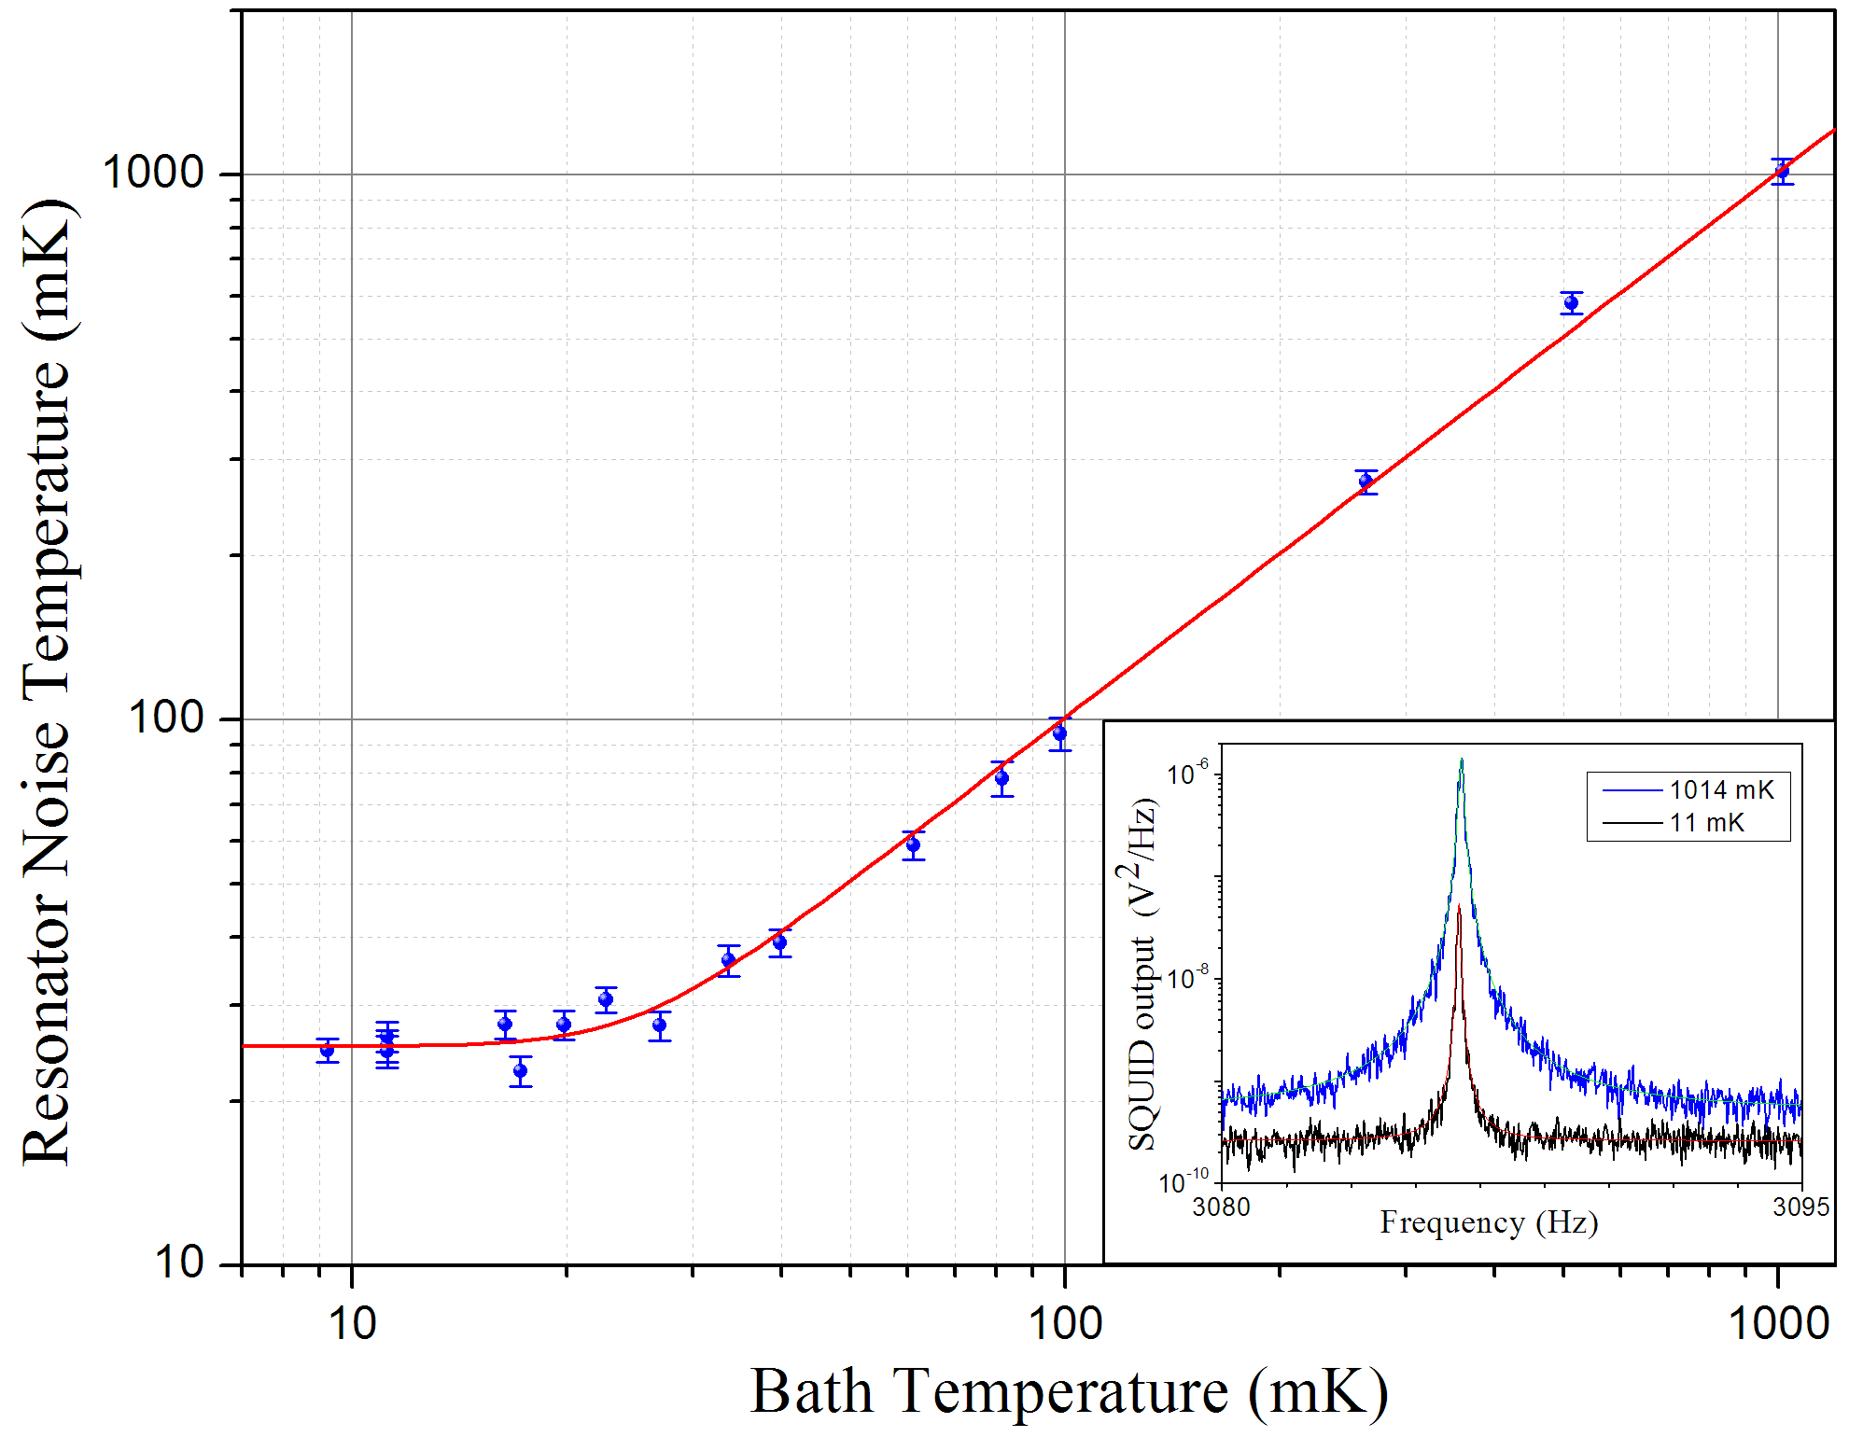
IBM-type ultrathin cantilevers with magnetic tip
SQUID-based detection
Cooling to millikelvin temperature
Force Noise
S_{F}=3×10⁻¹⁹ N/√Hz
O. Usenko et al. Appl. Phys. Lett. 98, 133105 (2011)

Slide 29
Decoherence in a mechanical resonator
Γ ∝ T/Q T Temperature
Q Quality Factor (=isolation from thermal bath)
From intrinsic mechanical (for ex. Clamping) losses
From residual gas scattering
Γ ∝ P T^{1/2} ∝ T/Q_{GAS} P Gas Pressure
Q_{GAS} Quality Factor due only to gas
From blackbody photons
Γ ∝ T⁹ (scattering)
Γ ∝ T⁶ (absorption-emission)
Notes:
In particular, for mechanical resonators, the decoherence may be induced by mechanical losses, by gas scattering, in both cases the decoeherence rate is roughly proportional to the ratio between temperature T and quality factor Q, which are defined by the coupling to the environment.
Then you have scattering from blackbody radiation, Another fundamental decoherence source, which is strongly dependent on temperature.
So -what you want, to suppress decoherence, in general is just to reduce as much as you can the temperature T, and increase as much as you can the quality factor Q, which means reduce the losses to the thermal bath.

