Slide 1
Enrico Nardi
Relazione coordinatore gruppo IV al CL preventivi del 1/7/2015
Info sul gruppo teorico
Attivitá delle sigle (contributi)
Il gruppo teorico nei Laboratori

Slide 2

Artist’s view of LNF Theory Group:
Le iniziative specifiche: “quantitá conservate"
Linea 1:Teoria dei Campi e di Stringa
FTeCP: Field Theory and Critical Phenomena
5 Sez. Loc. Resp. Maria Paola Lombardo
GSS: Gauge theories, supergravity & string theory
7 Sez. Loc. Resp: Stefano Bellucci
Linea 2: Fenomenologia Particelle Elementari
PhenoLNF: Phenomenology of the Fundamental Interactions
2 Sez. Loc. Resp: Gino Isidori
Linea 5: Fisica Astro-Particellare
TAsP: Theoretical Astroparticle Physics 13 Sez. Loc. Resp: Enrico Nardi
Linea 6: Fisica Statistica e Teoria di Campo Applicata
SEMS: Spectroscopies, Electron correlations, Modeling-Simulations and Low-dimensional Systems
2 Sez. Nat. Resp: Stefano Bellucci

Slide 3
Statistiche di Gruppo

Slide 4
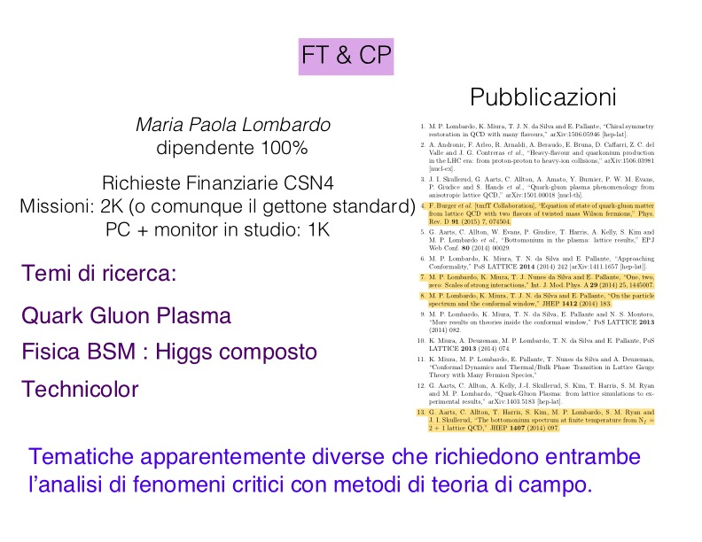

Slide 5
LNF Theory Group: Applied Physics and Supergravity – July 2015
Research activity
Theory Nat. projects (Iniziative Specifiche) in Applied Physics and Supergravity at LNF
I.S. Loc. (Nat.) FTE Topics
Spokesperson
SEMS Bellucci 13.6 [Complex systems] Methods in Cond. Mat. Phys.,
GSS Bellucci 3.9 [Fields/Strings] Supersymmetry, supergravity, BH

Slide 6
GSS Gauge Theories, Supergravity and String Theory - S. Bellucci (LNF loc. spokesperson) + S. Ferrara (ass.), E. Orazi (ass.), G. Gionti (ass.), A. Yeranyan (Fermi Inst. PostDoc)
Main research issues
Richiesta 2016 7 KE Missioni
I) String Theory, Supergravity.
II) Perturbative and non perturbative properties of Gauge Theories.
Study of theories with non linearly realised supersymmetry both in the rigid case, leading to
generalised Born-Infold Actions, and in supergravity, giving a new way to construct models
for inflation.
Supersymmetric completions of R+R2 and R2 theories were derived and minimal models for inflation.
Cosmological models for N=2 generalised mass terms for higher-form gauge fields, suggested by the
massive BI action, with generalised dualities of higher form gauge fields.
Self–duality of the N = 1 supersymmetric Born–Infeld action implies a double self– duality of the
tensor multiplet square–root action when the scalar and the antisymmetric tensor are interchanged via
Poincaré duality. This phenomenon extends to D space–time dimensions for non–linear actions
involving pairs of forms of rank p and D−p−2. As a byproduct, we have constructed new two–field
generalizations of the Born–Infeld action whose equations of motion are invariant under a U(1),
U(1)xU(1) and SU(2) dualities. In the systems with U(1) duality, the introduction of Green–Schwarz
terms results in explicit non–linear mass–like terms for dual massive pairs [1].
U(1)^{n} supersymmetric Born-Infeld Lagrangians with a second non-linearly realized
supersymmetry. The resulting non-linear structure is more complex than the square root present in
the standard Born-Infeld action, and nonetheless the quadratic constraints determining these models
can be solved exactly in all cases containing three vector multiplets. The corresponding models are
classified by cubic holomorphic prepotentials. Their symmetry structures are associated to projective
cubic varieties [2].

Slide 7
GSS - S. Bellucci (LNF loc. spokesperson) + S. Ferrara (ass.), G. Gionti (ass.), A. Yeranyan (Fermi Inst. PostDoc)
Publications 2015
S Bellucci, S Krivonos, A Sutulin, "Testing the FPS approach in d= 1", Journal of High Energy Physics
2015 (4), 1-16
S Bellucci, N Kozyrev, S Krivonos, A Sutulin, "Space-filling D3-brane within coset approach",
arXiv preprint arXiv:1505.07386
S Bellucci, N Kozyrev, S Krivonos, A Sutulin, "Component on-shell actions of supersymmetric 3-branes:
II. 3-brane in D= 8", Classical and Quantum Gravity 32 (11), 115008 (2015)
S Bellucci, N Kozyrev, S Krivonos, A Sutulin, "Component on-shell actions of supersymmetric 3-branes:
I. 3-brane in D= 6“ Classical and Quantum Gravity 32 (3), 035025 (2015)
S. Ferrara, A. Kehagias and M. Porrati, R^2 Supergravity,’' arXiv:1506.01566 [hep-th].
S. Ferrara and A. Kehagias, ``Higher Curvature Supergravity, Supersymmetry Breaking and Inflation,’
arXiv:1407.5187 [hep-th], to appear in the Proceedings of Erice 2014.
[1] S. Ferrara, A. Sagnotti and A. Yeranyan, ``Doubly Self-Dual Actions in Various Dimensions,'' JHEP
1505 (2015) 051 [arXiv:1503.04731 [hep-th]].
S. Ferrara and A. Sagnotti, ``Massive Born--Infeld and Other Dual Pairs,’' JHEP 1504 (2015) 032.
L. Andrianopoli, R. D'Auria, S. Ferrara and M. Trigiante, ``Observations on the partial breaking of
N=2 rigid supersymmetry,’' Phys. Lett. B744 (2015) 116 [arXiv:1501.07842 [hep-th]].
[2] S. Ferrara, M. Porrati, A. Sagnotti, R. Stora and A. Yeranyan, ``Generalized Born--Infeld Actions and
Projective Cubic Curves,’' Fortsch. Phys. 63 (2015) 189 [arXiv:1412.3337 [hep-th]].

Slide 14
SEMS Spectroscopies, Electron correlations, Modeling-Simulations and low-dimensional systems - S. Bellucci (nat. spokesperson) + M. Benfatto, S. Bistarelli, M. Bozzi, A. Cataldo, K. Hatada, K.Hayakawa, C.Natoli, L.Pierantoni, D. Mencarelli, A. Pantano, F.Palumbo,E. Perfetto, G.Stefanucci, A.Tagliacozzo; coll. Unical (gruppo CS, A. Sindona)
Main research issues
Spectroscopies, Electron correlations, Density Functional Theory, Modeling-Simulations
and low-dimensional systems
Richiesta 2016 11,5 KE Missioni
LNF activities in 2015
  The project uses tools from field theory, quantum mechanics, modeling and simulations,
  to analyze spectroscopies, electron correlations and various properties of low-dimensional
  systems in condensed matter physics:
  * Electron spectroscopy of magnetic systems;
  * NanoElectromagnetics (microwave/RF/photonics);
  * Multiple scattering theory for non-local and multichannel potentials;
  * Quantum effects in nanoparticles;
  * Collective response of low dimensional, many body systems to abrupt perturbations;
  * Electronic properties and plasmon excitations in graphene and doped graphene;
  * Ab initio simulations and spectroscopy of Graphene/Metal interfaces.
  Interdisciplinary and multidisciplinary project: fusion of classical electrodynamics with novel
  methods and approaches of condensed matter physics;
  methods allowing elucidating local properties of magnetic systems; understanding the
  2D character of the interface collective excitation in the electronic structure of graphene sheets
  deposited on metal surfaces; graphene properties

Slide 15
SEMS - S. Bellucci (nat. spokesperson) + A. Sindona (CS local spokesperson)
EUcollaborations in 2015
  - University of Lorraine, and Belarus State University, Institute for Nuclear Problems,
  through the 7th FRAMEWORK PROGRAMME, International Research Staff Exchange
  Scheme “Nano-thin and micro-sized carbons: Toward electromagnetic compatibility application
  (NAmiceMC)”, Proposal Number: 610875, Grant Agreement Number: PIRSES-GA-2013,
  2013-2017. S. Bellucci
  - Laboratory for Solid State Physics at the Department of Physics of matter and radiations
  University of Namur, Nanostructures Department from the Research Institute for Technical
  Physics and Materials Science of the Hungarian Academy of Sciences in Budapest, Institute
  for Biochemical Physics at the Russian Academy of Sciences in Moscow, Institute of Physics
  of the National Academy of Sciences of Ukraine in Kiev, Department of Radiophysics of the
  Faculty of Physics in Vilnius University, and Belarus State University, Institute for Nuclear
  Problems, through the 7th FP International Research Staff Exchange Scheme “Fundamental
  and Applied Electromagnetics Of Nanocarbon (FAEMCAR)”, Proposal Number: 318617,
  Grant Agreement Number: PIRSES-GA-2012, 2012-2015. S. Bellucci
  - CNRS Université de Rennes, Ludwig-Maximilians-Universität München, Université de
  Bourgogne, Institute of Physics in Prague of the Academy of Sciences of the Czech Republic,
  Southern Federal University at Rostov-on-Don, University of Science and Technology of
  China of the Chinese Academy of Sciences, Chiba University in Japan, Birla Institute of
  Technology and Science at Pilani in India, through the 7° FP International Research Staff
  Exchange Scheme “A Multiple Scattering Computing Platform For (Nano) Materials
  (MSNano)”, Grant Agreement Number: 2012-317554, 2012-2016, M. Benfatto

Slide 16
SEMS - . Bellucci (nat. spokesperson) + A. Sindona (CS local spokesperson)
Further International collaborations in 2015
  - Yerevan State University, Armenia, through EMERGING SECURITY CHALLENGES
  DIVISION SCIENCE FOR PEACE AND SECURITY (SPS) PROGRAMME PROJECT
  PROPOSAL - Multi-Year Science for Peace (SfP) “Development of Biosensors using Carbon Nanotubes”,
  NATO Grant SPS EAP SFP 984537 2014-2016, S. Bellucci.
  Graphene-Based Revolutions in ICT And Beyond GRAPHENE Flagship Grant agreement n. 604391 CP-CSA.
  “Multi-layered sandwich graphene devices (MILESAGE)”, 2015-2017, S. Bellucci.
National collaborations in 2015
  Grant ASI Italian Space Agency: 2014-2017 “SHAPE- A New Theoretical Framework
  of the Microgravity-Cell Interaction” , S. Bellucci: Definire il modello teorico capace di spiegare
  l’interazione tra campo gravitazionale ed organismi viventi.
  Italian Ministry for Health, Research Project PE-2011-02347026 (Ricerca Finalizzata, “Delivery and imaging
  of micro RNAs by multifunctional carbon nanotubes and circulating micro RNAs as innovative therapeutic and
  diagnostic tools for pediatric pulmonary hypertension”, 2014-2017, S. Bellucci.
Talks in 2015
  UNICAL Cosenza: 10/3/2015 S. Bellucci: "INFN and the EU Graphene Flagship Project".
  NATO Advanced Res.Workshop FANEM 25-27 May 2015 Minsk, S. Bellucci:
  " Electrical conductivity of graphene: a time-dependent density functional theory study ".
  NATO Advanced Res.Workshop FANEM 25-27 May 2015 Minsk, D. Mencarelli: "Full-wave techniques
  for the multi-physics modeling and design of nano-structured devices "
  NANOMEETING 28-29 May 2015 Minsk, S. Bellucci: “Carbon nanotubes in biology and medicine”
  What Next at LNF 27 February 2015 LNF, S. Bellucci: “INFN in the Graphene Flagship”
  What Next at LNF 26 February 2015 LNF, F. Micciulla: “NEXT”

Slide 17
SEMS - . Bellucci (nat. spokesperson) + A. Sindona (CS local spokesperson)
Publications 2015
V Ohanyan, O Rojas, J Strecka, S Bellucci, On the absence of actual plateaus in zero-temperature
magnetization curves of quan tum spin clusters and chains, arXiv preprint arXiv:1506.02933
S Dinicola, MG Masiello, S Proietti, P Coluccia, G Fabrizi, A Palombo, F Micciulla, S Bistarelli, G Ricci,
A Catizone, G De Toma, M Bizzarri, S Bellucci, A Cucina, Multiwalled carbon nanotube buckypaper
induces cell cycle arrest and apoptosis in human leukemia cell lines through modulation of AKT and
MAPK signaling pathways,Toxicology in Vitro Volume 29, Issue 7, October 2015, Pages 1298–1308
O Zeni, A Sannino, S Romeo, F Micciulla, S Bellucci, MR Scarfi, Growth inhibition, cell-cycle alteration
and apoptosis in stimulated human peripheral blood lymphocytes by multiwalled carbon nanotube
buckypaper, Nanomedicine 10 (3), 351-360 (2015)
G Ruppeiner, S Bellucci, Thermodynamic curvature for a two-parameter spin model with frustration,
Physical Review E 91 (1), 012116 (2015)
DG Kvashnin, S Bellucci, LA Chernozatonskii, Sharp variations in the electronic properties of graphene
deposited on the h-BN layer, Physical Chemistry Chemical Physics 17 (6), 4354-4359 (2015)
G Stefanucci, S Kurth, Steady-State Density Functional Theory for Finite Bias Conductances
arXiv preprint arXiv:1505.07364
E Perfetto, G Stefanucci, Some exact properties of the nonequilibrium response function for transient
photoabsorption, Physical Review A 91 (3), 033416
AM Uimonen, G Stefanucci, Y Pavlyukh, R van Leeuwen, Diagrammatic expansion for positive
density-response spectra: Application to the electron gas, Physical Review B 91 (11), 115104 (2015)
E Perfetto, G Stefanucci, Transient dynamics in the Anderson–Holstein model with interfacial screening
Journal of Computational Electronics 14 (1), 352-359, (2015)
J Bartolomé, F Bartolomé, AI Figueroa, O Bunău, IK Schuller, T Gredig, F Wilhelm, A Rogalev, P
Krüger, C R Natoli, Quadrupolar XMCD at the Fe K-edge in Fe phthalocyanine film on Au: Insight
into the magnetic ground state, Physical Review B 91 (22), 220401, (2015)

Slide 18
SEMS - . Bellucci (nat. spokesperson) + A. Sindona (CS local spokesperson)
Publications 2015 (continued)
F Bartolomé, O Bunău, LM García, CR Natoli, M Piantek, JI Pascual, K Schuller, T Gredig, F Wilhelm,
A Rogalev, J Bartolomé, Molecular tilting and columnar stacking of Fe phthalocyanine thin films on
Au (111), Journal of Applied Physics 117 (17), 17A735 (2015)
M Benfatto, C Meneghini, A Close Look into the Low Energy Region of the XAS Spectra: The XANES
Region, Synchrotron Radiation, 2015, pp 213-240 – Springer
P Frank, M Benfatto, M Qayyam, B Hedman, K O Hodgson, A high-resolution XAS study of aqueous
Cu (II) in liquid and frozen solutions: Pyramidal, polymorphic, and non-centrosymmetric, J. Chem.
Phys. 142, 084310 (2015)
G Chattopadhyay, F Coccetti, L Pierantoni, TM Wallis, I Mehdi, Special issue on terahertz nanomaterials
and applications, IEEE Transactions on Terahertz Science and Technology 5 (3), 332-334 (2015)
M Dragoman, D Neculoiu, AC Bunea, G Deligeorgis, M Aldrigo, D Vasilache, A Dinescu, G
Konstantinidis, D Mencarelli, L Pierantoni, M Modreanu, A tunable microwave slot antenna based on
graphene, Applied Physics Letters 106 (15), 153101 (2015)
D Mencarelli, L Pierantoni, A di Donato, M Farina, Microwave characterization of anisotropic graphene
by applying the Duality theorem, Journal of Computational Electronics 14 (1), 214-221 (2015)
TS Gspann, N Montinaro, A Pantano, JA Elliott, AH Windle, Mechanical properties of carbon nanotube
fibres: St Venant’s principle at the limit and the role of imperfections, Carbon (2015)
K Hatada, K Hayakawa, F Palumbo, A Marcelli, Observation of Scissors Modes in solid state systems
with a SQUID, arXiv preprint arXiv:1505.00999
C Masciovecchio, A Battistoni, E Giangrisostomi, F Bencivenga, E Principi, R Mincigrucci, R Cucini,
A Gessini, F D'Amico, R Borghes, M Prica, V Chenda, M Scarcia, G Gaio, G Kurdi, A Demidovich,
MB Danailov, A Di Cicco, A Filipponi, R Gunnella, K Hatada, N Mahne, L Raimondi, C Svetina,
R Godnig, A Abrami, M Zangrando, EIS: the scattering beamline at FERMI, Journal of synchrotron
radiation 22 (3), 0-0

Slide 19
TAsP: Theoretical Astroparticle Physics
Gaetana Anamiati (Dott.)
Sofiane Boucenna (Ass. ric.)
Martin Krauss (Ass. ric.)
Enrico Nardi (Resp. loc.)
Afferenti (100 %):
TAsP-LNF Main Research Topics:
Cosmological matter/antimatter asymmetry (Leptogenesis)
Dark Matter (models & properties)
Neutrinos (Majorana, Dirac, models for masses and mixings)
Lepton Flavor, Lepton Flavor Violation in theories BSM
Spont. Flavor Symmt. Breaking & theories for Yukawa couplings
Richieste CSN4: 5Ke (missioni)

Slide 20
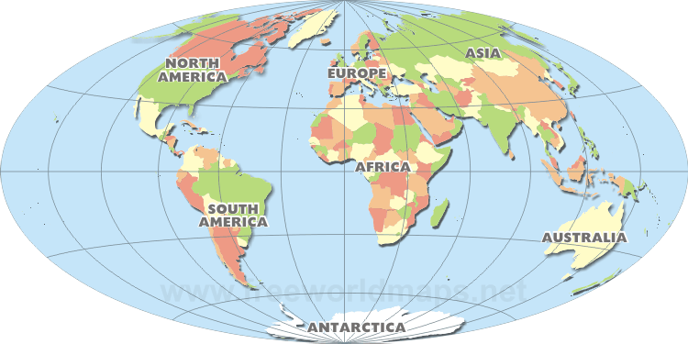
Contributi fondamentali all’attivitá di TAsP (last few years)
Chee Sheng Fong (Malaysia)
Martin Krauss (Germany)
Eduardo Peinado (Mexico)
Aurora Meroni (Italy)
Sofiane Boucenna (Algeria)
Diego Aristizabal (Colombia)
Penguin & Cangaroo

Slide 21
Collaborations
U. Liège - Belgium (D. Aristizabal Sierra)
U. Sao Paulo - Brasil (Chee Sheng Fong)
U. Roma 3 - Italy (D. Meloni)
SISSA – Trieste – Italy (S. Petkov, M. Spinrath, I. Girardi)
U. Colima - Mexico (A. Aranda)
Stony Brook - USA (M.C. Gonzalez-Garcia)
U. Wurzburg - Germany (S. Morisi, W. Winter, W. Porod)
U. Valencia - Spain (J.W.F. Valle, M. Hirsch)
U. Southampton - UK (S.F. King, P. Di Bari)
Orsay, LPT - France (A. Vicente)
Tata Institute - India (Ketan M. Patel)
U. Antioquia - Colombia (D. Restrepo, O. Zapata)
ICREA Barcelona - Spain (J. R. Espinosa)
U. Napoli - Italy (G. Ricciardi, F. Buccella)

Slide 22
Il gruppo teorico nei Laboratori
17 workshops/conferenze LNF nel 2014; 5 (co)organizzate dal TH-GR
New frontiers for Majorana fermions from condensed to dark matter - 5-6 May, 2014
(RM1,CNR-SPIN,NA)
LNF Spring School "Bruno Touschek” 12 - 16 May, 2014
Nanoscience & Nanotechnology 2014 6 - 7 October, 2014
Bruno Touschek Memorial Lectures 4 December, 2014
1st Rome Joint Workshop: “Rethinking Naturalness” 17-19 December, 2014
(RM1, RM3)
Inserzione Pubblicitaria:
Rome Joint Workshops: meetings brevi (3 gg) su argomenti particolarmente controversi.
2º RJW (tenuto il 6-8 May 2015): "Top mass: challenges in definition and determination"
Se avete suggerimenti/proposte per altri RJW sono benvenute (G. Corcella, EN)

Slide 23
Relazioni fra il TH-GR e gruppi LNF di altre CSN
CSN-4
GR-I
(Atlas,LHCb,Kloe,Padme)
Linea 1 (FT&CP)
Linea 2
(PhenoLNF)
GR-II
(Opera,Juno,Km3,Pamela)
Linea 3 Fisica Nucl.
GR-III
(ALICE)
Linea 4 Metodi mat.
Linea 5 (TAsP)
GR-V
(Next)
Linea 6 (SEMS)
GRAZIE PER L’ATTENZIONE

