Slide 1
L’esperimento PADME at LNF
Mauro Raggi – Laboratori Nazionali di Frascati
LNF preventivi
LNF, 1th July 2015
PADME website
http://www.lnf.infn.it/acceleratori/padme/
PADME Kick-off meeting
http://agenda.infn.it/event/padme-kickoff

Slide 2
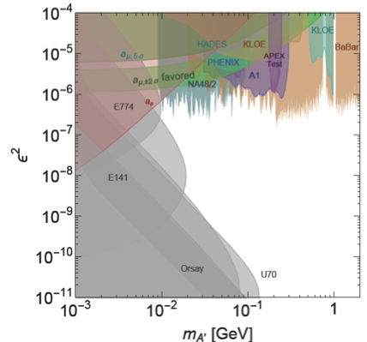
A’ visible searches status
Favored parameters values explaining (g-2)_{μ} (green band)
  A’-boson light: 10-100 MeV
Status of dark photon searches
  Beam dump experiments (grey):
    e⁺e⁻ appearance after a dump
  Fixed target:
    Peak search over QED backgrounds
  Mesons decays:
    Peaks in M(e⁺e⁻) or M(μ+μ−)
Indirect exclusion from g_{e}-2 and g_{μ}-2
  Recent tight limit in red filled area
arXiv:1411.1770v2
Many different techniques and assumptions on dark photon interaction models
  Kinetic mixing, decay to electrons, no dark sector particles
(g-2)_{μ} band recently excluded by NA48/2 measurement in meson decays

Slide 3

Dark photon searches in the world
A1 @ MAMI
WASA @ COSY
HADES @ GSI
Magix @ MESA
Minibone
@ Fermilab
VEPP-III
Cornell
Phenix @ RHIC
ATLAS, CMS @ LHC
ALICE @ LHC
P-348 @ SPS
SHIP @ SPS
NA48/2 @ SPS
Mu3e @ PSI
NA62 @ SPS
BaBar @ PEP-II
KLOE2 @ DAFNE
PADME @ BTF
JLAB: APEX
HPS, DarkLight
BDX
Belle @ KEKB
BelleII @ superKEKB
Legenda:
Publishing
Approved
Proposals

Slide 4
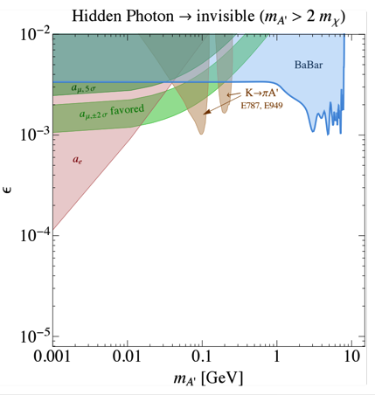
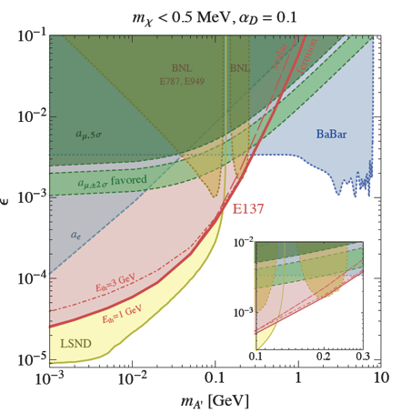
Status A’→χχ invisible decays
Babar ’08 ArXiv 0808.0017
Search for Invisible Decays of a Light Scalar in Radiative Transitions Υ_{3S}γA’
arXiv:1406.2698v1
arXiv:1309.5084v1
ε² and M_{A’}
  ε², M_{A’},M_{χ} and α_{D}
Two different techniques are used: direct A’ search, χ scattering searches
  Direct searches for A’ only depend on 2 parameters : ε² and M_{A’}
  χ scattering searches depend on 4 parameters: ε², M_{A’},M_{χ} and α_{D}
  Kaon indirect constraints are on the other hand model dependent

Slide 5
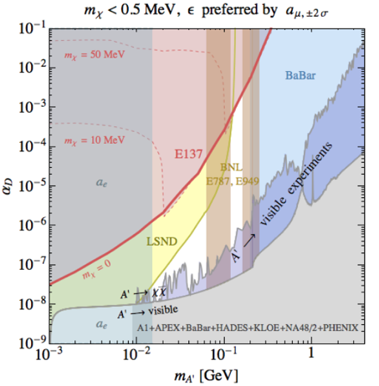
Combining visible and invisible
N.B. This kind of exclusion plot fixes ε with (g-2)_{μ} and shows α_{D} vs m_{A’}
PADME
arXiv:1406.2698v1
PADME can access the plot independently of α_{D} up to 20-30MeV
The exclusion by PADME is independent from the value of m_{χ} as well

Slide 6
The PADME approach
At present all experimental results rely on at least one of the following model-dependent assumptions:
  A’ decays to e⁺e⁻ (visible decays assumption) and thus BR(A’→e⁺e⁻) = 1
  A’ couples with the same strength to all fermions (ε_{q}= ε_{l}) (kinetic mixing)
In the most general scenario (PADME)
  A’ can decay to dark sector particles with m<M_{A’}/2, and BR(A’→e⁺e⁻ <<1)
    Dump and meson decay experiment only limit ε²BR(A’→e⁺e⁻ <<1)
  A’ can couple to quark with a coupling constant smaller ε_{l} or even 0
    Suppressed or no production at hadronic machines and in mesons decays
PADME aims at detecting A’ produced in e⁺e⁻ annihilation and decaying into any final state by searching for missing mass in e⁺e⁻→γA’, A’→χχ
  No assumption on the A’ decays products and coupling to quarks
  Only minimal assumption: A’ bosons couples to leptons
  PADME will limit the coupling of any new light particle produced in e⁺e⁻ collisions: scalars (H_{d}), vectors (A’ and Z_{d})

Slide 7
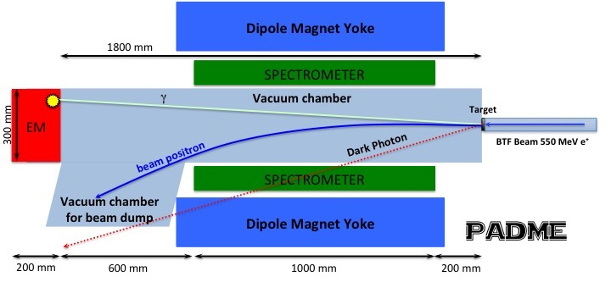
The PADME experiment
  Beam: 10³-10⁴ e⁺ on target per bunch, at 50 bunch/s (10¹³-10¹⁴ e⁺/year)
Detector components:
  Active target, thin: 50-100μm diamond (Time, Ne-, beam position and spot)
  Magnetic spectrometer/ scintillating veto ~1m length
  Conventional magnet, B≈0.6T but large gap for gaining acceptance
  Cylindrical crystal (BGO or LYSO) EM calorimeter R=15 cm (with 1x1x20 cm³ crystals)
    Measures: time, energy and direction of photons
Compute the M_{miss}² = (P⁴_{e-} + P⁴_{beam} - P⁴_{γ})²
  P⁴_{e-} =(0,0,0,m_{e}) and P⁴_{beam} =(0,0,550,sqrt(550² + m_{e}²))
1.75 m

Slide 8
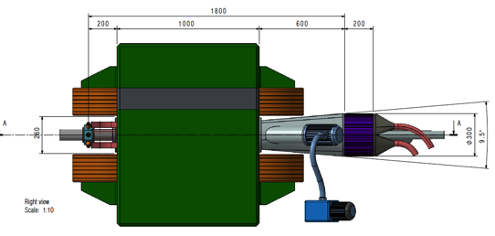
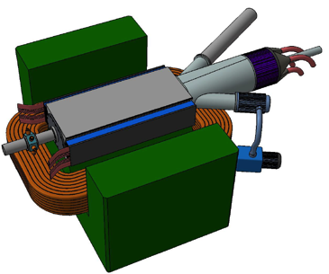
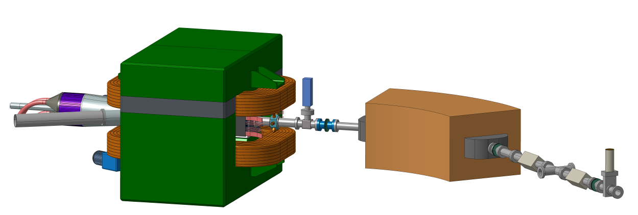
The PADME experiment
By C. Capoccia LNF SPAS

Slide 9
Main background sources
Geant4 simulation accounts for:
  Bremsstrahlung, 2 photon annihilation, Ionization processes, Bhabha and Moller scattering, and production ofδ-rays.
  Custom treatment of e⁺e⁻→γγ(γ) using CalcHep generator.
e⁻
A’
Signal: e⁺e⁻→γ +missing mass (A’)
γ
e⁺
Backgrounds
e⁻
e⁻
γ
γ
γ
γ
e⁺
e⁺
γ
γ
γ
e⁺
e⁺
+1 electron
+1 γ
+2 γ

Slide 10
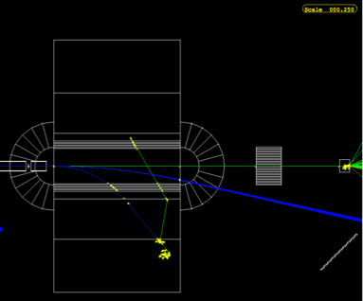
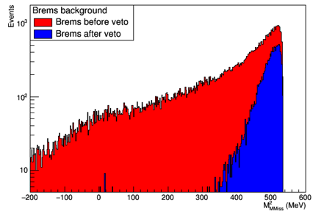
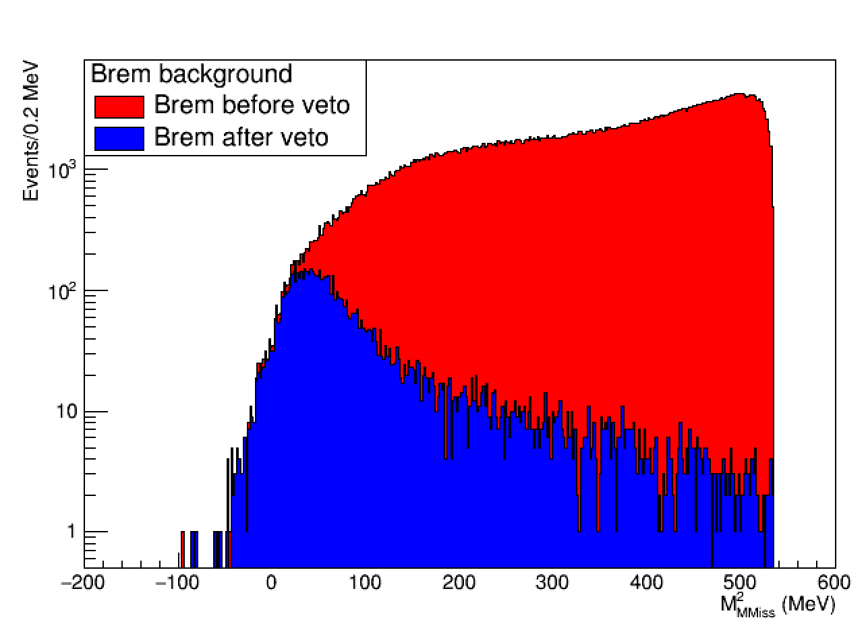
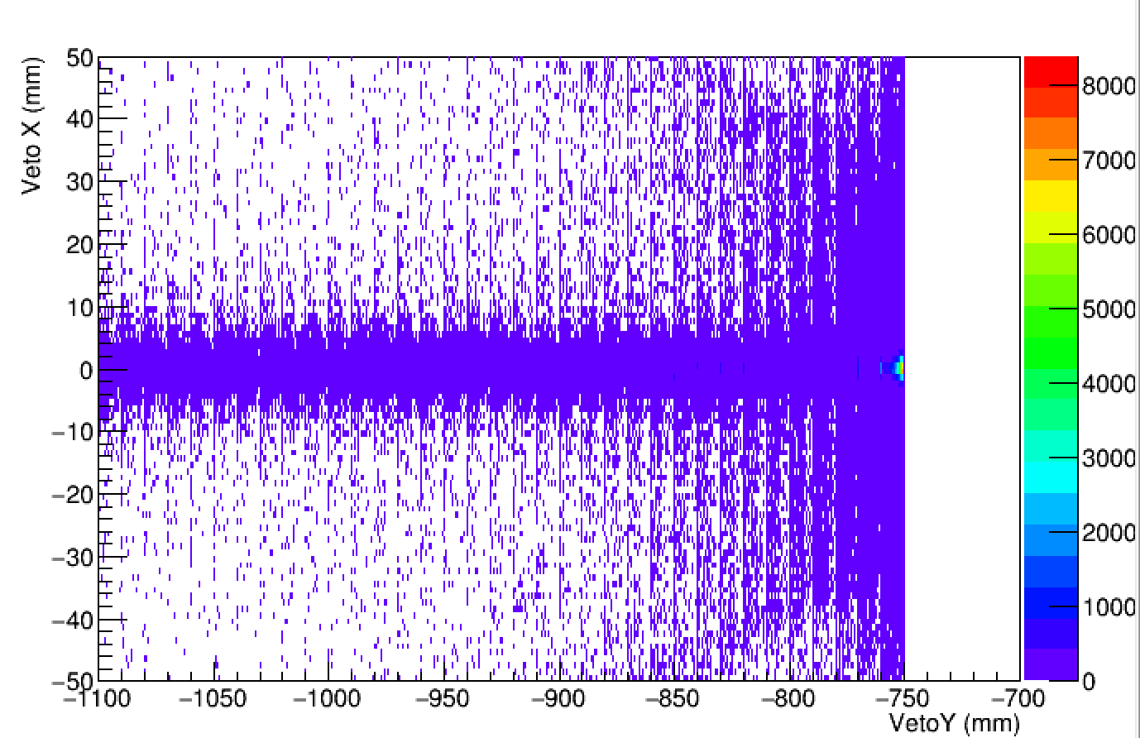
Main background studies
Bremsstrahlung BG
Present inefficiency is due e+ very close to the beam spot due to the emission of low energy photons.
Improving with an imaging veto?
3γ BG
3γ
3γ
3γ

Slide 11

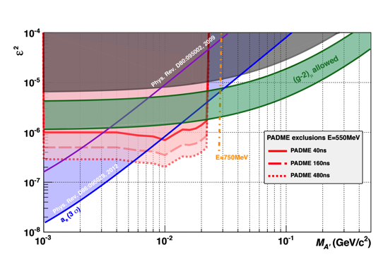

PADME invisible sensitivity estimate
Based on 2.5x10¹⁰ fully GEANT4 simulated 550MeV e⁺ on target events
Number of BG events is extrapolated to 1x10¹³ electrons on target
  Using N(A’γ)=σ(N_{BG})
  δ enhancement factor δ(M_{A’}) = σ(A’γ)/σ(γγ) with ε=1
PADME invisible decays exclusion

Slide 12
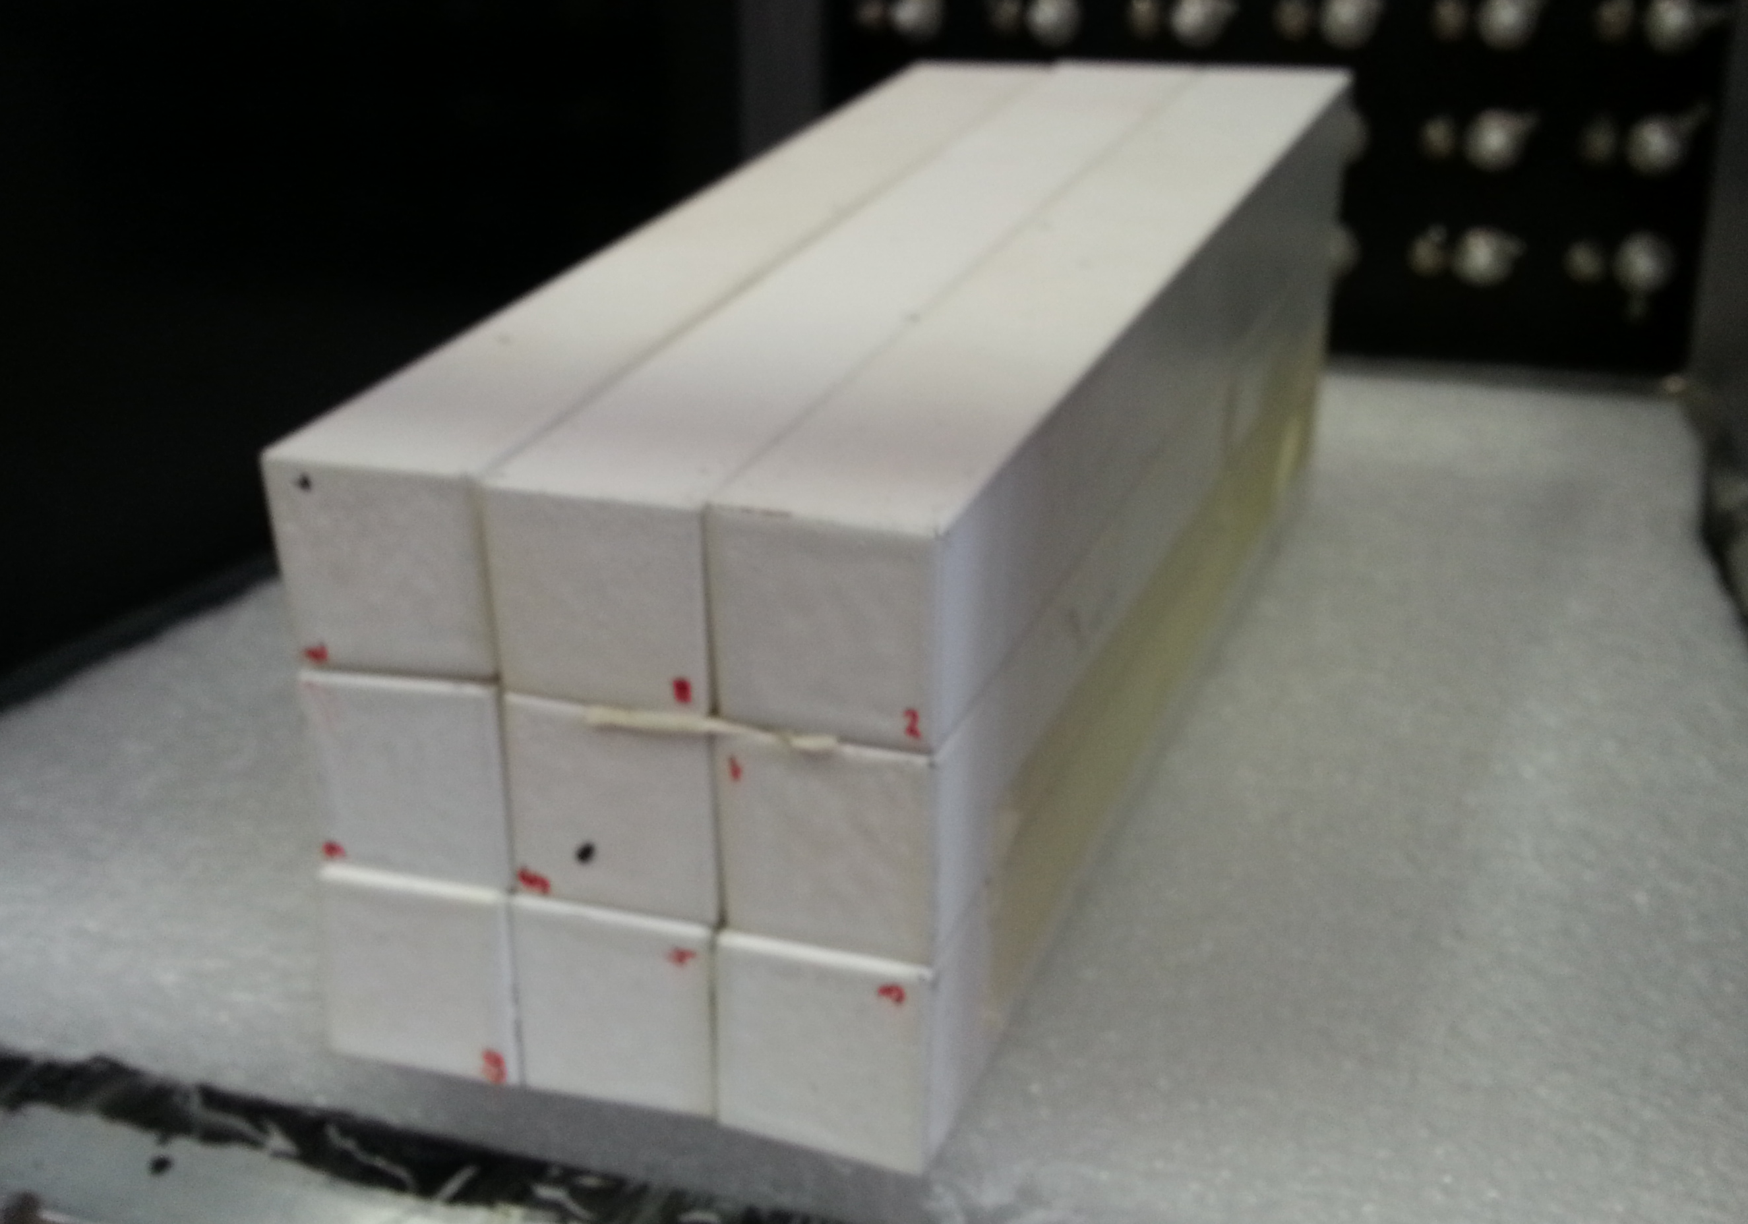
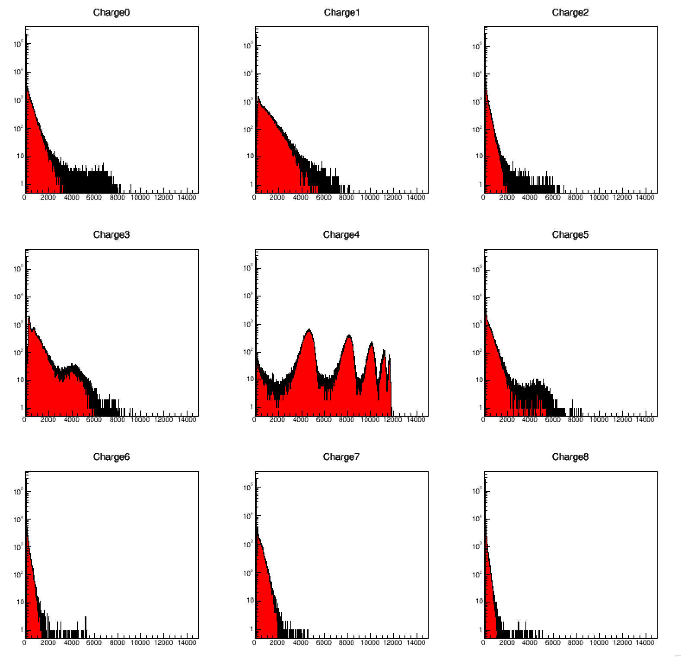
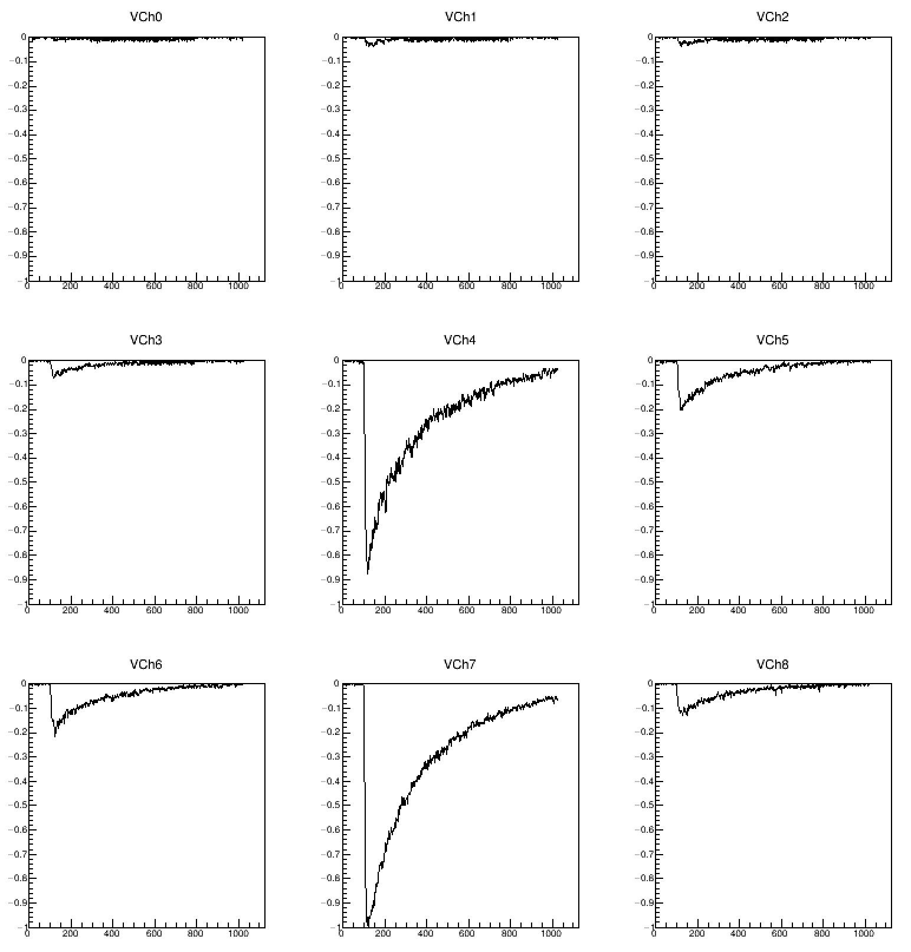
PADME ecal L3 BGO matrix test
3×3 matrix, 2.2×2.2x23 cm³ L3 BGO crystals
readout by Hamamatsu 1” photomultipliers + CAEN V1742 digitizer

Slide 13
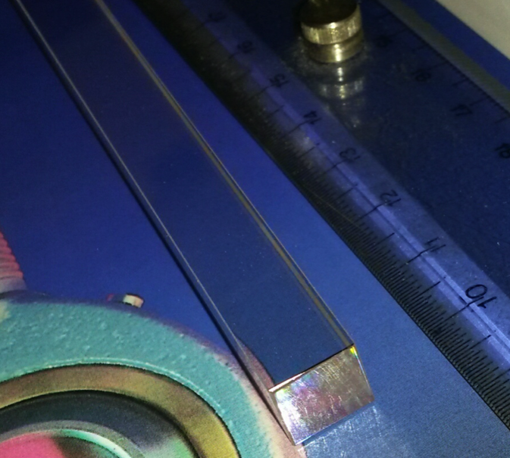
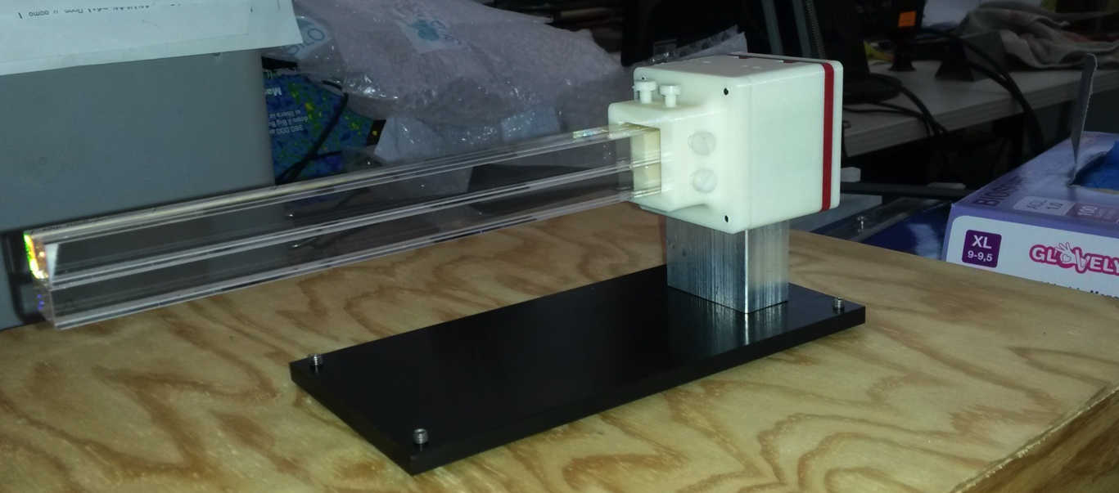
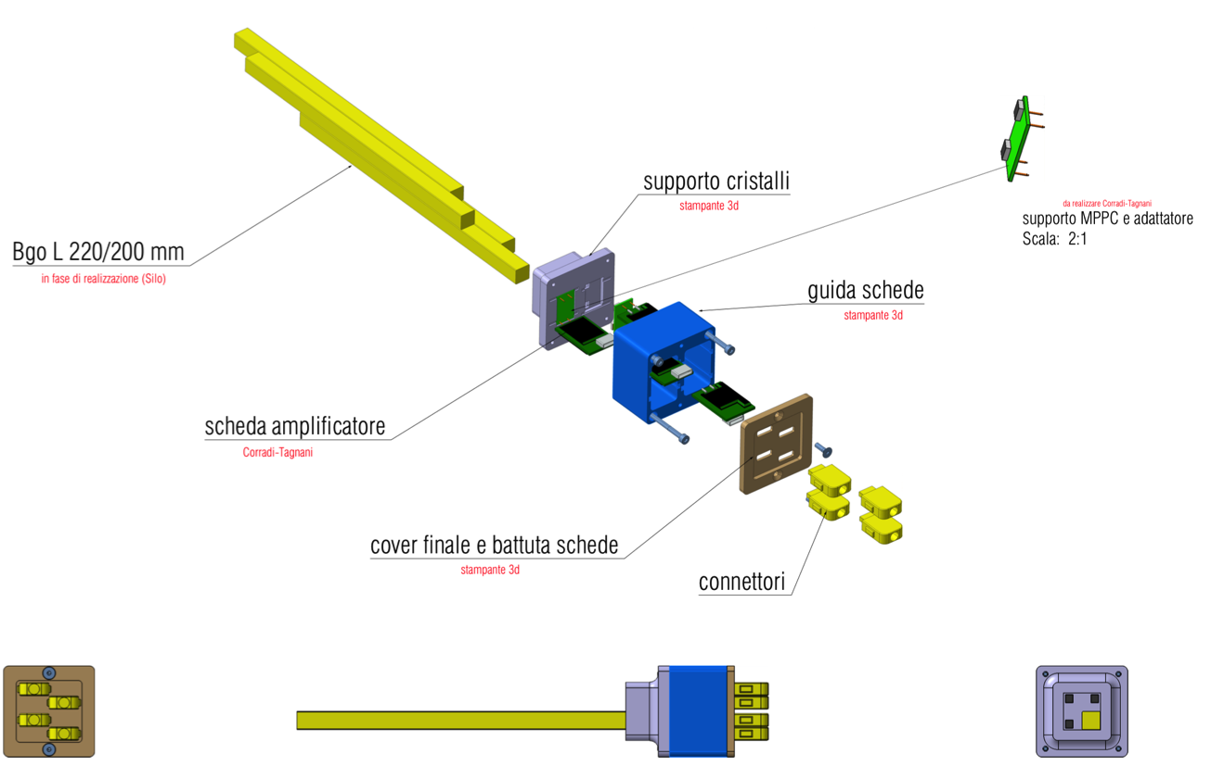
Ecal taglio dei cristalli
240 Euro+IVA per lavorazione
(1 cristallo L3 → 4 cristalli PADME)
Grazie al coordinatore di Roma1
  3 cristalli di BGO di L3 sono stati tagliati (in 4 pezzi 1×1 cm²)
  e lucidati
  Dei 12 cristalli uno è stato danneggiato in fase di lucidatura delle superfici laterali

Slide 14
PADME anagrafica
Personale di ricerca
INFN Lecce
G. Chiodini (Gr. 1) 30%
INFN Lecce and Università Salento
Caricato (Gr. 5) 20%
M. Martino (Professore, Gr. 5) 20%
M. De Feudis (Dott. Gr. 5) 100%
S. Spagnolo (Gr. 1) 20%
CNR-NANO and Università Salento
G. Maruccio (Professore, Gr. 5) 20%
A. Monteduro (Dott. Gr. 5) 20%
INFN LNF (Divisione Ricerca)
M. Raggi 30%
R. Bedogni 10%
F. Bossi 20%
R. De Sangro 20%
G. Finocchiaro 20%
M. Palutan 20%
G. Piperno (A.d.R.) 100%
T. Spadaro 20%
B. Sciascia 10%
V. Kozhuharov (Università Sofia) 50%
G. Georgiev (Università Sofia) 50%
INFN LNF (Divisione Acceleratori)
B. Buonomo (20%)
L. Foggetta (20%)
A. Ghigo (10%)
INFN Roma
P. Valente 50%
S. Fiore (ENEA) 20%
F. Ferrarotto 60%
E. Leonardi 40%
Università Sapienza
G. Organtini (Professore) 30%
INFN Padova
U. Dosselli 20%
2.3 FTE (7 ricercatori)
4.0 FTE (14 ricercatori)
2.0 FTE (5 ricercatori)
Supporto tecnico
INFN Lecce
G. Fiore (Tecnico e progettista) 30%
INFN Lecce and Università Salento
M. Corrado (Tecnico) 20%
C. Pinto (Tecnico elettronico ) 20%
INFN Frascati (SPAS)
C. Capoccia (Progettista meccanico) 20%
E. Capitolo (Progettista meccanico) 20%
INFN frascati (SELF)
G. Corradi (Progettista Elettronico) 20%
INFN Frascati Servizio Vuoto
V. Lollo

Slide 15
Richieste 2015 CSN1
 | Missioni | Trasporti | Apparati
LNF | 1.5 K€ | 3K€ | 15 K€
Lecce | 2.5 K€ |  | 2 K€ | 1Keuro PCB + 1Keuro consumi
RM1 | 1.0 K€ |  | 5 K€ | Fotosensori Ecal (APD)
Totale | 5.0 K€ |  | 25 K€
I soldi di apparati saranno usati per le seguenti operazioni
LNF 2015: meccanica prototipo ECAL + taglio cristalli + elettronica di Front-end prototipi

Slide 16
Piano finanziario 2015-2017
PADME-invisible | 2015 | 2016 | 2017 | 2018 | Totale
Magnete positron veto | 3 | 20 30 | 20 30 |  | 43 60
Diamond target | 2 | 70 | 30 |  | 102
Front charged veto |  | 50 | 100 |  | 150
Calorimetro BGO/LYSO APD+FEE DAQ | 15 5 | 135/520 90 | 120 280 |  | 150/520 215 280
Small Angle Veto |  | 20 | 30 |  | 50
Large Angle Veto |  | 20 | 80 |  | 100
Vuoto+servizi |  |  | 50 |  | 50
Computing and storage |  |  | 60 | 20 | 80
Totale | 25 | 435/820 | 800 | 20 | 1280/1665
Uncertainties 20% better cost estimate in the Technical proposal ;
Tracking spectrometer not included
Detailed breakdown of some of this costs in PADME kickoff meeting
http://agenda.infn.it/event/padme-kickoff

Slide 17
Richieste per sezione
2015 | Missioni | Trasporti | Apparati
LNF | 1.5 K€ | 3K€ | 15 K€
Lecce | 2.5 K€ |  | 2 K€ | 1Keuro PCB + 1Keuro consumi
RM1 | 1 K€ |  | 5 K€ | Fotosensori Ecal (APD)
Totale | 5 K€ |  | 25 K€
2016 | Missioni | Consumo | Apparati
LNF | 16 K€ | 4 K€ | 235 K€ | Cristalli calorimetro + meccanica 135 K€ Magnete (cavi, servizi) 20 K€ Imaging front veto 50 K€ Positron veto (magnete) 30 K€
Lecce | 8 K€ | 2 K€ | 70 K€ | Diamond target + FEE
RM1 | 8 K€ | 2 K€ | 130 K€ | Fotosensori calorimetro (APD) + FEE 90 K€ Small angle veto (BaF₂) 20 K€ Large angle veto (Scint.) 20 K€
Totale | 32 K€ | 8 K€ | 435 K€

Slide 18
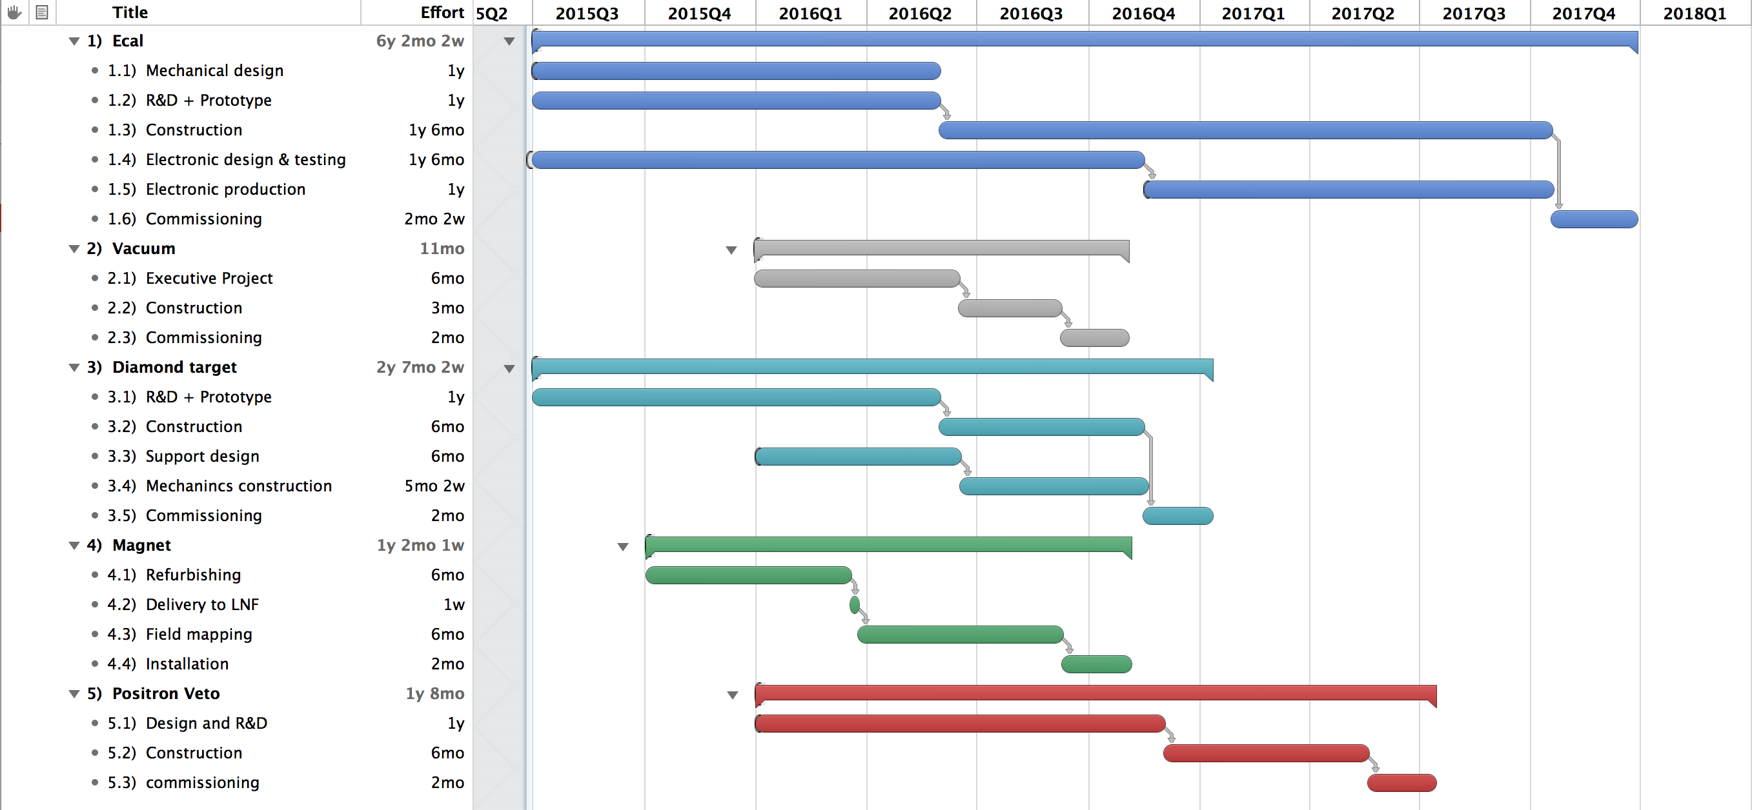
Possibile schedula per PADME
La schedula prevede che la CSN1 fornisca il profilo di spesa proposto nella slide precedente.
Tutte le attività che richiedono impegno finanziario sostanziale schedulate dopo la metà del 2016

Slide 19
Richieste ai servizi LNF
SPAS
  Capoccia (20% 2015; 40% 2016): coordinamento progettazione del general layout dell’esperimento
  Capitolo (30% 2015; 60% 2016): Progettazione e realizzazione meccanica prototipi ECAL
SELF (G. Corradi):
  2015 (20%): Progettazione e realizzazione prototipi elettronica FE ECAL.
  2016 (40%): Produzione e test dell’elettronica di readout di ECAL.
Servizio vuoto:
  2016 (20% FTE): Collaborazione alla progettazione e realizzazione della camera da vuoto di PADME
Servizio misure magnetiche:
  2016(20% FTE 2015): Caratterizzazione del magnete di PADME
Servizio LINAC: (50% FTE) Impulso allungato, microbeam, target sottile
Servizio Calcolo:
  2015: Connessione in fibra per la sala BTF e nuova sala controllo BTF
  2016: Realizzazione dell’infrastruttura di calcolo per PADME

Slide 20
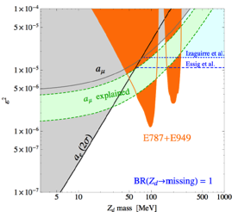
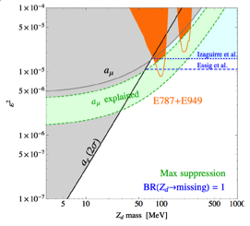
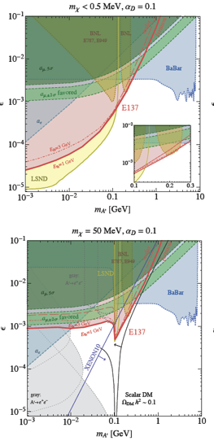

Invisible A’ model dependence
Exclusion with Kaons
Scattering exclusion
In models assuming that the dark photon couples to SM through kinetic mixing ε_{q}≠0
K±→π±νν can be used to constrain K±→π±A’
Z_{d}=A’
Depending on how the model is built the limit can change significantly for example allowing the mass mixing with SM Z.
PhysRevD.89.095006

Slide 21
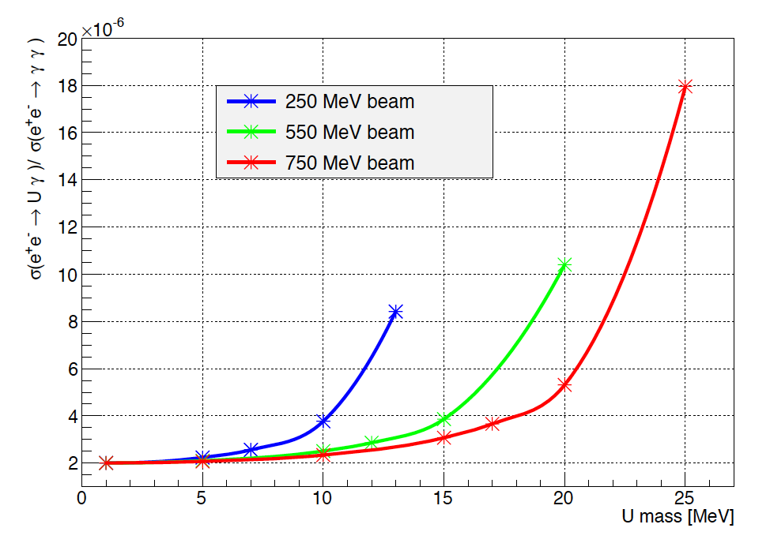
Cross section enhancement

Slide 22
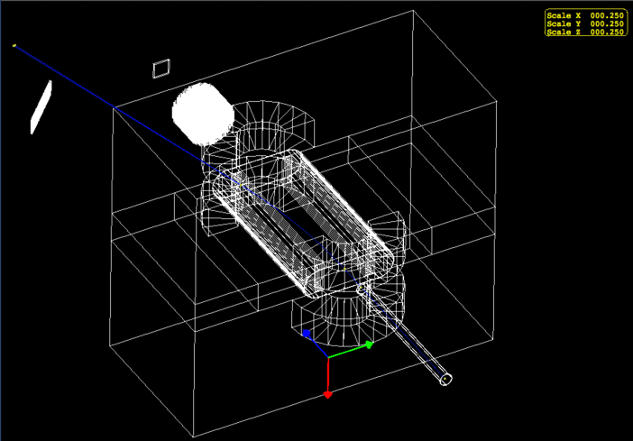
PADME Geant4 simulation

Slide 23
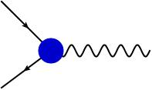



The simplest dark sector model
The simplest hidden sector model just introduces one extra U(1) gauge symmetry and a corresponding gauge boson: the “dark photon" or U boson.
  Two type of interactions with SM particles should be considered
As in QED, this will generate new interactions of the type:
  Not all the SM particles need to be charged under this new symmetry
  In the most general case q_{f} is different in between leptons and quarks and can even be 0 for quarks. [P. Fayet, Phys. Lett. B 675, 267 (2009).]
The coupling constant and the charges can be generated effectively through the kinetic mixing between the QED and the new U(1) gauge bosons
  In this case q_{f} is just proportional to electric charge and it is equal for both quarks and leptons.
e⁻
A’
e⁺
γ
A’

Slide 24
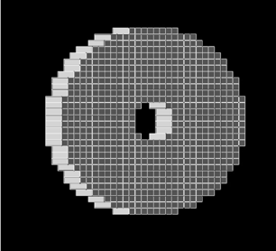
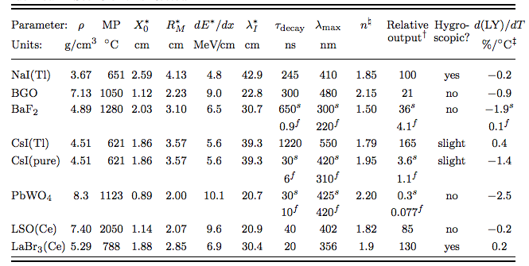
The electromagnetic calorimeter
30 cm
Cylindrical shape: radius 150 mm, depth of 200 mm
  Inner hole 4 cm radius
  Active volume 13120 cm³, total of 656 crystals,10x10x200 mm³
Material LSO(Ce): high LY, high ρ, small X₀ and R_{M}, short τ_{decay}
Material BGO: high LY, high ρ, small X₀ and R_{M}, long τ_{decay}, (Available for free from the L3 dismounted ECAL)
Expected performance:
  σ(E)/E =1.1%/√E ⨁ 0.4%/E ⨁1.2% SuperB calorimeter test at BTF [NIM A 718 (2013) 107–109]
  σ(θ) = 3 mm/1.75 m < 2 mrad
  Angular acceptance 1.5-5 degrees

Slide 25
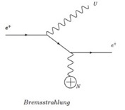
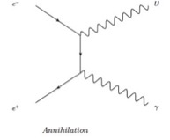
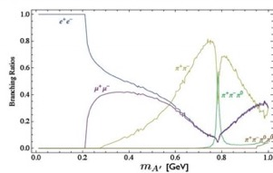
A’ production and decays
A’ boson can be produced in e⁺ collision on target by:
  Bremsstrahlung: e⁺N →e⁺NA’
  Annihilation: e⁺e⁻→ γA’
  Meson decays
If no dark matter candidate lighter than the A’ boson exists:
  A’→e⁺e⁻, μ⁺μ⁻, π⁺π⁻.
  These are the so called “visible” decays
  For M_{A’}<210 MeV A’ only decays to e⁺e⁻ with BR(e+e-)=1
If any dark matter particle χ with 2M_{χ}<M_{A’} exists
  A’ will dominantly decay into pure DM
  and BR(l+l-) becomes small ~ ε²
  A'→χχ ~ 1. These are the so called decays to “invisible” particles
Bremsstrahlung
Annihilation
Meson decays
Decays to “visibles”

Slide 26
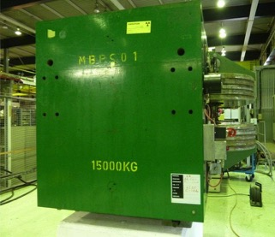
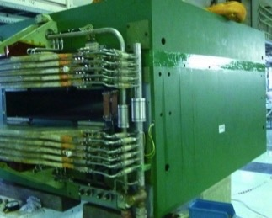
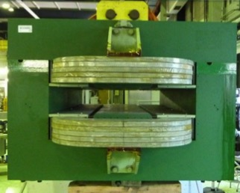
A possible analyzing magnet for PADME
116 cm
11 to 20 cm gap
52 cm
Available at CERN magnet division

