Slide 1

ELI Nuclear Physics (Romania)
Laser-Induced Photonuclear Physics
nuclear physics methods to study laser-target interactions, new nuclear spectroscopy, new photonuclear physics

Slide 2
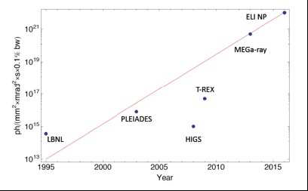
ELI-NP γ beam: the quest for higher flux and narrow bandwidths

Slide 3

GBS – Beam Specifications
Energy [MeV] | 0.2 – 19.5
Spectral Density [ph/s∙eV] | 0.8 – 4∙10⁴
Bandwidth rms [%] | ≤ 0.5
# photons/pulse within FWHM bdw. | ≤ 2.6∙10⁵
# photons/s within FWHM bdw. | ≤ 8.3∙10⁸
Source rms size [μm] | 10 – 30
Source rms divergence [μrad] | 25 – 200
Peak brilliance [N_{ph}/s∙mm²∙mrad²∙0.1%] | 10²⁰ – 10²³
Radiation pulse length rms [ps] | 0.7 – 1.5
Linear polarization [%] | > 99
Macro repetition rate [Hz] | 100
# pulses per macropulse | 32
Pulse–to–pulse separation [ns] | 16
Polarization axis wiggling [deg] | < 1
Synchronization to an external clock [ps] | ≤ 0.5
Source position transverse jitter [μm] | < 5
Energy jitter pulse–to–pulse [%] | < 0.2
# photons jitter pulse–to–pulse [%] | ≤ 3

Slide 4
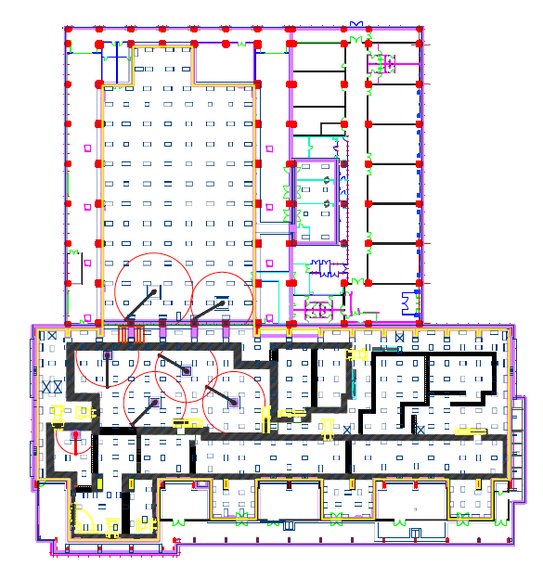
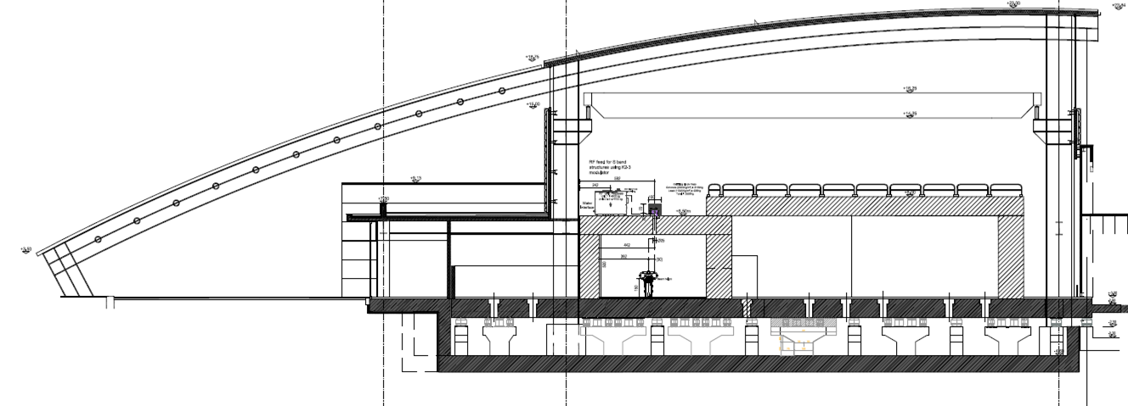
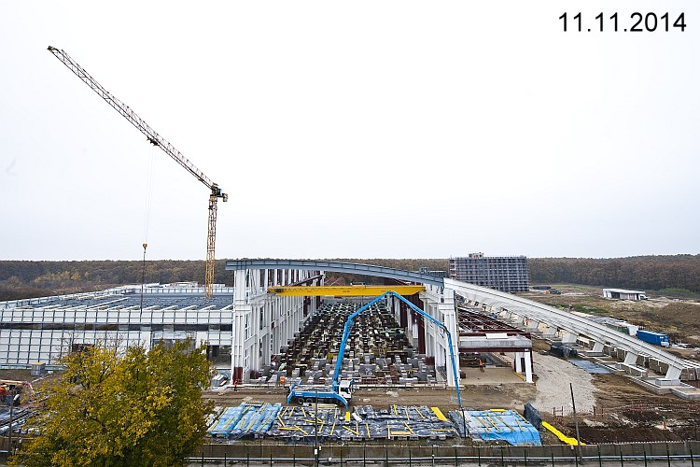
ELI–NP Building Structure
A – A
40 t crane
RF modulators
technical
rooms
HPLS
Support Laboratories
laser
experiments
anti–vibration
platform
A
anti–vibration
mounts
accelerator
bays
basement
GBS
A
ELI –NP Main Experimental Building
~ 15,000 m²

Slide 5
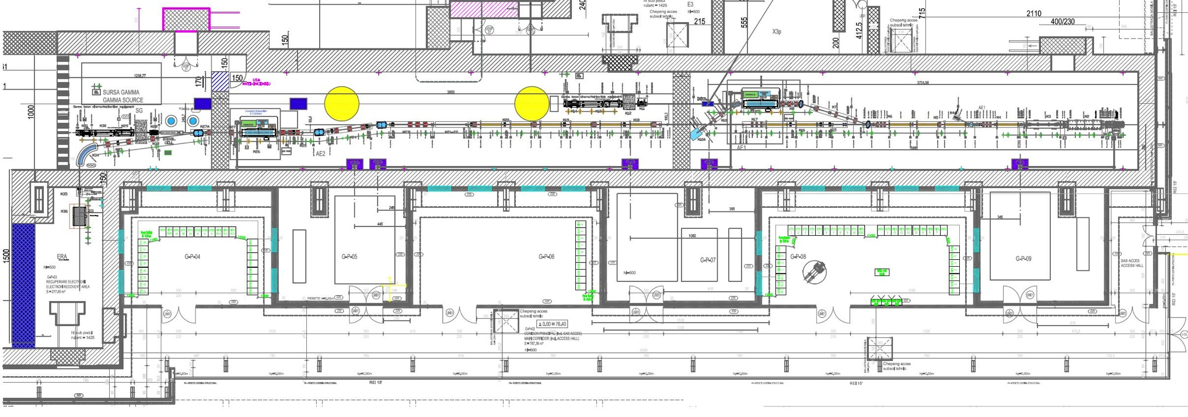
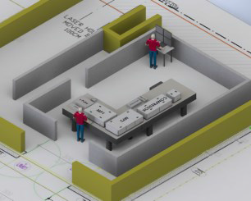
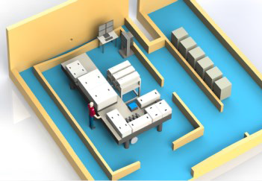
Gamma Beam System – Layout
e– beam
dump
Interaction Point
High Energy
e– beam
dump
Interaction Point
Low Energy
Photogun
multibunch
beam
coll&diag
beam
coll&diag
e– beam
dump
Racks
Room
Control
Room
Racks
Room
Interaction Laser
High Energy
e– RF LINAC
High Energy
720 MeV
Interaction Laser
Low Energy
e– RF LINAC
Low Energy
300 MeV
Photo–drive Laser
e– source
Master clock synchronization @ < 0.5 ps

Slide 6
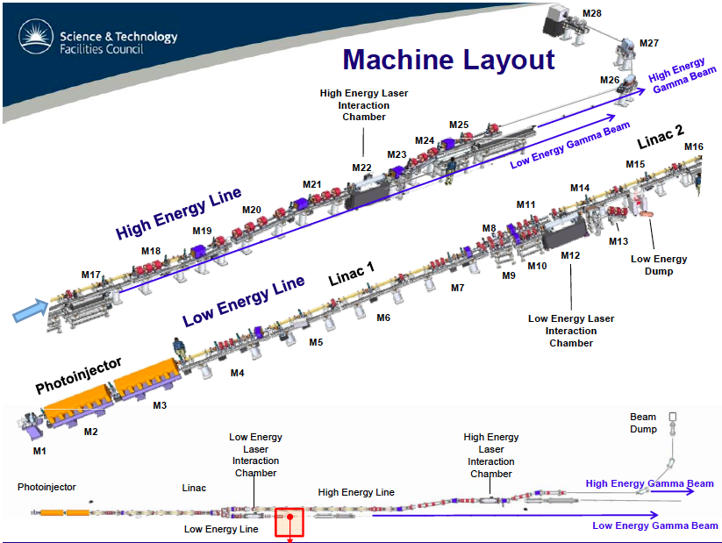

Slide 7
Technical solution: the dragon shape circulator
2 parabolic reflectors M1 & M2
M1 fixed
M2: 5 degrees of freedom
M0: 2 tilts for injection
Mirror-pair system
For interaction plane switch
Rotation for synchronization
➔Alignment issues

Slide 8
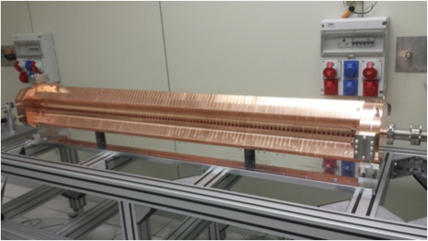
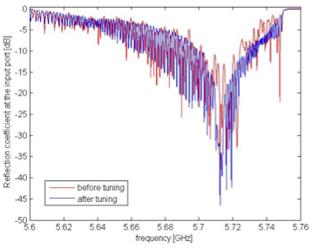
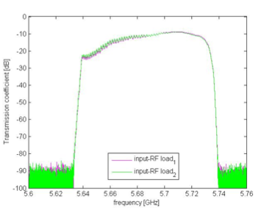
D.Alesini, COMEB
V. Lollo, R. Di Raddo, P. Chimenti, M.Magi, F. Pellegrino,
A. Mostacci, L. Ficcadenti, L.Piersanti, F. Cardelli

Slide 9

2015 has started in a very positive way
FAT Scandinova Modulator C and S band OK (50 MW 100Hz).
1st C-Band prototype successfully tuned and tested at high power
FAT Photocathode laser ok, IP misses only the main amplifier
Magnets produced
LLRF gun ok, Aluminum prototype
Diagnostics in production
Almost all IOC ready and tested
………….

Slide 10
EuroGammaS Organisational Breakdown Structure (OBS)
Hierarchical management structure, communication routes and reporting links
Governing Board
Institute Partner Members
Industrial Partner Members
Project Coordinator, Machine Leader, Q&C Manager
IFIN-HH
Project Coordinator
Luigi Palumbo
Project Office
Technical TEAM
Finance Manager
(tba)
Q&C Manager
(Antonio Napolitano)
Machine Leader
(Alessandro Variola) INFN
Scientific Coordinator
(Luca Serafini)
Legal Advisors
(from Consortium)
Deputy (Optics)
(Fabian Zomer) CNRS
Deputy (Linac)
(David Alesini) INFN
Training Manager
(tba)
Safety Coordinator
(tba)
Deputy (Integration)
(Antonio Falone) INFN
Work Packages
WP 01a
Accelerator Physics
(Cristina Vaccarezza)
INFN Frascati
WP 01b
Source
Physics
(Vittoria Petrillo)
INFN Milan
WP 02
Optics
(Kevin Cassou)
CNRS
WP 03
Accelerating Structures
(David Alesini)
INFN Frascati
WP 04a
High Power RF & Distribution
(Roberto Boni)
INFN Frascati
WP 04b
LLRF & syncrhonisation
(Alessandro Gallo)
INFN Frascati
WP 05
STFC Modules, Magnets & Vacuum
(Neil Bliss)
STFC Daresbury
WP 06
INFN Modules
(Sandro Tomassini)
INFN Frascati
WP 07
Diagnostics
(Andrea Mostacci)
INFN Frascati
WP 02A
Lasers
(Franck Falcoz)
Amplitude
WP 02B
Interaction chambers
(Herve Rocipon)
Alsyom
WP 08
Control System
(Giampiero
Di Pirro)
INFN Frascati
WP 09
Gamma Systems
(M. Gambaccini)
INFN Ferrara
WP 10
Radioprotection
(Adolfo Esposito)
INFN Frascati
WP 11a
CAD/3D integration layout
(V. Pettinacci) INFN
WP 11c
Electrical Power
(Ruggero Ricci) INFN
WP 11d
Cooling & Air
(Ugo Rotundo)
INFN

Slide 11
LNF Impact
We are the main contractor, so we are responsible for the final result
All the different phases are assured by partners or subcontractors. We are in charge of the following up.
We are in charge only of integration in house of module 1,2,3 and of the radioprotection systems (dumps). Diagnostics is dimensioned by LNF.
We are in charge of the overall integration and of the supervision of all the contracts
We are in charge of the commissioning
We are unfortunately in charge of all what is missing….
Wp Leaders
Technicians and engineers for the integration and installation phase
Physicist and engineers for the commissioning phase

Slide 12
Conclusions
- Extremely challenge project. State of the art
- INFN deeply involved. Responsabilities
- Tight planning (delay?)
- Needs a strong participation form INFN and LNF
- Opening of opportunities for NP fundamental physics activity

