Slide 1
CERCA
Collective Effects Reduction in Circular Accelerators
INFN has a longstanding tradition and a series of well developed competences on issues related to various aspects of the ongoing global effort in accelerator technology aiming to the reduction of collective effects in circular Accelerators.
As single units, LNF, Na, Sa and Rome1 are collaborating with CERN and in international contests on issues aiming to optimize the performance of most of the existing and future circular colliders:
HiLumi LHC, which is the major funded upgrade to increase LHC luminosity by a factor of 10 beyond its design value. The project is co-funded by the EU and implies significant upgrades not only for LHC but for all the machines in the injection chain (LINAC, Booster, PS and SPS).
FCC (Future Circular Collider): INFN and Roma1 are also participating to the global effort (lead by CERN) to study a post-LHC particle accelerator in a worldwide context. The project is co-funded by the EU and it is exploring the potential of hadron and lepton circular colliders, considering the technology R&D programs that would be required to build them.
Motivations:
The goal of this call is:
Put together most of the competences available at INFN to fully qualify materials to be compliant to operational parameters of such future accelerators.
Create an INFN network able to completely perform such theoretical and experimental studies.
Strengthen and increase visibility to our facility in view of further international collaborations.

Slide 2
… and follows NS committee V recommendations:
Last Referee report of IMCA (Innovative Material and Coatings for Accelerators)
(October 2014) By: E. Fagotti (LNL). R. Musenich (Ge) e W. Scandale (LAL).
The experiment IMCA is starting its last year of activity, but it is clear (and also desirable) that such “historically” consolidated research will not stop at the end of 2015. The laboratories (in particular that one at LNF) has grown over the years thanks to the strong contributions of CSN5 and has become an important reference for the study of the interaction between the accelerated particle beams and material surfaces.
The work carried out is certainly important and well-led, of international level, in all its lines of activities. Publications give answers considered relevant by the community of accelerators physicist but also of interest in a much wider context.
In this regard, a more profound discussion should be undertaken to clarify the extent and form of future internal or external contributions (CSN5, MAC and / or other) to implement / maintain such high standard facilities at INFN.

Slide 3
CERCA: the Beam screen for
HL-LHC & FCC-hh

Slide 4
CERCA: the Beam screen Functional map
Function
Process
Study
Who
Reduce Beam-induced
Cryogenic loads
Limit residual Heat load to cold mass
Material properties
LNF
Sa
LNF
Na
RM1
Sa
LNF
LNF
All
Increase rise time of transverse resistive-wall instability
Intercept / fully reflect Synchrotron Radiation
Reflectivity @ SR facility
Limit wall Impedance
Resistive wall and coupling impedance
Resist eddy-current forces at magnet quench
Structural material with high resistivity and high adhesion
Material study under varying B
Preserve field quality in magnet aperture
(cold) Surface chemical composition during el. Ph. and Ion bombardment
Low permeability materials
Maintain good beam vacuum
Pumping from shielded cold surface
PY and SEY at realistic geometries and conditions
Limit development of electron cloud
Limit R, PY and SEY of beam exposed surface
Simulations

Slide 5
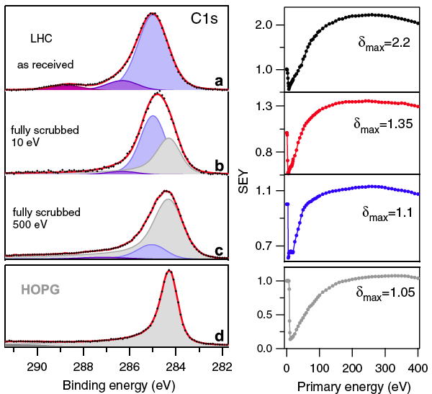
With IMCA the collaboration developed:
We developed a state of the art Surface and material science laboratory.
We measure and feed material parameters (R, PY, and SEY) into simulations.
Understand their profound nature to:
Optimize chemical (mechanical) process to reduce their detrimental influence on beam.
Search for new material / coatings with intrinsically “good” parameters.
XPS
SEY
SR Reflectivity and PY (@BESSY-II)
CERCA @ LNF:

Slide 6
IMCA results:
Measurement and evaluation of the longitudinal coupling impedance of the PS
Measurement and evaluation of the transverse coupling impedance

Slide 7
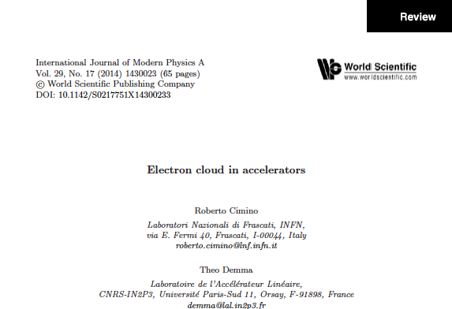
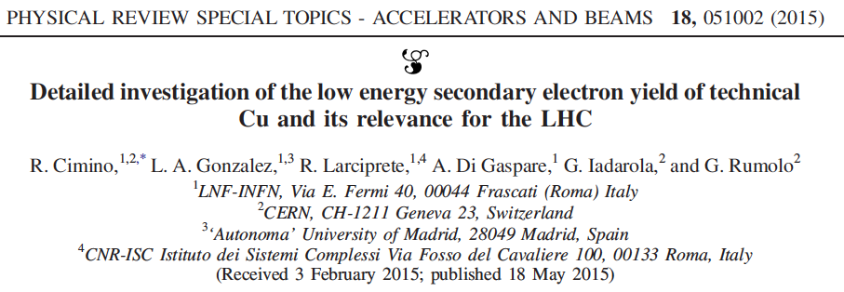
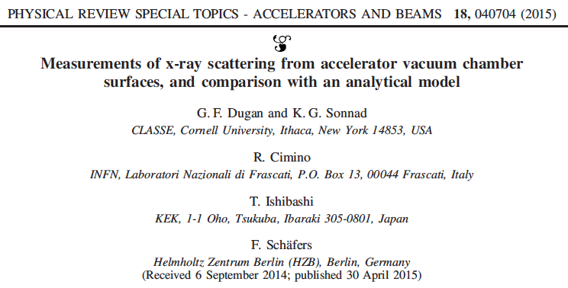
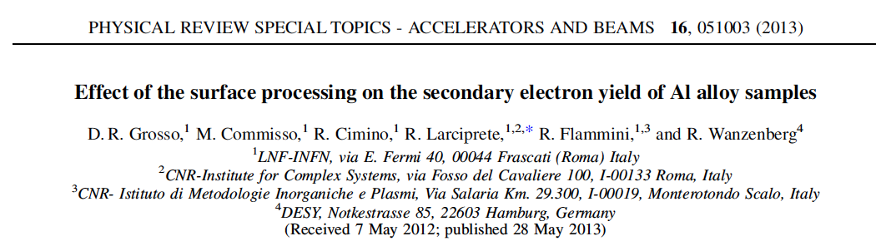
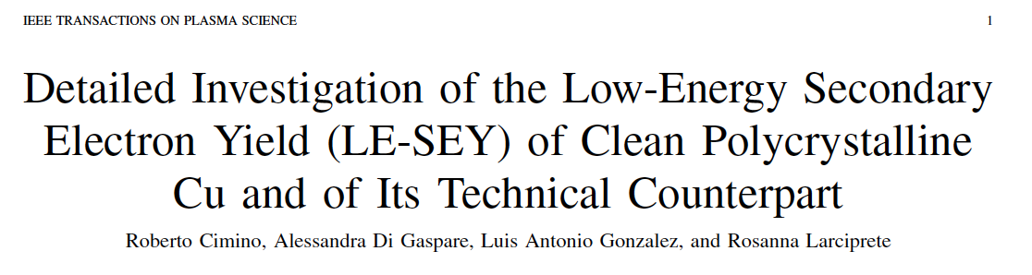
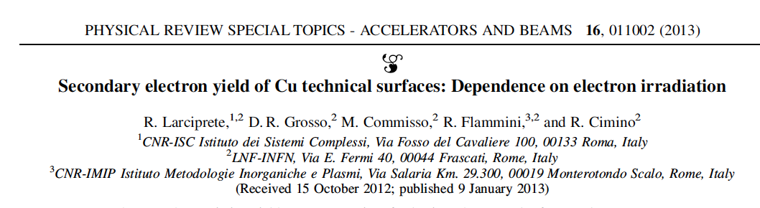
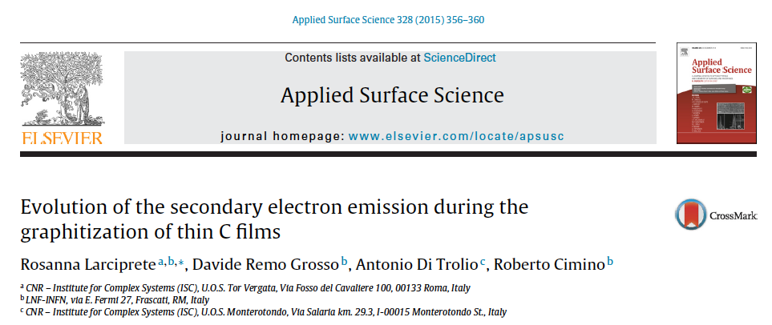
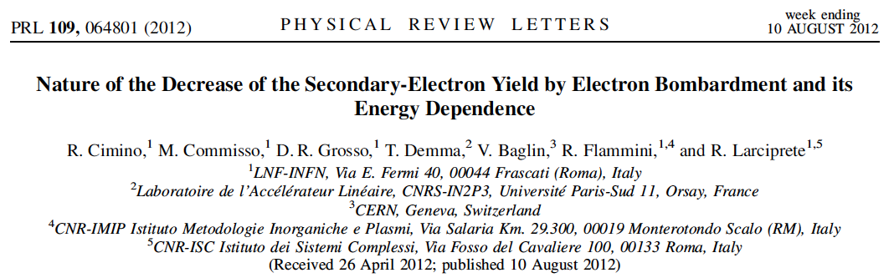
IMCA production (1)

Slide 8
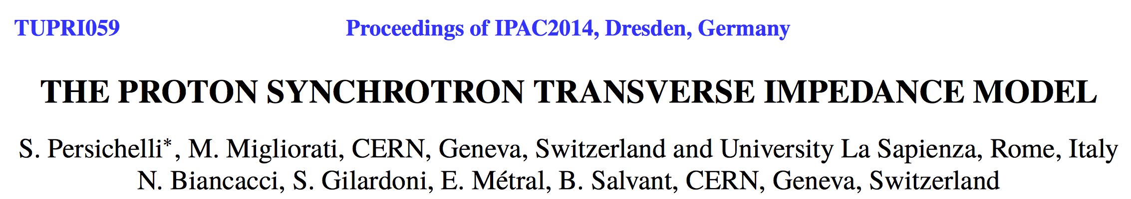
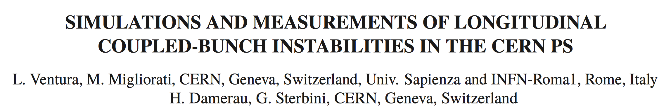
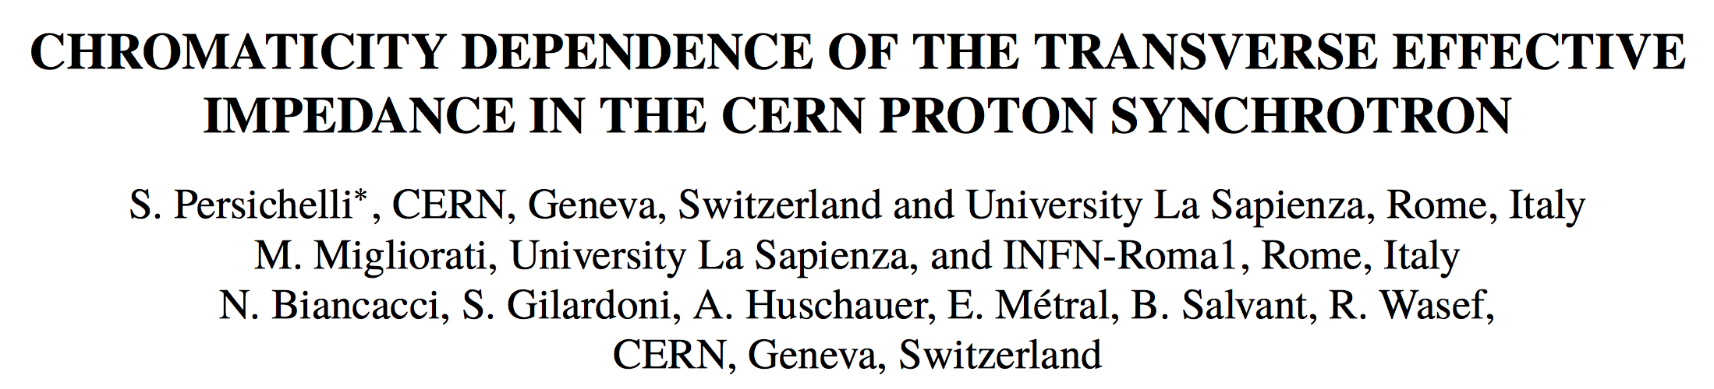
IMCA production (2)
Proc. of IPAC2015:

Slide 9
CERCA – Groups and people (under construction…)
LNF: R. Cimino (national and local responsible), M. Biagini, A. Drago, S. Guiducci, R. Larciprete, A. Di Trolio, A. Variola … - (total of about 3 FTE). Main activity: study, measurements and characterization of materials under vacuum, with particular regard to surface properties like surface chemistry, Secondary Electron Yield (SEY), Photoemission, Photoelectron Yield (PY), photon Reflectivity (R) in realistic conditions and under electron, photon and ion bombardment.
Roma1: M. Migliorati (local responsible), A. Mostacci, L. Palumbo, G. Favia, L. Ventura - (total of about 3 FTE). Main activity: Study, simulations and bench measurements of coupling impedances. Beam measurements at CERN. Study of collective effects and instabilities.
Napoli: M. R. Masullo (local responsible), … - (total of about X FTE). Main activity: Coupling impedance measurements with wire and antenna method and (with Sa) at LT and in presence of magnetic field.
Salerno: U. Gambardella (local responsible), G. Iannone, S. Pagano, A. Saggese, ….. - (total of about 2 FTE), Main activity: setting up a system to study materials and superconducting coatings. The presence of magnetic varying magnetic field B will be also considered.

Slide 10
CERCA – Single units:
LNF, Rome , Salerno, Napoli
Status
Goals
Foreseen activity 2016

Slide 11
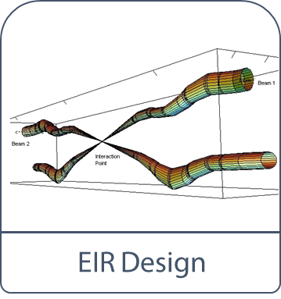
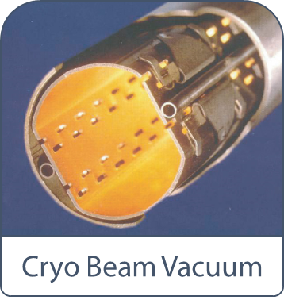
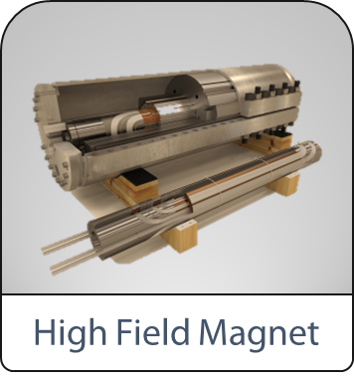
CERCA @ LNF: Status and international collaborations
With IMCA and previous SNCV activities: recognized international visibility
EuroCirCol: Coordinated by CERN. More than 400k€ to INFN (Ge–LNF–Mi)
Different tasks:
machine-detector interface vacuum magnets
}
@ LNF in WP4: 208 k€ for “Study vacuum stability at Cryogenic temperature” in WP4. (no hardware!)

Slide 12
FYI: we also bought
… a lottery ticket!
ERC Advanced Grant 2015 by R. Cimino
(Submitted the 2-6-15).
GECO
Green Circular Colliders
GECO aims to bring to maturity the possibility offered by a highly X ray reflecting beam screen, to control and dissipate the SR induced heat load in the warm part of any future hadron accelerator at the energy frontiers. This will results in a much more cost effective accelerator. The proposed solution has to be solid, stable and validated to be compliant to all the functionalities required to a BS for optimum machine performance.

Slide 13
CERCA @ LNF: Goals
Upgrade of the existing set up to:
  Perform studies on beam-induced stimulated desorption phenomena by photons, electrons and ions.
  Perform chemical composition (XPS) and SEY studies at low temperatures
  Optimize temperature and electron/ion induced desorption set up to measure gas stability on small sample by improving sample holders manipulators and quadrupole mass spectrometer.
In close collaboration with CERN (main sponsor with~ 300k€):
  Design, build, commission and use an experimental set up to study at available Synchrotron radiation facilities (ANKA) photon-stimulated desorption.
In close collaboration with BESSY 2:
  Continue studying and producing the necessary input parameters for (at wavelenght) Reflectivity and photo yield (PY) studies of candidate materials for HL-LHC and FCC-hh.

