Slide 1
Web Services
CMS and Agata Run Control
The GRIDCC Project
Michele Gulmini
INFN Laboratori Nazionali di Legnaro
Incontro CCR - December 10, 2008

Slide 2
Contents
The CMS Run Control and Monitor System
    Service Oriented Architecture
Developing Web Services
    Server side experience
The GRIDCC project
The Agata Run Control
Developing Web Services
    Client side experience

Slide 3
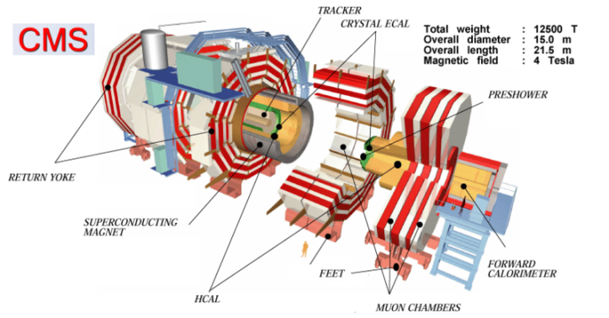
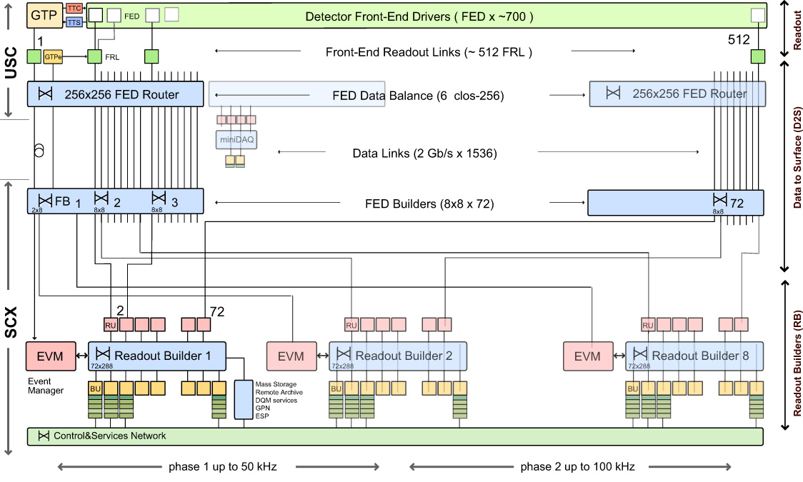
CMS
Total weight: 12500 T
Overall diameter: 15.0 m
Overall length: 21,5 m
Magnetic field: 4 Tesla
DAQ TDR Design
Incontro CCR - 10.12.2008

Slide 4
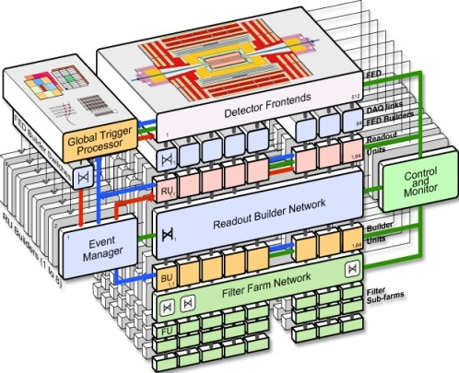
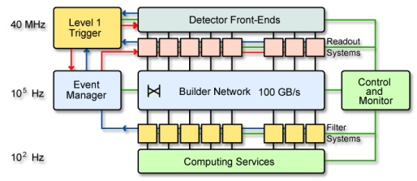
Control and Monitor Requirements
Baseline DAQ Configuration
512 inputs
2024 outputs
Control and Monitor requirements
O(10⁴ ) distributed Objects to
  control
  configure
  monitor
On-line diagnostics
Interactive system

Slide 5
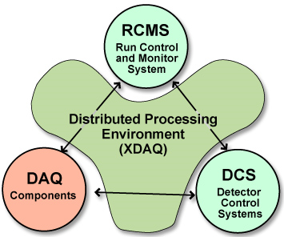
Run Control and Monitor System
RCMS is integrated in the CMS On-line system :
It controls the “DAQ component”
  Data transport
  Event processing
It monitors the “Detector Control System” DCS
  manages the slow controls of the whole experiment.
The SOAP protocol and the Web Services have been adopted as the main means for communication .
The online process environment is XDAQ,
a C++ framework for a distributed Data Acquisition System.

Slide 6
RCMS – Run Control and Monitor System
Service Oriented Architecture
1998: Java and CORBA (Common Request Broker Architecture) as communication backbone
  Used in test-beams and DT chambers production centers
2001: HTTP + XML communication (JAXM)
  Tomcat application server
  Java applet GUI
2003: Adoption of SOAP as control communication backbone
  First RCMS official release (RCMS 1)
  “DAQKit” for CMS sub-detector DAQ teams
  Used in test-beams and production centers
2005: WSDL and Apache Axis
  RCMS 2
  JSP based GUI
  Sub-detector local DAQs, MTCC I&II (2006)
Sept 2008: first LHC collision beam
  RCMS 3: Tomcat 5.5, Axis 1.4

Slide 7
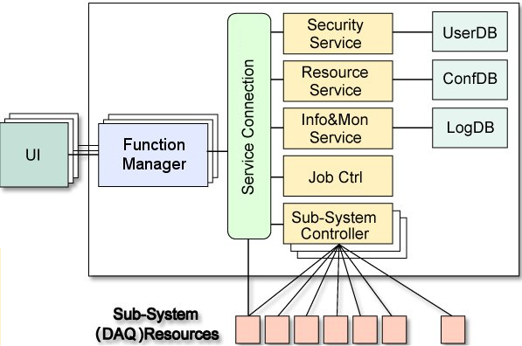




RCMS Architecture
Top FM
Services
Services
Services
Sub-Detector
Sub-Detector
Function Manager
Monitor Flow
Sub-Detector
Sub-Detector
Event
Processor
FSM
Engine
Control Flow
Sub-Detector
Sub-Detector
State Flow
Input
Handler
Resource
Proxy
Error Flow
DAQ (XDAQ)
Resources
Customizable
Resources

Slide 8


Control Structure at MTCC I & II (2006)
Web Browser (GUI)
User interaction with Web Browser connected to Level 0 FM.
TOP
Level 0 FM is entry point to Run Control System.
Level 0 FM
LTC
RPC
DT
ECAL
Level 1 FM interface to the Level 0 FM and have to implement a standard set of inputs and states.
CSC
DAQ
TRK
HCAL
Level 1 FM
FB
RB
FF
FEC
FED
Level 2 FMs are sub-system specific custom implementations.
Level 2 FM
Resources are on-line system components
Resources

Slide 9
RCMS & Web Services – Why?
TDR(2002):
  it is planned to maximise the use of standard software technologies in the RCMS.
  Web technologies and in particular Web Services have been chosen because they have been designed to interconnect highly heterogeneous and distributed systems, therefore implying a rich choice of available tools and solutions.
  Many of these widely-spread software tools follow an open-source approach, thus facilitating the integration with other software packages.
Central DAQ provides tools to the sub-detector DAQ teams to develop their own local DAQ and control systems (XDAQ and RCMS).
Adoption of XDAQ and RCMS (DAQKit) in the sub-detectors makes the integration of the overall CMS DAQ easier.
Adoption of web services standards (WSDL and SOAP) helps sub-detector custom developments integration.

Slide 10
Web Services:
Server Side
Development

Slide 11
Web Services: the beginning
WSDL Experience in CMS started in 2004
  Major revisit of all CMS DAQ software (XDAQ 3, RCMS2 …)
Sun J2EE (Java 2 Enterprise Edition) tutorial is probably the best way to start learning and working with Java Web Services
  Web Services are a sub-set of the J2EE specifications
Apache Axis documentation is also quite good
A (quick) investigation was done:
  Apache Tomcat / Axis 1.2
  Sun JWSDP 1.4 (Java Web Service Development Package)
    Uses Tomcat
  Sun Java System Application Server 8
Interoperability tests:
  Web Service interface defined in Java
  WSDL generated from Java by using “Java2WSDL” tools (available both for Sun and Axis)

Slide 12
Apache Axis & Sun JWSDP
Web Application Life Cycle:
  1. Develop the web component code.
  2. Develop the web application deployment descriptor.
  5. Deploy the application into a web container.
1) Java Code:
  (almost) 100% reusable
    If careful to use only “standard” (JAX-RPC) APIs
    Examples provided by Axis and Sun often use “custom” classes (API implementations)
      javax.xml.rpc.* classes – OK
      org.apache.axis.* classes – NO (for code reuse)
2) Deployment descriptors:
  Custom (deploy.wsdd, sun-<module-type>.xml, …)
5) Web container installation, configuration, maintenance
  Custom
Full interoperability was demonstrated

Slide 13
Tomcat/Axis Java – The choice
Had already experience with Apache Tomcat
  Open source and free to use
  already powering numerous large-scale, mission-critical web applications
The learning curve of a new Application Server in not deep
  Sun Application Server is quite complex
  JWSDP Reference Implementation was using Tomcat
Axis has a very active user community and was already adopted by many companies
  implements a sub-set of the J2EE functionalities
Migration to another J2EE Application Server does not imply java code changes
Links: http://ws.apache.org/axis/ , http://tomcat.apache.org/

Slide 14
WSDL and Java Interface
WSDL is complex
  It is not easy to write it by hand.
  It is more comfortable (easier and faster) to define the services API in Java and then generate the WSDL (Java2WSDL tools)
Java to WSDL mapping - Limitations
  “Behind the scenes, JAX-RPC maps types of the Java programming language to XML/WSDL definitions. For example, JAX-RPC maps the java.lang.String class to the xsd:string XML data type. Application developers don’t need to know the details of these mappings, but they should be aware that not every class in the Java 2 Platform, Standard Edition (J2SE) can be used as a method parameter or return type in JAX-RPC”.
  Supported types:
    boolean, int, …
    java.lang.Boolean, java.lang.Integer,…
    Arrays: boolean[], int[], …
    Java Beans

Slide 15
WSDL and Java Exceptions
Exceptions (Axis documentation)
  This is an area which causes plenty of confusion, and indeed, the author of this section is not entirely sure how everything works, especially from an interop perspective.
  RemoteExceptions map to SOAP Faults
    If the server method throws a java.rmi.RemoteException then this will be mapped into a SOAP Fault. The faultcode of this will contain the classname of the fault. …If the recipient does not know how to create an instance of the received fault, this mechanism does not work. …you can only reliably throw java.rmi.RemoteException instances, rather than subclasses.
    When an implementation in another language receives such an exception, it should see the name of the class as the faultCode, but still be left to parse the body of the exception. You need to experiment to find out what happens there.
  Exceptions are represented as wsdl:fault elements
    If a method is marked as throwing an Exception that is not an instance or a subclass of java.rmi.RemoteException…The exception is no longer a SOAP Fault, but described as a wsdl:fault in the WSDL of the method. According to the JAX-RPC specification, your subclass of Exception must have accessor methods …
    If your exception meets this specification, then the WSDL describing the method will describe the exception too, enabling callers to create stub implementations of the exception, regardless of platform.
    Again, to be sure of interoperability, you need to be experiment a bit. Remember, the calling language may not have the notion of Exceptions, or at least not be as rigorous as Java in the rules as to how exceptions must be handled.

Slide 16
Example: An RCMS Exception
All RCMS service exceptions extend java.rmi.RemoteException
  Reduce interoperability problems
package rcms.fm.fw.service.command;
import java.io.Serializable;
import java.rmi.RemoteException;
/**
* Command Service Exception class.
*
*/
public class CommandServiceException extends RemoteException implements Serializable {
…
public CommandServiceException() {}
public CommandServiceException(String s) {…}
public CommandServiceException(String s, Throwable ex) {…}
public Throwable getException() {return exception;}
public void setException(Throwable exception) {…}
public String getMsg() {return msg;}
public void setMsg(String msg) {
this.msg = msg;
}
}

Slide 17
Development Environment
Eclipse Integrated Development Environment (www.eclipse.org)
Eclipse Plugins (http://www.eclipseplugincentral.com/ )
  Sysdeo Tomcat Launcher plugin
  Lomboz plugin (J2EE applications)
Xdoclet to ease the deployment of the services
  http://xdoclet.sourceforge.net
  Mainly in the first phase we needed to change often the service API.
  Axis deployment descriptors automatically generated
    XDoclet is an open source code generation engine. It enables Attribute-Oriented Programming for java. In short, this means that you can add more significance to your code by adding meta data (attributes) to your java sources. This is done in special JavaDoc tags.

Slide 18
Example: an Axis service
package rcms.fm.ws.command;
import javax.xml.rpc.ServiceException;
…
/**
* CommandService Web Service.
*
* @axis.service name="CommandService" scope="Application“ enable-remote-admin="true"
*
* @axis.bean name="CommandServiceException" package="rcms.fm.fw.service.command"
* @axis.bean name="StateMachineBean“ package="rcms.statemachine.definition.bean"
…
*/
public class FMCommand implements ServiceLifecycle,CommandServiceIF {
private CommandService commandService = null;
/**
* Synchronous commad execution….
* …
* @axis.method
* @param command the command to execute
* @param uriPath the URI identifying a resource
* @return the state after command execution
* @throws CommandServiceException
*/
public StateBean execute(String[] uriPath, CommandBean command) throws CommandServiceException {
…
}
…
}

Slide 19
Ant and XDoclet
<!--Build file for deploying and undeploying RCMS web services into axis and make stubs.
This file is only used by RCMS developers.-->
<project name="rcms-parameter-deploy" default="axis-deploy" basedir=".">
<property file="build.properties" />
…
<!-- Generate the axis deployment descriptor -->
<target name="axisdoclet">
<taskdef name="templatedoclet" classname="xdoclet.DocletTask" classpathref="xdoclet.class.path" />
<templatedoclet destdir="${output}" verbose="1">
<template templateFile="${deploy.xdoclet.template}" destinationFile="${deploy.wsdd}">
<configParam name="Xmlencoding" value="utf-8" />
</template>
</templatedoclet>
</target>
<!-- Generate the axis undeployment descriptor -->
…
<!-- Deploy the services into axis engine -->
<target name="axis-deploy" depends="axisdoclet,axisdoclet-undeploy">
<taskdef resource="axis-tasks.properties" classpathref="axis.classpath" />
<axis-admin port="${target.port}" hostname="${target.server}" failonerror="true" servletpath="${target.appname}/services/AdminService" debug="true" xmlfile="${output}${deploy.wsdd}" />
</target>
<!-- Undeploy the services into axis -->
…
<!-- Generate the stubs -->
…
</project>

Slide 20
Example: Axis deployment descriptors
<?xml version="1.0" encoding="utf-8"?>
<deployment xmlns=http://xml.apache.org/axis/wsdd/ xmlns:java=http://xml.apache.org/axis/wsdd/providers/java xmlns:xsi="http://www.w3.org/2000/10/XMLSchema-instance">
<service name="CommandService“ provider="java:RPC">
<parameter name="className" value="rcms.fm.ws.command.FMCommand" />
<!-- check if remoteAdmin param is present -->
<parameter name="enableRemoteAdmin" value="true" />
<parameter name="allowedMethods"
value="execute getState getUpdatedState getStateTree getUpdatedStateTree getStateMachine getStateList "/>
<parameter name="scope" value="Application"/>
<beanMapping qname="ns:CommandServiceException" (Axis documentation)
xmlns:ns="urn:FMCommand"
languageSpecificType="java:rcms.fm.fw.service.command.CommandServiceException"
/>
<beanMapping qname="ns:StateMachineBean"
xmlns:ns="urn:FMCommand"
languageSpecificType="java:rcms.statemachine.definition.bean.StateMachineBean"
/>
…
</service>
</deployment>
<?xml version="1.0" encoding="utf-8"?>
<undeployment xmlns=http://xml.apache.org/axis/wsdd/ xmlns:java=http://xml.apache.org/axis/wsdd/providers/java xmlns:xsi="http://www.w3.org/2000/10/XMLSchema-instance">
<service name="CommandService">
</service>
</undeployment>

Slide 21
The GRIDCC Project
http://www.gridcc.org

Slide 22
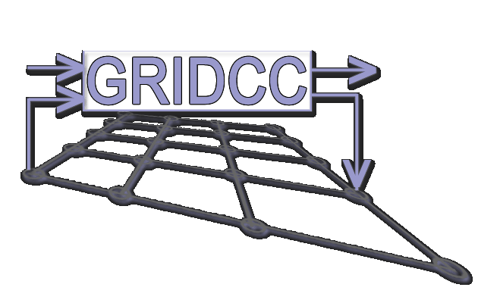
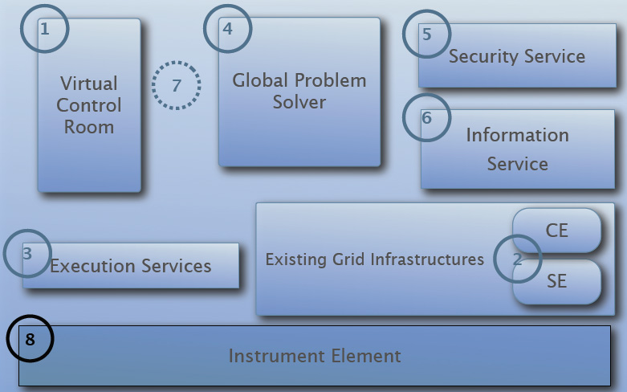
RCMS and GRIDCC
The Grid enabled Remote Instrumentation with Distributed Control and Computation (GRIDCC) is a project funded by the European community, aimed to provide access to and control of distributed complex instrumentation.
It is a 3-years project started in September 2004
The RCMS software is the core of the Instrument Element of the GRIDCC.
The RCMS software was developed in closed collaboration with the GRIDCC.
CMS is one of the main applications for the GRIDCC project .

Slide 23

Instrument Element (IE): the basic idea
Instrument
Element
Instrument
Element
Instrument
Element
Virtual
Control
Room
Virtual
Control
Room
Computing
Element
Computing
Element
Computing
Element
Storage
Elements
Storage
Elements
Web Service
Interface
Storage
Element
Execution
Service
Existing
Grid Infrastructures

Slide 24
(Some) GRIDCC Developments
Virtual Control Room (VCR)
Instrument Element web service façade
  WS-I compliance
Instrument Reservation (Web) Service
Problem Solver (Web) Service
Integration with GRID (EGEE) components
IE Security
Quality of Service
Automatic discovery of GRIDCC components (P2P approach)
Grid on a CHIP
  light version of IE to facilitate its adoption in the embedded systems, including the FPGA based – Axis standalone
Tiny IE : light version of IE
  Easier software deployment and installation
JMS (Java Messaging System) experience
  When the web services performance is not enough…
  RMM – JMS (GRIDCC IBM)

Slide 25
Final Release: Instrument Element
DB Store
File Store
Custom Store
Secure
RMM-JMS
BDII
GlueSchema extension
Instrument Reservation
Service (IRS)
Discovery
Custom (JMS, ..... )
Data/Info Pubblishing
I’m
here
Instrument
Element
SRM-2.2
StoRM
BestMan
GSI Security
WS-I Compliant
GSI Security
Kerberos Security
Instrumentation Contorl
Web Service
GRID Access
SRM/GRIDFTP
Instruments Access
Instrument Quality of Service(IQS)
Custom

Slide 26
Web Services Performance
Server
Clients
Client/Server communications type:
Simple HTTP
SOAP + XML over HTTP
Web Service
The hardware and Software:
Application Server: Dual Xeon1.8 GHz, with 1.5 GB RAM, Ethernet 1 Gbps
Red Hat Linux Advanced Server 2.1. Tomcat 5.0.28 Axis
Clients: 15 Pentium III 600 MHz, with 256 MB RAM, Ethernet 1 Gbps
Linux Red Hat 7.0. java 1.4 application

Slide 27
When the WS performance is not enough…
CMS DAQ Monitoring has been implemented in XDAQ (C++)
  O(10⁶) monitorables per second
  XML communication protocol (WS-Eventing standard) at the beginning
  Binary protocol now
GRIDCC exploits JMS (Java Message System)
  RMM – JMS (IBM GRIDCC)

Slide 28
The Agata Experiment
http://www-win.gsi.de/agata/

Slide 29
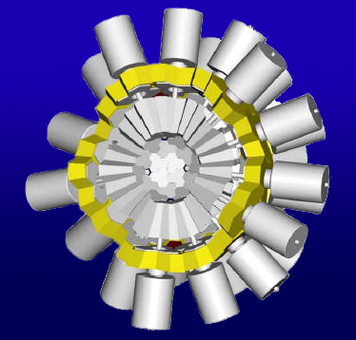
Agata Project
The aim of Agata project is to develop, build and employ an Advanced GAmma Tracking Array, AGATA, for nuclear spectroscopy.
AGATA is being realized within a European collaboration and is intended to be employed in experimental campaigns at radioactive and stable beam facilities in Europe.
  First campaign: Legnaro
  Installation at LNL in progress
  First data taking test next week

Slide 30
Agata DAQ
Front-end electronic
and pre-processing
Slow Control
Pulse Shape Analysis
Histogrammer
Run Control and
Monitor
System
Event Builder
Tracking
The collaboration:
Orsay (main data flow)
Daresbury (slow control)
Cracov (GUIs)
Legnaro (Run Control)
On-line
Data analysis
Storage

Slide 31
Agata DAQ & Run Control
The DAQ is developed in Ada programming language
  Narval ( http://narval.in2p3.fr/ )
    Orsay team (IN2P3)
LNL is developing the “Run Control”
GRIDCC Instrument Element software is used
  No major server side developments so far
    Porting to Java 6 and Tomcat 6
  Concentrate on “custom” control and monitor
Wish (To Do) list
  Use Modern Web Services standards and tools
    JAX-WS APIs
    JAXB binding
    Axis 2

Slide 32
Agata Run Control Structure
GUI
WSDL Facade
Run Control Services
Run Control
Top Manager
Logging
Service
Resource
Service
Narval
Manager
Ancillary
Manager
Slow
Manager
Storage
Manager
Grid
Manager
Ancillary
Manager
Slow
Manager
DAQ
Narval
Slow
Control
Disk
Manager
Grid
Data Mover
Prisma
DAQ
Slow
Control

Slide 33
Web Services
Client side Development

Slide 34
WSDL: Axis Java client (I)
RCMS, GRIDCC and Agata web applications use Axis stubs
  They communicate with other Java Axis Web Services
  For instance CMS Function Managers (FMs) retrieve the configuration from the Resource Service WS, send commands to other FMs, receive state change notifications from other FMs
Agata DAQ is developed in Narval (Ada programming language)
  Narval distributed system provides a WSDL for control and monitoring purposes (Generated by Ada2WSDL)
  Axis Java stubs were generated
    no particular problems
<?xml version="1.0" encoding="UTF-8"?>
<definitions name="narval_aws"
…
<!-- Generated by AWS/Ada2WSDL v1.1
on Wednesday 06 February 2008 at 10:05:01 -->
<types>…
</types>…
<message name="Send_Command_With_Arguments_Request">
<part name="Command" type="xsd:string"/>
<part name="Arguments" type="n1:String_Array"/>
</message>
<message name="Send_Command_With_Arguments_Response">
<part name="Result" type="xsd:string"/>
</message>
…

Slide 35
WSDL: Axis Java client (II)
Agata: Slow Control WSDL (Daresbury)
  Defined in C language
    int Do-Reset (int *rc);
    int Do-SetUp (int *rc);
    int Do-Stop (int *rc);
    int Do-Go (int *rc);
    …
  WSDL generated using gSOAP
  WSDL implemented in Tcl for “digitizer electronics” (Daresbury)
    Tcl Web Server : http://www.tcl.tk/software/tclhttpd/
  WSDL implemented in Ada (ENX) for “segment and core mezzanines” ( http://enx.in2p3.fr/ )
Run Control Java/Axis stubs generated (Legnaro)
  First tests: no problems encountered
<?xml version="1.0" encoding="UTF-8"?>
<definitions name="DataAcquisitionControlServer“ targetNamespace="http://npg.dl.ac.uk:8015/DataAcquisitionControl.wsdl"
<message name="Get-StateRequest">
</message>
<message name="Get-StateResponse">
<part name="ResponseCode" type="xsd:int"/>
<part name="Code" type="xsd:int"/>
<part name="State" type="xsd:string"/>
<part name="Reason" type="xsd:string"/>
</message>
…

Slide 36
WSDL: XDAQ Client (CMS)
CMS XDAQ C++ framework does not provide WSDL support
But it fully supports SOAP (Xoap library)
Communication with RCMS web services is achieved by libraries that construct the proper SOAP messages
  Used Mainly for asynchronous notifications (state changes, errors)
When stub generation from the WSDL is not available
  SOAP messages can/must be constructed by hand
  It works fine
  Complexity depends on WSDL complexity
In the class constructor:
rcmsStateNotifier_( logger_,getApplicationDescriptor(),getApplicationContext() )
Then:
try
{
rcmsStateNotifier_.stateChanged( "Error", xcept::stdformat_exception_history( exception ) );
}
catch( xcept::Exception &e )
{
LOG4CPLUS_ERROR( logger_, "Failed to notify state change: "
<< xcept::stdformat_exception_history(e) );
}

Slide 37
WSDL: Perl Client
WSDL and SOAP support in Perl is provided by SOAP::Lite package
    Collection of Perl modules which provides a simple and lightweight interface to the Simple Object Access Protocol
    CERN Linux SLC 3.0.4 packages:
      perl-MIME-Lite (3.01-1), perl-MailTools (1.62-1), perl-SOAP-Lite (0.55-3), perl-TimeDate (2.22-1)
  DII (Dynamic Invocation Interface) approach
Widely Used in CMS
    Scripts to stress the control system
    Reproduce bugs
    Performance measurements
Also used inside Labview for Mac (see later)

Slide 38
Perl Script : example
#!/usr/bin/perl
# getStateFM.pl
# Author: Andrea Petrucci
# date: 23/10/2005
use strict;
use SOAP::Lite;
my $WSDLCommandService="http://pccms143.cern.ch:8080/rcms/services/CommandService?wsdl";
my $NSCommandService = "urn:FMCommand";
my $HOSTCommandService = "http://pccms143.cern.ch:8080/rcms/services/CommandService";
my $CommandService = SOAP::Lite
->readable(1)
->xmlschema('http://www.w3.org/2001/XMLSchema')
->on_action( sub { return '""';} )
->proxy($HOSTCommandService)
->uri($NSCommandService);
my $method = SOAP::Data->name('getState')
->prefix('ns1')
->uri($NSCommandService);
my $result = $CommandService->call($method => ($uri));
if ($result->fault){
print join ';',
$result->faultcode,
$result->faultstring;
}else {
my $stateBean = $result->valueof('//getStateResponse/getStateReturn');
print "$stateBean->{'stateString'}\n";
}

Slide 39


WSDL Clients: GUIs for Run Control
Clients
Two basic ways:
web service compliant clients
browser via a JSP GUI
Server
IMS
JSP GUI
( RCMS Framework)
C ++
Function
Manager
Perl
Java
Resource
Service
Visual Basic
. NET
SOAP/HTTP
Visual C++
Portal
Web Service

Slide 40
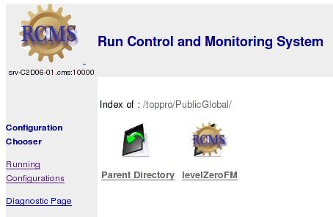
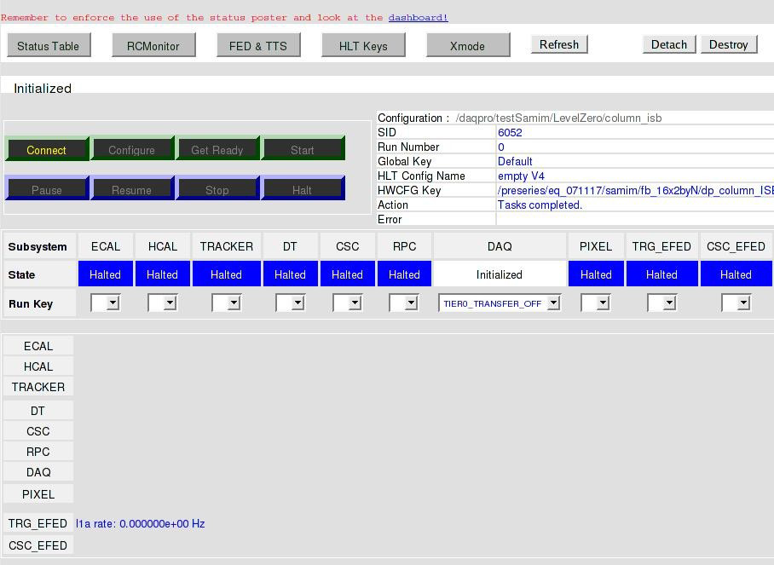
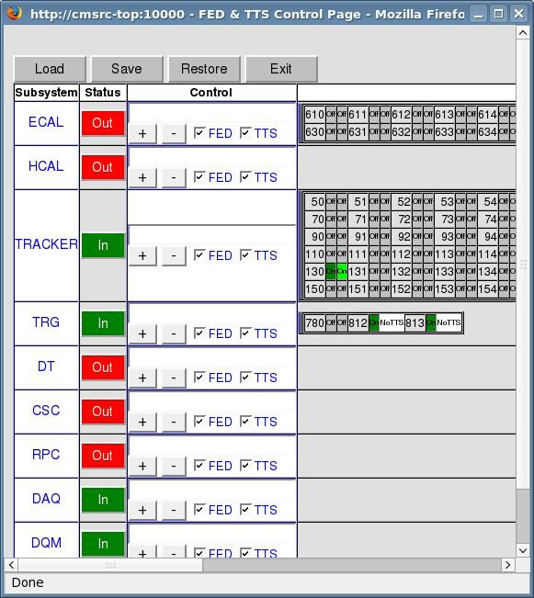
JSP CMS Run Control GUIs
1) RCMS GUI
2) Function Manager Level Zero GUI
3) FED and TTS GUI
JSP (Java Server Pages)
  Server side code generating HTML pages
  Use Java/Axis stubs
  Javascript and AJAX technology

Slide 41
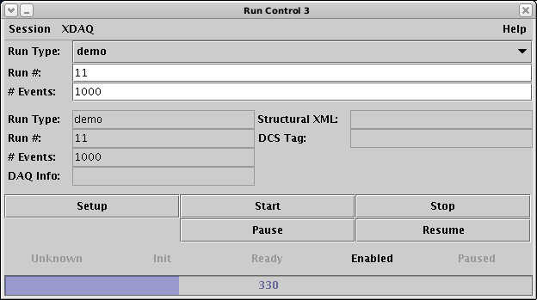
Java Applet GUI example
CMS test beams and production centers

Slide 42
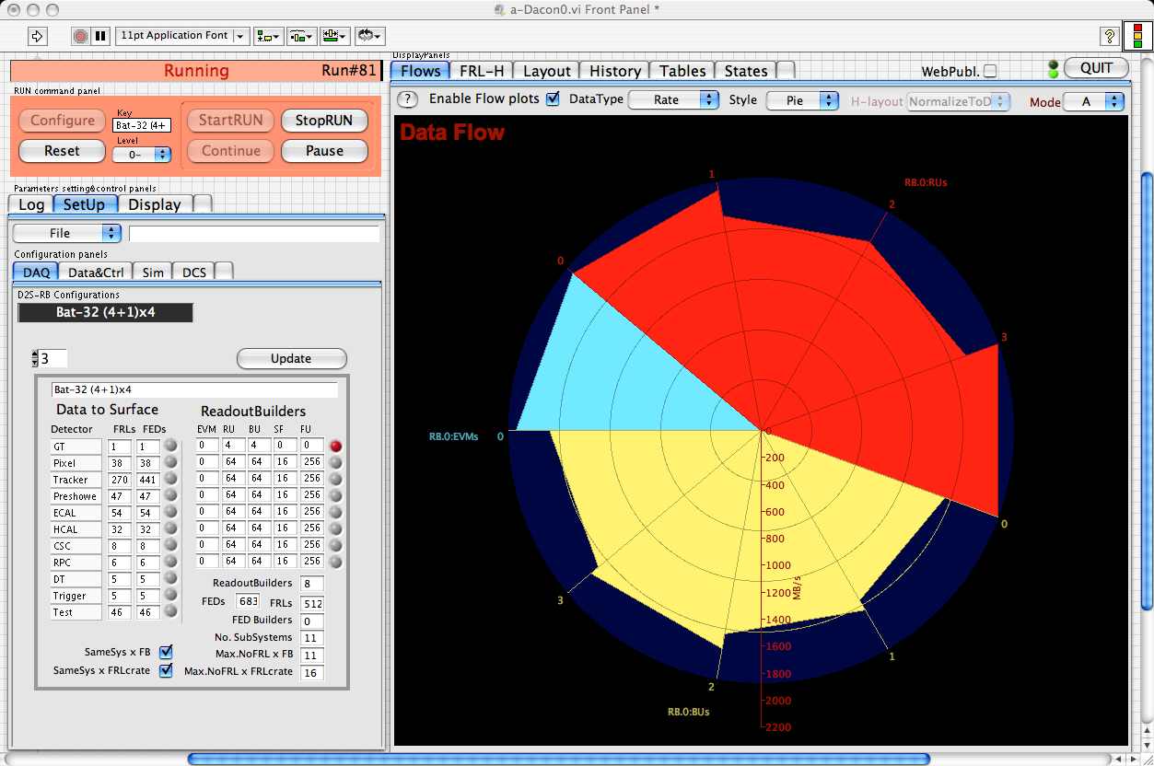
LabView GUI
WSDL client tests both with Mac and Windows
  Windows: .NET support (OK)
    Some troubles with complex data structures
  Mac: (KO)
    Perl scripting language as a workaround

Slide 43
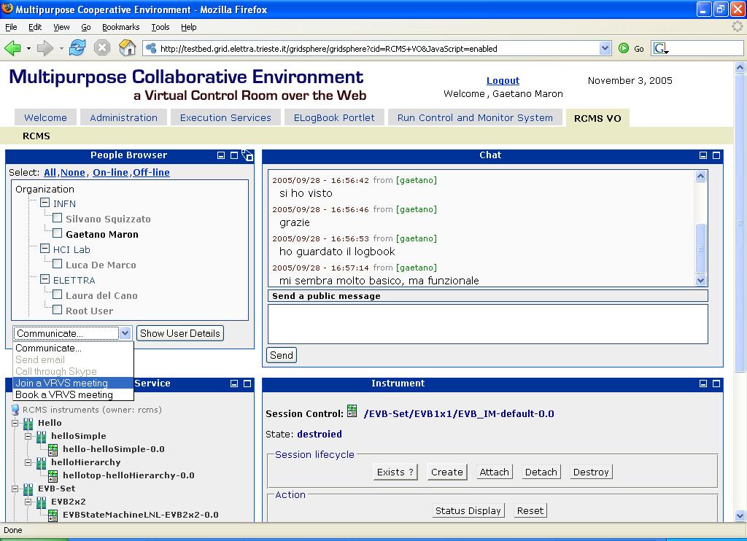
GRIDCC VCR – Portal and Portlet

Slide 44
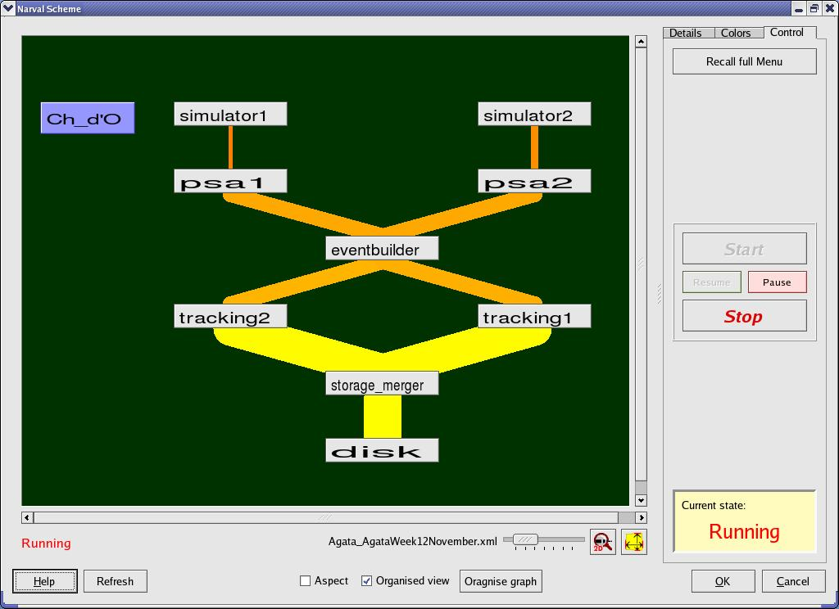
Agata GUI (Cracov)
Prototype available, Developed in C++, Qt based
Communicates to the Agata Run Control through the GRIDCC WSDL facade
Agata Week November 2007:
  “Lucky the WSDL files given to me are fully compatibile with my gSOAP standard” (Jurek Grebosz)

Slide 45
Considerations
Web Services are a wonderful paradigm for…
  Interoperation of software running on different platforms and developed with different programming languages
  Quick development of clients
    Allow to concentrate on the business part of the application
Many many useful “Web Services tools” available
Suitable for “online” systems when performance is not a big issue
  Run Control systems

Slide 46
Questions
?

Slide 47
People
List of people working on the contents of this presentation (not exhaustive, not ordered):
  Michele Gulmini
  Gaetano Maron
  Pietro Molini
  Andrea Petrucci
  Alexander Oh
  Francesco Lelli
  Eric Frizziero
  Sergio Traldi
  Luigi Zangrando
  Silvano Squizzato

Slide 48
SPARE SLIDES

Slide 49
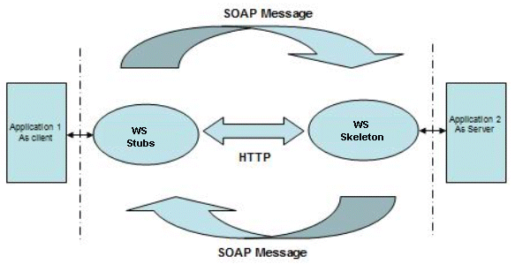
JAX-RPC
JAX-RPC provides an easy to develop programming model for development of SOAP based Web services.
The figure elaborates the normal Web service invocation architecture for the synchronous request-response mode :
The client uses runtime libraries to serialize Java objects to a SOAP message and sends it to the Web service end point, using HTTP transport.
As the Web service side that is deployed on Apache Tomcat receives this request, the service-side JAX-RPC runtime deserializes the SOAP message in to Java types and invokes the method on the Web service and in turn makes a call to Application 2.
The Web service, after processing the request, sends response back to the client in a similar.

Slide 50
References
Web service : Web Services Architecture (http://www.w3.org/TR/ws-arch/)
WSDL : Web Service Description Language (http://www.w3.org/TR/wsdl)
  Basic Profile Version 1.0 (http://www.ws-i.org/Profiles/BasicProfile-1.0-2004-04-16.html)
Apache Tomcat : The Apache Jakarta Tomcat 5 Servlet/JSP Container (http://tomcat.apache.org/tomcat-5.0-doc/index.html)
Apache Axis : Axis User’s Guide (http://ws.apache.org/axis/java/user-guide.html)
J2ee : Java 2 Platform, Enterprise Edition (http://java.sun.com/j2ee/1.4/)
JAX-RPC : Java API for XML-Based RPC (http://java.sun.com/webservices/jaxrpc/index.jsp)

Slide 51
The Grid Technologies to extend the limit of a single computer (center)
Computing
Element
Storage
Element
Grid Gateway
Grid Technologies
Computing
Element
User Interface
Computing
Element

Slide 52
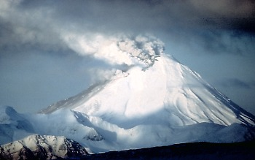
Extending the Grid Concepts
Grid Gateway
Grid Technologies
Satellite views
to monitor the volcano
Terrestrial probes to monitor
The volcano activities
To model calculations
and disaster predictions
Control and Monitor Room

Slide 53
RCMS Services
  SECURITY SERVICE
    login and user account management;
  RESOURCE SERVICE (RS)
    information about DAQ resources and partitions;
  INFORMATION AND MONITOR SERVICE (IMS)
    Collects messages and monitor data; distributes them to the subscribers;
  JOB CONTROL
    Starts, monitors and stops the software elements of RCMS, including the DAQ components;

Slide 54
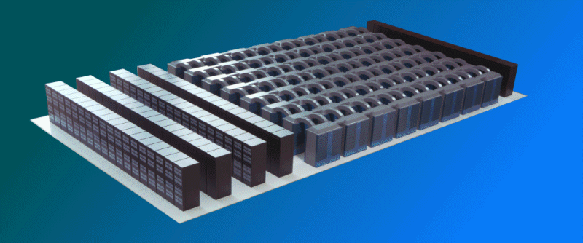

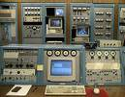
The GRIDCC Architecture
Instruments Grid
Computational Grid
CE
CE
WMS
SE
Grid
Instrument
Element
Execution
Service
Workflow Mng System
Virtual Control Room
Agreement Service
Cooperative Environment
F. Lelli, 3rd (final) GRIDCC Annual Review, London, 15 October 2006

Slide 55
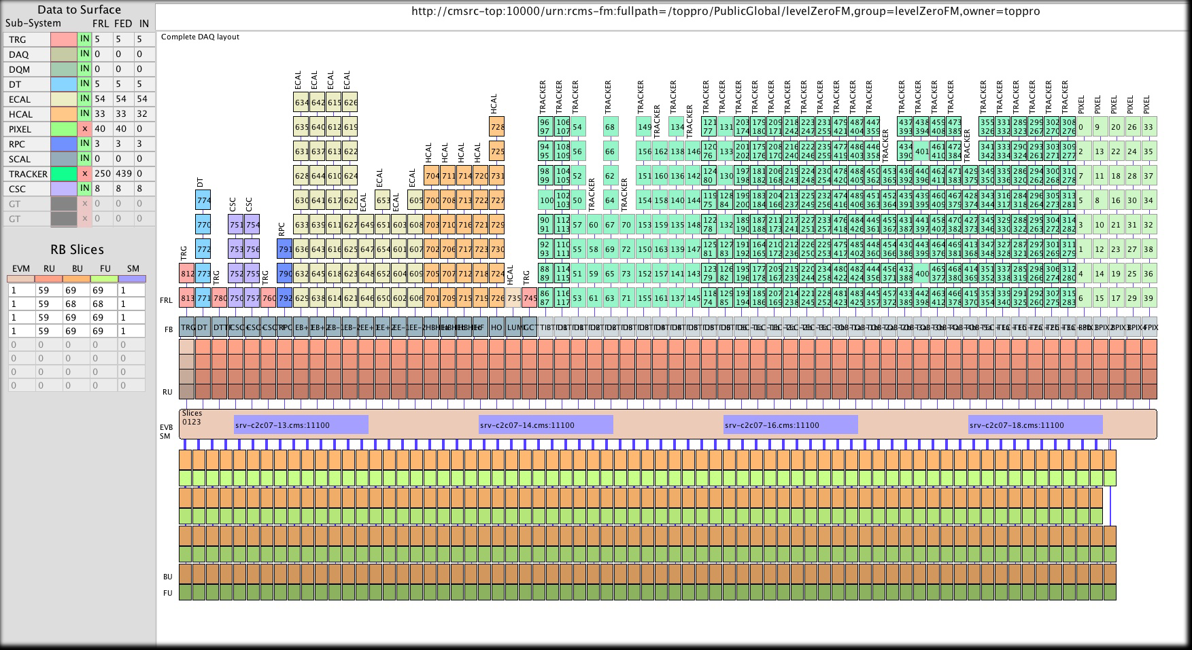
First collision beam configuration. Sept 08

Slide 56

Instrument Element Requirements
Computing
Element
Storage
Element
Web Services
Instrument Element
Grid
Any Protocol or physical connection
Sensor Network
Instrument
Computing
Element
Instrument
Element
Instrument
1: Provide a uniform access to the physical devices
W
2: Allow a standard grid access to the instruments
E
D
F
A
C
3: Allow the cooperation between different instruments that belong to different VOs
B

Slide 57
GRIDCC – IE technologies
Web Service compliant (WS-I)
Tomcat + Axis (and Java) and Axis standalone are the main technologies of the IE
All the services are deployed on a single or multiple instances of Tomcat, according to the needs of the application
Message oriented middleware (Pub/Sub) is based on the Java Messaging System (JMS). The following implementations are used in the project
  RMM - JMS (GridCC IBM)
MySQL and Oracle are used as Data Base for the RS
STORM vers. 1.2 is the used SE that exposes a SRM interface version 2.2

