Slide 1
Laboratori Nazionali del Gran Sasso
Scientific Program
EDIT 2015
INTERNATIONAL SCHOOL
Alba Formicola LNGS

Slide 2
Laboratori Nazionali del Gran Sasso

Slide 3
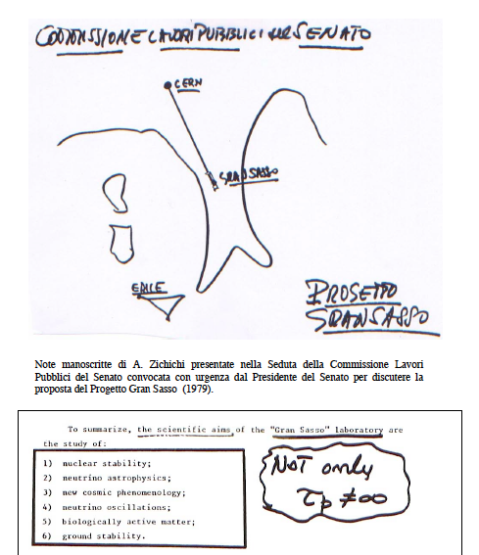
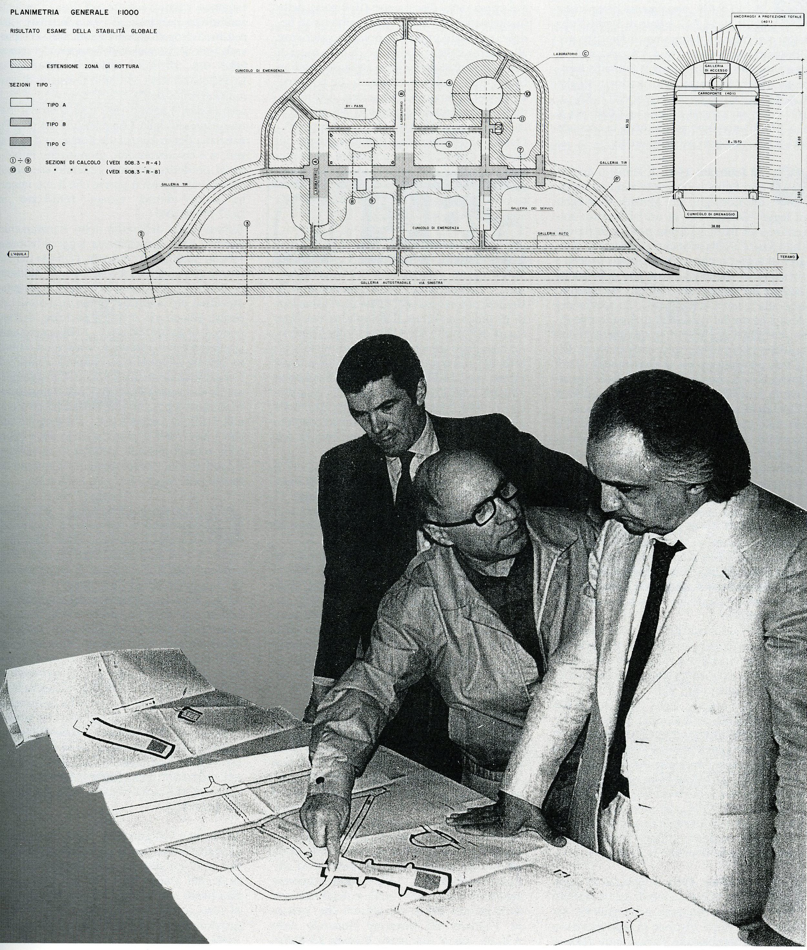
The birth

Slide 4
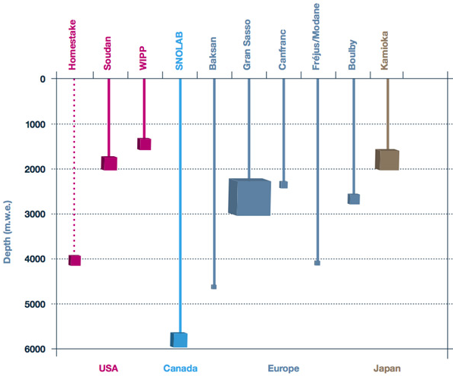
Underground Science Laboratories
LNGS
  Largest
  Easy access
Plot adapted from http://www.deepscience.org/contents/facilities.shtml

Slide 5
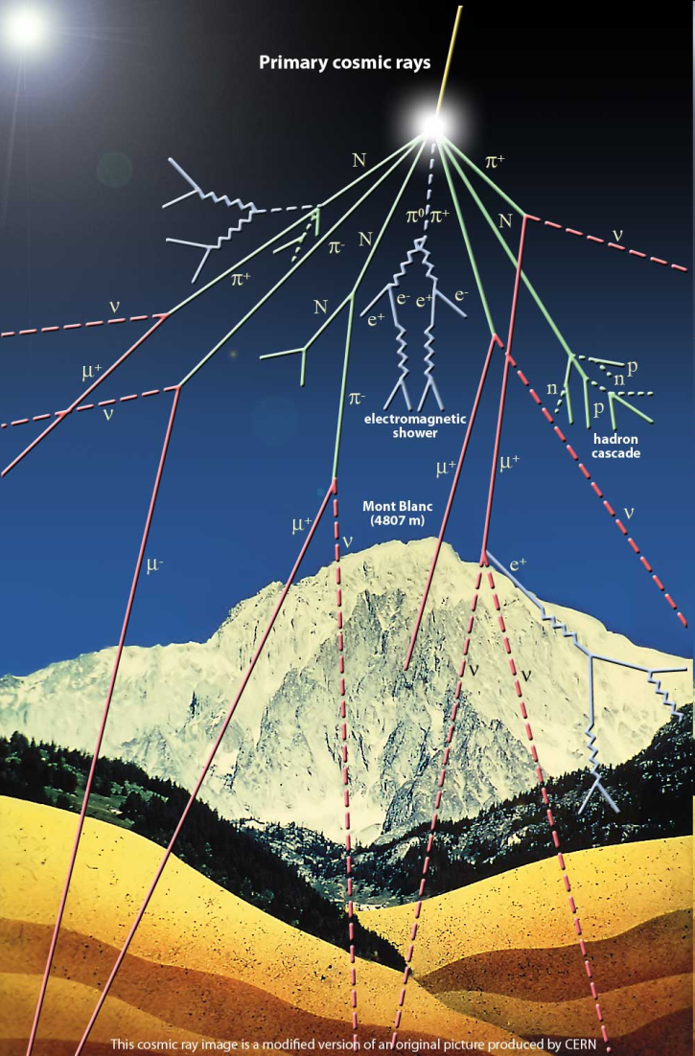
Underground labs: why?
rare events <-> weak signals
=> low radiation environment
E.g: dose to human body in normal environment:
  ~ 1/3 internal (⁴⁰K)
  ~ 1/3 local radioactivity
  ~1/3 cosmic ray muons: highly penetrating particles
Reduction of radiation background in rare events searches:
  Ultrapure detector materials
  Ultrapure heavy shielding
  Deep underground laboratories
  => muon reduction at LNGS 1/10⁶
Notes:
5

Slide 6
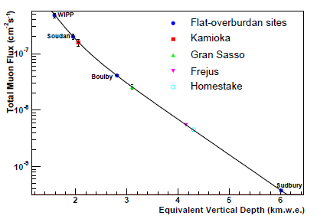
Muon Flux versus depth
LNGS: 10⁻⁶ wrt surface
LNGS
Hime and Mei, Phys.Rev. D73 (2006) 053004

Slide 7
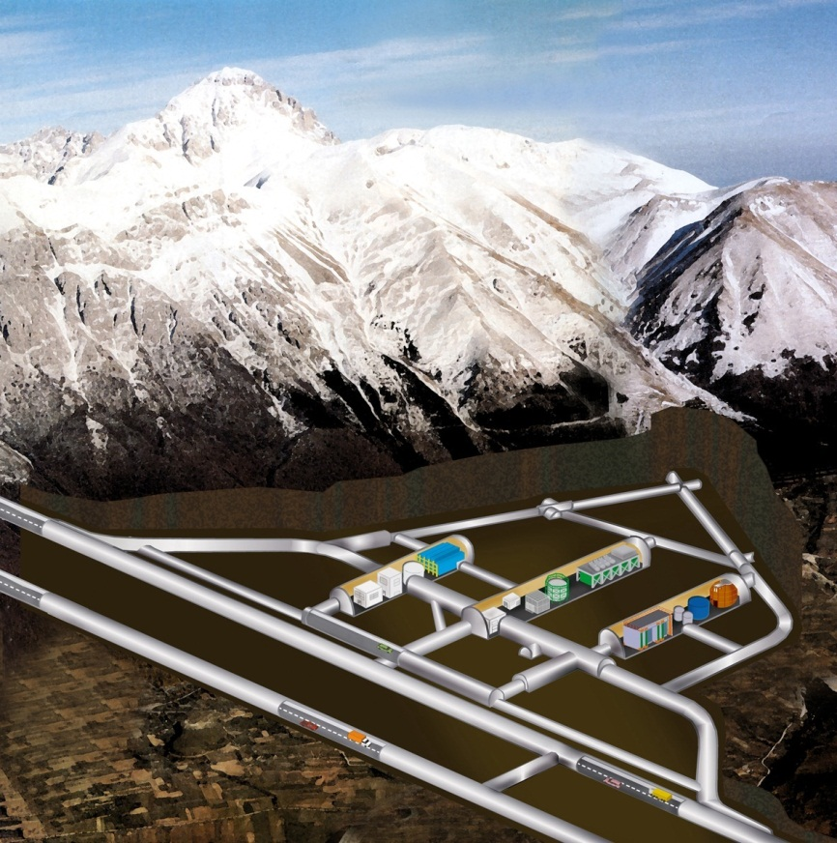
The LNGS Laboratory
42.46°N 13.57°E
Muon flux: 3.0 10⁻⁴ m⁻²s⁻¹
Neutron flux:
2.92 10⁻⁶ cm⁻²s⁻¹ (0-1 keV)
0.86 10⁻⁶ cm⁻²s⁻¹ (> 1 keV)
Rn in air: 20-80 Bq m⁻³
Surface: 17 800 m²
Volume: 180 000 m³
Ventilation: 1 vol / 3.5 hours
3400 m.w.e.
1.1 μ / (m² h)

Slide 8
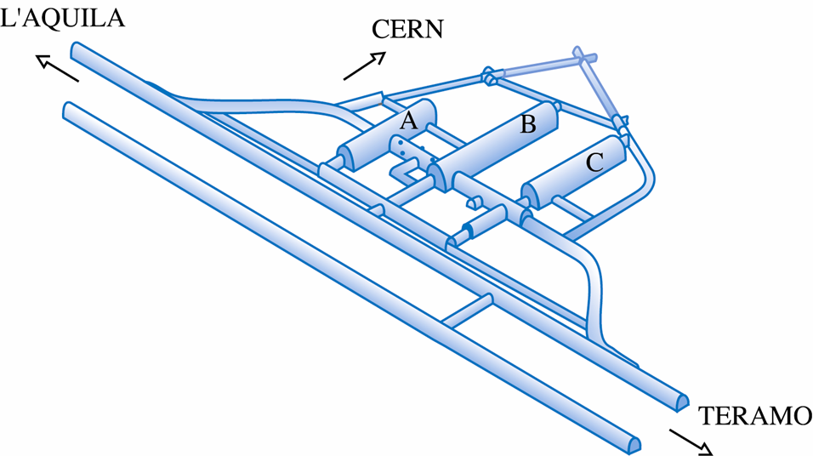
A busy laboratory
CRESST
XENON 1T
ERMES
GERDA - II
LVD
XENON
GINGER
ERMES-W
LUNA
CUORE
DARK SIDE 50
BOREXINO
VIP
LUNA-MV
COBRA
LOW ACTIVITY LAB
DAMA/LIBRA

Slide 9
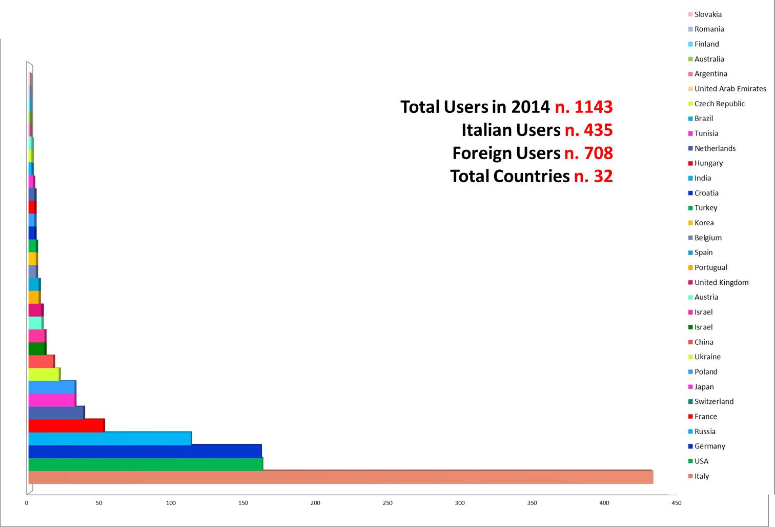
An International Laboratory
Main users: Italy, Germany, USA, Russia

Slide 10
LNGS main topics
Selected topics
NOT
a comprehensive review of Physics at LNGS
Core activities in the LNGS program
Neutrino Astrophysics
Neutrino Physics
Dark Matter searches
Astro-Nuclear Physics

Slide 11
Cosmogenic AND Solar Neutrinos
Men in pits or wells sometimes see the stars…
Aristotle

Slide 12
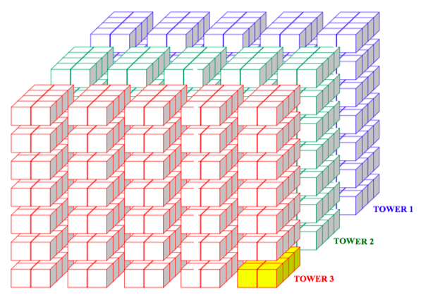
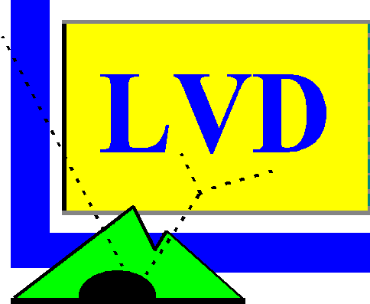
LVD
Search for ν from Core Collapse Supernovae
  LVD live since 1992.
  90% c.l. upper limit of gravitational stellar collapses (D ≤ 20 kpc)
  R < 0.12 events/year

Slide 13
…. and for the future
Continue data taking trying to keep the experiment as much performing as it was since the past 21 years!
AND catch an SN collapse

Slide 14
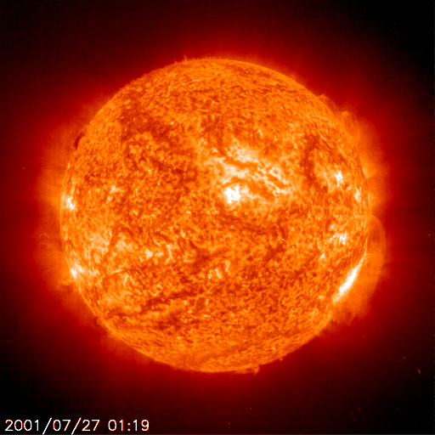
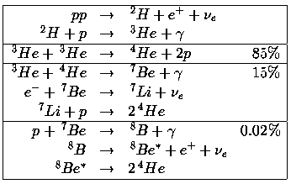
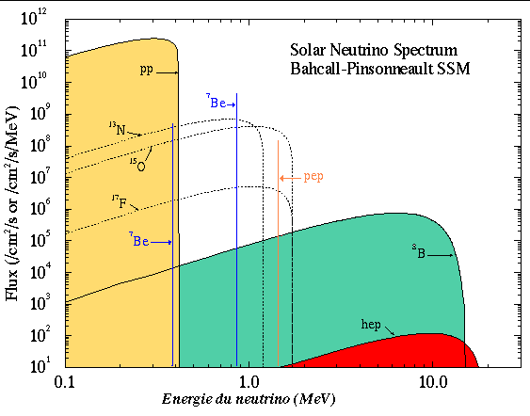
Solar Neutrinos
Sun is a precious source of neutrinos
  studied on the Earth: ~10¹⁰ cm⁻²s⁻¹
Sun Astrophysics
Neutrino Physics

Slide 15
Borexino
“A remarkable detector called Borexino has operated for the past seven years…”
Wick Haxton Nature v.512 p.378, 28 August 2014

Slide 16
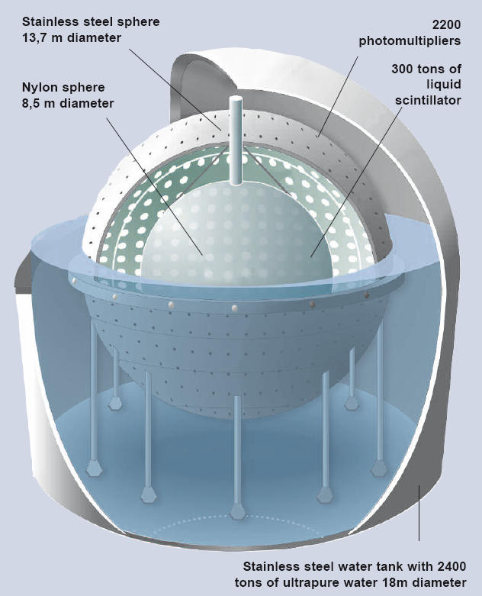
BOREXINO: real time detector of solar neutrinos
300 tons liquid scintillator in a nylon bag
2200 photomultipliers
2500 tons ultrapure water
The sun is an intense neutrino source:60 Billions neutrinos per second per cm² at the Earth surface
Neutrinos produced in the core of the sun reach the Earth in 8 min.
Light produced in Sun’s core takes >100,000 years to reach the Sun surface
Aug. 2014: Borexino reported first measurement of neutrinos produced from the primary p-p reaction
Physics World: 2014 Top Ten Physics Breakthrough
Notes:
16

Slide 17
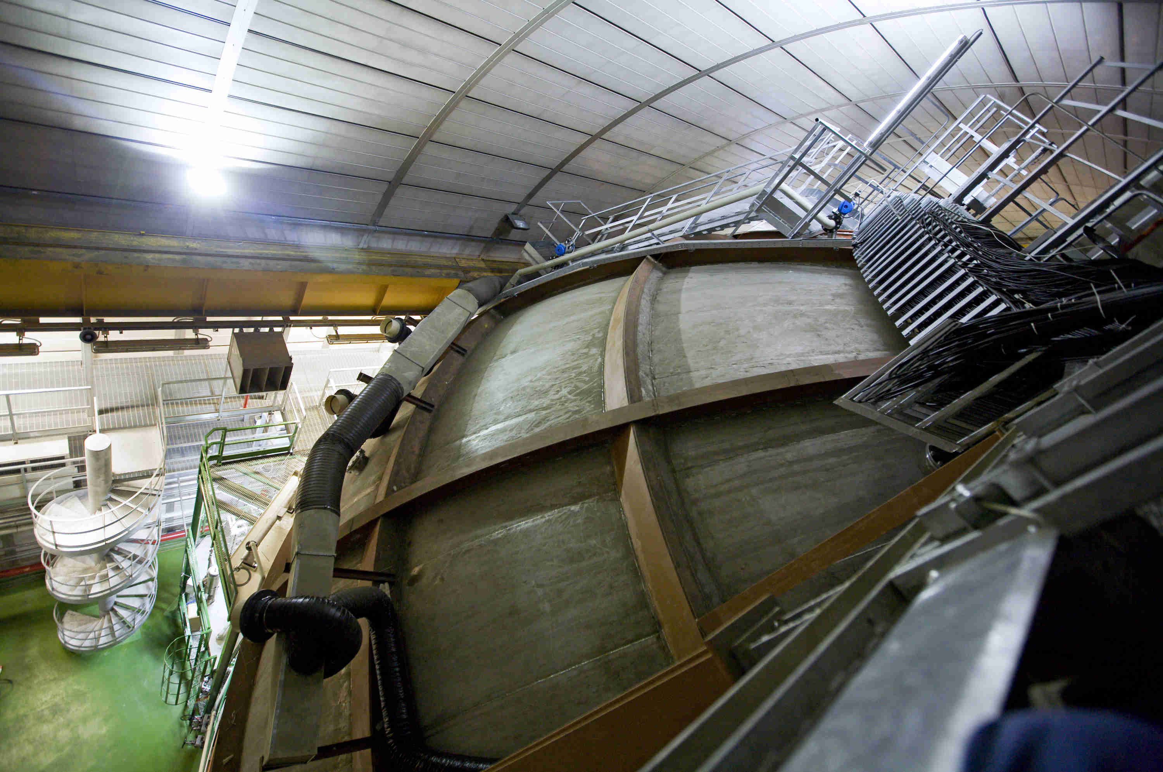
Borexino @ LNGS

Slide 18
Borexino: next challenge
CNO ν rate is a fraction of beta rate from ²¹⁰Bi
²¹⁰Bi rate monitored by ²¹⁰Po α rate
  provided that rates are stable
  Solar Neutrino rates (cpd/t)
  pp:1.44 ±0.13 ± 0.10
  Nature 512, 383 (2014)

Slide 19
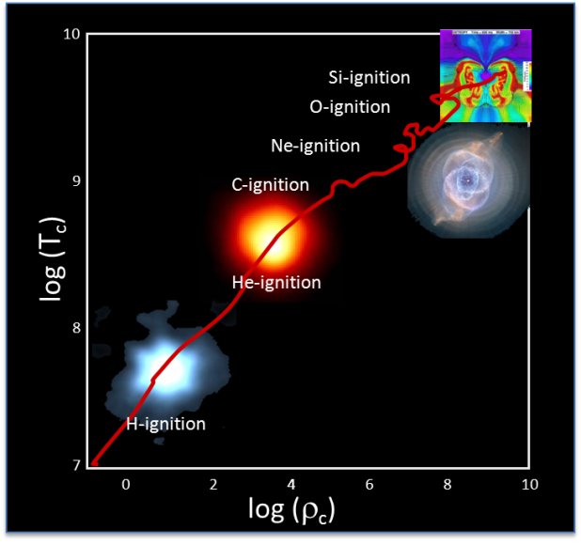
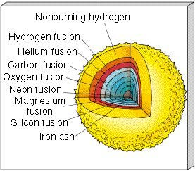
Nuclear astrophysics LUNA experiment
nuclear fusion reaction cross sections
  Stars powered by nuclear reactions
  Key parameters to model stars
    chemical composition, opacity…
    reactions cross sections
      determine the origin of elements
      stellar evolution and dynamics
    Many reactions need high precision data.

Slide 20
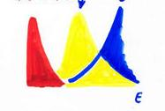
From Sun to novae and beyond
Stellar Energy+Nucleosynthesis
Hydrogen Burning
Gamow Peak
σ(E_{star}) with E_{star} << E_{Coulomb}
σ
σ(E) = S(E) e^{–2πη} E⁻¹
2πη = 31.29 Ζ₁Ζ₂ √μ/Ε
Maxwell
Boltzmann
∫
Reaction Rate(star) ≈
Φ(E) σ(E) dE

Slide 21
LUNA astrophysical motivation
Solar neutrinos:
  ³He(³He,2p)⁴He, ³He(⁴He,γ)⁷Be, ¹⁴N(p,γ)¹⁵O
Age of globular cluster:
  ¹⁴N(p,γ)¹⁵O
Light nuclei nucleosynthesis
    (¹⁷/¹⁸O abundances, ¹⁹F production, ²⁶Mg excess,...):
  ¹⁵N(p,γ)¹⁶O, ¹⁷N(p,γ)¹⁸O, ²⁵Mg(p,γ)²⁶Al
Big Bang Nucleosynthesis:
  ²H(α,γ)⁶Li, ³He(⁴He,γ)⁷Be, ²H(p,γ)³He
Light nuclei nucleosynthesis:
  ¹⁷O(p,α)¹⁴N, ²²Ne(p,γ)²³Na, ²³Na(p,γ)²⁴Mg, ¹⁸O(p,γ)¹⁹F, ¹⁸O(p,α)¹⁵N
  NEXT
He burning and stellar evolution:
  ¹²C(α,γ)¹⁶O
s process nucleosynthesis:
  ¹³C(α,n)¹⁶O, ²²Ne(α,n)²⁵Mg

Slide 22
LUNA MV
Higher energy machine
  3.5 MV single ended positive ion accelerator
  Mainly devoted to He-burning in stars
  Relevant at higher temperatures than H-burning
¹²C(α,g)¹⁶O the most important reaction of nuclear astrophysics: production of the elements heavier than A=16, star evolution from He burning to the explosive phase (core collapse and thermonuclear SN) and ratio C/O
Sources of the neutrons responsible for the S-process: 50% of the elements beyond Iron
¹³C(α,n)¹⁶O: isotopes with A≥90 during AGB phase of low mass stars
²²Ne(α,n)²⁵Mg: isotopes with A‹90 during He and C burning in massive stars
(α,γ) on ³He, ¹⁴N, ¹⁵N, ¹⁸O……

Slide 23
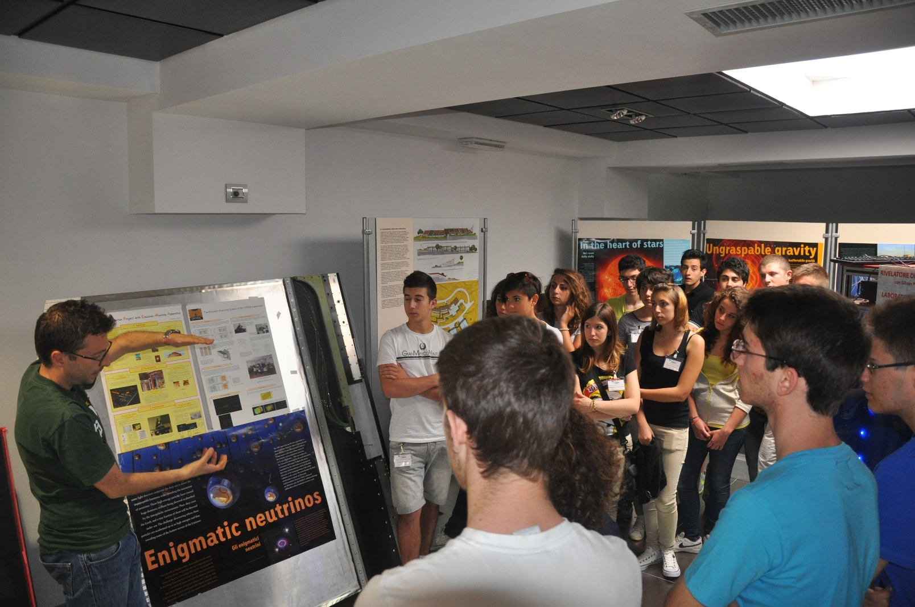
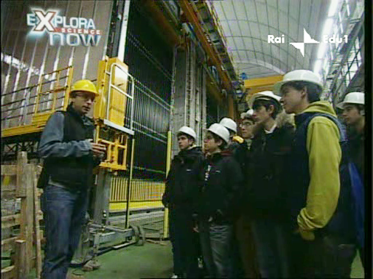
Outreach & Education
8000 visitors/year
1500-2000 visitors at LNGS open day
2014 European researcher’s night with GSSI and L’Aquila Univeristy: 15,000 participants in L’Aquila
Educational activities at several levels: from youngest to post-Doc and Physics teachers
3 education and high-education projects with Abruzzo Region on EU funds 2007-2013: 5.4 M€

