Slide 1

Test on crystals and large area MPPCs
Laboratory course: Day 3
Calorimetry Laboratory

Slide 2
Experience Description
The 6 students will be separated in two groups.
The experience is composed by two parts:
Test of three scintillating crystals (LYSO, BaF_{2,} undoped CsI pure) with a Na²² source
Test of new TSV (Through Silicon Vias) large area MPPC of Hamamatsu

Slide 3
Crystals test
Using a manual crystal station, each group will evaluate for each crystal:
The Light Yield (LY)
The Longitudinal Response Uniformity (LRU)
Study the time emission distribution
Readout will be done with a CAEN Waveform digitizer at 1 Gsps. Two different formats will be available for data analysis:
Charge and time already evaluated for each channel
Full wave with all samples digitized at 1 ns

Slide 4
Inorganic Scintillators -1-
The scintillation mechanism depends on the structure of the crystal lattice. In a pure inorganic crystal, electrons are only allowed to occupy selected energy bands.
In the pure crystal, absorption of energy can elevate electrons from the valence band to the conduction band leaving a gap in the valence band.
However, the return of an electron to the valence band with the emission of a photon is an inefficient process. Few photons are released per decay, the energy is emitted by other mechanisms. In addition, band gap widths in pure crystals are such that the resulting emitted photon is too high to lie within the visible range.

Slide 5
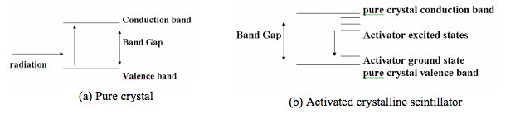
Inorganic Scintillators -2-
Small amounts of impurities are therefore added to the crystal. Tl is added to NaI in trace amounts. The impurities are called activators.
Energy states are created within what would be the forbidden band in the pure crystal. The electron can de-excite through these levels back to the valence band. The energy levels created by the activator’s presence within the crystal are narrower than in the pure crystal.

Slide 6
Characteristics of crystals used in the lab
 | LYSO | BaF2 | CsI
Radiation Length X0 [cm] | 1.14 | 2.03 | 1.86
Light Yield [% NaI(Tl)] | 75 | 4/36 | 3.6
Decay Time[ns] | 40 | 0.9/650 | 20
Photosensor | APD | RMD APD | SiPM
Wavelength [nm] | 402 | 220/300 | 310
These crystals have been selected with a lot of variation on parameters :
mechanical consideration (density of LYSO is 7 g/cm³ w.r.t to 4-5 g/cm³ of the other two)
Large variation in the light output and in the time emission distribution
→ Undoped CsI is also slightly hygroscopic and softer than the other two.
→ The BaF₂ is a special crystal since has two different components .

Slide 7

Experimental setup
Tag system
(small LYSO crystal + MPPC)
Tag system
(small LYSO crystal + MPPC)
²²Na
γ(511 keV)
²²Na
2 cm
γ (511 keV)
UV extended
PMT
Gain = 3.8 x 10⁶
Crystal
Data acquisition run:
Tag system & Na22 source can move along the crystal axis
8 different positions, within 2 cm step from the PMT
20000 events per position
Trigger is provided by the discriminated Tag system

Slide 8
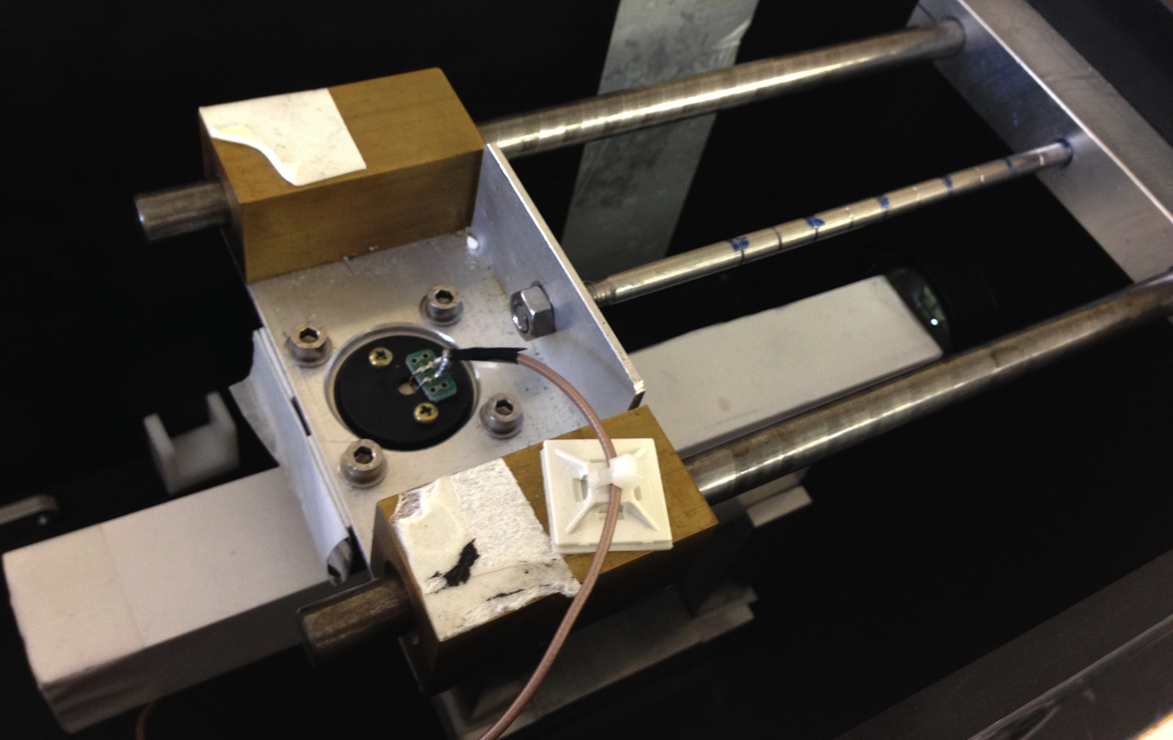
Experimental setup (2)
Tag system (LYSO)
PMT
Source
²²Na
Crystal

Slide 9
Example of the charge distributions
Charge response to a 511 keV photon for the 8 positions along crystal axis
Gaussian fit applied to extract the peak do to the 511 keV photon

Slide 10
Example of Light Yield evaluation
From the charge distributions we can measure the number of P.E

Slide 11
Longitudinal Response Uniformity
Slope of the linear fit of the LY normalized to the central value as a function of the distance of the source from the PMT
Opto Materials 01,

Slide 12
MPPC test
Using the MPPC station, each group will evaluate for the two TSV large area MPPC:
The response to a Hamamatsu blue laser as function of Vbias
The dark current as function of Vbias
With fixed temperature
The test will be done on two Micro Film MPPC
(16 cells 3x3 mm² SIPM with 50 μm pixel size)
Irradiated with a neutron flux of 1.7 n/cm²s of 14 MeV neutrons
Not irradiated

Slide 14

Irradiation technique
PICO AMMETTER
Neutron Source
Digital SCOPE
MPPC
MPPC
FNG provides Neutron with 14 MeV of energy. The scaled damage with respect the 1 MeV neutron is a factor 1.8 greater:
n_flux 1.7x10¹¹ @ 14 MeV ~ n_flux 3x10¹¹ @ 1 MeV
safety margin of the experiment
2 m from the source
Reference PM tube
Led @ 360 nm

Slide 15
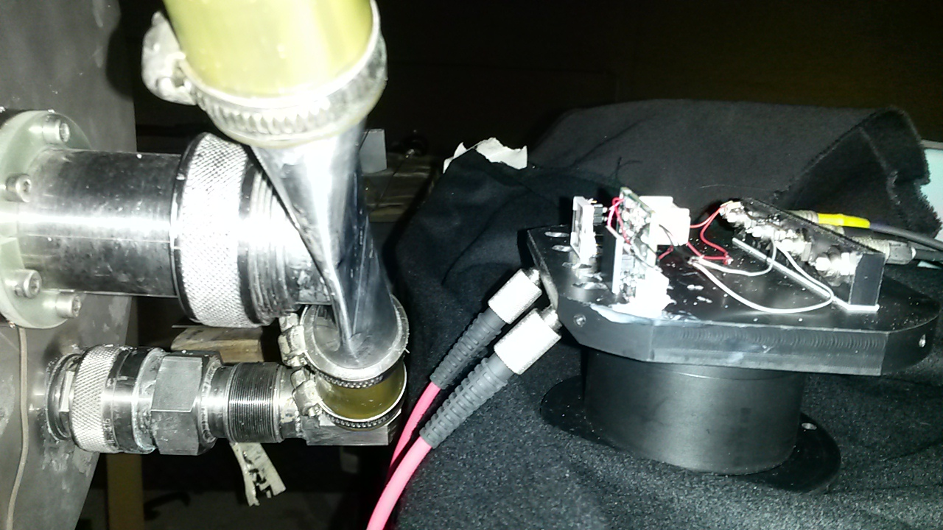
Experimental setup
MPPC
Readout for the
signal
dark current
Optical fiber connected to the Laser

Slide 16
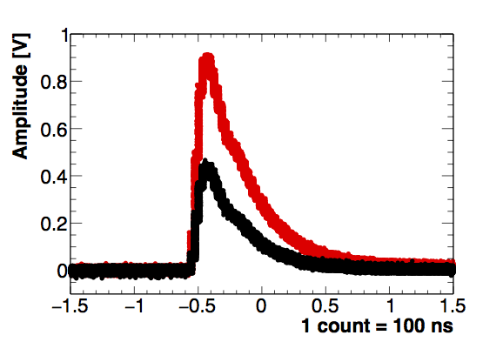
Example of results after irradiation
Total irradiation 1.1 x 10¹¹ n_14 MeV/cm² ≈ 2/3 Experiment requirement 2x10¹¹ n_1 MeV/cm² equivalent
Before irradiation
After irradiation
Digital SCOPE
30 °C
1 cell (3x3 mm²)
Integrated Neutron Flux [n/(cm²)]
R = MPPC / PMT
The students will complete the studies measuring these quantities as function of Vbias
Integrated Neutron Flux [n/(cm²)]

