Slide 1
General Information
Calorimetry Laboratory

Slide 2
E-Log Instruction
Go to the login page
https://dbweb4.fnal.gov:8443/ECL/mu2e_cal/U/login
Users: edit_students
Password: calorimetry
Open task Edit2015:
add related entry:

Slide 3
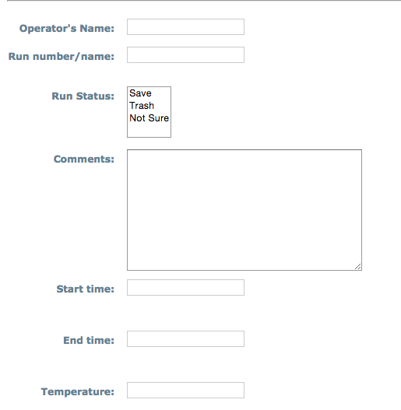
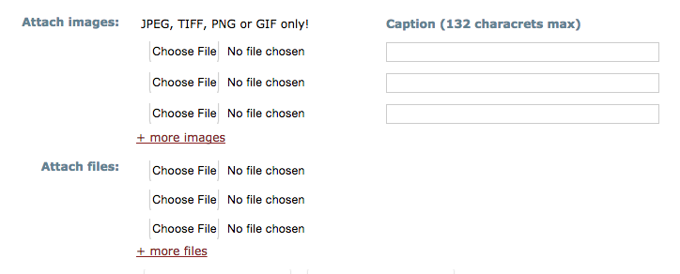
Creat new entry using the form LNF_laboratory:
Fill with the information – attach files / images :
Post the enty

Slide 4
BTF experience

Slide 5
DAQ Layout
Beam
Digitizer boards
Matrix:
0 → 8 chs
1 → 7 chs
2 → 5 chs
3 → 5 chs
²0
⁰0
⁰5
¹2
³0
²1
⁰1
⁰6
¹3
³1
²3
⁰2
⁰7
¹4
³2
²4
⁰3
¹0
¹5
³3
²5
⁰4
¹1
¹6
³4
³5 → Pin Diode
²6 → RPC ³6 → Finger 1
¹7 → Sum 9 ²7 → RPC ³7 → Finger 2

