Slide 1


Neutrino Physics and Detectors
K. Long
Imperial College London/STFC

Slide 2


The Standard Model
u
c
t
g
Fundamental
  Particles &
  forces
Understanding:
  Symmetries
  Conservation laws
  Dynamics
up
charm
top
gluon
Quarks
s
γ
d
b
down
strange
bottom
photon
Force Carriers
ν_{e}
ν
ν
ν_{e}
ν
ν
W
μ
τ
μ
τ
Leptons
e-neutrino
μ-neutrino
τ-neutrino
τ
W boson
e
μ-neutrino
τ-neutrino
e-neutrino
μ
Z
electron
muon
tau
Z boson
Generations of matter
I
II
III
Higgs
Boson
Higgs
Boson
Discovered completing the picture …

Slide 3
The Standard Model
Eur. Phys. J. C 74, 3046 (2014)
Taught, robust, predictive …
Notes:
Contours at 68% and 95% CL obtained from scans of MW versus mt (top) for the t including MH (blue) and excluding MH (grey), as compared to the direct measurements
(vertical and horizontal green bands and ellipses). The theoretical uncertainty of 0.5 GeV is added to the direct top mass measurement. In both figures, the corresponding direct measurements are excluded from
the t.

Slide 4
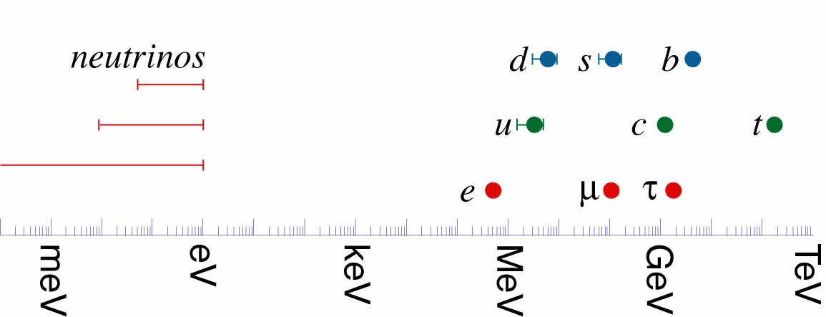

Slide 5
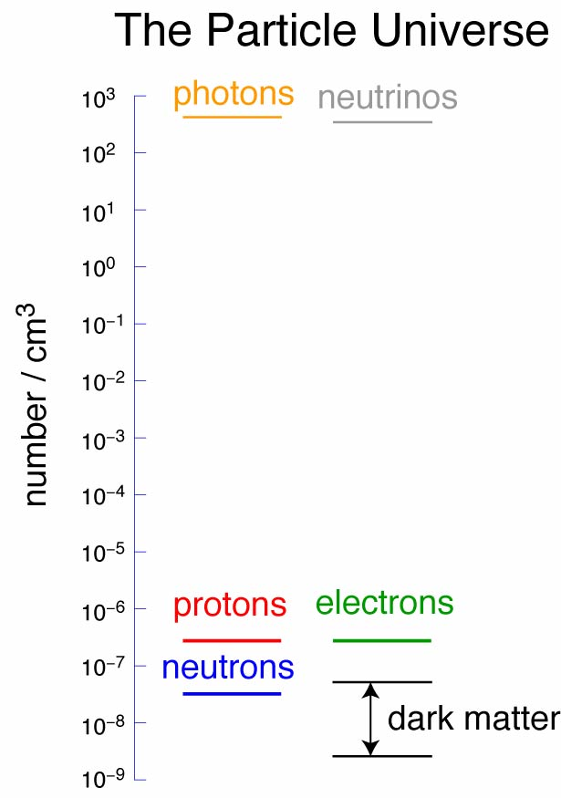

Slide 6
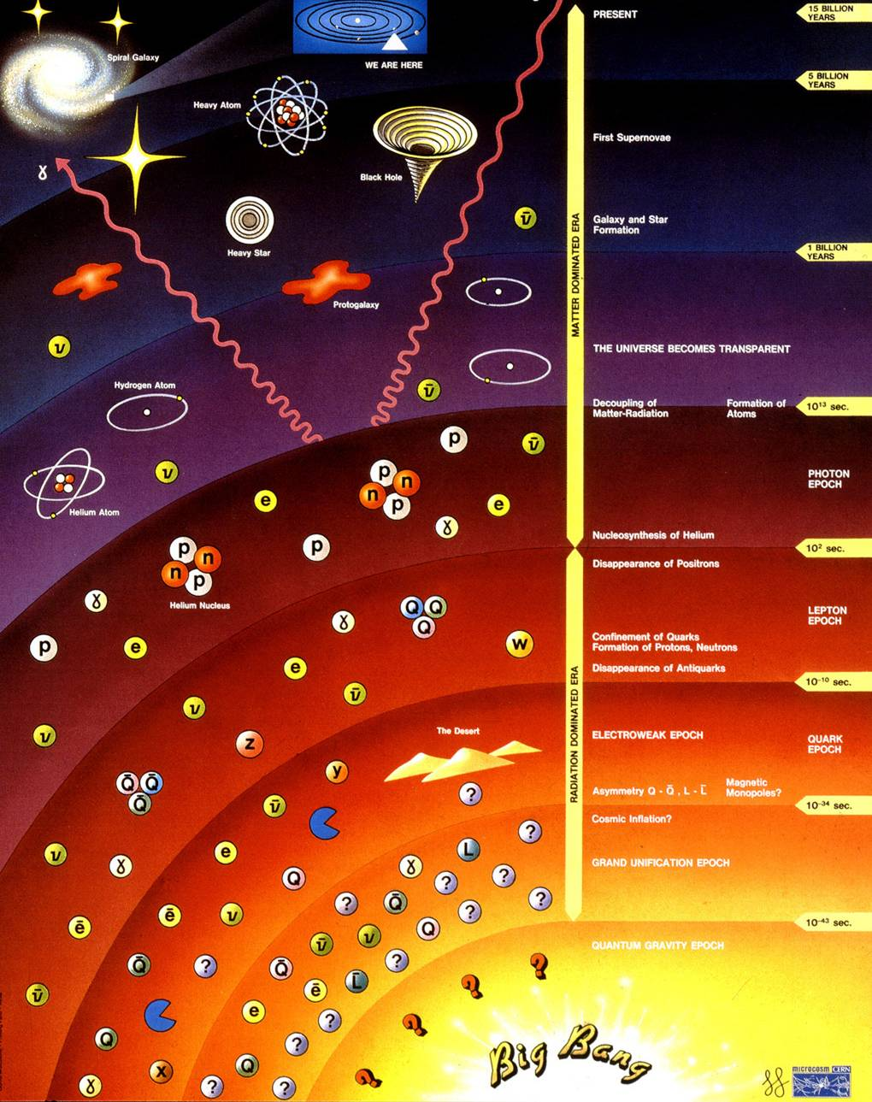
Dark matter
Galaxy/star
formation
Removal of
anti-matter
Inflation
Is the neutrino responsible for today’s Universe?

Slide 7
The Standard NEUTRINO Model
To understand particle physics, cosmology, our Universe …
… we must measure the properties of the neutrino.

Slide 8
Plan
Pedigree and provenance
Oscillations; the present generation
Sterile neutrinos
The Standard Neutrino Model and beyond
Cross sections
Scanning the horizon
Conclusions

Slide 9
PEDIGREE AND PROVENANCE
9
NEUTRINO PHYSICS AND DETECTORS

Slide 10
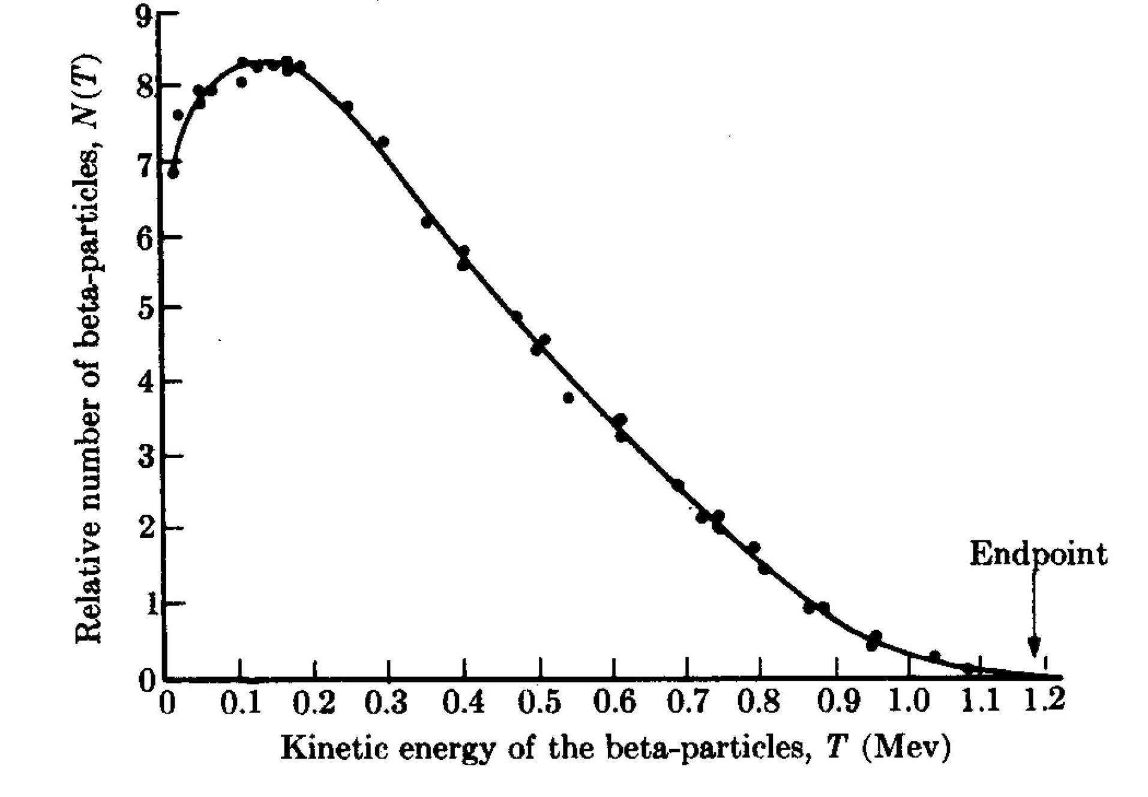
Neutrinos; the first generation:
Neutrino
hypothesis
Electron-anti-neutrino
discovery
Neutrino hypothesis:
  Postulated to conserve energy in nuclear beta decay (Dirac):
  Properties:
    Electrically neutral
    Very light
    Weakly interacting
Inverse beta decay:
  Using v_{e} from reactors
Reines
1956
Cowan

Slide 11
Discovery of muon neutrino: ν_{μ}
Brookhaven; Alternating Gradient Synchrotron
Beryllium
target
Protons
Neutrinos
Neutrino
detector
Lederman,
Schwarz,
Steinberger
Steinberger,
Ledermann,
Swartz

Slide 12
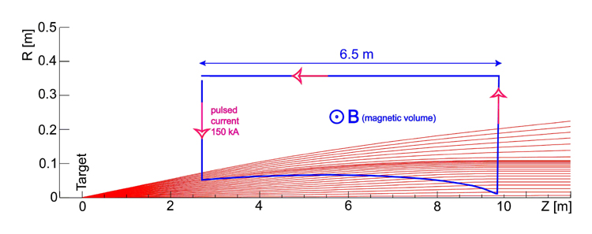
Innovation, the first neutrino beam:
Increase neutrino flux by order of magnitude:
  Focus π/K produced in proton-target interaction:
    Ideally point to parallel;
      Requires toroidal magnetic field
Requires:
  Extracted, pulsed proton beam

Slide 13
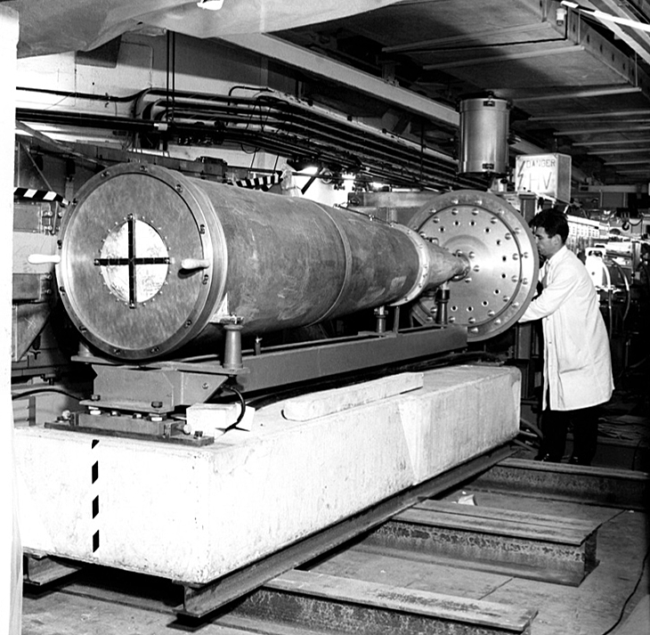
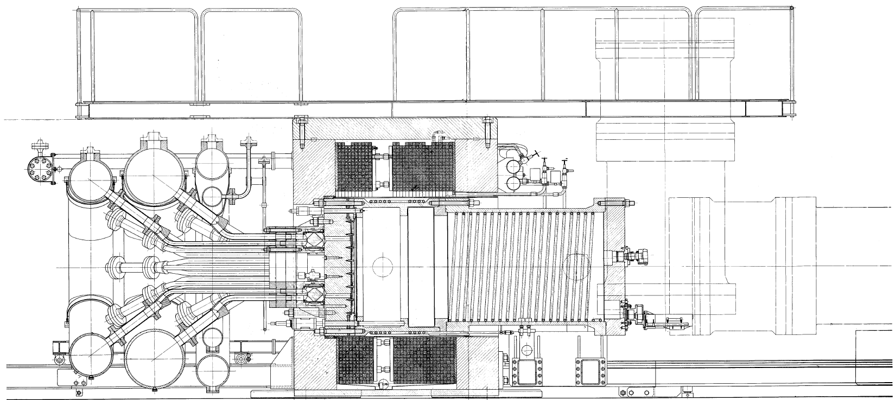
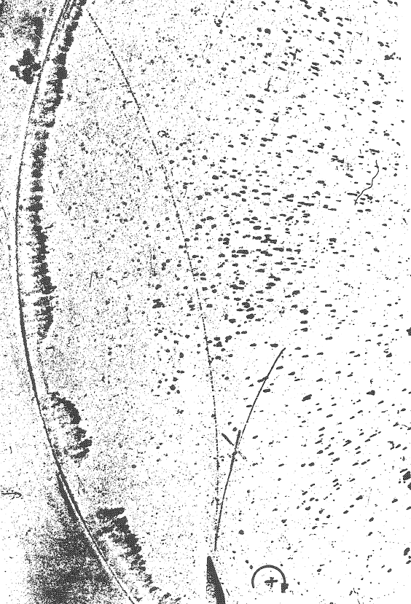
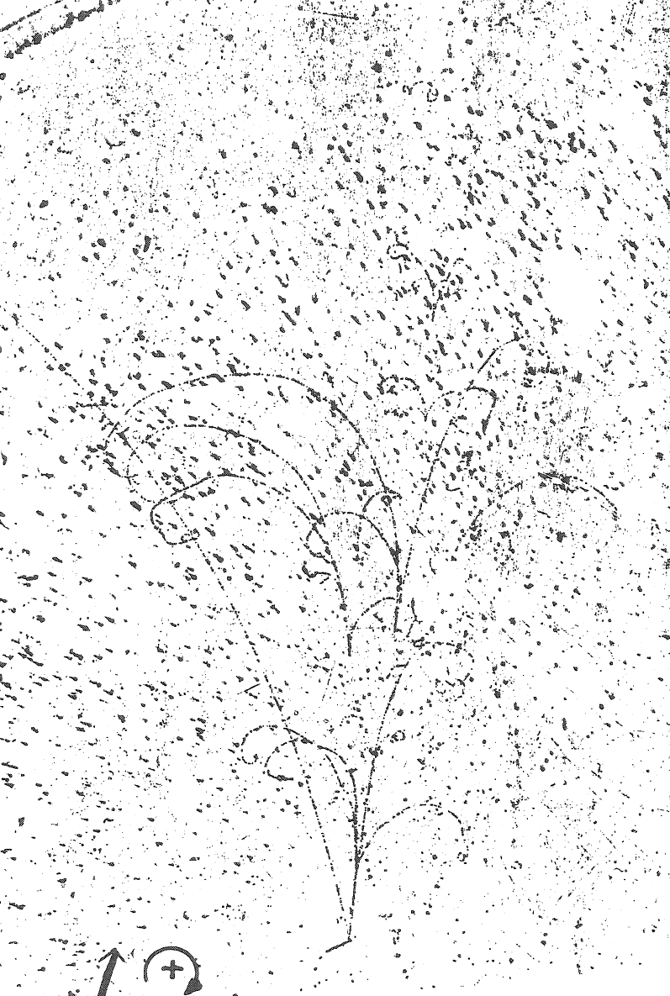
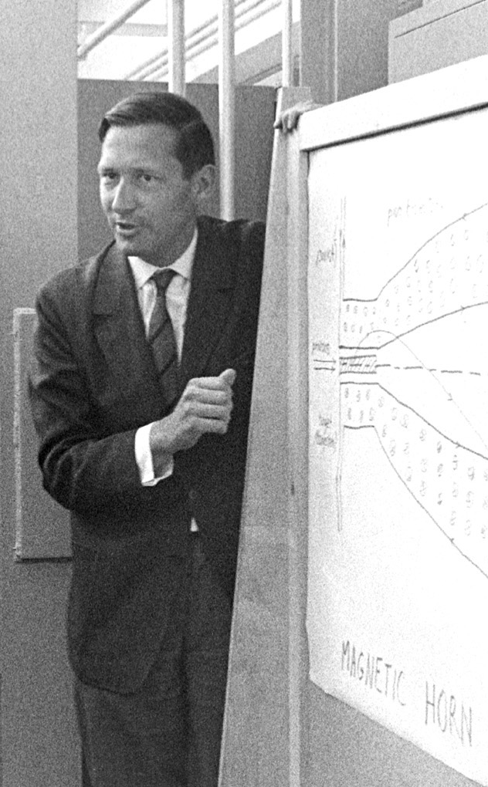
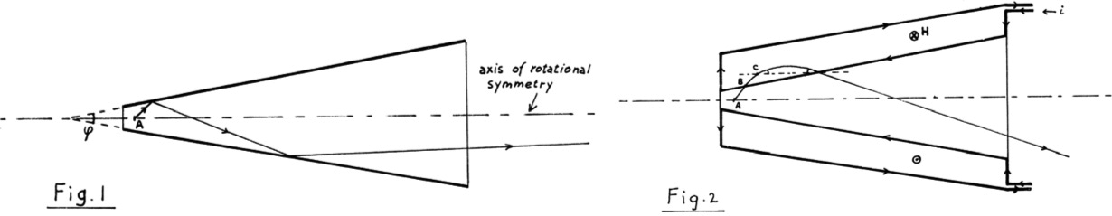
Innovation, the first magnetic horn:
Simon van der Meer
CERN, 1961
Confirmation:
muon-/electron-neutrino universality
Further innovation:
  The bubble chamber

Slide 14
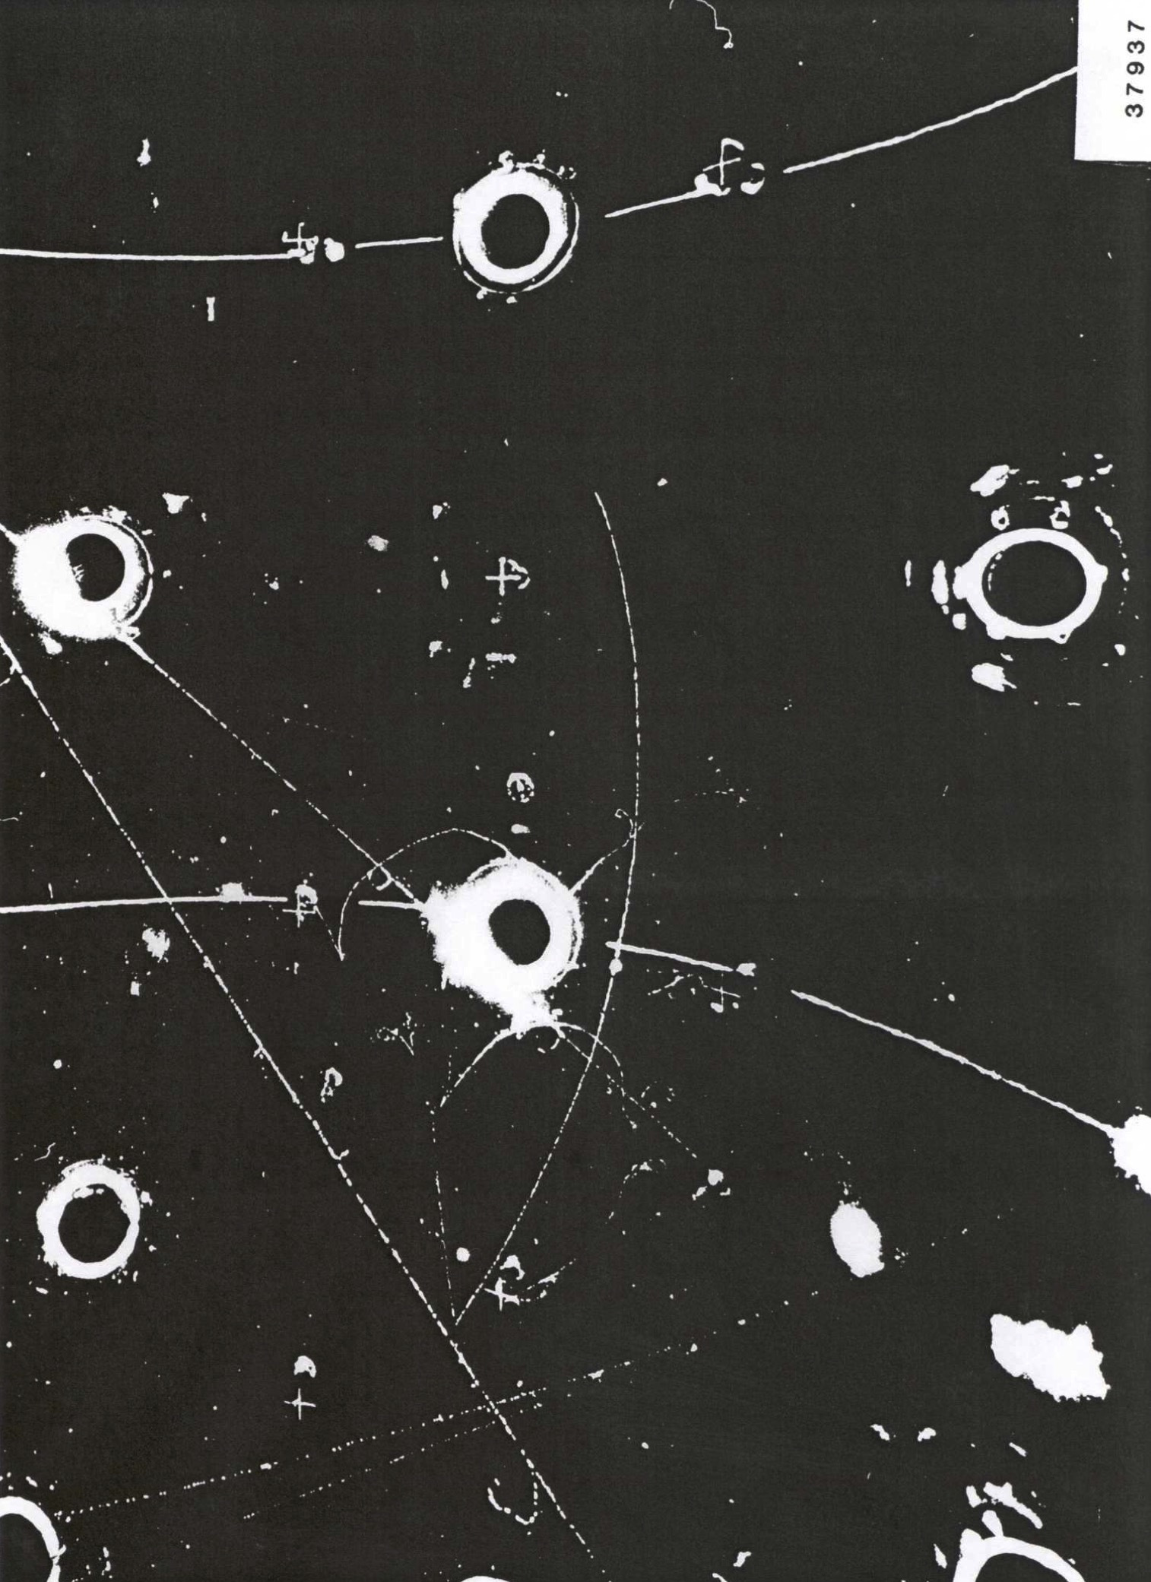
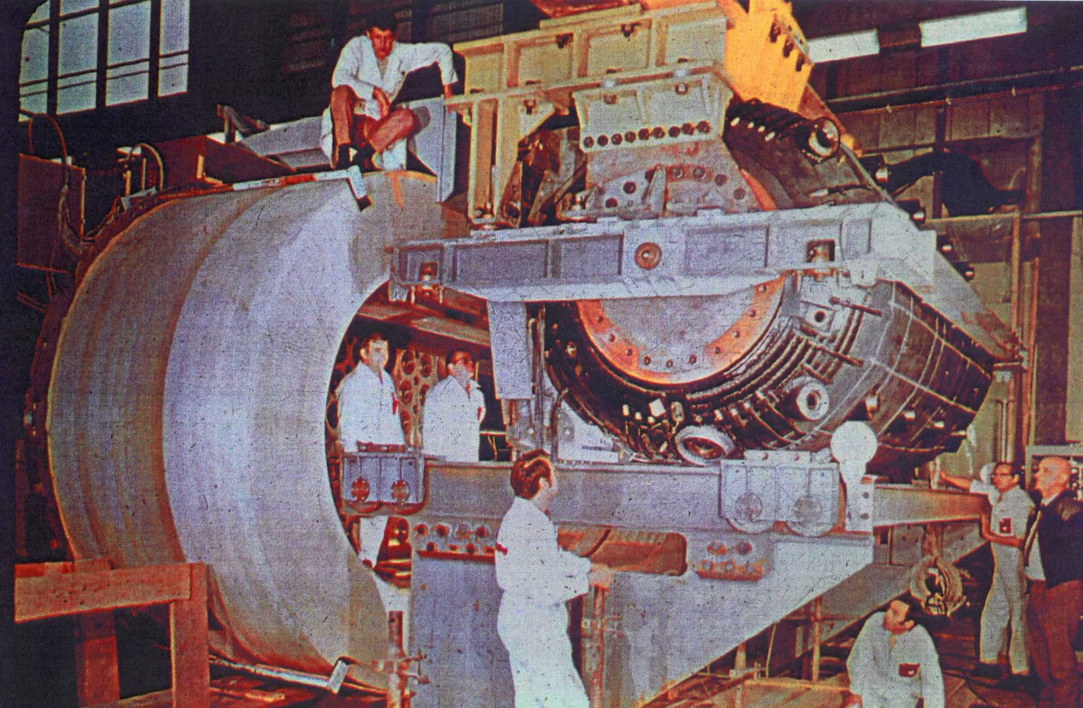
Discovery of neutral currents:
Development …
of beam and detector:
  Improved horn:
    Parabolic; with neck and downstream toroids
  Improved detector:
    Gargamelle
1971

Slide 15
Neutrino beams:
S.E. Kopp; Phys. Rep. 439 (2007) 101

Slide 16
Neutrino & the Standard Model
CERN
Horn and bubble chamber
First neutrino beam
IHEP
SKAT, JINR
CERN
Gargamelle, Aachen/Padova, CDHS,
CHARM, BEBC, CCFR, NOMAD, CHORUS
BNL
first neutrino
“beam”
BNL/FNAL
CITF, HPWF, 7’ BC, 15’ BC, E605,
E613, E734, E776, NuTEV
CERN
Horn #2 & Gargamelle
1950
1960
1970
1980
1990
2000
2010
2020
2030
ν_{μ}
discovery
Development of
E/w SM, QPM, QCD
ν_{e}/ν_{μ}
universality
Neutral
Current
discovery

Slide 17
Oscillations; the present generation
17
NEUTRINO PHYSICS AND DETECTORS

Slide 19
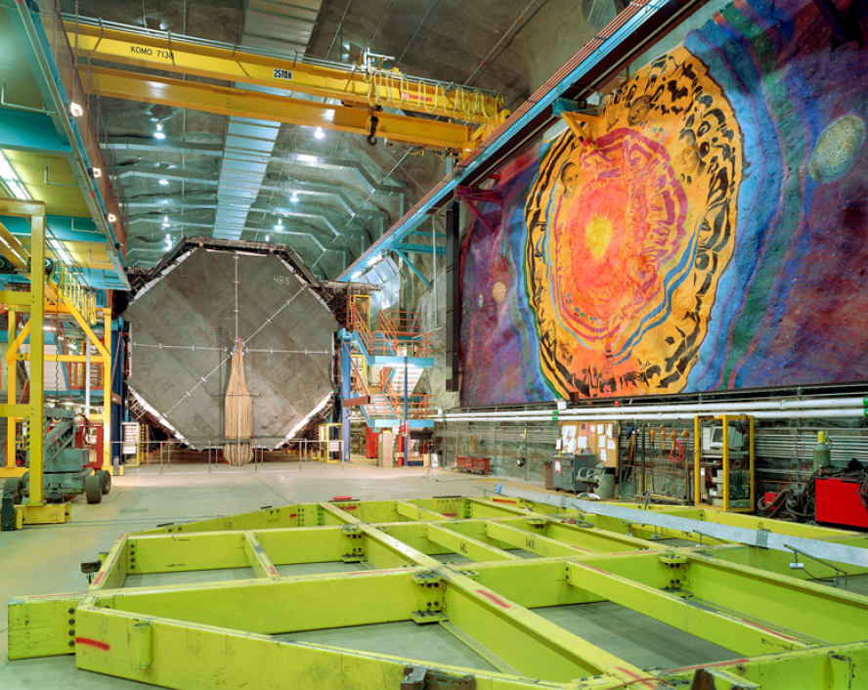
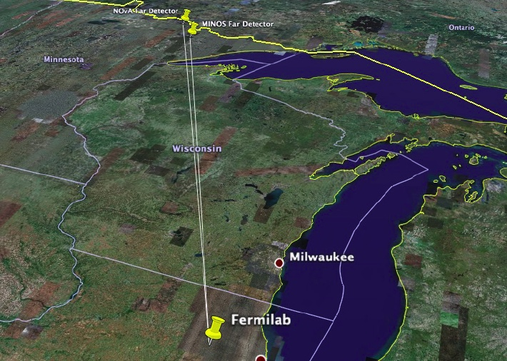
Long-baseline neutrino oscillation programme:
Present long-baseline experiments:
  Europe: OPERA, ICARUS
  Japan: T2K
  US: MINOS, MINOS+, NOvA

Slide 20
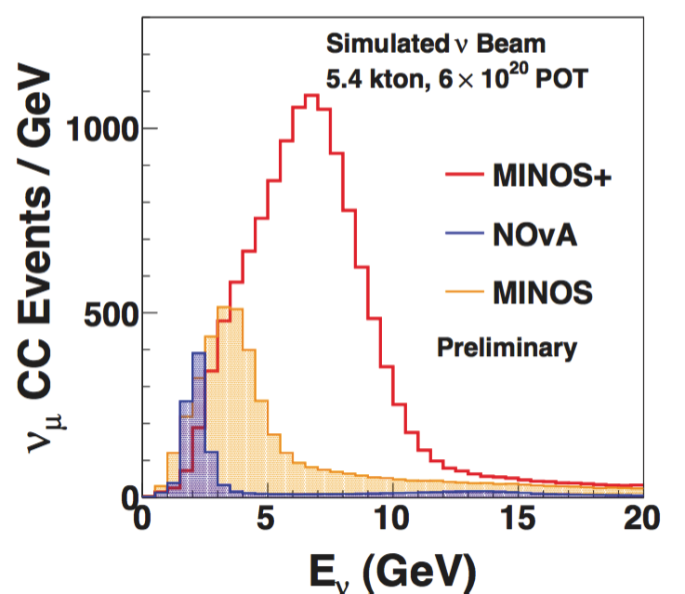
MINOS and MINOS+:
ν_{μ}
disappearance
Sousa; Neutrino’14

Slide 21
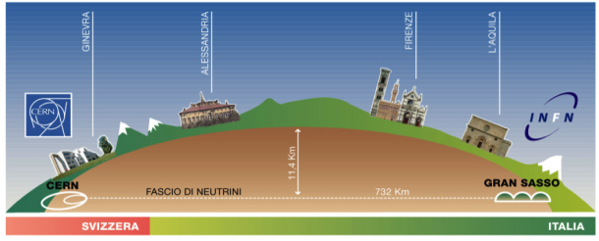
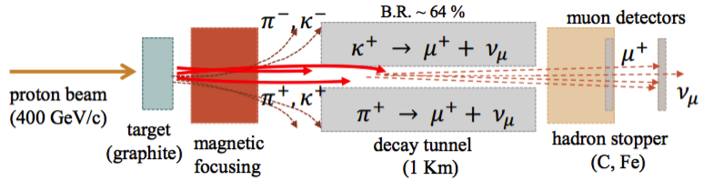
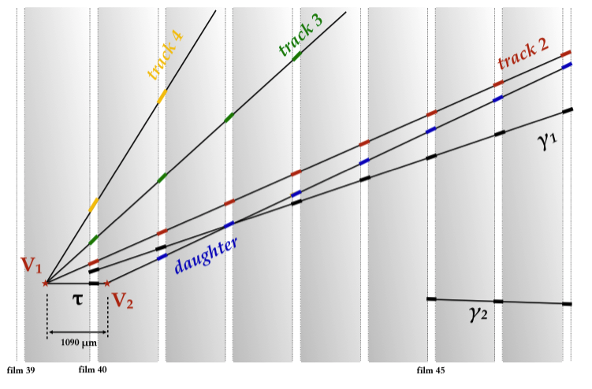
CERN to Gran Sasso:
Farnese; Neutrino ‘14
Opera: ν_{τ} appearance

Slide 22
CERN to Gran Sasso:
Dusini; Neutrino ‘14
ICARUS: ν_{e} appearance
  LAr TPC [innovation]:
    Electronic, high-resolution
    event reconstruction
  6 ν_{e} appearance events:
    No evidence for “LSND-like”
    sterile neutrinos
    Oscillation explanation of
    MiniBooNE excess excluded

Slide 23
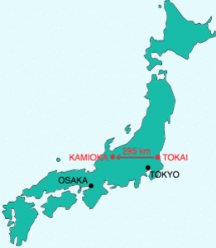
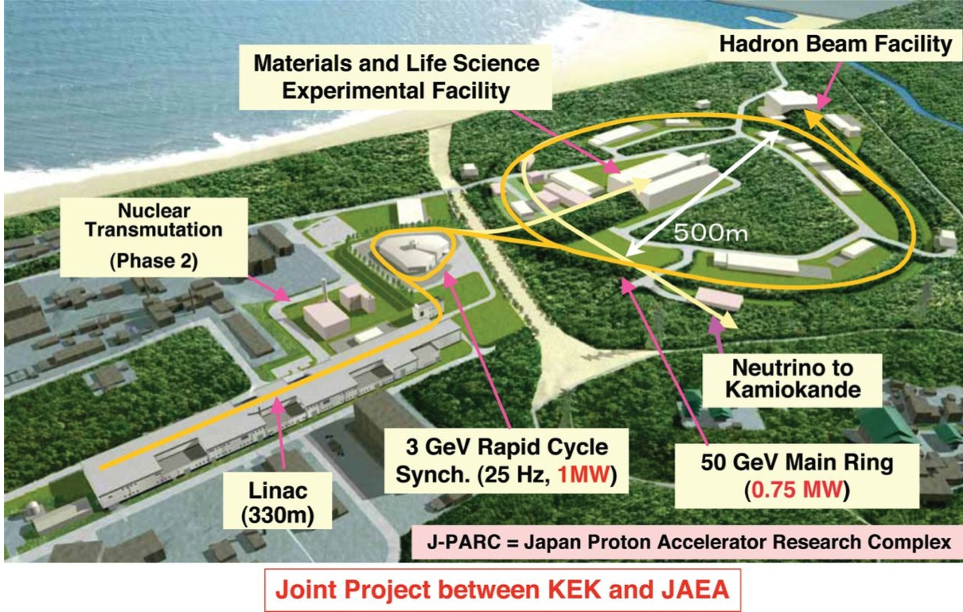
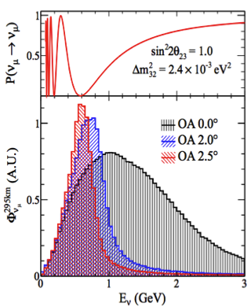
T2K: electron-neutrino appearance:
Bordoni, Neutrino’14

Slide 24
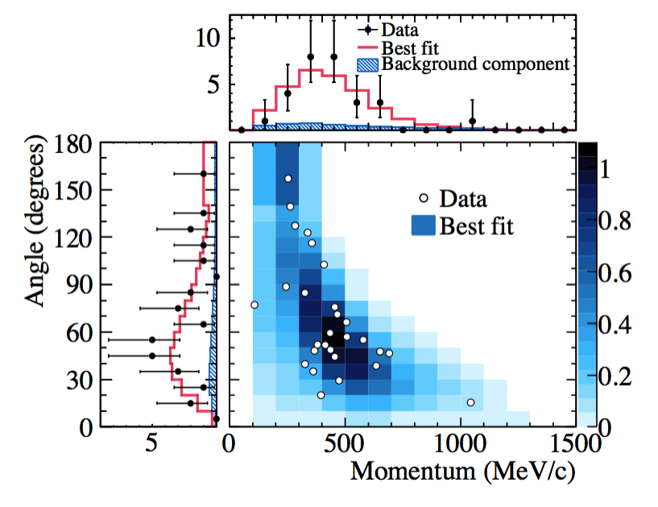
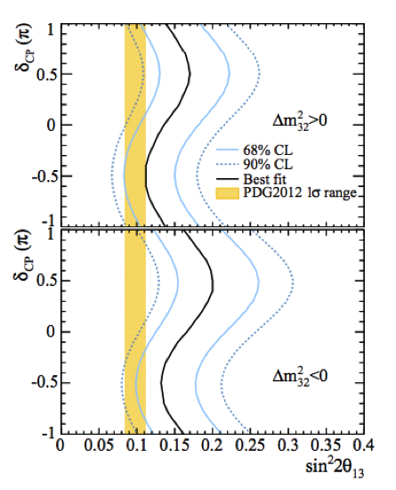
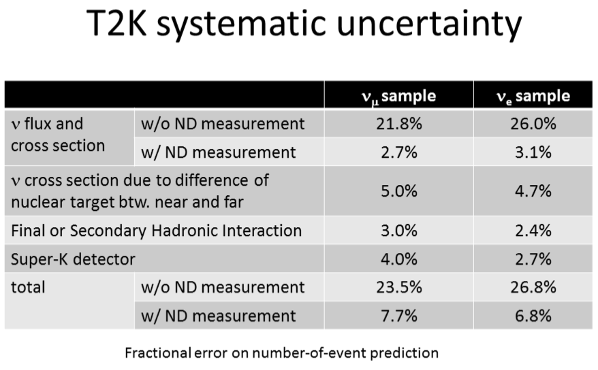
T2K: electron-neutrino appearance:
Bordoni, Neutrino’14

Slide 29
Neutrinos indicate SM is incomplete
Neutrino oscillations imply:
  Neutrinos have mass; mass states mix to make flavour states
Neutrino mass ➔ new degrees of freedom:
  Right-handed neutrinos or Majorana neutrinos
  New interactions?
Mixing among three neutrinos:
  CP-invariance violation in lepton sector
  Origin of matter-dominated Universe?
Possible cosmological impact:
  Inflation;
  Galaxy and star formation;
  Dark matter

Slide 30
“Standard Neutrino Model (SνM)”

Slide 31
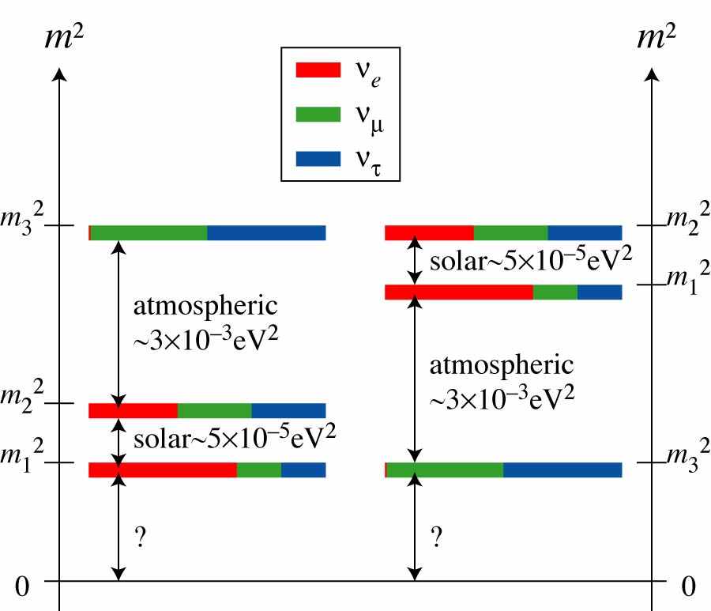
http://kamland.lbl.gov/FiguresPlots/; http://www-numi.fnal.gov/PublicInfo/forscientists.html
Notes:
Survival probability described in the previous figure with L/E range extended to 0 km/MeV. The point derived from the Chooz data ( short baseline ) is included.
This figure shows the ratio of the observed spectrum of accelerator ν_{μ} CC and ν_{μ} CC interations from MINOS and MINOS+, calculated with respect to the predicted spectrum without oscillations. The blue curve shows the corresponding oscillated prediction and its 1σ systematic uncertainty band, calculated using the best-fit oscillation parameters from MINOS. The observed data are well-described by the oscillation model.

Slide 32
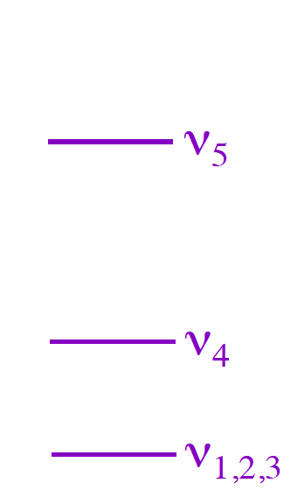
Anomalies; light-sterile neutrinos?
PRD 88 (2013) 073008
Wide variety of data described by the SvM
Anomalous behaviour in a variety of channels:
Steriles
Global analysis gives:
  Consistent description of:
    Appearance alone;
    Disappearance alone
  But:
    Tension between appearance and disappearance
Notes:
Allowed region in the sin2 2#eμ–m241 plane in the global (GLO) 3+1-HIG fit of short-baseline neutrino oscillation data compared with the 3 allowed regions obtained from
(−)μ !(−)e short-baseline appearance data (APP; inside the solid blue curves) and the 3 constraints obtained from(−)e short-baseline disappearance data (e DIS; left of the dot-
ted dark-red curve), (−) μ short-baseline disappearance data (μ DIS; left of the dash-dotted dark-green curve) and the combined short-baseline disappearance data (DIS; left of the
dashed red curve). The best-fit points of the GLO and APP fits are indicated by crosses.

Slide 33
Future programme, specification
Complete the “Standard Neutrino Model” (SνM):
  Determine the mass hierarchy
  Search for (and discover?) leptonic CP-invariance violation
Establish the SνM as correct description of nature:
  Determine precisely the degree to which θ₂₃ differs from π/4
  Determine θ₁₃ precisely
  Determine θ₁₂ precisely
Search for deviations from the SνM:
  Provide redundant measurements of sufficient precision to:
    Test the unitarity of the neutrino mixing matrix
    Seek relationships within SνM or between neutrinos and quarks
  Search for sterile neutrinos, non-standard interactions, …

Slide 34
Sterile neutrinos
34
NEUTRINO PHYSICS AND DETECTORS

Slide 35
Light sterile neutrinos
Present, inconclusive, data on:
  ν_{μ} ➔ ν_{e} [LSND, MiniBooNE]
  ν_{e} ➔ ν_{X} [Reactor flux, gallium source]
Ideally study:
and
  Determine neutral current rate
    Oscillation to steriles changes neutral-current rate
  Study ν_{e}N and ν_{μ}N scattering
    Including hadronic final states to eliminate hadronisation uncertainties
Notes:
Add “parenbar”

Slide 36

Short Baseline Neutrino programme
arXiv:1503.01520
Definitive search for Δm² ~ 1eV² sterile neutrinos:
  Exploit L, E and L/E modulation; detectors at three baselines
    Appearance, ν_{μ} ➔ ν_{e}, and, disappearance, ν_{μ} ➔ ν_{X}
  Exploit 3 LAr detectors; minimise inter-detector systematics
Robustly address backgrounds and uncertainties:
  ν_{e} contamination in FNAL Booster Neutrino Beam
  Photons produced by NC νN and cosmic rays
  External ν interactions in earth or experimental hall

Slide 37
arXiv:1503.01520
SBND
MicroBooNE
ICARUS
T600

Slide 38
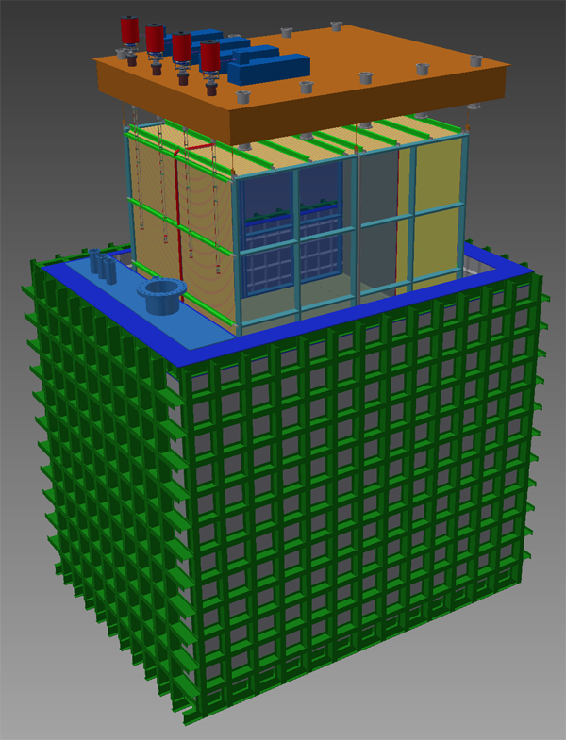
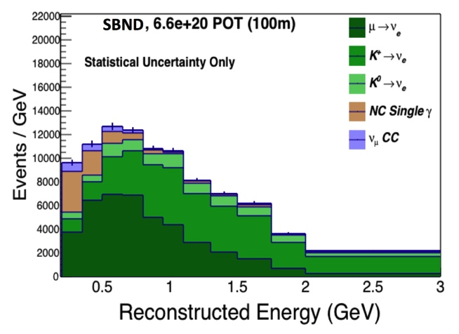
Short Baseline Near Detector
arXiv:1503.01520
275 T LAr TPC @ L = 110m
  Characterise beam before oscillation
  Address many dominant systematic uncertainties
Neutrino scattering
  Total νN sample: ~7 × 10⁶
    From 6.6 × 10²⁰ pot (~3 years)
  Inclusive ν_{e} samples:
    Charged current: ~37 × 10³
    Neutral current: ~14 × 10³
  High-statistics studies:
    Cross sections
    Final states

Slide 39
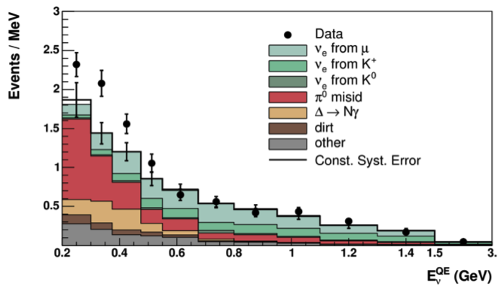
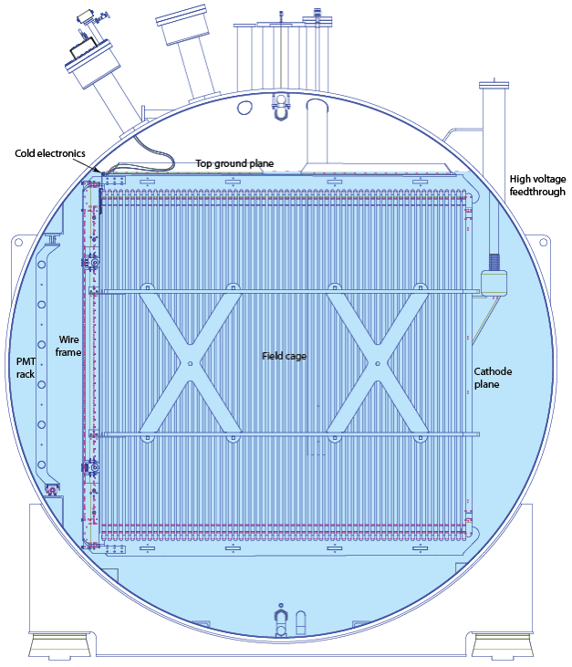
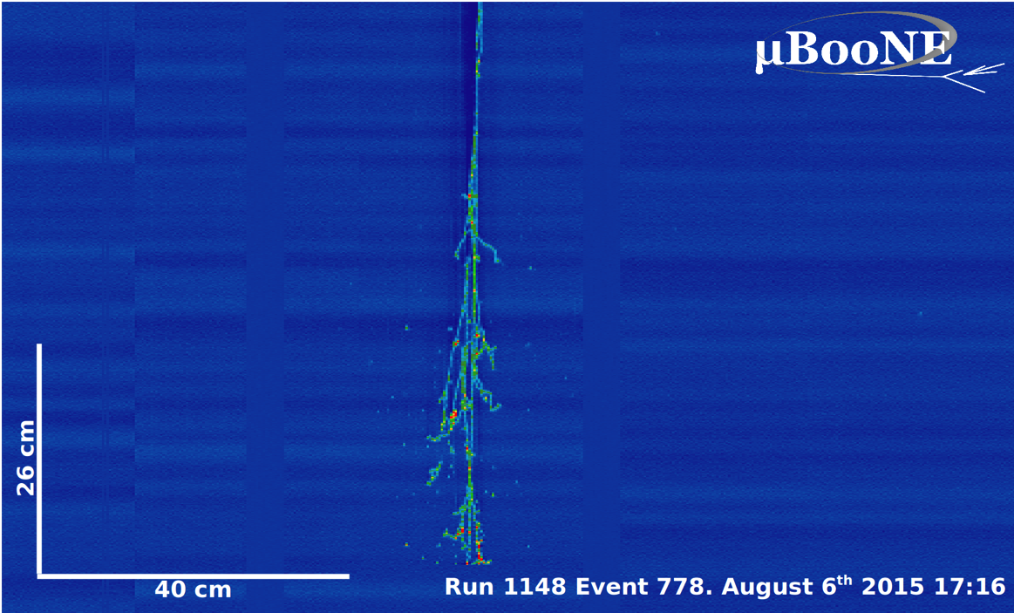
MicroBooNE
FERMILAB-PROPOSAL-0974
MiniBooNE
170 T LAr TPC @ L = 470
Solo capabilities:
  Investigate MiniBooNE low-energy ν_{e} excess;
  Measure neutrino cross sections (BNB & NuMI)
  LAr detector R&D
Neutrino scattering
  Total νN sample: ~2.5 × 10⁵
    From 6.6 × 10²⁰ pot (~3 years)
  Inclusive ν_{e} samples:
    Charged current: ~1.5 × 10³
    Neutral current: ~0.5 × 10³
  Further studies of:
    Cross sections/final states
Neutrino
Phys.Rev.Lett. 110 (2013) 161801

Slide 40
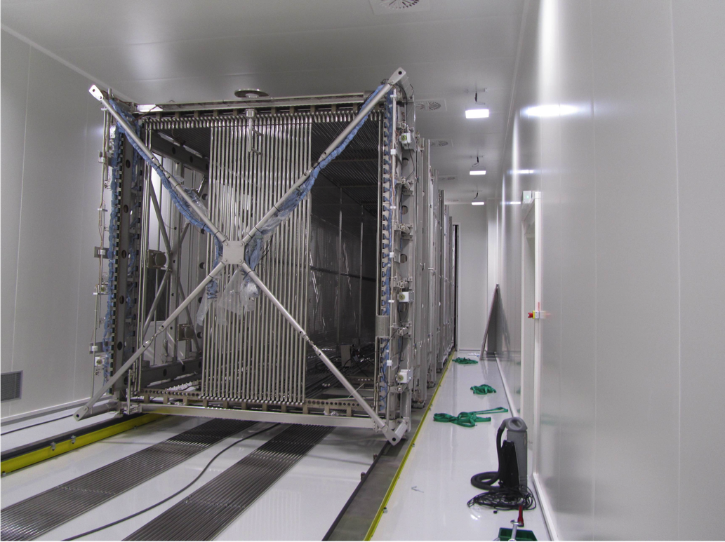
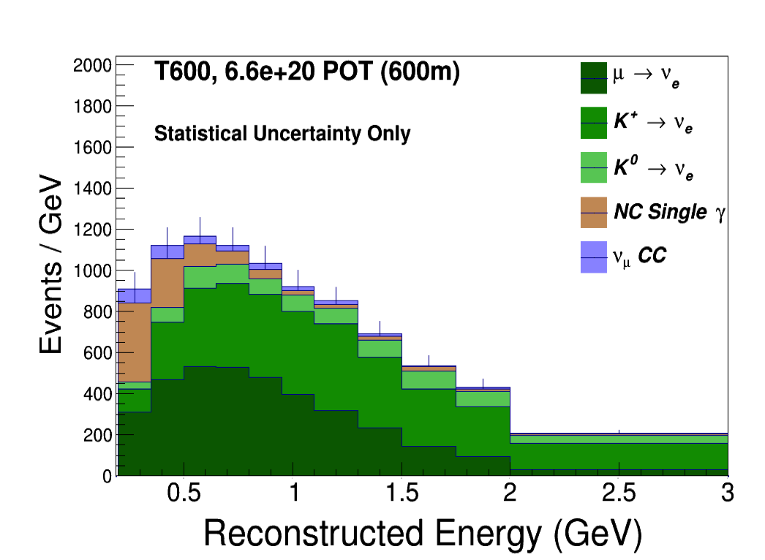
ICARUS T600
arXiv:1503.01520
760 T LAr TPC @ 600 m
  Large mass gives good ν_{e} rate
Exposed to:
  Booster Neutrino Beam; and
  Off-axis to NuMI beam
Refurbishment; WA104:
  Part of CERN Neutrino Platform programme
  Both T300 modules transported
  from Gran Sasso to CERN
  Scheduled to arrive at FNAL
  early 2017

Slide 42
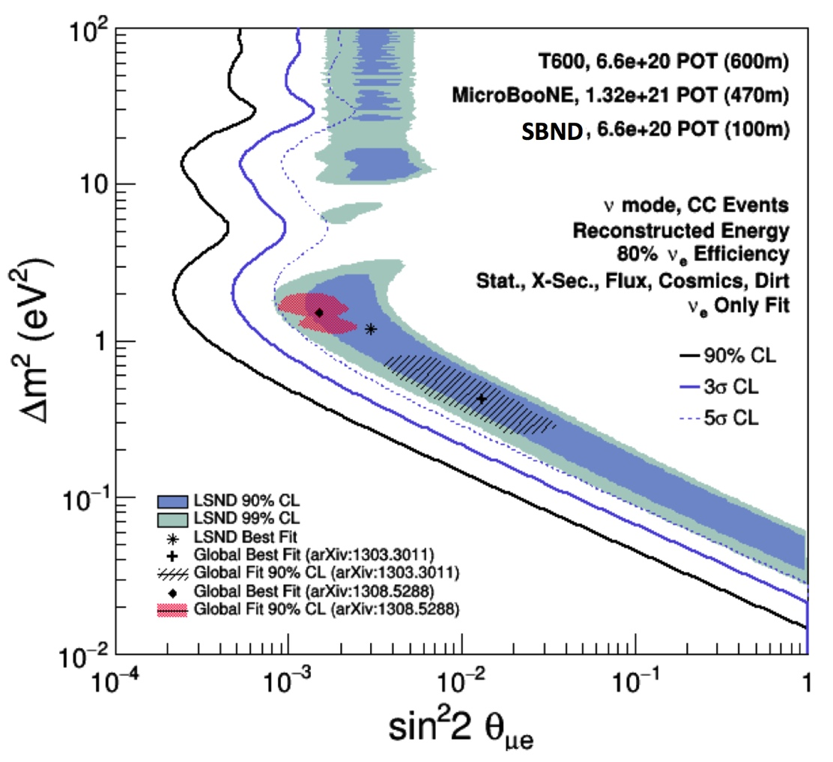
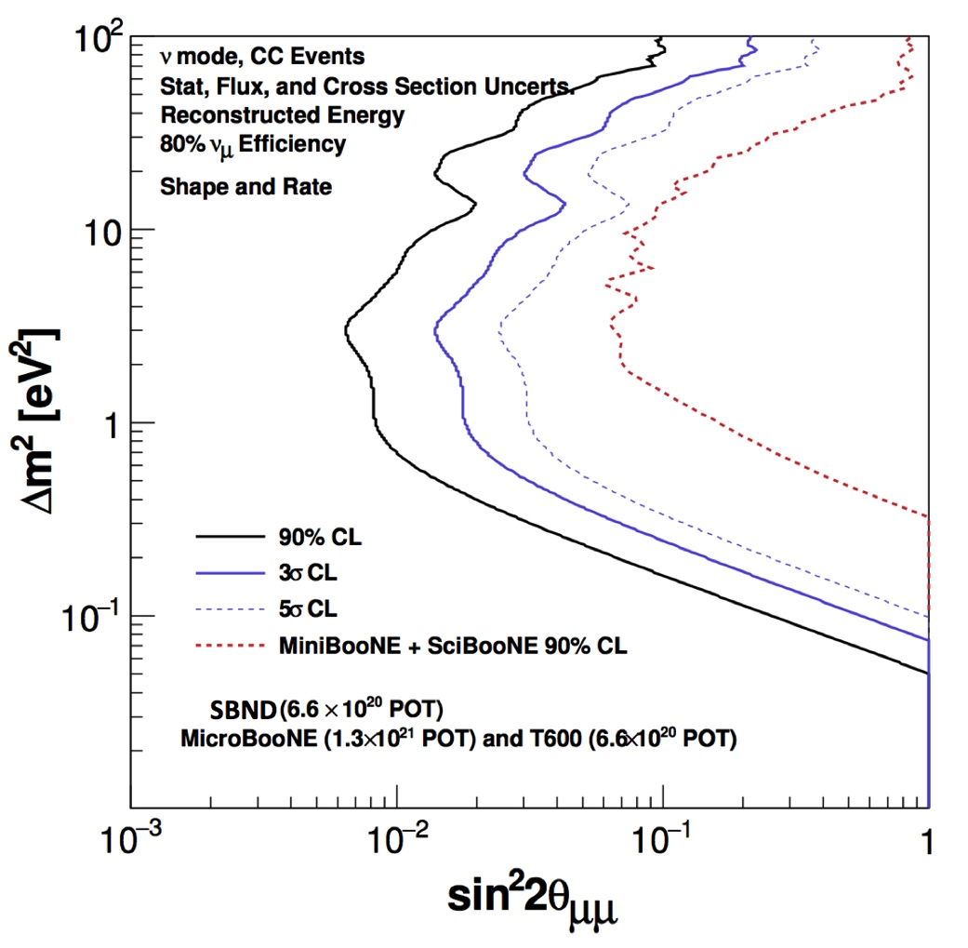
Short Baseline Neutrino sensitivity
Region of interest can be addressed at 5σ
Notes:
Sensitivity of the SBN Program to $\nu_{\mu} \rightarrow \nu_{e}$ oscillation signals. All backgrounds and systematic uncertainties described in the proposal are included. The sensitivity shown corresponds to the event distributions, which includes the topological cuts on cosmic backgrounds and an additional 95% rejection factor coming from an external cosmic tagging system and internal light collection system to reject cosmic rays arriving at the detector in time with the beam.
Sensitivity prediction for the SBN program to $\nu_{\mu} \rightarrow \nu_{x}$ oscillations including all backgrounds and systematic uncertainties described in the proposal. SBN can extend the search for muon neutrino disappearance an order of magnitude beyond the combined analysis of SciBooNE and MiniBooNE.

Slide 43
Capability to build on discovery?
Confirmation would be a major discovery;
  One that would change the direction of the field
Therefore, essential to develop capability to go beyond the performance of the present generation
Innovation in beam to observe:
  Oscillation
    ISODAR: observe oscillation using isotope decay at rest.
  As many channels as possible …

Slide 44
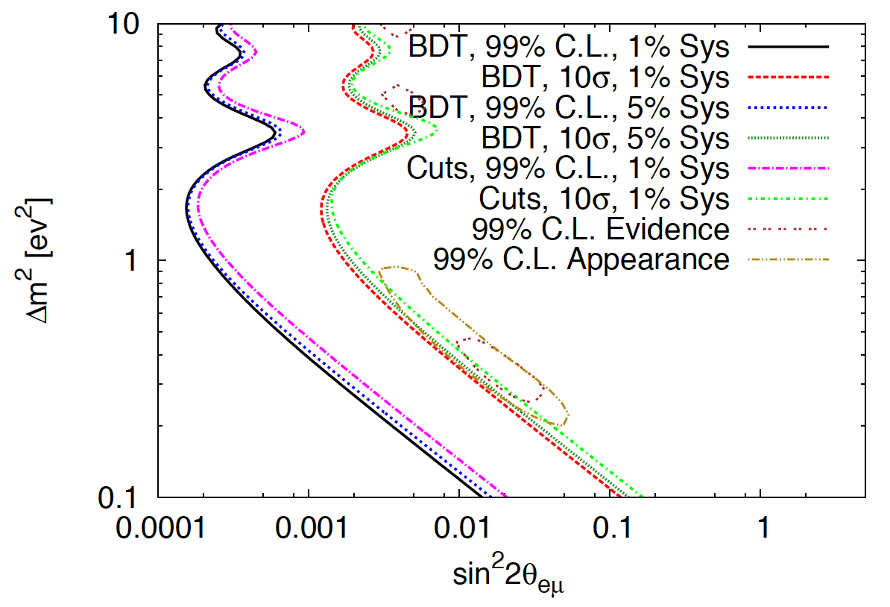
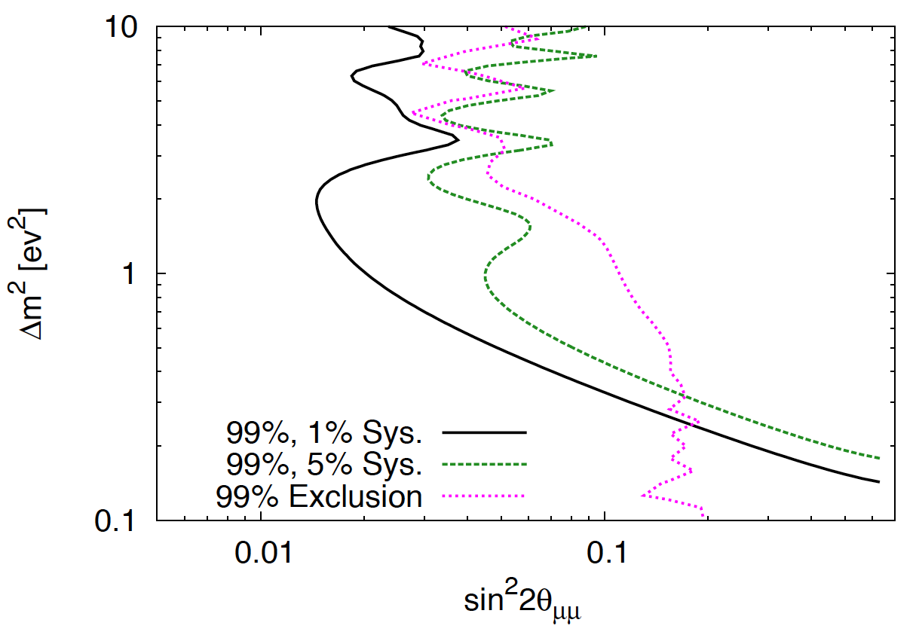
nuSTORM
10.1103/PhysRevD.89.071301

Slide 45
Standard Neutrino Model and beyond
45
NEUTRINO PHYSICS AND DETECTORS

Slide 46
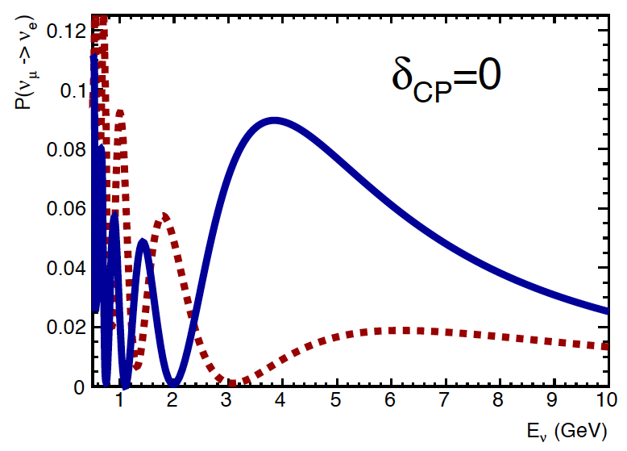
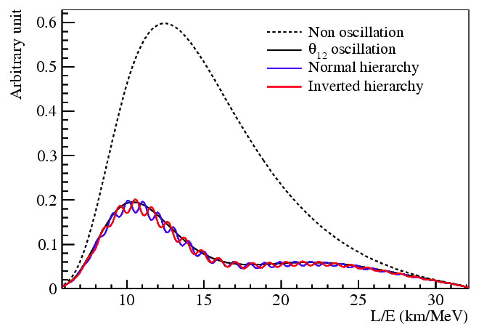
Completing the SνM
P. Shanahan:
Atmospheric: INO, PINGU, ORCA
LBL: NOνA, DUNE [design study, CHIPS]
Mass hierarchy:
  Two approaches:
    Exploit the “matter effect”
    Exploit L/E dependence
CP-invatiance violation:
  Two approaches:
    Direct observation
    Exploit L/E dependence
A. Stahl:
Reactor: JUNO, RENO-50

Slide 47
Completing the SνM
[Design study: ESSnuSB]
Mass hierarchy:
  Two approaches:
    Exploit the “matter effect”
    Exploit L/E dependence
CP-invariance violation:
  Two approaches:
    Direct observation
    Exploit L/E dependence
      DAEδALUS:
        π+ decay at rest:
          1307.6465, 1307.2949, 1006.0260

Slide 48
Deep Underground Neutrino Experiment
https://web.fnal.gov/project/LBNF/SitePages/DUNE%20and%20LBNF%20Reports%20and%20Papers.aspx
Principal objectives:
  CP-invariance violation
  Mass hierarchy
  Precision osc. physics:
    Parameter measurement
    “Beyond SνM” search
  Near-detector physics:
    Part of osc. programme
    Neutrino scattering
Additional opportunities:
  Nucleon decay search
  Supernova search
  Astroparticle physics
  Dark matter search
Collaboration:
  DUNE LBNE, LBNO + others
  Global:
    776 people, 114 institutions,
    26 countries
U

Slide 49
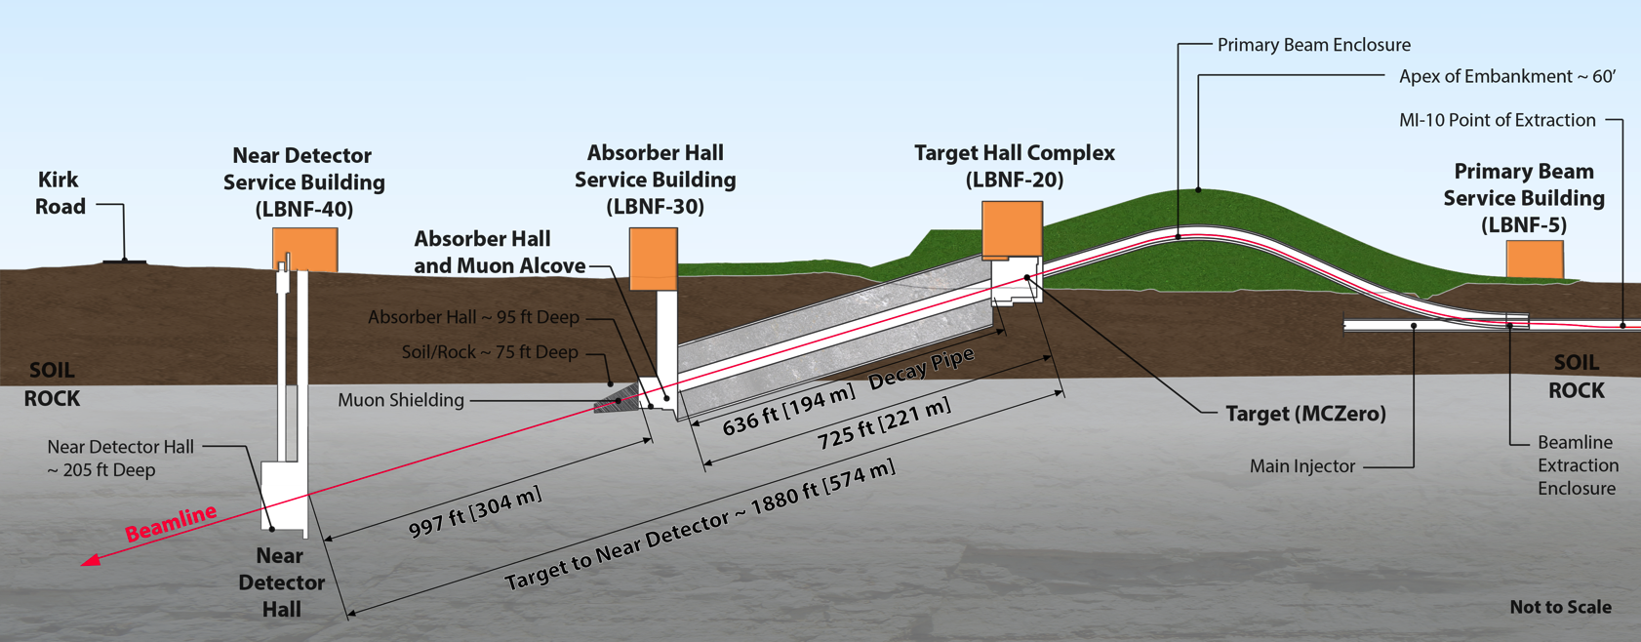
Long Baseline Neutrino Facility
https://web.fnal.gov/project/LBNF/SitePages/DUNE%20and%20LBNF%20Reports%20and%20Papers.aspx
New neutrino beam on Main Injector:
  Horn-focused, wide-band beam
  Peak in E_{ν} ~ 3 GeV; matched to 1300 km baseline
  Main Injector, with PIP II, delivers 1.07 MW @ 80 GeV
PIP II: 800 MeV s/c linac:
  1.2 MW @ 120 GeV; 1.07 MW @ 80 GeV – baseline for LBNF/DUNE
PIP III: u/g 3 GeV s/c linac [2.4 MW @ 120 GeV]

Slide 50
DUNE: far detector strategy
https://web.fnal.gov/project/LBNF/SitePages/DUNE%20and%20LBNF%20Reports%20and%20Papers.aspx
Sanford Underground Research facility (SURF)
40 kT LAr TPC:
  Modular approach: 4 caverns, 4 independent 10 kT modules
  Approach allows:
    Staged build
    Flexibility to exploit advancements in LAr TPC technique

Slide 51
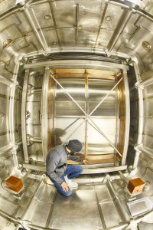
DUNE: far detector reference
https://web.fnal.gov/project/LBNF/SitePages/DUNE%20and%20LBNF%20Reports%20and%20Papers.aspx
Single-phase LAr TPC
  Development of ICARUS
  Design presented in CDR
  Reviewed in “CD1 refresh”
Single-phase prototype:
  “ProtoDUNE”; to be tested in CERN Neutrino Platform
Development programme:
  35 T prototype – 2015
  MicroBooNE – 2015
  SBND/ICARUS – 2018

Slide 52
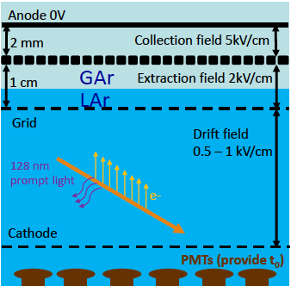
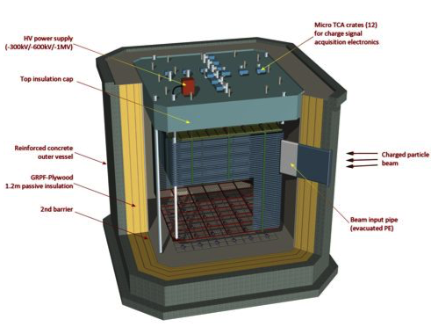
DUNE: far detector alternative
arXiv:1409.4405
Dual phase LAr TPC:
  Electron drift in liquid
  Amplification in Ar gas
  Potential benefits:
    Fully active LAr volume
    Improved signal to noise
  Presented in CDR,
  reviewed in CD1 refresh
Prototypes:
  WA105 @ CERN Neutrino Platform
    Insulated membrane tank
    Active area 36 m²
    Mass 705 T
  3x1x1 m³ WA105 prototype:
    Test of GTT membrane technology
      Cryostat completed!
    Operation 2016; important milestone!

Slide 53
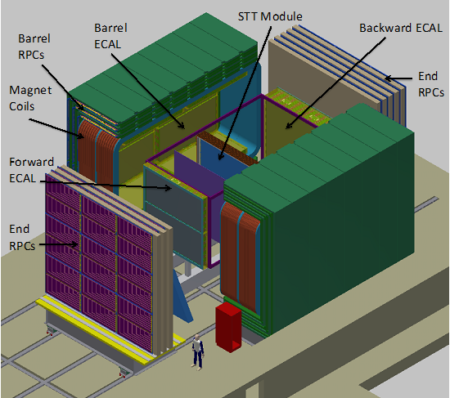
DUNE: near detector
https://web.fnal.gov/project/LBNF/SitePages/DUNE%20and%20LBNF%20Reports%20and%20Papers.aspx
Fine-grained detector:
  Central straw-tube tracker
  Pb/scintilator ECAL
  Dipole magnet
  RPC-based muon detectors
Advantages of addition of:
  LAr TPC; and/or
  High-pressure Ar TPC
under discussion

Slide 54
Strait; NuFact15
Resource loaded.

Slide 55
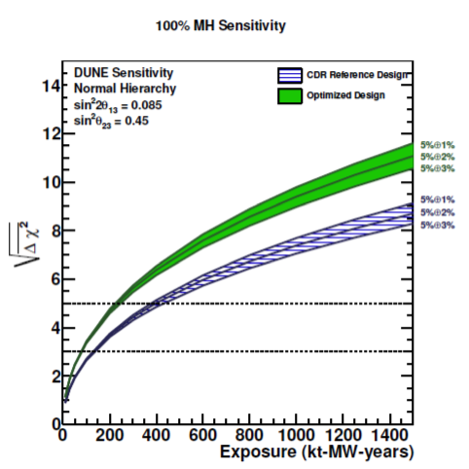
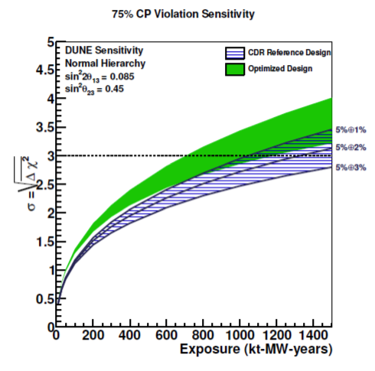
DUNE: sensitivity
https://web.fnal.gov/project/LBNF/SitePages/DUNE%20and%20LBNF%20Reports%20and%20Papers.aspx

Slide 56
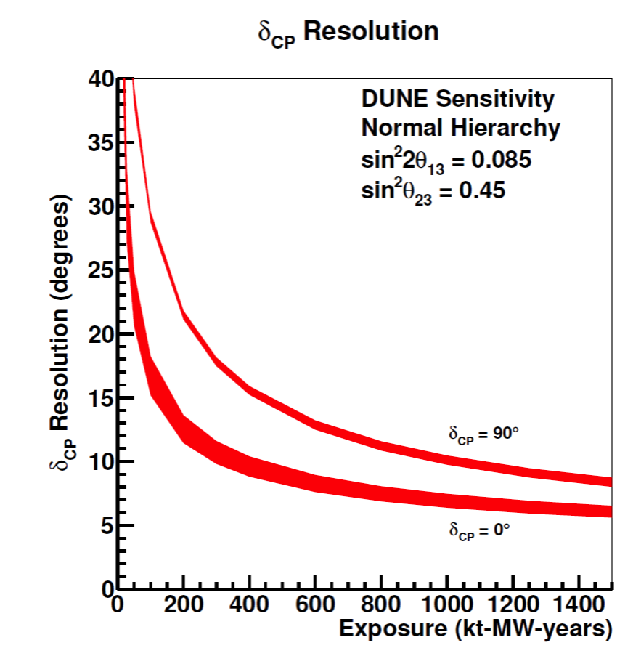
DUNE: precision
https://web.fnal.gov/project/LBNF/SitePages/DUNE%20and%20LBNF%20Reports%20and%20Papers.aspx
Notes:
The resolution of a measurement of CP as a function of exposure assuming normal MH. The resolution is shown for a CP-conserving value (CP = 0) and the value that gives the maximum CP violation for normal MH (CP = 90). The shaded region represents the range in sensitivity due to potential variations in the beam design.
The resolution of a measurement of sin2 23 as a function of exposure assuming normal MH and sin2 23 = 0.45 from the current global fit. The shaded region represents the range in sensitivity due to potential variations in the beam design.

Slide 57
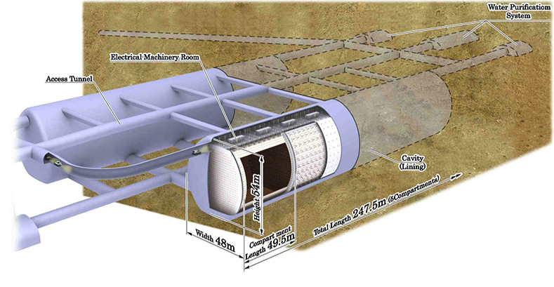
J-PARC to Hyper-K
Prog. Theor. Exp. Phys. 2015, 00000; DOI: 10.1093=ptep/0000000000
Additional opportunities:
  Atmospheric and solar neutrinos
  Proton decay
  Astroparticle physics
Collaboration:
  Proto-collaboration Jan15
  Global:
    240 scientists; 70 institutes;
    12 countries
Accelerator neutrinos:
  CP-invariance violation
  Precision osc. physics:
    Parameter measurement
    “Beyond SνM” search
  Near-detector physics:
    Part of osc. programme
    Neutrino scattering

Slide 58
J-PARC
Neutrino beam:
  Horn focused, narrow-band;
  2.5º off axis:
    Peak in E_{ν} ~ 0.6 GeV;
    matched to 295 km baseline
  Delivers 0.35 MW on target
Upgrade path:
  ➔ 2020:
    Main Ring PS upgrade:
      1 Hz operation
    High-gradient cavity upgrade
      High impedance core
  Considering run to 2024/5

Slide 59
Upgrade for Hyper-K era
Prog. Theor. Exp. Phys. 2015, 00000; DOI: 10.1093=ptep/0000000000
Proposed programme to deliver 1.3 MW to target

Slide 60
Hyper-K
Prog. Theor. Exp. Phys. 2015, 00000; DOI: 10.1093=ptep/0000000000
560 kT fiducial mass ring-imaging H₂O Cherenkov
  Two independent modules; each with a total mass of 495 kT
  Inner detector:
    99k 20-inch PMTs; 20% photo-cathode coverage
  Outer detector:
    25k 8-inch PMTs

Slide 61
Hyper-K near detectors
* https://indico.fnal.gov/getFile.py/access?contribId=308&sessionId=29&resId=0&materialId=poster&confId=8022
Essential to constrain flux and cross sections
  ν_{μ}N and ν_{e}N
Upgrades to present ND280 detector considered:
  3D grid water detector (WAGASCI, J-PARC T59)
  High-pressure Ar TPC [*]
  Water-based liquid scintilaltor [NIM A660 51 (2011)]
  Emulsion detector (J-PARC T60)
Intermediate detectors under consideration:
  TITUS [arXiv:1504.08272]:
    2 kT, Gd doped, H2O Cherenkov
    Placed at ~2 km so that flux shape is similar to that at Hyper-K
  nuPRISM [arXiv:1412.3086]:
    Measure νN as a function of o.a. angle …

Slide 62
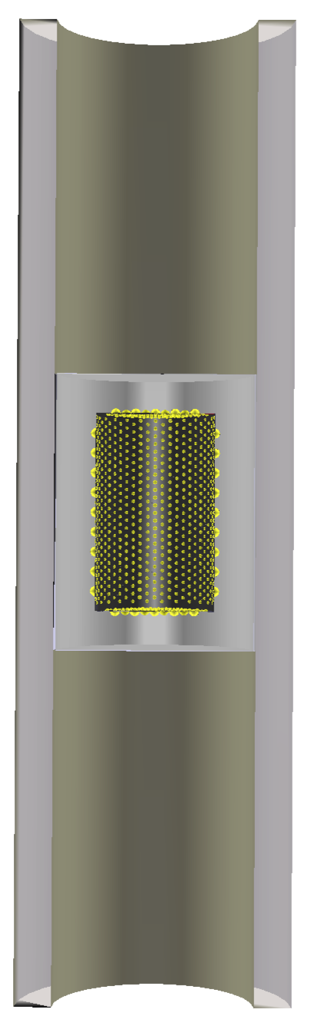

nuPRISM
arXiv: 1412.3086
Off-axis: <E_{ν}> = f(θ)

Slide 63
Kobayashi: NuFact15

Slide 64
Hyper-K: sensitivity and precision
Prog. Theor. Exp. Phys. 2015, 00000; DOI: 10.1093=ptep/0000000000

Slide 65
DUNE and Hyper-K
arXiv:1501.03918
T2K and NOνA:
  Each has an excellent programme on its own;
  Combined, sensitivity to (e.g.) δ enhanced
DUNE and Hyper-K:
  Each has an excellent programme on its own;
  Combined, sensitivity to (e.g.) δ enhanced …
... additional, programmatic, benefits:
  Optimised for same L/E at different L and E:
    Allows SνM paradigm to be tested;
  Different, E, L, technology:
    Different matter effects;
    Different systematics systematics

Slide 66

Beyond the SνM
Capability to go beyond the next generation required to:
  Probe the SνM to elucidate the physics of flavour
Ballet et al., arXiv:1410.7573v2
Notes:
Posterior probability density functions for cos for each of the solar sum rules considered in Section 3.1. The patterned regions are unphysical, which shows that the BM and GR3 sum rules could only be consistent with the known data if there is a significant deviation from the current best-t values.

Slide 67
Beyond the SνM
Capability to go beyond the next generation required to:
  Probe the SνM to elucidate the physics of flavour
Innovation in beam to:
  Increase sensitivity and precision;
  Allow detailed study of non-leading effects

Slide 68
Neutrino Factory
arXiv:1112.2853; 1308.0494
Optimise sensitivity
and precision:
  Requirements:
    Large ν_{e} (ν_{e}) flux
    Detailed study of
    sub-leading effects
Unique:
  Large, high-energy
  ν_{e} (ν_{e}) flux
    Muon-beam cooling
    huge advantage
  Favourable rigidity allows:
    Optimise E for given L
[See also MOMENT: “linear” NF]

Slide 69
Neutrino Factory
Bayes, Coloma, Huber, arXiv:1112.2853; 1308.0494, 10.1103/PhysRevLett.111.061803
IDS-NF
NuMAX

Slide 70
Cross sections
70
NEUTRINO PHYSICS AND DETECTORS

Slide 71



Cross-section measurement
T2K: Phys.Rev.Lett. 113 (2014) 24, 241803; MINERvA: 10.1103/PhysRevLett.112.231801; Ghosh, NuFact15
T2K
MINERνA
MINERνA
Notes:
Unfolded e CC inclusive differential cross-sections as a function of pe (top), cos(e) (middle) and Q2 (bottom). The inner (outer) error bars show the statistical (total) uncertainty on the data. The dashed (solid) line shows the NEUT (GENIE) prediction. Overflow (underflow) bins are indicated by > (<) labels, and are normalized to the width shown.
Ratios of the charged-current inclusive cross section per nucleon as a function of E (left) and as a function of reconstructed x (right) for C/CH (top), Fe/CH (middle), and Pb/CH (bottom). Error bars on the data (simulation) show the statistical (systematic) uncertainties. The 2 calculation includes correlations among all bins shown. Events with x greater than 1.5 are not shown.
Jorge: In these inclusive ratios, the high x ratios of Fe/CH and Pb/CH are dominated by quasi-elastic and resonance. That the measurements are so far away from the GENIE predictions suggests that we do not understand the A-dependence of QE and resoanance production (!) dominant interactions for oscillation experiments!

Slide 72


Cross-section measurement
Lots of data to analyse and understand:
  MINERvA, ND280, MINOS-ND, NOvA-ND
Important advances in theory:
  Complete, accurate description challenging
    ν_{e} ≠ ν_{μ} : some aspects understood
  ν ≠ ν : vector-axial-vector interference
    ν_{e} ≠ ν_{e} : pernicious!
Additional measurements required:
  CAPTAIN-MINERvA [arXiv:1309.1740]
  SBN detectors:
    SBND, MicroBooNE, ICARUS

Slide 73

nuSTORM and cross section measurement
LOI to FNAL PAC: 1206.0294;
EoI to CERN: CERN-SPSC-2013-015, SPSC-EOI-009,1305.1419;
Proposal to FNAL PAC, May 2013
nuSTORM event rate is large:
  Statistical precision high:
    Can measure double-differential cross sections
Events per 100 Tonne
Events per 100 Tonne

Slide 74

CCQE cross section measurement:
Proposal to FNAL PAC, May 2013
Systematic uncertainties for CCQE measurement at nuSTORM:
  Six-fold improvement in systematic uncertainty compared with “state of the art”
  Electron-neutrino cross section measurement unique

Slide 75
Scanning the horizon
75
NEUTRINO PHYSICS AND DETECTORS

Slide 76
Future neutrino programme
An exciting programme of discovery lies ahead:
  DUNE and SBN at LBNF
  Hyper-K at J-PARC
  Reactor, atmospheric, astroparticle, solar
Innovation and the development of capability:

Slide 77

Innovation in detector
Energetic development of detector technique:
  Large mass, LAr TPC:
    DUNE prototypes, WA105, SBND, MicroBooNE, ICARUS, CAPTAIN
  Near detectors for systematics and cross sections:
    nuPRISM, TITUS, CAPTAIN, DUNE ND
Supported by the CERN Neutrino Platform:

Slide 78
SνM: Accelerator-based contributions
CERN
Horn and bubble chamber
First neutrino beam
IHEP
SKAT, JINR
CERN
Gargamelle, Aachen/Padova, CDHS,
CHARM, BEBC, CCFR, NOMAD, CHORUS
FNAL
MINOS, MINOS+, NOvA
Global neutrino
progamme
Hyper-K
LBNF/DUNE
CERN Neutrino Platform
CERN
OPERA, ICARUS
BNL
first neutrino
“beam”
BNL/FNAL
CITF, HPWF, 7’ BC, 15’ BC, E605,
E613, E734, E776, NuTEV
KEK/J-PARC
K2K, T2K
CERN
Horn #2 & Gargamelle
1950
1960
1970
1980
1990
2000
2010
2020
2030
ν_{μ}
discovery
Development of
E/w SM, QPM, QCD
Development of
Standard Neutrino
Model
ν_{e}/ν_{μ}
universality
Neutral
Current
discovery
Innovation in detectors to provide:
— High-precision
— Large data sets
— Control of systematics
Innovation in accelerators to go beyond
Discovery of
CP-invariance violation?

Slide 79

Innovation in neutrino beam
Neutrino Factory offers un-paralleled performance
  Essential R&D: demonstration of ionization cooling
    MICE: Muon Ionization Cooling Experiment

Slide 80
Muon Ionization Cooling Experiment
ISIS
RAL
MICE

Slide 81



Beam-line instrumentation

Slide 82


Cooling demonstration; 2017/18

Slide 83

Reminder; the “cooling equation”
Paraxial (and other) approximation:
Emittance:
  MICE Muon Beam optics and diffuser settings
Material:
  Absorber change (LH2; LiH);
p, E and β:
  Vary beam momentum, optics

Slide 84

“Step IV”; 2015/16

Slide 85


Slide 86



MICE trackers
350 μm scintillating-fibre tracker:
  10 p.e./mip demonstrated with cosmics
  470 μm intrinsic resolution per plane
MC: delivers per-cent level emittance measurement

Slide 88
Conclusion
88
NEUTRINO PHYSICS AND DETECTORS

Slide 89
Neutrino physics
Laid the foundations for the Standard Model:
  The neutrino itself!
  Neutral and charged currents
  The quark parton model
  QCD and structure functions …
Points the way to physics beyond the Standard Model
  Neutrino oscillations imply ...
    Neutrinos have mass and mix
  ... and point to the existence of new particles and/or forces ...

Slide 90
Future neutrino programme
An exciting programme of discovery lies ahead:
  DUNE and SBN at LBNF
  Hyper-K at J-PARC
  Reactor, atmospheric, astroparticle, solar
Innovation and the development of capability:
  Detector: to deliver the planned/future programme
  Accelerator: to elucidate the physics of flavour
    Beams derived from muon decay have unique potential
Taken together we have a programme by which to:
  Understand origin of neutrino mass and if a new scale exists;
and thereby open a new window on laws of nature!

