Slide 1

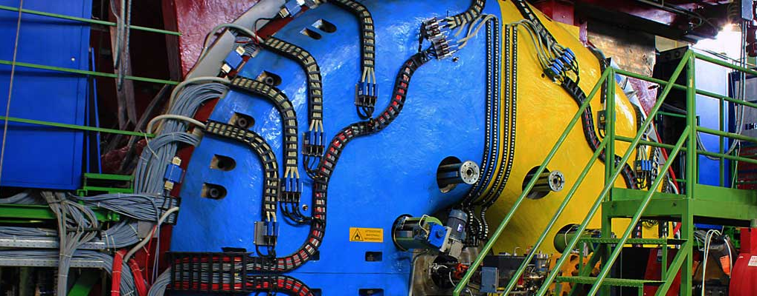

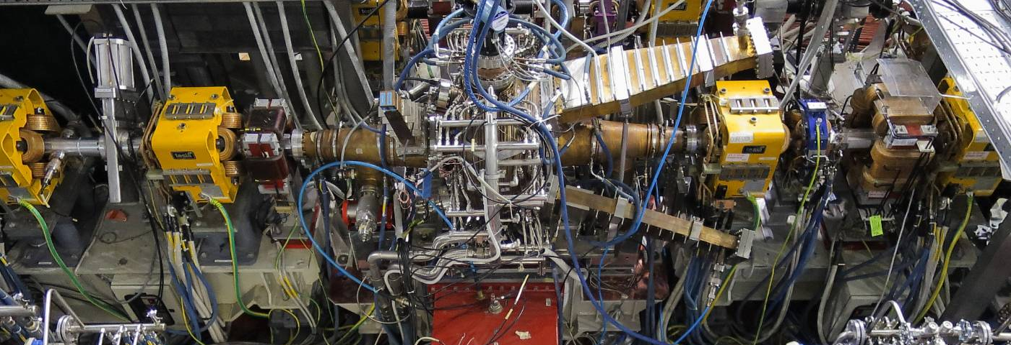



Accelerator Laboratory:
RF ACCELERATING STRUCTURES

Slide 2
Summary
Introduction
Standing Wave Structures (Resonant cavities)
Travelling Wave Structures (Iris loaded waveguides)
Lab Experimental activity
Characterization of an Aluminum model of the S-band RF GUN for the ELI-NP project
Characterization of an Aluminum model of the S-band RF deflector for the CTF3 project
The LNF RF Team:
D. Alesini, M. Bellaveglia, F. Cardelli, A. Gallo, A.Mostacci, L. Piersanti
RF Crew
RF Accelerating Structures

Slide 3
Fundamental relations of the relativistic dynamics
RF Crew
RF Accelerating Structures

Slide 4
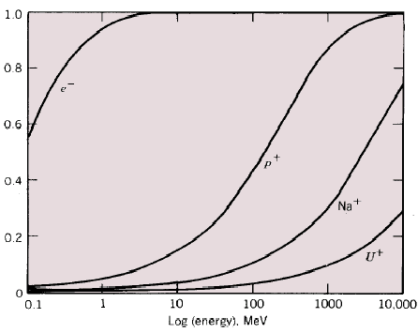
Energy-velocity plot
Velocity variations are negligible at energies well above the particle rest energy!
Leptons (light particles) are pratically fully relativistic in any existing dedicated accelerators (W_{k}>>W₀, with the exception of the very first acceleration stage) while protons and ions are typically weakly relativistic (W_{k}<W₀ – but not always, see high energy hadron colliders such as the LHC).
For leptons the accelerating process occurs at constant particle velocity (v ≈ c), while protons and ions velocity may change a lot during acceleration. This implies major important differences in the technical characteristics of the dedicated accelerating structures.
β= v/c
Particle energies are typically expressed in electron-volt [eV], equal to the energy gained by 1 electron accelerated through an electrostatic potential of 1 volt:
1 eV=1.6x10⁻¹⁹ J
W_{k}[MeV]
e⁻ relativistic ( ) at W>1MeV (W₀=511keV)
p relativistic at W>1000 MeV (W₀=938MeV)
RF Crew
RF Accelerating Structures

Slide 5
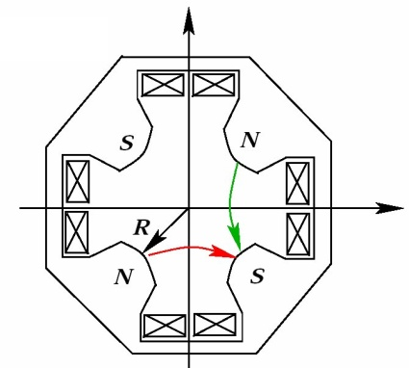
Fundamental equation of the particle motion
ACCELERATION
BENDING AND FOCUSSING
Longitudinal Dynamics
Transverse Dynamics
Electric field
Deflection
(magnetic field)
Beam
RF Crew
RF Accelerating Structures

Slide 6
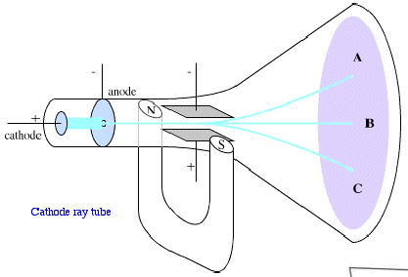
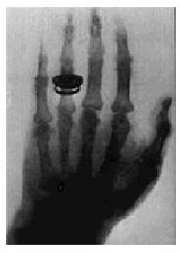

From Electrostatic to RF acceleration
The first historical particle accelerator was built by the Nobel prize Wilhelm Conrad Röntgen. It consisted in a vacuum tube containing a cathode connected to the negative pole of a DC voltage generator. Electrons emitted by the heated cathode were accelerated while flowing to another electrode connected to the positive generator pole (anode). Collisions between energetic electrons and anode produced X-rays.
The energy gained by the electrons travelling from cathode to anode is equal to their charge multiplied the electrostatic potential difference between the two electrodes.
cathode
X
anode
e-
-
+
PRINCIPLE:
The DC voltage of a generator is used to accelerate particles
Basic limitation: the energy gain ∆W=q∆V is proportional to the DC voltage ∆V which is limited by unavoidable breakdown phenomena!
RF Crew
RF Accelerating Structures

Slide 7
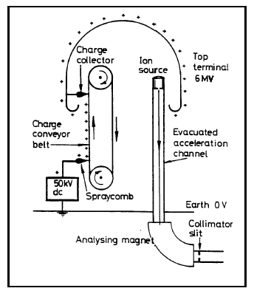
To increase the achievable maximum energy Van de Graaff invented an electrostatic generator based on a dielectric belt transporting positive charges to an isolated electrode hosting an ion source. The positive ions generated in a large positive potential were accelerated toward ground by the static electric field.
DC voltage as large as 15 MV can be obtained (E ~ 15MeV)
APPLICATIONS
Still ~ 350 Van De Graaff are in operation worldwide, typically at V<25MV, I<100mA. They are used for:
Material analysis:
such as Semiconductors structure analysis,
X-ray production, …;
Material modification:
ion implantation for semiconductors
RF Crew
RF Accelerating Structures

Slide 8
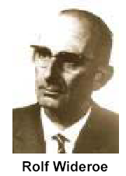
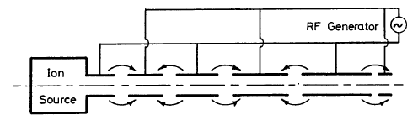
RF Acceleration : the Wideröe “Drift Tube LINAC” (DTL)
Basic idea:
The particles produced by a filament are accelerated by the electric field in the gap between electrodes connected alternatively to the poles of an AC generator.
The original idea of Ising (1924) was implemented by Wideroe (1927) who applied a sine-wave voltage to a sequence of drift tubes. The particles do not experience any force while travelling inside the tubes (equipotential regions) and are accelerated across the gaps. This kind of structure is called Drift Tube LINAC (DTL).
If the length of the tubes increases with the particle velocity during the acceleration such that the time of flight is kept constant and equal to half of the RF period , the particles are subject to a synchronous accelerating voltage and experience an energy gain of ∆W=q∆V at each gap crossing.
In principle a single AC voltage can be used to indefinitely accelerate a beam, avoiding the breakdown limitation affecting the electrostatic accelerators.
Please notice that this technique requires bunched beams, i.e. in order to be synchronous with the external AC field, particles have to be gathered in non-uniform temporal structures
gap
In 1928 Wideröe by means of 3 tubes (2 gaps) accelerated Na e K ions at 50 keV with an RF of 25 kV and 1 MHz.
In 1931 Sloan e Lawrence used 30 tubes to accelerate Hg ions to the energy of 1.25 MeV with an RF of 42 kV e 10 MHz; in 1934, by using 36 tubes and a higher RF voltage, they got to 2.8 MeV.
RF Crew
RF Accelerating Structures

Slide 9
Beam -to-accelerating field synchronization
:
The Wideröe DTL provides synchronization between a charge particle in motion and an accelerating E-field.
If particles enter the LINAC with an energy W_{in}, while travelling inside the n-th drift tube they will show energy W_{n} and velocity v_{n} given by:
The length of the n-th drift tube has to be
The condition L_{n}<<λ_{RF} (necessary to model the tube as an equipotential region) requires β<<1. The Wideröe technique can not be applied to relativistic particles
RF Crew
RF Accelerating Structures

Slide 10
Standing Wave (SW) Accelerating Structures: Resonant Cavities
Electric field
beam
RF Crew
RF Accelerating Structures

Slide 11
Resonant Cavity Shapes
λ/4
Reentrant or nose-cone cavities
λ/2
Disk-loaded or coaxial cavities
Pill-box or cylindrical cavities
RF Crew
RF Accelerating Structures

Slide 12
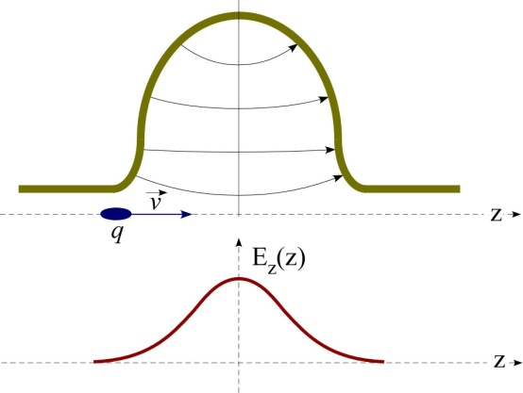
Resonant Cavity Examples
Pill-box like (or bell-shape)
RF Crew
RF Accelerating Structures

Slide 13
Acceleration with SW cavities
RF Crew
RF Accelerating Structures

Slide 14
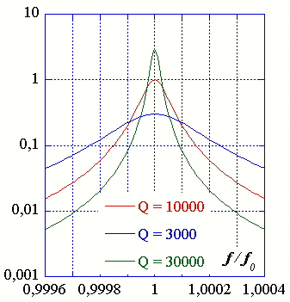
Cavity dissipation – Q factor
conductivity
skin depth
RF Crew
RF Accelerating Structures

Slide 15
Shunt impedance
Frequency and
material conductivity
Mode field
configuration
RF Crew
RF Accelerating Structures

Slide 16
Modes of a Resonant Cavity: General Problem
The resonant cavity modes are solutions of the homogeneous Maxwell equations inside closed volumes surrounded by perfectly conducting walls. The mathematical problem has the following formal expression:
Homogeneous Maxwell Equations
(wave equation)
+
perfect metallic boundaries
RF Crew
RF Accelerating Structures

Slide 17
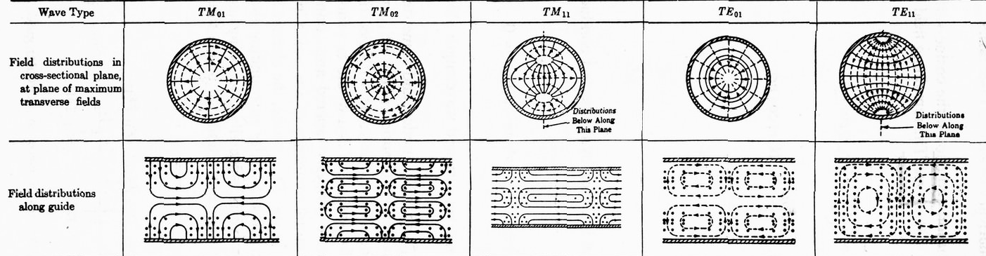
Analytical field solutions: the Pill-box cavity
Wave Type
TM₀₁
TM₀₂
TM₁₁
TE₀₁
TE₁₁
Circular waveguide modes
RF Crew
RF Accelerating Structures

Slide 18
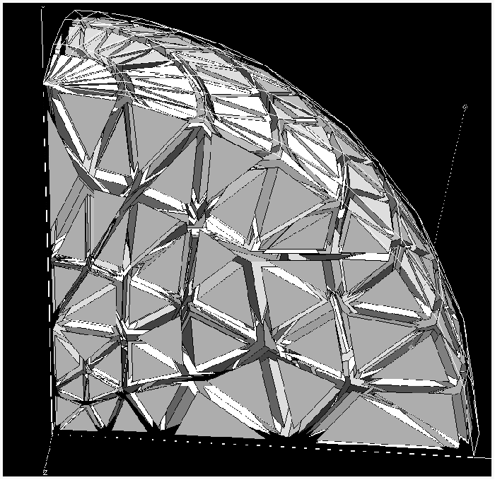
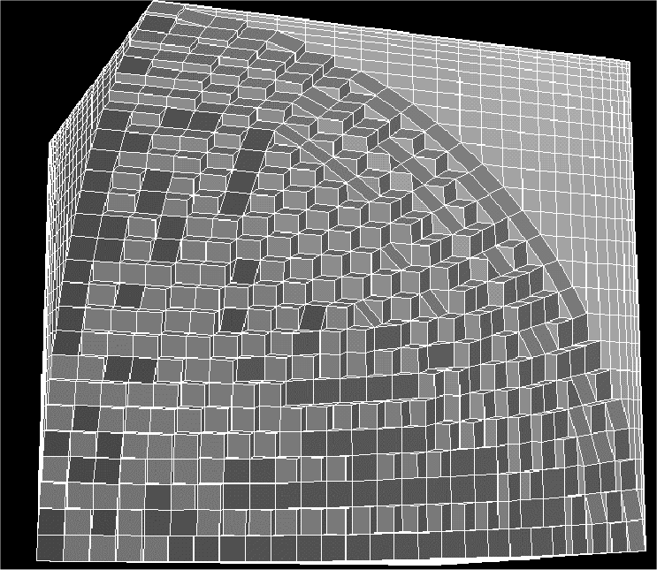
Numerical Solutions
In the majority of cases analytical field solutions are not available and numerical methods are applied.
There are various codes dedicated to the solution of the Maxwell equations in closed and/or open volumes starting from a discretized model of the structure under study. Codes can be classified in various ways:
2D (2-dimensionals) and 3D (3-dimensionals) codes;
Finite differences and finite elements codes;
Time-domain and frequency domain codes.
RF Crew
RF Accelerating Structures

Slide 19
Figure of merit of a SW cavity
RF Crew
RF Accelerating Structures

Slide 20
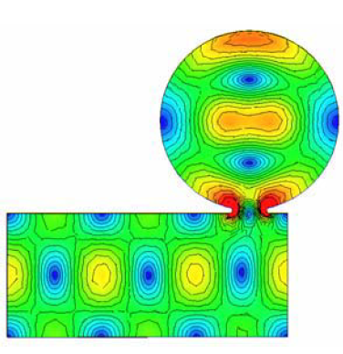
Input-Output coupling
Magnetic (loop)
input coupler
Waveguide (slot)
input coupler
RF Crew
RF Accelerating Structures

Slide 21
Coupling and loading parameters of a cavity
It can be easily demonstrated that, provided that all the monitor ports are weakly coupled (β_{n}<<1), the input coupling of a cavity is related to the input reflection coefficient ρ by:
RF Crew
RF Accelerating Structures

Slide 22
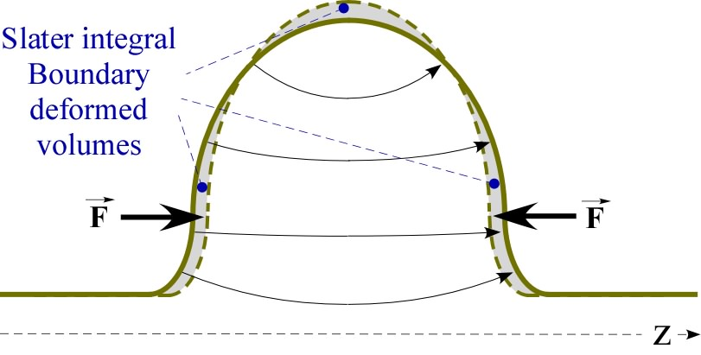
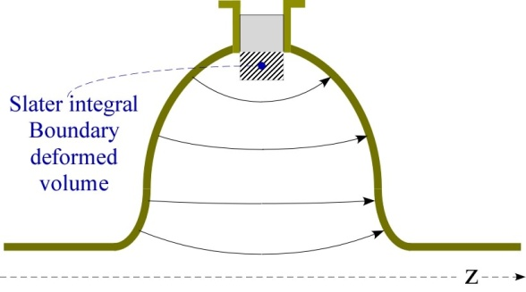
Tuning
RF Crew
RF Accelerating Structures

Slide 23
Perturbations
It turns out that if the perturbing object is a perfectly conducting sphere the values of the form factors are:
If a sphere of radius a is moved along the beam axis of a cavity, the E field profile and the R/Q of a resonant accelerating mode can be estimated according to:
sign of the E-field profile
RF Crew
RF Accelerating Structures

Slide 24
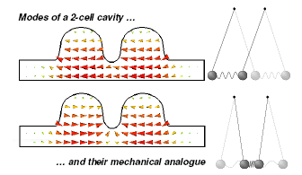
Multi-cell Cavities
RF Crew
RF Accelerating Structures

Slide 25
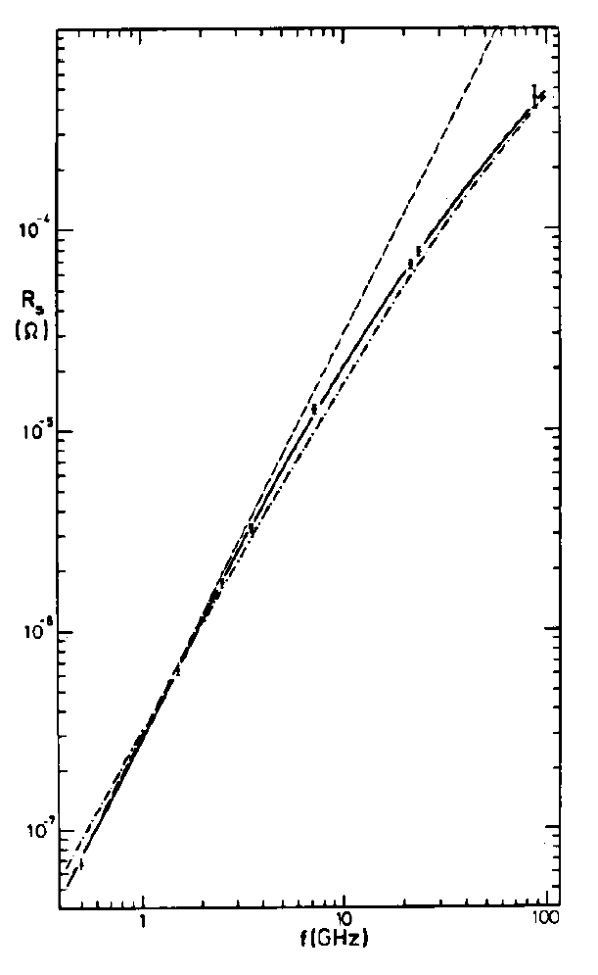
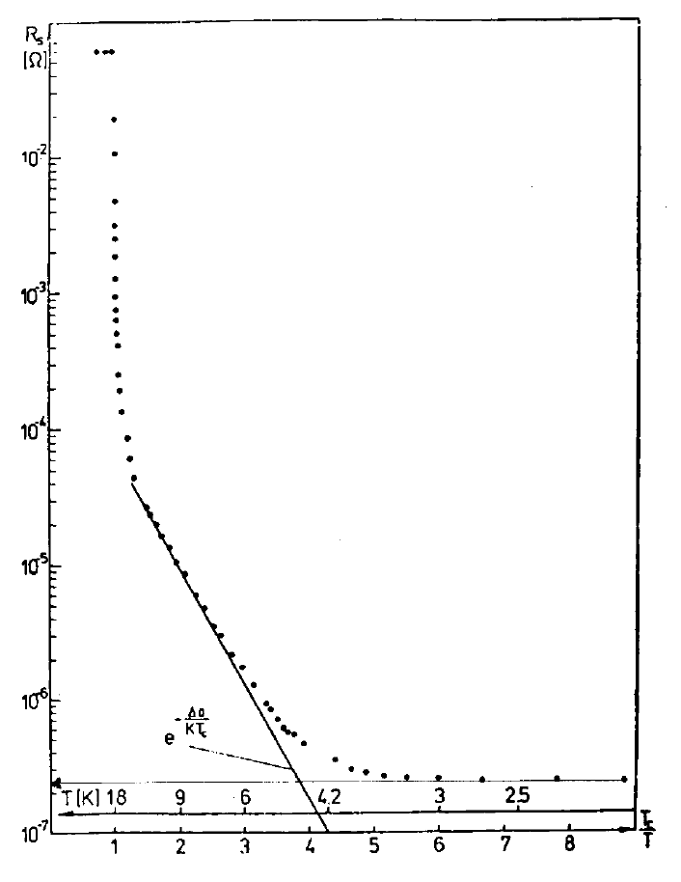




RF Superconductivity
R_{BCS} vs. T
(Log scale)
R_{BCS} vs. f
(Log-Log)
Surface resistance
John Bardeen, Leon Neil Cooper and John Robert Schrieffer (BCS) , 1957.
1.3 GHz, 2-cell cavity for Cornell ERL injector.
RF Crew
RF Accelerating Structures

Slide 26
Examples of multi-cell cavity: the TESLA / ILC cavity
RF Crew
RF Accelerating Structures

Slide 27
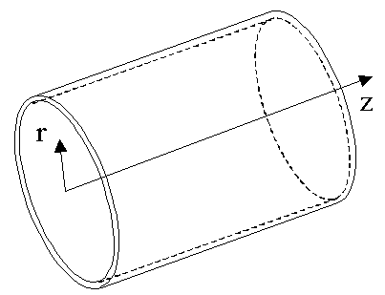
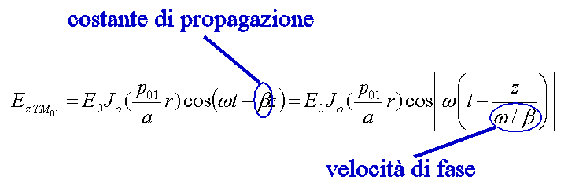
Traveling Wave (TW) Accelerating Structures
Particle beams can be accelerated not only by standing waves but also by traveling waves.
In this case it is necessary to let an e.m. wave with non-zero longitudinal electric field travel together with the beam in a special guide in which the wave phase velocity matches the particle velocity. If this is the case the beam absorbs energy from the wave and it is continuously accelerated.
Constant cross-section waveguides
By solving the wave (Helmholtz) equation it turns out that an e.m. wave propagating in a constant cross section guide will never be synchronous with a particle beam since the propagation speed (i.e. the wave phase velocity) is always larger than the speed of light c.
Let’s consider for instance the first mode (TM₀₁) with a non zero longitudinal electric field of a circular waveguide . The accelerating field at a given frequency ω has the following expression:
propagation constant
phase velocity
RF Crew
RF Accelerating Structures

Slide 28

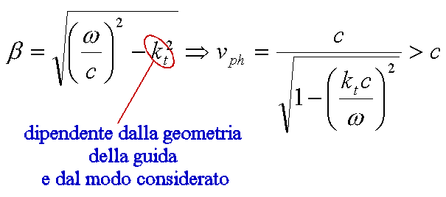
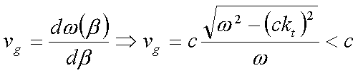
The wave phase velocity and the propagation constant β are simply related by:
while, solving the wave equation, the propagation constant and the phase velocity result to be functions of the frequency according to:
specific of the guide geometry and of the selected mode
As already mentioned the wave phase velocity is always larger than c, so that the accelerating field and the particles in the beam can never be synchronous.
Please notice that the phase velocity is not the energy propagation velocity of the structure. In fact the energy propagates with the group velocity given by:
RF Crew
RF Accelerating Structures

Slide 29
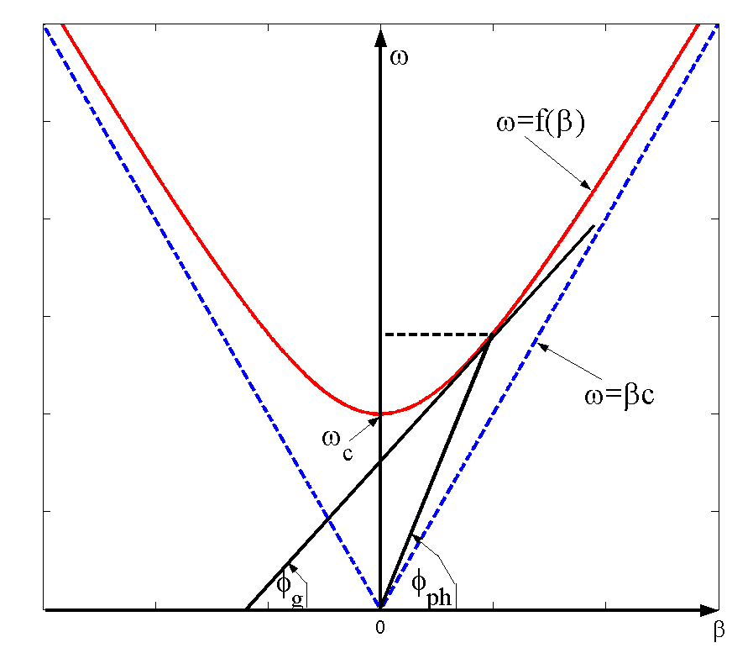
The ω vs. β plot is called dispersion curve of the waveguide.
Noticeable aspects are:
a) the tangent of the φ_{ph} angle is the wave phase velocity at the operating frequency ω ;
b) the propagation constant β is real (propagating mode ) only if ω > ω_{c} (ω_{c} = cut-off frequency of the selected mode);
c) if ω < ω_{c} the mode does not propagate in the structure;
d) the tangent of the φ_{g} is the wave group velocity in the structure. In constant cross section waveguide, phase and group velocities have the same sign (forward waves), but this is not true in general since in some peculiar guides (like periodical iris loaded structures) they may have opposite signs (backward waves);
e) The plot for negative β corresponds to waves propagating in opposite direction (towards negative z).
Dispersion plot
ω∗
β∗
Constant cross section
waveguides:
RF Crew
RF Accelerating Structures

Slide 30
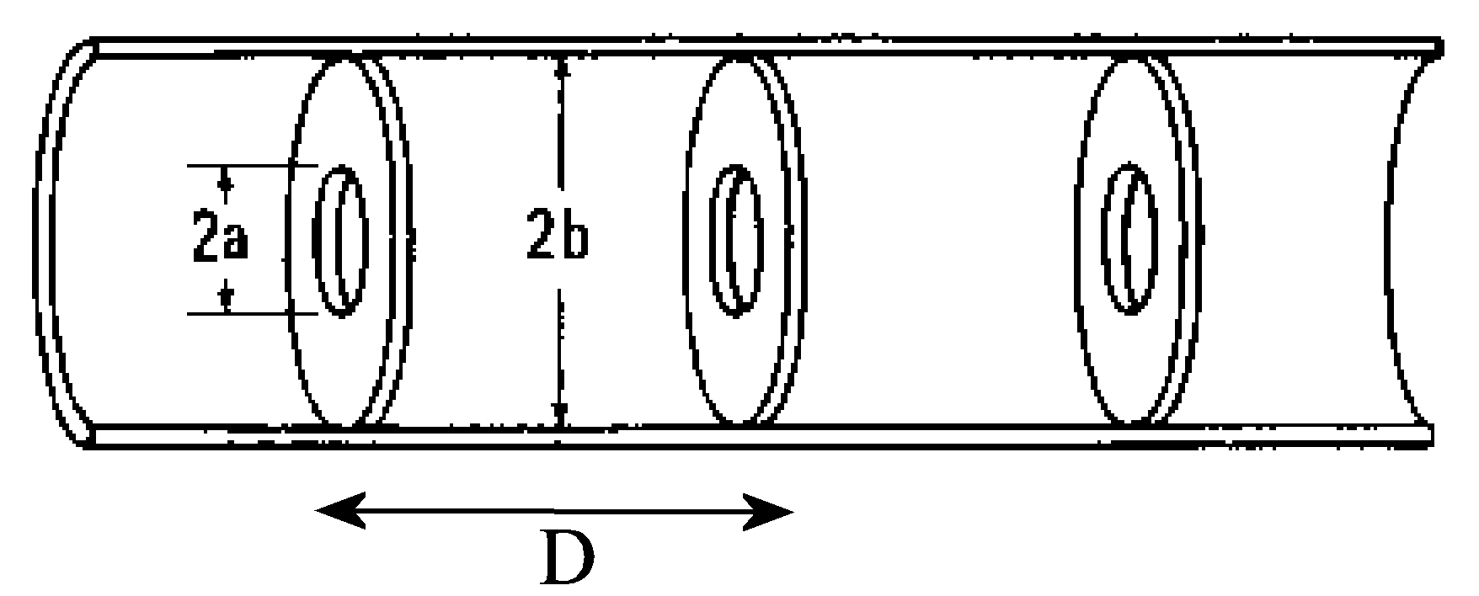
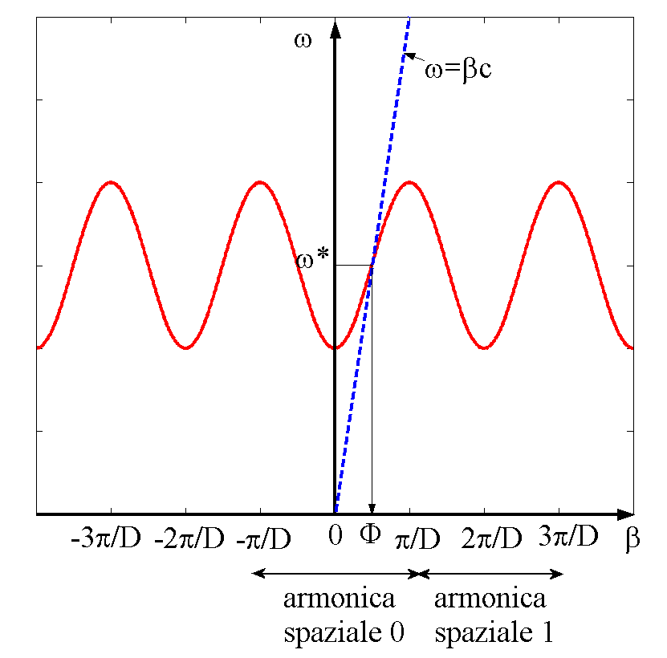
Periodic structures
In order to slow-down the wave phase velocity, iris- loaded periodic structure are used.
According to the Floquet theorem, the field in this kind of structures is that of a special wave travelling within a spatial periodic profile, with the same spatial period D of the structure. The periodic field profile can be Fourier expanded in a series of traveling waves (spatial harmonics) with different phase velocity according to:
z
A typical dispersion curve of an iris loaded structure has the following characteristics:
the plot is periodic respect to the variable β, and the period is 2π/D;
each period is the dispersion curve of a different spatial harmonic;
the geometry of the guide can be designed such that the fundamental spatial harmonic E₀ is synchronous with the beam (i.e. phase velocity = beam particle velocity) for a selected operating frequency ω*;
the high-order harmonics (n=1,2,3,...) are asynchronous respect to the beam, so they do not contribute to the acceleration;
periodic structures can only operate in limited frequency bands (stopbands associated with periodicity, as in other physics process ...)
RF Crew
RF Accelerating Structures

Slide 31
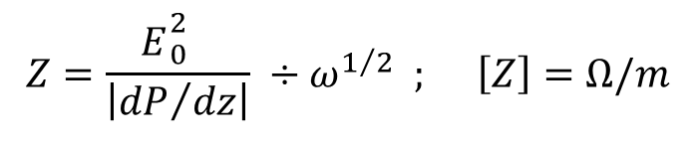
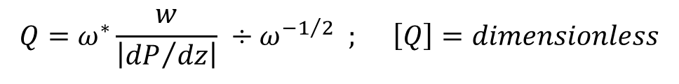
Merit Figures of a periodic structure
Traveling wave (TW) accelerating structures are typically qualified by the following merit figures :
a) Shunt impedance per unit length Z: It is defined as the ratio between the squared amplitude of the fundamental harmonic accelerating field (E₀) and the power dissipated per unit length in the structure (dP/dz):
$$Z=\frac{ E{}_{0}^{2}{}}{\left|{dP}/{dz}\right|} ÷ω^{1/2} ; \left[Z\right]=Ω/m$$
The higher the Z value, the higher the available accelerating field for a given RF power dissipation per unit length;
b) Q factor per unit length: It is defined as the ratio between the stored energy per unit length (w) the power dissipated per unit length (dP/dz), times the operating frequency ω*:
$$Q=ω^{∗}\frac{w}{\left|{dP}/{dz}\right|} ÷ω^{{−1}/2} ; \left[Q\right]=dimensionless$$
RF Crew
RF Accelerating Structures

Slide 32
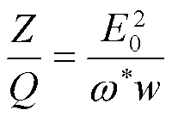
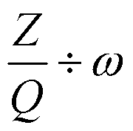
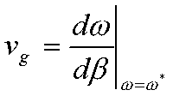
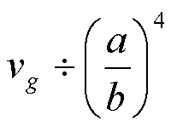
c) Z/Q ratio: From previous definitions it turns out:
Similarly to the SW structures, this parameter only depends on the structure design, which means that it is independent on the conductivity of the structure inner surface. Since for a given E₀ value the stored energy per unit length w is inversely proportional to ω² (for homotetic scaling of the dimensions):
and since the operating frequency ω* is inversely proportional to the dimension scaling factor, the Z/Q factor, differently from the SW case, results to grow linearly with frequency.
d) Group velocity v_{g}: The group velocity is defined as:
and it represents the velocity of the energy flow in the structure. It may be demonstrated that the group velocity approximately scales with a and b dimensions according to:
RF Crew
RF Accelerating Structures

Slide 33
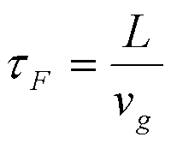
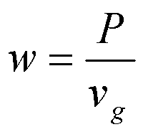

The group velocity v_{g} is a very important qualifying parameter of a TW structure. The filling time τ_{f}, i.e. the time necessary to propagate an RF wavefront from the input to the end of a TW accelerating section of length L is given by:
High group velocities allow reducing the duration of the RF pulse feeding the structure. However, the RF power P flowing through the structure (P = flux of the Poynting vector) and the stored energy per unit length w are related by:
and since E₀ is proportional to the square root of w, clearly a low group velocity is preferable to increase the effective accelerating field for a given power flowing in the structure.
e) Frequency ω*. Since:
To increase Z the operating design frequency must be the highest possible. However, the power available from ordinary RF power sources at high frequencies decreases rapidly with frequency. Also RF power density on the structure surface increases and the irises diameter decrease linearly with frequency, so problems related with heating increase and beam stay clear reduction at high frequencies have to be taken into account.
RF Crew
RF Accelerating Structures

Slide 34


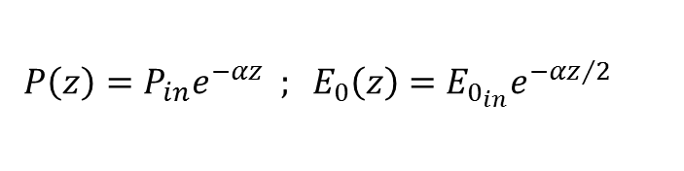


f) attenuation:. Because of the wall dissipation, the RF power flux decreases along the structure according to the following equation:
$$\frac{dP}{dz}=−αP$$
where α is the structure attenuation coefficient. It may be shown that:
$$α=\frac{ω}{Qv_{g}}÷ω^{3/2}$$
In a purely periodic guide, made by a sequence of identical cells (also called “constant impedance structure”), α does not depend on z and both the RF power flux and the intensity of the accelerating field decay exponentially along the structure :
$${P\left(z\right)=P_{in}e^{−αz} ; E}_{0}\left(z\right)=E_{0_{in}}e^{{−αz}/2}$$
It is possible to design structures with nearly constant accelerating field along z . The diameter of the cell irises has to be gradually reduced, reducing the group velocity along the structure in order to keep nearly constant the energy stored per unit length w and power dissipated per unit length dP/dz . These are called “constant gradient structures”, and are not exactly periodic.
g) Working mode: It is defined as the phase advance of the
fundamental harmonic over a period D:
For practical reasons related to the experimental measurement of the dispersion curve of actual devices, the working modes are typically designed to be:
RF Crew
RF Accelerating Structures

Slide 35
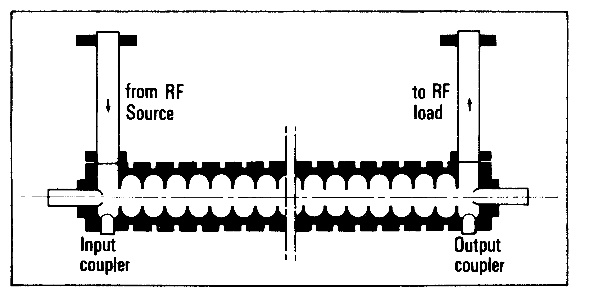
Examples of TW structure: the Stanford LINAC (SLAC)
L ≈ 3 m
RF Crew
RF Accelerating Structures

Slide 36
EDIT 2015 – Accelerator Lab
RF Measurements
Instrumentation Description
Experience #1: characterization of a SW cavity (S-band RF Gun)
Experience #2: characterization of a TW structure (S-band RF deflector)
RF Crew
RF Accelerating Structures

Slide 37
VNA conceptual scheme: the 4 blocks
Source
1
DUT
Z₀ LOAD
A Vector Network Analyzer measures the scattering matrix elements s_{ij} – i.e. Input/output matching and forward/backward transfer function – of a Device Under Test.
Signal
Separation
2
Incident
Reflected
Transmitted
Detector and
Receiver
An internal sine-wave sorce is made sweeping a given frequancy span and reflected and transmitted signas are measuerd and normalized to the source. The direction of the excitation can be inverted.
3
Process and
Display
4
RF Crew
RF Accelerating Structures

Slide 38
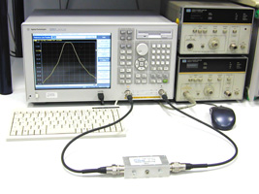
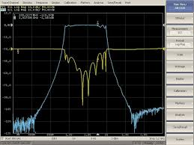
Network Analyzer Block Diagram
Incident
Transmitted
DUT
SOURCE
Reflected
SIGNAL
SEPARATION
INCIDENT (R)
REFLECTED
(A)
TRANSMITTED
(B)
RECEIVER / DETECTOR
PROCESSOR / DISPLAY
RF Crew
RF Accelerating Structures

Slide 39
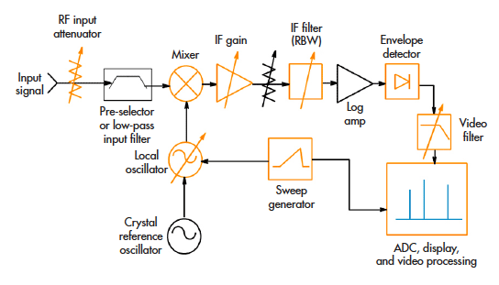
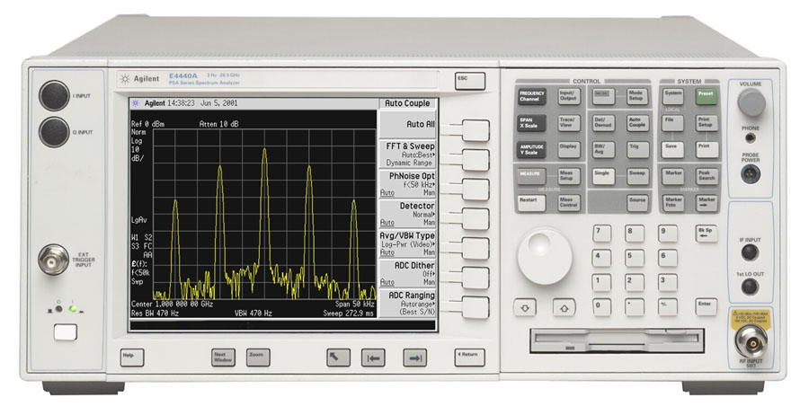
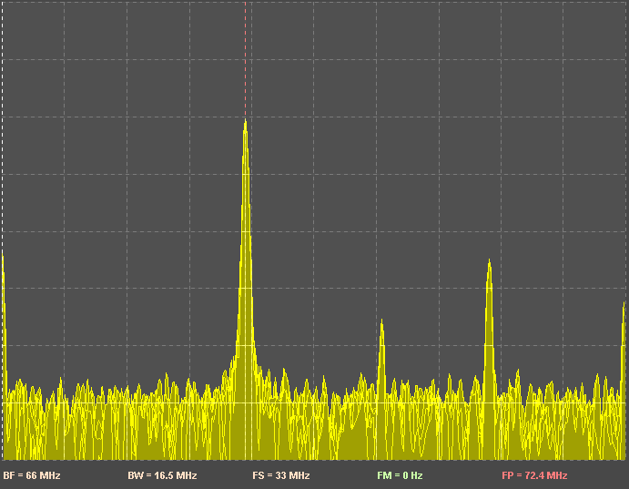
Spectrum Analyzer Block Diagram
A Spectrum Analyzer characterizes signals in frequency domain. An internal source sweeps a selected frequency range to downconvert and filter the input signal. The IF filter output power reveals the spectral content of the signal at the instantaneous frequency scanned by the instrument.
RF Crew
RF Accelerating Structures

Slide 40
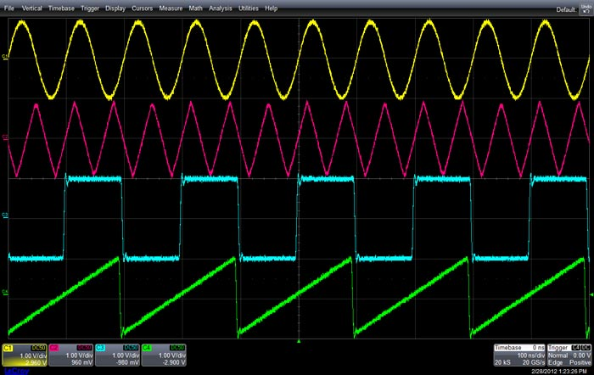
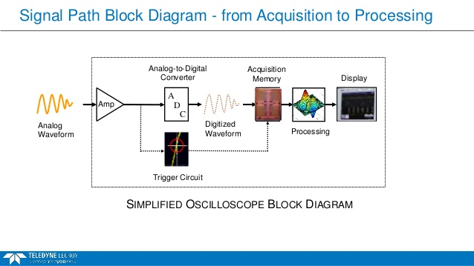
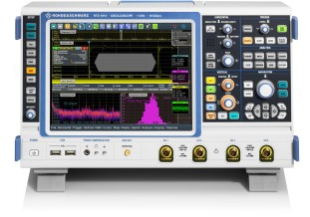
Digital Oscilloscopes
A Digital Oscilloscope characterizes signals in time domain. The input signal is buffered by a front-end amplifier and then A-to-D converted. Instrument BW and resolution depend essentially by the characteristics of the front-end ADC . Digital data stream is stored, processed and displayed according to experimental needs. Special algorithms working on the acquired samples allow smart triggering of the instrument.
RF Crew
RF Accelerating Structures

Slide 41
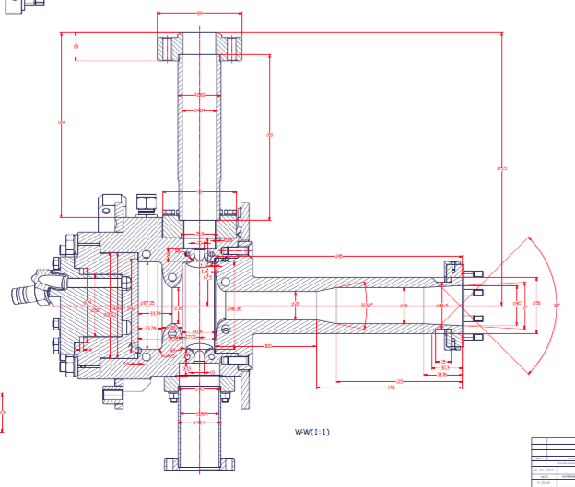
Experience #1: ELI-NP S-band RF-Gun
Parameter | Design value (Cu) | Meas. value (Al)
Working frequency | 2.856 (GHz) | ?
Working mode | π | ?
Unloaded Q | 14500 | ?
Input coupling coeff. (ß) | 3 | ?
Input external Q | 4800 | ?
Filling time | 420 ns | ?
Shunt impedance (R) | 1.7 MΩ | ?
R/Q factor | 117 Ω | ?
Repetition rate | 100 Hz | X
Max RF input power | 16 MW | X
Peak field at cathode | 120 MV/m | X
cathode
bead
½ cell
cell
beam pipe
RF Crew
RF Accelerating Structures

Slide 42
Experience #1: RF characterization of an Aluminum model of the ELI-NP S-band RF-Gun
f₀, f_{π}, ∆f, Q_{L}, Q₀, ß measurement with Network Analizer
Longitudinal electric field profile measurement with “bead-drop” technique (mode π):
  Ticks drawn on the fishing line are equally spaced every 5 mm
  Fill an excel spreadsheet with 2 columns: bead position (z) and f_{res}
  Calculate and plot ∆f/f vs z;
Longitudinal electric field profile measurement with “bead-drop” technique (mode 0):
  Same as mode π… but centered at f₀
Shunt impedance (or R/Q) calculation:
  From the same spreadsheet, calculate V_{acc} and then use the formula for R (or R/Q);
Filling time measurement (time domain with realistic RF pulse)
RF Crew
RF Accelerating Structures

Slide 43
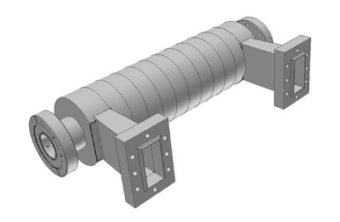
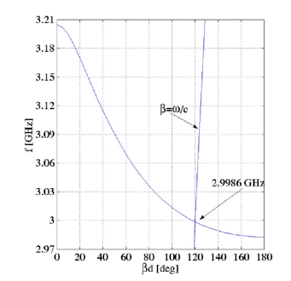
Travelling Wave structure
The Aluminum model of the CTF3 combiner ring RF deflector
accelerating cell
RF power
couplers
beam pipe
Dispersion curve
RF Crew
RF Accelerating Structures

Slide 44
Experience #2: RF Travelling Wave structure
Example of a disassembled C-band TW structure;
BW measurement at f_{RF}=3 GHz with Network Analizer;
Filling time measurement #1:
  Using a realistic pulse from RF signal generator (f_{RF}=3 GHz, t_{pulse} =1 µs, rep.rate=10-100 Hz) fed to the structure;
Filling time measurement #2:
  Using a CW RF reference with amplitude modulation, according to the scheme of slide 3 (f_{mod}=5 MHz, Ampl=1 V_{pp}, offset=2.5 V);
  With spectrum analizer monitor the frequency content of the feeding signal;
  Measure with the oscilloscope the time needed to traverse the structure from the distance of the 2 maxima.
RF Crew
RF Accelerating Structures

Slide 45
TW structure filling time measurement setup
f_{RF}
LO
RF
CPL
TW structure
IF
CPL
ATT 10 dB
Funct. generator
TTL
TRG
Oscilloscope
RF Crew
RF Accelerating Structures

Slide 46
N.A. settings and measurement results
General measurement
settings:
IF BW 40 kHz
# points 1601
f_{center} = 2.83 GHz
f_{span} = 100 MHz
Parameter | Mode π | Mode 0
Working frequency | 2.85564 (GHz) | 2.81422 (GHz)
S11 @ f_{res} | -10.8 dB (lin = 0.289) | -23.2 dB (lin = 0.07)
Q₀ | 8990 | 10100
Q_{L} | 3200 | 4700
Coupling coefficient (ß) | 1.81 | 1.15
Single mode measurement
settings:
IF BW 40 kHz
# points 1601
f_{center} = f_{res}
f_{span} = 10 MHz
RF Crew
RF Accelerating Structures

