Slide 1
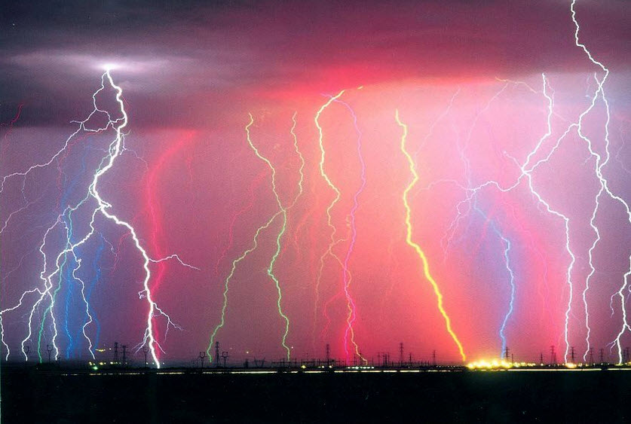
PART 2
PROBLEMS AND SOLUTIONS
WITH
GASEOUS COUNTERS
Fabio Sauli
TERA 20-29, 2Foundation and CERN
EDIT 2015 Laboratori Nazionali di Frascati, October 015

Slide 2
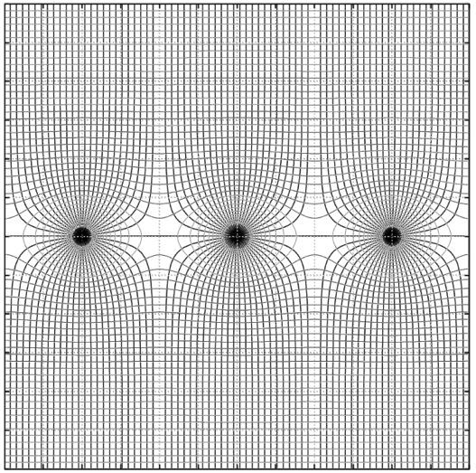
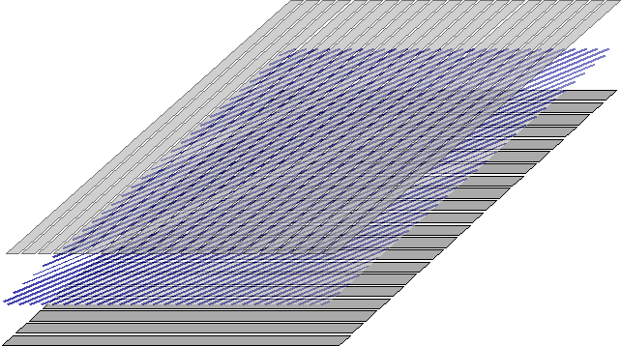
MULTIWIRE PROPORTIONAL CHAMBER (MWPC)
CHARGE INDUCTION ON CATHODE PLANES:
2-D LOCALIZATION
THIN ANODE WIRES BETWEEN TWO CATHODES:
G. Charpak and F. Sauli
Nucl. Instr. and Meth. 113(1973)381
G. Charpak et al, Nucl. Instr. and Meth. 62(1968)262

Slide 3
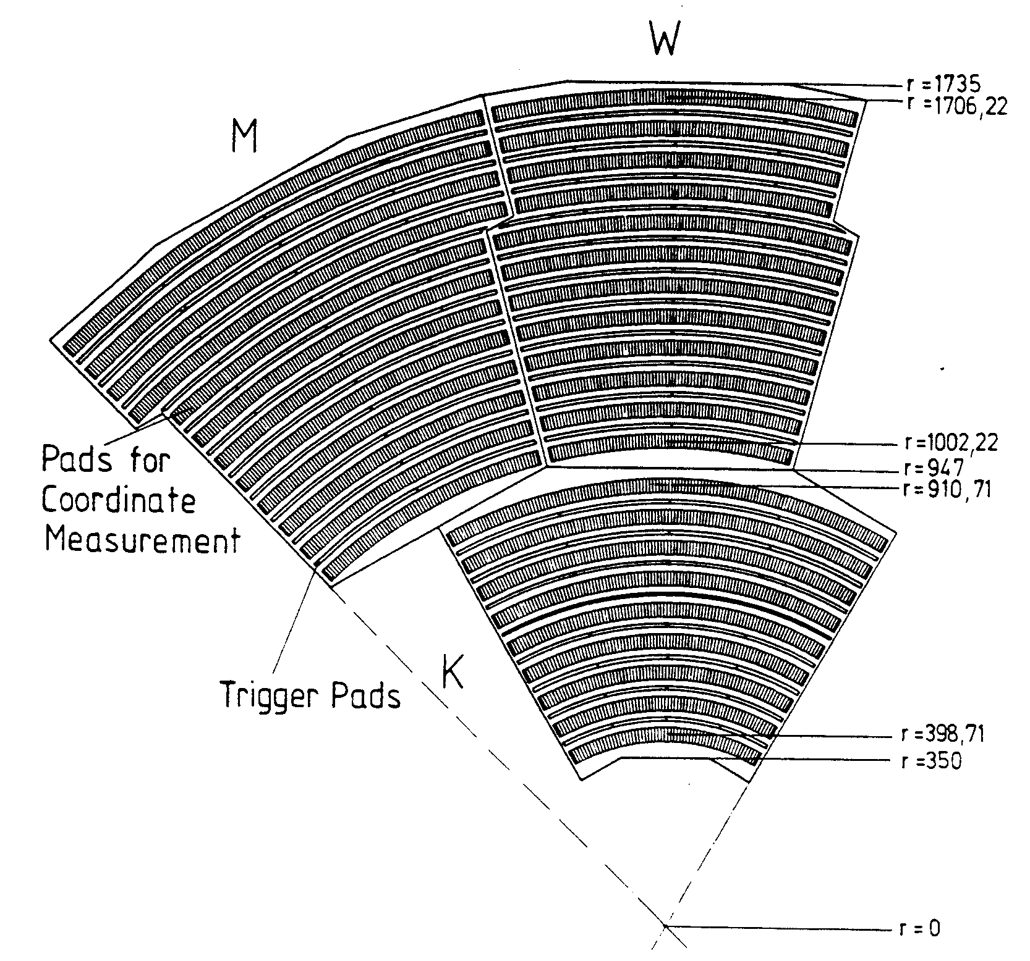
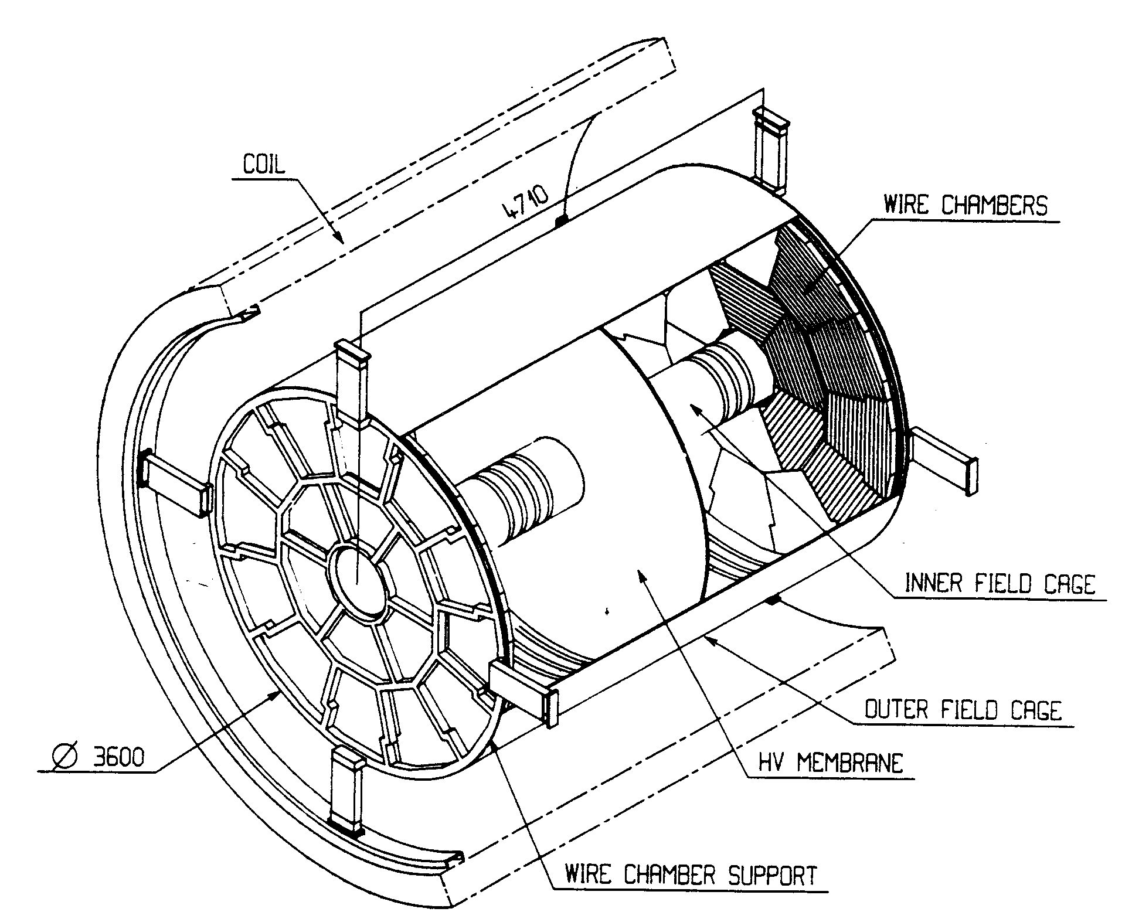
TIME PROJETION CHAMBER (TPC)
D.R. Nygren and J. N. Marx, Physics Today No.31 Vol. 10(1978)
ALEPH TPC
D. Decamp et al,Nucl. Instr. and Meth. A294(1990)125

Slide 4
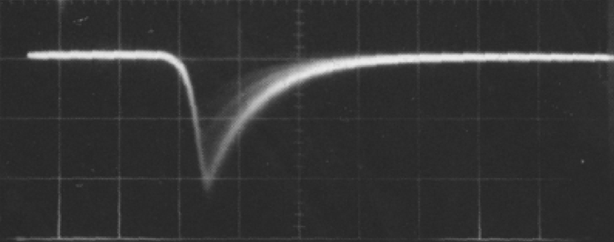
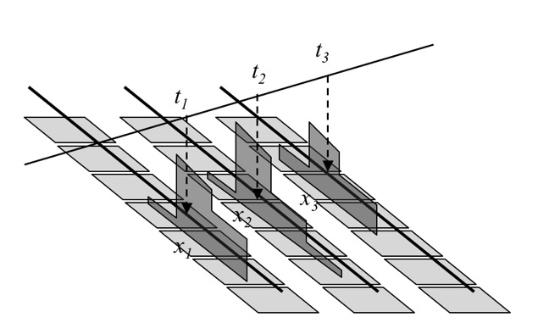
TIME PROJETION CHAMBER (TPC)
TPC: FULL 3-D LOCALIZATION
Z: DRIFT TIME
ΔZ ~ 10 mm (200 ns)
X: PAD ROWS
ΔX ~ 10 mm
8 mm
Y: ANODE WIRE
ΔY ~ 4 mm
Volume resolution
ΔV~ 50 mm³
-8
-4
0
4
8 mm

Slide 5
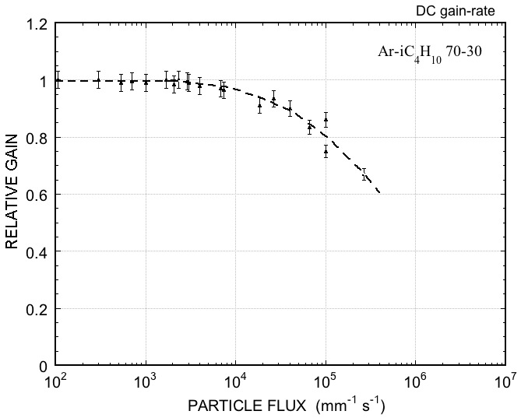
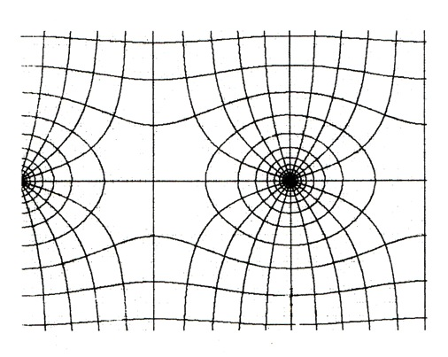
RATE-DEPENDENT GAIN REDUCTION
SPACE CHARGE NEAR THE ANODE:
BUILDUP OF SLOW POSITIVE IONS MODIFIES THE ELECTRIC FIELD
RELATIVE GAIN AS A FUNCTION OF RATE:
e⁻
~ 100 ns
I⁺
~ 100 µs
~ 10⁴ mm⁻¹s⁻¹
A. Breskin et al, Nucl. Instr. and Meth. 124(1974)189

Slide 6
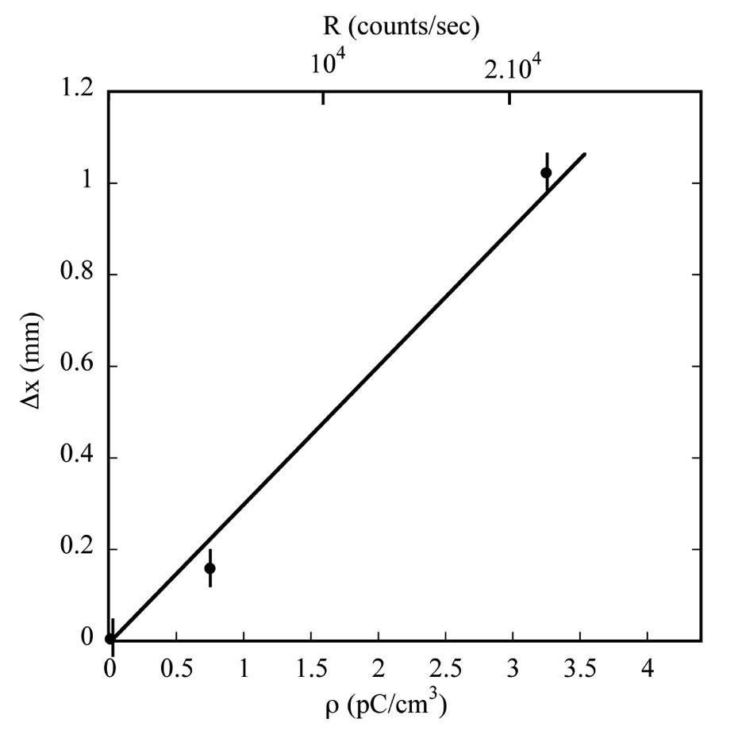

POSITIVE ION BACKFLOW
LATERAL DISPLACEMENT OF ELECTRONS DRIFTING NEAR A POSITIVE IONS COLUMN
⁵⁵Fe SOURCE 1 cm FROM ION COLUMN , 10 cm DRIFT
Displacement
+
e
Charge density
D. Friedrich, et al, Nucl. Instr. and Meth. 158(1979) 81

Slide 7
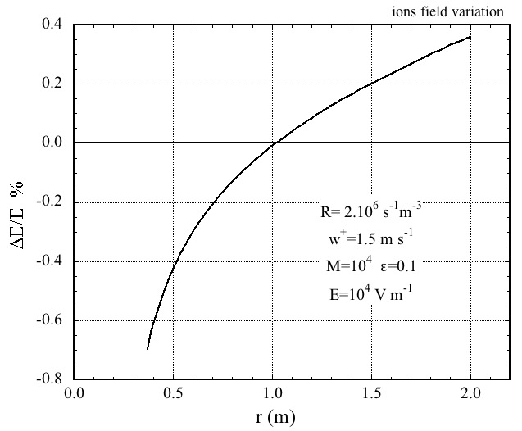
POSITIVE ION BACKFLOW
SLOW POSITIVE IONS ACCUMULATE IN THE DRIFT VOLUME AND MODIFY THE FIELD RESULTING IN TRACKS DISTORTIONS:
PERCENTAGE DRIFT FIELD MODIFICATION (ALEPH MWPC-TPC)
I_{D}
I_{A}
GATING:
ADD A WIRE MESH WITH VOLTAGE-CONTROLLED TRANSPARENCY
IONS BACKFLOW RATIO
ONLY POSSIBLE AT SMALL RATES:
Maximum electron drift time
< Time between events
THE WISH:
MWPC: IBF ~ 30%

Slide 8
SECONDARY PROCESSES
PHOTONS FEEDBACK:
AVALANCHE SPREAD
IONS FEEDBACK:
CATHODE DAMAGE, AGING, …..
e
+
e

Slide 9
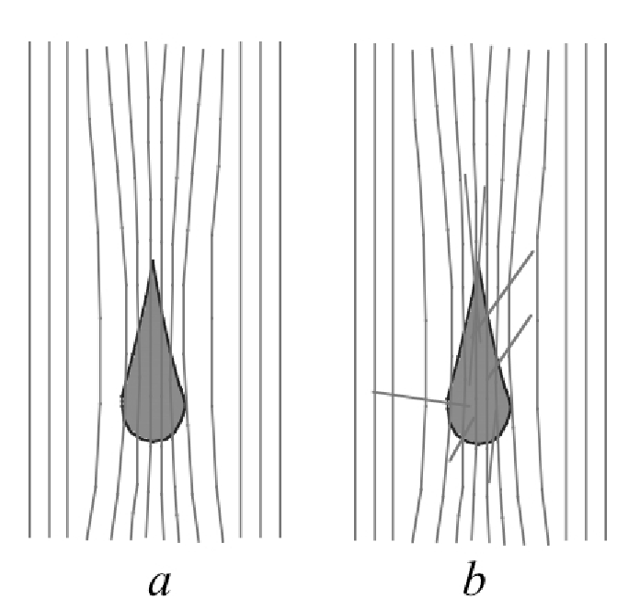
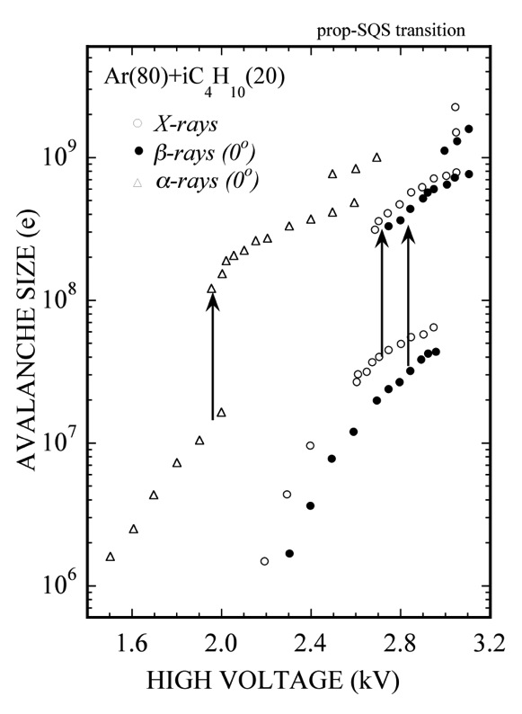
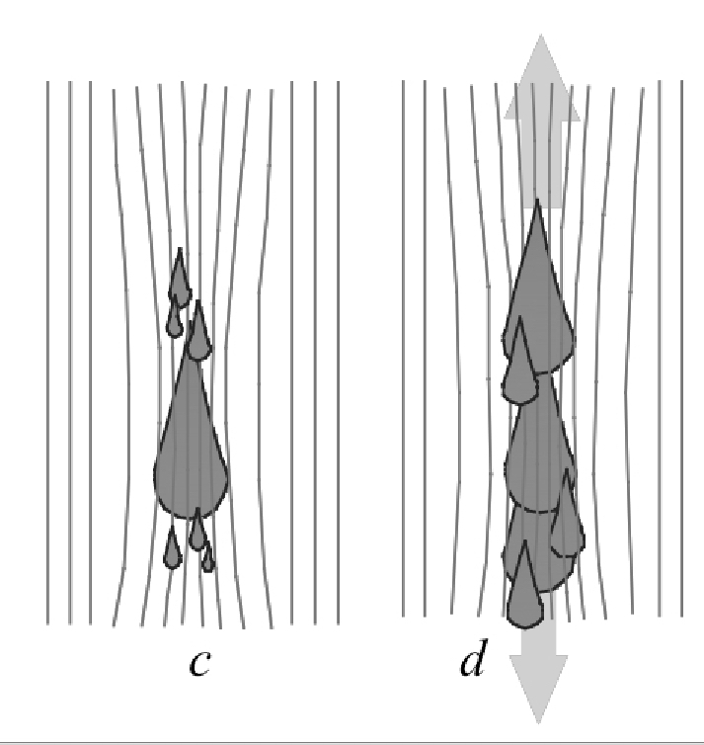
TRANSITION FROM PROPORTIONAL TO STREAMER
N. Koori et al, Jap. J. Appl. Phys. 25(1986)986

Slide 10
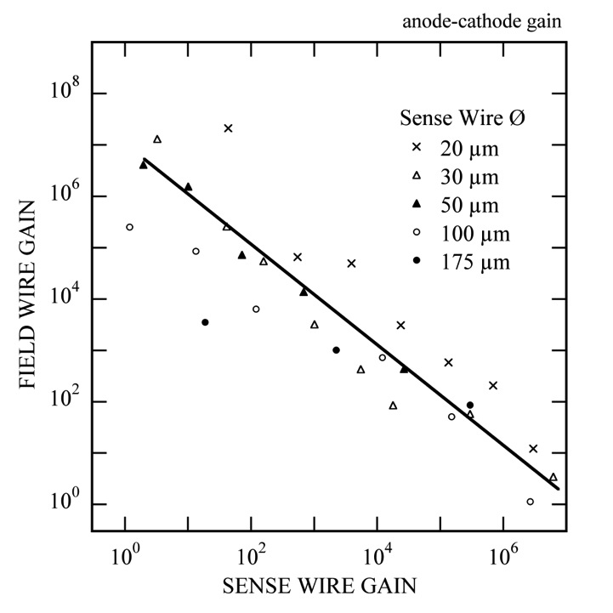
THE RAETHER LIMIT
Maximum avalanche size before transition or breakdown:
Q_{MAX}=(Primary ionization)x(Gain) ~ 10⁷ e
Typical proportional gain ~ 10⁴
Fast particles ΔE ~ 2 keV:
Q=(100)x(10⁴)=10⁶
Neutrons ΔE ~ 2 MeV
Q=(10⁵)x(10⁴)=10⁹
Multiwire structures:
Cathode pre-amplification of field emitted electrons
10³
M_{C}
M_{A}
10⁴
M=M_{C} x M_{A}
P. Giubellino et al, Nucl. Instr. and Meth. A245(1986)155

Slide 11
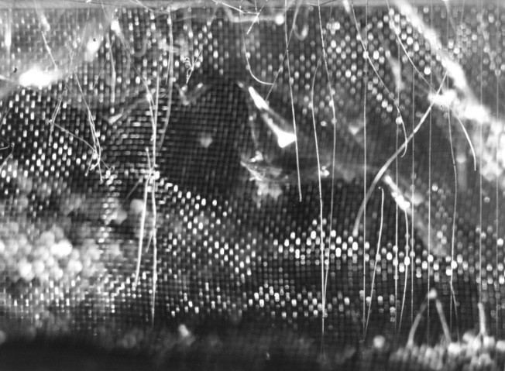
BREAKDOWN
Spark damages in MWPCs:
Fabio’s Museum of Horrors

Slide 12
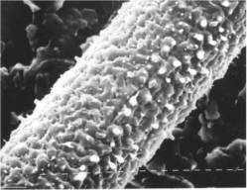
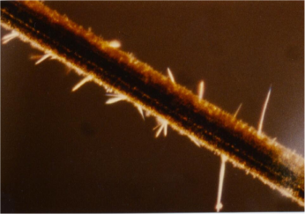
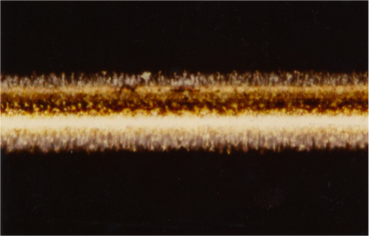
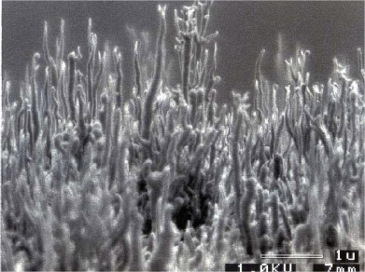
AGING
Polymerization of organic compounds with formation of deposits on thin wires:
O. Ullaland, LBL-21170 (1986)107
I. Juric and J. Kadyk, LBL-21170 (1986)141
I. Juric and J. Kadyk, LBL-21170 (1986)141
M. Binkley et al,
Nucl. Instr. and Meth. A515(2003)53

Slide 13
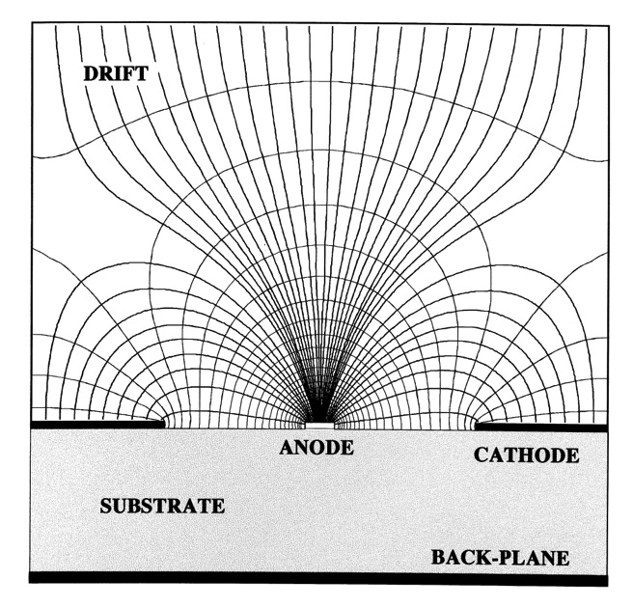
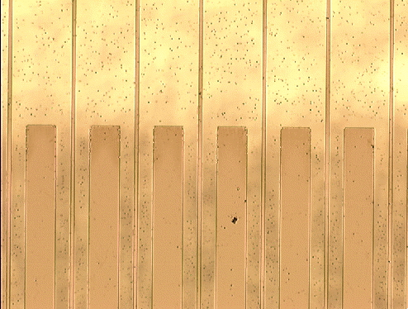
MICRO-STRIP GAS COUNTER
Anton Oed, 1988
10 µm wide anode strips, 50 µm cathode strips at 100 µm pitch on glass substrate:
A. Oed, Nucl. Instr. and Meth. A263(1988)351

Slide 14
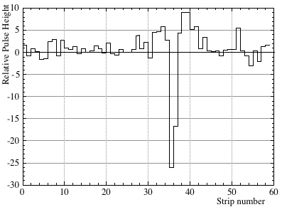
AGING
Single track signal width (two-track resolution):
200 µm pitch
FW ~ 400 µm
R. Bouclier et al, Nucl. Instr. and Meth. A367(1995)163

Slide 15
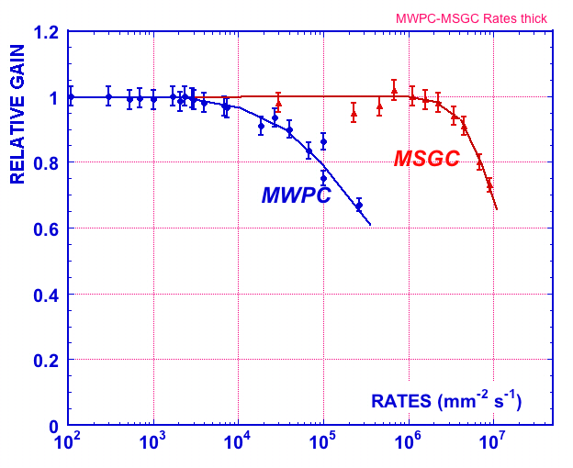
RATE CAPABILITY
Rate capability: 1 MHz/mm²
10⁶ mm⁻² s⁻¹
Volume resolution
ΔV ~ 1 x 1 x 2= 2 mm³
Fast signals ~ 30 ns (1.5 mm)

Slide 16
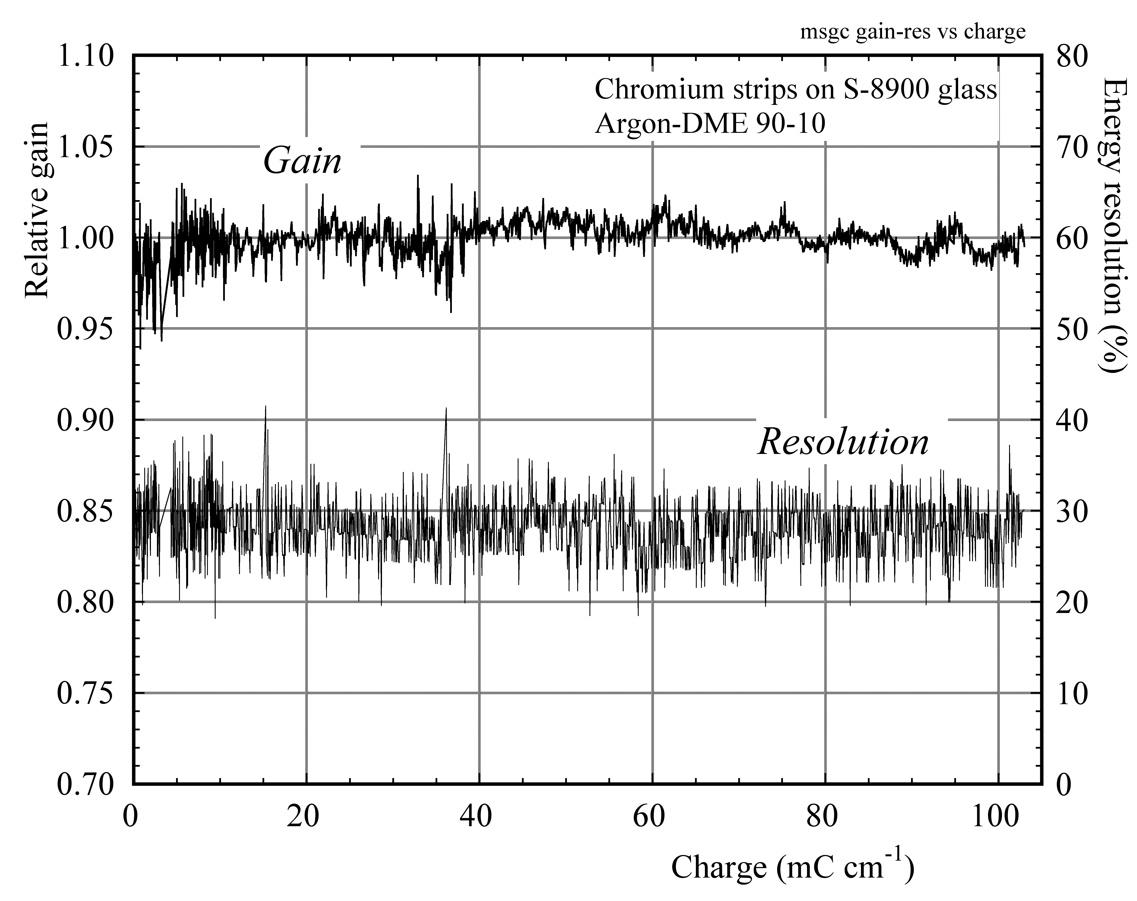
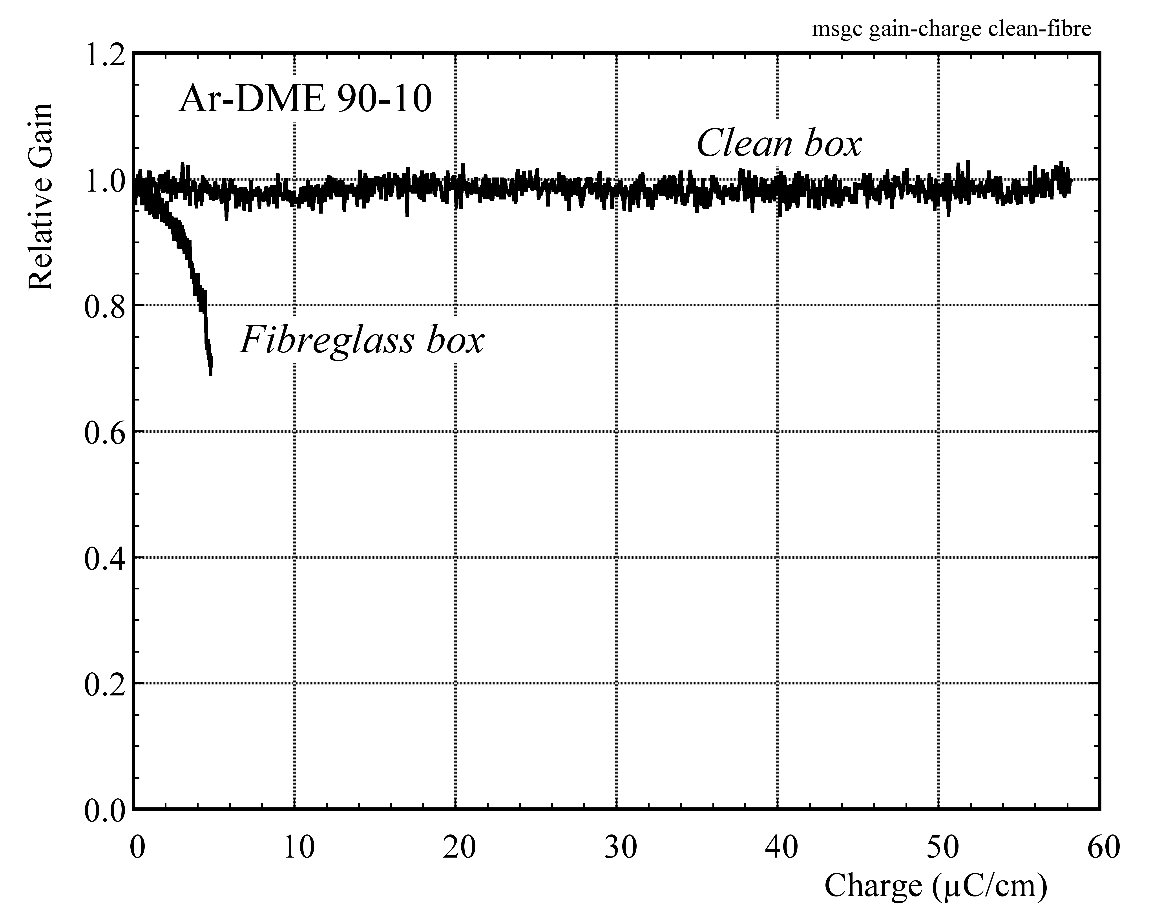
MSGC AGING
MSGC GAIN vs COLLECTED CHARGE
EXTREME SENSITIVITY TO CONTAMINATIONS
R. Boucler et al, Nucl. Instr. and Meth. A367(1995)163
R. Boucler et al, Nucl. Instr. and Meth. A348(1994)109

Slide 17
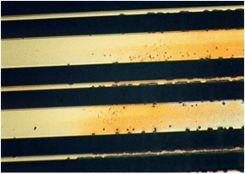
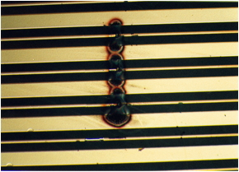
MSGC DISCHARGES
DISCHARGES IN MICROSTRIP CHAMBERS
Pre-amplification of electrons emitted by cathode strip edges
MINIMUM IONIZING PARTICLES
Q= 100 x10⁴=10⁶
n→ ~ MeV p
Q ~ 10⁴ x 10⁴ = 10⁸
p
Field emission
~ 10⁴ x 10⁴ = 10⁸
T. Beckers et al, Nucl. Instr. and Meth. A346(1994)95
Fabio’s Museum of Horrors

Slide 18
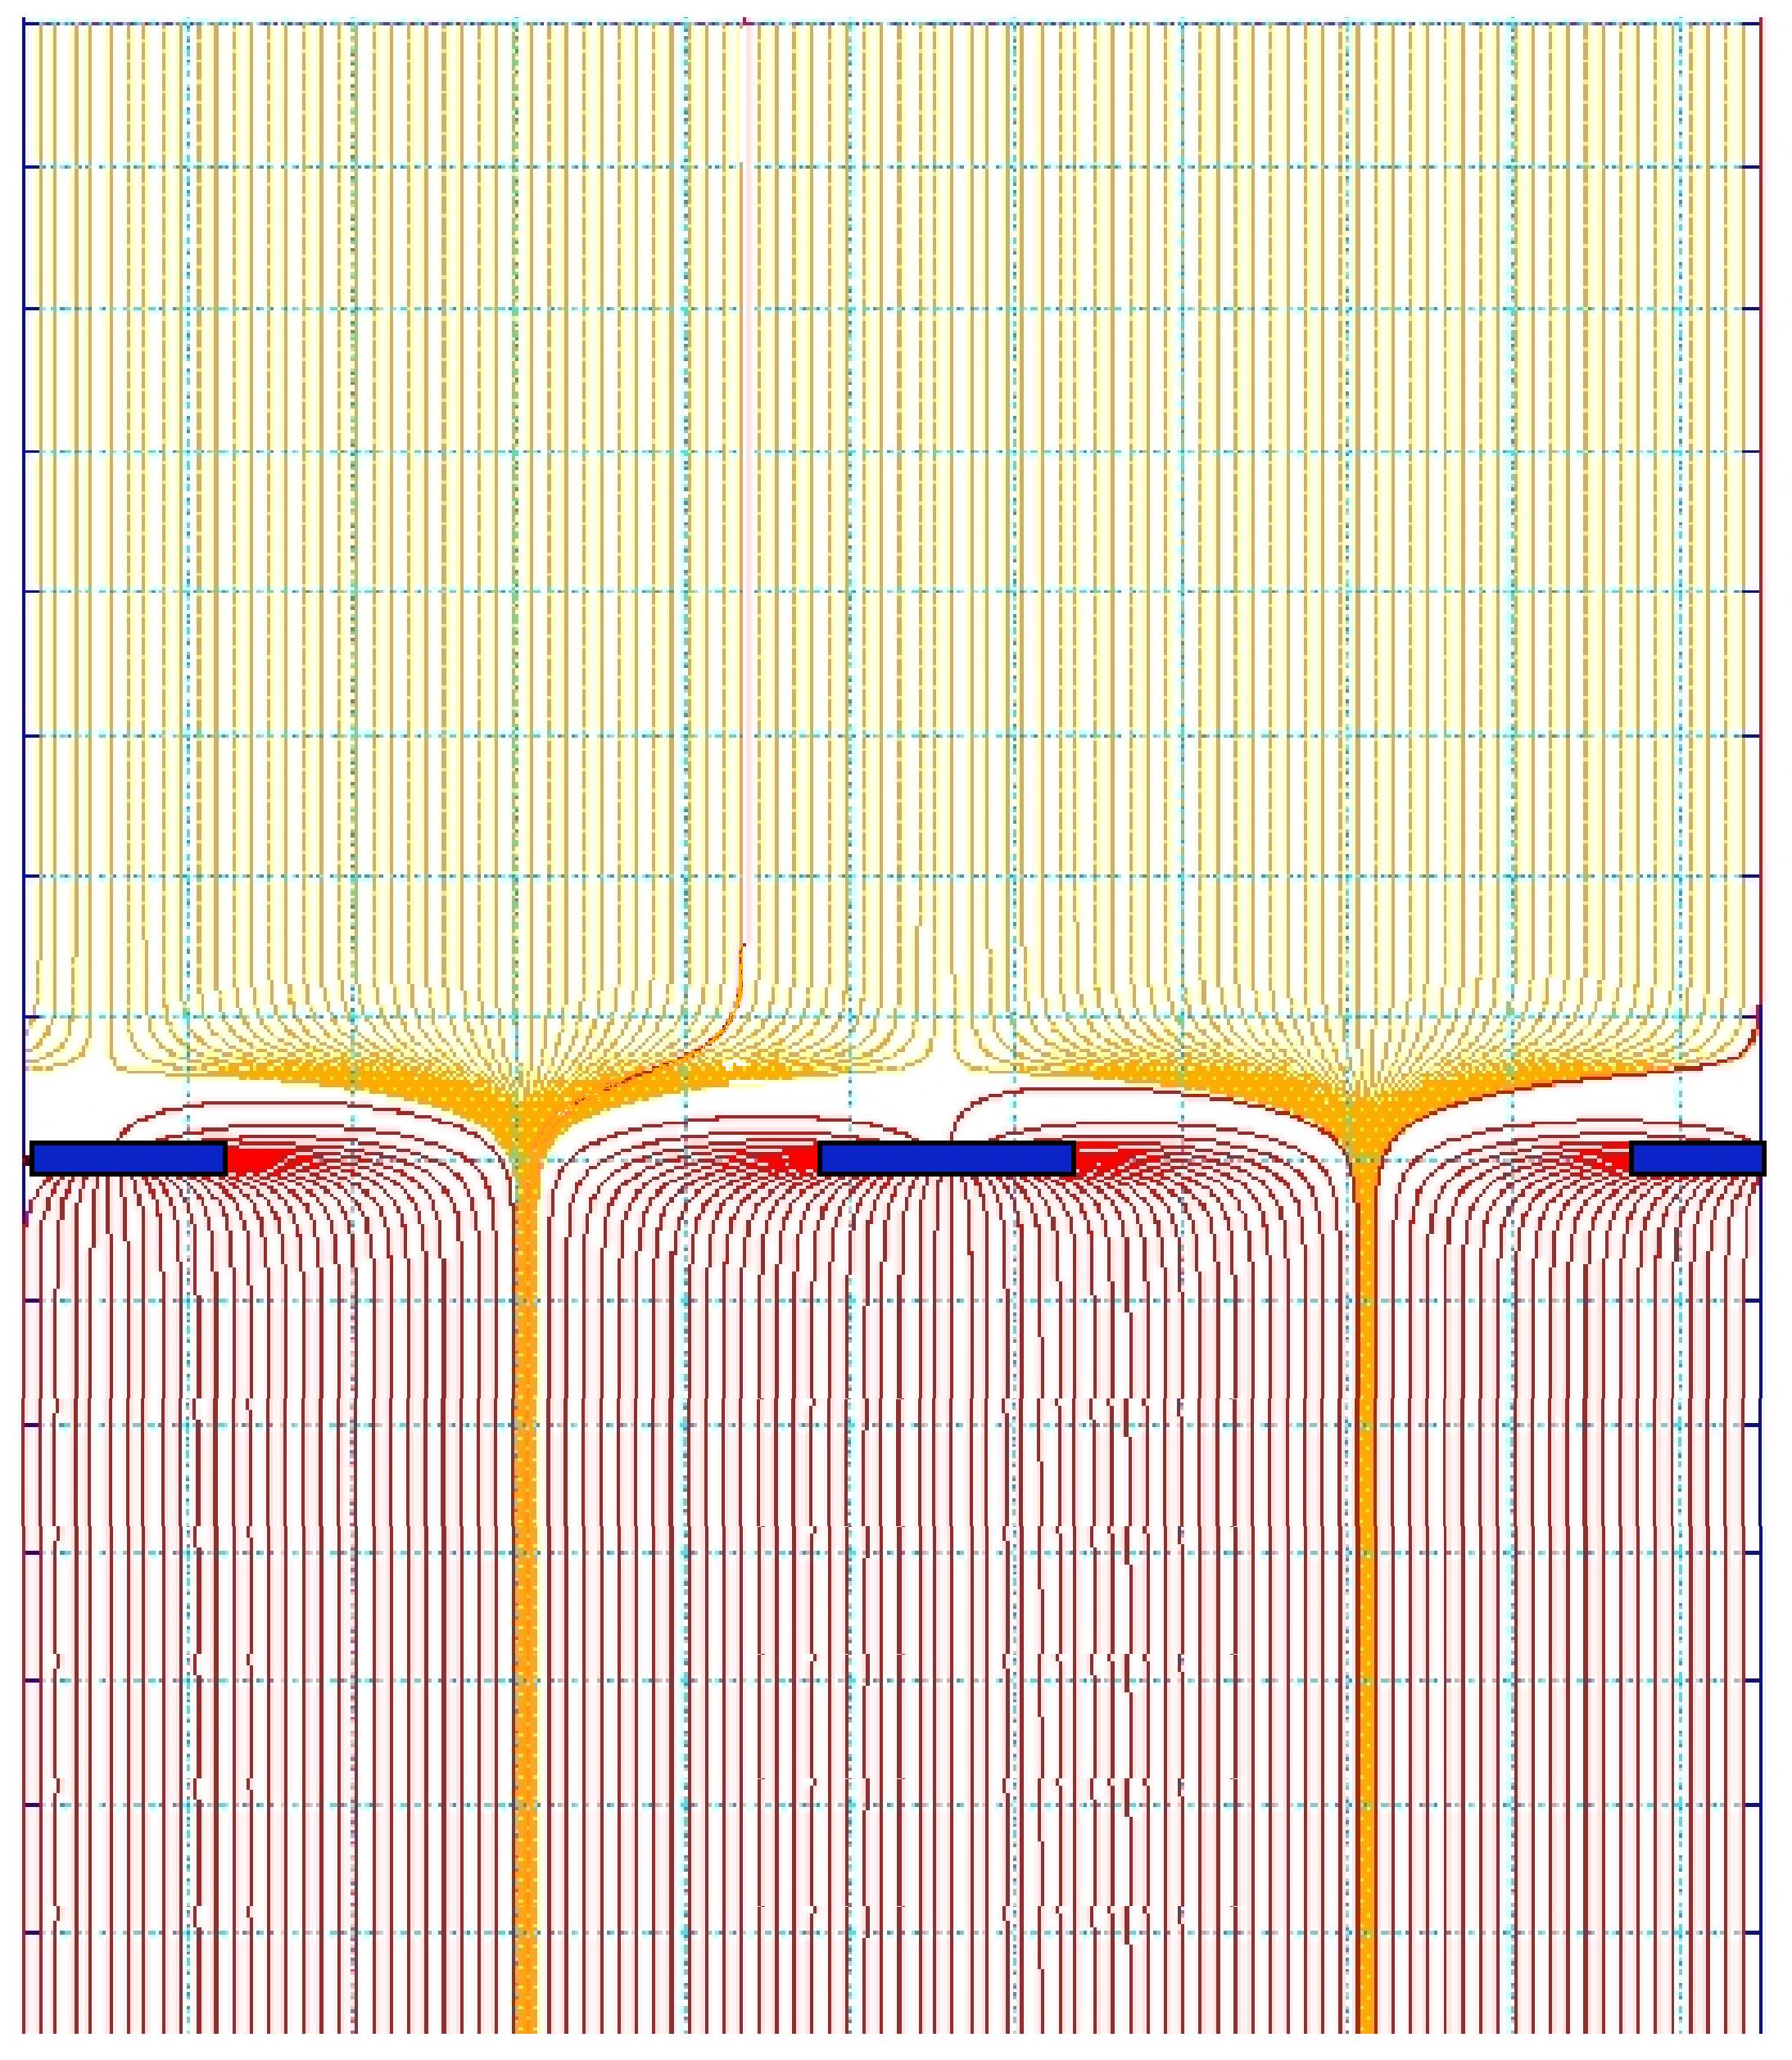
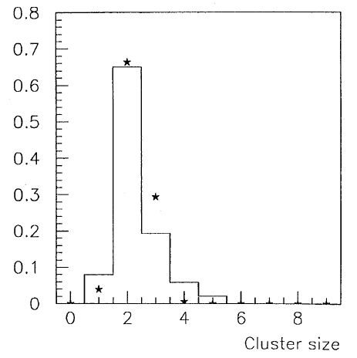
MICROMEGAS
HIGH/LOW FIELD REGIONS SEPARATED BY A MESH
Signal distribution: 200 µm fwhm
200 V/cm
100 µm pitch
50-100 µm
50 kV/cm
J. Derré et al,
Nucl. Instr. and Meth. A459(2001)523
Y. Giomataris et al,
Nucl. Instr. and Meth. A 376(1996)29

Slide 19
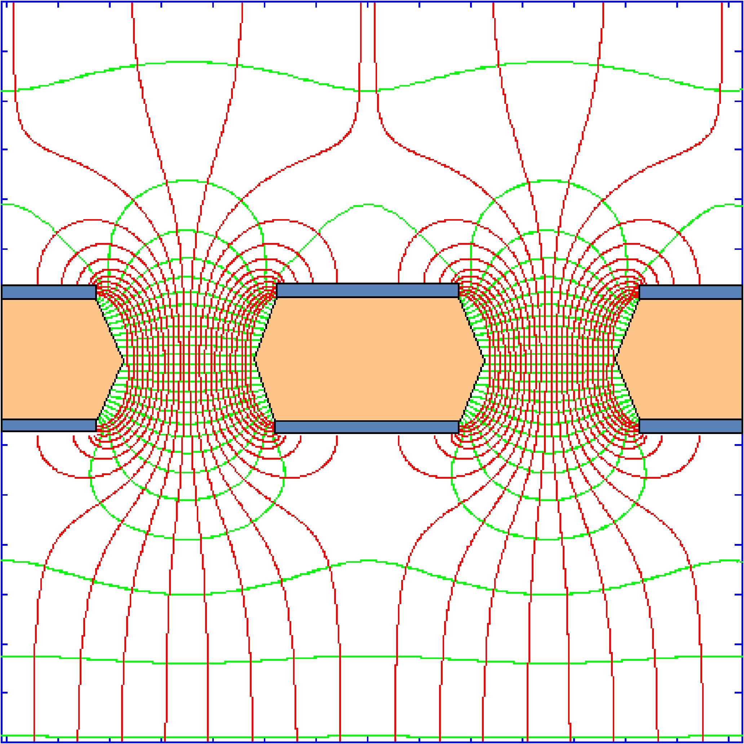
GAS ELECTRON MULTIPLIER (GEM)
Thin (50 µm) metal-coated polymer foil with high density of holes:
FAST ELECTRON SIGNAL ONLY
ON ANODE STRIPS
DRIFT
GEM
INDUCTION
F. Sauli, Nucl. Instr. and Meth. A386(1997)531

Slide 20
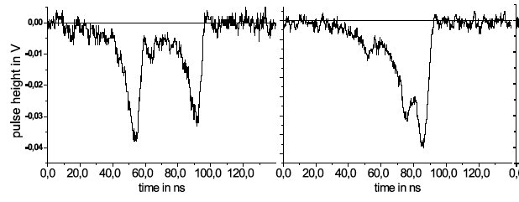
GEM TWO-TRACK RESOLUTION
TWO-TRACK RESOLUTION
(DRIFT TIME):
30 ns ~ 1.5 mm
10 ns
TWO-TRACK RESOLUTION
(PROJECTION):
M. Ziegler, PhD Zürich Univ. (2002)
400 µm fwhm
VOLUME RESOLUTION
~ 1 mm³
A. Bressan et al, Nucl. Instr. and Meth. A425(1999)262

Slide 21
GEM RATE CAPABILITY
GEM GAIN vs RATE (SOFT X-Rays)
J. Benlloch et al, IEEE NS-45(1998)234

Slide 22
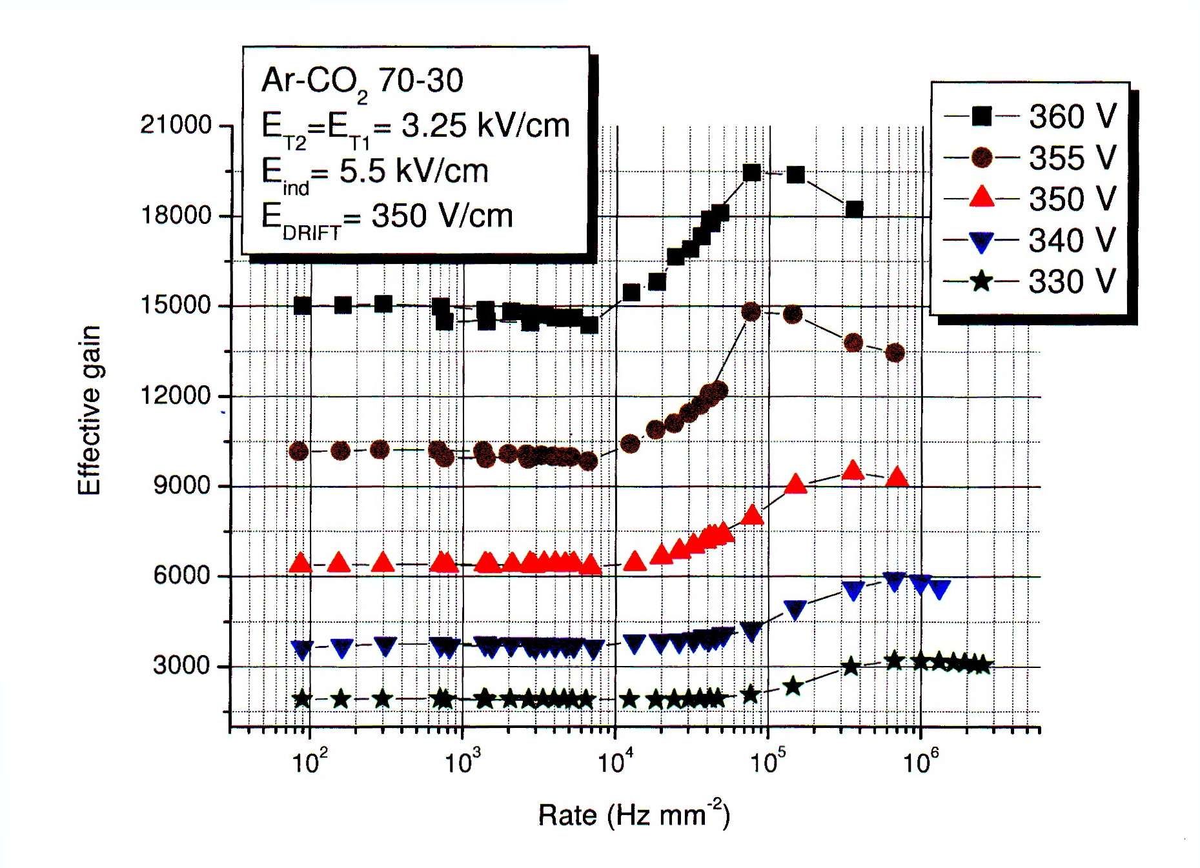
GEM RATE CAPABILITY
A STRANGE OBSERVATION: GAIN INCREASE AT VERY HIGH RATES
(2006, UNPUBLISHED)
Peter Everaerts, PhD Gent University (2006)

Slide 23
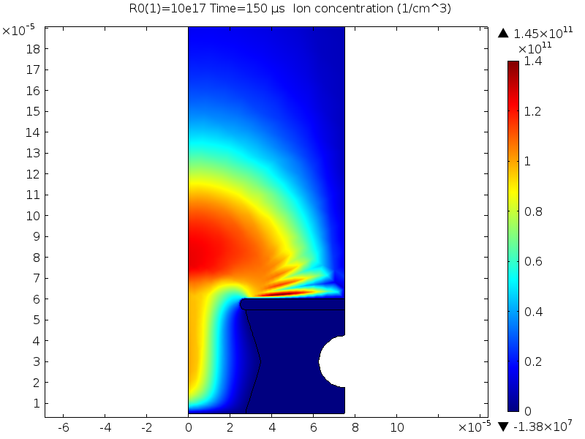
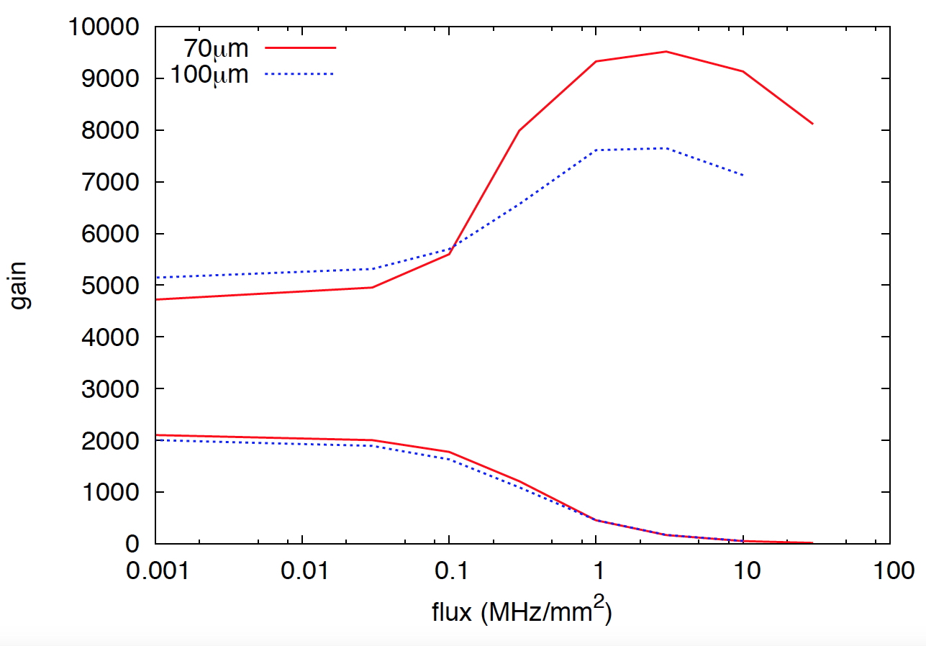
GEM RATE CAPABILITY
A RECENT SIMULATION
COMSOL Finite Element Analysis
GARFIELD
S. Franchino et al, Subm. IEEE Nucl. Sci. Symposium (San Diego, Oct. 31, 2015)

Slide 24
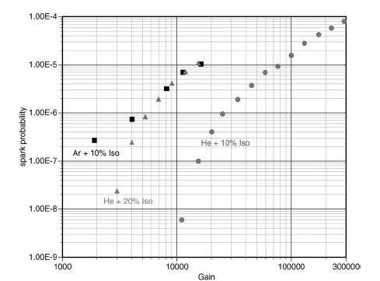
discharges: micromegas
MICROMEGAS: SPARK PROBABILITY IN HADRON BEAM
FOR A GAIN OF 5.10³ , 10⁶ PARTICLES s⁻¹:
~ ONE DISCHARGE / SECOND
10⁻⁶
5 10³
A. Delbart et al, Nucl. Instr. and Meth. A478(2002)205

Slide 25
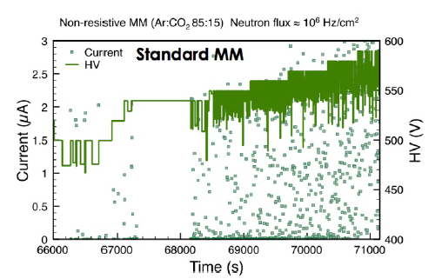
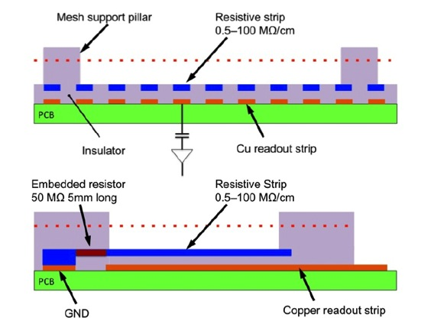
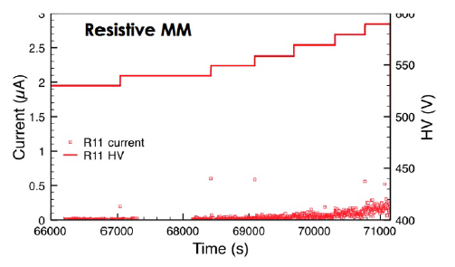
discharges: resistive micromegas
SPARK RATES IN NEUTRON BEAM EXPOSURE:
BUILT ON A HIGH-RESISTIVITY POLYMER
T. Alexopolous et al, Nucl. Instr. and Meth. A640(2011)110

Slide 26
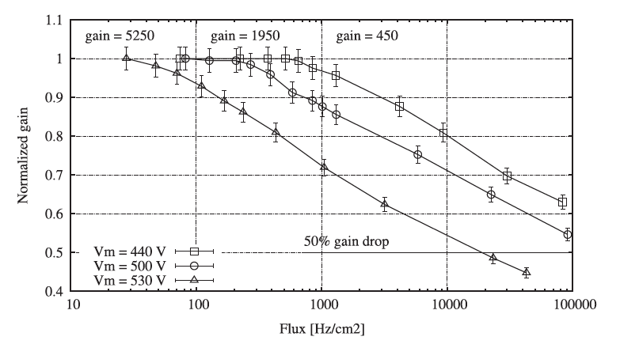
discharges: resistive micromegas
GAIN REDUCTION AS A FUNCTION OF RATES:
J. Galán et al, Nucl. Instr. and Meth. A732(2013)229

Slide 27
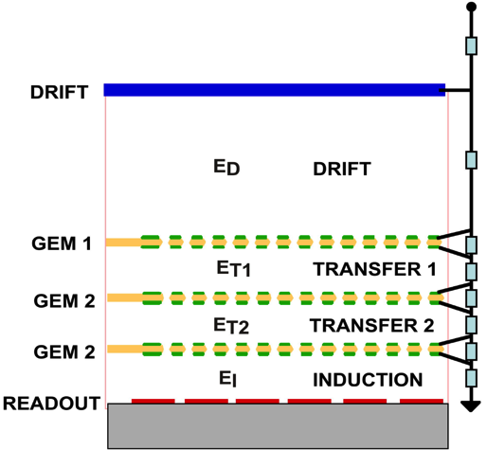
discharges: multi-gem
TRIPLE-GEM (TGEM): CASCADED GEM ELECTRODES
C. Büttner et al, Nucl. Instr. and Meth. A409(1998)79

Slide 28
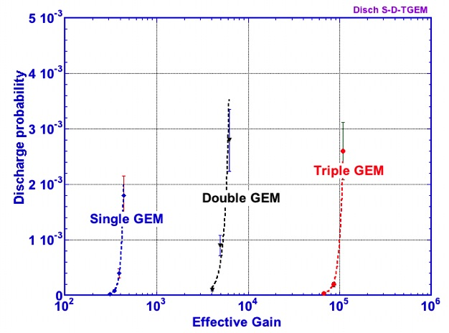
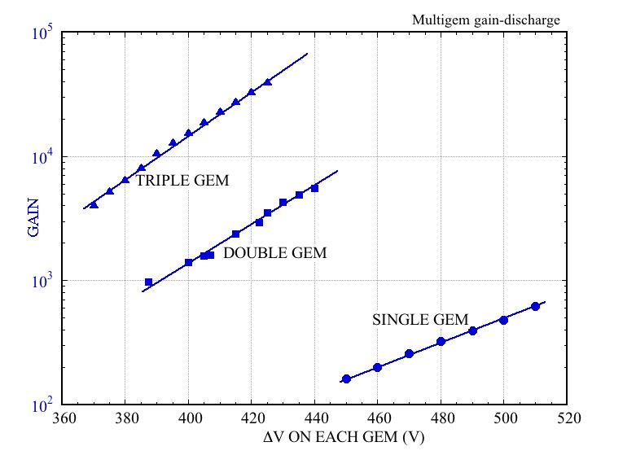
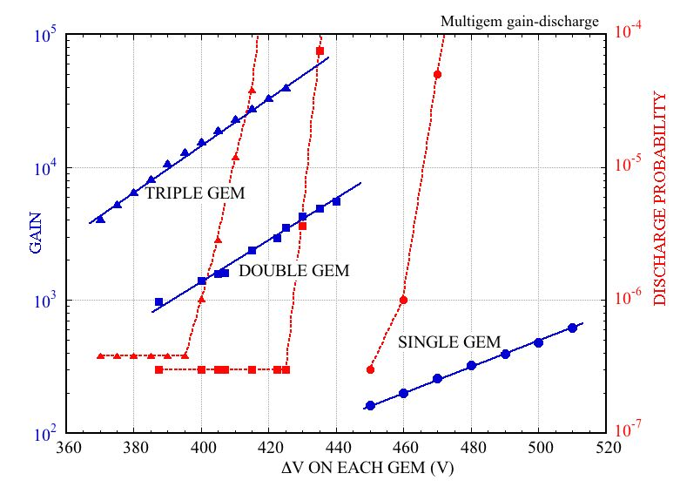
discharges: multi-gem
GAIN VS VOLTAGE – 5.9 keV
DISCHARGE PROBABILITY VS GAIN:
DISCHARGE RATE ON ~ 5 MeV α
Q~10⁸
Q~10⁹
Q~10⁷
Q~10⁹
Q~10⁷
Q~10⁸
WHAT ABOUT THE RAETHER LIMIT?
S. Bachmann et al,
Nucl. Instr. and Meth. A479 (2002) 294
IN MULTI-GEMS, THE CHARGE SPREADS OVER MANY INDEPENDENT HOLES!

Slide 29
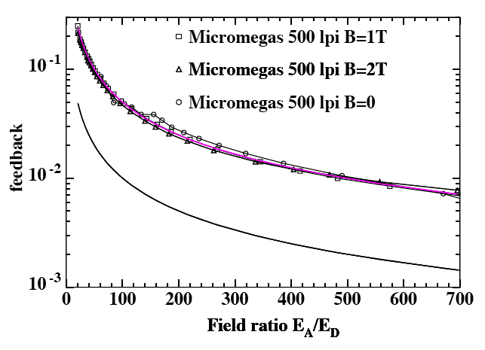
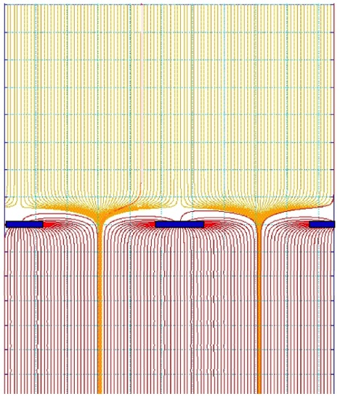
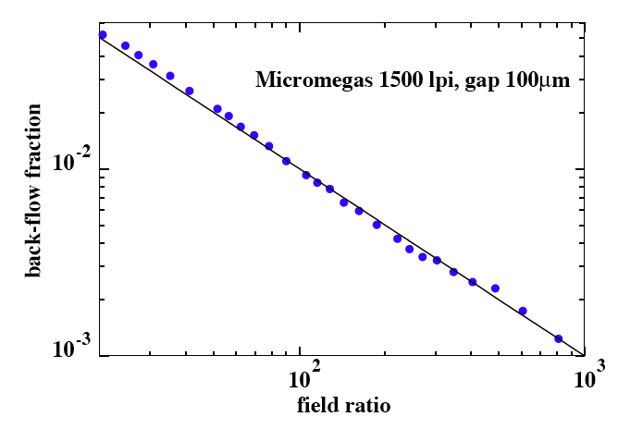
positive ions backflow: micromegas
THE IONS BACKFLOW DEPENDS ON AVALANCHE SPREAD, BUT CANNOT BE SMALLER THAN THE FIELD RATIO:
5%
E_{A}~ 40 kV cm⁻¹
1%
FIELD RATIO
E_{D}~ 400 V cm⁻¹
E_{A}~ 40 kV cm⁻¹
Ar-CH₄ 97-3
P. Colas et al, Nucl. Instr. and Meth. A535(2004)226

Slide 30
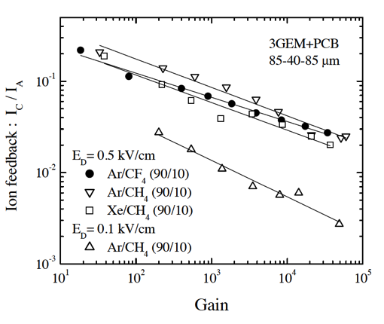
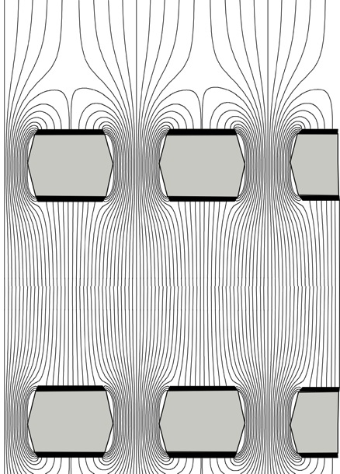
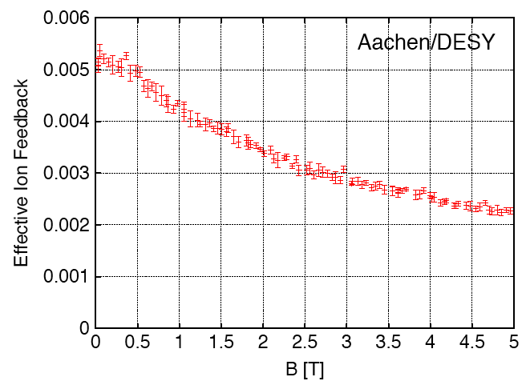
positive ions backflow: multi-gem
THE IBF VALUE RESULTS FROM THE INTERPLAY OF GEOMETRY, FIELDS, DIFFUSION:
2 10⁻²
5 10⁻³
Gain
A. Bondar et al, Nucl. Instr. and Meth. A496(2003)325
MAGNETIC FIELD:
THE WISH:
2 10⁻³
M. Killenberg et al, Nucl. Instr. and Meth. A530(2004)251

Slide 31



positive ions backflow: gem with offset holes
EXPLOIT THE DIFFERENCE BETWEEN IONS’ AND ELECTRONS’ DIFFUSION IN AN OFFSET DOUBLE THICK-GEM
TRANSVERSE DIFFUSION:
OFFSET SCAN:
F. Sauli et al, Nucl. Instr. and Meth. A560(2006)269

Slide 32



alice tpc gem upgrade
BASELINE: FOUR OFFSET GEMs
Ar-CO₂ 70-30: ~ 0.8%
Ne-CO₂ (ALICE): ~ 5%
B. Ketzer et al, Nucl. Instr. and Meth. A732(2013)237

Slide 33

alice tpc gem upgrade
QUAD-GEM WITH ALTERNATING DIFFERENT PITCH
IBF AND ENERGY RESOLUTION VS VOLTAGE ON THE FIRST GEM:
ALICE TDR CERN-LHCC-2013-020

Slide 34


alice tpc gem upgrade
SIMULATION STUDIES FOR PANDA: TRIPLE GEM OPERATED IN Ne-CO₂ 90-10
2 10⁷ p-p ANNIHILATIONS GAIN M=2000 IBF 2.5 10⁻³
SPACE CHARGE DENSITY:
ELECTRIC FIELD DISTORTIONS:
F.W. Bohmer et al,Nucl. Instr. and Meth. A719(2013)101

Slide 35

radiation resistance: micromegas
SYSTEMATIC IRRADIATION OF SMALL PROTOTYPES:
G. Iakovidis, MPGD 2013
20 C cm⁻²
~ 4 10¹⁴ MIPS cm⁻²
F. Hartjes, MPGD 2009

Slide 36


radiation resistance: gem
LHCb TRIGGER:
20 C/cm²
~ 4 10¹⁴ MIPS cm⁻²
M. Alfonsi et al, Nucl. Instr. and Meth. A518(2004)106
A. Sharma and M. Tytgat,
CMS Technical Design Report, (2014).

Slide 37

BUY ME ACHETE-MOI COMPRAMI KAUFEN SIE MICH купить мне
36
AND IF YOU WANT TO KNOW MORE…
http://www.cambridge.org/F4GASEOUS
F. Sauli
The gas electron multiplier (GEM): Operating principles and applications
Nucl. Instr. and Meth. In Press (7 Aug. 2015)

Slide 38

THE END
THE END
THANKS FOR YOUR ATTENTION

