Slide 1
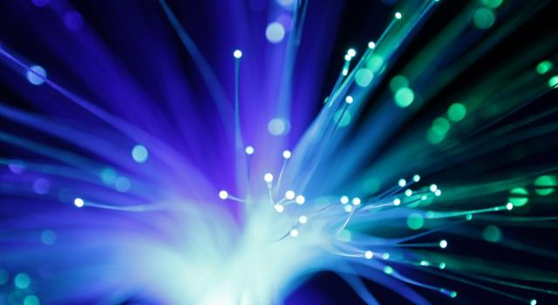
PART 1
PHOTON DETECTION AND IMAGING WITH GASEOUS COUNTERS
Fabio Sauli
TERA Foundation and CERN
EDIT 2015 Laboratori Nazionali di Frascati, October 20-29, 2015

Slide 2
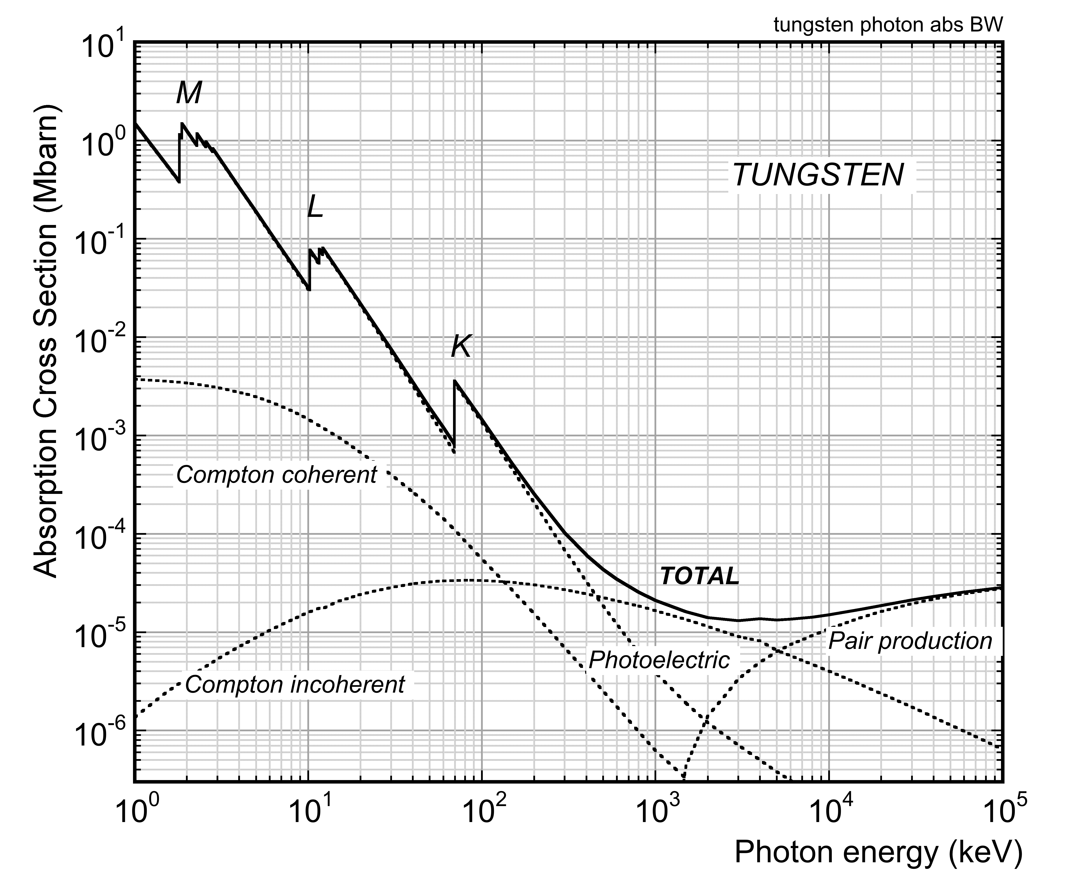
PHOTON ABSORPTION
I₀
I
E_{γ}
E_{K}-E_{L}
x
E_{γ} - E_{K}
Photoelectric
I₀ : Incoming flux
I : Outgoing flux
Compton
E_{C}
Θ_{C}
Absorption coefficient (cm⁻¹):
E_{γ}
E_{e}
Θ_{e}
E_{γ}
e⁺
e⁻
Absorption length (cm):
ρ: density (g cm⁻³)
N: atoms (molecules) cm⁻³
σ: absorption cross section (cm²)
A: Avogadro number

Slide 3
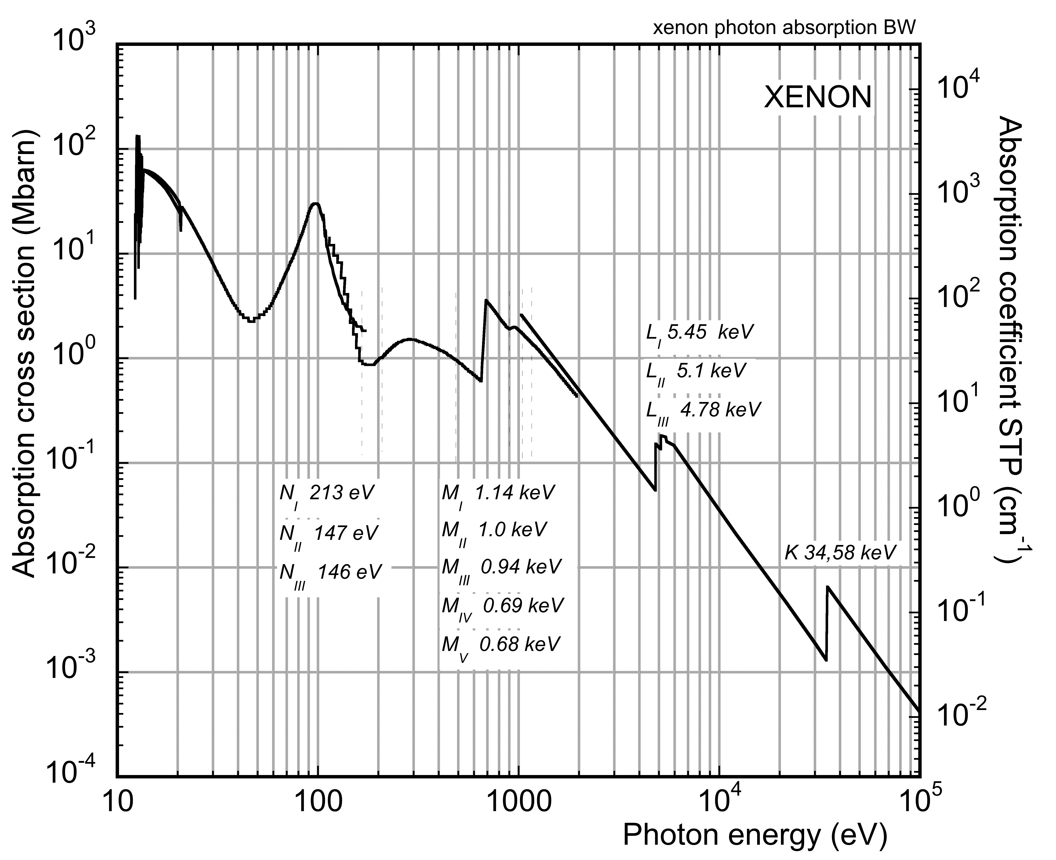
XENON PHOTON ABSORPTION CROSS SECTION AND LENGTH
UV
1 Mbarn=10⁻¹⁸ cm²
SOFT X-RAYS
HARD X-RAYS
For gases at STP:
@ E_{γ}=10 keV
λ ~ 1 cm (STP)
E_{I}
http://xdb.lbl.gov/
http://henke.lbl.gov/optical_constants/
http://www.nist.gov/pml/data/xraycoef/

Slide 4
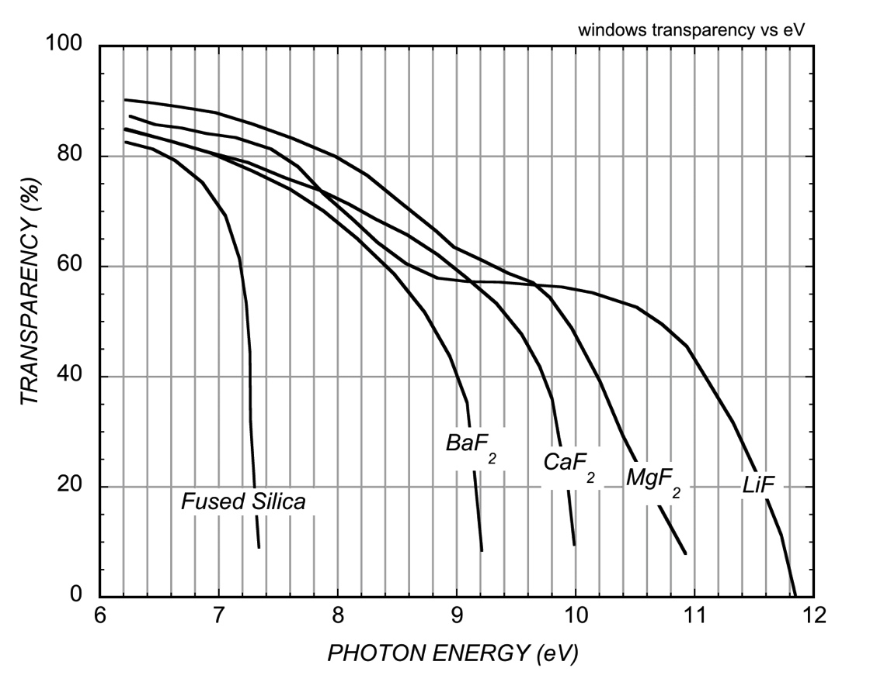
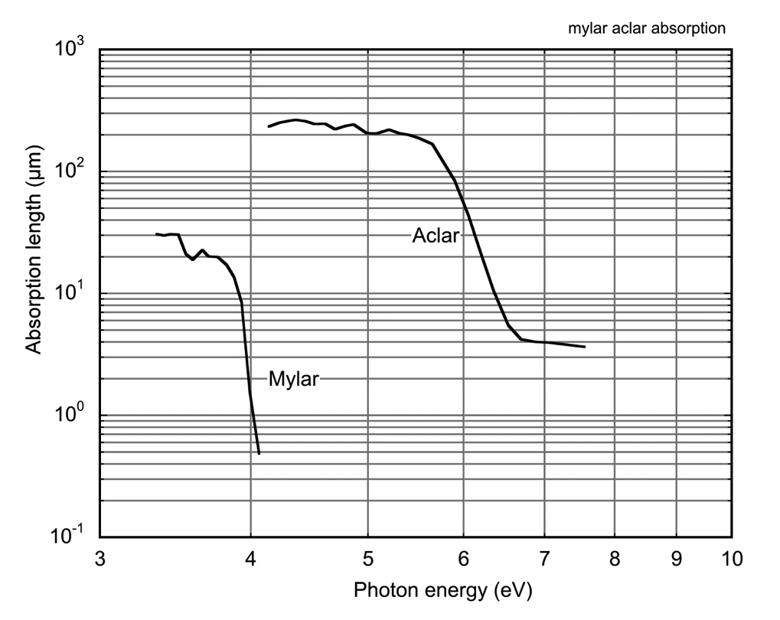
WINDOWS TRANSPARENCY – visible to ultraviolet
UV GLASS AND FLUORIDE CRYSTALS:
THIN POLYMER FOILS:

Slide 5
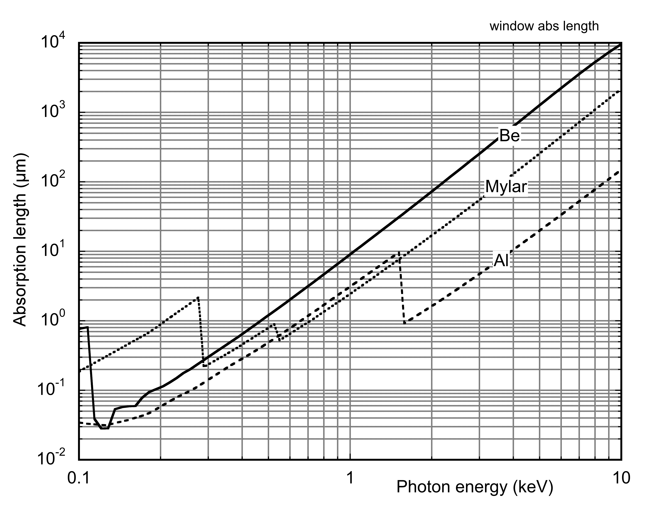
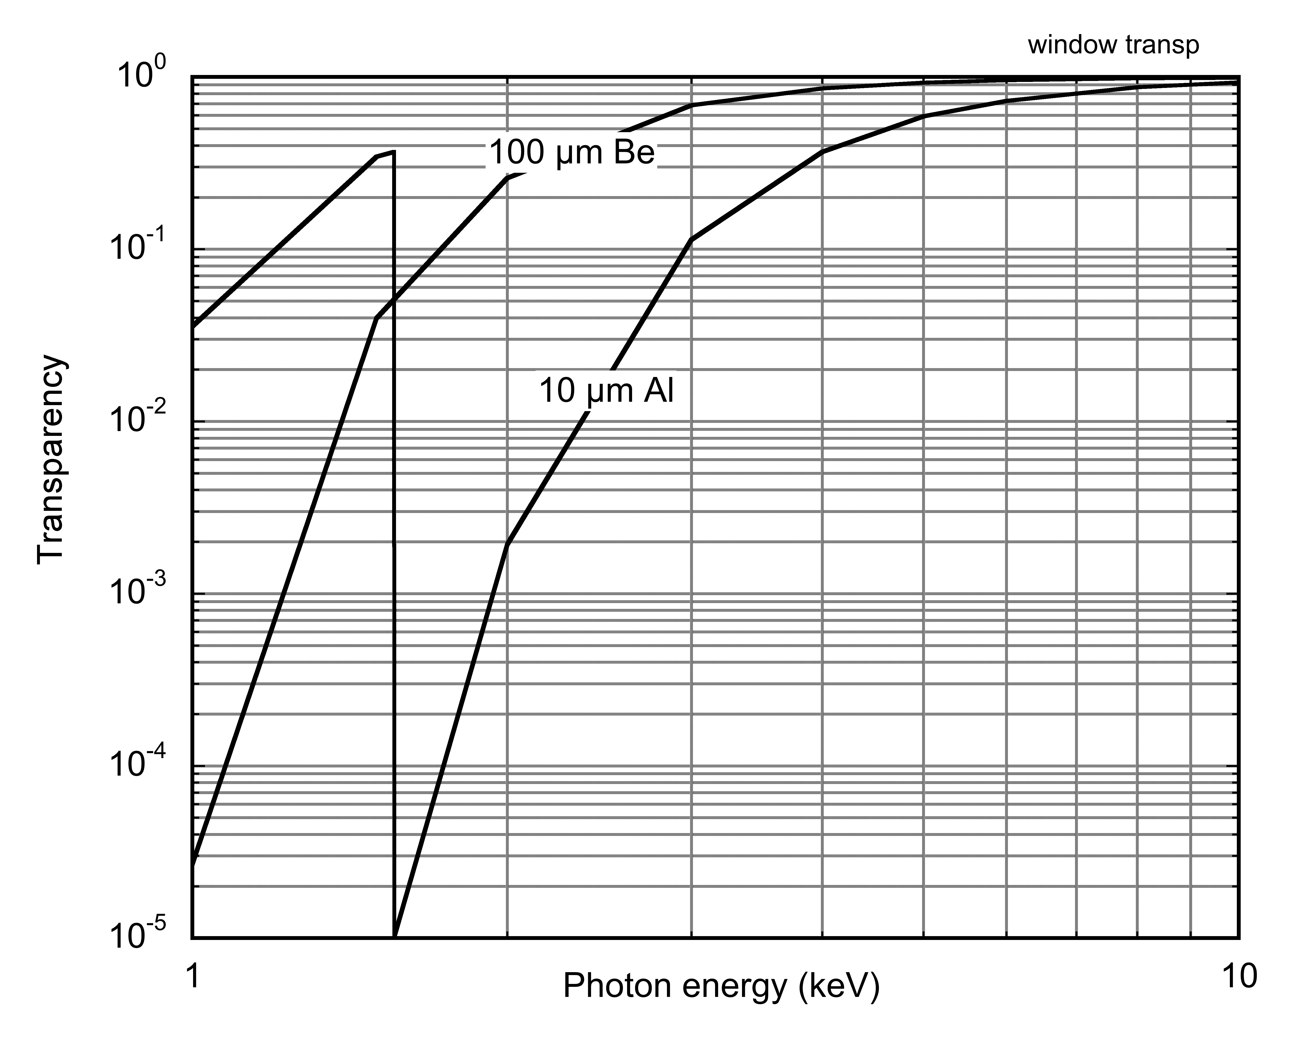
WINDOWS TRANSPARENCY – SOFT x rays
ABSORPTION LENGTH VS ENERGY:
TRANSPARENCY VS ENERGY:

Slide 6
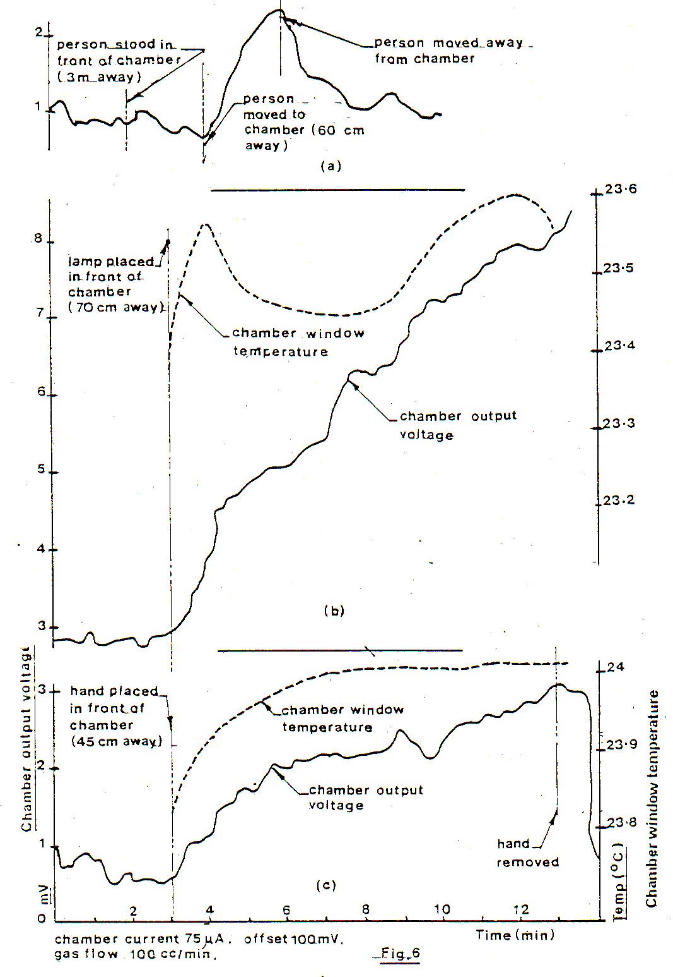
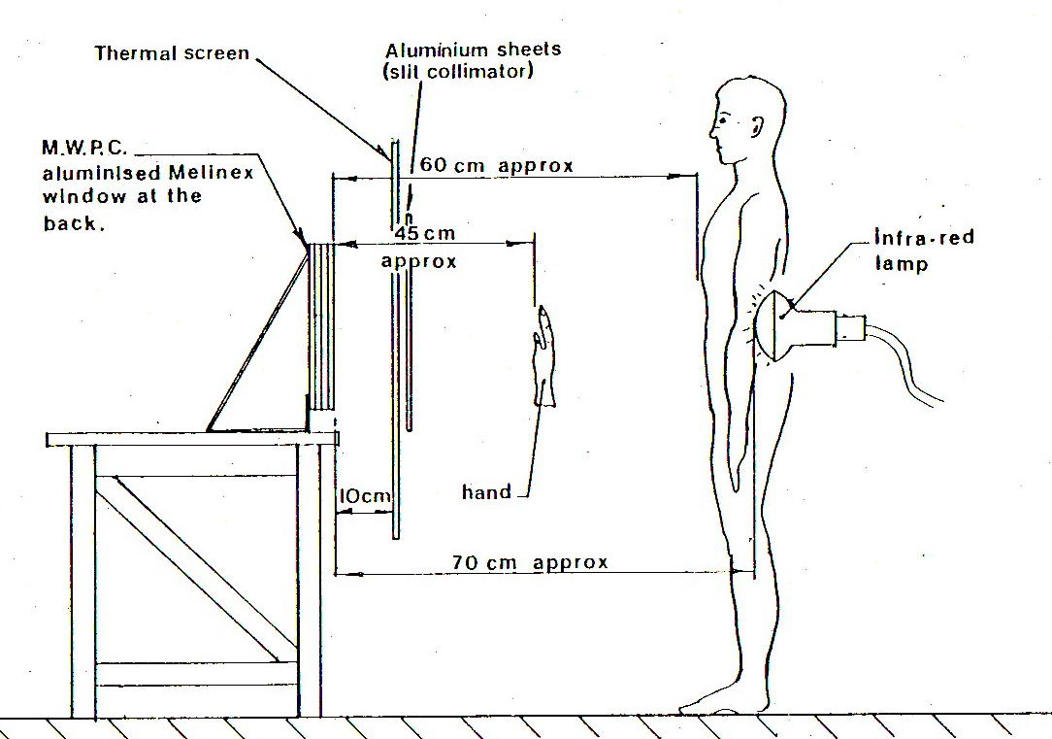
A CURIOUS OBSERVATION: MWPC INFRARED SENSITIVITY?
STUDY OF GLOW DISCHARGES IN MWPCs
Rutherford Lab (1979)
J.B. Marsh, K.H. Souten and B. O’Hagan
RL-79-038 (1979)

Slide 7
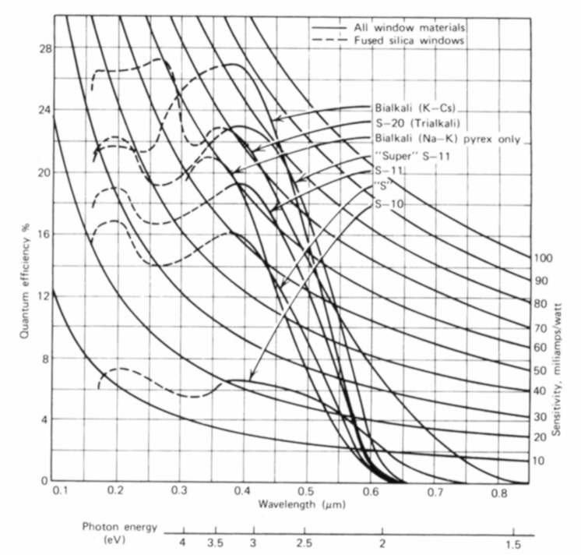
PHOTON DETECTION IN THE VISIBLE
SPECTRAL RESPONSE OF PHOTOCATHODES (IN VACUUM):
Trialkali (S-20)
VACUUM PHOTODIODE:
Bialkali (K-Cs)
I
GAS PHOTODIODE:
I
- Damaged by impurities (O₂, H₂O,…)
- Backscattering reduces Quantum Efficiency
GAS DETECTOR WITH GAIN:
ULTRAVIOLET
VISIBLE
- Photon feedback
- Positive ions damage of photocathode

Slide 8
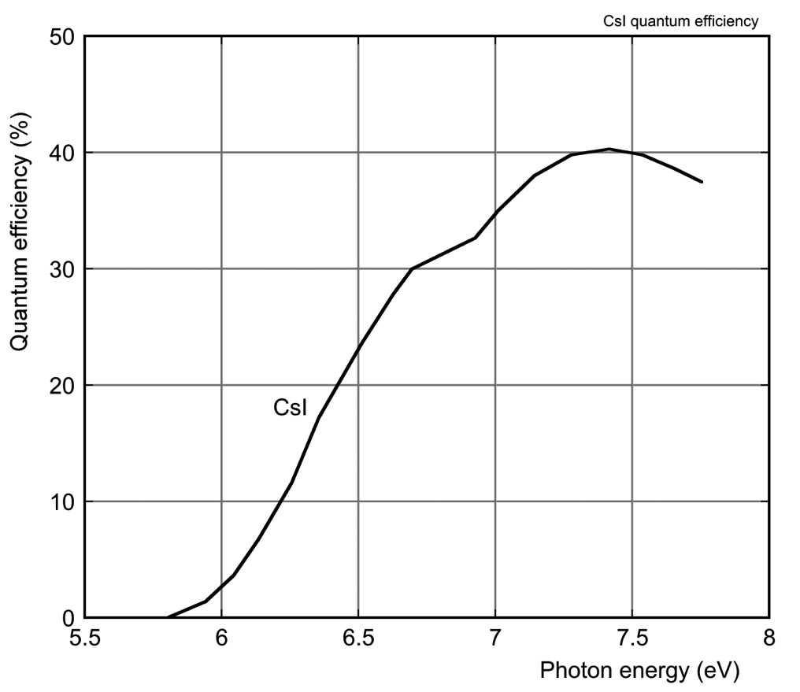
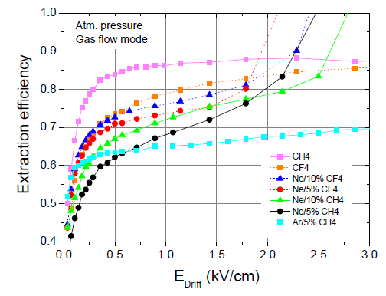
CAESIUM IODIDE PHOTOCATHODES
IN GASES:
FIELD DEPENDENCE OF THE PHOTOELECTRON EXTRACTION EFFICIENCY:
CsI QUANTUM EFFICIENCY (IN VACUUM):
J. Seguinot et al, Nucl. Instr. and Meth. 297(1990)133
C. D. R. Azevedo et al., 2010 JINST 5 P01002

Slide 9
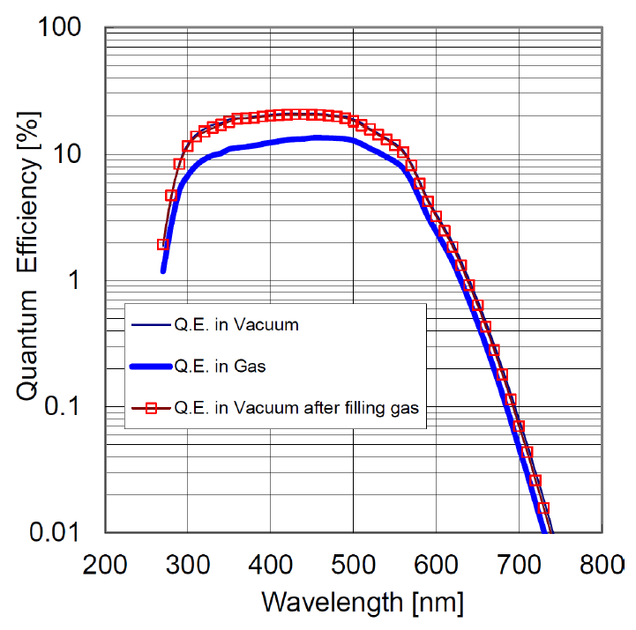
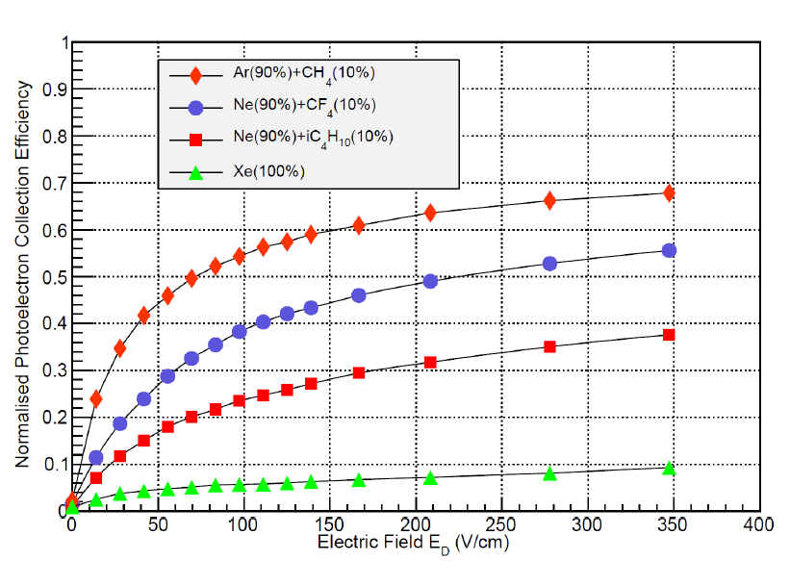
VISIBLE PHOTOCATHODES IN GASEOUS COUNTERS
MICRO-PATTERN GAS DETECTORS: GEM, MICROMEGAS, GLASS CAPILLARY
Quantum Efficiency of Bi-alkali Photocathode in Ar-CH₄ (90-10):
Photoelectron Collection Efficiency in several gases at increasing fields:
F. Tokanai et al, Nucl. Instr. and Meth. A610(2009)164

Slide 10
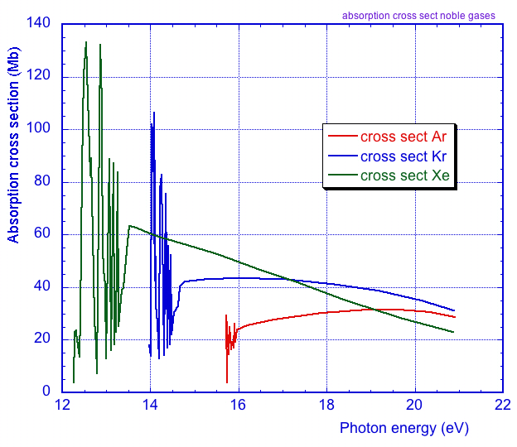
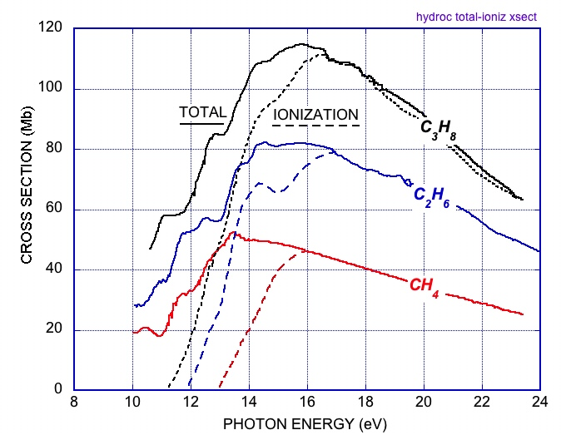
UV PHOTONS ABSORPTION
NOBLE GASES: PHOTOIONIZATION THRESHOLD
MOLECULAR GASES:
TOTAL AND IONIZATION CROSS SECTIONS:
H. S. W. Massey, Electronic and Ionic impact Phenomena (Oxford Press 1969)
G. Marr, Photoionization Processes in Gases
(Academic Press NY 1967)

Slide 11
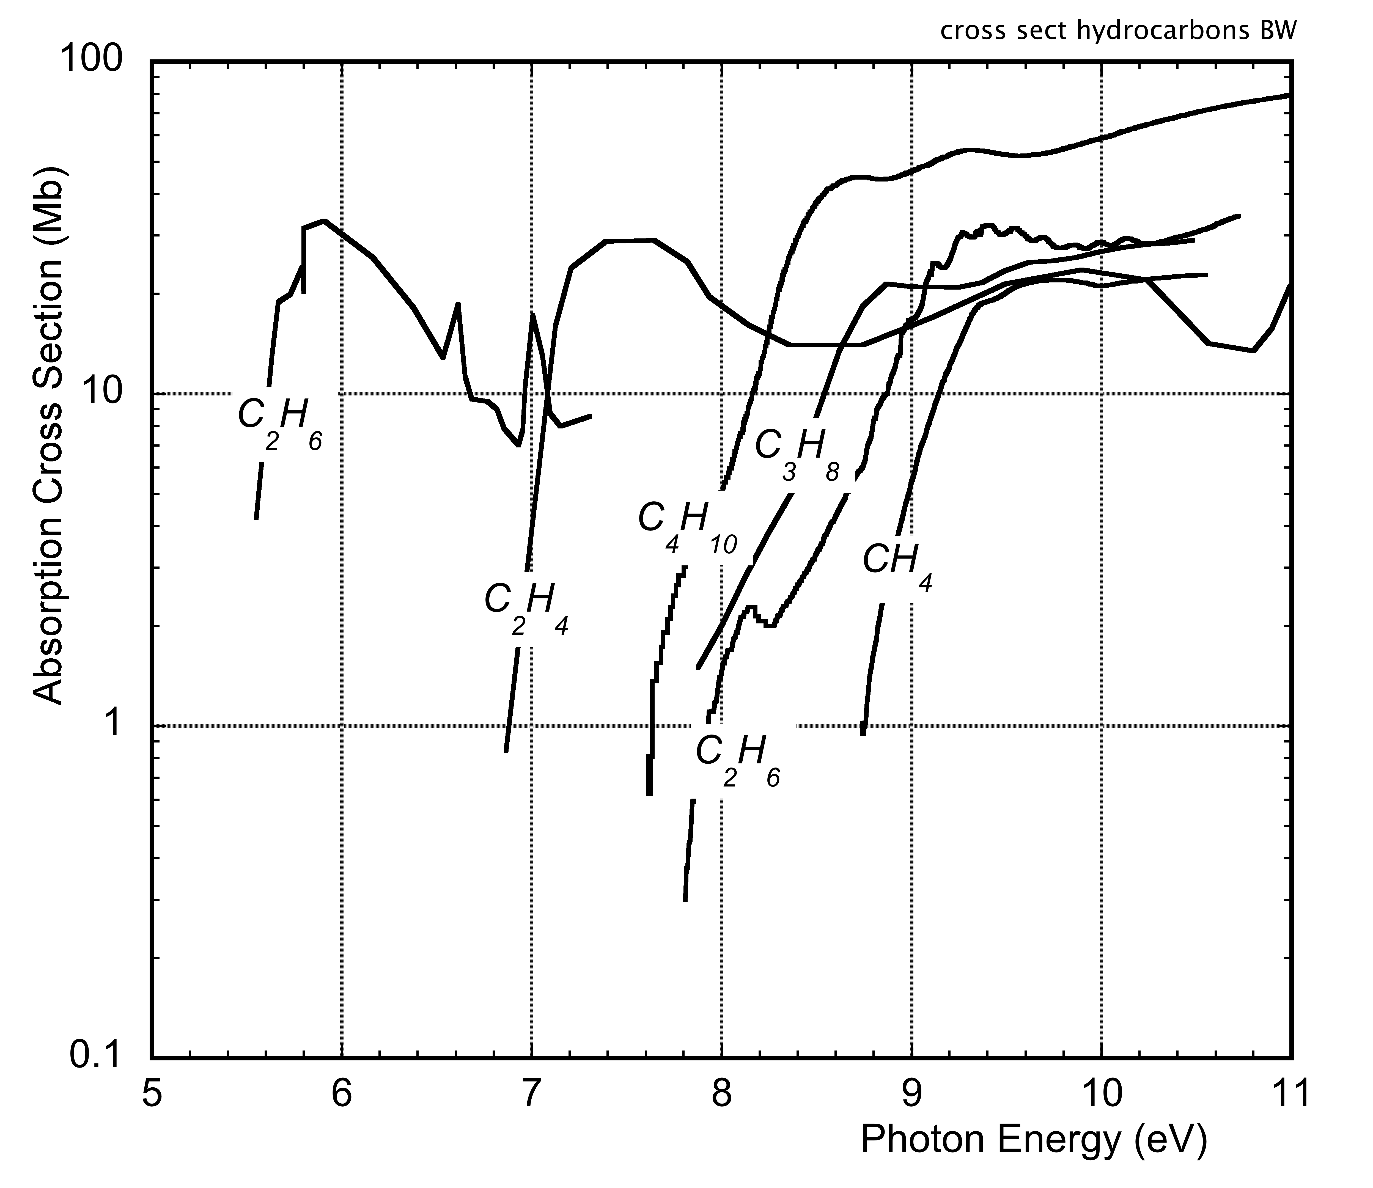
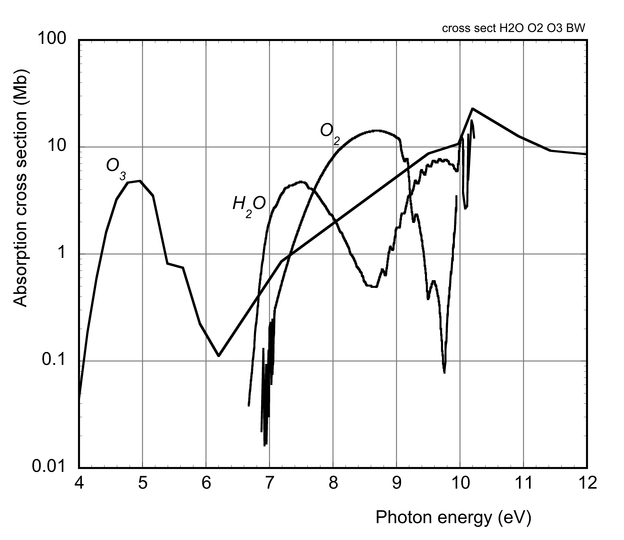
UV PHOTONS ABSORPTION
HYDROCARBONS
OXYGEN, OZONE, WATER:
F. Sauli, Gaseous Radiation Detectors
Cambridge University Press (2014)

Slide 12
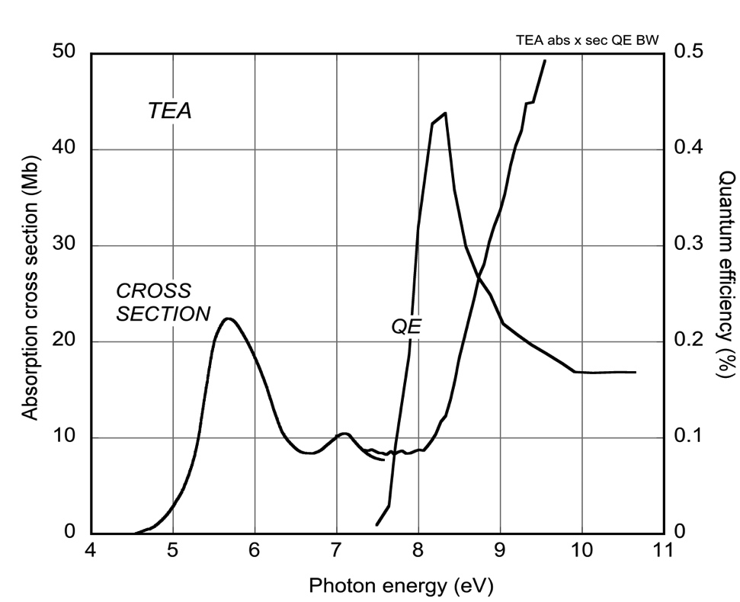
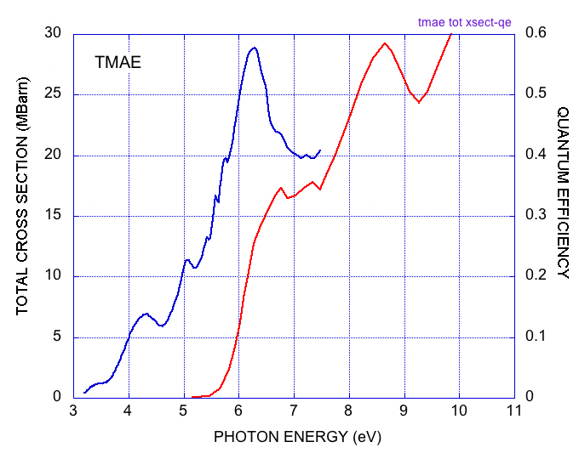
LOW THRESHOLD PHOTOIONIZING VAPORS
Triethylamine (TEA) (C₂H₅)₃N
E_{i} = 7.5 eV
Tetrakis-dimethilamino-ethylene (TMAE)
C[(CH₃)₂N]₄
E_{i} = 5.3 eV
σ_{TOT}
QE
R. Holroyd et al, Nucl. Instr. and Meth.A261(1987)440

Slide 13
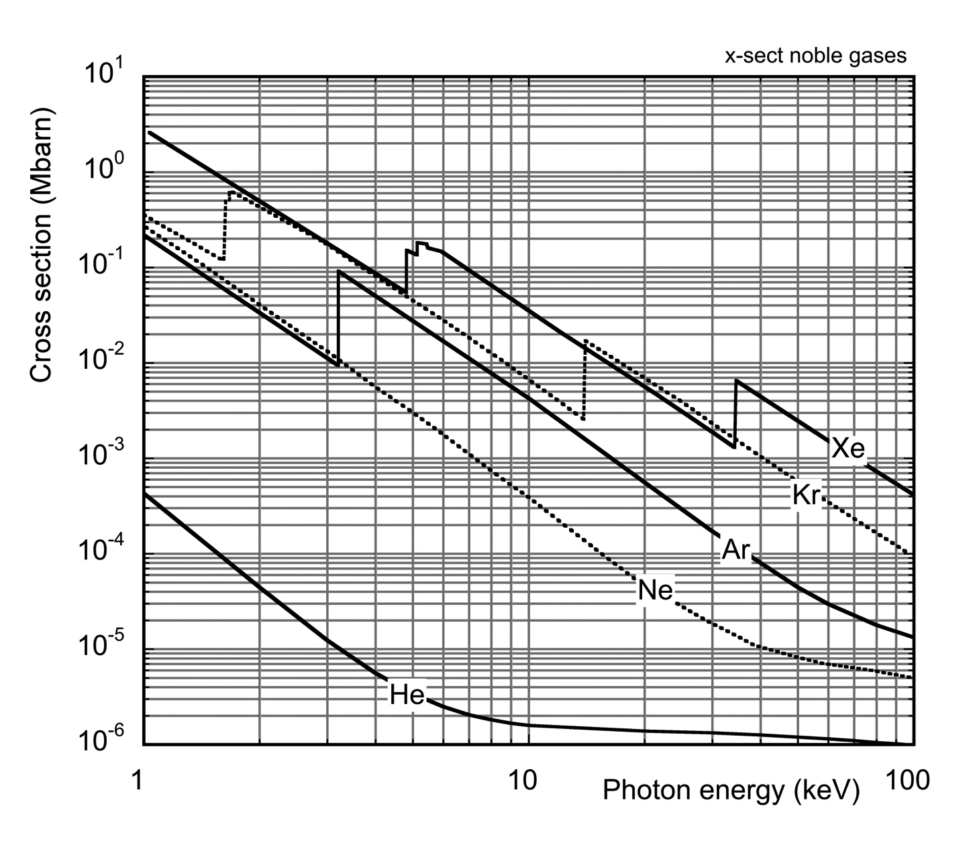
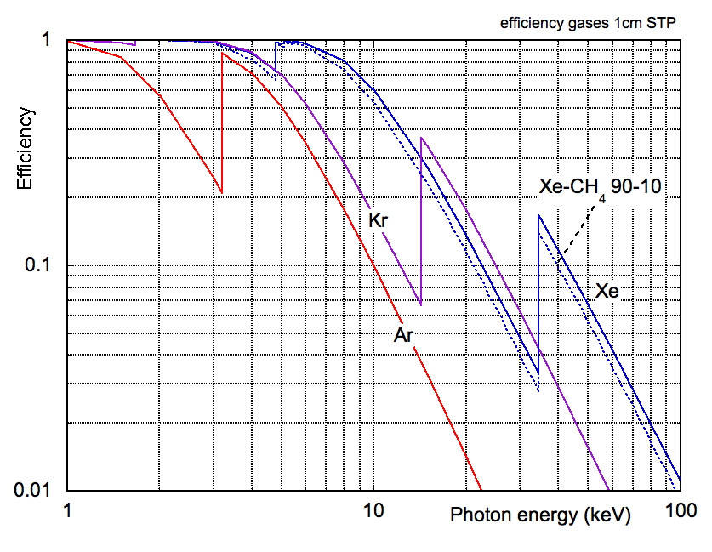
PHOTOELECTRIC CROSS SECTION: SOFT X-RAYS
ABSORPTION CROSS SECTION:
DETECTION EFFICIENCY
1 cm GAS @ STP (0⁰C, 1 ATM):

Slide 14
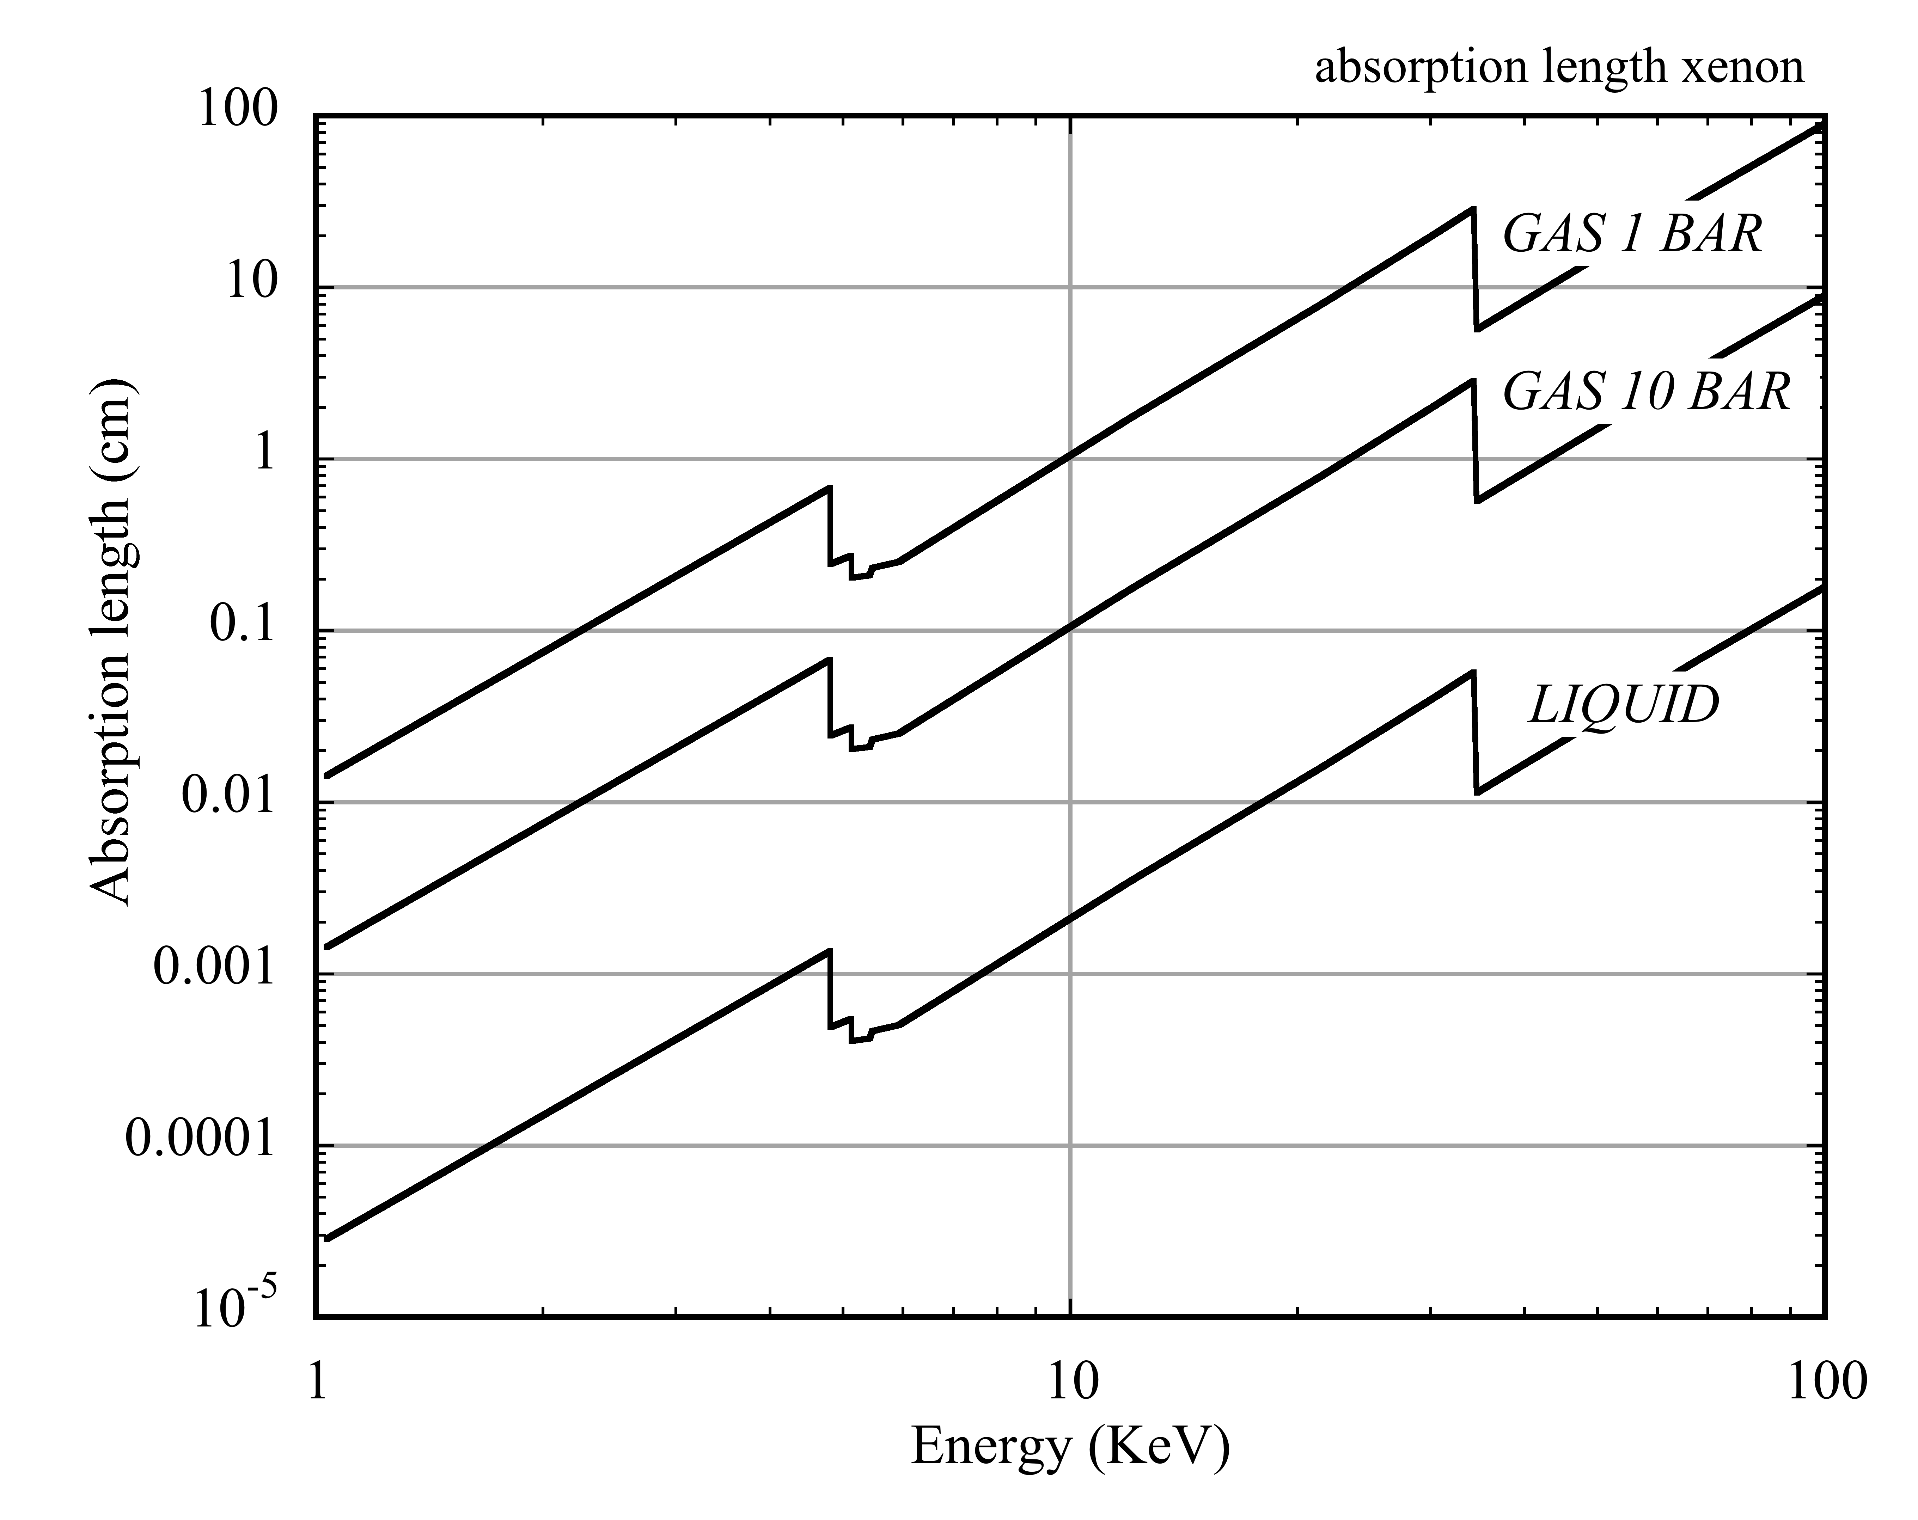
ABSORPTION LENGTH: SOFT X-RAYS IN XENON

Slide 15
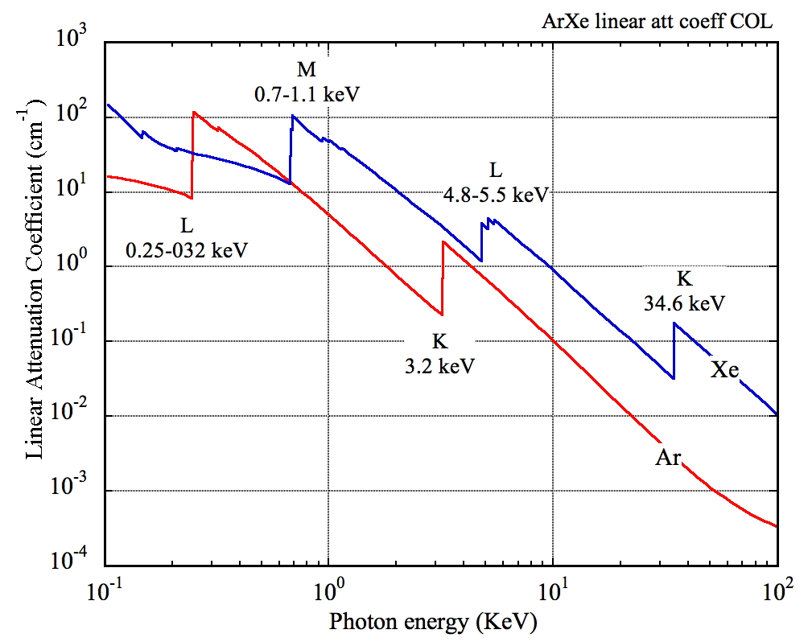
SOFT X-RAYS: PHOTOELECTRIC
LINEAR ATTENUATION COEFFICIENT (STP):
L-SHELL:
E_{L}-E_{M}
E
E-E_{L}
K SHELL FLUORESCENCE:
E_{K}-E_{L}
E_{L}-E_{M}
E
E-E_{K}
ESCAPE
E
E-E_{K}
NON-RADIATIVE (AUGER)
~ E
E

Slide 16
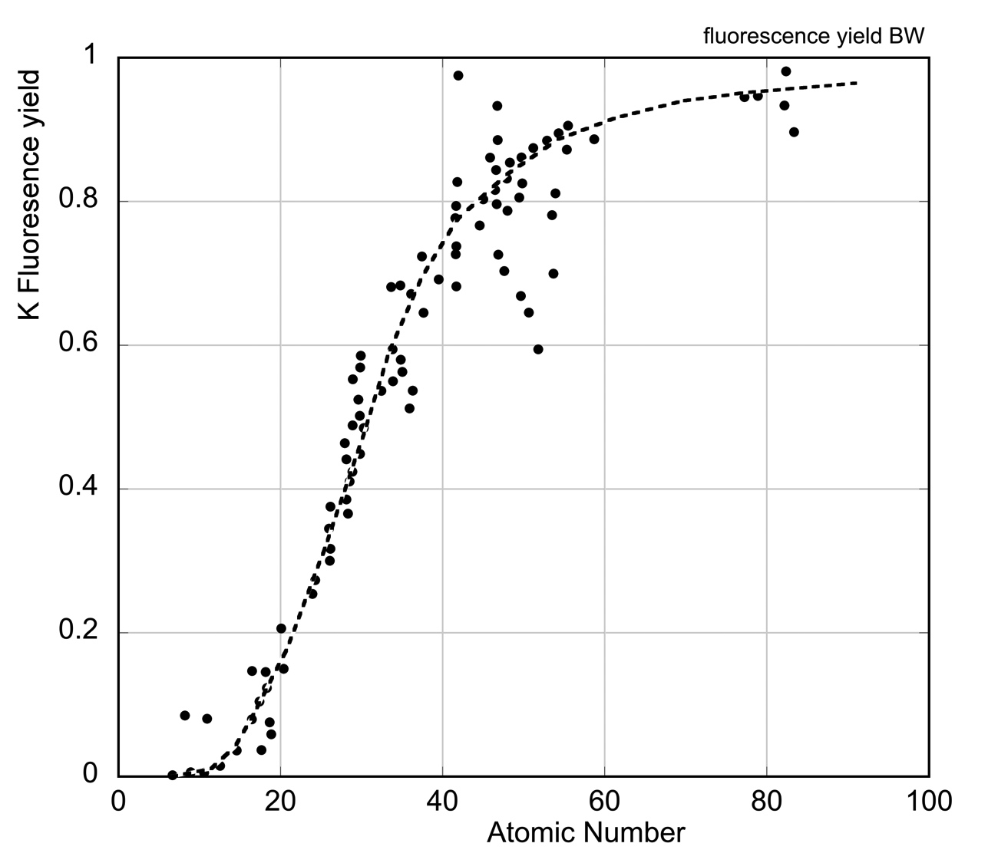
FLUORESCENCE YIELD
FY = Probability of Fluorescence / Total
Ar
FY~10%
Xe
FY~90%

Slide 17
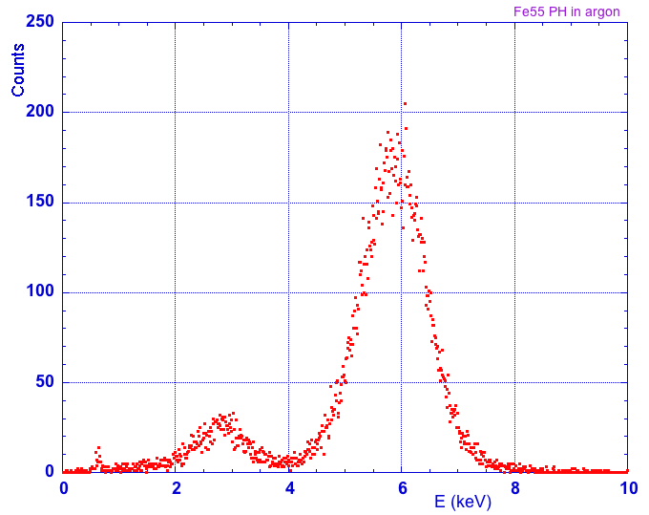
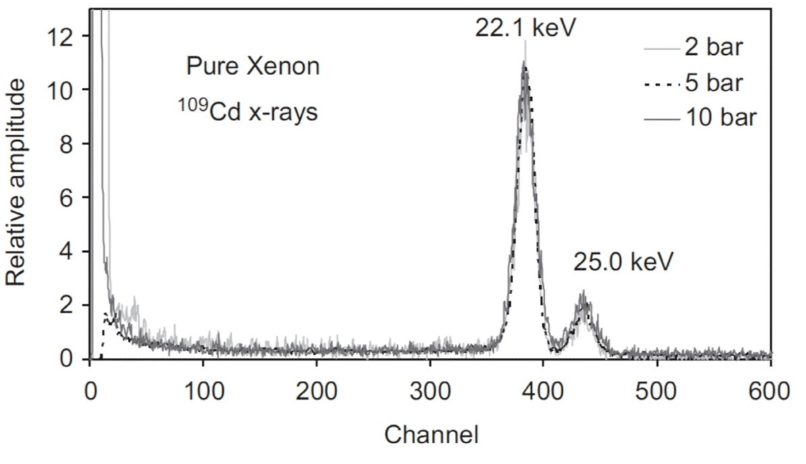
SOFT X-RAYS: FLUORESCENCE YIELD AND ESCAPE PEAKS
5.9 keV ⁵⁵Fe SOURCE IN ARGON:
5.9 keV
22-25 keV ¹⁰⁹Cd SOURCE IN XENON:
~ 3 keV
ESCAPE
TOTAL ENERGY:
L+K, AUGER

Slide 18
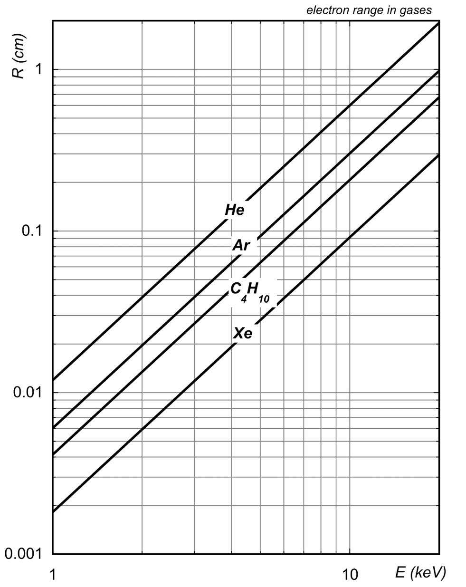
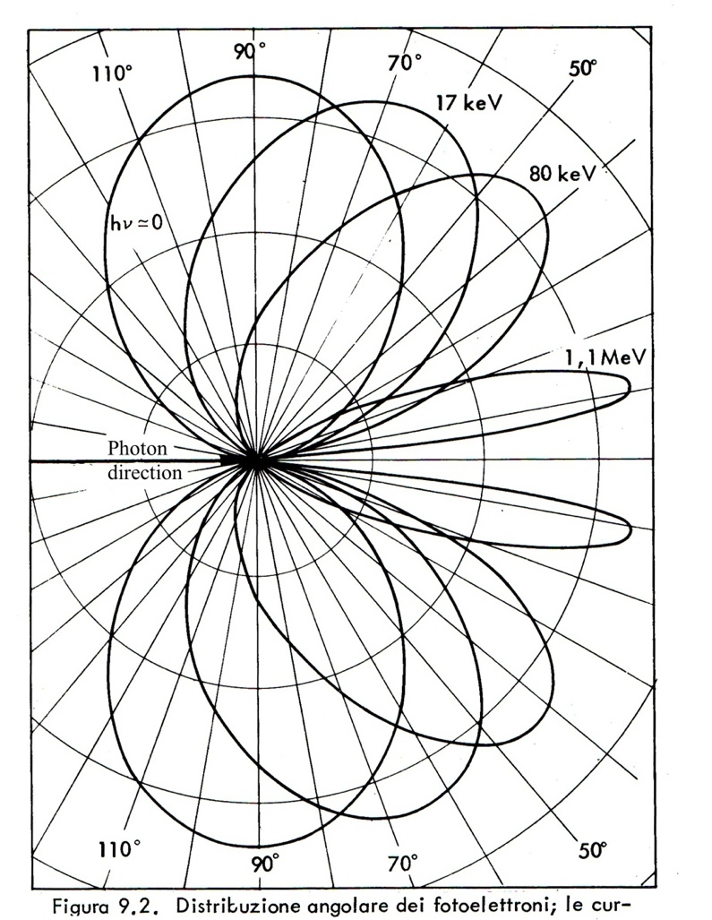
ANGULAR DISTRIBUTION AND RANGE OF PHOTOELECTRONS
e
ELECTRON RANGE:
PHOTOELECTRON EMISSION ANGLE:
θ
E_{γ} 5.9 keV
200 µm
5.9 keV X-ray
E_{e}=E_{γ}-E_{K}= 2.7 keV in Ar

Slide 19
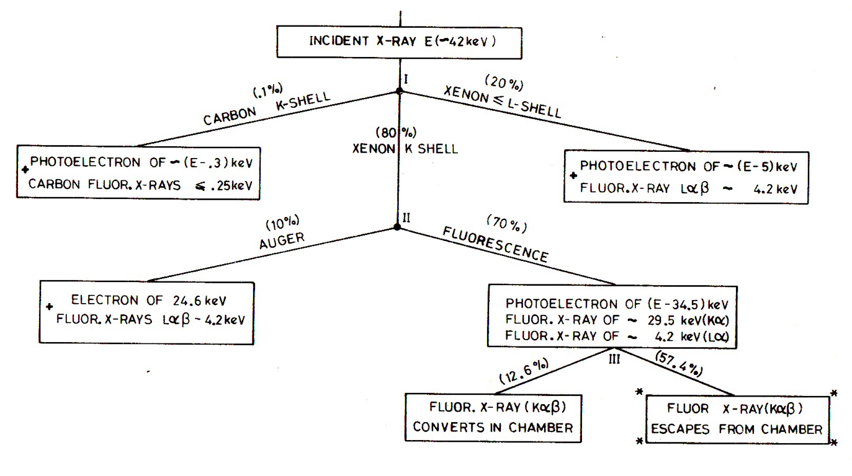
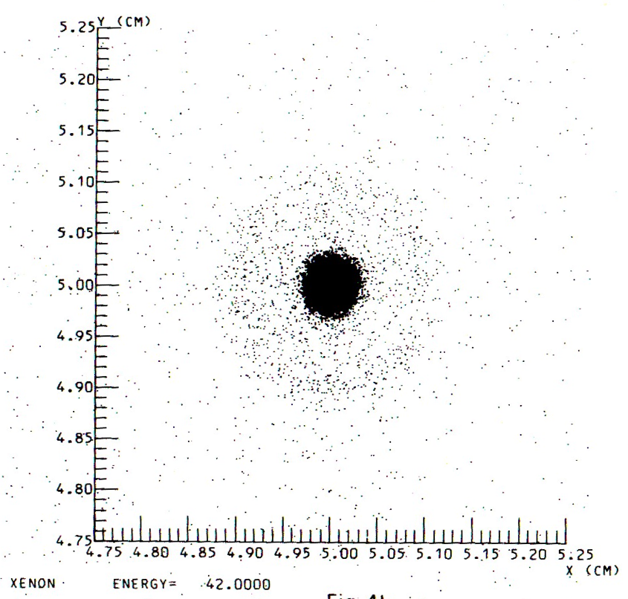
COMPUTED POSITION RESOLUTION LIMITS
42 keV PHOTONS ON XENON
POSITION RESOLUTION FOR A POINT-LIKE COLLIMATED BEAM:
2 mm
600 µm
J.E. Bateman et al, RL-75-140

Slide 20
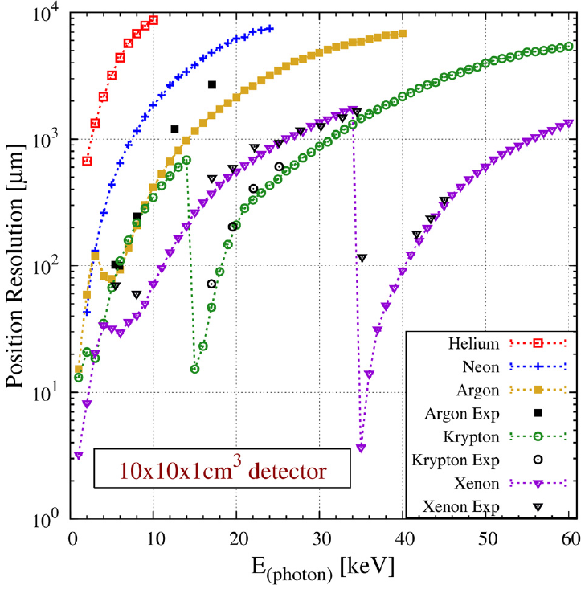
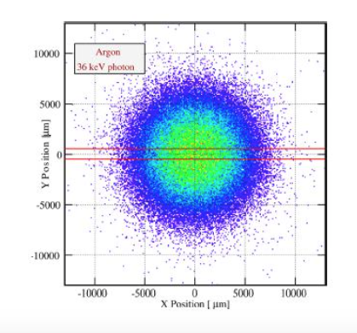
COMPUTED POSITION RESOLUTION LIMITS
X-Rays in He, Ne, Ar, Kr and Xe AT STP
36 keV in Ar:
C. Azevedo et al., Phys. Lett. B 741(2015)272

Slide 21
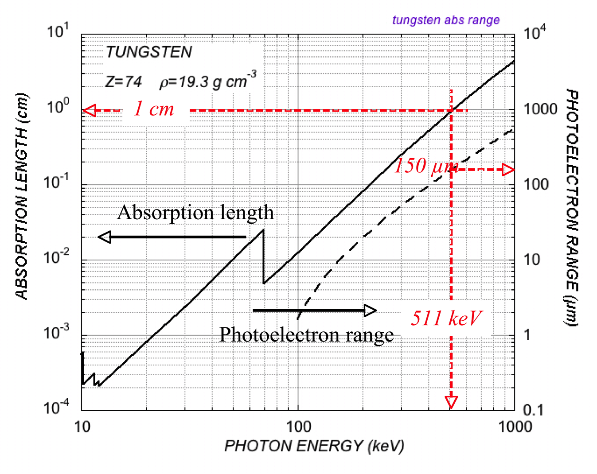
hard x and gamma rays: converters
γ
USEFUL CONVERTER THICKNESS AND ELECTRON RANGE
CONVERTER
s
e
e
GAS DETECTOR
DETECTION EFFICIENCY:
s: converter thickness
λ: absorption length
100 µm converter --> ε ∼ 1%

Slide 22
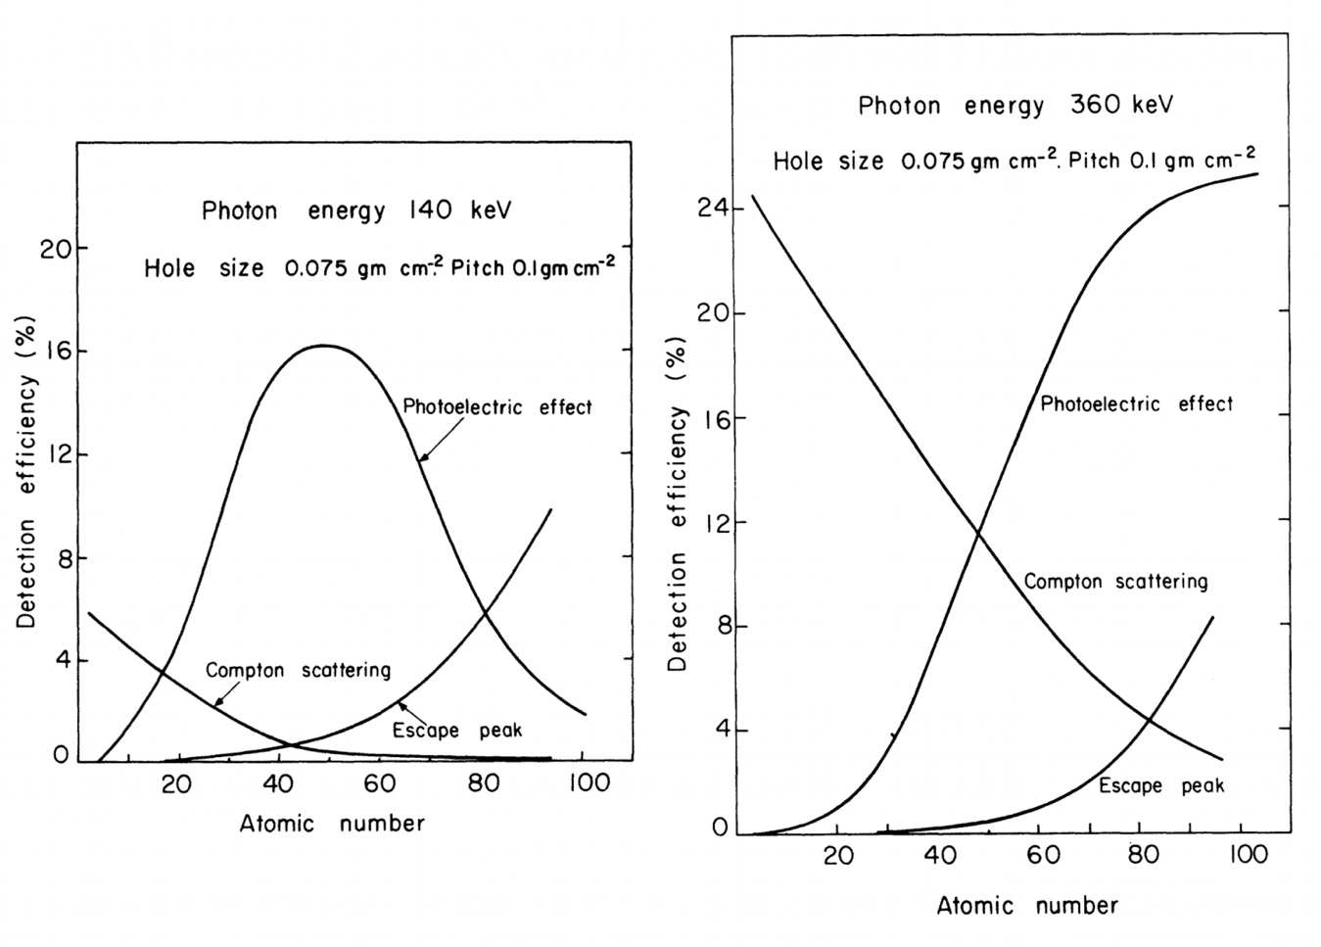
hard x and gamma rays: internal converters
HEAVY DRIFT CHAMBER
Stack of converter Grids at graded potentials
EFFICIENCY vs CONVERTER ATOMIC NUMBER:
360 keV
HV
140 keV
e
MWPC
A. Jeavons et al, IEEE Trans. Nucl. Sci. NS-23 (1978)41

Slide 23
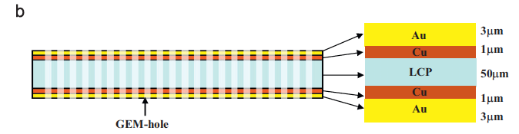
hard x and gamma rays: internal converters
GOLD-COATED GAS ELECTRON MULTIPLIER (GEM)
DETECTION EFFICIENCY
T. Koike et al,
Nucl. Instr. and Meth. A648(2011)180

Slide 24
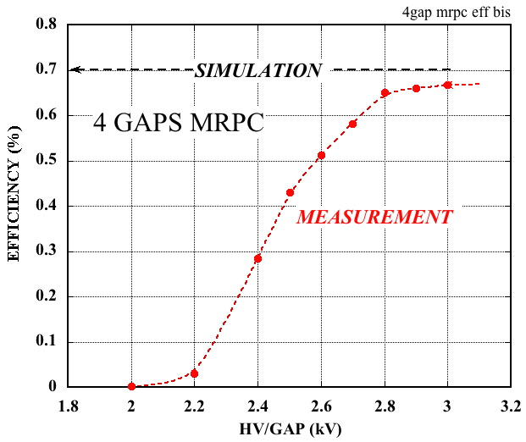
hard x and gamma rays: internal converters
DETECTION OF 511 keV γ FOR PET
MULTI-GAP RESISTIVE PLATE CHAMBER
400 µm HIGH RESISTIVITY GLASS PLATES
+HV
- HV
D. Watts et al, J. Rad. Res. 54 (2013)i136

Slide 25
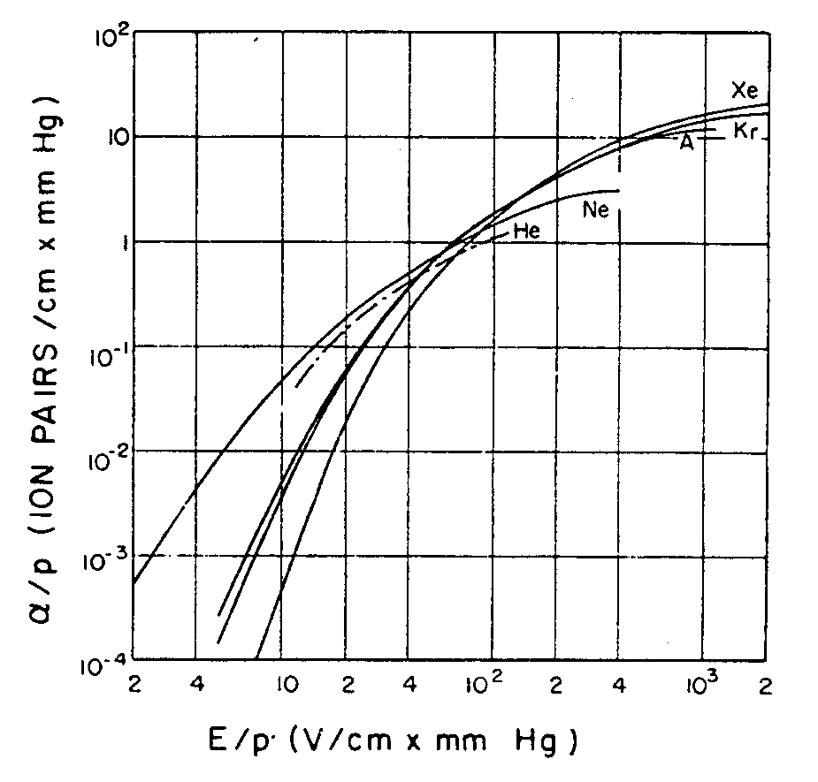
AVALANCHE CHARGE MULTIPLICATION
Mean free path for ionization:
CHARGE MULTIPLICATION IN UNIFORM FIELD
N: molecules/cm³
Townsend coefficient:
l
Ionizing collisions/cm
E
x
Ions
Electrons
Incremental increase of the number of electrons in the avalanche:
Multiplication factor or Gain:
Maximum avalanche size before discharge (Raether limit):
Q_{MAX} ≈ 10⁷ e
(PART 2)
H. Raether, Electron Avalanches and Breakdown in Gases (Butterworth 1964)
S.C. Brown, Basic Data of Plasma Physics (MIT Press, 1959)

Slide 26
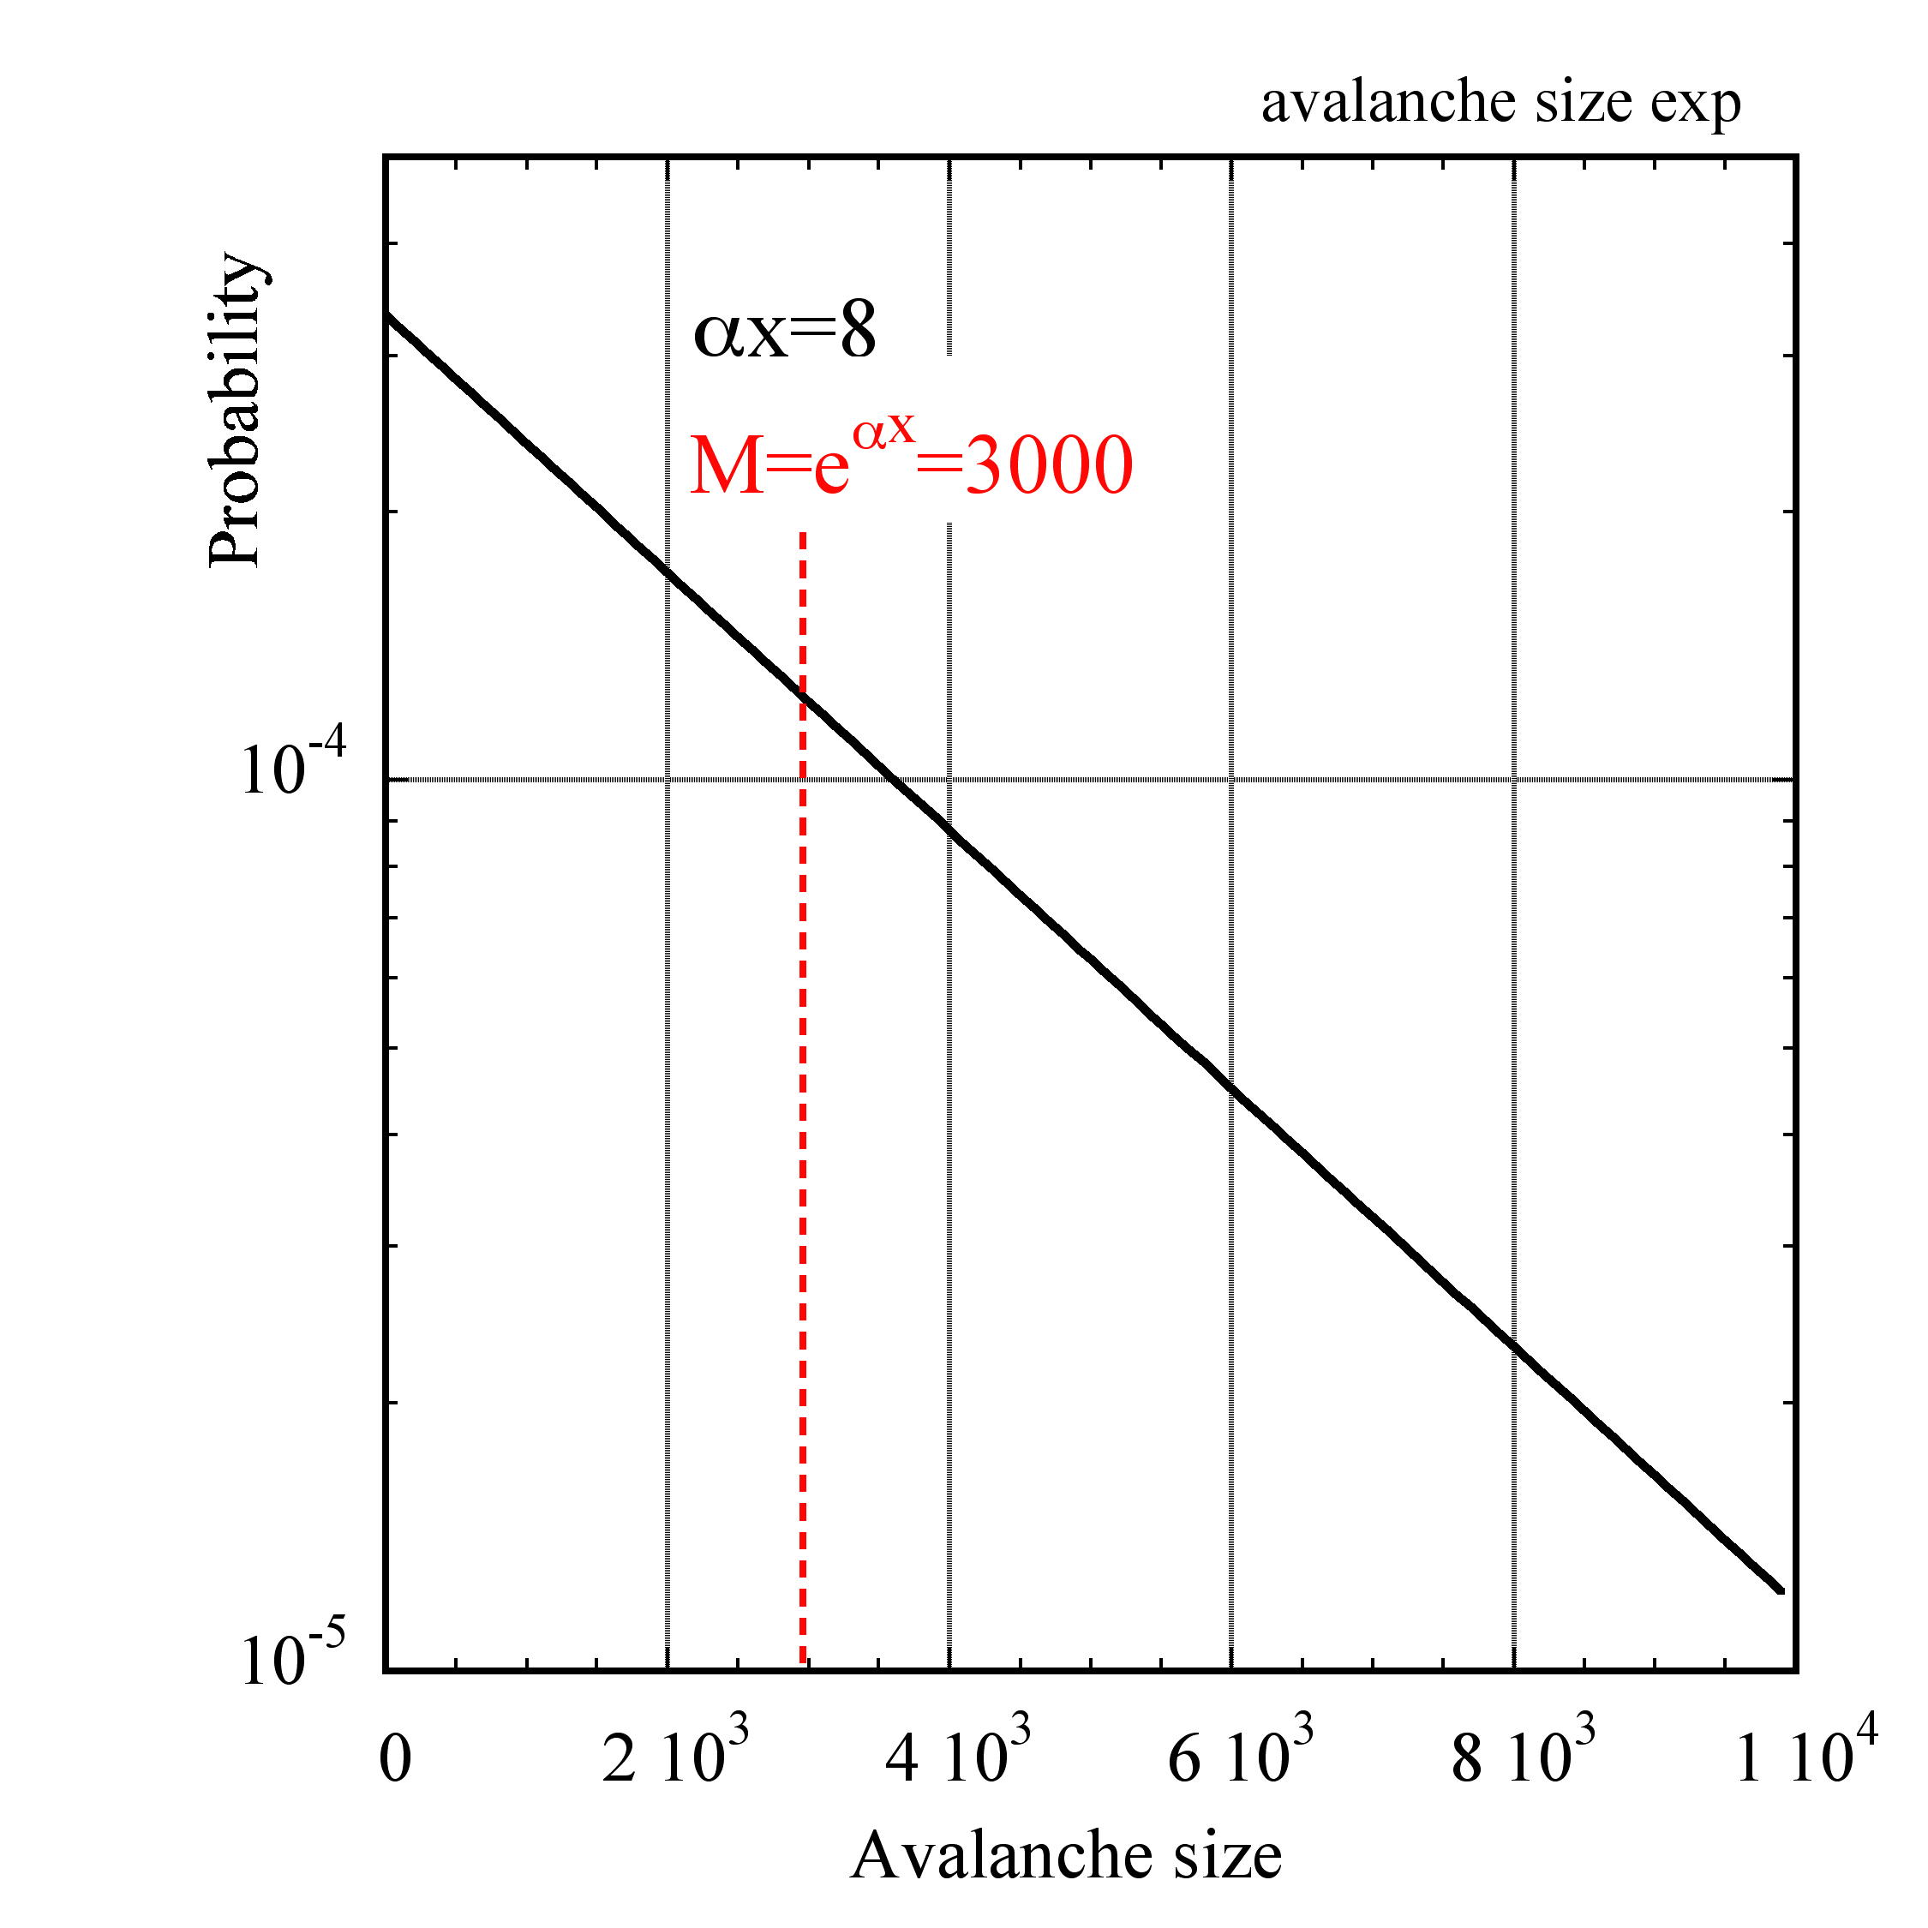
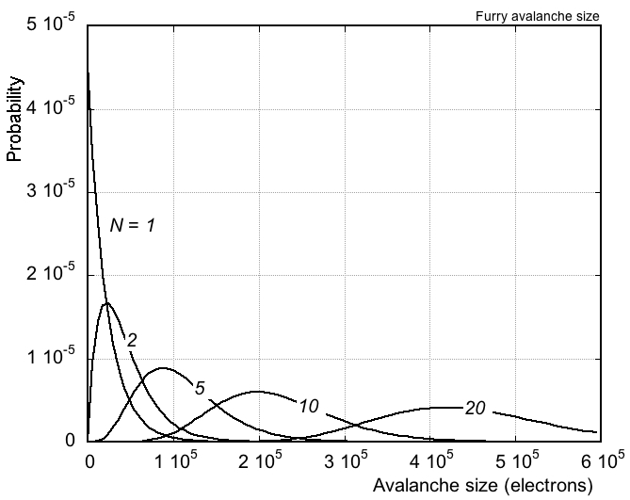
SINGLE electron avalanche: FURRY statistics
SINGLE ELECTRON
AVALANCHE SIZE DISTRIBUTION
N ELECTRONS:
MAXIMUM PROBABILITY FOR n=1!

Slide 27
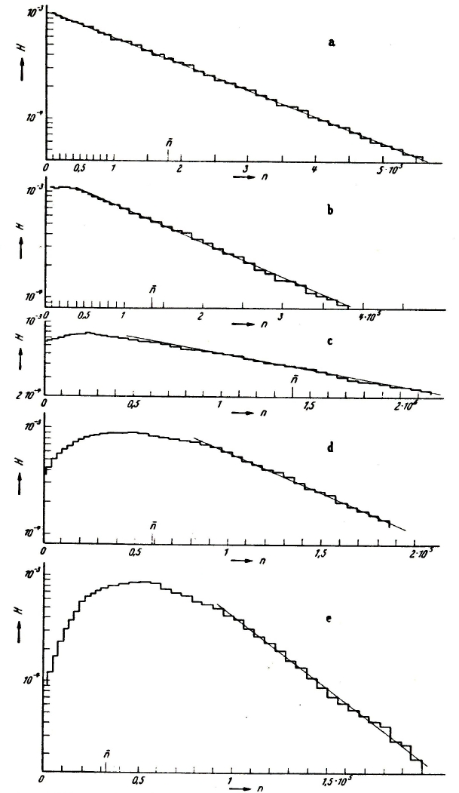
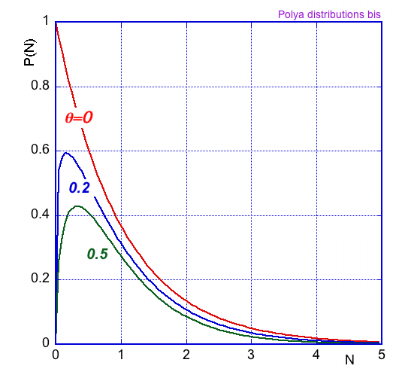
SINGLE electron avalanche: POLYA statistics
AVALANCHE DISTRIBUTION AT INCREASING GAINS (FIELDS)
POLYA DISTRIBUTION
EXPERIMENTAL:
H. Schindler, S.F. Biagi, R. Veenhof
Nucl. Instr. and Meth. A624(2010)78
H. Sclumbohm, Zeit. Physik 151(1958)563

Slide 28
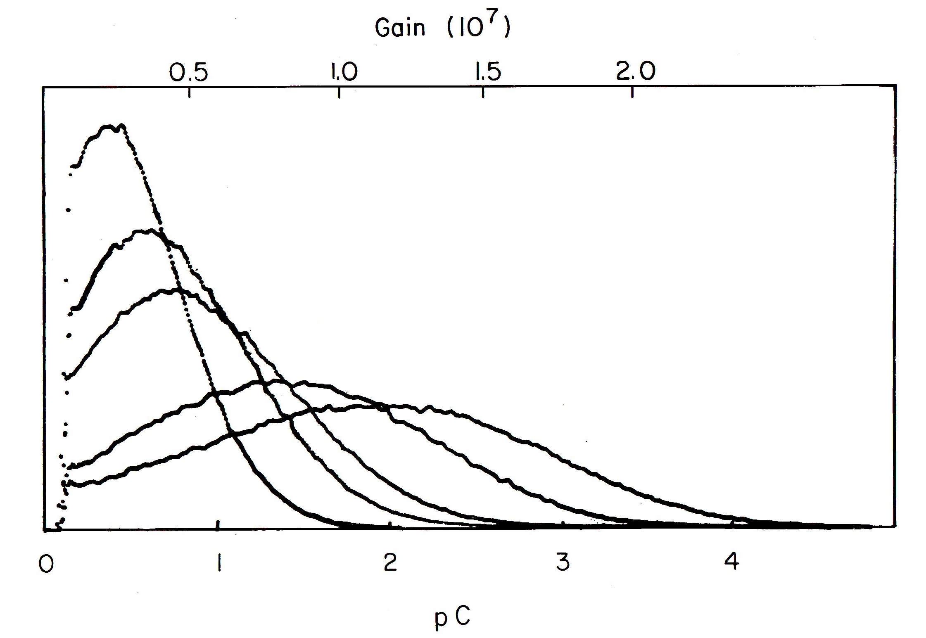
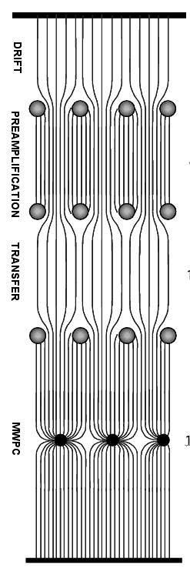
THE MULTISTEP CHAMBER
SINGLE ELECTRON PH DISTRIBUTIONS:
PREAMPLIFICATION
GAIN 10³
TRANSFER
10%
MWPC
GAIN 10⁵
TOTAL GAIN 10⁷
R. Bouclier, et al.,
Nucl. Instr. and Meth. 205 (1983) 403
] G. Charpak and F. Sauli, Phys. Letters 78B(1978)523

Slide 29
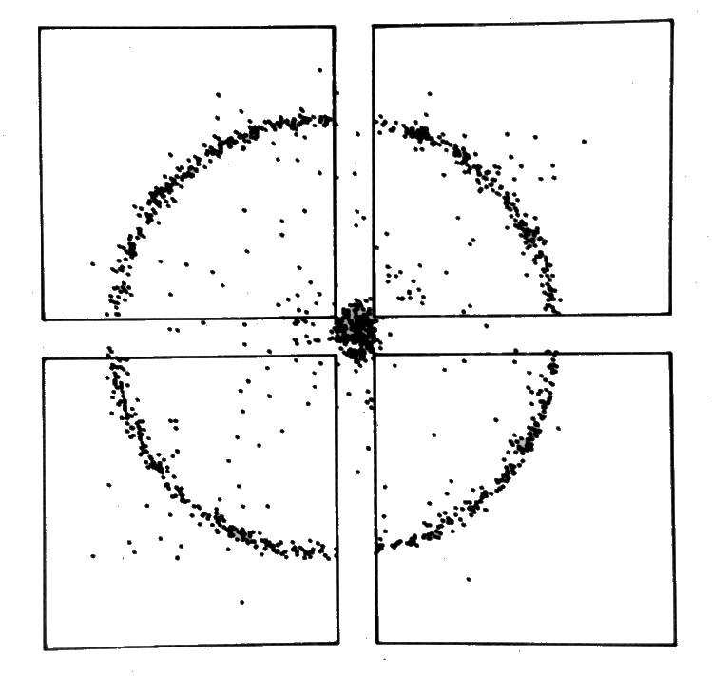
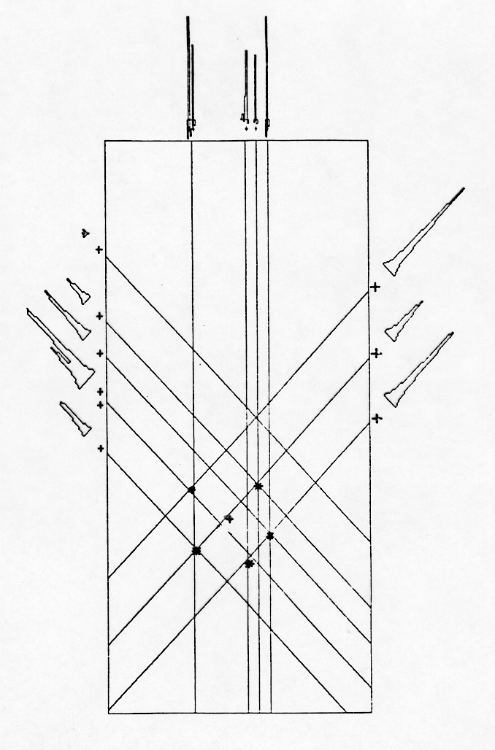
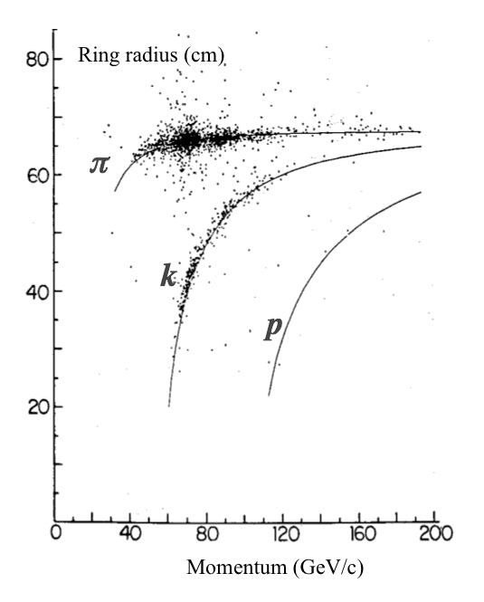
CHERENKOV RING IMAGING
OVERLAPPING CHERENKOV RINGS
He-CH₄-TEA (92-5-3)
E-605 RICH
5-PHOTONS RING
PARTICLE IDENTIFICATION
R. McCarty, et al,
Nucl. Instr. and Meth. A248(1986)69

Slide 30
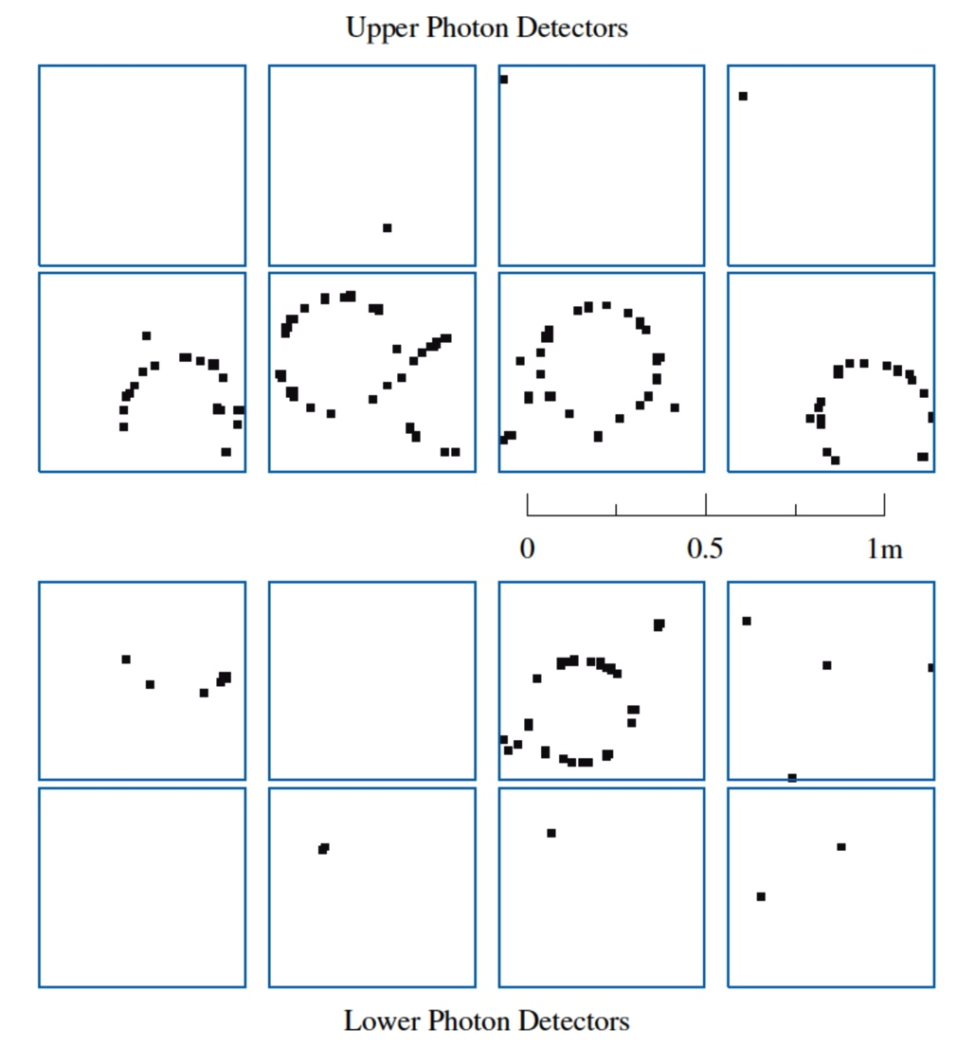
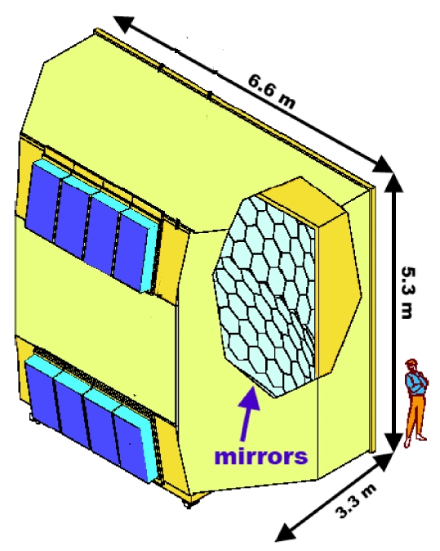
UV PHOTONS DETECTION: MWPC
COMPASS RING IMAGING CHERENKOV COUNTER (RICH)
Window
MWPC
CsI-coated cathode pads
E. Albrecht et al, Nucl. Instr. and Meth. A502(2003)112

Slide 31
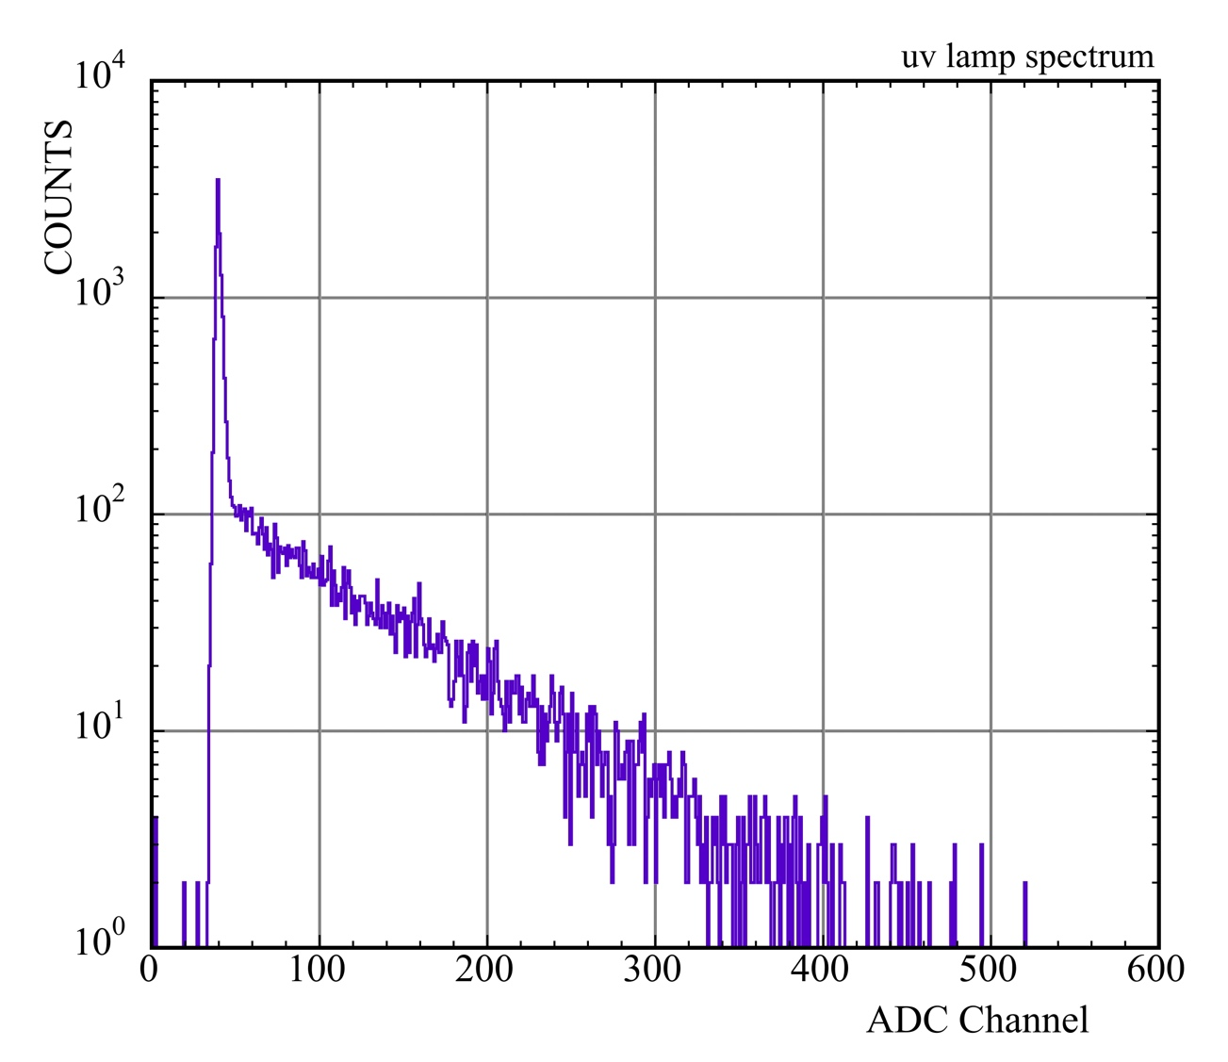

single electron avalanche in MPGDs
GAS ELECTRON MULTIPLIER (GEM)
E_{DRIFT} ~ 0
CsI LAYER
TRIPLE-GEM
CsI Photocathode
e
MORE GEMS
- No photon feedback
- Strong suppression of ions feedback
F. Sauli, Nucl. Instr. and Meth. A553(2005)18

Slide 32


UV PHOTON DETECTION AND LOCALIZATION
TRIPLE GEM WITH HEXABOARD READOUT
TWO-PHOTONS EVENT:
MATRIX OF HEXAGONAL PADS INTERCONNECTED ALONG THREE DIRECTIONS
F. Sauli et al, IEEE NSSS 2004 Conf. Rec.Vol. 1, 12

Slide 33


single electron avalanche in MPGD
MICROMEGAS
UV PHOTON
MICROMEGAS
Ne-iC₄H₁₀ 95-5
WINDOW
PHOTOCATHODE
e⁻
M=6.10⁴
Polya: θ=2.3
T. Zerguerras et al, Nucl. Instr. and Meth. A608(2009)397

Slide 34




SINGLE ELECTRON AVALANCHE
CsI-COATED MICROMEGAS WITH TIMEPIX READOUT
J. Melai et al, Nucl. Instr. and Meth, A628(2011)133

Slide 35


THICK GEM
MECHANICAL DRILLING OF METAL-CLAD PC BOARD:
SELF-SUPPORTING
HIGH GAIN
R.Chechik et al,
Nucl. Instr. and Meth. A535(2004)303
Breskin et al,
Nucl. Instr. And Meth. A623(2010)132
ALSO NAMED LARGE ELECTRON MULTIPLIER (LEM)
P. Janneret, Thesis at Neuchatel University (2001)
A. Badertscher et al, Nucl. Instr. And Meth. A617(2010)188

Slide 36



UV PHOTONS DETECTION: THICK GEM
DEVELOPMENT FOR THE COMPASS RICH UPGRADE
GAIN
100 µm
LARGE RIM:
HIGH GAIN
CHARGING UP
10 µm
RIMLESS:
LOW GAIN
STABLE
0
ΔV (kV)
0.1 mm rim
No rim
M. Alexeev et al, Nucl. Instr. and Meth. A695(2012)159

Slide 37


COMPASS RICH UPGRADE
COMPASS RICH UPGRADE PROTOTYPE
TRIPLE-THICK GEM CsI-COATED 30x30 cm²
9-PHOTONS RING
M. Alexeev et al, Nucl. Instr. and Meth. A732(2013)264

Slide 38


SINGLE ELECTRON AVALANCHE
THICK COBRA
- G > 10⁶
- collection efficiency ~100%
- R_{p(anode)}= 60 μm
- R_{p(top)} = 90 μm
- only a few discharges for several months even for high photon flux
F. Amaro et an JINST5 (2010)
J.F.C.A.Veloso et al
Nucl. Instr. and Meth. A639(2011)

Slide 39


VISIBLE PHOTOCATHODES WITH GASEOUS COUNTERS
NEW STRUCTURES:
COBRA, MICRO-HOLES AND STRIPS, PACEM….
GEM+MICRO-HOLE AND SRIP PLATE
GEM-MHSP:
IBF: 3 x 10 ⁻⁴
IBF: ~ 10 ⁻²
R. Chechik, A. Breskin,
Nucl. Instr. and Meth. A595(2008)116
A.V.Lyashenko et al., 2009 JINST 4 P07005

Slide 40


cryogenic CsI PHOTOCATHODES
LIQUID XENON
THICK-GEM with CsI Photocathode + MICROMEGAS
S. Duval et al,. JINST 6(2011)P04007

Slide 41


VISIBLE PHOTOCATHODES WITH GASEOUS COUNTERS
KAPTON AND PYREX GEM DETECTORS
Bi-alkali Photocathode in Ar-CH₄ (90-10)
GAIN VS VOLTAGE
GasPMT with Pyrex glass CP
T. Sumiyoshi et al Nucl. Instr. and Meth. A639(2011)121

Slide 42
SOFT X-RAYS: ENERGY RESOLUTION
Energy resolution:
Ionization
Avalanche statistics
Average gain:
A_{i} : single electron avalanche size
Gain variance:
Furry statistics:
Polya statistics:
FANO FACTORS
Ionization variance:
F: Fano factor
GAS F
Ar 0.19
Ar-CH₄ 0.19
Xe <0.17
Furry: b=1 Polya:
Ne+0.5%Ar 0.05

Slide 43


SCINTILLATION PROPORTIONAL COUNTERS
PHOTON EMISSION BEFORE CHARGE MULTIPLICATION:
NO AVALANCHE DISPERSIONS
NOBLE GASES SCINTILLATION SPECTRA ~1bar

Slide 44


SCINTILLATION PROPORTIONAL COUNTERS
SCINTILLATION COUNTERS
ENERGY RESOLUTION:
CLOSE TO STATISTICAL LIMIT
A. Policarpo et al, Nucl. Instr. and Meth. 102(1972)337

Slide 45



ELECTRON COUNTING
LOW PRESSURE (10 Torr) PROPORTIONAL COUNTER
110 eV
676 eV
A. Pansky et al, Nucl. Instr. and Meth. A330(1993)150

Slide 46


SOFT X-RAYS ENERGY RESOLUTION
RESOLUTION %
TOTAL
AVALANCHE
NOISE
IONIZATION
GAIN
5.9 keV
fwhm 1.3 keV
H. Sipilä and E. Kiuru, Adv. X-Ray Analysis 21(1978)

Slide 47



MICROMEGAS ENERGY RESOLUTION
INGRID: MICROMEGAS WITH TIMEPIX READOUT
5.9 keV ⁵⁵Fe in Ar-CH₄ 90-10
GAP INDEPENDENCE OF GAIN
14% fwhm
M. Chefdeville et al,
Nucl. Instr. and Meth. A591(2008)147

Slide 48


GEM WITH SILICON PIXEL READOUT
X-RAY POLARIMETER
R. Bellazzini et al, Nucl. Instr. and Meth. A623(2010)766

Slide 49


GEM WITH SILICON PIXEL READOUT
R. Bellazzini et al, Nucl. Instr. and Meth. A581(2007)246

Slide 50

GEM WITH SILICON PIXEL READOUT
σ ∼ 4 µm
R. Bellazzini et al, Nucl. Instr. and Meth. A581(2007)246
END OF PART 1

