Slide 1
X-ray generator: an application of micro pattern gas detector
4th Micro Pattern Gaseous Detector Conference (Trieste, Italy)
Toru Tamagawa (RIKEN, Japan)
Kazuki Nishida^{(*)} (TUS/RIKEN), Wataru Iwakiri (RIKEN),
Ryoichi Suzuki (AIST), Hidetoshi Kato (AIST), Shigetomo Shiki (AIST),
Takao Kitaguchi (Hiroshima Univ.), Yoko Takeuchi (TUS/RIKEN),
Teruaki Enoto (Kyoto Univ.), Asami Hayato (RIKEN)
(*) graduate student, heavily contribute to this work.
Who we are?
=> Original developer of SciEnergy GEM since 2003!
=> Applying them to astrophysical satellite mission.
Abnormal use of GEM for X-ray generator
Notes:
15分＋5分＝20分 スライドは全部で10枚程度かな。今はタイトルと目次を除いて12枚。少し多い。。。

Slide 2
Outline
Introduction of "triggerable X-ray generator"
Fabricate and test the x-ray generator
Timing capability
A problem - breakdown
Possible industrial applications
Summary and Outlook

Slide 3
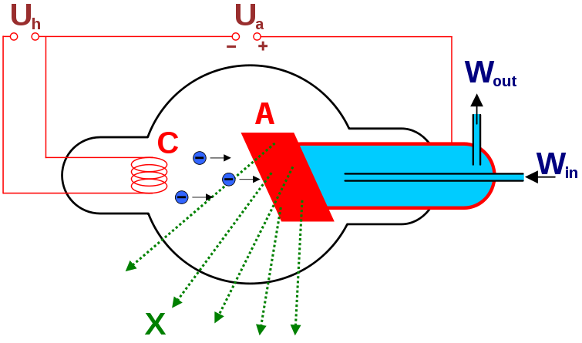
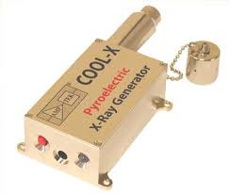
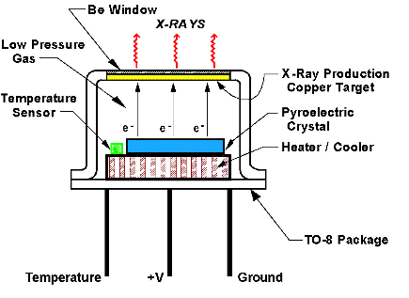
Ordinal X-ray generators at lab.
Ordinary X-ray Tube
Pyroelectric X-ray Generator
Amptek COOL-X
electron source: filament (thermal)
High intensity
Robust in operation
Cooling system needed
= Large in size
High V created by heat with pyroelectric crystal
Small and handy
easy to operate
Intermittent operation
Low intensity, short life

Slide 4
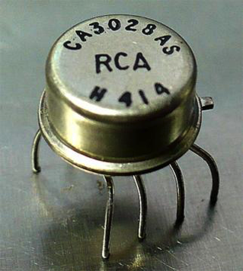
Triggerable X-ray generator
What we need?
How to realize triggerable X-ray?
Purpose
Onboard calibration device for X-ray detectors in space.
Drift velocity measurement of GEM-TPC polarimeter (Kitaguchi, #54)
Continuous energy calibration of micro-calorimeter (compensate energy scale variation.)
Requirements
Small enough for flight
Triggerable (ns~μs timing)
Final goal
On-chip X-ray gen.
A part of circuit.
10-100 kV
(1) HV ON/OFF
(3)
target
electrons
Electron
source
X-ray
(2) shutter
(1) Switching high voltage
Need specific electronics for swith
Expensive for high speed electronics robust against HV.
(2) Mechanical shutter
Limited speed (~1 ms)
Need large mechanics.

Slide 5
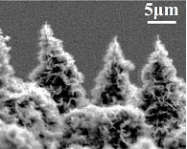
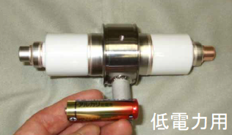
Conceptual design
Selection of electron source
Combining CCNS with GEM
Thermal emission (filament) => NG
Field emission (FE) => promising
Push
on
GEM
Carbon nanotube (CNT)
Very sharp tip (good FE device)
FE threshold ~ 10 kV/cm
Connection between CNT and substrate is very fragile. easy to be destroyed by strong E.
CCNS substrate
CCNS substrate
Easy to apply FE-threshold-field
100V per 100um thick => 10 kV/cm
Switching the electron source V~100 V
Low voltage (<100V) switching make everything easy.
Coniferous Carbon Nano Structure (CCNS)
Very sharp at tip
Robust at root
Already used for
portable X-ray generator at AIST, Japan
Moreover, unwanted part of CCNS is covered by GEM substrate (reduce electron absorption at mesh)

Slide 6
Outline
Introduction
Fabricate and test the x-ray generator
Timing capability
A problem – breakdown
Possible industrial applications
Summary and Outlook

Slide 7
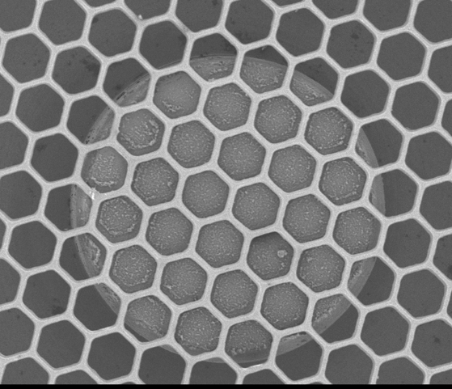
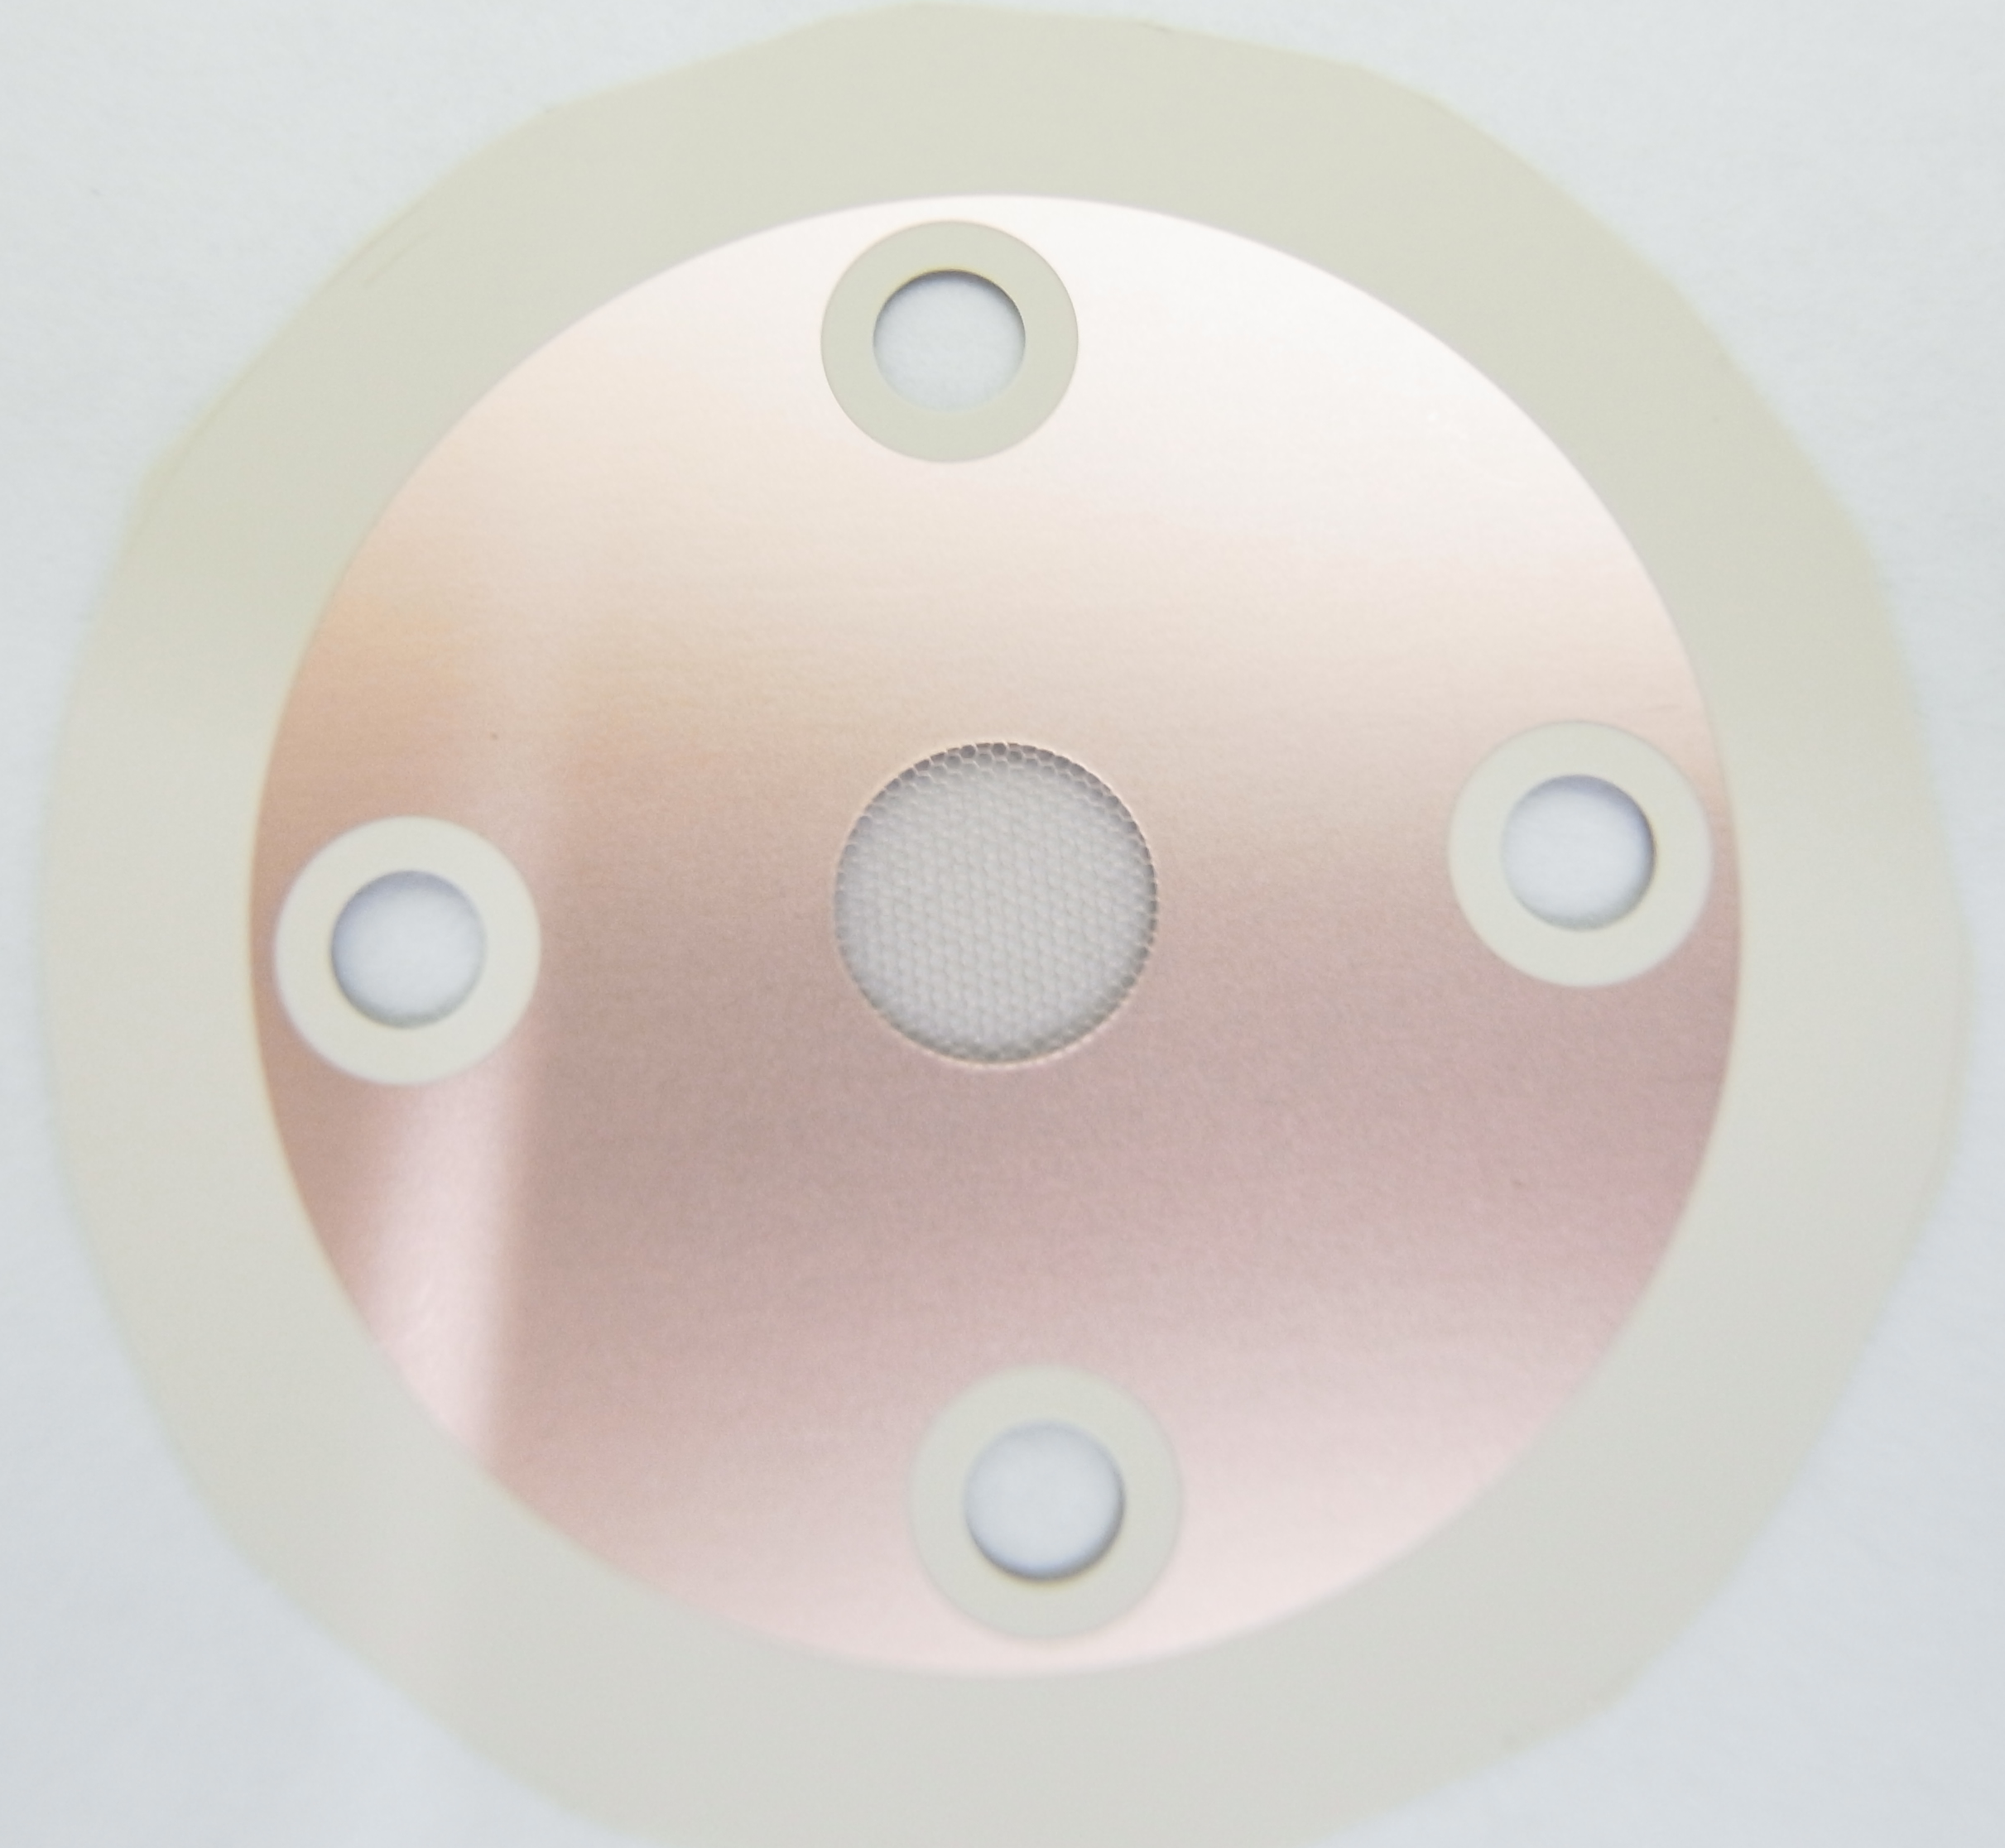
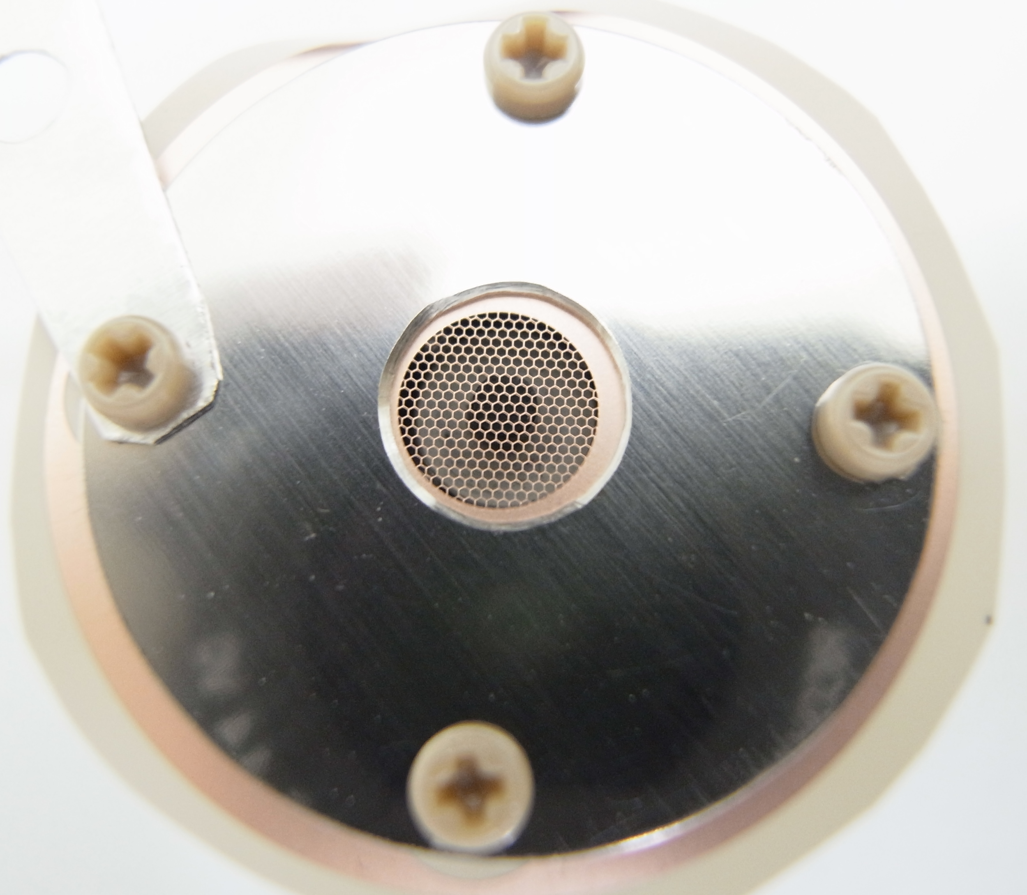
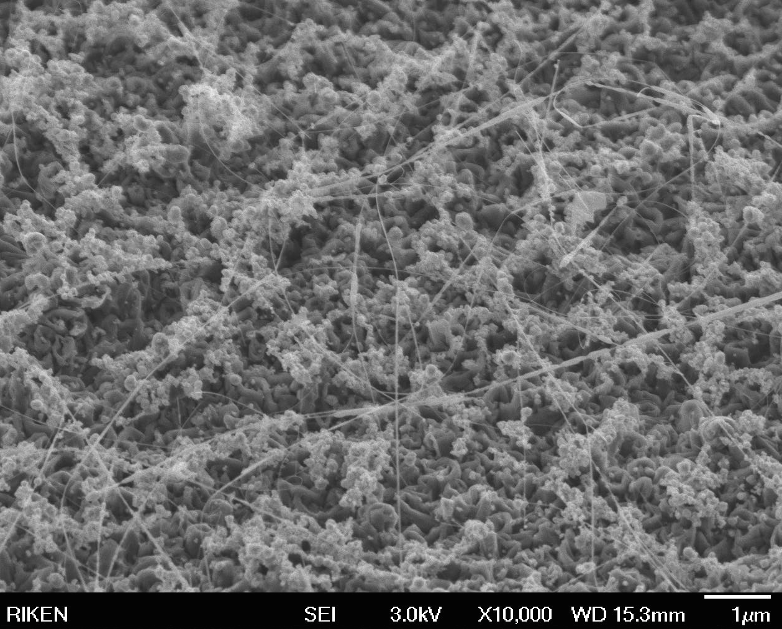
Electron source: CCNS+GEM
Electron source
SEM images
CCNS substrate
made at AIST, Japan
GEM
6mm
In dia.
x30
2mm
in dia.
300 um
magnified
x10⁴
CCNS + GEM
1um
*) Thanks Arai-san (Fujikura) for GEM.

Slide 8
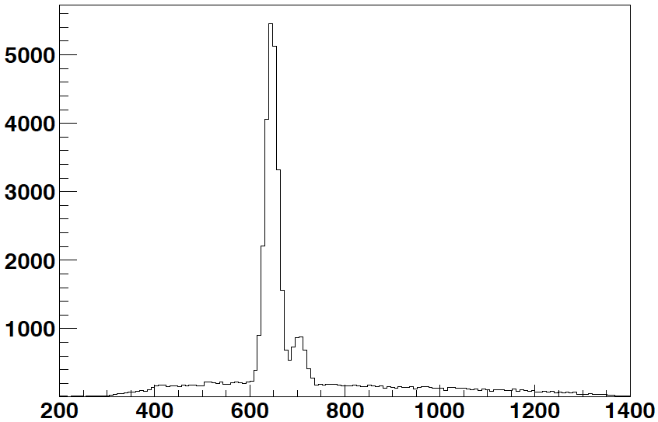
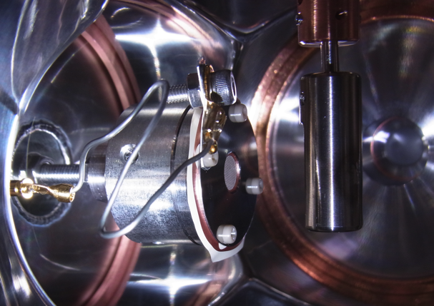
X-ray emission test
Test Setup
X-ray Spectrum
CCNS
GEM
Ti target
Ti Kα (4.5keV)
electrons
+10kV
Count/ch
Ti Kβ (4.9keV)
Be
window
X-ray
~100V
Si det.
(XR-100)
ADC (ch)
X-ray emitted at 75 V (75um thick GEM)
Typical X-ray flux: 10⁷~10⁸ c/s/sr
CCNS+
GEM
The X-ray generator worked perfectly as we expected !
X-rays
e
target

Slide 9
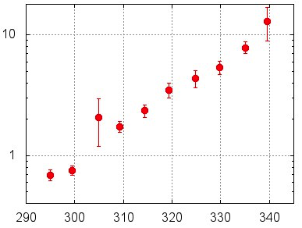
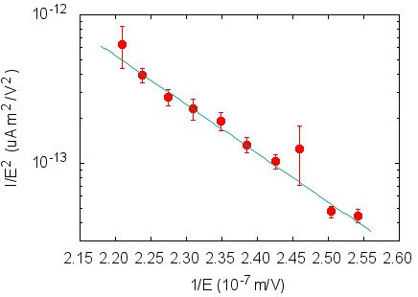
I-V curve of electron source
I-V plot of CCNS+GEM
Faular-Nordenheim relation
E: external electric field
γ: field amplification factor
(sharper tip has larger γ.)
Current (A)
Simple model of FE
E
I/E² (uA m²/V²)
0
GEM voltage (V)
work
func φ
potential
γ = 1.01x10³
(cf. γ=1000-2000 for CNT)
Fermi
level
Electron
tunneling
(FE)
2.2 2.3 2.4 2.5
1/E (10⁻⁷ m/V)
Our electron source obeys the low of field emission of a typical CNT. (efficient electron emissions)
Vacuum
w/ E-field
CCNS

Slide 10
Outline
Introduction
Fabricate and test the x-ray generator
Timing capability
A problem - breakdown
Possible industrial applications
Summary and Outlook

Slide 11
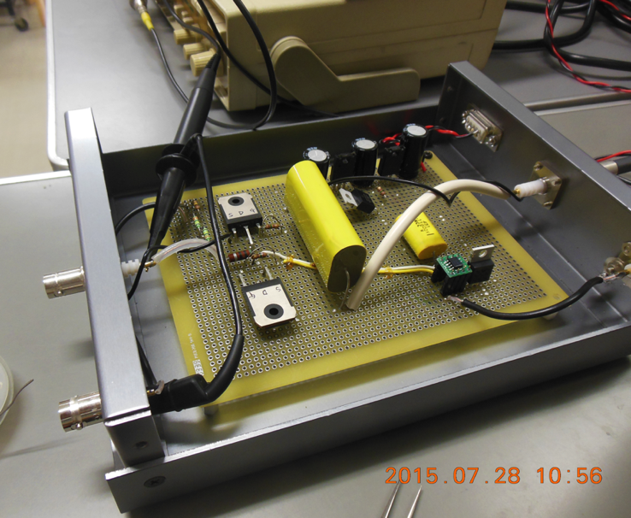
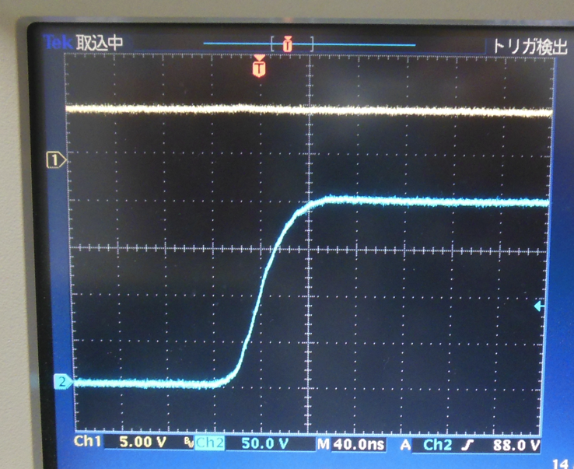
Timing capability test setup
Gate driver (pulses)
CCNS
GEM
Ti target
DC 100V
~100V
+10kV
Pulsed
100V
TTL Pulse
electrons
HI
TTL
pulse
Gate drive IC
IC
Half-bridge
MOSFET
Be
window
LO
X-ray
Si det.
HV out (200V)
Simple gate driver for switching GEM V
About 20ns rise/fall-time with 4700pF load. (cf. 10ns with zero-load)
20ns
Rise-time

Slide 12
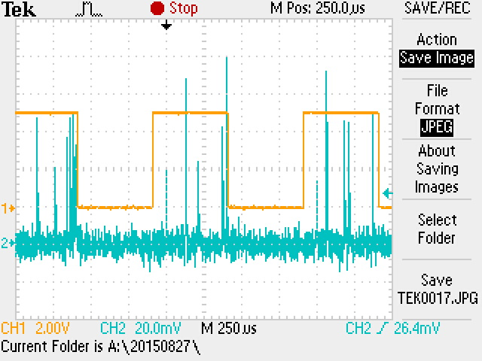
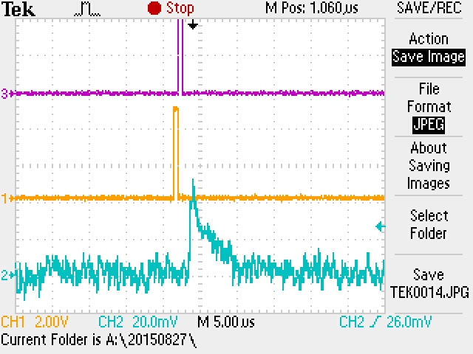
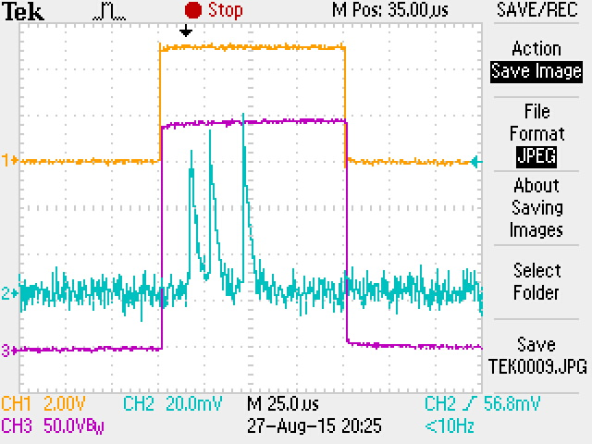
Timing capability
500 usec
0.6 usec
Input pulse
X-rays
X-rays when pulse-on, no X-ray when pulse-off
100 usec
NOTE: The minimum width was limited by the gate driver IC. We can improve more.
Pulsed operation successful.
CCNS-GEM X-ray gen. working as a triggerable X-ray generator.

Slide 13
Outline
Introduction
Fabricate and test the x-ray generator
Timing capability
A problem - breakdown
Possible applications
Summary and Outlook

Slide 14
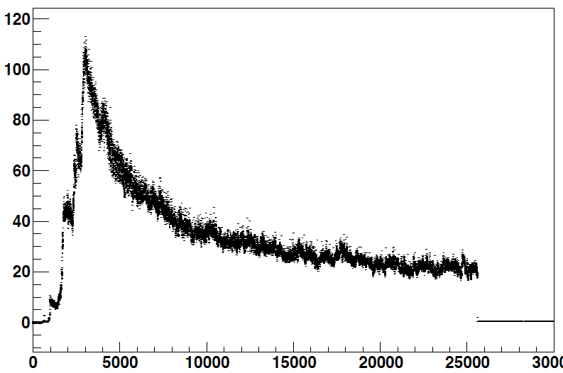
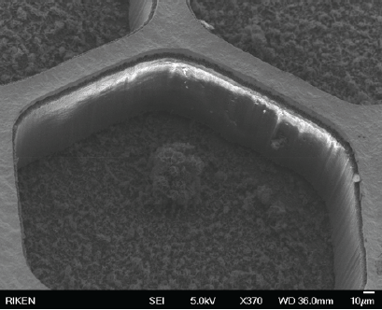
One problem: breakdown
SEM image of broken GEM
GEM 330 V
aging started
ramp-up
GEM V
Tripped
Target current (uA)
Aging ongoing
Elapsed time (sec)
GEM voltage breakdown at higher applied voltage (>300V).
Resistance of GEM down to a few kΩ.
This drops the reliability of our X-ray generator.
Harmless fragment

Slide 15
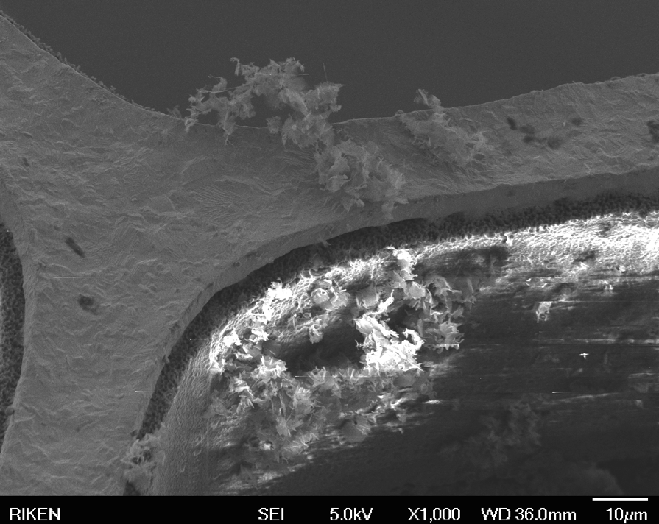
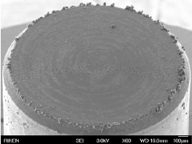
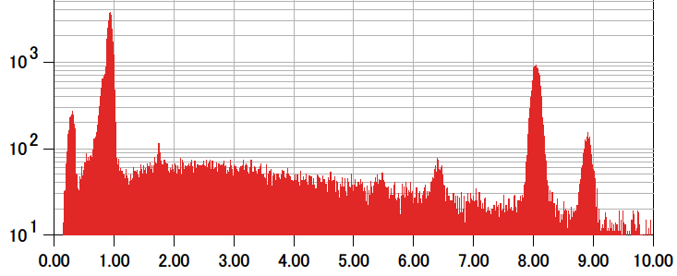
SEM image of a smoking gun
carbon fragment
Covered by electrode
active area
GEM electrode
carbon fragment
Breakdown mechanism
Brand-new CCNS substrate contains carbon fragments in the surrounding area.
Coming off the fragments and attaching to the GEM cause breakdown.
CKα
EDS spectrum
Cu L
Cu Kα
Cu Kβ
How to prevent?
Mask the fragments with electrode.
X-ray energy (keV)
Clear evidence of carbon fragments
We are testing how it works.

Slide 16
Outline
Introduction
Fabricate and test the x-ray generator
Timing capability
A problem - breakdown
Possible industrial applications
Summary and Outlook

Slide 17
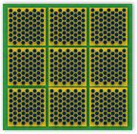
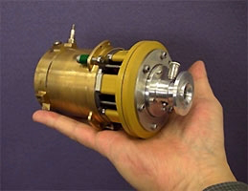
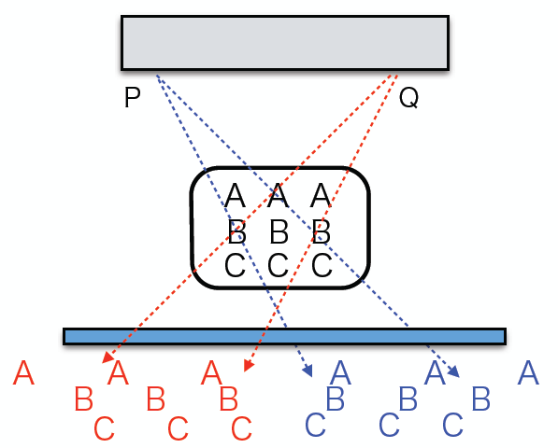
Possible industrial applications
Flat panel X-ray generator
Imaging fast rotating devices
X-ray generator
GEM electrode matrix circuit: Any portion of generator can be turned on separately.
Portable gas turbine
(c) IHI
trigger
3D imaging with parallax
Flat panel X-ray gen
No movable portion
400,000rpm=6.7kHz
400W generator
X-ray imager
Take snap shots coincident with rotation of turbine.
Functionality is needed not in imager but in X-ray generator.
object
X imager
We are developing highly-functional
X-ray generators with MPGD technique.
Superpose images with displacement
to make focus on a layer.

Slide 18
Summary and outlook
A new triggerable X-ray generator combining CCNS with GEM are fabricated.
It is demonstrated that the CCNS+GEM X-ray generator worked perfectly as we expected.
It is demonstrated that the X-ray generator had at least 600ns switching capability. (of course, can improve more.)
There are a lot of industrial applications. More ideas welcome!
Thank you for your attention!

