Slide 1
New substrate, high spatial resolution and big-area THGEMs: development and applications
Yuguang Xie
ygxie@ihep.ac.cn
State Key Laboratory of Particle Detection and Electronics
Institute of High Energy Physics, CAS
and University of Science and Technology of China
Oct. 14 2015
MPGD2015, Trieste, Italy

Slide 2
Outline
New substrate THGEMs
High spatial resolution THGEM
Big-area THGEM
Applications
Summary

Slide 3
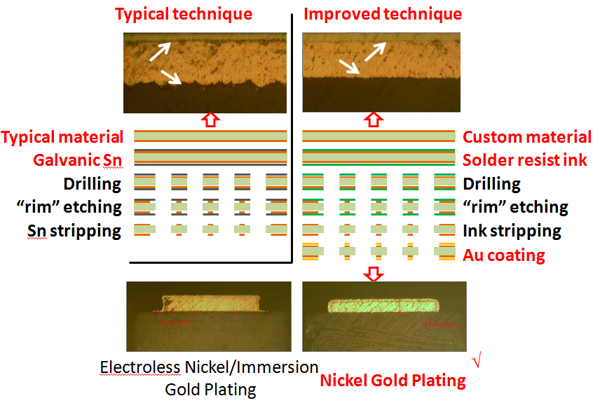
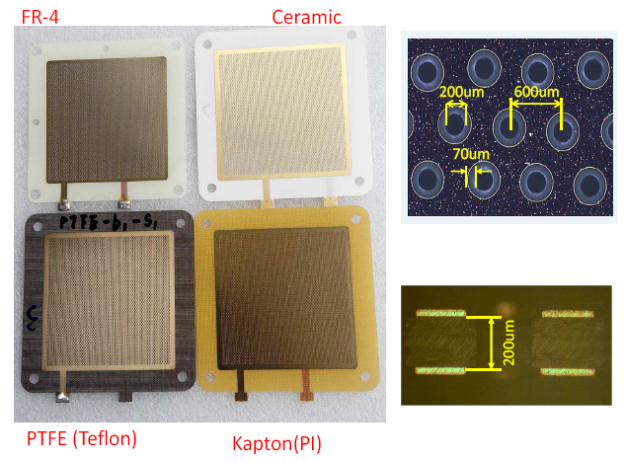
New substrate THGEMs
Motivation
In some cases, FR-4 is not the best choice.
low neutron absorption and scattering, for neutron(thermal) detection
low natural radioactivity, for low background experiments
Development and production
Mechanical drilling, PCB-type substrates
Y. Xie et al. / NIM A 729 (2013) 809–815
Substrate | S-Area/m^2 | HD/mm | Pitch/mm | TH/mm | Delivery/day
FR-4 | <=0.5*1.0 | 0.15~0.3(0.2) | >=0.4 (0.6) | 0.1~0.3(0.2) | 20
PTFE (Teflon) | <=0.5*1.0 | 0.15~0.3(0.2) | >=0.4 (0.6) | 0.1~0.3(0.2) | 30
Kapton | <=0.5*1.0 | 0.15~0.3(0.2) | >=0.4 (0.6) | 0.05~0.3(0.2) | 30
Ceramic | <=0.5*0.5 | 0.15~0.3(0.2) | >=0.4 (0.6) | 0.1~0.3(0.2) | 30

Slide 4
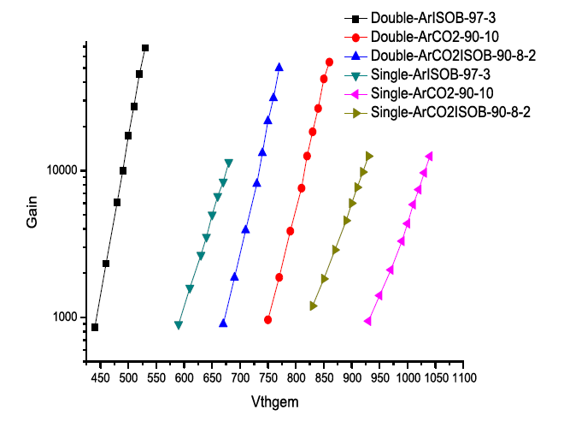
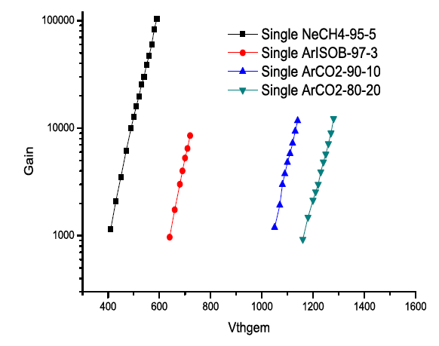
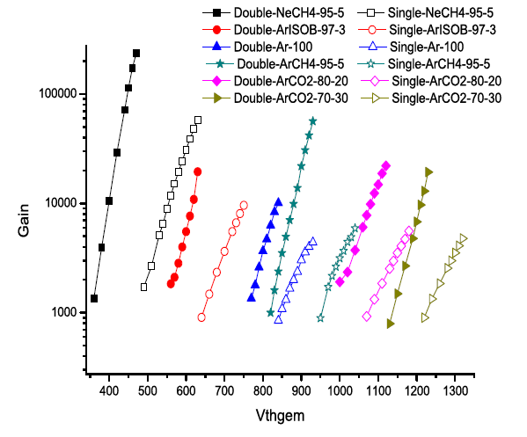
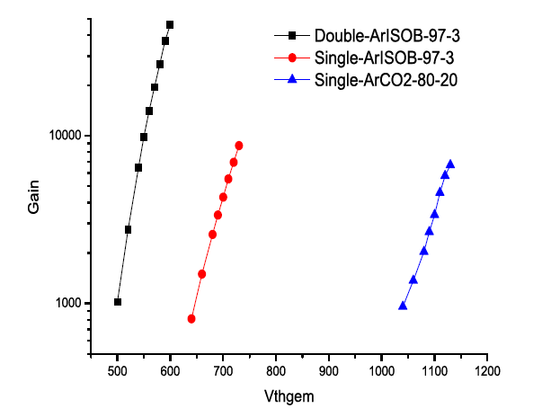
Performance
Ceramic
FR-4
PTFE
Kapton

Slide 5
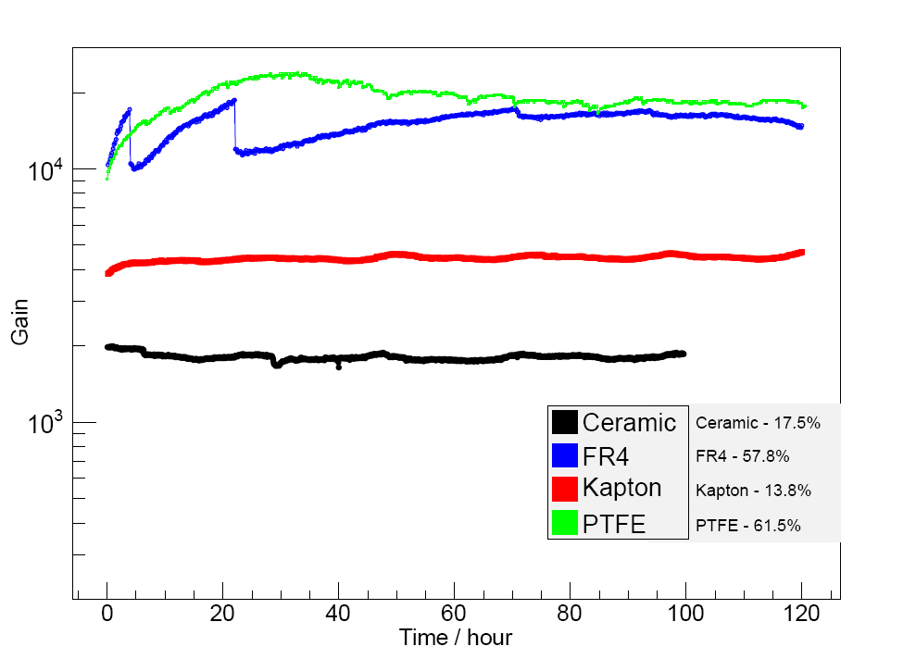
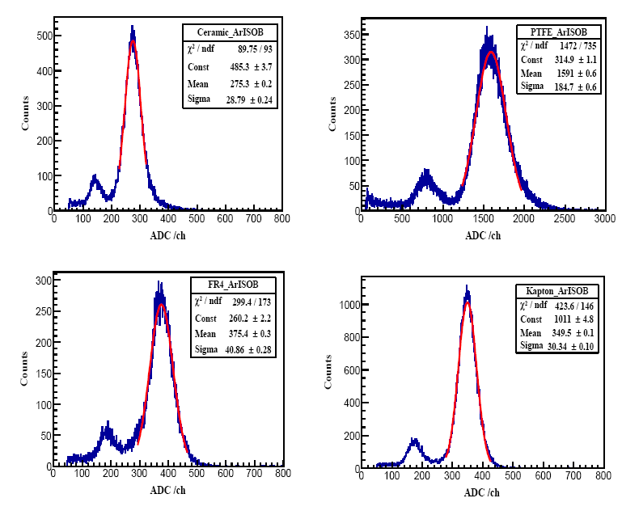
Longterm gain
Energy resolution
Less erating time &HV connection error
T & P not controlled

Slide 6
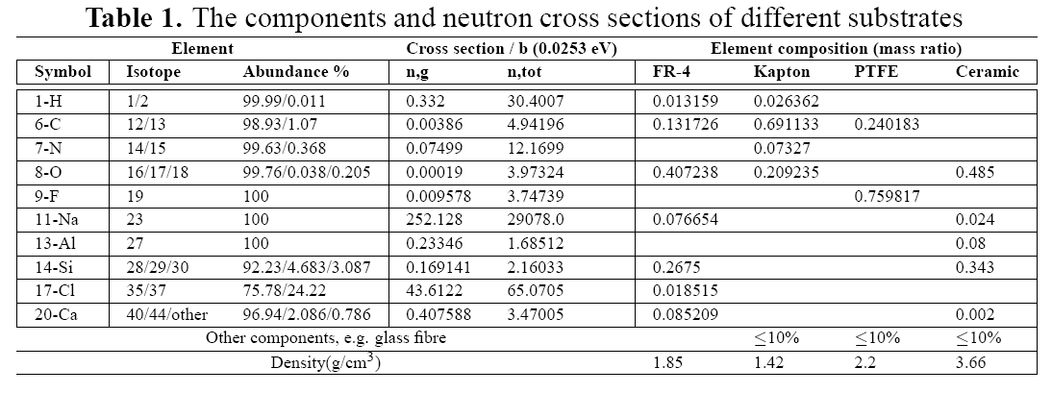
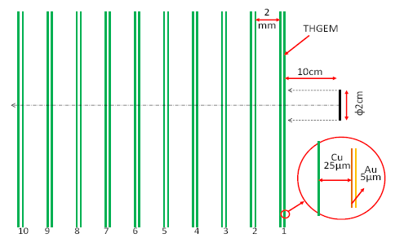
Scattering and absorption on thermal neutron
Simulation done in G4, thermal neutron(0.0254eV), full components for substrates(0.2mm)
Separate effects: adsorption and elastic scattering
Separate cases: bare, bare+25um Cu and bare+25um Cu + 5 um Au laminates.
Cu results in loss by both absorption and scattering;
Au results in loss by absorption mainly.
total neutron absorption and scattering ratio: Kapton(high) > FR-4 > Ceramic > PTFE (low)
Gamma-induced electron background: Ceramic > PTFE > FR-4 > Kapton

Slide 7
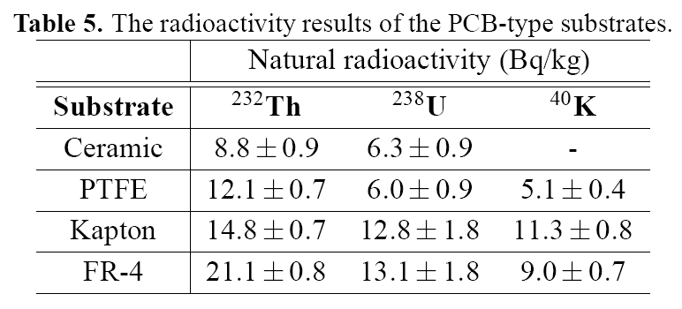
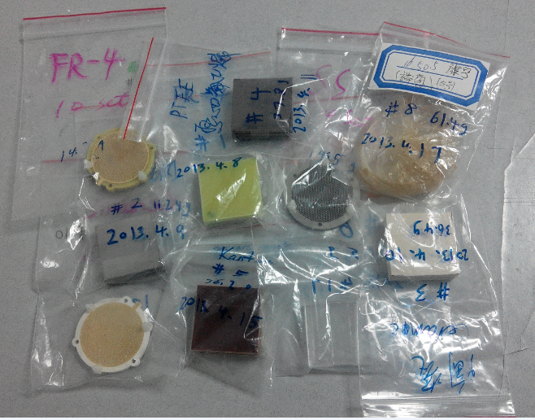
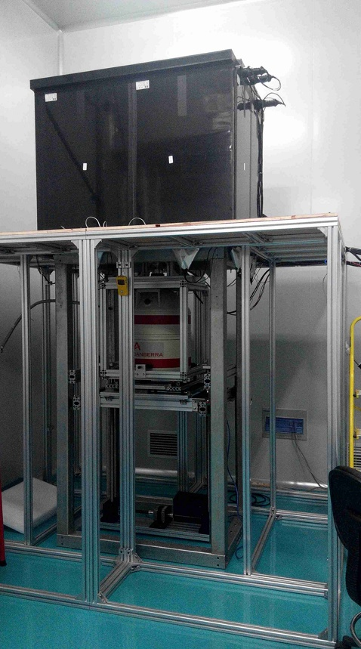
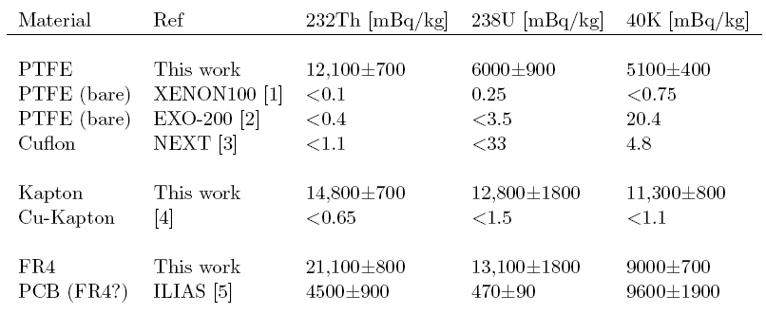
Low radioactivity
Samples
The HPGe detector( 0.01cps, 0.6cpm, crystal φ60mm )
The PCB-type substrates are not as “pure” as original materials
The natural radioactivity is 3-4 order higher than pure materials applied to low background experiments.
The PCB-type materials are good for THGEM making and can reach good performance.
THGEMs based on the pure materials are worthy of development

Slide 8
Summary of new substrate THGEMs
Substrate | FR-4 | Ceramic | PTFE (Teflon) | Kapton (PI)
Material comparison
Thickness/mm | 0.1-3.2 | 0.06-1 | 0.2-3 | 0.01-0.5
Electrical characteristics | general | HF transmission | Corrosion&T resistance | high insulation
Mechanical properties | rigid & tough | fragible | tough, flexible | toughn, flexible
Cost | Cheap | High | High | High
Regular performance：Ar+IsoB：97-3，120h test
Withstand voltage (in air) /V | 1400 | 1200 | 1600 | 1800
Gain of single layer | 8.0*10^3 | 5.0*10^3 | 1.0*10^4 | 1.0*10^4
Stability | Good | weak | Good | Good
Special performance ( 4(high) > 3 > 2 > 1(low))
Neutron absorp and elastic | 3 | 2 | 1 | 4
Gamma-induced e BG | 2 | 4 | 3 | 1
Natural radioactivity | 4 | 1 | 2 | 3
Total score | 9 | 7 | 6 | 8
Applications
Neutron detection | v_v | ^_^ | v_v | v_v
Low BG experiment | v_v | ^_^ | ^_^ | -_-
Big-area detector/m^2 | ^_^ | v_v | ^_^ | ^_^
Therefore, it’s not easy to find an all-purpose THGEM substrate . Substrates should be chosen according to applications!

Slide 9
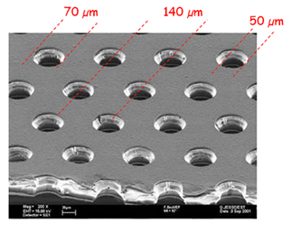
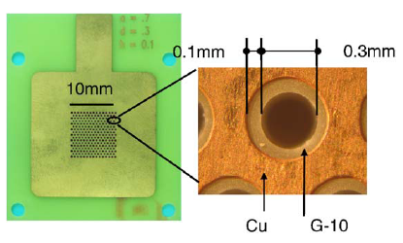
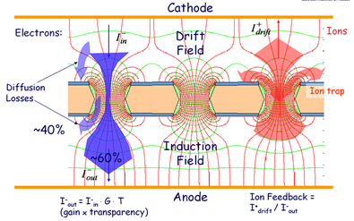
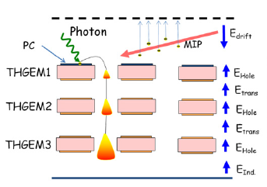
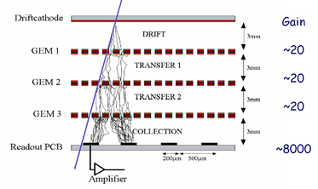
High spacial resolution THGEM
Motivation
GEM(Gas Electron Multiplier), 1997 by F. Sauli）
THGEM(Thick GEM), 2004 by A. Breskin
GEM | Items | THGEM
50 | T/um | >=200
70 | D/um | >=200
140 | P/um | >=500
10 | Rim/u | >=20
~10^3 | GainS | >=10^4
~10^4 | GainD | >=10^5
<20% | σE(FWHM)S | ~20%
~25% | σE(FWHM)D | ~30%
<100u | σx | <500u
High | Tech | Normal
High | Cost | Low
Fragile | Durability | Robust
Good | Stability | +++
Kapton Ceramic? | Substrates | FR-4, PTFE, Ceramic , Kapton
动 机
50um Kapton
3um Cu
9

Slide 10
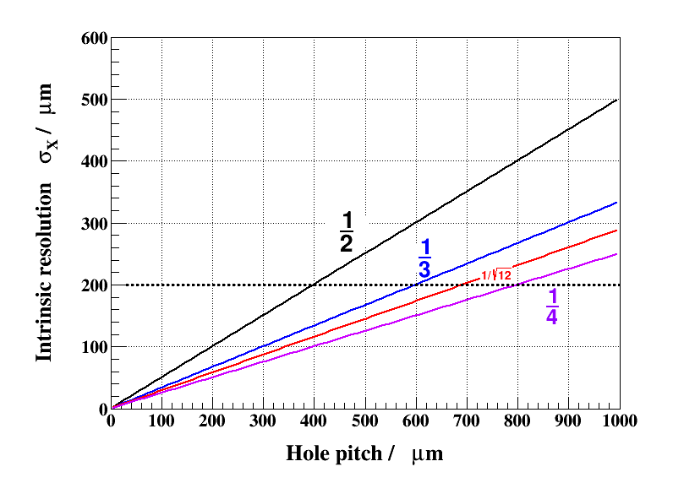
Intrinsic spacial resolution
The spacial resoluton is determined by both readout method (strip or pad) and THGEM foil, here we focus on THGEM itself.
THGEM
GEM
The only way is to reduce the pitch of holes!

Slide 11
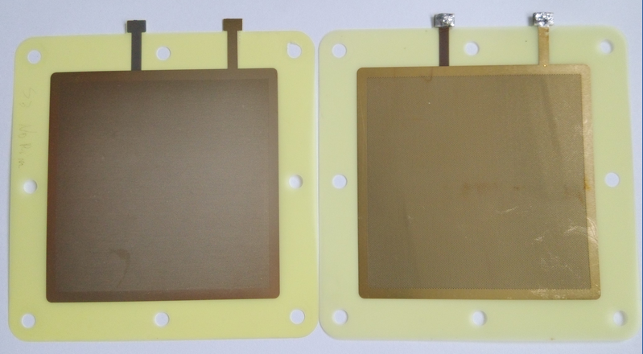
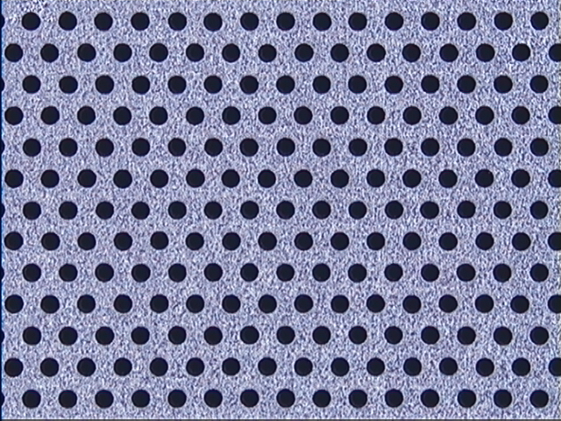
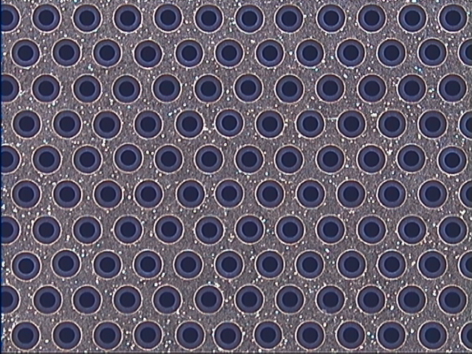
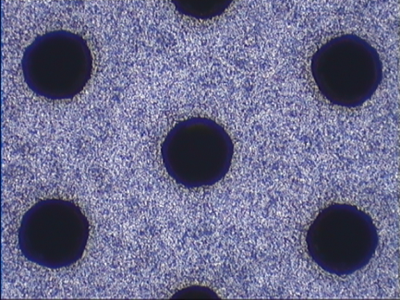
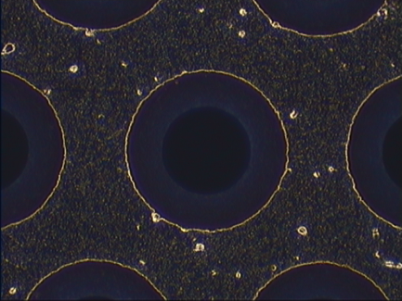
Laser bombardment
Mechanical drilling
Regular：HD: 100um, Pitch: 300um
Limit： HD: 50um, Pitch: 150um
Regular：HD: 200um, Pitch: 500um
Limit： HD: 150um, Pitch: 350um
HD:100um
Pitch:300um
TH:100um
Rim :20um
Intrinsic σx:87um
150um - HD
400um - Pitch
100um - TH
70um - Rim
116um - Intrinsic σx

Slide 12
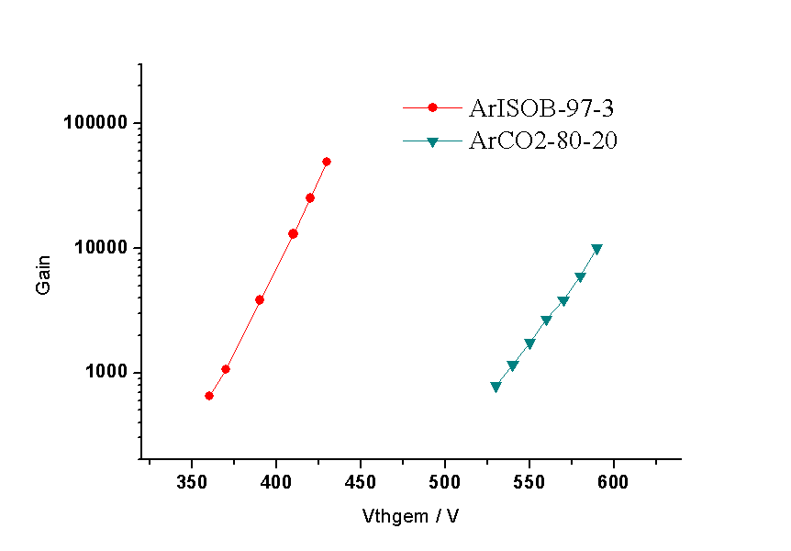
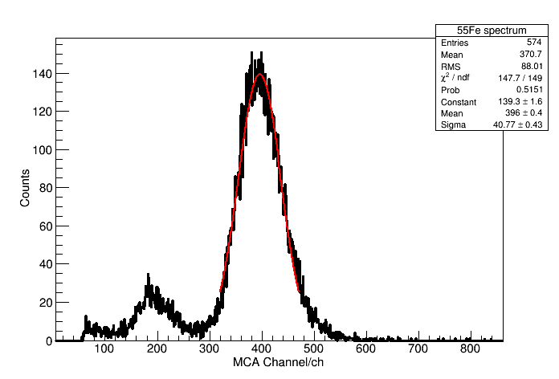
THGEM by laser ( 60*60mm^2), double layer
Gain
Energy resolution
24%@gain=4×10^3
>1×10^4@ArCO2=80:20
>5×10^4@ArISOB=97:3
The THGEM by laser can be used to achieve high spacial resolution
close to that of standard GEM

Slide 13
Big-area THGEM
Motivation
Big-area THGEMs are the necessary requirement for many real applications:
Digital hadron calorimeter(DHCAL), Muon detector, etc. Big area means > 0.5*0.5m^2 here.
 | 2013( from Rui’s talk) | Goal
GEM： | 1.2m*0.5m | 2.0m*0.5m
Resistive Micromegas | 2m^2 | 3.4m*2.2m
THGEM | 0.6m*0.6m | 1.0m*0.5m（this work）
Difficulty and technologies
Difficulty：It is time-consuming to produce big-area THGEMs by mechanical drilling.
Typical hole density: 3.2holes/mm^2 (pitch:0.6mm), drilling speed: 350hole/min
Area >0.2*0.2m^2, hole number>128000/piece , time >6h!;
Area >0.5*0.5m^2, hole number>800000, time>38h!!!。
Technologies：
1. Laser bombardment
High producing efficiency, high precision, very small hole pitch(<200um)
2. Chemical etching
A possible way, but it is not reported to produce THGEM yet.

Slide 14
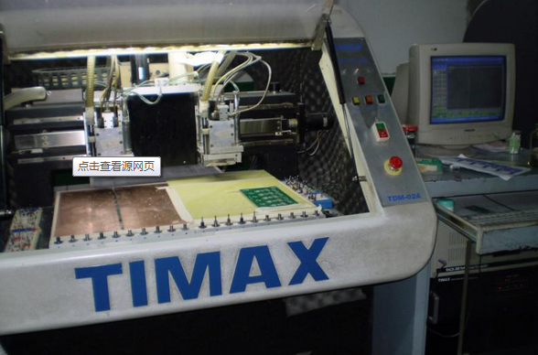
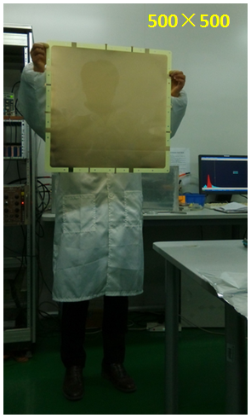
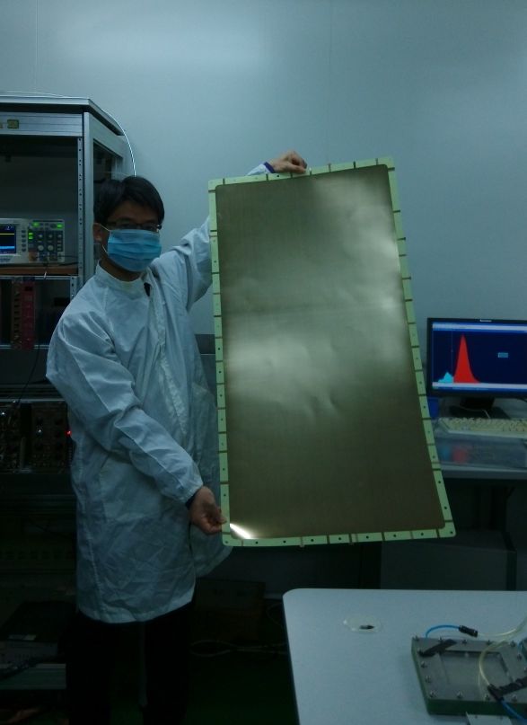
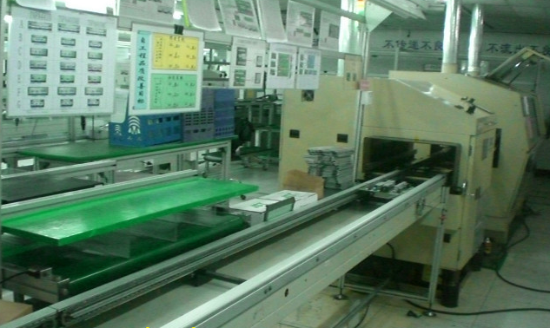
Samples by mechanical drilling
So far, it is still the only reliable way to produce big area THGEM by mechanical driling, even though it is time-consuming. Another limitation is the width of PCB production line and the dimension of the numerical control drilling machine. So max size is 1.2*0.5m^2。
500×500, HD:0.3, Pitch: 1.0mm, 6.25h!
1000×500, HD:0.3, Pitch: 1.5mm, 9.62h！
1000×500

Slide 15
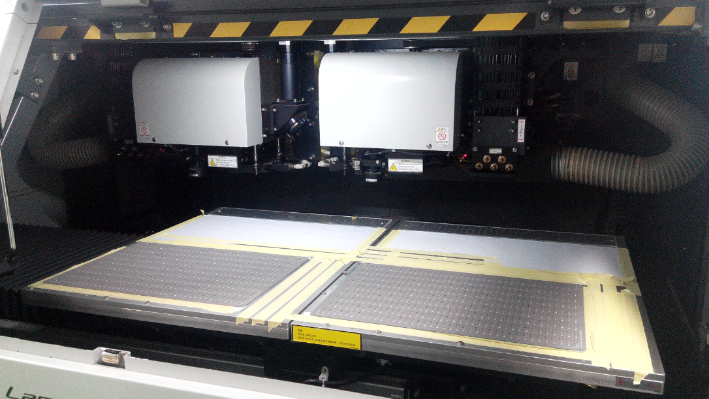
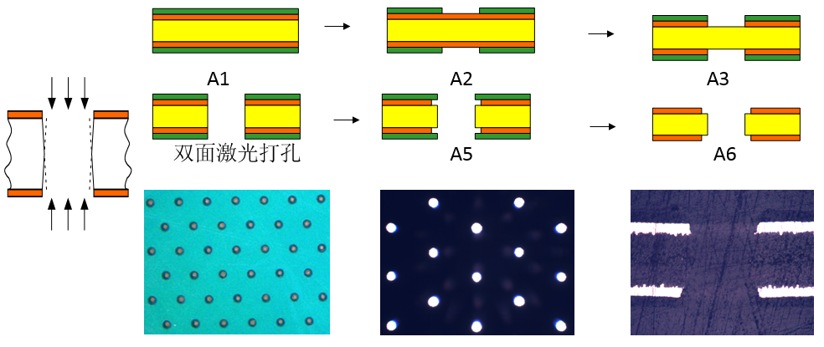
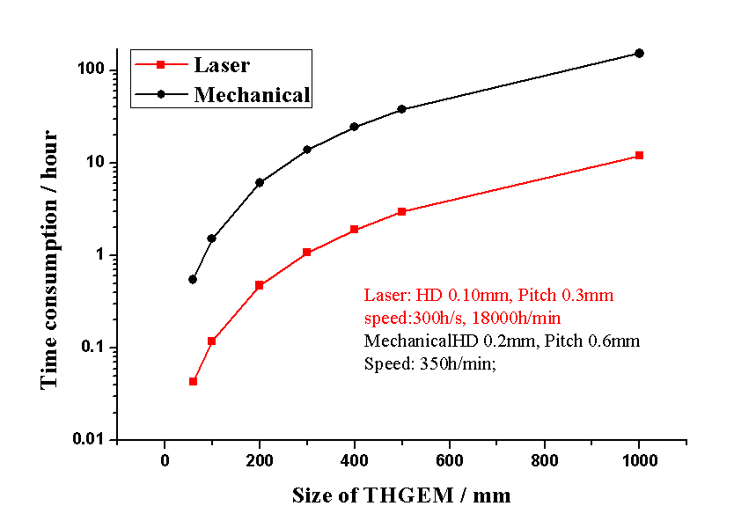
Laser bombardment
It is also used to produce standard GEM foil, such as in Japan. This technology can break the bottleneck of mechanical drilling. The max size can be produce: 1.2×0.5m^2 (this work)
Double-side laser bombardment
Both FR-4 and Kapton is OK. Six main steps.
The key step is double-side bombardment
Speed comparison
Laser：HD 0.10mm, 300h/s, 18000h/min
Foil: HD 0.10mm, Pitch 0.3mm
Mechanical：0.15mm, 200h/min; 0.2mm, 350h/min; 0.25mm, 500h/min;
Foil: HD 0.2mm, Pitch 0.6mm;

Slide 16
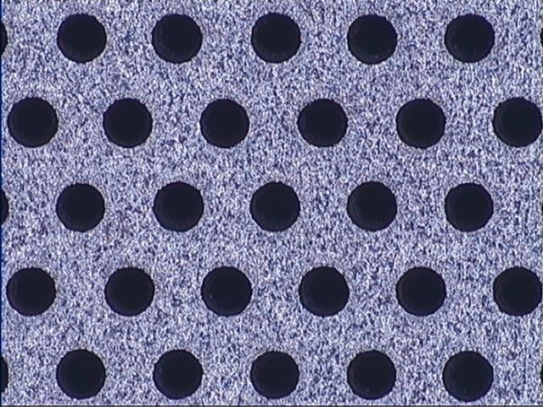
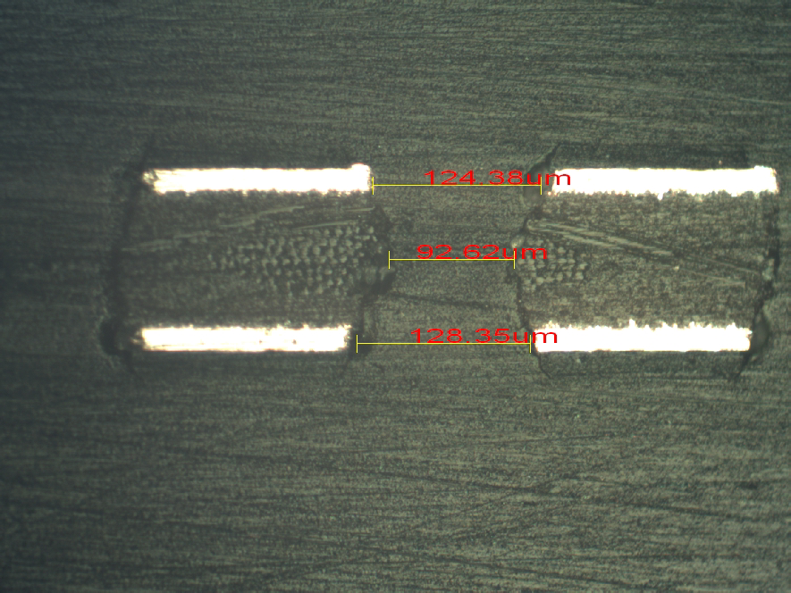
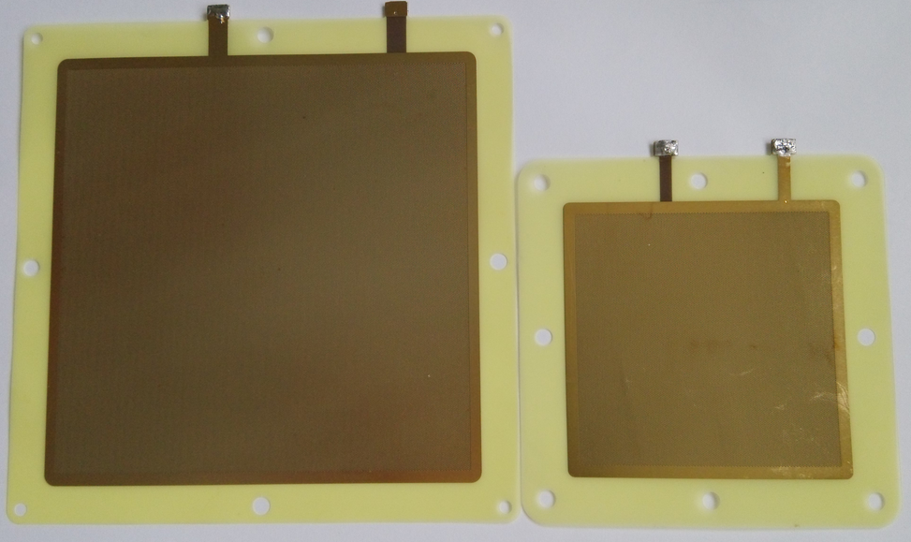
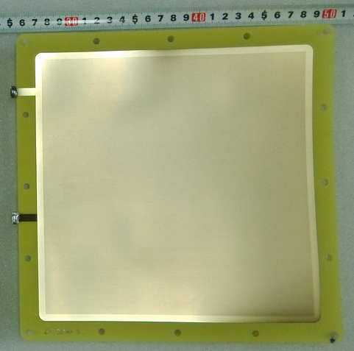
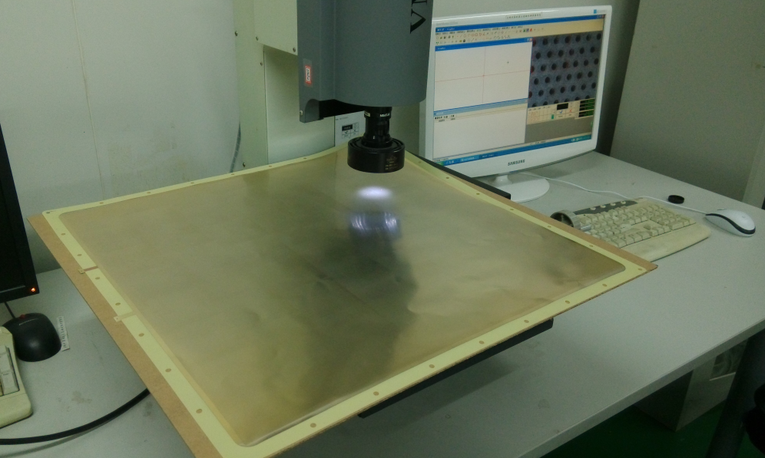
Samples by laser bombardment
Pitch <=300um
Intrinsic σx <=86um
60×60, 100×100, 200×200, and 500×500mm^2
<= 100×100: tested and have good performance, but yield rate need to be improved;
> 200×200: samples made, to be tested, still under development
100×100mm^2
60×60mm^2
200×200mm^2
500×500mm^2

Slide 17
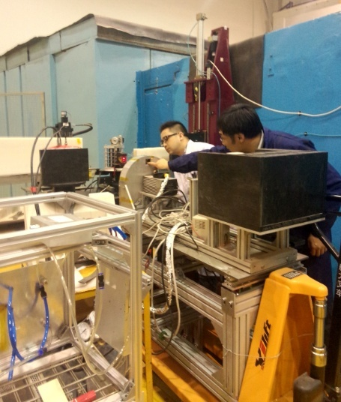
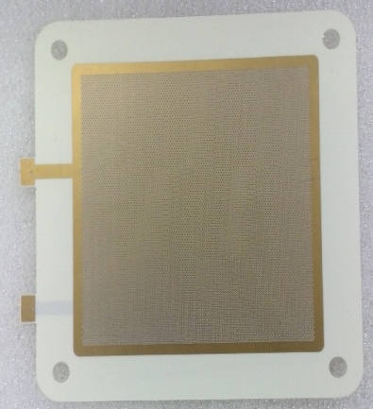
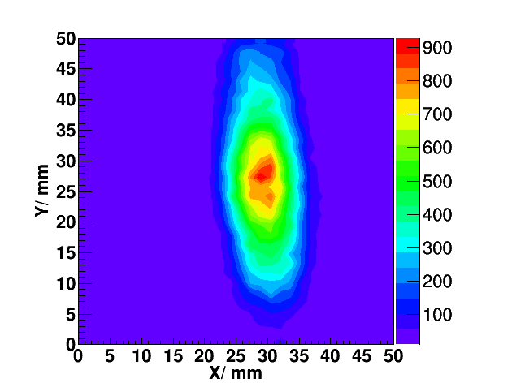
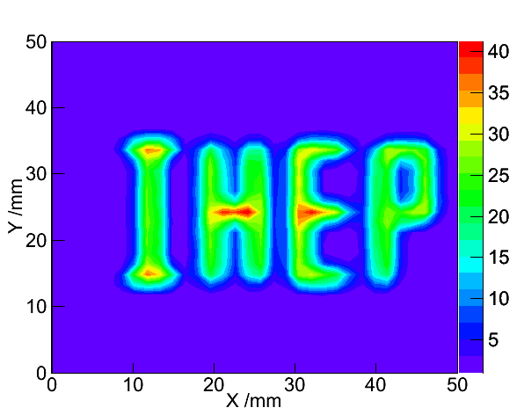
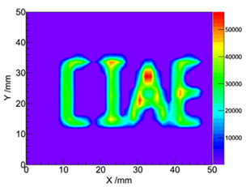
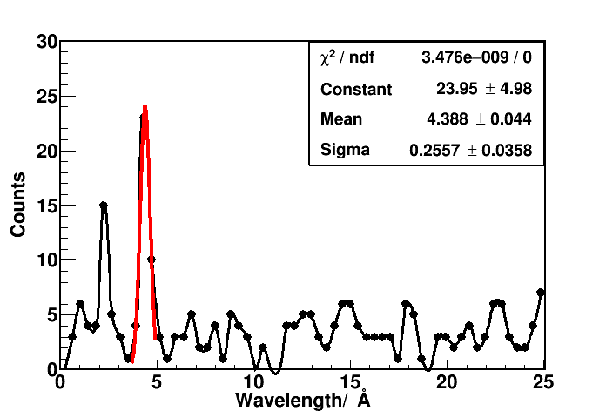
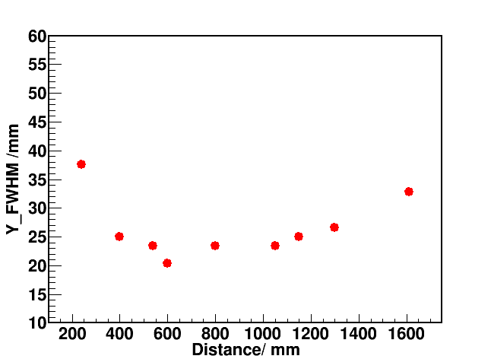
Applications
1.B-coated neutron detector( CSNS, Jianrong Zhou et.al, poster for details)
Ceramic THGEM，low neutron scattering and adsorption, 200×200mm^2 THGEMs
Good performances .
Test 1 @ CIAE: Reflect spectrummeter：
Monochromator： Graphite
Neutron wavelength：4.75 /2.4 Å
FLux：~5×10³ n/cm²·s
Beam size：~20mm×40mm
TOF result
Focus measurement
2.4 Å 4.7 Å
n, 2D

Slide 18
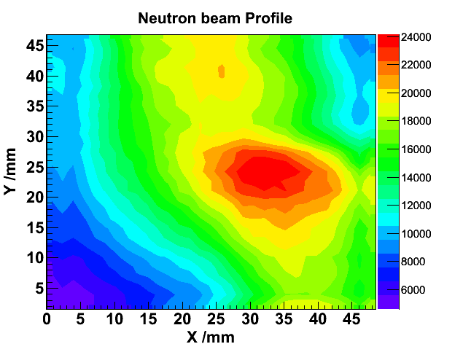
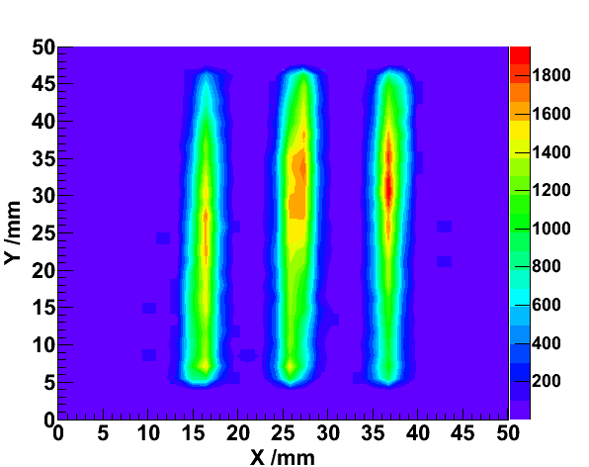
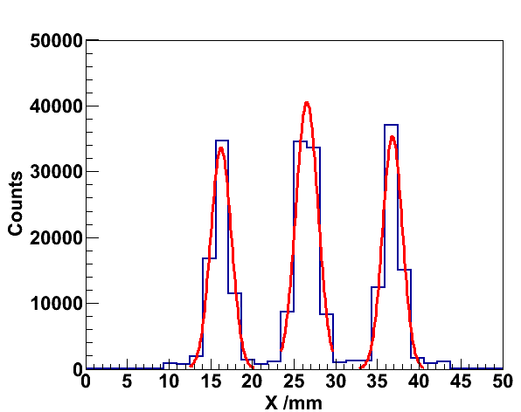
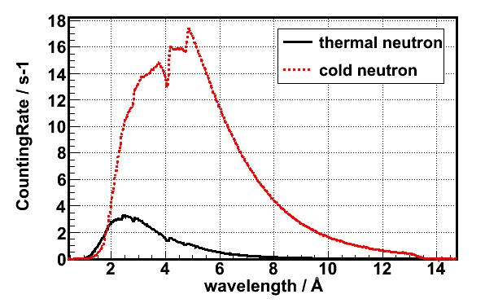
Test 2 @ CMRR: Powder diffraction spectrometer
Neutron wavelength：1.59 Å (0.0324eV)
Flux：～3*10⁴ n/cm².s
Beam size：～25mm×30mm
Detector
Monochromator
Beam pipe
Sample Env
FWHM:
2.87±0.01 3.00±0.01 2.75±0.01
TOF
WL@TOF
Aging test

Slide 19
2. Tracking and imaging for electron
Tracking：THGEM-TPC, σx-100um,
0.1~50MeV electron, works in vacuum tank.
TPC THGEMs, homemade, as default
high precision, pitch0.3mm,
Standard GEMs, as reference
CERN( Rui et.al ), test is ongoing.
Track sampling 3-D
80mm
45
Pad size: 0.46*0.46mm, Gap:0.1mm
72*7 PADs + 7 strips= 511 chs
FEE: CASAGEM ASIC, Q&T/ch
TPC fieldcage length 120mm
Minor strip structure
Gain: single: 5*10^3
double 2*10^4
Induced readout board

Slide 20
Imaging：particle distribution detector (PDD) σx-100um,
0.1~50MeV electron, works in vacuum tank.
Beam test, 142PC+572
Pi(MIP) 400~700MeV
60mm
Strip: 0.46mm, Gap:0.1mm
X 100 + Y 100 = 200 chs
FEE: CASAGEM ASIC, Q/ch
Detector + ASIC FEE +
ADC + DAQ commissioning

Slide 21
Front-end electronics, CASAGEM ASIC chips
designed by Tsinghua University, 16ch/chip
Structure：preAmp + 5 trends shaping
Gain：2mV/fC, 4mV/fC, 20mV/fC, 40mV/fC
Shaping time：20ns、40ns、60ns、80ns
Channel：16+1(1 trigger)
Output： Single-ended parallel output
Ortec:142PC+572
CASAGEM

Slide 22
3、GPM(LAr/LXe experiments )
4、Digital hadron calorimiter
(for Circular E-P Collider, CEPC )
Low BG, high gain THGEM
5、Mu detector (for CEPC)
THGEM as an option
Big-area production
2-D readout/layer
The upgrade of CMS & ATLAS u detectors will adopt MPGD。

Slide 23
Summary
New substrate THGEMs had been made and tested, good performance was achieved, including: FR-4、Ceramic、PTFE and Kapton PCT-type substrates.
The ceramic and PTFE substrates have lower natural radioactivity and neutron adsorption and scattering.
THGEM can reach <=86um intrinsic spacial resolution by laser technology, HD<=100um, Pitch<=300um.
4. THGEM of 1.0×0.5m^2 has been made by mechanical drilling, but huge time-consuming. THGEM of 0.5×0.5m^2 has been made by laser bombardment with very high production efficiency. Laser bombardment is a promising method for big-area THGEM production.
5. New types and big-area THGEMs are applying to experiments.
Thank you for attention!

