Slide 1

Two-phase Cryogenic Avalanche Detector with electroluminescence gap and THGEM/GAPD-matrix multiplier
Andrey Sokolov
Novosibirsk State University (NSU)
Budker Institute of Nuclear Physics (Budker INP)
Novosibirsk, Russia
15 October 2015

Slide 2
Outline
Presentation of LCEP
Two-phase CRAD in Ar: concept of low-threshold detector for rare-event experiments
3. Proportional EL in two-phase Ar
4. CRAD spatial resolution
5. Calibration with neutron source
6. Summary.

Slide 3
Laboratory of Cosmology and Elementary Particles (LCEP)
LCEP is joint laboratory of Budker INP (BINP) and Novosibirsk State University (NSU)
LCEP location: BINP (experimental division) and NSU (theoretical division)
LCEP is operated in the frame of BINP and NSU research programs
Experimental division of LCEP:
A. Bondar, R. Belousov, A. Buzulutskov (coordinator), A. Dolgov (head of the lab), A. Chegodaev, V. Nosov, L. Shekhtman, E. Shemyakina, R. Snopkov, A. Sokolov
Students: N. Smirnov, K. Zatrimailov, A. Davydov, G. Vatnik
We collaborate with team from Plasma Division (BINP) on neutron scattering system development:
- S. Polosatkin, E. Grishnyaev

Slide 4
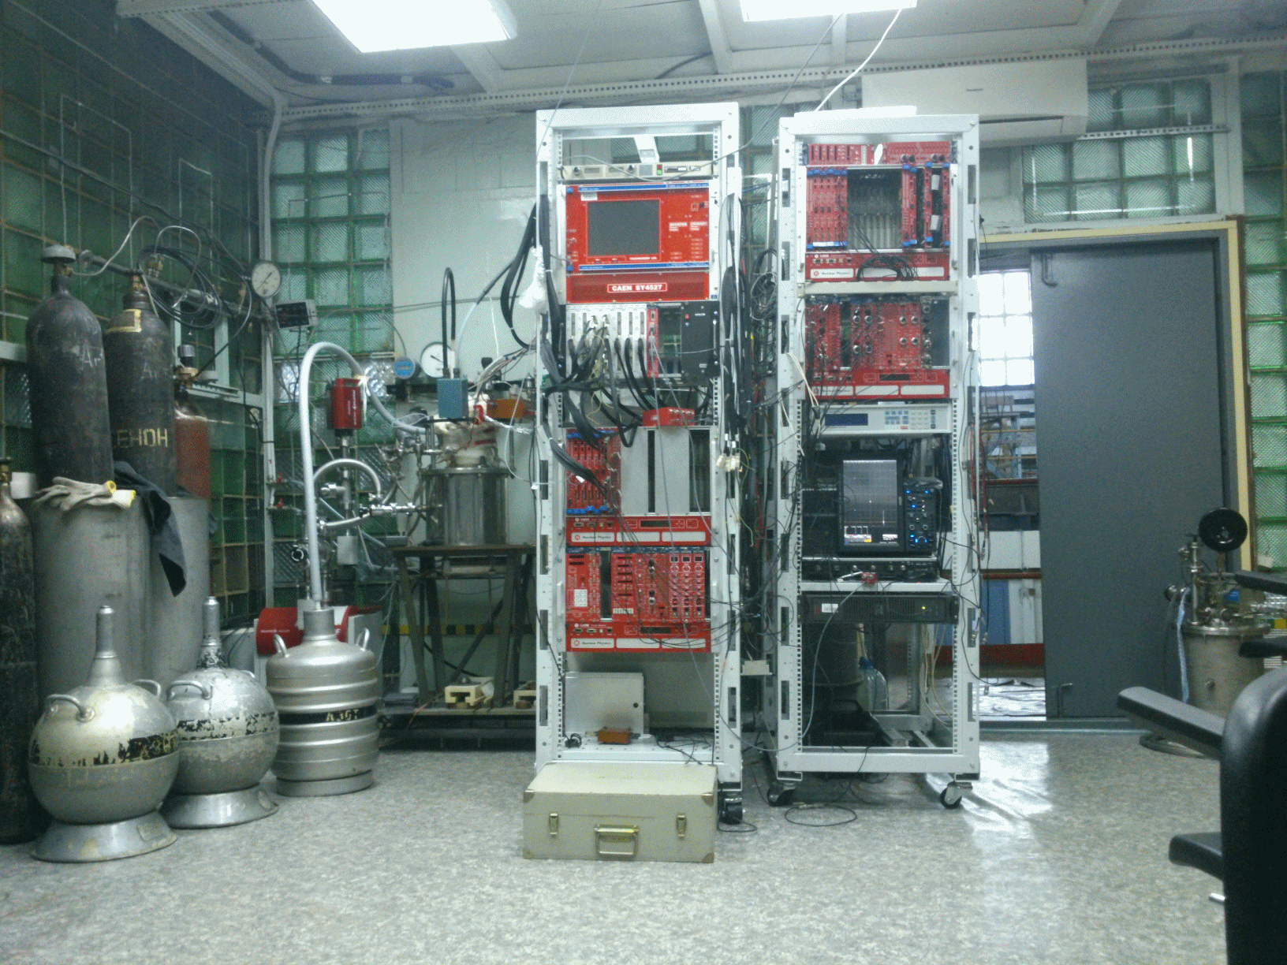
LCEP laboratory: experimental setup with 9 l cryogenic chamber for 2013-2015 measurement campaigns

Slide 5
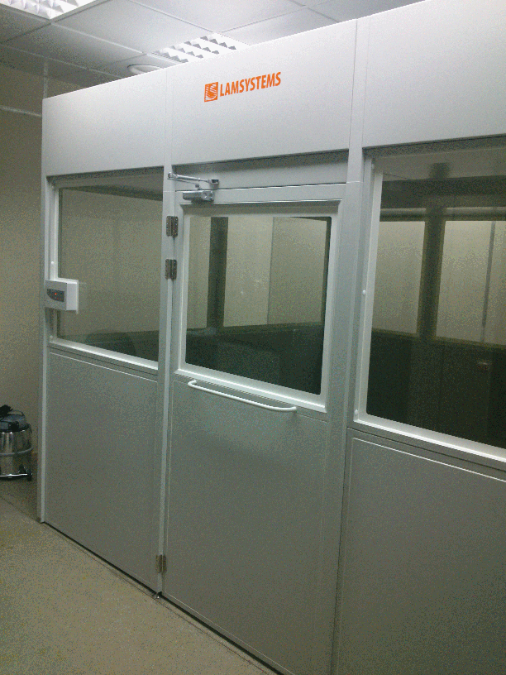
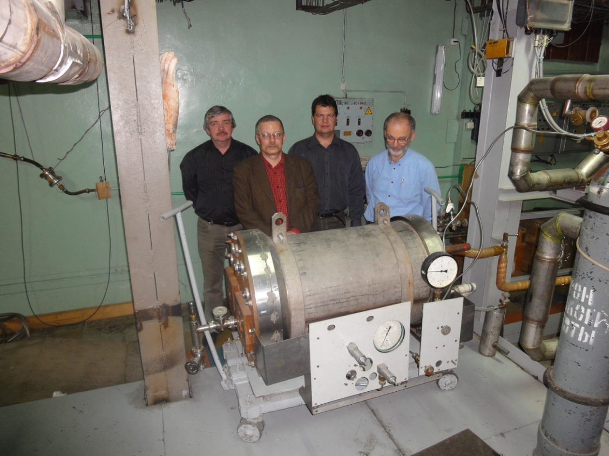
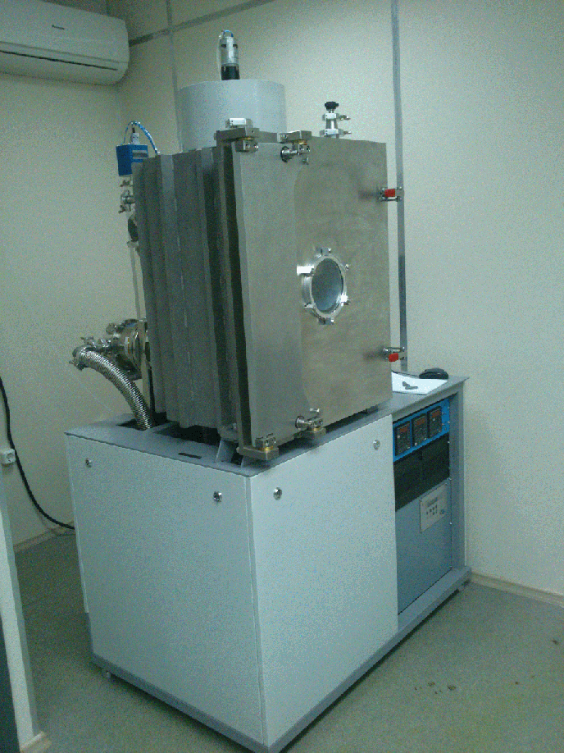
LCEP laboratory: clean room, vacuum evaporation setup and 160 l cryogenic chamber prototype

Slide 6
Two-phase detectors for rare-event experiments: principles of operation

Slide 7
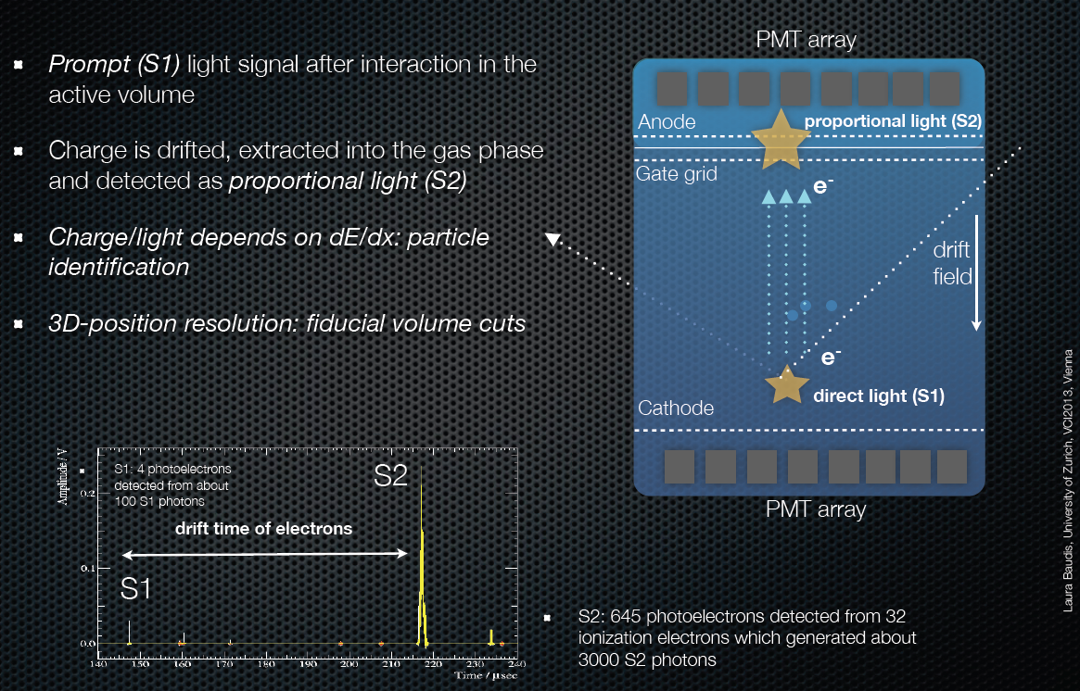
Two-phase detectors for rare-event experiments: principles of operation
L. Baudis, VCI 2013 talk

Slide 8
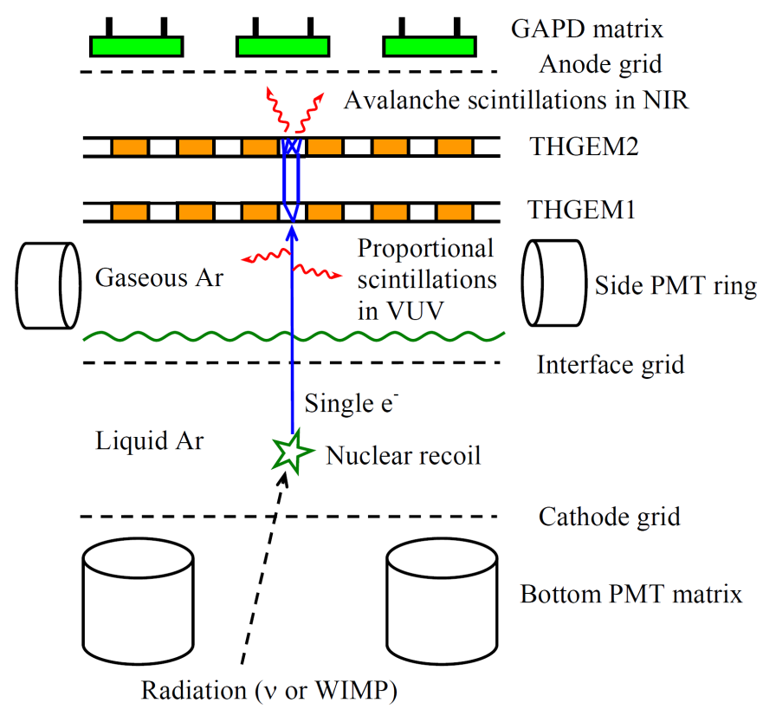
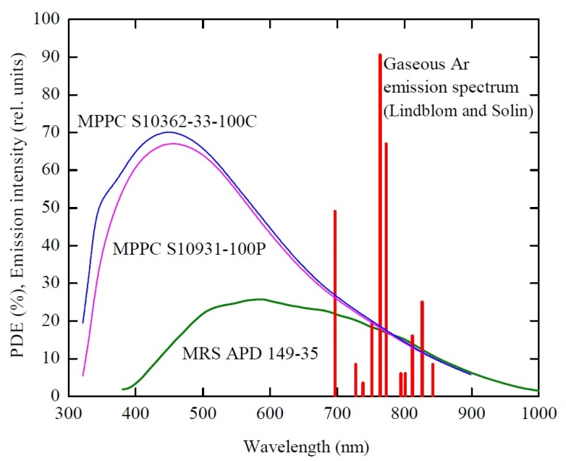
Our detector concept: two-phase CRAD in Ar with EL gap and THGEM/GAPD-matrix multiplier for rare-event experiments
Concept: Detector of nuclear recoils of ultimate sensitivity for Coherent Neutrino-Nucleus Scattering and Dark Matter Search experiments
Two-phase Cryogenic Avalanche Detector (CRAD) in Ar with electroluminescence (EL) gap and THGEM/GAPD-matrix multiplier
Principle:
- Combining THGEM/GAPD-matrix readout with PMT readout of proportional EL, of the ionization (S2) signal, in single-electron counting mode
[Budker INP: A. Bondar et al, JINST 5 (2010) P08002; A.Buzulutskov et al, EPL 94 (2011) 52001]
- Final goal is to develop nuclear-recoil detectors of ultimate sensitivity, i.e. operating in single-electron counting mode with superior spatial resolution
- Single-electron counting capability is provided by EL scintillations recorded with PMTs, while superior spatial resolution by combined (charge/optical) THGEM/GAPD-matrix multiplier
- In Ar, we can use GAPDs without WLS due to intense NIR avalanche scintillations

Slide 9
Proportional EL in two-phase Ar

Slide 10
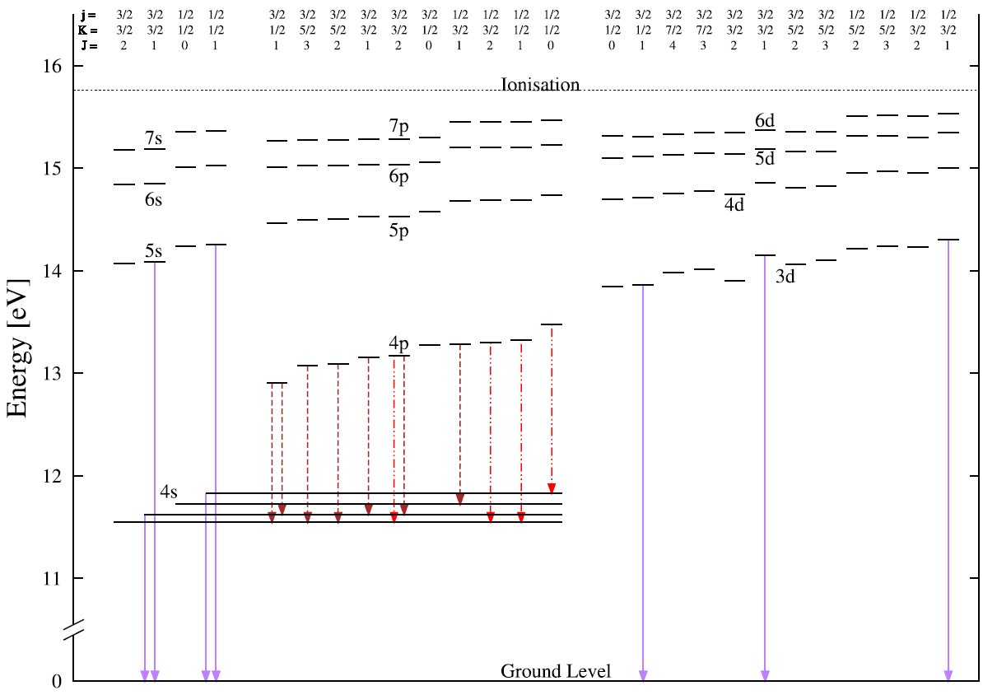
Ar energy levels
Notes:
emission

Slide 11
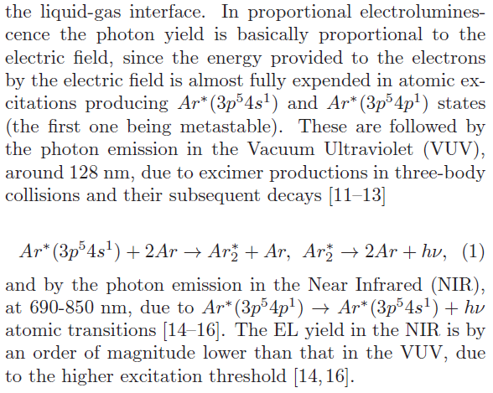


Proportional EL in two-phase Ar: basic mechanisms
Ar excimer emission in VUV
(around 128 nm):
Ar atomic emission in NIR (690-850 nm):
11
11

Slide 12
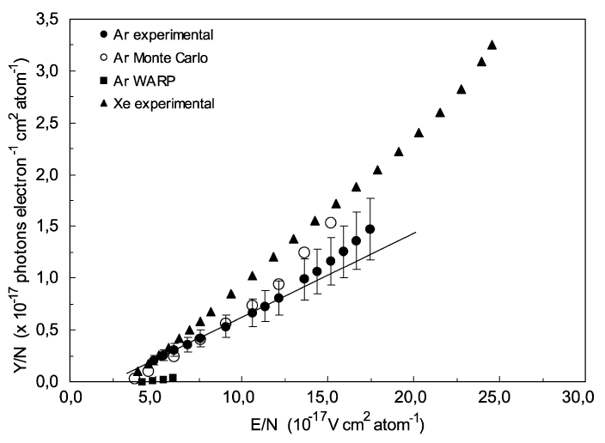
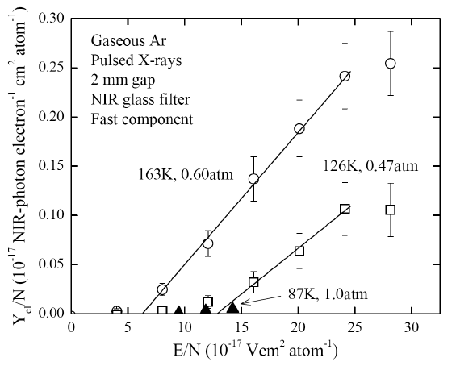

Motivation to study proportional EL: confusing data
2012 JINST 7 P06014
Notes:
incitement

Slide 13
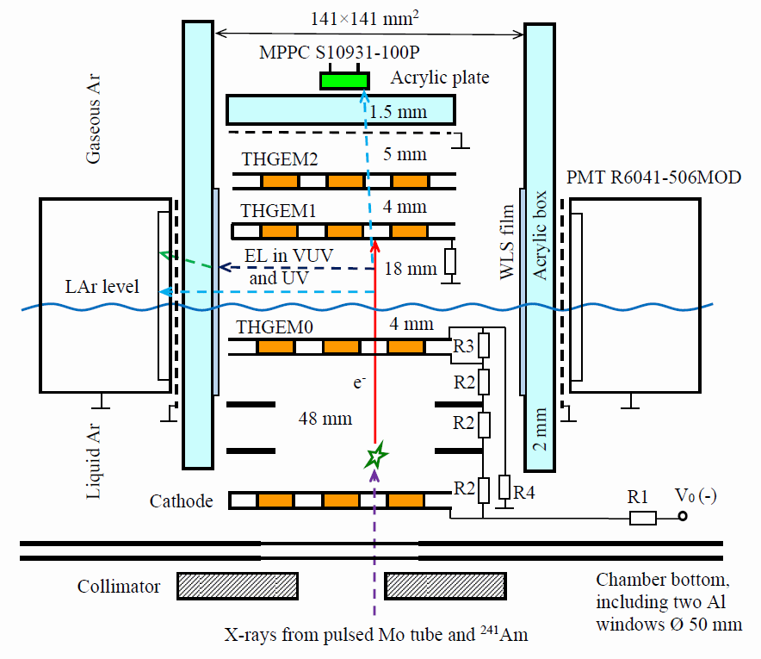
Proportional EL in two-phase Ar: Experimental setup
NIM A732:213-216, 2013
Notes:
combined

Slide 14
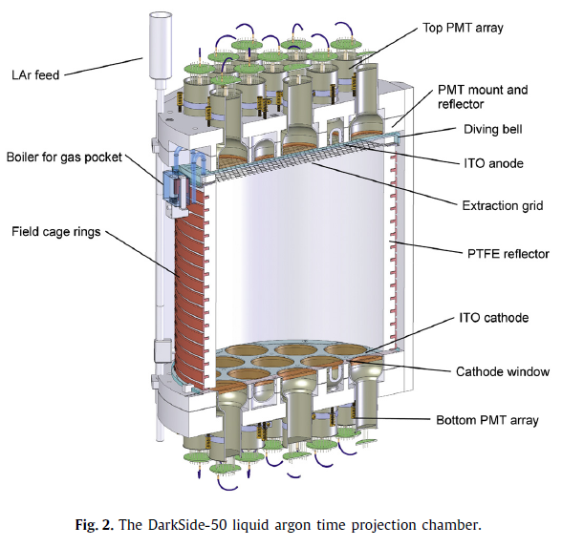
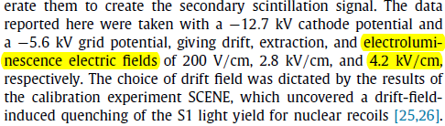


Motivation to study proportional EL:
DarkSide and SCENE experiments

Slide 15
Proportional EL in two-phase Ar: Experimental setup

Slide 16
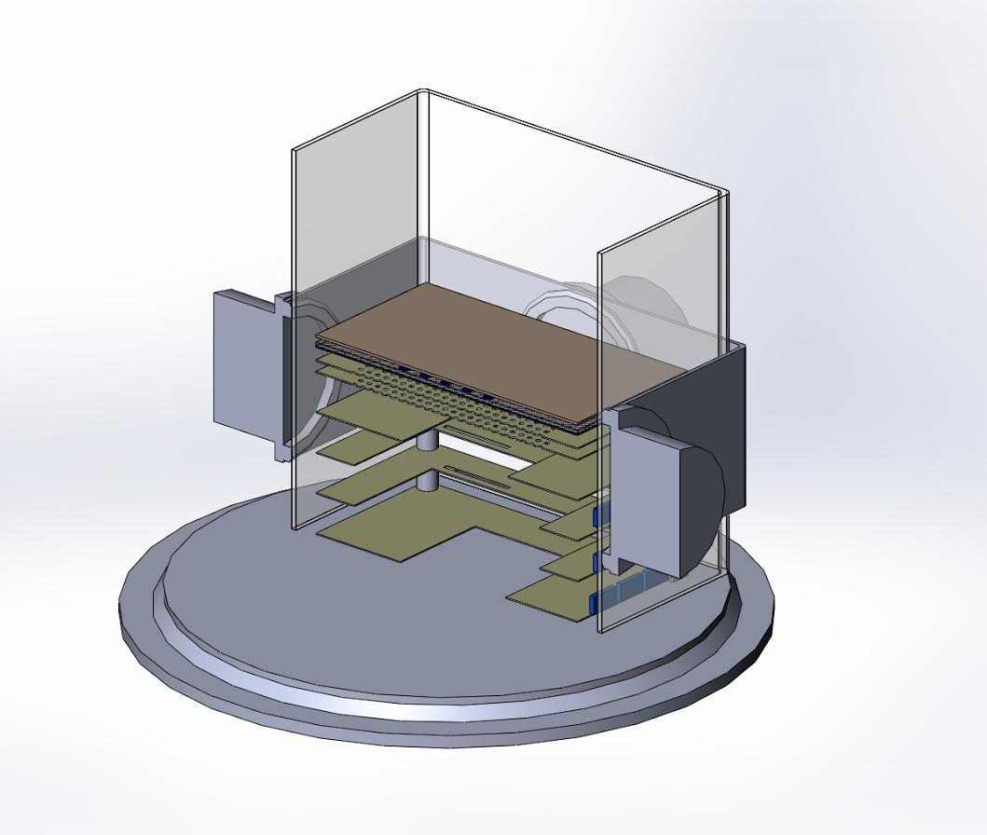
3D view of experimental setup
PMTs
GAPD’s 5x5 matrix
THGEMs

Slide 17
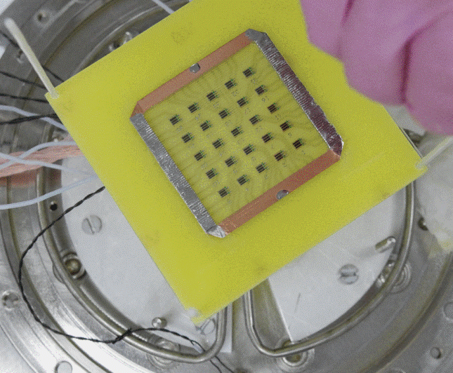
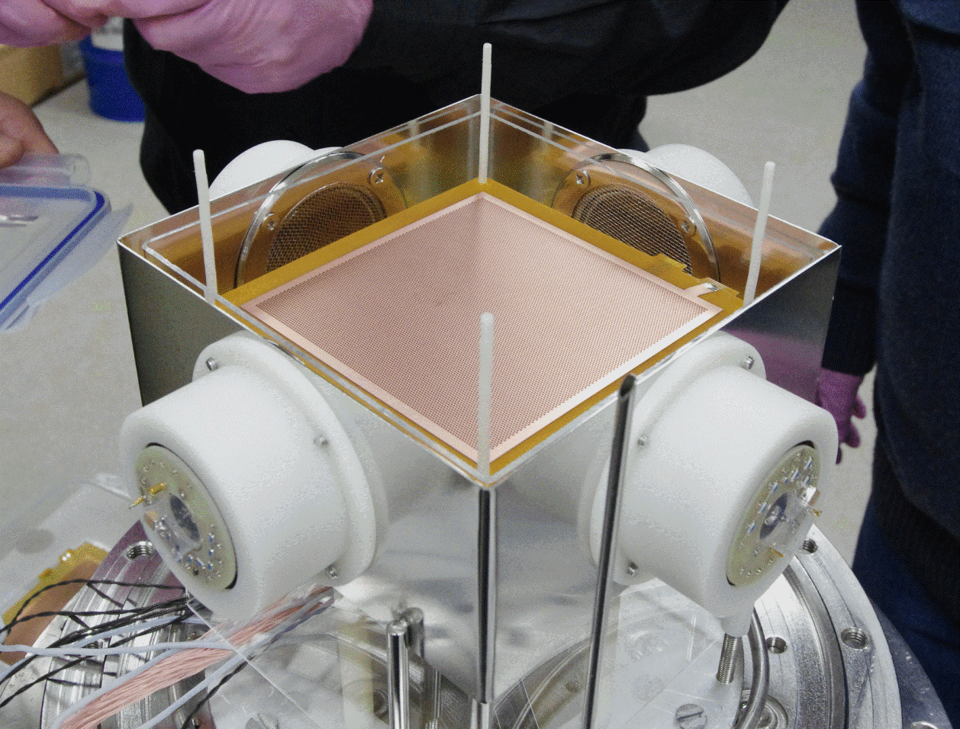
Experimental setup
GAPD’s 5x5 matrix: Hamamatsy S10931-100P
Extraction grid: THGEM
PMT: Hamamatsu R6041-506-MOD

Slide 18
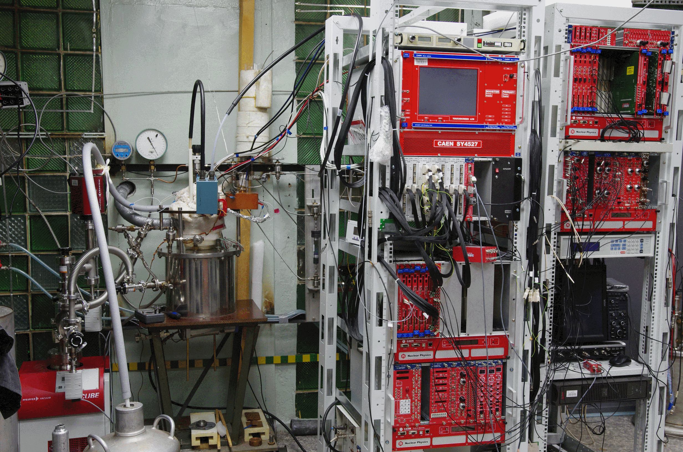
Experimental setup

Slide 19
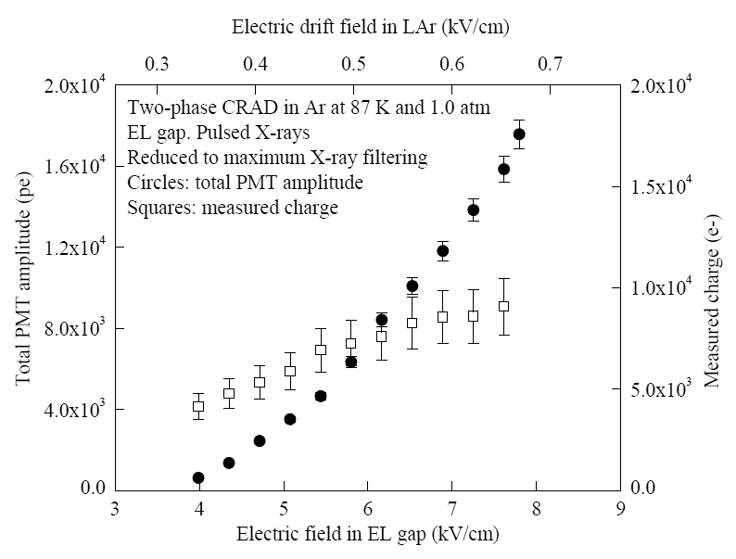
Proportional EL in two-phase Ar: Light and charge signal dependence on field
JINST 4: P09013

Slide 20
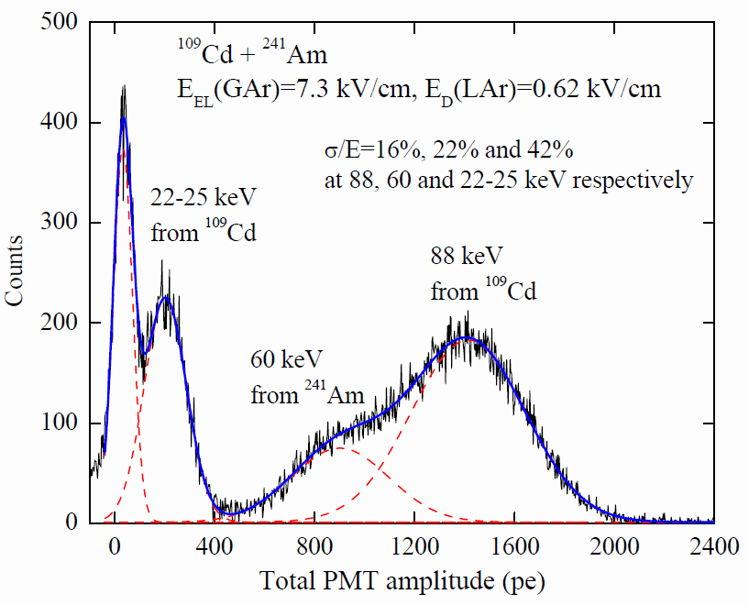
¹⁰⁹Cd gamma-ray spectrum in EL gap

Slide 21
“Pure Ar emission” approach in EL yield:
wrong both in VUV and NIR!

Slide 22
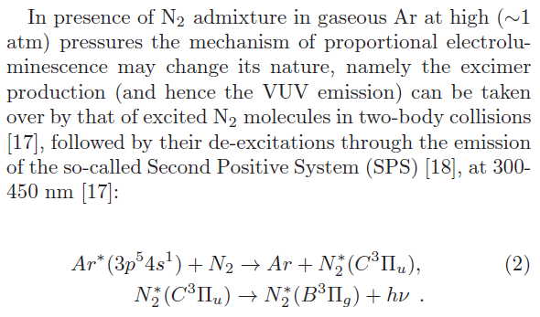

Proportional EL in two-phase Ar in presence of N₂
T. Takahashi et al., NIM 205 (1983) 591:
N₂ Second Positive System (SPS)
emission in UV (300-430 nm):
22
22

Slide 23
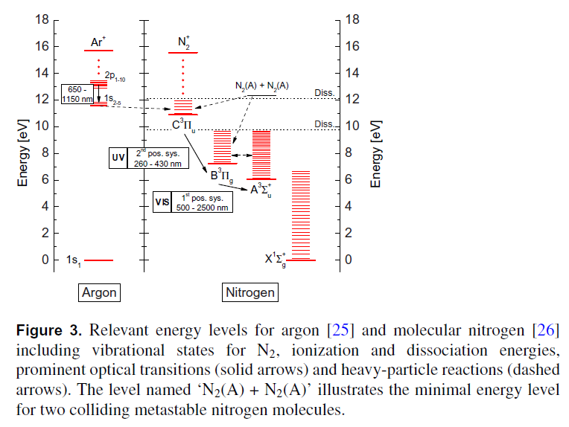
Ar and N₂ energy levels

Slide 24
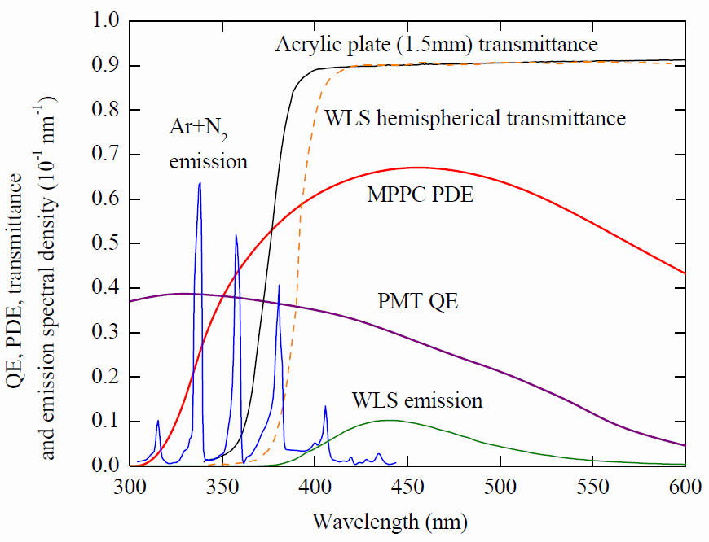

Optical spectra

Slide 25
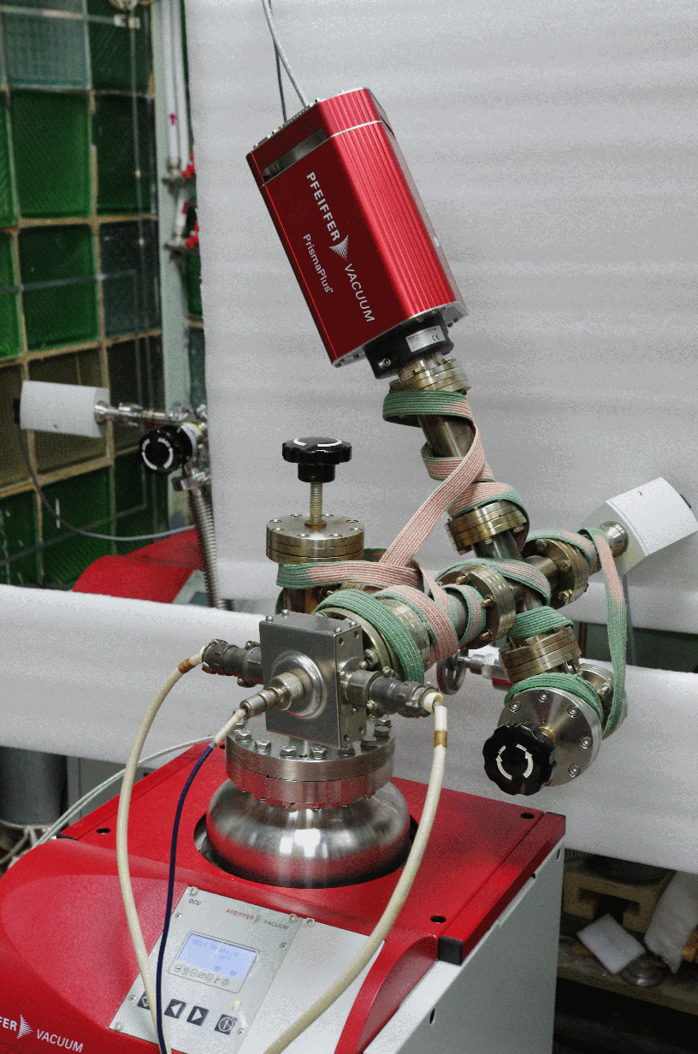
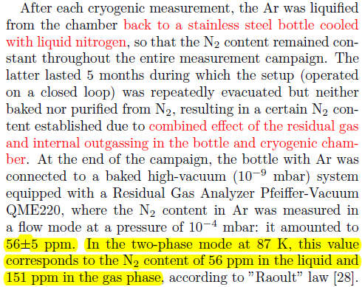
N₂ content measurement

Slide 26
Proportional EL in two-phase Ar: Light and charge signal dependence on field

Slide 27
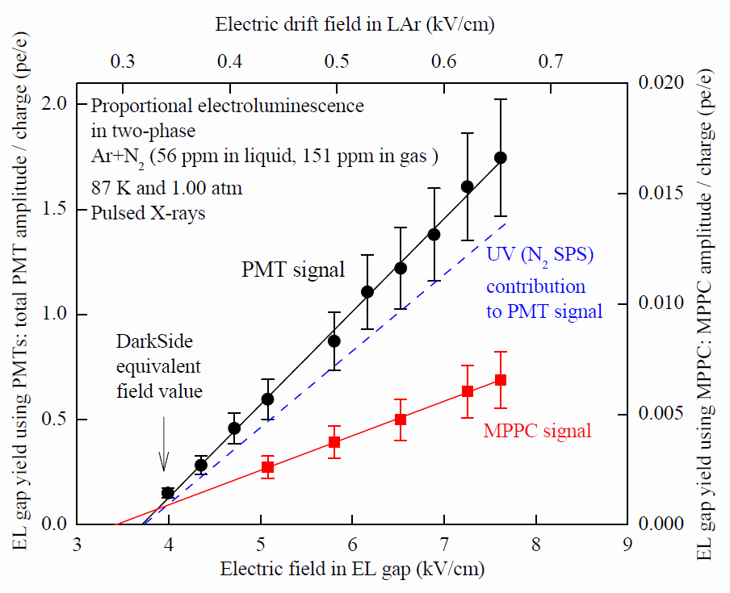
EL gap yield
Notes:
contribution

Slide 28

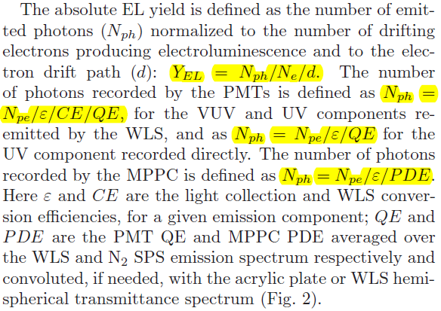
Absolute EL yield

Slide 29
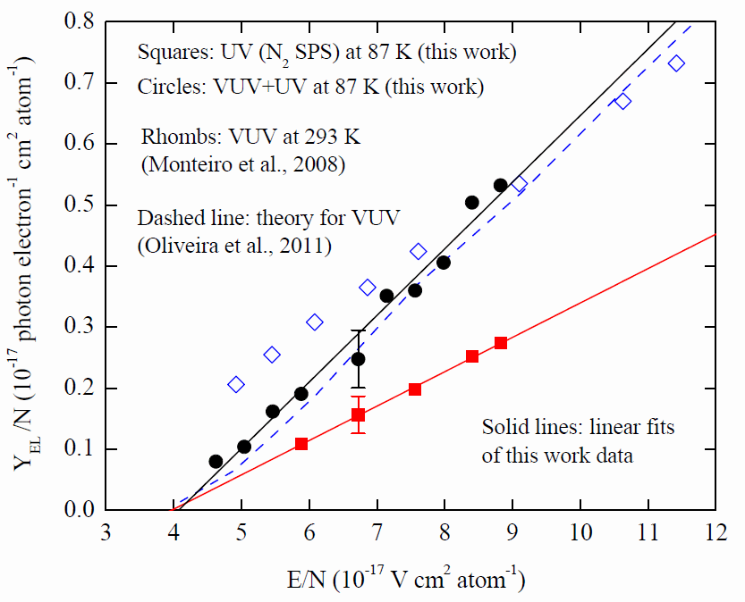


Absolute EL yield
Buzulutskov et al. arXiv:1509.00664v1
Overall in VUV (Ar₂ excimer) and UV (N₂ SPS):
In UV (N₂ SPS):

Slide 30
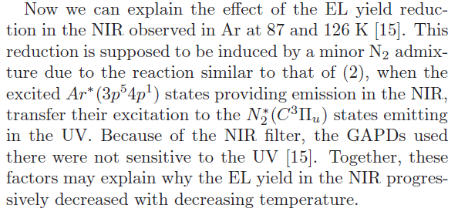
Explanation of NIR suppression at 87 K

Slide 31
Two-phase CRAD in Ar doped with N₂, with 9 l cryogenic chamber: ultimate sensitivity assessment
At the moment we have a sensitivity of 1.5 pe/e at 7 kV/cm (2.7 times more than expected in “pure Ar” approach)
Expected sensitivity enhancement:
- Adding more (100-200 ppm) N₂, fully converting VUV to UV: factor of 2
- Removing WLS and using UV transparent acrylic: factor of 100/15%=6.7
- Doubling the number of PMTs or replacing those with MPPCs (200 pieces of 6x6 mm² Hamamatsy S13360-6050PE): factor of 2
This would result in 1.5*2*6.7*2= 40 pe/e: more than enough!

Slide 32
CRAD Spatial resolution

Slide 33
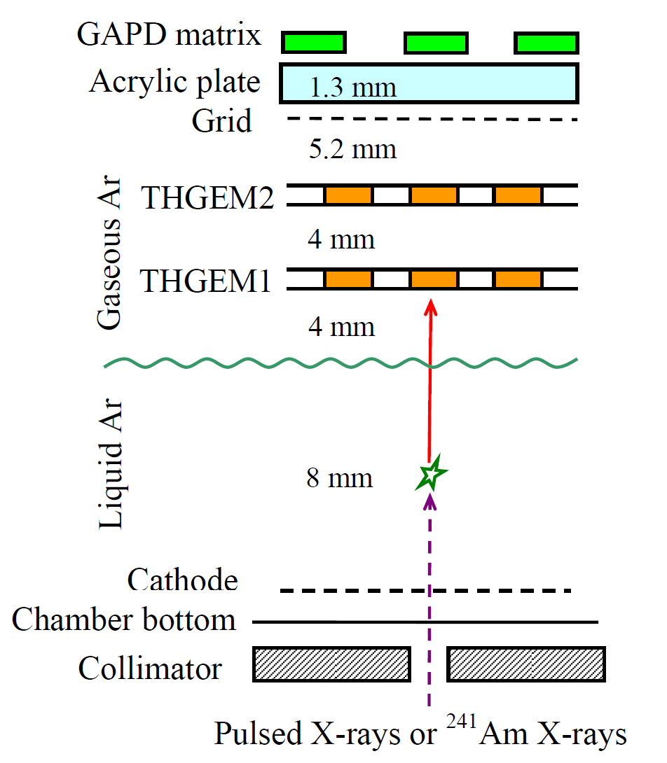
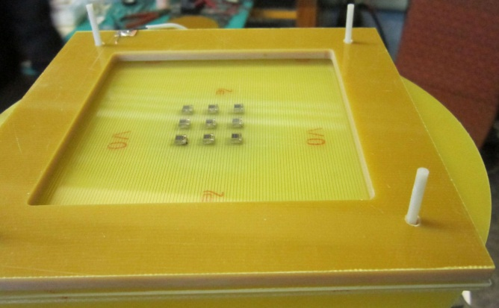
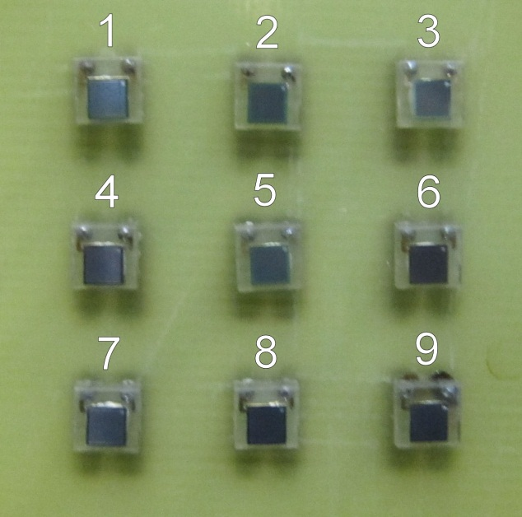
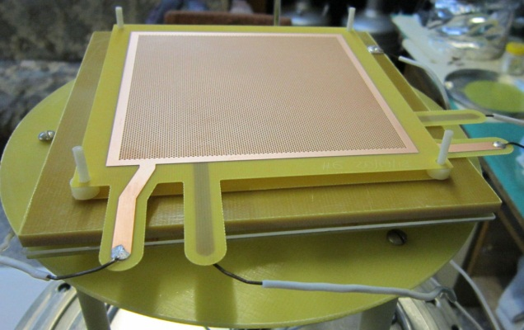
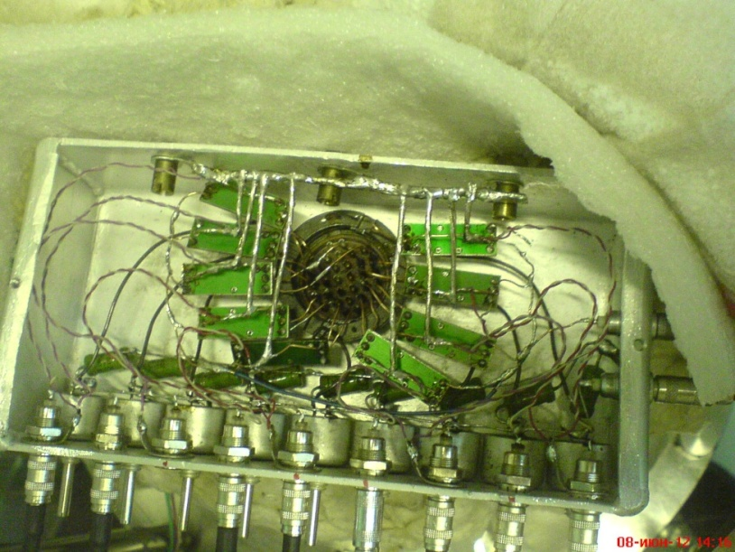
Two-phase CRAD in Ar with THGEM/GAPD-matrix charge/optical readout in the NIR
- Double-THGEM multiplier in the gas phase
- 3x3 GAPD matrix (1 cm spacing) optical readout in the NIR
- Each GAPD (CPTA 149-35) having 2x2 mm2 active area
- 9 fast amplifiers (CPTA) outside the chamber
- Irradiated with pulsed X-rays (~20 keV, 240Hz) through a 2mm diameter collimator, to estimate spatial resolution
- Operated in single X-ray photon counting mode

Slide 34
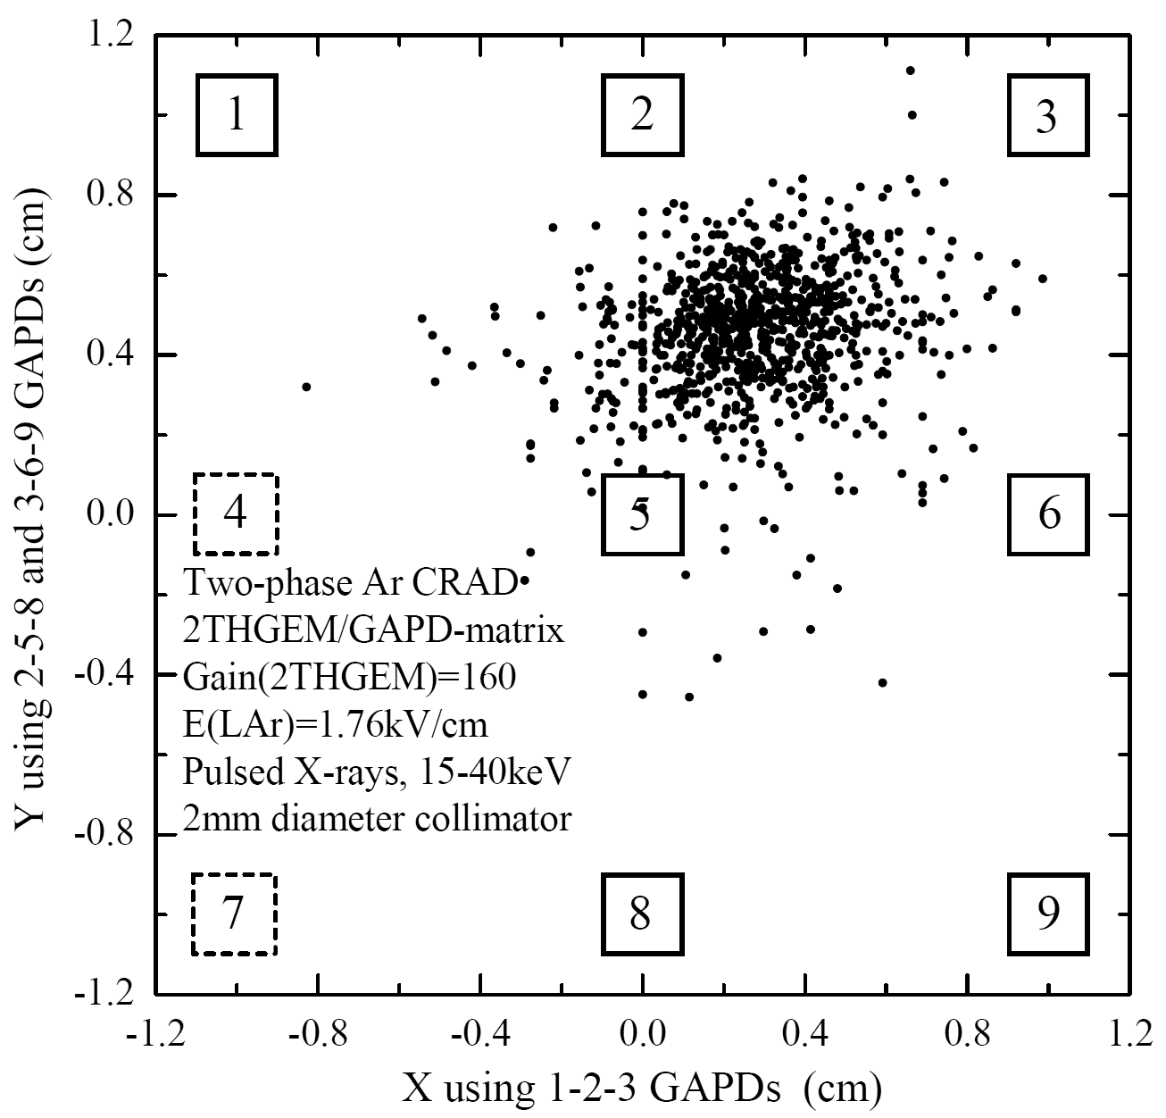
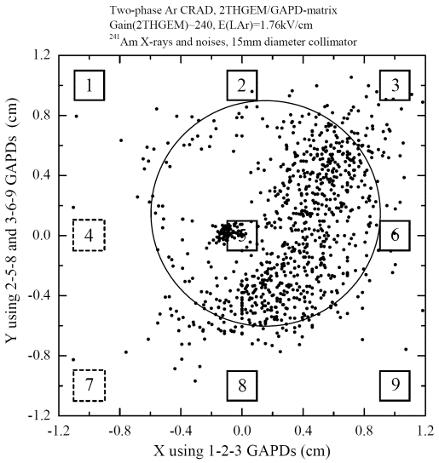
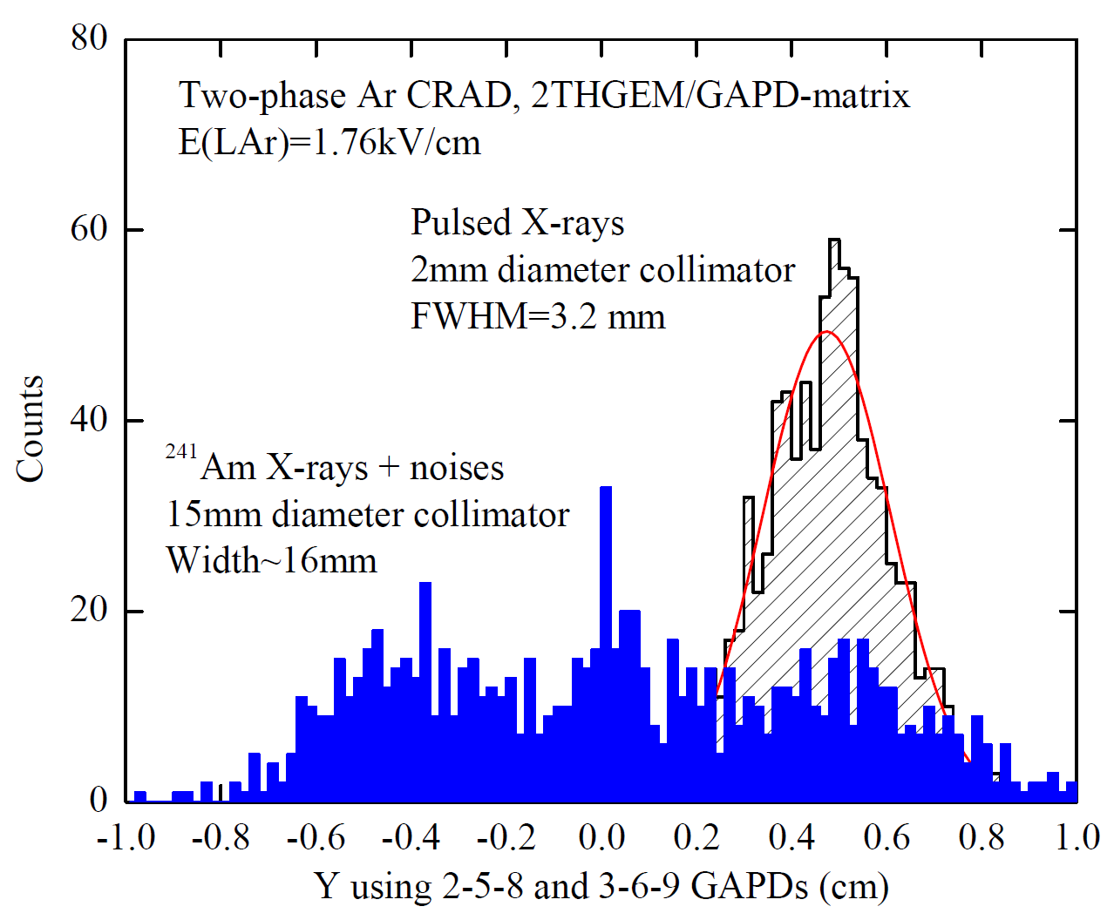
Two-phase Ar CRAD with THGEM/GAPD-matrix multiplier: spatial resolution
- Reconstructed image of X-ray conversion region (defined by 2 and 15 mm collimators) from GAPD-matrix amplitudes
- Using center-of-gravity algorithm corrected for simulation of light rays gives FWHM=3 mm → spatial resolution of THGEM/GAPD-matrix is about 1 mm (σ).
- Spatial resolution of THGEM/GAPD-matrix readout is far superior compared to that of PMT-matrix: of the order of 1 mm, for deposited energy of 20 keV at charge gain of 160.

Slide 35
Calibration with neutron source

Slide 36
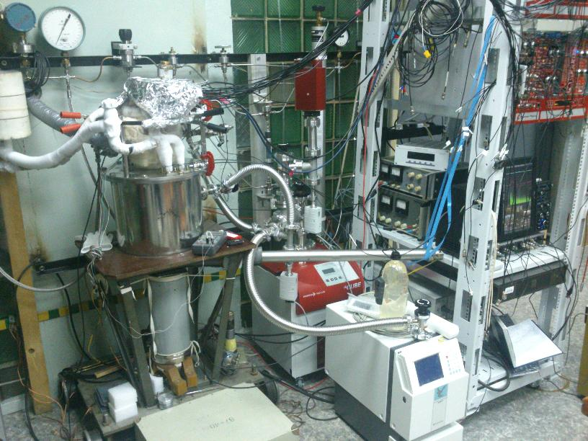
Two-phase CRAD with DD neutron scattering system
CRAD cryostat
Neutron source
Neutron detector

Slide 37
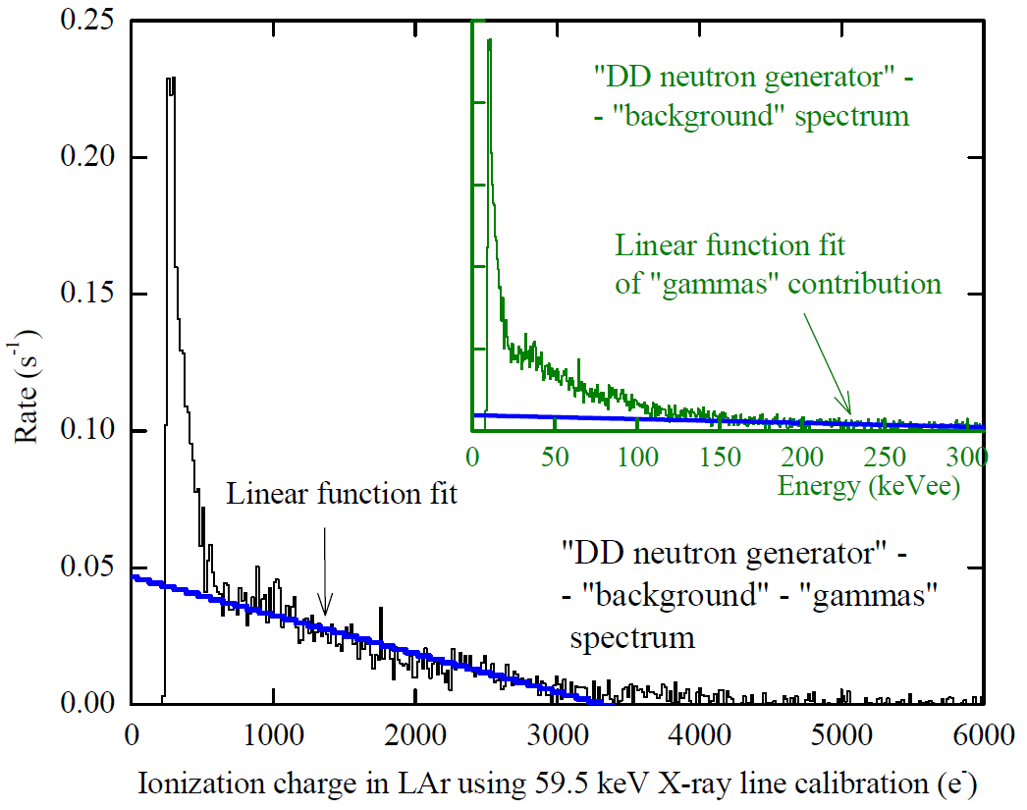
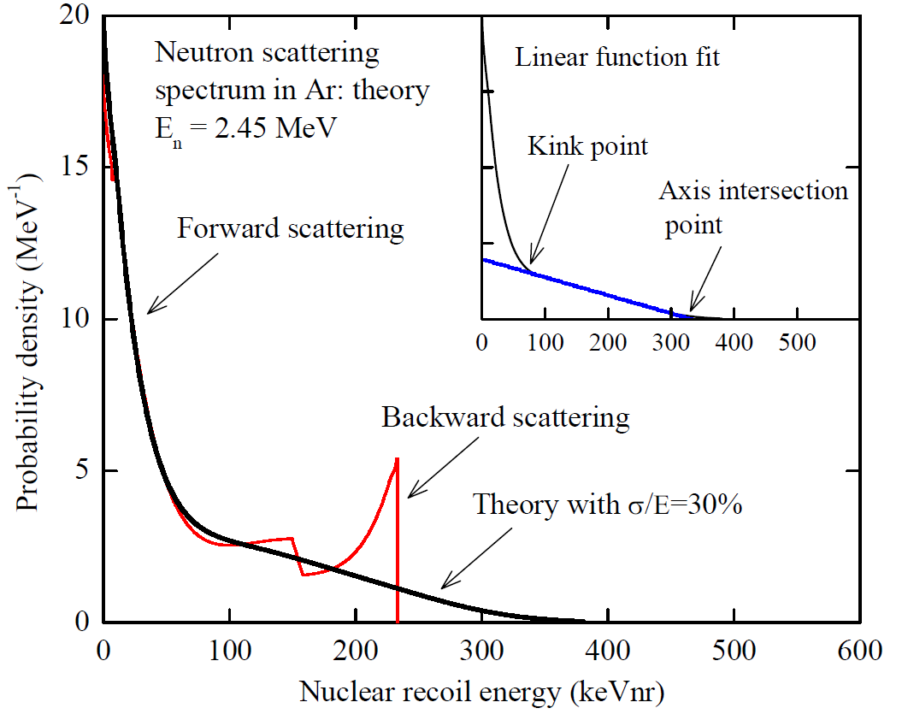
Neutron scattering spectrum
The theoretical spectrum was computing using Scattronix code.
From the comparison the experimental and theoretical distributions one can conclude that ionization yield equal 9.7±1.3 e⁻/keV for the 233 keV recoil energy and 7.8±1.1 for the 80 keV.

Slide 38
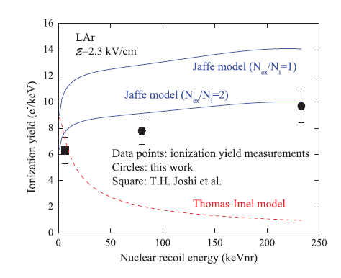
Comparison with theoretical models
The ionization quenching factor amounted to 0,30±0.04 for the 233 keV recoil energy and 0,27±0.04 for the 80 keV.
More details: A. Bondar et al. EPL, 108 (2014) 12001

Slide 39
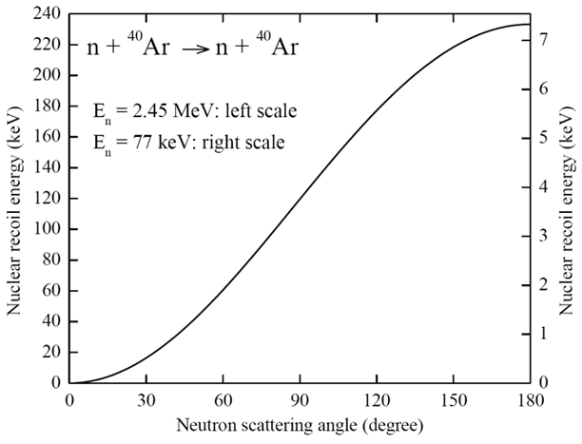
Neutron double scattering concept
Cryostat
GAPD matrix
4cm
α
4cm
n
n
D-D neutron generator
Having high spatial resolution in CRAD, of 1 mm, one can reach accuracy about 2º in the scattering angle, corresponding to the nuclear recoil energy as low as a few keV

Slide 40
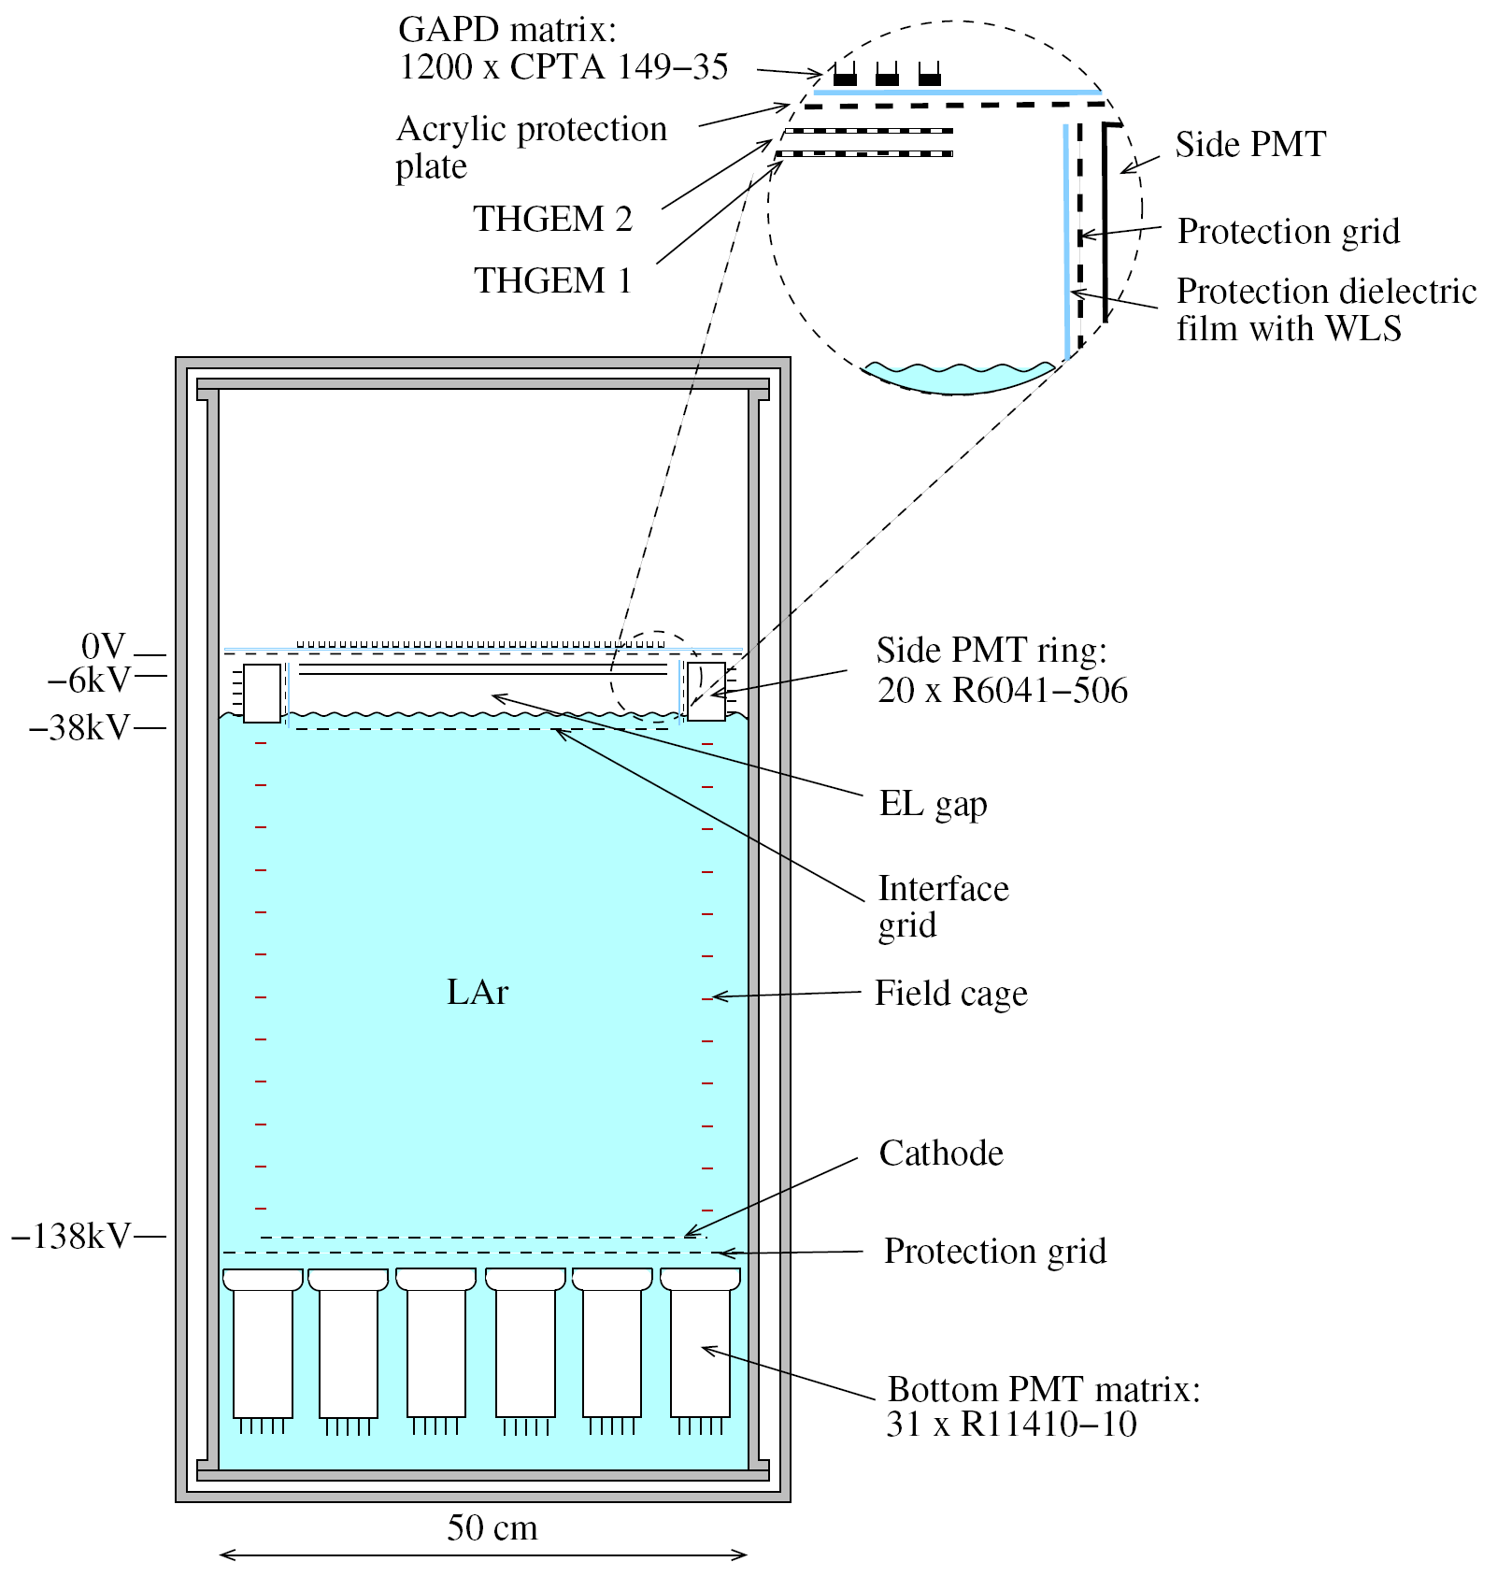
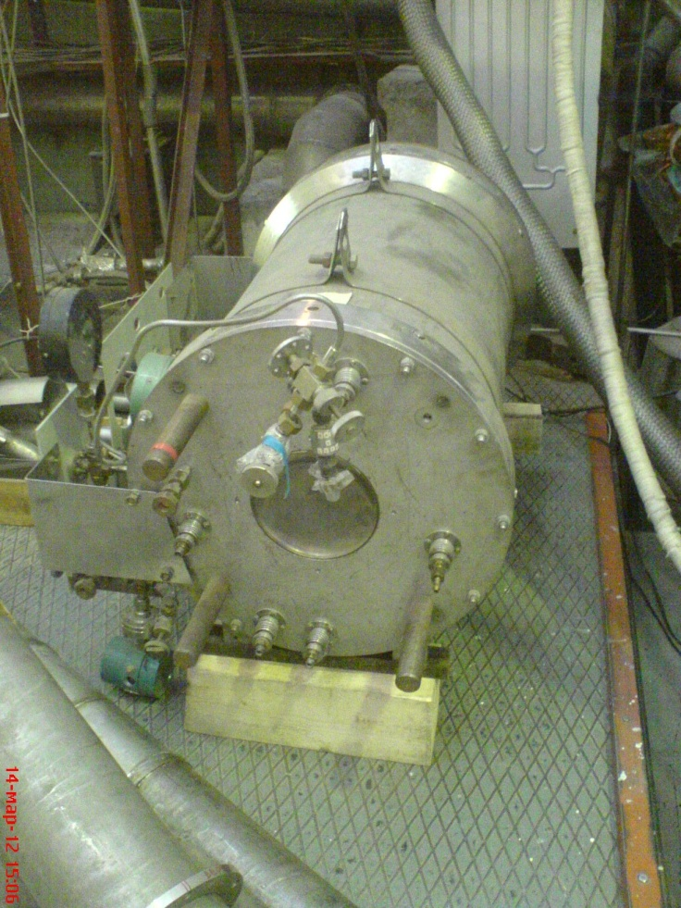
Two-phase CRAD in Ar: elaborated project with 160 l cryogenic chamber
- Cryogenic chamber with 50 cm electron drift and 50 l active volume (70 kg of active LAr and 200 kg in total).
- The bottom and side PMTs provide single- and double-electron trigger for primary ionization
- The EL gap, having a thickness of 4 cm, matches with the size of side PMTs
- The total number of photoelectrons recorded by both PMT arrangements will be 40 pe. This is enough to make a selection between single- and double-electron events
- Avalanche scintillations produced in the holes of the second THGEM are recorded in the UV using a matrix of GAPDs: this will provide a high (sub-cm) spatial resolution

Slide 41
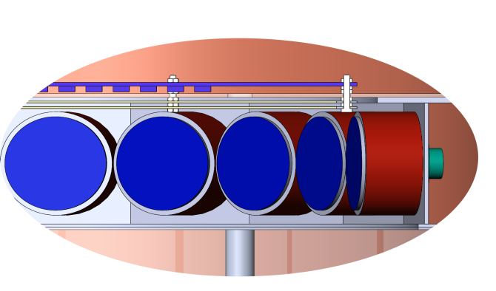
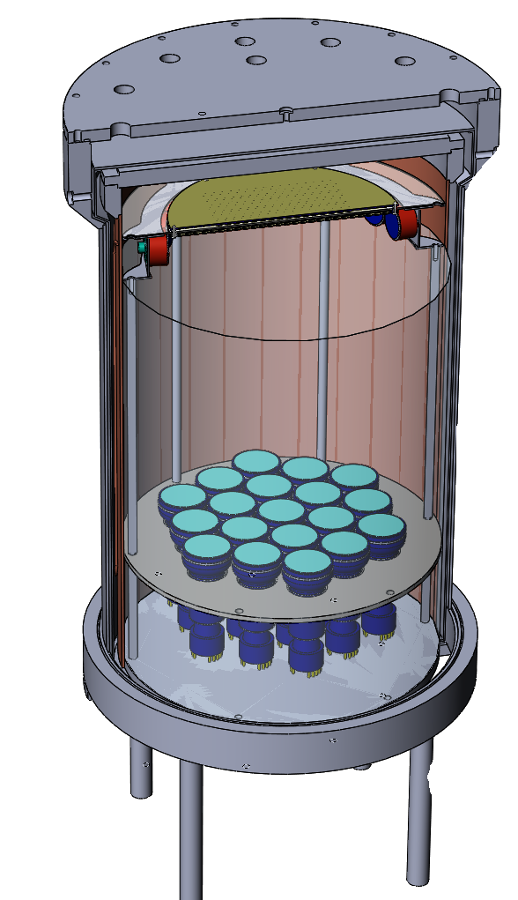
3D-view of the 160l CRAD
GAPD matrix
ThGEMs
Side PMTs
Detector total volume - 160 l
Detector fiducial volume – 50 l
Working temperature – 87 K
Drift field – 2 kV/cm
Number of photomultipliers:
  side 20
  bottom 19
Number of GAPDs – 512
Liquid Argon
Bottom PMTs
Cryostat

Slide 42
Summary
The idea of Cryogenic Avalanche Detectors (CRADs) had triggered intense and difficult R&D work in the course of last 10 years. This resulted in the concept of optical readout of CRADs with combined THGEM/GAPD-matrix multipliers.
Two-phase CRAD showed excellent performance, namely high sensitivity (>100 pe per 20 keV at charge gain of ~100) and superior spatial resolution (~1 mm).
Proportional EL in gaseous Ar has for the first time been systematically studied in the two-phase mode. Liquid Ar had a minor (56 ppm) admixture of N2, which significantly enhanced EL light output. Proportional EL had an amplification parameter of 109±10 photons per drifting electron per kV.
The ionization quenching factor has been measured equals 0,27±0.04 and 0,3±0.04 for the 80 and 233 keV nuclear recoil, correspondingly.
Based on this results one can expect that an energy threshold of CRAD with combined THGEM/GAPD-matrix can be less than 1 keV.
Such kinds of CRADs may come to be in great demand in rare-event experiments, such as those of Coherent Neutrino-Nucleus Scattering, Dark Matter Search and Giant LAr TPCs for (astrophysical) neutrino physics, as well as in medical imaging fields (e.g. PET).

Slide 43
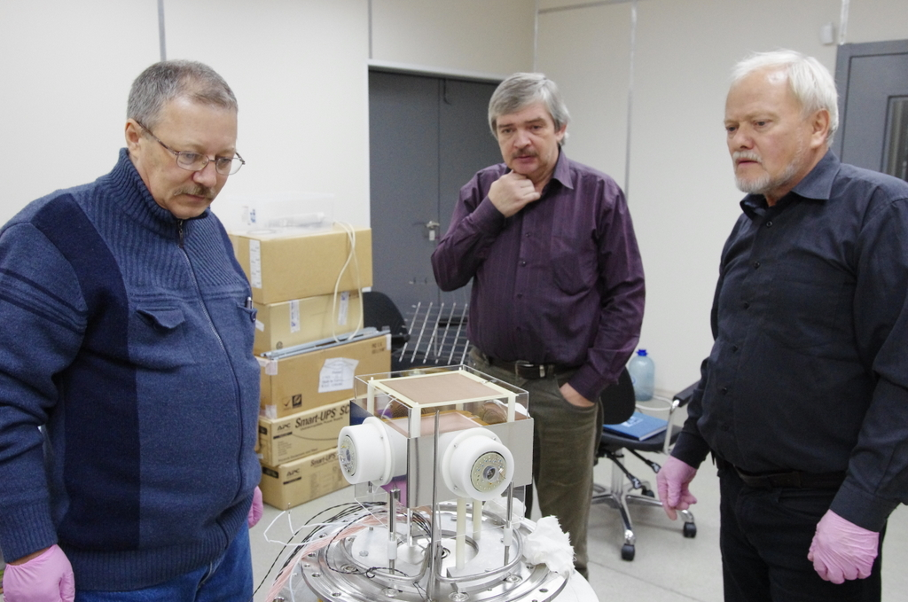
Detector assembly
Detector assembly at 10/10/14

Slide 44
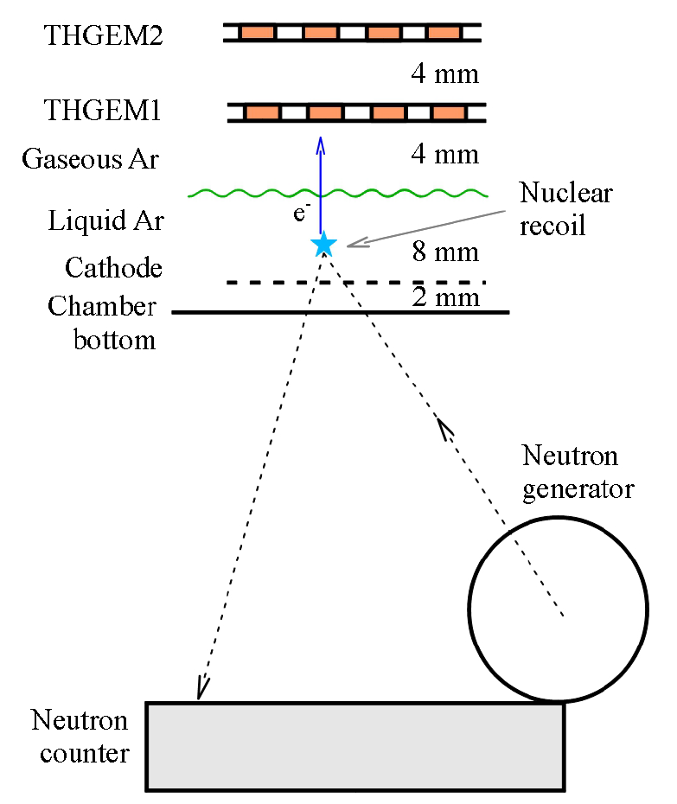
Experimental setup
2THGEM assembly with active area 10x10 cm2 inside
DD fusion reaction
Continuously emitted monoenergetic neutrons with kinetic energy 2.45 MeV
10⁴ neutrons per second
Pb screen to suppress gamma-ray background

