Slide 1
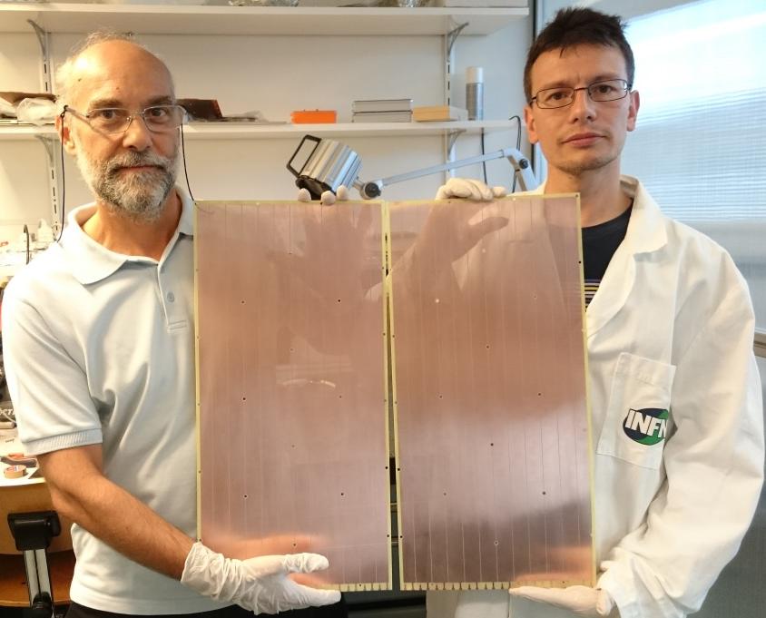
Status of COMPASS RICH-1 upgrade with MPGD-based Photon Detectors
Fulvio Tessarotto ( I.N.F.N. – Trieste )
on behalf of the COMPASS THGEM group:
Alessandria, Aveiro, Calcutta, Freiburg, Liberec, Prague, Torino, Trieste
The COMPASS RICH-1 PD upgrade
The structure of the hybrid detector
The THGEM raw material selection
Production of THGEMs and Micromegas
Detector assembly, test and installation
Conclusions

Slide 2
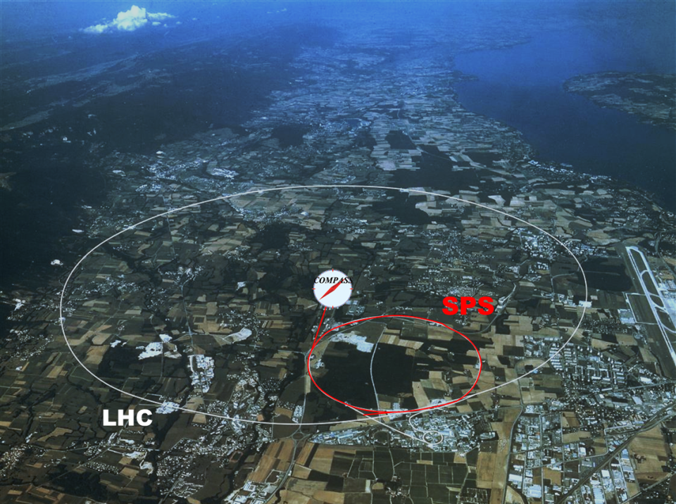













COMPASS II Collaboration
Дубна (LPP and LNP), Москва (INR, LPI, State University),Протвино
Bochum,
Bonn (ISKP
& PI),Erlangen,Freiburg,
Mainz,München TU
~ 250 physicists
from 24 Institutions
of 13 Countries
Warsawa (NCBJ),
Warsawa (TU)
Warsawa (U)
CERN
Praha (CU/CTU)
Liberec (TU)
Brno (ISI-ASCR)
USA (UIUC)
Yamagata
Saclay
Calcutta (Matriviani)
Lisboa/Aveiro
Torino (University,INFN),
Trieste (University,INFN)
Taipei (AS)
Tel Aviv
Experiments with muon beam:
  Spin structure, Gluon polarization
  Flavor decomposition
  Transversity
  Transverse Momentum-dependent PDF
  DVCS and HEMP
  Unpolarized SIDIS and TMDs
Experiments with hadron beams:
  Pion polarizability
  Diffractive and Central production
  Light meson spectroscopy
  Baryon spectroscopy
  Pion and Kaon polarizabilities
  Drell-Yan studies
COMPASS - I (2002 – 2011)
COMPASS - II (2012 – 2017) …

Slide 3
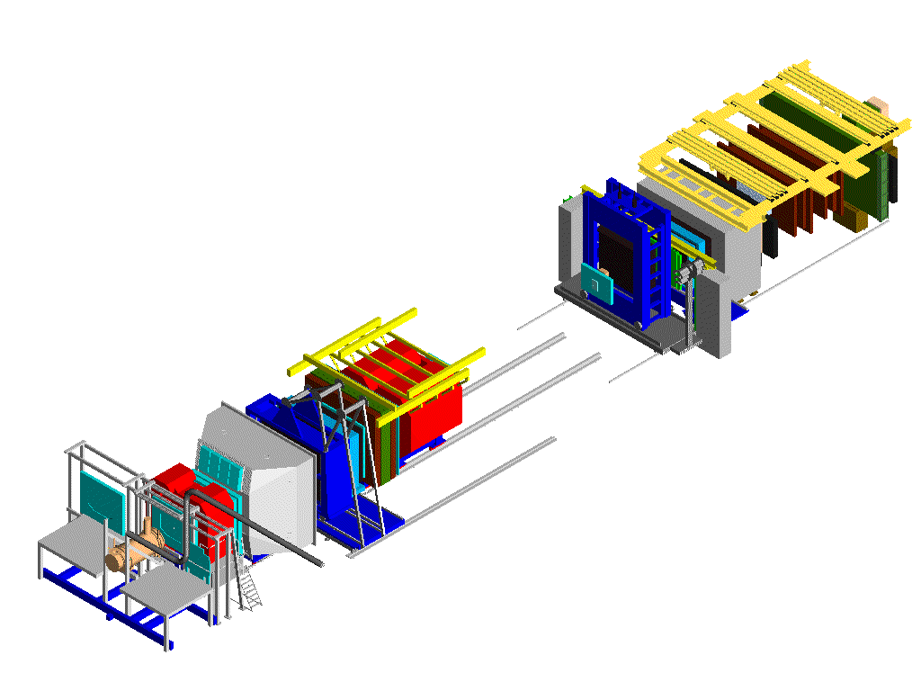
IN THE COMPASS SPECTROMETER
Beam:
160 GeV µ⁺
2 . 10⁸ µ/spill
(4.8 s/16.8s)
P_{μ} ~ 80%
trigger-hodoscopes
DW45
straws
Polarised Target
SM2 dipole
Muon-filter2,MW2
RICH_1
HCAL1
Gem_11
SM1 dipole
ECAL2,HCAL2
MWPC Gems Scifi
Muon-filter1,MW1
straws,MWPC,Gems,SciFi
Veto
Silicon
Gems,SciFi,DCs,straws
P. Abbon et al., NIM A 577 (2007) 455
P. Abbon et al., NIM A 779 (2015) 69
SciFi
Micromegas,DC,SciFi
BMS

Slide 4
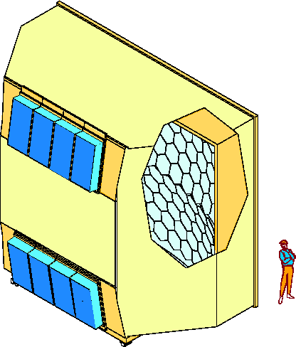
HADRON PID IS PROVIDED BY RICH-1
COMPASS RICH-1: a large gaseous RICH
with two kind of photon detectors
providing:
3 m
6 m
Al vessel
hadron PID from 3 to 60 GeV/c
acceptance: H: 500 mrad V: 400 mrad
trigger rates: up to ~100 KHz
beam rates up to ~10⁸ Hz
material in the beam region: 2.4% Xo
material in the acceptance: 22% Xo
detector designed in 1996
in operation since 2002
first PD upgrade in 2006
( total investment: ~ 4 M € )
MWPC’s + CsI
UV mirror
wall
5 m
PMT’s
radiator:
C₄F₁₀
radiator gas: C₄F₁₀
beam pipe
PD’s: ~6 m²

Slide 5
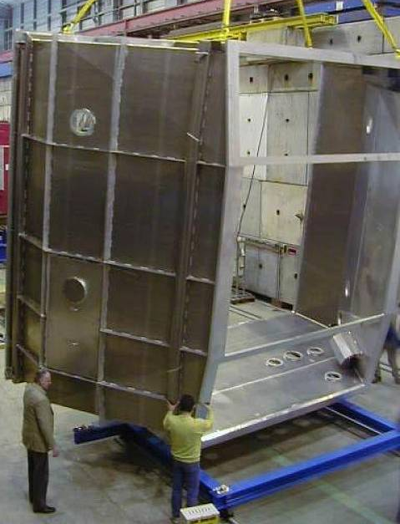
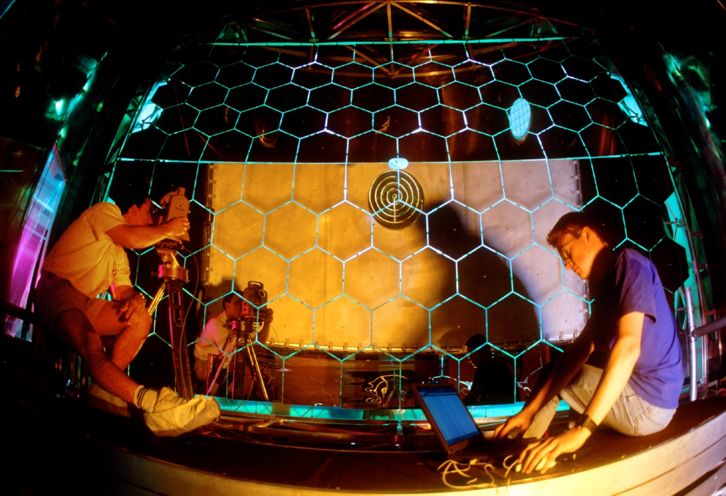
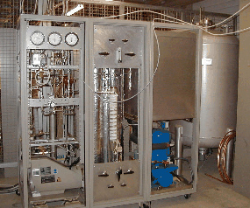
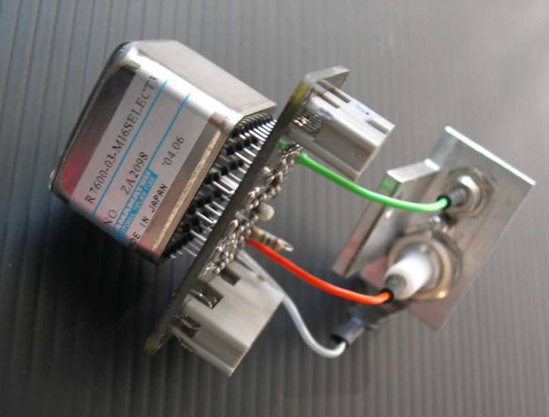
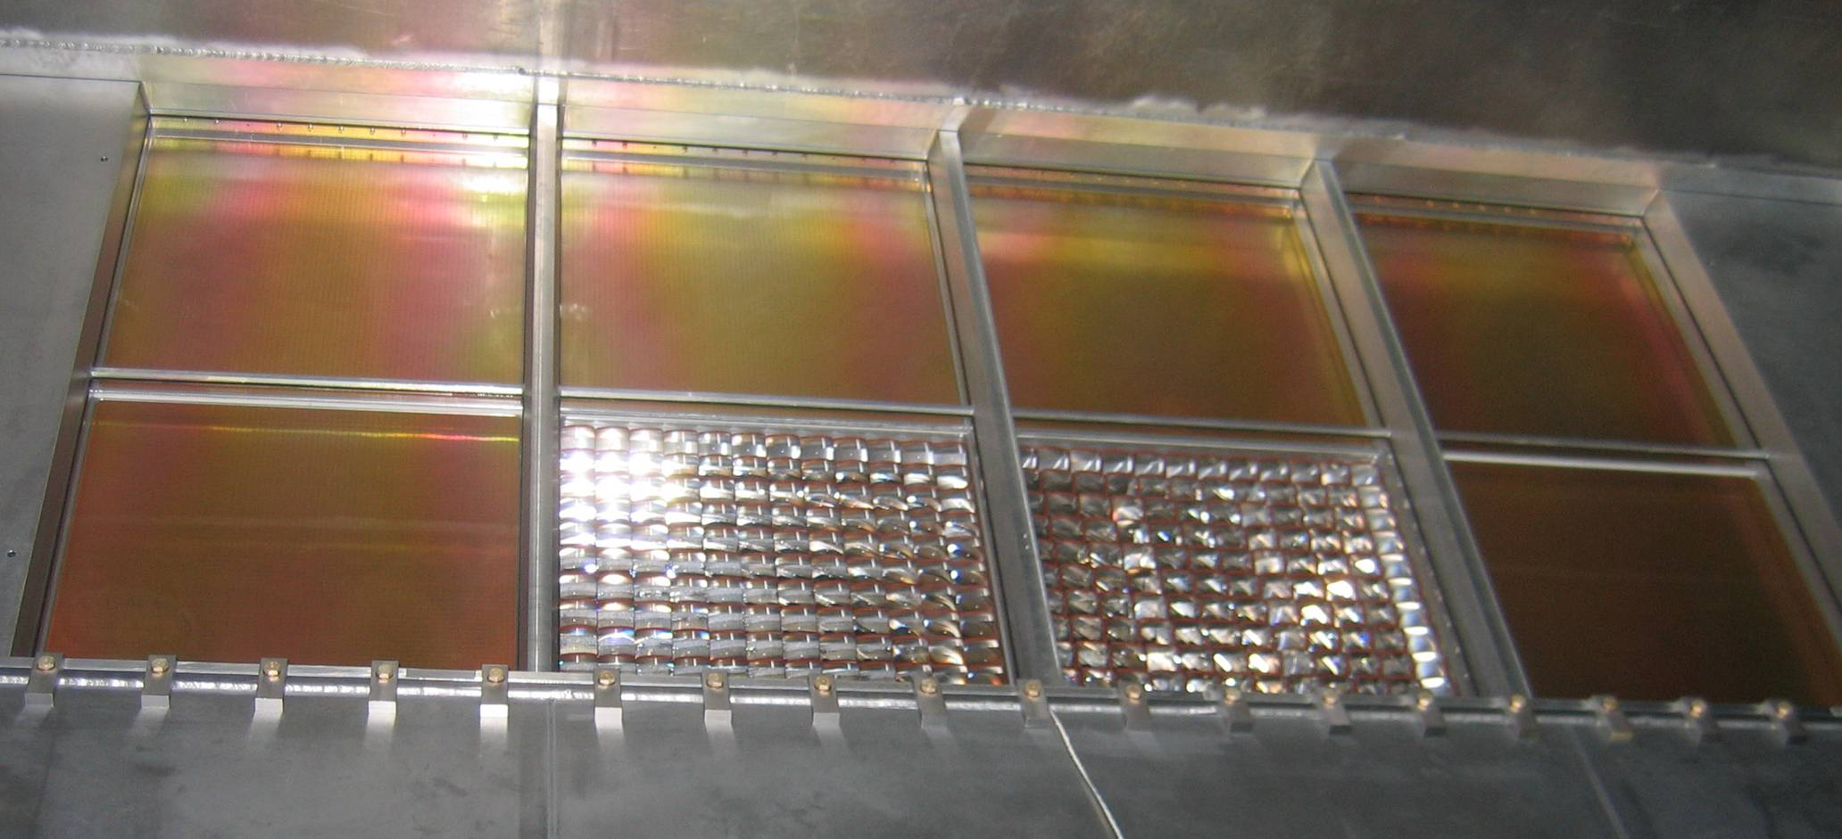
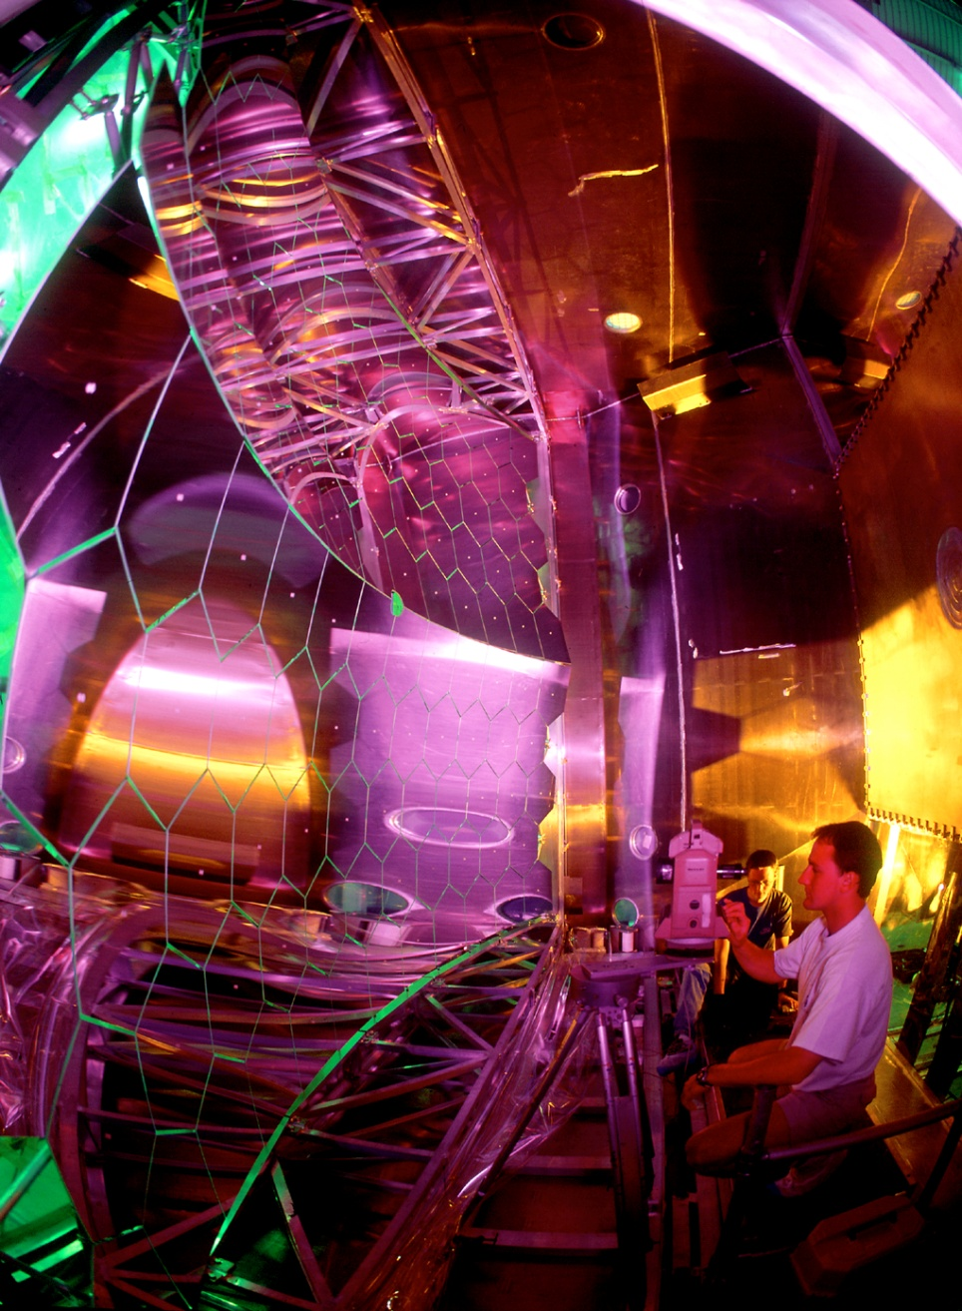
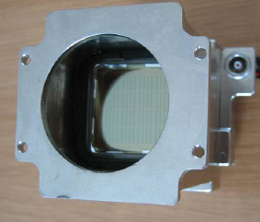
Gas radiator, mirrors, PD’s

Slide 6
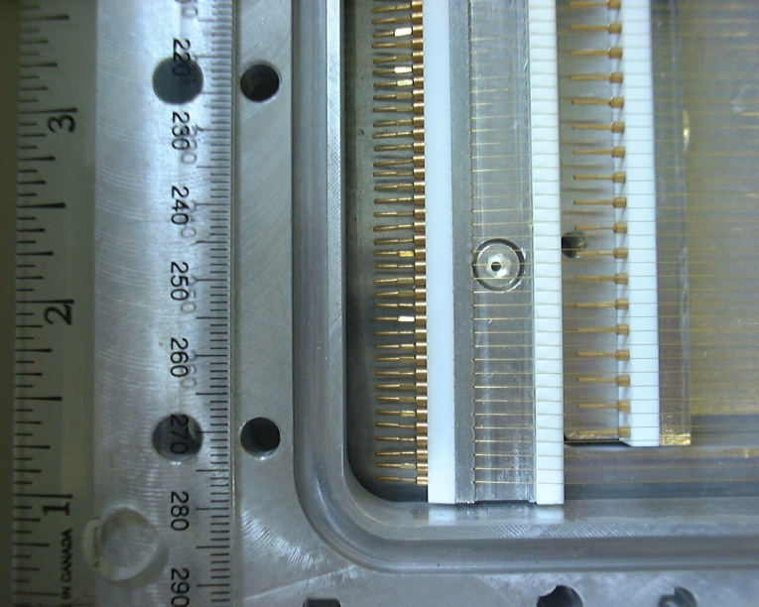
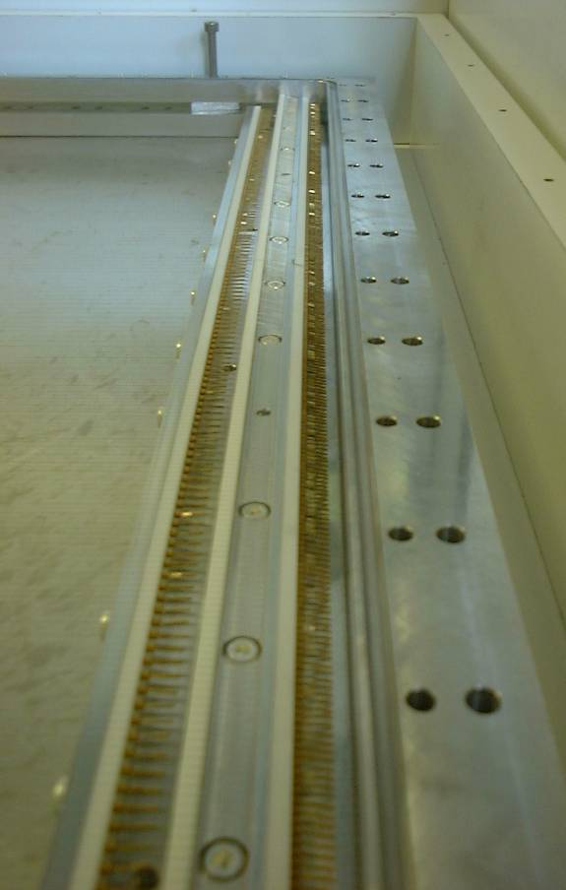
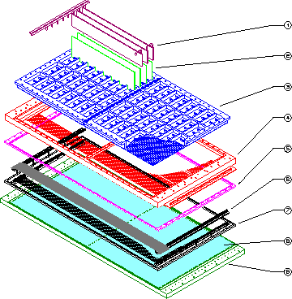
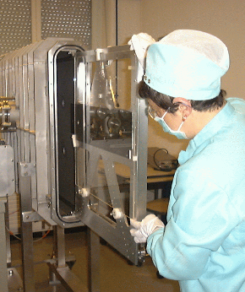
COMPASS RICH-1 MWPC’s with CsI

Slide 7
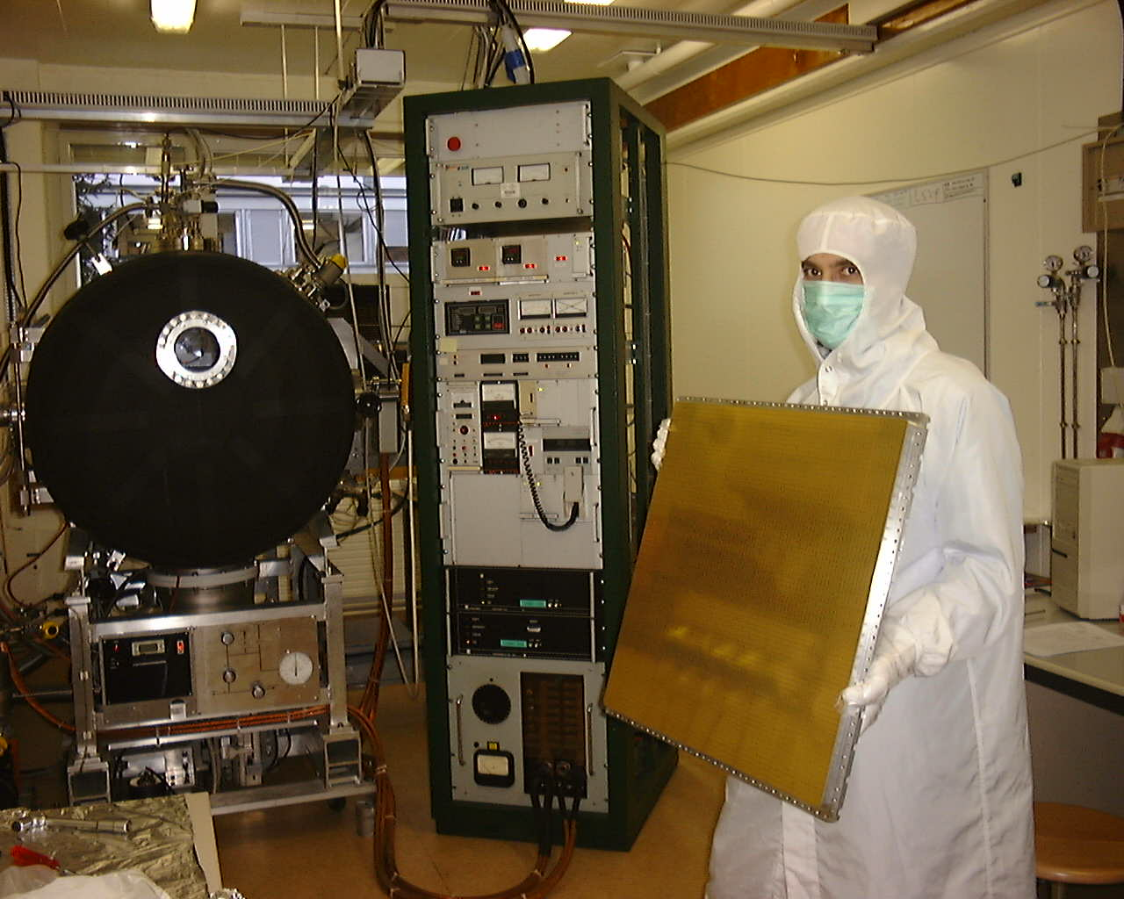
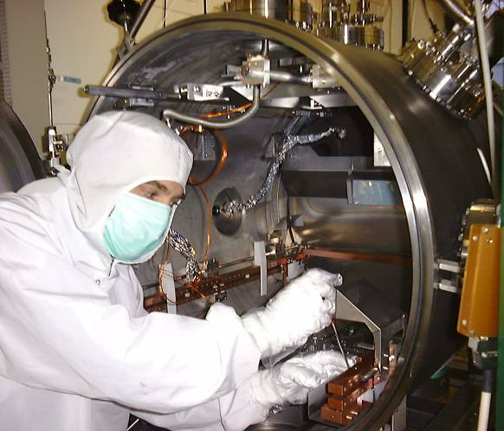
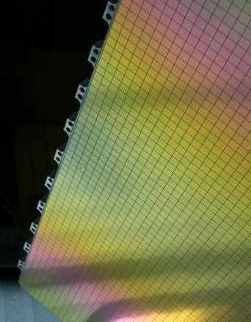
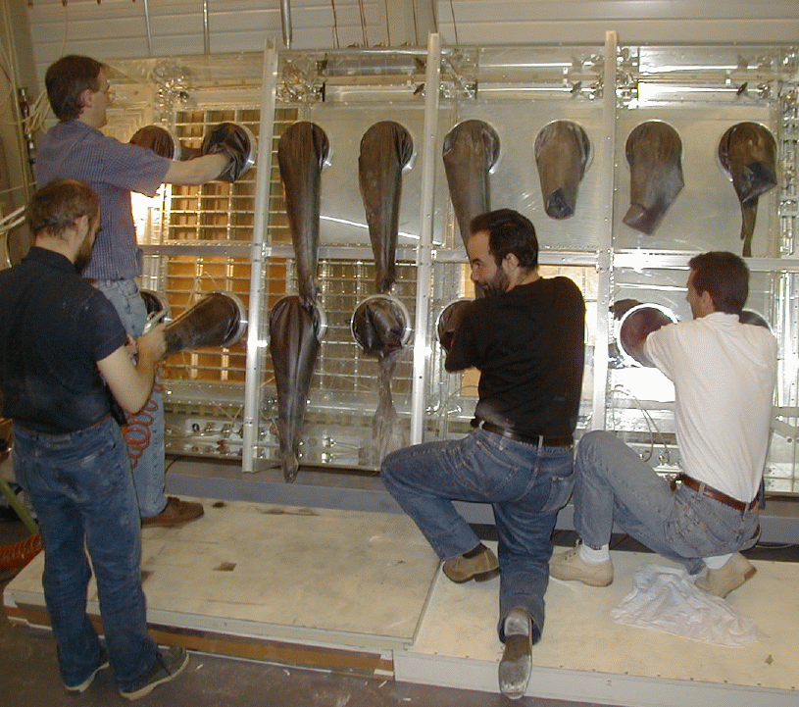
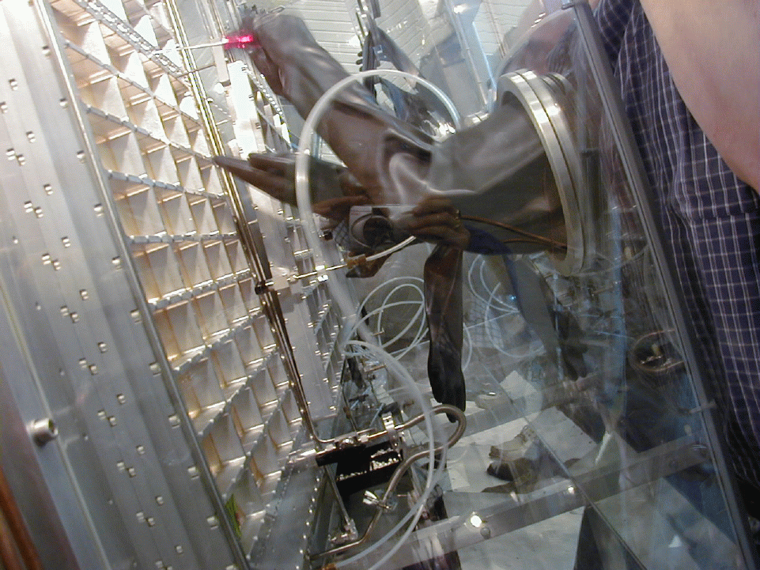
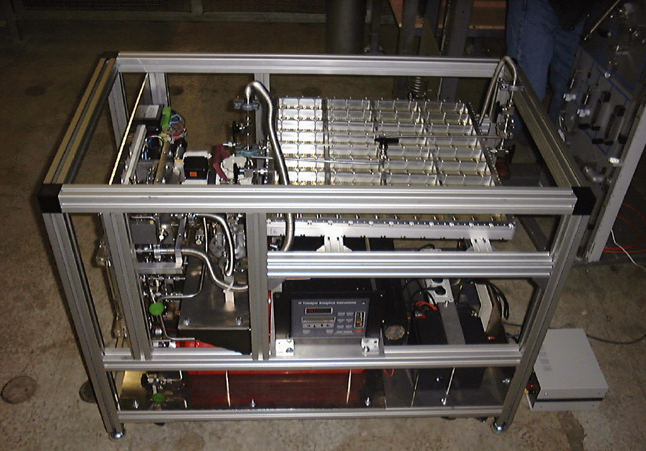
The CsI photocathodes

Slide 8
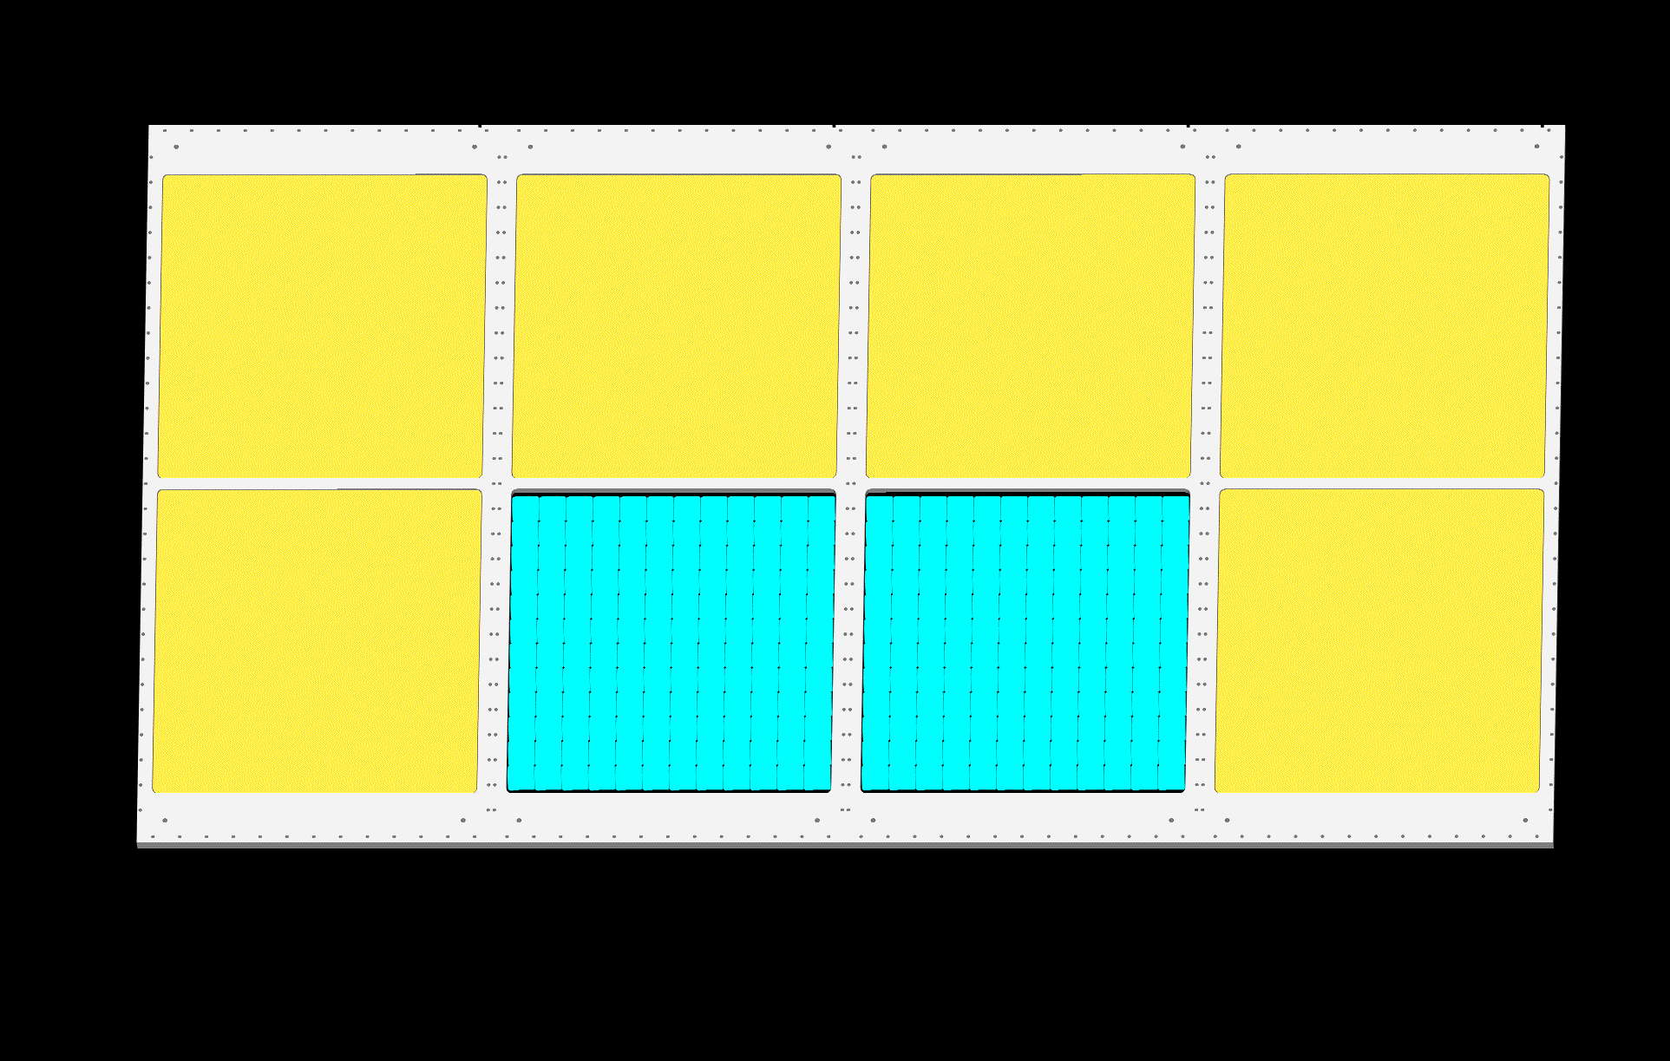
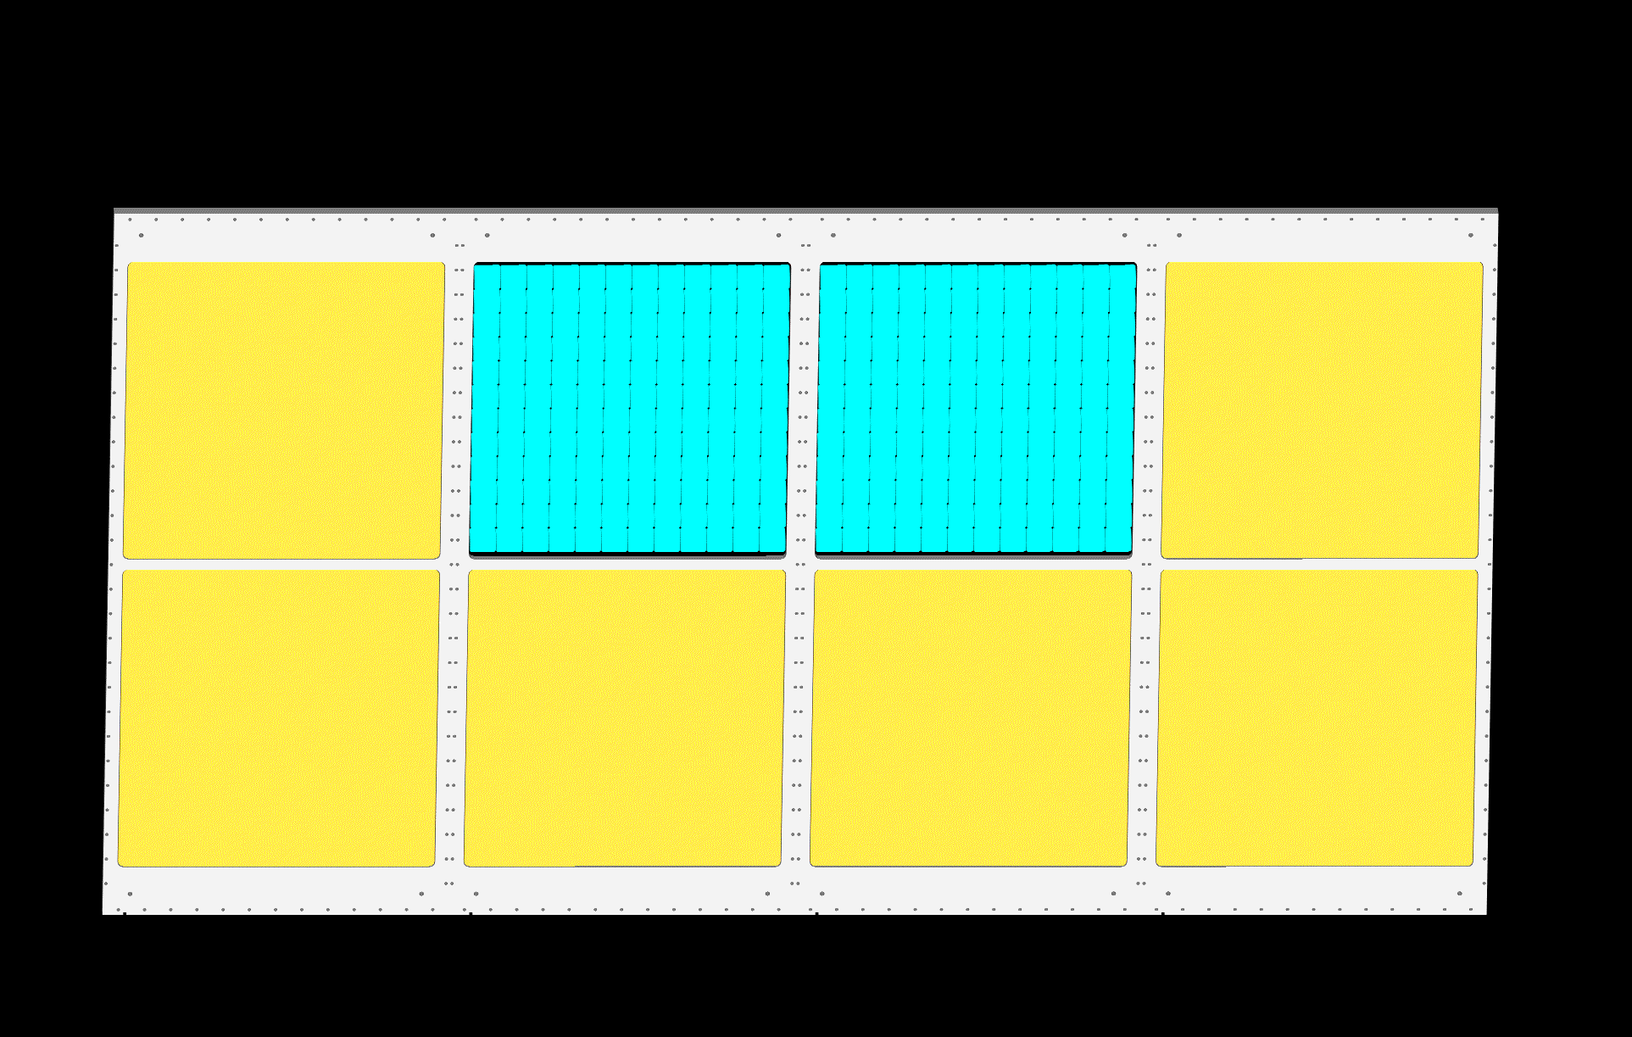
COMPASS RICH-1 PD upgrade
3 m
for COMPASS run 2016
Al vessel
6 m
MWPC’s
MPGD-based PDs
UV mirror
wall
1.4 m²
5 m
PMTs
beam pipe
radiator:
C₄F₁₀
radiator gas: C₄F₁₀
MWPC’s
MPGD-based PDs
4 new detectors of 600 mm x 600 mm

Slide 9
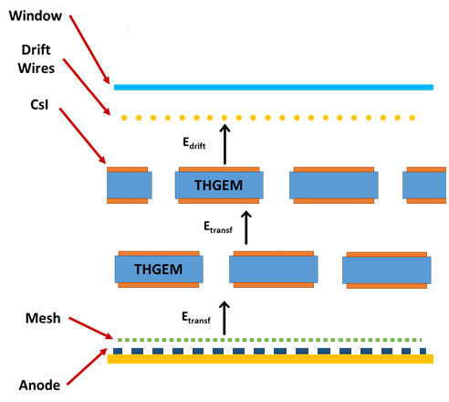
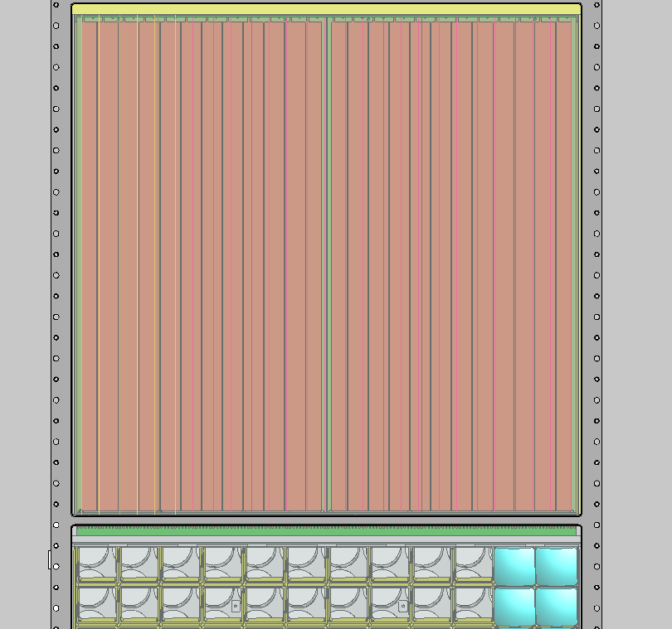
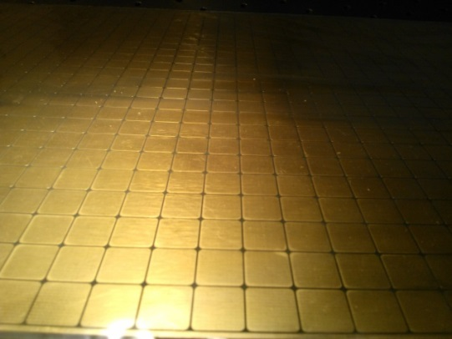
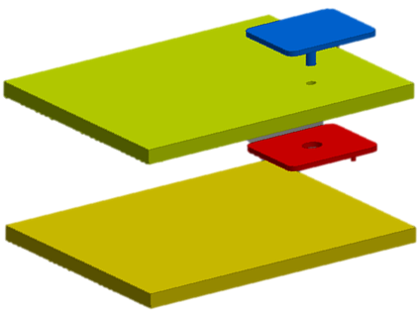
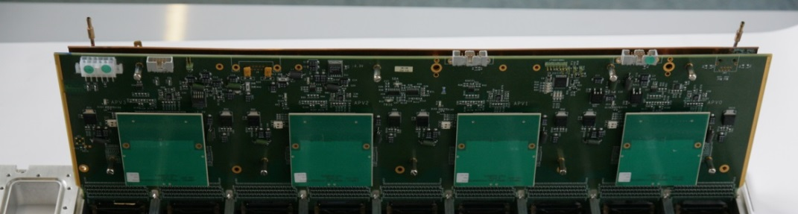
The new photon detectors
each detectors consists of two modules having 600 x 300 mm²
hybrid: 2 THGEMs + 1 Bulk Micromegas
Multi-Pad Anode 8mm X 8mm pads
at positive HV
Staggered THGEMs
Signal read out via capacitive coupling pad readout and APV25 F/E boards

Slide 10
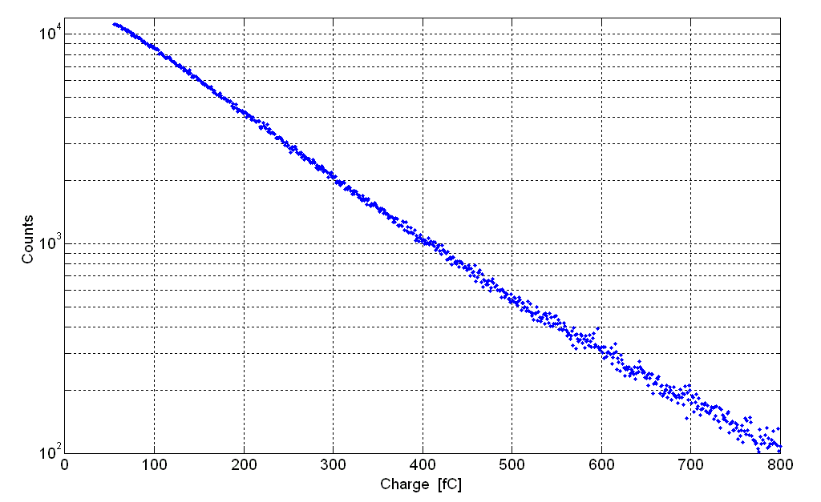
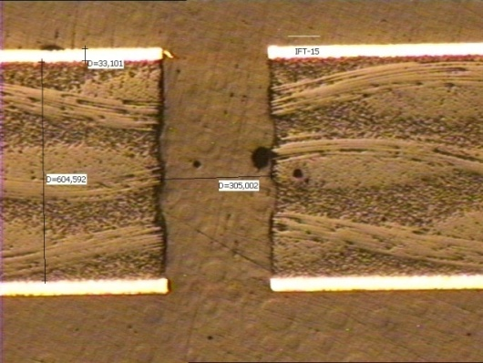
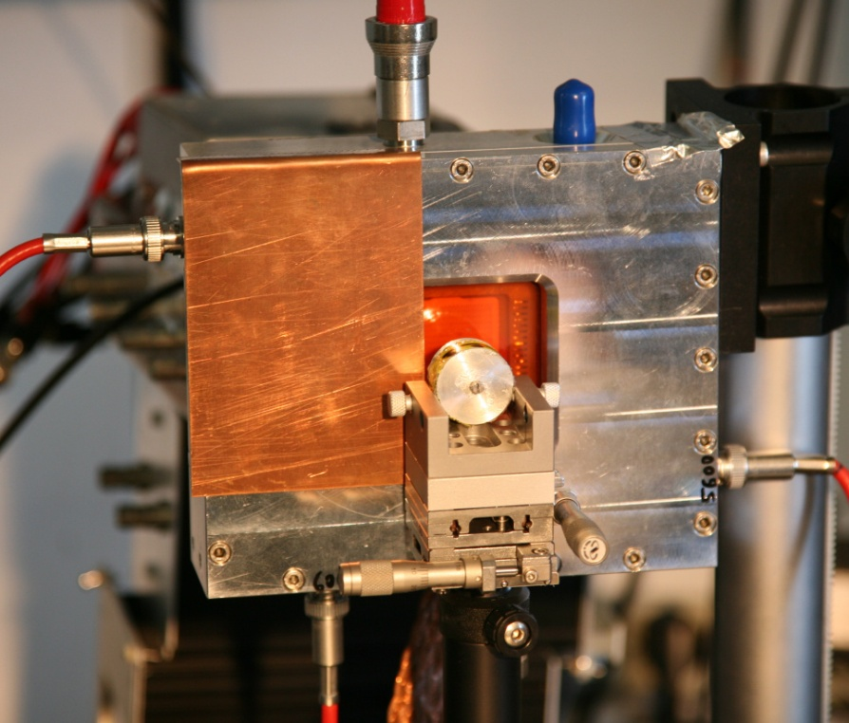
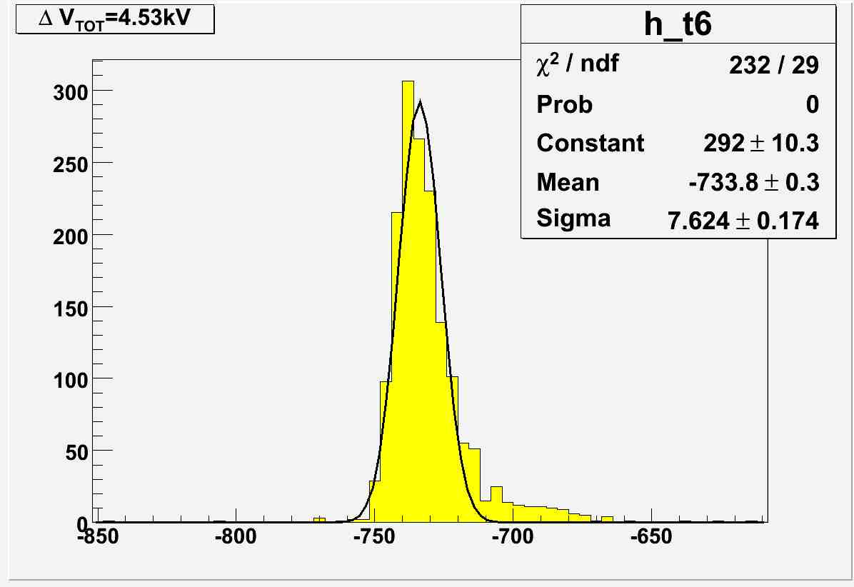
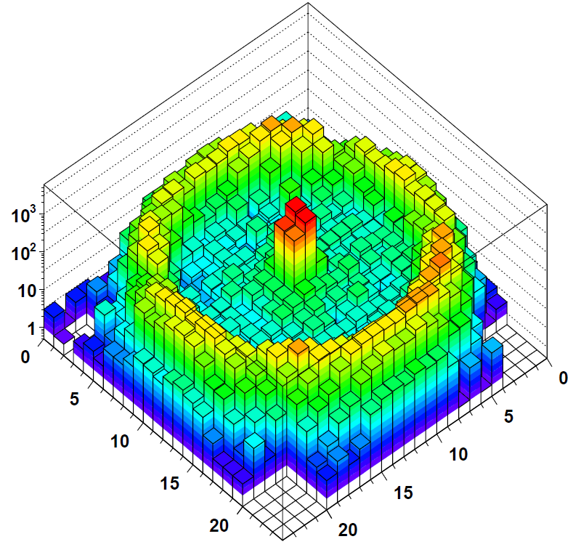
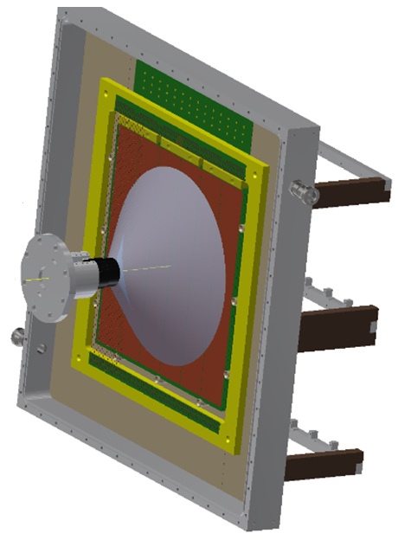
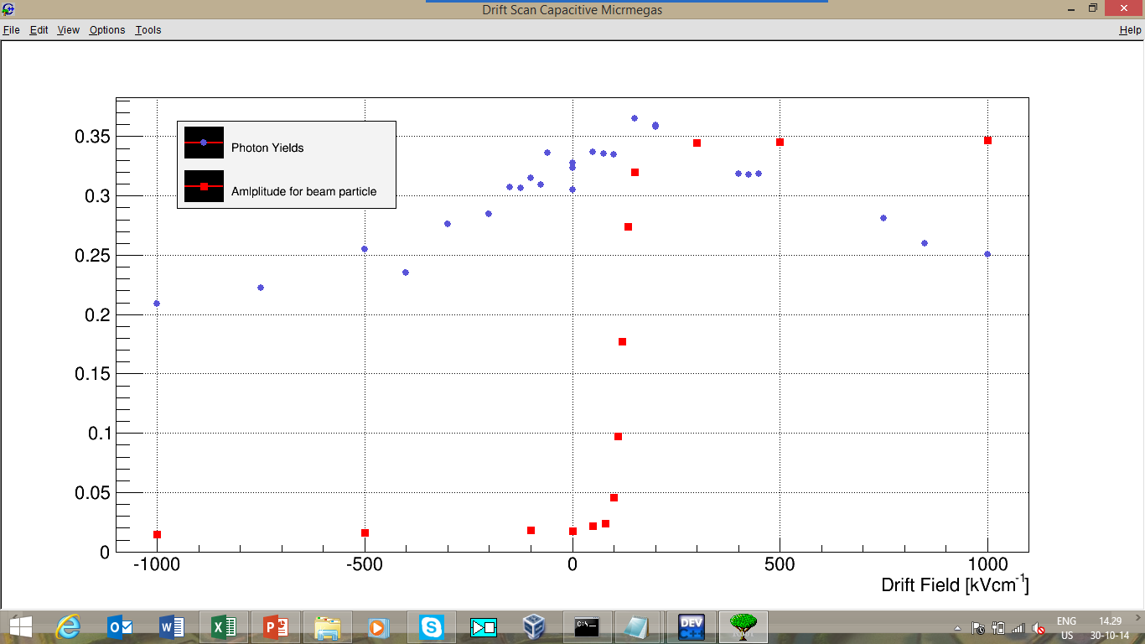
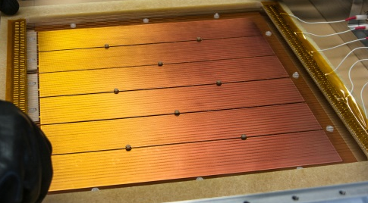
Result of 7 years of dedicated R&D
Effective gain = 0.91 · 10⁶
Ar/CH₄: 50/50
PARAMETERS:
Diam. = 0.4 mm
Pitch = 0.8 mm
Thickn. = 0.4 mm
Rim = 10 μm
Photon yield & Charged Particles vs Drift Field
a. u.
see the poster by Shuddha Dasgupta

Slide 11
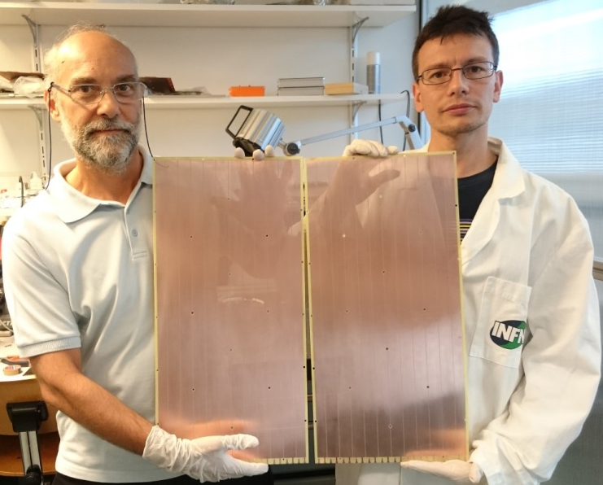
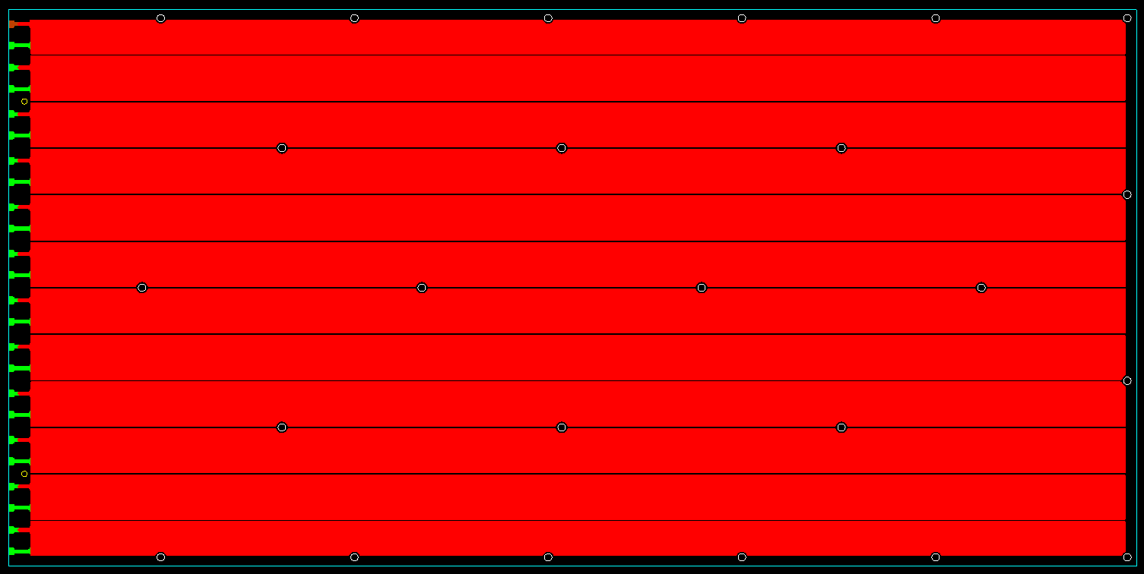
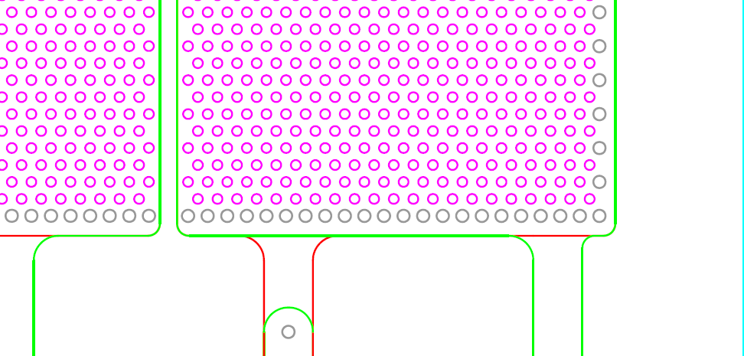
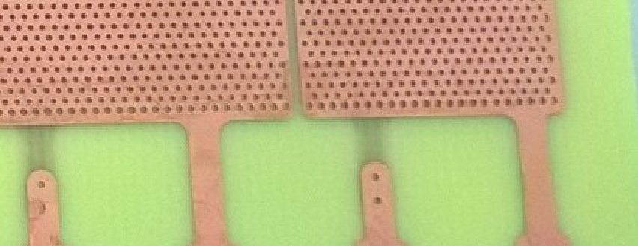
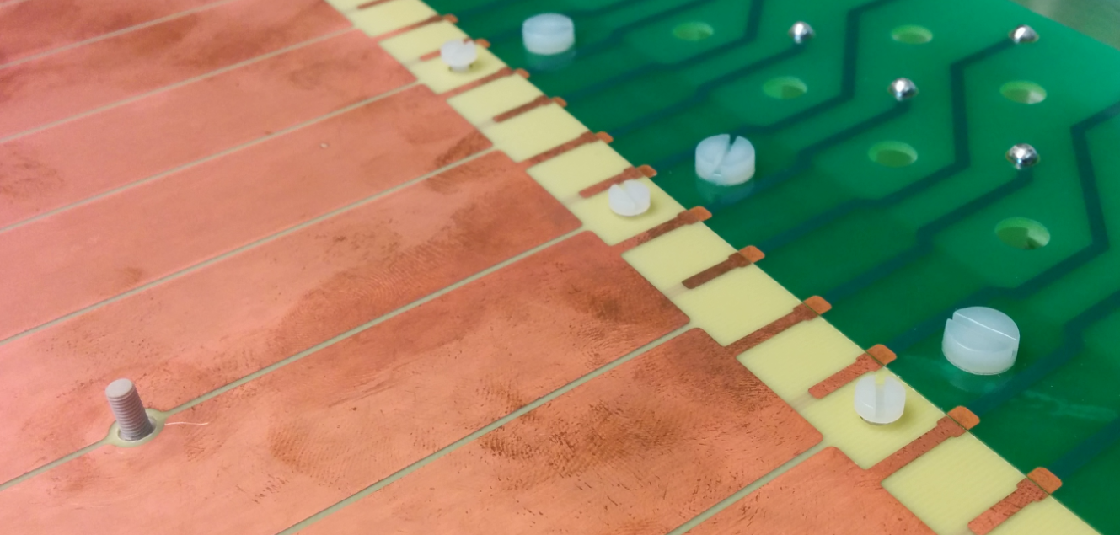
The design of the COMPASS THGEM
Thickness: 0.4 mm, hole diameter: 0.4 mm, pitch: 0.8 mm
12 sectors on both top and bottom, 0.7 mm separation
24 fixation points to guarantee THGEMs flatness
border holes diam.: 0.5 mm
pillars in PEEK

Slide 12

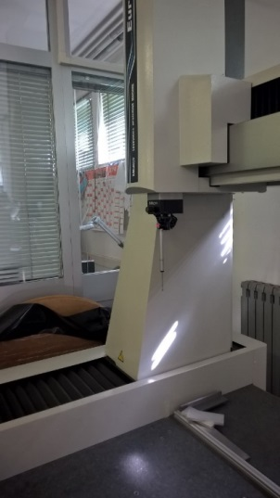
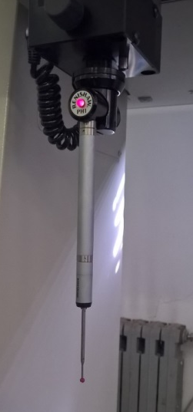
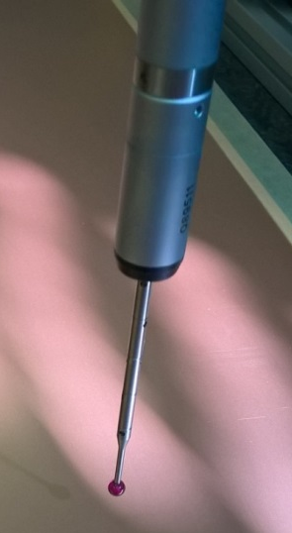
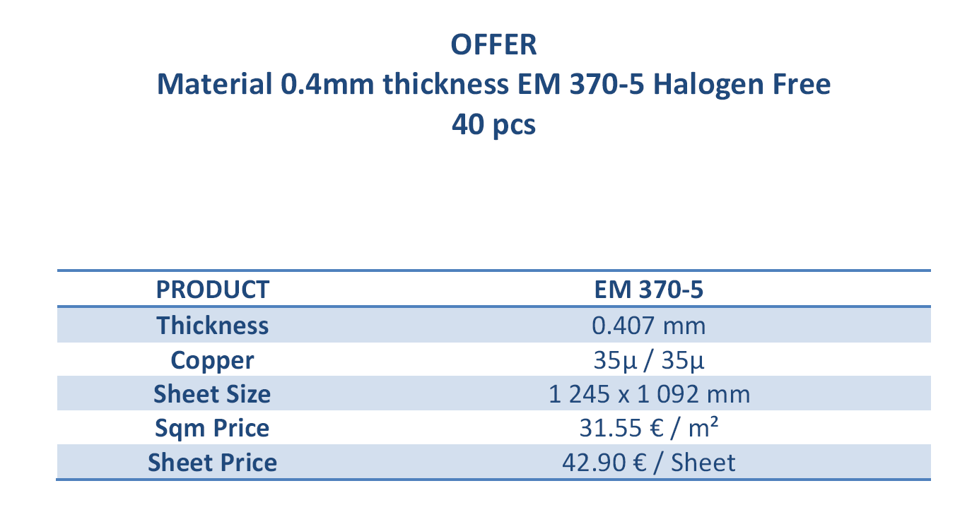
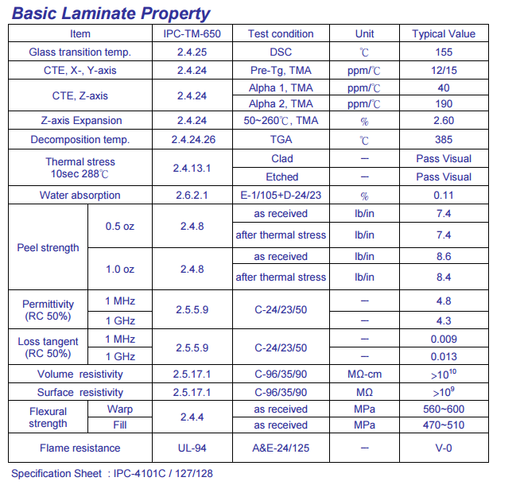
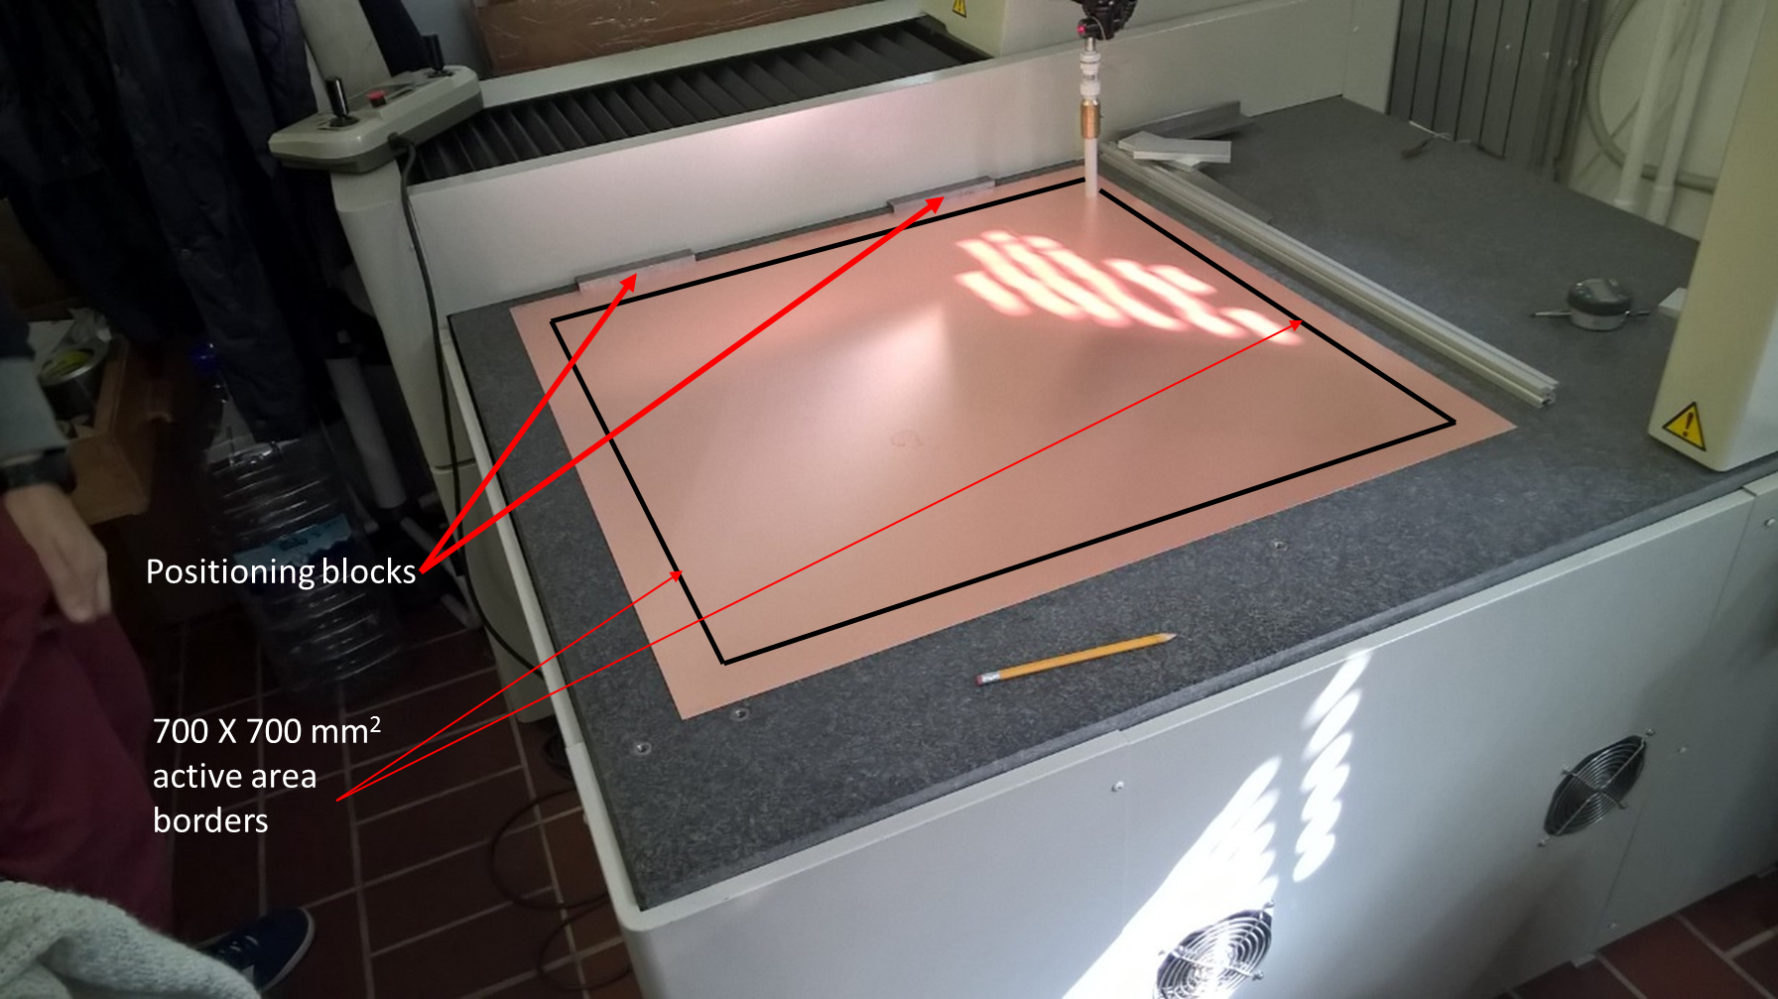
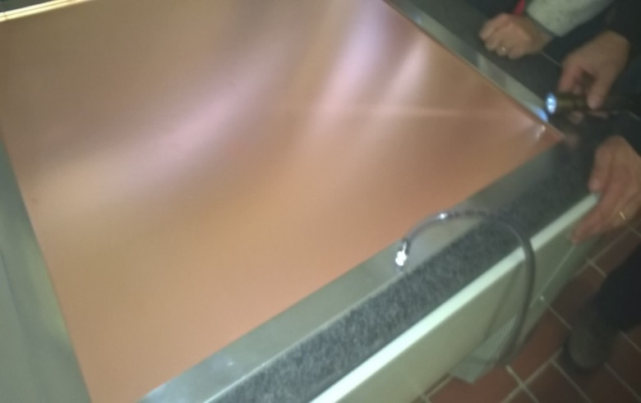
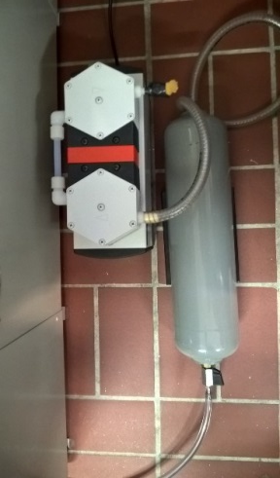
THGEM raw material selection
Our thickness uniformity requirements are stricter than those offered by producers → material selection
50 foils of 1245 mm x 1092 mm → cut out borders → 800 mm x 800 mm → thickness measurement
Mitutoyo EURO CA776
coordinate measuring machine with ruby touch probe,
hosted in a thermalized room
  underpressure induced flatness
for each foil 36 x 36 points in square pattern are measured
2 measurements (direct and reversed) to allow consistency checks.

Slide 13
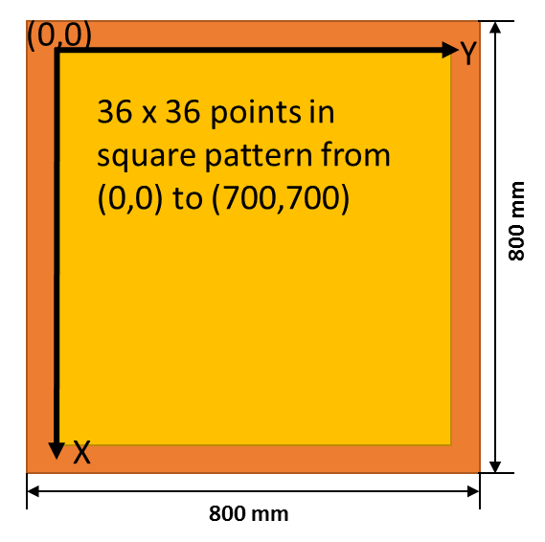






THGEM raw material selection
$$δ_{thickness}\sim 2.6\%$$
  typical result for a good piece.
  all foils have been labelled and measured → database of local thickness of all THGEMS
  δ for the 100 raw THGEM pcb (%)
THGEM 313
  from each foil twoTHGEMS can be produced:
  50 foils → 100 raw THGEM pcb
  THGEM pcb size = 620 mm x 320 mm,
  active area = 581 mm x 287 mm
THGEM 413
  about half of the foils sent to ELTOS for THGEM production
49 p.cs
2%<δ<3%
  serial production ongoing

Slide 14









Production of the THGEMs at ELTOS
  image transfer
  development
  etching
  stripping dry-film
  multi-spindle drilling
  mounting
In Trieste a specific cleaning procedure is applied : polish with fine grain pumice powder, pressure water cleaning, ultrasonic Bath with Sonica PCB solution (PH11), distilled water rinsing and oven @ 160 ºC

Slide 15








THGEM quality assessment
current monitor recording,
discharge counting
rejected
rejected piece
ΔV(V)
accepted
first 4 pieces: 1 rejected. Possibly recovered by repeating the cleaning treatment
Gain uniformity measurement
AMPTEK Mini-X Au used at 15 kV, 200µA + Cu foil provides 8 keV X-rays uniform illumination at a rate > 5 kHz cm⁻² (for 1 cm Ar/CO₂ 70/30)

Slide 16






Storage, transport, Au and CsI coating
  individual label is visible on the top face of each THGEM
  THGEM ready for coating
  CsI coating plant
  handling frame
  Storage box with N₂ flow
  New glove box

Slide 17





Final size Micromegas prototypes
σ/<G> = 5% for each of the two Micromegas

Slide 18





Serial production of final MM
Final Micromegas by CERN
Tests on 2500 pads:
electrical continuity
and capacity meas.
→ 38-42 pF/pad
anodic pad: + HV via large R
70 µm fiberglass
48 pads
readout pad: at ground via F/E, embedded inside anodic pcb
anodic pad pcbs produced by TVR
Next steps: gluing Micromegas on support frames and testing them
signals
R (HV)
R (HV)
With their APV25 electronic F/E board

Slide 19





discharge cross-talk via pads
Two adjacent pads kept at anomalous high voltage (720 V) to enhance trip frequency (~ 0.2 Hz)
one of the 2 pads at standard voltage :
no trips observed
only effect: 2V drop → ~4% drop in gain

Slide 20




Time variations of the hybrid detector gain
p, T sensor at gas input and output
GAIN MEASUREMENTS
ALTERNATING
W, W/O CORRECTION
Correction of Voltage $f\left(P,T\right)$ LabVIEW based system fully automated + logging
applying voltage compensation: gain evolution ~ 40% → ~ 10 %

Slide 21






The need of field shaping electrodes
THGEM border study
large field values at the chamber edges and on the guard wires
Field shaping electrodes in the isolating material protections of the chamber frames
isolating material (Tufnol 6F/45) protection

Slide 22





The mechanical frames and the wires
drift and field wires: Cu-Be, Au coated
4 mm pitch, 100 µm diam.
manual soldering
tension meter

Slide 23




The final mechanical structure is complex

Slide 24

non trivial integration with other RICH PDs

Slide 25
CONCLUSIONS & OUTLOOK
final parameters for MPGD-based PD’s after 7 years of R&D
Hybrid: 2 THGEMs + Micromegas; detector with 2 modules 600x300
COMPASS THGEM production well advanced, MM production started
Systematic quality control procedure defined
Final detector assembly, test and installation are challenging
RICH-1 will be upgraded with MPGD-based PD’s for 2016 run

