Slide 1


Development of Resistive Micromegas
for Sampling Calorimetry
Sampling Calorimetry with Resistive Anode Micromegas
(SCREAM)
Theodoros Geralis
NCSR Demokritos
12/10/2015
LAPP Annecy, France
M. Chefdeville, Y. Karyotakis, I. Koletsou
NCSR Demokritos, Greece
T. Geralis, G. Fanourakis, A. Kalamaris, D. Nikas, A. Psallidas
CEA Saclay, France
M. Titov

Slide 2
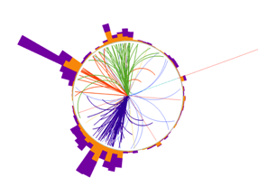
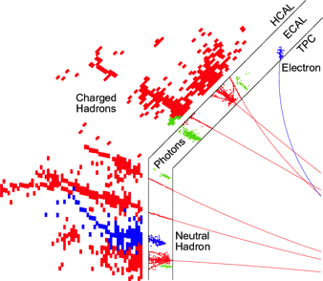
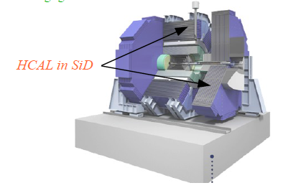
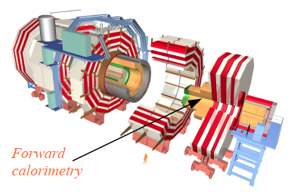
Resistive Micromegas for Particle Flow Calorimetry
At future linear colliders or at the HL-LHC
  HCAL with ~1x1 cm² pads
  Easy and cheap to build large areas
  High granularity for PF both in transverse and
    longitudinal direction,
  Small sensitive area thickness (< 1cm)
  Large dynamic range and linearity (1 – 100s of MIPs)
  Suppress discharges by resistive coating
  Possibility to use in the high eta forward region
  High rate capability
  Operation stability
  Good ageing properties
  Radiation tolerance

Slide 3

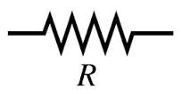
R&D on Resistive Micromegas for High Rate Calorimetry
Resistive layers prevent streamers to develop to sparks by quenching it at an early stage
R: Resistance to ground
C: Capacitance between resistive coating and ground
It depends on the extend of the cascade (~100 μm) that
is a function of the transverse diffusion (gas, drift length , HV)
given the thickness and the material of the dielectric
RC: gives typical time of the charge evacuation
High charge deposition deforms locally the E field → lower Gain
→ Quench spark → loss of linearity
τ : time of cascade development ~ 10 ns
RC > τ → Spark quenching
RC ~ τ → Spark develops
Our study: Vary RC (effectively vary R) and and study
response linearity and discharge rate.
Mesh
UV
Resistive pad
C
Anode pad
Charge evacuation:
  Sideways, horizontal evacuation of charge not adequate for large surfaces and high rates
    due to development of steady state charges
  Individual surface resistivity for every pad with buried resistor to ground, limits cross talk and cumulative effects of large surfaces (proposed by Rui De Oliveira)
Resistive pad
Microvia
Microvia
40μm kapton
1kV breakdown
voltage
Buried resistor: variable length and shape→ variable value
Copper pad

Slide 4
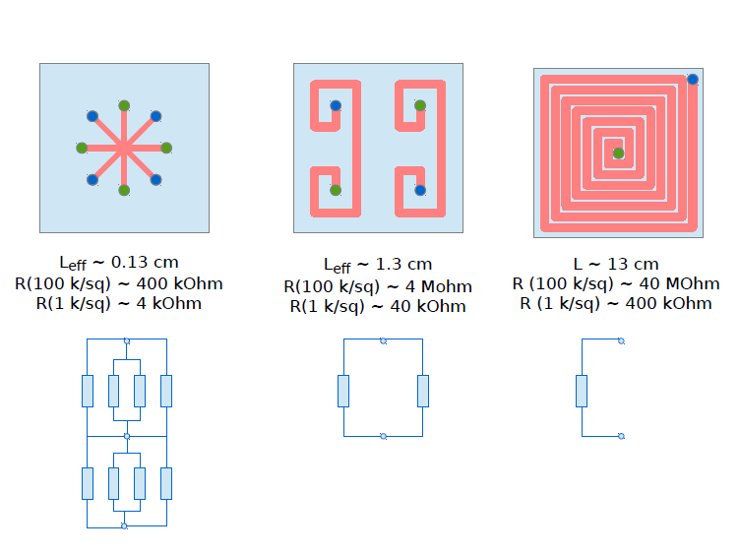
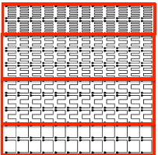


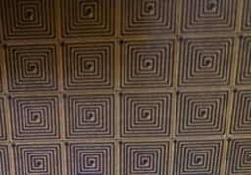
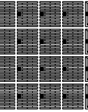
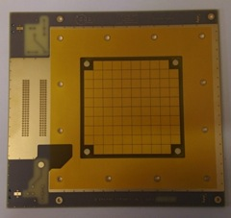
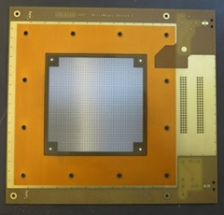
Buried resistance configuration used for these studies
Star
Mirror
Snake
Spider
Buried resistivities implemented
4 kOhm
40 kOhm
400 kOhm
1 MOhm
4 MOhm
40 MOhm
Variable buried
resistors 1 – 20 MΩ
Real R1 values:
400 -750 KOhms
with 100KΩ/Sq
Real R1 values:
4 MOhms
with 100KΩ/Sq
Real R1 values:
40 MOhms
with 100KΩ/Sq
Real R1 values:
1 MOhm
with 100KΩ/Sq
R/O with the first
Coverlay pressed on
96 pads, 1x1 cm²
Readout card: gassiplex (96 channels)
Final detector with resistive
And mesh layed on the pcb

Slide 5
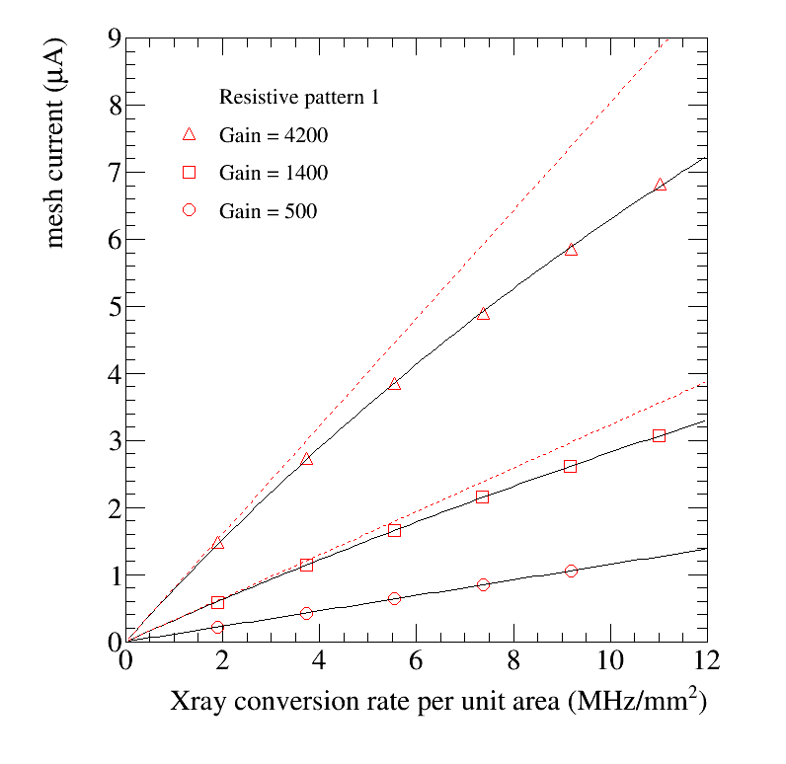
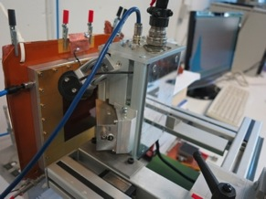
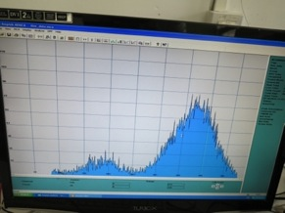
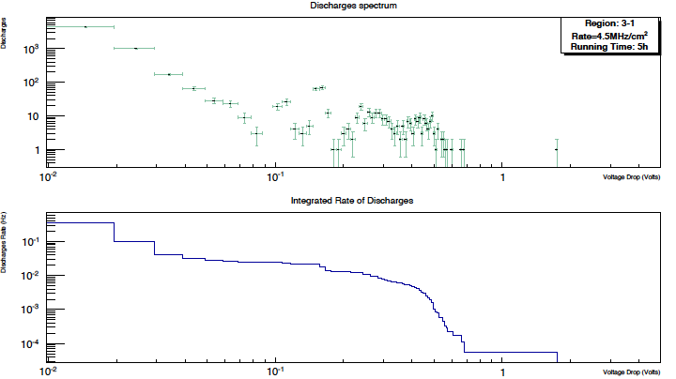
Resistive Micromegas High rate tests with X-rays
X-ray Gun tests at the RD51 lab: Cu 8 keV at very high rates
Measure the Mesh current as a function of the X-ray tube current
Intermediate R: excellent linearity up to rates 1 MHz/mm²
25% lower gain for rates 10 MHz/mm²
X-ray Gun tests at Demokritos: Rh 3 keV at very high rates
Energy Resolution not very good → should improve homogeneity
Test linearity and measure the discharge rate and the Mesh
Voltage drop spectrum (rates up to 11 MHz/cm²)
Raether limit
Discharges:
No voltage drop at 11 MHz/cm² during 5 h.
Record spectrum form V>8mV (Raether limit)

Slide 6
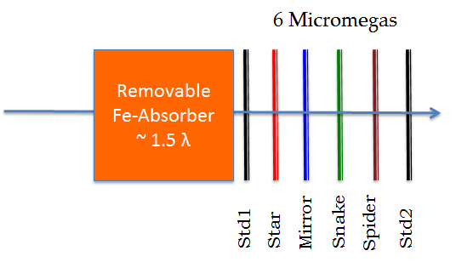
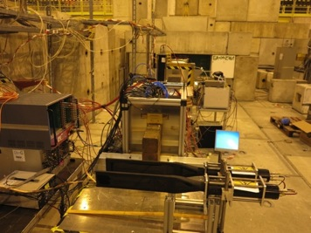
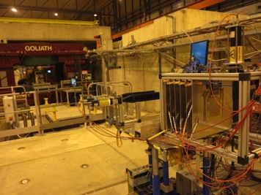
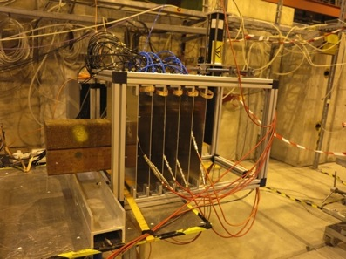
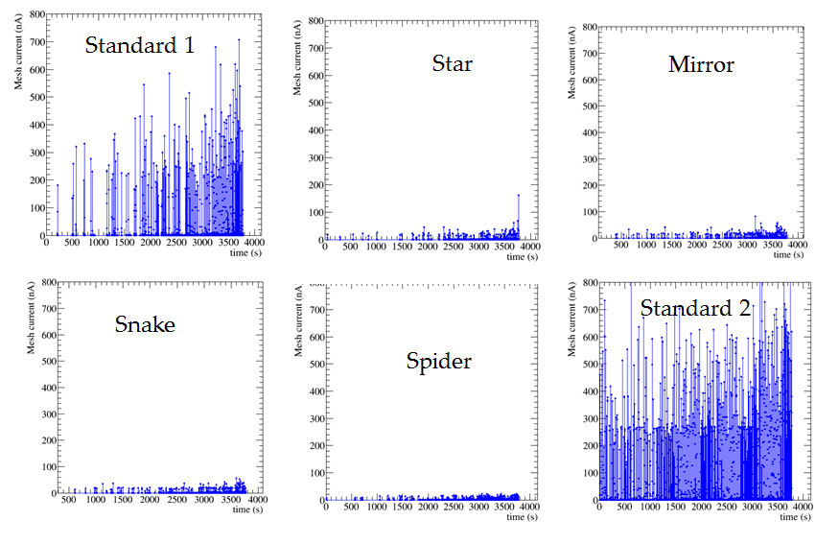
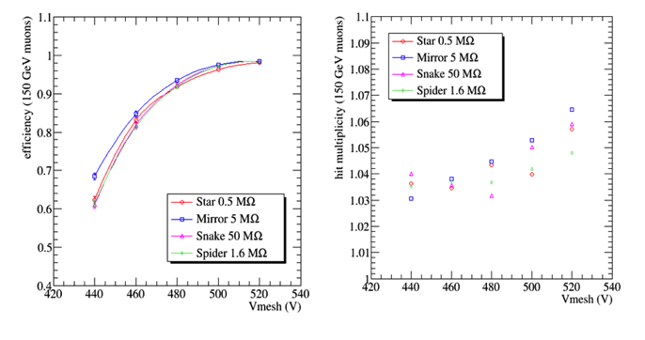

RD51 SPS/H4 testbeam in December 2014
Resistivities: (0.5, 1.6, 5 and 50) Mohm
Muon and pion beams without and with absorber
Mesh current with pions (2-400 kHz)
Efficiency and Hit multiplicity

Slide 7
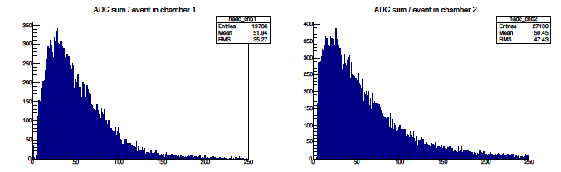
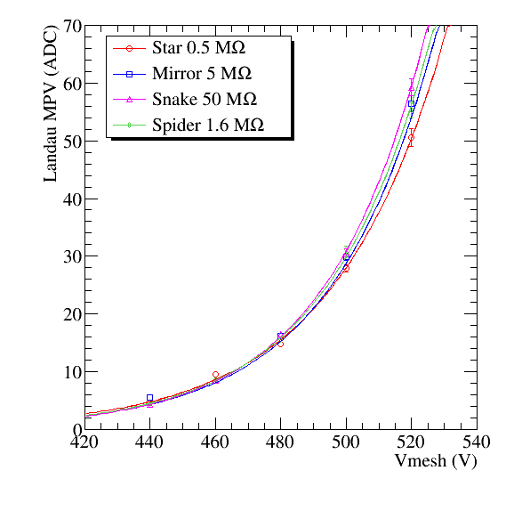
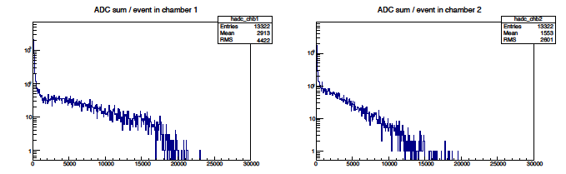
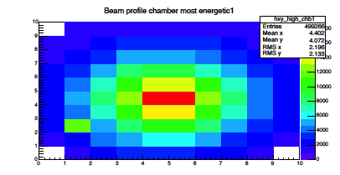
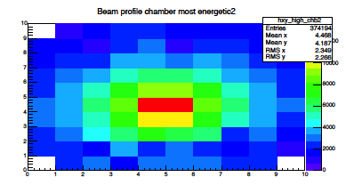
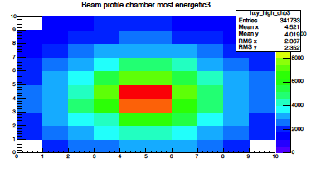
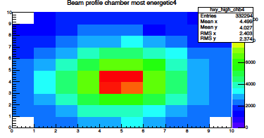
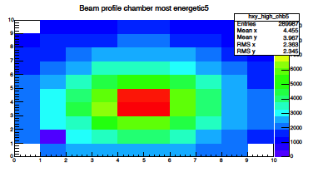
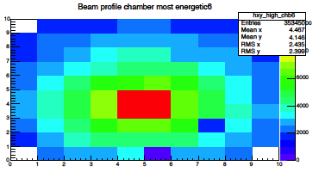
Energy distributions – Beam profile
Landau distribution for mips (muons at 150 GeV)
Non resistive
Resistive
0 300 0 300
Energy distribution for pions at 150 GeV with absorber
Non resistive
Resistive
0 30000 0 30000
Possibility to calibrate with mips
Beam spot in all detectors:π beam at 150 GeV with Fe absorber

Slide 8
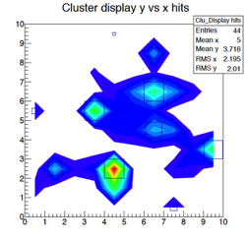
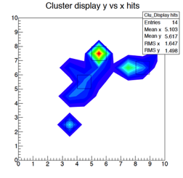
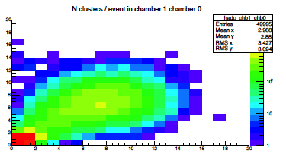
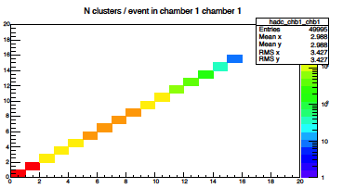
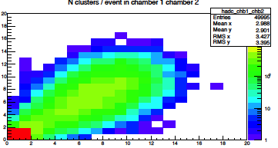
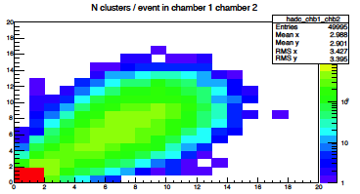
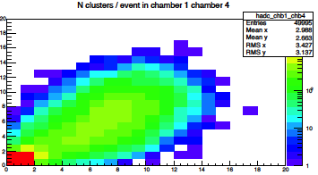
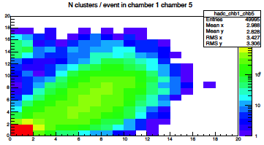
Energy Flow Clustering Algorithm
Define all neighbor pads for every pad
Connect pad A to neighbor pad B: Con(A,B)
  if B has higher deposited Energy than A
Pad A can connect to itself
If Con(A,B) and Con(B,C) ➔ Con(A,C)
Cluster Energy and position is defined as:
TEST BEAM EVENTS
Number of Clusters in “Star” vs Nclusters in all other detectors
Nice correlation, separate mips and pion clusters

Slide 9

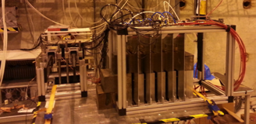
RD51 SPS/H4 testbeam in July 2015
Detector | Buried resistivities implemented
Star1 | 4 kOhm
Mirror1 | 40 kOhm
Snake1 | 400 kOhm
Star100 | 400 kOhm
Spider | 1 MOhm
Mirror100 | 4 MOhm
Snake100 | 40 MOhm
  Explore buried resistance range: 4x10³ – 4x10⁷ Ohm
3 new detectors of lower resistivity (+ 4 of previous batch)
Run with muons (mips, efficiency), pions (discharges)
  and electrons (charge-up)
DAQ: VME, Gassiplex FE, C++ Demokritos software,
  acquisition rate up to 1.4 kHz.
New prototypes
Main tests
Muon beam: Mips, efficiencies
Rate scan with pions – One detector
  at a time in the same position
Electron beam. Test all Resistive uM at
  shower maximum one by one using
  as reference a standard uM
Build mini calorimeter with 6 res. uM
  and a total of ~20 X_{0.} Test with electrons
Res uM
Removable
Fe-Absorber
~ 1.5 λ
Fe 3.5X₀
Fe 2.2X₀
Fe 3.5X₀
Fe 3.5X₀
Fe 3.5X₀
Fe 3.5X₀
Fe 3.5X₀
Fe 2.3X₀
Fe 3.5X₀

Slide 10
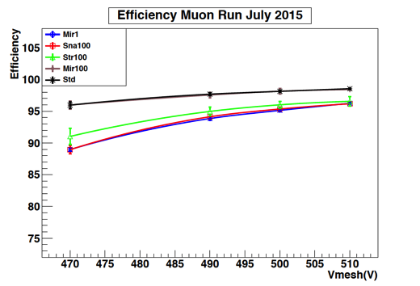
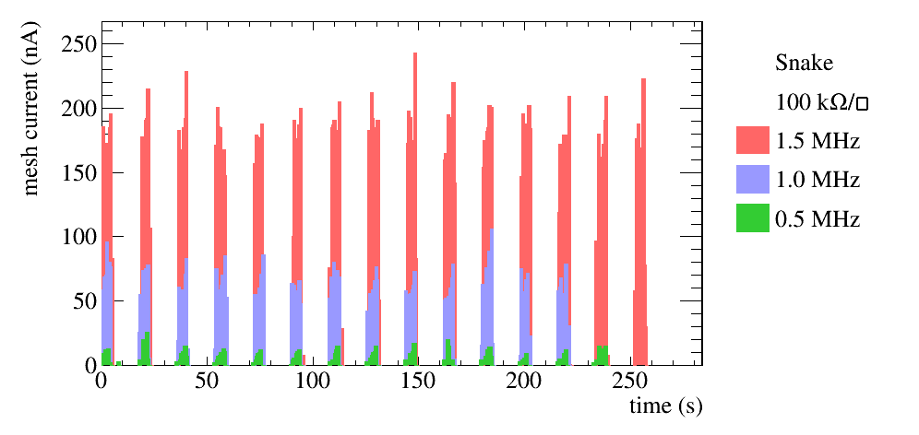
Muon beam: Mips, efficiencies: 150 GeV μ beam.
  Calculate efficiencies using 3 other detectors
  out of the six that were included in that test.
  Efficiencies reach ~ 95% at moderate gains.
Rate scan with pions – One detector
  at a time in the same position
Res uM
Removable
Fe-Absorber
~ 1.5 λ
Pion beam: 200 GeV,
Rates: 0.1 – 1.5 MHz
Beam profile: ~2 cm²
Monitor Mesh Current and Voltage with RD51 slow control
SPS Spill structure as seen by
the highest resistivity detector
Current at low levels and constant
During spill

Slide 11
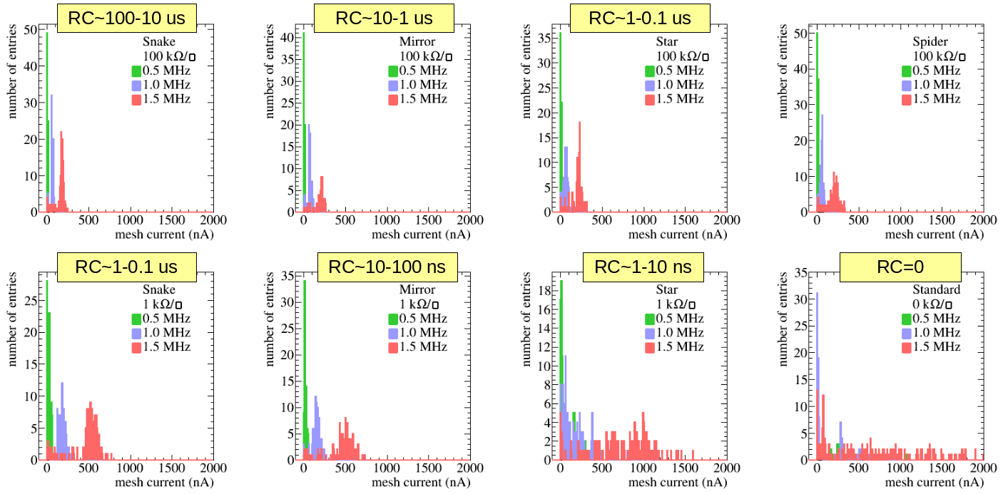
2) Rate scan with pions – One detector at a time in the same position (II)
The lowest resistivity prototype (Star1 – 4 kOhm)
presents strong variations and high currents at high rates
The rest of the prototypes do no draw high mesh currents
➔Lowest limit on RC (1 – 10) ns

Slide 12
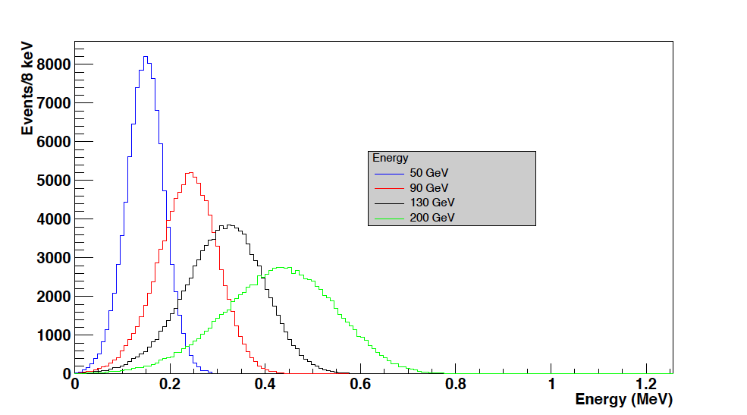
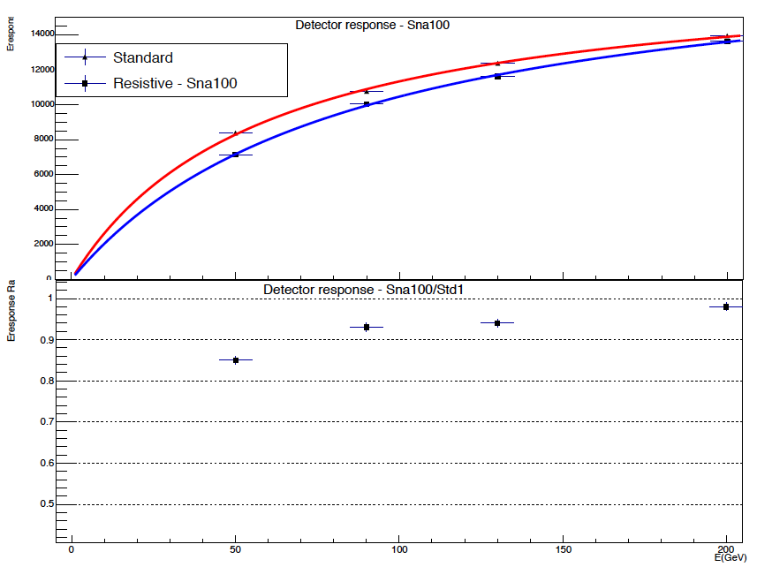
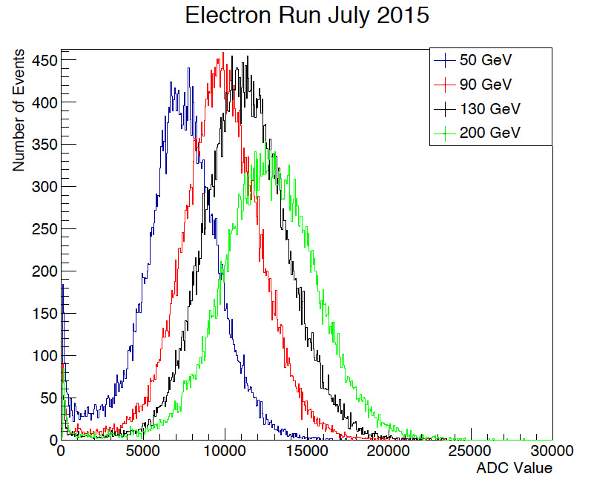
3) Electron beam. Test all Resistive uM at shower maximum one by one using as reference a standard uM
Non-Resistive: at 2.3 X₀, used as preshower and veto to clean up
the beam from pion contamination
One Resistive: at the shower maximum (6 X₀) is studied for charge up
due to high charge deposition within a single event
Electron energy: 50, 90, 130 and 150 GeV at low rates
Different gas gains
Different transverse diffusion
We observe small differences
Fe 3.5X₀
Fe 2.2X₀
Std
Res
Digitization
still to be
worked out
Geant - Spectra
0.5 1.0
Test beam Spectra
Ratio should be constant
At 50 GeV somewhat smaller

Slide 13

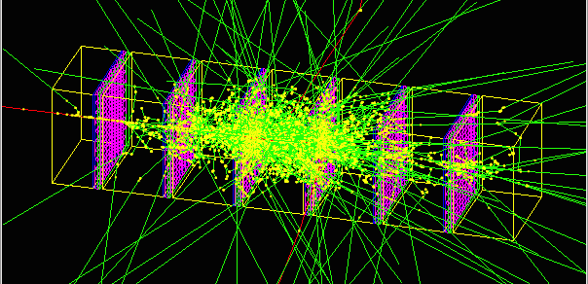
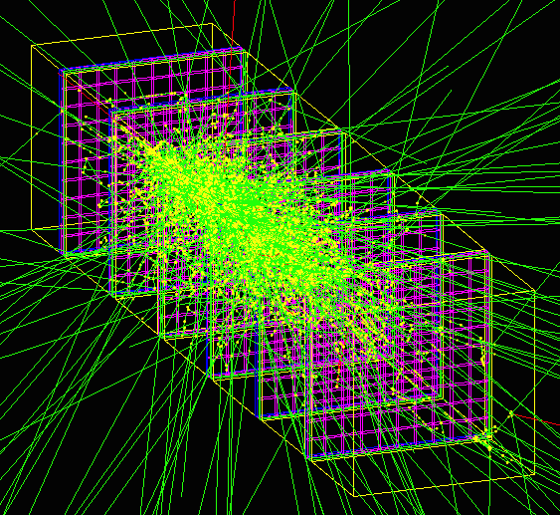
4) Build mini calorimeter with 6 res. uM and a total of ~20 X_{0.} Test with electrons
Fe 3.5X₀
Fe 3.5X₀
Fe 3.5X₀
Fe 3.5X₀
Fe 3.5X₀
Fe 2.3X₀
Fe 3.5X₀
Electron Beam: 30, 50, 70, 90, 130, 200 GeV
Gas Gain: 1500, 3000
Use the first chamber to reduce the pion contamination
Simulated Events (Geant4): Exact geometry, 90 GeV shower

Slide 14
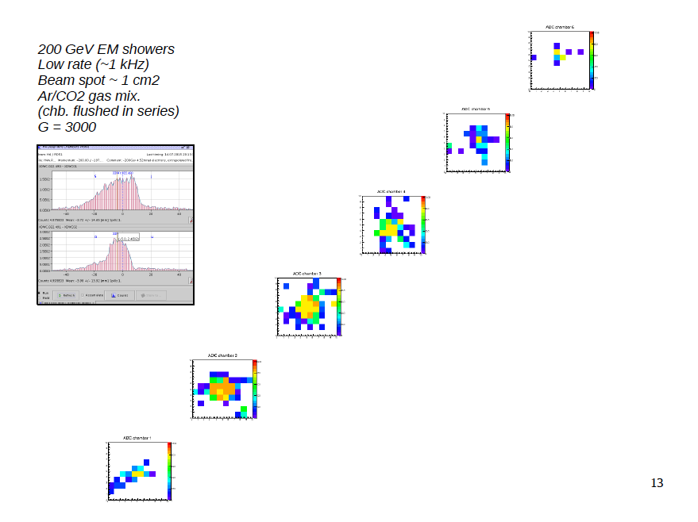

Slide 15
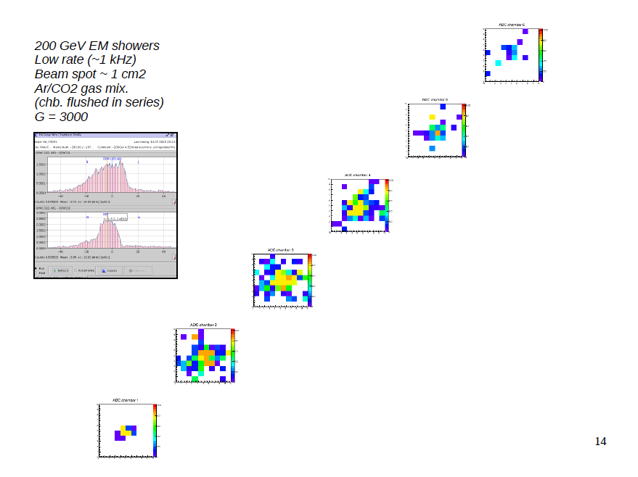

Slide 16
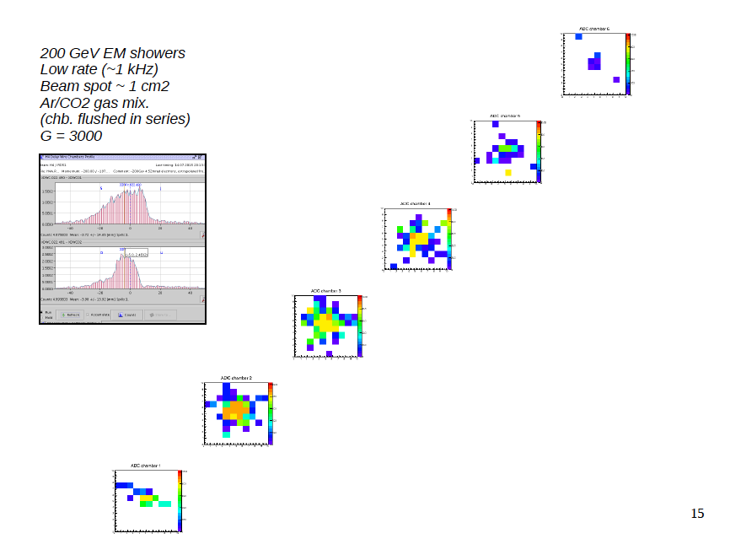

Slide 17













200 GeV Electron Beam: Detector spectra
Energy deposition in every detector
for 200 GeV electrons (left)
Shower profile (average) in every one
of the 6 layers
Shower maximum is visible in the 3rd
Detector
The first chamber is used to suppress
The pion contamination of the beam
Differences in the gain will be corrected
from the mips spectra
1st Resistive
2.3 X₀
2nd Resistive
5.8 X₀
3rd Resistive
9.3 X₀
4th Resistive
12.8 X₀
5th Resistive
16.3 X₀
6th Resistive
19.8 X₀

Slide 18




Energy spectra: Analog (left), Digital (right) for two different gas Gain (up – down)
Energy = Sum of all 6 chambers adc values

Slide 19



Analog Energy response saturates due to poor sampling and side leaks
Digital Energy response is even worse as expected
Tempting to check ADCSum (E) resolution:
Is not expected to be good for ECALs
Due to low sampling ratio 10⁻⁴
It is even worse due to poor sampling
But:
Stochastic term is in excellent agreement
Between Data (red curve) and MC (blue curve)
Constant term is not included in the MC

Slide 20
Conclusions
We have studied resistive Micromegas prototypes for calorimetry and scanned
  five orders of magnitude in resistivity based on the buried resistor technique
We reached the limits of RC where a transition to discharge free operation starts
  above the level of the avalanche time development (1 – 10 ns)
Charge-up is minimized above these resistivities keeping at the same time an
  excellent linearity beyond 1 MHz/mm² for mips but rather lower for showers
Single event charge-up in high deposition events like in EM showers is negligible
Future plans: Build a large prototype with good data sampling (more layers)
  Study in detail Energy resolution, dependence on temperature,
  Energy calibration etc.

Slide 21
Many Thanks
  We had a lot of fun thanks to
  Rui De Oliveira, Antonio Teixeira
  Eraldo Oliveri and Yorgos Tsipolitis
  For their great support !

