Slide 1


Study of Negative-Ion TPC using μ-PIC
for Directional Dark Matter search
Tomonori Ikeda (Kobe Univ.)
Kentaro, Miuch (Kobe Univ.)
DANIEL, Snowden-ifft (Occidental College)
JEAN-LUC, Gauvreau (Occidental College)
+NEWAGE Group
DM Experiments with MPGD
NEWAGE
Motivation
Measurement
Summary
Notes:
Good morning.
I’m Tomonori Ikeda , a graduate student at Kobe University.
The theme is study of Negative-Ion TPC using μPIC for directional dark matter search.

Slide 2
1. DM experiment with MPGD
Notes:
First , I talk about Dark matter experiment with MPGD.

Slide 3
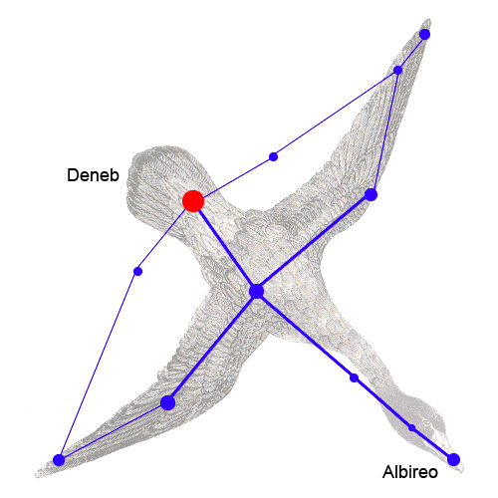
Directional Dark Matter Search with MPGD
Image of elastic scattering
DM
Jun. 2nd
Sun
WIMP
232km/s
60°
WIMP
γ
Cygnus
nucleus
Earth
Dec. 4th
By MPGD
Dark matter is coming to the earth from Cygnus
Reconstruct 3D track of nuclear recoil using MPGD
Recoil angle distribution gives strong evidence.
PLB578 (2004) 241–246
Notes:
I explain the method of Dark matter research by using MPGD.
This figure shows our galaxy. Galaxy has dark matter.
We are in solar system, move towards Cygnus.
So relativity dark matter is coming to the earth from Cygnus.
りらてぃゔり
Right figure shows WIMP-nucleus scattering .
Nucleus is recoild by WIMP.
We get this nuclear track with MPGDs and calcurate recoil angle gamma.
The distribution of gamma is expected to show an asymmetry.
There are many forward scatterings .
This signature should be strong evidence of dark mattter (ovsevation).

Slide 4

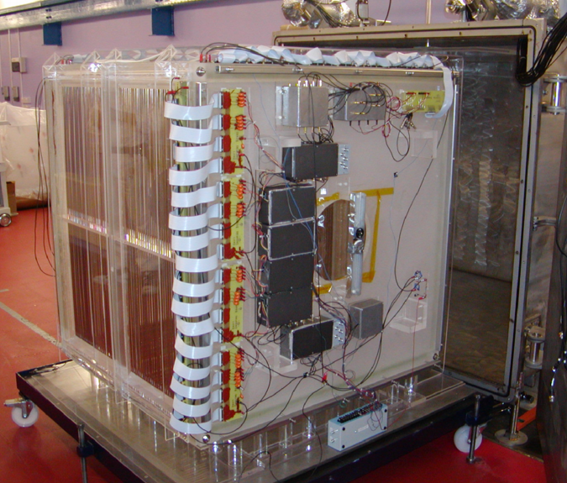

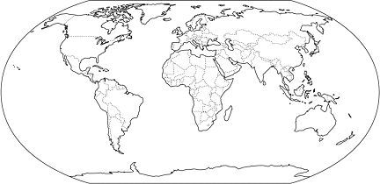
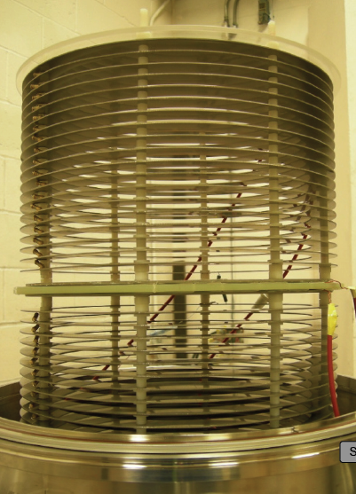


DM experiments using Gas Detector
MIMAC
・MicroMegas(~424um pitch)
・Underground
・10×10×25 cm³
DRIFT
・MWPC(2mm pitch)
・First started gas detector
・Underground
・Low background
・Large size(~1m³)
1m
25cm
DM-TPC
・CCD(256um pitch)
・2D track
・Head/tail recognition
・Underground
NEWAGE
・μ-PIC(400um pitch)
・3D track
・Direction-sensitive limit
・Underground
30cm
Notes:
Here I show you DM experiments using gas detector in the world.
DRIFT team use MWPC with negative ion.
DRIFT group has a low background , and large size detector in underground.
DM-TPC uses CCD camera and succeed in head/tail recognition.
MIMAC and NEWAGE use MPGDs,
For MIMAC, Micromegas which pich is almost 400 um, is used .
The Detector volume is 10 times 10 times 25 cubic centimeter.
NEWAGE use u-PIC.
Electrodes’s pich is 400 um.
We have the best direction-sensitive limit.
ずをさしながら言います。
DRIFT->DM=Tpc-> MIMAC->NEWAGE

Slide 5
2. NEWAGE
Notes:
I explan NEWAGE experiment in detail.

Slide 6
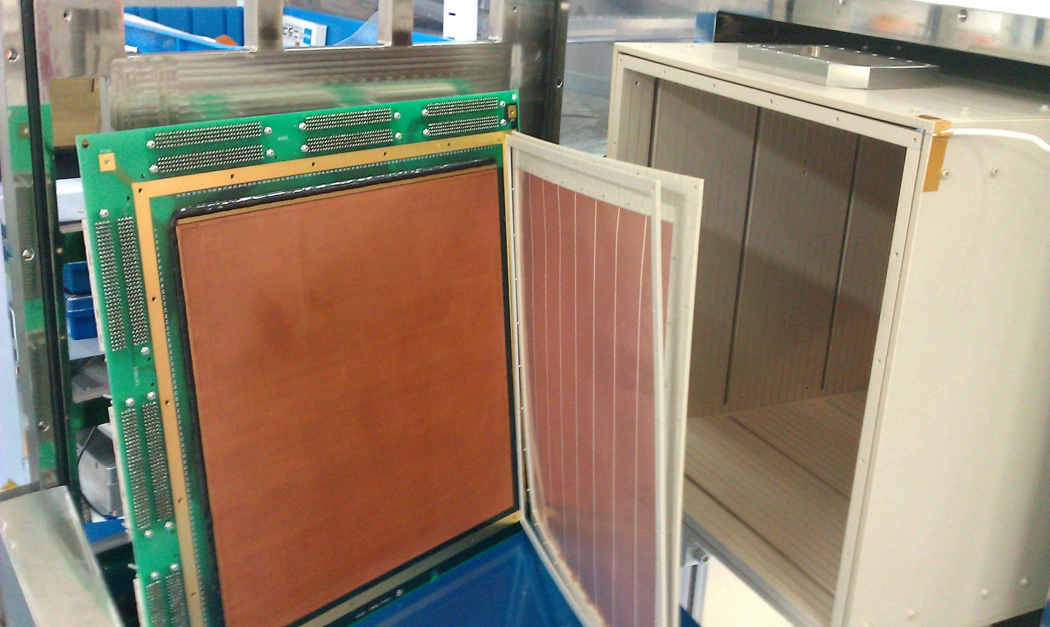
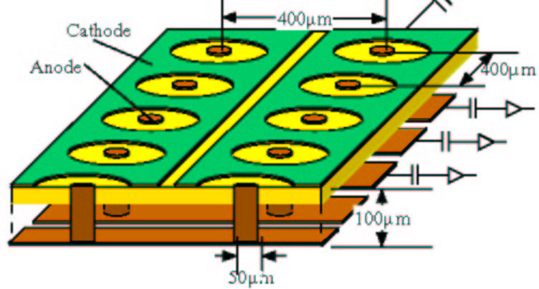
NEWAGE0.3b’ Detector @Kamioka mine
μ-PIC
Drift Cage
GEM
30cm
31cm
41cm
30cm
μ-PIC: Anode pitch 400 μm
Gasgain ~10³
Detection volume
  30×30×41 cm³
Gas
  CF₄(76 torr)
hole diameter : 70 μm
pitch : 140 μm
Good for spin dependent DM search
GEM：Preamplifier (Gas gain ~10)
LCP 100μm
Notes:
NEWAGE detector is at Kamioka mine in Japan.
This is the whole detector system.
Left module is electronics, and this is gsa circulation system.
This vessel is uTPC.
The length of Drift cage is fourty one centimeter.
GEM is thirty one times thirty one square centimeter.
And uPIC is 30 times thirty square centimeter.
So the Detecton volume is 30 times 30 times 41 cubic centimeter.
We use CF4 gas, because Fluorine has a large csoss section of Spin Dependent interaction.

Slide 7
Latest Result
Conditions RUN14
period：2013/7/20~8/11, 10/19~11/12
live time ：31.6 days
fiducial volume：28×24×41 cm³
CF4 gas(76Torr)
mass：10.36 g
exposure：0.327 kg・days
Skymap in galactic coordinate
the best direction-sensitive limit (K.Nakamura et.al, PTEP(2015)043F01s)
Black point is nuclear recoil event
Gradation color: detector eficiency
Notes:
Now I show you the latest result of NEWAGE。
This is obtained skymap of carbon and flourine recoils in galactic coordinate. CF
Horizontal axis is galactic longitude, and vertical axis is galactic latitude.
Black dots is observed recoil events and gradation color is detection efficiency.
And they are consistent.
We made a cosine distribution and obtained direction-sensitive limit.
In this figure, horizontal axis is mass of DM, and vertical axis is cross section.
This work is red limit curve.
NEWAGE has the best direction-sensitive limit.
the green line are non-directional dark matter search .
they have limits better than directional experiment.
So we need to reduce background event, in order to reach there limits

Slide 8
3. Motivation
Notes:
I would like to talk about why we want to use negative ion gas.

Slide 9
Background
NEWAGE0.3b’
Z
C
Main background event in μTPC
  ⑦ in the high energy region
  C in the low energy region
α-rays (U/Th-chain) from the glass cloth in PI 100μm of μ-PIC is dominant
We already could XY fiducialize
The Z fiducialization is, if possible , very important.
Notes:
This figure is a cross section view of NEWAGE0.3b’ detector
The green label is u-PIC and GEM, Drift plane.
Black arrows show background candidates.
We have already understood the main background source.
Main backgrounds are α-rays from radioactive contamination in u-PIC.
Shown by number 7 arrow, and C arrow, both come from u-PIC.
If we could fiducialize in the Z-direction, we can improve our sensitivity.
So Z fiducialization , if possible , is very important.

Slide 10
Self Triggering TPC
Electric field
: absolute Z
: relative Z
e⁻
e⁻
μ-PIC & GEM
Nuclear track
Z
Trigger timing
Absolute Z-position cannot be known in self-trigger.
Notes:
Here I explain the reason why we can’t detect absolute Z-position.
The problem is we don’t know time zero in self trigger.
In this figure, ionized electrons drift to u-PIC and GEM.
Time zero is here.
But our trigger timing is this point when electrons arrive at u-PIC.
So we can only get relative Z, red line , we can’t know absolute Z, the blue one.

Slide 11
Z-fiducialization used by DRIFT
[Physics of the Dark Universe 9-10(2015)1-7]
The first measurement of absolute Z-position in a self-triggering TPC
Using negative ion gas CS₂ with a few percent O₂
CS₂⁻
minority charges
CS₂⁻
30 Torr CS₂
10 Torr CF₄
1 Torr O₂
Z
minority peak
t_{b}
t_{a}
MWPC
t_{b}
t_{a}
Notes:
Recently DRIFT group succeeded in the measurement of absolute Z-position.
They use CS₂ gas mixed with a few percent O₂.
CS2 catch ionized electrons and drift as negative ion CS2-.
With an existence of O2, another types of negative ion called minority charges are generated.
They are drifted at different speed and create peaks in arrival time called minority peaks.
Right panel is a typical wave form.
The last pulse is made by CS₂⁻, and earlier pulses are made by minority charges.
Using this equation, we can calculate absolute Z-position.
Utilizing

Slide 12
Negative Ion Gas Candidates
CF4(electron drift(normal) gas)
Being used for NEWAGE
Typical drift velocity : ~cm/μs
Operation Gas gain 3000 (76Torr)
Amplifer gain 160mV/pC(ASDchip)
Negative Ion Gas
CS₂
SF₆
Toxic, Volatile, inflammable
Electron Affinity 0.89eV
Used with MWPC
Requirement of gas gain
Doesn’t have Flourine
Non-toxic, Non-volatile, Nonflammable
Electron Affinity 1.1eV
Insulating gas
High electric field is necessary
Recently demonstrate with THGEM
Requirement of gas gain
,using amplifier[1V/pC], then the amplitude of minority peak will be 15mV at Nuclear recoil (50keV)
~480・
76Torr
P
using amplifier(1V/pC)
[N.Phan talk at CYGNUS2015 , June 2015]
We need to add CF₄.
~980・
76Torr
P
Typical drift velocity: 10⁻²cm/μs
We can use slow shaping time amplifier(good S/N).
Notes:
Now I discuss the candidate of negative ion gas.
Typical negative ion gas for TPC is CS2.
CS₂ gas is hard to handle because of three properties.
It is toxic, volatile and inflammable.
The requirement of gas gain is only 480, because drift velocity of negative ion is very slow.
The order is 10 to the minus two cm/us.
we can use slow shaping time amplifier.
It is good S/N, and good gain.
For DM experiment, A disadvantage of CS2 gas is it doesn’t have flurine.
So we need to add CF4.
As another candidate of negative ion gas, recently SF6 gas is demonstrated for THGEM.
It is non-toxic non-volatile and nonflammable.
It is easily to handle
The advantage is SF6 gas has flourine.
So we doesn’t need adding another gas.
But it is used as insulating gas , its electron affinity is very large , so it is expected to difficult to achieve sufficient gas gain.
If we can use, very happy.

Slide 13
4. Measurement
Notes:
We tested uPIC+GEM system with CS2 gas and SF6 gas.

Slide 14
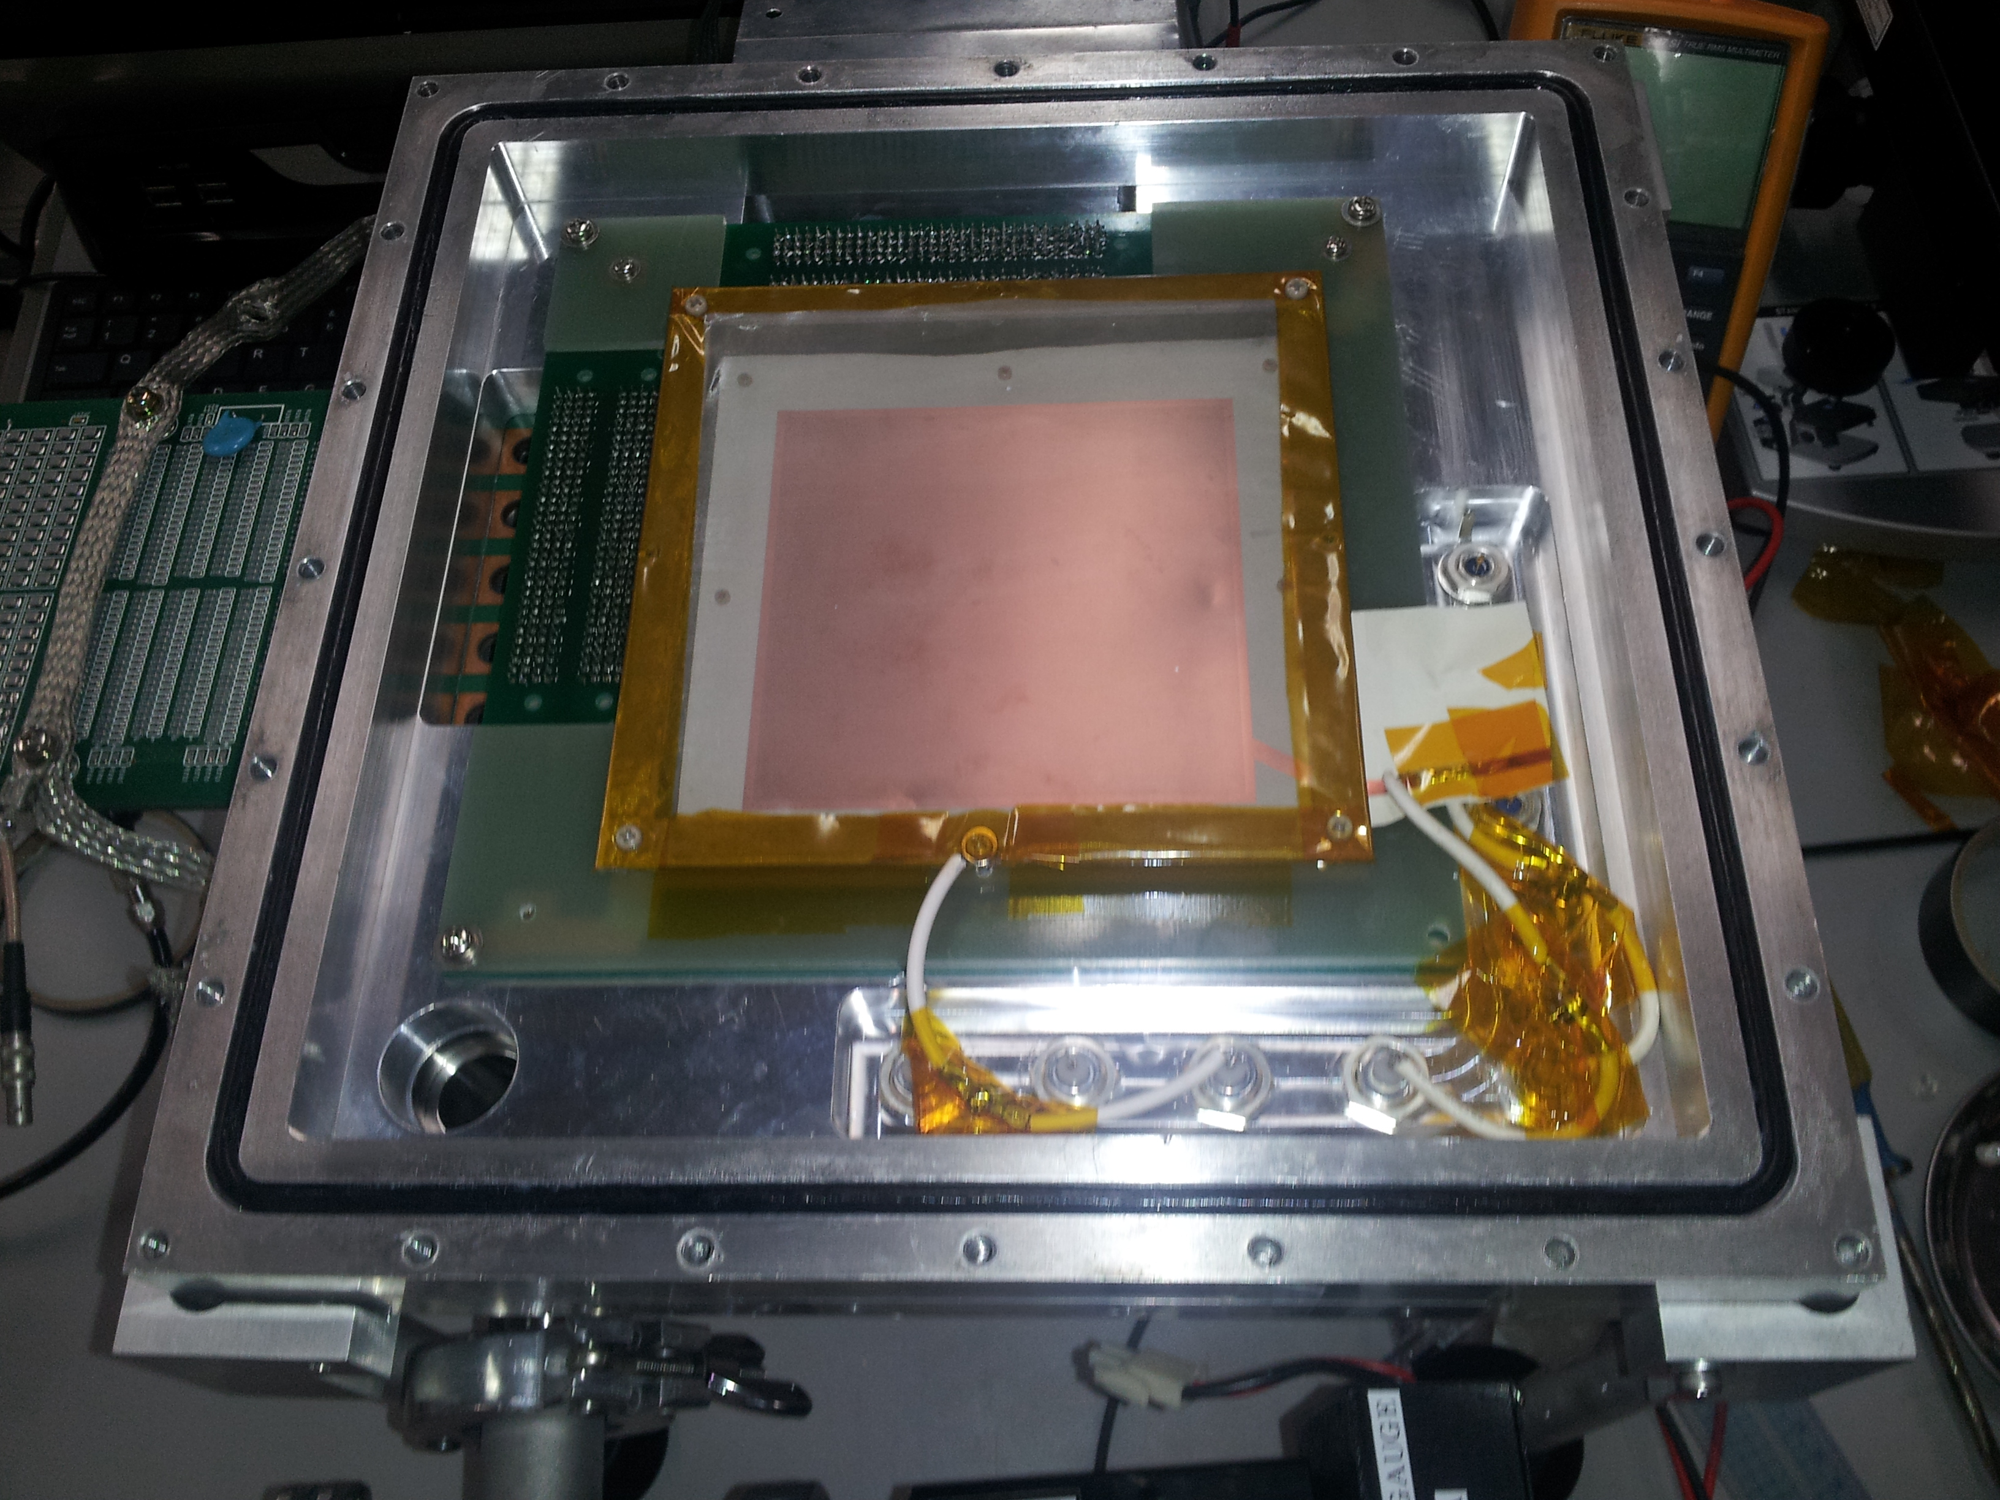
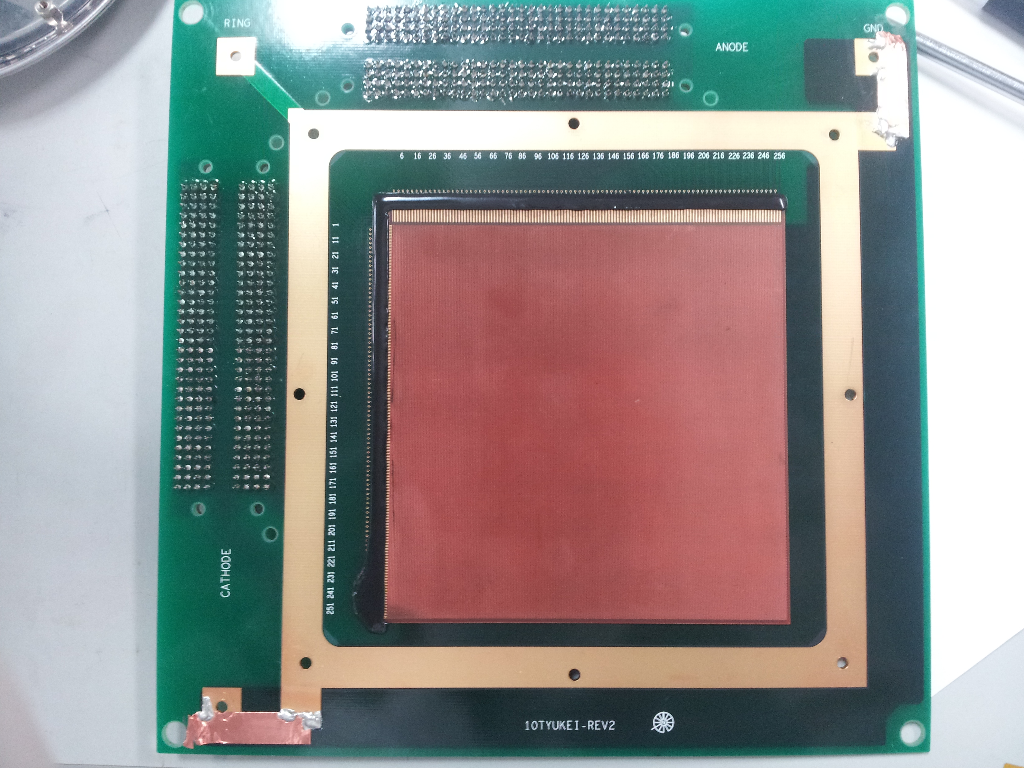
NEWAGE0.1c detector
Anode readout
Drift mesh
μ-PIC 10×10 cm²
Cathode readout
GEM
Drift mesh(SUS)
10mm
GEM (10×10cm) LCP 100um
μ-PIC (10×10cm)
3mm
Amplifier
1.1V/pC or 160mV/pC
readout
Notes:
For test of negative ion gas, we construct detector,
uPIC has a detection area of 10 times 10 square cm.
GEM is made of LCP , width is 100um, and set 3mm above uPIC.
Drift mesh is set 10mm above GEM

Slide 15
4.1 CS₂
Notes:
Next, for CS2 gas measurement.

Slide 16
Test CS2 with u-PIC+GEM @Occidental collage
Gain Curve
for 38 Torr
for 76Torr
CS₂ 76Torr and 38Torr give more than 1000 total gain!
Notes:
At Occidental collage, a test with CS2 gas was performed.
This figure is gain curve.
Xaxis is anode voltage of upic.
The blue point is CF4 gas ,76Torr,
CS2 gas 76Torr is green point. Total gas gain is higher than CF4 .
Total gas gain achieved requirement of gas gain, so we expecte to detect nuclear recoil events at lower energy.
Red point is Cs2 gas 38torr,.
For CS2 38torr,, total gas gain also achieved requirement.
this is good trend.
Because in lower pressure , nuclear track will be longer ,so we can expect angular resolution become better.

Slide 17
ΔGEM Dependence
Gain Curve
for 38 Torr
for 76Torr
μ-PIC+GEM system with CS2 worked very well.
Adding O₂ gas , we will be able to observe minority peak.
Notes:
We measured delta gem dependence..
X-axis is delta GEM voltage.
at uPIC anode=550V, CF4 76Torr and CS2 76 Torr showed almost same trend.
As a result, uPIC+GEM system with CS2 worked very well.
Adding O2 gas , we will be able to observe minority peak.

Slide 18
4.2 SF₆
Notes:
I talk about SF₆ gas measurement.

Slide 19
test SF6 with uPIC+GEM @ Kobe Univ.
SF6 waveform
252Cf Nuclear Recoil
waveform
E = 1100 V/cm
SF₆ 152Torr
Anode =630V
ΔGEM = 650V
Amp:τ=1μs
CF₄ 152Torr
E = 674 V/cm
Anode = 539V
ΔGEM = 363V
Amp:τ=1μs
Notes:
Here I show you typicall waveform.
We use Californium two handred fifty five as source.
Top panel is waveform of SF6 .
The pressure is one handred fifty two Torr.
And we use amplifier which shaping time is 1 microsec.
So pulse width is very long about 10 micosec..
The feature is rise time is slow, because of drift velocity of negtive ion SF6 minus.
Compared to CF4 gas shown by bottom panel, it is clear.
It is no problem for low rate experiment.

Slide 20
SF₆ Gas Gain
55Fe
Gain ~300
仮
SF₆ 152torr
E = 1047 V/cm
Anode = 670V
ΔGEM = 728V
Total gas gain is about 300.
When we improve the amplifier , this gas gain is sufficient.
Then minority peak will be appeared.
Notes:
Finally we measured gas gain by using iron fifty five.
Gas pressure is 152Torr.
Total gas gain is about 300.
Thank for strong electric field of MPGD, Gas gain could achieve several handred .
When we improve amplifier,
the gas gain is sufficient for Nuclear recoil (100keV), then minority peak will be appeared.
We are planig to test with long drift system, and try to observe minority peaks.
requirement
Ampのimprovemnet

Slide 21
Drift Velocity of SF₆⁻
At 76Torr, Photon feedback was observed between u-PIC and GEM.
wave form
GEM
SF6 76Torr
photon
photon
μ-PIC
SF6 76Torr
Drift velocity
~10⁻² cm/μs
Notes:
Photon feedback was observed between u-PIC and GEM ,
Using this effect, we measure Drift velocity of SF6-.
This figure shows dependence of electric field over pressure.
Drift velocity is proportional to electric field, and we obtained about 10 to the three minus cm/us.
It is consistent with measurement of Drift group.

Slide 22
5. Summary
A first test of μ-PIC+GEM with negative ion gas was performed.
For CS₂, the total gas gain is higher than 10000.
For SF₆, the total gas gain is about 300.
SF₆ gas needs optimization , going to study
In the future, with both of them, minority peaks will be observed.
MPGDs with negative ion gas will create more opportunities for low background experiment.
Notes:
A first test of u-PIC + GEM with negativeion gas was performed.
For CS₂, the total gas gain is higher than 10000.
For SF₆, the total gas gain is about 300.
SF₆ gas need to optimize , going to study.
In the future, with both of them, minority peaks will be to observed with uPIC+GEM system.
we are planning to use SF6 gas because of safety aspect.
And we can remove background event, will achieve smaller scattering coss-section.
At the end, MPGDs with negativ ion gas will create more opportunities for low background experiment.

Slide 23
Thank you for your attention!

Slide 24
4. Back-up

Slide 25
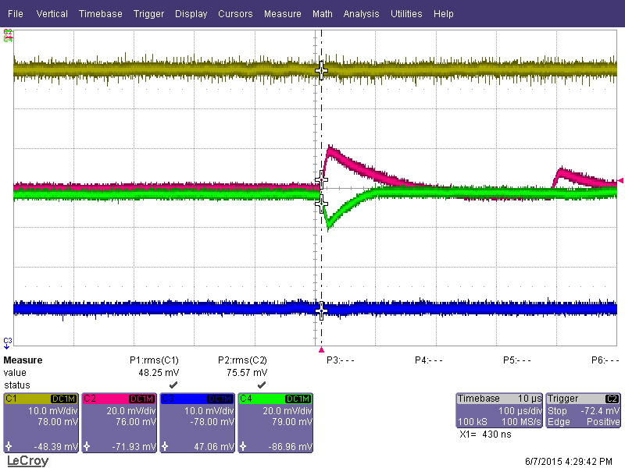
Electronics for CS₂
We used CREMAT’s CR-111 charge sensitive preamplifier.
CS2 76Torr
55Fe
VDRIFT=-1.5kV
GEM=-800V/-460V
uIPC anode=550V
CH2 (anode 13cstrips sum)
20mV/div
CH4 (cathode 13cstrips sum)
20mV/div
100us/div

Slide 26
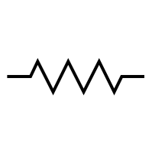
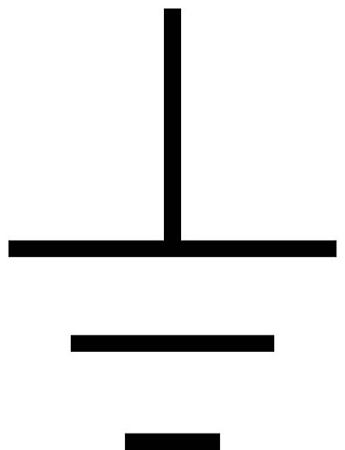
Electronics for SF₆
Electronics
CLEAR-PULSE
CS515-1 1V/pC
Shaping amplifier for SF₆
1nF
100
10K
IN
100
10K
OUT
100pF
50
100pF
50
1K
100
100
Highpass τ=1μs
1st Lowpass Filter
2nd Lowpass Filter
Amplifier 1.1 V/pC
120 nC/pC
Notes:
Drift velocity of negative ion is slower than electrons, typically ten to the negative second cm par micro sec.
So rise time is very long, shaping time is needed micro sec order.
We made slow time constant and high gain amplifier.

Slide 27
Spin dependent(SD) cross section
The SD cross section is written using σ_{SD} as

Slide 28
Minority Peak of SF₆
From N. Phan, Cygnus 2015
THGEM( 4mm)

Slide 29
Amplifier for liquid Argon TPC
Development of LTARS ASIC
  pre-amp. & shapers in a chip
  high density (32ch I n a chip)
  power supply voltage ±0.9V
  ENC ~2000@300pF
  conv.gain ~9V/pC

Slide 30
Detection efficiency in detector coordinate

